Slide 1
Coldbox design update
You can write unit / affiliation. leave blank if not applicable.
To change content go to: Menu -> Insert (Mac = Display) -> Header and Footer
19-06-2019

Slide 2
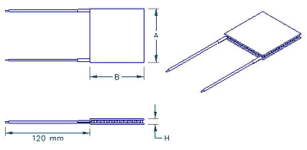
Peltier element
New Peltier element: HP-127-1.4-2.5-72
It is the optimal element among available elements.
Single 40x40 mm element simplifies construction
We order 4 elements for the prototype. Immediate shipping.
Large order for all institutes (~50) has 16 weeks lead time.
Imax | 3.7 amp(s)
Qmax | 37.4 watt(s)
Vmax | 16.3 volt(s)
DT max | 72 Th=300K
A | 40 mm
B | 40 mm
H | 4.8 mm

Slide 3
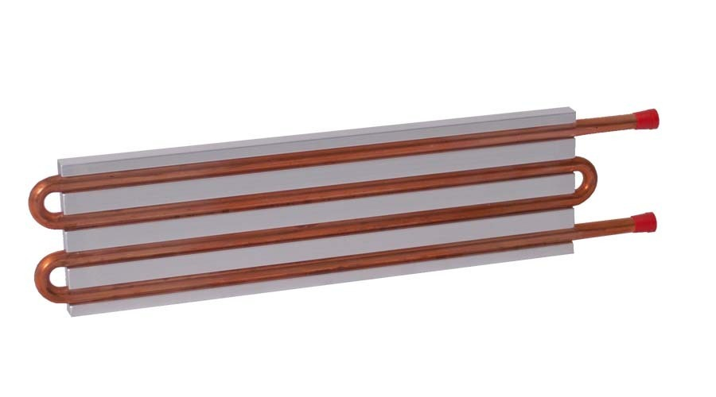
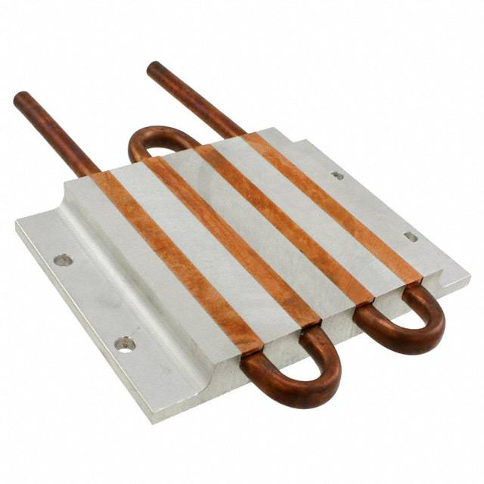
Coldplate
The new Peltier element means that the original coldplate is no longer optimal.
New coldplate: CP10-G18 from AMS Technologies.
Benefits:
Dimensions better suited to single 40x40mm Peltier element
Two vacuum chucks can be mounted on single coldplate
Reduced cost

Slide 4
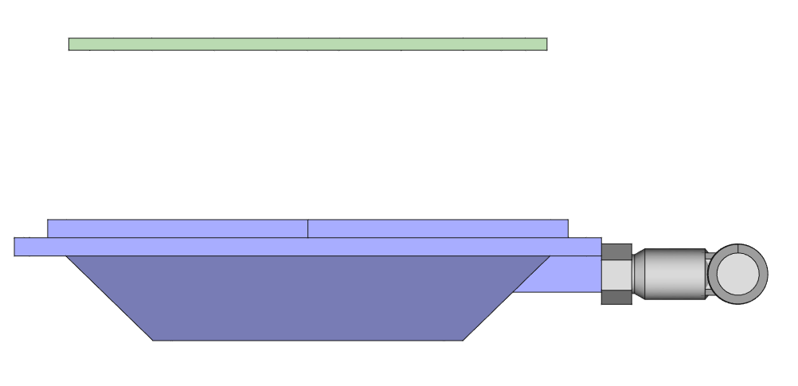
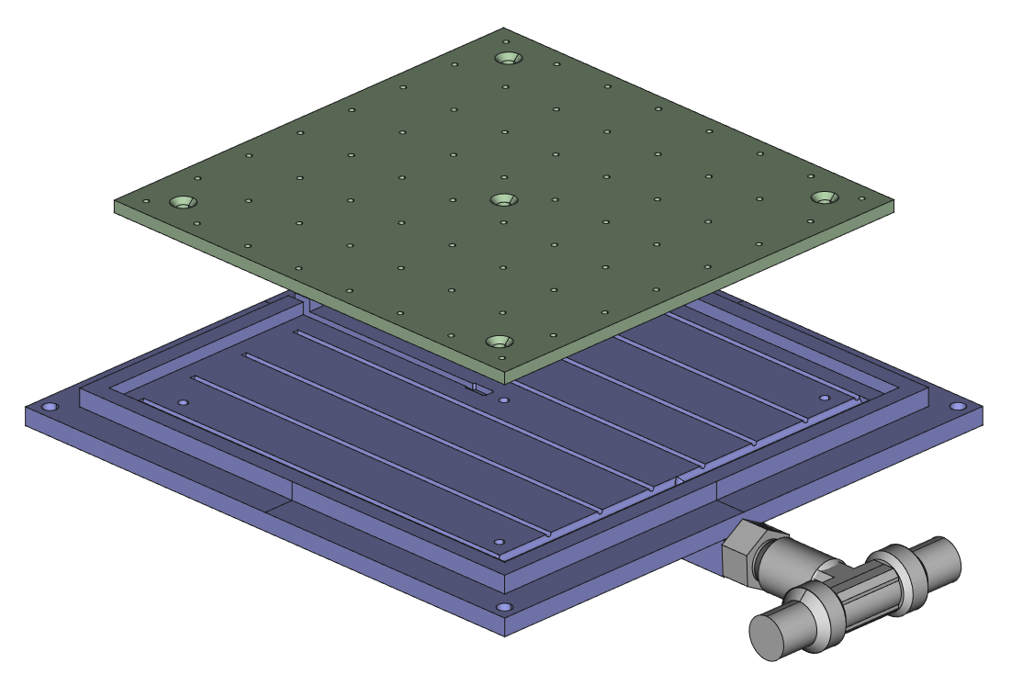
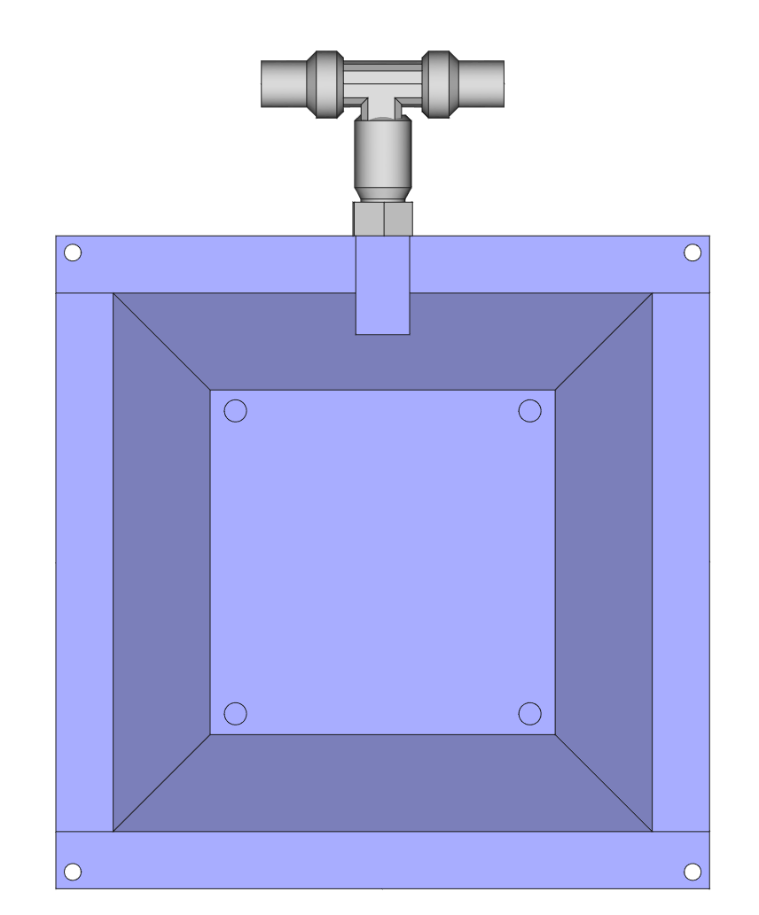
Vacuum chuck
Vacuum chuck has been redesigned to reduce thermal mass and make it compatible with the new coldplate and Peltier element.
A slot has been added for a 4-wire PT100 element beneath the top plate.
PT100 slot
Mount holes
Vacuum inlet

Slide 5
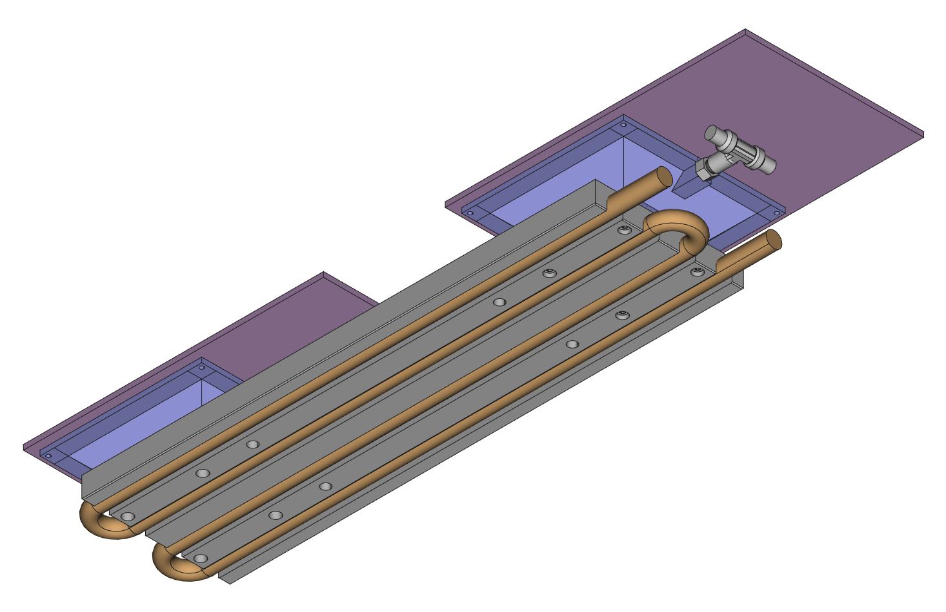
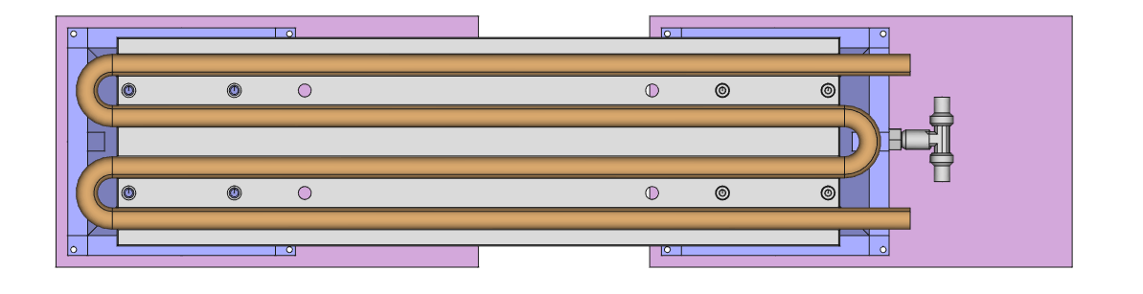
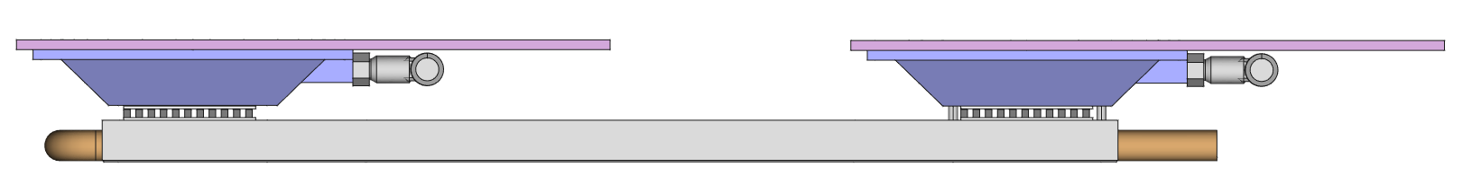
Assembly
Assembly requires 12 holes to be drilled in coldplate.
Not an issue, lots of clearance to tubes.
May be possible to request this modification by manufacturer on large order for all institutes.
Vacuum chuck to coldplate mounting holes
Coldplate to box frame mounting holes

Slide 6
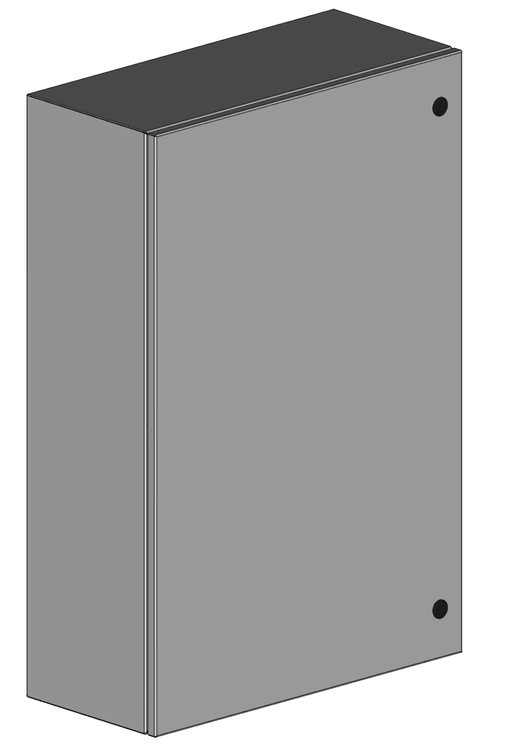
Coldbox
New coldplates means the coldbox can be further reduced in size.
Current design uses EN4SD362410GY.
610 mm
The length of this box means plenty of room for routing of services inside shielding enclosure. (30cm)
914 mm
254 mm

Slide 7
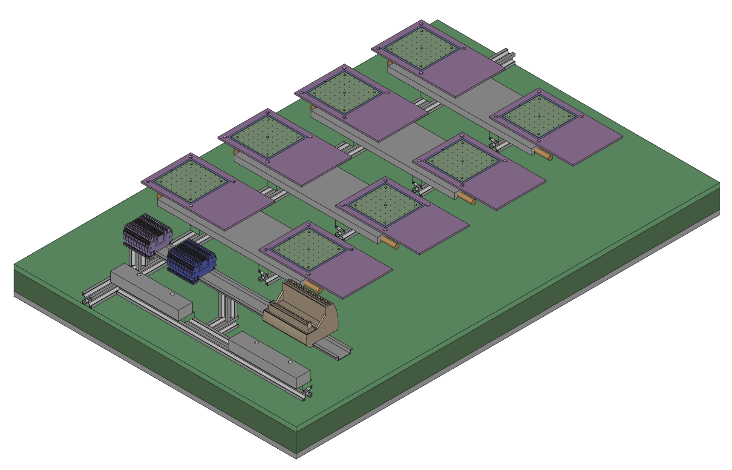
Coldbox assembly
4x coldplate-chuck assemblies
Module and Peltier power terminal blocks
Bottom insulation
Extruded aluminium frame
Manifolds
50-pos connector for sensors
DIN rail

Slide 8
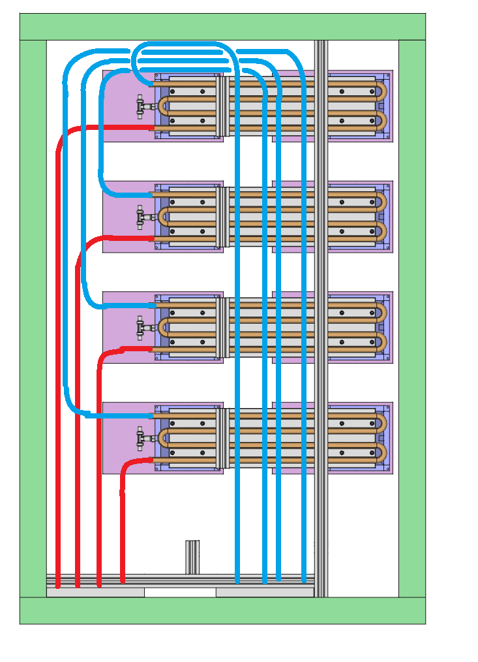
Tube routing
Tubes are routed beneath coldplates.
Consists of four lines.
Each line cools one coldplate
All lines are same length -> flow is evenly distributed.
Bottom view of coldbox assembly

Slide 9
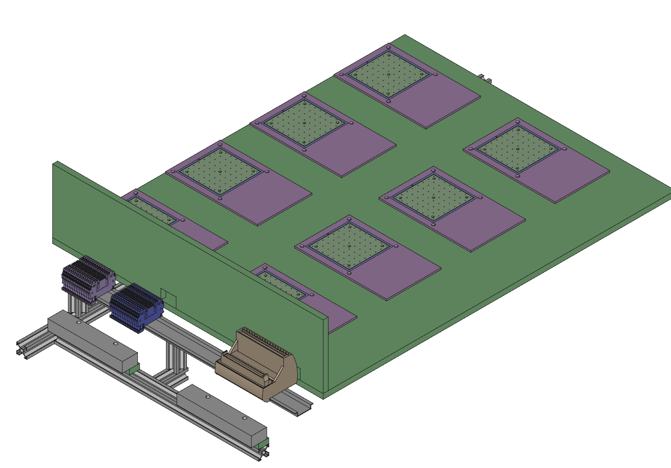
Coldbox assembly
Two thin (1cm) Armaform insulation plates are added to insulate the vacuum chucks (-25C) from the coldplates (+10C).
Cables are routed through slots in vertical wall.

Slide 10
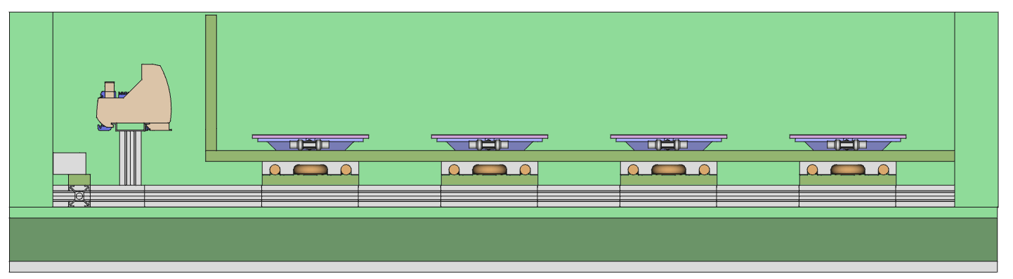
+10°C volume
-25°C volume

Slide 11
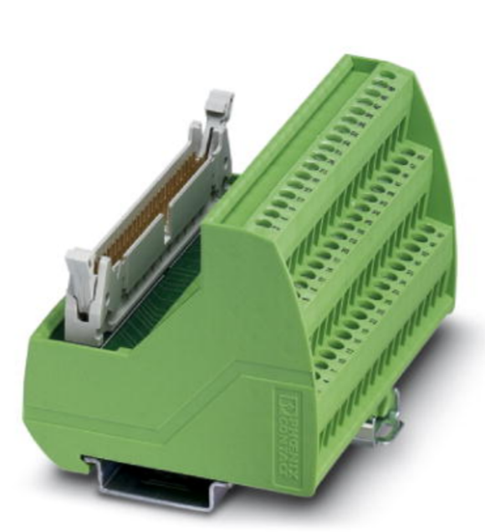
Services
To make things simpler, we’ll just route all cables through a hole in the coldbox.
All sensors are connected through a 50-wire flat ribbon cable to a 50-pin DIN-mount terminal block.
To individual sensors
Flat ribbon cable out of box to DAQ system

Slide 12
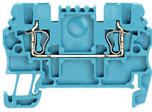
Services
Low voltage cables (Peltier and module power) is connected via DIN-mount terminal blocks.
x32

Slide 13
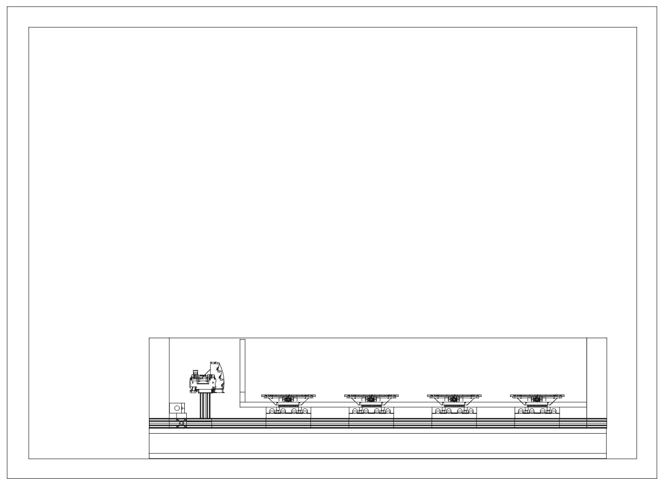
~25cm
~5cm

Slide 14


