Slide 1
Coldbox design update
You can write unit / affiliation. leave blank if not applicable.
To change content go to: Menu -> Insert (Mac = Display) -> Header and Footer
12-06-2019

Slide 2
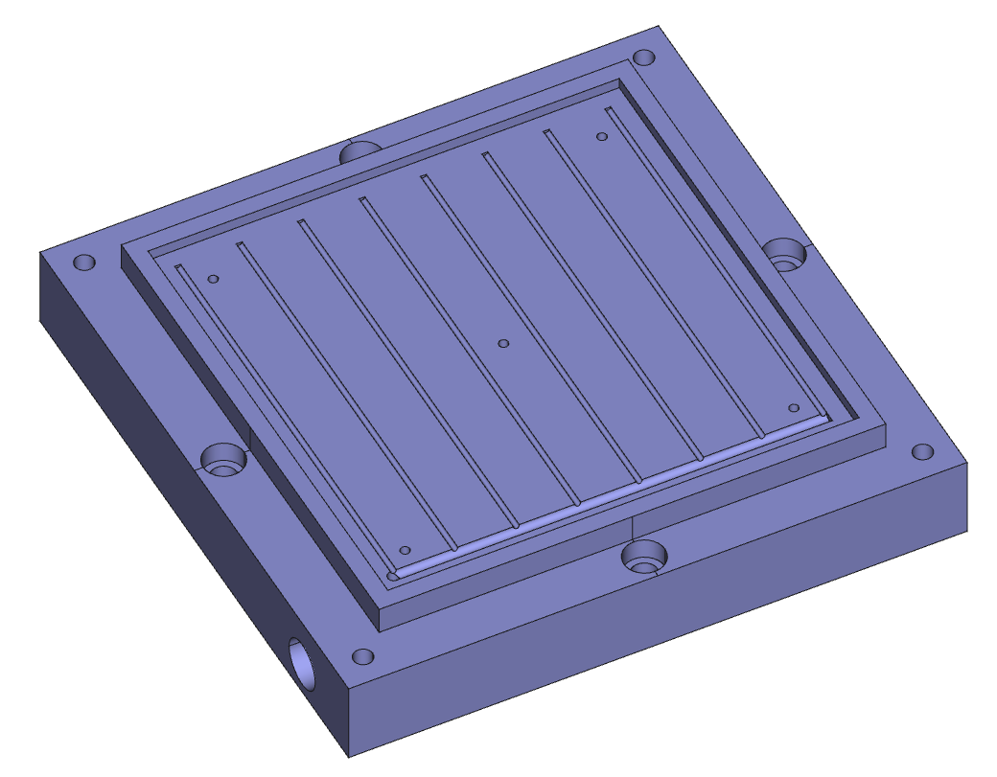
Vacuum chuck design
Vacuum chuck consists of three parts:
Base
Cover plate
Carrier rest plate
Vacuum chuck base
Vacuum distribution grooves
Vacuum inlet

Slide 3
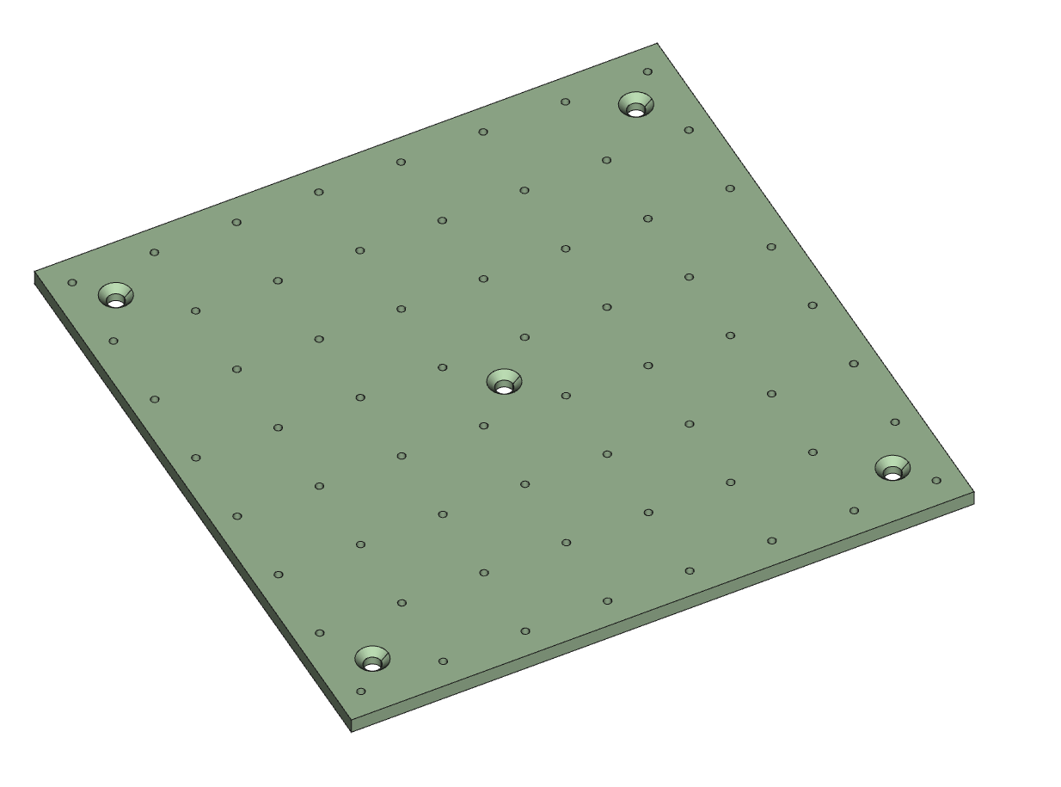
Vacuum chuck design
Vacuum chuck consists of three parts:
Base
Cover plate
Carrier rest plate
Vacuum chuck cover plate
Mounting holes
Vacuum feedthrough holes

Slide 4
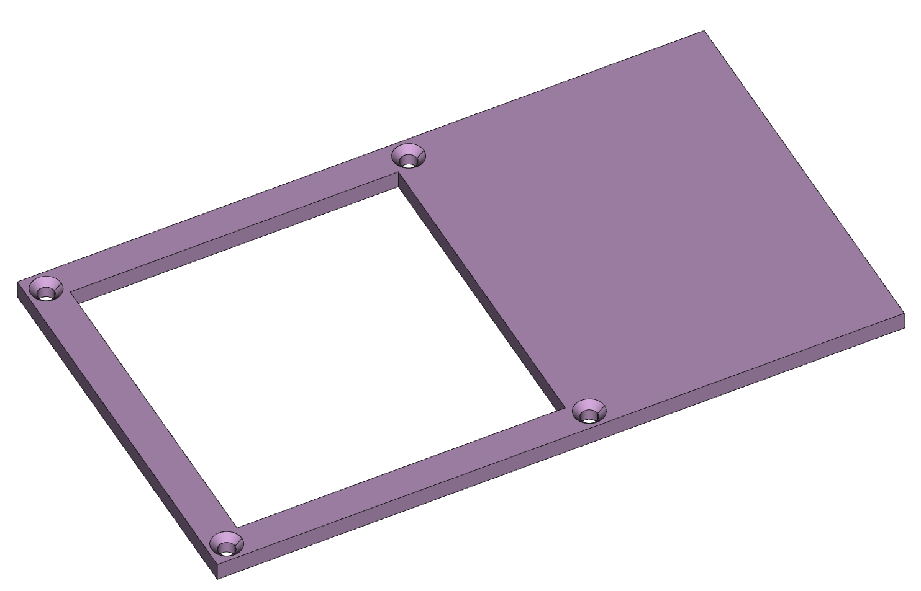
Vacuum chuck design
Vacuum chuck consists of three parts:
Base
Cover plate
Carrier rest plate
Vacuum chuck carrier rest plate
Design of carrier rest plate can be finalized when we know the design of the module carrier.
Mounting holes

Slide 5
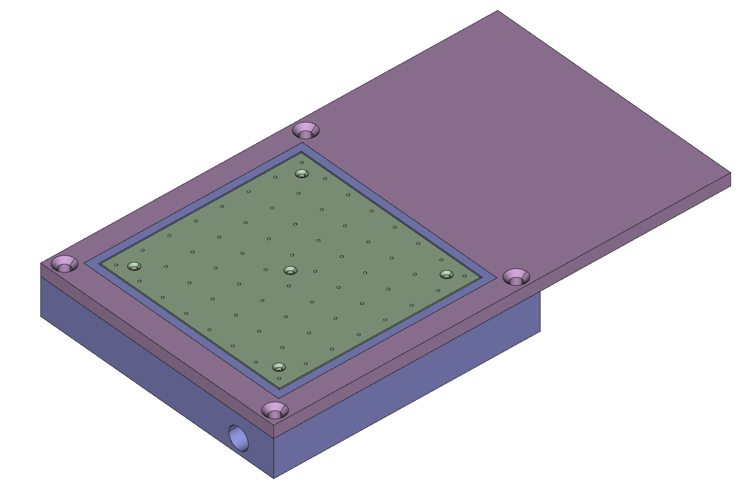

Slide 6
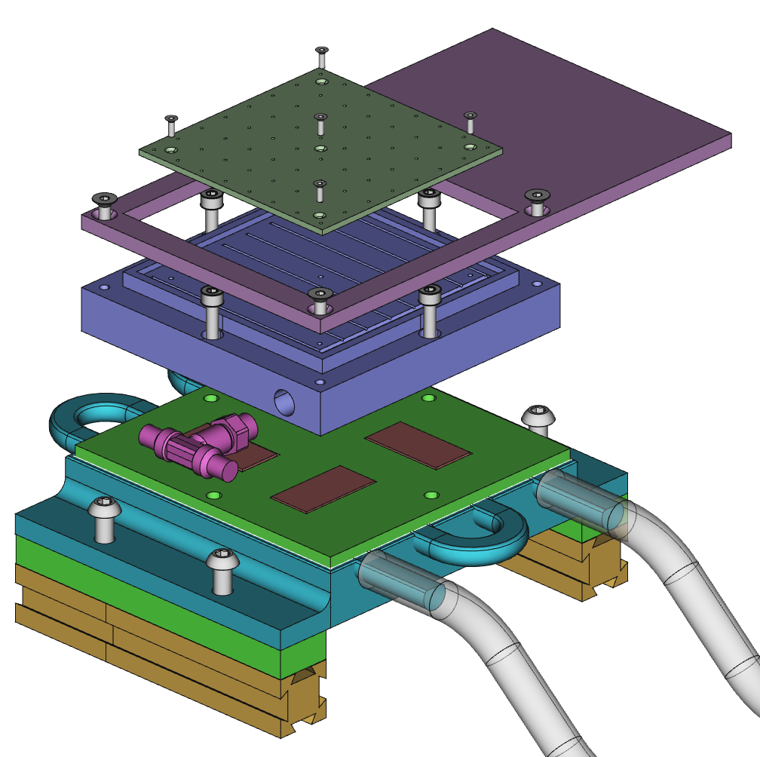
Chiller stackup
Vacuum chuck cover plate
Vacuum chuck carrier rest plate
Vacuum chuck base
Vacuum T adapter
4mm insulation
Peltier elements
Coldplate
10mm armacell insulation
20x20mm extruded aluminium profile
Flexible tubing

Slide 7
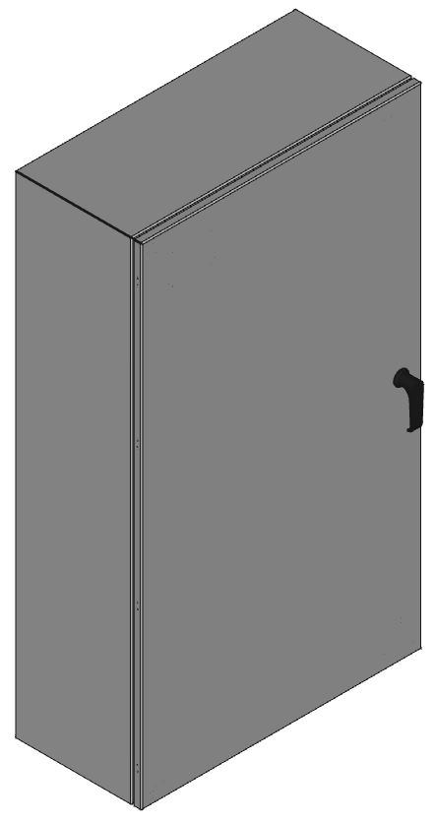
Coldbox
EN4SD422410GY
New enclosure
15.2 cm shorter, 5cm lower
610 mm
1067 mm
254 mm

Slide 8
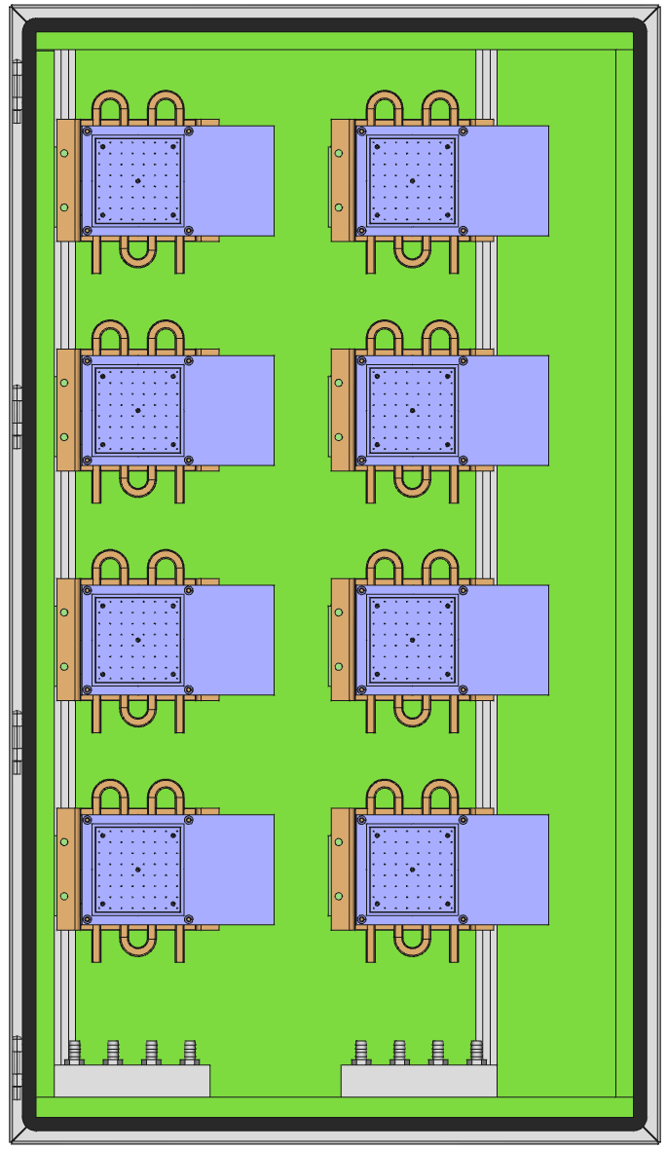
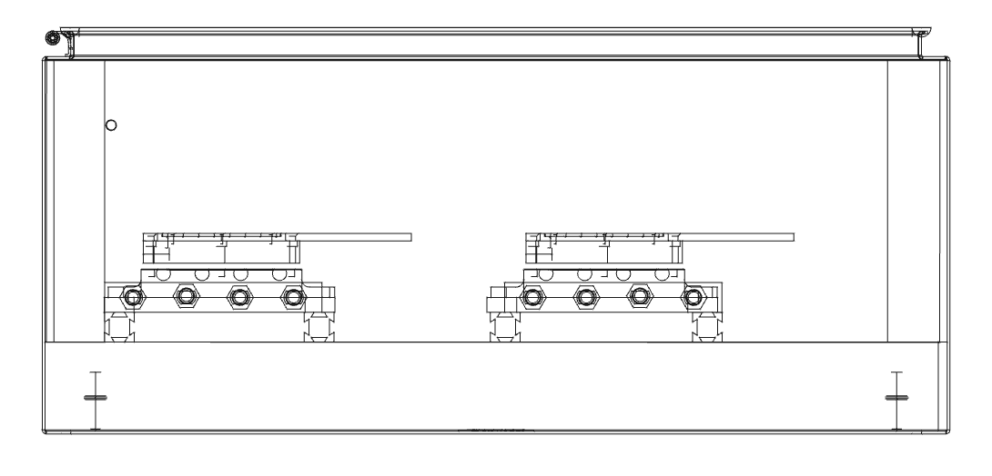
Coldbox layout
All major structural elements fit well inside enclosure.
Tubing is routed below coldplates.
Structural elements are fastened to an extruded aluminium frame.

Slide 9
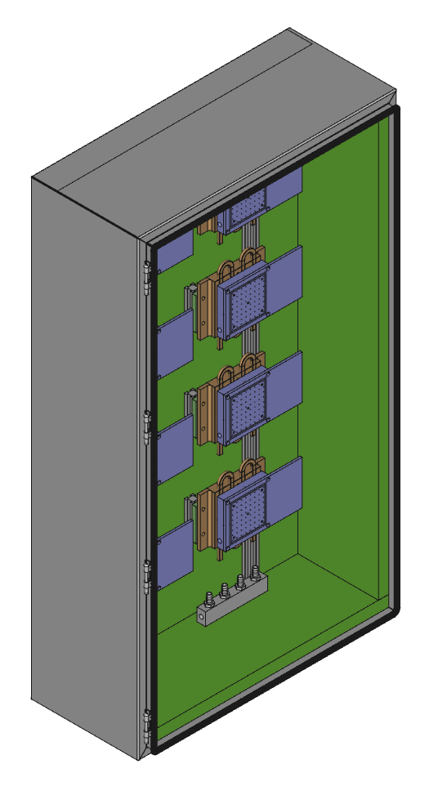

Slide 10
Outstanding issues
How to measure temperature of module?
Do we really need temperature on cold-side of peltiers as suggested last meeting?

Slide 11


