Slide 1
Coldbox design update
You can write unit / affiliation. leave blank if not applicable.
To change content go to: Menu -> Insert (Mac = Display) -> Header and Footer
28-05-2019

Slide 2
Suggestion: 8 modules instead of 9
Original design called for 9 modules to be tested concurrently.
We suggest instead 8.
Reasons:
The FPGA mezzanine cards usually have 4 connections each
8 modules can be more easily arranged in coldbox
4x2 modules is more practical than 3x3 modules space-wise

Slide 3
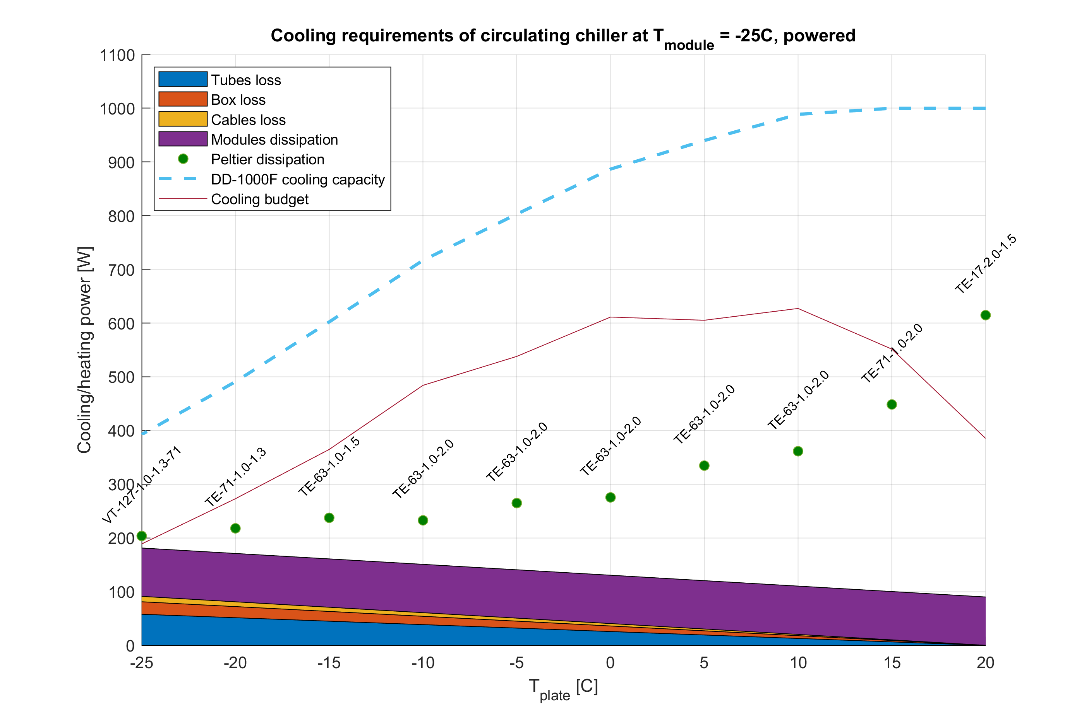
Cooling requirements
New calculation takes into account cooling plate thermal resistance.
We find that the optimal coldplate temperature is between 0C to 5C. This gives a cooling budget of ~600W with the Dyneo DD-1000F.
The peltier element TE-63-1.0-2.0 is optimal at this configuration.
Maximum cooling capacity

Slide 4
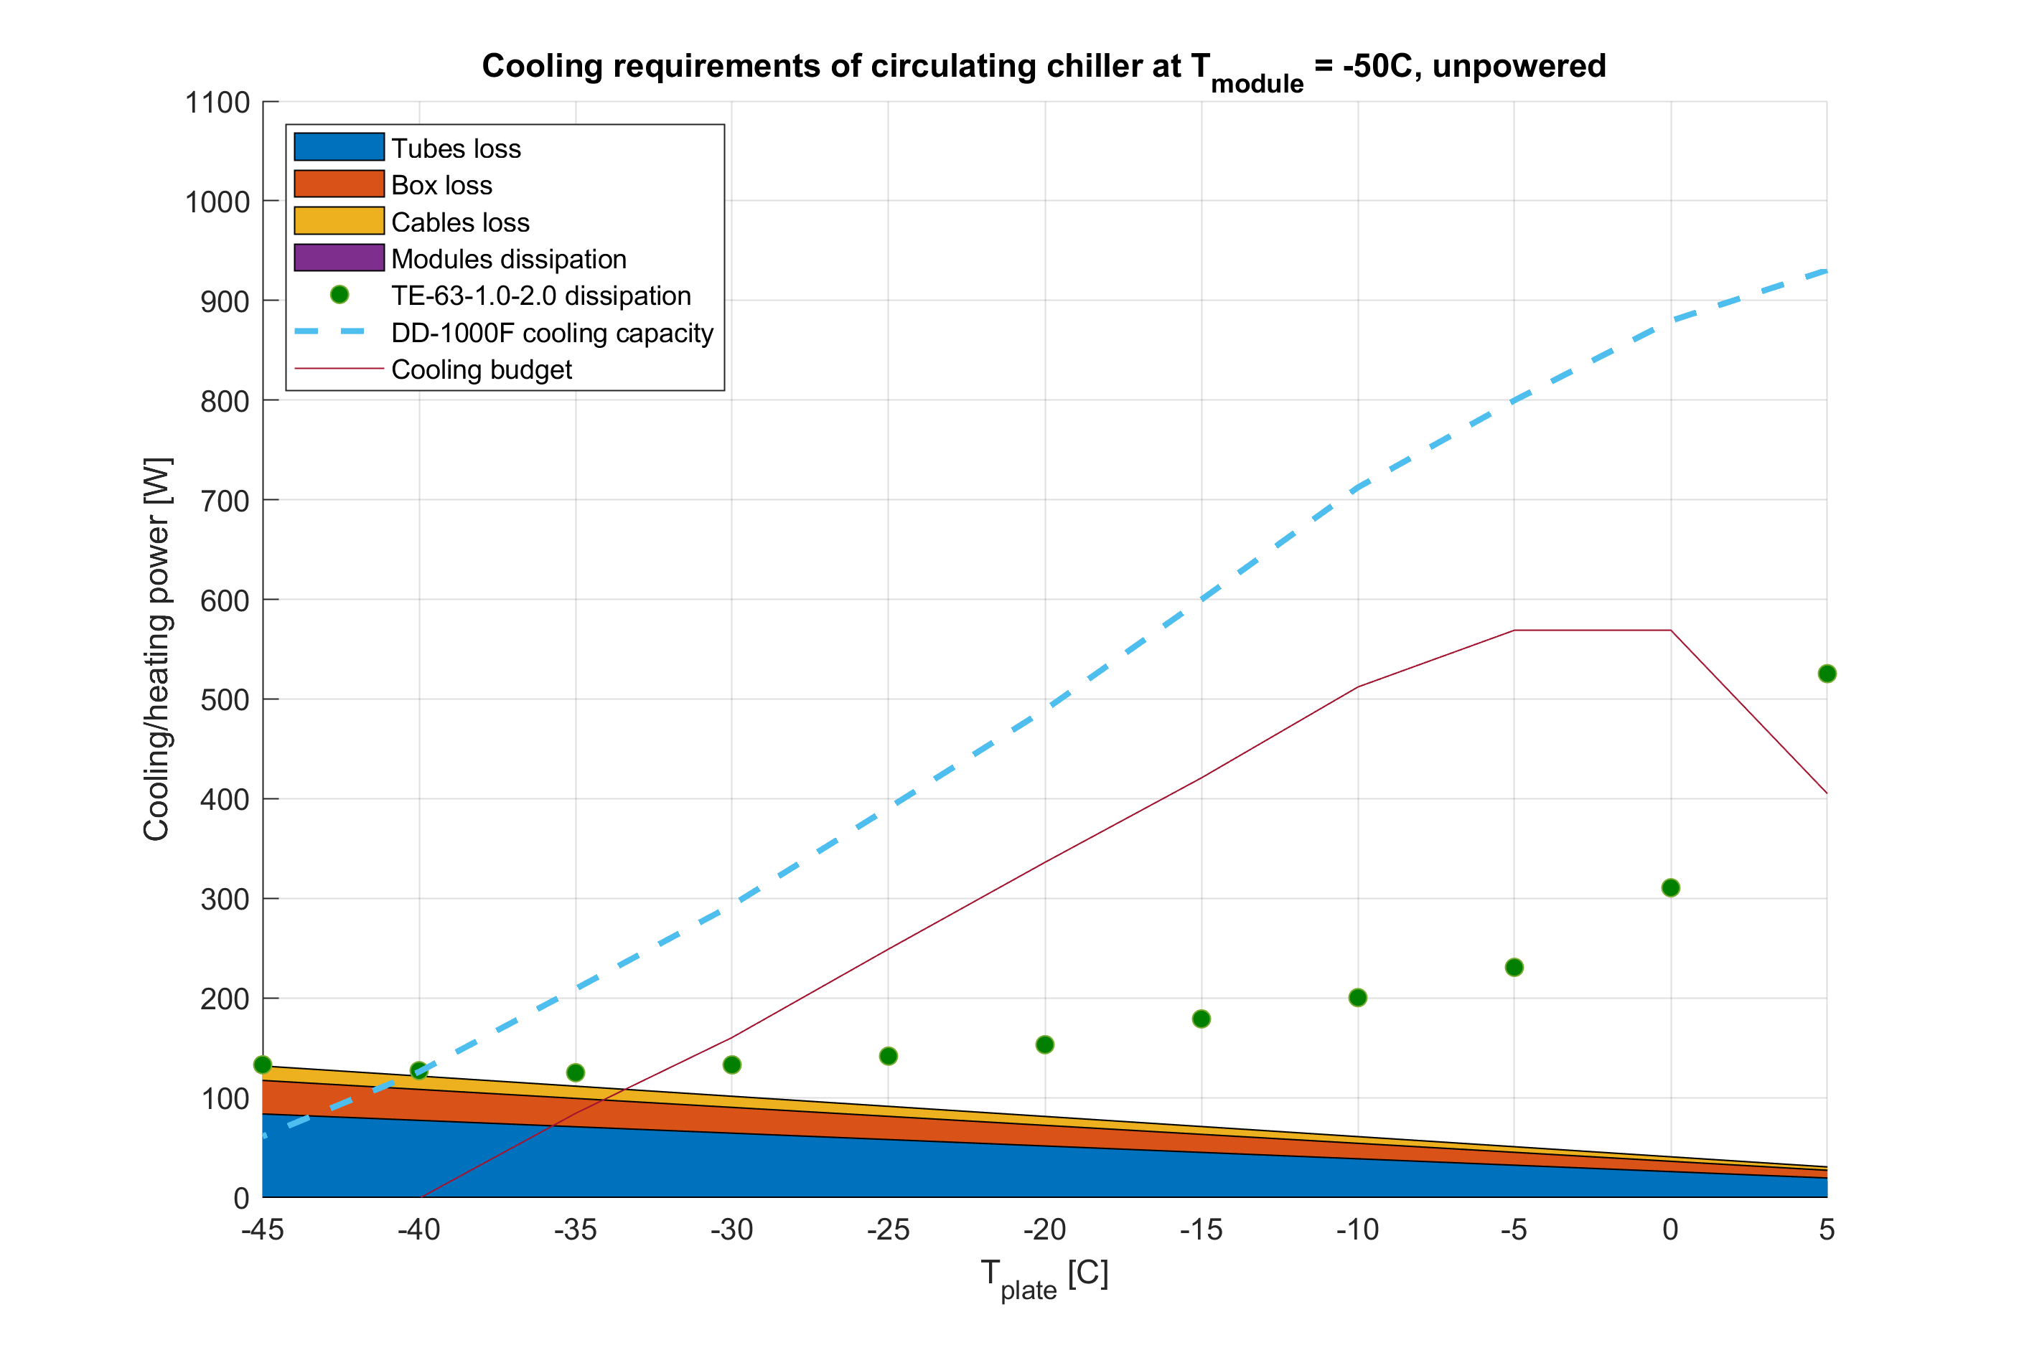
Cooling requirements
Thermal cycling takes the unpowered module to -50C.
With the TE-63-1.0-2.0 peltier element, the optimal coldplate temperature is -5C to 0C.
~600W in cooling budget means we can go much lower than -50C if desired.
Maximum cooling capacity

Slide 5
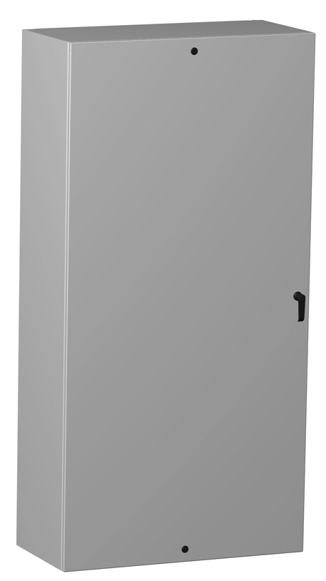
Enclosure proposal
614 mm
Hammond Manufacturing EN4SD482412GY
Door can be easily removed or cut a hole in.
No interior protrusions (I think… Waiting for confirmation)
Interior walls easily padded with insulation
1228 mm
Cost: 450 EUR
324mm

Slide 6
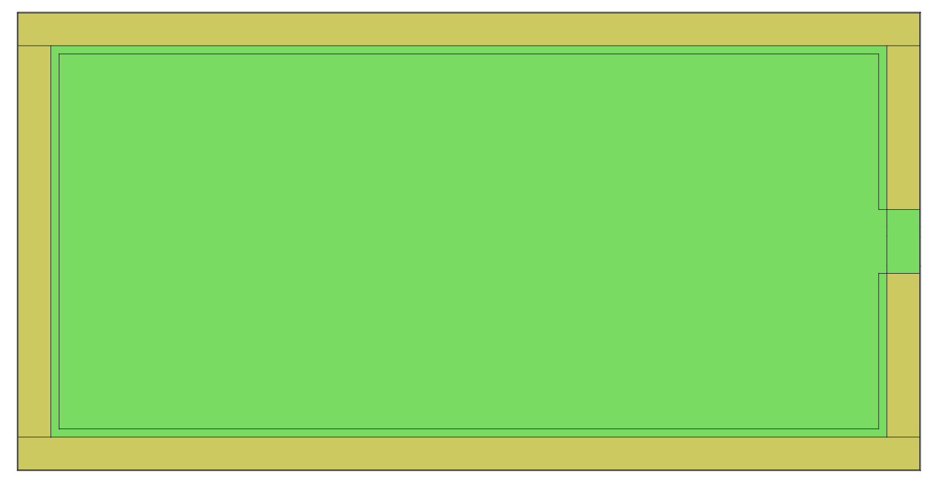
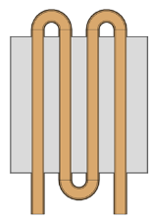
Cooling liquid scheme

Slide 7
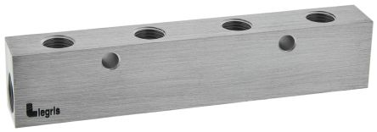
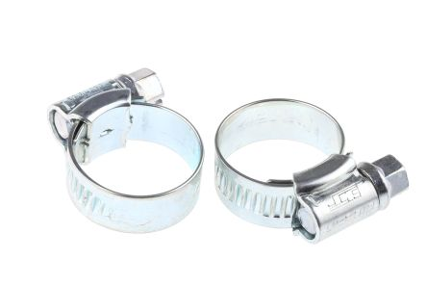

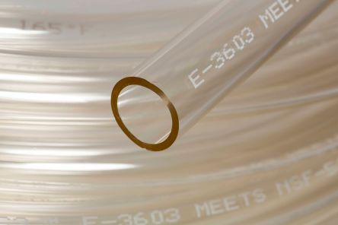
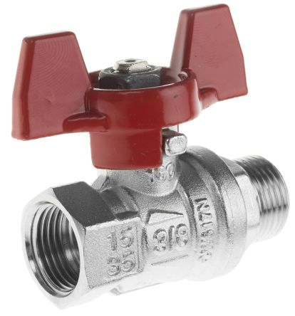
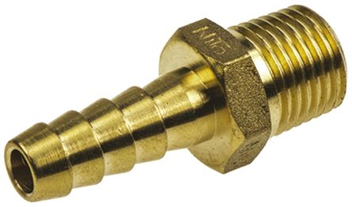
Components for cooling liquid
All components can be purchased directly from RS Components. Complete list of components has been made.
No custom components = No need for a machine shop
Expected cost: Less than 200 EUR

Slide 8
Vertical stackup
We place a thin (1cm) layer of solid Armaform insulation above the liquid cooling tubes with cutouts for cooling blocks.
This provides a clean “floor” where to place cables for sensors, modules, etc.
Separating cabling from tubing reduces mess.
Space for cables (LV, HV, data, peltier, etc)
Armaform insulation (for separation of cables and cooling)
Space for cooling (tubes, connectors, etc)
Armaform insulation (for protection of Turvac)
Turvac vacuum insulation

Slide 9
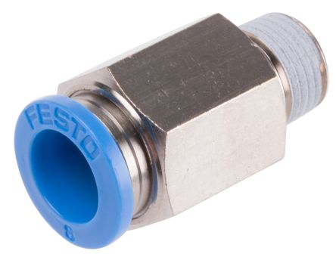
Vacuum
Use standard push-in pneumatic connectors and flexible tubing.
Connectors and tubes are rated for vacuum and expected temperature range.

Slide 10
Summary
With Dyneo DD-1000F we have a large (600W) cooling budget at both electrical testing and temperature cycling.
We can easily take modules to -55C and below.
Cooling liquid distribution in coldbox has been designed using off-the-shelf components and no need for special tools.

Slide 11
Title card

Slide 12


