Slide 1
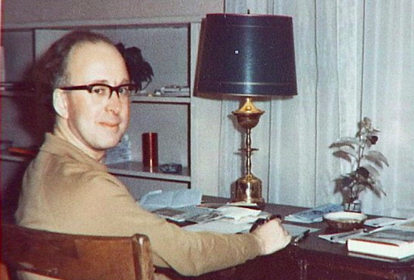

Particle Physics Today, Tomorrow and Beyond
John Ellis

Slide 2
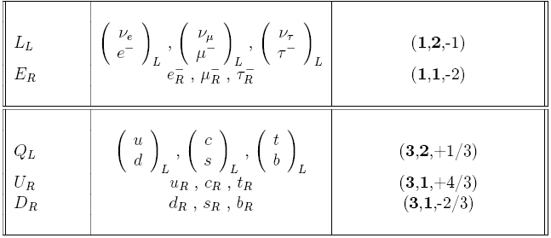
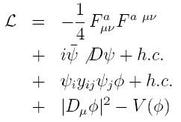
Summary of the Standard Model
Particles and SU(3) × SU(2) × U(1) quantum numbers:
Lagrangian: gauge interactions
matter fermions
Yukawa interactions
Higgs potential
Untested
before 2012

Slide 3
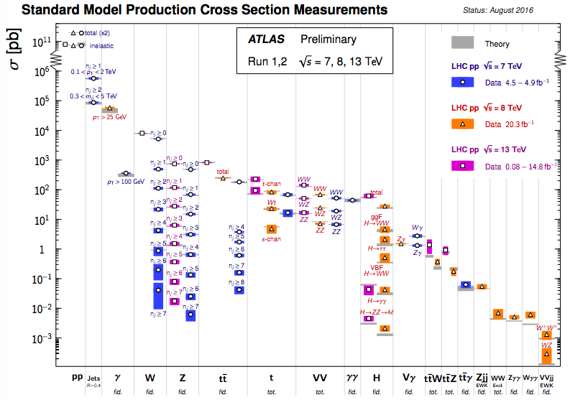
New Physics beyond the SM?
Standard Model Cross-Sections @ LHC

Slide 4
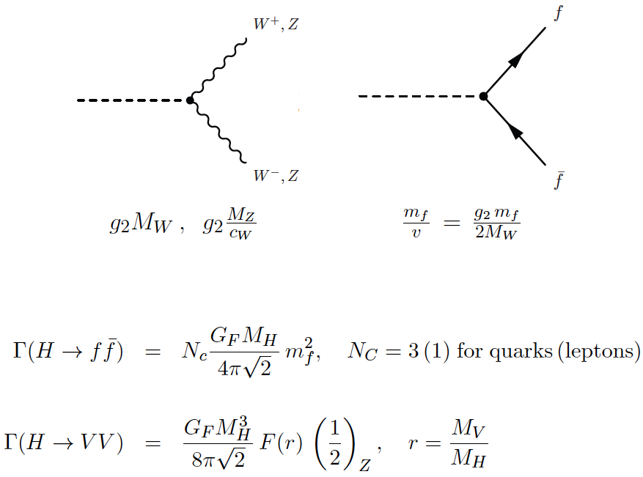
Higgs Boson Couplings
Weinberg 1967
Higgs 1966

Slide 5
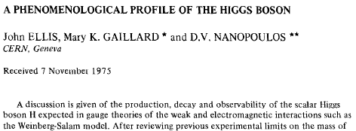
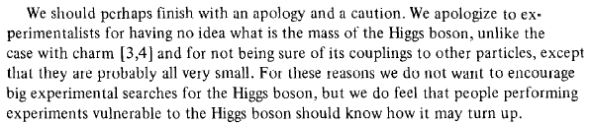
A Phenomenological Profile of the Higgs Boson
1975
First attempt at systematic survey

Slide 6
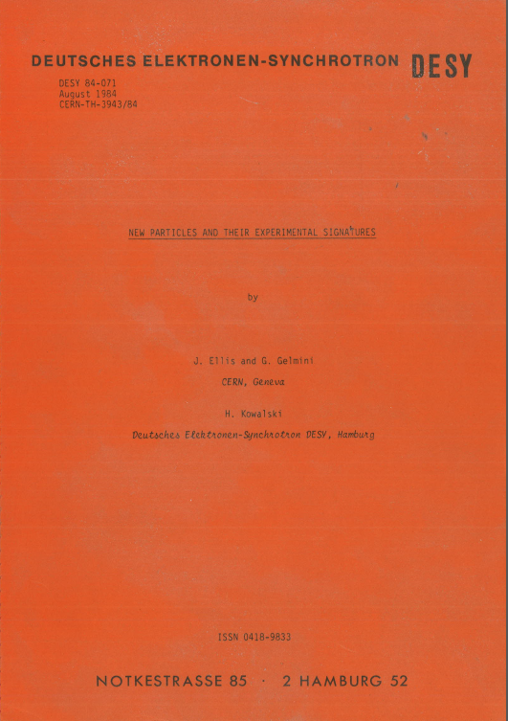
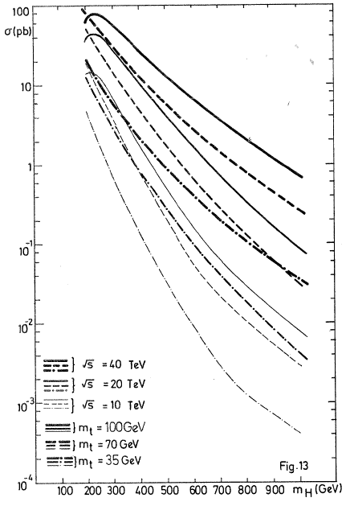
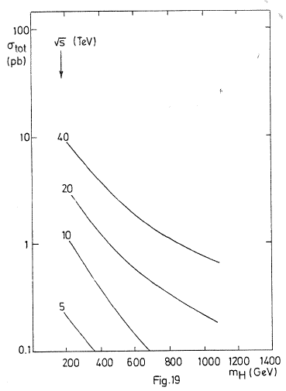
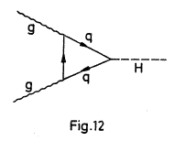
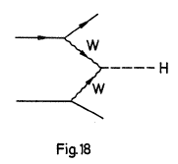
A Preview of the Higgs Boson @ LHC
1984
Prepared for LHC Lausanne workshop 1984
JE, Gelmini & Kowalski, 1984

Slide 7
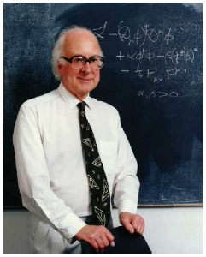
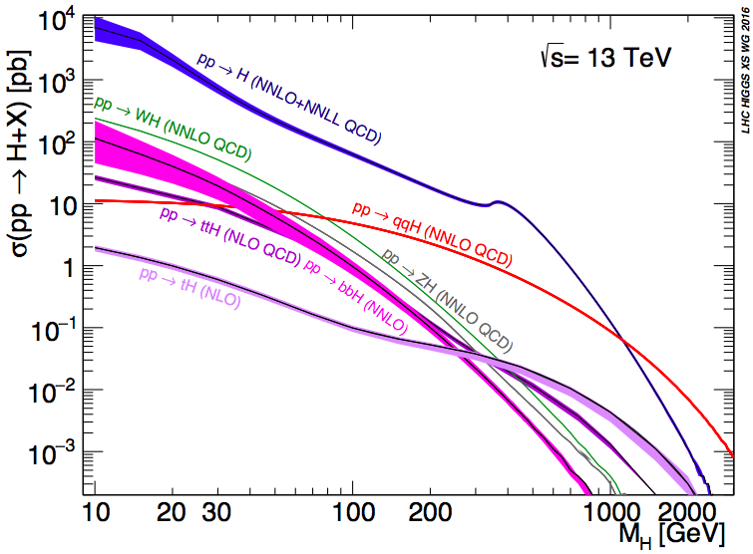
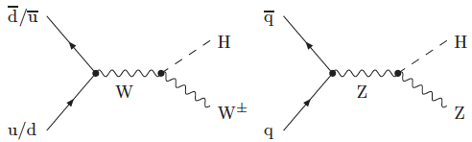
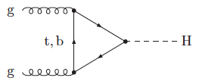
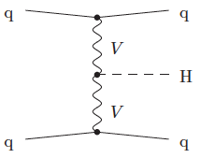
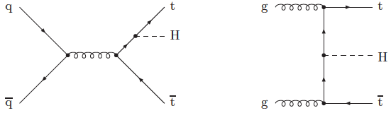
Higgs Production at the LHC
A la recherche du
Higgs perdu …
LHC Higgs Cross-Section
Working Group
(LHXSWG)
Many production modes measurable if M_{h} ~ 125 GeV

Slide 8
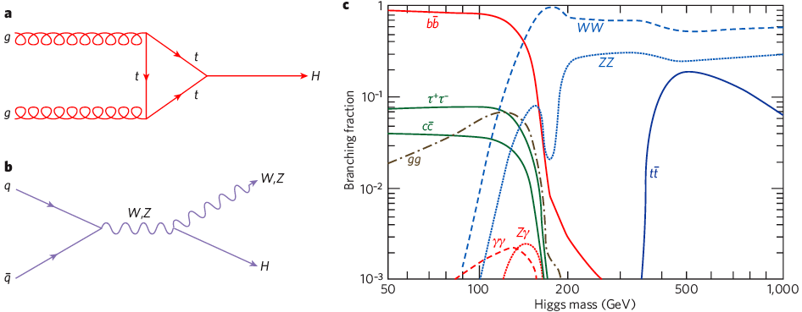
Higgs Decay Branching Ratios
Couplings proportional to masses (?)
Important couplings through loops:
  gluon + gluon → Higgs → γγ
Many decay modes measurable if M_{h} ~ 125 GeV

Slide 9

Large Hadron Collider at CERN

Slide 10
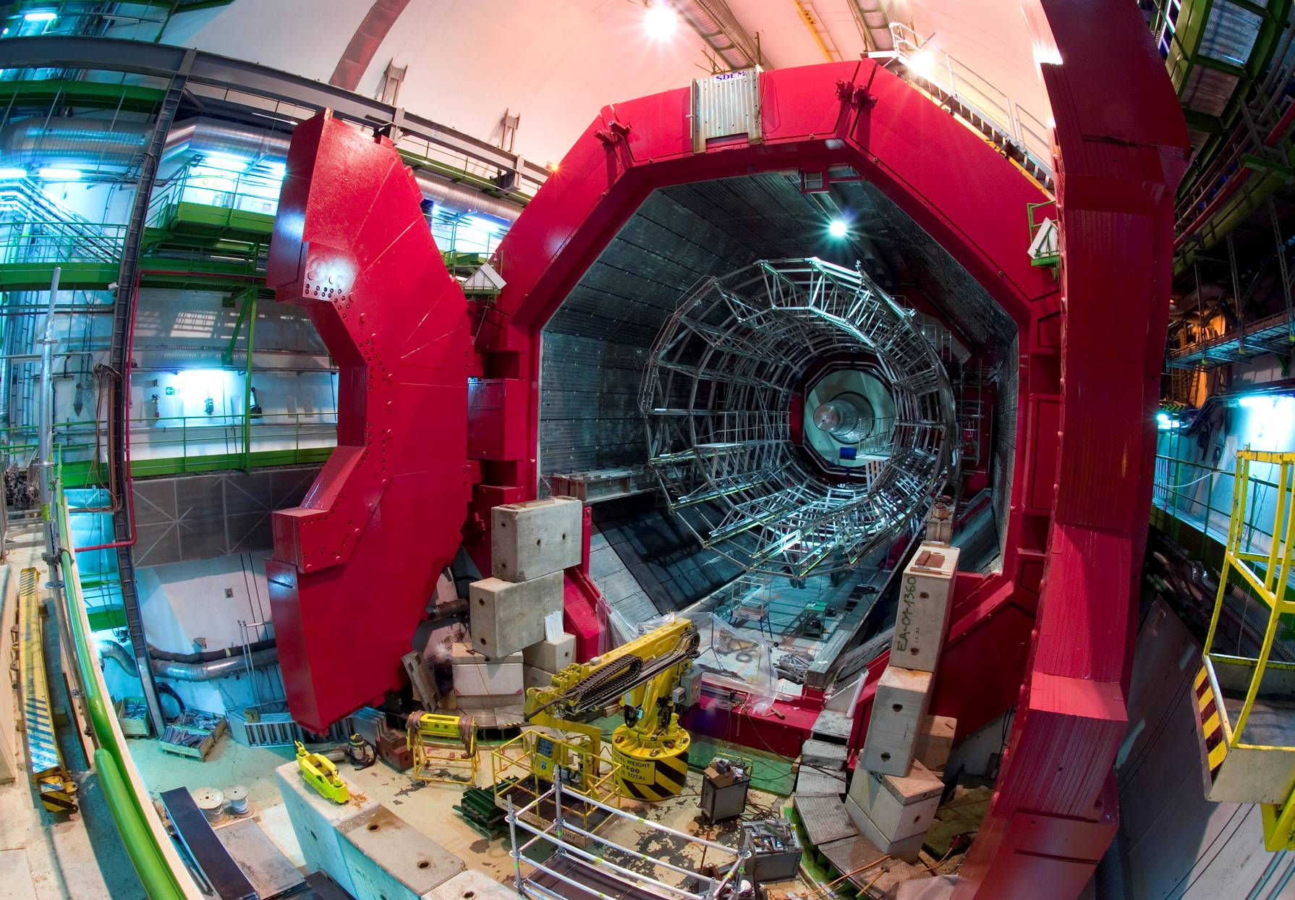
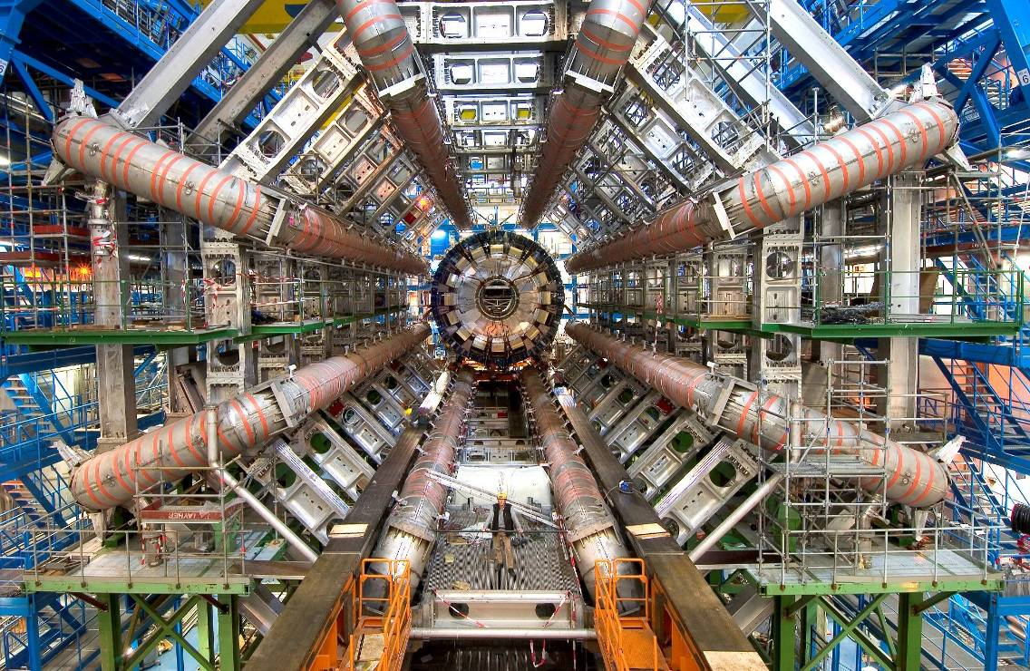
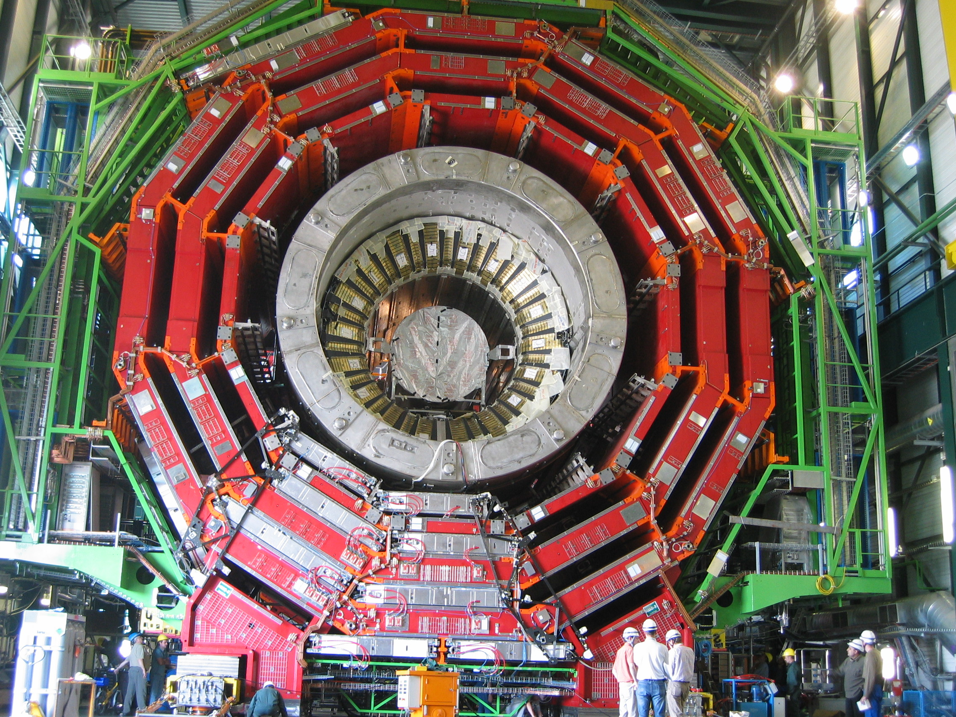
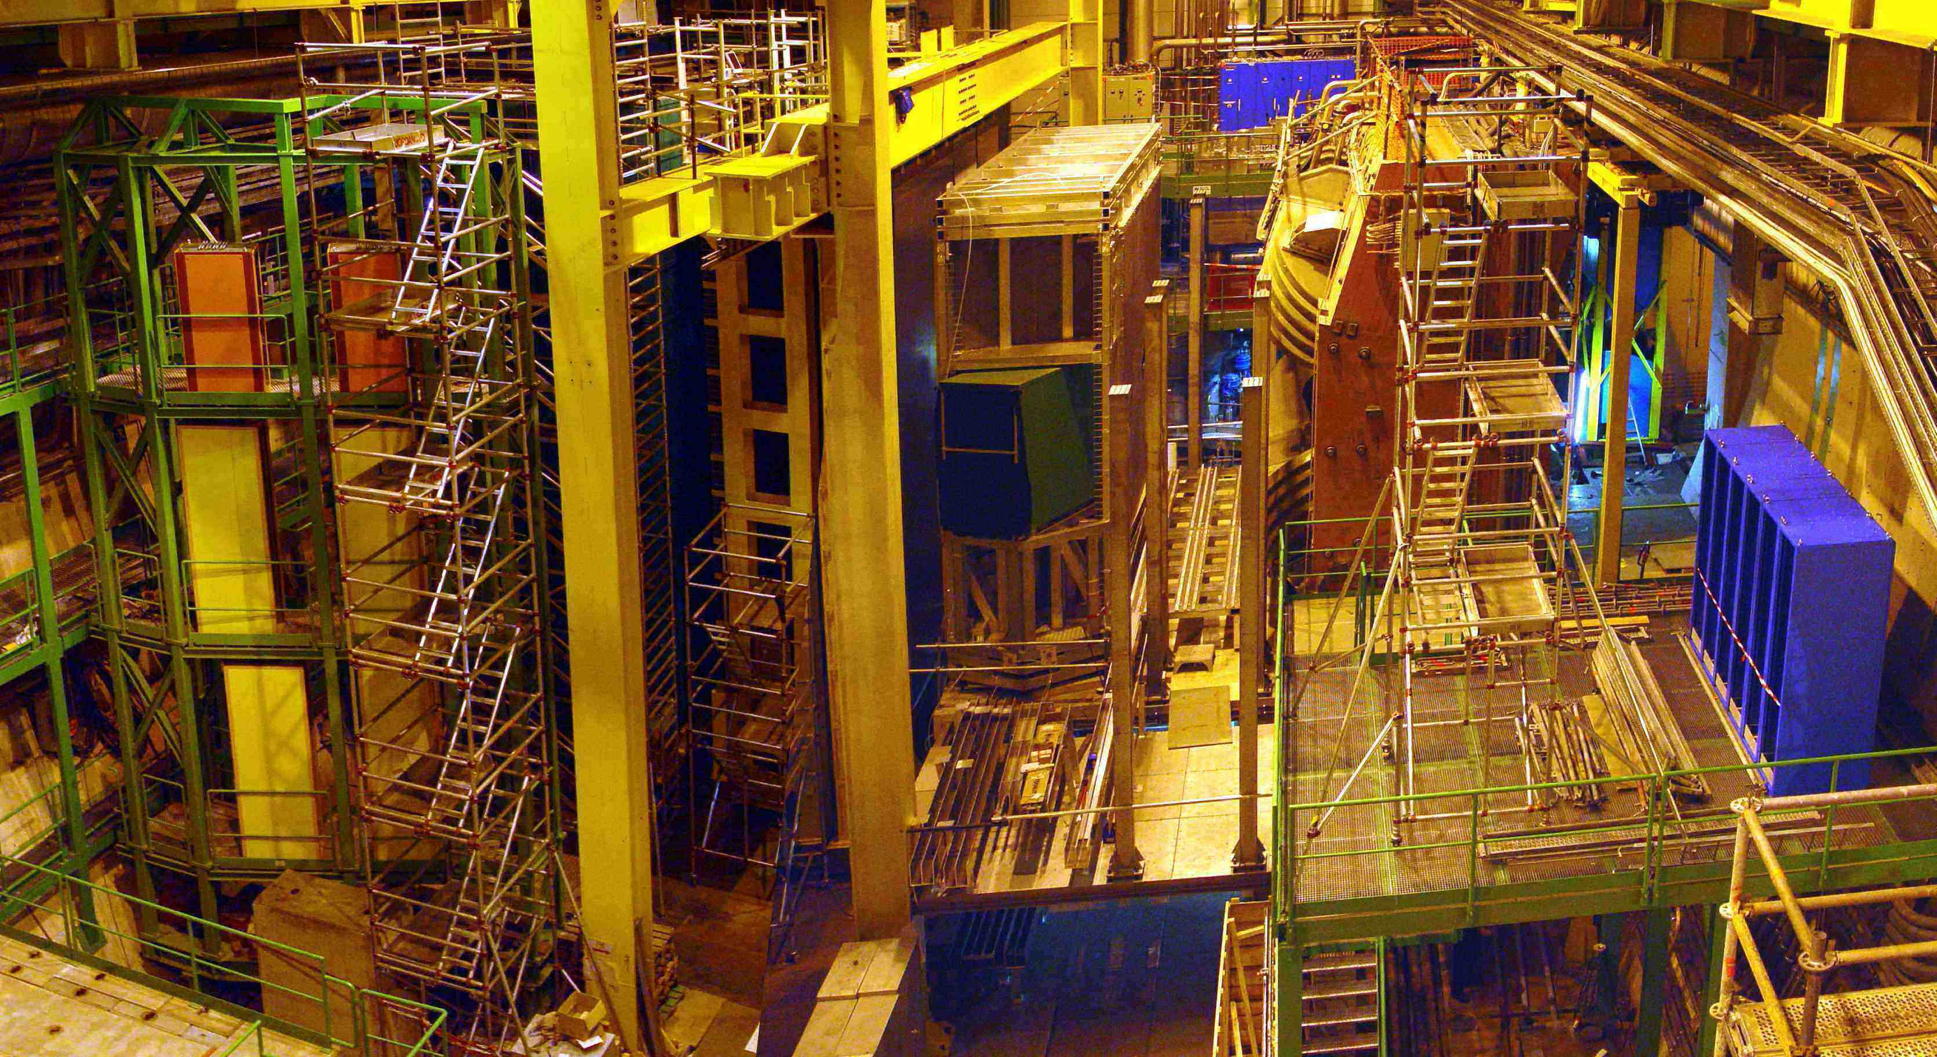
ALICE: Primordial cosmic plasma
ATLAS: Higgs and dark matter
CMS: Higgs and dark matter
LHCb: Matter-antimatter difference

Slide 11
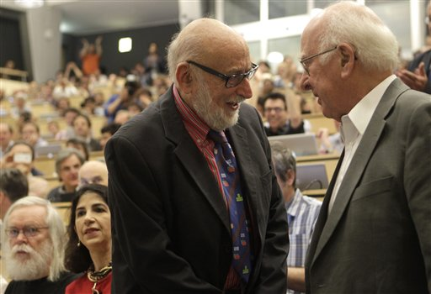
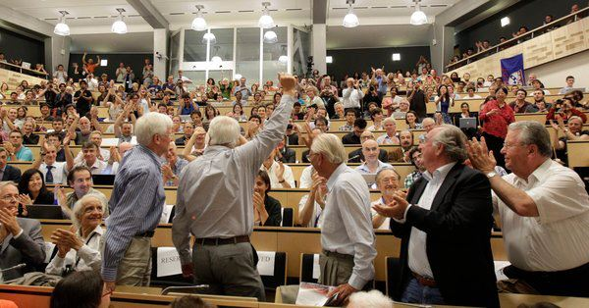
Higgsdependence Day!

Slide 12
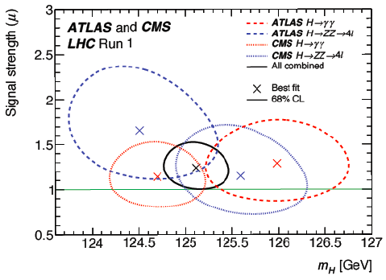
Higgs Mass Measurements
ATLAS + CMS ZZ* and γγ final states
Run 1:
Run 2: (CMS ZZ*)
Makes precision tests possible
Crucial for stability of electroweak vacuum

Slide 13


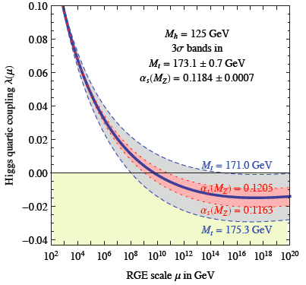
Theoretical Constraints on Higgs Mass
Large M_{h} → large self-coupling → blow up at low-energy scale Λ due to
renormalization
Small: renormalization
due to t quark drives
quartic coupling < 0
at some scale Λ
→ vacuum unstable
Vacuum could be stabilized by Supersymmetry
Instability @
10^{9.4±1.1} GeV
Degrassi, Di Vita, Elias-Miro, Giudice, Isodori & Strumia, arXiv:1205.6497

Slide 14
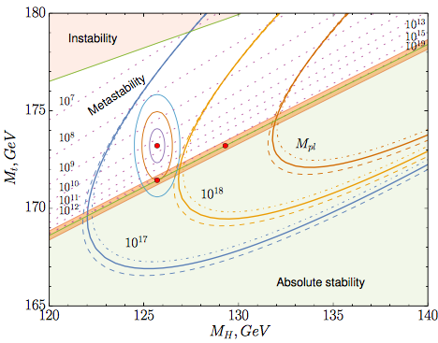
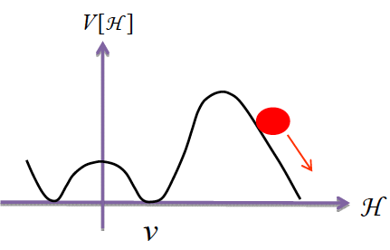
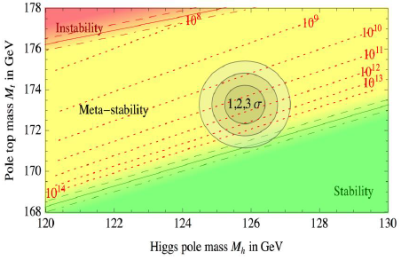
Vacuum Instability in the Standard Model
Very sensitive to m_{t} as well as M_{H}
Instability scale:
m_{t} = 173.3 ± 1.0 GeV ➔ log₁₀(Λ/GeV) = 9.4 ± 1.1
New D0
World
average
New ATLAS
New CMS
Bednyakov, Kniehl, Pikelner and Veretin: arXiv:1507.08833
Buttazzo, Degrassi, Giardino, Giudice, Sala, Salvio & Strumia, arXiv:1307.3536

Slide 15
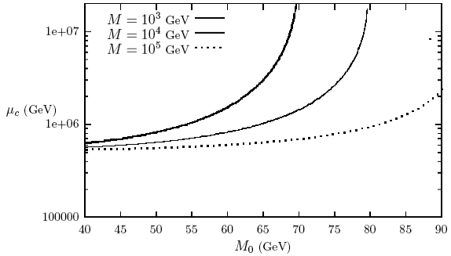

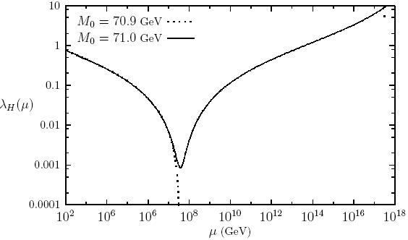
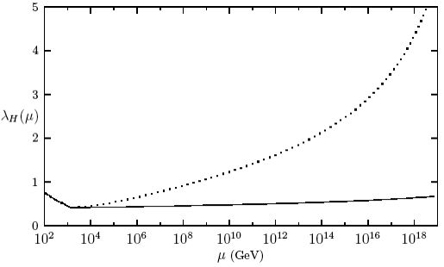
How to Stabilize a Light Higgs Boson?
Top quark destabilizes potential: introduce introduce stop-like scalar:
Can delay collapse of potential:
But new coupling must be
fine-tuned to avoid blow-up:
Stabilize with new fermions:
  just like Higgsinos
Very like Supersymmetry!
JE + D. Ross

Slide 16
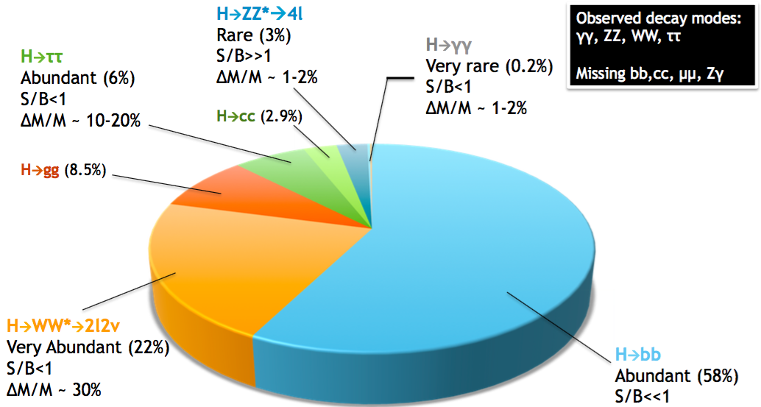
What we Expect
What do we know?

Slide 17
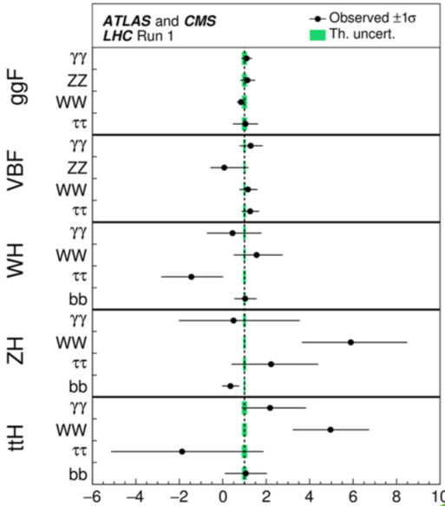
Production
Measurements in Run 1
Open questions:
  H➔bb?
    2.6σ @ LHC
    2.8σ @ FNAL
  H➔μμ?
  ttH production?
  tH production?

Slide 18
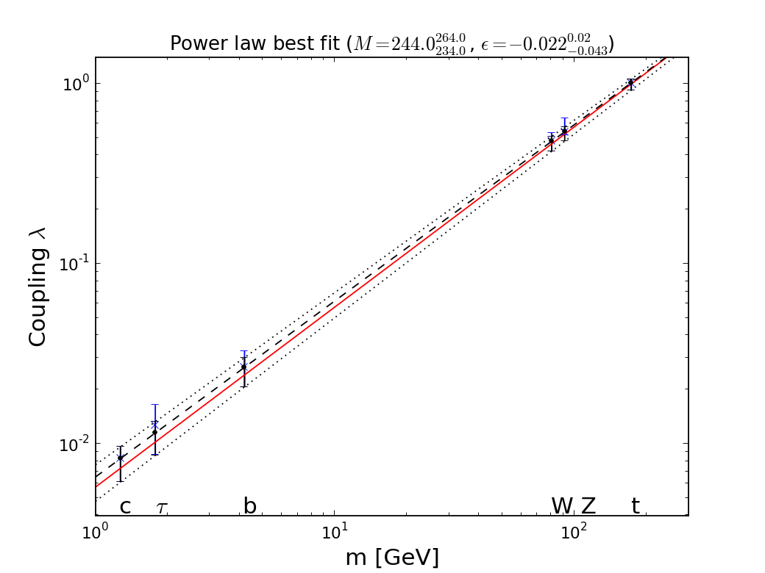
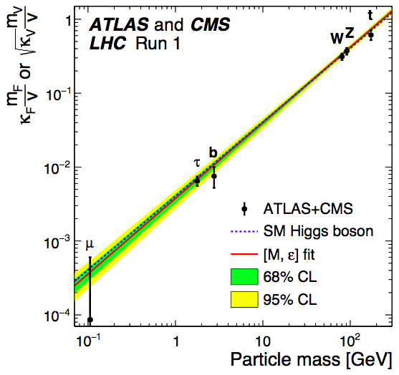

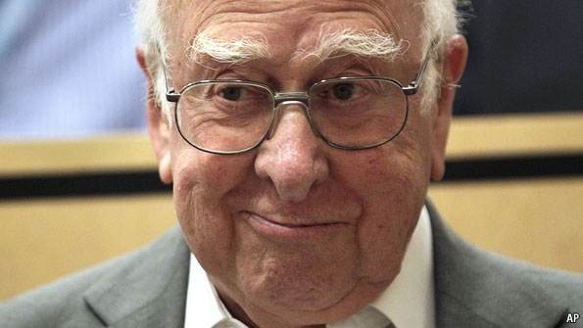

It Walks and Quacks like a Higgs
Do couplings scale ~ mass? With scale = v?
Red line = SM, dashed line = best fit
Global
fit
JE & Tevong You
Blue dashed line = Standard Model

Slide 19
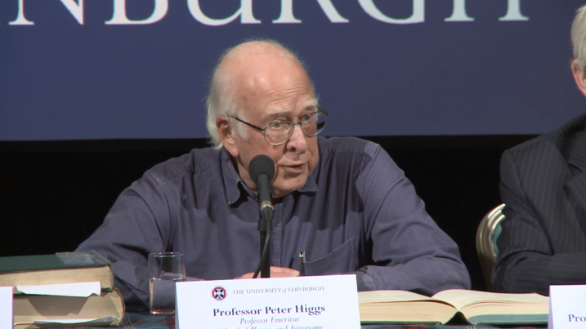
Dixit Swedish Academy
Today we believe that “Beyond any reasonable doubt, it is a Higgs boson.” [1]
http://www.nobelprize.org/nobel_prizes/physics/laureates/2013/advanced-physicsprize2013.pdf
[1] = JE & Tevong You, arXiv:1303.3879

Slide 20



« Empty » space is unstable
Dark matter
Origin of matter
Masses of neutrinos
Hierarchy problem
Inflation
Quantum gravity
…
Run 2
SUSY
Run 2
SUSY
Run 2
SUSY
Run 2
SUSY
SUSY
SUSY
^{The} Standard Model
Notes:
20

Slide 21
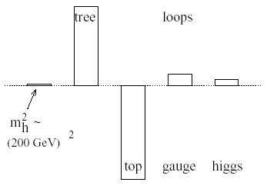
Elementary Higgs or Composite?
Higgs field:
<0|H|0> ≠ 0
Quantum loop problems
Fermion-antifermion condensate
Just like QCD, BCS superconductivity
New ‘technicolour’ force?
Cutoff
Λ = 10 TeV
Heavy scalar resonance?
Problems with precision
electroweak data
Pseudo-Nambu-Goldstone
boson?
Cut-off Λ ~ 1 TeV with
Supersymmetry?

Slide 22
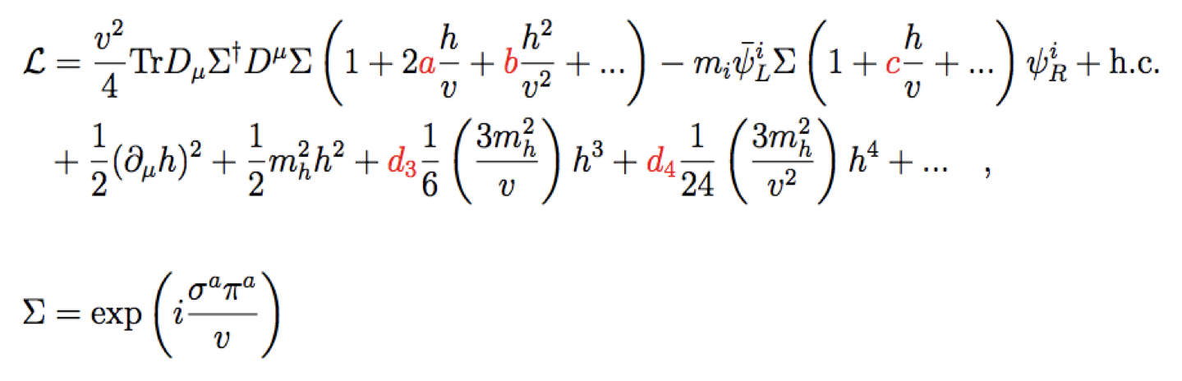

Phenomenological Framework
Assume custodial symmetry:
Parameterize gauge bosons by 2 × 2 matrix Σ:
Coefficients a = c = 1 in Standard Model
Notes:
Coefficients chosen to reproduce SM in limit of unit coefficients a, c, b etc. To follow this talk all you really need to remember is that a parametrizes the gauge couplings of the scalar and c parametrizes its fermionic couplings.

Slide 23
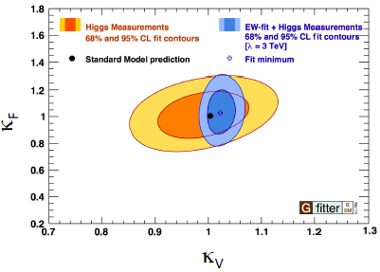
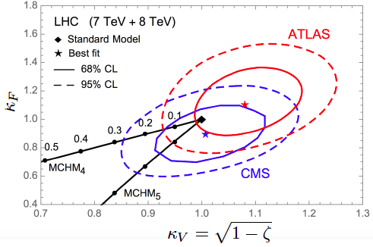
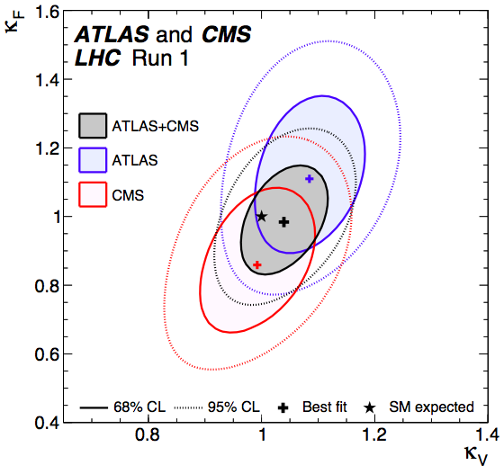
Global Analysis of Higgs-like Models
Rescale couplings: to bosons by κ_{V}, to fermions by κ_{f}
Standard Model: κ_{V} = κ_{f} = 1
Consistency between Higgs and EW measurements
Must tune composite models to look like SM

Slide 24

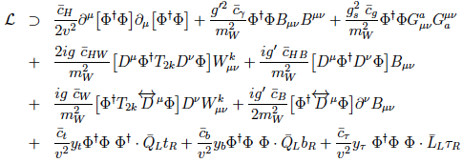
Standard Model Effective Field Theory
Assuming H(125) is SM-like: Model-independent search for new physics
Higher-dimensional operators as relics of higher-energy physics, e.g., dimension 6:
Operators constrained by SU(2) × U(1) symmetry:
Constrain with precision EW, Higgs data, TGCs ...

Slide 25
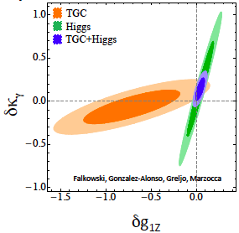
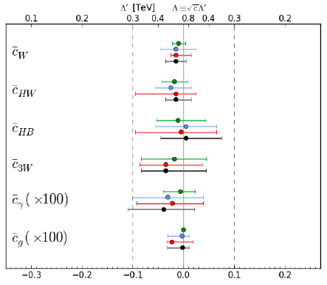
Global Fits including
LHC Dta
Associated H production
LHC Triple-gauge couplings
Global combination
Individual operators
JE, Sanz & Tevong You, arXiv:1410.7703
Preferred framework for analyzing Run 2

Slide 26

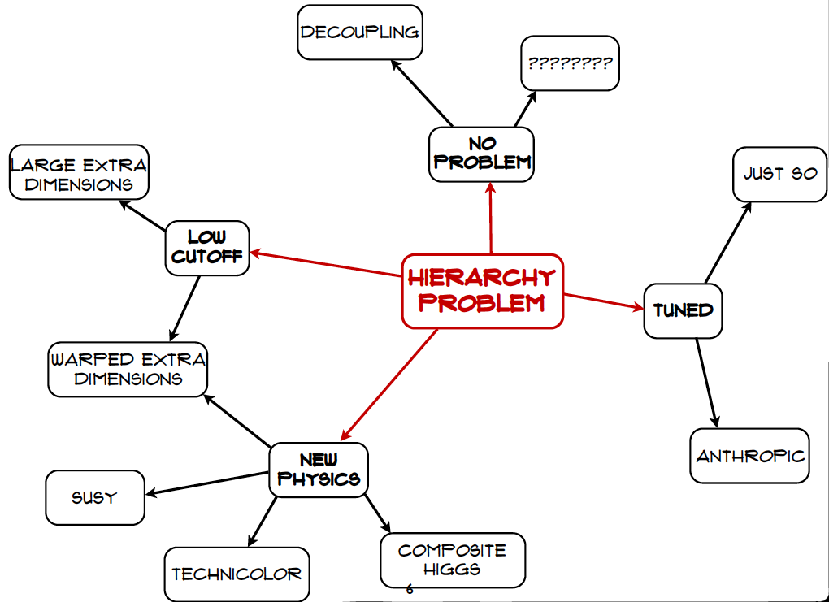
Craig@LHCP
If you know of a better hole, go to it

Slide 27
What lies beyond the Standard Model?
Supersymmetry
New motivations
From LHC Run 1
Stabilize electroweak vacuum
Successful prediction for Higgs mass
  Should be < 130 GeV in simple models
Successful predictions for couplings
  Should be within few % of SM values
Naturalness, GUTs, string, …, dark matter

Slide 28
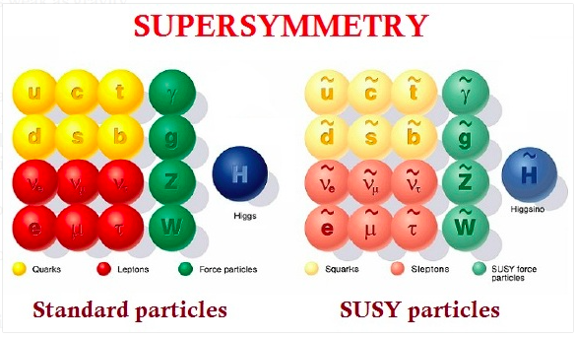
Minimal Supersymmetric Extension of the Standard Model

Slide 29
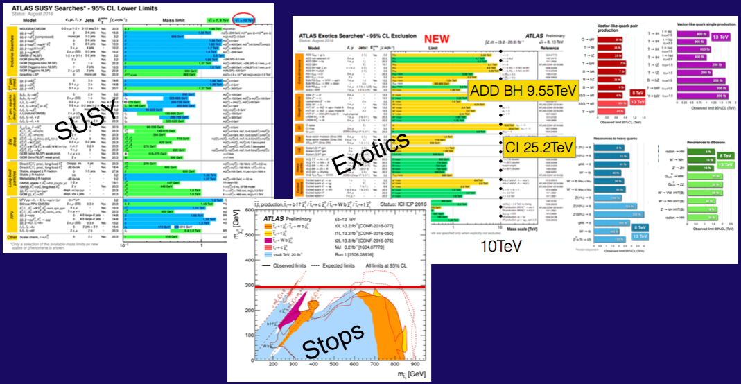
Nothing (yet) at the LHC
No supersymmetry
Nothing else, either
More of same?
Unexplored nooks?
Novel signatures?

Slide 30


Craig@LHCP

Slide 31



Inputs to Global Fits for New Physics
Electroweak
observables
Flavour
observables:
Interpretation
requires
lattice inputs
Dark Matter
LHC
observables

Slide 32

Best-Fit Sparticle Spectrum
Phenomenological MSSM
Accessible to LHC?
Bagnaschi, Sakurai, JE et al, arXiv:1710.11091

Slide 33


Other Possible LHC Signatures
Phenomenological MSSM
Long-lived sparticle?
B_{s,d} ➔ μ⁺μ⁻ decay < SM?
Bagnaschi, Sakurai, JE et al, arXiv:1710.11091

Slide 34

Direct Dark Matter Searches
Compilation of present and future sensitivities
SUSY
models
Neutrino
“floor”

Slide 35

The LHC in Future Years

Slide 36



Projected e⁺e⁻ Colliders:
Luminosity vs Energy

Slide 37


Future Circular Colliders
The vision:
explore 10 TeV scale directly (100 TeV pp) + indirectly (e⁺e⁻)

Slide 38



Future Circular e⁺e⁻ Collider?
M = 246.0 ± 0.8 GeV, ε = 0.0000^{+0.0015}_{-0.0010}
Not just Higgs physics:
Also Tera-Z, Oku-W, Mega-t

Slide 39

Higgs Cross Sections
At the LHC and beyond:

Slide 40

Squark-Gluino Plane
Discover 12 TeV squark,
16 TeV gluino @ 5σ

Slide 41
Summary
The discovery of the Higgs boson at the LHC is a big challenge for theoretical physics!
The LHC may yet discover physics beyond the SM at ~ 13 TeV
If it does, priority will be to study it
If it does not, natural to focus on the Higgs
In either case, a large circular collider offers the best prospects

