Slide 1
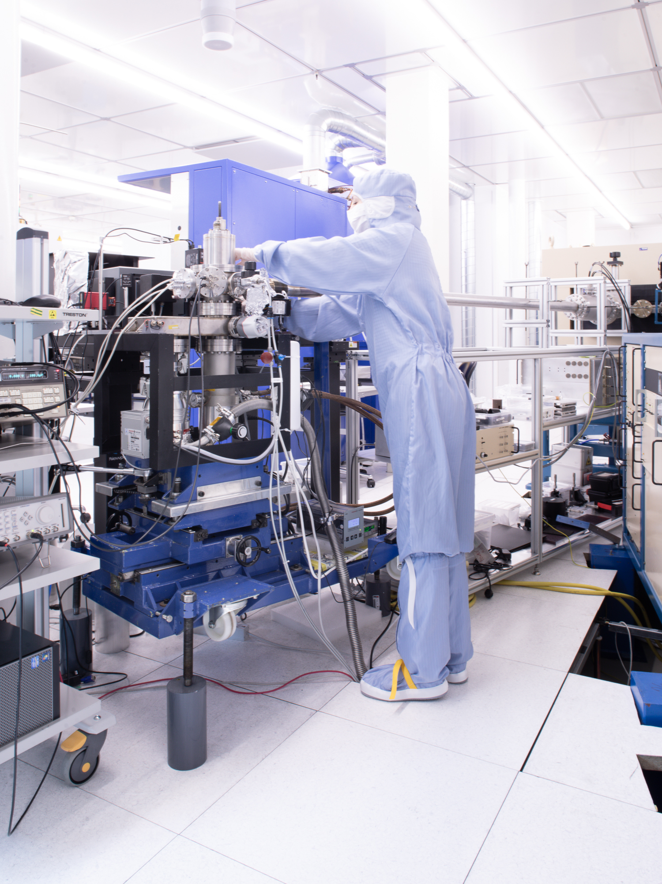

Point defects in semiconductors as quantum platform
Ongoing research at the Semiconductor Physics Section
Lasse Vines
University of Oslo
lassevi@fys.uio.no

Slide 2
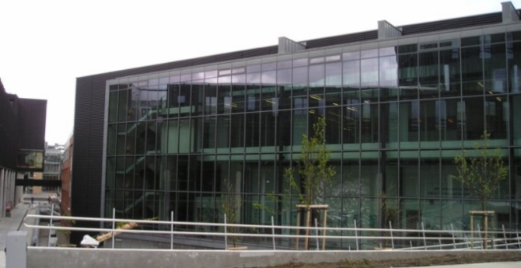
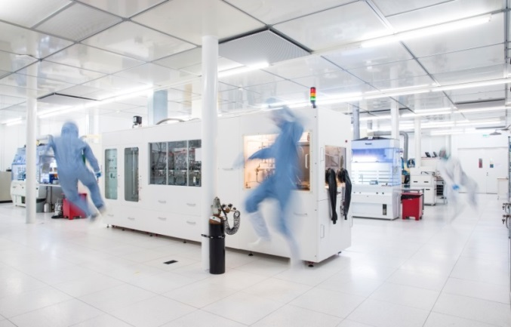

Semiconductor Physics Section
LENS – Light and Electricity from Novel Semiconductors
MiNa-Lab
Application-motivated basic research...
focus on defects, doping and diffusion, synthesis of novel semiconductors and ion beam physics, towards applications within solar cells, QT, power electronics and sensors
Office: Kristen Nygårds hus (3.etg.)
Lab: MiNa-Lab
Clean room(440 m²) and 9 Characterization labs
~45 people:
- 5 Profs.
- 4 admin/engineers
- 10 postdocs/researchers
- 12 PhD students.
- 15 Master students
Norwegian Micro- and Nanofabrication Facility

Slide 3
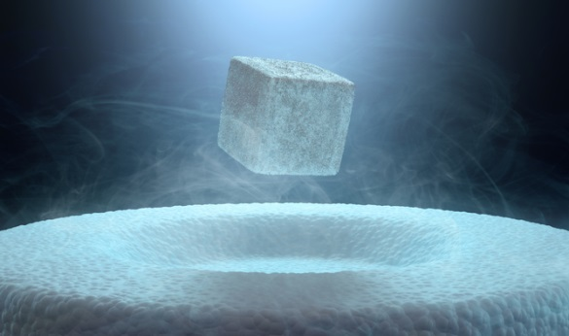
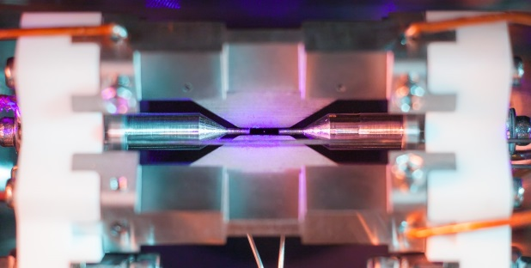
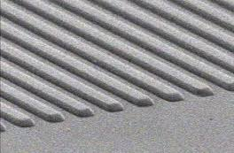
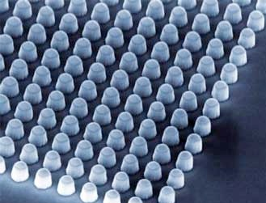
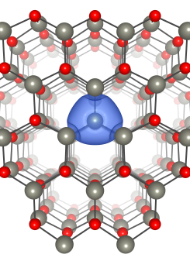
Choice of material platform for physical realizations of QT
Superconductors
Trapped ion
Atomic vapor
Optical gratings
Quantum dots
Defects in semiconductors
…
Superconductors
Trapped ions
www2.physics.ox.ac.uk
Optical gratings
Quantum dots
Point defects

Slide 4

Point defects in semiconductors for QT
Certain point defects can act as isolated two level systems with possibility for spin manipulation and single photon emission properties satisfying the qubit requirements

Slide 5
Point defects in semiconductors for QT
Certain point defects can act as isolated two level systems with possibility for spin manipulation and single photon emission properties satisfying the qubit requirements
Example: The NV- center in diamond
N atom next to C vacancy
Spin state with S = 1
Spin state is stable for milliseconds even at RT → what you need for QC
Spin state can be optically initialized, entangled and read out
Excite with laser → single-photon emission

Slide 6
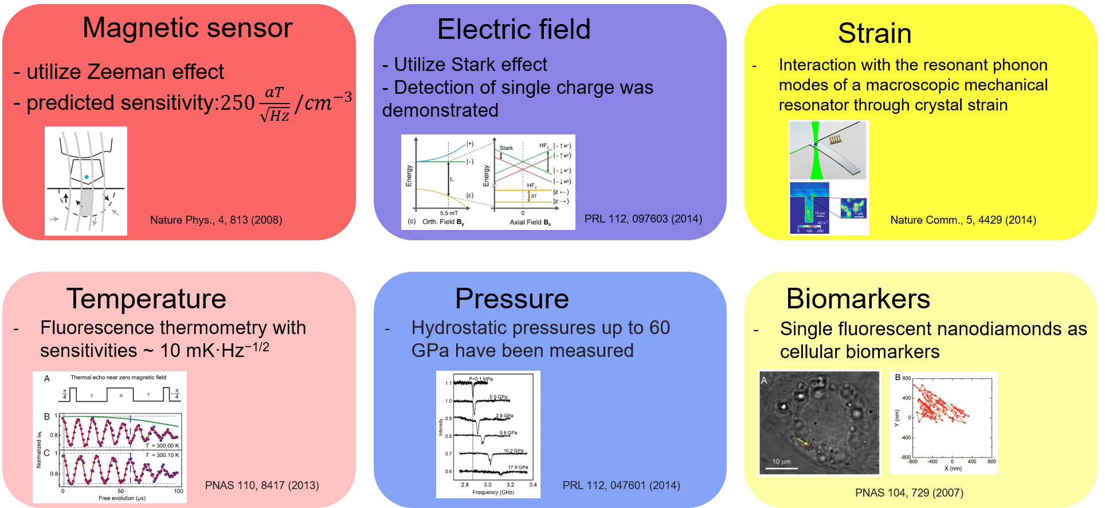
Point defects in semiconductors for QT
Sensing applications

Slide 7
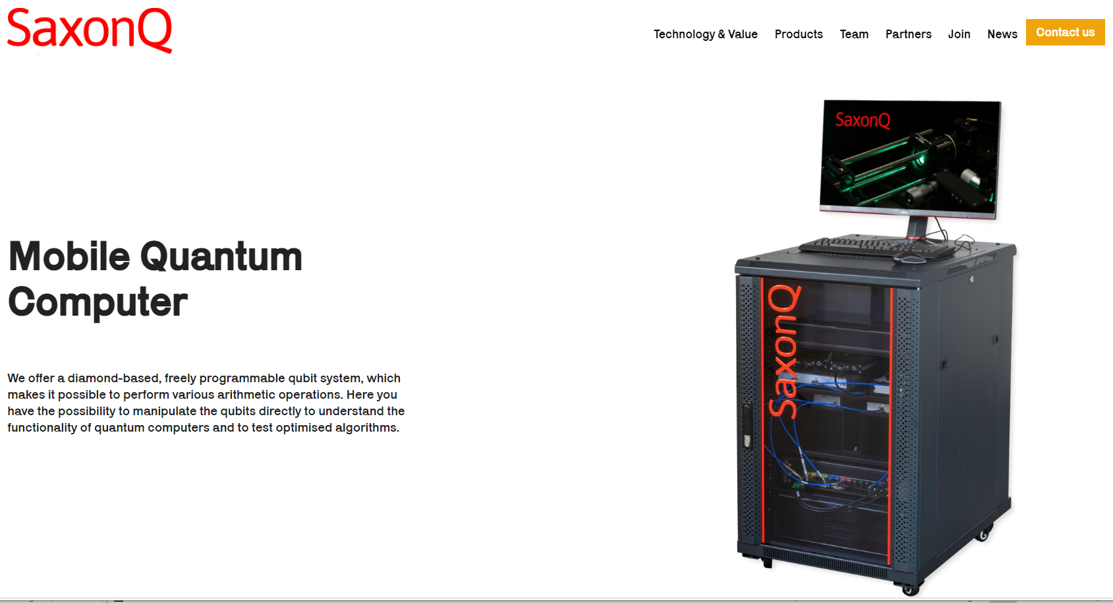
Point defects in semiconductors for QT

Slide 8
Single photon emission from point defects
E_{c}
Ideal single-photon source:
Triggered (on-demand)
g⁽²⁾(0) = 0
Indistinguishable photons
High repetition rate
Room temperature
Chip integration
E_{v}

Slide 9
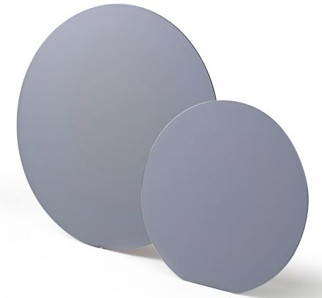
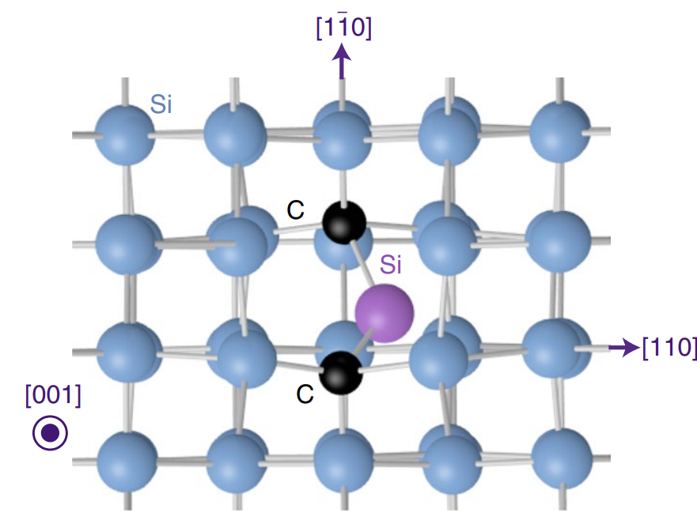
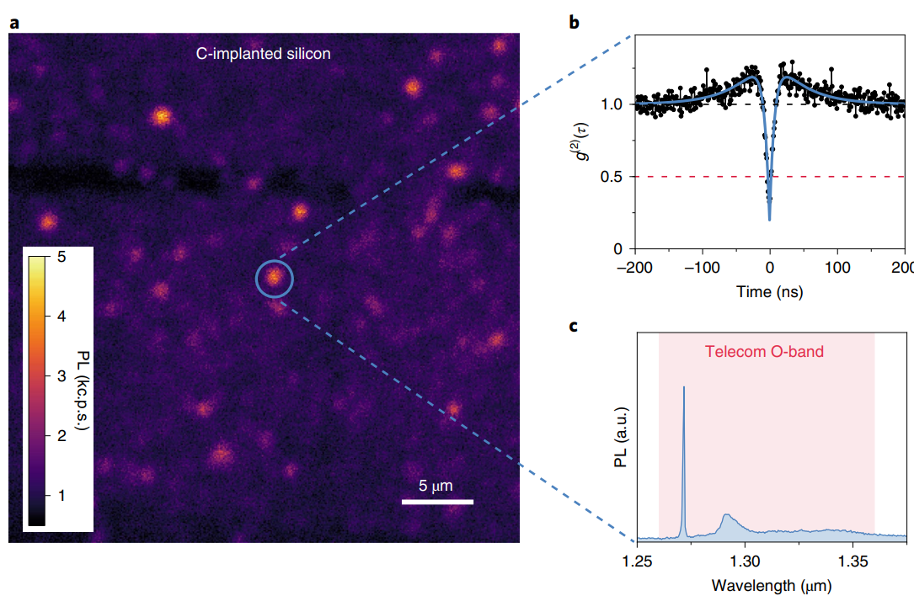
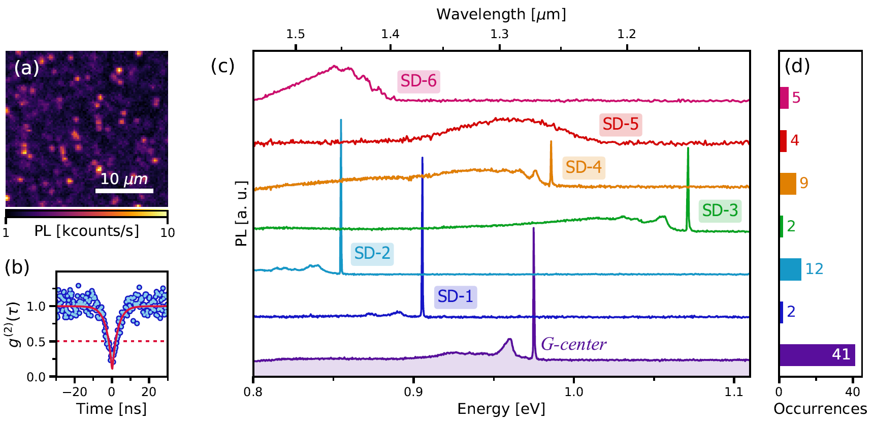
Identification and single photon emission (SPE) from point defects in Silicon
Point defects suitable as solid state qubits and single photon emitters (SPE)
- First identification of SPE in Si, the G-center
Si reveal several other SPEs, e.g. W, T and C-center, but also several unknown defects suitable for telecom wavelengths
W. Redjem, ..., A. Y. Kuznetsov, ... G. Cassabois, Nature Electronics, 3, 738, (2020)
A. Durand, ... , A. Y. Kuznetsov, ... A. Dreau, Phys. Rev. Lett., 126, 083602 (2021)

Slide 10
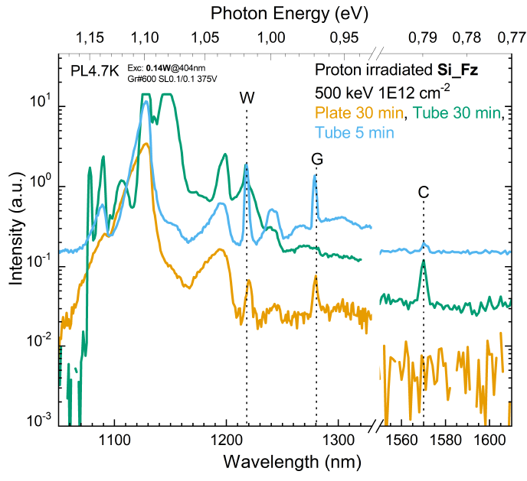
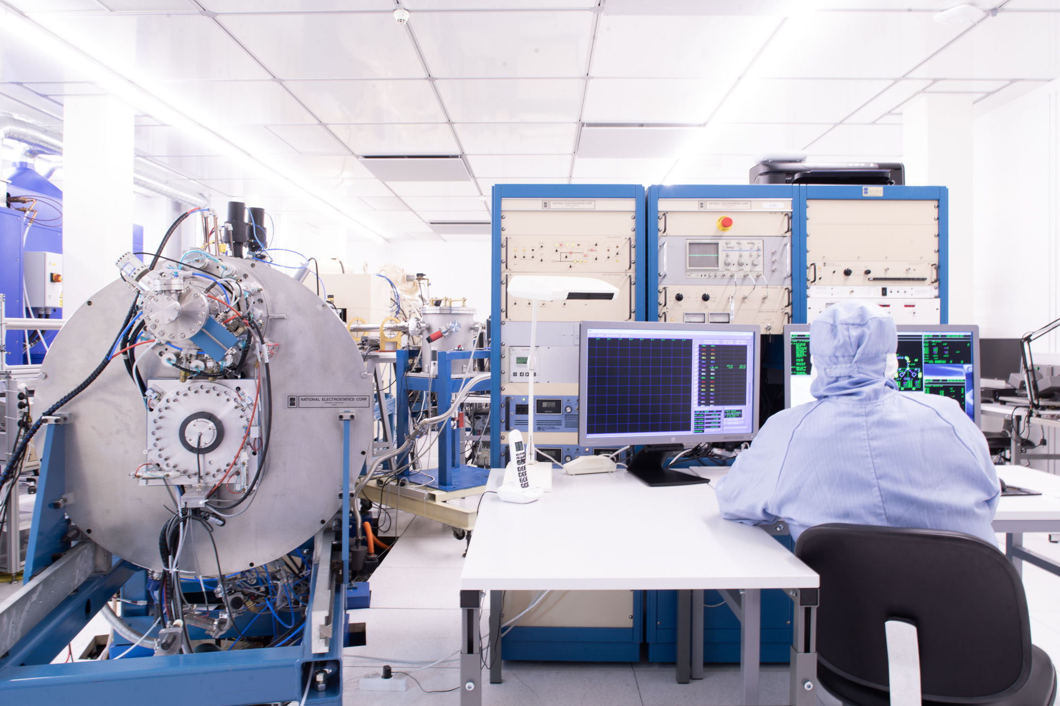
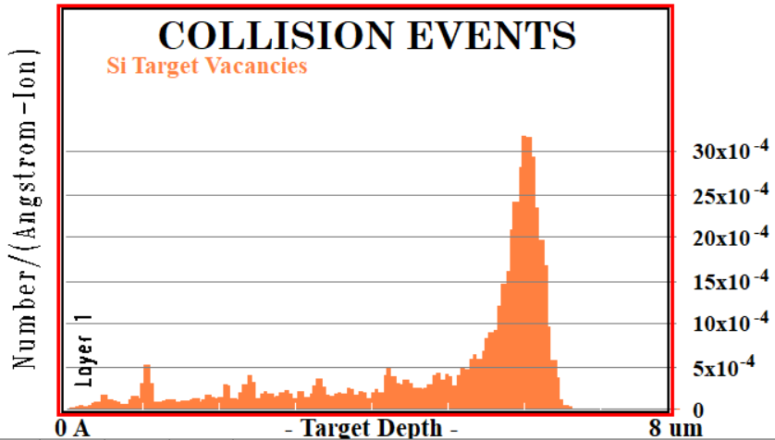
Formation of qubit candidates through ion implantation

Slide 11
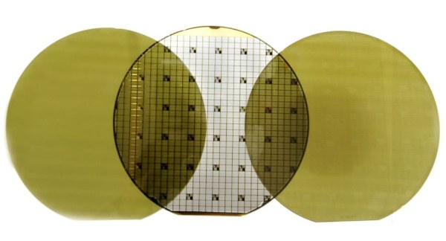
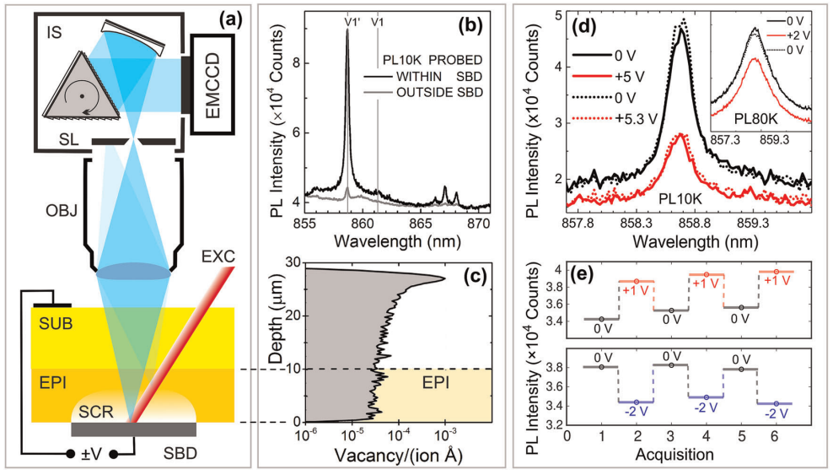
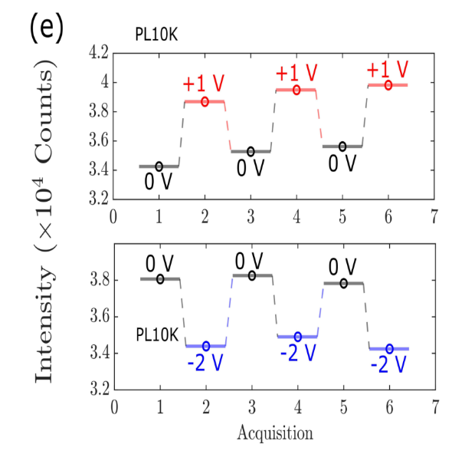
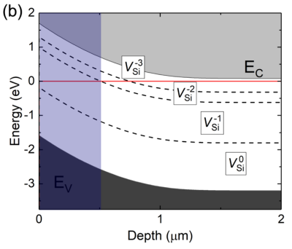
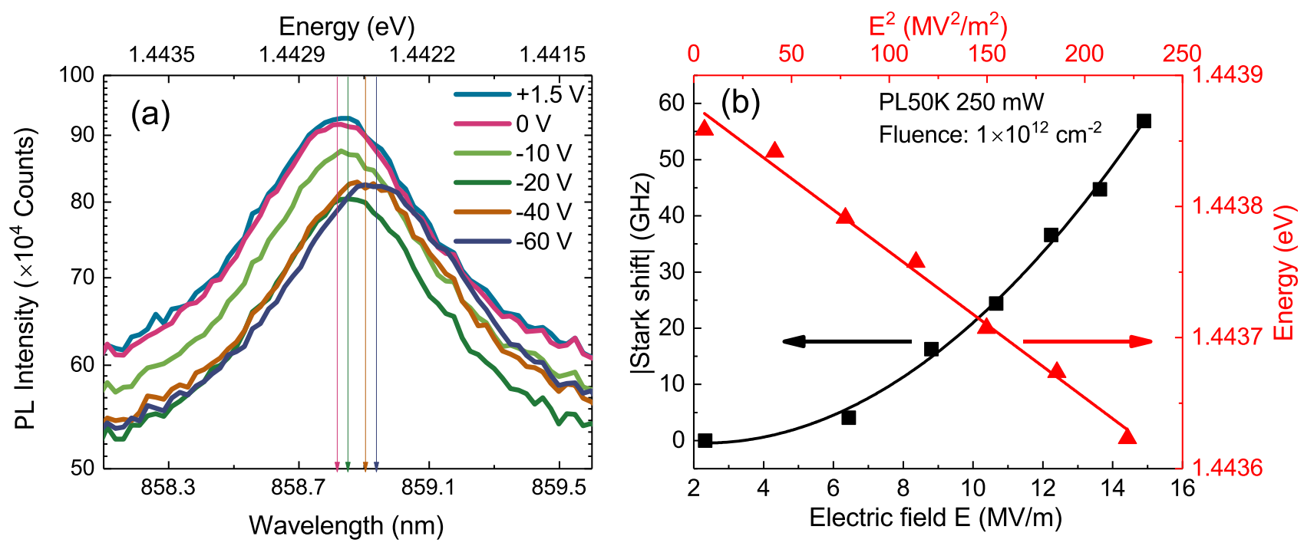
Charge state identification and control of quantum defects in Silicon Carbide
Emission control
Stark effect (for tuning and sensing)
SiC hosts several well-known “quantum defects”
Only one charge state is bright
The charge state can be controlled by and electric field
V_{Si}, exhibit a quadratic Stark shift
M. Bathen, ..., L. Vines, npj Quantum Information, vol. 5, 111 (2019)
M. Bathen and L. Vines, Advanced Quantum Technologies, 4, 2100003 (2021)
M. Bathen,... L. Vines and U. Grossner, Defect and Diffusion Forum, 425, 35 (2023)

Slide 12
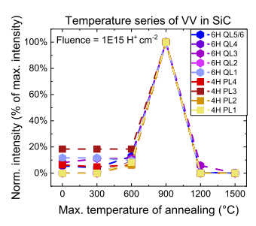
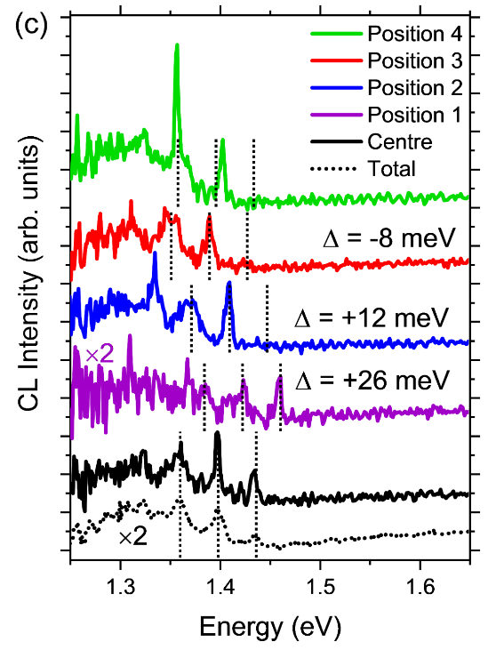
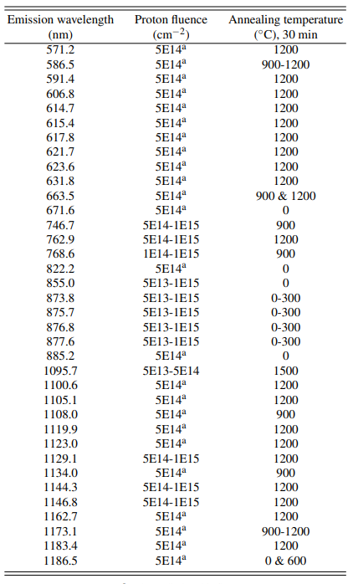

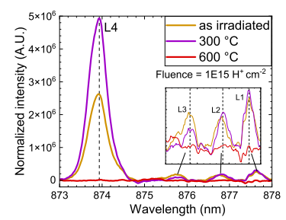
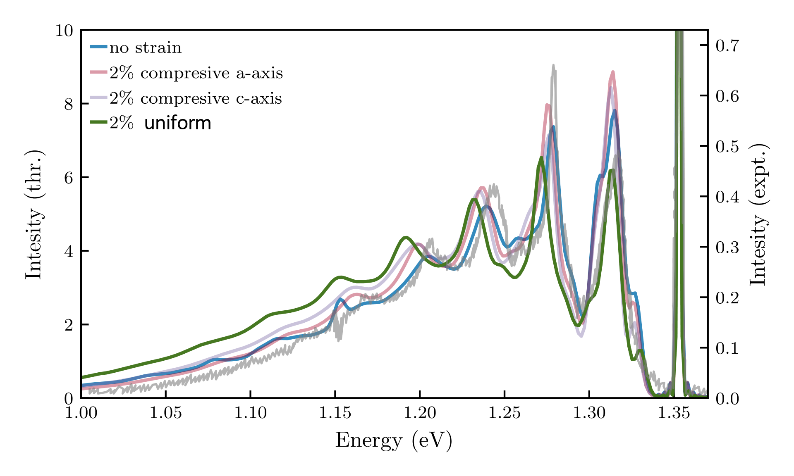
Ongoing projects
SPE's in SiC polymorphs and other materials
Strain effect on emission lineshape
E. Ousdal, M. Bathen, A. Galeckas, A. Kuznetsov, L. Vines, submitted to J. Appl. Phys (2024)
G. C. Vasquez, M. Bathen ..., L. Vines, Nano Lett., vol. 20, p. 8689 (2020)

Slide 13
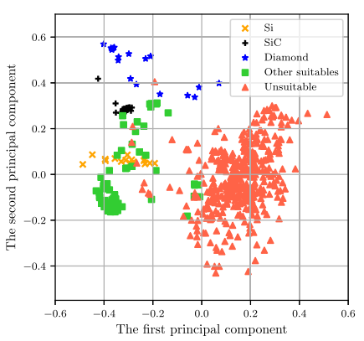

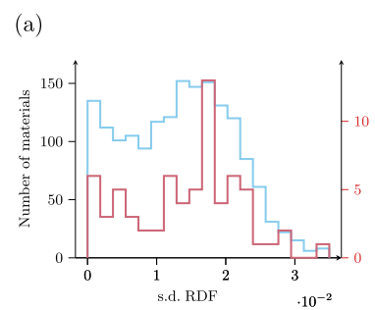
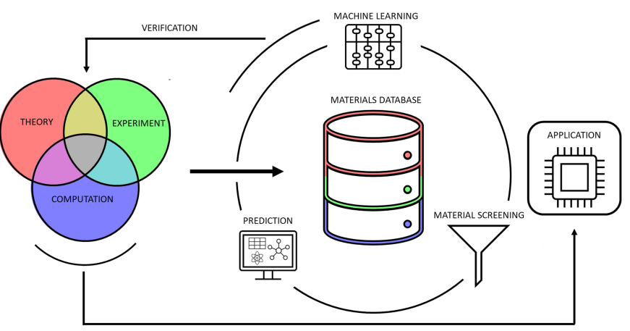
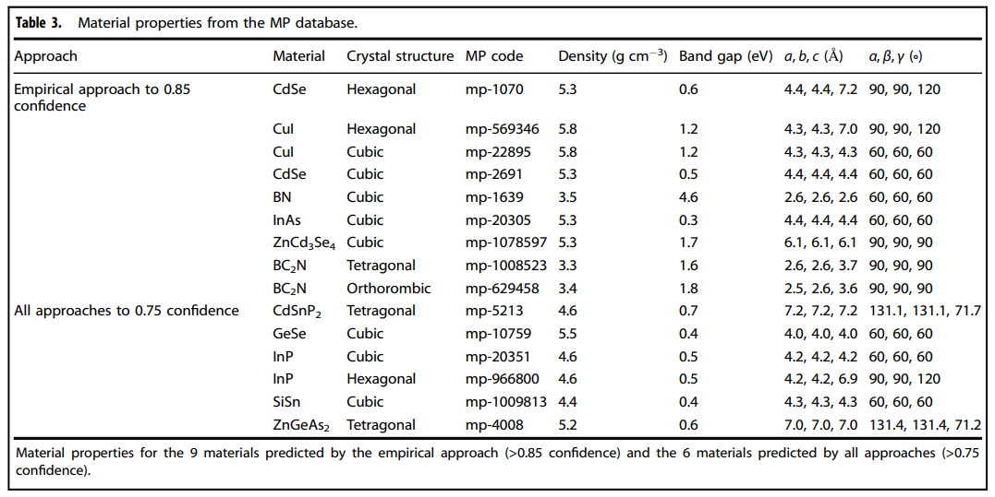
Predicting solid state material platforms for quantum technologies
Crystal structure from large datasets were used as a starting point to predict suitable material hosts for quantum emitters.
Unconventional parameters was found to be important for the material selection
Resulted in a list of potential material candidates for experimental investigation
O. Hebnes, M.Bathen, Ø. Schøyen, S. Winther-Larsen, L. Vines and M. Hjorth-Jensen, npj Computational Materials (2022) 8:207

Slide 14

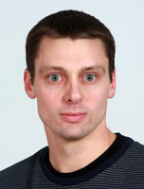



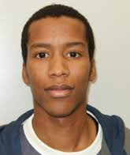



Thank Th
Andrej
Lasse
Augustinas
Thank you for the attention!
Vegard
Marianne
Christopher
David
Erlend
Alireza
Mariann
Luis Roberto Jimenez Arteta
lassevi@fys.uio.no
Joseph Panana Vera

Slide 15
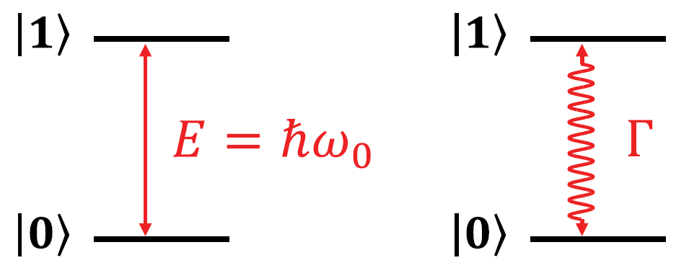
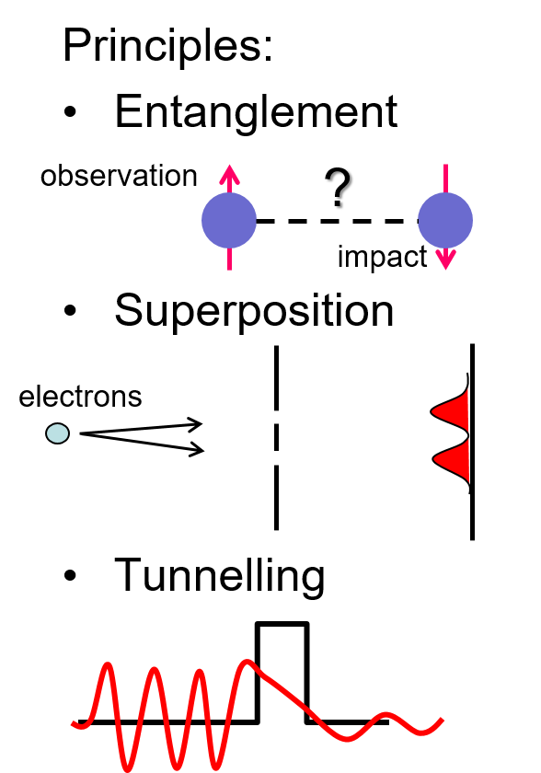
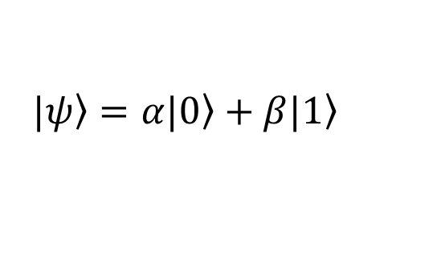
What is quantum sensing ?
Definitions:
Use of quantum system with quantized energy levels to measure a physical quantity
Use of quantum coherence (i.e., wavelike spatial or temporal superposition states) to measure a physical quantity.
Use of quantum entanglement to improve the sensitivity or precision of a measurement, beyond what is possible classically
$$\left.|ψ\right\rangle =α\left.|0\right\rangle +β\left.|1\right\rangle$$
Degen et al., Rev. Mod. Phys., Vol. 89, No. 3, (2017)

Slide 16
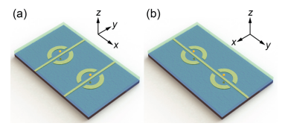
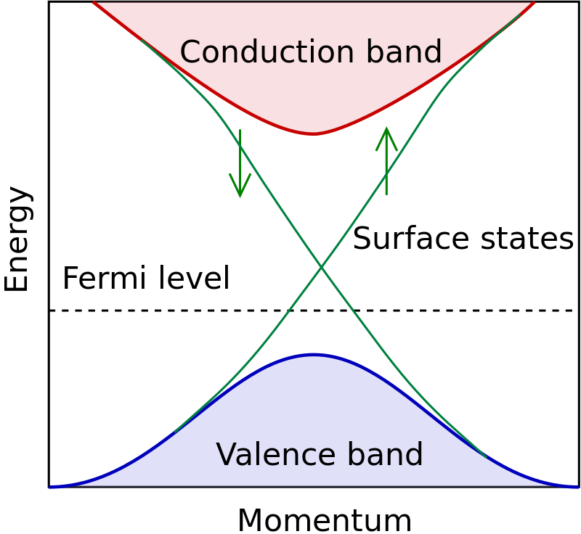
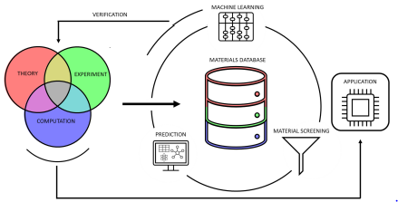
Ongoing QT research at the University of Oslo
Nanoparticle and epitaxial quantum dots
Liquid He quantum dots
Machine learning for new quantum materials
Point defects
Properties of quantum materials

Slide 17
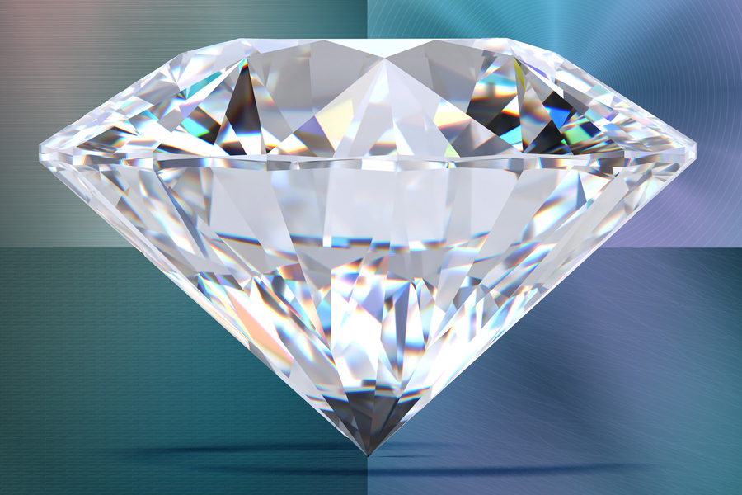
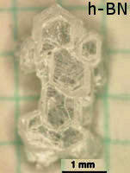
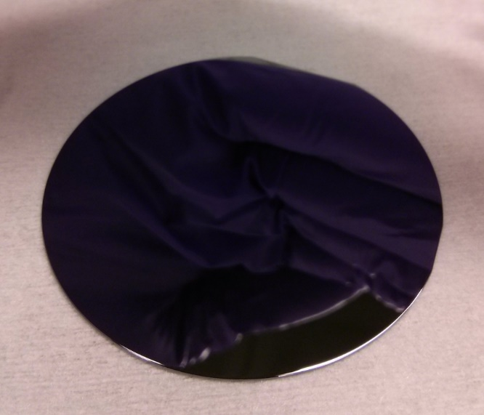
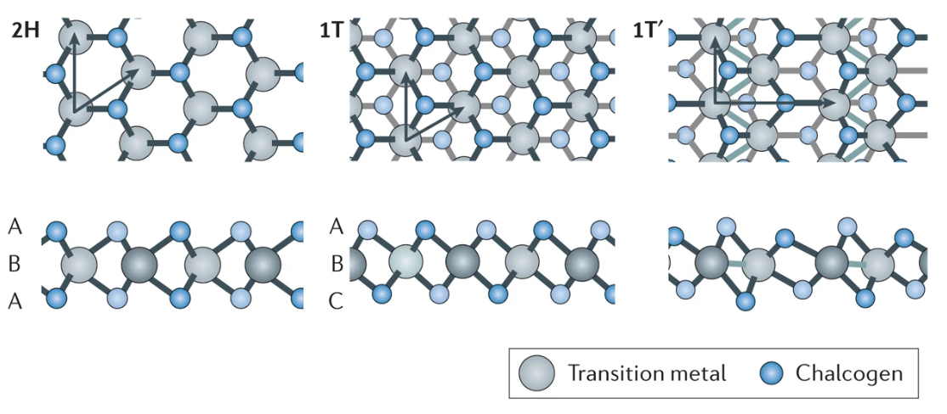
Semiconductor materials for QT
Silicon
Point defects
Spin qubit CMOS devices
Silicon carbide
Point defects
Diamond
Point defects
Gallium arsenide
Quantum dots
2D-TMDCs
Bound excitons
Hexagonal boron nitride
Point defects
Notes:
Although platforms exist, still scarce
Also, dont understand why in some materials, and not in others

Slide 18

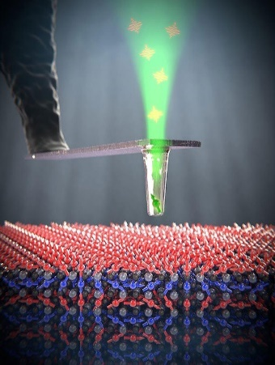

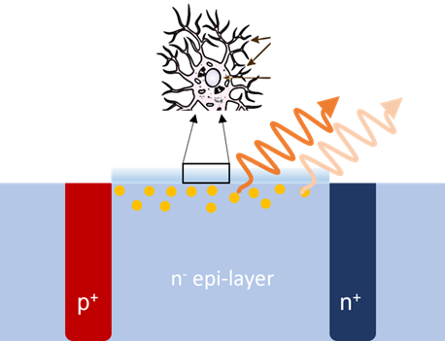



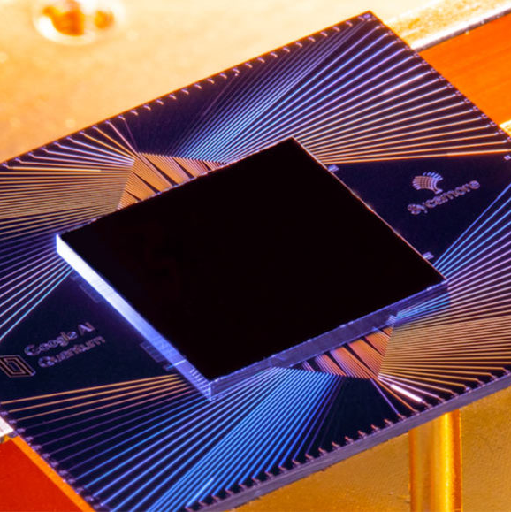
Quantum technologies promise new capabilities
Nanoscale
Communi-cation
Computing
Sensors
Extreme conditions
Signals in cells
Quantum internet
Quantum cryptography
Secure communication
Better logistics and optimization
Predict the weather
Predict new medicines and materials for e.g. solar cells and batteries
Finance
Notes:
Gorpu into three categories.

Slide 19

Questions?

