Slide 1
  Breaking Moore’s Law
Challenges of quantum transport in nanoscale sensor development for particle physics
Jan Malamant
  PhD student at the High Energy Physics section
  University of Oslo

Slide 2
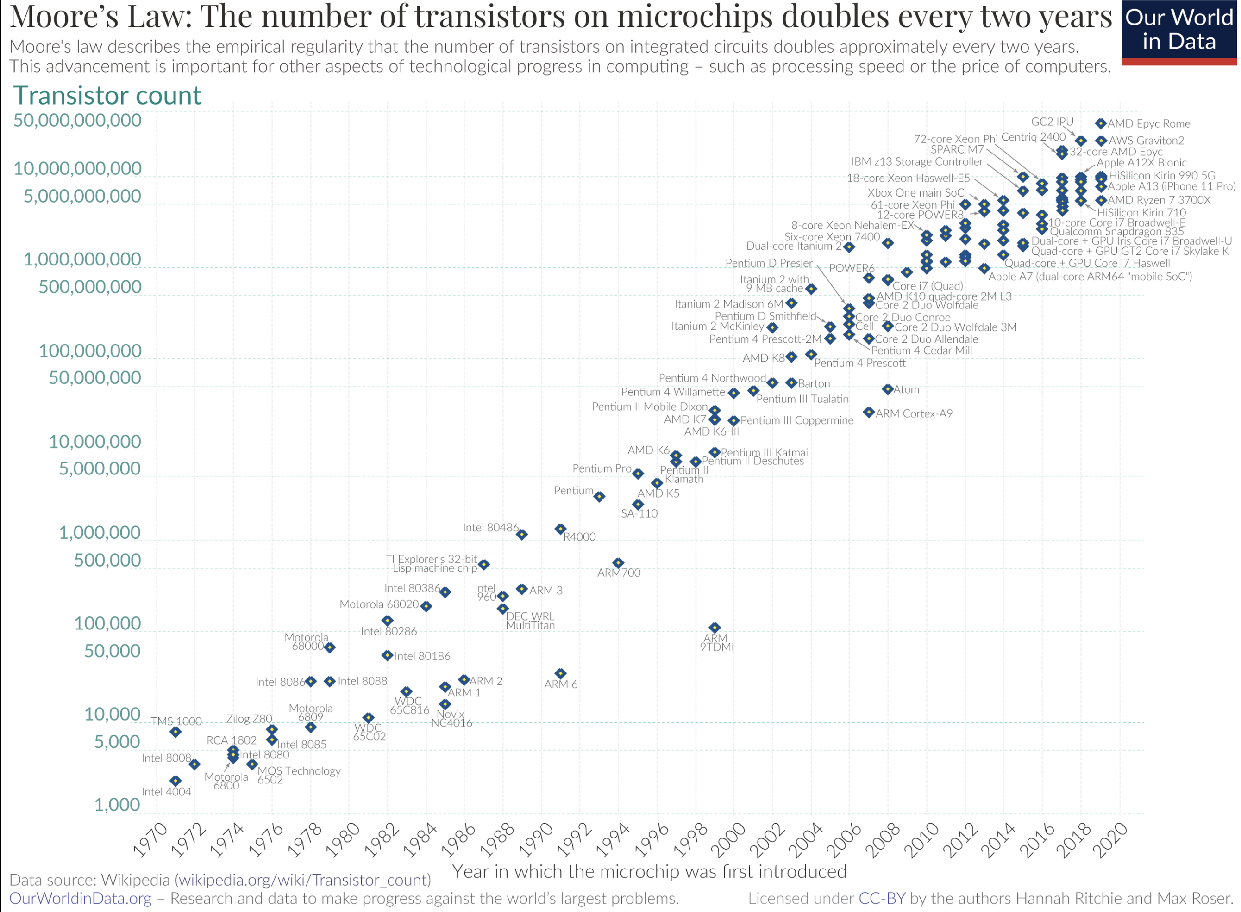

Slide 3
CERN’s Quantum Initiative & DRD5 Collaboration
7 New Detector R&D Collaborations at CERN
In particular, DRD5 focuses on «Quantum Sensors»
Definition: A «quantum sensor» is a device which senses quantum states…
In particle physics context:
  Incident radiation deposits energy in device
  So radiation induces a change in quantum state
  Read out quantum state for an ultra-precise measurement

Slide 4
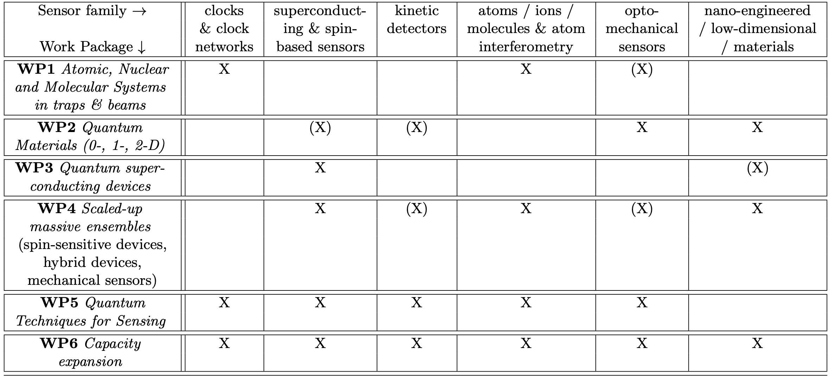
CERN’s Quantum Initiative & DRD5 Collaboration
7 New Detector R&D Collaborations at CERN
In particular, DRD5 focuses on «Quantum Sensors»
Meanwhile, Norway has a strong group working on semiconductor radiation trackers

Slide 5
CERN’s Quantum Initiative & DRD5 Collaboration
7 New Detector R&D Collaborations at CERN
In particular, DRD5 focuses on «Quantum Sensors»
Meanwhile, Norway has a strong group working on semiconductor radiation trackers

Slide 6
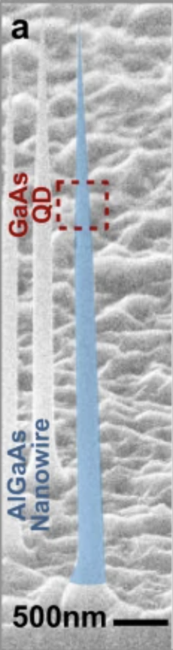
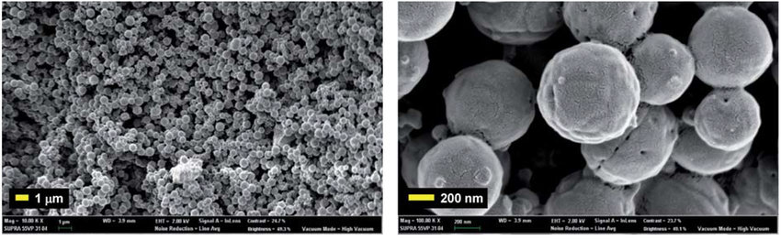
Semiconductor structures at nanometer scales
When structures reach the size of : «quantum confinement» occurs
  The structure impacts the properties of the material itself
  Can tune the properties to best fit the measurement you want to make
Depending on how many spatial axes are not «quantum confined»
  0D: Quantum dots
  1D: Nanowires
  2D: Nanoplatelets
L. Leandro et al «Resonant excitation of nanowire quantum dots» (2020) npj Quantum Information
https://doi.org/10.1038/s41534-020-00323-9
N. Ngafwan et al «Study on novel fluorescent carbon nano materials in food analysis» (2021), Food Science and Technology, DOI: 10.1590/fst.37821

Slide 7
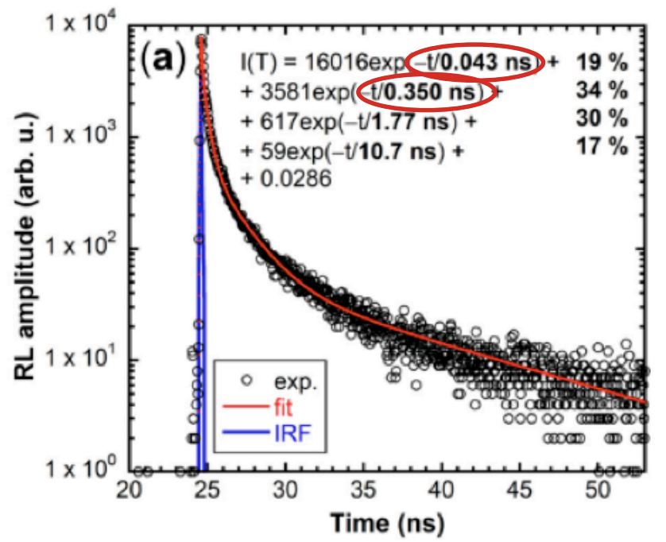
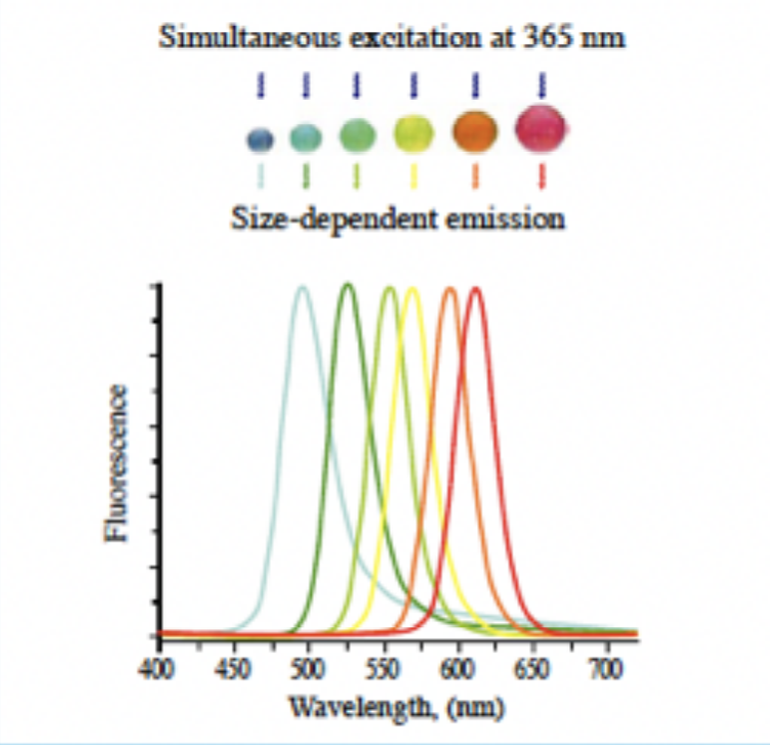
Example: Quantum dot scintillation
Scintillation in quantum dot has impeccable timing resolution
Also more radiation hard than one would expect…
Emission wavelength can be tuned by quantum dot size
K. Decka et al., Scintillation Response Enhancement in Nanocrystalline Lead Halide Perovskite Thin Films on Scintillating Wafers. Nanomaterials 2022, 12, 14. https://doi.org/10.3390/nano12010014
Clear benefits of using nano engineered structures for both high and low energy physics!
Actual development of devices requires quantum transport simulations…
Taken from Michael Doser’s seminar on «Quantum Sensors for High Energy Particle Physics» in March 2024

Slide 8
Why Quantum Transport Simulations?

Slide 9
Scaling simulations down to nanoscale
Problems with quantum mechanical effects!
  Compressive strain in materials
  Tensile strain in materials
  Electron-phonon coupling and others…
  Discrete Impurities
However, these problems can «kind of» be remedied in semiclassical simulations…

Slide 10
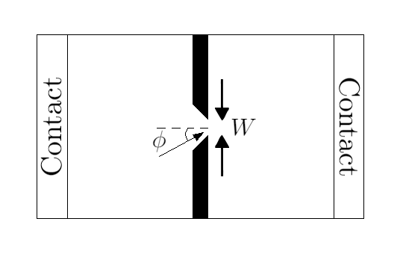
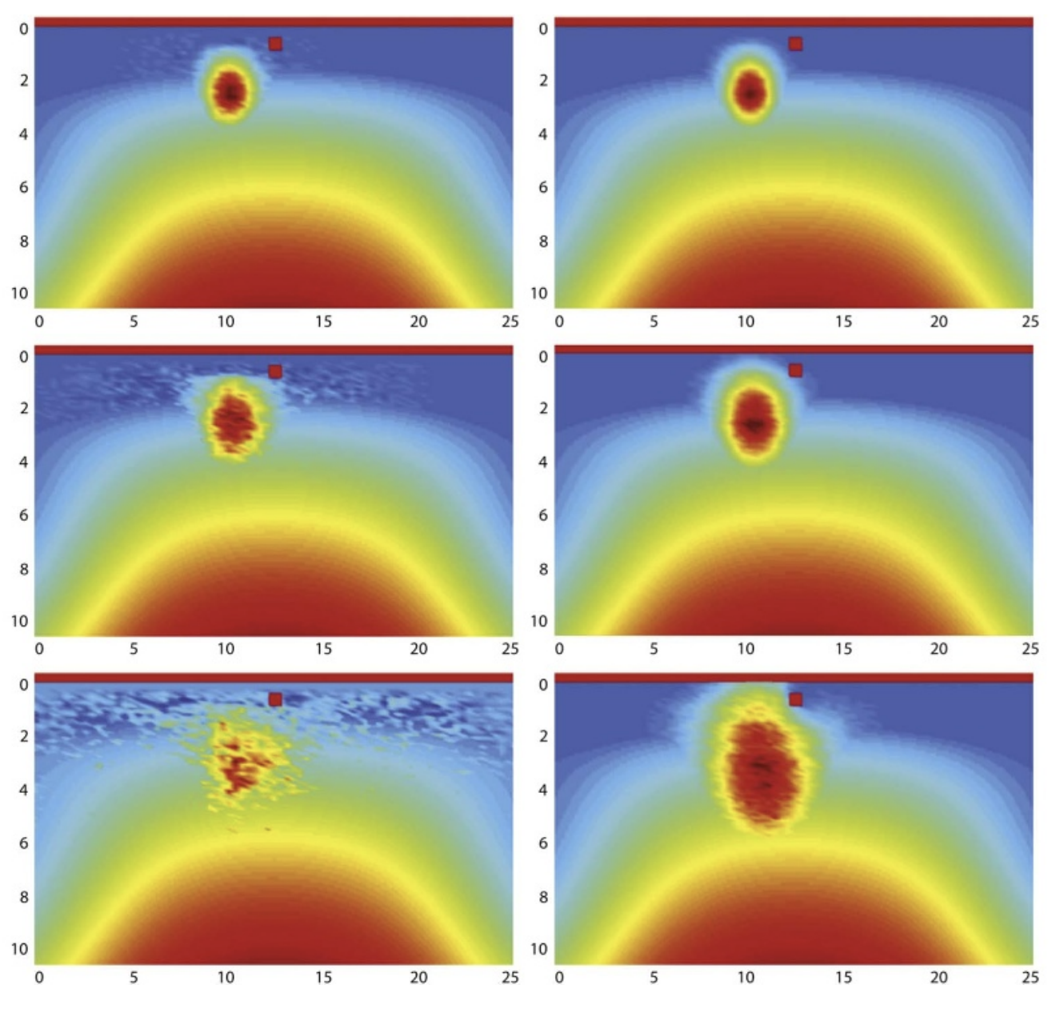
We do we need «Quantum Transport»?
Need full quantum mechanical picture for:
  Superpositions
  Entanglement
Illustration of a quantum point contact, taken from
https://en.wikipedia.org/wiki/Quantum_point_contact
Can simulate things such as
  Interferometry with quantum point contacts (QPC)
  Interference caused by impurities
  Quantum tunneling
  Others?
Decoherence of electron wave packet due to impurity. Quantum Transport (Left) and Semiclassical Transport (Right)

Slide 11
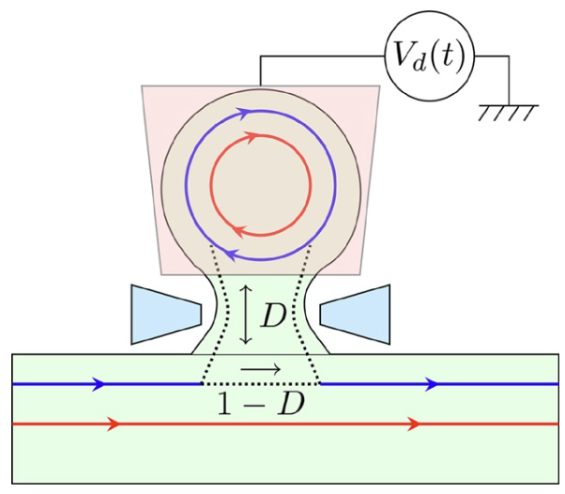
Example: Mesoscopic capacitor
Used as a single-electron emitter
Quantum dots coupled to (electronic) chiral edge states via a quantum point contact
  For particle tracking… similar to pixel detectors
Incident radiation creates electron-hole pairs in QD
Tunnel through QPC within some time-frame
Couples to highly coherent chiral edge state
  Chiral edge state can be read out as a current
Read out current
Benefits:
Very high spatial resolution (~nm)
Radiation hard
Potentially extremely sensitive (high S/N ratio)
High temporal resolution (?)
Taken from B. Roussel et al (2017), https://doi.org/10.1002/pssb.201600621
Requires a fully quantum mechanical simulation!

Slide 13
Thank you for listening! 🧐

Slide 14
Extra spice

Slide 15
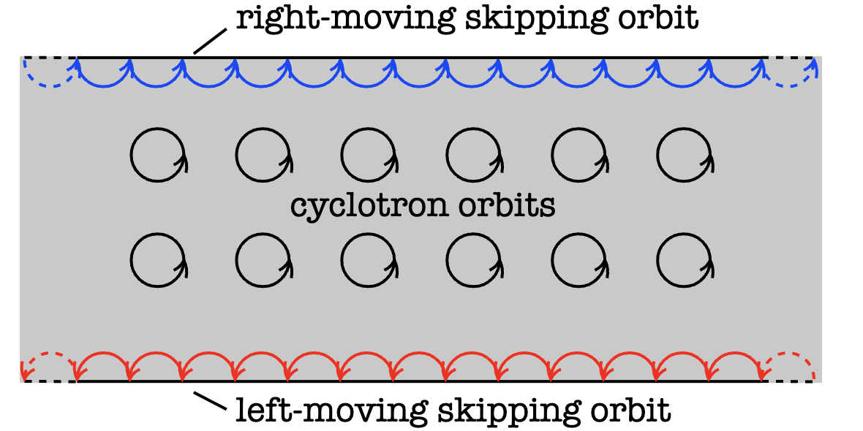
Chiral edge states
A material under a strong enough magnetic field exhibits the Quantum Hall effect
In addition: electronic states which travel along your material with quantised energy levels
    These are called chiral edge states
Taken from
https://topocondmat.org/w3_pump_QHE/QHEedgestates.html

Slide 16
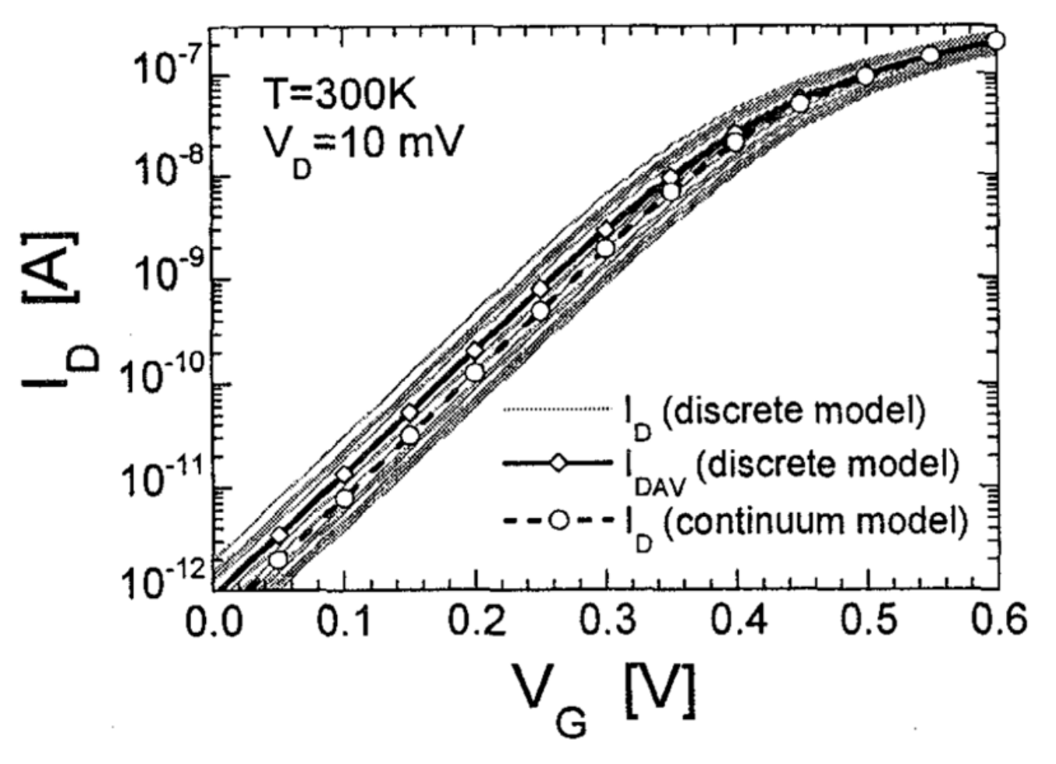
Discrete impurities
Doping concentration of 1e20 cm^-3 is the same as 0.1nm^-3
In a 10nm sized Quantum Dot: You have ONE impurity
  Uncertainty in doping concentration
  Placement of impurity
Taken from: David K Ferry et al 2022 Semicond. Sci. Technol. 37 043001

Slide 17
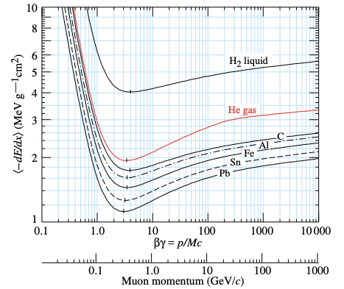
What would the current be?
Using e.g mesoscopic capacitors with nanometer sized QDs…
-dE/dx of 1GeV/c muons is around 1-2 MeV per gram per cm^2 in various solids
  So ``at worst´´, on average 2.26eV is released per nanometer
  Energy required to create electron-hole pair in Si: ~3.6eV
  In conclusion: Only a few electron-hole pairs are created from incident radiation through nanometer-scale trackers
  TINY current! (picoampere?)
Taken from Particle Data Group «Passage of Particles Through Matter». Last updated August 2019

Slide 18
  Interesting problems for HEP
Can electron interferometry be used for read-out electronics?
Can it be directly used in front-end?
What kind of new types of sensors can be made with interferometric techniques?
  Inspiration from atom interferometry and quantum optics
  GW detection? Probably not since the coherence is kept for microns, not kilometers
  Reduce shot-noise? A radiating particle would disturb the superposition
  Mesoscopic capacitors? A QD coupled to edge channels via a quantum point contact allows to perform interferometry directly on signals generated by incident radiation

