Slide 1
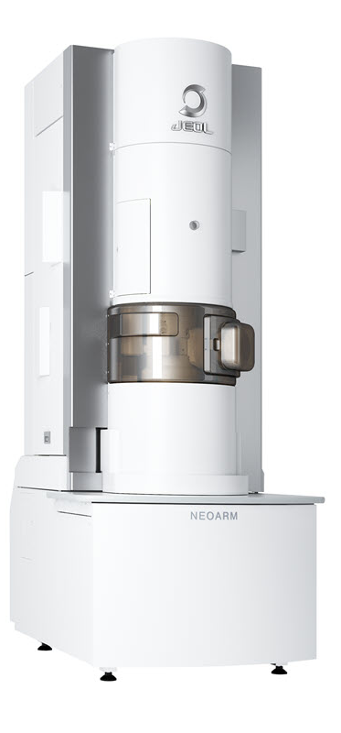
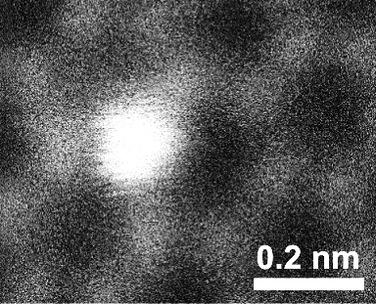

Opportunities for Probing Quantum Materials at High Spatial Resolution
FS Hage
Si
Dept. of Physics
C
& SMN

Slide 2
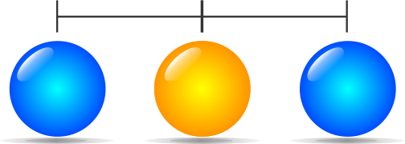
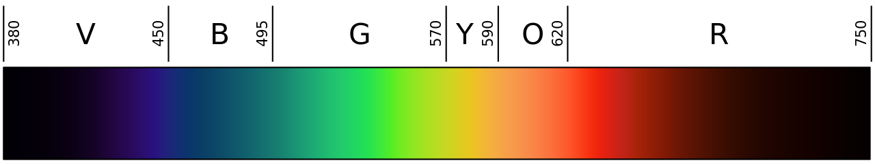
Imaging individual atoms
~ 0.1 nm = 1 Å
Wavelength
in nm
The visible spectrum
(source Wikipedia.org)

Slide 3
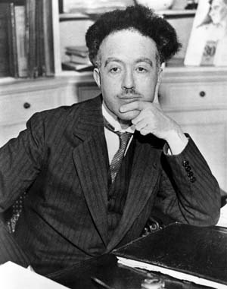
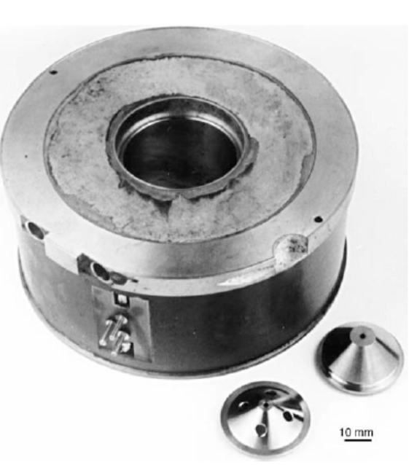
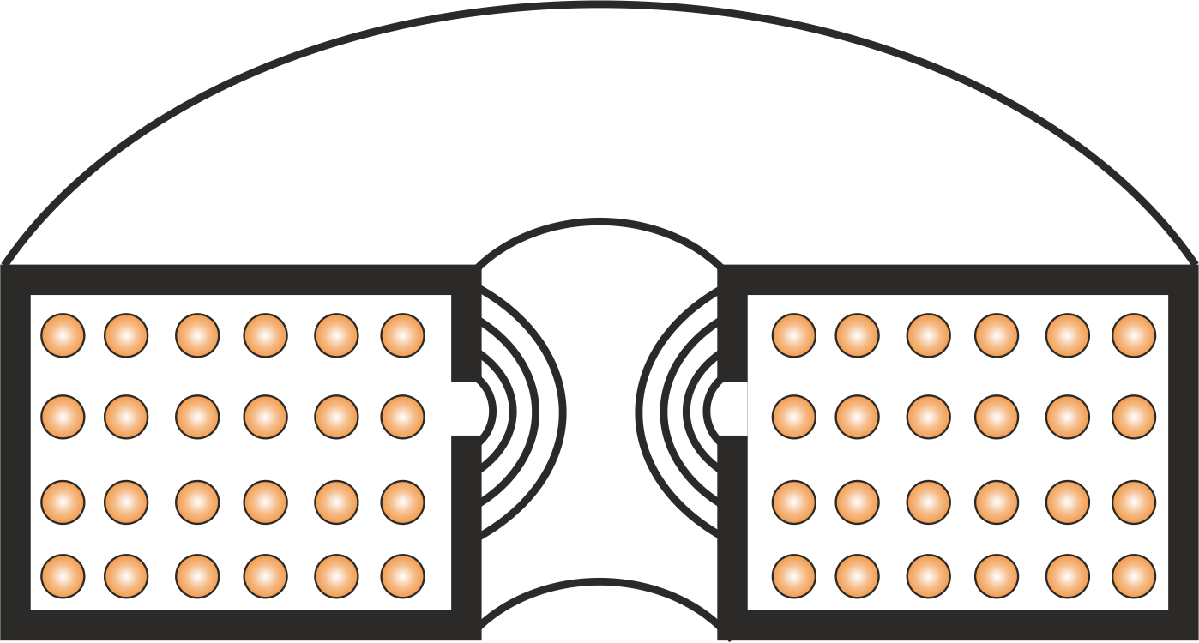
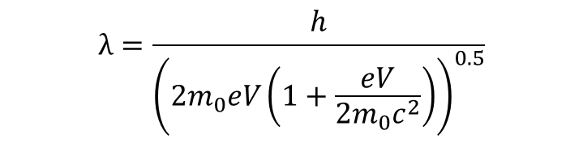

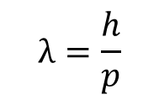
Wave-particle duality (de Broglie)
$$λ=\frac{h}{p}$$
Focus to electron probes of
< 1 Å using magnetic lenses
For electrons:
$$p=m_{0}v={\left(2m_{0}eV\right)}^{0.5}$$
Wikipedia.org
Wikipedia.org
$$λ=\frac{h}{{\left(2m_{0}eV\left(1+\frac{eV}{2m_{0}c^{2}}\right)\right)}^{0.5}}$$
Louis de Broglie
Lorentz force:
F = −e(E + v × B)
To look at atoms we need a wavelength smaller than 0.1 nm!
Accelerating electrons by ~ 0.1 MV
resulting in wavelengths: ~ 0.001 nm
DB Williams and CB Carter,
Transmission Electron Microscopy
- A Textbook for Materials Science
Springer 2009

Slide 4
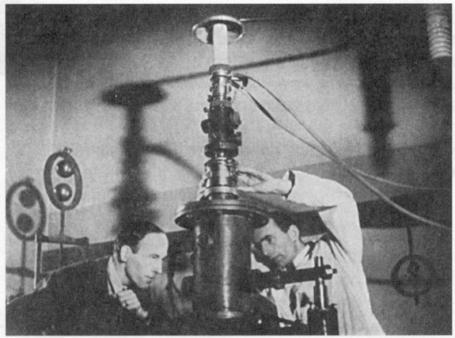
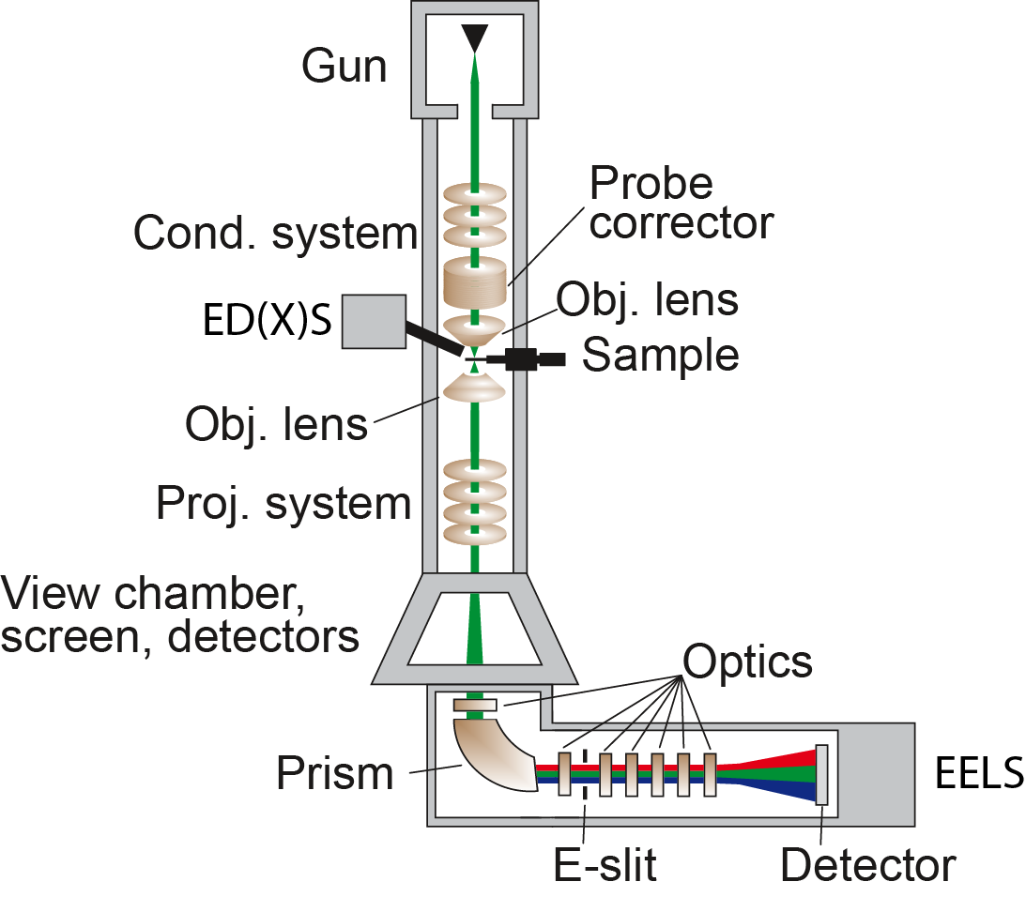
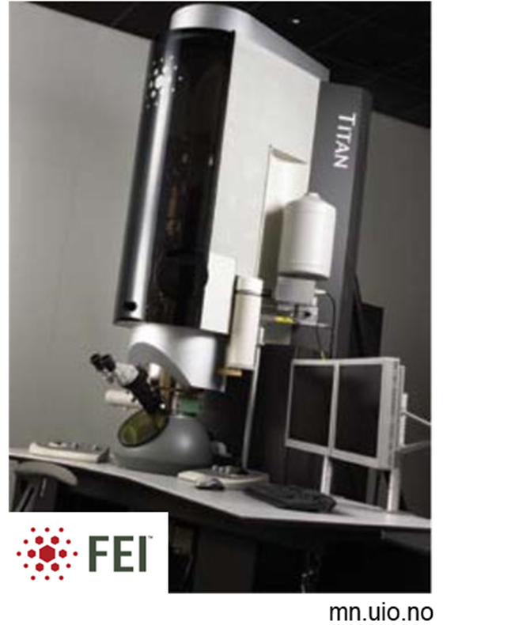
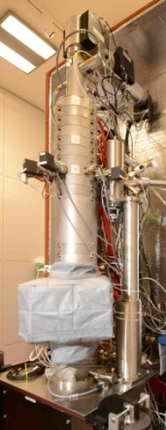
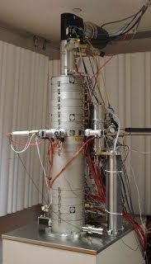

The transmission electron microscope
Globalsino.com
Ruska and Knoll working on the first electron microscope (finished 1932)
superstem.org

Slide 5
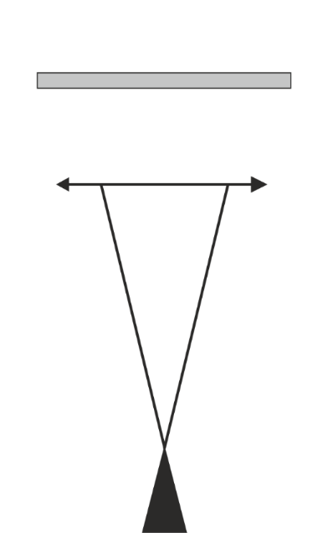

A bit about the work I will present here
Sample
E. coils
DB Williams and CB Carter,
Transmission Electron Microscopy
- A Textbook for Materials Science
Springer 2009
Electron source

Slide 6
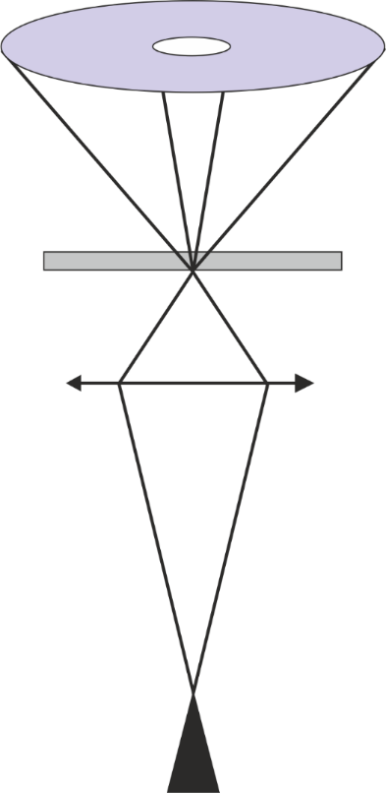
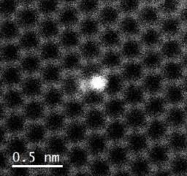
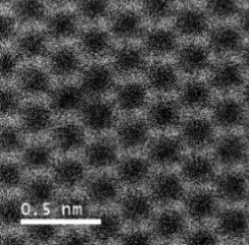
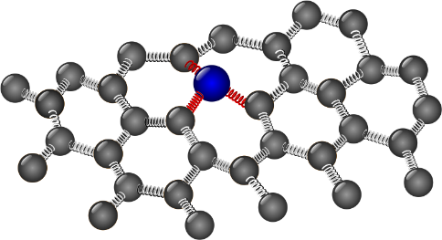
A bit about the work I will present here
Image
detector
ADF
Si
ADF: annular dark-field
“Z contrast”
Sample
B
Graphene with single atom defects
C
Si
Nion UltraSTEM100MC @ SuperSTEM
Si
Electron source
Hage et al., Science (2020)

Slide 7
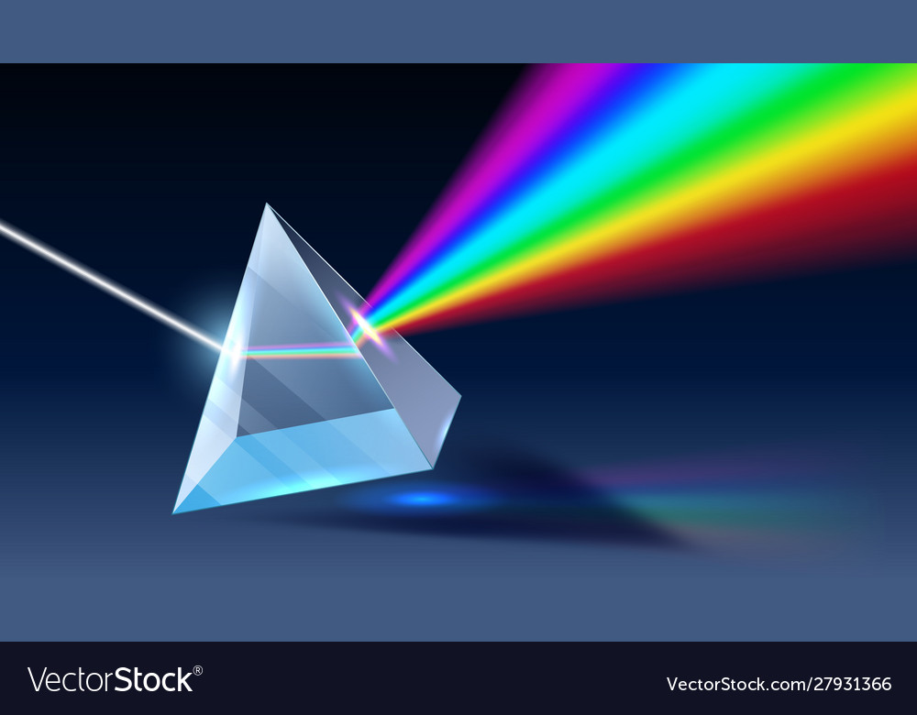
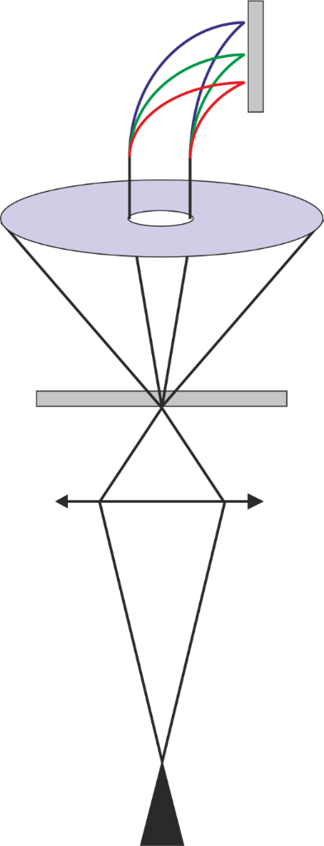
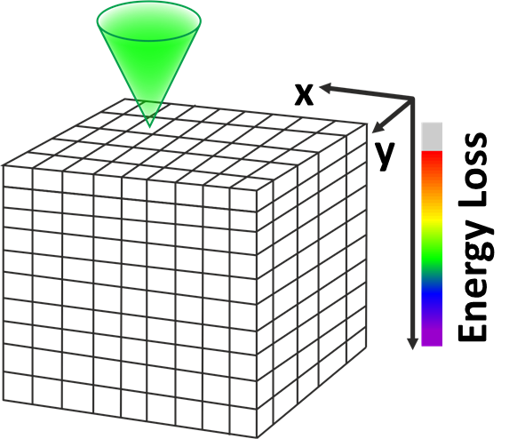

A bit more about the work I will present here
EELS: electron energy loss spectroscopy
$$Prism$$
Image
detector
ADF
Si
ADF: annular dark-field
“Z contrast”
Sample
B
Graphene with single atom defects
C
Si
Nion UltraSTEM100MC @ SuperSTEM
Si
Electron source
Hage et al., Science (2020)

Slide 8
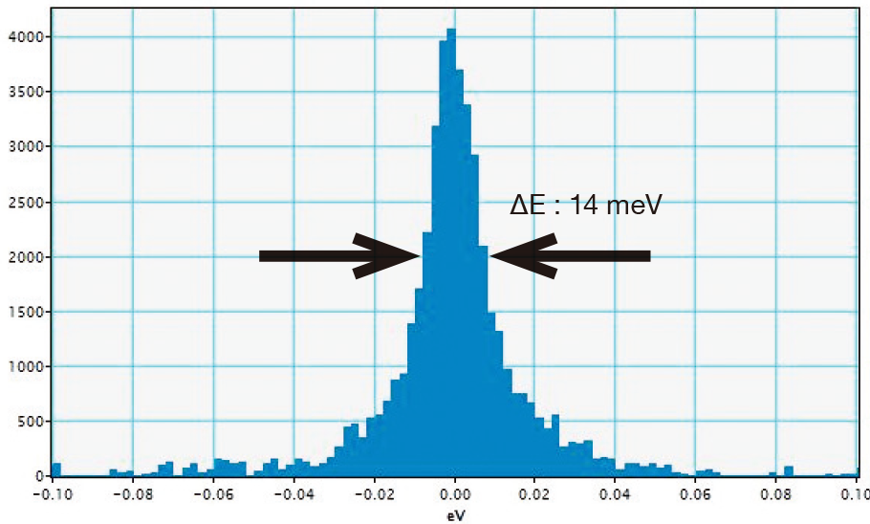
The new JEOL NEOARM
JEM-ARM200F NEOARM
Monochromated
Installation done: early fall 2026
Improved atomic resolution imagining and spectroscopy
In-situ capabilities (gas, heating, cooling)
Improved energy resolution (< 50 meV)
Atomic resolution surface sensitive imaging (SE/BSE detector)
Improved low voltage and low dose capabilities (for sensitive materials).
Aligned at 200 kV,
80 kV and 60 kV.
Improved efficiency
and sensitivity!
ZLP
@ 30 kV
Source: jeolusa.com
Page 8

Slide 9
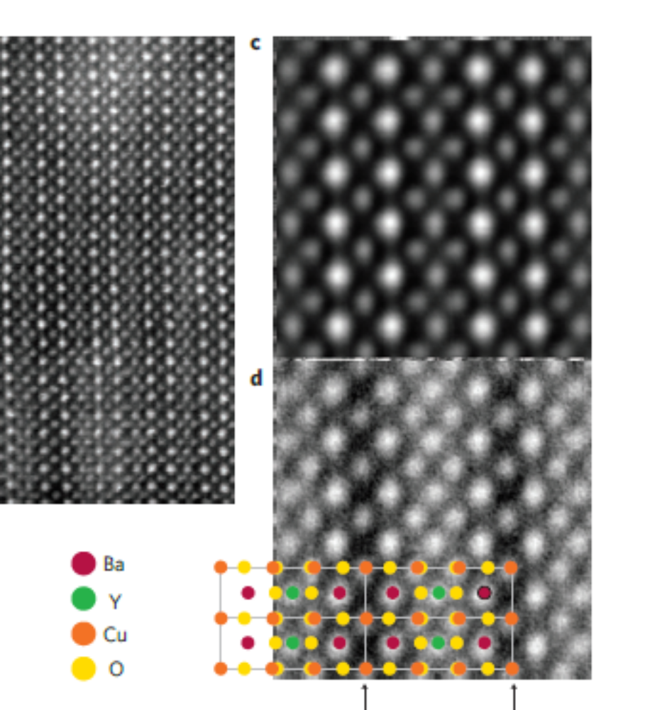
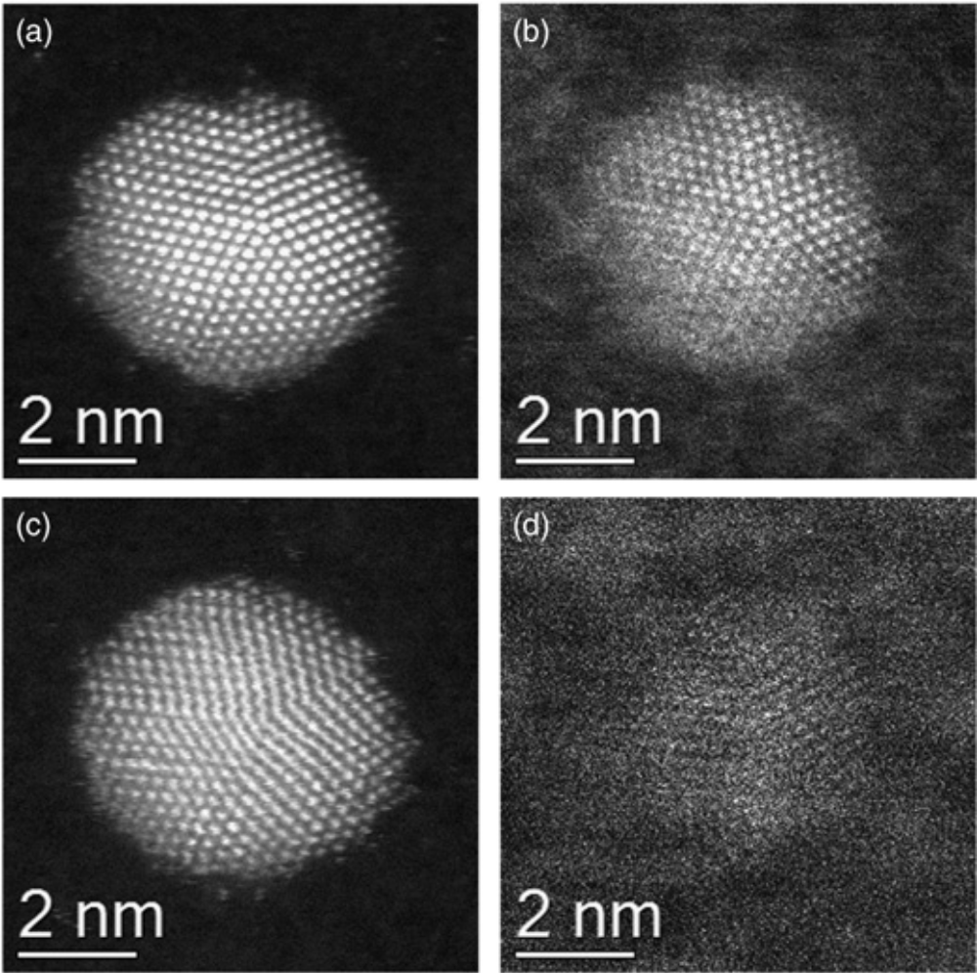
Surface sensitivity
SE: secondary Electrons
BSE: Back-Scattered Electrons
HAADF: High-Angle Annular Dark-Field
Atomically resolved images
Simultaneously
YBCO
HAADF
“2D projection”
SE
“surface”
ADF
“2D projection”
SE
“surface structure”
Source: Mitchell and Casillas, Microscopy Today, 2016
Au nanoparticle on amorphous carbon
Source: Zhou et al, Nature Materials, 2009

Slide 10
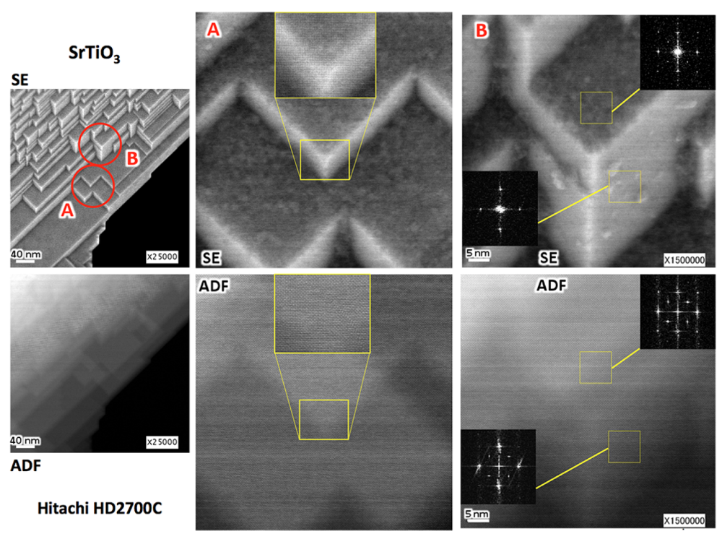
Surface sensitivity
Depth information
Simultaneously
Source: Egerton and Zhu, Microscopy, 2023
Source: Mitchell and Casillas, Microscopy Today, 2016

Slide 11
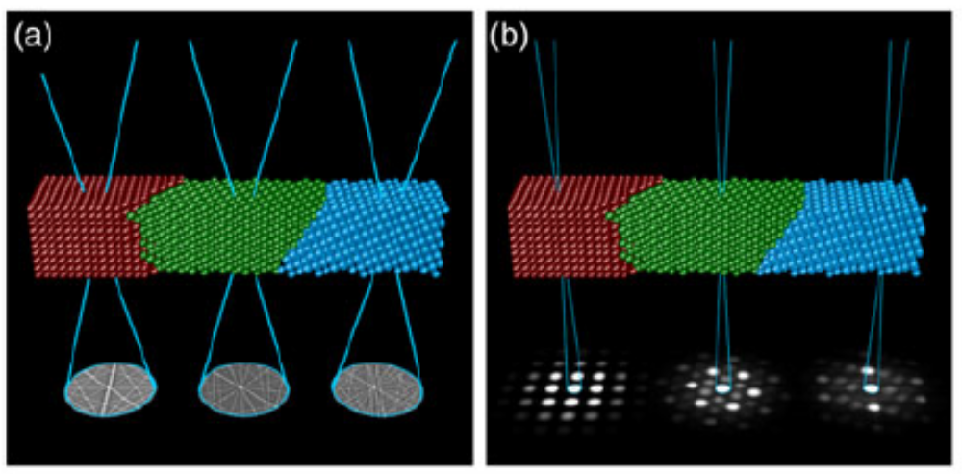
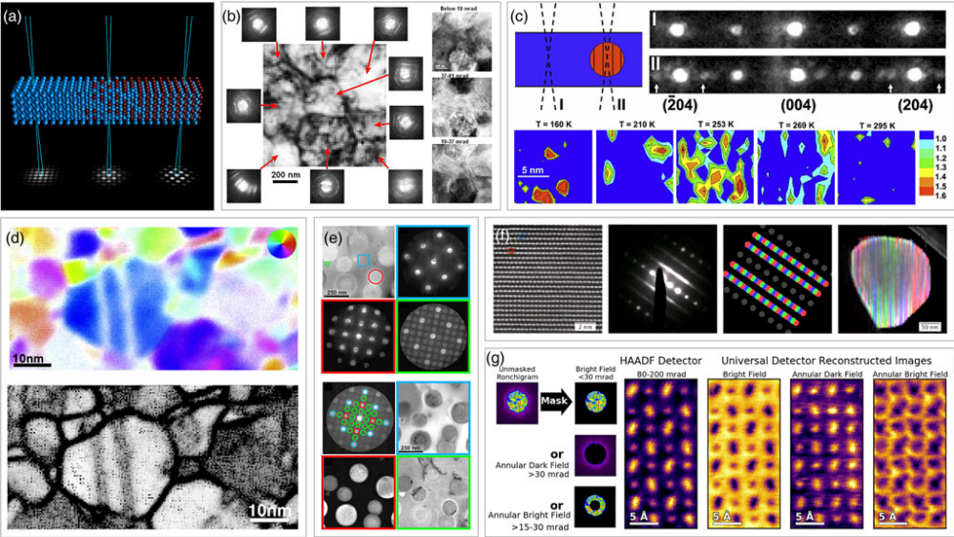
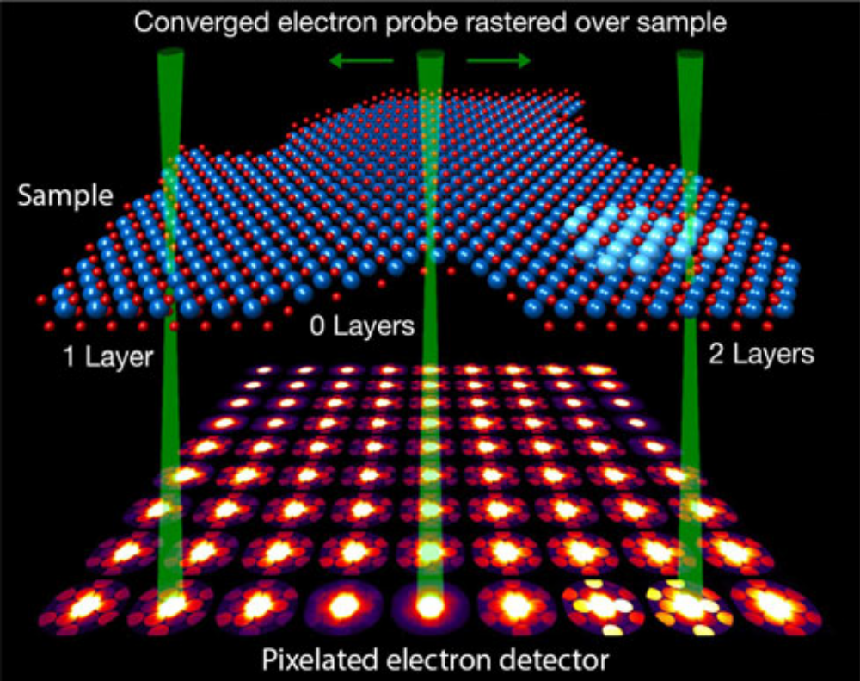
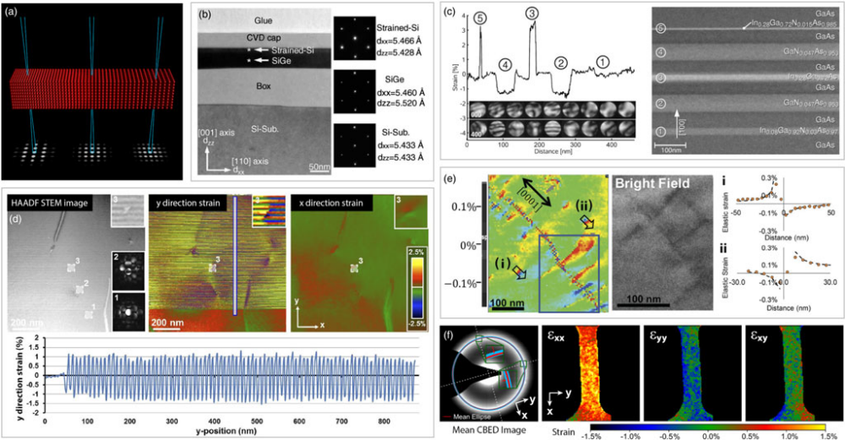
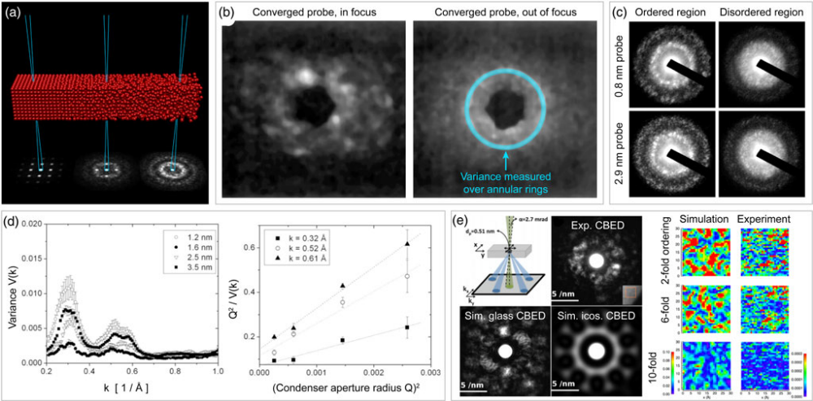
Improved charaterisation of disordered materials
Orientation, phase and strain mapping
Nanoscale point-by-point diffraction
C Ophus M&M (2019), 25, 563–582

Slide 12
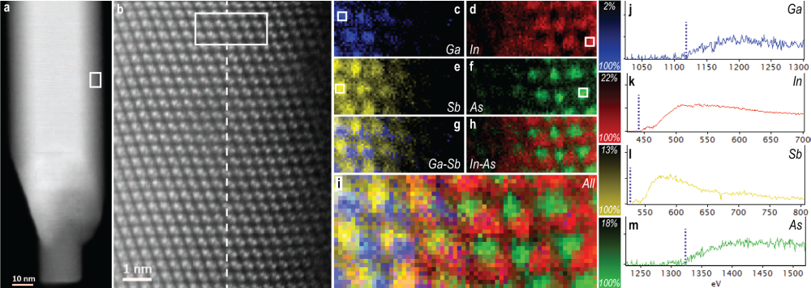
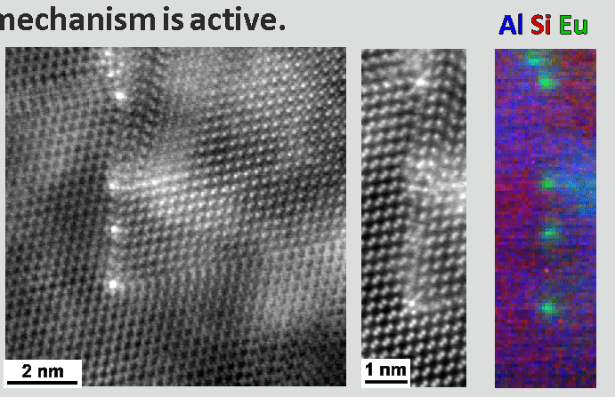
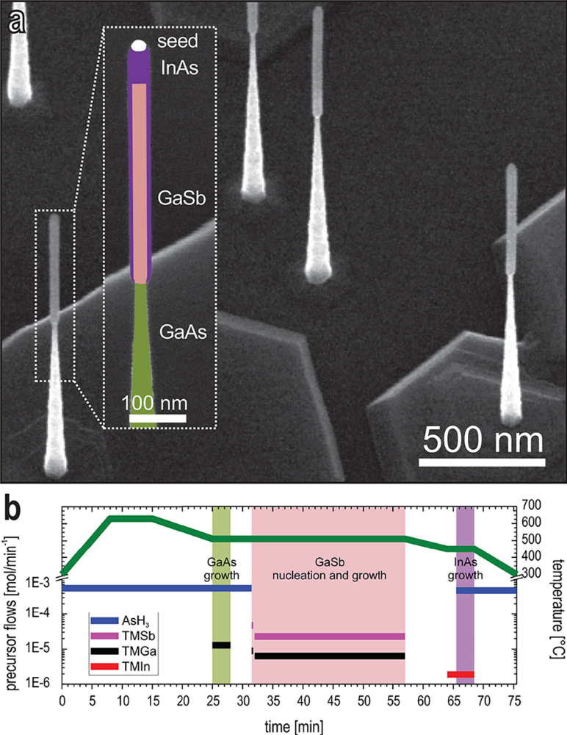

Singe atom sensitivity
– elemental mapping and structure
Defects at Si grain boundaries
Semiconductor
Interface
Quality
J Li et al., Scientific Reports, 5 (2015)13802
R Zamani et al, Nano Letters 18 (2018) 1557–1563

Slide 13
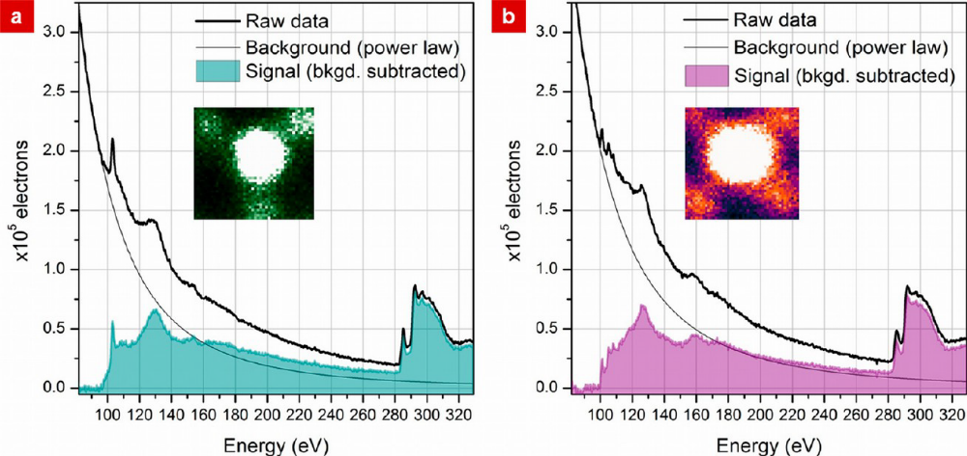
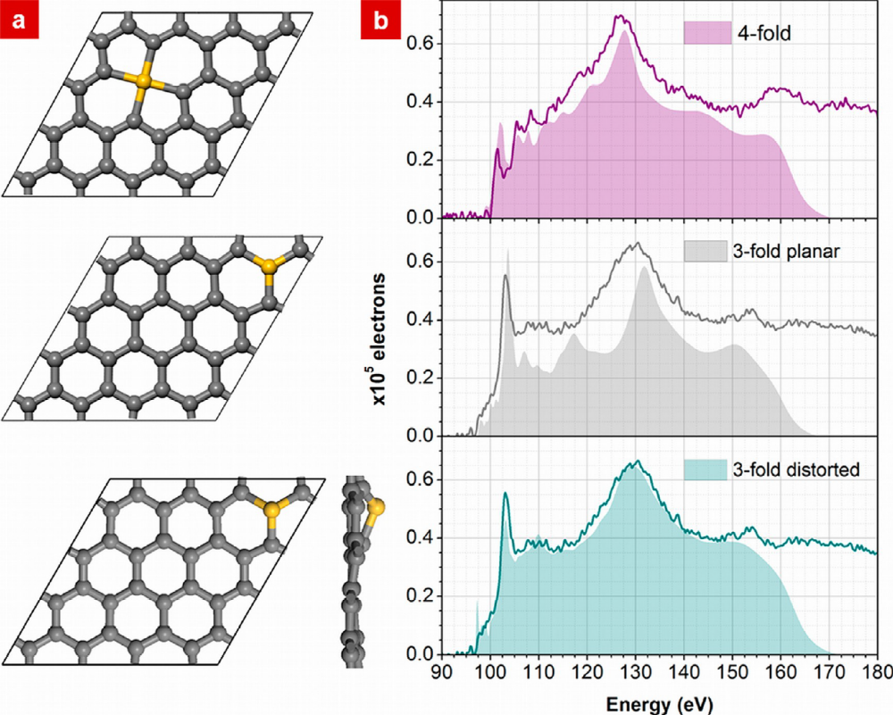
EELS
Single atom sensitivity
EELS
Si atom
Si L_{2,3}
Si atom
Si L_{2,3}
Si atom
C K
Si L_{2,3}
Si atom
Si atom
Si L_{2,3}
Si L_{2,3}
C K
Ramasse et al, Nano Letters 13 (2013) 4989−4995

Slide 14
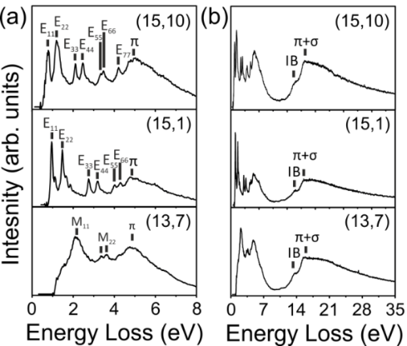
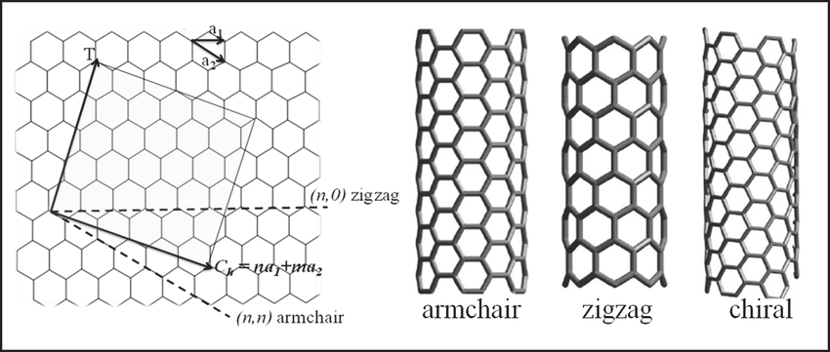
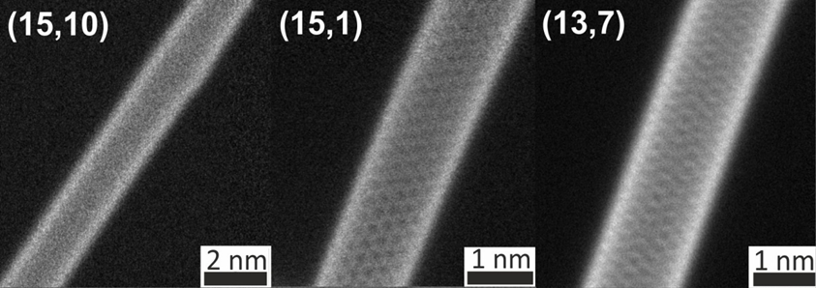
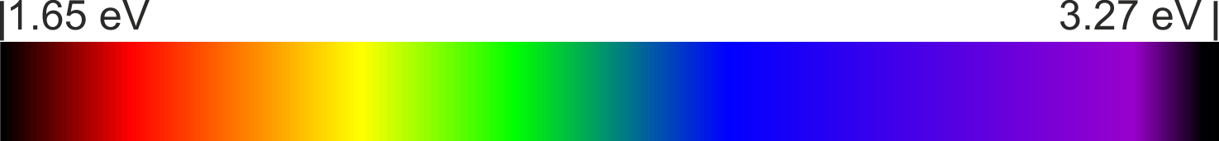

UV-VIS-IR response
@ at the nanoscale
Excitons
FS Hage et al., PRB (2017)
V Choudhary and A Gupta, in Carbon Nanotubes - Polymer Nanocomposites (2011), ed. S. Yellampalli
IR
Vis.
UV
FS Hage et al., PRB (2017)
1.65 eV
3.27 eV
Visible light

Slide 15
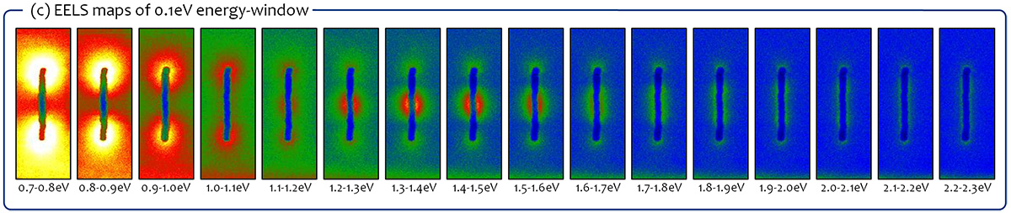
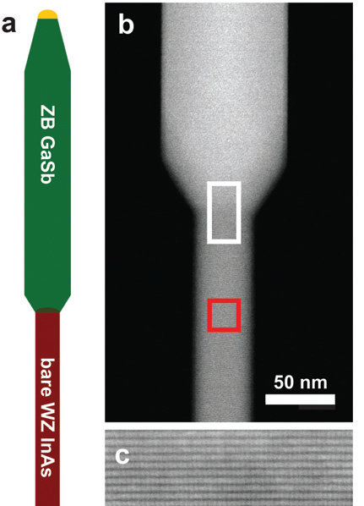

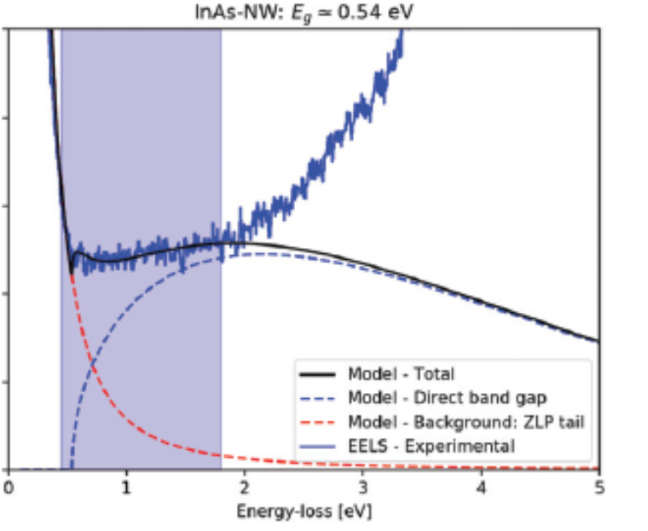


UV-VIS-IR response
@ at the nanoscale
1.65 eV
3.27 eV
Visible light
Surface plasmon resonance
mapping of a gold nanorod
ΔE: 30meV @60kV
Source: jeolusa.com
Sub 1 eV band
gap measurement
ΔE: 30-40 meV @60kV
EELS
Source: Zamani et al PCCP 2021

Slide 16
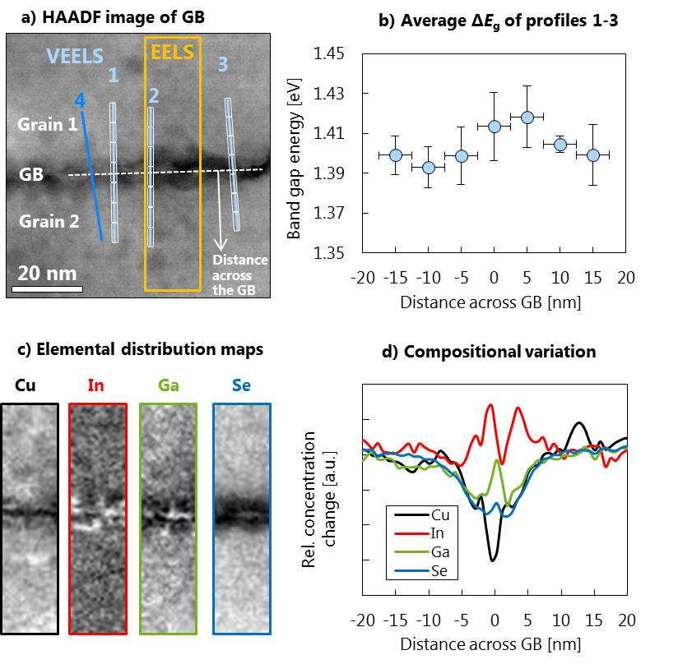
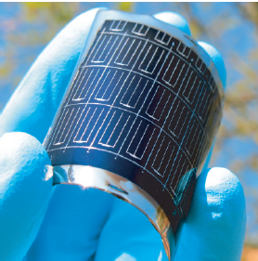
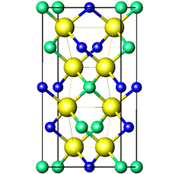
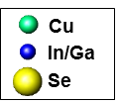

Interface band-gap
CIGS solar cell
on flexible substrate
~30 meV change in
the band gap signal
PV absorber
material
Crystal
structure of CIGS
Chirilă, A. et al. Nat Mater 10, 857–861 (2011).
Core loss
D. Keller et al., APL 109 (2016) 153103

Slide 17




Acknowledgements
QM Ramasse (SuperSTEM and Leeds Uni. )
DM Kepaptsoglou (SuperSTEM and York Uni.)
TP Hardcastle, CR Seabourne, AJ Scott, R Brydson (Leeds Uni.)
R Zamani (Chalmers and Lund Uni.)
D Keller and R Erni (EMPA)
J Li, P Schumacher (Montanuniversität Leoben)
f.s.hage@fys.uio.no

