Slide 1
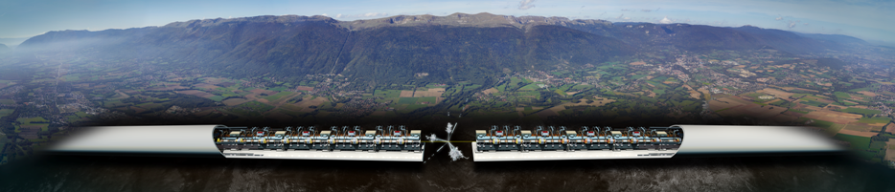
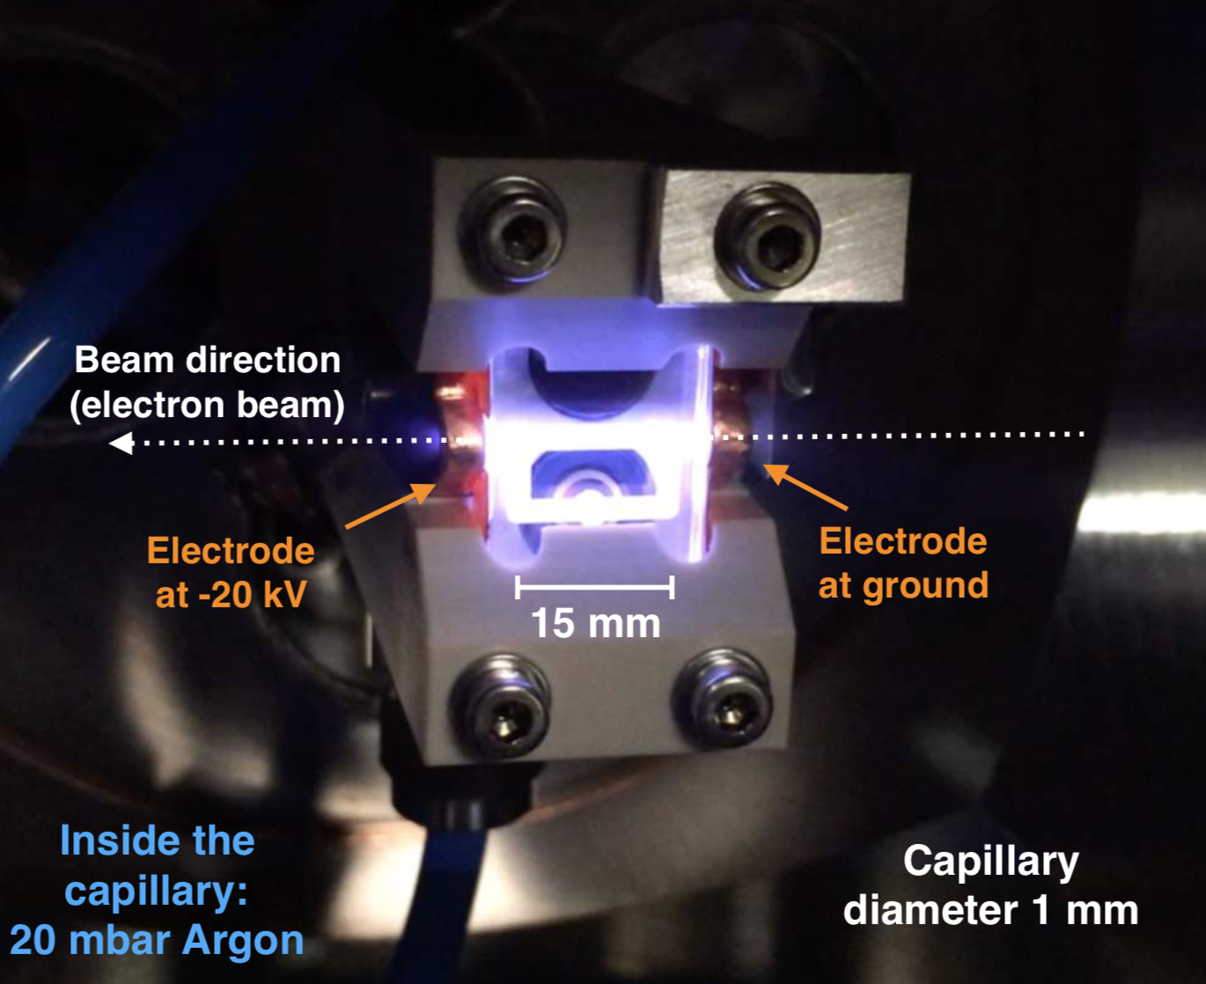
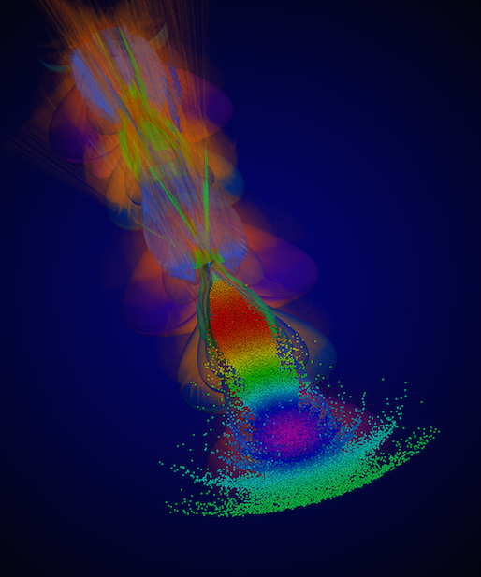
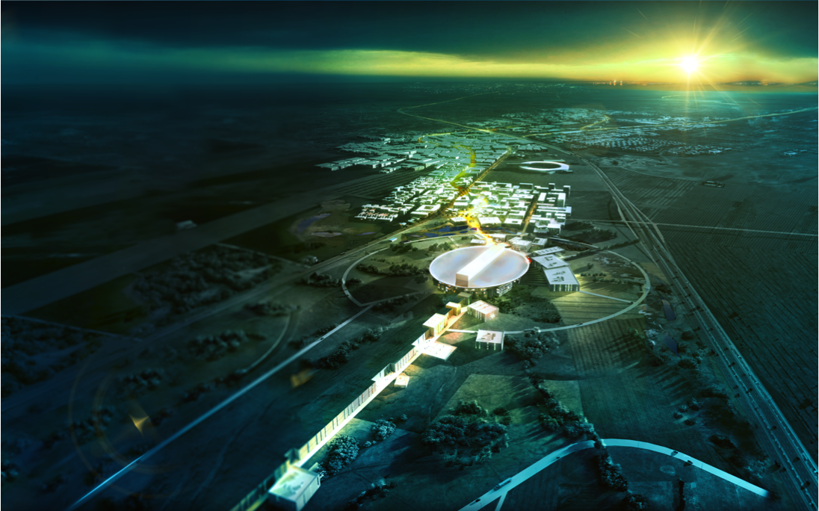
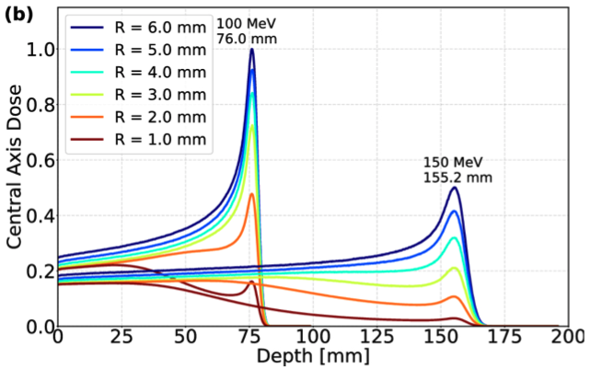
Accelerator research at Oslo
Plasma lenses
Linear Colliders
options for Multi-TeV electron positron colliders
European Spallation Source
(The world’s most powerful proton driver)
Plasma wakefield acceleration
(Novel acceleration techniques)
PROTON
THERAPY
Prof. Erik Adli, Department of Physics, U. Oslo

