Slide 1
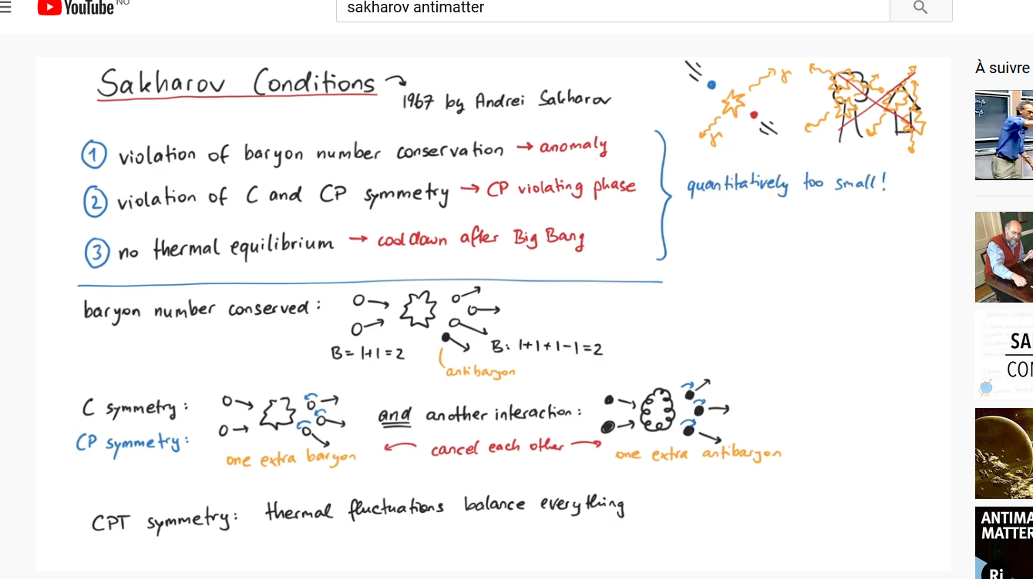
European Strategy Update
Preamble: « many of the mysteries about the universe, such as the nature of dark matter, and the preponderance of matter over antimatter, are still to be explored. »
BARYONIC ASSYMETRY
Sakharov conditions:
  Baryon number violation
  CP symmetry violation
  Universe out of thermal equilibrium: thermal fluctuations balance everything
Pretty much physics (youtube)

Slide 2


«The first priority is the completion of the programme of measurements of the oscillation parameters, most notably the CP-violating phase of the mixing matrix and the neutrino mass ordering. »
Neutral meson oscillations
LHCb (2020):
1st observation of time-dependent CP violation in B_{s}⁰ mesons, in their decays into charged K mesons.
K⁰(d$\overline{s}$): Brookhaven (1964)
B⁰(dƀ): Babar and Belle (2001)
B⁰_{s}(sƀ): LHCb (2013)
D⁰(cū): LHCb (2019)
Going on
ATLAS & CMS
Searching for matter–antimatter asymmetry in the Higgs boson–top quark interaction
DUNE: CP violation in the lepton sector

Slide 3
A tool for dark matter research: axions
ALICE:
New results on the production rates of antideuterons based on data collected at the highest collision energy delivered so far at the Large Hadron Collider. […] the presence of antideuterons in space is a promising indirect signature of dark matter candidates.
BASE:
The BASE collaboration reports the first laboratory search for an interaction between antimatter and a candidate particle for dark matter
₋ d u

Slide 4
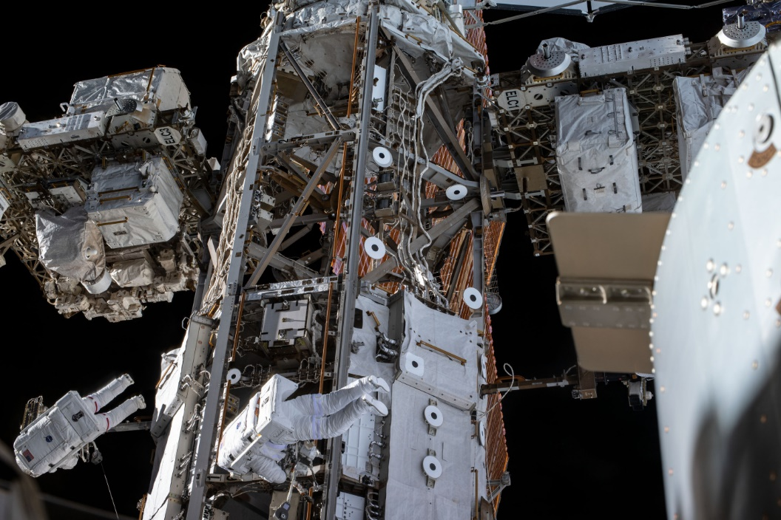
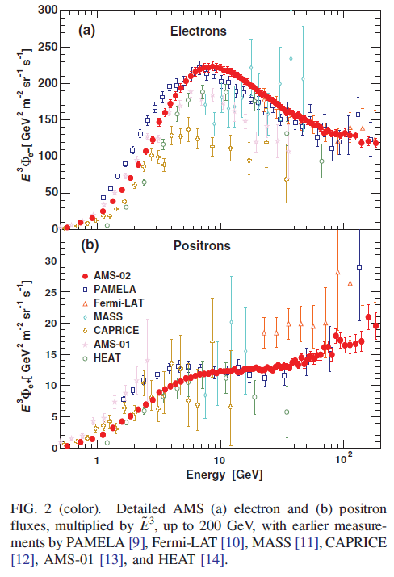
AMS-02: Alpha Magnetic Spectrometer
Antimatter in cosmic rays
Aguilar et al., Phys. Rev. Lett. 113, 121102 (2014)

Slide 5
Synergies with neighboring fields
Section 5 of the deliberation document - Synergies with neighbouring fields: «There are also synergies with atomic physics, as exemplified by the antihydrogen experimental programme at CERN’s AD antiproton decelerator and its upgrade, ELENA.»
The quest for new physics with the Physics Beyond Colliders programme, J. Jaeckel et al. Nat. Phys (2020):
«Lower-energy facilities, such as […] the antimatter factory, have been recently upgraded […] and were therefore not considered within the PBC study. »

Slide 6

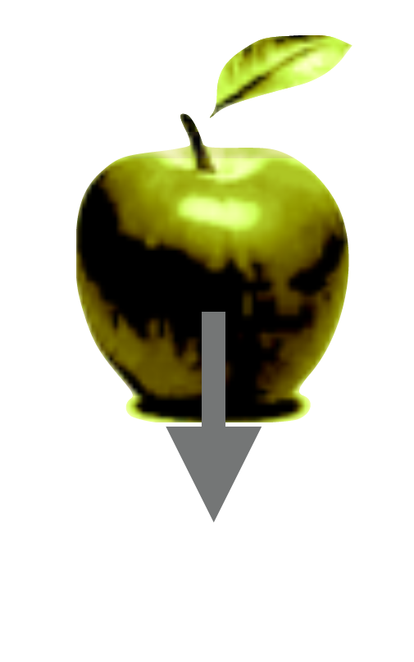
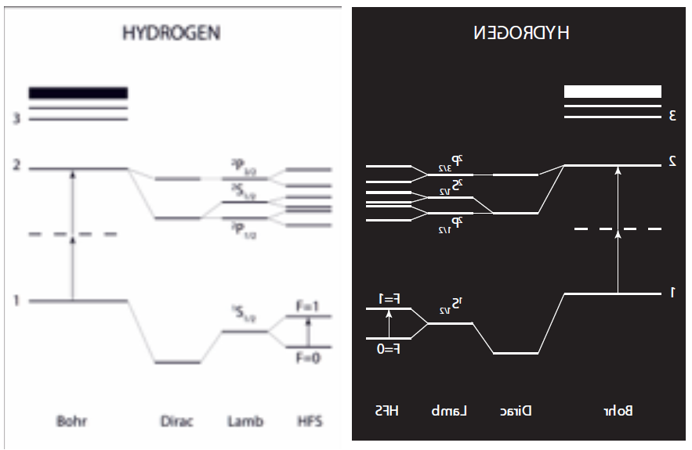
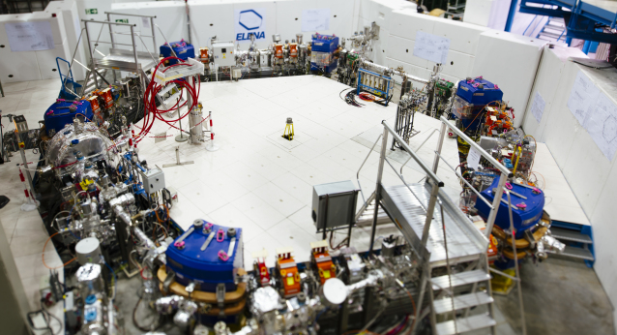
Antiproton Decelerator / ELENA
Probing the Weak Equivalence Principle on antimatter:
  gravity on neutral antimatter
Search for CPT violation:
  antihydrogen spectroscopy
  antiproton magnetic moment
  antiprotonic helium (masse of antiprotons)
  antiproton Electric Dipole Moment
«… flavour physics and CP violation, which play a vital role in determining the parameters of the Standard Model, are explored by a wide spectrum of experiments all over the world. These include measurements of electric or magnetic dipole moments of charged and neutral particles, atoms and molecules, …»

Slide 7
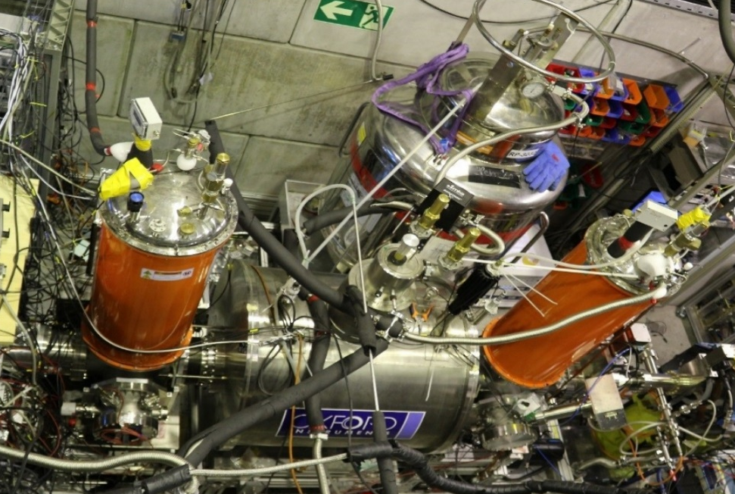
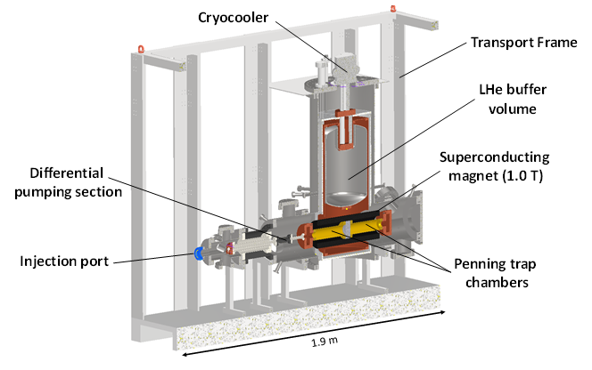

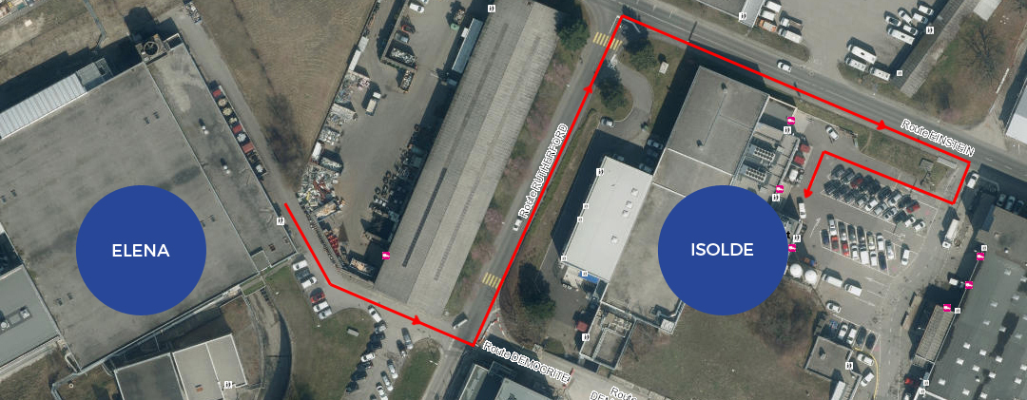
Nuclear physics with antiprotons
BASE-STEP
d d d
ISOLDE and the PUMA (antiProton Unstable Matter Annihilation)
d d d
d d d
d d d
10⁹
d
d d d
d d d
d d d
d d d
d d d
d d d
d d d
d d d
d d d

Slide 8
Conclusion
Antimatter is part and will be part of:
Search for CP violation beyond the Standard Model
Search for dark matter
Astroparticle physics
Search for CPT violation (atomic physics)
Nuclear physics

