Slide 1
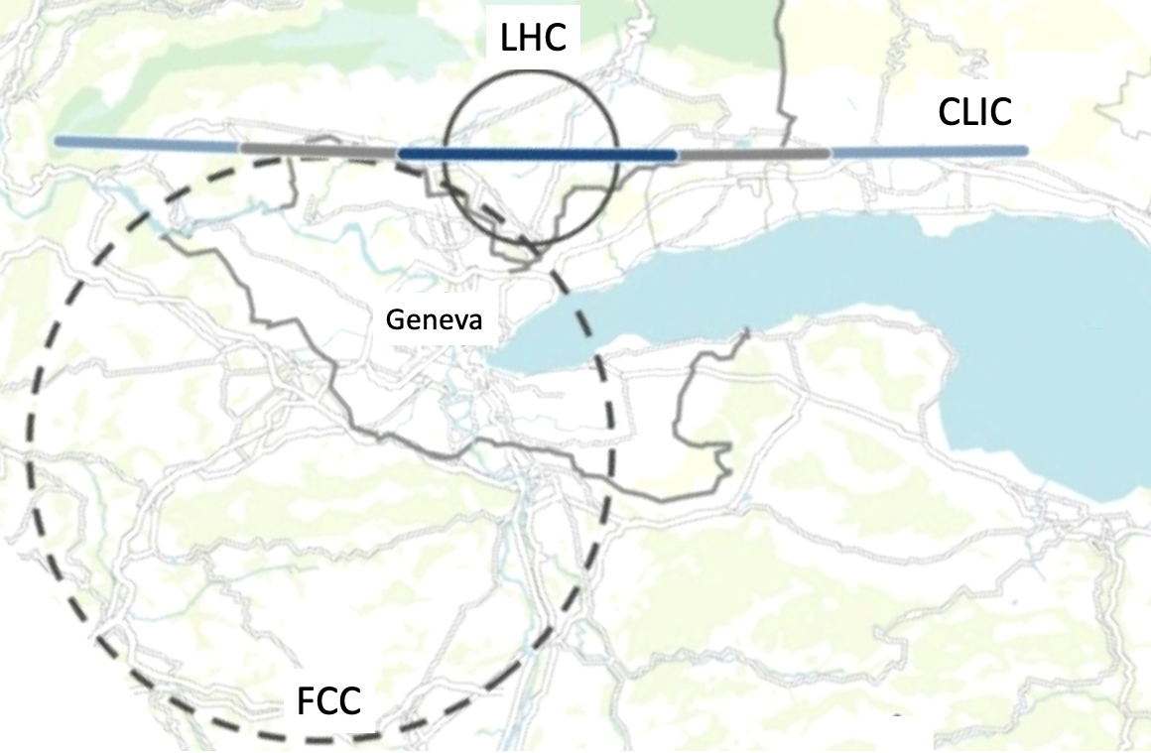
HEP seminar
European Particle Physics Strategy Update 2018 – 2020
November 13, 2020
Erik Adli, UiO

Slide 2
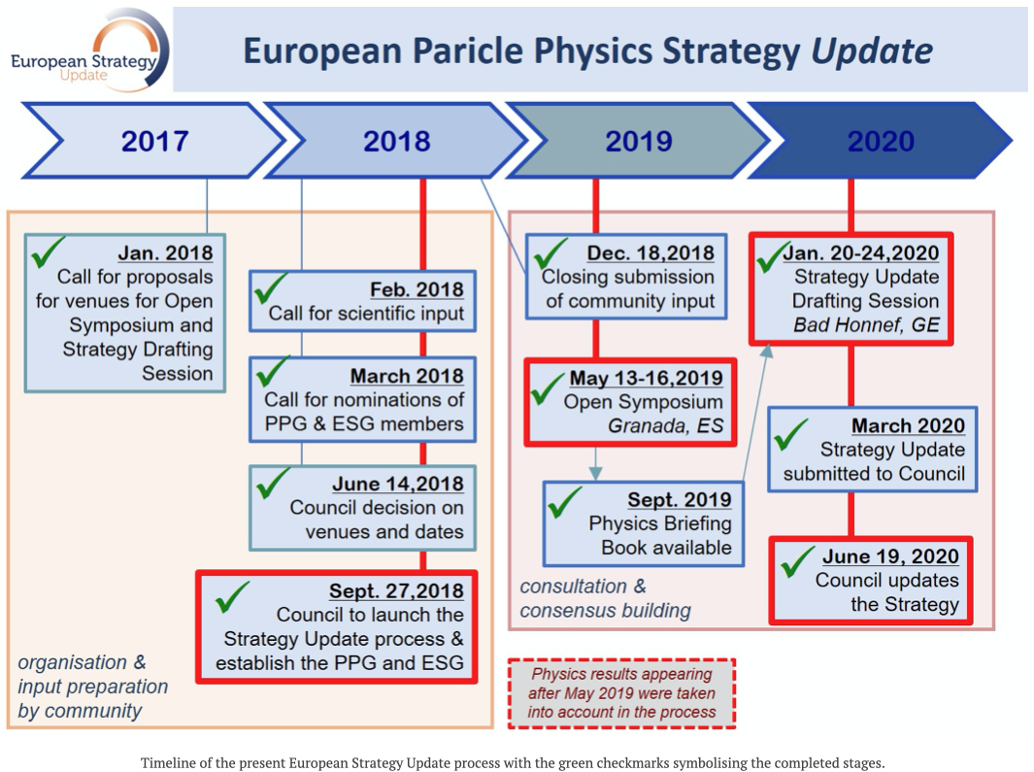
A bottom-up process!
Notes:
Bottom

Slide 3
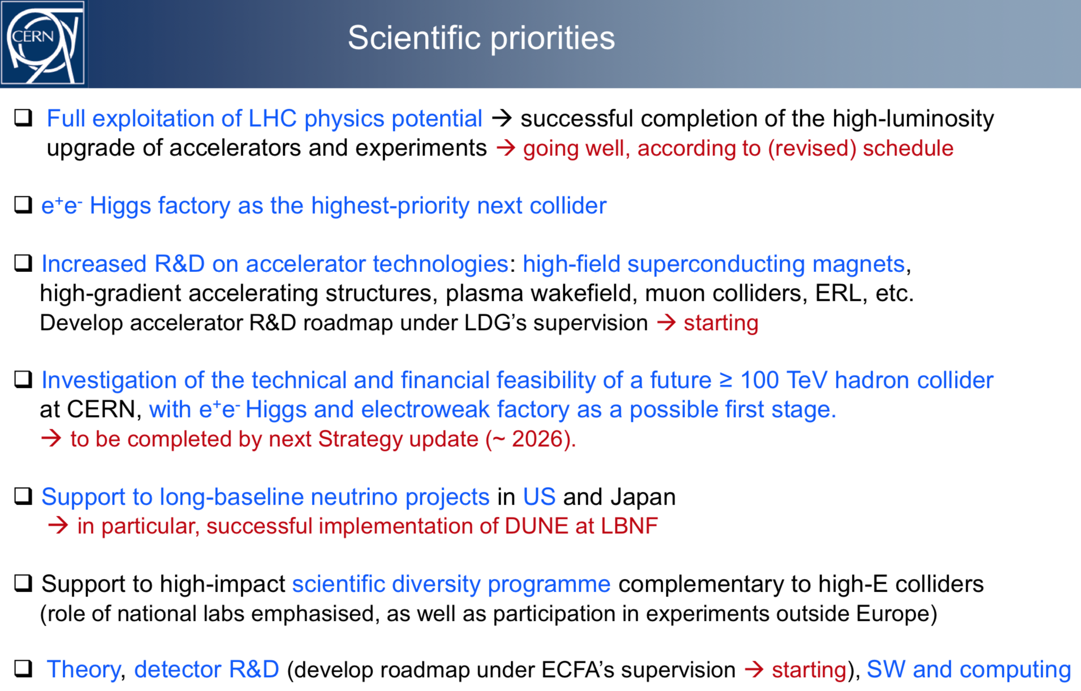
CERN DGs view on the strategy implementation.

Slide 4
