Slide 1
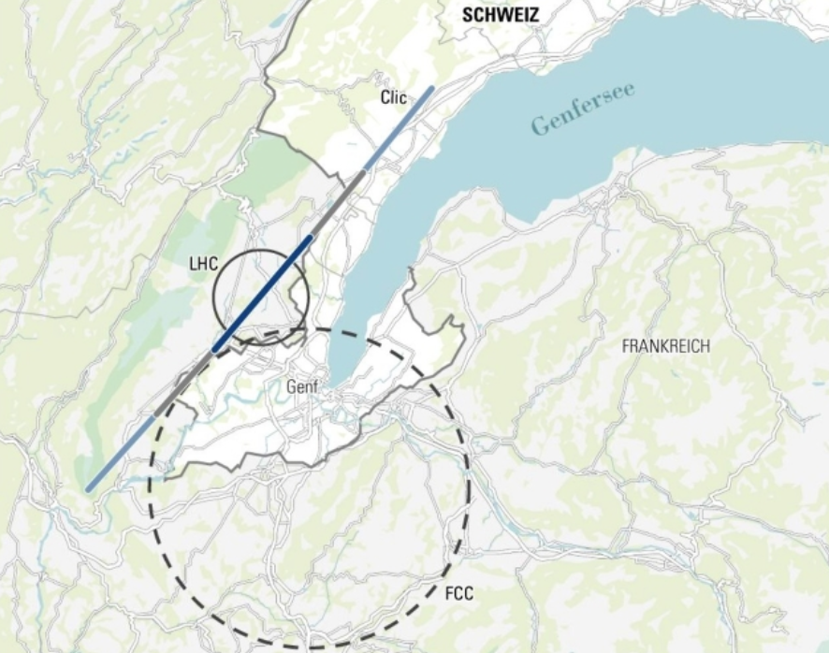
Hva skjer etter LHC?
Fremtidige partikkelknusere
Erik Adli
Department of Physics, U. Oslo
Fysikermøtet 2019
Oslo, Norway
Strategioppdateringen 2018-2020:
Update of The European Strategy for Particle Physics.
Notes:
Thanks to the organisers for the invitation to speak
PP at the energo frontier.
Try to give you some insight in how the future of the field may look like – especially in terms of the next collider - and why
Currently there is a European startegy discussion ongoing in the community, and this talk reflects the current status. Much material are taken from the meetings.

Slide 2
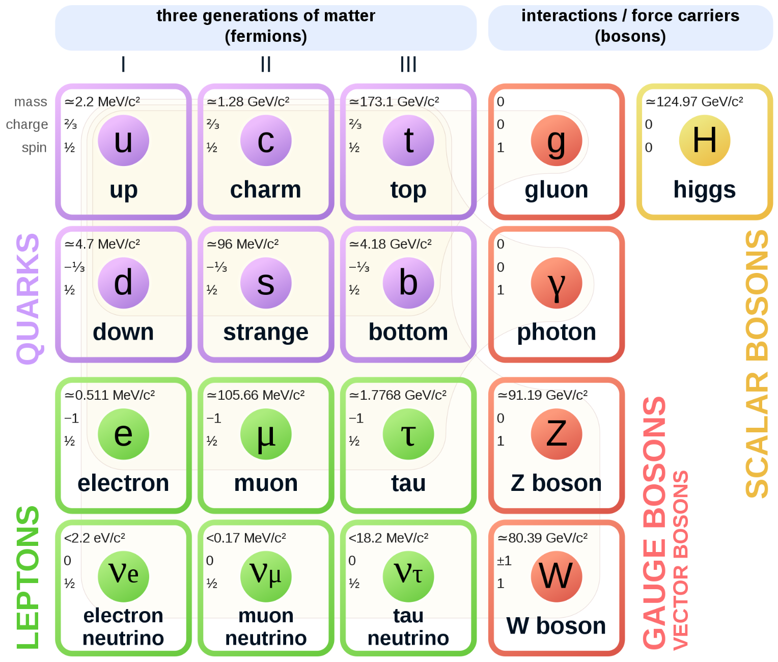
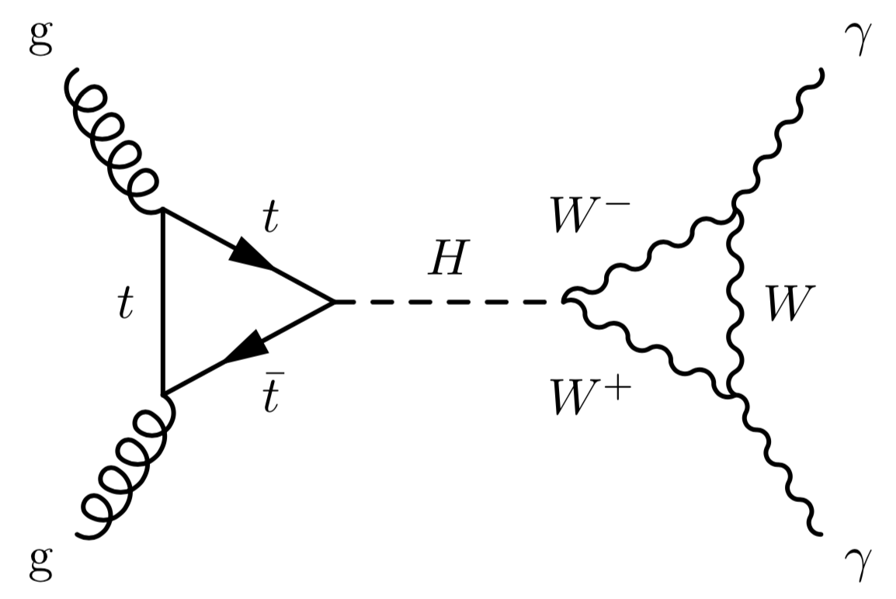
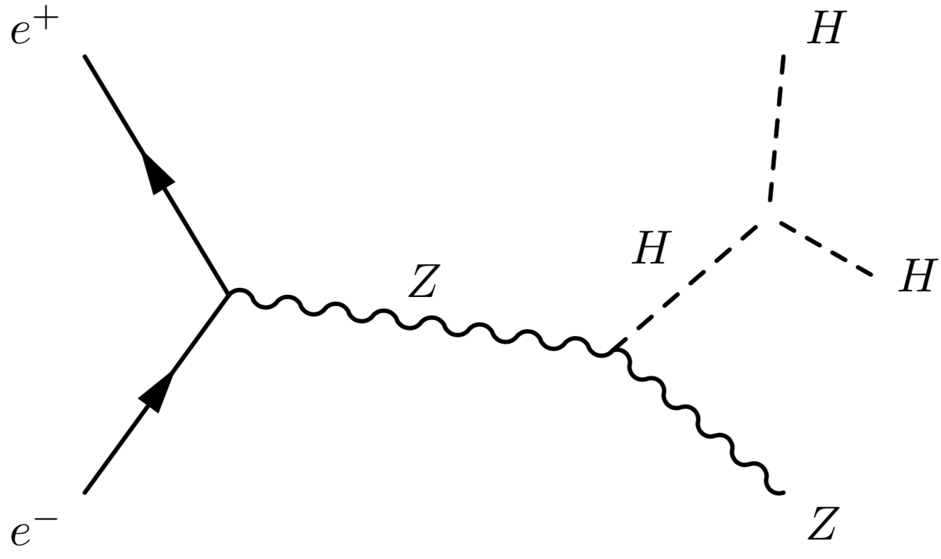
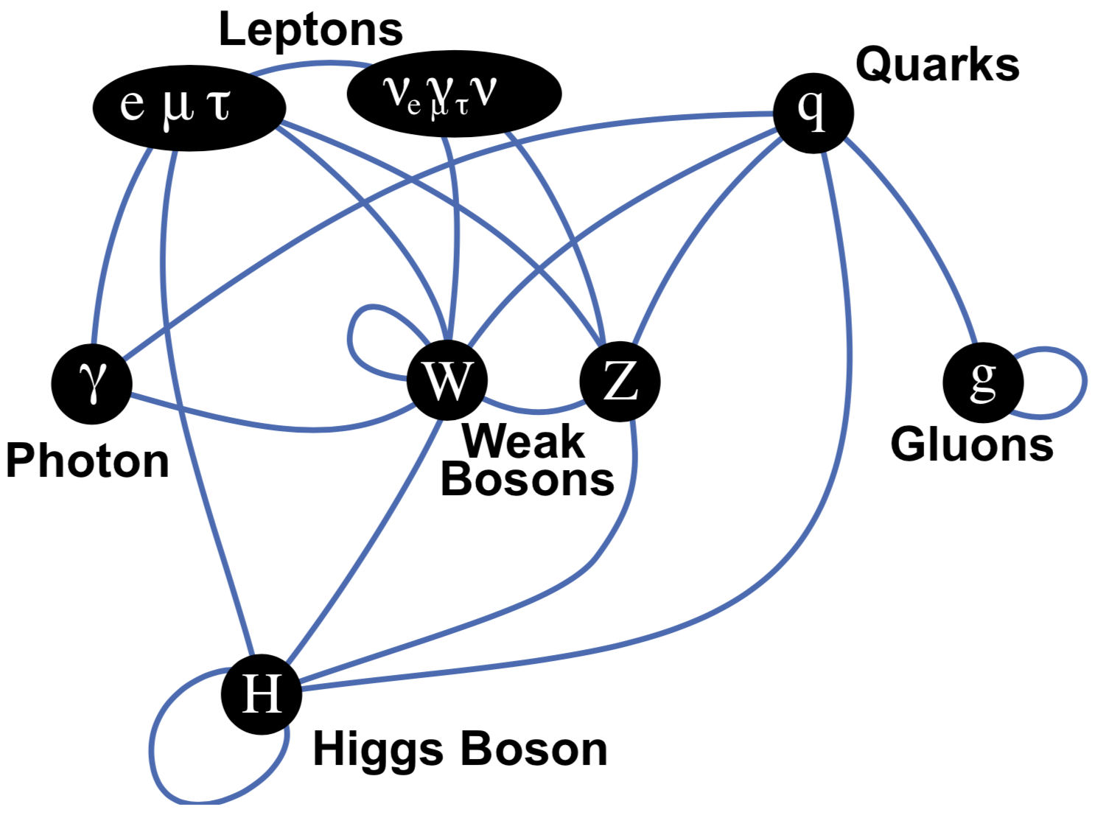
The Standard Model
+ antiparticles
Wikipedia
Unanswered questions:
Three families? 19+7 free parameters?
Nature of the Higgs field?
Anti-matter
Dark matter
...
Experimental results required to guide us!
The Standard Model is a relativistic quantum-field theory, consistent and predictive. It describes all phenomena accessible at colliders.
Notes:
Elementary Particle Physics is described by The Standard Model – the model that described all the fundamental particles we have observed. The matter particles, fermions, the interaction bosons, the Higgs boson.The SM decribes equally well all interactions between the particles, and the quantum fields their represent. Using QFT the model can be described as a Lagrangian, here in a very compact form populareized by CERN. The terms in the Lagrangian describes the interaction bosons, how they interact with fermions, mass terms by couplings to the Higgs field , and the Higgs field itself. “Read”.

Slide 3
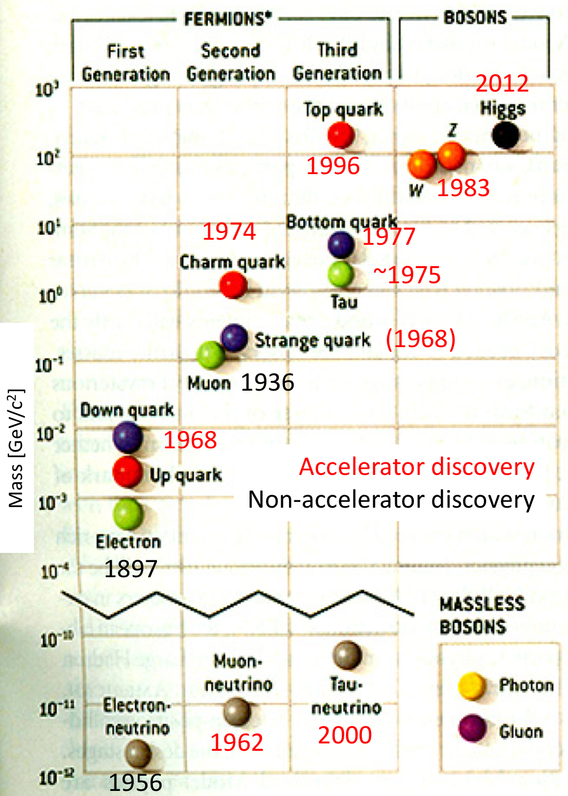
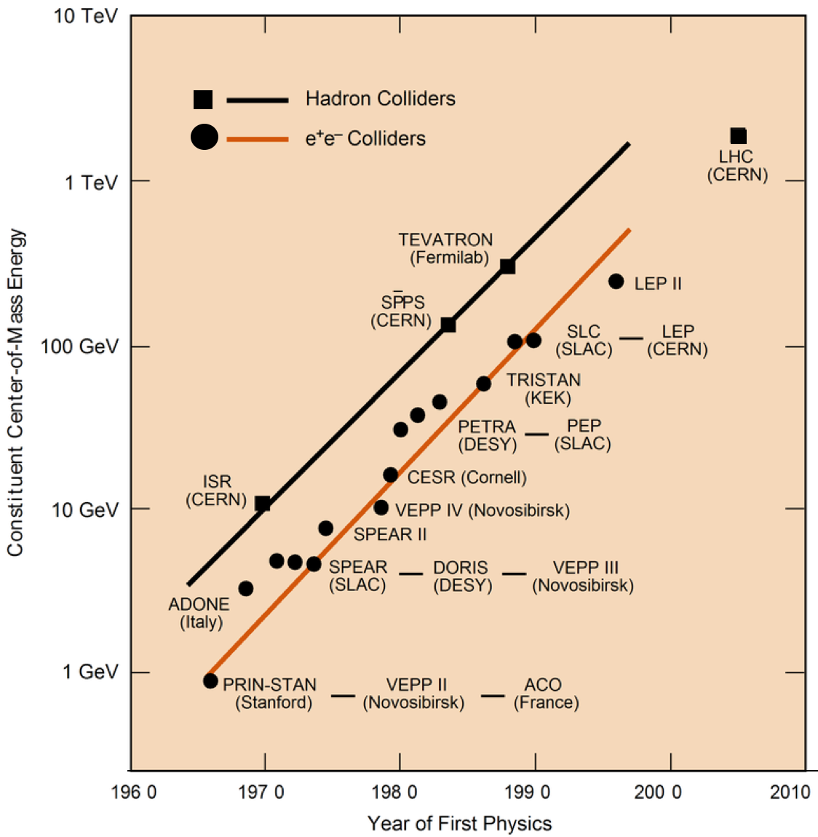
The role of particle accelerators
The last particle predicted by the standard model,
discovered at the LHC in 2012.
?
Notes:
I will speak aboit the ENergy Fronter, and which particle accelerators we consider for the next steps. The reason I focus on partilce accelerators can be seen here ...

Slide 4
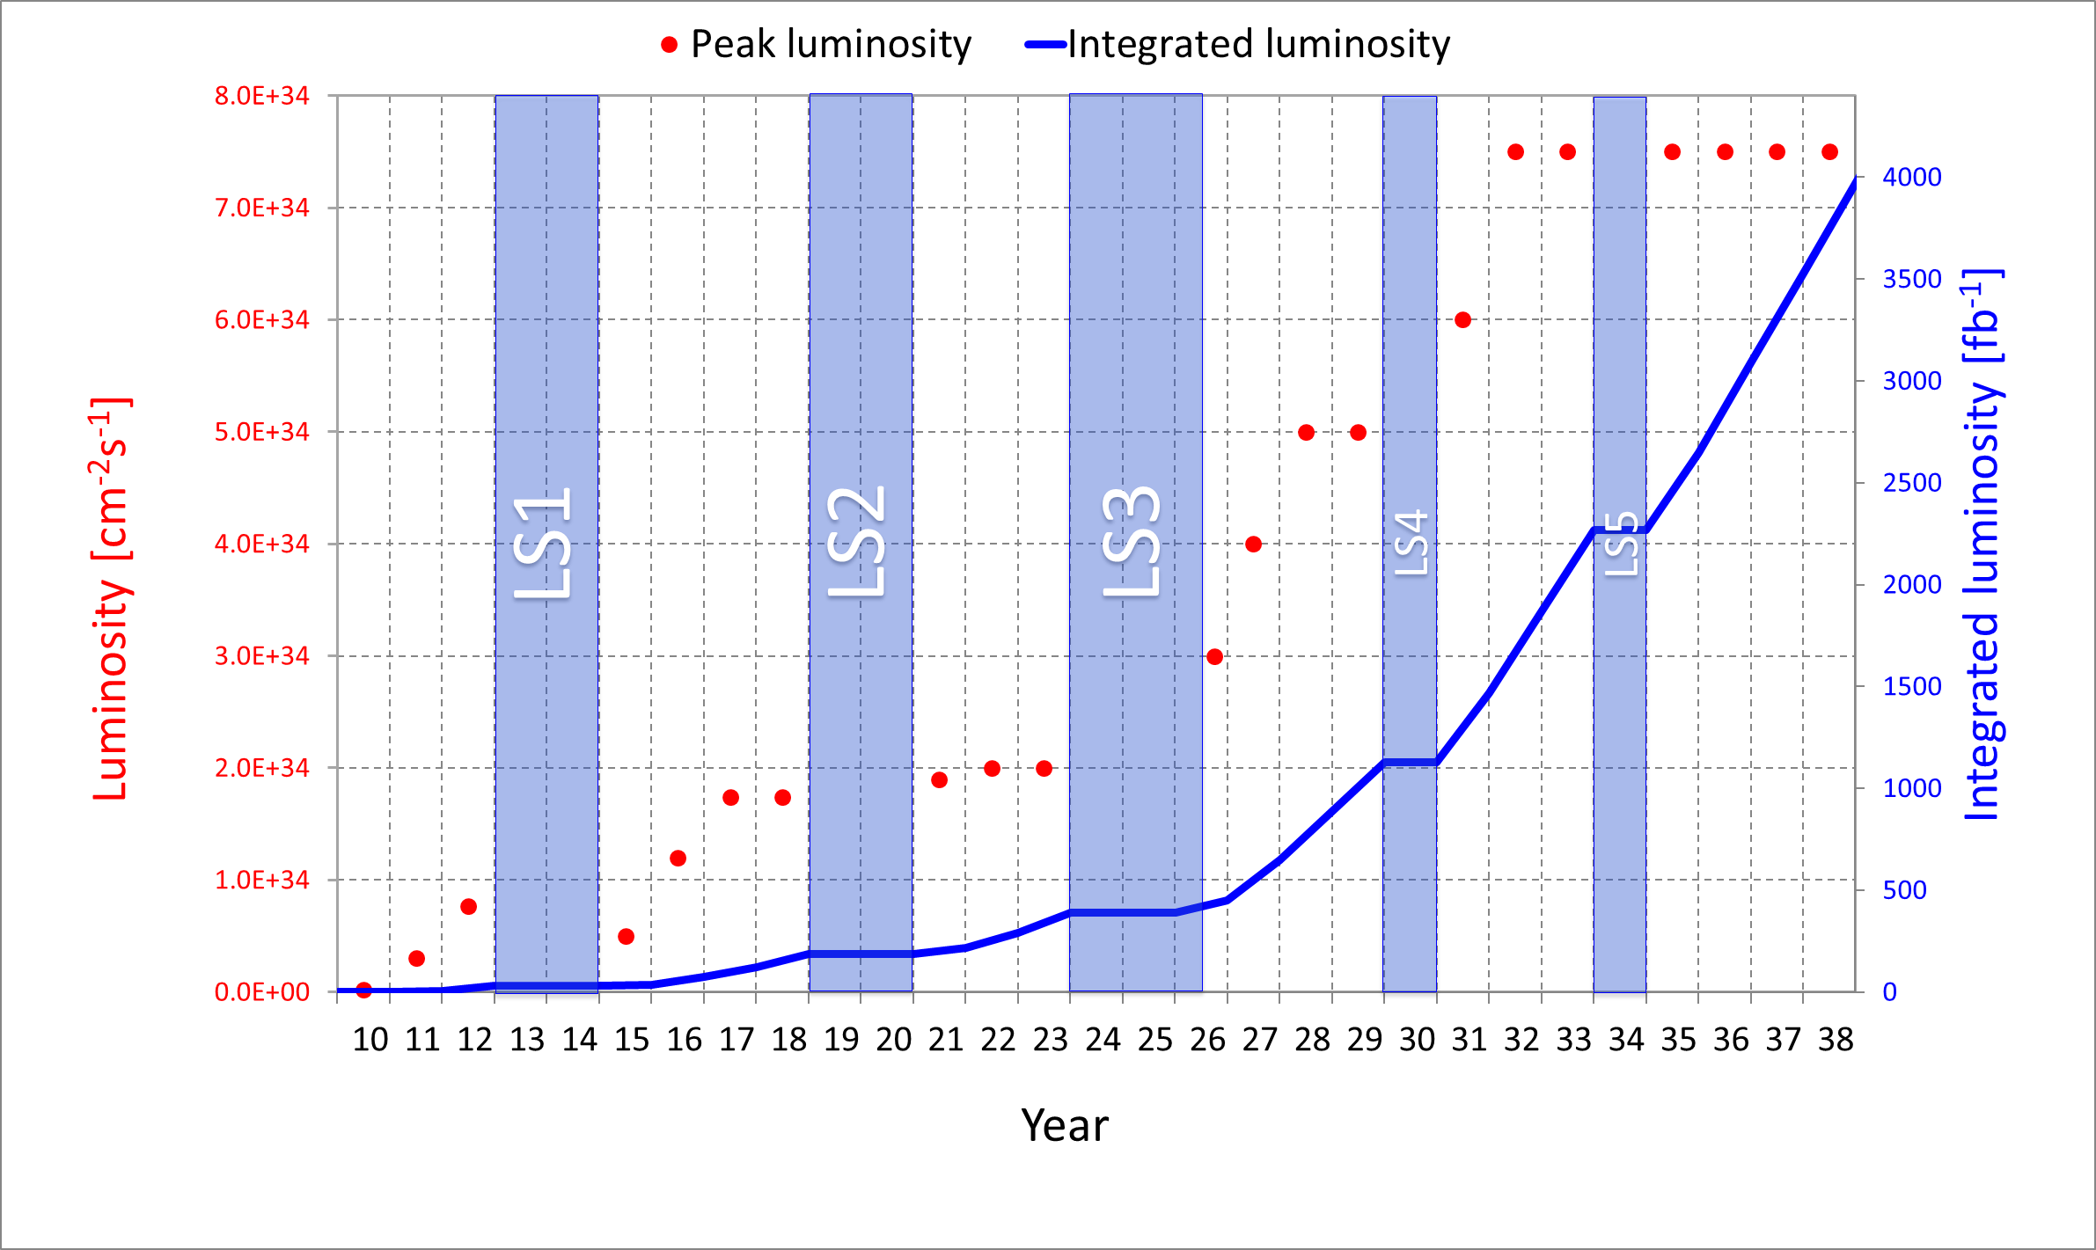
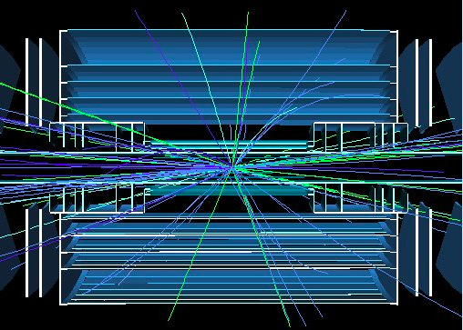
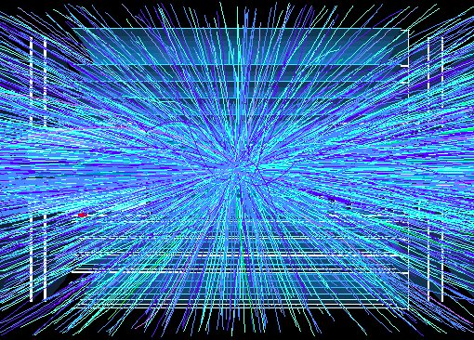
“Near” future: LHC upgrades
Large Hadron Collider
∙ proton-proton collisions (Pb, Au)
∙ collision energy of 14 TeV
∙ 10¹¹ protons at 40 MHz, squeezed to a width of 10 μm, yielding a luminosity = rate/cross-section of 10³⁴ cm⁻² s⁻¹
LHC track density
HL-LHC: High Luminosity LHC
L x 5-10
HL-LHC track density
What defines a collider :
∙ particle type
∙ collision energy
∙ luminosity
“Timeline plot” – as used in the strategy discussions:
Ursula Bassler
Beyond HL-LHC we need to either change to e- e+, or to increase the collision energy, while retaining a high luminosity
LHC was 25 years in the making, decision to fund in 1995. Urgent to plan new project for the future
Proposed projects on the energy frontier: proton-proton or e- e+? Circular or linear?

Slide 5
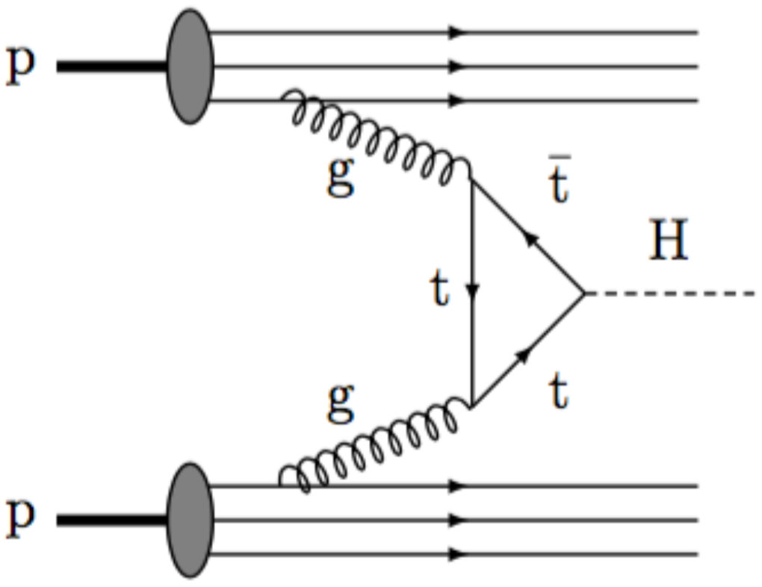
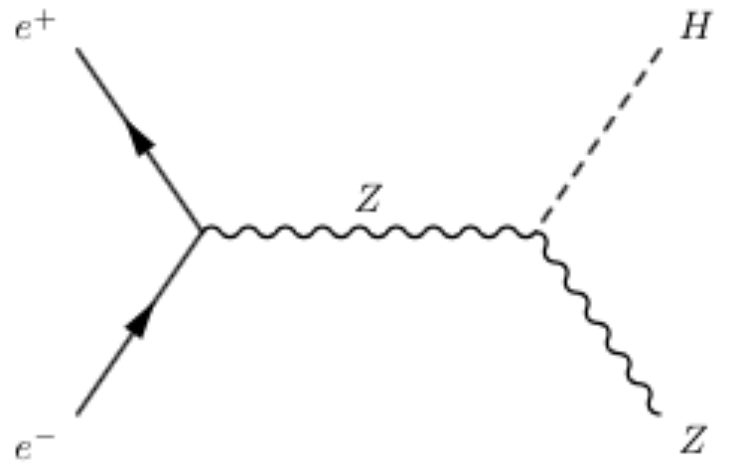
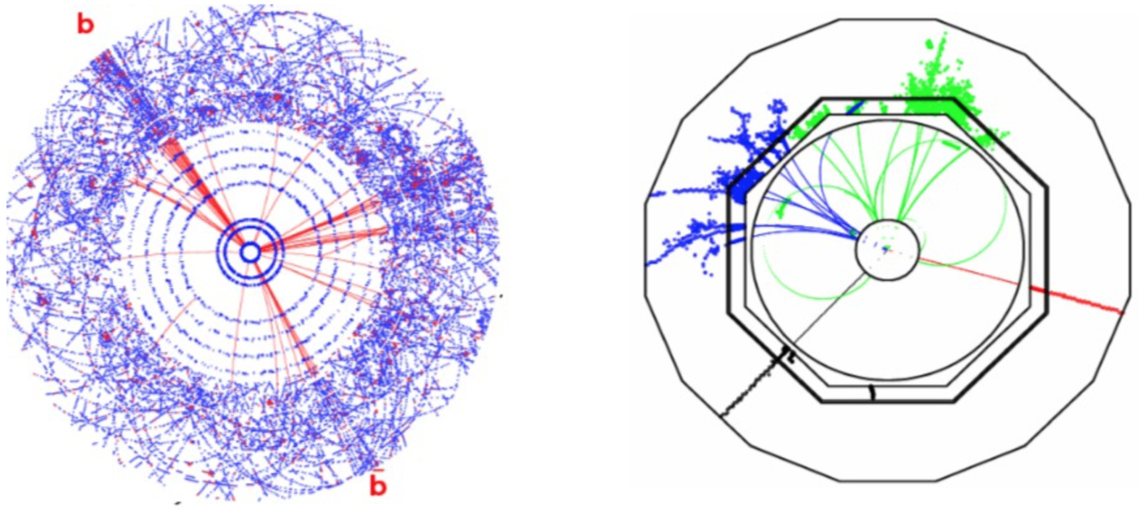
proton-proton versus e- e+ colliders
High signal-to-noise; cleaner events
Well defined initial stage
  Higgs decay width can be established. > model independent measurements
Initial state not available
Strong background, busy events, filtering, triggers
Notes:
Why consider changing to e- e+ ? They are fundamental particles. These has several effects on the analysis;
Protons are composite objects, while it is the partons, the quarks and gluons that rise to processes that we are interested in.

Slide 6
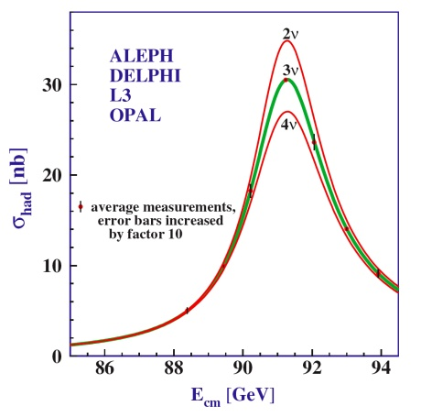
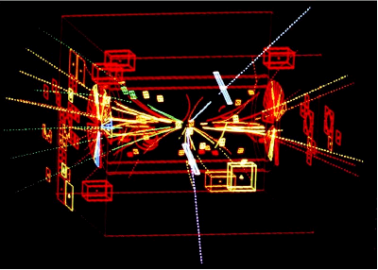

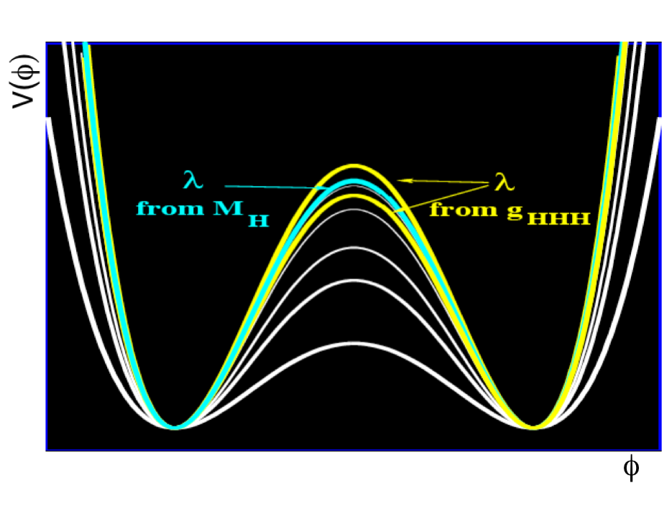
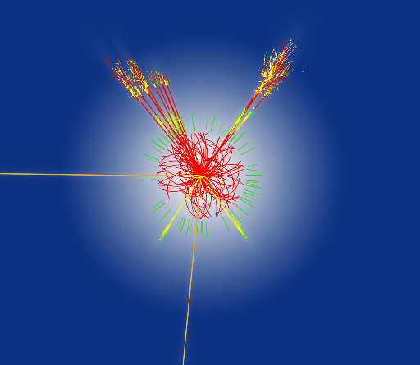

Example: recent colliders at CERN
2000
1983
Z, W discovery
“LEP changed high-energy physics from a 10% to a 1% science.”
2012
Future machine?
Higgs discovery
Future machine: per mille precision, model independence

Slide 7

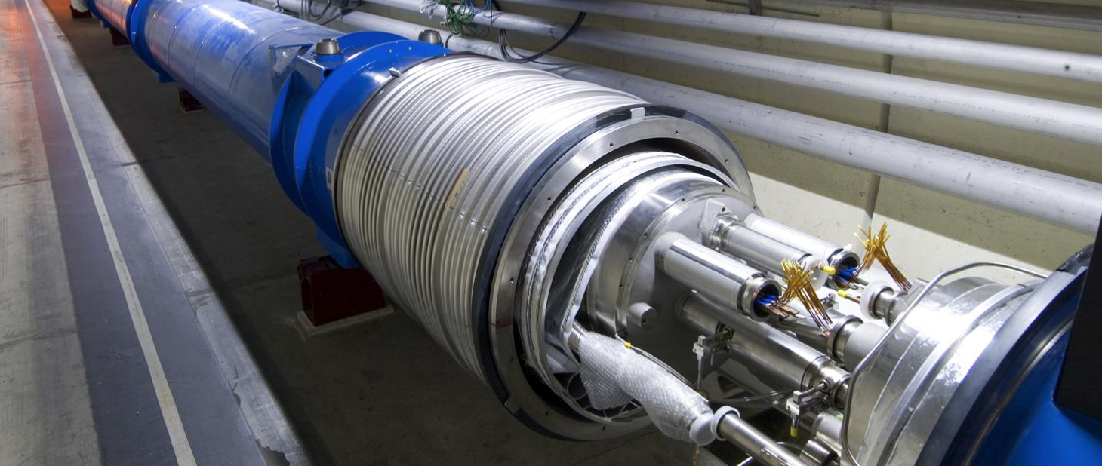
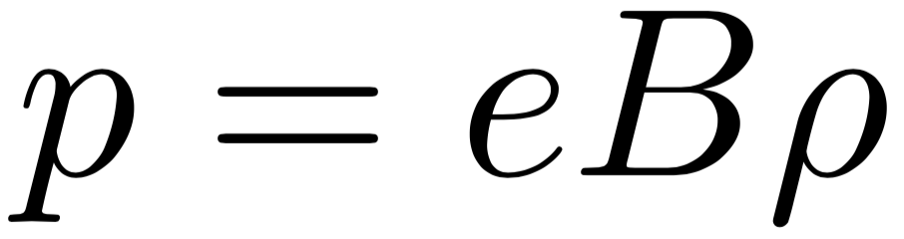
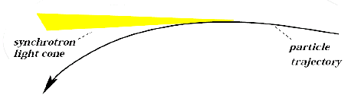
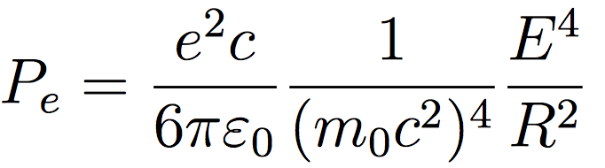
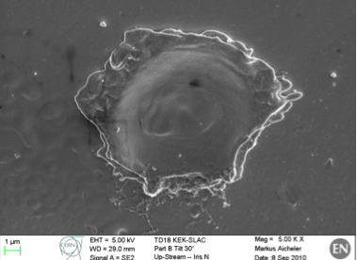
Energy and luminosity limitations, for rings and linacs
Energy challenges
Luminosity challenges (examples)
Circular proton-proton colliders
LHC: 14 TeV collision energy, limited by 8T SC magnet field
Collective electromagnetic effects
constrain charge
Circular e- e+ colliders
Synchrotron radiation loss constrains charge
Synchrotron radiation loss limited LEP collision energy to 209 GeV.
e+
e-
Linear e- e+ colliders
Colliding beams with nm width, as opposed to μm width for LHC, required for the same luminosity.
Reaching high accelerating RF fields.
100 MV/m is the state of the art. 10 km <= 1 TeV.
Progress on the Energy Frontier relies on the evolution – or revolution – of particle accelerators

Slide 8
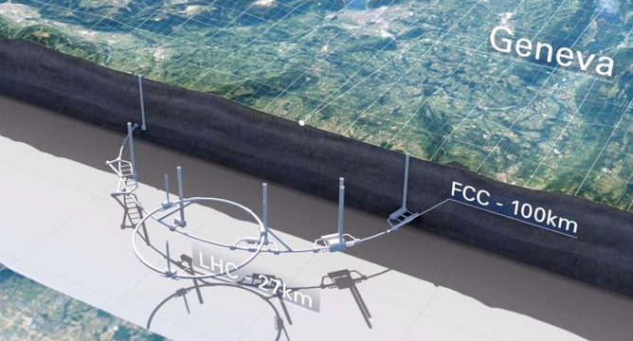
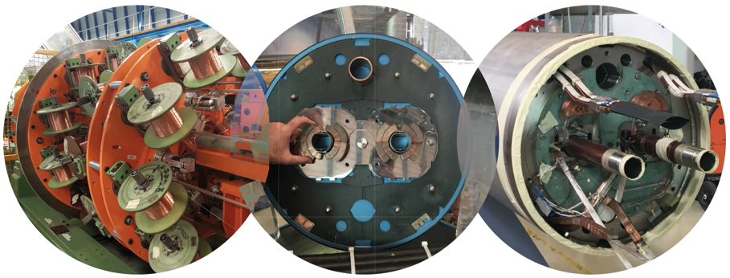
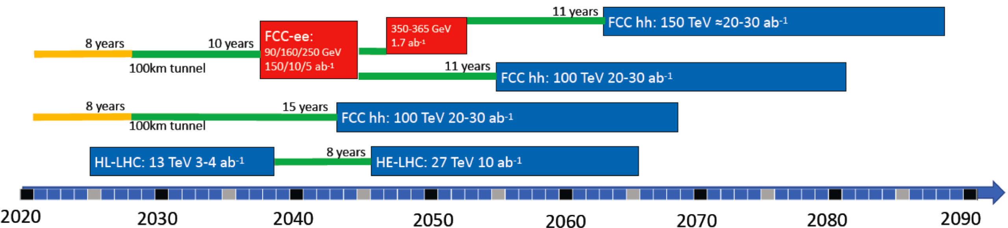
The Future Circular Collider - FCC
Idea: Increase energy to 7 times that of LHC . Tunnel of 98 km. 16T Nb₃Sn magnets at 2K. Re-use of LHC for 3.3 TeV injection.
Main challenge: magnet development. 15-20 years R&D, first possible start T0+23 years (8+15). Cost: tunnel 6 BCHF, total 24 BCHF (+/- 30%).
Option: use the tunnel for e- e+ collisions first, up to 365 GeV (1.7 x LEP energy). Charge adjusted to keep synchrotron radiation loss at 100 MW for all energies.
For FCC-ee: no technological show stoppers. Cost: total 11.5 BCHF (+/- 30%). FCC magnet development in parallel.
Main challenge:
16T Nb₃Sn magnets

Slide 9
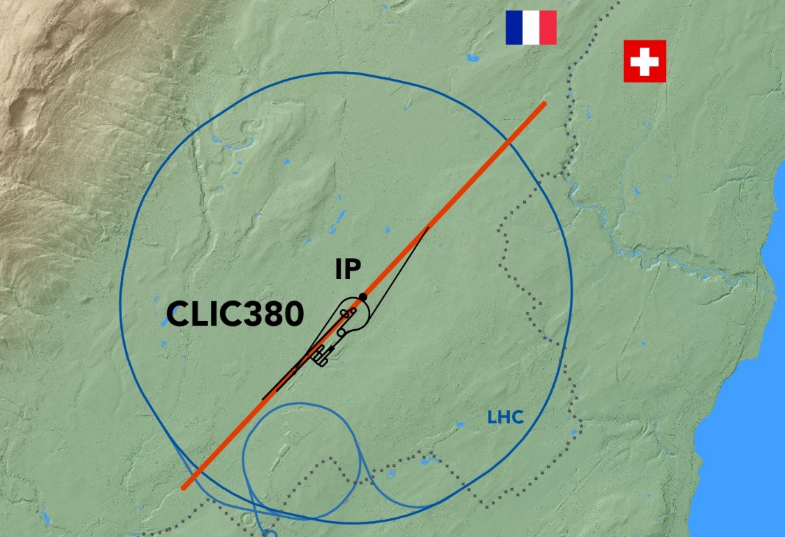
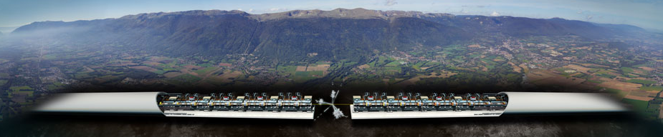
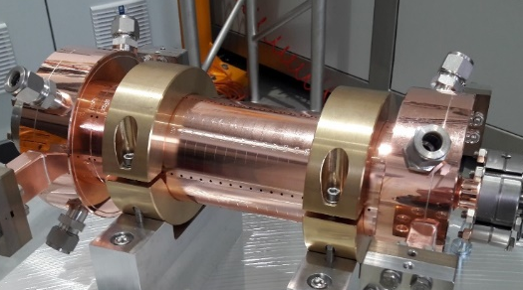
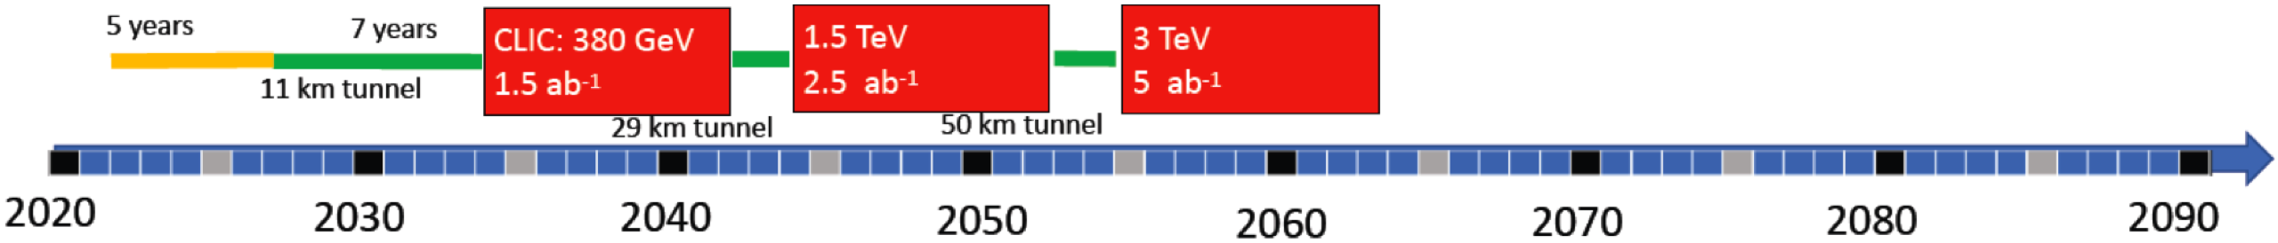
Linear Electron Positron Colliders: CLIC
The Compact Linear Collider, CLIC
Normal conducting 12 GHz, two-beam acceleration, 100 MV/m.
First stage 380 GeV, 11 km. Upgradable to 3 TeV, 50 km.
Two-beam acceleration with 100 MV/m demonstrated at CERN
Conceptual Design done – about 5 years of technical design required before construction
Cost: 5.9 BCHF (380 GeV) + 5.1 BCHF (1.5 TeV) + 7.3 BCHF (3 TeV) = 18.3 BCHF total
Also Japanese site option: “ILC”
CLIC 100 MV/m accelerating structure

Slide 10
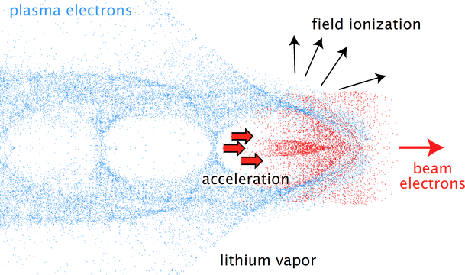

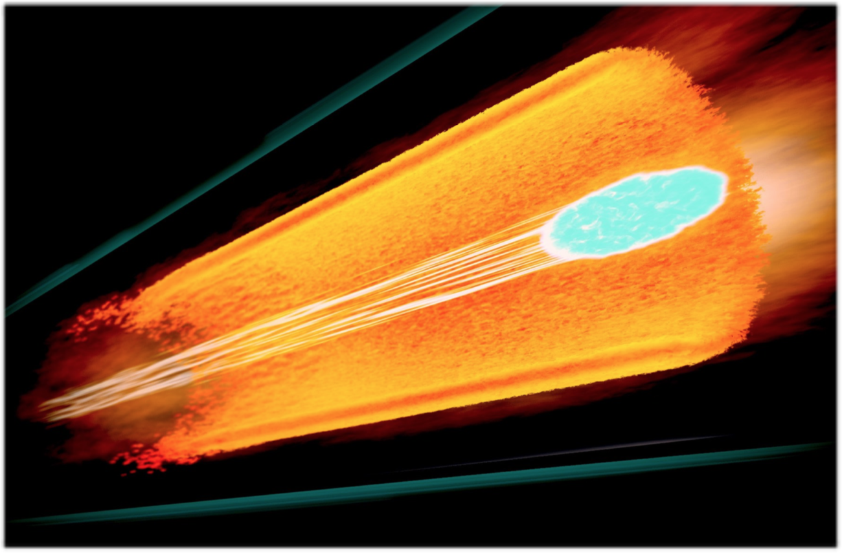
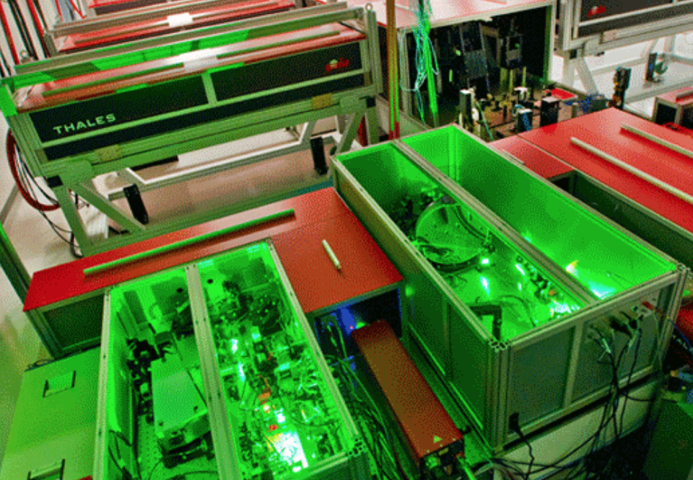
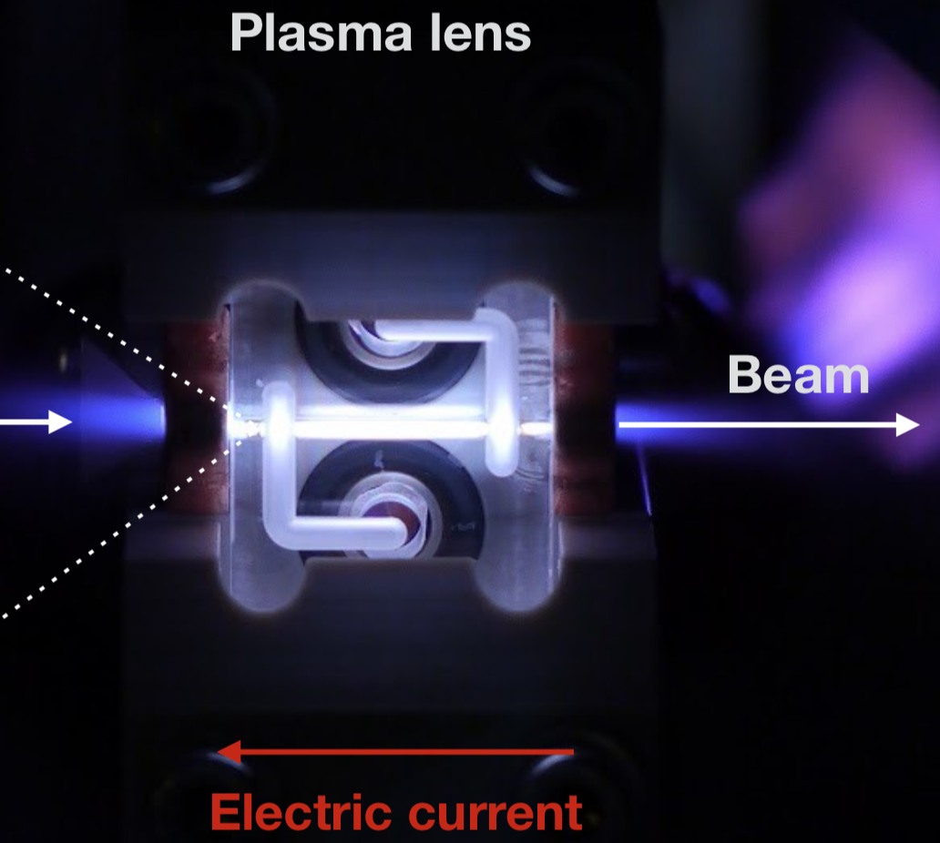
Novel accelerator concepts: plasma acceleration
RF cavities: limited by metal surface break down
Alternative: high fields inside plasmas:
Plasmas are already broken down; can sustain the very high fields.
100 GV/m accelerating fields, as opposed to 100 MV/m
Typical numbers :
Plasma density ~ 10¹⁶⁻ ¹⁸/cm³
Field scale: 10-100 GV/m
Principle: drive a wave in plasma
with particle or laser beams
Length scale :
λ_{p}/2π=10-100 μm
Plasma acceleration
of positrons
Credit: Frank Tsung, UCLA
TW-PW laser technology
Plasma lenses for particle beams
CLEAR visit !

Slide 11
Novel accelerator concepts: muon collider
Novel concepts: boost accelerator performance with radical change in technology
Very promising and interesting research, many hurdles to overcome before use in a collider.
Muon collider pros and cons
Produce sufficiently dense muon beams
Rapid acceleration
Mitigate radiation hazards
Negligible synchrotron radiation
Main challenge: τ_{μ} = 2.2 μs
Protons on target hadronic showers,
Pions decay into muons
Muon are captured, bunched and then cooled.
Rapid acceleration to collision energy
Collision
Precision, plus discovery potential!
3 TeV ∼ LHC
14 TeV ∼ FCC-hh;
30 TeV ∼ “amazing"
lepton
vs protons

Slide 12

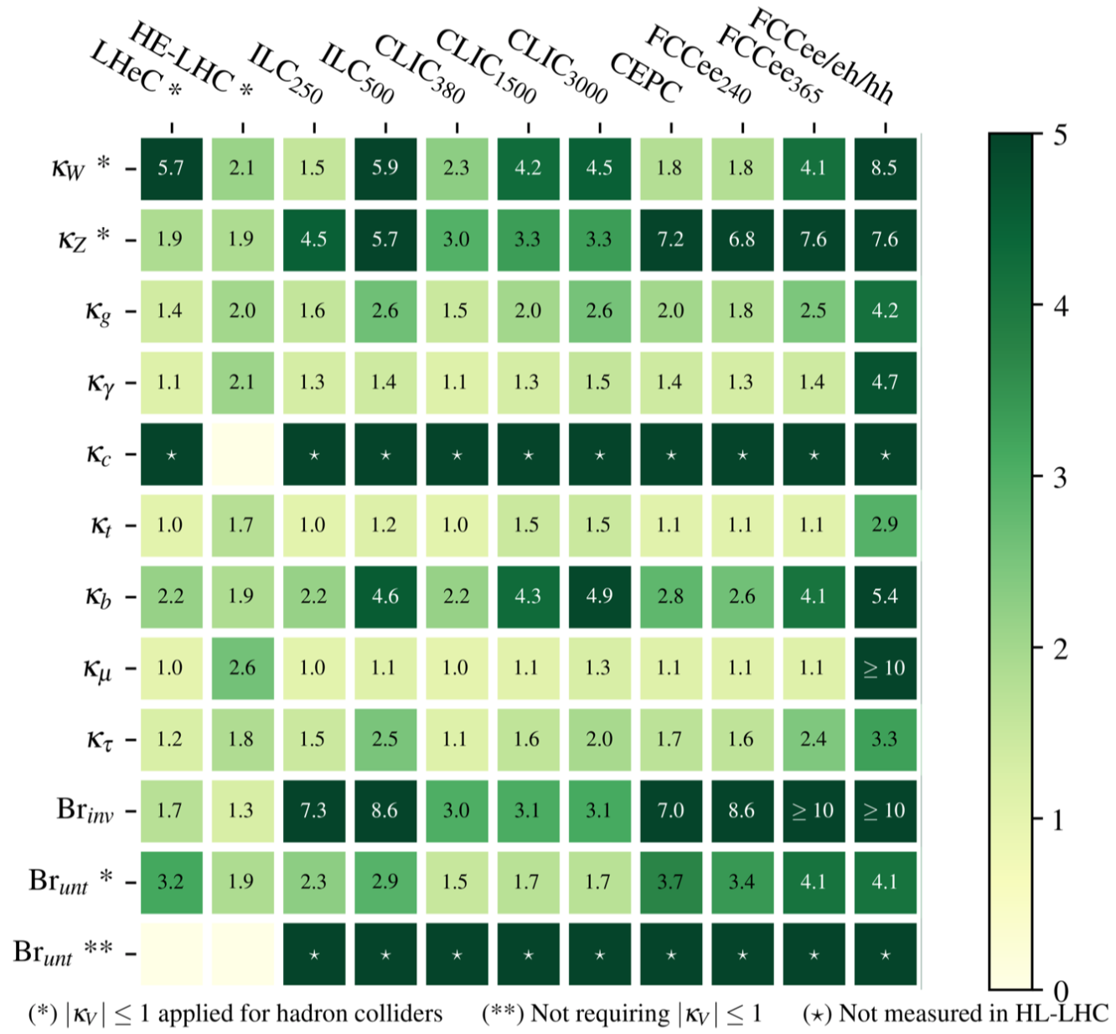
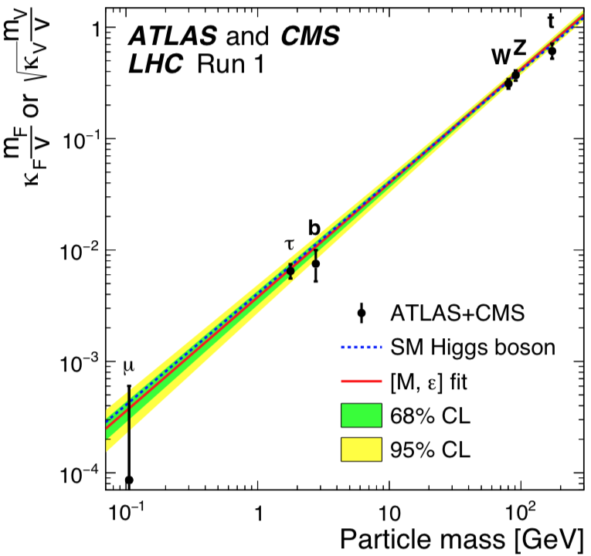
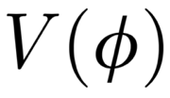
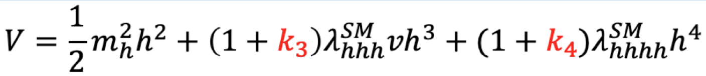
Comparison of machine physics potential: examples
Improvement of precision compared to HL-LHC
Precision measurements of Higgs couplings
?
Probing the Higgs potential
M. Cepeda, ESU meeting, Granada, 2019
arXiv:1905.03764 [hep-ph]
Measurements of the Higgs potential could be done at a FCC-hh, or at a Multi-TeV e- e+ collider
Current opinions seem to be: an e-e+ Higgs factory desired as first machine
“The guaranteed physics of new machines is centered on revealing the deeper nature of the Higgs.”
Nima Arkani-Hamed

Slide 13
Summary
LHC will continue ∼20 years, HL-LHC upgrade from ∼2026
Several future projects suggested, FCC and linear colliders, to address open questions. Novel technology being developed, great promise, not yet ready to consider for a collider
Best option? Depends on time scale, and budget. Strong potential for future upgrades and reuses are important considerations
Exiting future for the field ahead!
Acknowledgements: much material taken from the European Strategy Update meeting, May 2019
Link to input from the Norwegian CERN community to the European Strategy Update

Slide 14
Extra

Slide 15
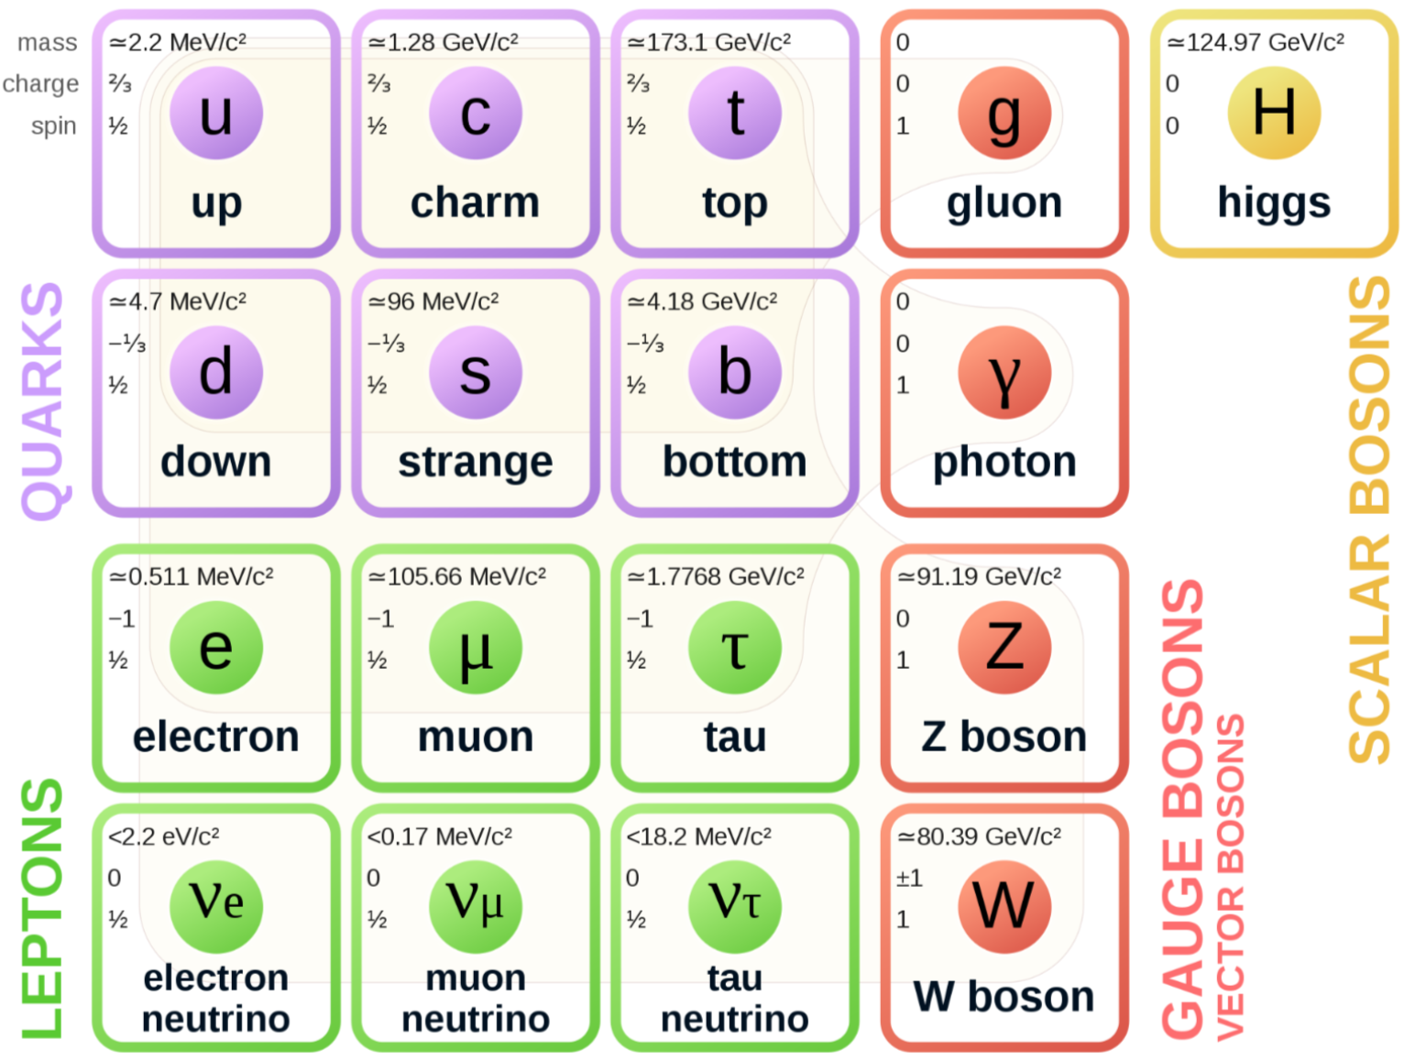
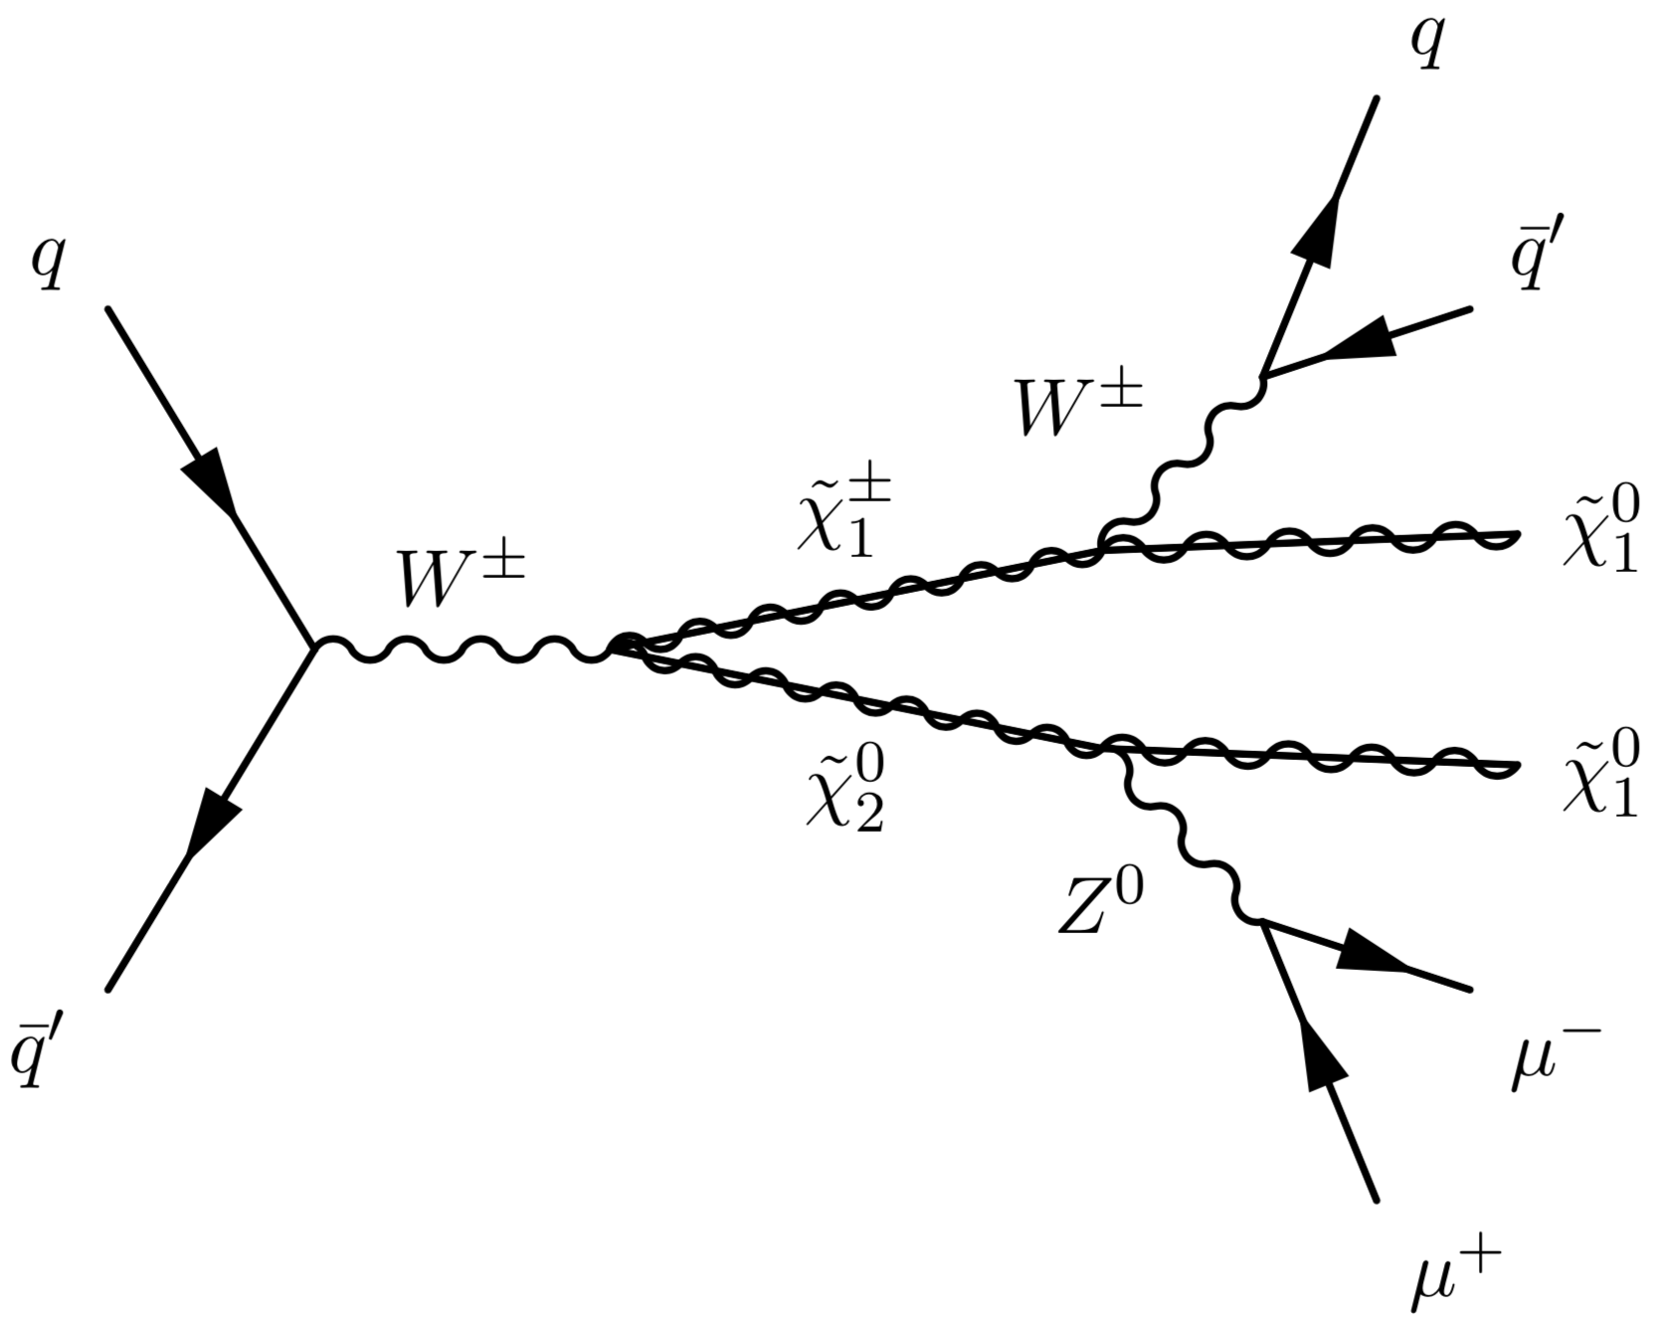
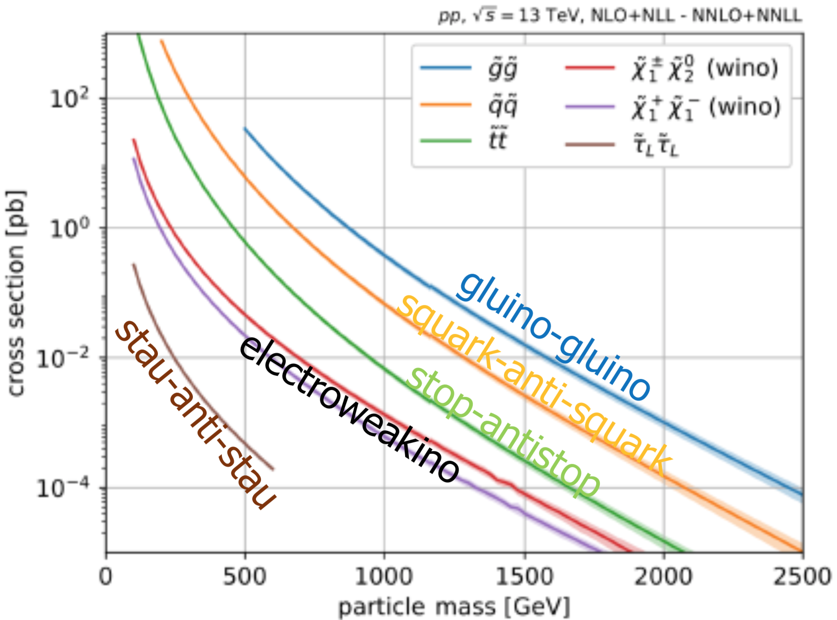
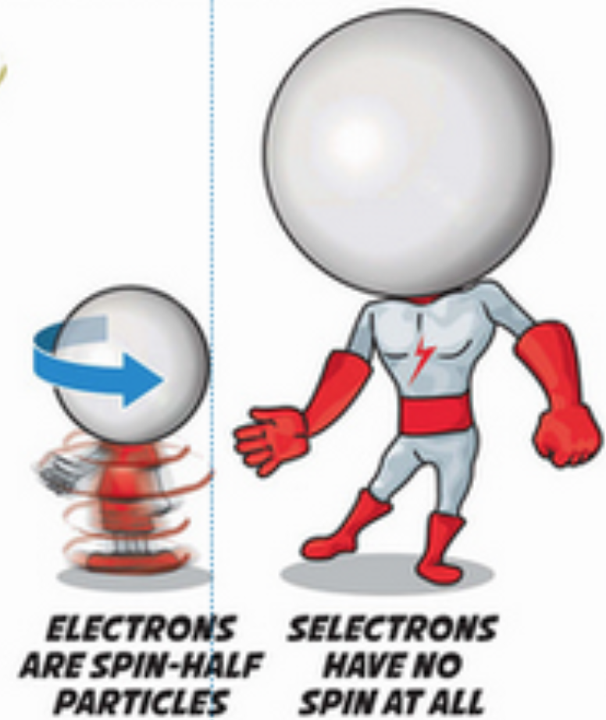
Unanswered questions
Searches and analyses
Direct discovery of new physics. e.g. dark matter particle
Constraining theories, e.g. exclude SUSY parameter space
Precision measurement as proof for new physics, e.g. deviation from coupling parameters
Three families? 19+7 free parameters?
Nature of the Higgs field?
Difference matter-antimatter?
95% of universe non-baryonic matter? Dark matter?
..
K.O. Vadla
See talk by A. Kvellestad
Theories and predictions
Supersymmetry (SUSY)
Extra dimensions
String Theory
..
STFC/
Ben Gilliland
Experimental results required to guide us!
Notes:
Despite the fact that the SM can be used to calculate all processes observed so far in Part Acc., there are many outstanding questions in particle physics.

Slide 16
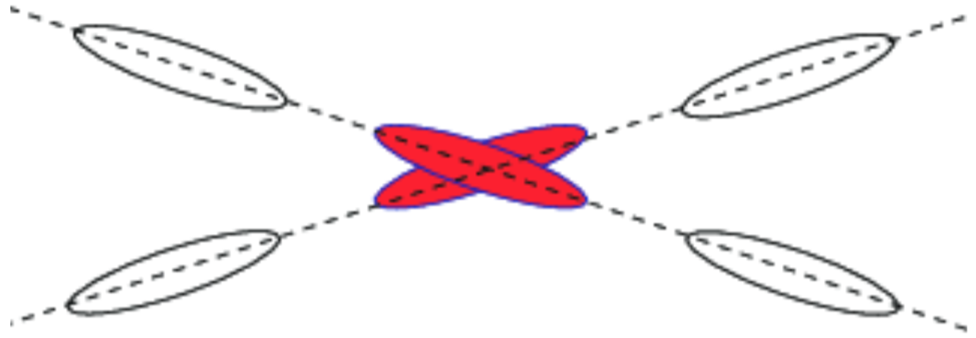
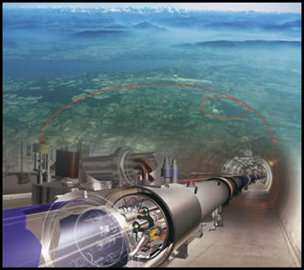
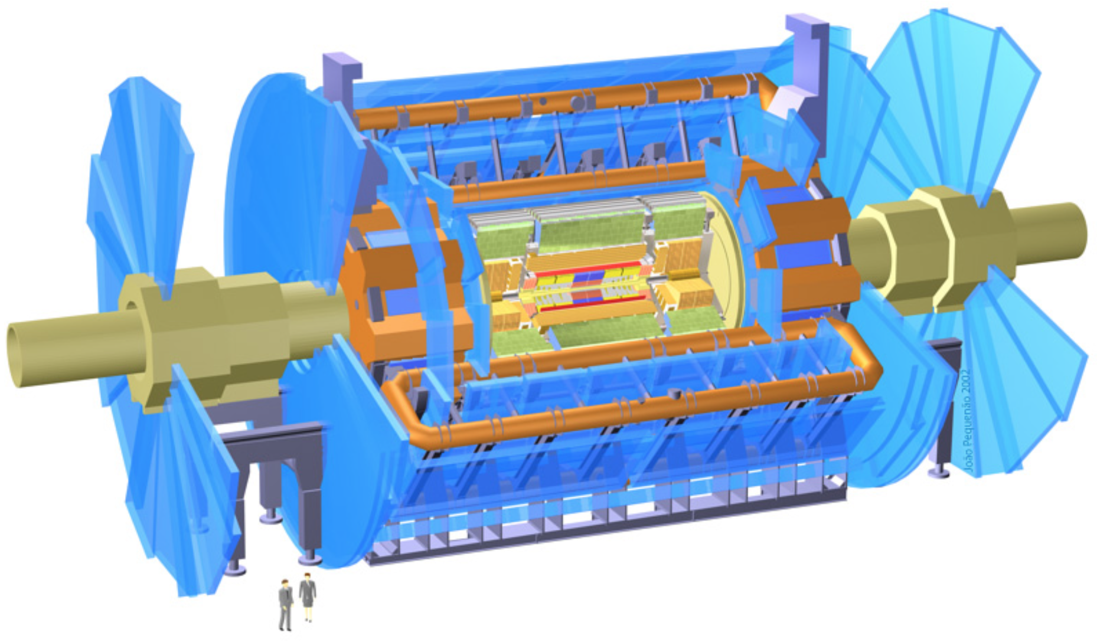
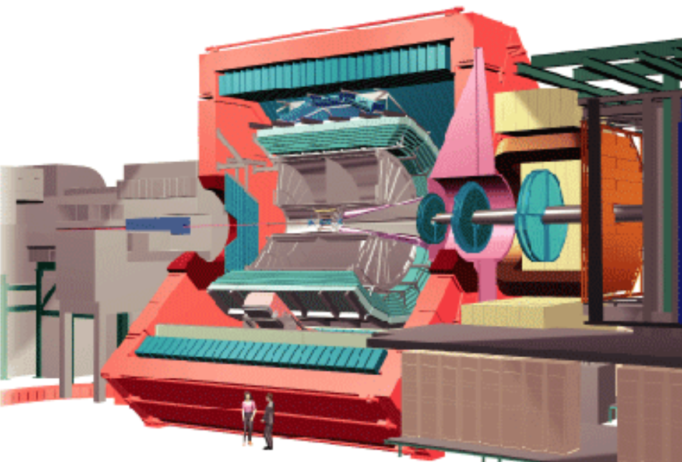
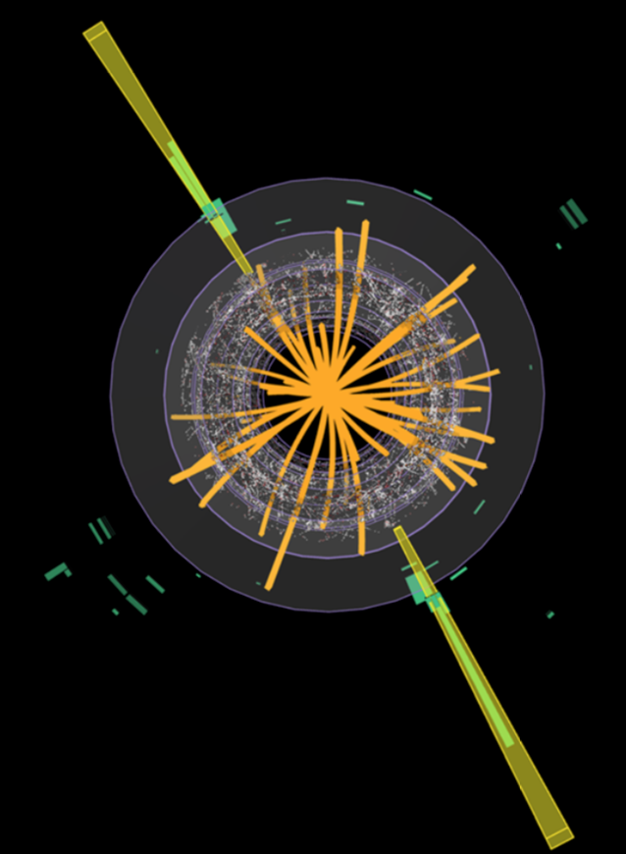
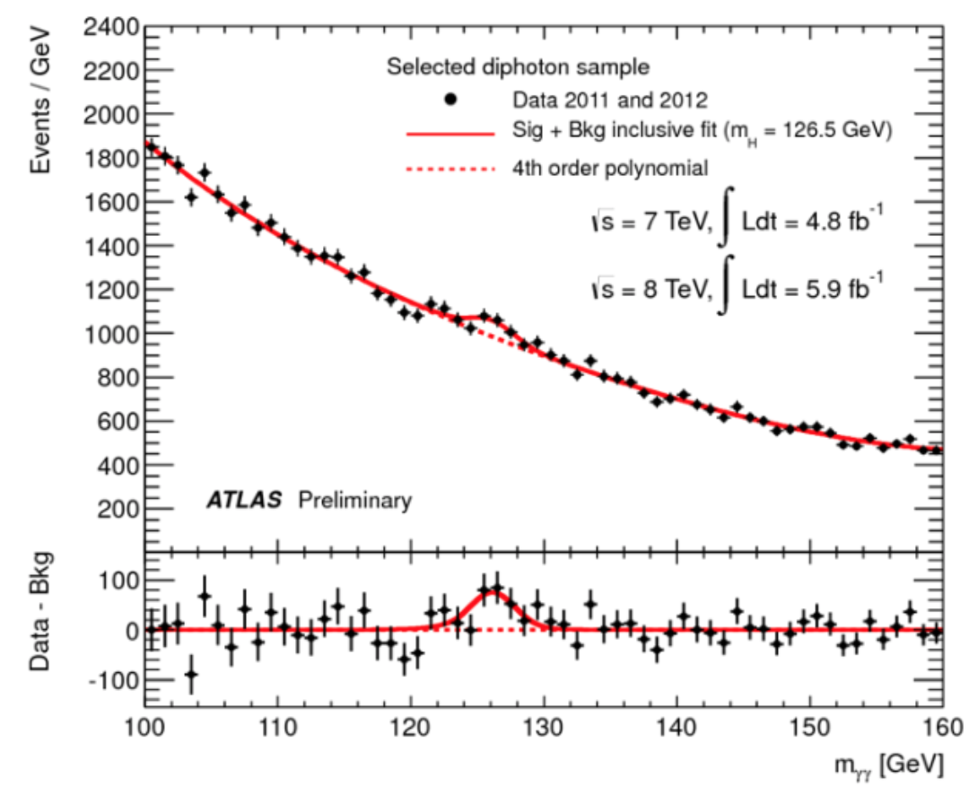
Where are we now?
ATLAS
ALICE
The Large Hadron Collider, LHC
∙ proton-proton collisions (Pb, Au)
∙ collision energy of 14 TeV
∙ 10¹¹ protons at 40 MHz, squeezed to a width of 10 μm, yielding a luminosity = rate/cross-section of 10³⁴ cm⁻² s⁻¹
What defines a collider :
∙ particle type
∙ collision energy
∙ luminosity
Higgs discovery at the LHC, 2012
Notes:
The LHC at CERN has collided particle for about 10 years, and will do so for maybe 20 more. It is a .... analysis are done by four exp around the ring, ATLAS and ALICE, where the Norwegian community is very active, the centre of mass energy, which I here for simplicity call the collision energy

Slide 17
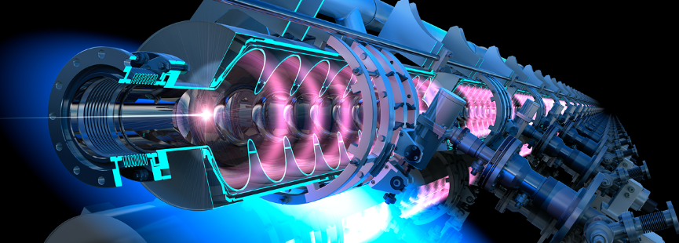

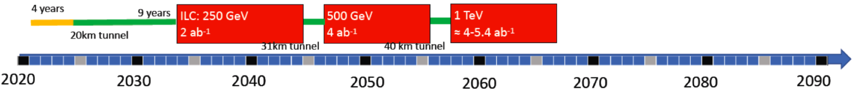
Linear Electron Positron Colliders: ILC
The International Linear Collider, ILC - Japan potential host
Superconducting 1.3 GHz cavities, 31.5 MV/m,
First stage 250 GeV, 31 km. Upgradable to 1 TeV, ~50 km.
Development of SCRF cavities with 31.5 MV/m, mostly done. Technology proven (XFEL).
Technical Design done – almost ready for construction
Cost: 4.8-6.3B 2012$ (250 GeV)
May go forward if the Japanese government agrees to pay the bulk, and with sufficient support from Europe and USA. decision process has taken a long time

Slide 18
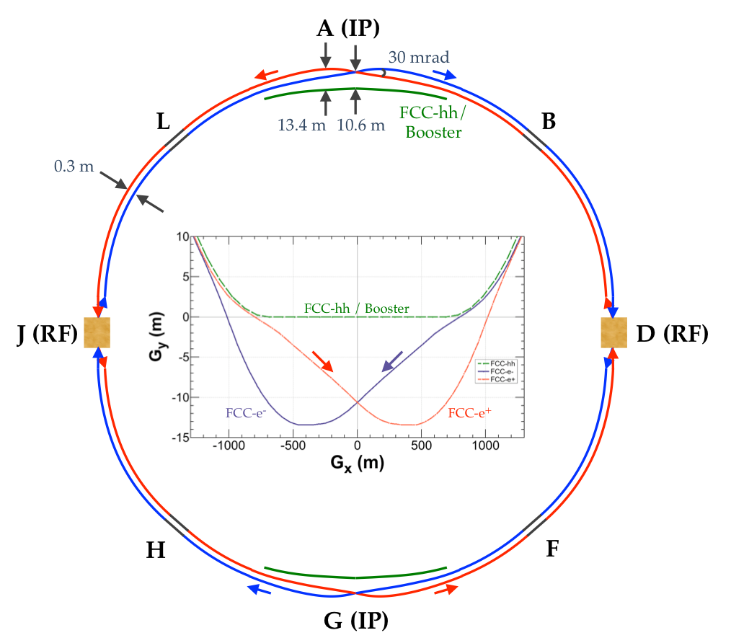

FCC-ee – an e- e+ collider as first step
Idea: Use the FCC tunnel first for e- e+ collisions, up to 365 GeV (1.7 x LEP energy). Charge adjusted to keep synchrotron radiation loss at 100 MW for all energies.
No technological show stoppers. Cost: total 11.5 BCHF (+/- 30%). FCC magnet development in parallel.
Chinese ”FCC” studies
98 km tunnel
Chinese has proposed a ”FCC-ee“ (CEPC) and a “FCC-hh” (SppS), to be built in China (2012)
Would be very similar to the FCCs
CEPC CDR finalized (2018)
Funding not ensured
Requires international cooperation
FCC-ee

Slide 19






AWAKE: proton-driven plasma
Full reuse of the CERN accelerator complex
AWAKE is installed at the CNGS beam line. An SPS bunch drives the plasma.
E. Adli et al. (The AWAKE collaboration), Nature 561, 363–367 (2018)
Electrons plasma-accelerated
by SPS protons
Using an LHC bunch as driver, Multi TeV- electron could be produced in a few km, and collided with another LHC bunch
M. Wing, Phil. Trans. R. Soc. A 377: 20180185 (2019)

Slide 20



Linear Colliders: energy extendibility
e+
e-
CLIC cost: 5.9 GCHF (380 GeV) + 5.1 GCHF (1.5 TeV) + 7.3 GCHF (3 TeV) = 18.3 GCHF total

Slide 21


Luminosity, Luminosity per power
All projects strive towards energy efficiency.

Slide 22

Gamma-gamma collider

Slide 23

arXiv:1905.03764 [hep-ph]

Slide 24
The Muon Collider LEMMA Scheme
Key concept:
Produce muon beam with low emittance using a positron beam
No cooling required
In design of 2018 two important issues were found
Muon multiple scattering
Issue with phase space
Attempt to consolidate is ongoing
Nadia’s talk
Muon current 10¹¹ s⁻¹ is 300 times lower compared to 3 x 10¹³ s⁻¹ for proton driver
Emittance O(10⁻³) smaller than in proton scheme, 40 ns vs. 25 μm

Slide 25

FCC magnet developments
FCC goal
The move from the 8T NbTi LHC magnet, to the 16T Nb³Sn FCC magnets are considered the major challenge for FCC-hh
Requires many years of intensive R&D

