Slide 1
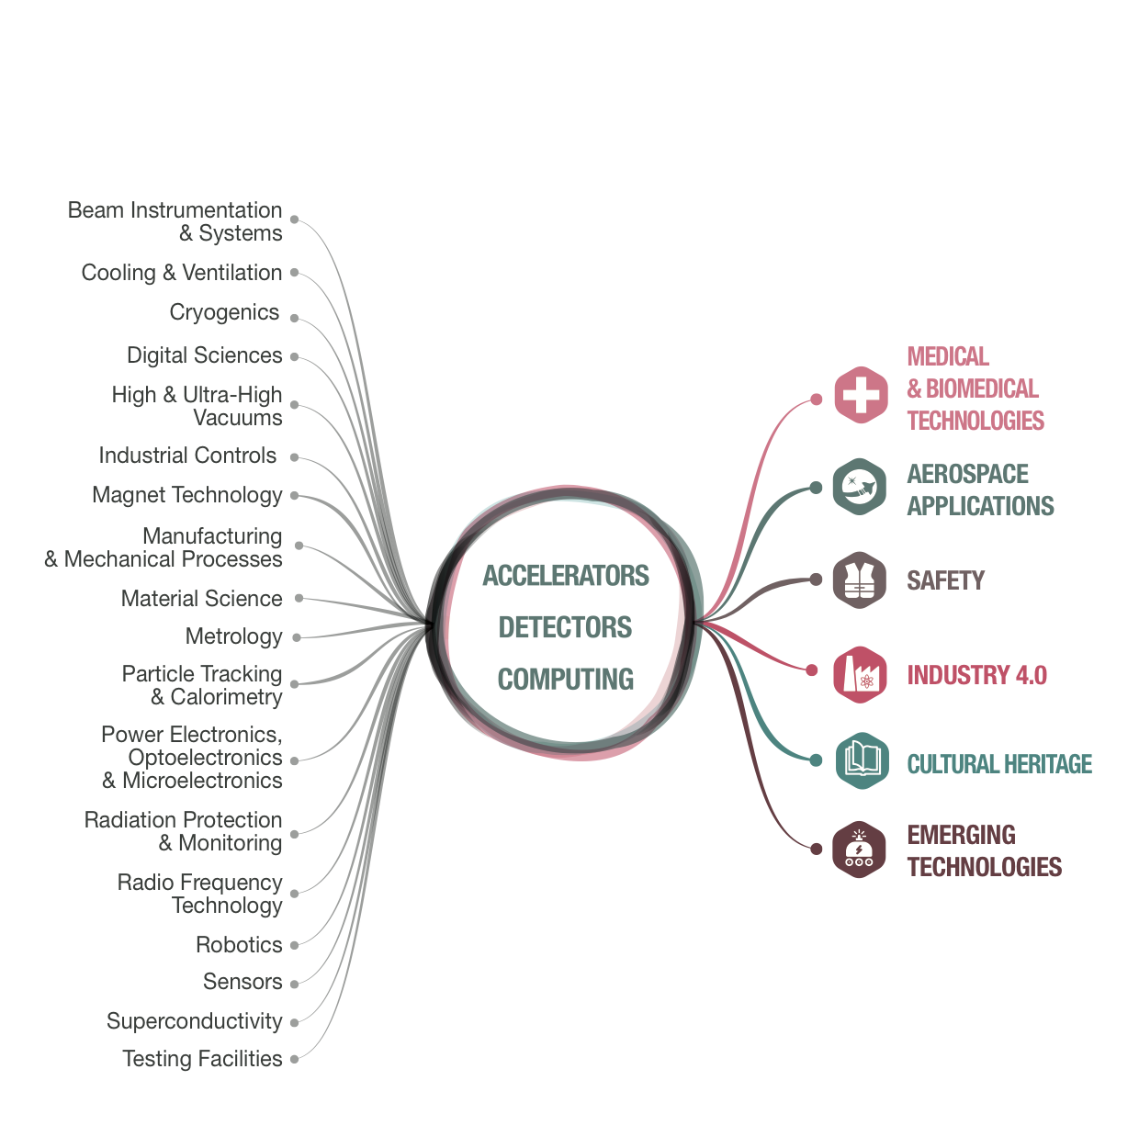
From CERN Technologies …
… to Society

