Slide 1

Sigma2s National e-Infrastructure for Research
Maria Francesca Iozzi, PhD, UNINETT/Sigma2

Slide 2
Agenda
About UNINETT Sigma2
Sigma2 e-Infrastructure Services:
      DMP
      Storage
      HPC and Data driven Computing
      Archiving
A future scenario for the Data Management?

Slide 3
National e-infrastructure - a very brief history
From the beginning, it was always recognized that e-infrastructure, just like other research infrastructure, should be shared.
Early on, research institutions competed for basically the same funding and established disconnected e-infrastructure resources.
In the early 2000’s, the need for coordination and sharing lead to the establishment of UNINETT Sigma and the Metacenter. Universities still competed for the same funding and had their own hardware resources, no common strategy.
In December 2014, the 4 major universities (UiB, UiO, UiT, NTNU) and the Research Council of Norway (RCN) decided to establish UNINETT Sigma2 and collectively operate the national e-infrastructure.

Slide 4
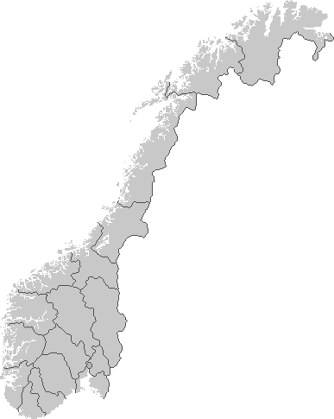






100G
Research & Education Network
10G
100G
100G

Slide 5
The Metacenter
National coordination and shared, consolidated resources have cost and efficiency advantages but creates a “distance” to the end-users (researchers)
This is countered by keeping the support staff and competence near where the research is going on, at the universities
Combined with a data-centric architecture for the e-infrastructure, this model combines the advantages of the centralized model and the local model

Slide 6
Who provides what?

Slide 7
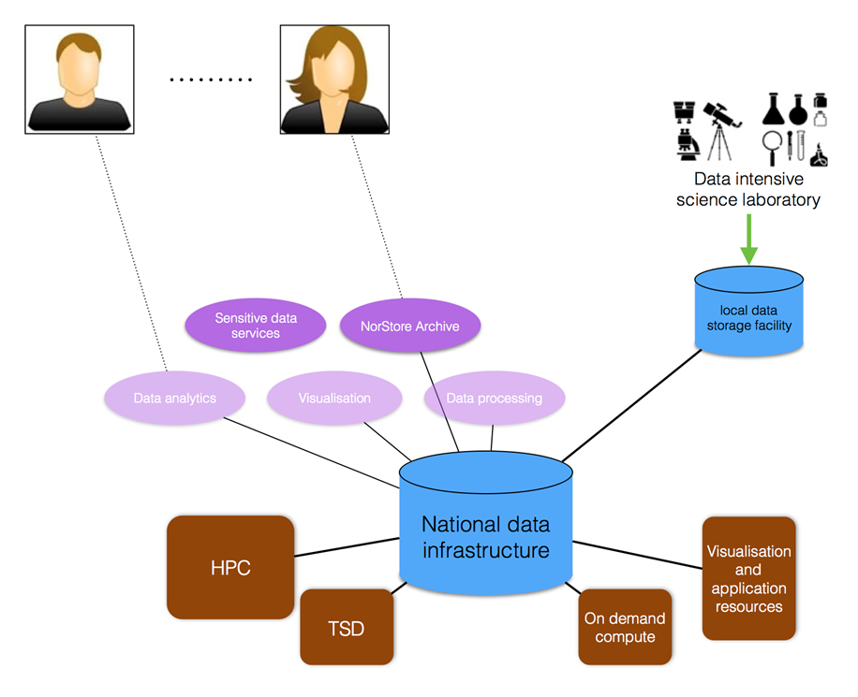
Data-centric architecture
Notes:
Brukeren har fokus. Bruker skal slippe å forholde seg til ulike datalager. Tjenestene er fokusert rundt datalageret

Slide 8
Sigma2 e-infrastructure services
The NIRD - National Infrastructure for Research Data - A complete and FAIR eco-system for research data
3
Data Processing
2
Data Collecting
Research Data
1
Data Planning
4
Data Archiving

Slide 9
Data Planning: easyDMP
3
Data Processing
2
Data Collecting
Research Data
1
Data Planning
4
Data Archiving

Slide 10
Motivation for easyDMP
Data management guidelines, are by definition not specific.
Researchers need help understanding and implementing the guidelines.
There was a need for a tool that breaks down the guidelines and support institutional/community specific guidelines
At the same time the tool can fulfil a self-learning role.

Slide 11
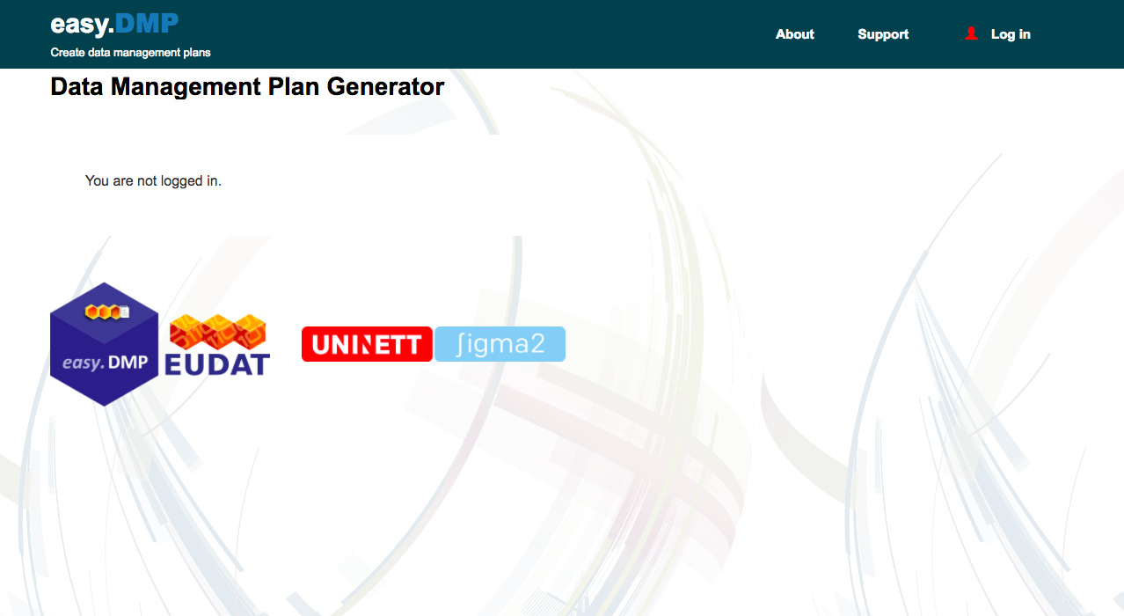
easyDMP
Developed in Collaboration with EUDAT2020
Implements Horizon2020 recommendations
Templates can be tailored to institutional needs
Runs on NIRD Service Platform
In production since April ‘18
https://easydmp.sigma2.no
11
Notes:
11

Slide 12
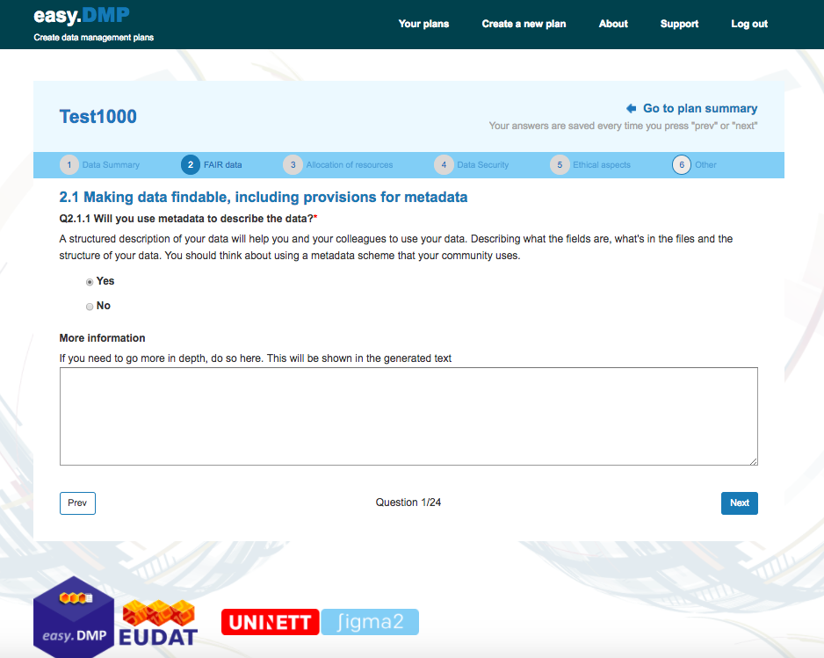
12
Notes:
12

Slide 13
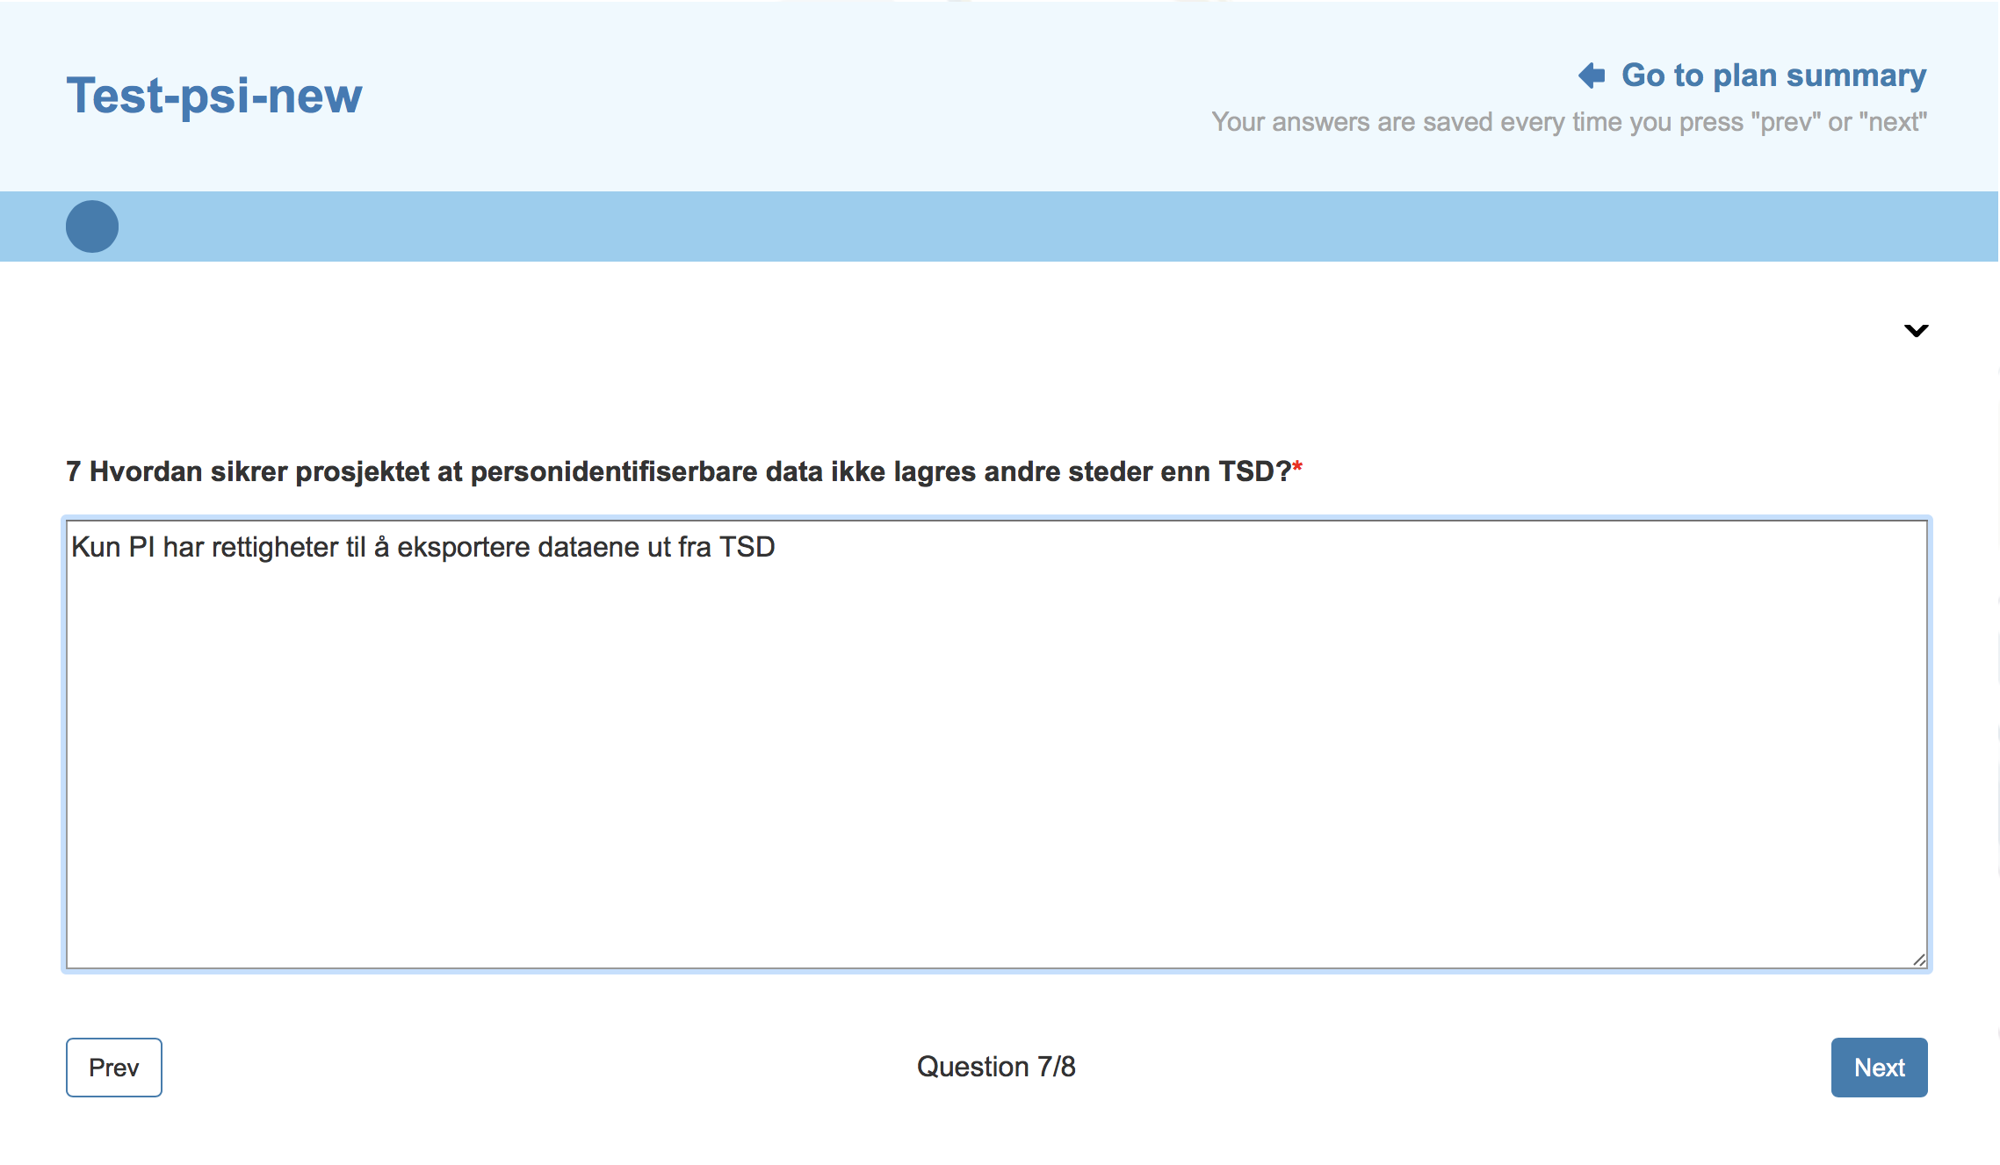
DMP Institutional Templates (II)
DMP Institutional Templates (II)
Shorter/simpler questionnaire with pre-filled answers.

Slide 14
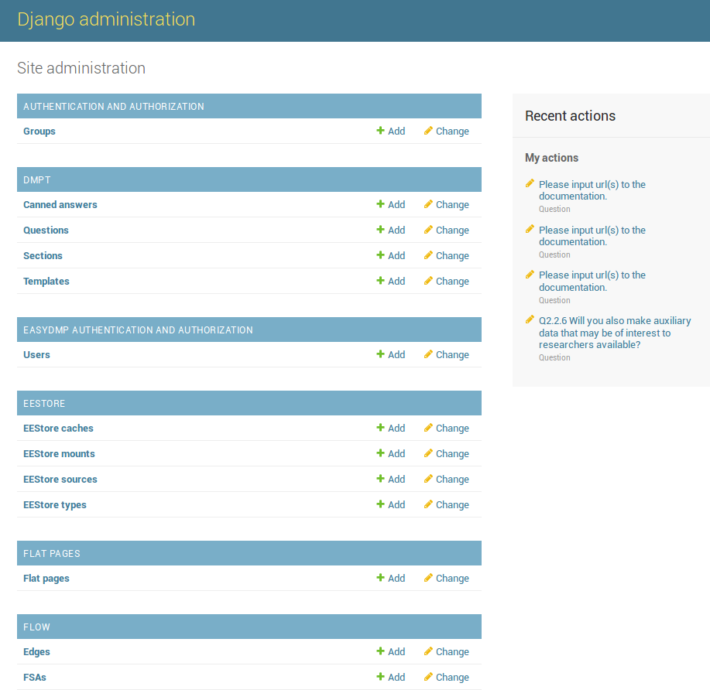
Customized DMP Templates
There is an admin interface that allows admins to create new templates
or update existing templates.

Slide 15

- The Norwegian Research Council has adopted the Science Europe Template –
- The template will be soon available in easyDMP

Slide 16
Data Collection: Project Storage
3
Data Processing
2
Data Collecting
Research Data
1
Data Planning
4
Data Archiving

Slide 17
NIRD Storage
 | Capacity | Allocated | Usage
NIRD (09.2017) | 4807 | 5602 | 4403
NIRD (10.2018) | +/- 7400 | +/- 8200
NIRD (03.2019) | +/- 9200 | ?
All storage is disk-based with object storage interface (OpenStack Swift, S3)
Geo-replication (async) + snapshots (daily)
Storage divided into various areas covering data lifecycle: Project working area, data archive and backups
M. F. Iozzi
17

Slide 18
NIRD Storage - Trends

Slide 19
Data Processing
3
Data Processing
2
Data Collecting
Research Data
1
Data Planning
4
Data Archiving

Slide 20
Computing Services - Overview
Ongoing transition
HPC-systems
Cloud-systems
Storage infrastructure
Vilje
(NTNU)
Hexagon
(UiB)
Abel
(UiO)
Stallo
(UiT)
NorStore
(UiO)
TSD «Colossous»
(UiO)
Kubernetes based infrastructure
Fram /A1
(Tromsø)
B1, C1
(Trondheim)
NIRD SP
(Tromsø)
NIRD SP
(Trondheim)
NIRD
(data-centric
arcitechture)
Upgraded
TSD
Oct. 2017
2019
2018
Apr. 2019
Jul. 2017, later expansions

Slide 21
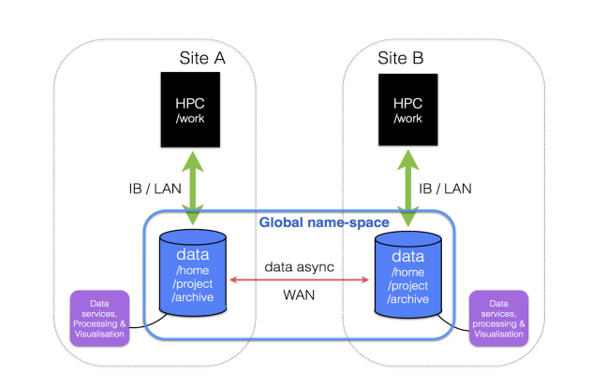
Distributed data centre model

Slide 22
Status and plans HPC
User support
  User support is transitioned from a 4-site support model to a common contact point at support@metacenter.no
Current hardware
  Currently the load is serviced by Fram, Abel and Stallo and Vilje (2018.x)
  Abel and Stallo will be in production until replaced with new systems B1/C1 in 2019
  Currently accelerators are GPUs and Xeon Phis on Abel, GPU’s on the NIRD Service Platform

Slide 23
High Performance Computing (HPC) resources
System | 2018.2 capacity [MCPUh] | RFK Allocation (2018-09-13) | Deployed
Abel | 38.0 | 35.6 | 10/2012
Stallo | 59.8 | 56.6 | 10/2012 + ext.
Fram | 129.2 | 123.0 | 11/2017
Vilje | 98.1 | 97.1 | 10/2012
Sum* | 325.1 | 312.3 | (96%)
B1 | ? |  | (2019)
Saga | ? |  | (2019)
HTC** platform | ? |  | (2018)
(*) Not including approx. 11M from late applications
(**) HTC = High Throughput Computing / cloud platform

Slide 24
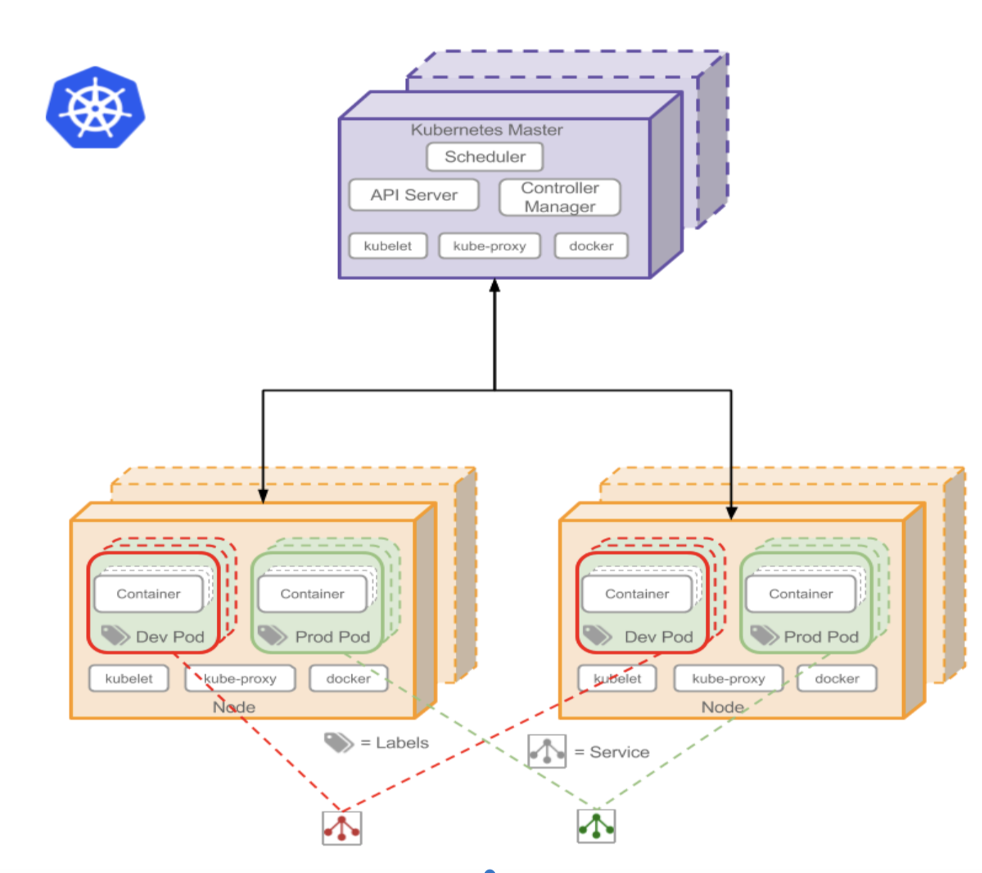
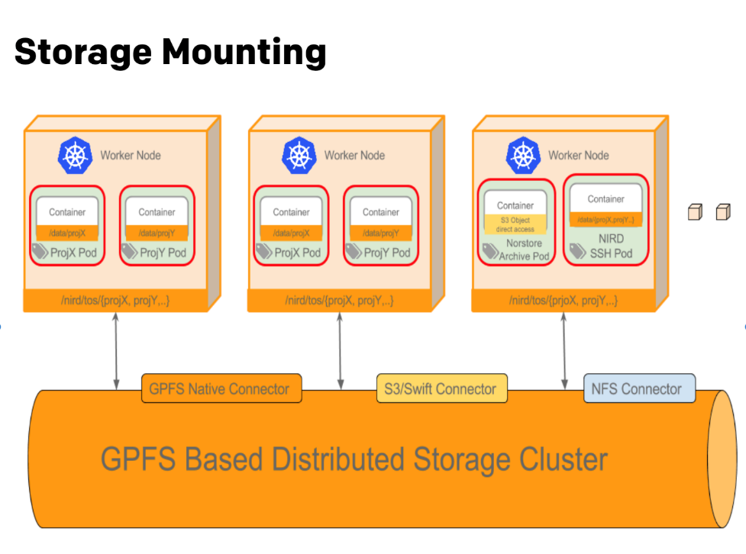
Data Processing: NIRD Service Platform
A kubernetes-platform running on computing nodes that mount the GPFS distributed storage. Services run into docker containers.

Slide 25
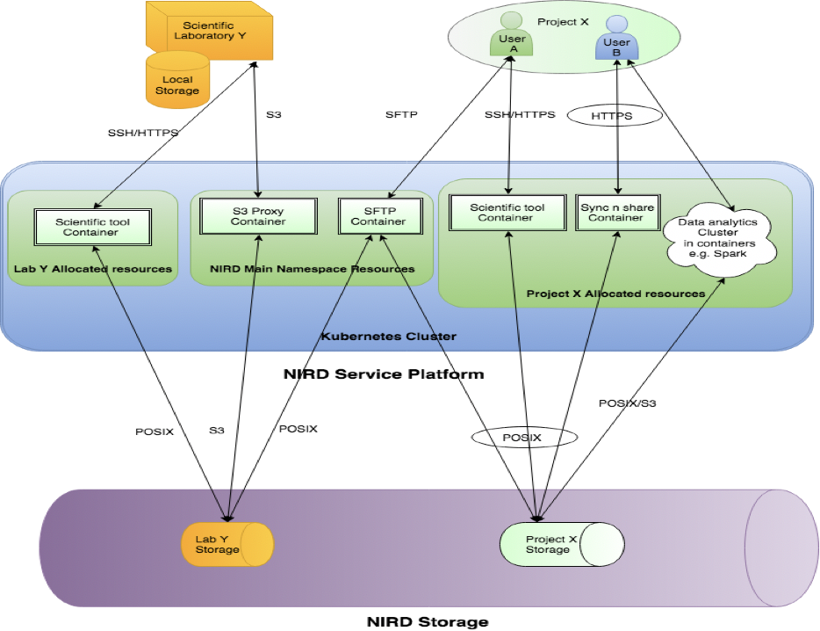
NIRD Service Platform

Slide 26
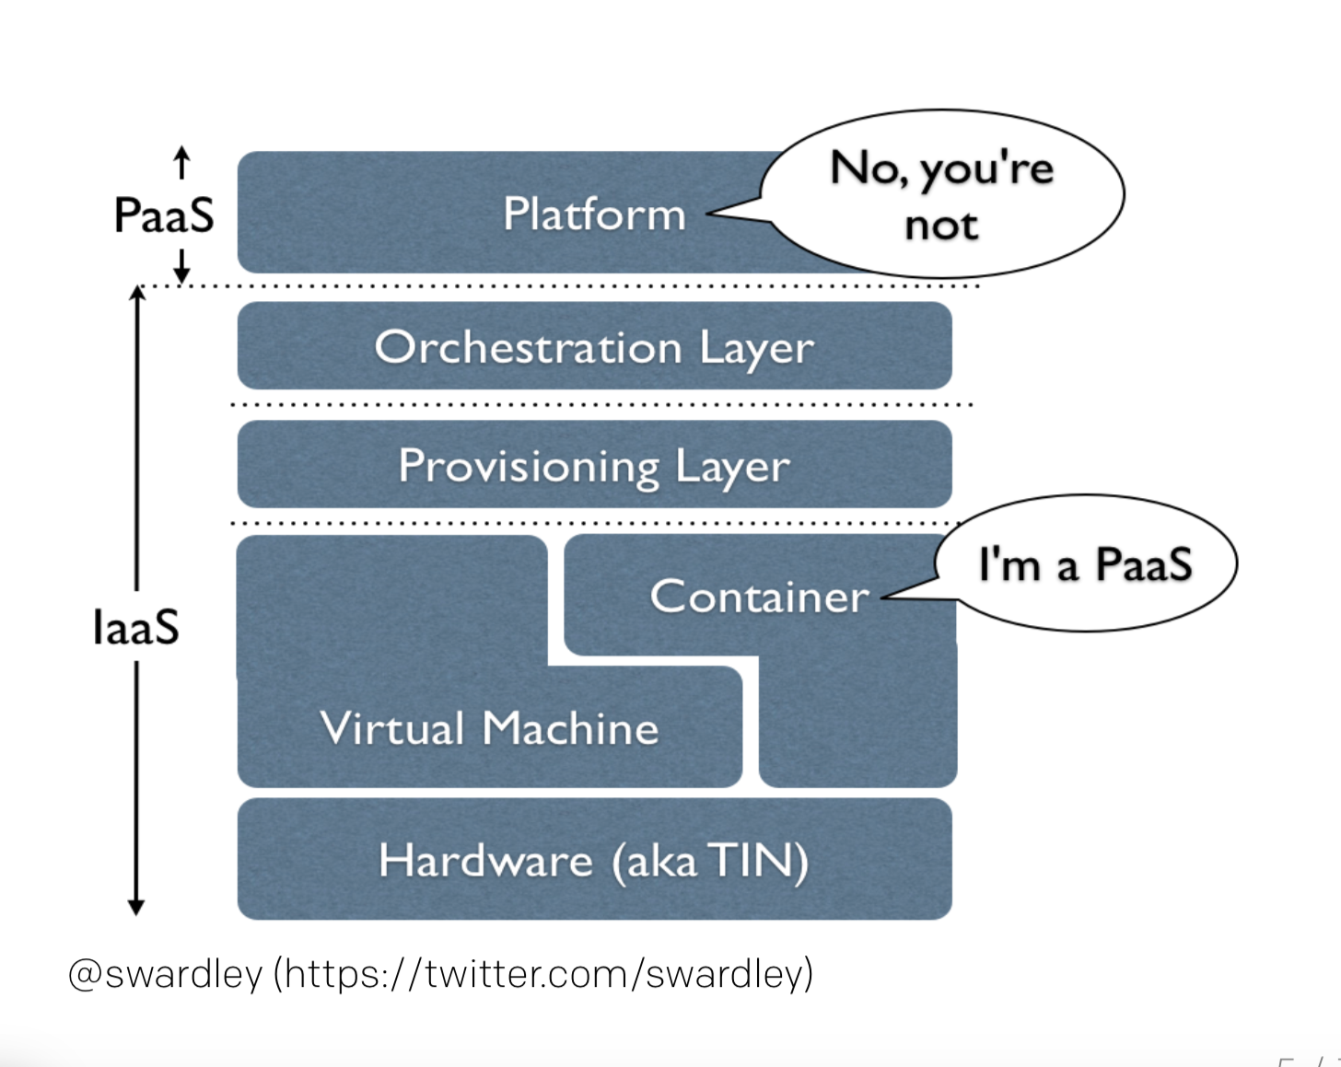
PaaS or NOT.PaaS?
A PaaS needs a resorse manager!

Slide 27
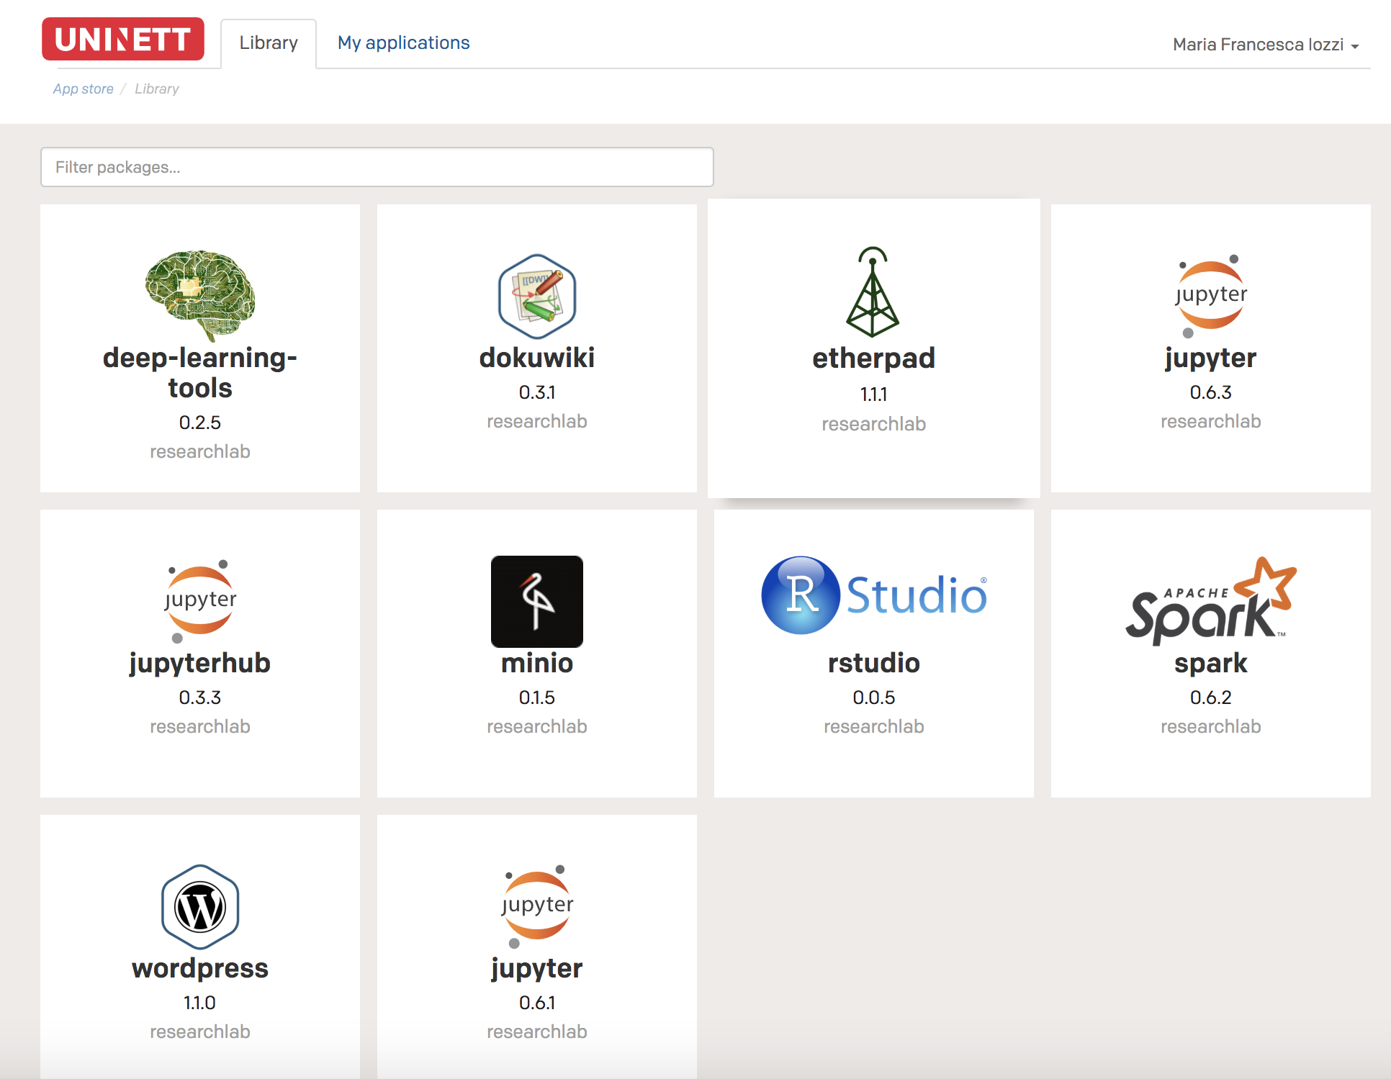
NIRD Toolbox
“NIRD Toolbox” launched by end of Oct 2018.

Slide 28

Services for sensitive research data
In early 2018, Sigma2 and UiO/USIT has signed a contract to make the TSD part of the national e-infrastructure
As a result of this contract, the uptake of the TSD will be facilitate for the projects that:
  Need HPC compute resources
  Need 10 TB or more storage capacity
The costs associated with this services will be then lowered if allocated through Sigma2
The application process will be the same as for the other services in the SIgma2’s infrastructure
Notes:
Inn her eller egen presentasjon?

Slide 29
Data Archiving: Research Data Archive
3
Data Processing
2
Data Collecting
Research Data
1
Data Planning
4
Data Archiving

Slide 30
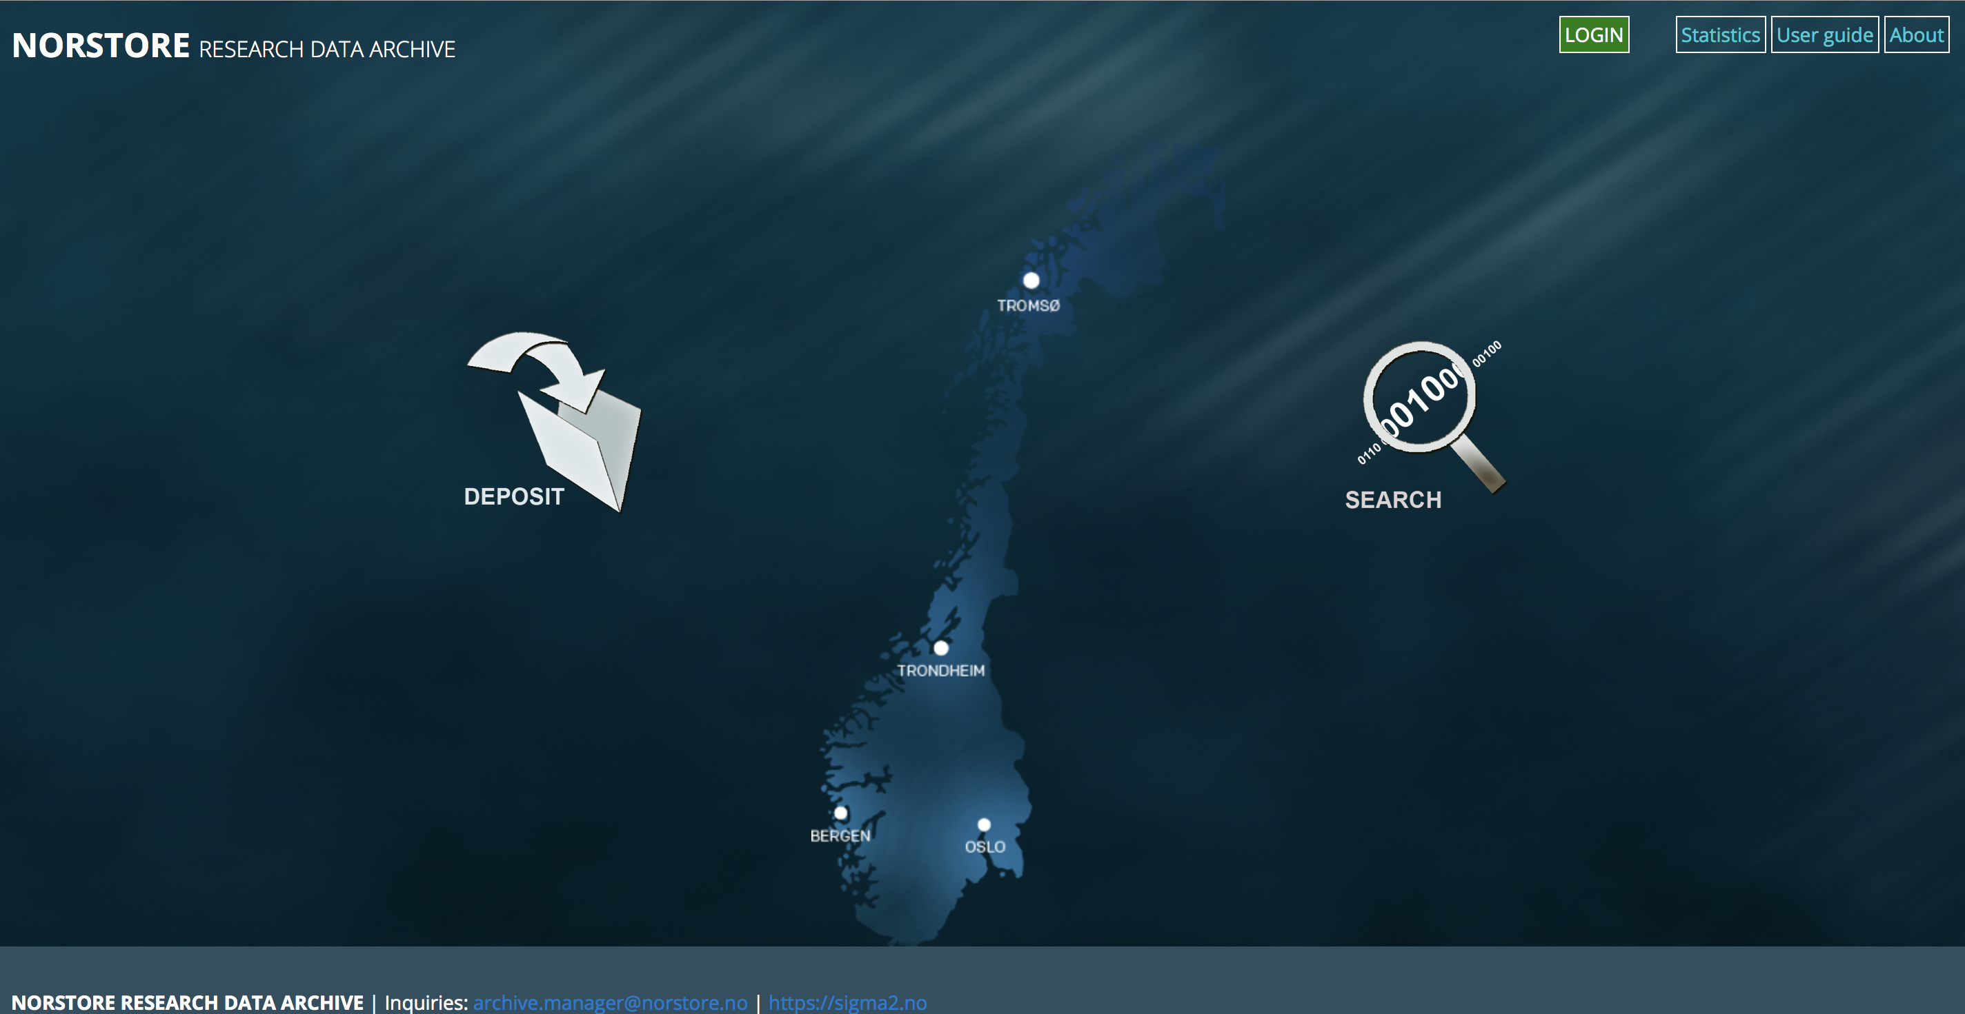
NIRD Archive
  Using the Dublin-core standard for metadata
  DOI-Metadata association
  Support OAI‐PMH (machine readable metadata harvesting)
  Graphical user interface for metadata search

Slide 31

Metadata – essence for research data
A must-have for credible research data
nometadata.org

Slide 32
Data Management - National Collaborations
Starting a tighter collaboration with NSD to develop a national DMP Tool
A national reference group for DMP tool soon established
Proposal for a Norwegian RDA node under developpement – will be sent in April 2019 → Forum for user driven discussion on data management

Slide 33
Data Management - Nordics Collaborations
EOSC Nordic project granted by the EOSCINFRA-05, starting in May-Aug 2019:
Circa 6Meuro over 3 years – All Nordics countries involved
Sigma2 leading WP5 (2MEuro) – ”Nordics Demonstrators”
T5.3 about Nordic distributed data management workflows
Actionable DMP tool (Collaboration with GoFAIR)

Slide 34
Currently …
Archive
Data
Storage
Computing
EasyDMP
Metadata
Storage
Plan
Current Situation:
Plan is isolated from process

Slide 35
A possible future scenario?
CristIN
Archive
Data
Storage
Archive
Data
Storage
Archive
Data
Storage
OrcID
Archive
Data
Storage
Archive
Data
Storage
easyDMP
Computing
Computing
EasyDMP
Metadata
Storage
Plan
Metadata
Storage
Plan
Current Situation:
Plan is isolated from process
Future Situation:
Plan is an integral part of the process

