Slide 1
European Spallation Source
Top level requirements for the vacuum system of the Dump Line
Fabio Ravelli, Marcelo Juni Ferreira
STS-Vacuum Group
European Spallation Source ERIC
2018.11.07

Slide 2
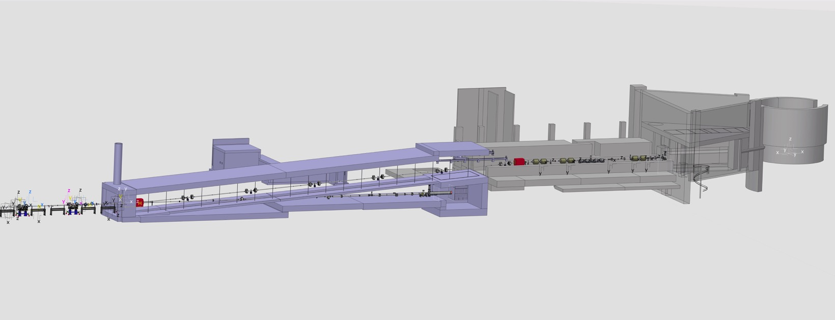
A2T Systems:
DogLeg, DumpLine, A2T

Slide 3
Vacuum Lay Out DumpLine
Vacuum Pressure Requirement for the DPL:
Operating vacuum pressure shall be <1e-7 mbar after 100hr from venting with dry N2
Leak rate of the individual component better than 1e-10 mbar l /sec water and
hydrogen dominated, organic less than 1% of the total pressure

Slide 4
The Dump Image System
Three identical vessels to host the scintillating screens and vertical actuators, only two fully equipped at commissioning
Built following the guidance contained in the ESS Vacuum Handbook
All metal construction for HV and, more important, for radiation hardness
Provide for some quick disconnect method to shorten hands on maintenance time

Slide 5
Choice of the DN250 vessel flanges
DN250 CF, the downstream component has the subsequent downstream flange in QCF from MKT
Half moon DN 250CF flange
DN250 Quick CF from MKT
DN250 CF, the view port has
brazed glass to metal transition
DN250 CF

Slide 6
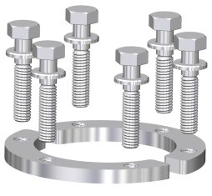
Half moon bolt ring, example in DN63 CF
Allows for quick dismounting from the top
Rotatable flange
Proven system
An electric drill can be used
Lighter than the chain system
Suggested by Ralf Huber

Slide 7
Q&A
Thanks!

