Slide 1


ESS Tuning Dump Imaging System
Input to the Vacuum Vessel CDR
Prof. Erik Adli
Department of Physics, University of Oslo, Norway
Cockcroft Institute, November 6, 2018

Slide 2
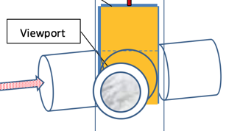
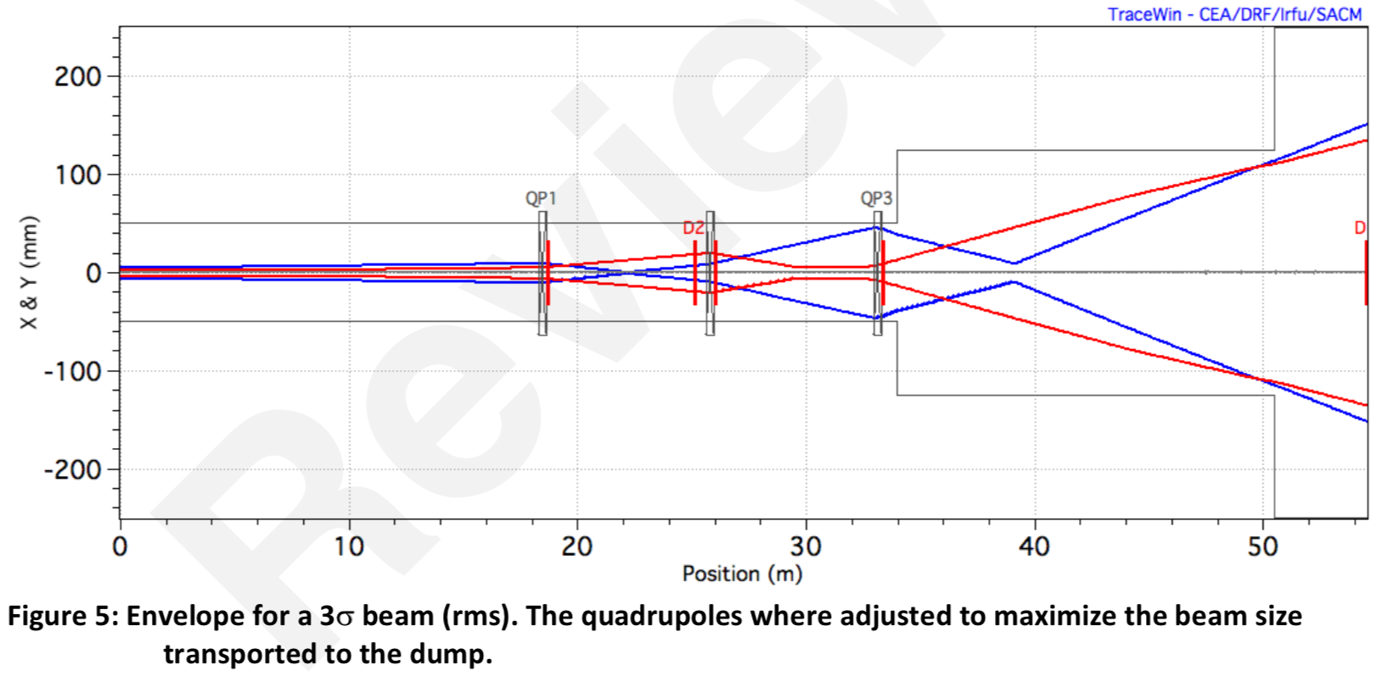
Some overall requirements of Im. Sys.
For the tuning dump, the overall limit is the 12kW.
Full pulse are allowed a low frequency to stay below the 12kW limit overall (around 1 pulse/30 sec).
If we send one full pulse we will be quite sure that the transversal optics is accurate so the beam size will be close to the nominal design.
Although the nominal beam size is not larger than 1x1 mm² at the dump, during beam tune up, the dump line optics allows for very large beam sizes at the dump and at the imaging systems.
250 mm
Imaging systems, including optical system and screen designed to maximalize FOV in the beam plane, while at the same providing a resolution of sub. 1 mm.
Key challenges for system related to:
large screens, long travel
large FOV
radiation environment
ESS-0191105
Beam Size Range on the Dump During Transverse Tuning

Slide 3
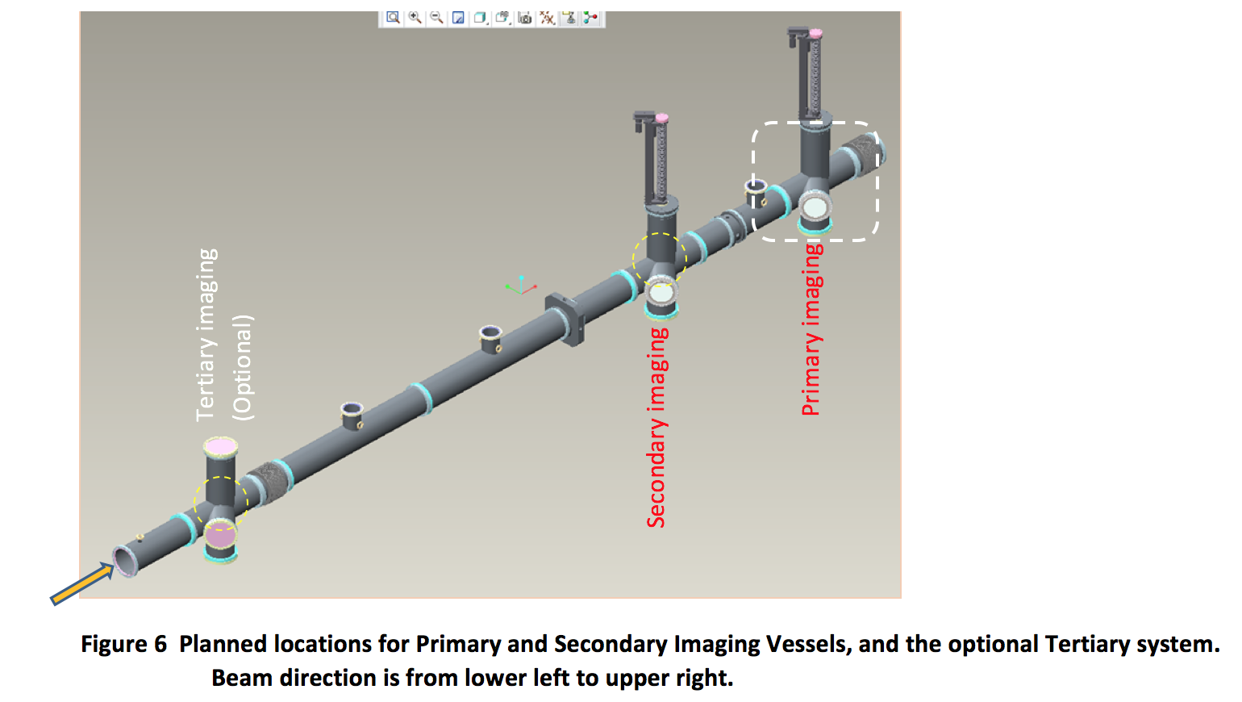
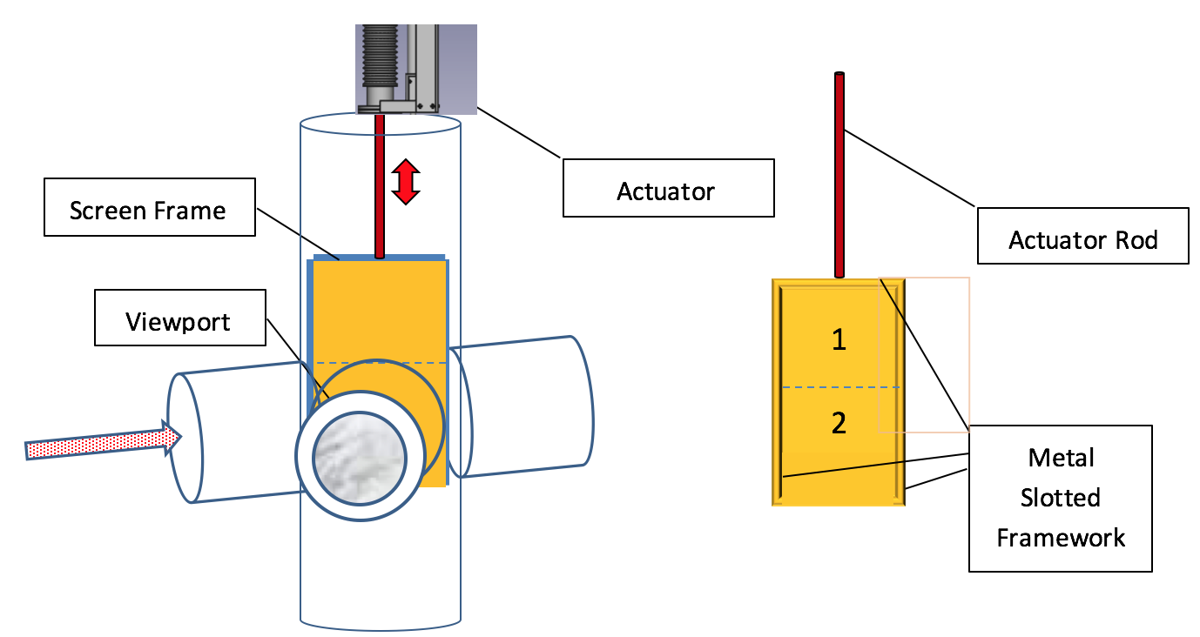
Two imaging systems
Two imaging systems are required to measure both spot size and divergence.
A third imaging system was discussed, but will not be installed due to cost.
Each imaging system will be equipped with two screens. The two screens gives redundancy, or, the possibility to test different materials/coatings (test beam for target coatings).
(details in talks from
Mark and Grey)

Slide 4
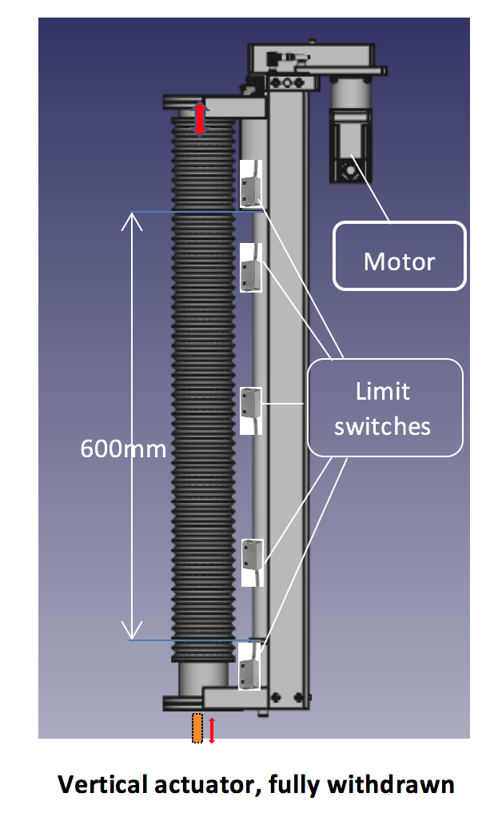
Interfaces imaging system and vacuum vessel
The imaging systems themselves passed their CDR in Oslo, 25-27 October 2017, with update to simplified system ESS-0331227.
Interfaces to vacuum vessel was not discussed at this time, but was discussed later at a meeting at Daresbury March 2018, and around the vacuum vessel PDR in August 2018.
Gray zones and interfaces (know from the PDR and previously) seems to have been sorted out by now :
The main mechanical interface imaging system and vacuum is the linear actuator. The actuator has been chosen in agreement with ESS, STFC and Oslo, and will be procured and integrated by STFC.
The screen holders, screens, motor control will be provided by Oslo.

Slide 5
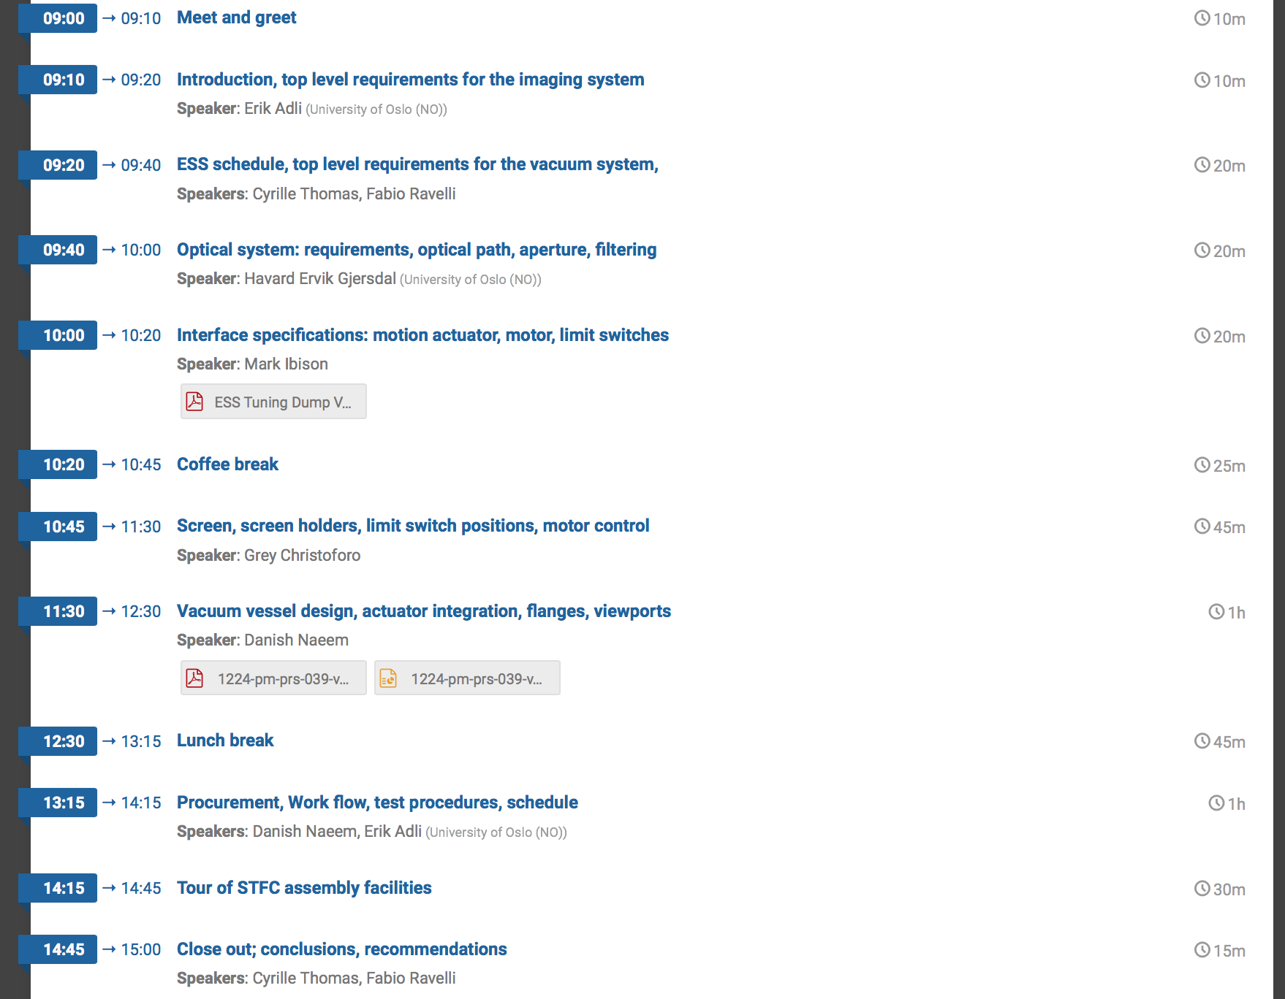
Agenda
Present all interfacing systems to the vacuum vessel
Present vacuum vessel design
Way forward

