Slide 1
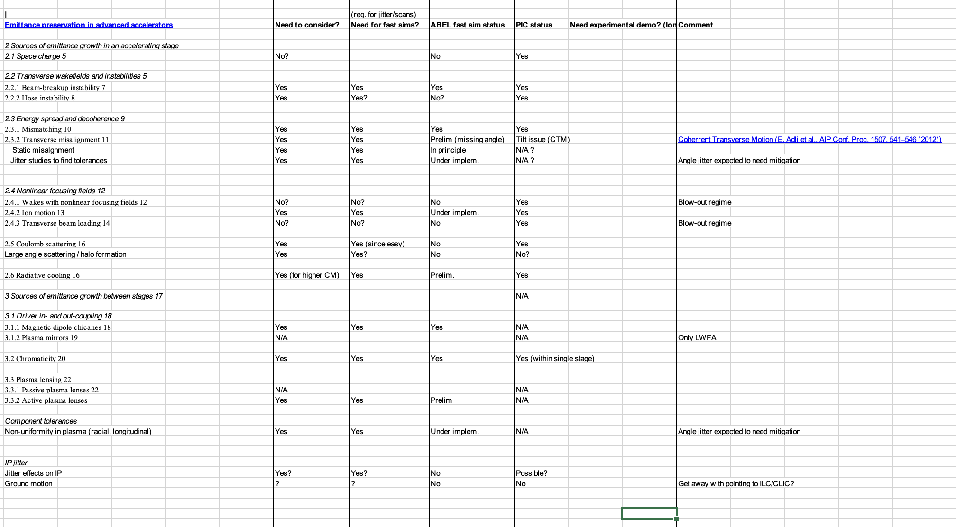
Sources of emittance growth in plasma linacs, and status of start-to-end simulations.
HALHF workshop: summary of sessions Q6

Slide 2
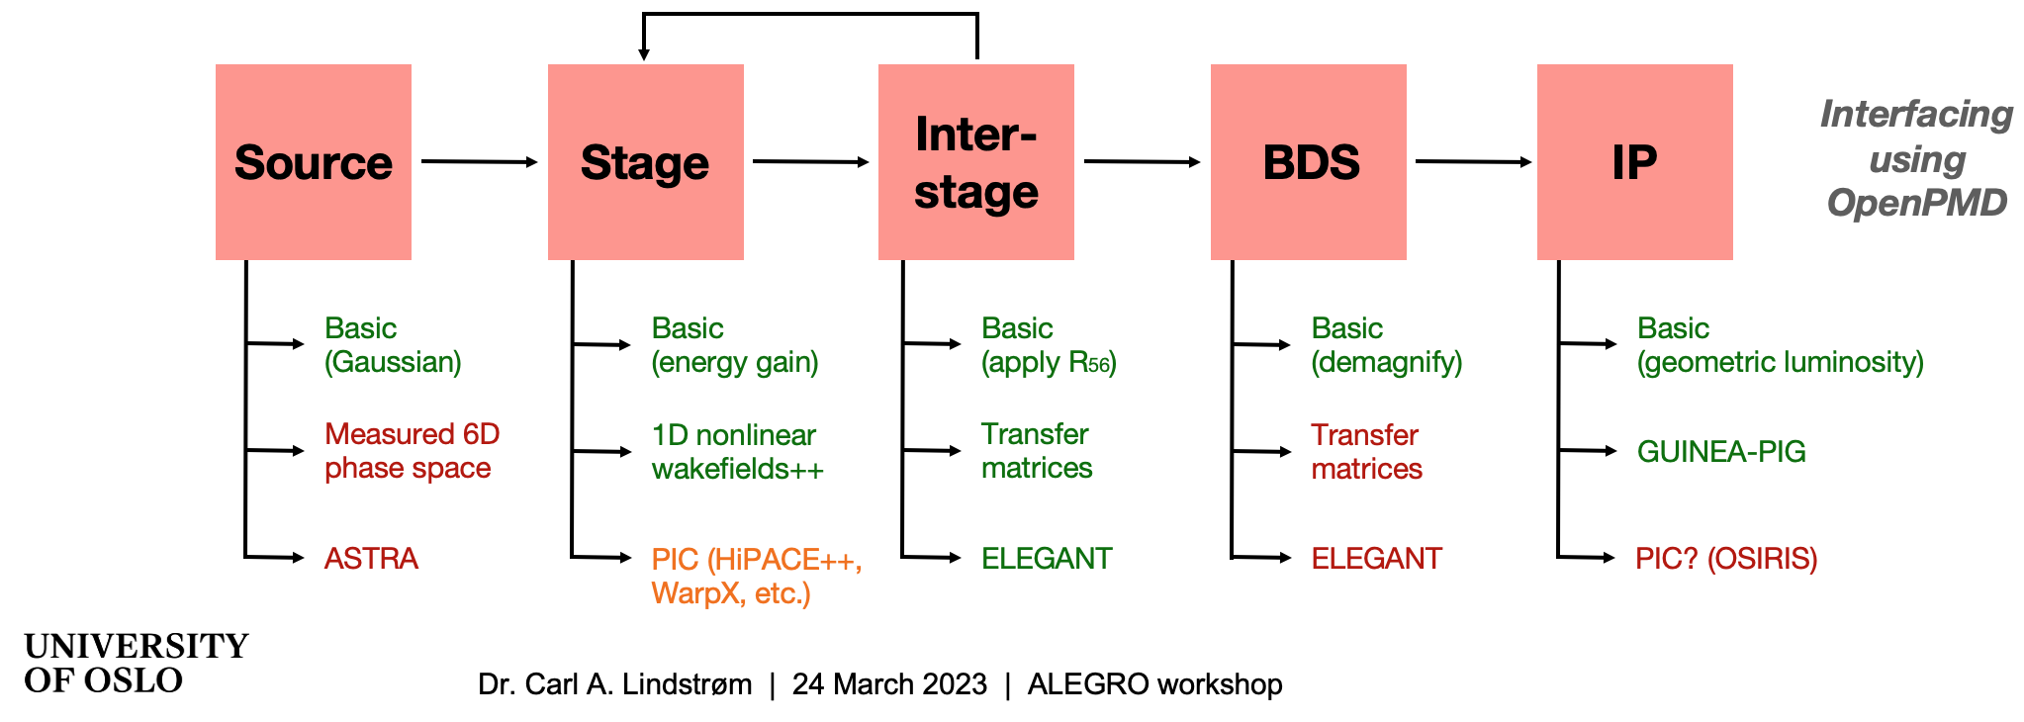
Multi-stage effects
Examples: instabilities build-up along the linac, total effect of different jitter on luminosity
ABEL: framework for integrated simulations, including the dynamics of interstages. Fast parameter-scans requires mixture of tracking, PIC and specialized fast sims.
Examples of multi-stage effects:
Wakefields/transverse instabilities
Radiation reaction
Beam and component jitter
Scattering
Ion motion
Plasma ramps
Spin-transport
...

Slide 3
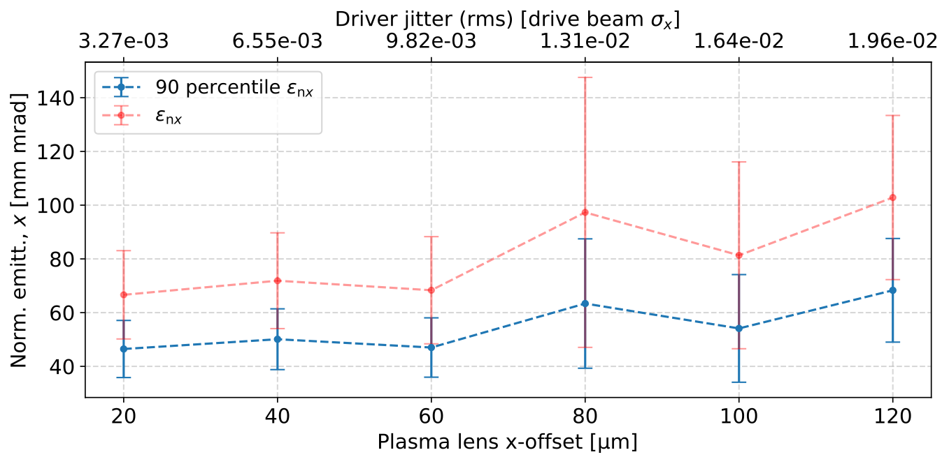
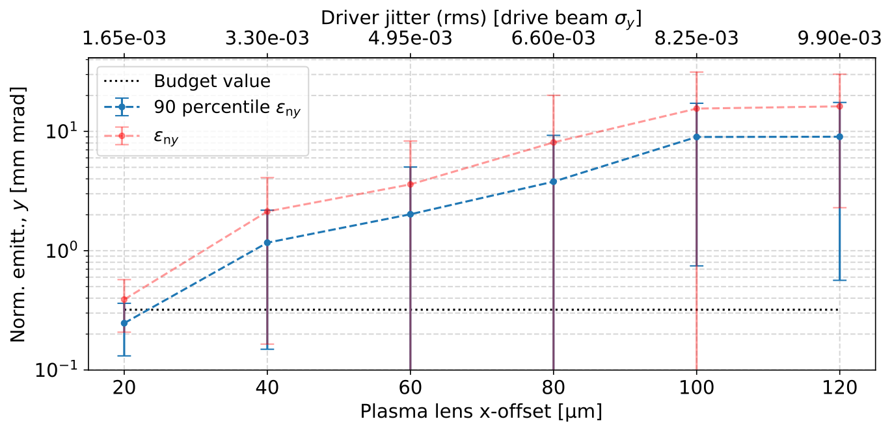
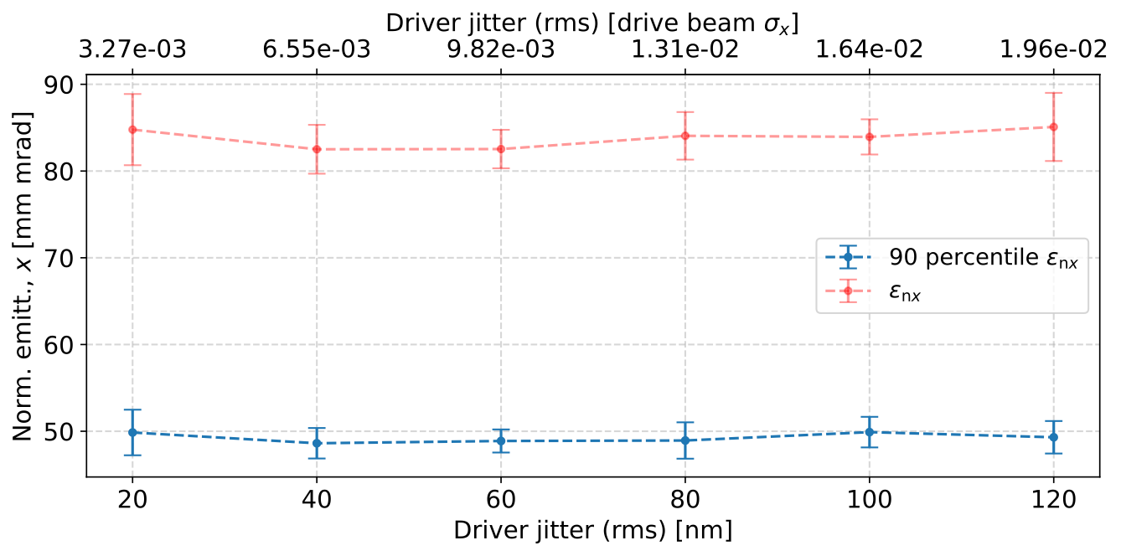
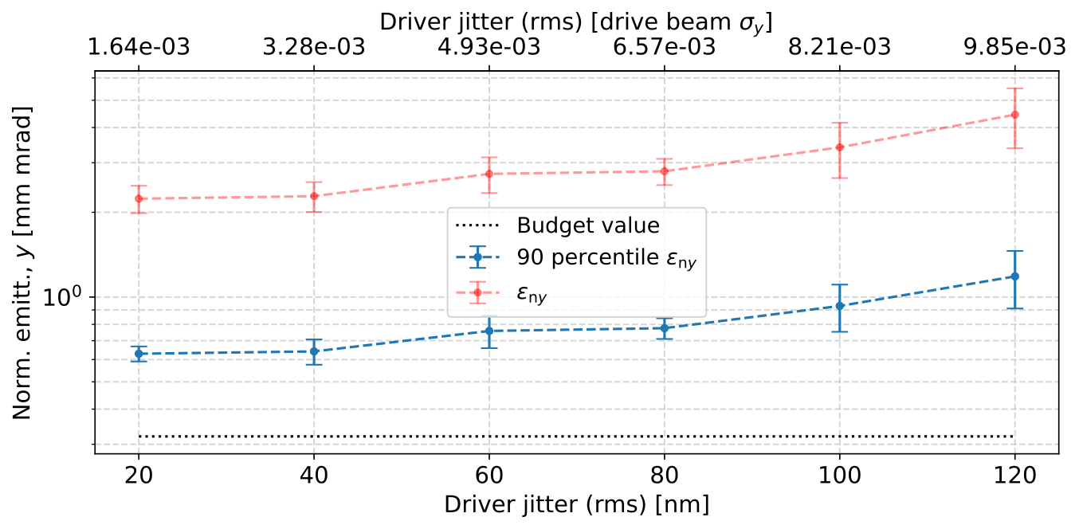
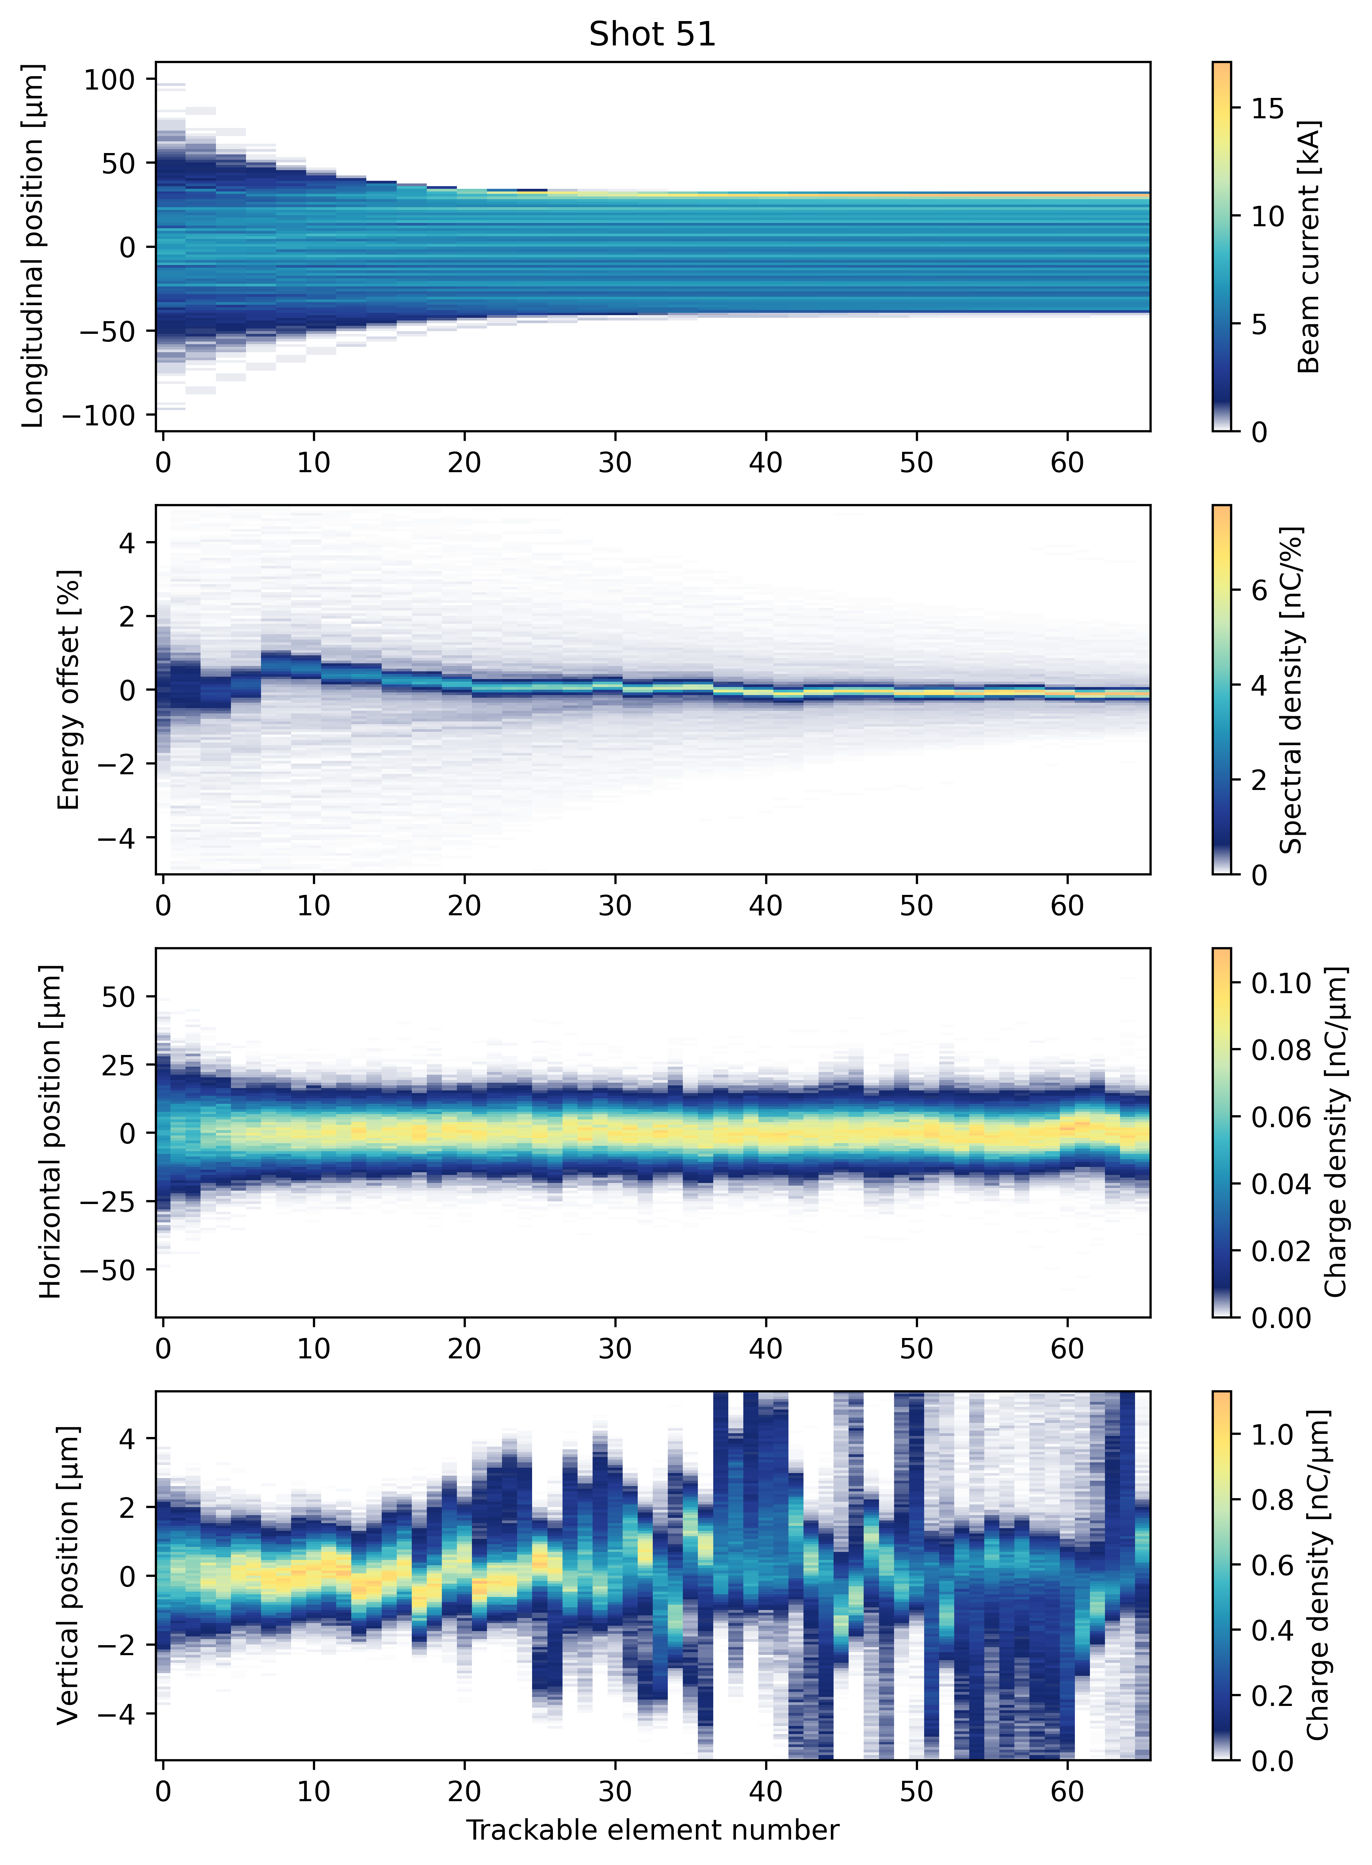
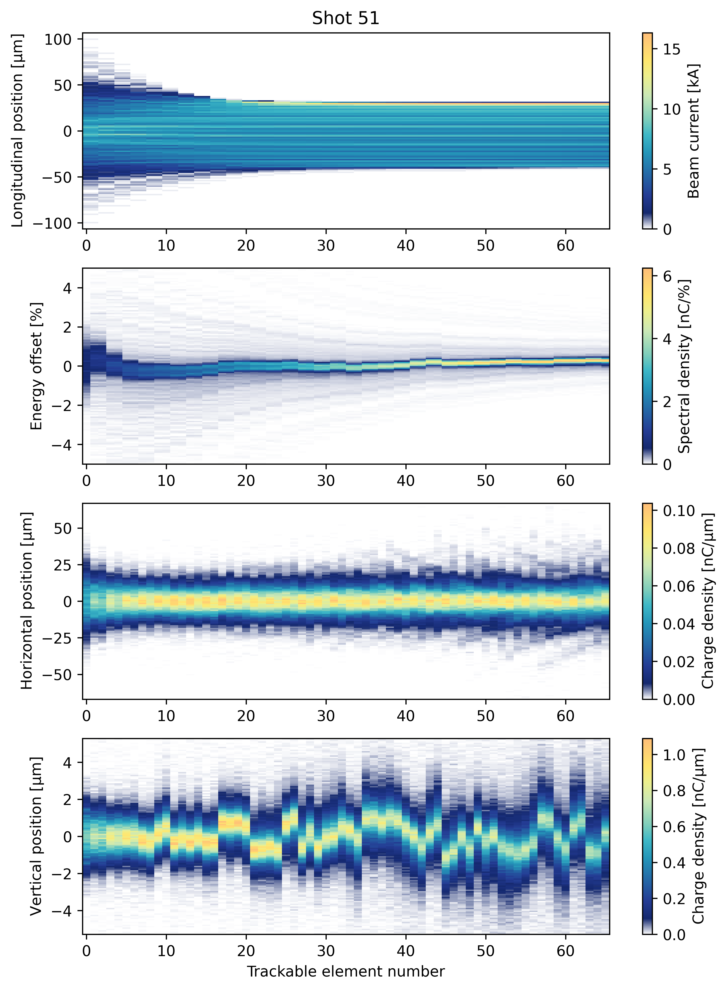
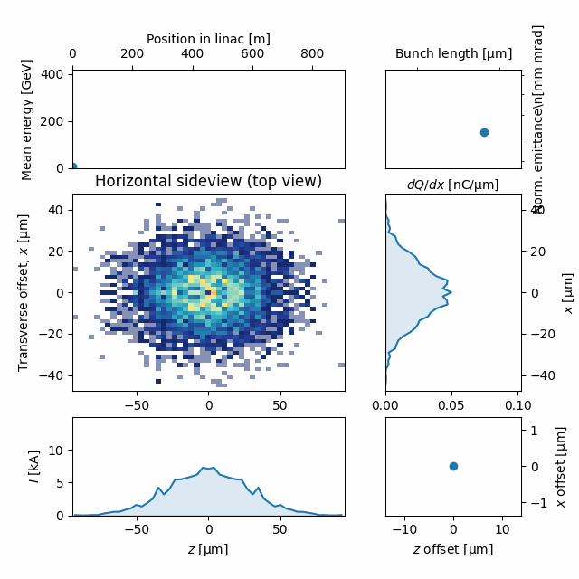
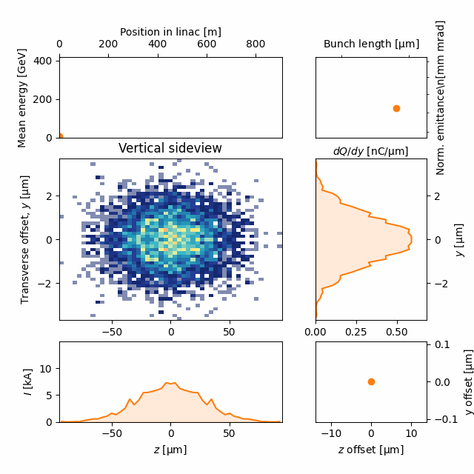
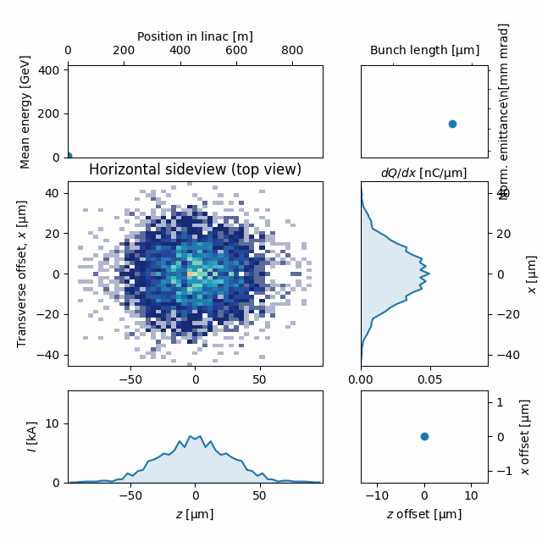
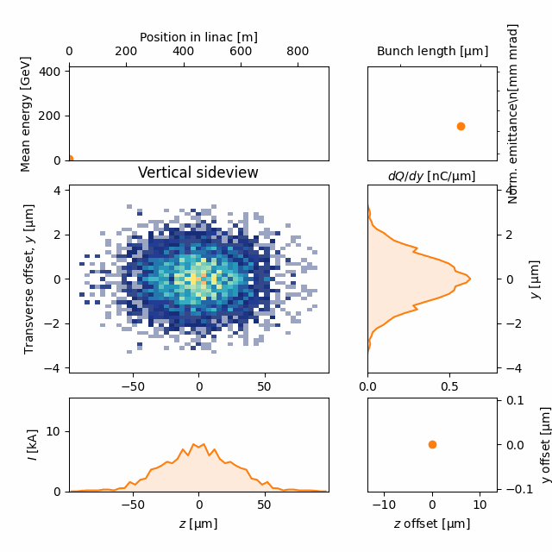

Updated drive beam jitter scan
Initial emittances 15 / 0.1 mm mrad
Transverse wake enabled, ion motion disabled
All physics effect enabled
Ion motion dominates emittance growth. Effectively damps hosing and makes beam resilient to transverse jitter.
120 nm rms jitter
120 nm rms jitter
2024-10-05 | Ben Chen | HALHF Workshop 3-8 October 2024
Page

Slide 4
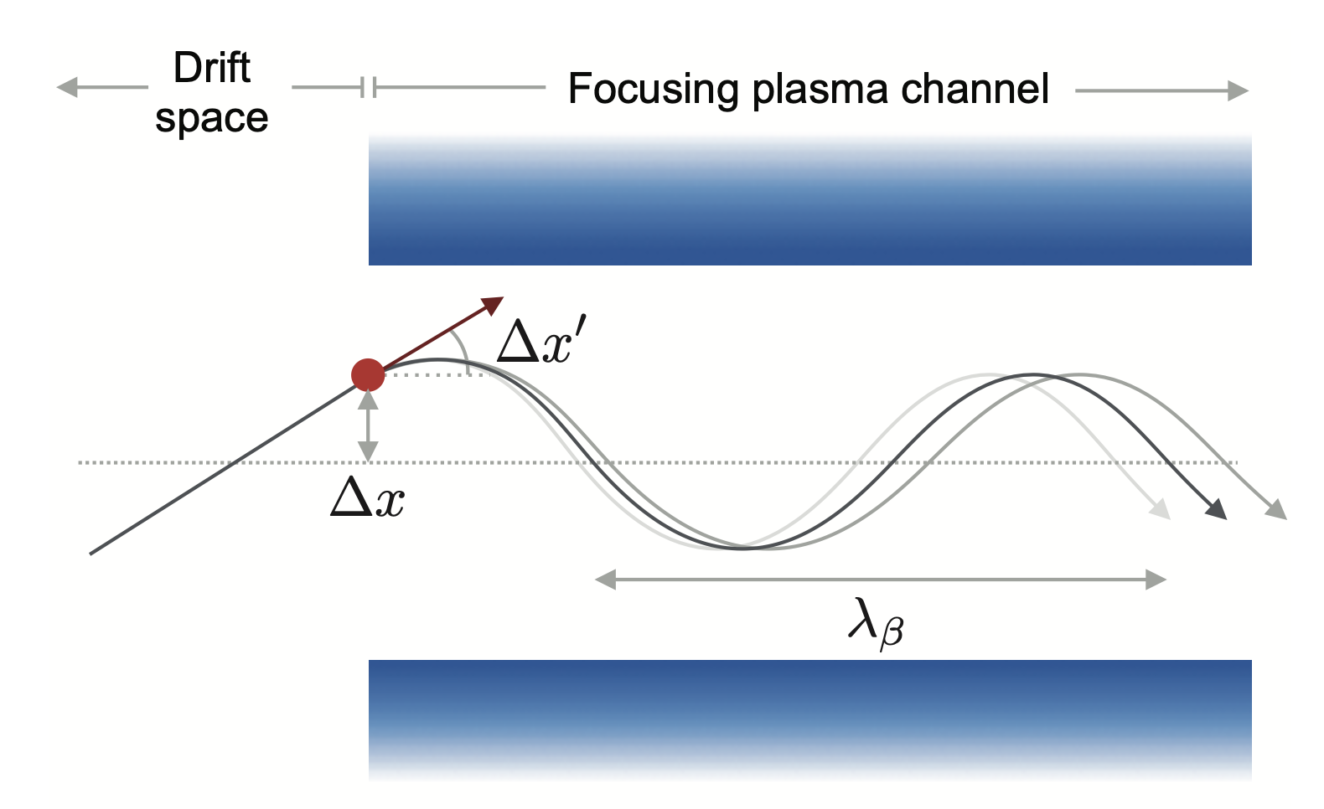
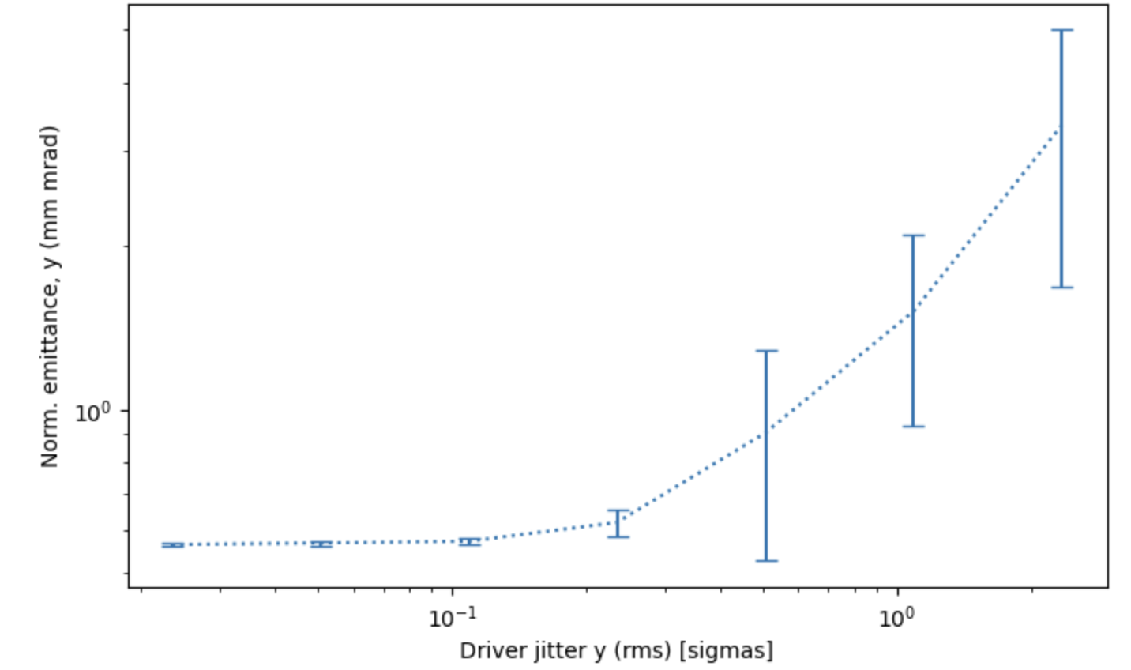
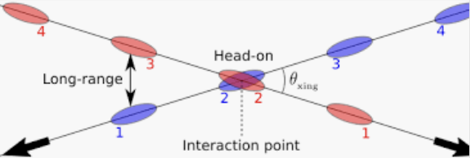
Kicks/IP jitter
Example plot, HALHF linac (StageBasic)
Emittance growth due to ion focusing only

Slide 5
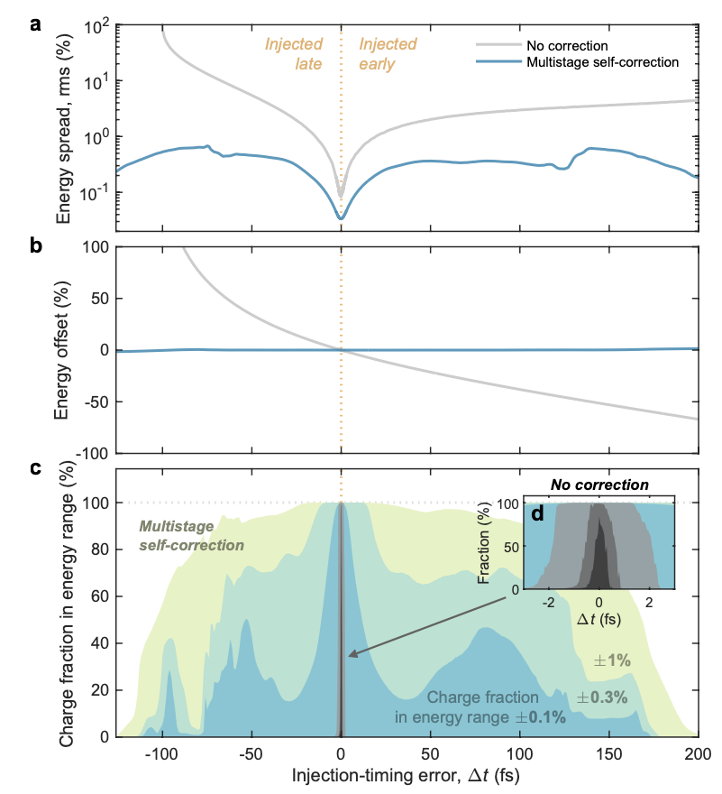
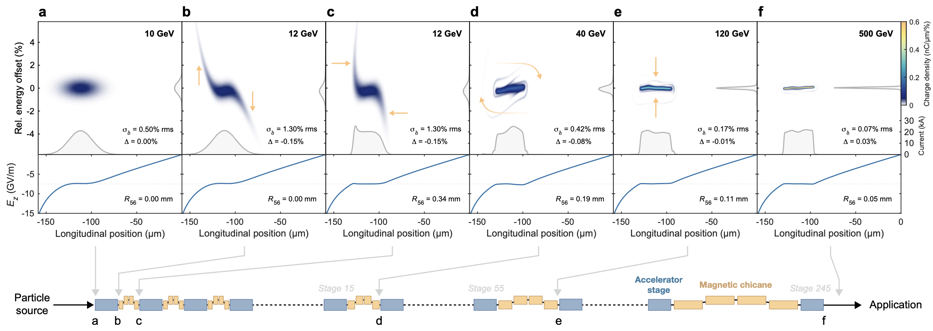
Longitudinal tolerances
Carl A. Lindstrøm, arXiv:2104.14460
Self-correcting longitudinal phase space in a multistage plasma accelerator
Expected to greatly mitigate initial tight phase tolerances.
To be studied: tolerances with full interstage

Slide 6
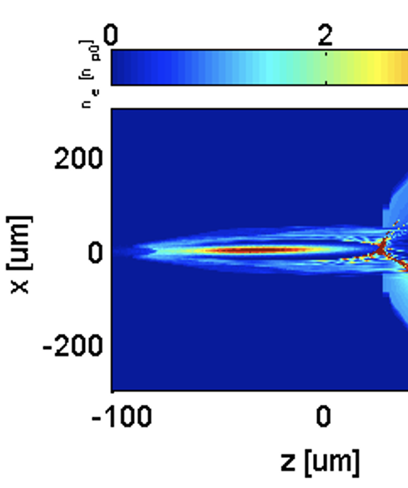
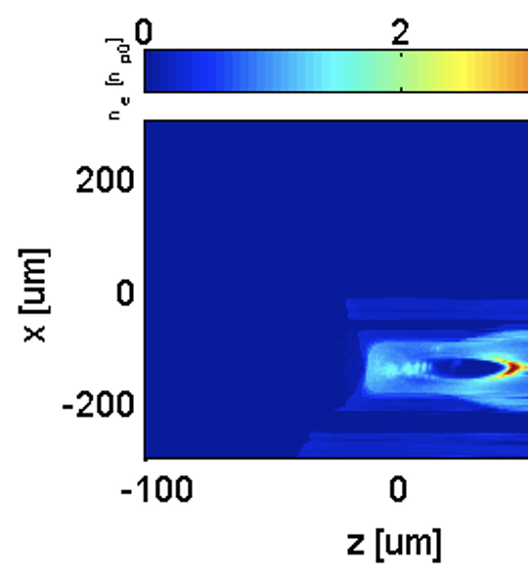
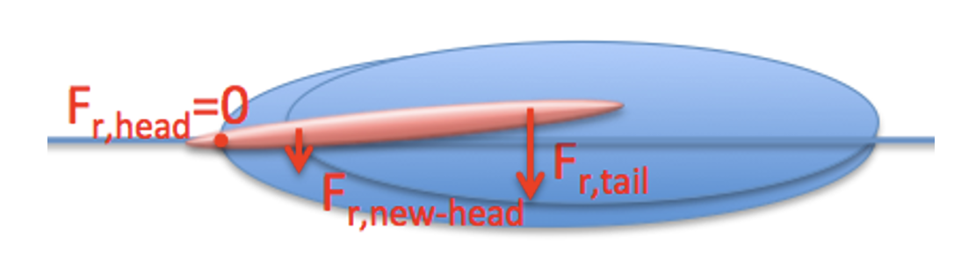
Asymetric drive beams in PIC problematic
A small amount of assymetry in drive beam leads to transverse drift in PIC codes (physical?)
Needs to be solved or better understood
0 cm
40 cm propagation

Slide 7
Experimental demonstration
Ways forward for demonstrating staging and interstage lattice?
  May be worth demonstrating staging at orded 100 MeV energy (as opposed to order 10 GeV)
  Requires relevant beam parameters (kA, sub um emittance, small energy spread)

Slide 8
Summary of discussions
Discussed sources of emittance growth
  Baseline change #1 fully supported (lower plasma density)
  Common understanding of possible sources
  Most single-stage effects implemented in HIPACE++
  ABEL framework for multi-stage effects nears completion
    Angle motion needs to be implemented
  For ESU update
    Calculate dynamic jitter tolerances for offset/angle
    Calculate component tolerances
    Work on parameter dependence matrix?
    Generate luminosity spectrum with new parameters
    Make ABEL more robust
  Medium-term:
    Study/implement ideal drive beam parameters (ion motion)
    Study/implement realistic plasma ramps (with ion motion)
    Benchmarking ABEL with other codes
    Study/understand non-symmetric drivers (drift)
    Staging experiment

Slide 9
Polarisation (PDF)

Slide 10
Question 6 (first half)
Discussion: what emtitance/growth tolerances needs to be quantified, and how :
- in time for ESU update
— work needed
- on a longer time scale,
— work needed

Slide 11
(more stuff)

Slide 12
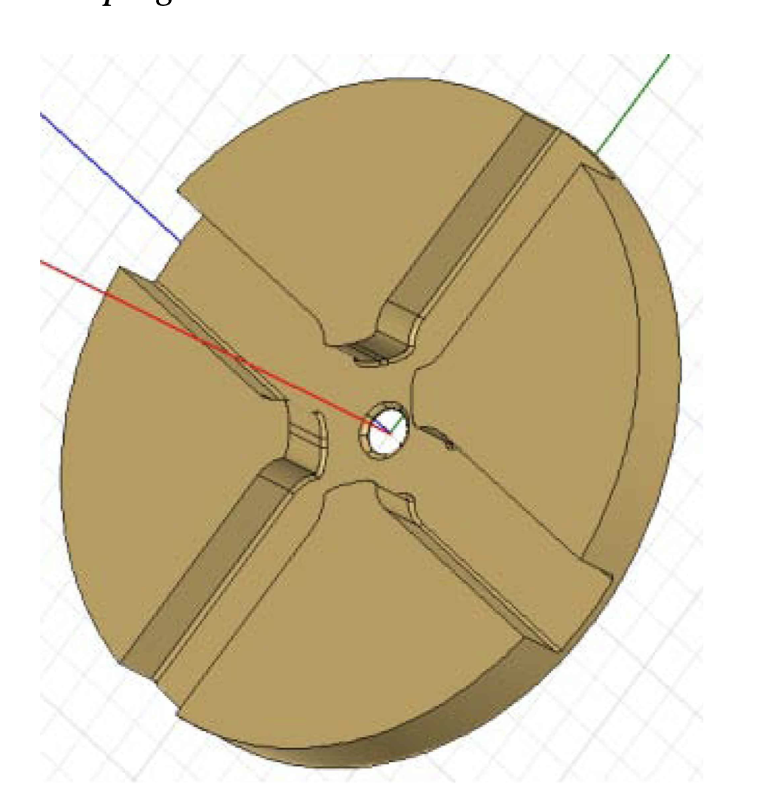
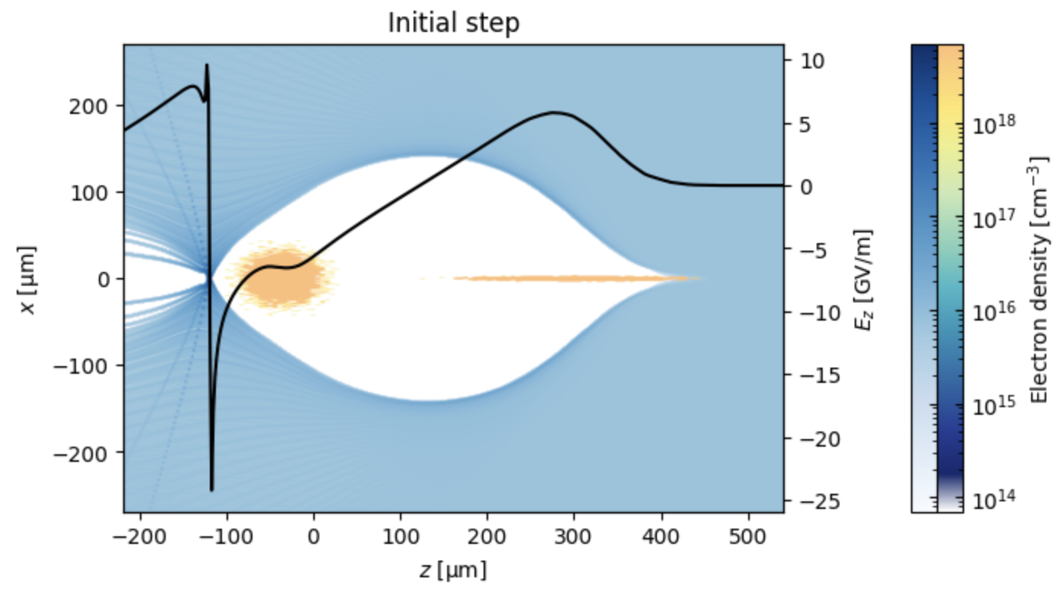
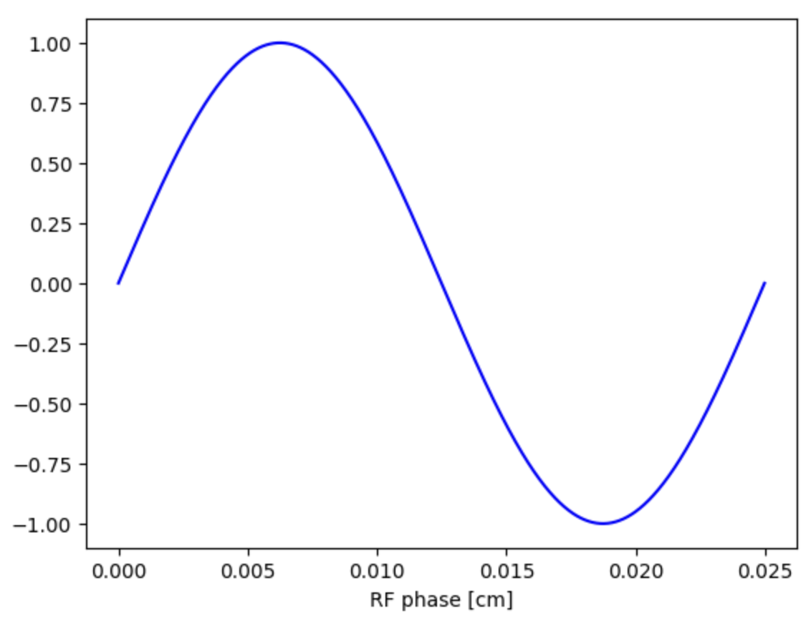
HALHF (7e21/m3 ) – 7 THz
CLIC - 12 GHz
iris r = 2 – 3 mm
transverse kicks
transverse wakefields
emittance growth
IP position jitter
Particularites of PWFA:
small transverse and longitudinal dimensions
  strong focusing kicks
  strong wakefields
  tight tolerances
driver generates cavity, drive beam jitter important
λ_{rf} = 2.5 cm

Slide 13
HALHF, PWFA LINAC ONLY
Feasibility issues, open questions, plans (v0.3)
System | Issues to demonstrate | Simulation and design studies | Experiments and test-facilities
Single stage | Gradient, energy gain, length, efficiency, rep. rate, (see HALHF linac table) | High-res, full PIC simulations of first and last plasma stage, all relevant physics included | Demonstrate 2B PWFA with simultaneous HALHF parameters Demonstrate high-rep rate, long lifetime plasma sources Demonstrate cooling of plasma stage, energy recovery? Precise Instrumentation
Interstage | Optics performance, non-linear lenses | Lattice design Component design | Any LWFA/PWFA staging preservering charge! Demonstrate novel components (non-linear plasma lens) Demonstrate staging with proposed interstage design, and HALHF-like beam parameters
Multi-stage effects | Wakefields/ transverse instabilities, Radiation reaction, Beam and component jitter, Scattering, Ion motion, Spin-transport .... | Multi-stage beam dynamics (self-correction) Show sufficient surpression of transverse instabilities Show acceptable radiation reaction effect Establish beam and component jitter tolerances Verify effects of Ion motion, scattering, spin .. | Demonstrate stability/jitter in acceleration process in single stage Benchmark physics models with single stage
Drive-beam distribution | TBD | Invent appropriate concept Lattice design | Demonstrate specialized components, e.g. magnets/kickers Staging including drive beam injection
Time scale for progress:
Few months to few years. Possibly in time for ESU/pre-CDR.
Time scale:
Few- to several years.

Slide 14
HALHF, PWFA LINAC ONLY
Feasibility issues, open questions, plans (v0.3)
System | Issues to demonstrate | Simulation and design studies | Experiments and test-facilities
Single stage | Gradient, energy gain, length, efficiency, rep. rate, (see HALHF linac table) | High-res, full PIC simulations of first and last plasma stage, all relevant physics included | Demonstrate 2B PWFA with simultaneous HALHF parameters Demonstrate high-rep rate, long lifetime plasma sources Demonstrate cooling of plasma stage, energy recovery? Precise Instrumentation
Interstage | Optics performance, non-linear lenses | Lattice design Component design | Any LWFA/PWFA staging preservering charge! Demonstrate novel components (non-linear plasma lens) Demonstrate staging with proposed interstage design, and HALHF-like beam parameters
Multi-stage effects | Wakefields/ transverse instabilities, Radiation reaction, Beam and component jitter, Scattering, Ion motion, Spin-transport .... | Multi-stage beam dynamics (self-correction) Show sufficient surpression of transverse instabilities Show acceptable radiation reaction effect Establish beam and component jitter tolerances Verify effects of Ion motion, scattering, spin .. | Demonstrate stability/jitter of acceleration process in single stage Benchmark physics models with single stage
Drive-beam distribution | TBD | Invent appropriate concept Lattice design | Demonstrate specialized components, e.g. magnets/kickers Staging including drive beam injection
Time scale for progress:
Few months to few years. Possibly in time for ESU/pre-CDR.
Time scale:
Few- to several years.
Progress: detailed HIPACE++ simulations performed, leading to important findings (Maxence)
Progress: CLEAR experiments being prepared
Progress: design and prototyping of NL APL started (Pierre)
Progress betatron: developed theory and simulations to identifying limits (Daniel)
Progress: FACET-II E302 (slowly) being prepared at SLAC
Progress wakefield: may be acceptable with new parameters (Ben)
Jitter tolerances: studies started (Ben)

Slide 15
HALHF, PWFA LINAC ONLY
Feasibility issues, open questions, plans (v0.3)
System | Issues to demonstrate | Simulation and design studies | Experiments and test-facilities
Single stage | Gradient, energy gain, length, efficiency, rep. rate, (see HALHF linac table) | High-res, full PIC simulations of first and last plasma stage, all relevant physics included | Demonstrate 2B PWFA with simultaneous HALHF parameters Demonstrate high-rep rate, long lifetime plasma sources Demonstrate cooling of plasma stage, energy recovery? Precise Instrumentation
Interstage | Optics performance, non-linear lenses | Lattice design Component design | Any LWFA/PWFA staging preservering charge! Demonstrate novel components (non-linear plasma lens) Demonstrate staging with proposed interstage design, and HALHF-like beam parameters
Multi-stage effects | Wakefields/ transverse instabilities, Radiation reaction, Beam and component jitter, Scattering, Ion motion, Spin-transport .... | Multi-stage beam dynamics (self-correction) Show sufficient surpression of transverse instabilities Show acceptable radiation reaction effect Establish beam and component jitter tolerances Verify effects of Ion motion, scattering, spin .. | Demonstrate stability/jitter of acceleration process in single stage Benchmark physics models with single stage
Drive-beam distribution | TBD | Invent appropriate concept Lattice design | Demonstrate specialized components, e.g. magnets/kickers Staging including drive beam injection
Time scale for progress:
Few months to few years. Possibly in time for ESU/pre-CDR.
Time scale:
Few- to several years.
Progress:ion motion shown to mitigate wake
Progress: component tolerances studies performed (Ben)
Progress: first texperiments in APL@CELAR (Pierre)
Progress betatron: simulations of HALHF and scaling laws (Daniel)
Progress wakefield: ion motion (Ben)
Jitter tolerances: offet tolerances studied (Ben)

Slide 16
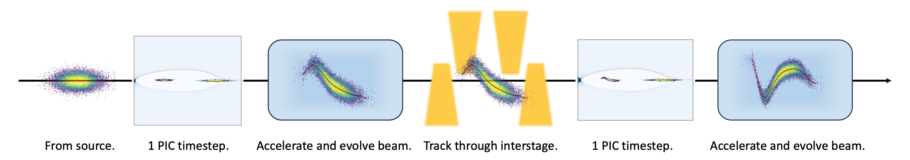
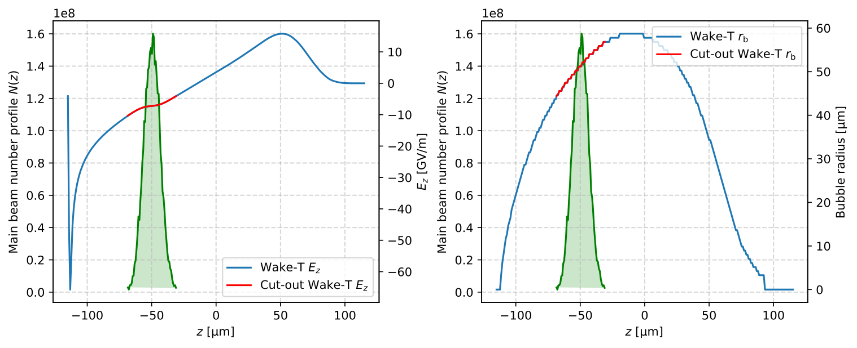



Simplified transverse wake instability model
Wakefield formalism has been used in CLIC to study the limitations on charge and efficiency.
Ansatz: for small offsets/perturbations, transverse instability in PWFA should behave similarly to BBU in conventional accelerators.
Outline for start-to-end simulation processes using simplified transverse instability model.
Transverse intra-beam wakefield (G. Stupakov):
  $$𝒲_{x}(ξ,s)=−\frac{2e}{πε_{0}}\overset{ξ}{\underset{ξ_{H}}{∫}}\frac{ξ^{′}−ξ}{(r_{b}(ξ^{′})+αk_{p}^{−1})^{4}}Θ(ξ^{′}−ξ)λ(ξ^{′},s)x(ξ^{′},s)dξ^{′}$$
Combine with Deng et al. equations for radiation reaction:
  $\frac{1}{c}\frac{du_{x}}{dt}≈−\frac{1}{2}k_{p}^{2}x−\frac{e}{m_{e}c^{2}}𝒲_{x}−\frac{1}{2}k_{p}^{2}cτ_{R}u_{x}\left(1+\frac{1}{2}k_{p}^{2}γ(x^{2}+y^{2})\right)$
  $\frac{1}{c}\frac{du_{z}}{dt}≈k_{p}\frac{E_{z}}{E_{0}}−\frac{1}{4}k_{p}^{4}cτ_{R}γ^{2}(x^{2}+y^{2})$
  $\frac{dx}{dt}≈\frac{u_{x}}{u_{z}}c$
$s$: beam location.
$ξ^{′}$: long. coordinate of driving particle.
$ξ$: long. coordinate of reference particle.
$ξ_{H}$: long. coordinate of beam head.
$α$: numerical factor ~1.
$k_{p}^{−1}$: plasma skin depth.
$Θ(ξ)$: Heaviside step function.
$λ(ξ,s)$: long. beam number density.
$x(ξ,s)$: particle transverse offset.
$u(ξ,s)=p/m_{e}c$: normalised $e^{−}$ momentum.
$$τ_{R}=2r_{e}/3c$$
$E_{0}=m_{e}cω_{p}/e$: wavebreaking field.
Need initial $E_{z}(ξ)$ and $r_{b}(ξ)$ as inputs from e.g. a PIC code (Wake-T used here).
2024-10-05 | Ben Chen | HALHF Workshop 3-8 October 2024
Page

Slide 17
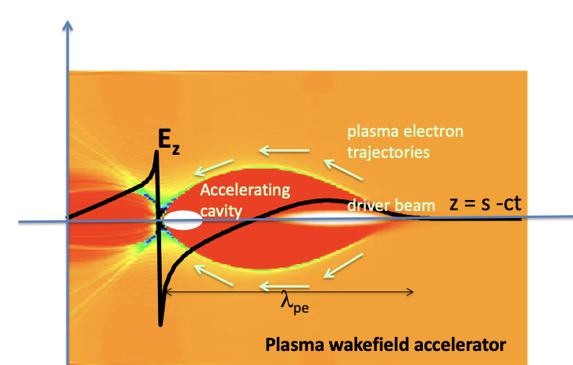
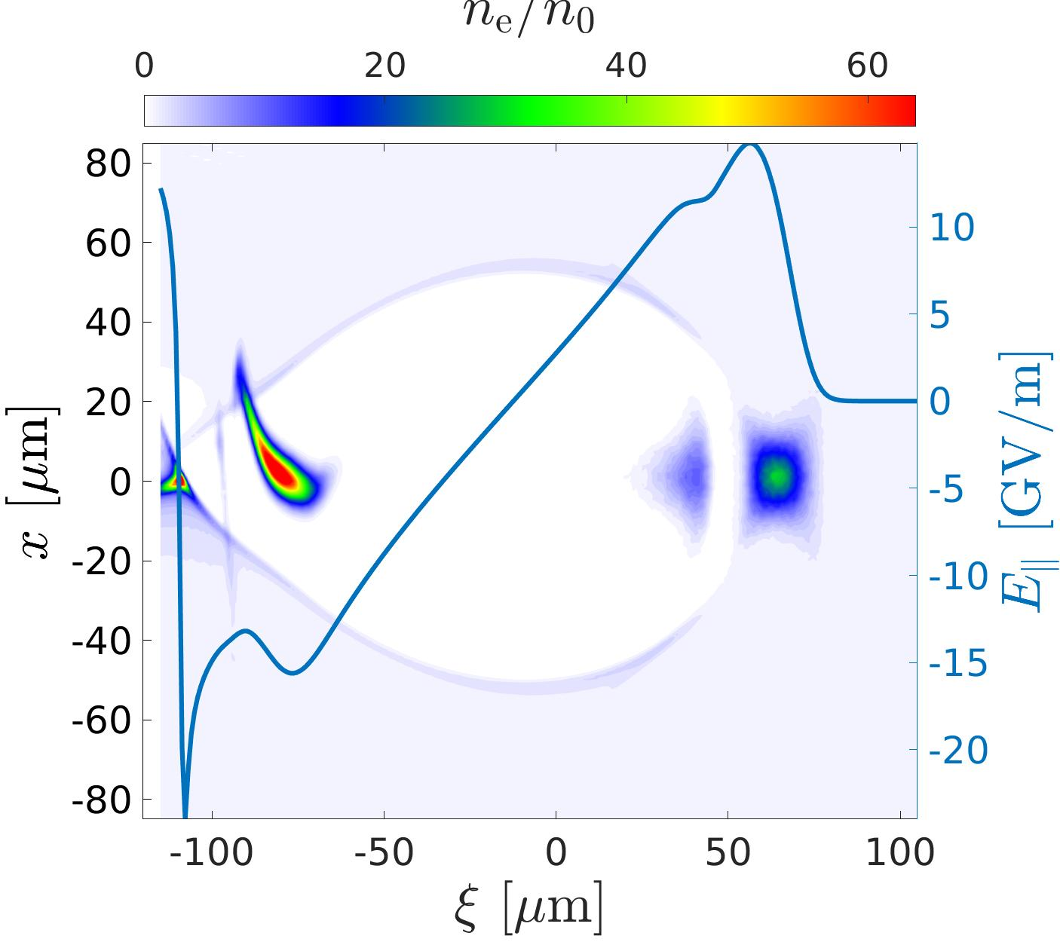
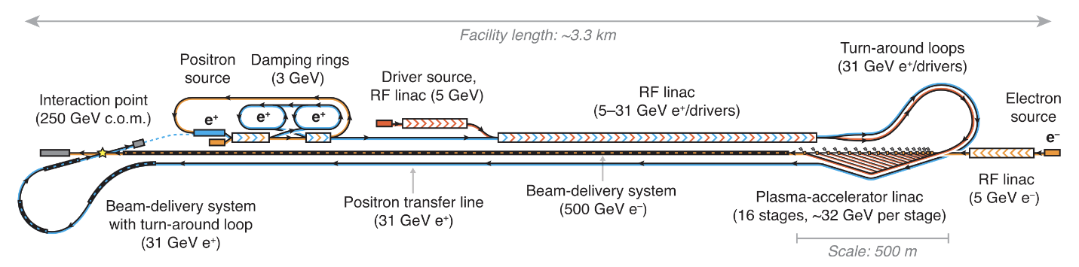
Tolerances in linear colliders
Example from CLIC documentation : A start-to-end simulation of a perfect machine shows that a luminosity of 4.3 × 1034 cm−2s−1 would be achieved.
For the expected alignment imperfections ... 90% of machines achieve a luminosity of 2.3×1034 cm−2s−1 or greater. The impact of static and dynamic imperfections is studied in [17]. The studies results in transverse and longitudinal tolerances, eventually on component level.

