Slide 1
Q4 Upgrade Ladder
R&D Topics, Facilities, Demonstrations, Milestones, Timeline
Barklow and Gessner

Slide 2

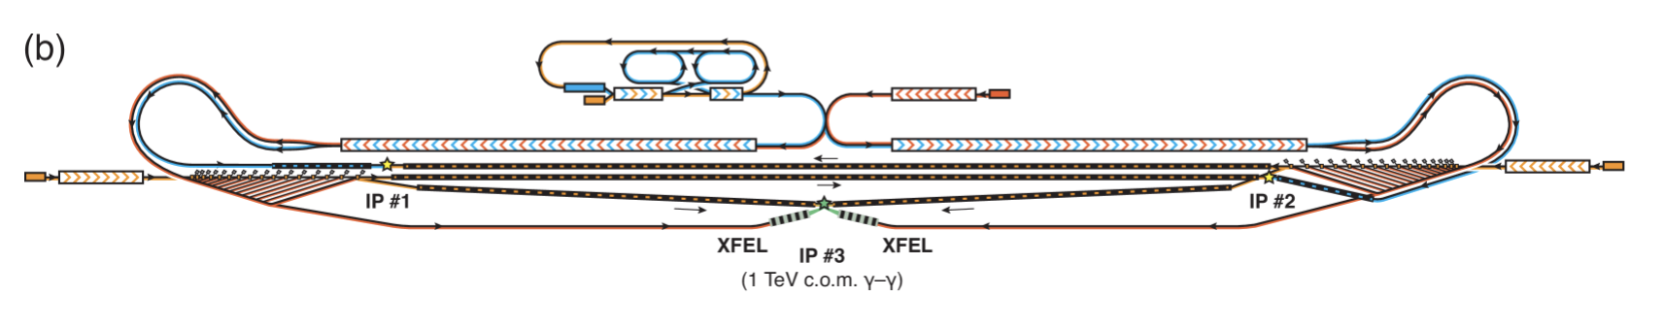

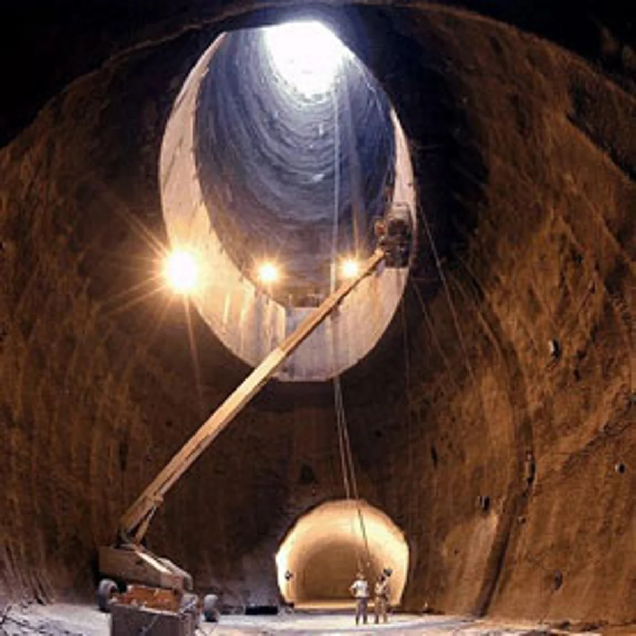
Upgrade Ladder and Facility Evolution
WHOLE
HALHF
HOLE

Slide 3
Session 1 (Friday Afternoon)
Prompt:
How do we map R&D activities onto facilities and demonstrators for the HALHF upgrades?
Discussion:
Start with just R&D activities and facilities needed for HALHF 250 CM.
Continue with discussion of upgrades to 350 and 550 GeV
Consider γγ upgrades

Slide 4
R&D Topics and Facilities for Baseline HALHF
Key accelerator physics challenges for HALHF:
Staging of plasma cells
High-rep rate plasma cells with power handling
 | Facilities | Status
Single-stage high-quality | FlashForward, FACET-II | On-going
Single-stage high-transformer ratio | FACET-II, AWA | On-going
Single-stage flat beam | AWA | On-going
Staging | SPARTA, CLARA? | Concept
Rep rate (plasma cell tech) | FlashForward, FACET-II, AWAKE | Physics investigations but no power handling yet
Rep rate (high-power handling) | FlashForward, Higher-energy demo | Concept

Slide 5
Facilities/Demonstrators vs Physics Opportunities
Future facilities that can support R&D while providing unique physics opportunities.
 | R&D Opportunities | Physics Opportunities | Energy Scale
O(100) MeV multi-stage demo | Staging |  | 100 MeV
FlashForward with undulator | Beam quality | UV FEL | 2 GeV
EuPRAXIA | Beam quality | XFEL | 5 GeV
XFEL Energy Doubler | Beam quality | XFEL | 10-20 GeV
SPARTA | Staging, Compton IP | NLQED, Muons for imaging, Dump physics? | 50 GeV
SPARTA-XCC | HALHF rep rate, multi-bunch, ε,... | Higgs Factory | 60+60 GeV
High-rep rate facility | Plasma stage power handling | e⁻p⁺ collisions, beam dump physics, detector test beams | 10-100 GeV

Slide 6
R&D Topics and Facilities for EW-Scale HALHF
EW-Scale HALHF includes γγ at 125 GeV and 380 GeV and asymmetric e⁺e⁻ at 350 GeV and 550 GeV.
Key accelerator physics challenges for EW-Scale HALHF:
Joule-class XFEL
Demonstrator for Compton IP with conversion to gammas
High-gradient positron linac
 | Facilities | Status
Joule-class XFEL | LCLS? Eu XFEL? | Concept
Compton IP demonstrator | FACET-II, LUXE, SPARTA | Concept
High-gradient positron linac | AWA | Concept
γγ demonstrator | LC facility 2nd IP, SPARTA upgrade with two linacs | Concept
High-energy staging | LC Test Beam facility | Concept

Slide 7
Upgrades for EW-Scale HALHF and LC Facility
EW-Scale HALHF and LC Facility includes γγ at 125 GeV and 380 GeV and asymmetric e⁺e⁻ at 350 GeV and 550 GeV.
 | Option | Status
LC Upgrade for 350 and 550 GeV asym. | HALHF-like upgrade for electron arm | Concept
HALHF upgrade to 550 GeV asym. | Energy upgrade for positron arm | Concept
HALHF upgrade to 380 GeV and 550 GeV γγ | “Double” HALHF and add XFEL | Concept
SPARTA-XCC | SPARTA upgrade | Concept

Slide 8
SPARTA to SPARTA-XCC Upgrade
SPARTA upgrade to γγ XCC
Two accelerators
50 GeV -> 62.5 GeV
0.2 nC ->1.0 nC
10 Hz -> 100 Hz
10 mm-mrad -> 0.2 mm-mrad,
1 bunch/train -> 100 bunches/train

Slide 9
Homework for R&D and EW Scale Upgrades
Consolidate tables and add timelines
SPARTA->XCC details
LC Facility Test Beam options
Concepts
Big thoughts
Construction
Building things
2030
2045
2024
2040
Demos
Doing things
Utilization
Colliding things

Slide 10
Session 2 (Saturday Afternoon)
Prompt:
How do we map R&D activities onto facilities and demonstrators for the TeV scale?
Discussion:
This may require R&D that can only be performed at an existing LC facility (including HALHF).
Specific challenges include
  Betatron radiation and radiation reaction
  Interstage optics strategy
  Plasma cell becomes comparable in size to betatron wavelength (like plasma lens)
  New BDS strategies . . .
  Topics related to γγ at 10 TeV. Need to understand e-e- vs γγ lumi spectra: broad spectrum for multi-boson production versus peaked for heavy new particle studies.

Slide 11
Upgrade R&D Table
Utilize test beam facilities associated with future HALHF and LC (Generic High-Energy Test Beam Facility HETBF)
 | Facilities | Status
Betatron radiation handling | HETBF
Betatron radiation reaction | HETBF
Staging at high energy | HETBF
Non-linear QED at Compton IP | HETBF

Slide 12
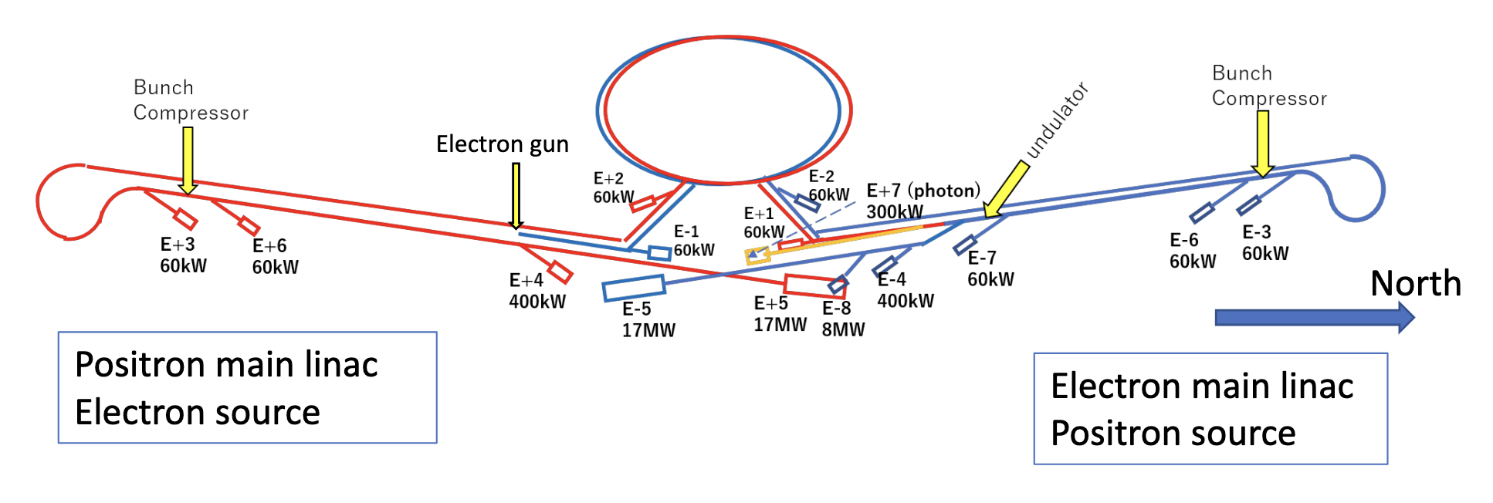
High Energy Test Beam Facility
HEBTF

Slide 13
Pre-Workshop thoughts

Slide 14
Demonstrators and Staging
Demonstrators
  Stage 0: Single plasma cell EUPRAXIA FEL < 10 GeV
  Stage 1: Multi-cell application SPARTA ~ 50 GeV
  (can SPARTA support R&D for gam gam collisions
  Joule/pulse soft-xray XFEL + focusing
Staging:
XCC Ecm=125 GeV, two 62 GeV PWFA
HALHF Ecm=250 GeV 500 GeV PWFA
XCC-specific R&D
  Beamline design:
  XFEL e- beam extraction and transport
  Round Beam Final Focus (Q3)
  Detailed XCC-specific X-ray Focusing: KB mirrors? alternatives?
  Integration of X-ray and electron focusing
  Position and timing stability of Compton collision

Slide 15
Milestones, Energy Scales and Timelines
Energy (GeV) Tech/Concept | 1-10 | 10-100 | 100-1000 | 1000-3000 | 3000-10000
FELs and single stage tech | FACET-II AWAKE EUPraxia
NLQED and multi-stage demo |  | SPARTA
XFEL R&D for γγ
Higgs Factory |  |  | HALHF 250 XCC-plasma
EW-scale collider |  |  | HALHF 380-500
TeV-scale collider |  |  |  | Plasma e⁺e⁻ Plasma γγ
Multi-TeV collider |  |  |  |  | Plasma e⁺e⁻ Plasma γγ
Timeline | 2024-2039 | 2030-2039 | 2040-2055 | 2050-2059 | 2060–

