Slide 1

Summary on Q3: Beam Delivery considerations for HALHF, for HALHF upgrades, and for advanced colliders
Andrei Seryi
Jefferson Lab
HALHF Workshop
Erice, 2024

Slide 2
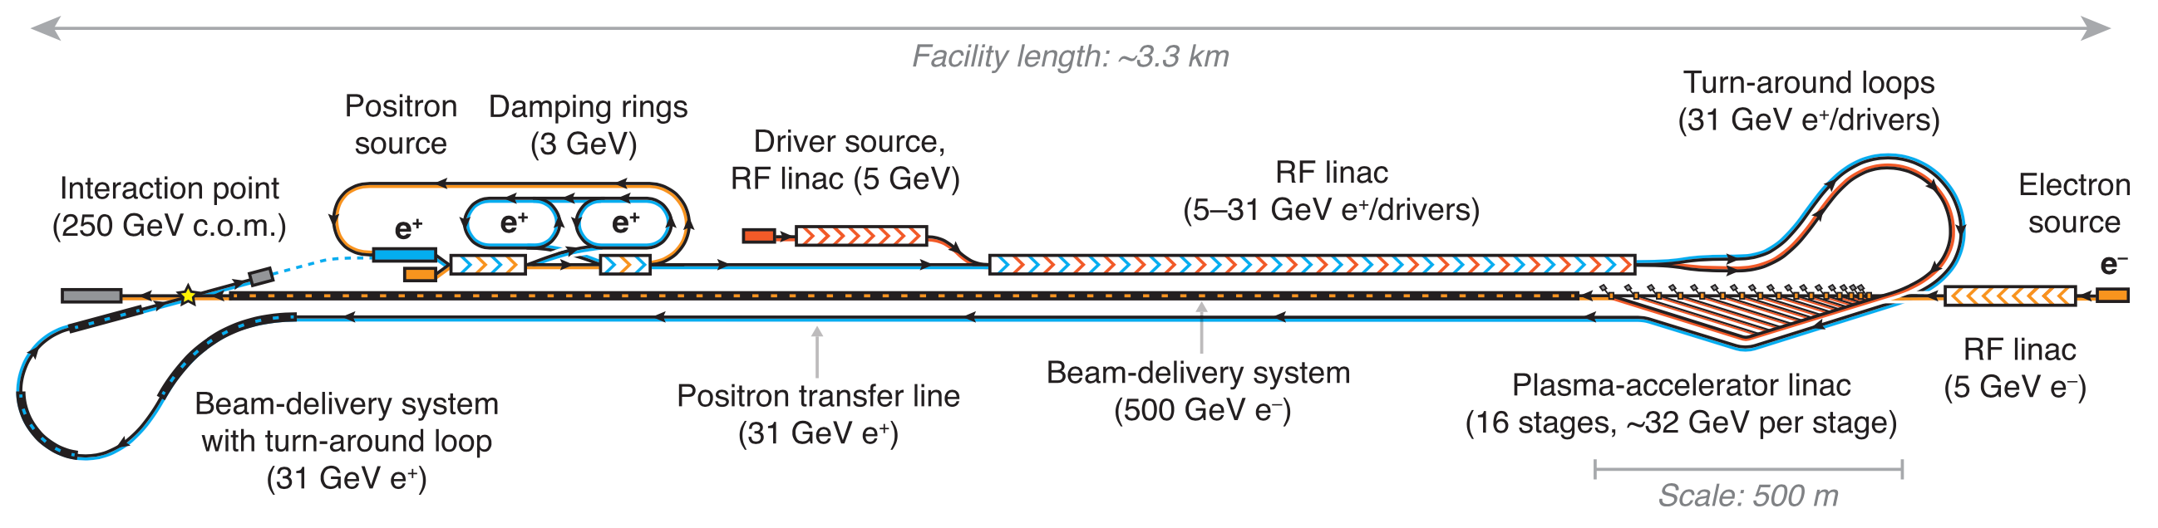
Summary of Q3 Working Group of HALHF workshop
Question 3
BDS: shorten, collimation, include positron source; positron/electron damping rings design
Answer for BDS:
  For HALHF itself, we have all the knowledge and demonstrations (ATF2@KEK) to design and build BDS, no need for additional demonstrations
  Shortening of BDS is possible, but mostly optional for HALHF
    Except that likely will have to use renewable collimators (vs survivable like in ILC)
  New ideas like distributed collimation in plasma sections can help to optimize baseline BDS for HALHF, and will become essential for HALHF upgrades
  Novel ideas (e.g. nonlinear energy collimation) may be essential for multi-TeV and may require demonstrations

Slide 3
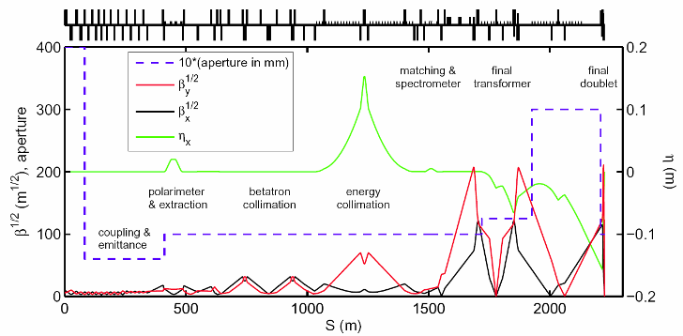
From ILC BDS to baseline BDS for HALHF
linac
IP
Revise 1um laser wire resolution
Optimize collimation assumptions. Survivable => consumable spoilers. Include tail cleaning in plasma stages
Optimize L* (shortening will help)

Slide 4
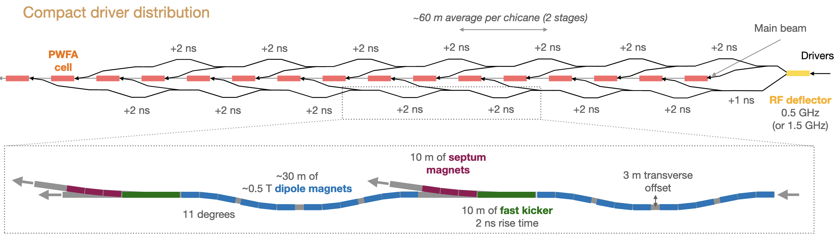
Distributed collimation in plasma sections – for HALHF design
Distributed collimation in plasma section will help to ease requirements to BDS collimation
While considering collimation inside and in between plasma stages:
  Consider radiation criteria: hands-on maintenance < 1 W/meter losses (for proton beam, conservative), and for electron beam up to 100 W/m (USPAS2011, N.Mokhov)
  Keeping low losses in distributed collimation would ease radiation considerations

Slide 5
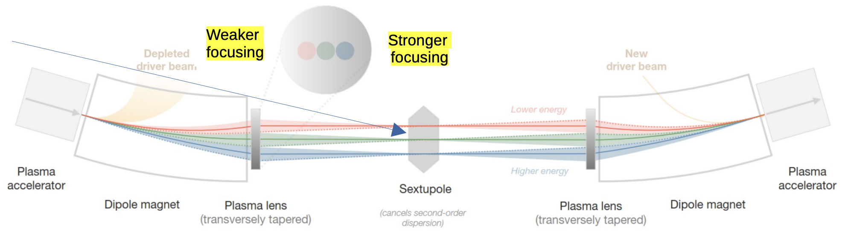
Distributed collimation in plasma sections – for HALHF design
Energy collimation
Vertical collimation
Horizontal collimation
While considering collimation inside and in between plasma stages:
  Take into account that this area needs to be heavily instrumented, to ensure tunability
  Install collimation only in some of sections
  Tunable vs fixed gap collimators to be considered
  Limit amount of beam collimated (W/m, radiation considerations)
Transverse (X,Y) and energy collimators can be installed
These distributed collimators may ease requirements for renewable spoilers in BDS

Slide 6
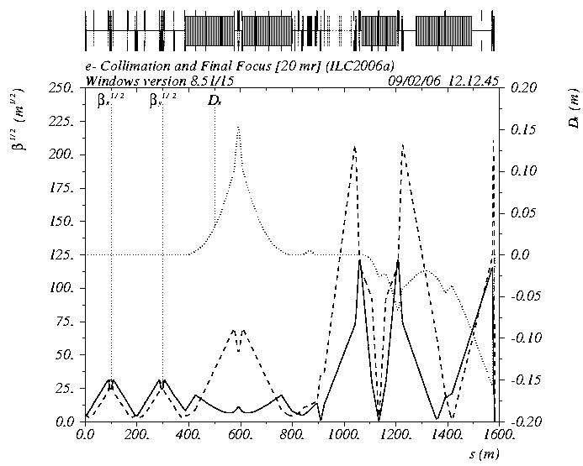
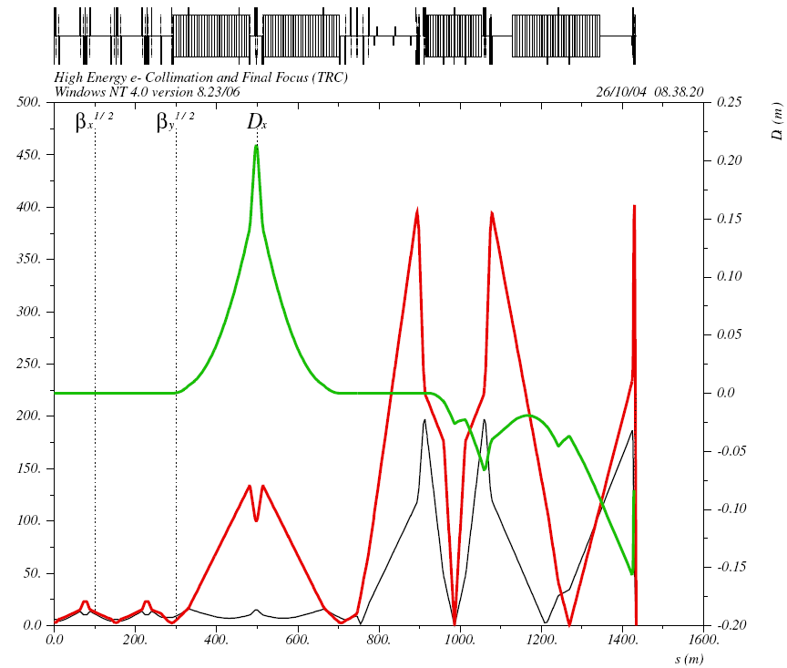
Survivable => consumable spoilers
In ILC with large dT between bunches can detect errant train and extract rest of train after two bunches
  Betatron spoilers survive up to two bunches (which MPS can let through)
  E-spoiler survive several bunches
In HALHF will need to assume that entire errant train can hit collimators
  Use BDS with renewable spoilers like was designed for NLC
    Good news – design exist and optics is actually shorter
Beam Delivery System Optics, a version with survivable spoilers
Beam Delivery System Optics, a version with consumable spoilers

Slide 7
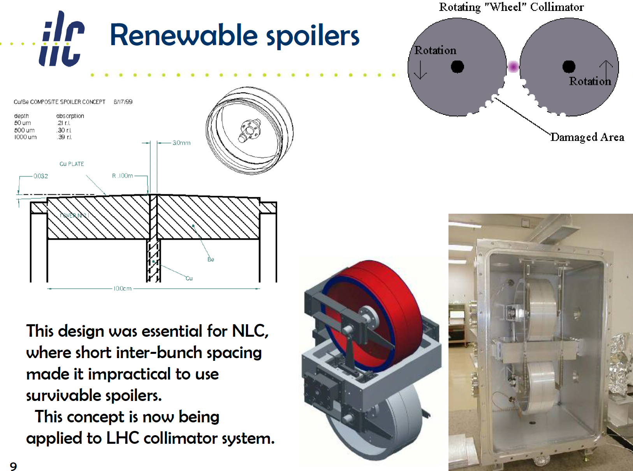
For ILC train structure can extract errant train after two errant bunches
For HALHF bunch train, may have to consider renewable collimators for HALHF, like it was considered for NLC
Distributed in plasma section collimators reduce probability of errant train arriving to BDS in HALHF
Mokhov, Pivi, Seryi, USPAS 2011 https://uspas.fnal.gov/materials/11ODU/ODU-Particle-Collider.shtml

Slide 8
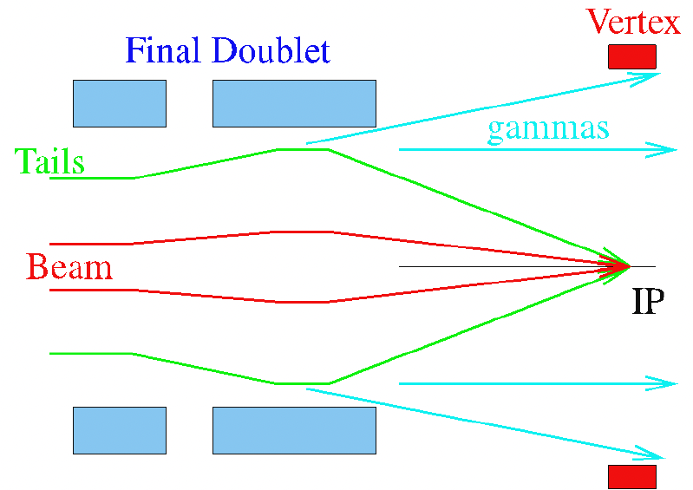
HALHF upgrade to round beam and advanced focusing
For round beam with triplet focusing
  Collimation depth, which for flat beam can be 10/100 (x/y) will change to around 10/10
  Scaling of collimation with energy will probably not change, but watch for larger fraction of the tail to be collimated, larger jitter amplification factor, etc.
Plasma lens close to IP
  If it can be inserted close to IP, effectively reducing L*, and without inserting intolerable amount of material inside of detector (!!!), then
  It can allow to dramatically decrease FF length and also the length of the collimation system
Plasma lens instead of Final Doublet
  Will reduce beam size in FD ~twice
  Reduce ~twice collimation depth
  To check loss of flexibility in x vs y chromaticity correction

Slide 9
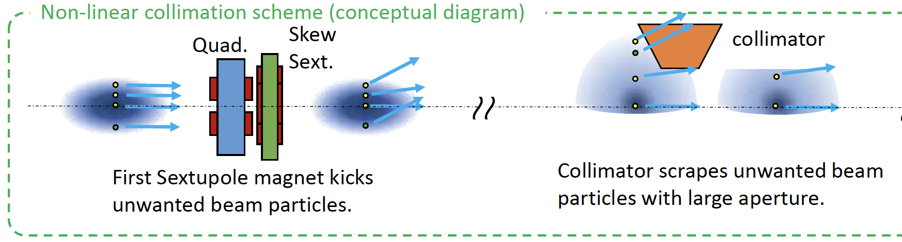
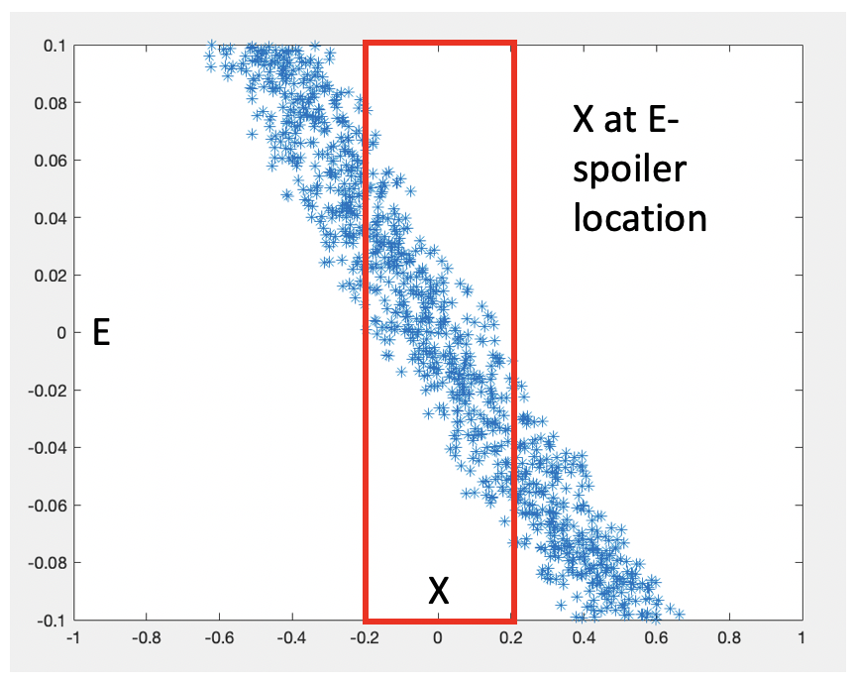
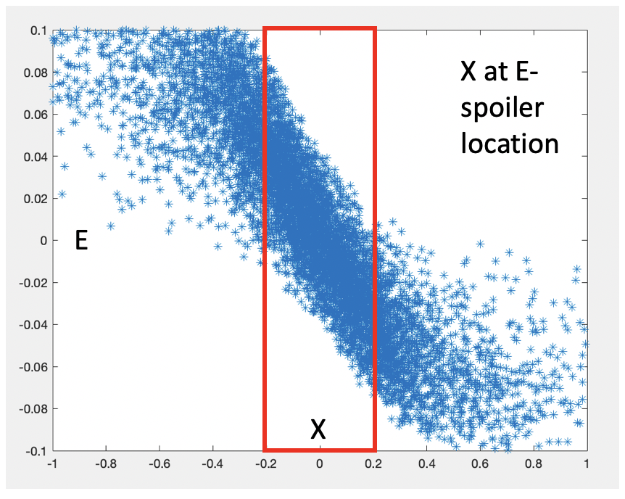
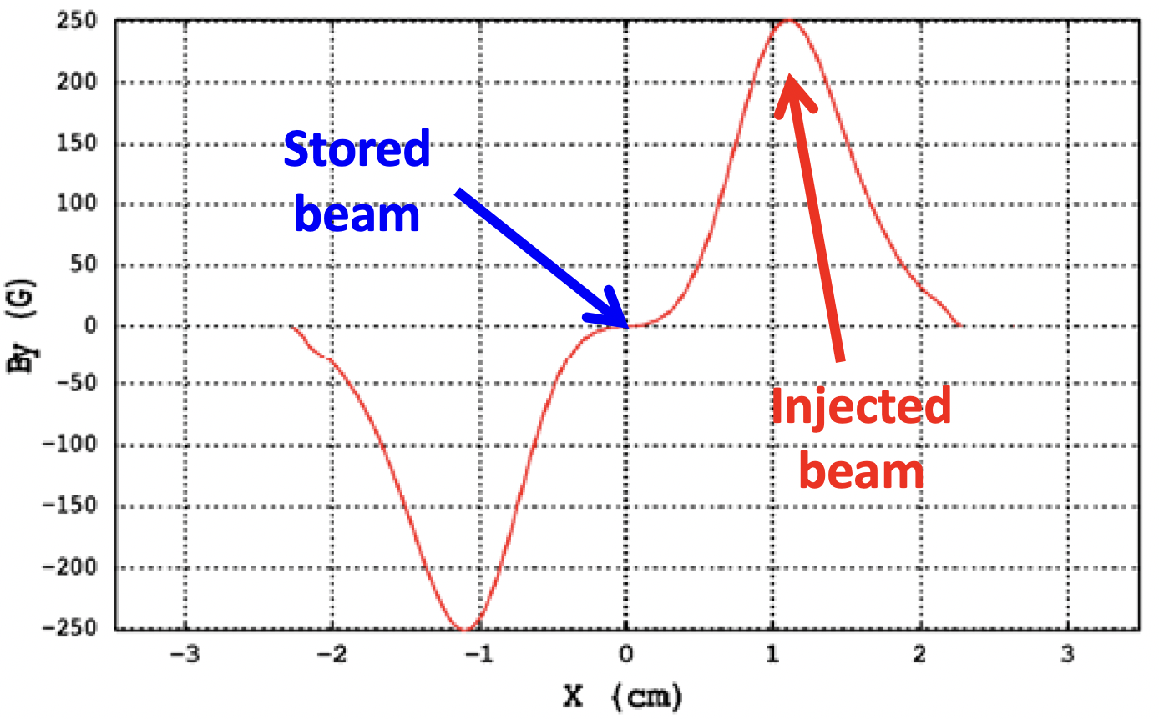
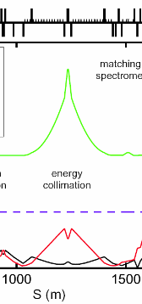
HALHF upgrade to ~TeV and multi-TeV – novel ideas
Final Focus itself scales nicely to multi-TeV
Most unfavorable scaling with energy is in the energy collimation system
  Distributed collimating between plasma stages will help, but new ideas needed
Inspired by nonlinear betattoron collimators at SuperKEKB and nonlinear injection kickers in new SR light sources, considering nonlinear energy collimation
Nonlinear collimator
Tobiyama, IPAC24
Nonlinear kicker
=>
=>
Extremely preliminary – simplified tracking of nonlinear energy collimation done during workshop – optimization of parameters is needed
Atkinson, IPAC2011

Slide 10
Reiterating the summary – key points on HALHF BDS for CERN strategy contribution
HALHF BDS design strongly benefits from ILC & NLC BDS designs
  NLC BDS with renewable spoilers, integrated with ILC BDS design (polarimeters, spectrometers, etc.), is the most close design meeting HALHF parameters
    Engineering design of renewable spoilers is to be further advanced
  ATF@KEK Final Focus test is the most essential demonstration – no other demonstrations are needed
Optional design improvements for HALHF BDS are possible
  Distributed collimation inside and in between of plasma sections will help
  This distributed collimation will also ease assumptions for renewable BDS collimators
Discussion of HALHF upgrades to TeV and multi-TeV opened plethora of ideas
  Final Focus is scaling nicely to multi-TeV energies
  The most unfavorable scaling is for energy collimation, but novel ideas such as distributed collimation in plasma sections and nonlinear energy collimation will likely revert the scaling and allow to design a compact BDS for multi-TeV advanced collider

