Slide 1

Beam Delivery and MDI design considerations for HALHF, for HALHF upgrades, and for advanced colliders
Andrei Seryi
Jefferson Lab
Q3 Session 2
HALHF Workshop
Erice, 2024

Slide 2
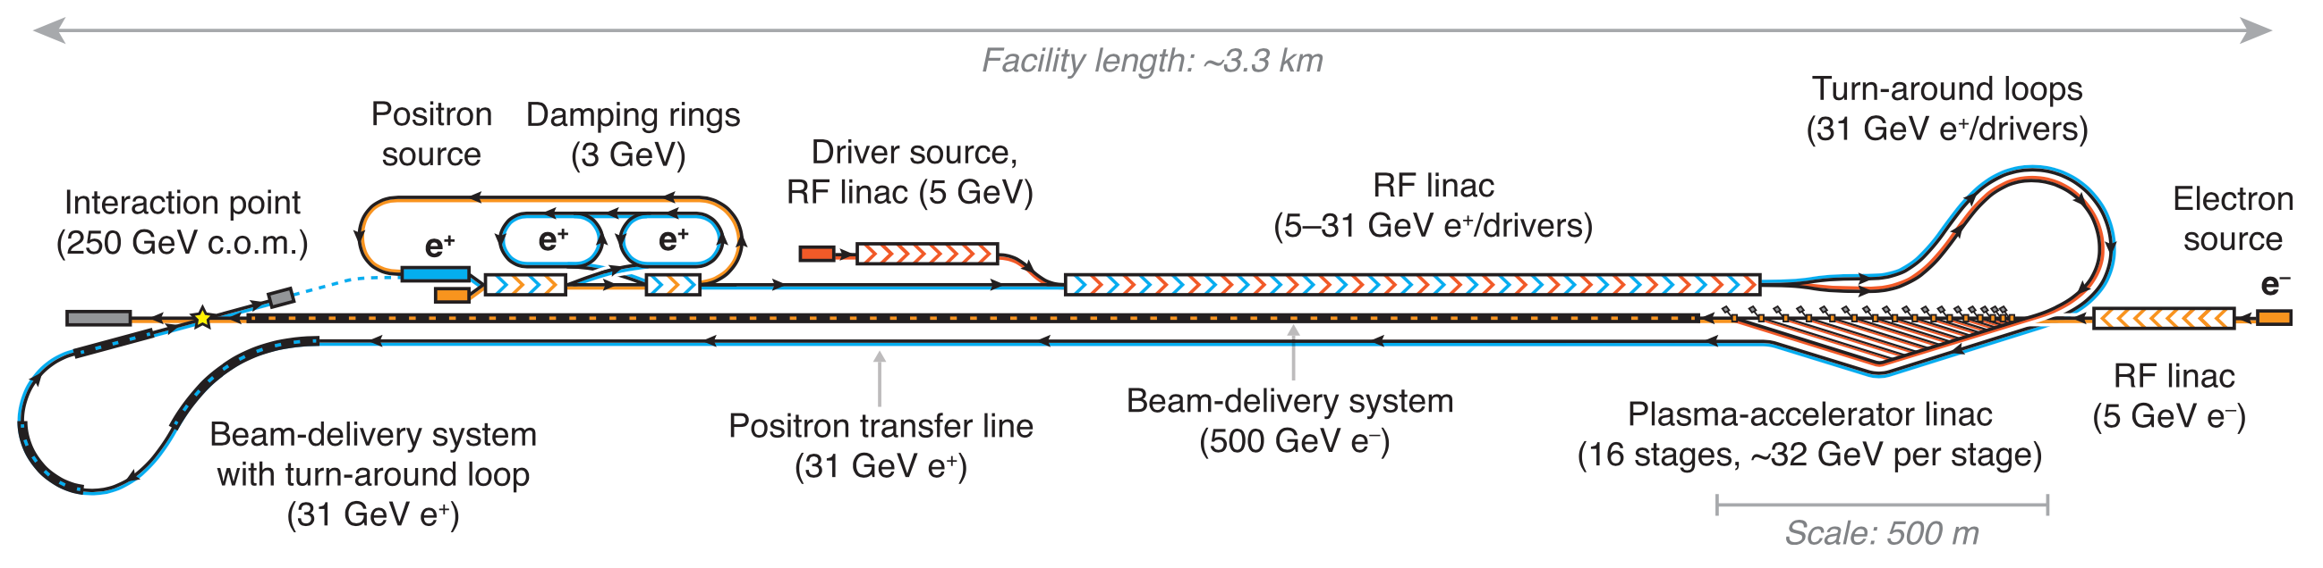
From the charge to our Working Group of HALHF workshop – 2nd session
Question 3
BDS: shorten, collimation, include positron source; positron/electron damping rings design
Answer for BDS:
  For HALHF itself, we have all the knowledge and demonstrations (ATF2) to design and build BDS, no need for additional demonstrations
  Shortening of BDS is possible (see discussion on next slides) but feels optional for HALHF
    But likely have to use renewable collimators (vs survivable like in ILC)
  New ideas (distributed collimation) are optional for baseline BDS, but will become essential for HALHF upgrades
    Discuss what is important for design of distributed collimators
  Novel ideas (nonlinear energy collimation – see below) may be essential for multi-TeV and may require demonstrations

Slide 3
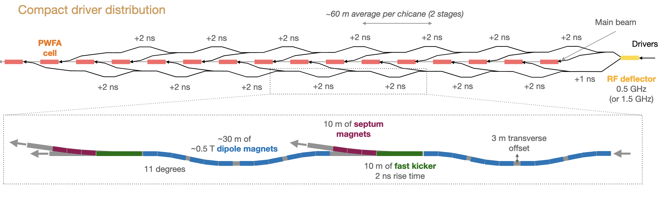
Distributed collimation in plasma sections – for discussion
What is important for consideration of collimation inside and in between plasma stages:
Distributed collimation may indeed become distributed radiation area – concentrating losses in one area instead of distributed may have advantages
Criteria for hands-on maintenance is < 1 W/meter losses (for proton beam, conservative)
  For electron beam can be up to 100 W/m ? TBC (USPAS2011, N.Mokhov)
If distributed collimation will result in such or lower losses – this would ease radiation considerations

Slide 4
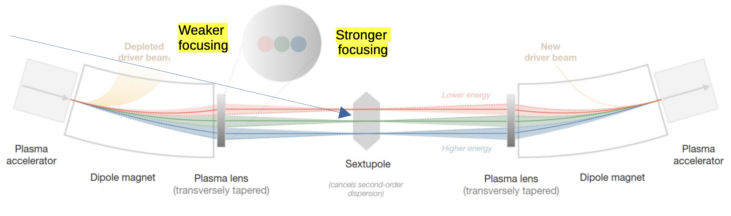
Distributed collimation in plasma sections – for discussion
Energy collimation
Vertical collimation
Horizontal collimation
What is important for consideration of collimation inside and in between plasma stages:
This area needs to be heavily instrumented, to ensure tunability
Maybe install collimation only in some of sections
Tunable vs fixed gap collimators
Amount of beam collimated (what is W/m loss at collimators)
For detailed design: what are beam sizes, beta-functions, etc. at various locations? What is phase advance between stages? Etc.

Slide 5
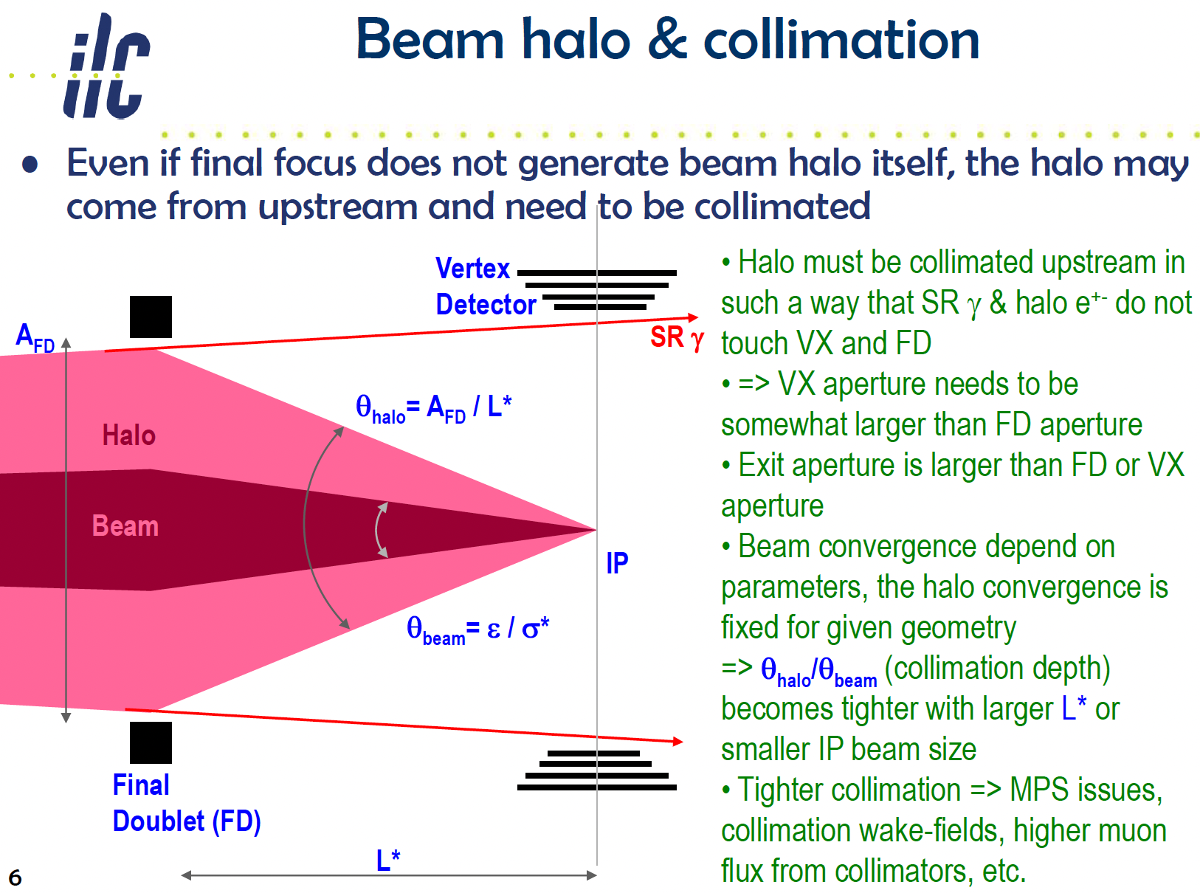
For discussion of collimation depth
Mokhov, Pivi, Seryi, USPAS 2011 https://uspas.fnal.gov/materials/11ODU/ODU-Particle-Collider.shtml

Slide 6
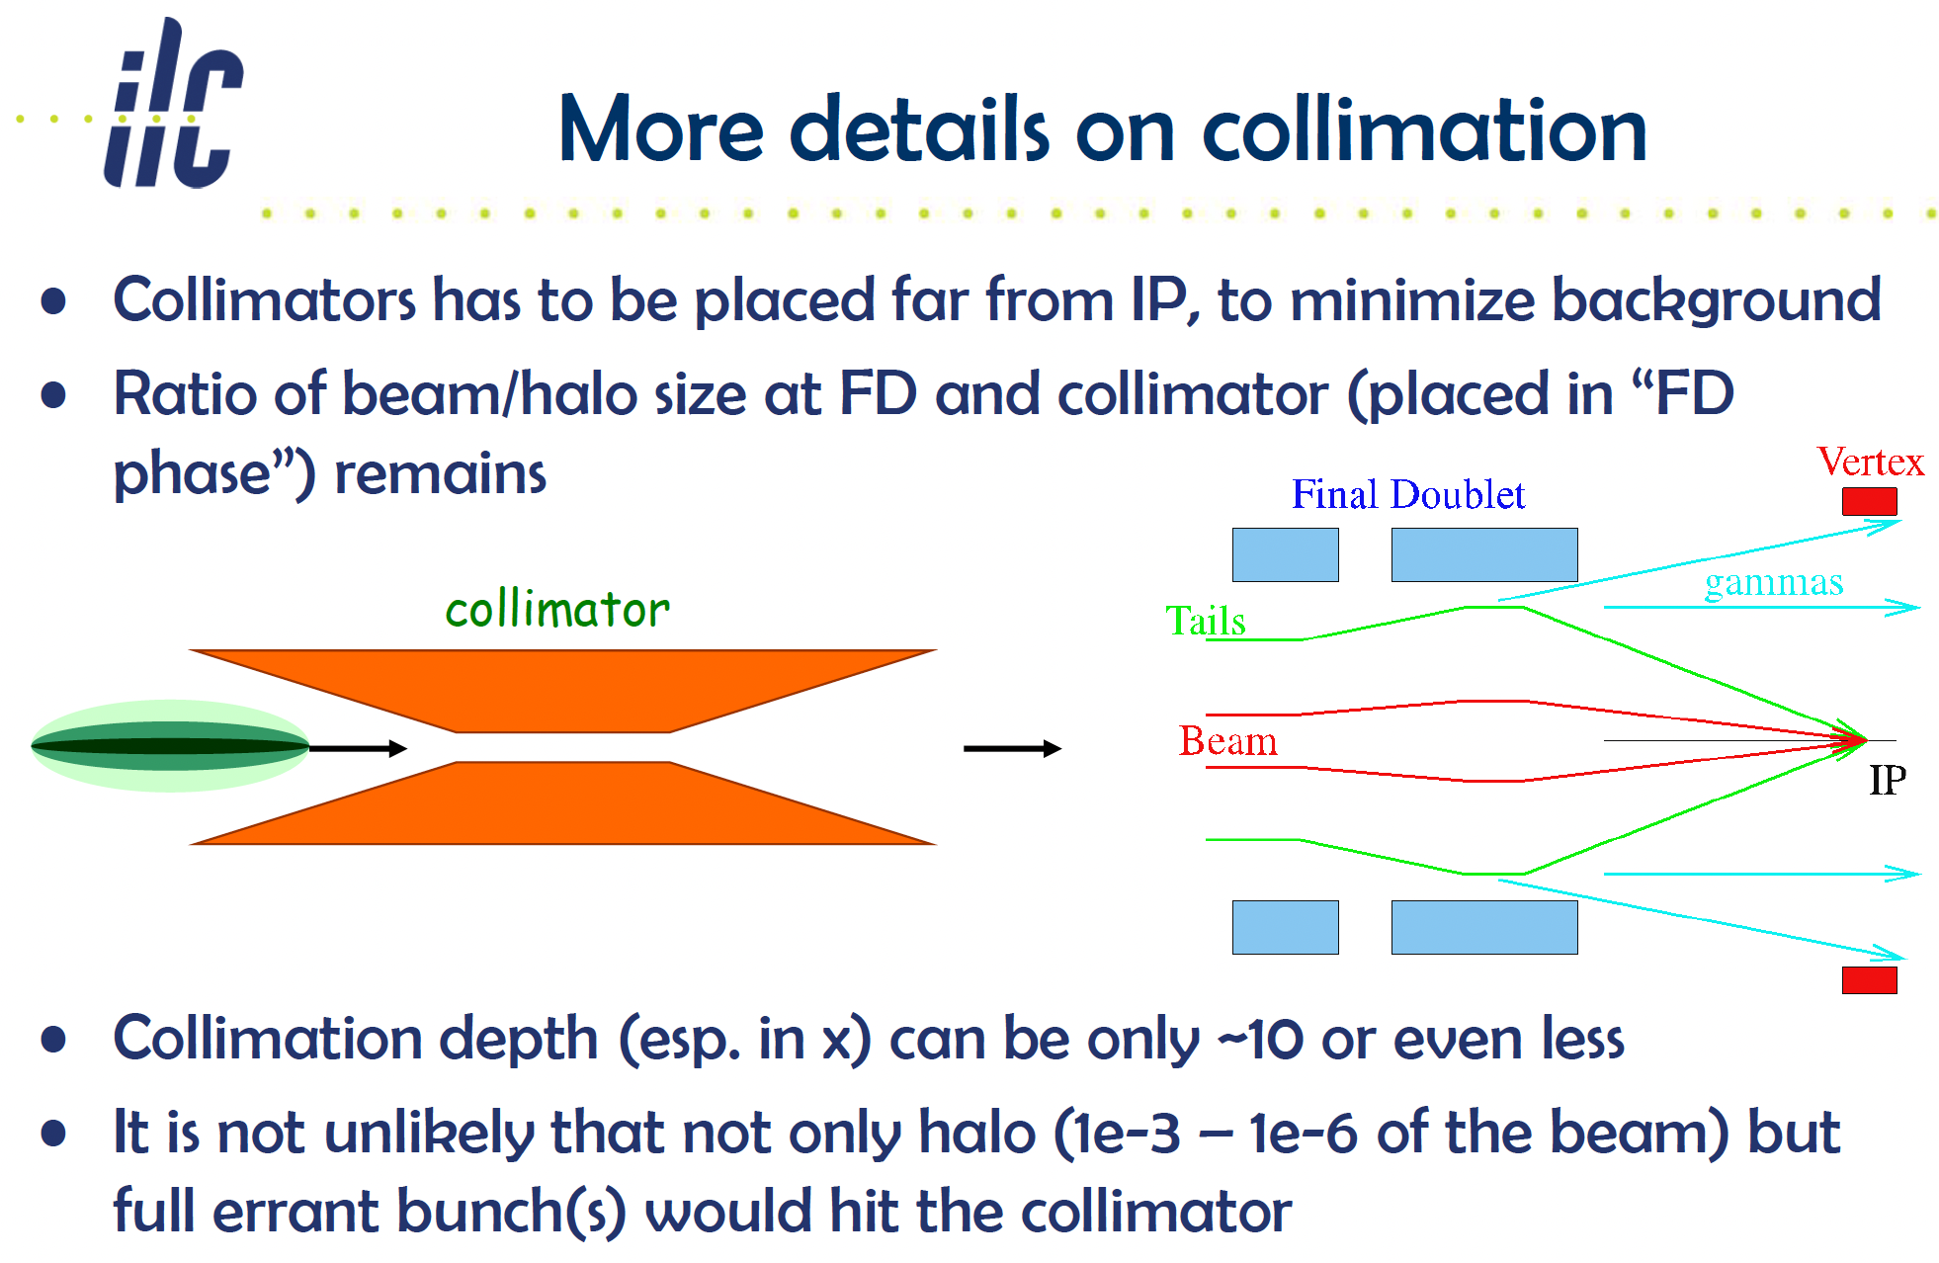
For discussion of collimation depth and errant beams
Mokhov, Pivi, Seryi, USPAS 2011 https://uspas.fnal.gov/materials/11ODU/ODU-Particle-Collider.shtml

Slide 7
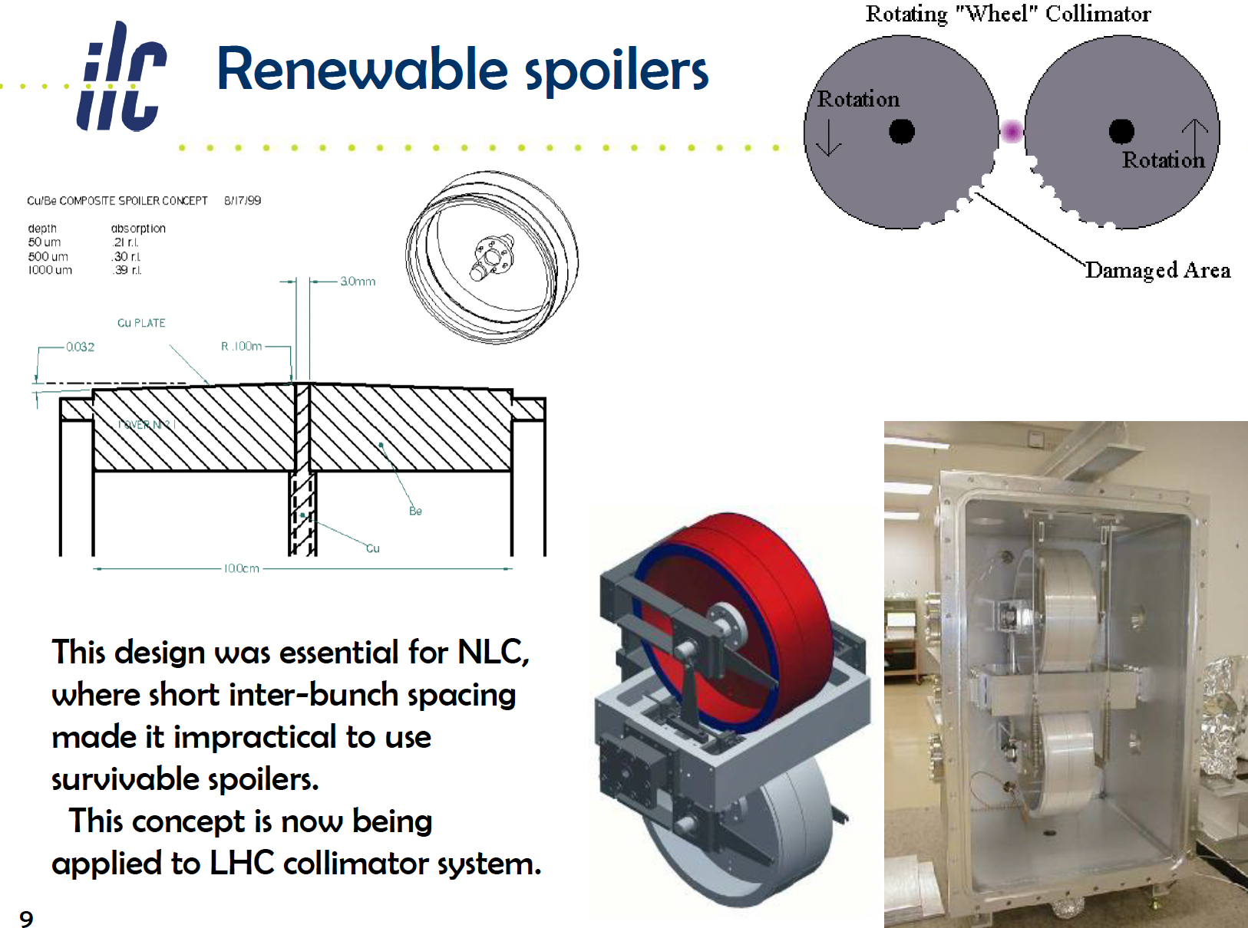
For ILC train structure can extract errant train after two errant bunches
For HALHF bunch train, may have to consider renewable collimators for HALHF, like it was considered for NLC
Mokhov, Pivi, Seryi, USPAS 2011 https://uspas.fnal.gov/materials/11ODU/ODU-Particle-Collider.shtml

Slide 8
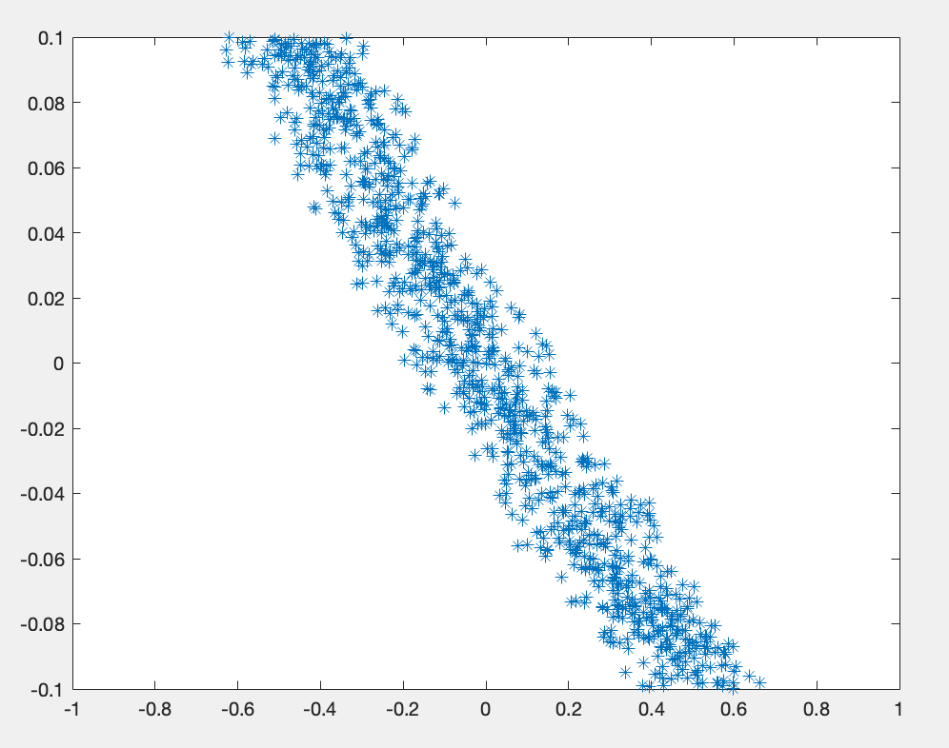
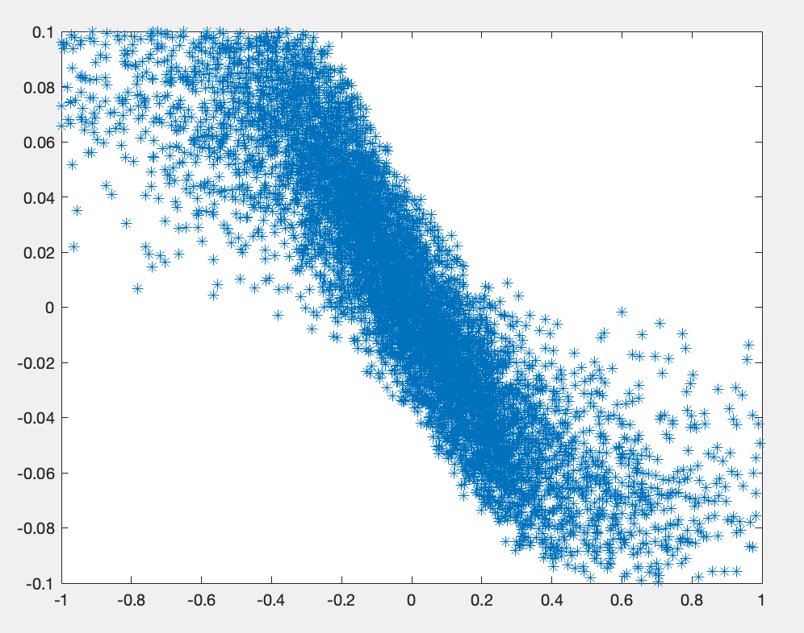
Nonlinear energy collimation – extremely preliminary
E
X
X
X at E-spoiler location
Idea discussed yesterday
Very simplified tracking of linear vs nonlinear energy collimator
  Power of 5 dependence of bending field added to dipole field

Slide 9
Backup – yesterday’s discussion slides

Slide 10
From the charge to our Working Group of HALHF workshop
Question 3
BDS: shorten, collimation, include positron source; positron/electron damping rings design
Answer for BDS:
  For HALHF itself, we have all the knowledge and demonstrations (ATF2) to design and build BDS, no need for additional demonstrations
  Shortening of BDS is possible (see discussion on next slides) but feels optional for HALHF
  New ideas (distributed collimation) are optional for baseline BDS, but will become essential for HALHF upgrades
  Novel ideas (nonlinear energy collimation – see below) may be essential for multi-TeV and may require demonstrations

Slide 11
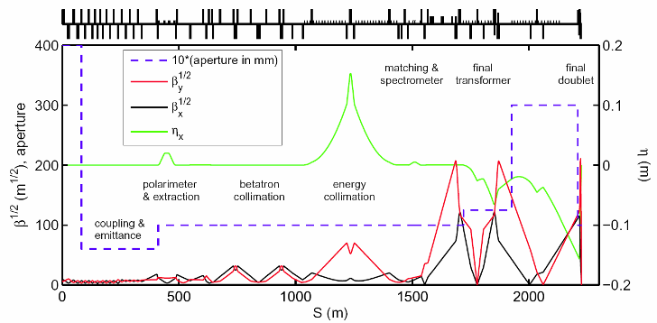
ILC BDS – what is under the hood & optional optimization for HALHF
linac
IP
Revise 1um laser wire resolution
Optimize collimation assumptions (survivable vs consumable), include tail cleaning in plasma stages
Optimize L*
See backup slides for details

Slide 12
HALHF upgrade to ~TeV and multi-TeV – for discussion
For TeV and multi-TeV upgrades the most unfavorable scaling with energy is in the energy collimation system
  Distributed collimating between plasma stages will likely help
  But additional ideas and different approaches may be needed
In general, due to SR, we do not want to bend (noticeably) the part of the beam that will arrive to IP
But we also need to bend the beam so we can separate the energy tails
So, we need to bend the beam and we cannot bend the beam
Where can we look for inspirational ideas to solve this contradiction?
Let’s look around and brainstorm if some ideas may be applicable for creating a different approach to energy collimation in HALHF upgrade and multi-TeV colliders

Slide 13
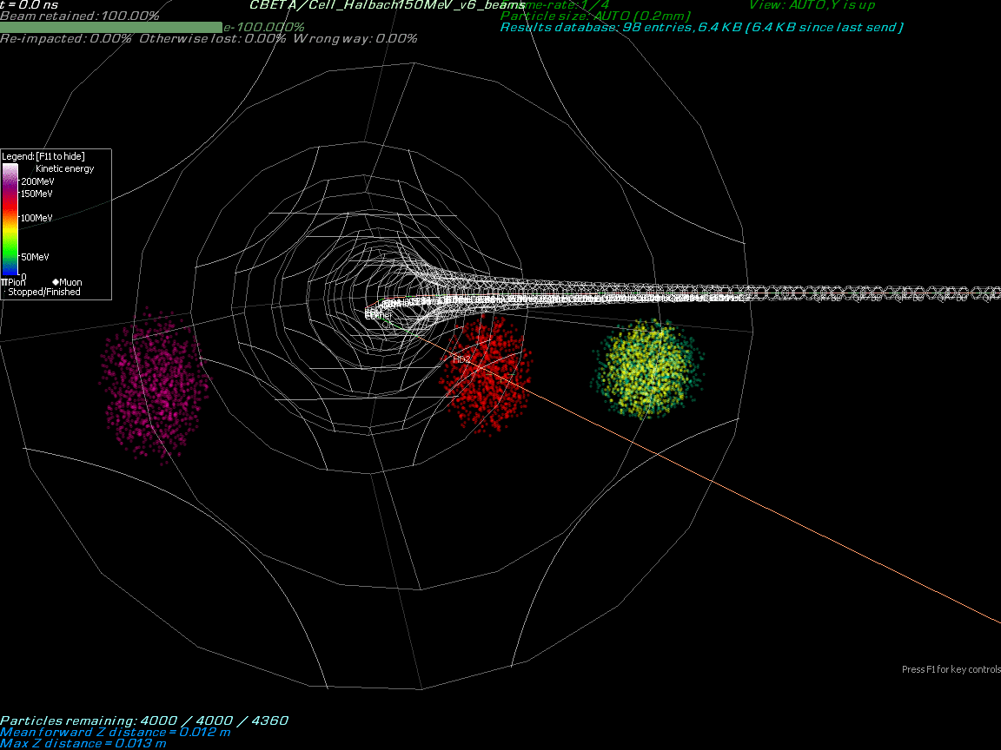
HALHF upgrade to ~TeV and multi-TeV – looking around and brainstorming
Four beams from different passes Bending in the Arc through one FFA beamline.
FFA is optimized so that bunches of very different energy stay inside of the same magnet aperture
Hypothesis: optimization of FFA-like beamline can be reversed, so that the selected energy have very smooth curved trajectory, but particles with energy offset will have very fast deviation from the central trajectory – this approach may be used for creating energy collimation system for multi-TeV colliders
Stephen Brooks
BNL

Slide 14
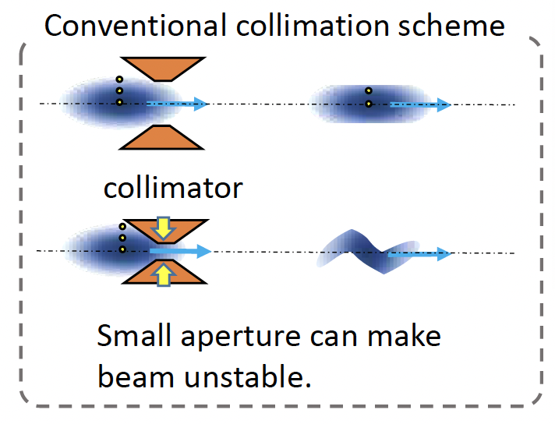
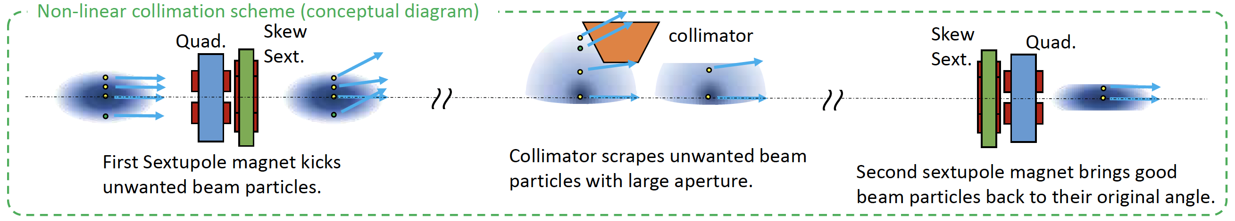
HALHF upgrade to ~TeV and multi-TeV – looking around and brainstorming
SuperKEKB installed transverse nonlinear collimation system, Makoto Tobiyama, IPAC24
But for our case we need energy collimation…

Slide 15
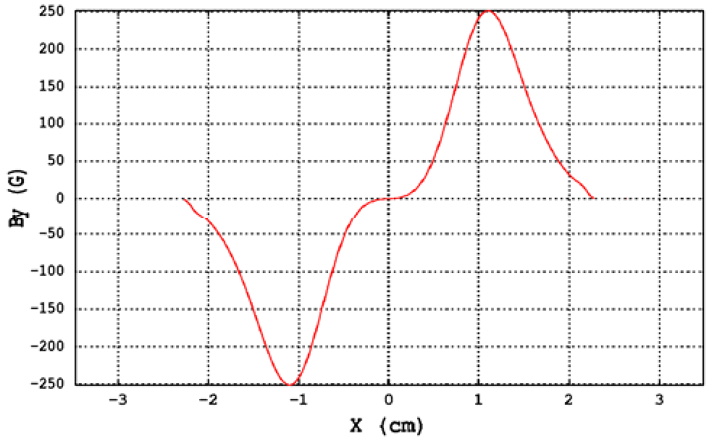
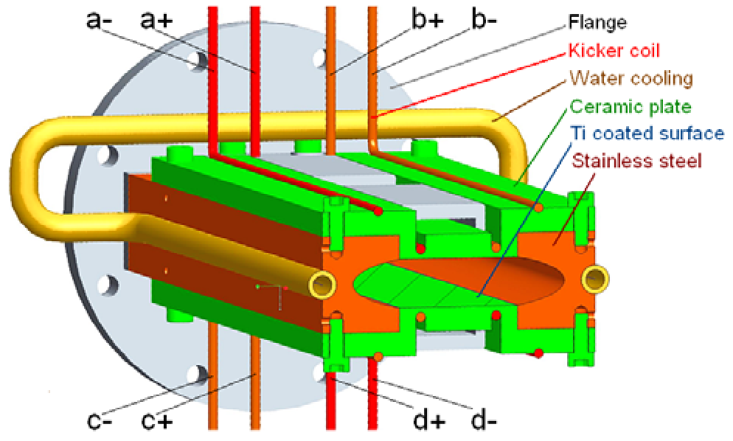
HALHF upgrade to ~TeV and multi-TeV – looking around and brainstorming
Non-linear kicker for light sources:
Inner and outer wires create 0-field region
Circulating beam see zero field
Injected beam see max field
Stronger focusing optics is possible
Stored beam
Injected beam
Atkinson, IPAC2011, BESSY II https://accelconf.web.cern.ch/IPAC2011/papers/thpo024.pdf

Slide 16
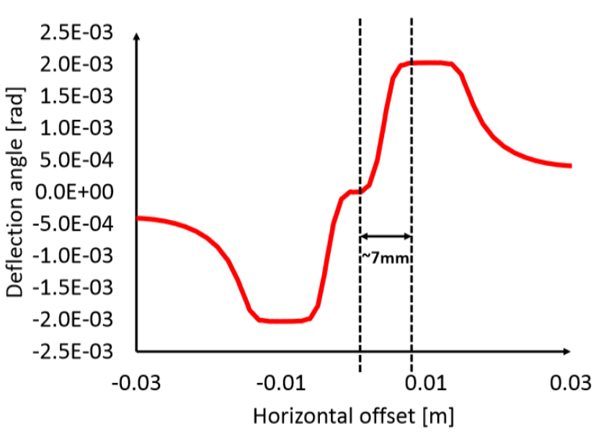
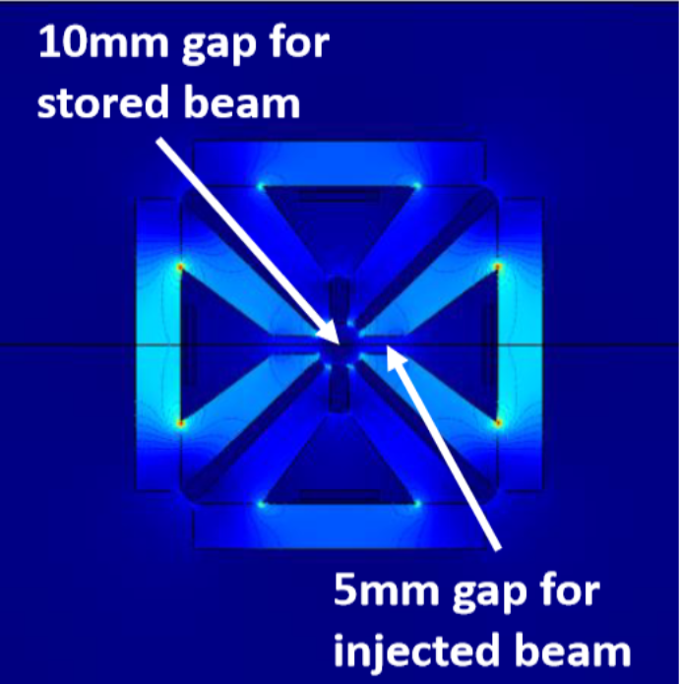
HALHF upgrade to ~TeV and multi-TeV – looking around and brainstorming
Non-linear kicker for light sources:
Octupole ferrite core kicker
Circulating beam see zero field
Injected beam see max field
Stronger focusing optics is possible
Stored beam
Injected beam
S White, IPAC2019, ESRF-EBS https://accelconf.web.cern.ch/ipac2019/papers/mopgw008.pdf

Slide 17
HALHF upgrade to ~TeV and multi-TeV – looking around and brainstorming
What if we use such nonlinear magnetic field, offset it with weak constant field, and use such field instead of standard dipoles in the energy collimation system?
Beam core
B=0
Beam tail
Hypothesis: such nonlinear bends will drastically increase effective dispersion function for the particles that we will want to collimate, allowing to shorten collimation system for multi-TeV
(Things to watch – beam core preservation, “blind spot” where B=0, …)

Slide 18
HALHF upgrade to round beam and advanced focusing – for discussion
For round beam with triplet focusing
  Collimation depth, which for flat beam can be 10/100 (x/y) will change to around 10/10
  Scaling of collimation with energy will probably not change, but watch for larger fraction of the tail to be collimated, larger jitter amplification factor, etc.
Plasma lens
  If it can indeed be inserted close to IP, effectively reducing L*, and without inserting intolerable amount of material inside of detector (!!!), then
  It can allow to dramatically decrease FF length and also the length of the collimation system

Slide 19
Backup slides
June AAC slides on general discussion of BDS for advanced colliders

Slide 20
To start and stimulate discussion
Let’s review the design approaches for Beam Delivery and Machine Detector Interface for advanced colliders, starting from designs of classical colliders, and discussing what design assumptions need to be revisited and how, in order to arrive to an optimal design suitable for next generation concepts
Outline
  Classical colliders BDS/MDI assumptions
    Diagnostic session
    Collimation section
    Final focus system
    Interaction region
    Extraction system
  What can be changes for advanced colliders
Next - briefly review designs of BDS/MDI on the example of NLC or ILC BDS, discussing important assumptions, and indicating where we can and should revise the assumptions in order to design BDS system suitable for plasma-based advanced collider

Slide 21
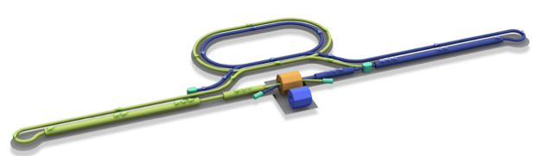
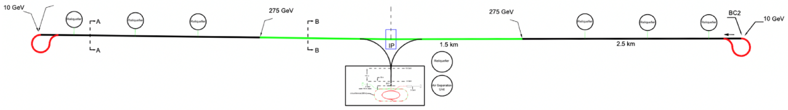
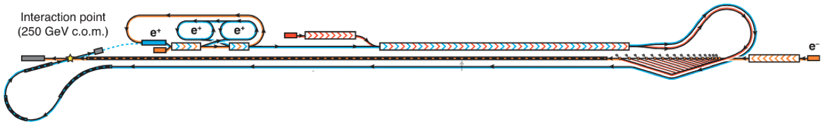
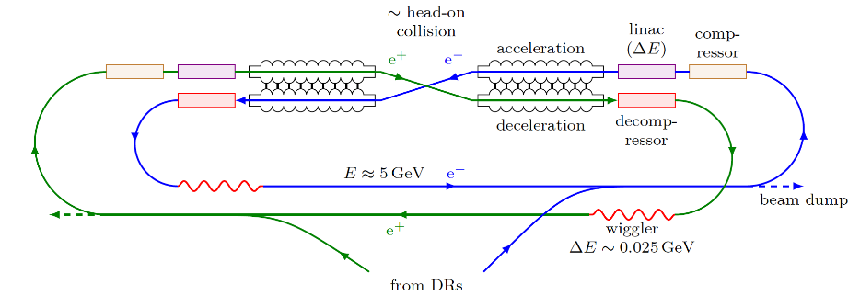
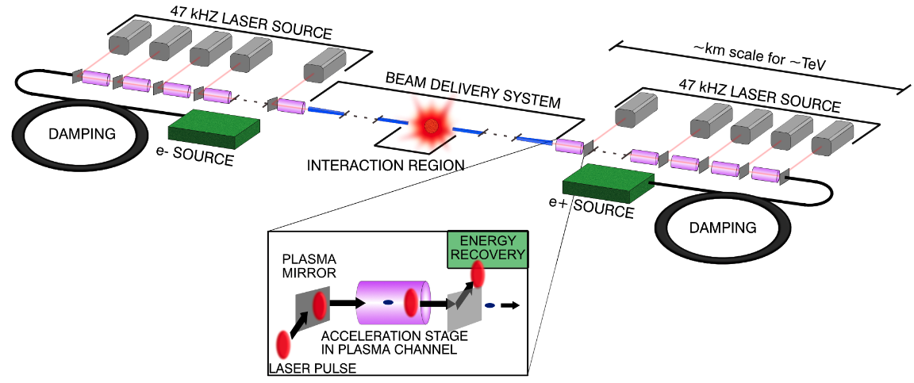
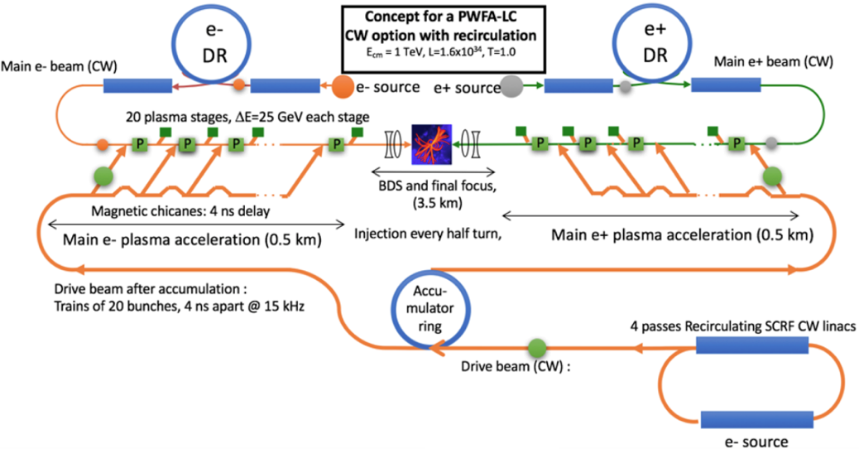
Linear collider Higgs factories and multi-TeV advanced linear colliders
C3
ILC
HALHF
See slides below
ERLC
B Foster et al 2023 New J. Phys. 25 093037
RF dipole crab cavity
Laser-driven plasma wakefield collider
Many of these designs took BDS from ILC (directly or with scaling) as a “black box”. Our goals for this talk to open the hood of BDS and discuss requirements of sub-systems, to eventually come up with a tailored design
Beam-driven plasma wakefield collider

Slide 22
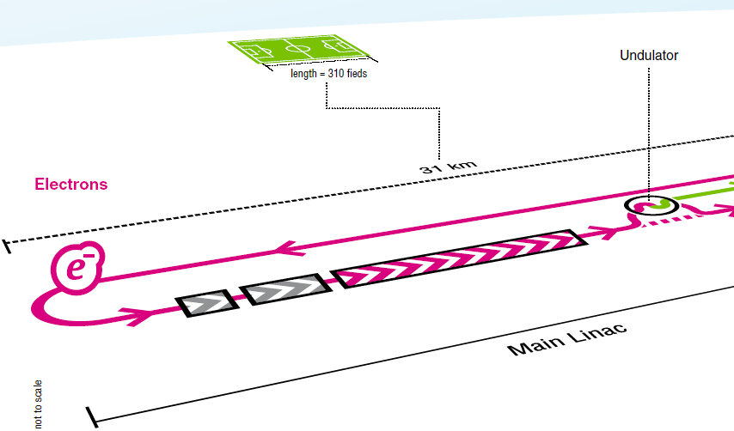
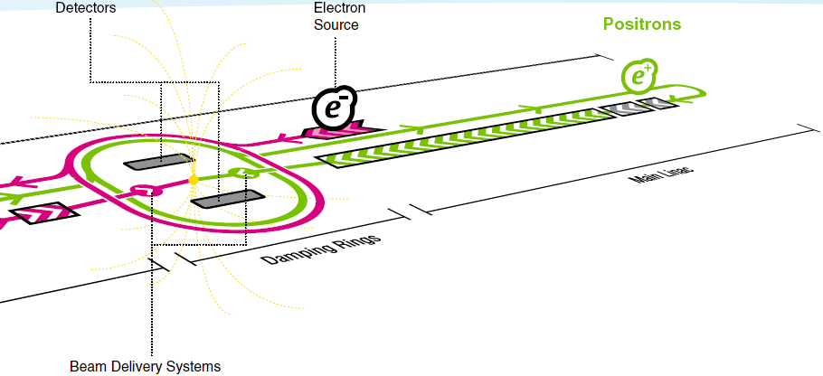
ILC Beam Delivery System and BDS tasks
Beam Delivery System (BDS)
It includes FF, and many other systems
Measure the linac beam and match it into the final focus
Remove large amplitude particles (beam-halo) from the linac to minimize background in the detectors
Measure and monitor key physics parameters (energy and polarization before and after collisions)
Ensure that the extremely small beams collide optimally at the IP
Protect the beamline and detector against mis-steered beams from the main linacs and safely extract them to beam dump

Slide 23
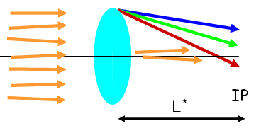
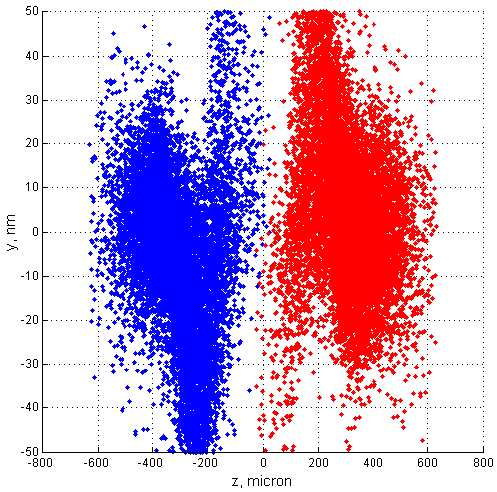
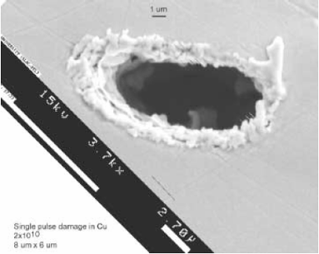
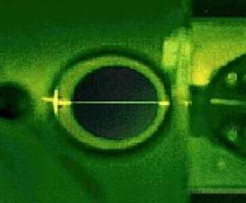
Factors driving BDS design (classical collider, like ILC)
Final Doublet chromaticity
  local compensation of chromaticity
Beam-beam effects
  background, IR and extraction design
SR emittance growth in BDS bends
  weak and long
Halo collimation
  survivability of spoilers
Beam diagnostics
  measurable size at laser wires
…

Slide 24
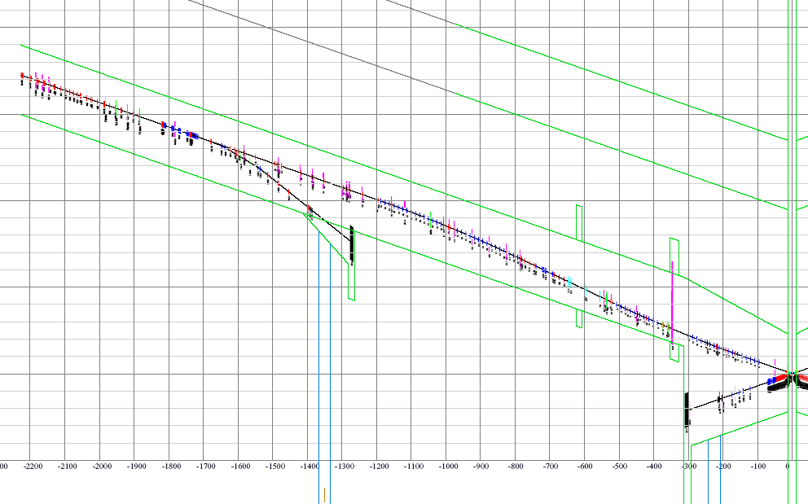
ILC BDS sub-sections & assumptions to be discussed
Diagnostic session
  Laser wire resolution
Tuning section
  N degrees to match
Collimation section
  Consumable or survivable
  N planes to collimate
  N collimations per plane
  Degree of cleanness
  Muons protection
Final focus system
  Classic vs local comp.
    E range, E spread
  Interaction region
  Extraction system
Diagnostics
Beam
Switch
Yard
β-collimator
Sacrificial
collimators
E-collimator
Final Focus
Tune-up & emergency Extraction
14mr IR
Tune-up dump
Muon wall
grid: 100m*1m
Main dump
Extraction

Slide 25
ILC BDS – what is under the hood & moving to multi-TeV
linac
IP
Revise laser wire resolution
Revise collimation assumptions, include tail cleaning in plasma stages
Revise L* and use of plasma lenses

Slide 26
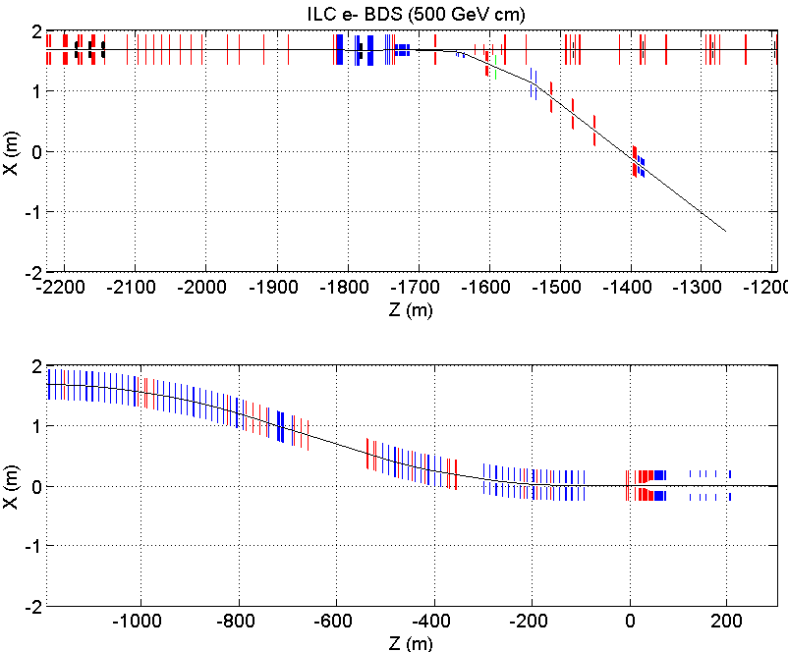
BDS diagnostics
MPS
coll
skew correction /
emittance diagnostic
polarimeter
septa
betatron
collimation
Skew correction and diagnostics section
Assume that large incoming errors can be corrected – to be reviewed
Assume that laser wire resolution is 1 micron – better laser wires may allow reducing space requirements
fast
kickers
fast
sweepers
tuneup
dump
beta
match
final
transformer
polarimeter
energy
collimation
IP
primary
dump
energy
spectrometer
fast
sweepers
final
doublet
energy
spectrometer
In RED: assumptions to be revised for advanced collider

Slide 27
BDS collimation
MPS
coll
skew correction /
emittance diagnostic
polarimeter
septa
betatron
collimation
Longest part of BDS!
Assumptions to revisit:
Spoilers-absorbers concept
Survivable vs consumable spoilers
Number of planes to collimate
Halo source location not know in ILC but know in plasma LC – plasma stages
Degree of cleanness to achieve in collimation (in muon collider tails generate everywhere) – match performance at 10TeV
fast
kickers
fast
sweepers
tuneup
dump
beta
match
final
transformer
polarimeter
energy
collimation
IP
primary
dump
energy
spectrometer
fast
sweepers
final
doublet
energy
spectrometer

Slide 28
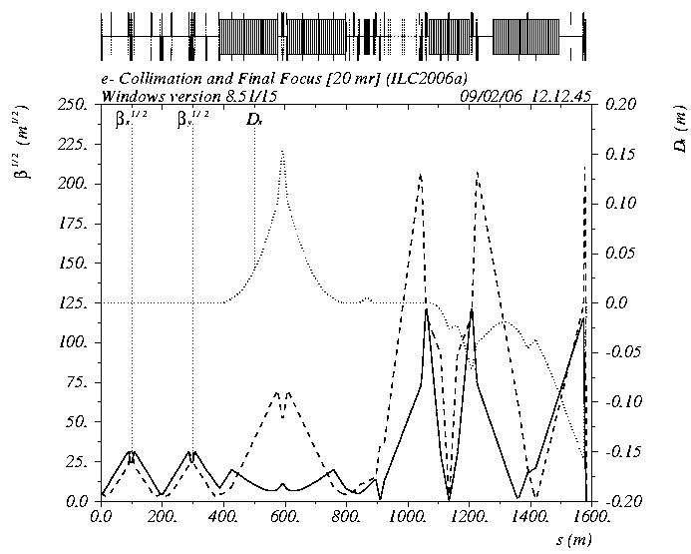
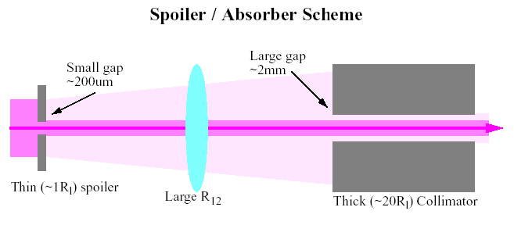
ILC BDS with survivable spoilers
Betatron spoilers survive up to two bunches (which MPS can let through – to review & revise)
E-spoiler survive several bunches
One spoiler per FD or IP phase
It is longer
Thin spoiler increases beam divergence and size at the thick absorber already sufficiently large. Absorber is away from the beam and contributes much less to wakefields.
Beam Delivery System Optics, a version with survivable spoilers

Slide 29
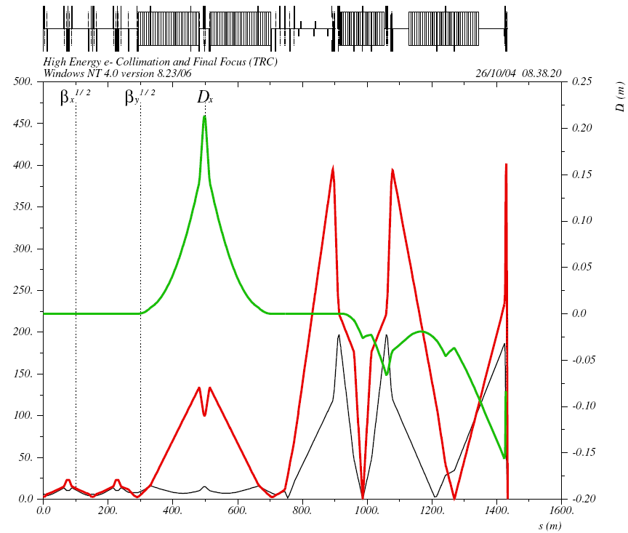
NLC BDS with consumable spoilers
Consumable spoilers – e.g. rotating wheel
Location of spoiler and absorbers is shown
Collimators were placed both at FD betatron phase and at IP phase
Two spoilers per FD and IP phase
Energy collimator is placed in the region with large dispersion
Secondary clean-up collimators located in FF part
Tail folding octupoles are included
It is shorter
Beam Delivery System Optics, a version with consumable spoilers

Slide 30
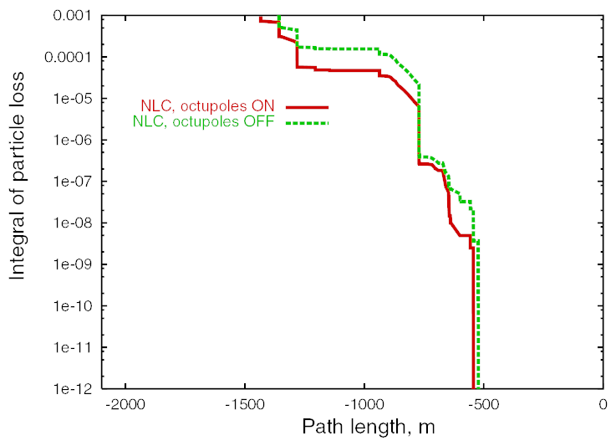
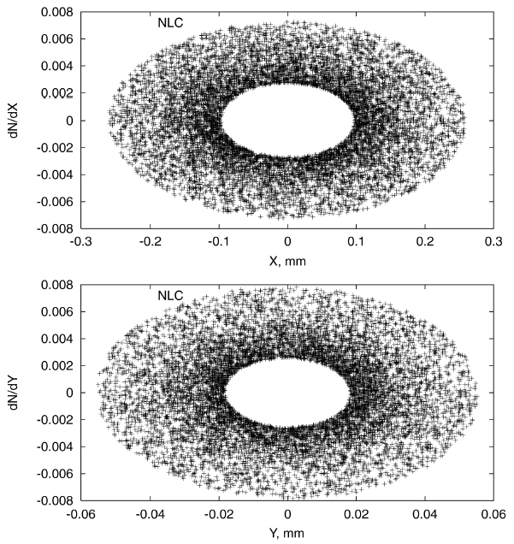
BDS Collimation assumptions
In ILC/NLC there are no beam halo losses closer than 500m from IP
This can be revised for plasma LC, since for mu-collider losses occur anywhere – match similar performance and compare
In ILC/NLC source of beam halo is not known
In plasma collider source of halo is likely known – this is each of many plasma acceleration stages!
Need to include local collimation on the way, this may allow reducing length of collimation section at the top energy
Collimation cleanness to be revised
Beam halo losses in NLC (ILC is similar). The collimation system ensures there are no losses closer than 500m from the IP

Slide 31
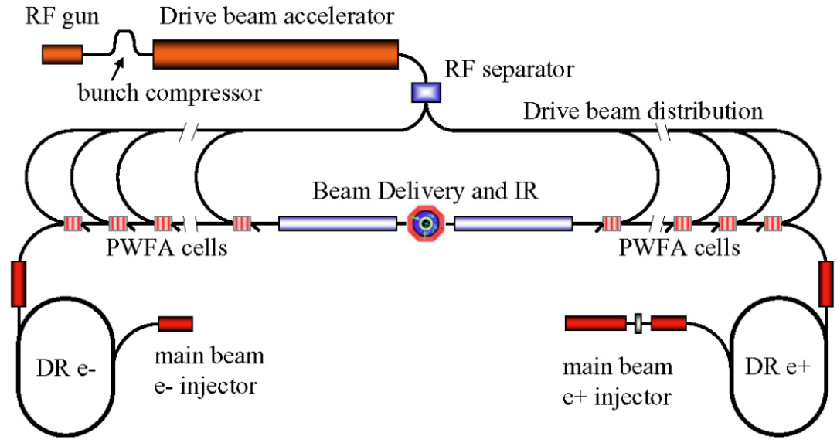
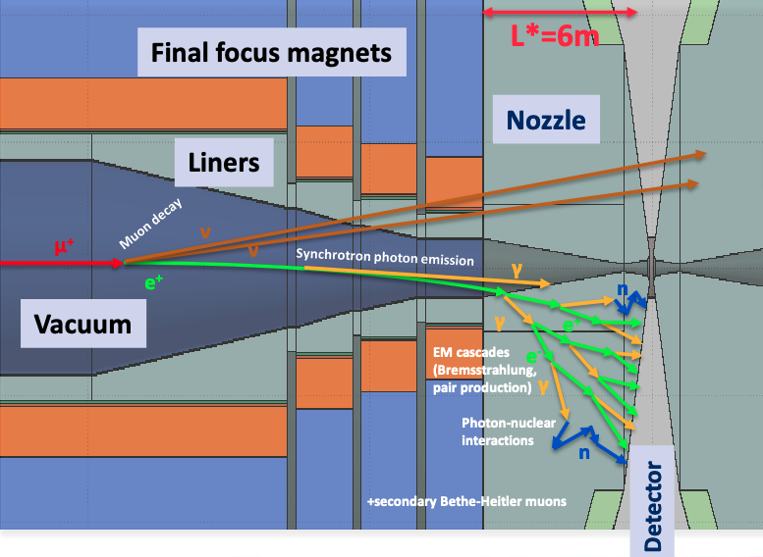
Final focus, collimation and MDI – muon and plasma colliders – common issues
ILC Final Focus is just 1/3 of Beam Delivery, length dominated by collimation
Multi-TeV plasma collider will likely generate large halo in plasma stages
A. Seryi, et al., PAC09, WE6PFP081
Muon collider needs protective nozzle in IR and beam halo mitigation
Raimondi & Seryi PRL 86, 3779, 2001
Example of where common approach needed for different designs
Muon collider may need similar approach for distributed beam halo cleaning as in plasma collider
Plasma collider may need IR nozzle as in muon collider to shorten its beam delivery and reduce footprint
A. Lechner, IMCC & MuCol MDI Workshop 2024

Slide 32
BDS MPS
MPS
coll
skew correction /
emittance diagnostic
polarimeter
septa
betatron
collimation
Not the longest but crucially important for defining design parameters of, e.g. collimation system
One of the key numbers: how many erroneous full E bunches can be let through
Design depends on details of the parameters
fast
kickers
fast
sweepers
tuneup
dump
beta
match
final
transformer
polarimeter
energy
collimation
IP
primary
dump
energy
spectrometer
fast
sweepers
final
doublet
energy
spectrometer

Slide 33
BDS Final Focus
MPS
coll
skew correction /
emittance diagnostic
polarimeter
septa
betatron
collimation
Is relatively short due to local compensation of chromaticity
Assumptions to revisit:
Energy losses and energy spread
Shorter L* would allow shorter FF
  Focusing closer into the detector, or
  Plasma lenses near IP to effectively reduce L*
fast
kickers
fast
sweepers
tuneup
dump
beta
match
final
transformer
polarimeter
energy
collimation
IP
primary
dump
energy
spectrometer
fast
sweepers
final
doublet
energy
spectrometer

Slide 34
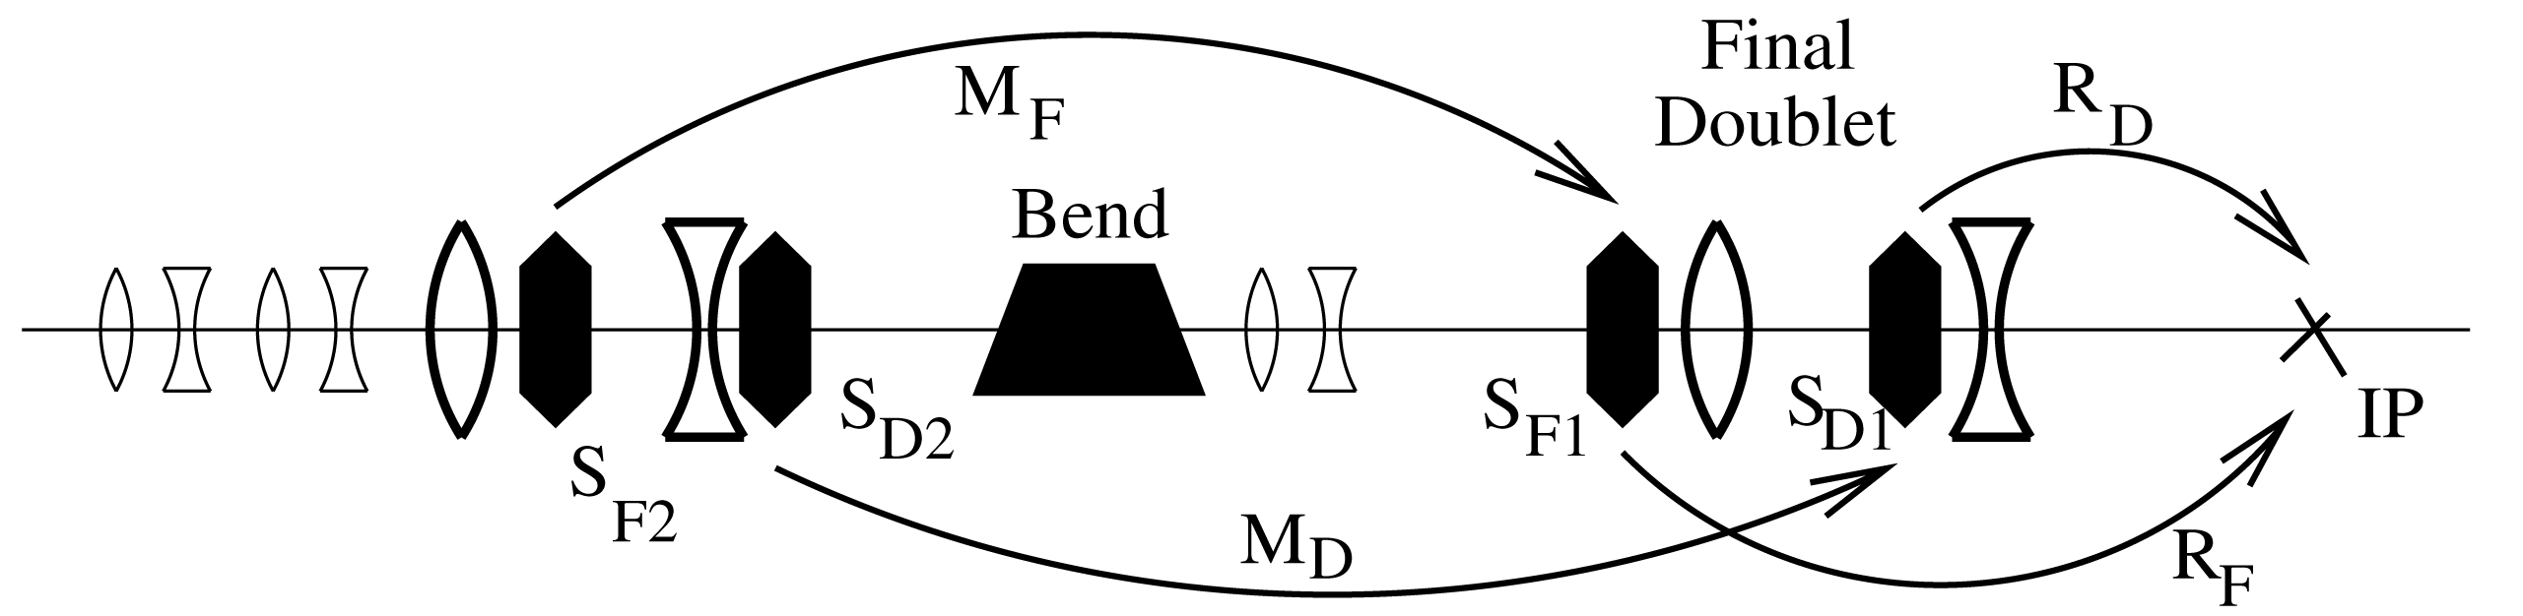
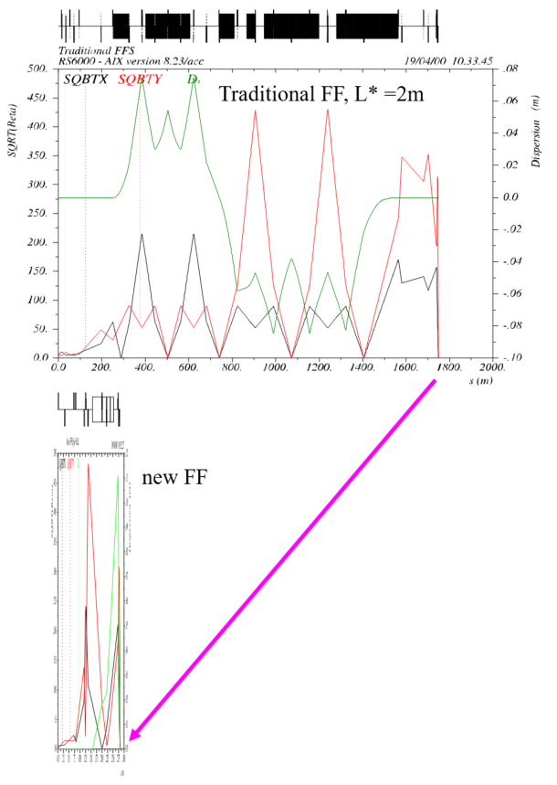
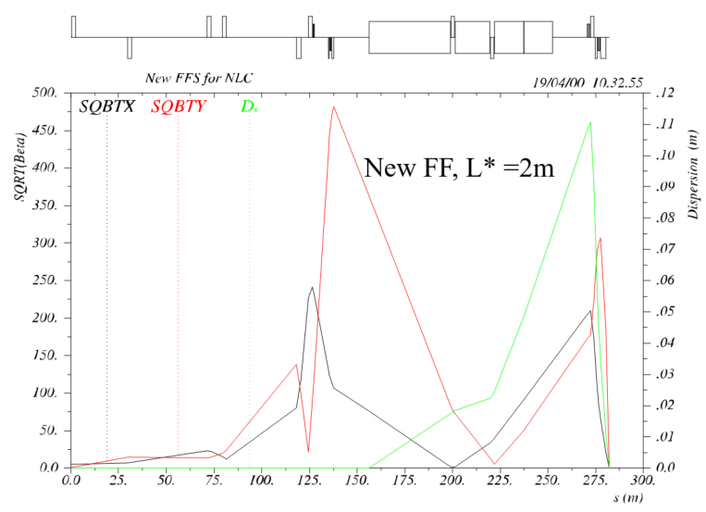
FF with non-local and local chromaticity compensation
FF with local chromaticity compensation with the same performance can be ~300m long, i.e. 6 times shorter
Moreover, its necessary length scales only as E^{2/5} with energy! One can design multi-TeV FF in under a km!
Example of NLC FF – with 2m L* it is <300m

Slide 35
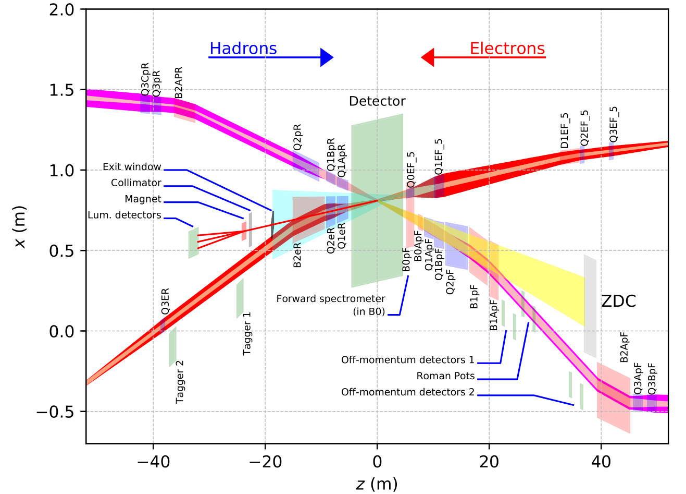
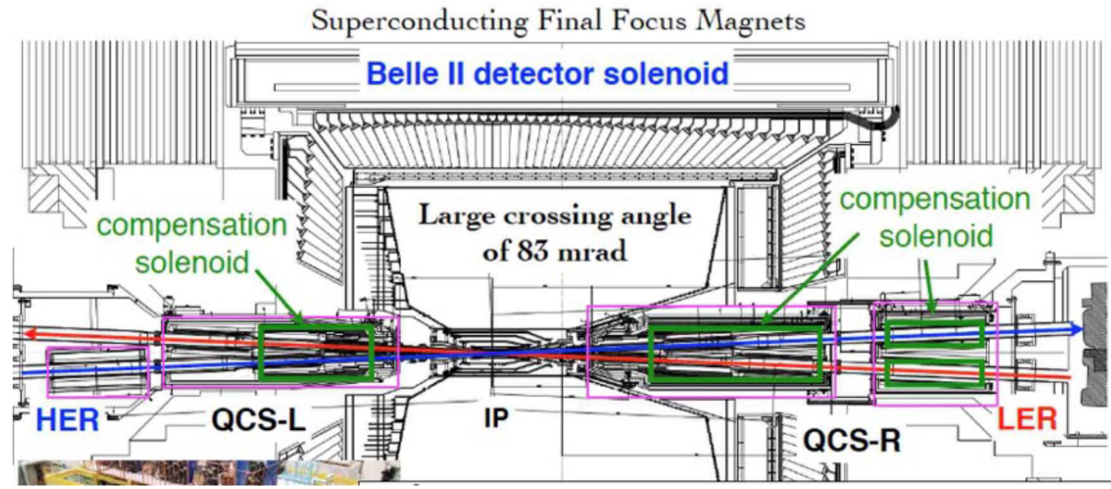
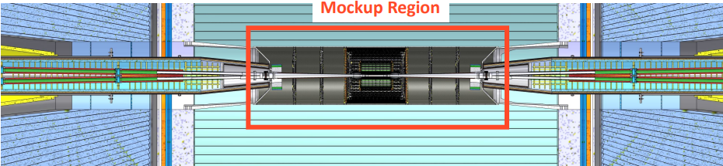
Importance to keep in touch with near future colliders designs & projects
EIC
Super KEKB
FCC-ee IR mock-up assembly & test lab at INFN Frascati
EIC Accelerator Collaboration working groups may be one of the ways to keep in touch

Slide 36
Summary: Major projects and concepts, and common challenges
Higgs factories – linear colliders
  International Linear Collider
  CLIC 250/380 GeV
  C3
  HELEN, ERLC, CLERC, ReLiC, Ghost-LC
  HALFH asymmetric plasma collider
Higgs factories – circular colliders
  FCCee; CepC
Multi-TeV colliders
  Muon collider
  Plasma collider
Electron-Ion Collider
CEBAF e+ and energy upgrade
Interaction Region
& MDI
Energy Recovery
Final Focus
& Collimation
High gradient acceleration
Beam-beam
Beam Cooling
beyond state of the art
Energy efficiency
Novel magnets
Positrons gen. & acc.
Many of these challenges require common R&D approach even for completely different concepts, and this is certainly very important for BDS/MDI areas

