Slide 1
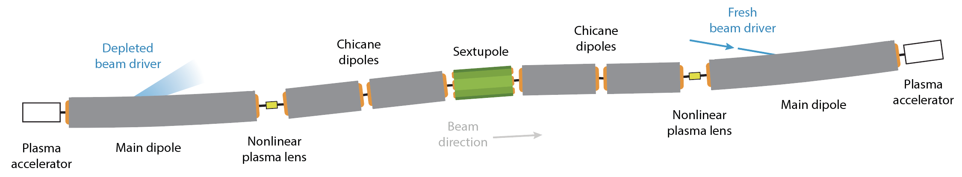
Q5 – Plasma-linac design staging, driver distribution
Driver transport and dump
Beam diagnostics and dump
Beam dynamics within the plasma stages
Next steps

Slide 2
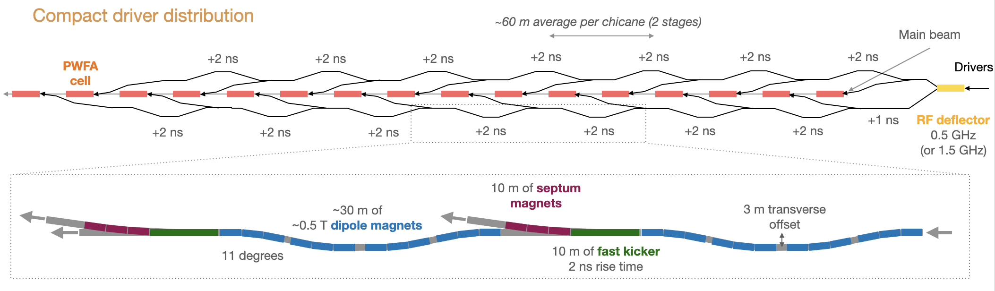
Q5 – Driver transport, diagnostics, beam dump
Delay chicanes
  Could be vertical or horizontal while injecting horizontal.
  Driver jitters important to monitor/control.
Fast kickers
  Ramp-up time < 1 ns, ramp-down < 80 ns: challenging in particular for stability.
  Harmonic kickers could be a solution?
  CW makes it easier?
Combiner ring
  Seems necessary, more time for ramp-down for the kickers.
Beam dumps
  Large average power, accept 10-100% initial driver energy.
  Conventional diagnostics.
No show-stopper. CW or not hugely important ( except for kickers).
Jitters in the vertical direction need careful monitoring.

Slide 3
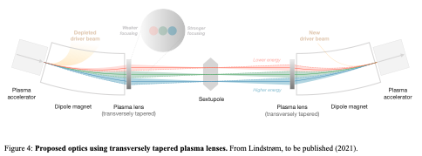
Q5 – Beam diagnostics and dump
Commissioning day 1: stage by stage, with diagnostics in each section
Could flip some dipole
BPMs probably before and after every stage; pointing needs to be monitored.
Online spectrometer around the sextupole in the coupling section?
Betatron radiation as diagnostics after each stage?
It’s a high-radiation environment, a concern for later.
Selective beamline, collimation clarified by Andrei
No show-stopper

Slide 4
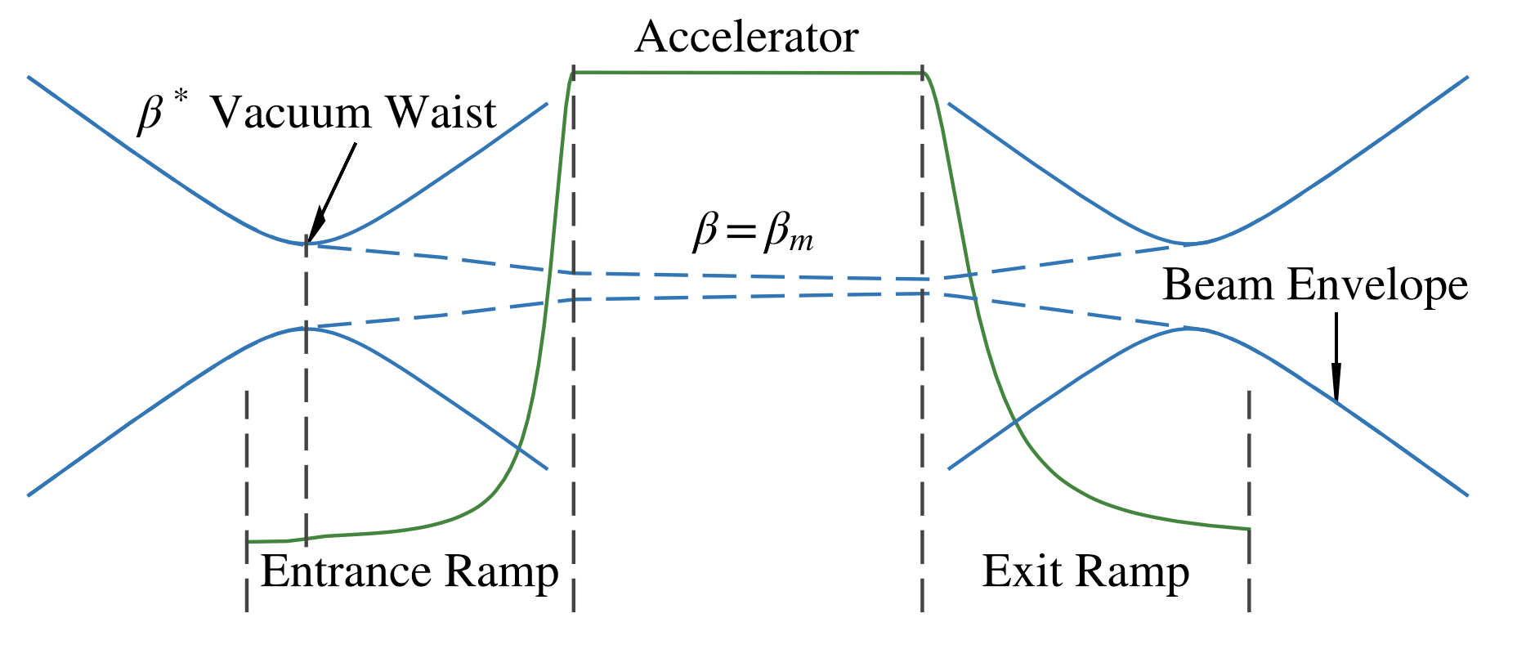
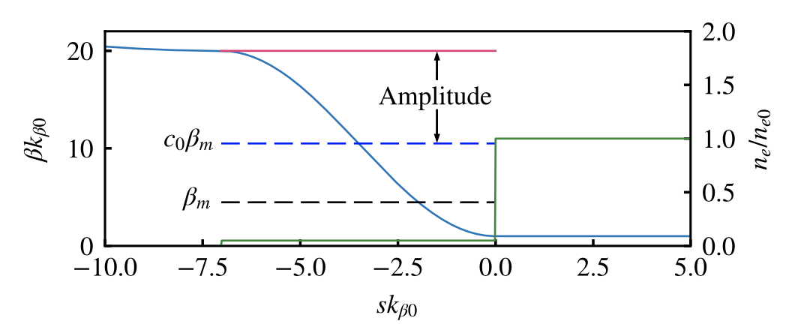
Q5 – Within the plasma
Ariniello et al. PRAB 22, 041304 (2019)
Plasma density ramps needs to be studies
  required for matching.
  but time-varying ion motion caused by driver may affect beam?
Guiding of driver likely necessary
  10 nm position error at the end of 10 m plasma stage → 1 nano-rad tolerance
Driver pinching (& hosing) should be monitored
  can create an time-depend ion motion
Needs some simulation study, doable today

Slide 5
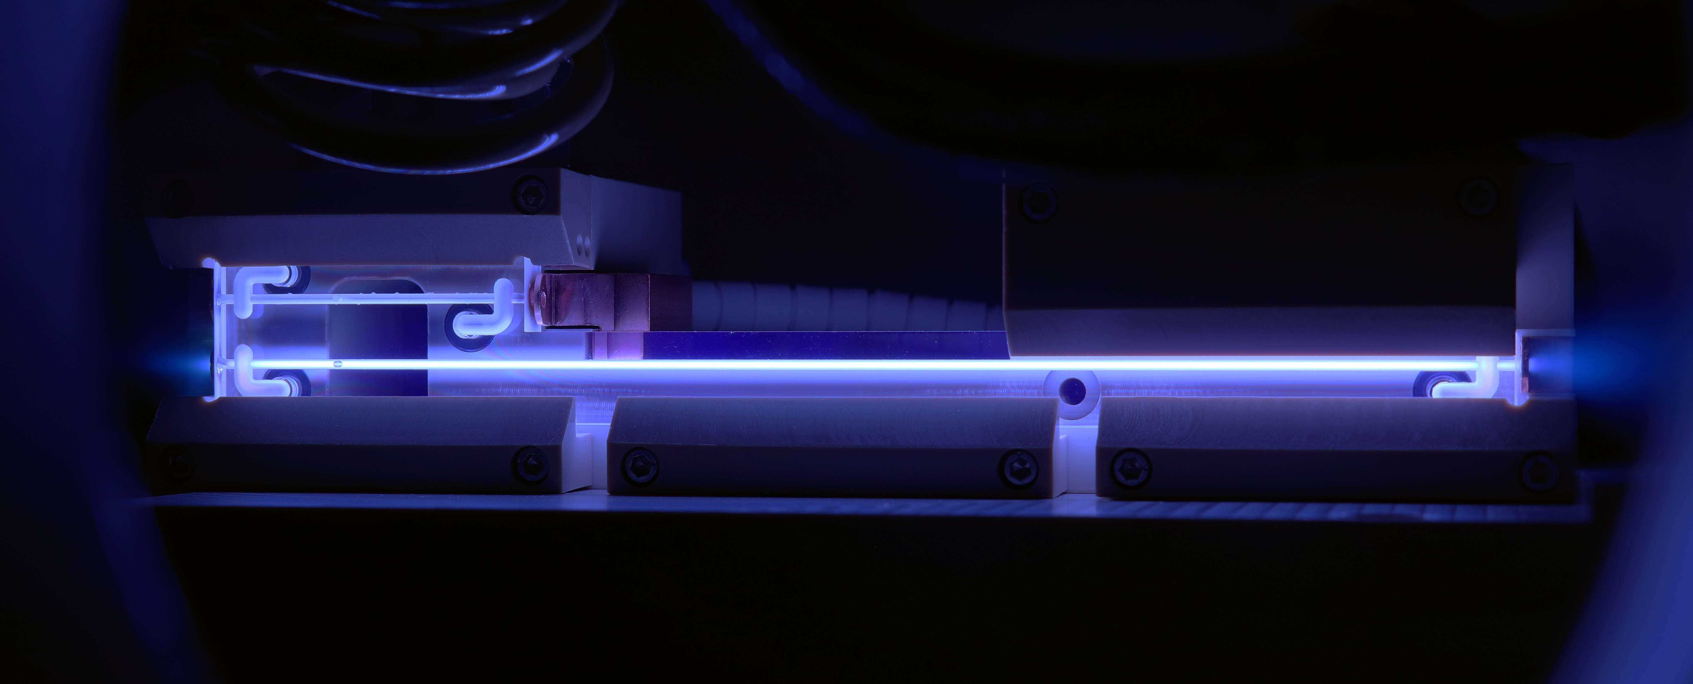
Q5 – Next steps
Simulation studies
  Ion motion & plasma ramps.
  Driver mismatch/pinching and ion motion.
  Driver guiding as a solution?
Experimental demonstrations
  Density ramps in existing facilities.
  Later on: dedicated sources with ramps for characterization.
  Delay chicanes for later when doing 2-stage demonstration.

Slide 6
Q5 – Driver transport, diagnostics, beam dump
Driver transport and dump
  Jitters are important
Beam diagnostics and dump
  Needs consideration, but no show-stopper identified
Beam dynamics within the plasma stages
  Plasma ramps and matching of driver need careful attention
  Driver guiding most likely required
Next steps
  Ion motion in simluations
  Ramps in experiments
Overall, no critical problem identified, but some challenges.

