Slide 1
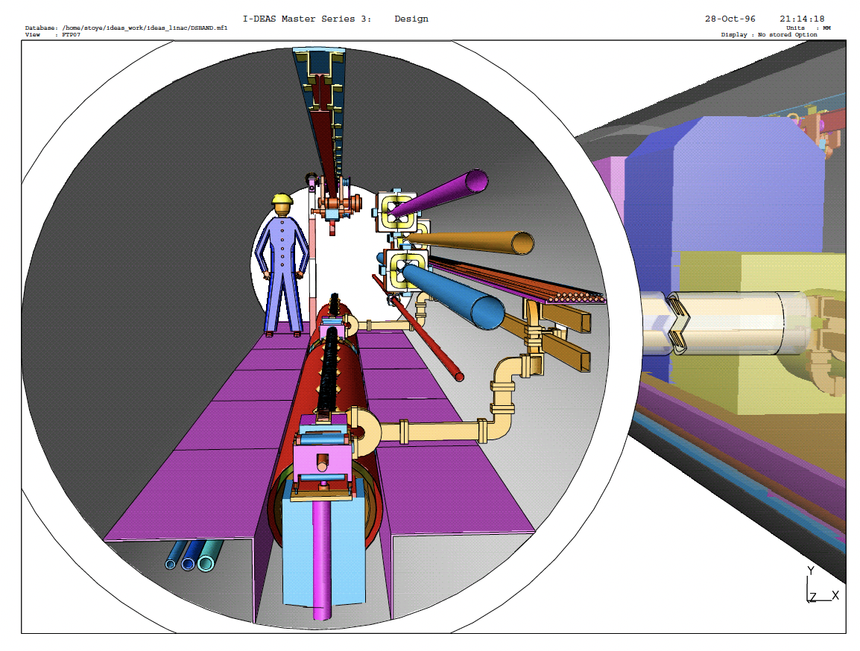
Q1: Drive Beam and
Positron Linac.
Summary of discussion sessions on conventional linacs
Benno List, DESY
HALHF workshop Erice 7.10.24

Slide 2
Proposed baseline change #3: Separate the driver and e+ linacs
#3: Separate driver and e+ linacs
  Doubles the number of linacs
  -> cost increase
  Allows separate optimisation of both linacs, decouples gradients, output energy, frequency
  -> beneficial
  Removes a lot of headaches we never considered (beam dynamics for opposite charge beams, variation of beam loading, …)
  -> beneficial
  Removes turn-around, resolves timing issues
  -> increases cost, but probably unavoidable
Keep in mind: overall pulse length must be the same for drive beam and positrons
Tension:
  want shorter pule length for high positron linac efficiency,
  limited by cost for klystrons

Slide 3
Ideas for drive and positron linacs
Positron linac:
Carl asks for 42 GeV positrons, 8nC bunch charge
High energy demands high gradient
-> try C3 like S-Band linac
Preliminary conclusion: Might work
  SLAC was S-band 2.84GHz 4nC
  But HALHF requires smaller emittance, smaller energy spread for nanobeam focus
  Large C3 gradient (60MV/m) counteracts longitudinal wakefields (next slide)
  Transverse wakefields (beam stability) was not discussed, -> question mark

Slide 4
S-Band C3 like linac for positrons
Assume
60MV/m
4.8nC (3E10)
Phi=5°
Sigma_z = 300um
RMS(energy) = 0.2%

Slide 5
Drive linac
Carl’s proposal: go CLIC like
  L-Band 1GHz
  Low gradient 2MV/m
  -> relatively long

Slide 6
Drive Linac 2MV/m
Assume
Triangular shape
Long wakefield from CLIC DB cavities (estimated, not checked)
1250um length
8nC (5E10)
2MV/m
Phase 5°
-> large energy spread: RMS 1.3%
Front - Back
Front - Back

Slide 7
Proposed baseline change #8: Reduce the driver separation
Very problematic:
Beam current and instantaneous beam power proportional to 1/delta t
-> going from 5ns to 1ns requires 5 times the klystrons, klystrons then dominate the cost
From drive linac pov: don’t do that
-> stay at the longest delta t compatible with plasma layout, maybe 4ns
-> triggered discussion in 2nd session:
  What is the core of the CLIC concept? -> pulse compression through folding
  Kyrre Sjøbaek: use delay loop to concentrate bunches in drive pulse
Put 15 bunches at 4ns into delay loop, delay by
15x4-2 = 58ns
Splice with 15 other bunches
-> get 30 bunches at 2ns
58ns is 18m circumference – a bit tight at 6GeV
-> needs some thoughts, maybe splice with next bunch train
General idea is promising, see discussion at end

Slide 8
Proposed baseline change #4: Reduce the energy asymmetry
Observation:
  Drive beam bunch energy is 2.5x bunch energy transferred to witness beam
  -> drive beam power is 2.5x witness beam power
  Overall klystron-to-beam power transfer efficiency always lower for electrons than positrons
  -> if klystron costs dominate, cost optimisation prefers smaller asymmetry
  Acerberated if drive linac is L-Band and low gradient vs S-Band e+ linac
  (L-band equipment more expensive than S-Band)
Generally:
Drive beam linac must be able to deliver beam power much, much cheaper than an equivalent conventional accelerator to justify a plasma stage
-> drive beam linac parameters must be relaxed compared to conventional accelerator
  Better RF to beam efficiency
  Lower demands on beam quality / emittance / energy spread
  Anything that makes drive beam linac cheaper to build
  Currently we move in the opposite direction: larger bunch charge (8 vs 5nC), large peak current (4A), lower frequency

Slide 9
Proposed baseline change #5: Larger number of stages
Proposed baseline change #6: Higher transformer ratio
Proposed baseline change #7: Longer bunch trains
Proposed baseline change #9: Use undulating delay chicanes
Larger number of stages:
  Lengthens pulse length
  -> reduces # klystrons
  -> see longer discussion
Higher transformer ratio:
Bunch charge (and current) in drive linac proportional to transformer ratio
-> T=2 means twice drive linac bunch charge
-> is an issue
Longer bunch trains:
not really discussed
Undulating delay chicanes:
  indirect effect on drive linac: pushes for smaller bunch separation
  -> see discussion on bunch separation

Slide 10

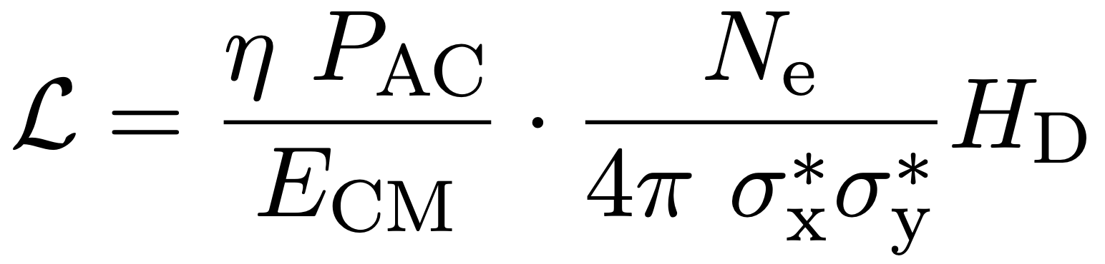
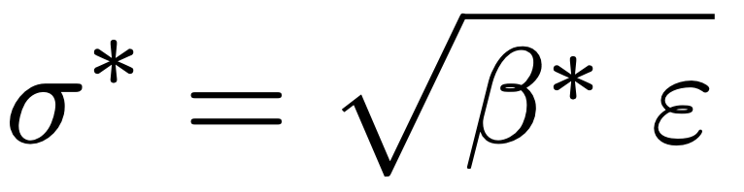
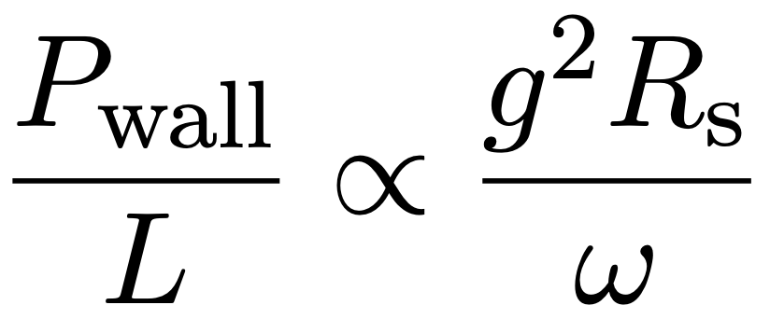
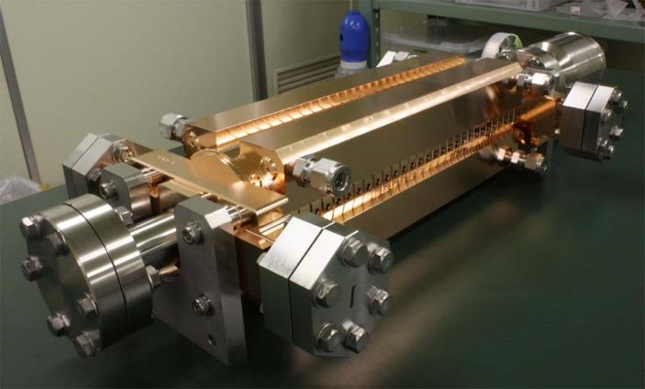
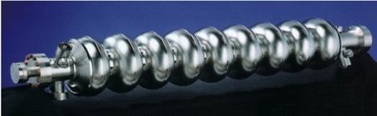
Linear Accelerator Challenges
Energy
Luminosity
Operation cost
$ ~ P_{AC}
Construction cost
$ ~ L
High Gradient g
High Efficiency η
Small Beamspot σ_{x}σ_{y}
Main Linac Technology
Losses in cavity walls
Nanobeam Technology
Damping ring (ε)
Final focus (β*)
Slide from TIPP 2021
Low resistivity
Small duty cycle:
Pulsed operation
High frequency &
Ultra-short pulses
ILC
Superconducting RF
CLIC
2 beam acceleration

Slide 11
Linear Accelerator Challenges
Energy
Luminosity
Operation cost
$ ~ P_{AC}
Plasma:
The ultimate high gradient, high frequency, short pulse option:
“Frequency”: THz?
“Cavity” fill time: femtoseconds
”pulse” is a single bunch
All the reasons why we pulse linacs with bunch trains (need to fill a cavity with RF, time to achieve stable field) do not apply
Plasma demands ultra-high instantaneous power for a single bunch
Plasma likes to have witness bunches spaced as much as possible, ideally evenly spaced
We need to transform a long-ish RF pulse into an ultra short pulse, call ratio T_{RF}
For n evenly spaced drive bunches: transformer ratio T_{RF} is given by T_{RF} = n
Increase this ratio as much as possible: Number of klystrons is prop to 1/ T_{RF}
Construction cost
$ ~ L
High Gradient g
High Efficiency η
Small Beamspot σ_{x}σ_{y}
Main Linac Technology
Losses in cavity walls
Nanobeam Technology
Damping ring (ε)
Final focus (β*)
Slide from TIPP 2021
Low resistivity
Small duty cycle:
Pulsed operation
High frequency &
Ultra-short pulses
ILC
Superconducting RF
CLIC
2 beam acceleration

Slide 12
Decouple Drive Beam bunch distance from whitness beam
Fundamental concept:
Distance between colliding (witness beam) bunches is larger than than n*Δt_{DB} (bunch separation of drive beam bunches)
Δt_{DB} drives delay chicane dimensions
-> make Δt_{DB} small (~1ns) (changes #8, #9)
Introduce additional gap to next witness beam
  New degree of freedom for optimisation
  Good for plasma recovery, cell heating etc
  Reduces average RF power – cost, # klystrons
1662ns
74ns
“ILC-HALHF bunch pattern”
4.6ns

Slide 13
Ways to increase t_{coll} / (n*Δt_{DB})
Supply drive beam with steady RF power over a time t_{coll} between colliding bunches -> make that long for low average power
Concentrate that energy into a short DB pulse of n bunches at Δt_{DB} separation
-> high instantaneous power
Requires some energy storage (similar to RF modulator)
  Drive beam bunches:
  -> beam manipulation (delay loops, combiner rings)
  -> CLIC like concept -> prefers low drive beam energy (stiffness)
  RF pulse itself: Pulse shortening
  Field in a cavity: Large cavity (L-band), high gradient stores energy: Superconducting RF (ILC-HALHF)
P
t

Slide 14
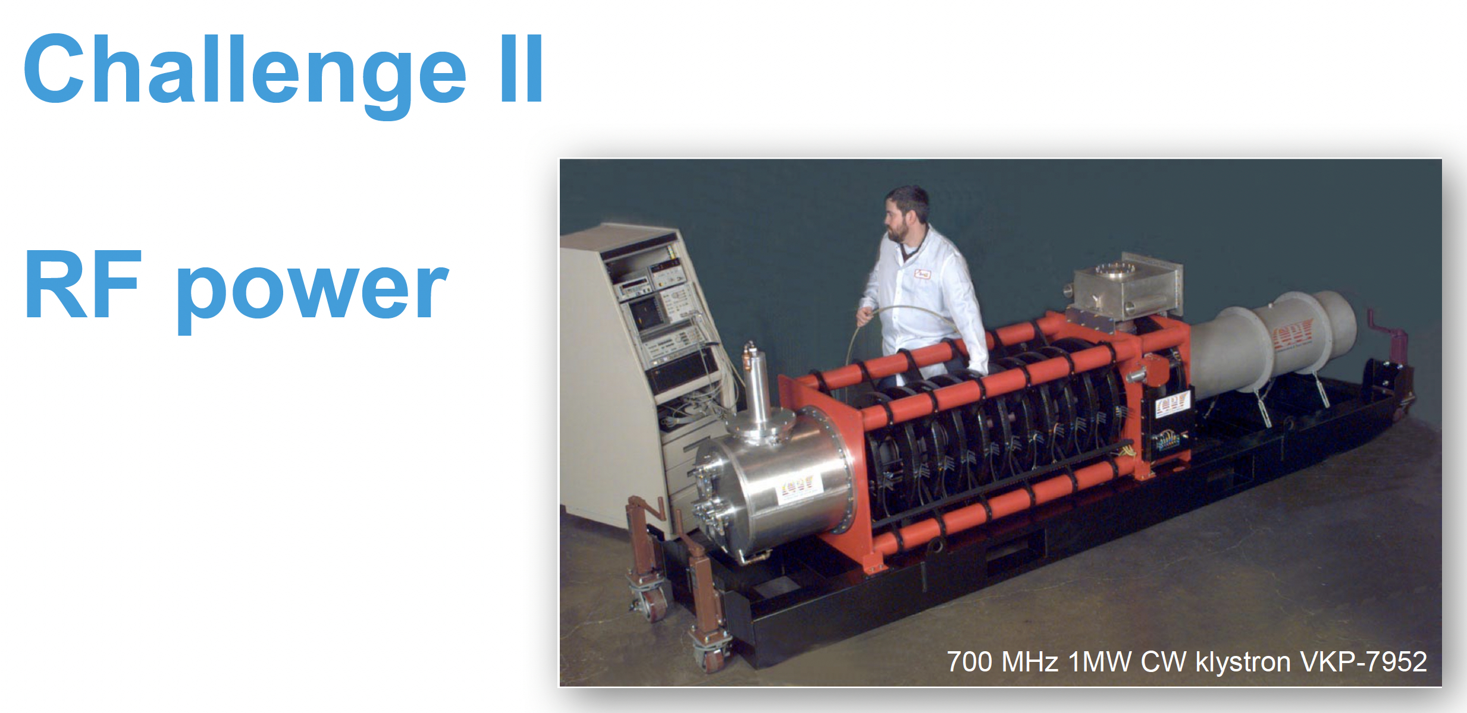
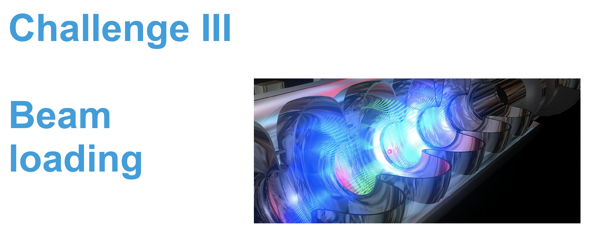
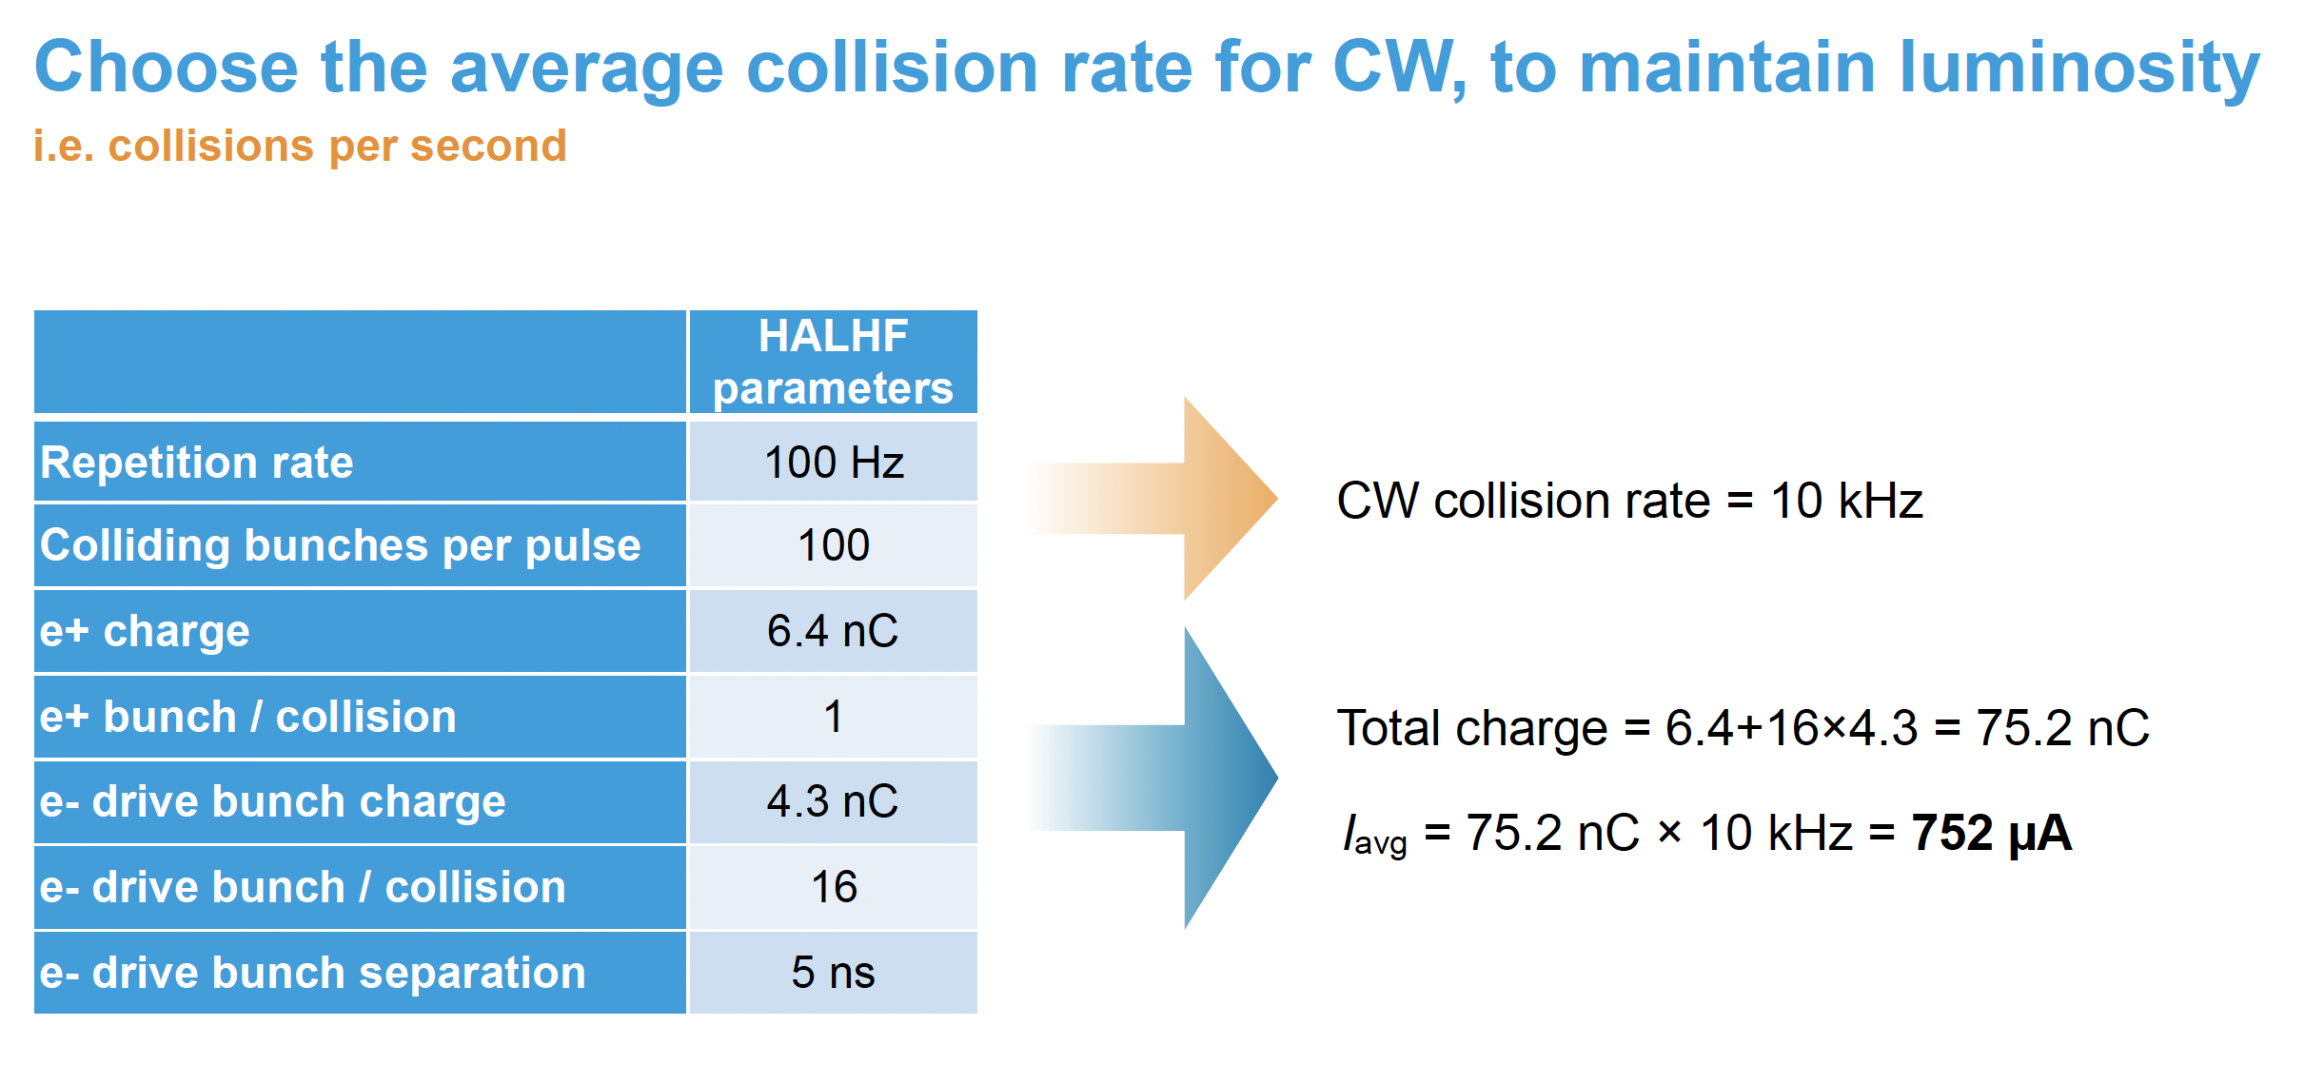
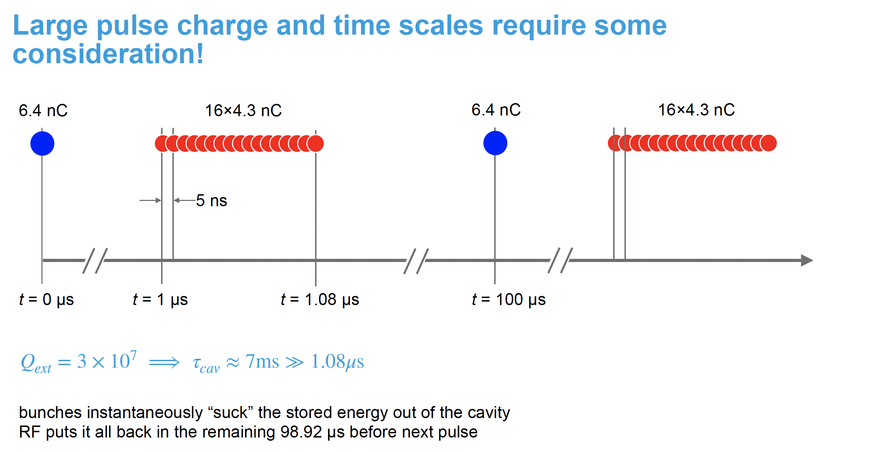
Reminder: Talk by Nick Walker in Oslo

Slide 15
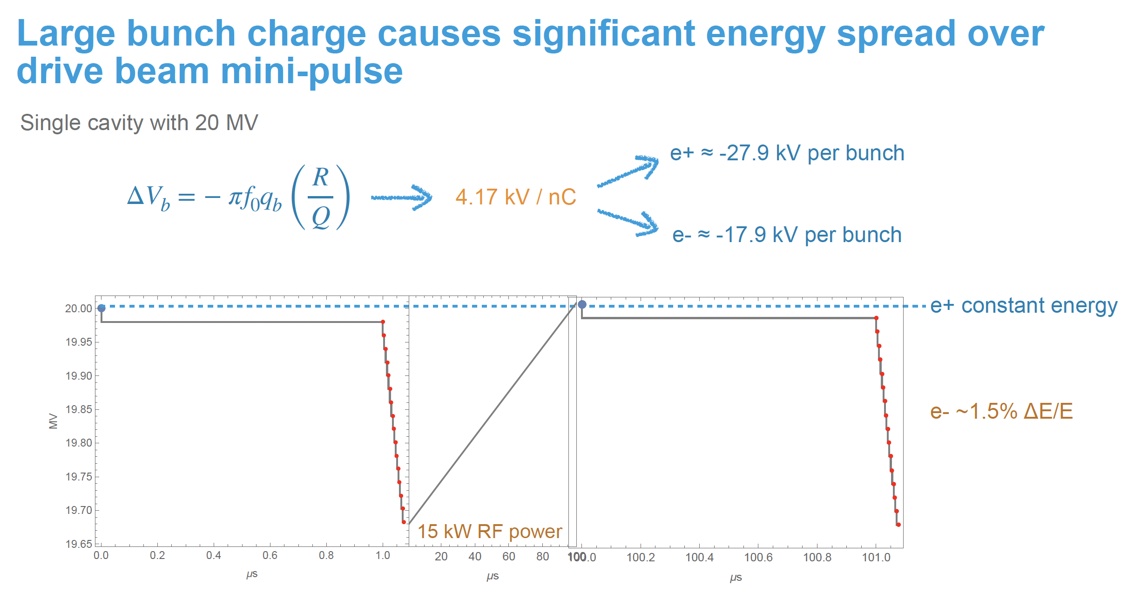
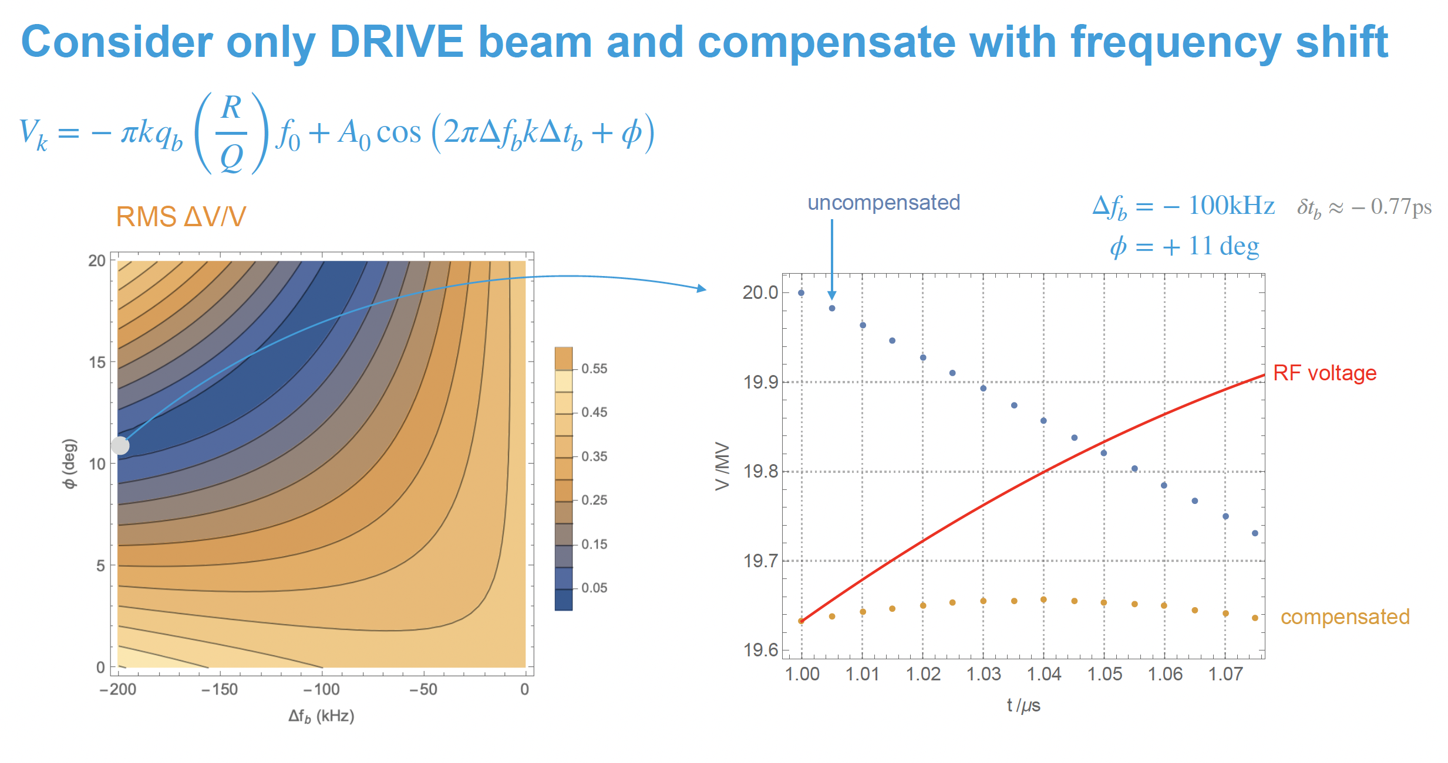
SRF Cavity as Energy Buffer
It’s not a nuisance, it’s the solution!
SRF L-Band cavity acts as power transformer:
  Fill it with low average power
  Extract energy quickly -> high instantaneous power
  Filed of the cavity is the energy reservoir
  Works because of
    Large Q0 of a superconducting cavity
    Large energy content of a large volume at high gradient (made possible by superconductivity)
  This is the fundamental reason why “HALHFing ILC” looks somewhat promising: you get with two existing, very valuable SC linacs for free!

Slide 16
What to conclude?
Plasma does not ”like” or require short, intense pulses: unlike a conventional normal conducting linac
Plasma prefers bunches spaced far apart, ideally evenly -> CW driver would be ideal
HALHF concept requires large bunch charges
-> easier at lower frequency (3GHz or less)
HALHF concept requires colliding a plasma accelerated beam with a conventionally accelerated beam -> requires compromises
Stay with pulsed scheme:
  Make pulses as long as possible, i.e. as long as conventional accelerator allows (say, 100 x 100ns for S-Band e+ linac)
  -> optimize with new degree of freedom
Go CW:
  Expensive e+ linac: superconducting, high gradient, CW
  No need for modulators – good!
  Low average power – may allow solid state amplifiers – good!
  Expensive SC e+ linac will prefer lower e+ energy -> in line with HALHF concept

Slide 17
Benno List
DESY IPP
Benno.List@desy.de
+49 40 8998 2752

