Slide 1
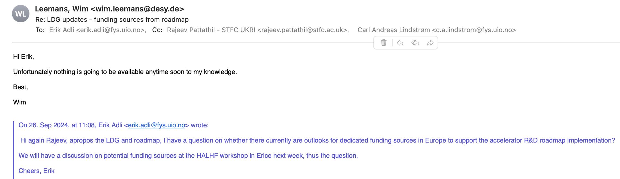
Possible future funding for HALHF/plasma collider
From LDG roadmap efforts?
From CERN? Highly unlikely, as long as FCC is on the table
Alegro plan: ERC SynGrant for LWFA paper study
From national grants, and EU
  Design studies
Discussion
Erik Adli, U. Oslo, with input from M. Vretenar, CERN/TIARA, R. Losito, CERN/MUCOL, October 5, 2024

Slide 2
Possible future funding for HALHF/plasma collider
Horizon Europe: Research infrastructures – EU projects
https://rea.ec.europa.eu/funding-and-grants/horizon-europe-research-infrastructures_en
Developing, consolidating and optimising the European research infrastructures landscape, maintaining global leadership (INFRADEV) – aka Design Studies, (ca 3 MEUR)
Next generation of scientific instrumentation, tools and methods and advanced digital solutions (INFRATECH) – hardware oriented (<= 10 MEUR)
Erik Adli, U. Oslo, with input from M. Vretenar, CERN/TIARA, R. Losito, CERN/MUCOL, October 5, 2024

Slide 3
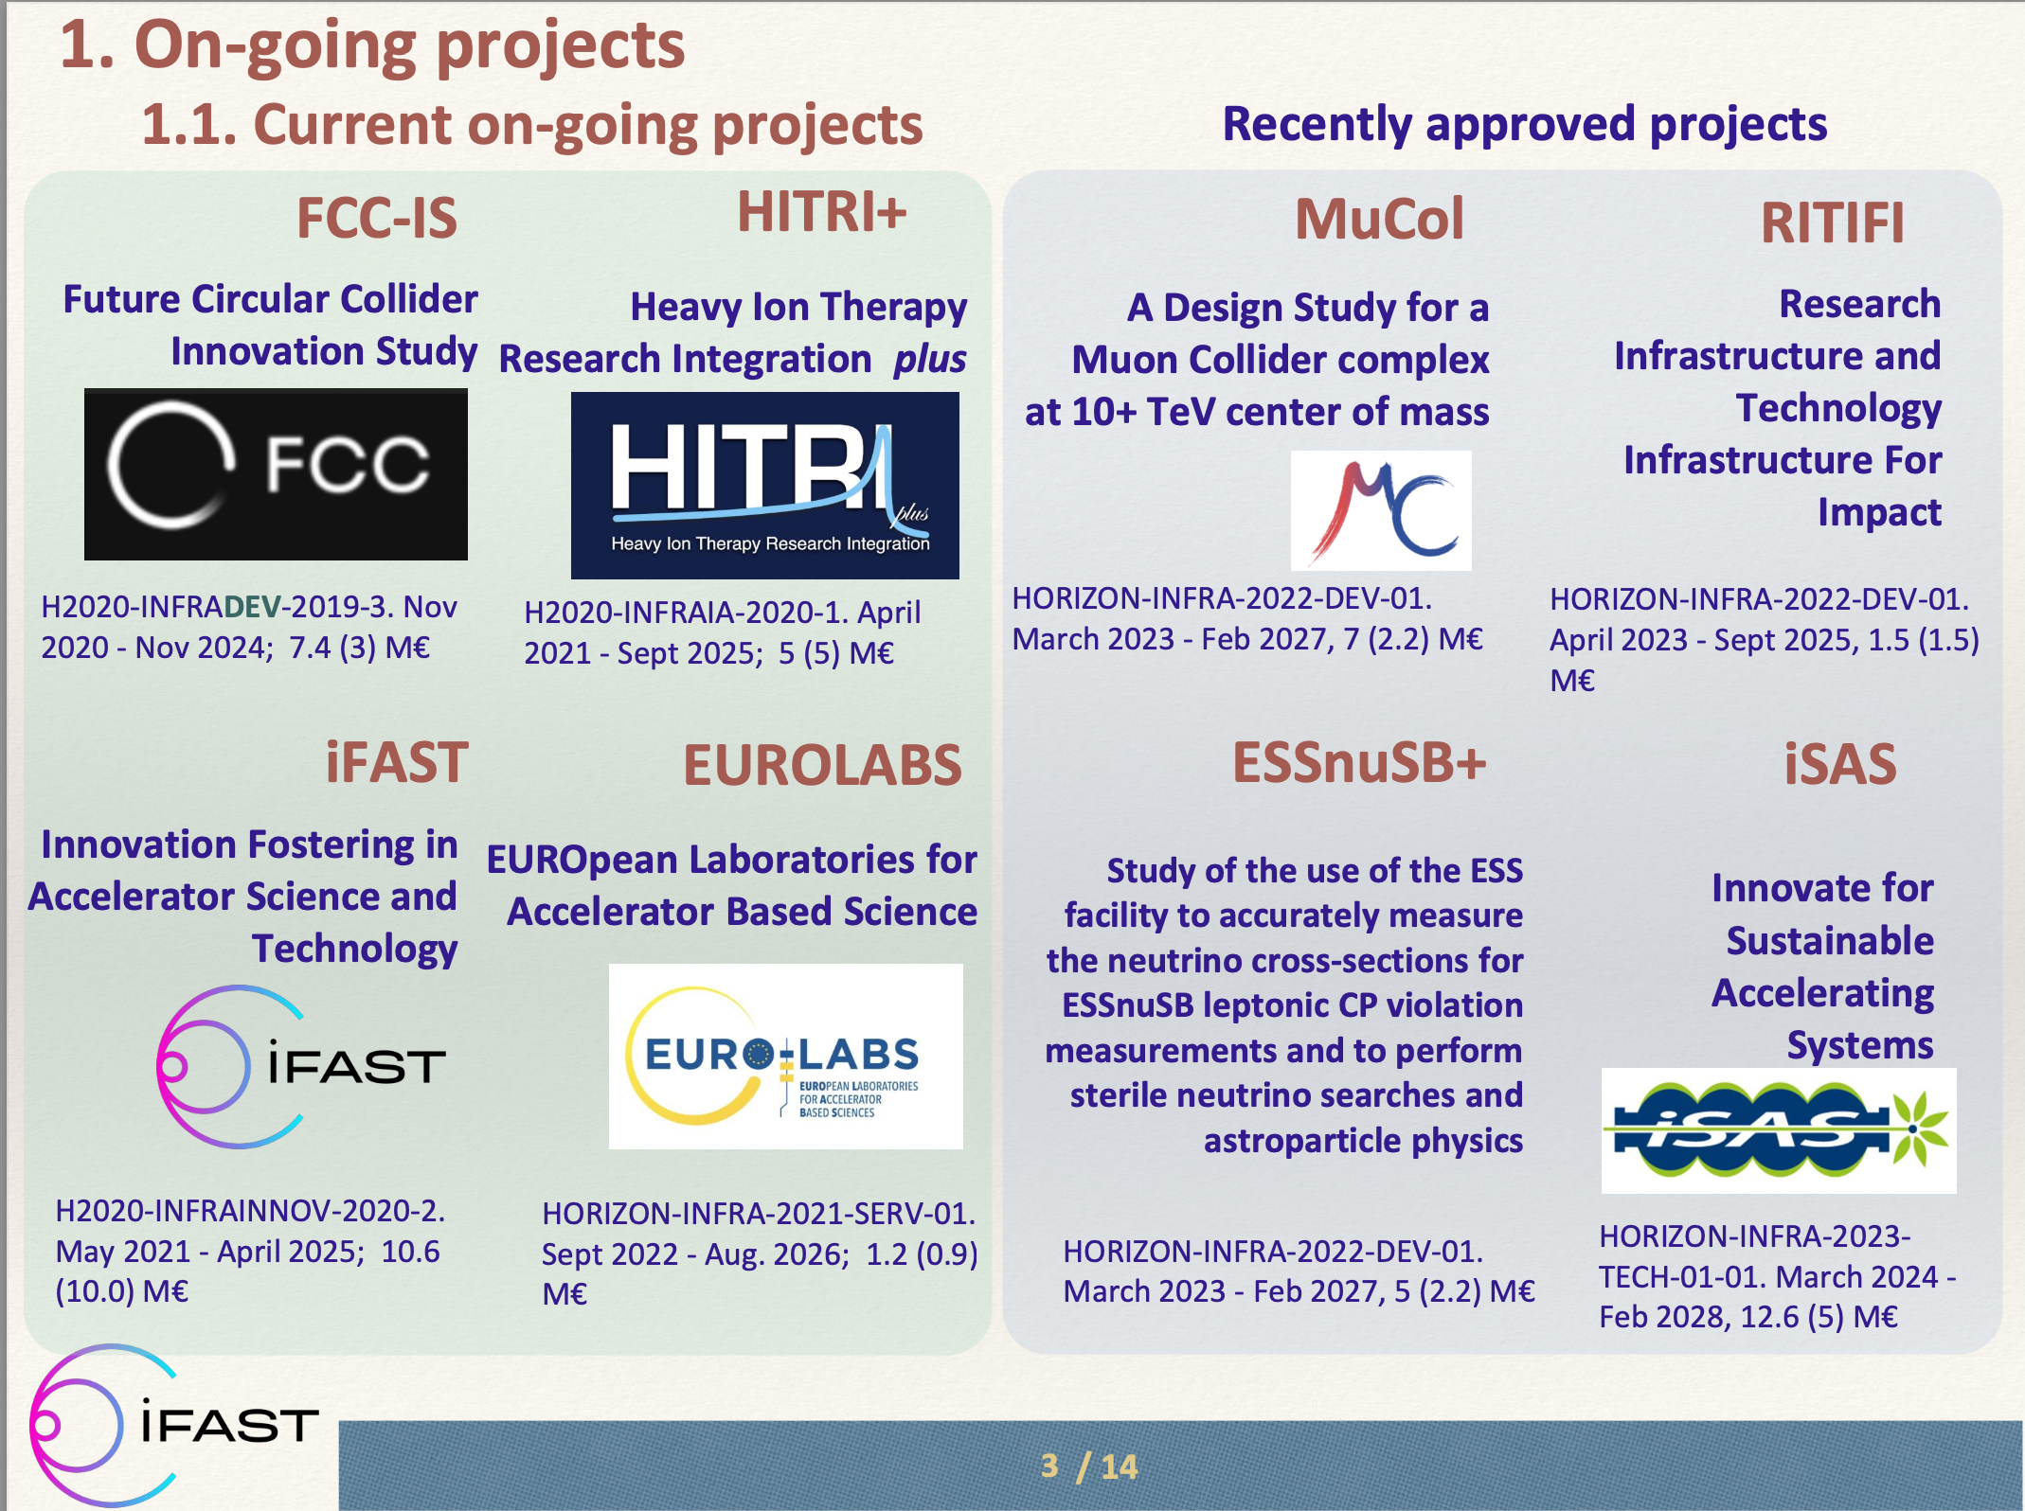
Example accelerator-related RI studies
Earlier approved design studies includes
EuroCirCol
ESSnuSB
CompactLight
EuPRAXIA....
...
José M. Pérez, on behalf of TIARA Collaboration 2024-04-19

Slide 4
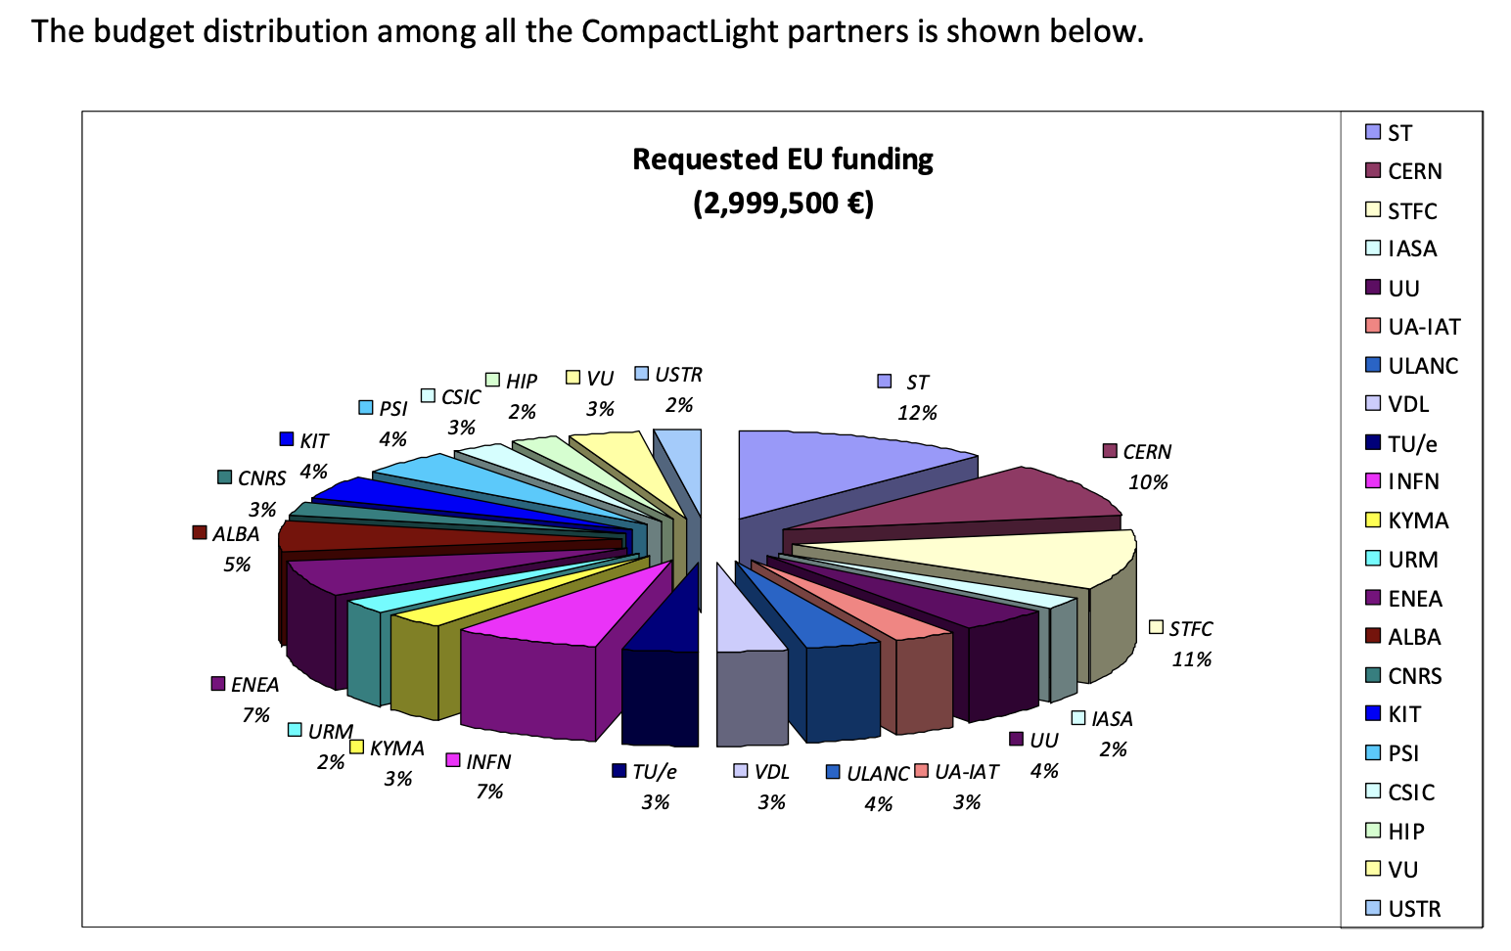
Structure (INFRADEV)
Order 3 MEUR in total
3 years
Several to many partners
Collaborative
Large application (~ 100 pages)
  Large effort
Very competitive
Why do it?

Slide 5
Benefits (INFRADEV)
Funding implies EU “approval stamp”
Funding implies “stamp” of project from project partners
  TIARA has supported previous accelerator INFRADEVs
Collaboration is formalized
“Community builder”
In case of EuPRAXIA: design study stepping stone to place on the ESFRI roadmap, and significant funding for the next phase

Slide 6
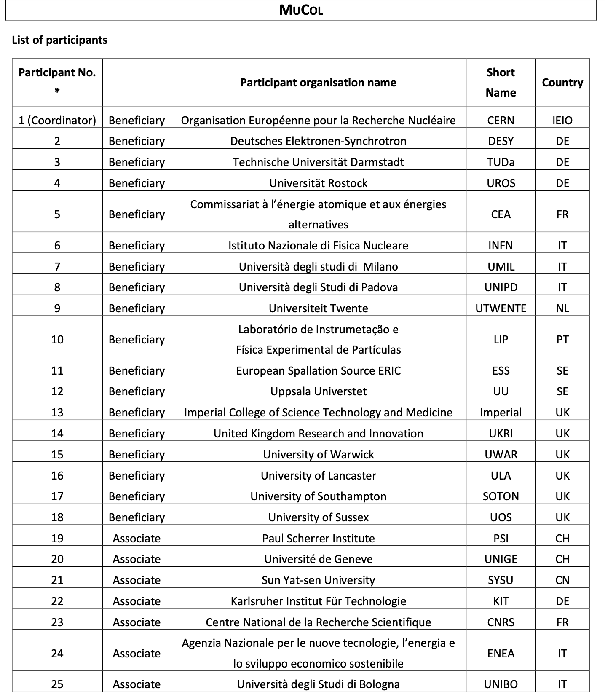
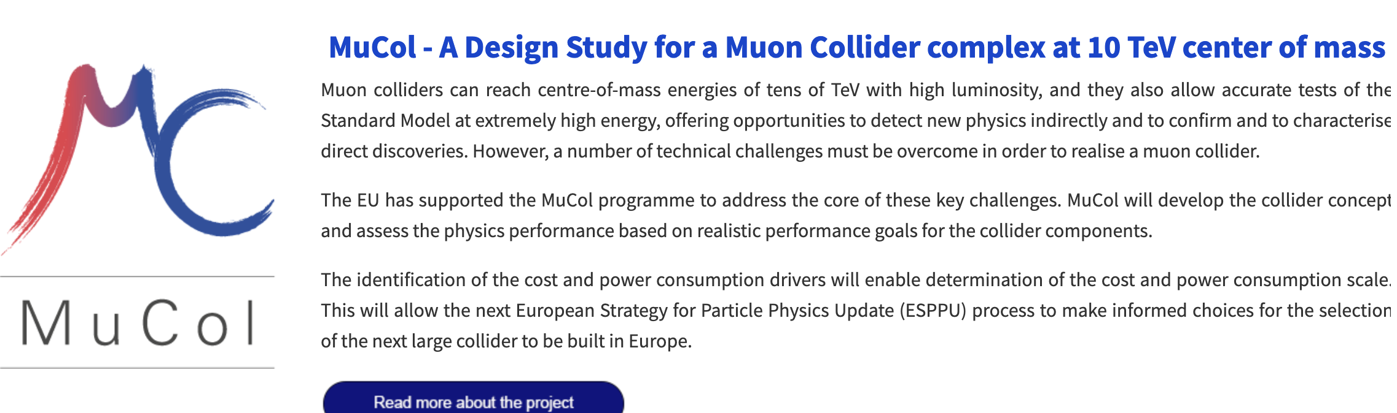
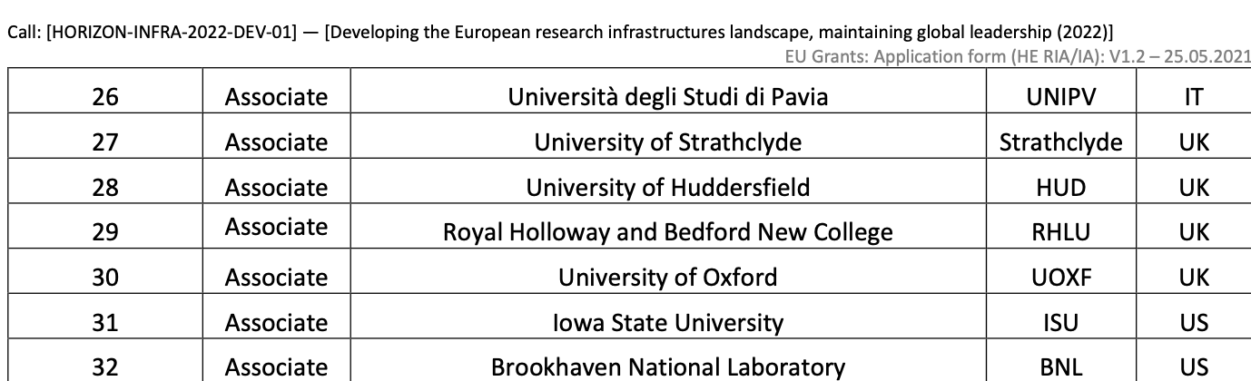
Requires:
full time study leader
full time technical coordinator
full time secretary
...

Slide 7
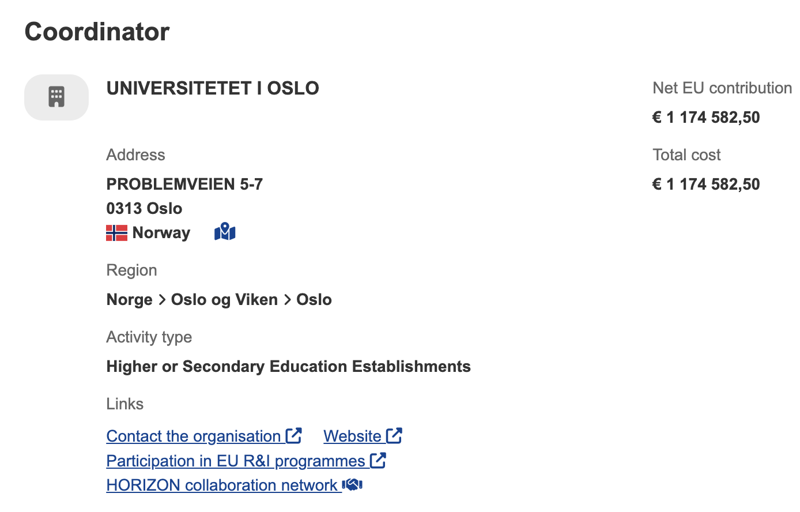


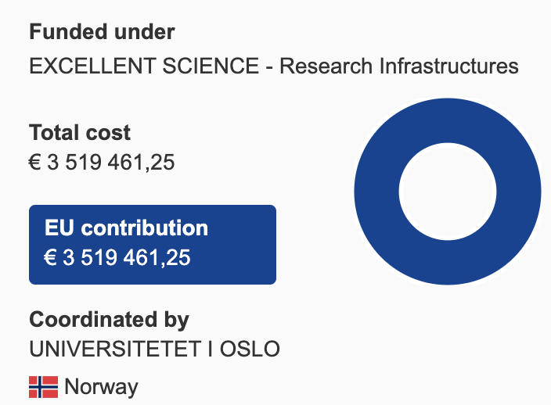
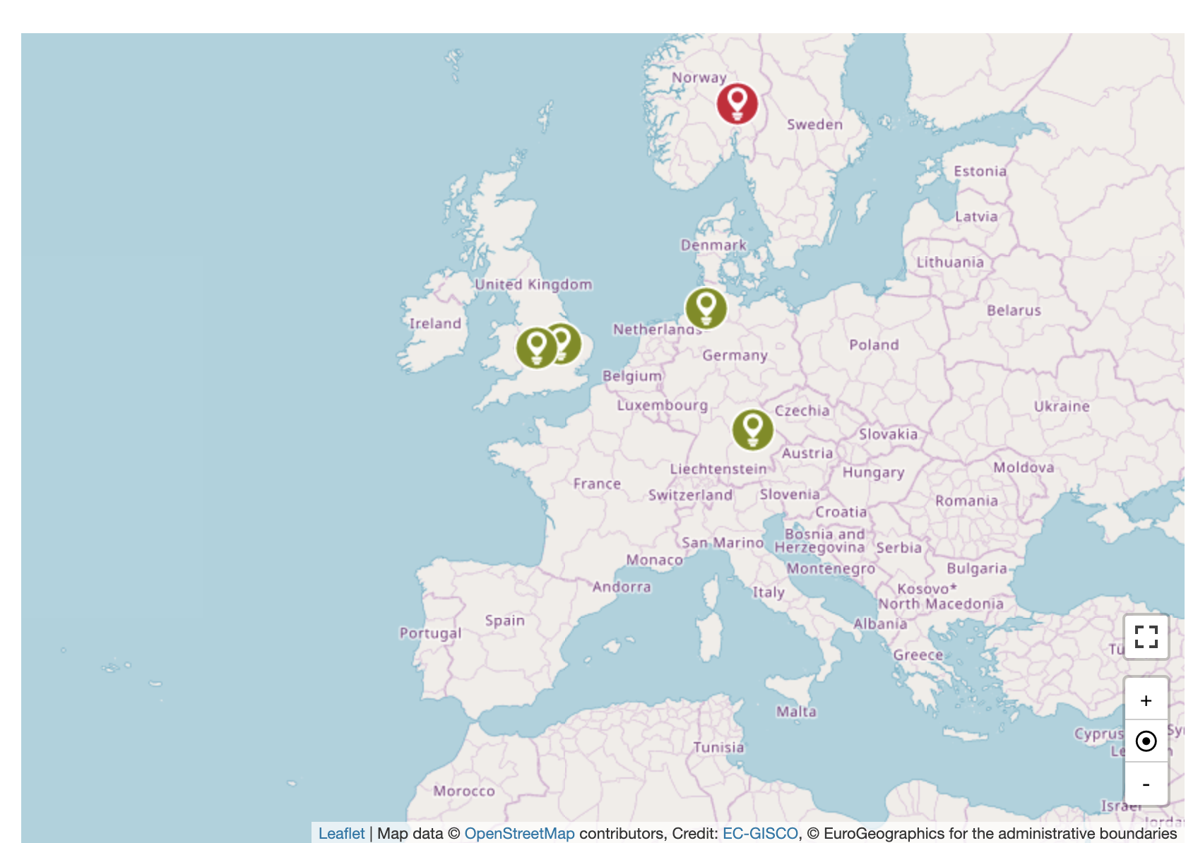
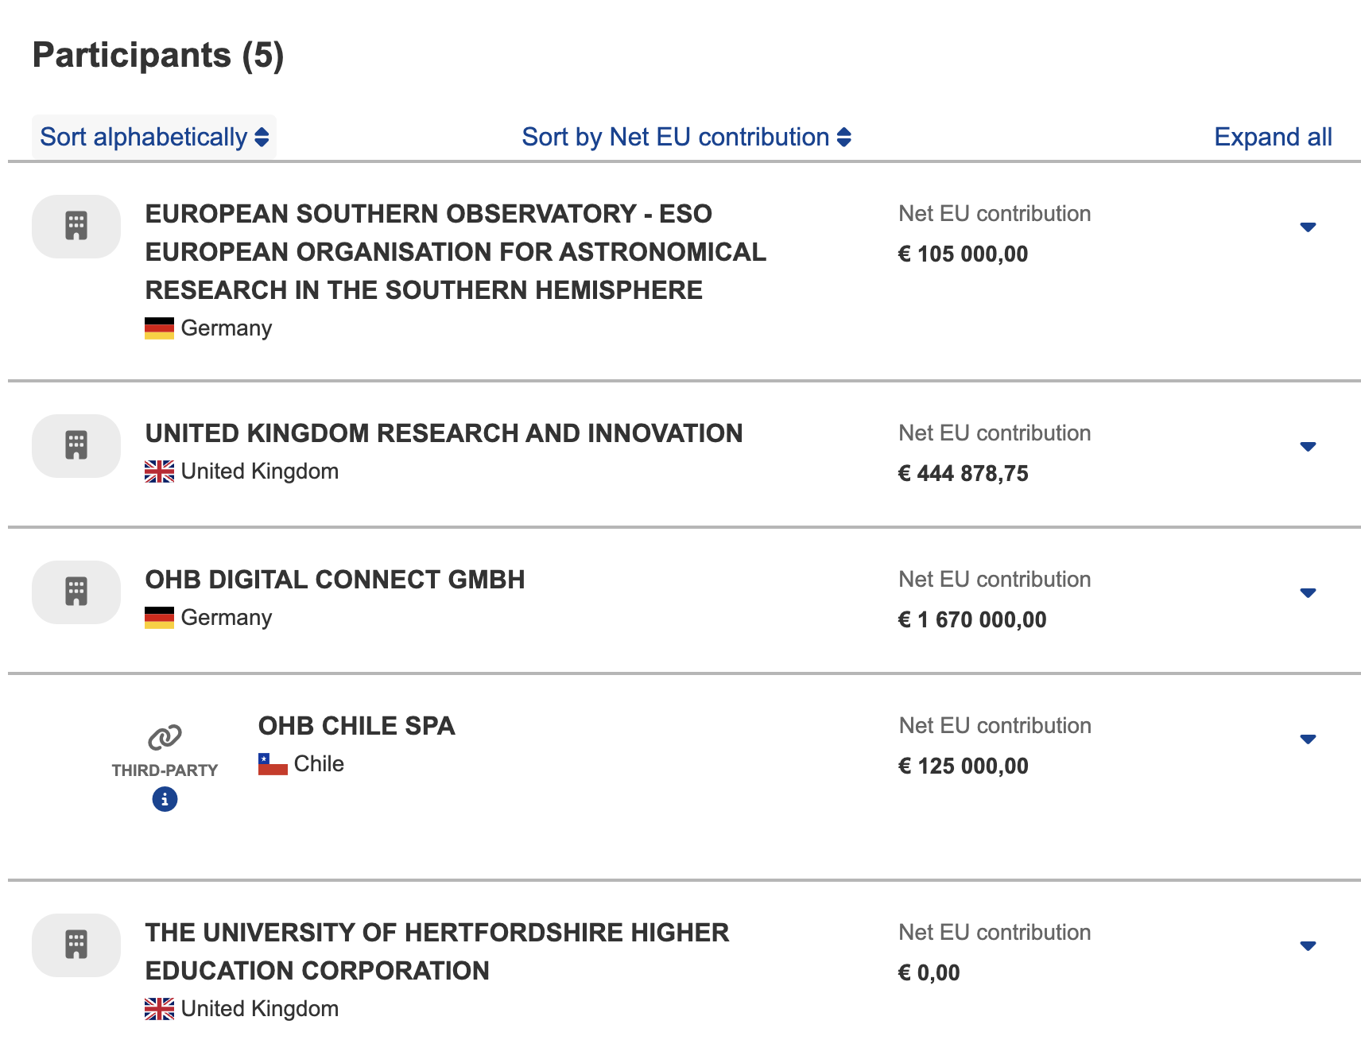
Lessons learned:
“only partners you know, trust and with fast response-time”

Slide 8
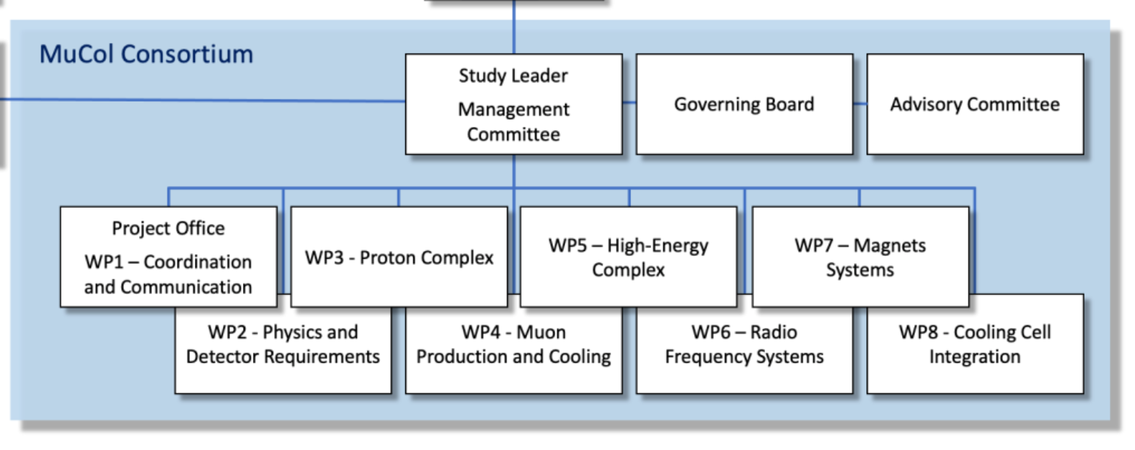
Timeline
Example of WPs (mucol)
Last general INFRADEV deadline: March 2024
Likely next deadline: around March 2026
  Likely call around October 2025
  No guarantee for similar total funding available
TIARA: time may be ripe for a plasma collider proposal
Needs careful selection of partners/WPs
TIARA: would invite for a feedback meeting, once a first outline/sketch is ready
Test Infrastructure and Accelerator Research Area (TIARA) :
The main objective of TIARA, a Consortium of European Research Institutions operating significant R&D Infrastructures in the European Particle Accelerator Research Area, is to create a dedicated structure to exchange experties and to facilitate and support the setting-up of joint R&D programmes and education and training in the field of Accelerator Science and Technology in Europe.

Slide 9
Discussion
Other ideas, for better, larger funding sources?
HALHF design-study ideas
Questions:
  Coordinator: Oslo? DESY? UK?
  UK funding status
  CERN (AWAKE, plasma source at MPP)
  EuPraxia (INFN?)
  US Effort (SLAC)

Slide 10
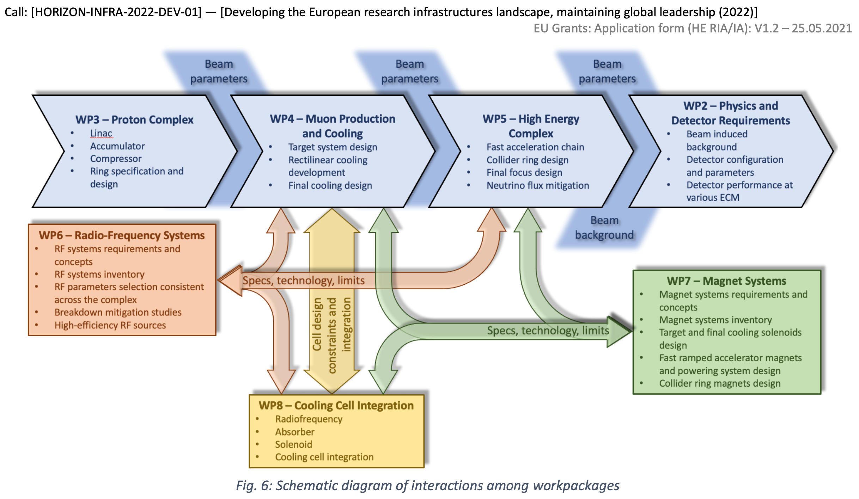

Slide 11
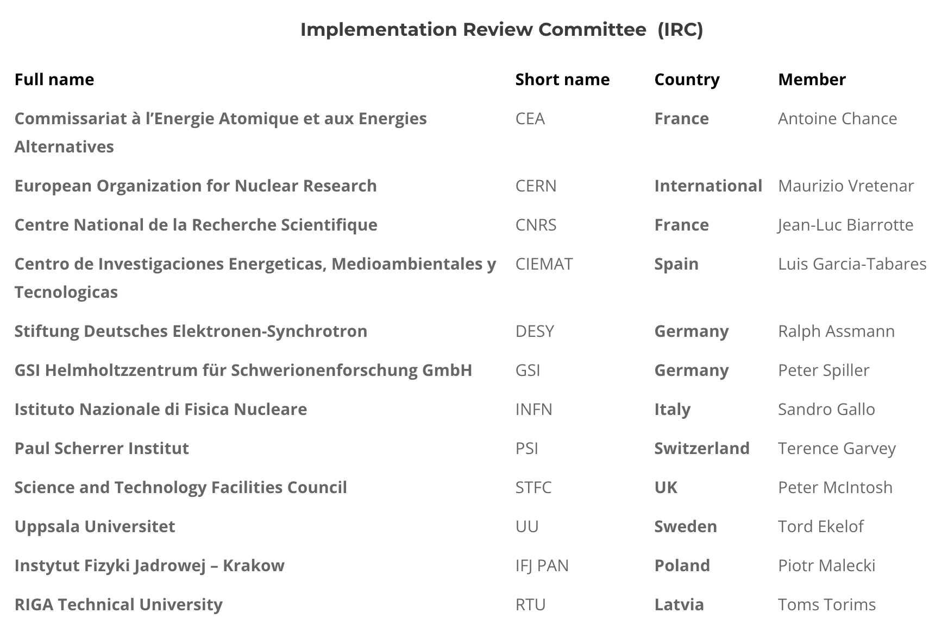
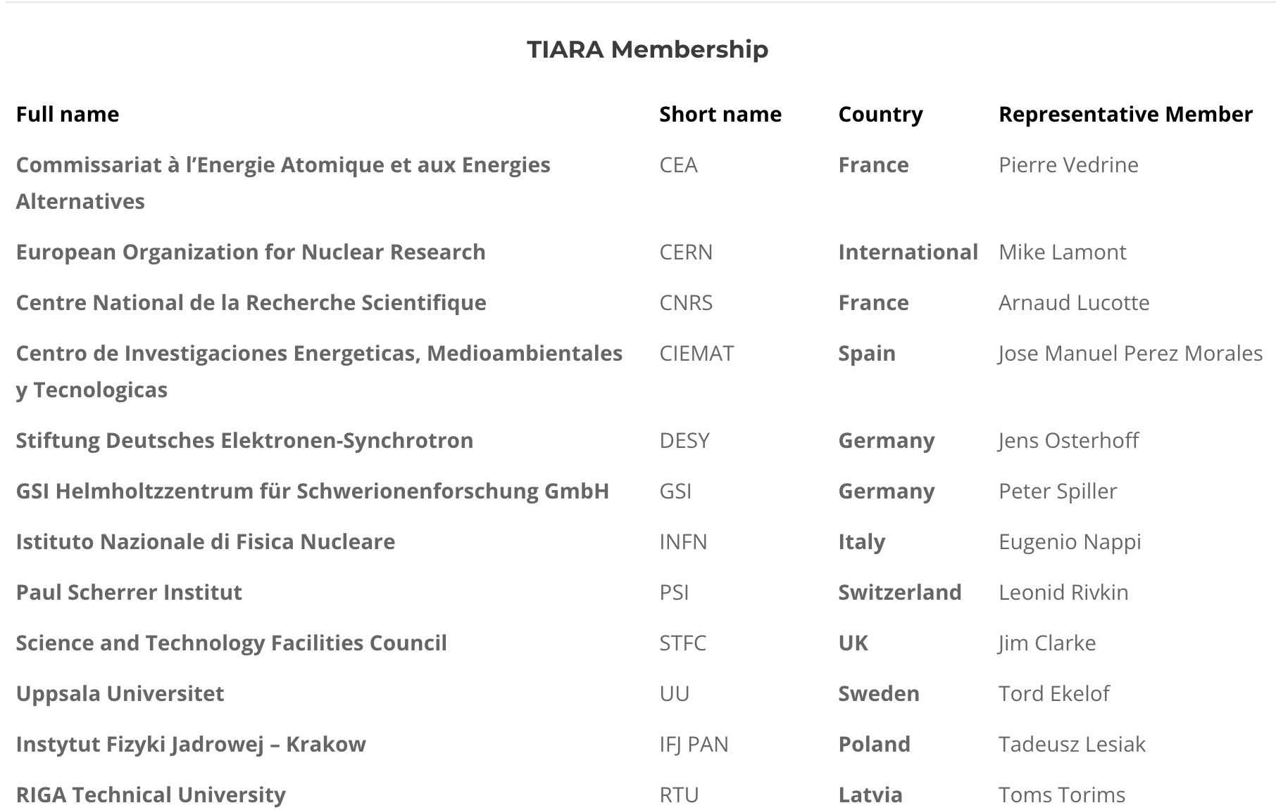
TIARA
https://www.eu-tiara.org/tiara-consortium/
Test Infrastructure and Accelerator Research Area (TIARA)
The main objective of TIARA, a Consortium of European Research Institutions operating significant R&D Infrastructures in the European Particle Accelerator Research Area, is to create a dedicated structure to exchange experties and to facilitate and support the setting-up of joint R&D programmes and education and training in the field of Accelerator Science and Technology in Europe.

Slide 12
