Slide 1
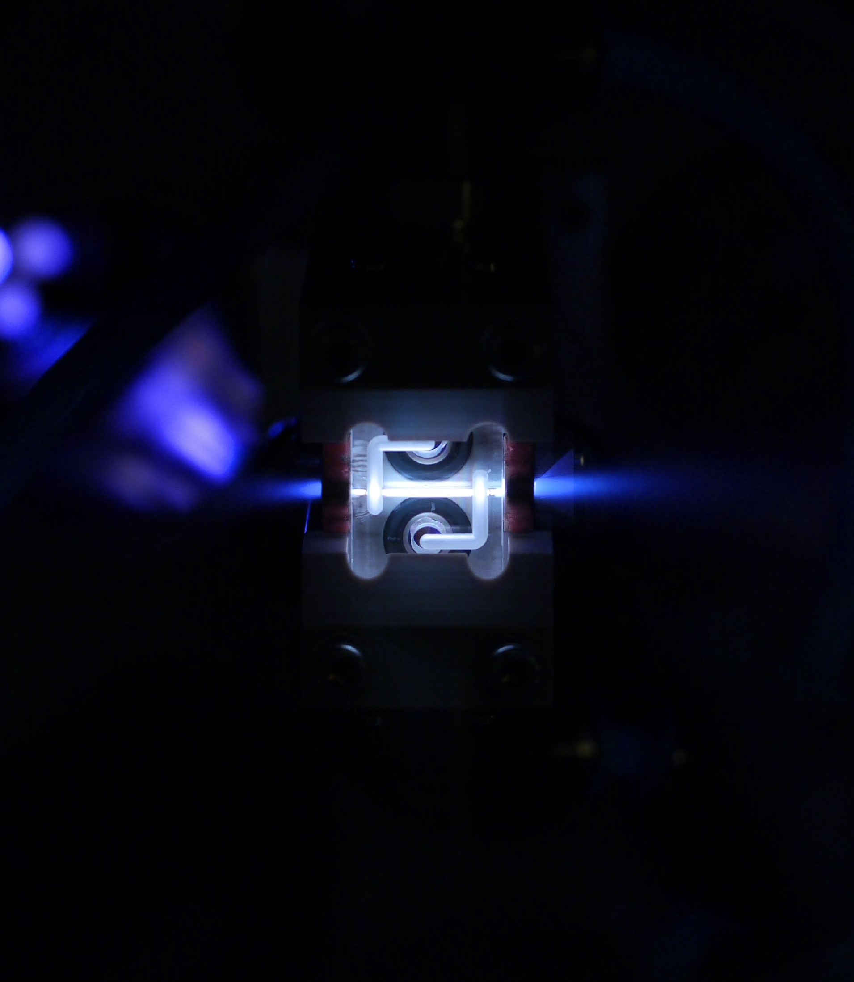


Effects of Radiation Reaction in Plasma Accelerators
For HALHF and Beyond
Daniel Kalvik
04.04.24

Slide 2
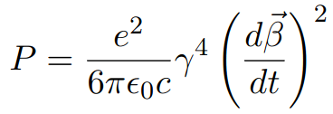
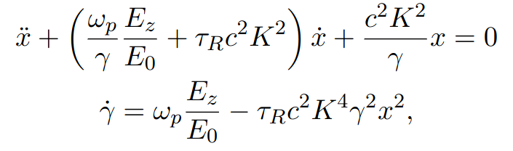
Background
The Larmor formula at high energies
Accompanied by the equations of motion (Deng et al.), treating the radiation reaction force as a perturbation,
04.04.24 | Daniel Kalvik | HALHF workshop

Slide 3
Background
The Larmor formula at high energies
Accompanied by the equations of motion (Deng et al.), treating the radiation reaction force as a perturbation,
Identical eq. for y
x²+y²
04.04.24 | Daniel Kalvik | HALHF workshop

Slide 4
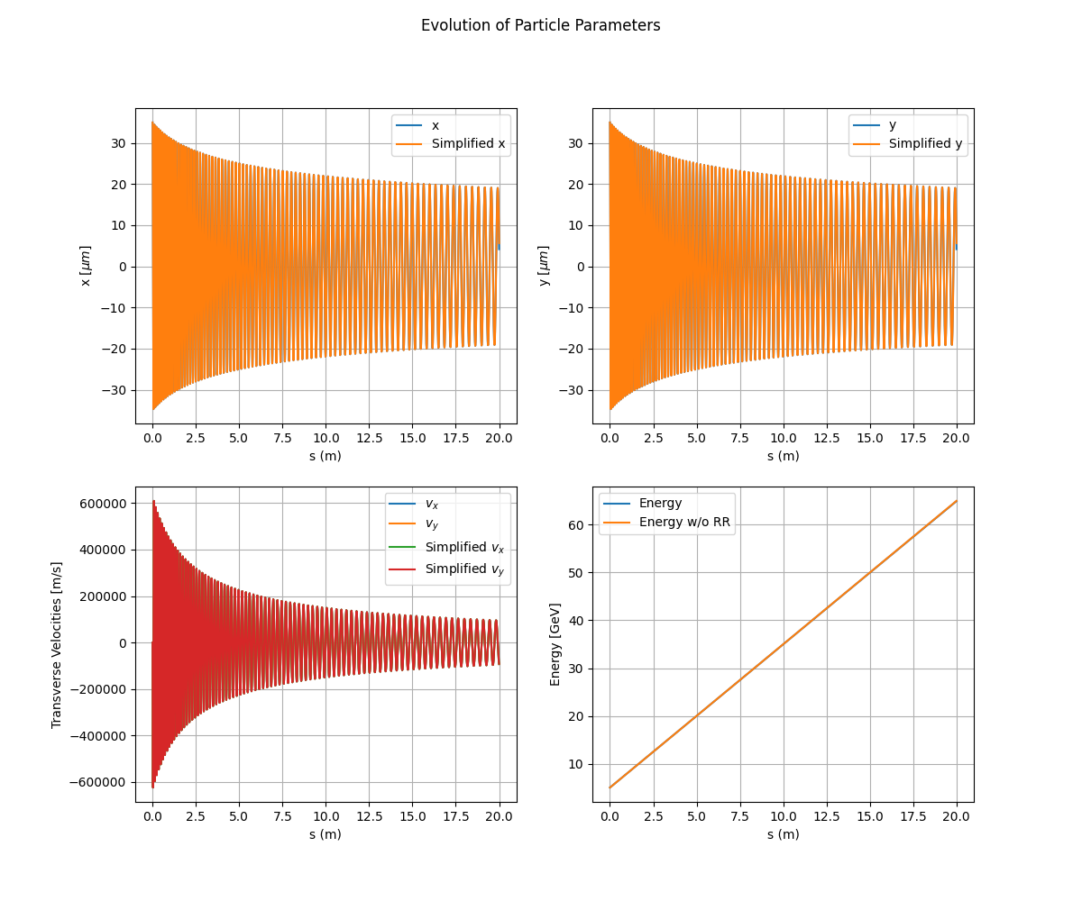
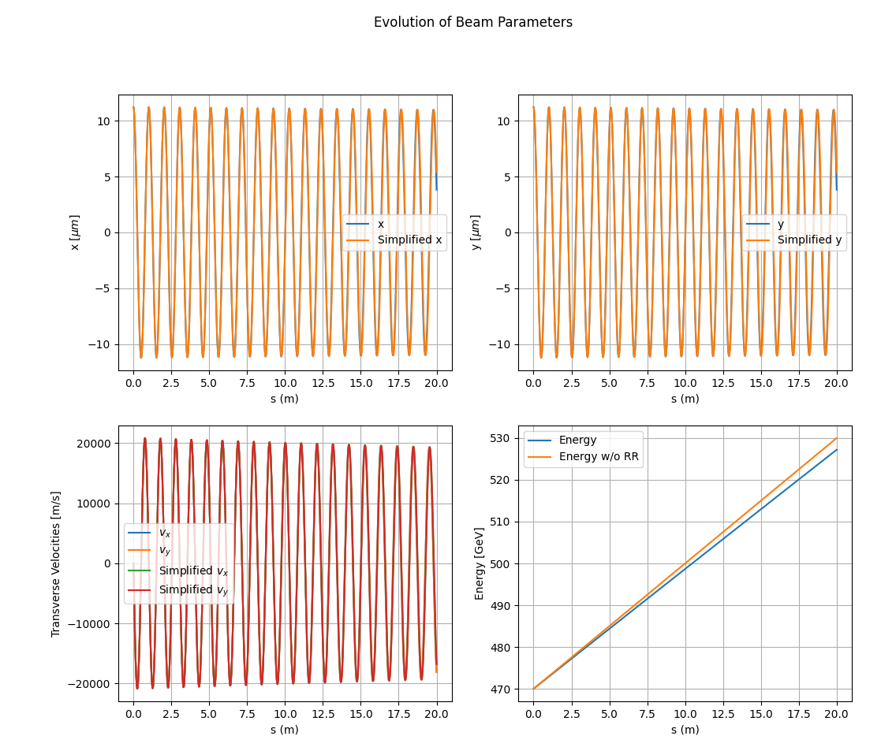
Single Particle Motion
Energy loss due to radiation reaction
With and without radiation damping
Adiabatic damping due to increase in energy
Caption
5 GeV
470 GeV
04.04.24 | Daniel Kalvik | HALHF workshop

Slide 5
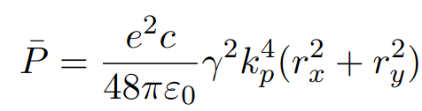
Energy Loss Assuming Harmonic Motion
A good approximation for a relatively small increase in Lorentz factor.
The mean energy loss for a single particle is
Caption
04.04.24 | Daniel Kalvik | HALHF workshop

Slide 6
Energy Loss Assuming Harmonic Motion
A good approximation for a relatively small increase in Lorentz factor.
The mean energy loss for a single particle is
Not Betatron Amplitude
Caption
04.04.24 | Daniel Kalvik | HALHF workshop

Slide 7
Energy Loss Assuming Harmonic Motion
A good approximation for a relatively small increase in Lorentz factor.
The mean energy loss for a single particle is
If the transverse motion is a perfect circle, the particle radiates constantly.
If the motion is a straight line (x and y oscillations in phase), it radiates sinusoidally, but with a larger maximum.
Amplitude in x-direction and amplitude in y-direction
Not Betatron Amplitude
04.04.24 | Daniel Kalvik | HALHF workshop

Slide 8
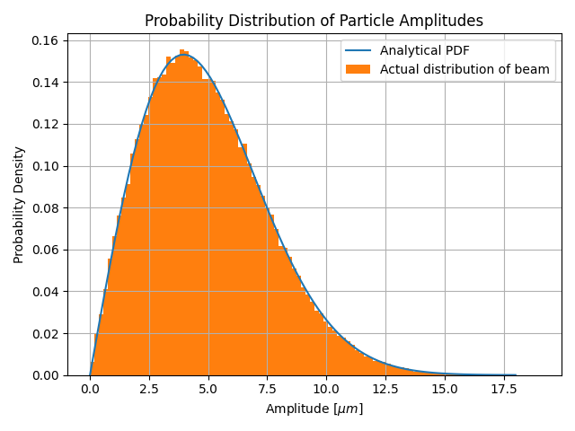

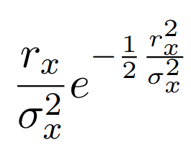
Extending This to a Particle Distribution (Beam)
Using distributions
To find the energy loss of the entire beam, we need the distribution of amplitudes in x and y.
We know the distribution of the particles and that (See Extra)
Using this gives the distribution
04.04.24 | Daniel Kalvik | HALHF workshop

Slide 9
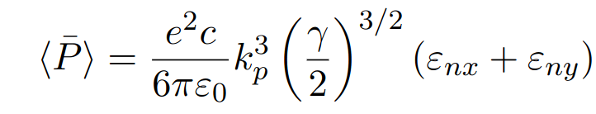
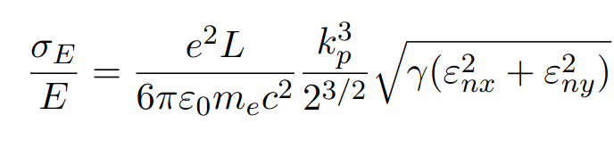
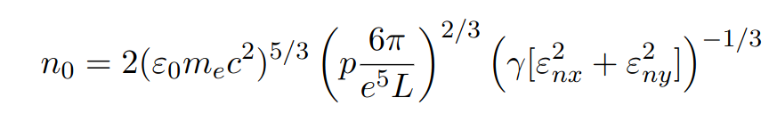
Extending This to a Particle Distribution (Beam)
This means that the radiated power
of the beam is given by
And the relative energy spread for a
single stage is given by
This gives the limit of plasma density;
Assuming NO initial energy spread!
Not applicable at high rel. energy spreads, saturates at ~8%
Some acceptable rel. energy spread
04.04.24 | Daniel Kalvik | HALHF workshop

Slide 10
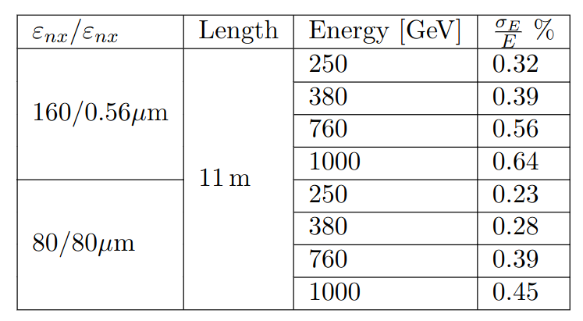
What does this mean for HALHF
Energy Spread
Round beam induces less energy spread! Better with gamma-gamma collider?
Shows the spread generated in a
single stage.
Must add the squares of this and
the initial spread at the stage.
n0 = 7e21 m⁻³
04.04.24 | Daniel Kalvik | HALHF workshop

Slide 11
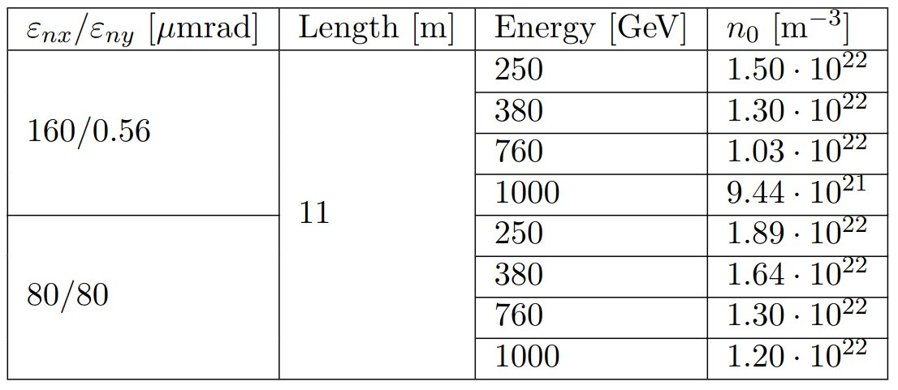
What does this mean for HALHF
Plasma Density
Plasma density is limited by energy spread requirements.
For 1% tolerance
Limit will be lower!
This is for 0 initial spread.
Spread will accumulate over multiple stages!
04.04.24 | Daniel Kalvik | HALHF workshop

Slide 12
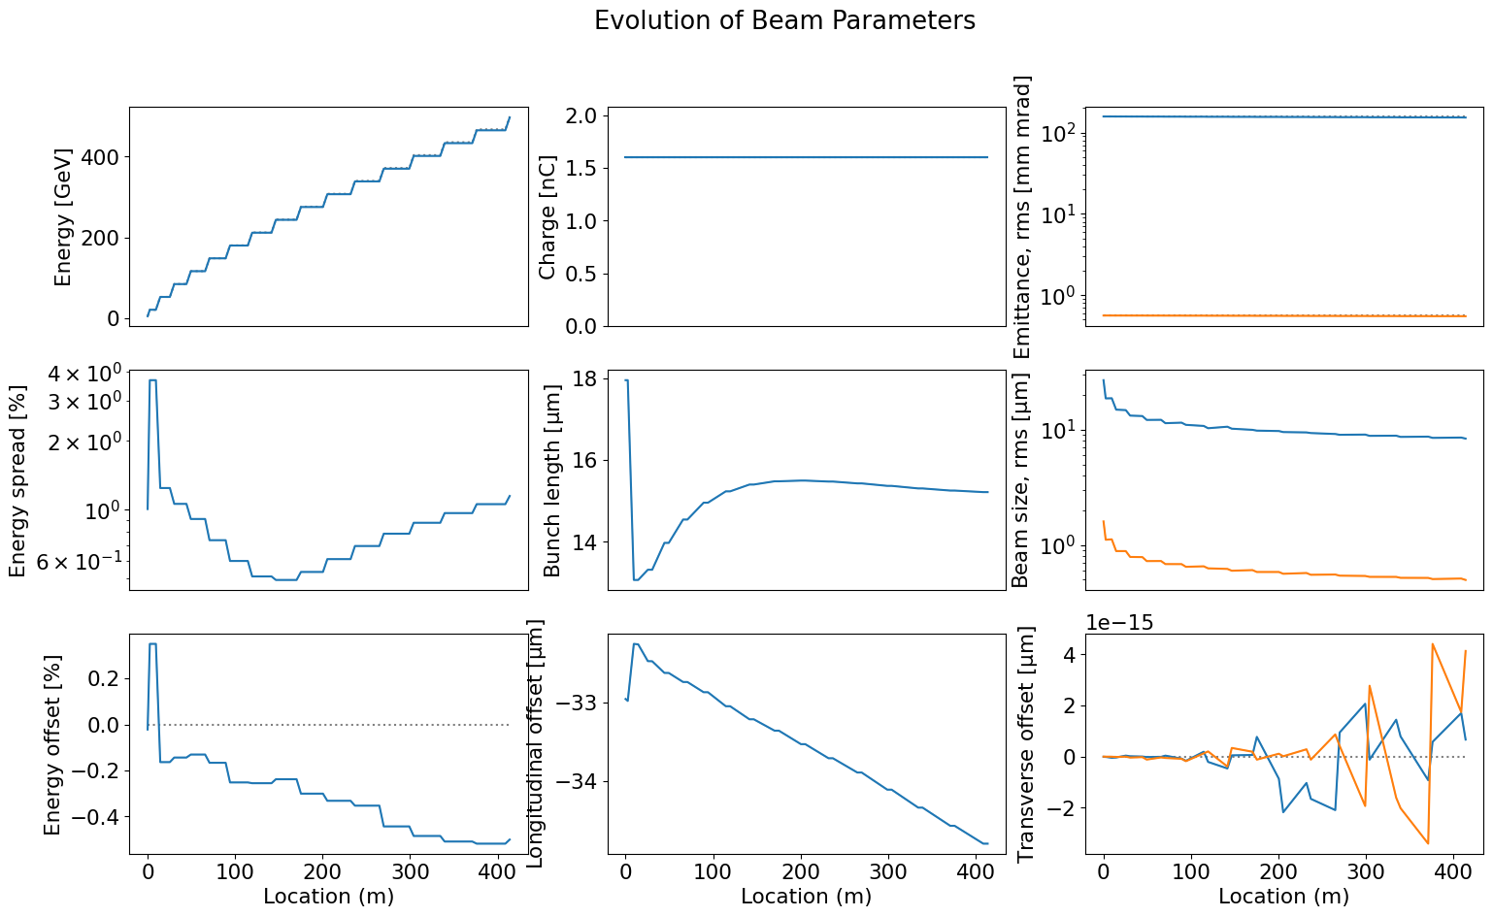
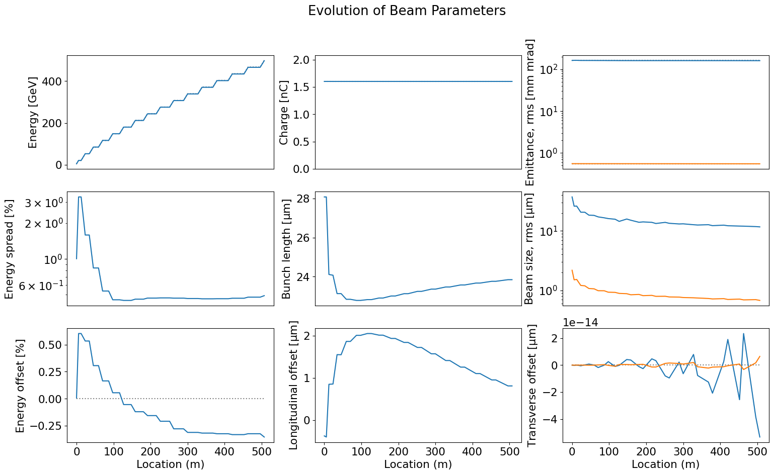
What does this mean for HALHF
Already at 500 GeV, we have had to lower the density
n0 = 2e21 m⁻³
n0 = 7e21 m⁻³
n0 = 7e21 m⁻³
n0 = 2e21 m⁻³
04.04.24 | Daniel Kalvik | HALHF workshop

Slide 13
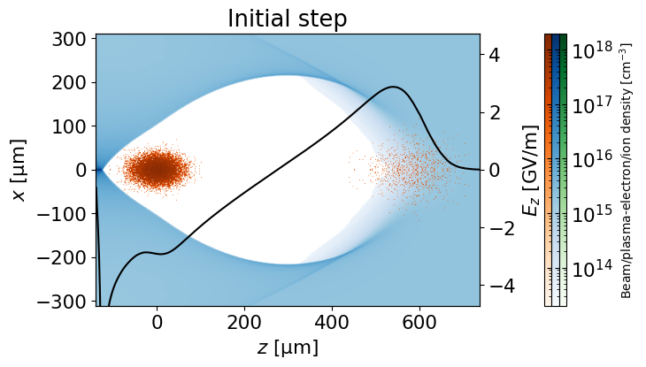
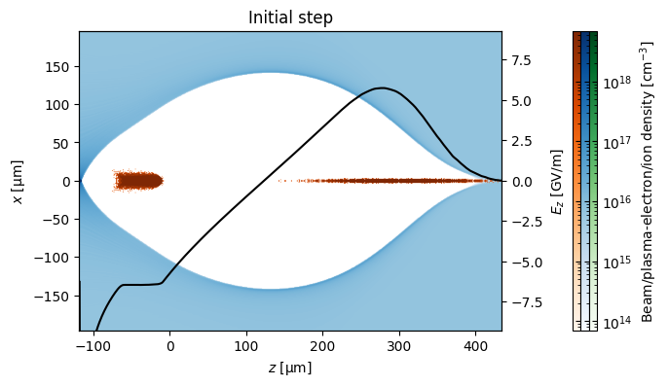
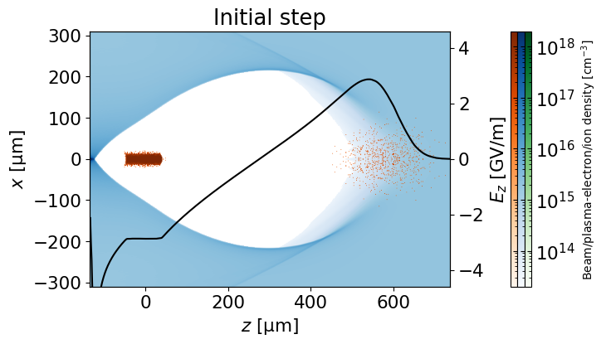
What does this mean for HALHF
Along with the self-correction mechanism, the beam shapes into a bullet.
n0 = 7e21 m⁻³
n0 = 2e21 m⁻³
04.04.24 | Daniel Kalvik | HALHF workshop

Slide 14
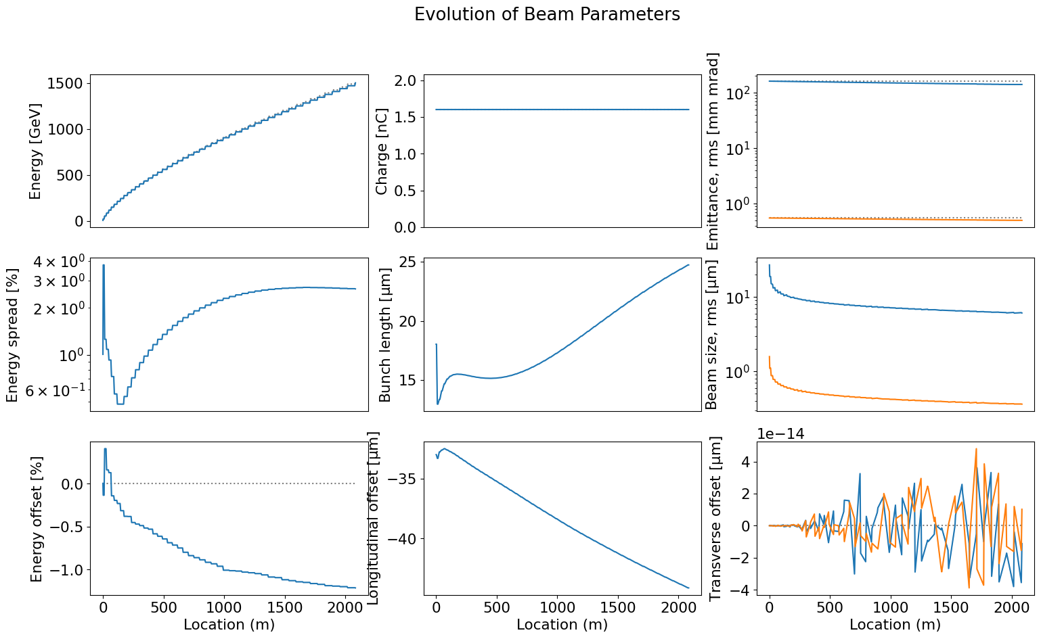
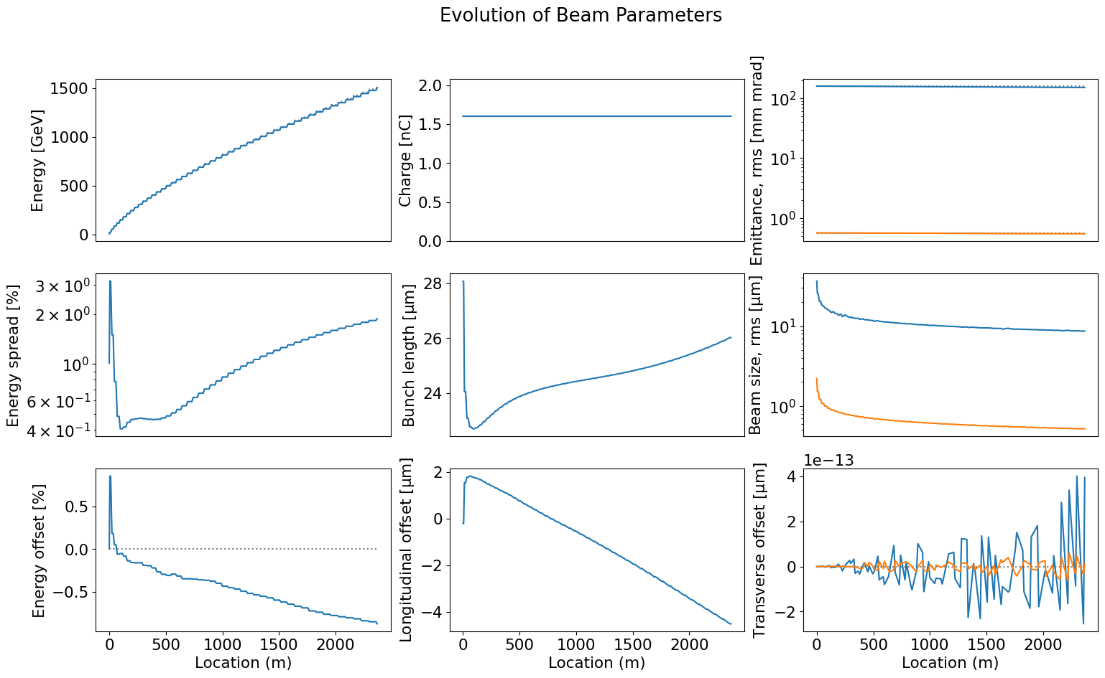
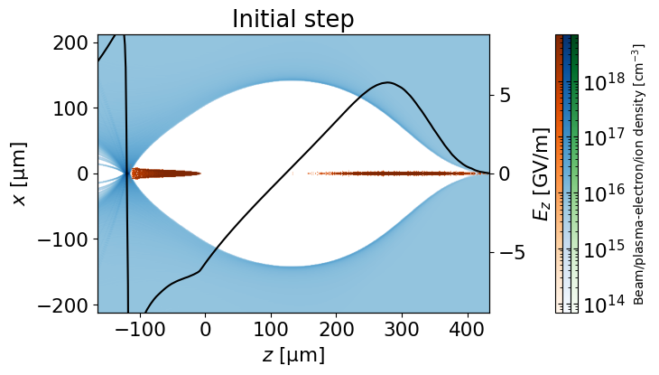
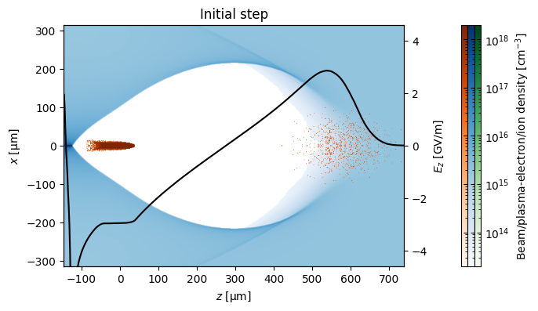
It is Critical to Choose the Right Parameters to reach TeV Energies
n0 = 7e21 m⁻³
n0 = 2e21 m⁻³
04.04.24 | Daniel Kalvik | HALHF workshop

Slide 15

What About Jitter?
Radiation due to small offsets in staging
When the beam enters the plasma, it will have a small random offset (jitter). In x, this means the new amplitude of the particles will be
This will induce more energy loss, but this loss will be more uncertain.
What can we tolerate for HALHF? What about a 5 TeV beam?
04.04.24 | Daniel Kalvik | HALHF workshop

Slide 16
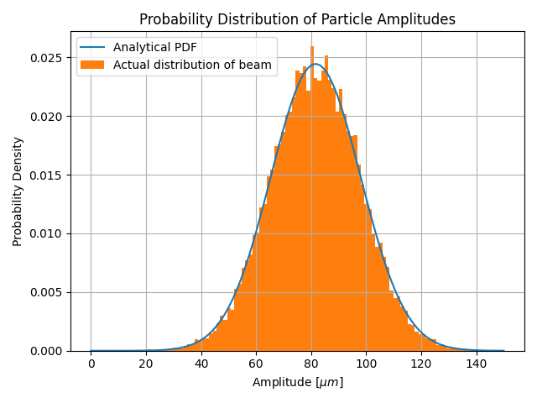
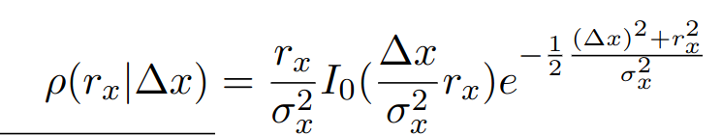
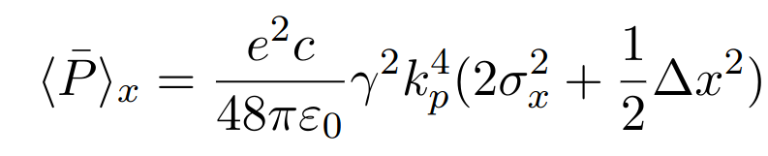
What About Jitter?
Radiation due to small offsets in staging
Introducing an offset to the beam gives a new distribution
And the energy loss in one plane
Unrealistically large x-offset to show that the formula is valid for all x-offsets.
04.04.24 | Daniel Kalvik | HALHF workshop

Slide 17
What About Jitter?
Radiation due to small offsets in staging
Introducing an offset to the beam gives a new distribution
And the energy loss in one plane
Unrealistically large x-offset to show that the formula is valid for all x-offsets.
Valid for small offsets
04.04.24 | Daniel Kalvik | HALHF workshop

Slide 18
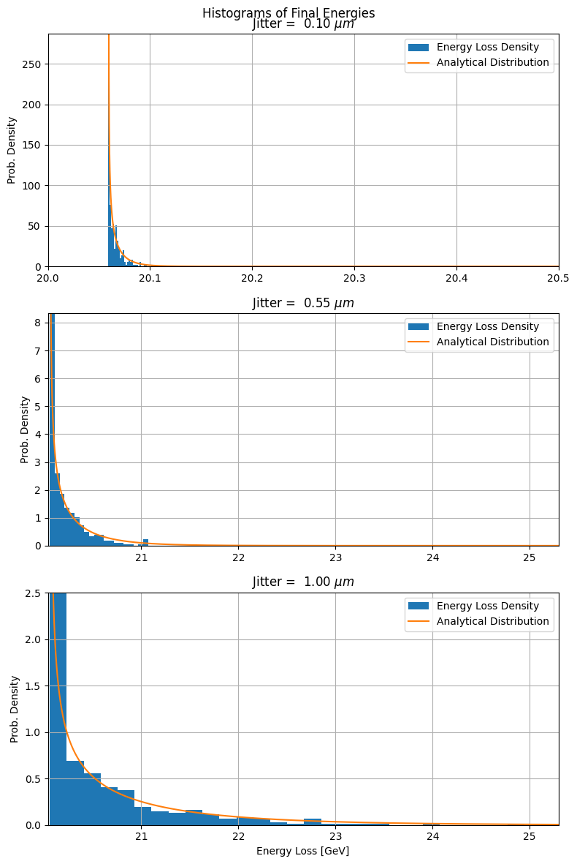
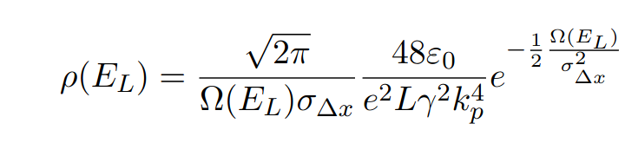
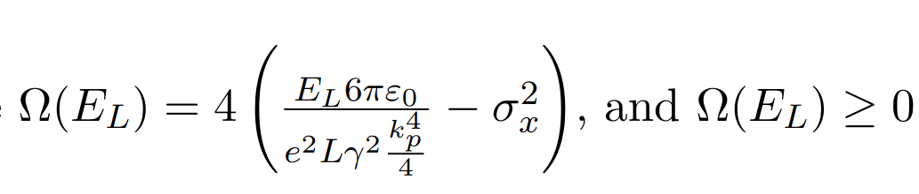
What About Jitter?
Radiation due to small offsets in staging
This gives a distribution final energies after a stage
where
Lets us calculate the tolerances of beam delivery systems.
Caption
04.04.24 | Daniel Kalvik | HALHF workshop

Slide 19
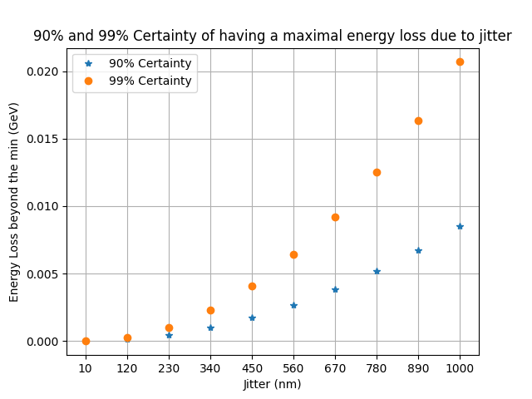
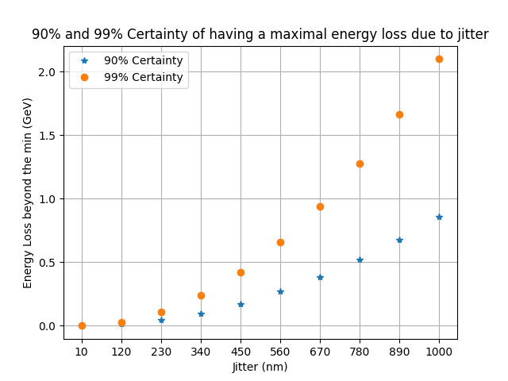
What About Jitter?
Extra energy loss (beyond what the beam would lose anyway) due to jitter
500 GeV
5 TeV
Caption
04.04.24 | Daniel Kalvik | HALHF workshop

Slide 20
What About Jitter?
Extra energy loss (beyond what the beam would lose anyway) due to jitter
If we accept 0.1% uncertainty in final energy -> no problem.
BUT;
Need to consider jitter in the 3 other dimensions (x', y, y') before we pop the champagne.
Caption
04.04.24 | Daniel Kalvik | HALHF workshop

Slide 21
Summary
The radiation reaction causes energy loss. Through statistical analysis, we can get the energy loss for the entire beam as well as the energy spread.
The energy spread increases with plasma density and beam "flatness". This limits the accelerating gradient, and suggests a gg-collider might be more advantageous.
The Radiation Reaction limits the number of stages that can apply the self-correction mechanism.
Jitter contributes to energy loss. Seems not to be a problem, but requires more research.
04.04.24 | Daniel Kalvik | HALHF workshop

Slide 22
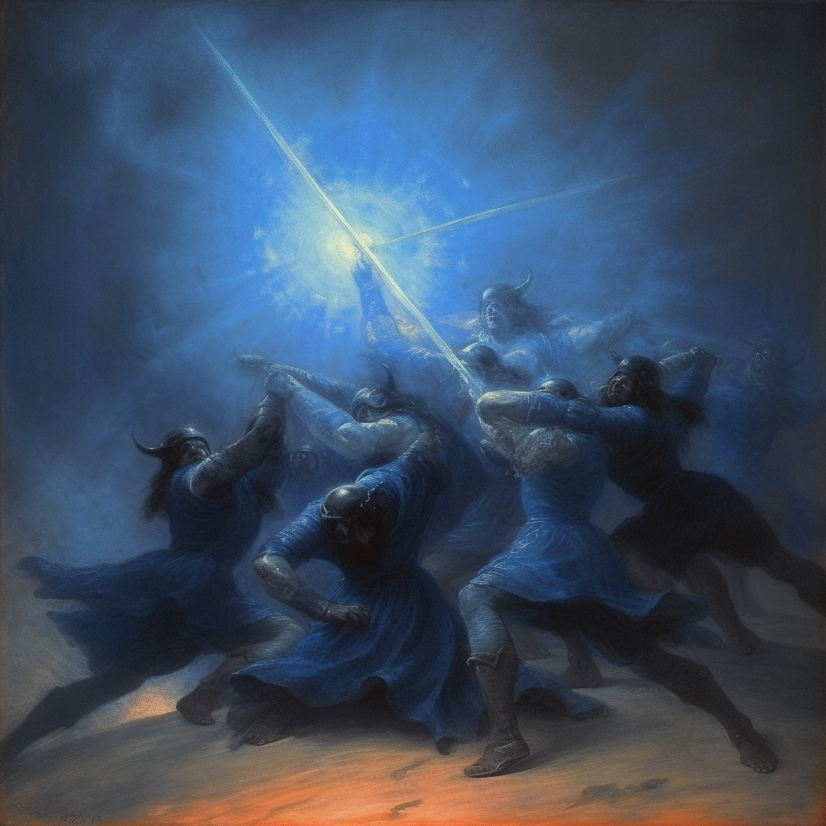
Oslo accelerator group:
Erik Adli, Kyrre N. Sjøbæk, J. B. Ben Chen,
Ole Gunnar Finnerud, Jiawei Cao, Daniel Kalvik,
Carl A. Lindstrøm, Pierre Drobniak
Funding:
European Research Council (ERC)
The Research Council of Norway

Slide 23
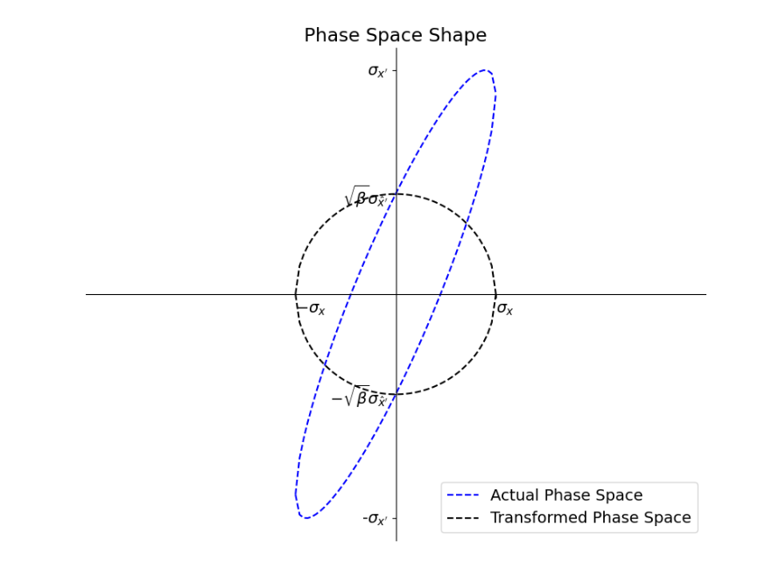

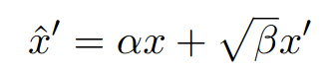
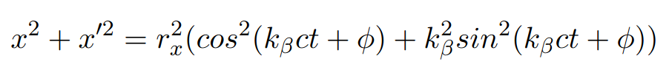


Extra
Matching and Betatron Amplitude
Normalized phase space (from ellipse eq.)
where
We also have
Which means where
Caption
04.04.24 | Daniel Kalvik | HALHF workshop

Slide 24
Extra
Matching and Betatron Amplitude
For a matched beam; α=0, and the single particle trajectories must follow the shape of the phase space.
I.e must match the shape of , or the energy spread will cause emittance increase.
We therefore know that
Caption
04.04.24 | Daniel Kalvik | HALHF workshop

Slide 25
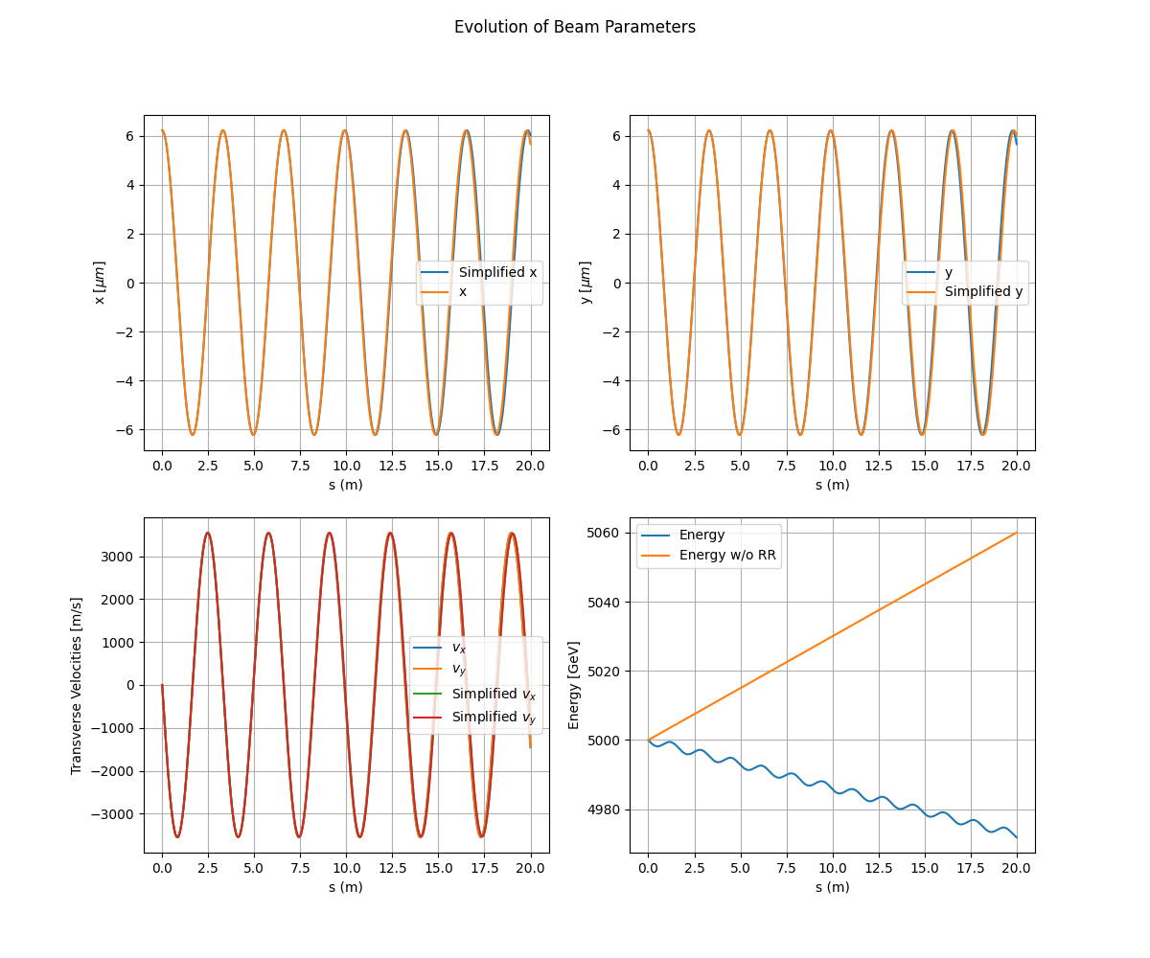
Extra
Betatron Motion at 5 TeV
Even at 5 TeV, the motion
w/wo radiation reaction is
almost the same
Caption
04.04.24 | Daniel Kalvik | HALHF workshop

