Slide 1
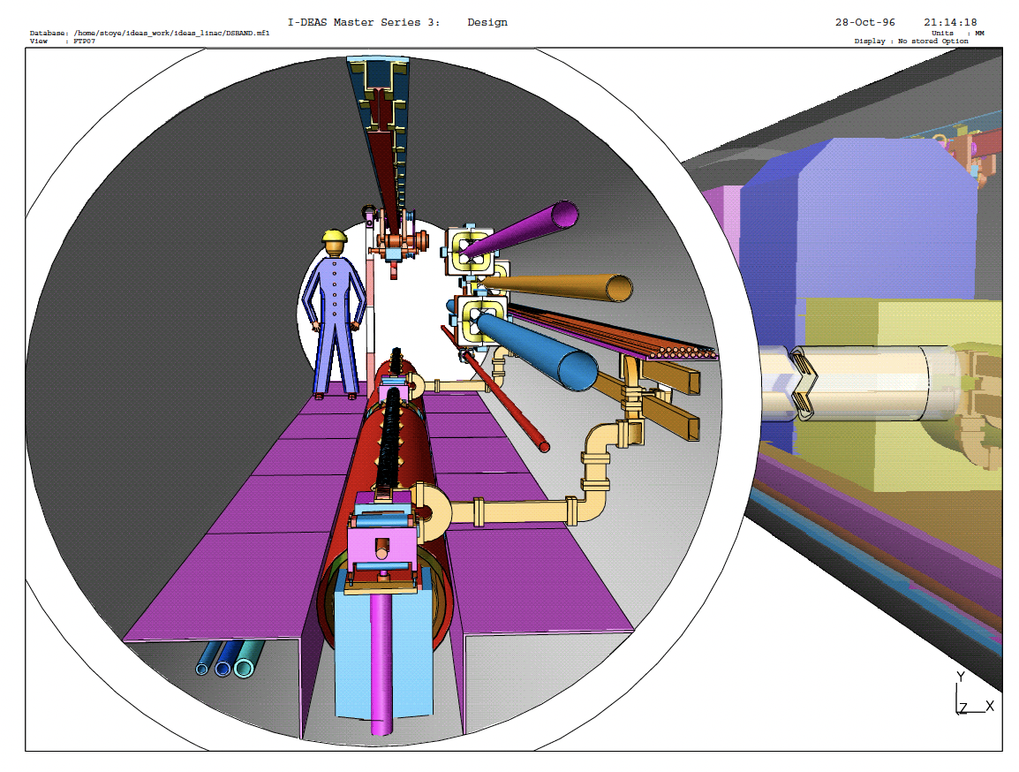
Considerations for
Warm RF Linac.
Implications of Short-Range Longitudinal Wakefields
Benno List, DESY
HALHF workshop, Oslo, 4.4.24

Slide 2
Bunch Length in Linac
SBLC: 1.8nC (1.1E10 e) in 300μm=1000fs
-> 1.8kA av. current in bunch
CLIC DB: 8.4nC in 1000μm=3335fs -> 2.5kA
HALHF: 4.3nC (2.7E10) for electrons, 6.4nC (4E10) for positrons
At target bunch length 42μm=140fs this corresponds to 31kA / 46kA -> factor 20!
-> wakefields, instabilities?
-> bunch length in drive linac needs to be longer than in plasma accelerator
-> what is the limiting factor?
-> how much bunch compression is possible at 31GeV?
Working assumption:
  Assume 300μm=1000fs
  Results in 4.3 / 6.4kA in linac
  -> significantly higher than SBLC, CLIC
  Still requires factor 7.5 compression!!!
SLIDE from Jan 29
Let’s look at Wakefields

Slide 3
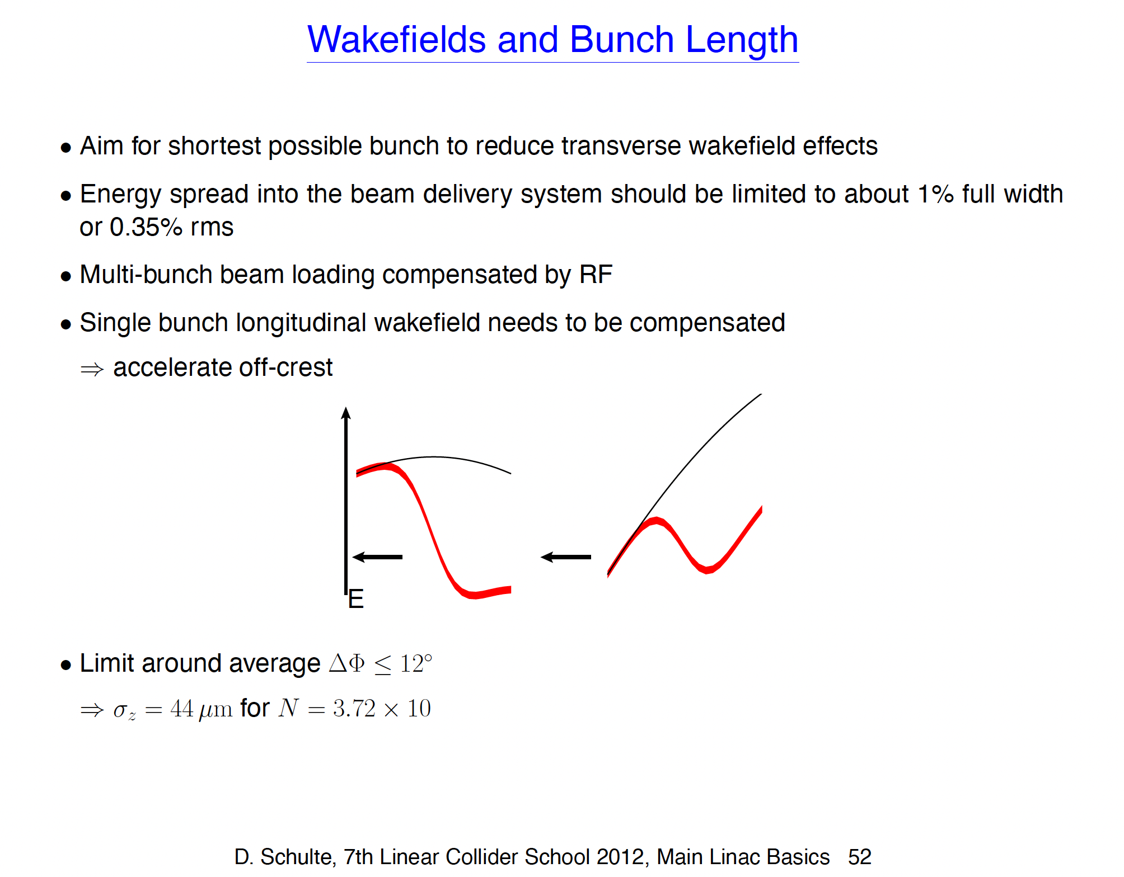

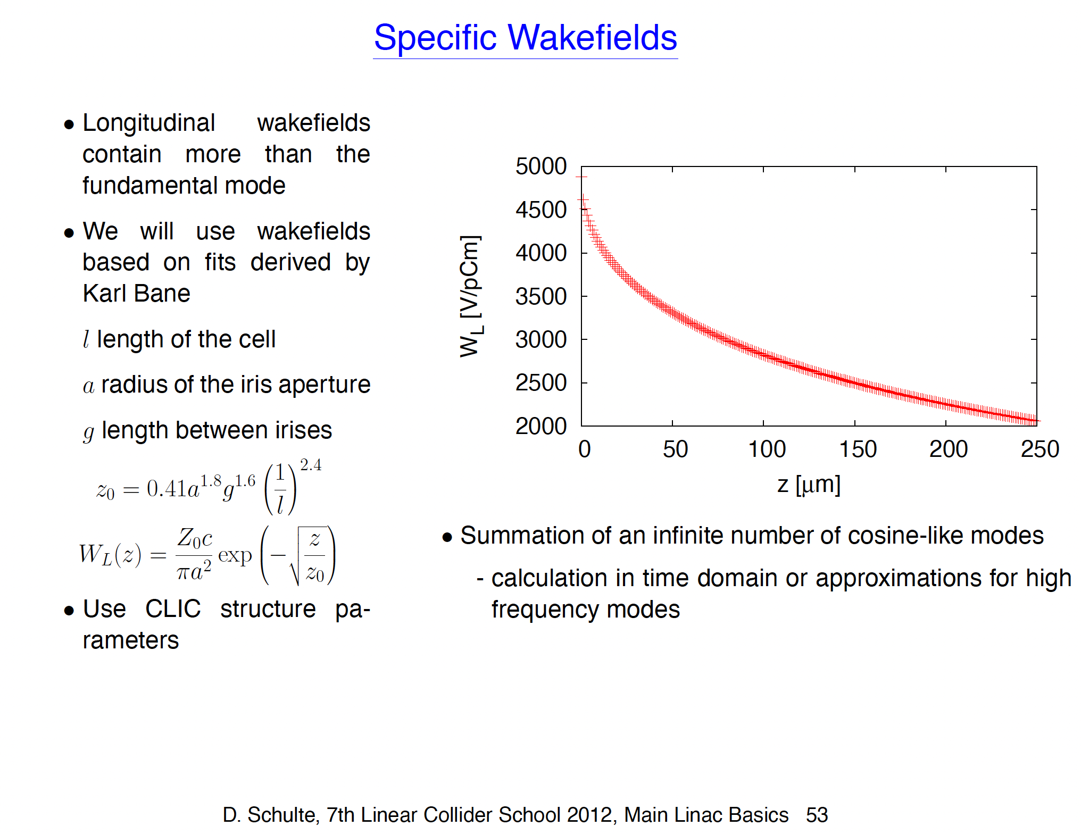
Back to the Basics
D. Schulte, Accelerator Basics, 7th Linear Collider school
https://agenda.linearcollider.org/event/5636/contributions/25265/

Slide 4
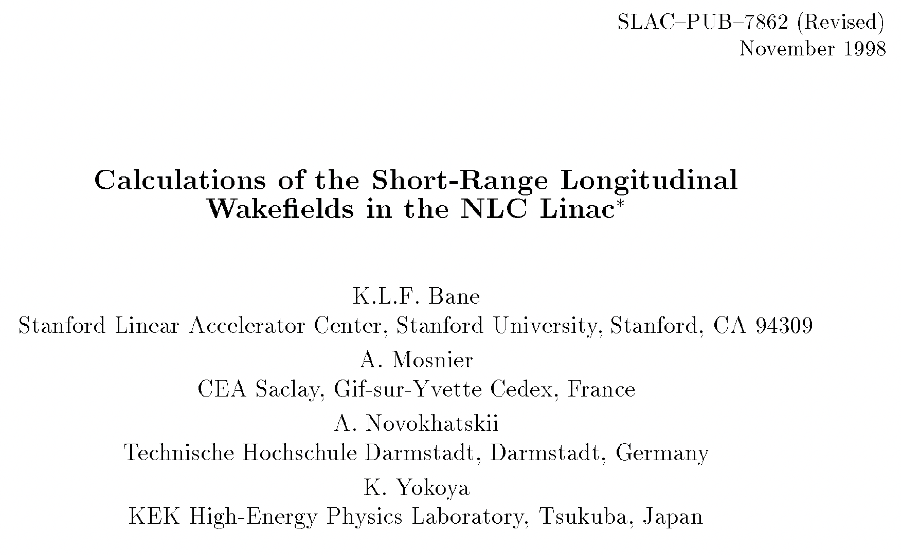
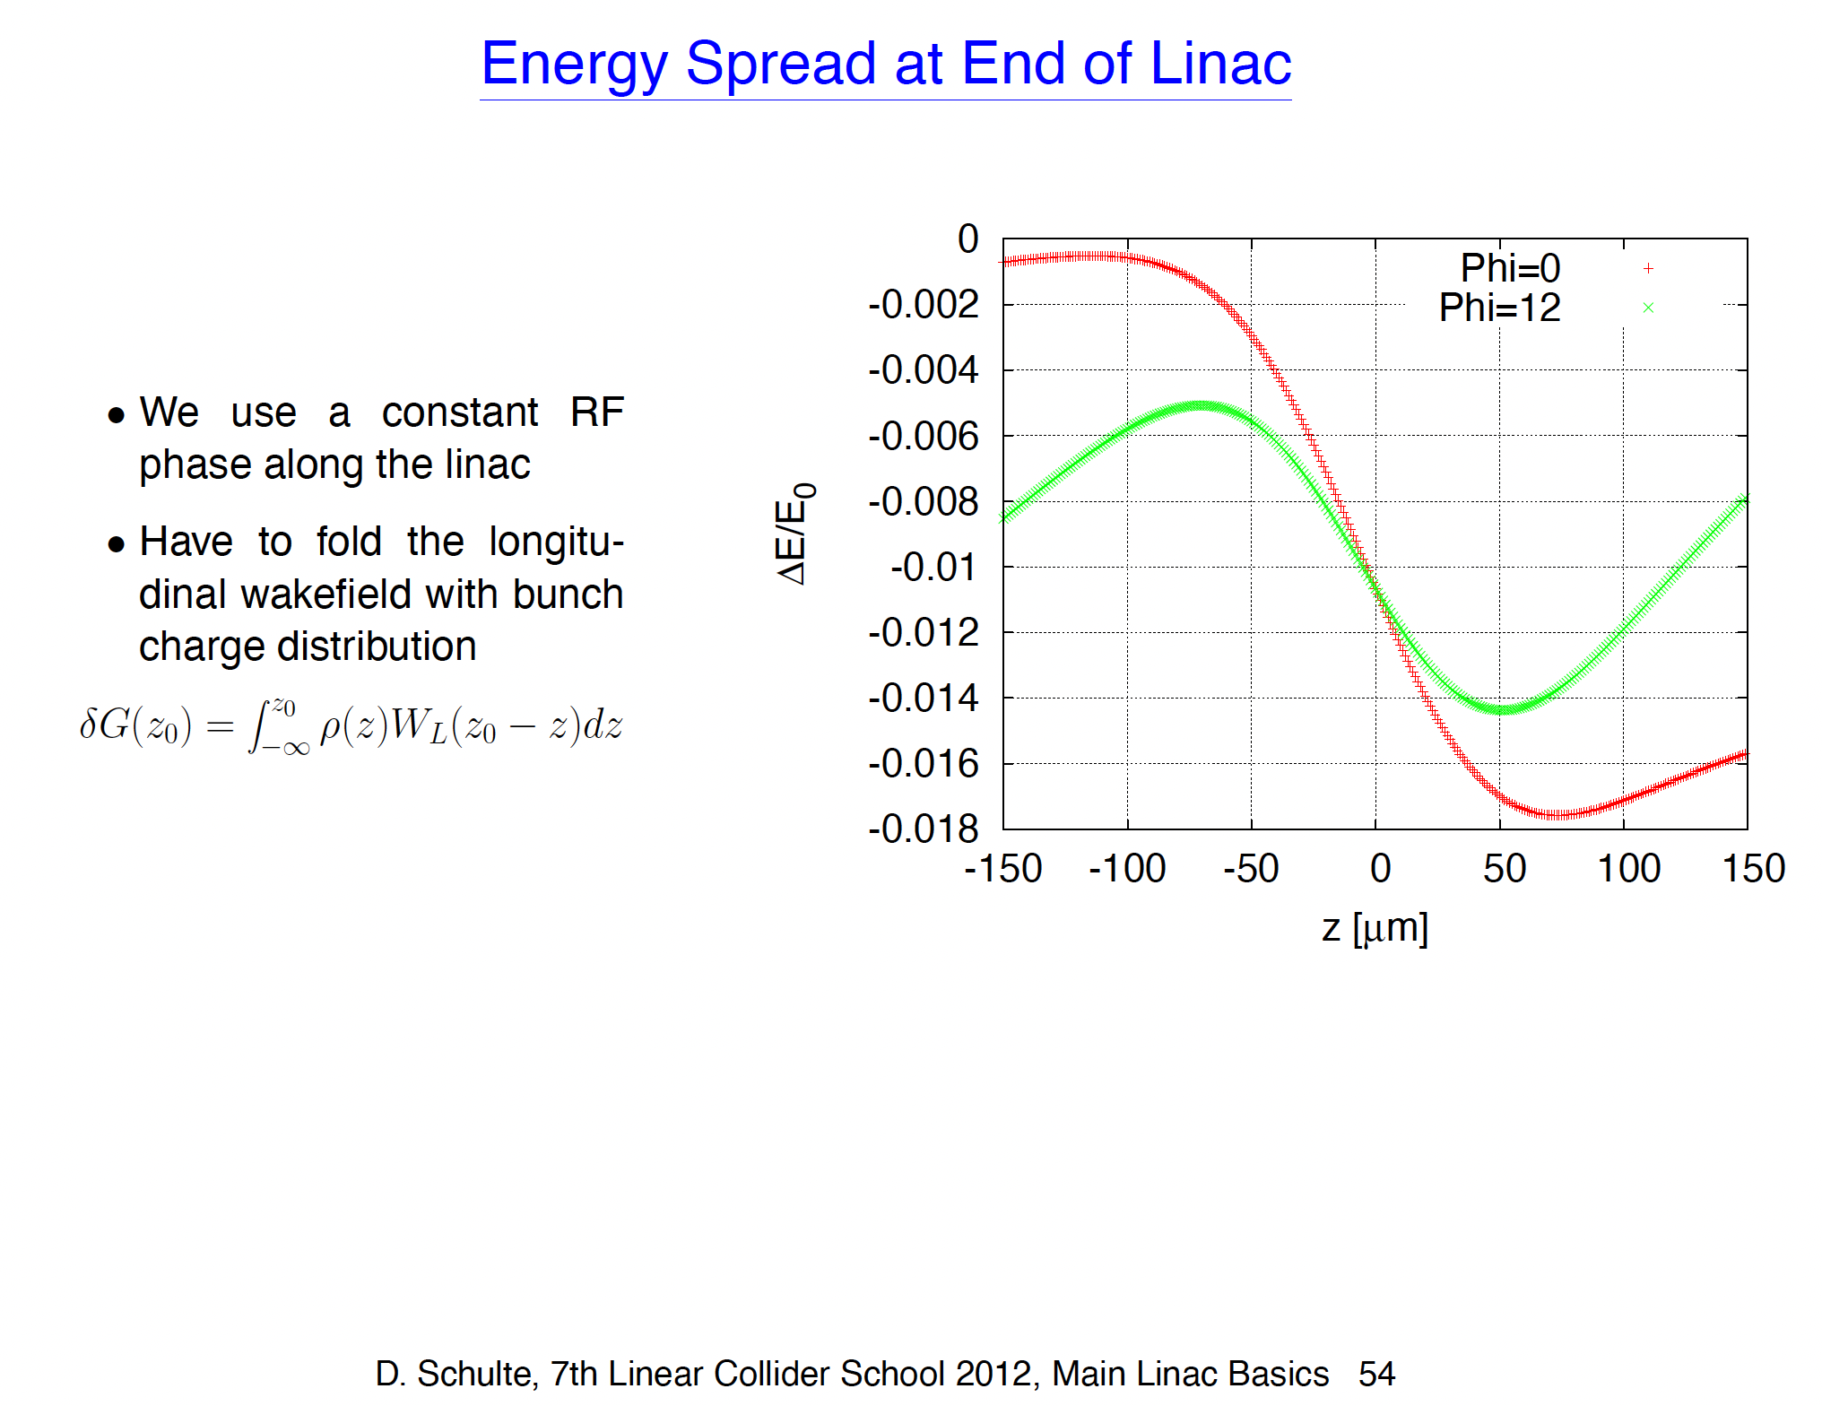
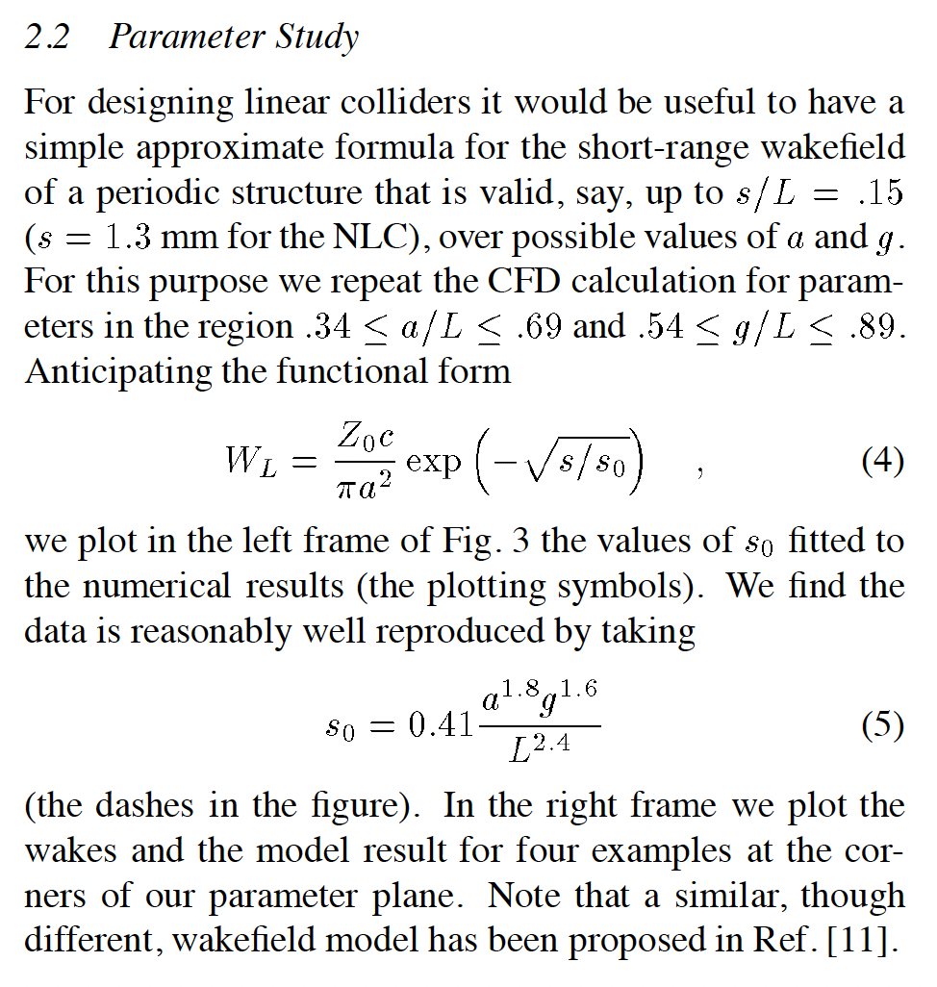
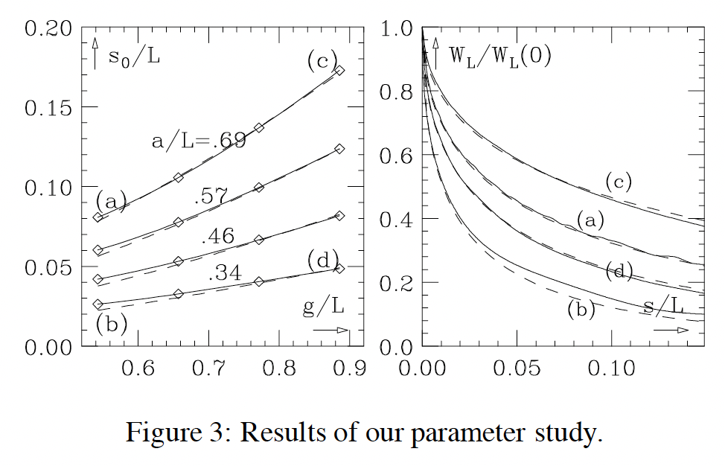
Short Range Longitudinal Wakefields and Bunch Length
Estimate Longitudinal Wakefield function from recipe given by Bane at al. SLAC-PUB-7862
Follow Strategy given by D. Schulte,
apply to S-Band and C3 structures

Slide 5
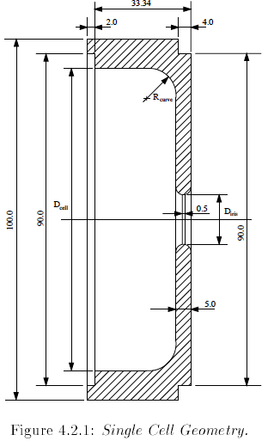
Result for SBLC like structure
Assume:
  Bunch length: 400um (!)
  RF phase: 20° (!)
  For 2.7E10 bunch population (drive beam only,
  positrons are worse!)
This results in an energy spread of +/- 0.62%
-> ~ twice as large as at CLIC (0.35%)
Result: An S-Band structure will be very hard, if not impossible, to operate at the bunch chargesand bunch lengths required for HALHF
Did not even look at transverse wakefields

Slide 6
Energy Spread and Phase
For each sigma / phi combination,
turning points of dE curve determine edges of energy distribution
From this, calculate energy distribution width, plot half width versus sigma_z for each phase
For a given target half width, here
+/-0.35%, plot necessary rf phase versus sigma_z of bunch
Result:
at sigma_z = 400um, about 30° would be required to get to 0.35% energy spread
Conclusion: S-Band will require very long bunches (400um or more) for reasonable energy spread!

Slide 7
Looking at a C3 Structure
Q=2.7E10*e
G=70MV/m
Phi=15°
Sigma=500um
C3 runs at 5.712GHz (C-Band),
assume 70MV/m gradient
Repeat analysis for 2.7E10 bunch population
Energy spread below 1% very hard to get!
Results in bunch lengths around 300-600um and up to 30° RF phase for 1% energy spread
-> A C-Band structure is probably incapable of delivering HALHF like bunch charges with reasonable length and energy spread
Phi=0
Phi=15°
Sigma=500um
Phi=15°

Slide 8
Look at L-Band: 1.3GHz
Q=2.7E10*e
G=20MV/m
Phi=12°
Sigma=150um
At HALHF bunch charges,
L-Band structures at 1.3GHz deliver small energy spreads at bunch lengths of 100-250um
Assumption:
  Cell shape scaled from SBLC cell shape to 1.3GHz
  Travelling wave, 120° phase advance
  Smaller iris than CLIC drive beam

Slide 9
LBand: New Parameter Set
Q=8.05nC
G=25.4MV/m
Phi=20°
Sigma=157um
Energy spread (dE/E)=0.49%
at 20° off-crest -> OK?
-> assumes 25.4MV/m (a lot!)
Directly delivers 157um RMS bunch length
8nC is huge, but an L-band linac at 1.3GHz could probably handle it

Slide 10
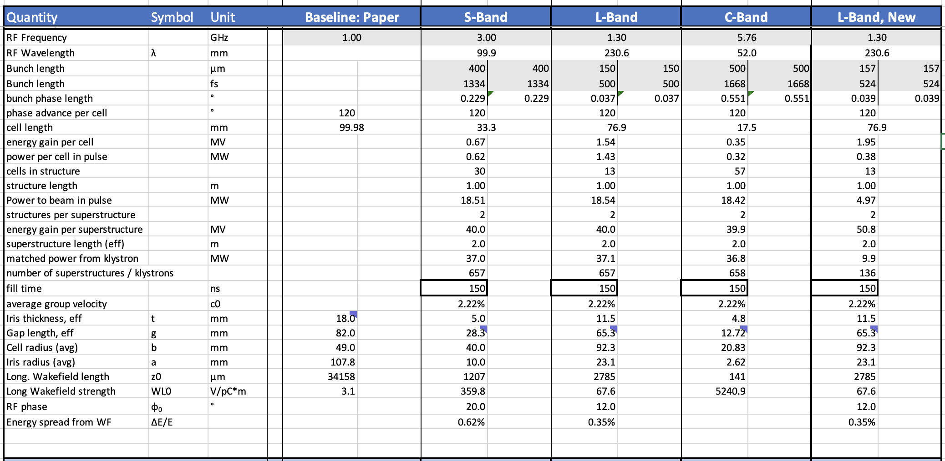
Parameter Sets: Wakefield related
Parameters from
Bayesian optimisation
CLIC DB
SBLC
SBLC, scaled
C3
SBLC, scaled

Slide 11
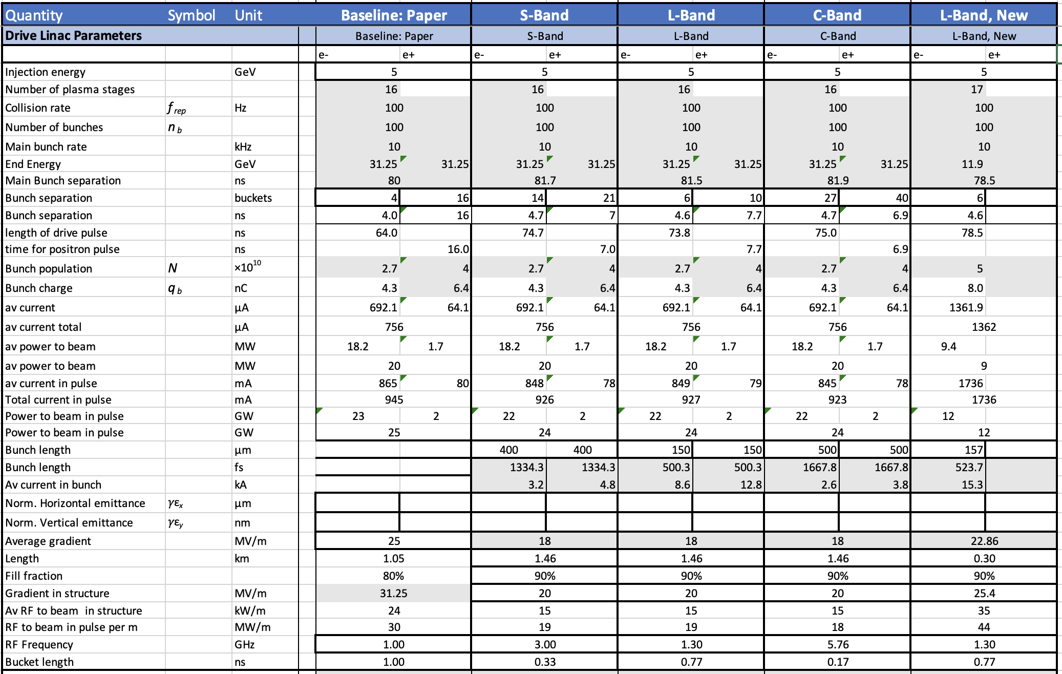
Parameter Sets, Drive Linac related
Positron linac separate
https://syncandshare.desy.de/index.php/s/Rsz3E2ffp77rCFK

Slide 12
Conclusions
High bunch charges of HALHF pose significant challenge for drive beam linac
Short-range longitudinal wakefields cause significant energy spread
Transverse wakefields and beam instabilities not studied, will pose additional challenges
Resonable energy spread at short bunch lengths requires RF frequencies below ~2GHz
-> excludes C3 like linac at 5.7GHz or
SBLC like linac at 3GHz
1.3GHz L-Band seems to work
-> should be used in cost estimation model:
larger cavities, larger klystrons -> higher cost
F=1.3GHz
Q=8.05nC
G=25.4MV/m
Phi=20°
Sigma=157um

Slide 13
Drive Beam Accelerator: Basic Observations
Assuming Input energy 5GeV, output 31.25GeV,
16x2.7E10 drive bunches, 4E10 main e+ bunch,
10kHz average bunch rate (100Hz x 100):
20 MW RF to beam (in pulse: 25GW)
Drive beam linac delivers 84% of the total beam power (rest in 5GeV linacs) – power does not depend on bunch pattern, frequency, … it is just the overall beam power
This is a lot. Requires e.g. 500 x 50MW klystrons, modulators, couplers etc
Length / gradient is not only limited by achievable gradient, but by amount of power that can be handled per meter
Drive beam linac should not dominate site length -> push for high gradient (25MV/m-ish)
Slide from last time

Slide 14
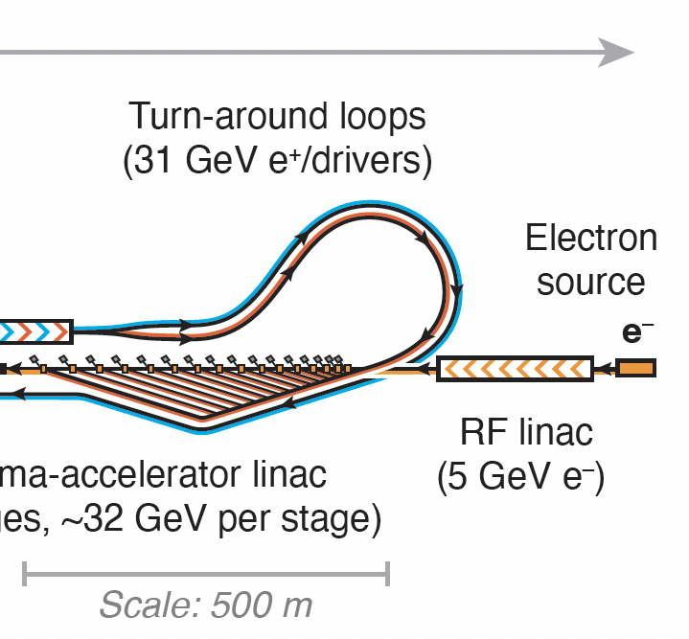
Drive Beam Linac: Basic Requirements
High total power:
20 MW RF to beam (in pulse: 25GW)
Gradient ~20MV/m
~5ns drive beam bunch separation driven from delay line fan dimensions on plasma section
Pulse length 8μs, current ~1A
-> pulsed klystrons: what is available?
-> power: ~20MW/m -> challenge to couplers
Short, intense bunches (4.3nC, 40μm?)
-> what bunch length is reasonable in linac???
Available designs with similar challenges:
  CLIC drive beam linac (L-Band TW)
  CTF3 drive beam linac (S-Band TW)
  SBLC (S-Band TW)
-> all are Traveling Wave
  High RF-to-beam efficiency
  High power, simple (cheap) couplers
  But relatively inflexible, beam loading must match precisely to avoid reflections

Slide 15
Drive Beam Linac: Requirements from Plasma Acceleration
What are the requirements on drive beam from the plasma accelerator?
  Bunch length: 42um
  -> might require bunch compressor?
  Normalised emittance? 100um OK?
  Energy spread? Energy chirp?
  Current profile?
  Beam stability / jitter?
Requirements on positron beam / bunches:
  Bunch length: 75um
  Emittance: 10um(!)
  Energy spread: 0.15%

Slide 16
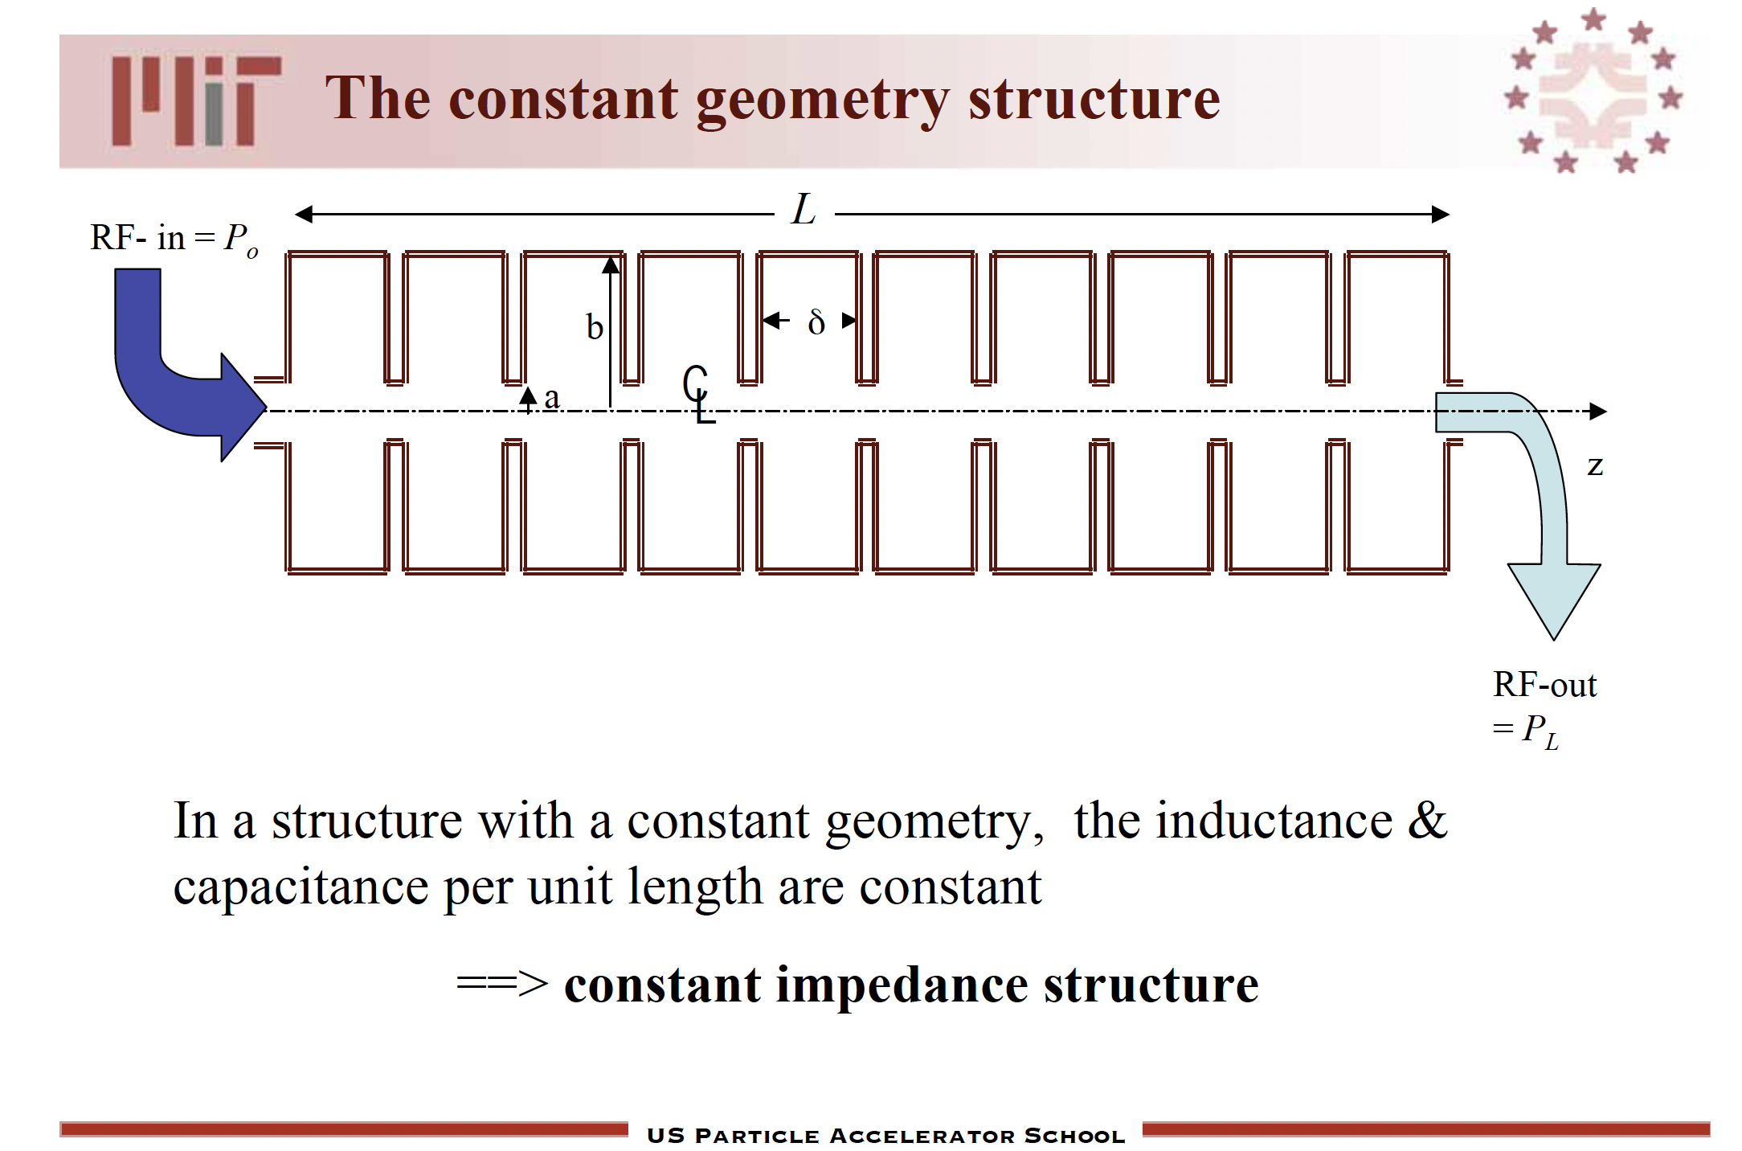
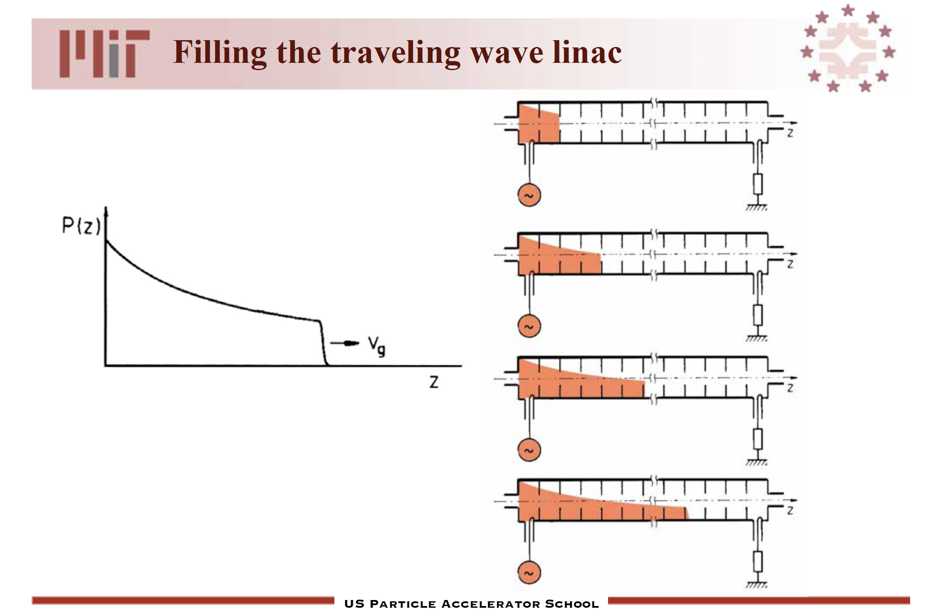
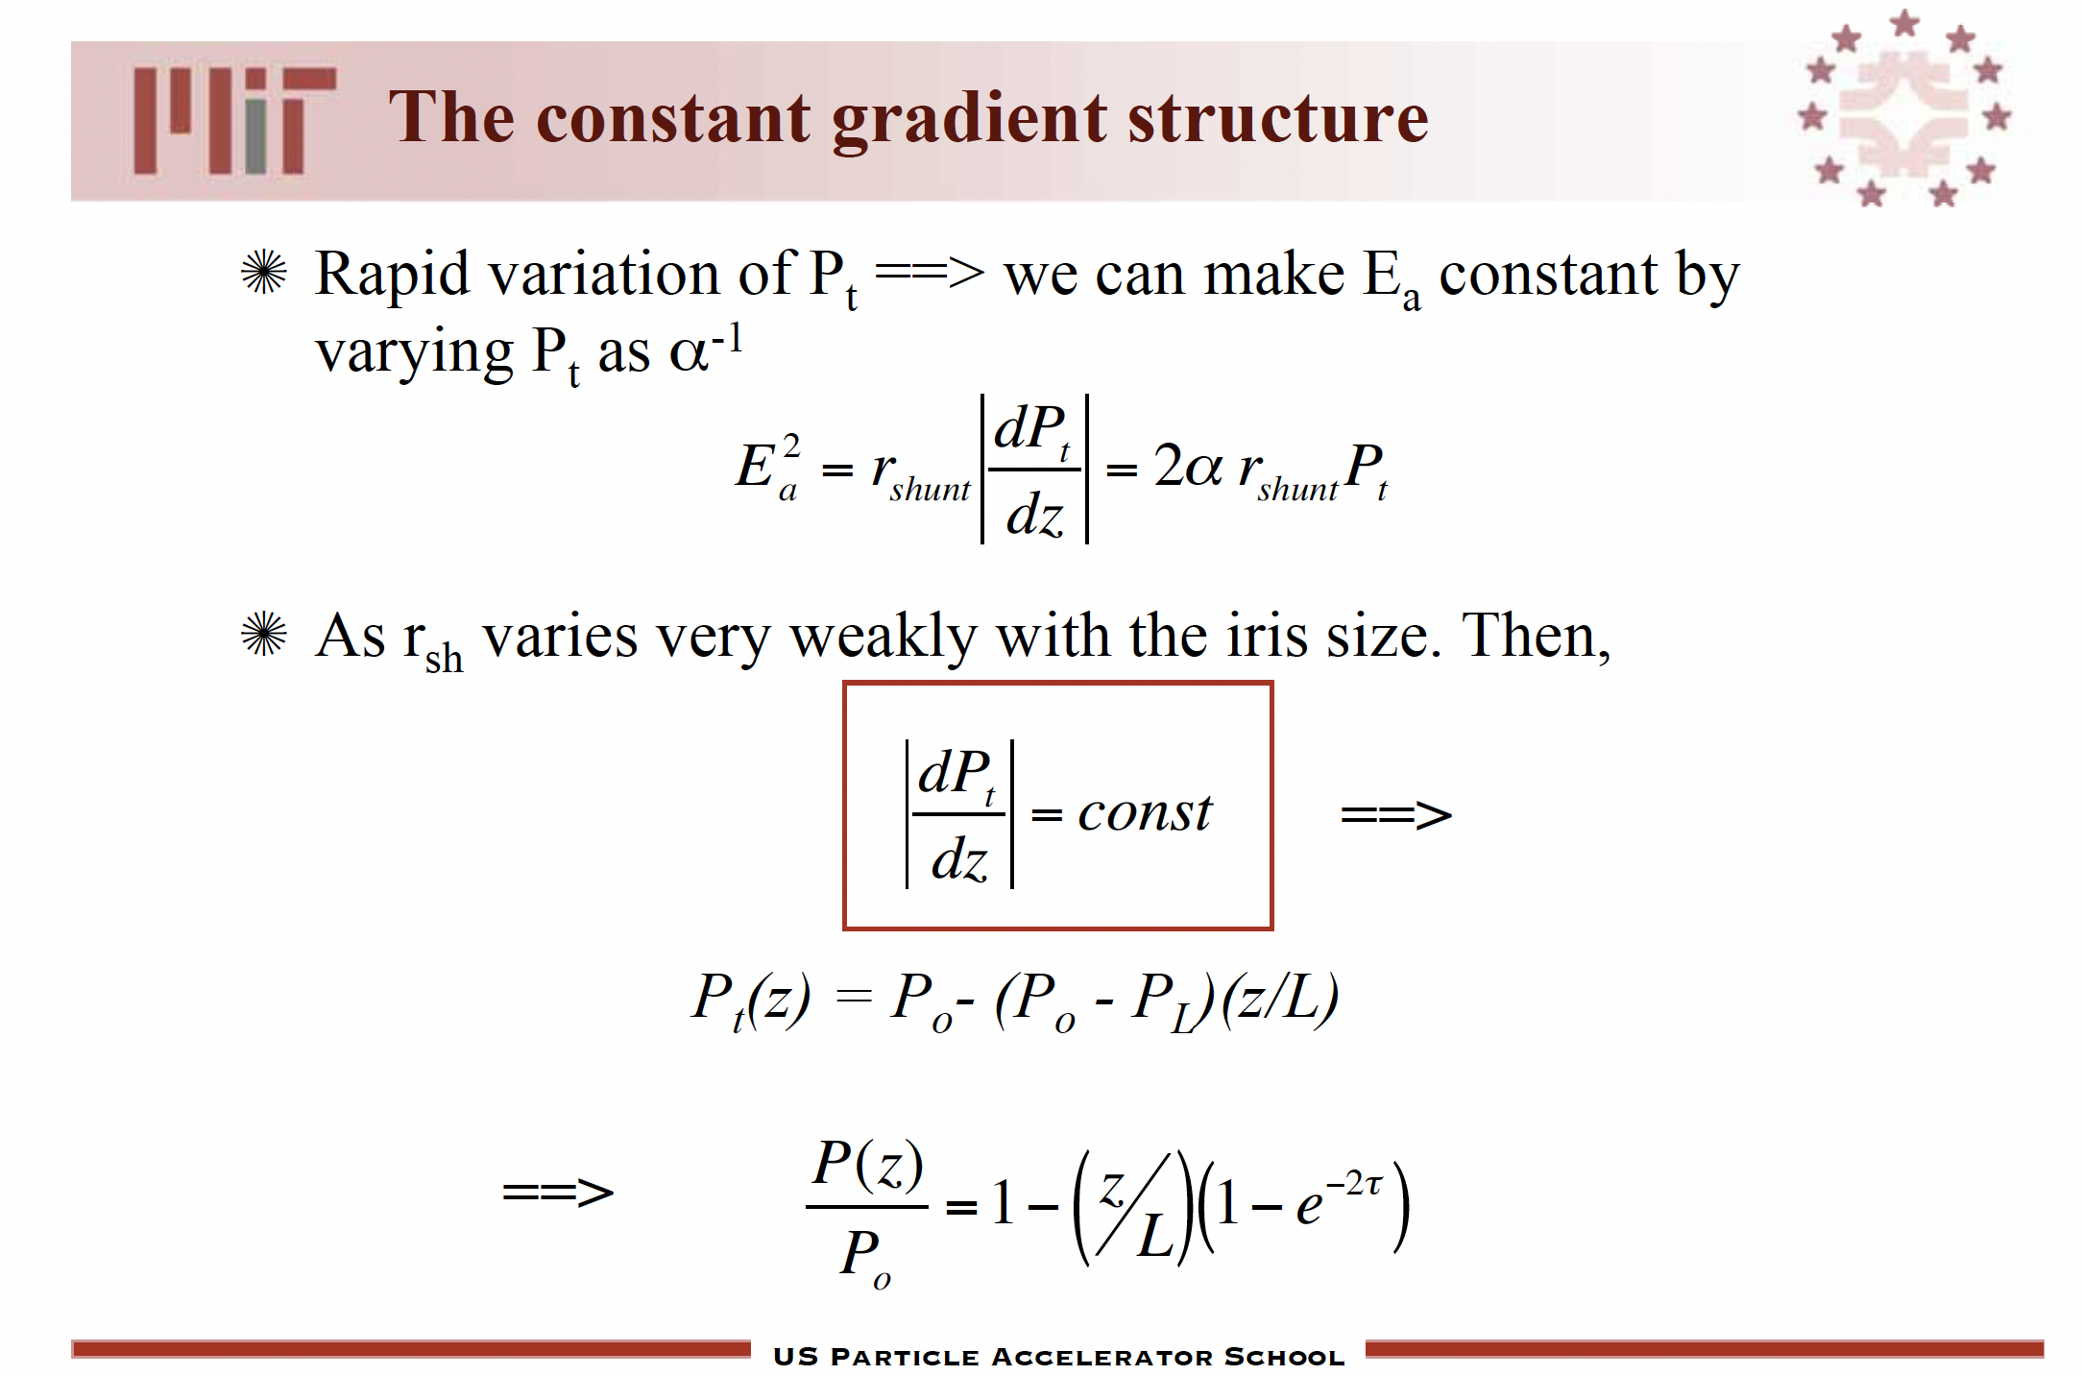
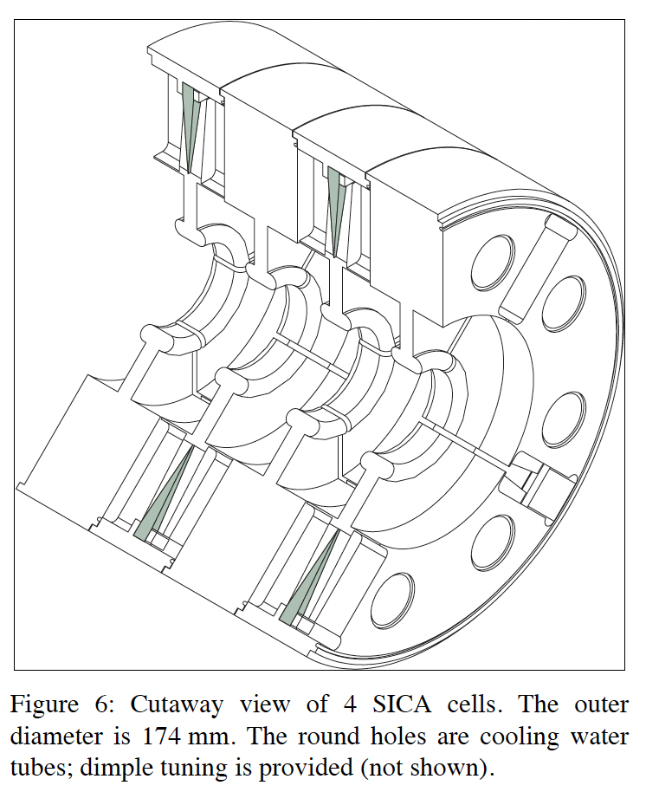
Traveling Wave NC Linacs: Constant Geometry vs Constant Gradient
W.A. Barletta, US Accelerator School 2009,
https://uspas.fnal.gov/materials/09UNM/Unit_4_Lecture_11_&_12_Traveling_Wave_Linacs.pdf
Constant geometry:
+ permits optimized cavity shapes
- average gradient lower than peak gradient
Constant gradient:
- cavity dimension varies -> use simple shape: SLAC cavity
+ average gradient = peak gradient
Example: SLC, SBLC
LINAC2000-TUA16

Slide 17
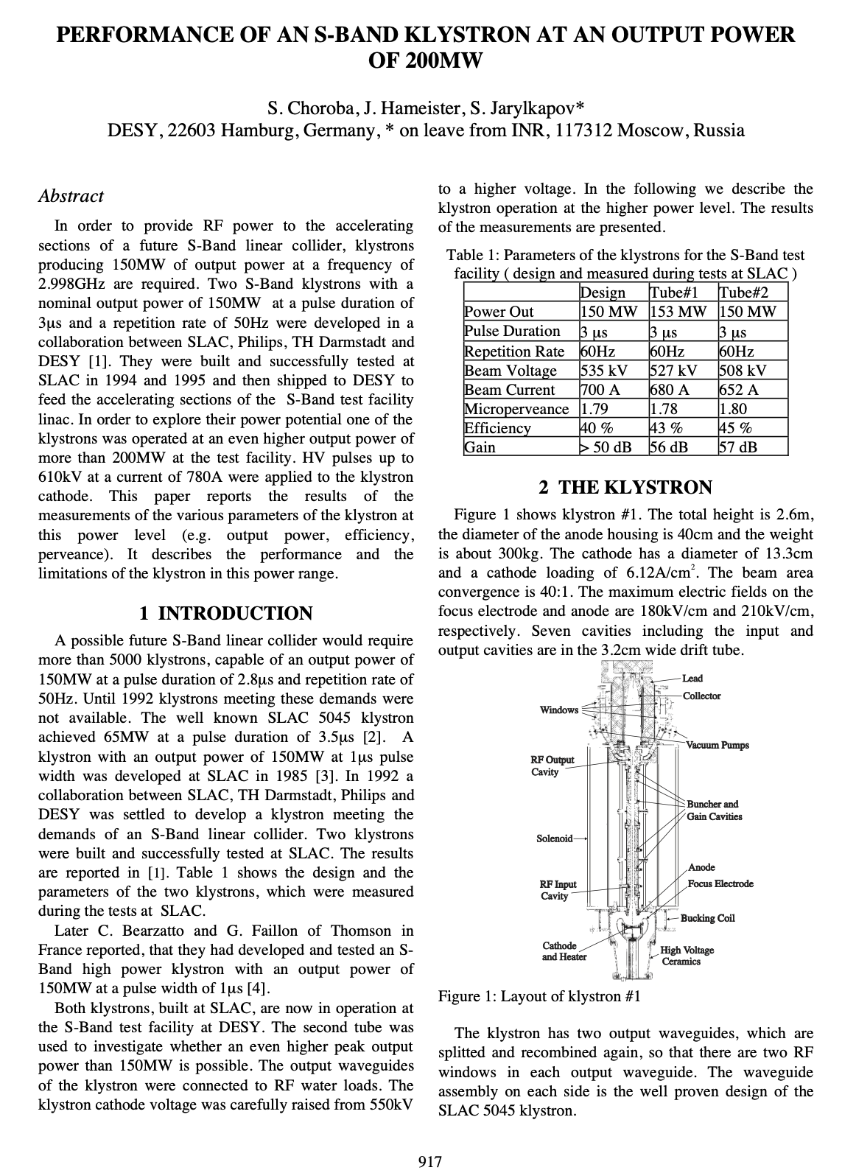
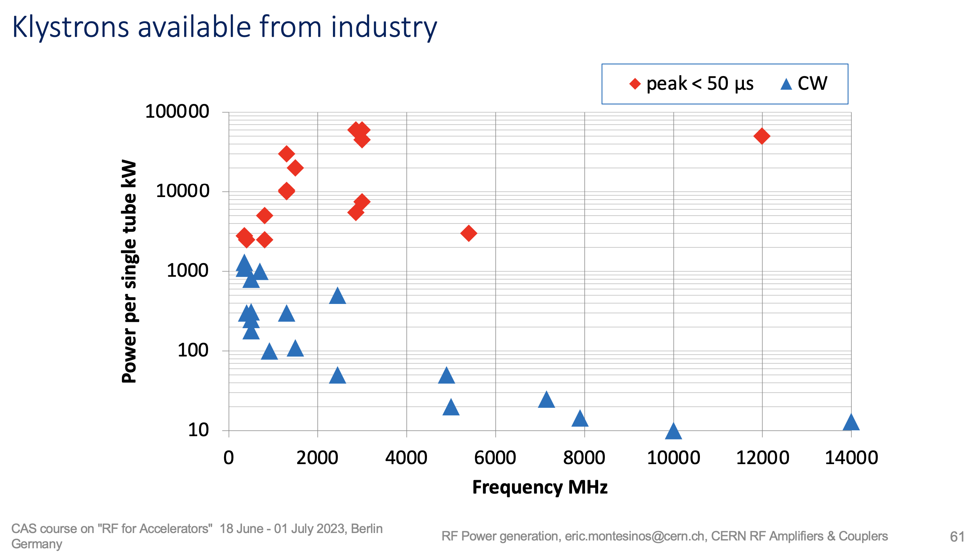
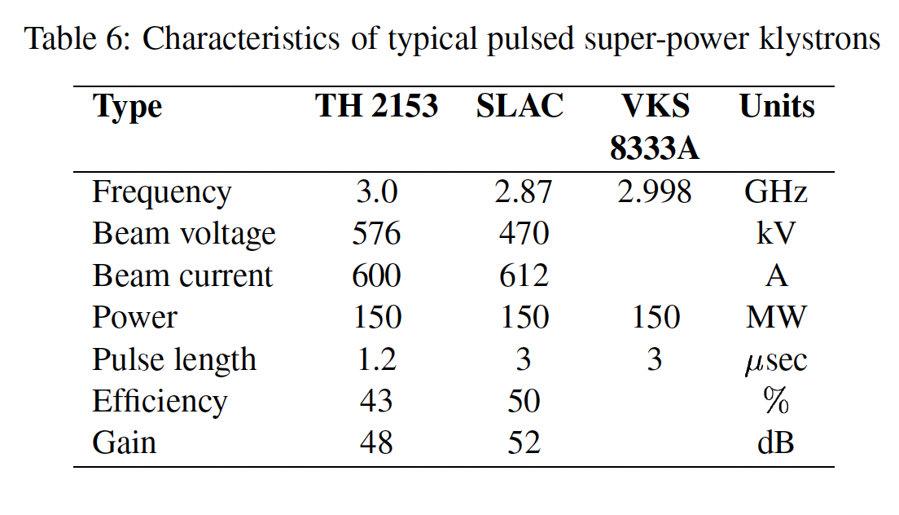
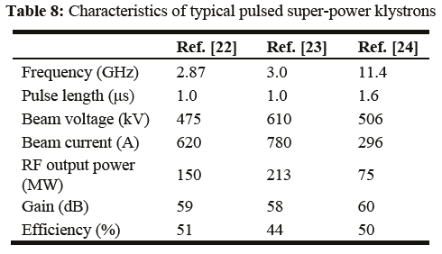
Pulsed Klystrons
Which high-power klystrons are available
50MW up to 200MW pulsed
klystrons have been built at 3GHz,
12GHz
Pulse lengths ~1-2 μs,
8 μs probably doable
Assume 3GHz, 50MW, 8 μs
klystron can be built
Choroba 1998,
LINAC 98 TH4066
RF Power generation, eric.montesinos@cern.ch
https://indico.cern.ch/event/1212689/contributions/5377054/
R.G. Carter, CERN-2005-003 p. 133
R.G. Carter, CERN-2011-007 p. 196

Slide 18
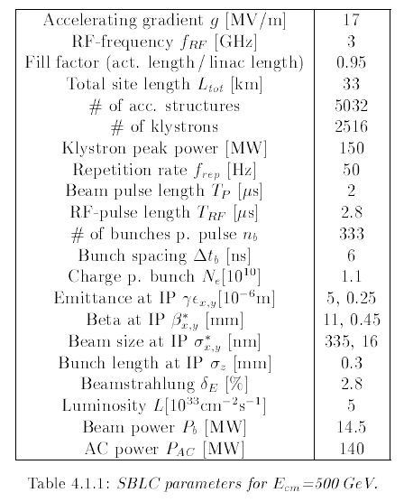

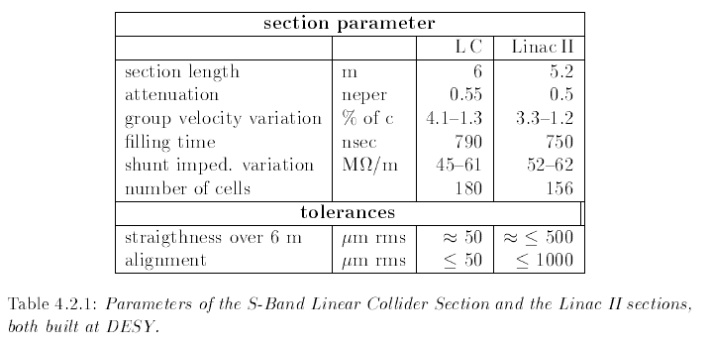
S-Band Linear Collider SBLC
An early TESLA competitor
Travelling wave S-Band linac
20MV/m, 3GHz, 300mA current
2us pulse length, 6ns pulse sep
150MW klystrons drive 6m long structure
-> Similar power requirements as for drive beam linac!
TESLA CDR
Chap 4: S-Band Linear Collider

Slide 19
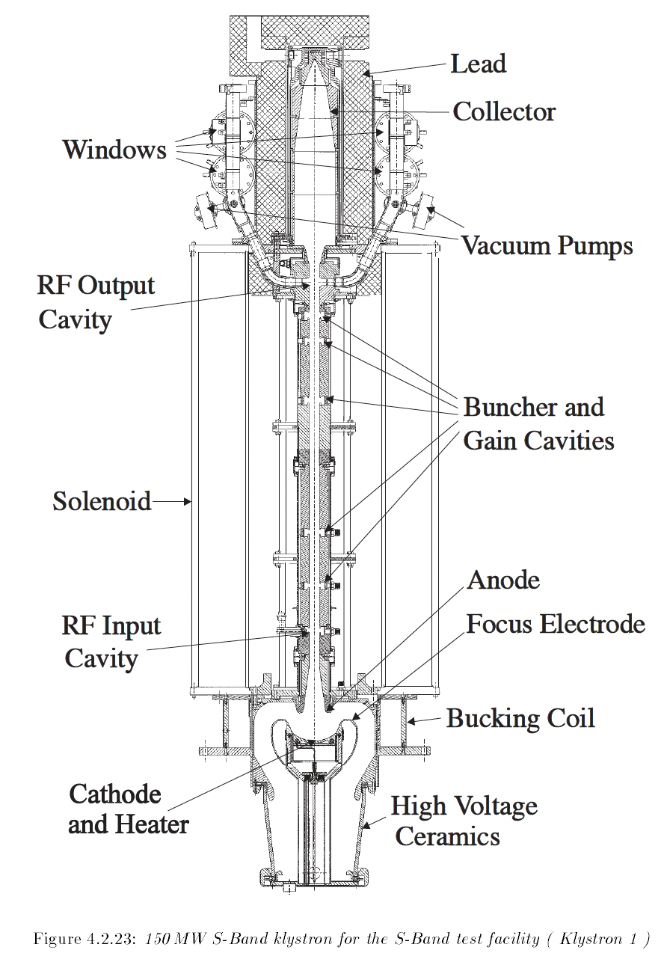
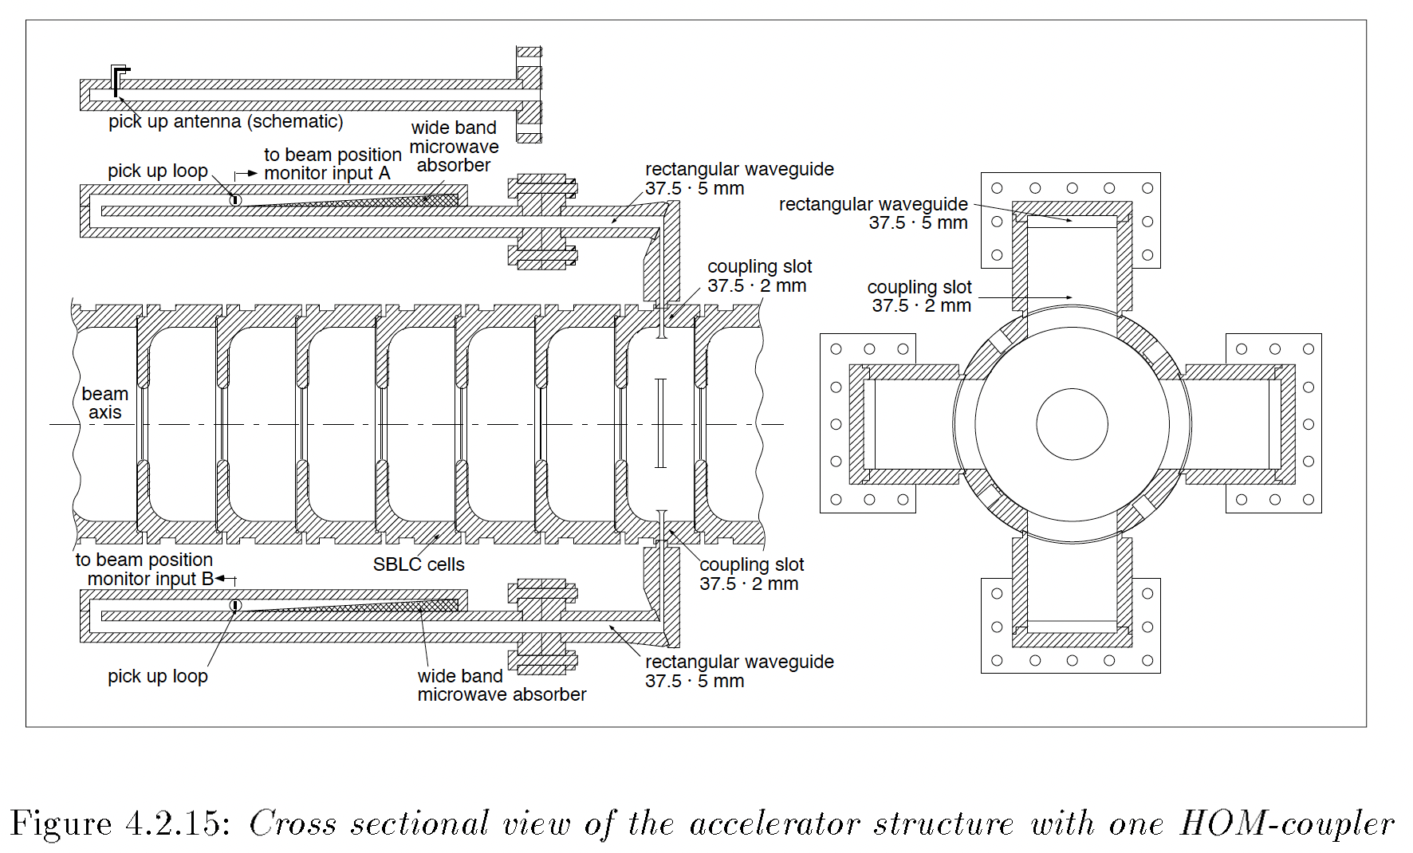
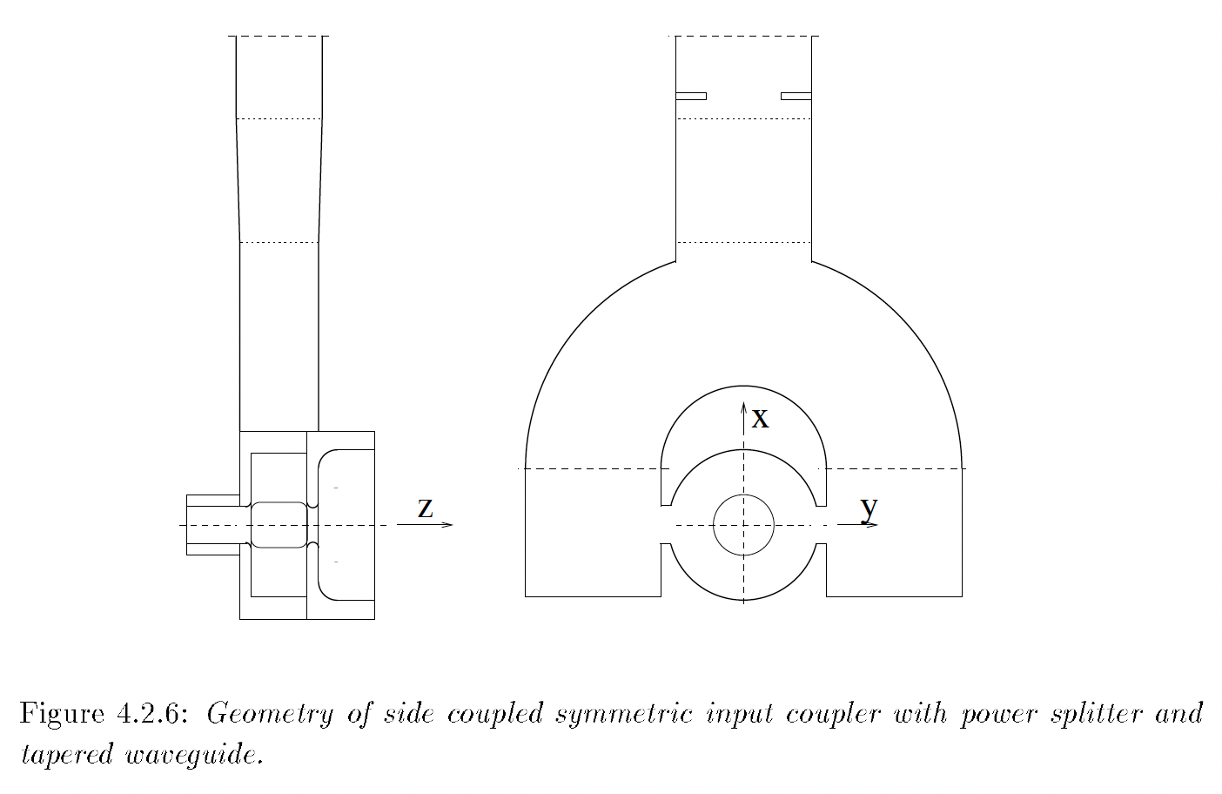
S-Band Linear Collider Components
Cell
HOM-Absorbers
Klystron
Input Coupler

Slide 20
SBLC Linac Principles
Travelling Wave structure, S-Band 3GHz
2π/3 phase advance per cell
6m long structure with 180 cells,
last 8 cells act as rf absorber
Constant gradient cells – cell and iris diameter, coupling and group velocity vary along structure to give uniform accelerating gradient
1 klystron powers 2 structures (12m)
Very high fill factor (95%)
Very high rf to beam efficiency (95%?)
Gradient 17MV/m
Current in pulse: 300mA = 30% of HALHF
790ns fill time – aim for 160ns? -> shorter structures
Pulse length: 2us (rf pulse: 2.8us) – 30% of HALHF
Very simple coupler for high power
Klystron prototype was built and tested
  Longer pulse duration seems feasible
  Assume higher efficiency possible today
  (55% was demonstrated)

Slide 21
Fill Time and Structure Length
SBLC:
  6m structures with 790ns fill time (v_{g}=2.5%c)
  -> 130ns/m
  1 klystron feeds 2 structures
Assume:
  1m long structures
  160ns fill time (80ns possible?)
  filling is done with beam operation
  -> throw away the first bunches!

Slide 22
Benno List
DESY IPP
Benno.List@desy.de
+49 40 8998 2752

