Slide 1
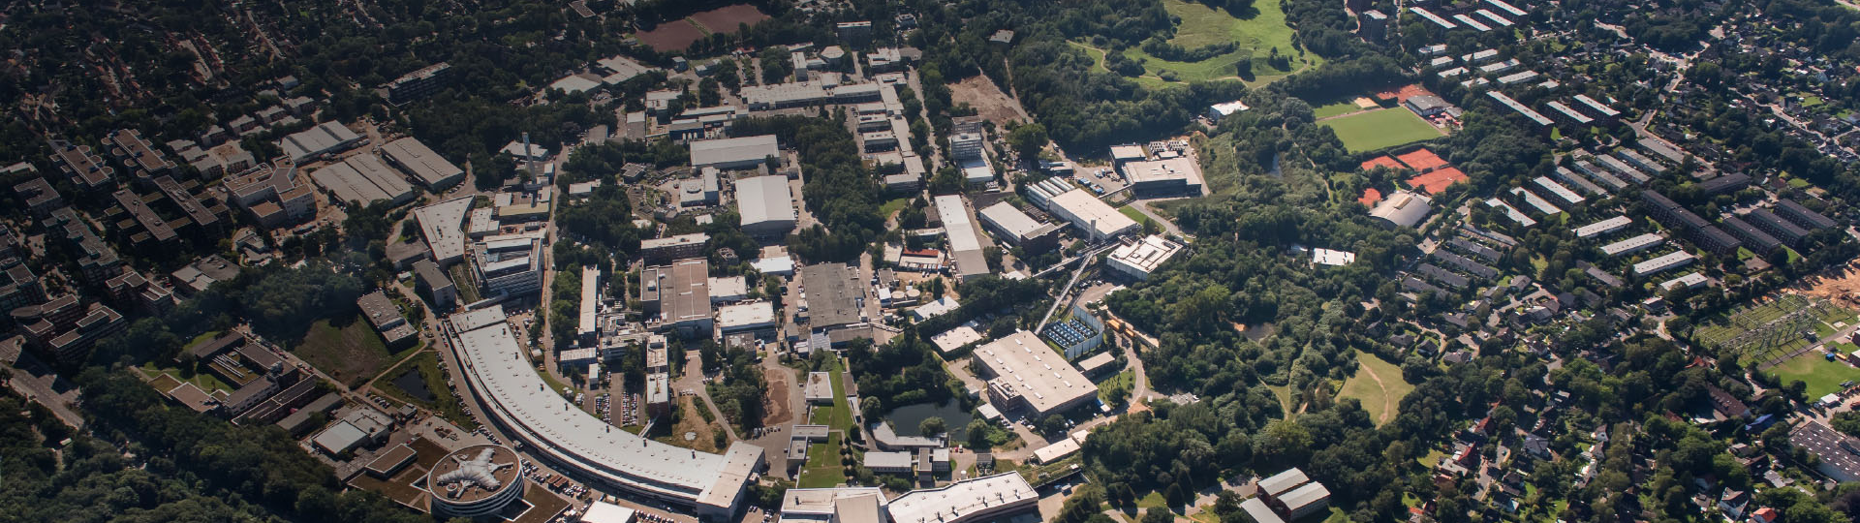
Resonant emittance mixing of flat beams in plasma accelerators
S. Diederichs, C. Benedetti, A. Ferran Pousa, A. Sinn, J. Osterhoff, C. B. Schroeder, and M. Thévenet
Maxence Thévenet – DESY
MPA1 - theory & simulation for plasma acceleration
Simulation tools for HALHF
Flat beams in plasma accelerators
Notes:
Motivate from use case, but could be more general

Slide 2
Simulation tools for HALHF
Flat beams in plasma accelerators
Notes:
Motivate from use case, but could be more general

Slide 3
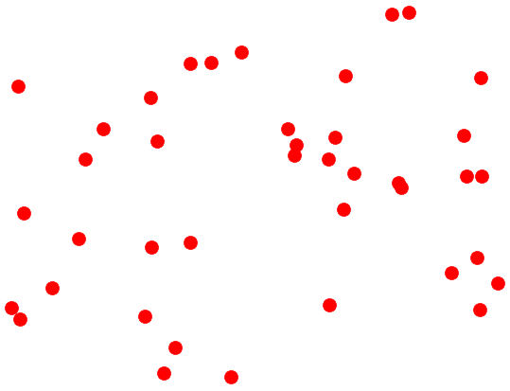
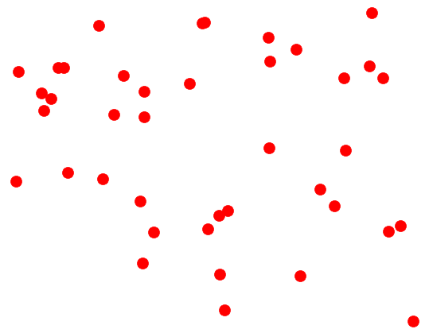
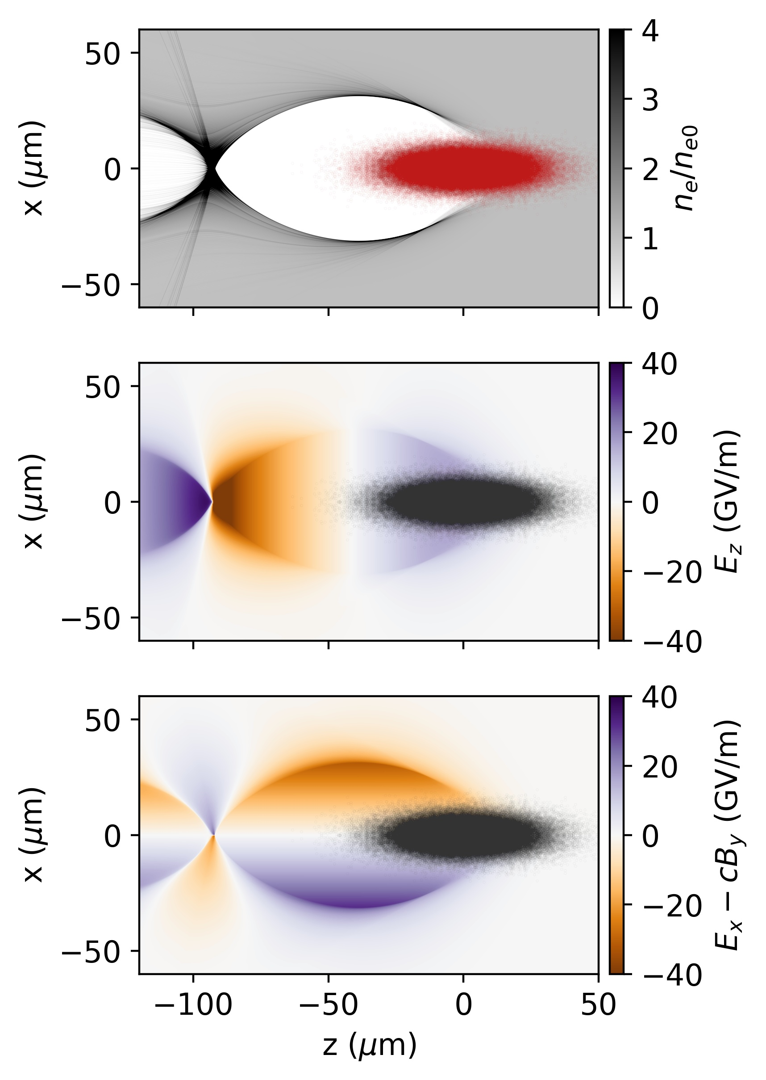
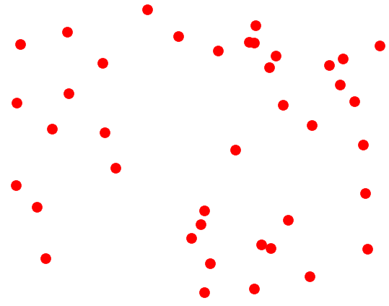
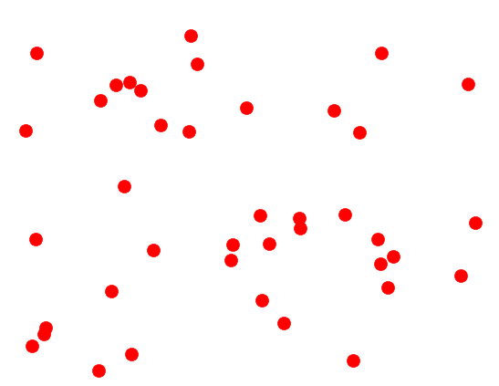

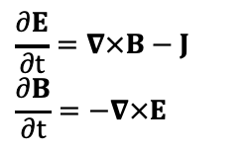



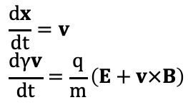
Particle-in-cell is used to simulate plasma acceleration
Plasma electrons are disturbed by the driver, and form a wake with large electric fields where a particle beam can be accelerated
Regular mesh
Macroparticles
$$\frac{dx}{dt}=v$$
$$\frac{dγv}{dt}=\frac{q}{m}\left(E+v×B\right)$$
Push particles
$x, v=f(E, B)$
Gather fields
$E, B=f(E, B)$
Deposit currents
$J=f(x, v)$
Maxwell’s equations solved on a regular mesh
Plasma dynamics solved with macro-particles
Solve fields
$E, B=f(J)$
$$\frac{∂E}{∂t}=∇×B−J$$
$$\frac{∂B}{∂t}=−∇×E$$
R. Hockney and J. Eastwood, Computer Simulation Using Particles (1988)
C. Birdsall and A. Langdon, Plasma Physics via Computer Simulation (2004)

Slide 4
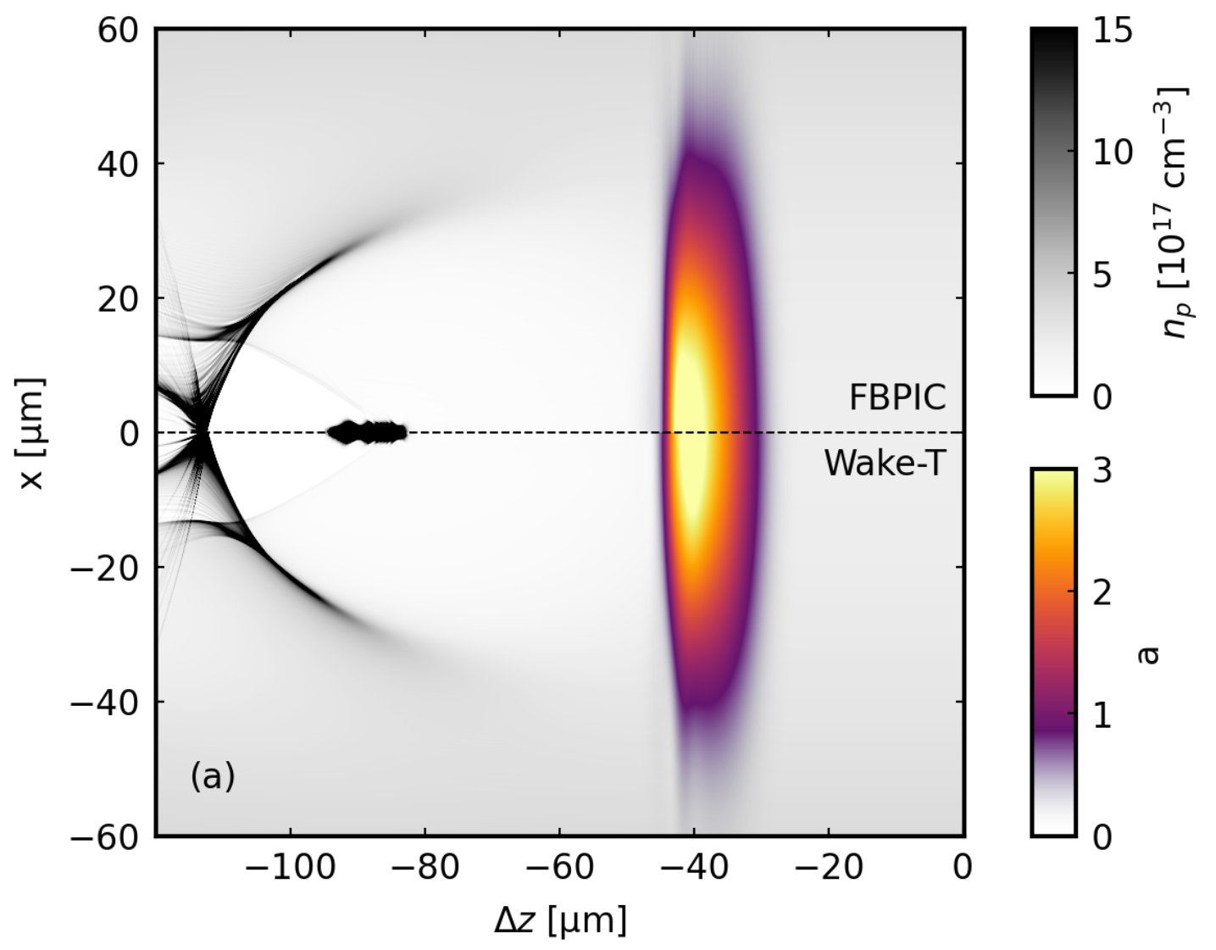
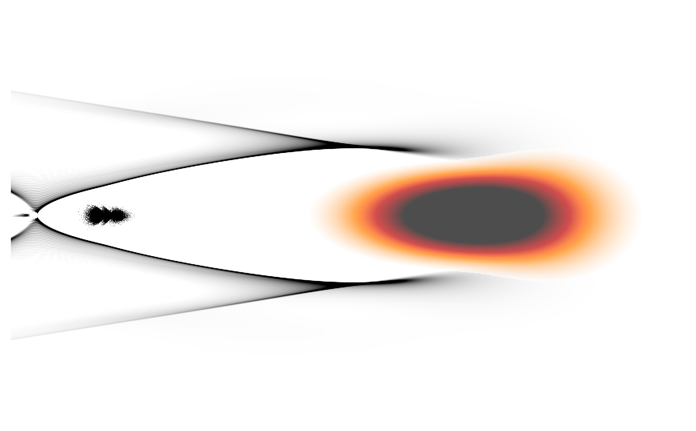
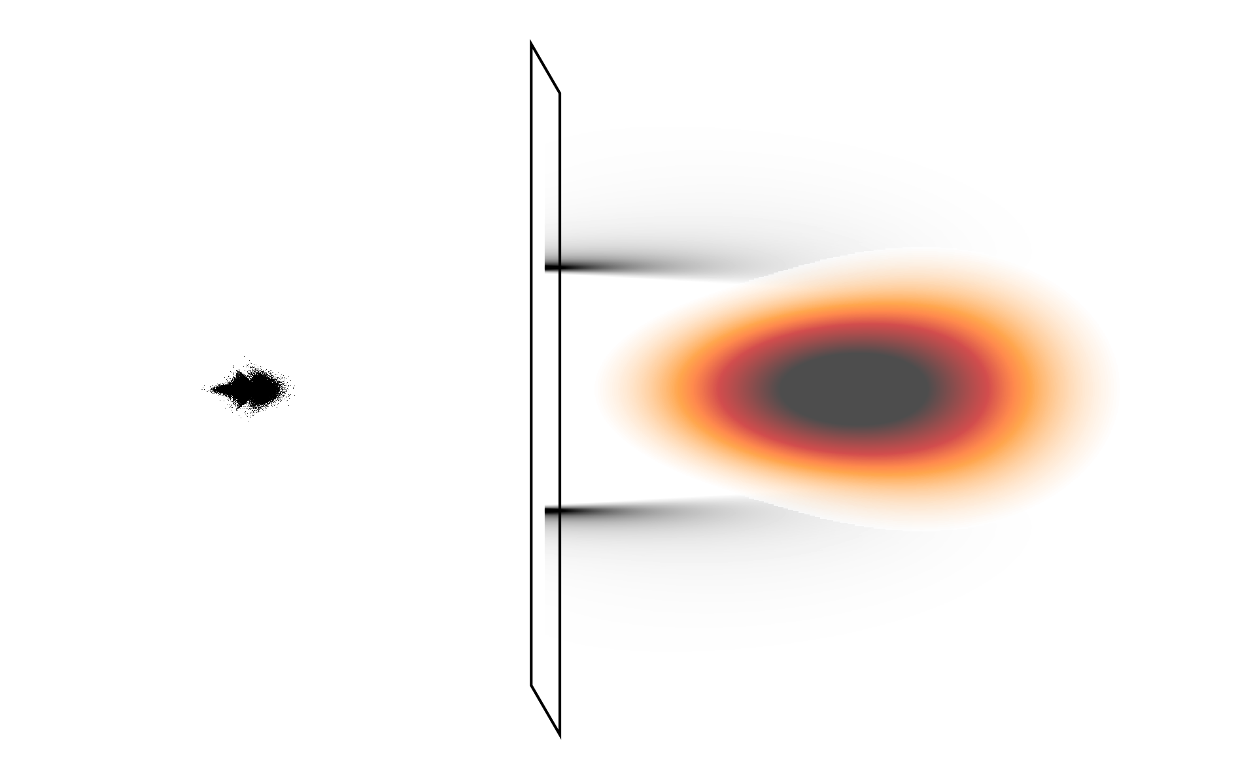
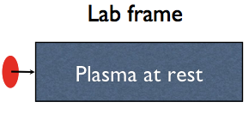
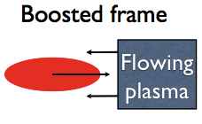

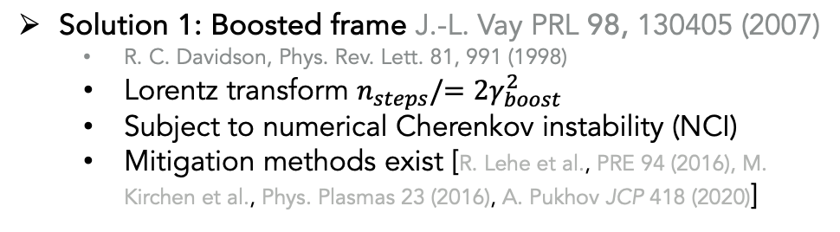
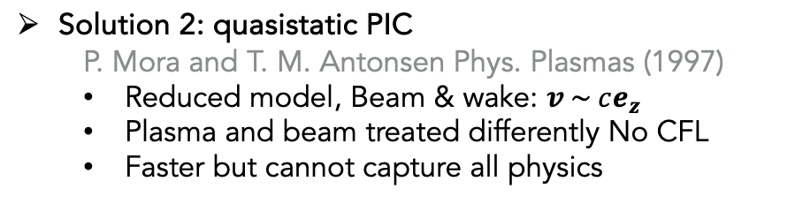
plasma acceleration: 1 problem, 2 solutions
Sharp features < 10 nm
Plasma accelerator: 1 m (1e8x)
$$v_{z}≃c$$
Problem: in PIC the CFL condition limits the time step to $∆t<c∆z$
Solution 1: Boosted frame J.-L. Vay PRL 98, 130405 (2007)
  R. C. Davidson, Phys. Rev. Lett. 81, 991 (1998)
  Lorentz transform $n_{steps}/=2γ_{boost}^{2}$
  Subject to numerical Cherenkov instability (NCI)
  Mitigation methods exist [R. Lehe et al., PRE 94 (2016), M. Kirchen et al., Phys. Plasmas 23 (2016), A. Pukhov JCP 418 (2020)]
Solution 2: quasistatic PIC
  P. Mora and T. M. Antonsen Phys. Plasmas (1997)
  Reduced model, Beam & wake: $v \sim ce_{z}$
  Plasma and beam treated differently No CFL
  Faster but cannot capture all physics
Lorentz
Transform

Slide 5



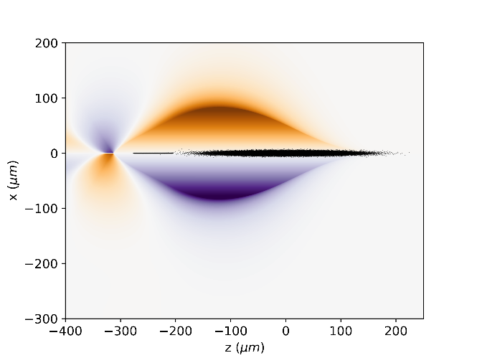
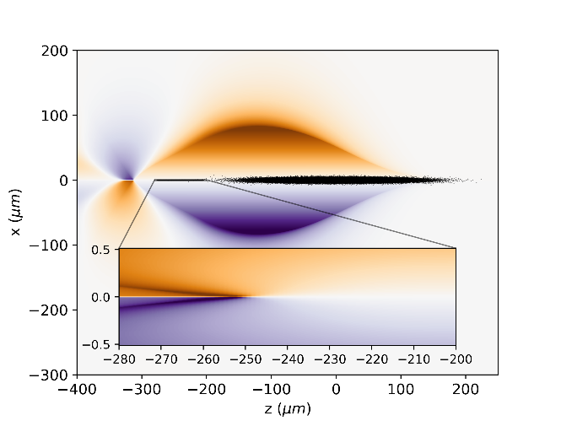
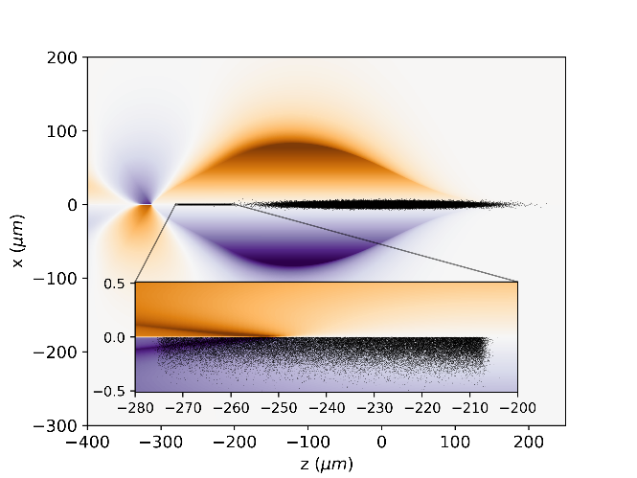

Open-source tools allow for modeling collider-relevant beams
HiPACE++
2D (axisymmetric) quasistatic code for laser/beam-driven plasma acceleration, incl. ion motion
GPU-capable multi-physics 3D quasistatic particle-in-cell code (laser-driven or beam-driven)
Collaboration
1 plasma stage takes seconds-to-minutes on a laptop, suitable for design studies. 20 stages + optimization to 150 GeV in < 1 hour
Fully converged (nm-scale resolution with mesh refinement) 3D simulations of a 20 GeV stage starting at 175 GeV for a 135 nm emittance beam w/ ion motion takes 30 min on 16 GPU-equipped nodes (Frontier has 9400) → small allocation allows thousands
A. Ferran Pousa et al., J. Phys.: Conf. Ser. (2019)
A. Ferran Pousa, et al. Proc. IPAC23, 1533
https://github.com/AngelFP/Wake-T
S. Diederichs et al., Comput. Phys. Comm. 278: 108421 (2022)
https://agenda.infn.it/event/35577/contributions/208606
https://github.com/Hi-PACE/hipace

Slide 6




Mesh refinement allows for convergence of challenging simulations
Driver
  $Q=2 nC$, $ϵ_{x,y}=10 μm$, $ℰ=20 GeV$, $Δℰ=1\%$, $L=53 μm$, matched
Witness
  $Q=833 pC$, $ϵ_{x,y}=135 nm$, $ℰ=175 GeV$, $Δℰ=0.35\%$, $L=64 μm$ beam-loaded (SALAME), matched
Plasma $n_{0}={10}^{16}cm^{−3}$, $r_{b}≃100 μm$, ion spike $≃10 nm$
Fine everywhere = Coarse + MR
MR allows for convergence at modest cost

Slide 7
Simulation tools for HALHF
Flat beams in plasma accelerators
Notes:
Motivate from use case, but could be more general

Slide 8
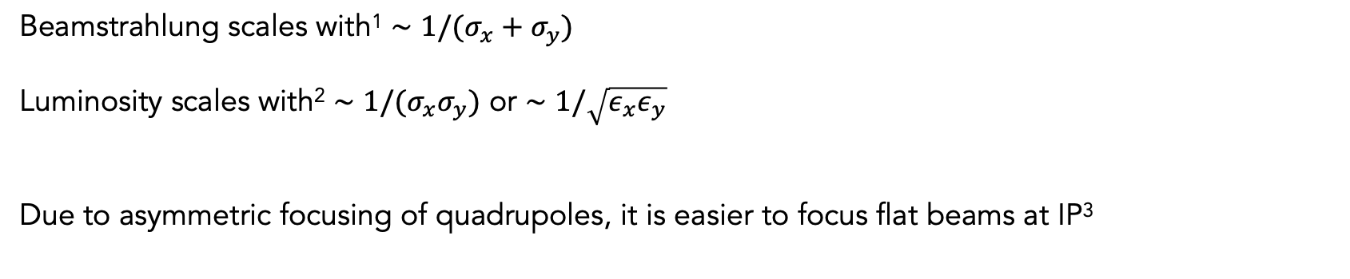



Flat beams are preferred at the interaction point
$$e^{−}$$
$$e^{+}$$
Beamstrahlung scales with¹ $∼1/(σ_{x}+σ_{y})$
Luminosity scales with² $∼1/(σ_{x}σ_{y})$ or $∼1/\sqrt{ε_{x}ε_{y}}$
Due to asymmetric focusing of quadrupoles, it is easier to focus flat beams at IP³
Flat beams with $σ_{x}≫σ_{y}$ ($ε_{x}≫ε_{y}$) minimize beamstrahlung while allowing for high luminosity
[1] Schroeder et al, JINST 2022
[2] Schulte, RAST 2016
[3] Raubenheimer, SLAC PUB 1993

Slide 9
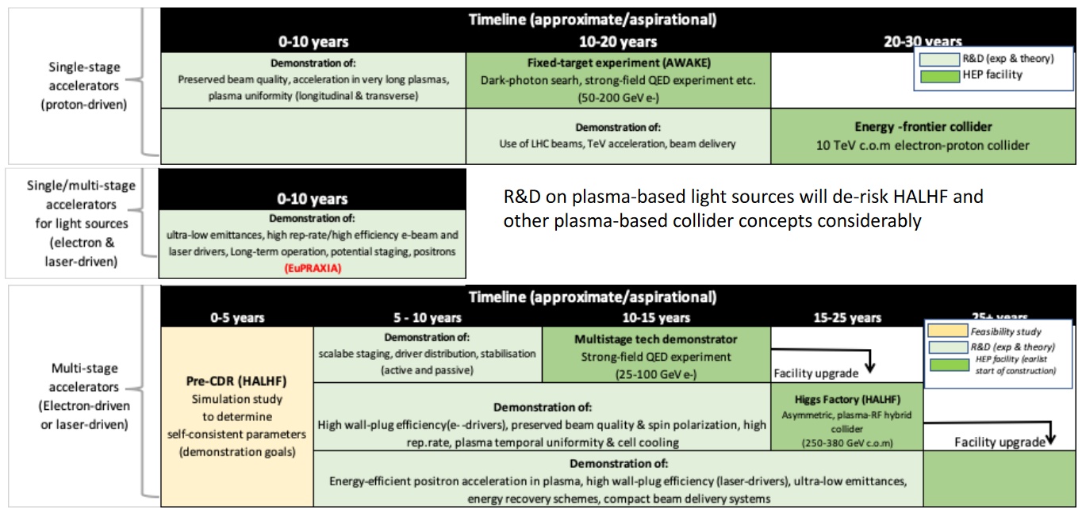
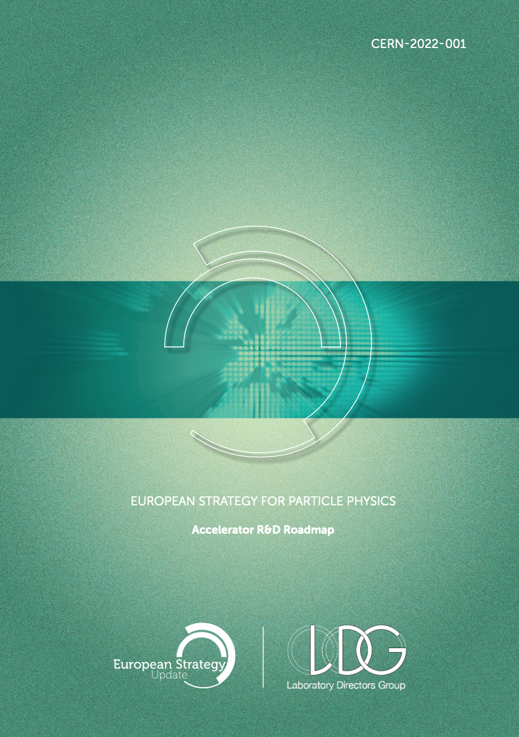
Acceleration of flat beams in plasma accelerators largely unknown
Key R&D challenges according to ESPP
Acceleration of flat beams not mentioned
Acceleration of flat beams not mentioned

Slide 10
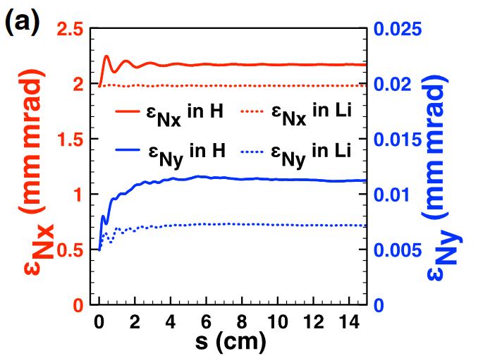
Acceleration of flat beams in plasma accel. largely unknown
Key R&D challenges according to ESPP
Acceleration of a flat electron beam in the blowout regime with ion motion¹
Acceleration of flat beams not mentioned
Acceleration of flat beams not mentioned
Flat beams are generally not considered a problem in plasma accelerators
[1] An et al, PRL 2017

Slide 11
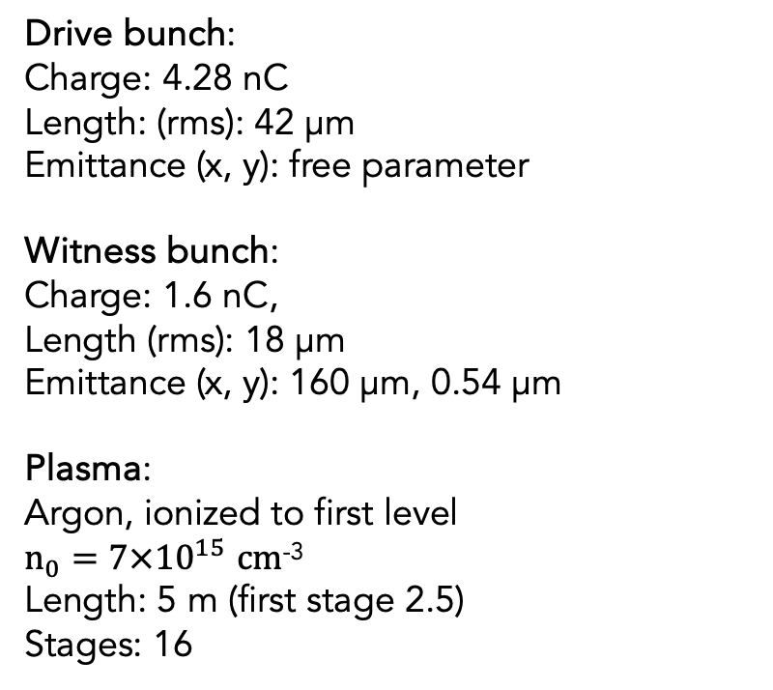
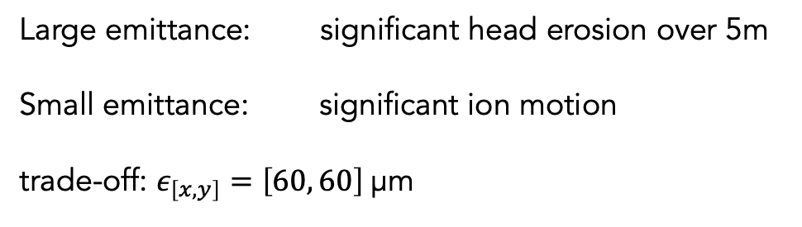
Simulations of the HALHF electron arm with a flat beam
Drive bunch:
Charge: 4.28 nC
Length: (rms): 42 µm
Emittance (x, y): free parameter
Witness bunch:
Charge: 1.6 nC,
Length (rms): 18 µm
Emittance (x, y): 160 µm, 0.54 µm
Plasma:
Argon, ionized to first level
$n_{0}=7×{10}^{15}$ $cm$⁻³
Length: 5 m (first stage 2.5)
Stages: 16
Large emittance: significant head erosion over 5m
Small emittance: significant ion motion
trade-off: $ε_{\left[x,y\right]}=\left[60, 60\right]$µm

Slide 12
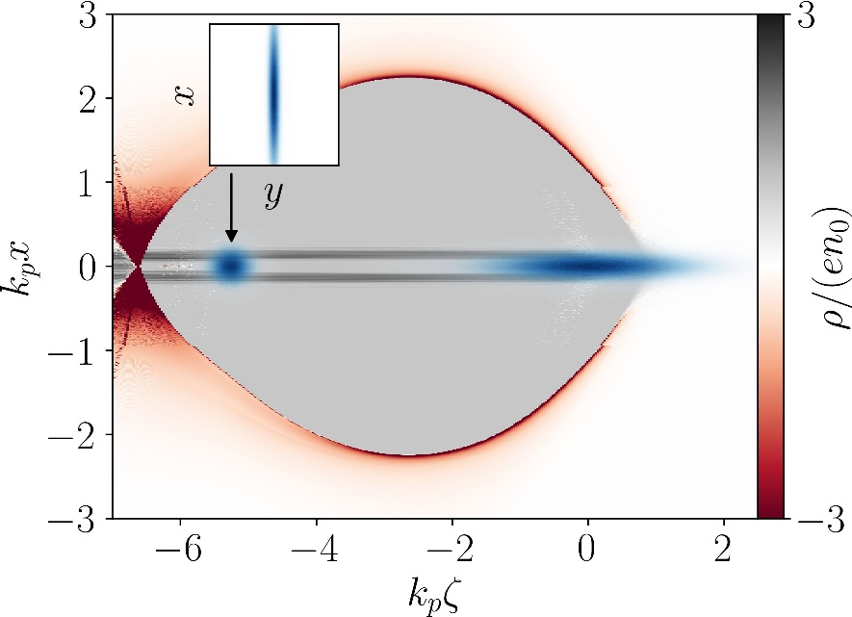
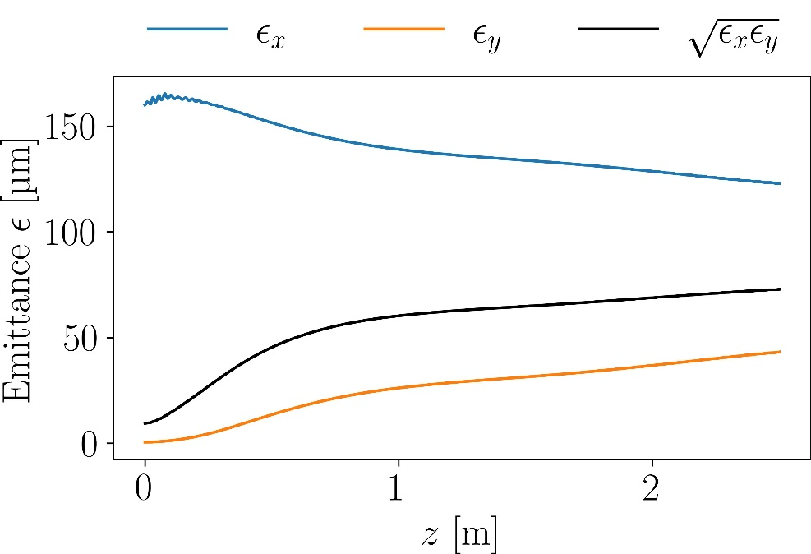
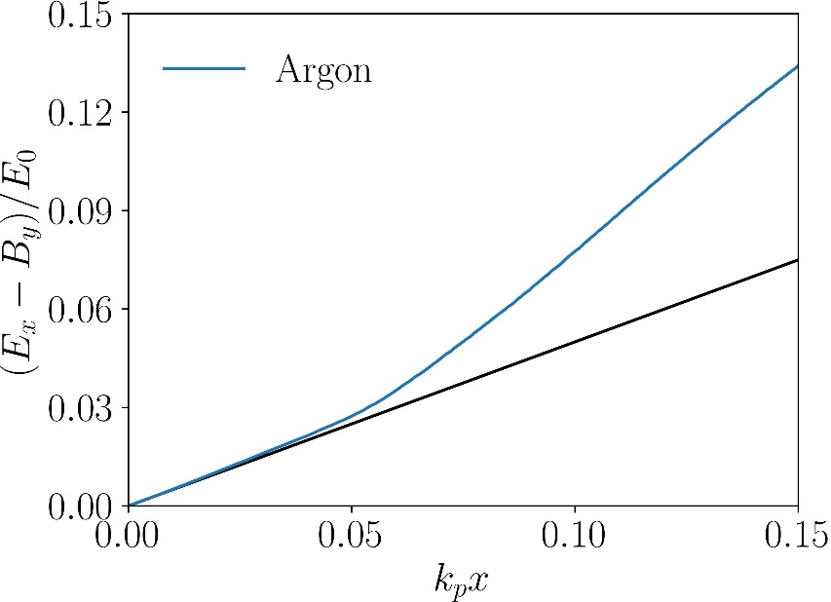
Drastic emittance growth in argon due to ionization
Emittance growth by factor of 7.7!
Intense space charge fields ionize Argon to higher levels
Final witness beam (500 GeV) ionizes Argon to 5th level
Witness beam must not ionize plasma further,
high ionization states also increase ion motion
(charge-mass-ratio)

Slide 13
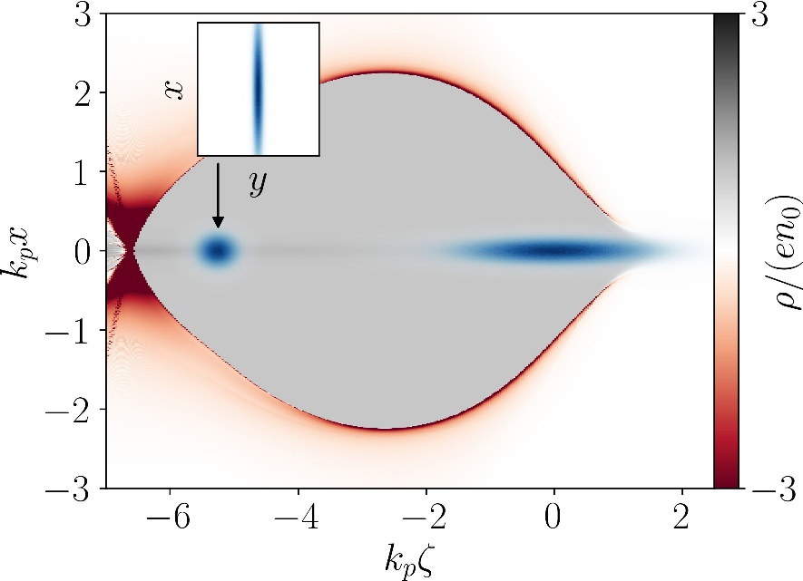
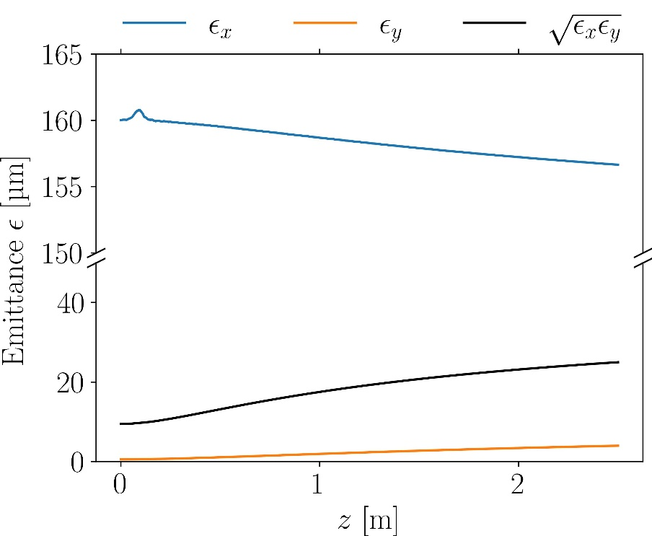
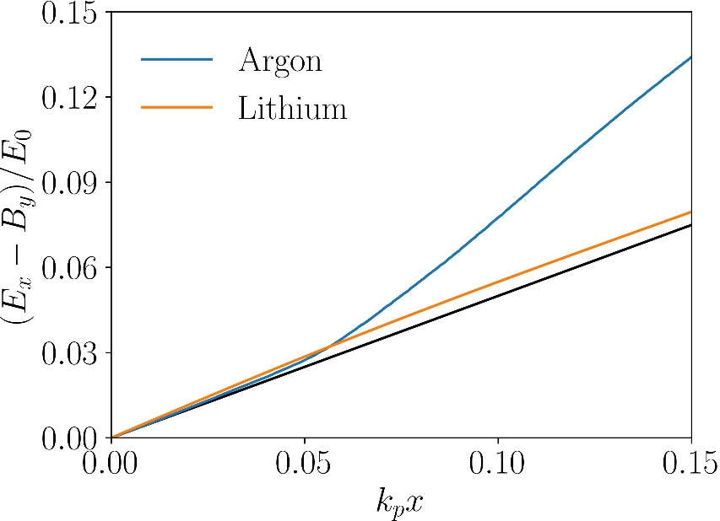
Still significant emittance growth for mild ion motion
Using lithium to avoid ionization
Emittance growth by factor of 2.6!
Only mild drive beam ion motion present

Slide 14
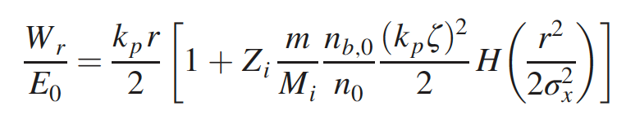

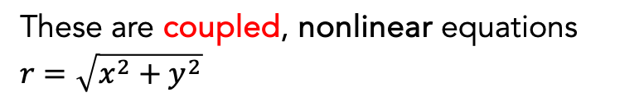
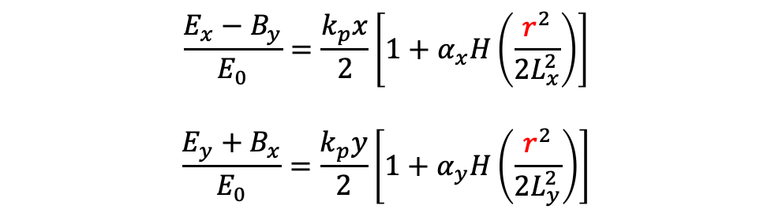


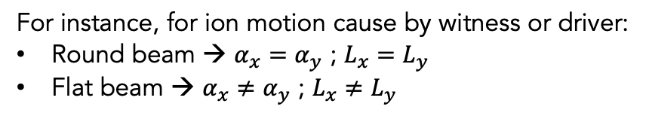
Ion motion leads to coupled, nonlinear transverse wakefields
Transverse wakefields for nonrelativistic ion motion
For instance, for ion motion cause by witness or driver:
Round beam → $α_{x}=α_{y}$ ; $L_{x}=L_{y}$
Flat beam → $α_{x}≠α_{y}$ ; $L_{x}≠L_{y}$
Nonlinearity coefficient $α$
approximated to
$$\frac{{E_{x}−B}_{y}}{E_{0}}=\frac{k_{p}x}{2}\left[1+α_{x}H\left(\frac{r^{2}}{2L_{x}^{2}}\right)\right]$$
$$\frac{{E_{y}+B}_{x}}{E_{0}}=\frac{k_{p}y}{2}\left[1+α_{y}H\left(\frac{r^{2}}{2L_{y}^{2}}\right)\right]$$
These are coupled, nonlinear equations
$r=\sqrt{x^{2}+y^{2}}$
with $H\left(q\right)=(1−e^{−q})/q$
Benedetti et al. PRAB 2017

Slide 15
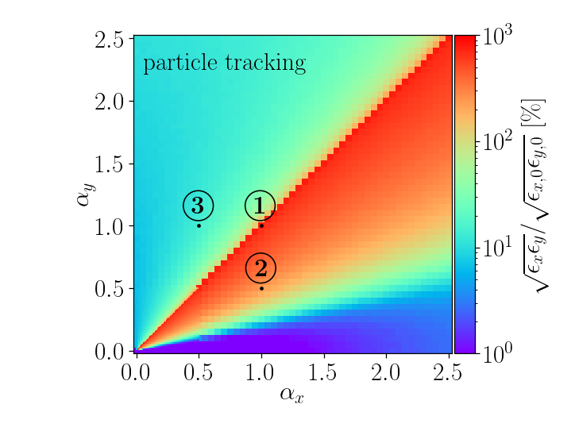

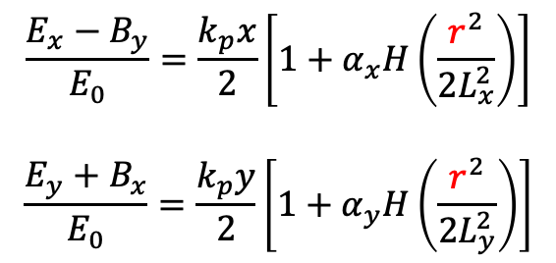
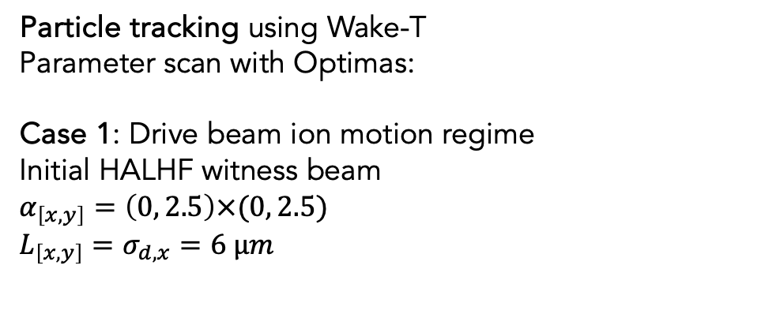
Ion motion leads to coupled, nonlinear transverse wakefields
Particle tracking using Wake-T
Parameter scan with Optimas:
Case 1: Drive beam ion motion regime
Initial HALHF witness beam
$α_{\left[x,y\right]}=\left(0, 2.5\right)×(0, 2.5)$
$L_{\left[x,y\right]}=σ_{d,x}=6 µm$
$$\frac{{E_{x}−B}_{y}}{E_{0}}=\frac{k_{p}x}{2}\left[1+α_{x}H\left(\frac{r^{2}}{2L_{x}^{2}}\right)\right]$$
$$\frac{{E_{y}+B}_{x}}{E_{0}}=\frac{k_{p}y}{2}\left[1+α_{y}H\left(\frac{r^{2}}{2L_{y}^{2}}\right)\right]$$

Slide 16
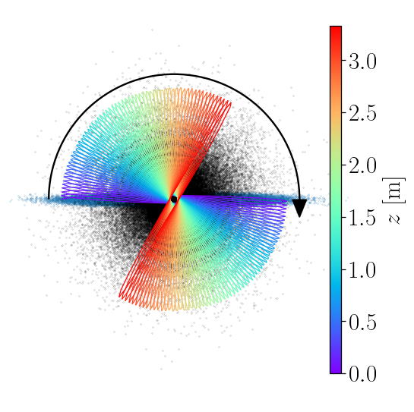
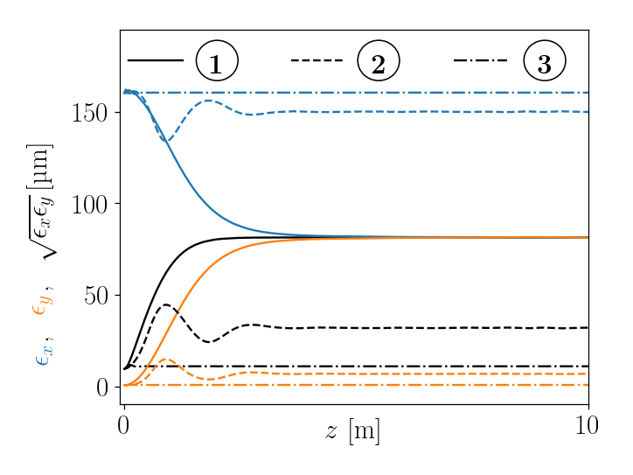
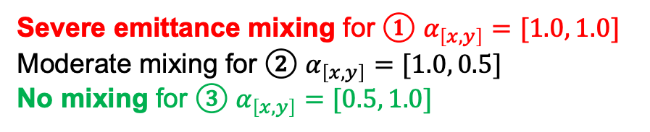
Axisymmetric case $α_{x}=α_{y}$ ; $L_{x}=L_{y}$ leads to full exchange
Particle tracking using Wake-T
Parameter scan with Optimas:
Case 1: Drive beam ion motion regime
Initial HALHF witness beam
$α_{\left[x,y\right]}=\left(0, 2.5\right)×(0, 2.5)$
$L_{\left[x,y\right]}=σ_{d,x}=6 µm$
Severe emittance mixing for ① $α_{\left[x,y\right]}=[1.0, 1.0]$
Moderate mixing for ② $α_{\left[x,y\right]}=[1.0, 0.5]$
No mixing for ③ $α_{\left[x,y\right]}=[0.5, 1.0]$
①

Slide 17
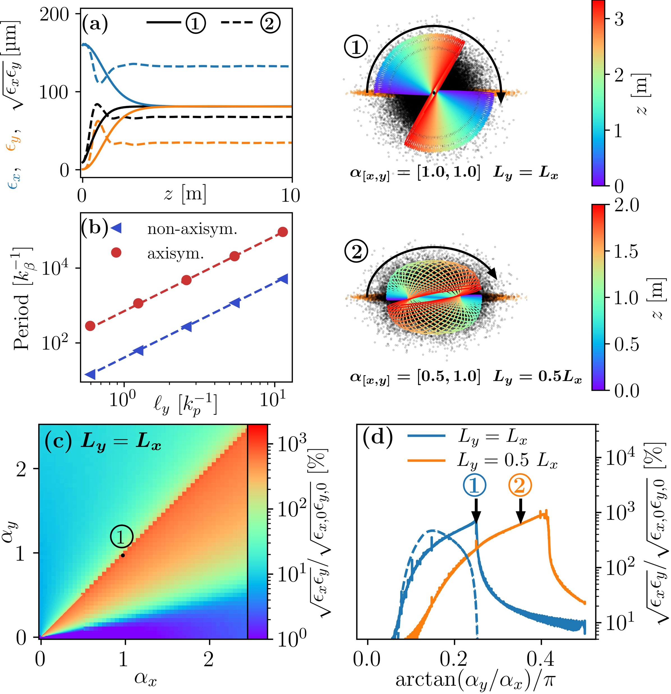
Two behaviors observed: resonant and bounded trajectories
Resonant
Full-round precession
Precession frequency may vary
→ Contribute to emittance exchange
Bounded
Major axis oscillates, NOT full precession
Betatron amplitudes in x and y roughly constant
→ Does not contribute to emittance exchange
Axisymmetric: all particles are resonant
Non-axisymmetric: not all particles are resonant
→ the fraction or resonant particles determines the emittance growth

Slide 18
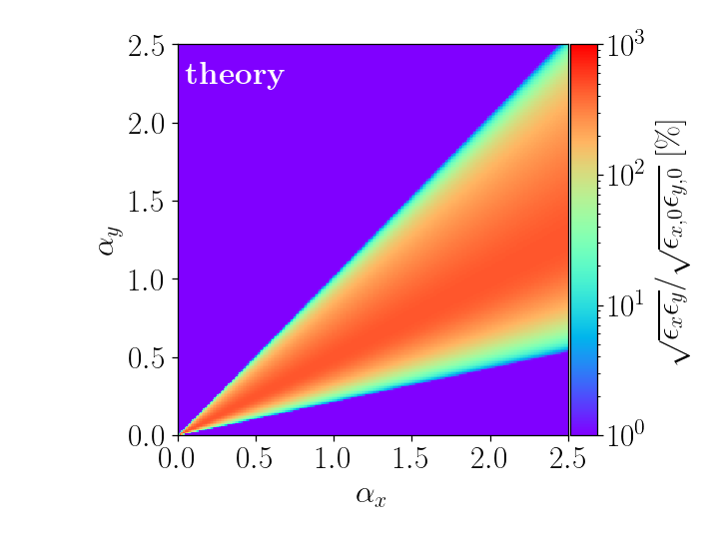
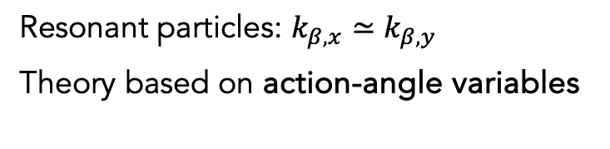
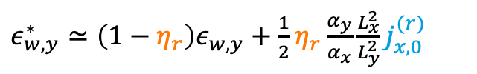
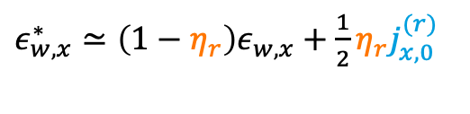
Model using fraction of resonant particles reproduces trends
Resonant particles: $k_{β,x}≃k_{β,y}$
Theory based on action-angle variables
$ε_{w,x}^{∗}≃\left(1−η_{r}\right)ε_{w,x}+\frac{1}{2}η_{r}j_{x,0}^{(r)}$
Average action
of resonant particles
$ε_{w,y}^{∗}≃\left(1−η_{r}\right)ε_{w,y}+\frac{1}{2}η_{r}\frac{α_{y}}{α_{x}}\frac{L_{x}^{2}}{L_{y}^{2}}j_{x,0}^{(r)}$
Safe parameter space without mixing
Fraction of resonant particles

Slide 19
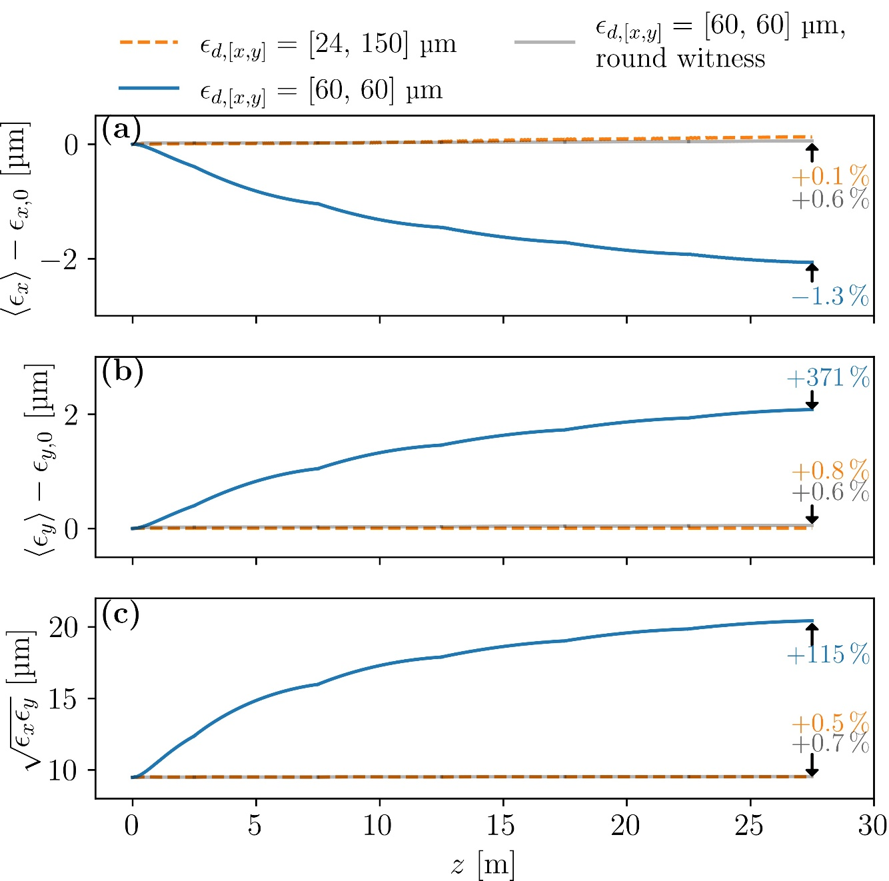
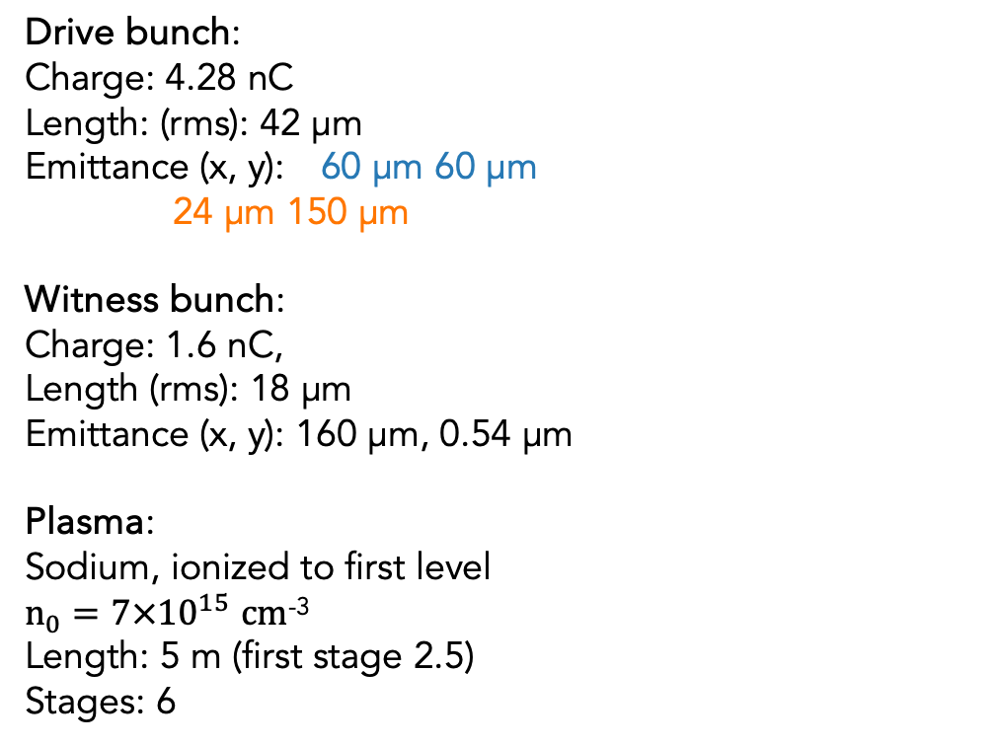
HiPACE++ simulation of 6 HALHF stages on driver-driven ion motion
Drive bunch:
Charge: 4.28 nC
Length: (rms): 42 µm
Emittance (x, y): 60 µm 60 µm
24 µm 150 µm
Witness bunch:
Charge: 1.6 nC,
Length (rms): 18 µm
Emittance (x, y): 160 µm, 0.54 µm
Plasma:
Sodium, ionized to first level
$n_{0}=7×{10}^{15}$ $cm$⁻³
Length: 5 m (first stage 2.5)
Stages: 6
Flat drive beam breaks resonance, prevents mixing in first 6 stages

Slide 20
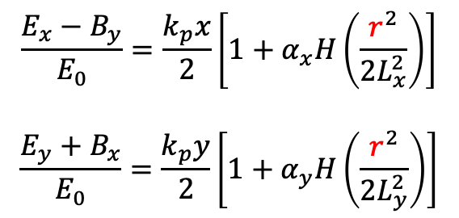
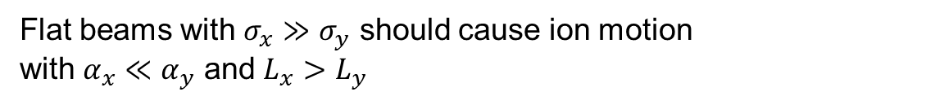
Witness-driven ion motion: are flat beams in the safe space?
Flat beams with $σ_{x}≫σ_{y}$ should cause ion motion
with $α_{x}≪α_{y}$ and $L_{x}>L_{y}$
Safe parameter space without mixing
$$\frac{{E_{x}−B}_{y}}{E_{0}}=\frac{k_{p}x}{2}\left[1+α_{x}H\left(\frac{r^{2}}{2L_{x}^{2}}\right)\right]$$
$$\frac{{E_{y}+B}_{x}}{E_{0}}=\frac{k_{p}y}{2}\left[1+α_{y}H\left(\frac{r^{2}}{2L_{y}^{2}}\right)\right]$$

Slide 21




Witness-driven ion motion: are flat beams in the safe space?
Particle tracking using Wake-T
Case 2: witness beam ion motion regime
Initial HALHF witness beam
$α_{\left[x,y\right]}=\left(0, 2.5\right)×(0, 2.5)$
$L_{x}=σ_{d,x}=6 µm$
$L_{y}=0.5 L_{x}=3 µm$
$α_{\left[x,y\right]}$ and $L_{\left[x,y\right]}$ cannot be choosen freely in a real accelerator
Also, feedback of witness beam on ions neglected
Self-consistent PIC simulations required

Slide 22


Witness-driven ion motion exhibits some emittance mixing
Drive bunch:
Charge: 4.28 nC
Length: (rms): 42 µm
Emittance (x, y): 2.8 mm
rigid
Witness bunch:
Charge: 1.6 nC,
Length (rms): 18 µm
Emittance (x, y): 5 µm, 35 nm
Plasma:
Hydrogen
$n_{0}=7×{10}^{15}$ $cm$⁻³
Length: 77.5 m
ILC-like
slice
slice
projected

Slide 23













Acknowledgements
Severin Diederichs
Alexander Sinn
Ángel Ferran Pousa
Severin Diederichs
Carlo Benedetti
Carl B. Schroeder
Jens Osterhoff
Eric Esarey
Work supported by Office of Science, US DOE, Contract No. DE-AC02-05CH11231
Andrew Myers
Weiqun Zhang
Rémi Lehe
Axel Huebl
Jean-Luc Vay

Slide 24


Conclusion
  Coupled, nonlinear wakefields from ion motion/ionization causes emittance mixing for flat beams
  Mixing is due to resonant particles with $k_{β,x}≃k_{β,y}$ (other bounded particles do not contribute)
  Round beams fully avoid emittance mixing
  Driver-driven ion motion: Resonance of the full beam can be avoided by flat drivers or laser
  Witness-driven ion motion: can resonance be avoided?
  Safe regions (where a negligible fraction of particles is resonant) may exist?
  Hosing needs to be reassessed
Thank you for your attention

Slide 25

Wake-T – Axisymmetric and quasistatic for quick simulations
Plasma electrons are disturbed by the driver, and form a wake with large electric fields where a particle beam can be accelerated
2D axisymmetric (RZ) quasistatic code for laser/beam-driven plasma acceleration, incl. ion motion
1 plasma stage takes seconds-to-minutes on a laptop, suitable for design studies. 20 stages + optimization to 150 GeV in < 1 hour
A. Ferran Pousa et al., J. Phys.: Conf. Ser. (2019)
A. Ferran Pousa, et al. Proc. IPAC23, 1533
https://github.com/AngelFP/Wake-T
A. Ferran Pousa, IPAC 2023

Slide 26


HiPACE++ – 3D Quasistatic PIC method on GPU
Modern HPC standard
  Modern C++, Python, CMake
  Open-source, documented, CI
Built on strong libraries
  AMReX – Adaptive Mesh Refinement at eXascale
  openPMD-api for I/O
Meant for inter-operability
  OpenPMD standard
  Belongs to an ecosystem of codes
Capabilities
  Single or double-precision, adaptive time step, etc.
  From laptop supercomputers (NVIDIA/AMD GPUs, CPUs)
Supercomputer landscape dominated by GPU
Top500 | 33/50
Green500 | 48/50
 | 4 GPUs | 1024 CPU cores
Runtime (seconds) | 6 | 556
Cost (node-hours) | 6 | 11900
https://www.top500.org/lists/top500/2023/11/
https://github.com/Hi-PACE/hipace
https://hipace.readthedocs.io
S. Diederichs et al., Comput. Phys. Comm. 278: 108421 (2022)
amrex
https://amrex-codes.github.io
https://github.com/openPMD/openPMD-api

Slide 27


Quasistatic PIC enables mesh refinement
MR in electrostatic PIC
MR with quasi-static PIC, no crossing
J.-L. Vay et al., Comput. Sci. & Disc. 5, 014019 (2012)
T. J. Mehrling et al., IEEE, AAC (2018)
Deposit densities (beam and plasma) $ρ, \vec{J}$, $S_{x}, S_{y}$
Solve fields ($E_{x}−cB_{y}, E_{y}+cB_{x},E_{z}. B_{z}$) and ($B_{x}. B_{y}$)
Advance plasma particles by 1 slice ($−Δζ$)
Advance beam particles by 1 time step ($+Δt$)
  on all levels
  BC on fine patch, solve, Interpolate in ghost cells
Tag by level

