Slide 1

Welcome
Prof. Erik Adli, Section Leader High Energy Physics
Department of Physics, University of Oslo, Norway
HALHF Workshop 2024
April 4-5, 2024

Slide 2
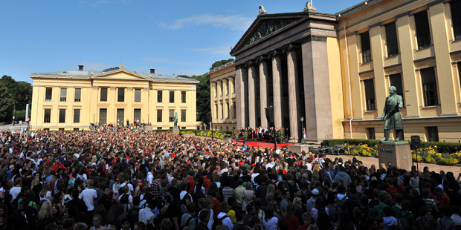


Department of Physics, University of Oslo
University of Oslo, Norway
Registered students: 27 227
PhD students: 3018
Scientific employees: 3 426
Yearly budget: ca. 800 MEUR
Shanghai ranking: 58
1811
The Faculty of Mathematics
and Natural Sciences
Registered students: 5500
PhD students: 700
Scientific employees: 1 300
The Department of Physics
Registered students: 520
PhD students: 104
Scientific employees: 157 (50 permanent)
Yearly budget: ca. 20 MEUR
(numbers from 2016)

Slide 3

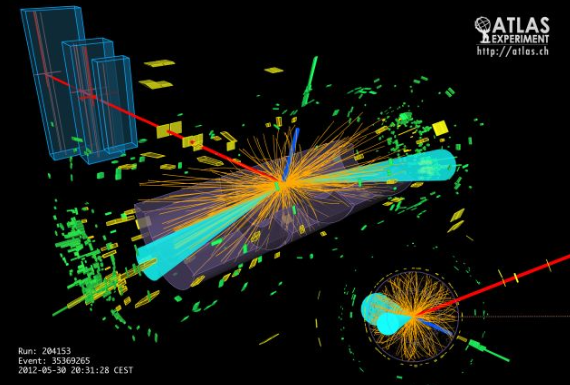
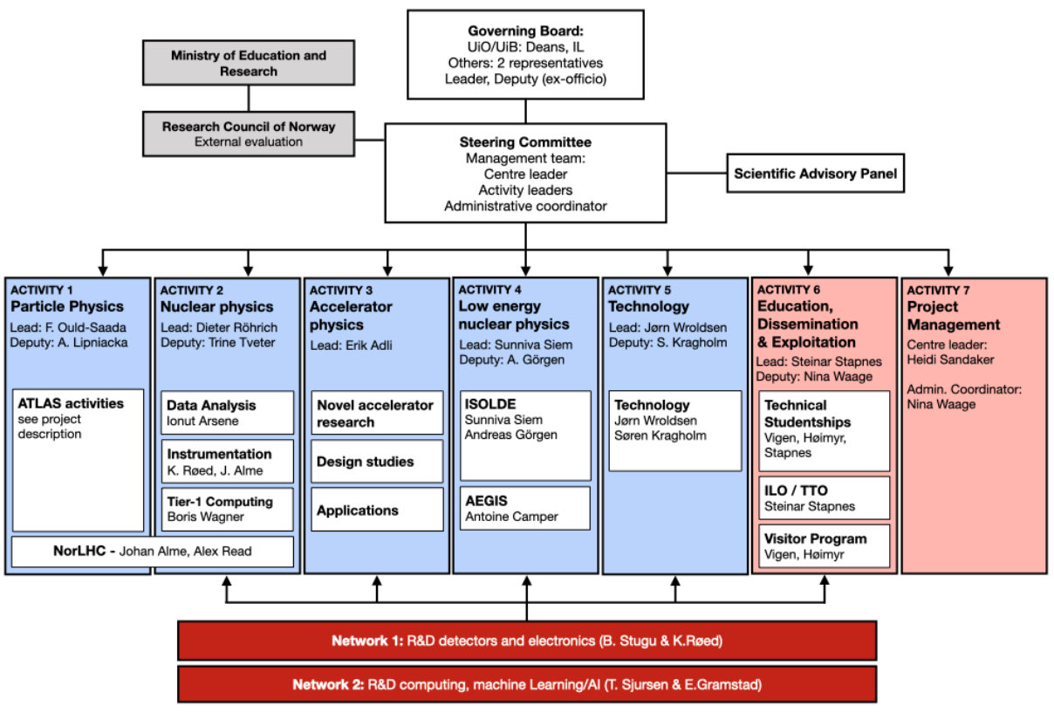
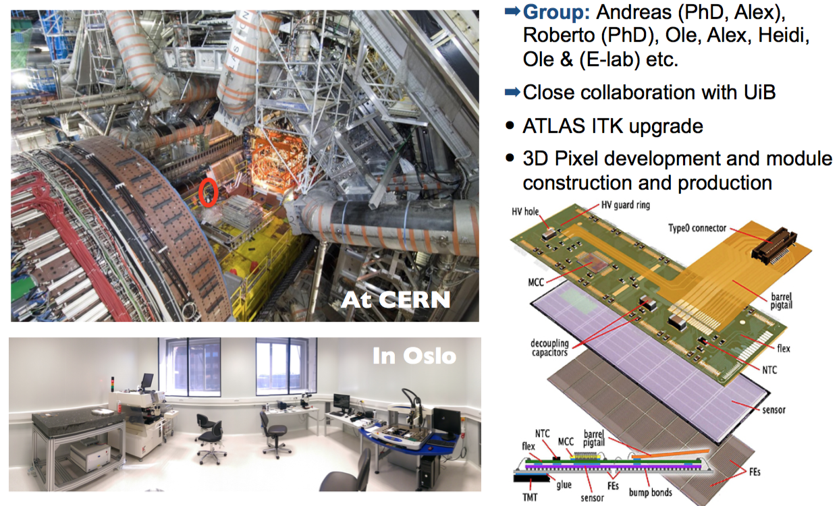


Oslo High Energy Physics Section

Slide 4

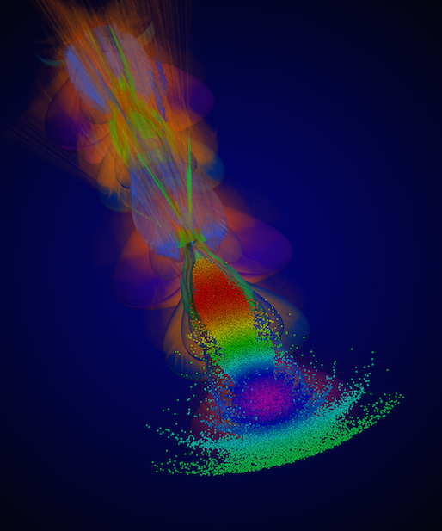

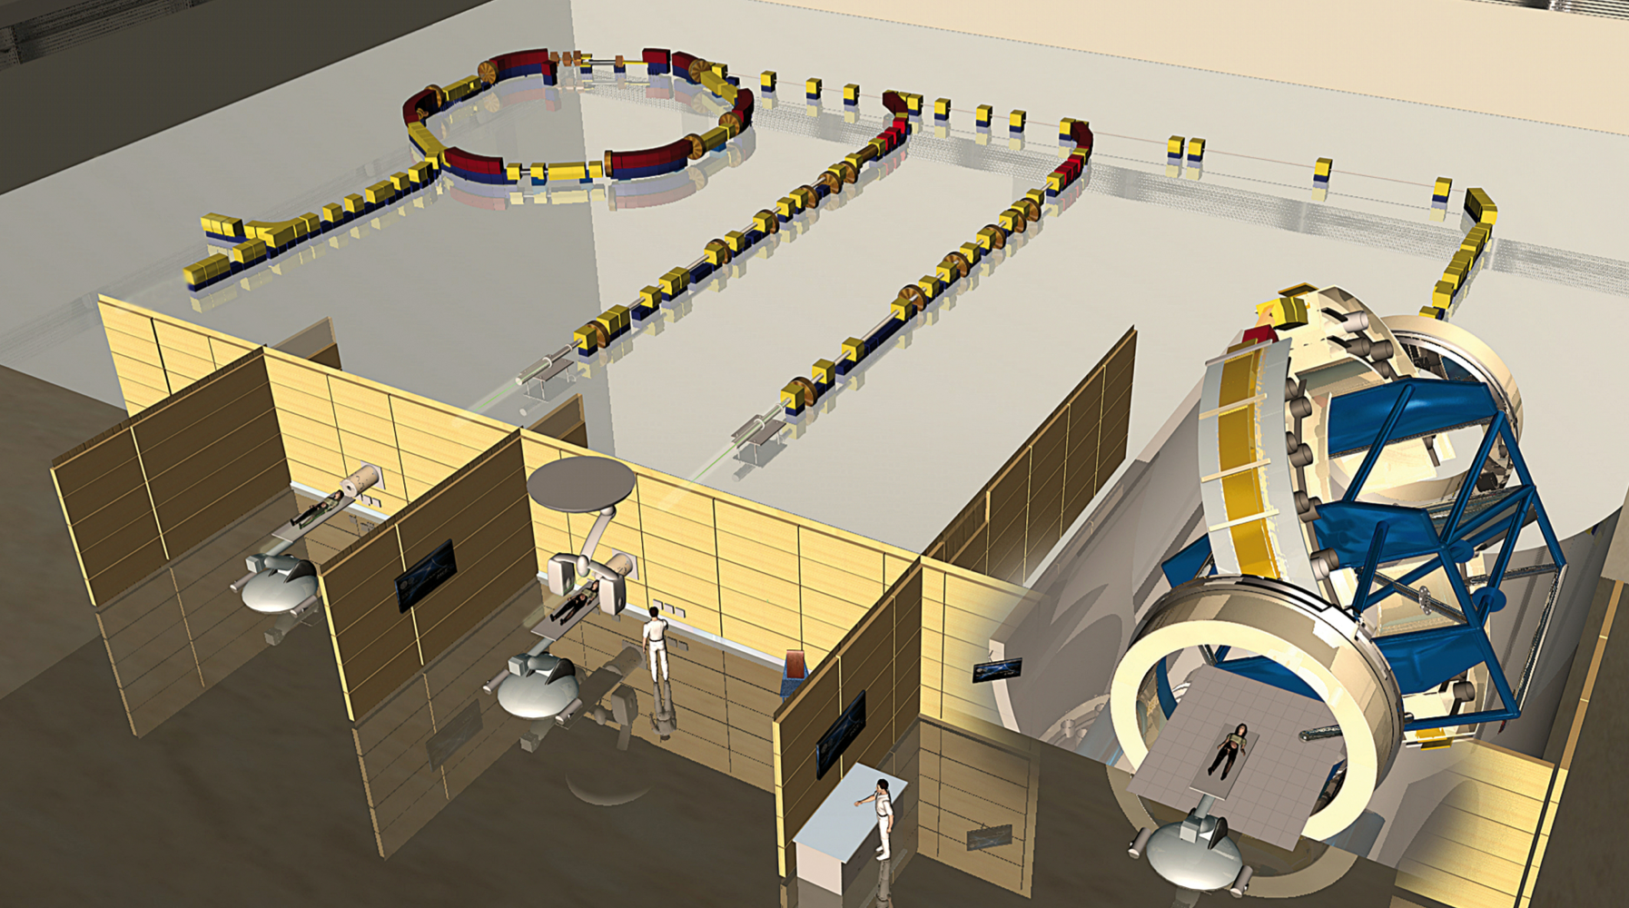
Oslo Particle Accelerator Group
Linear Colliders
European Spallation Source
Plasma wakefield acceleration
Particle therapy

Slide 5
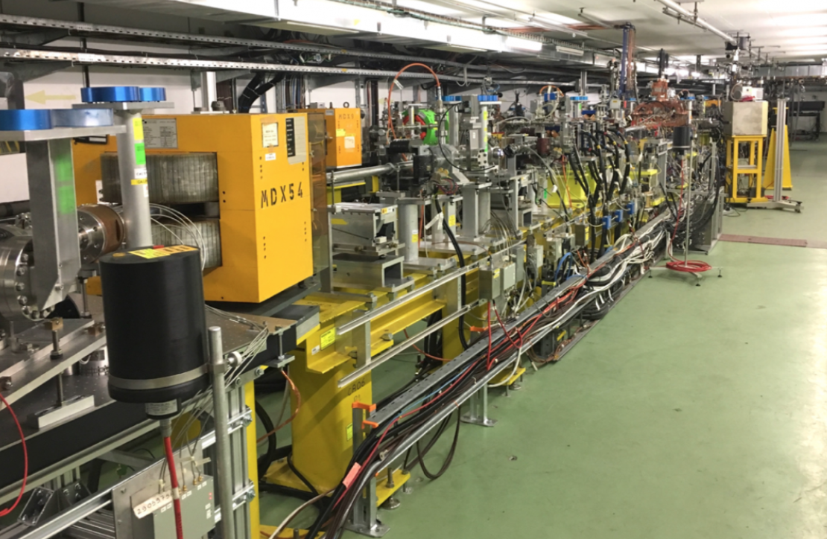
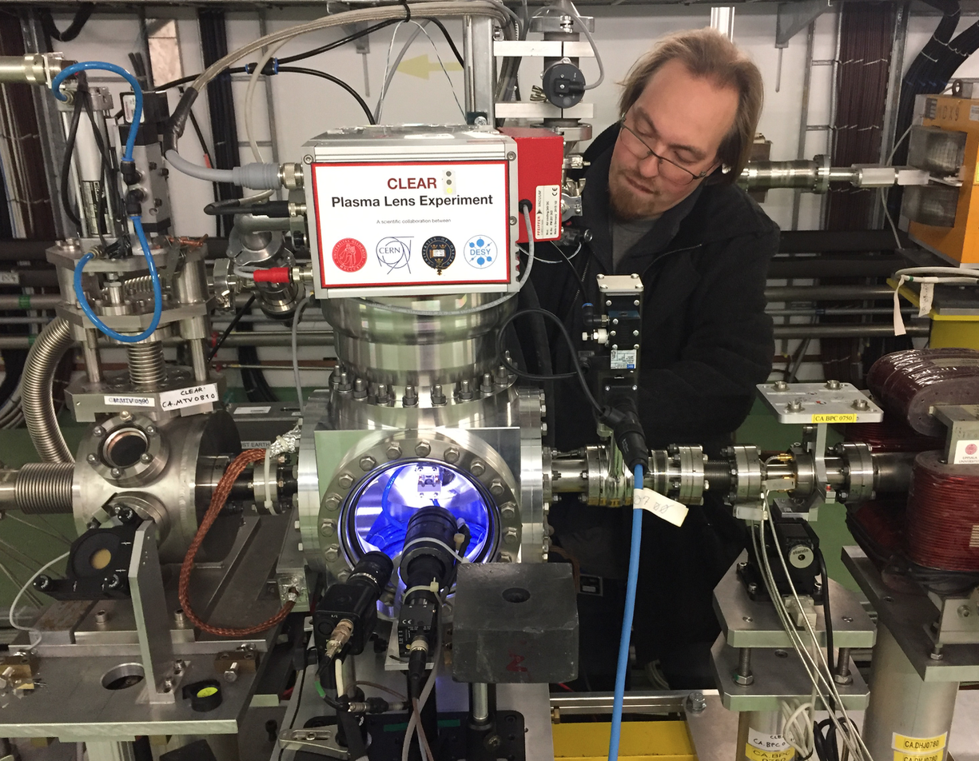
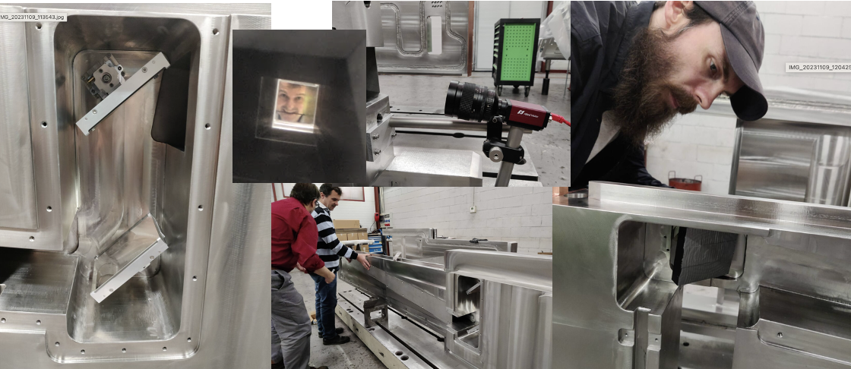
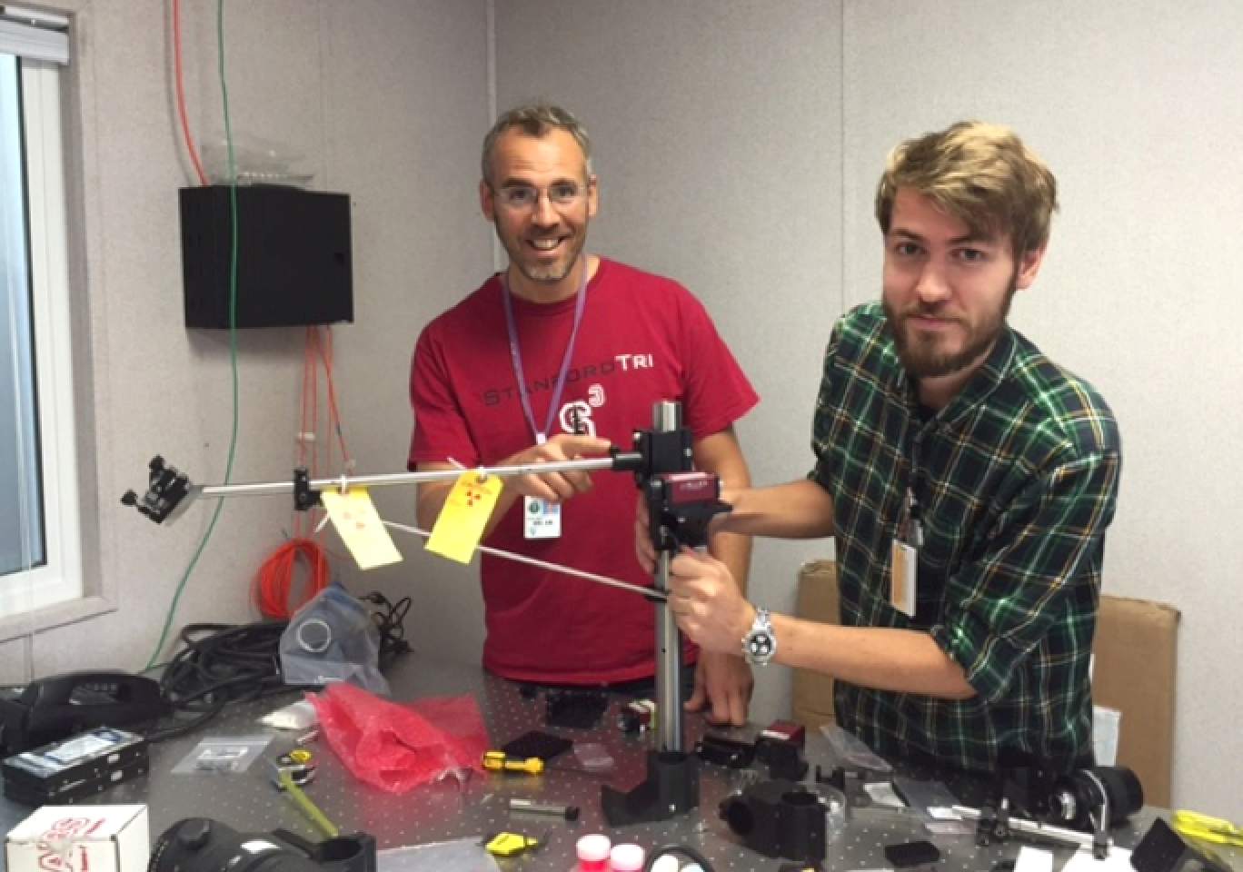
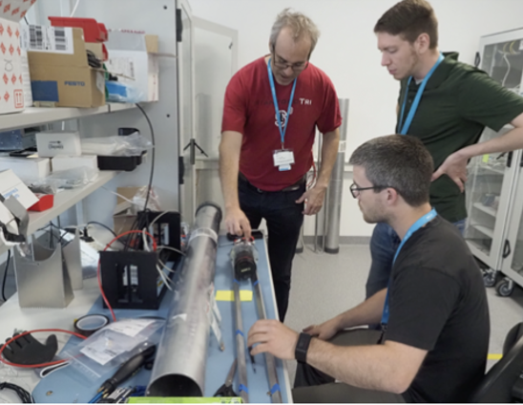
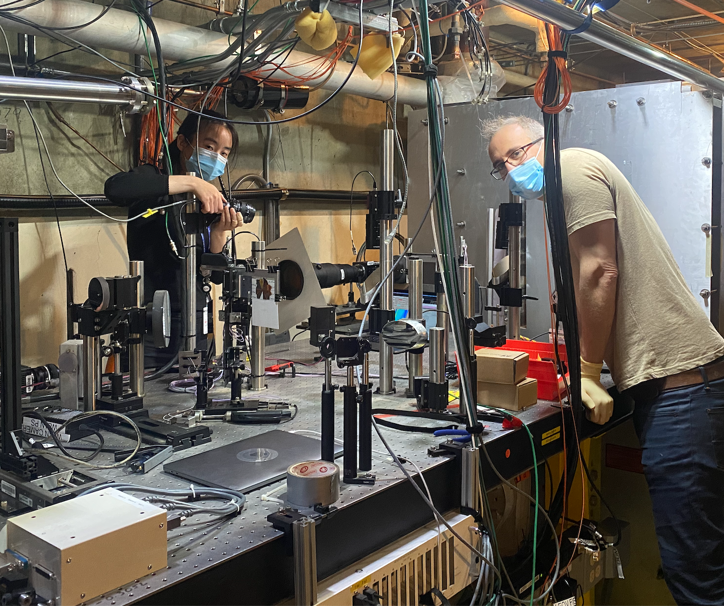
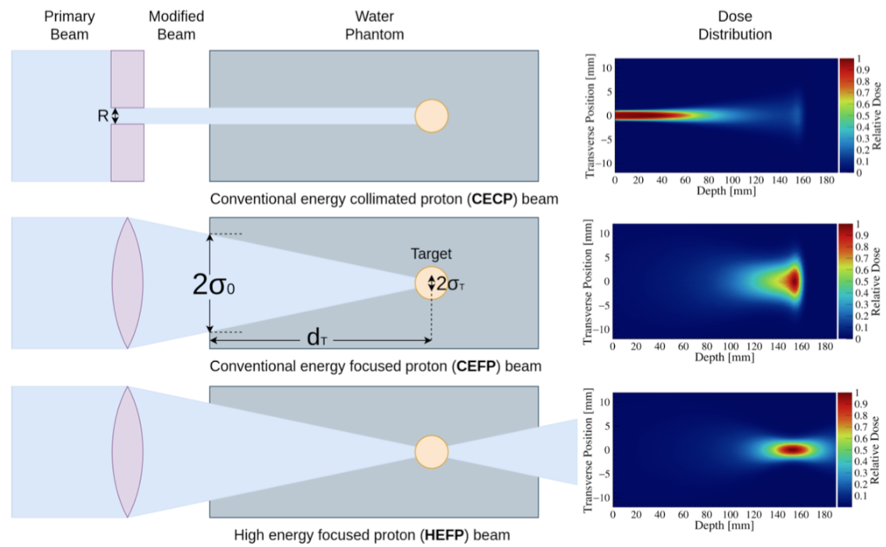

Oslo Particle Accelerator Group
Linear Colliders
CLIC/CLEAR
ESS
PROFMONS
European Spallation Source
Plasma wakefield acceleration
OSLO PROTON
THERAPY CENTRE
Particle therapy
SLAC

Slide 6



