Slide 1
Taking Advantage of Nuclear Isomers
Sean Liddick
9th Workshop on Nuclear Level Density and Gamma Strength
U of Oslo, May 2024

Slide 2
Spin Distributions
Distribution of spins as a function of excitation energy.
Spin distributions parameterized using a single formula with a spin cutoff parameter.
Distribution shown is at 6.5 MeV for a variety of procedures to obtain the spin-cutoff parameter.
Determining the ratio between different spins allows for a comparison to theoretical distribution.
 | Von Egidy 09¹ | Von Egidy 05² | Single Particle³ | Rigid Sphere⁴ | TALSYS 1.8 | DICEBOX
Ratio 5-8/ 1-5 | 0.62 | 0.46 | 1.0 | 0.58 | 0.61 | 0.72
[1] T. Von Egidy and D. Bucurescu, Phys. Rev. C, 80, 054310 (2009)
[2] T. Von Egidy and D. Bucurescu, Phys. Rev. C, 72, 044311 (2005)
[3] U. Facchini and E. Saetta-Menichella, Energ. Nucl. (Milan) 15,54 (1967).
[4] S. M. Grimes, et al, Phys. Rev. C 10, 2373 (1974).

Slide 3
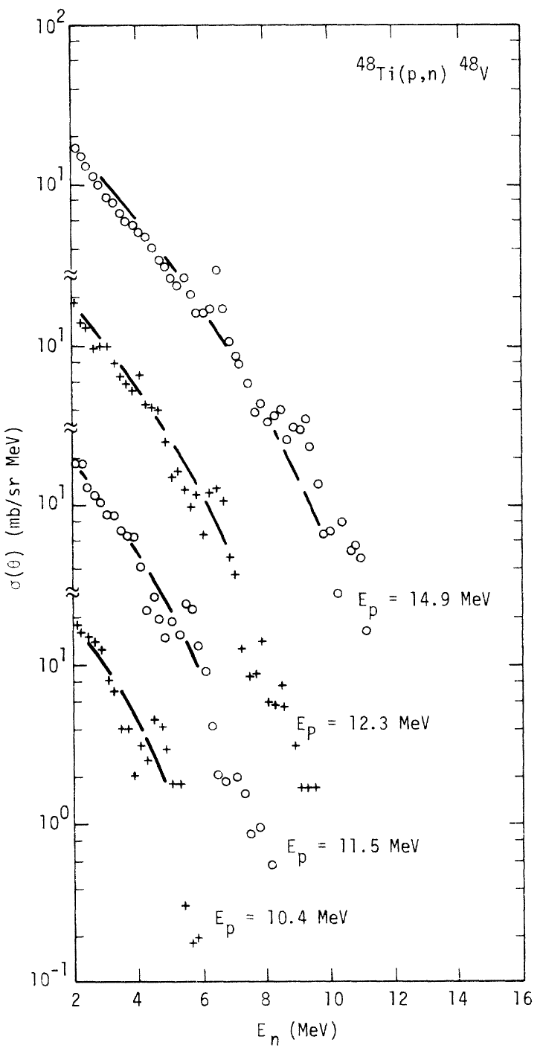
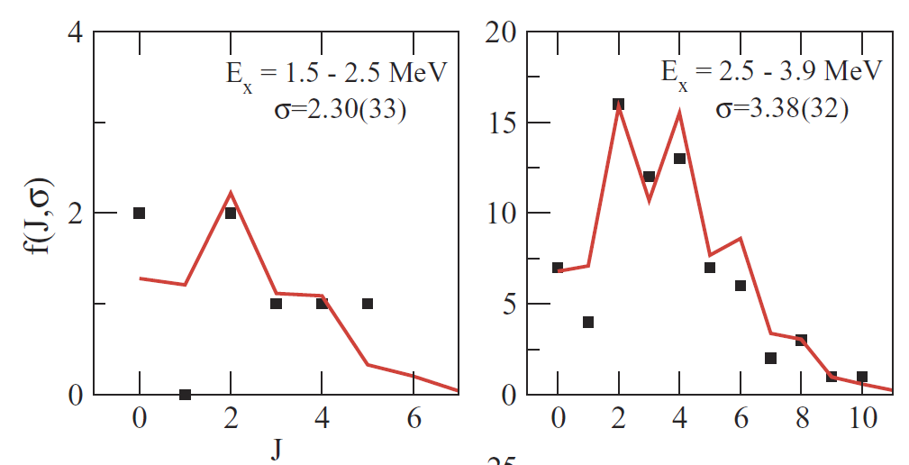
How to Measure?
Count known discrete levels
Anisotropy of the angular distributions of particles evaporated in various reactions
  (p,n), (a,n) over energy ranges ~3-10 MeV
Ratios of spins in neutron resonances
T. Von Egidy and D. Bucurescu, Phys. Rev. C, 80, 054310 (2009)
S. M. Grimes, et al, Phys. Rev. C 10, 2373 (1974).
P. Kohler et al., Phys. Rev. C 76, 025804 (2007

Slide 4
New Way to Infer Information from a Spin Distribution?
Use Isomers
  Produce one nucleus in multiple beta-decaying states
Separate out individual states and observe beta decay
  Populate different spin ranges in daughter nucleus
Apply β-Oslo method
  Extract function form of γSF and NLD
Apply shape method
  Extract correct slope for γSF
  Apply correct slope to NLD
Compare NLD from different spin ranges
  Extract ratio of spin ranges and compared with theoretical spin distributions

Slide 5
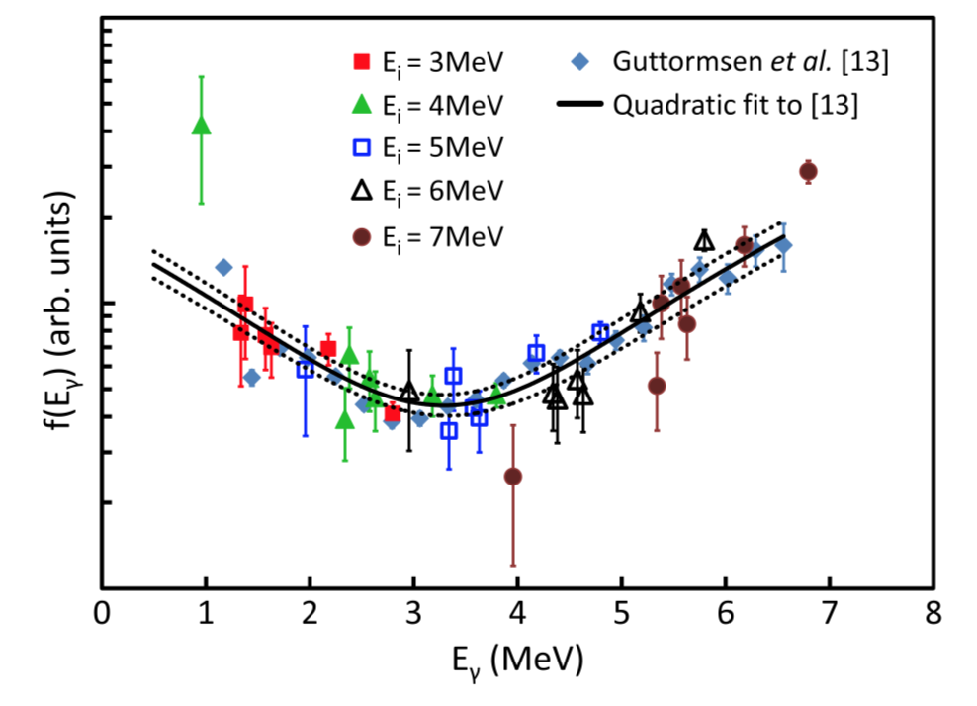
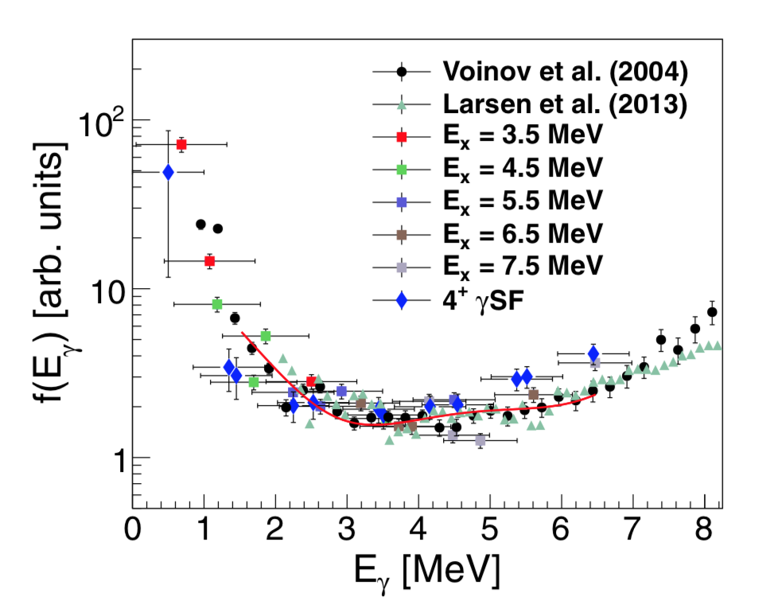
The Shape Method
Initial level density: same
Final spins/parities: same
Getting energy dependence of the γSF - shape
Repeat for different excitation energies
Normalize each excitation energy set to the others to take into account the feeding probability
M. Wiedeking et al., PRL (2012)
2⁺
M. Jones et al., PRC (2018)
2⁺
S.N. Liddick, May 2024 Oslo
, Slide 5

Slide 6
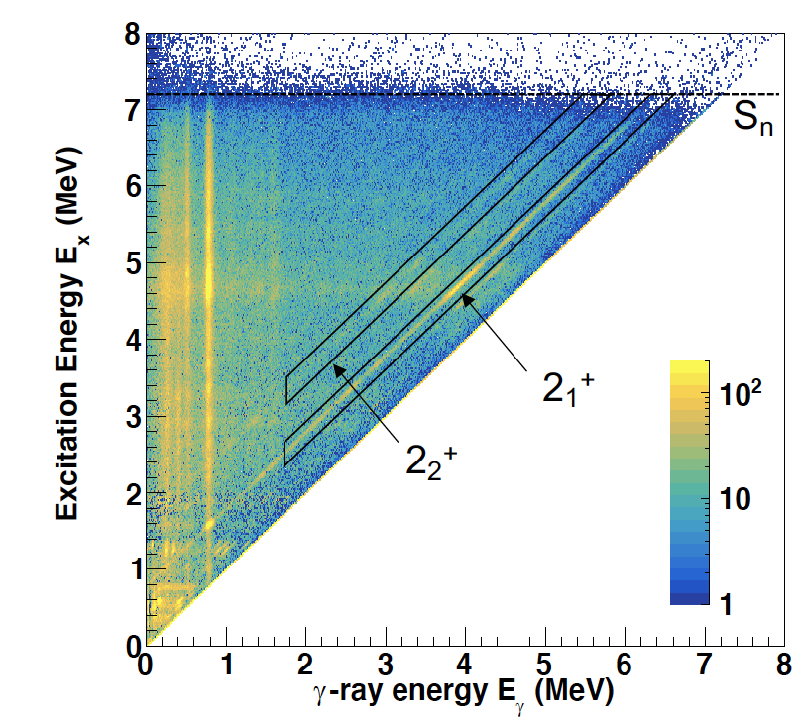
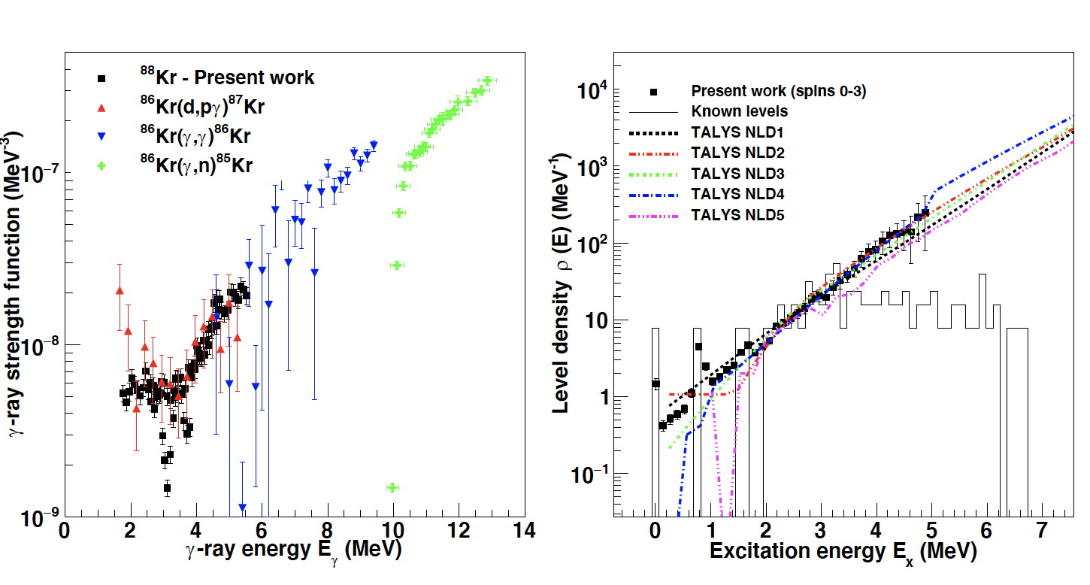
The Shape Method with Beta Decay
Extract shape of the γ-ray strength function
Use this result within the β-Oslo method to extract a model-independent level density
T_{1/2}=76.3 m
⁸⁷Kr
⁸⁸Kr
2⁺
β⁻
(n,γ)
2⁺
⁸⁸Br
Muecher, Spyrou, et al. PRC 107, L011602 (2023)
M. Wiedeking, M. Guttormsen PRC 104, 014311 (2021)

Slide 7
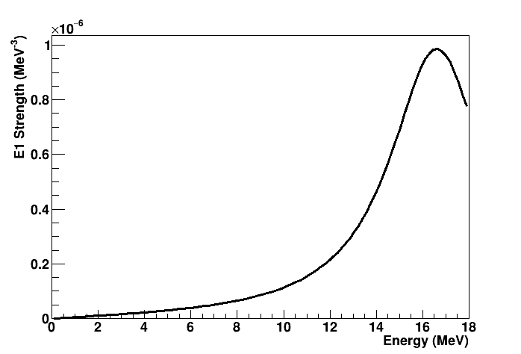
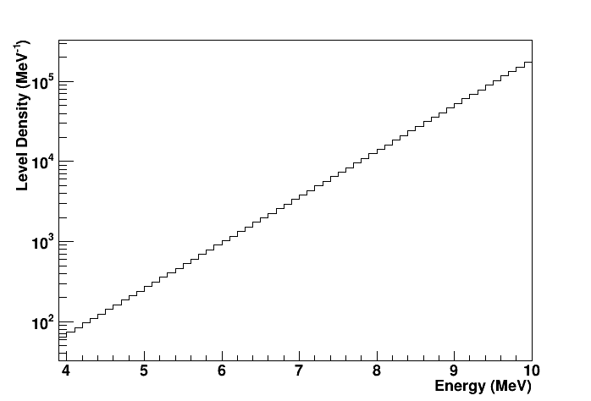
Fictitious Mass 70 Nucleus: Strength and Level Density
Artificial nucleus (loosely modeled on ⁷⁰Cu).
Well separated pairs of states for the shape method
  2⁺
  4⁺
  6⁺
States above 4.3 MeV simulated using RAINIER
  Standard Lorentzians for γSF
  CT for NLD
Populated fictitious nucleus above 4.3 MeV in two different spin ranges
  2-4⁻
  5-7⁻
2⁺
E1 Strength
6⁺
4⁺
6⁺
4⁺
2⁺
NLD
1750
885
2⁺

Slide 8
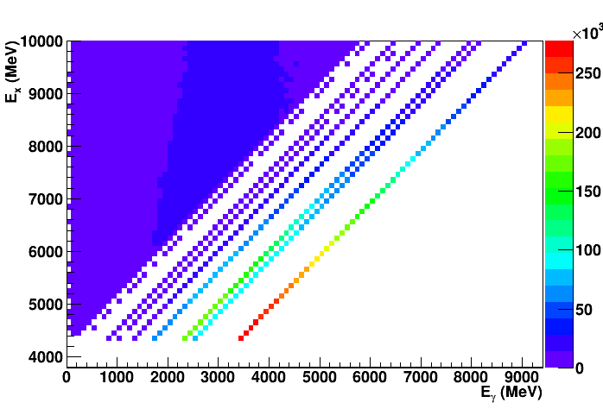
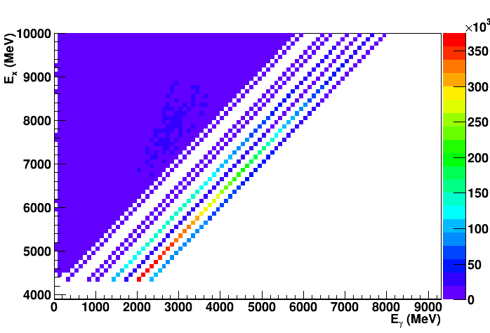
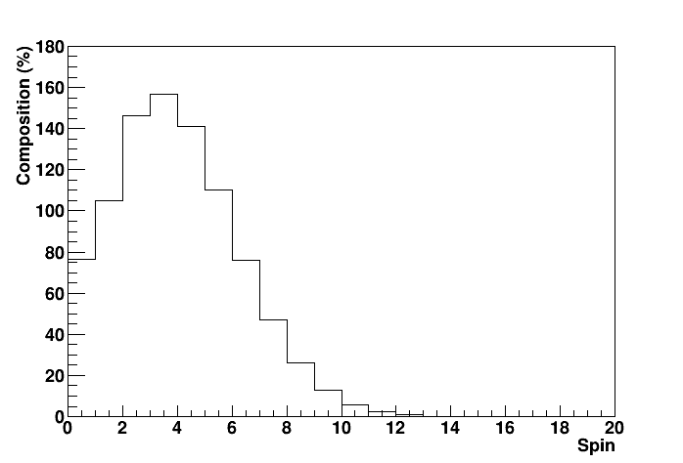
Fictitious Mass 70 Nucleus: Primary Distributions for Two Different Spin Ranges
Populated fictitious nucleus above 4.3 MeV to 10 MeV in two different spin ranges
  2-4⁻
  5-7⁻
Spin distribution
  @6.5 MeV
Primary
Spins - 2-4
885
2⁺
6⁺
4⁺
6⁺
4⁺
2⁺
1750
885
2⁺
Primary
Spins - 5-7
1950

Slide 9
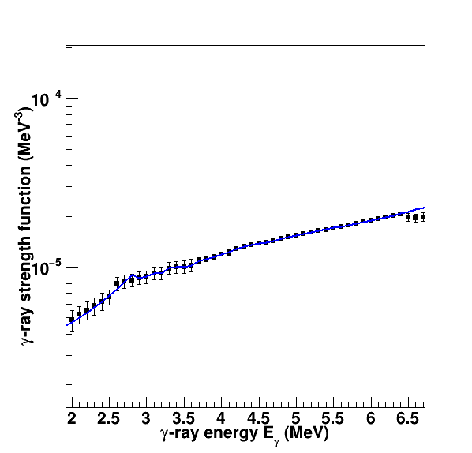
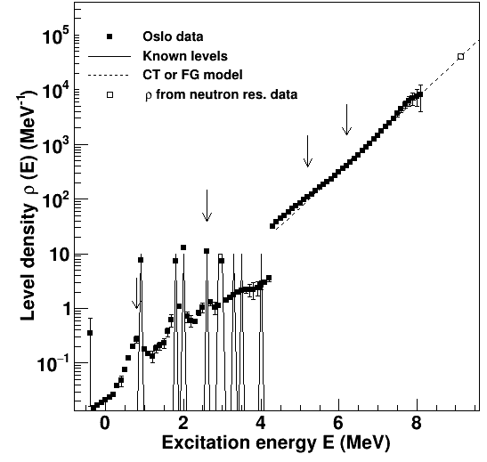
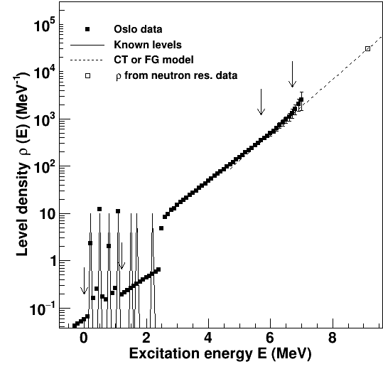
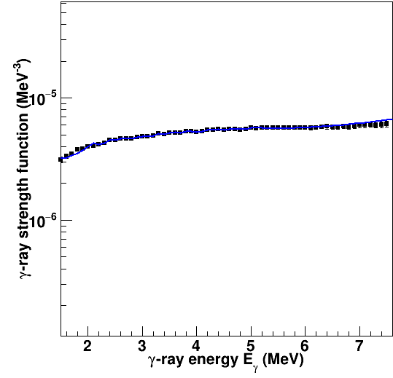
Fictitious Mass 70 Nucleus: β-Oslo
Perform standard β-Oslo analysis process
Only looking for functional forms of γSF and NLD
Accurate normalization not required in this step.
High spin states shifted down in energy (shifted back up later)
Only looking for functional forms of γSF and NLD
Populated from starting spins 2-4
Populated from starting spins 5-7
NLD
γSF
NLD
γSF

Slide 10
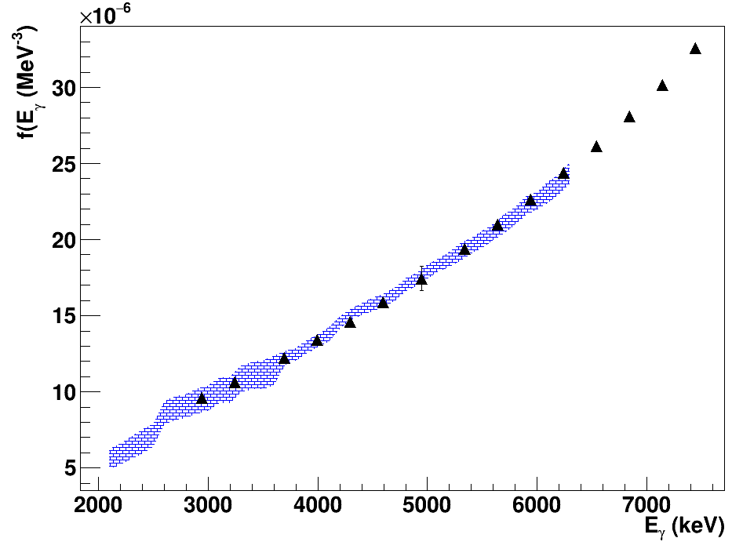
Fictitious Mass 70 Nucleus: Shape Method
Perform shape method analysis to extract shape of γSF
Shape method sets correction factor for functional form from β-Oslo
Apply shape of γSF to NLD
Initial population: 2-4
γSF from shape
γSF from βOslo

Slide 11
Fictitious Mass 70 Nucleus: NLD from Shape Method
Perform identical procedure to initial spin range 5-7
  shape method analysis to extract shape of γSF
  Apply shape of γSF to NLD
Comparison between theoretical NLD and simulated results
 | Ratio (high/low)
Theory | 0.61
Simulated Data | 0.57(8)

Slide 12
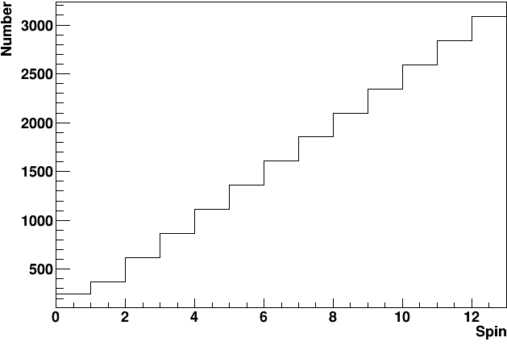
Differentiate Between Two Different Spin Distributions
Perform exact same process with different spin distribution
Apply shape of γSF to NLD
Comparison between theoretical NLD and simulated results
 | Ratio (high/low) von Egidy | Ratio (high/low) linear ramp
Theory | 0.61 | 1.85
Simulated Data | 0.57(8) | 2.01(28)

Slide 13
Where To Go From Here?
Systematics, systematics, systematics with simulated data
Experimental data with ⁷⁰Cu has been taken.
  6⁻, 3⁻, 1⁺ beta-decaying states.
Better nuclei?
  Large Q value, low P_{n}, large population of high-energy states
  At least two beta-decaying states
    Large spin difference between two (populate distinct regions)
    Large energy difference (easy to separate)
  Relatively well known low-energy level schemes with pairs of low-spin and high-spin states.
Potential Candidates…
  ¹⁰⁰Nb (1⁺,5⁺, 0.3 MeV sep, pairs of 2⁺/4⁺)
  ¹³⁶I (1⁻, 6⁻, 0.2 MeV sep, pairs of 2⁺/6⁺)
  ⁹⁸Y (0⁻,4, 0.4 MeV sep, pairs of 2⁺/4⁺)
  Plenty more…
    but with more uncertain spin assignments

Slide 14
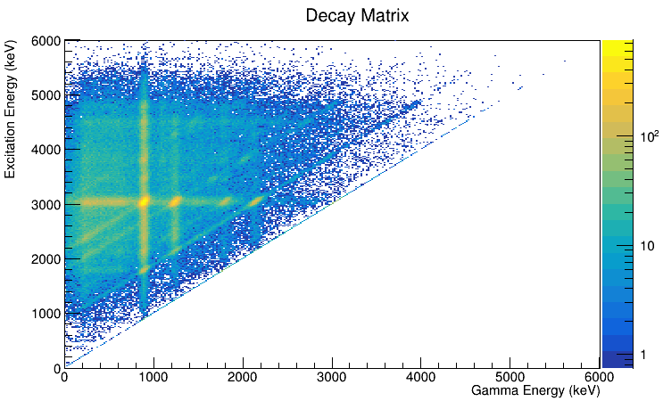
Summary
Isomers can be used to get information on the spin distribution (preliminary).
Apply both b-Oslo and shape method to the same data populated within different spin regions
An abundance of systematic investigations still to be performed
Multiple isomeric states exist to perform the measurement
⁷⁰Cu 6⁻

