Slide 1


1
The IsoVector Giant Dipole Resonance in the Neodymium Isotope Chain – Past and Future Investigations

Slide 2
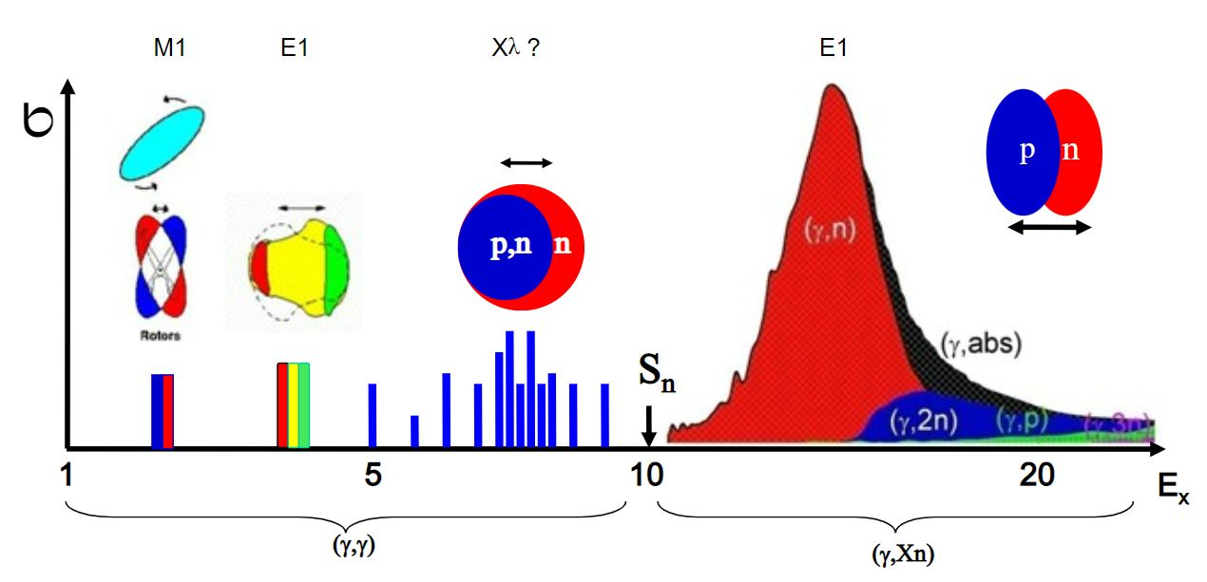
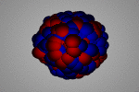
IsoVector Giant Dipole Resonance (IVGDR)
2
What is it?
  Collective excitation of the nucleus in which the protons and neutrons vibrate en masse against one another
L.M. Donaldson – 9th Workshop on Nuclear Level Density and Gamma Strength – 27 – 31 May 2024
Notes:
We can start with some background on the IsoVector Giant Dipole Resonance. It is a collective excitation of the nucleus in which the protons and the neutrons vibrate en masse against one another as is shown in this illustration here.

Slide 3
IsoVector Giant Dipole Resonance (IVGDR)
3
How do we excite it?
  Real photons
  Virtual photons
  Radiative capture
L.M. Donaldson – 9th Workshop on Nuclear Level Density and Gamma Strength – 27 – 31 May 2024
Notes:
It is excited by a variety of methods including real photons, virtual photons and radiative capture.

Slide 4
IsoVector Giant Dipole Resonance (IVGDR)
4
Why is it important?
  Wide range of applications in Nuclear Astrophysics, the design of nuclear reactors and neutron shielding, radioisotope production and radiation therapy
  Behaviour provides information on symmetry energy of nuclear matter
  Properties are crucial in determining nucleosynthesis in the s-, r- and p-processes
Accurate photo-absorption data and an understanding of the IVGDR are critical for the entire nuclear physics community!
L.M. Donaldson – 9th Workshop on Nuclear Level Density and Gamma Strength – 27 – 31 May 2024
Notes:
The IsoVector Giant Dipole Resonance has far-reaching implications in the field of nuclear physics. It is an excellent tool for studying the nuclear properties of the ground state and has a wide range of applications in Nuclear Astrophysics, the design of nuclear reactors and neutron shielding, radioisotope production and radiation therapy.
The behaviour of the IVGDR provides information related to the symmetry energy of nuclear matter, which has applications for the nuclear equation of state in neutron stars.
The location and strength of the IVGDR are also crucial in determining nucleosynthesis in the s-, r- and p-processes.
So it is clear that accurate photo-absorption data and an understanding of the IVGDR are critical for the entire nuclear physics community.

Slide 5
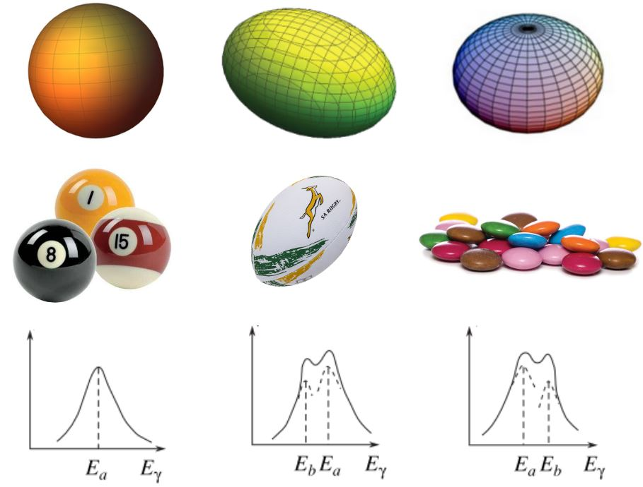
Shape Dependence of the Energy Distribution
5
Spherical
Prolate Deformed
Oblate Deformed
We expect an energy distribution that is strongly dependent on the nuclear shape
This shape evolution is best observed in the Nd and Sm isotope chains
L.M. Donaldson – 9th Workshop on Nuclear Level Density and Gamma Strength – 27 – 31 May 2024
Notes:
We also need to know what to expect when it comes to the effect of deformation on the IsoVector Giant Dipole Resonance. We know that we expect an energy distribution that is strongly dependent on the nuclear shape.
In the top row, we have the modelling types of nuclear shapes, namely, a sphere, a prolate axially symmetric ellipsoid (which can also be thought of as a rugby ball) and an oblate ellipsoid (which can be thought of as the shape of these candies here).
For a spherical nucleus, we expect a narrow, single-peaked resonance. For a prolate or oblate ellipsoid, we expect an overall broadening of the resonance and the eventual K-splitting. Later in the talk, I will make reference to K=0 and K=1 components. To point them out to you now, the K=0 component would be the lower energy bump and the K=1 component would be the higher energy bump.
Now, two prime examples of the shape evolution from spherical to deformed nuclei are the Neodymium and Samarium isotope chains.

Slide 6
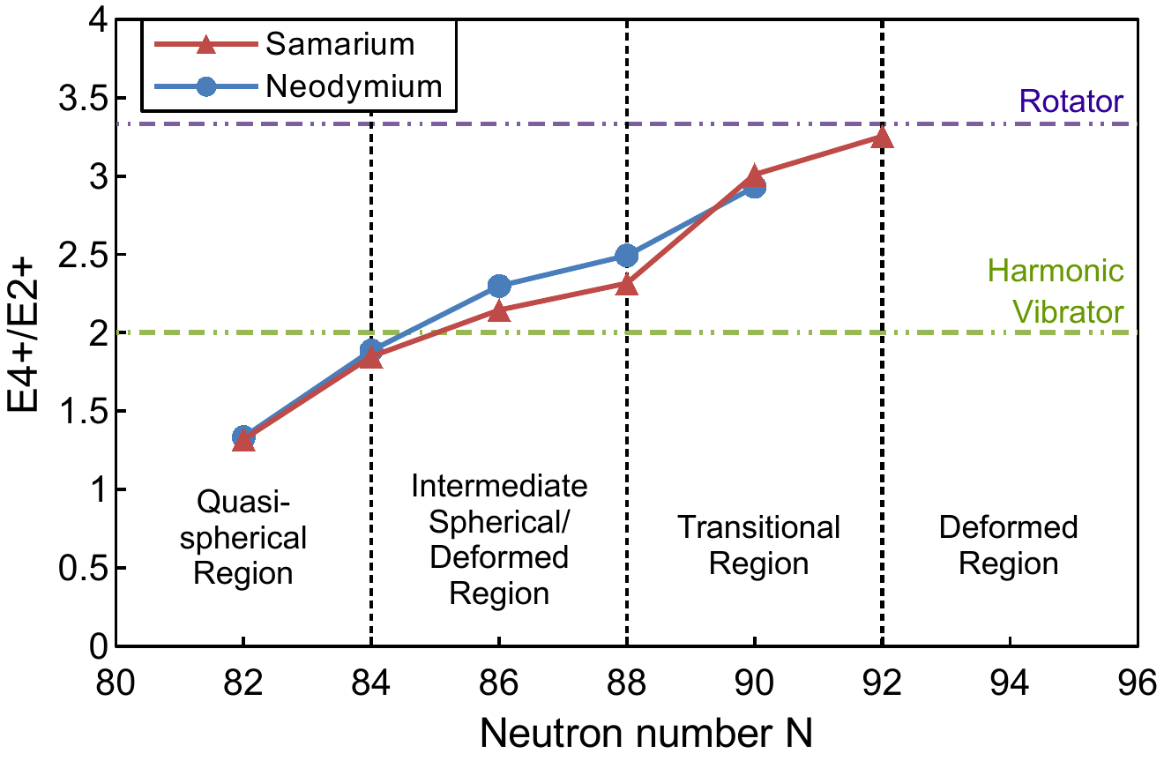
Shape Evolution in the Nd and Sm Chains
6
Sharp increase in E(4⁺)/E(2⁺) ratio between ¹⁴⁸Nd and ¹⁵⁰Nd and from ¹⁵⁰Sm to ¹⁵²Sm
  Indicative of transition from a more spherical to a more deformed shape
Both the Nd and Sm isotope chains have been studied using photo-absorption experiments at Saclay and using relativistic Coulomb excitation at iThemba LABS
L.M. Donaldson et al., Physical Review C 102 (2020) 064327.
L.M. Donaldson – 9th Workshop on Nuclear Level Density and Gamma Strength – 27 – 31 May 2024
Notes:
A good way to get an indication of the shape of the nuclei in an isotope chain is to look at the ratio of the energy of the first 4+ state to the energy of the first 2+ state. This figure shown here separates both the neodymium and samarium isotope chains into four regions: the quasi-spherical region; the intermediate spherical/deformed region, where the nucleus is treated as being spherical on average but with a small deformation, or as having a small permanent deformation; the transitional region and the deformed region. The transitional region is particularly interesting since this region comprises nuclei that alter the properties of nuclear surfaces dramatically. So where the neutron number varies from 88 to 92, there is essentially a phase transition from a spherical vibrator to an axial rotor.
The IVGDR in the Nd and Sm chains has been studied using photo-absorption experiments at Saclay and using relativistic Coulomb excitation at iThemba LABS.

Slide 7
IVGDR Shape Evolution: Real Photo-absorption
7
Performed a study of the evolution of the IVGDR across the Nd and Sm isotope chains
Investigated using the photon monochomator at the 60 MeV linac at Saclay
Used in-flight annihilation of monochromatic positrons
Width of the quasi-monoenergetic beam of photons was 300 keV
Partial cross sections σ(𝛾,n) + σ(𝛾,np) + σ(𝛾,2n) measured separately and simultaneously
For details, see:
  P. Carlos et al., Nuclear Physics A 172 (1971) 437.
  P. Carlos et al., Nuclear Physics A 225 (1974) 171.
  G. Audit et al., Nucl. Instr. 79 (1970) 203.
  H. Beil et al., Nucl. Instr. 67 (1969) 293.
L.M. Donaldson – 9th Workshop on Nuclear Level Density and Gamma Strength – 27 – 31 May 2024

Slide 8
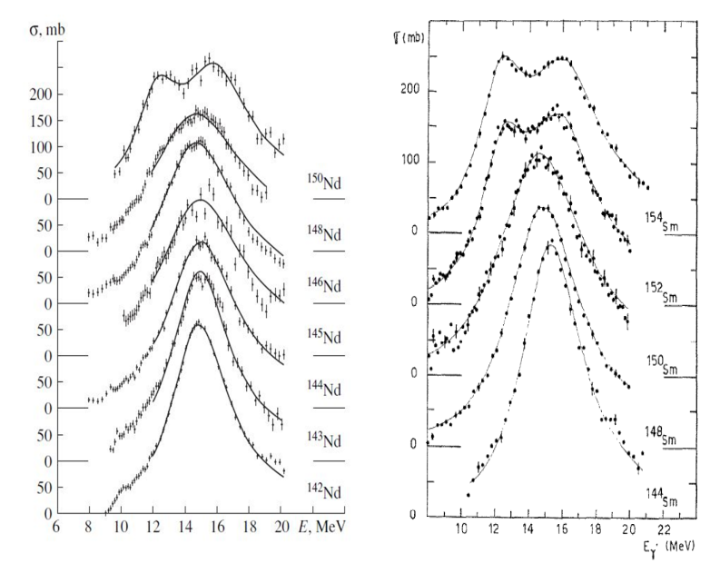
IVGDR Shape Evolution: Real Photo-absorption
8
Total photo-absorption cross sections for the IVGDR in Nd and Sm have shown:
  Double-peaked and very broad for more deformed ¹⁵⁰Nd and ^{152, 154}Sm
  General broadening between these extremes
  Single-peaked and narrow for spherical ^{142, 144}Nd and ¹⁴⁴Sm
A. Bohr, B. R. Mottelson, Nuclear Structure
Vol. II (Benjamin, Reading, 1975) p. 490 ff.
P. Carlos et al., Nuclear Physics A
225 (1974) 171.
L.M. Donaldson – 9th Workshop on Nuclear Level Density and Gamma Strength – 27 – 31 May 2024

Slide 9
IVGDR Shape Evolution: Real Photo-absorption
9
Total photo-absorption cross sections for the IVGDR in Nd and Sm have shown:
  Double-peaked and very broad for more deformed ¹⁵⁰Nd and ^{152, 154}Sm
  General broadening between these extremes
  Single-peaked and narrow for spherical ^{142, 144}Nd and ¹⁵⁴Sm
A. Bohr, B. R. Mottelson, Nuclear Structure
Vol. II (Benjamin, Reading, 1975) p. 490 ff.
P. Carlos et al., Nuclear Physics A
225 (1974) 171.
L.M. Donaldson – 9th Workshop on Nuclear Level Density and Gamma Strength – 27 – 31 May 2024

Slide 10
IVGDR Shape Evolution: Real Photo-absorption
10
Total photo-absorption cross sections for the IVGDR in Nd and Sm have shown:
  Double-peaked and very broad for more deformed ¹⁵⁰Nd and ^{152, 154}Sm
  General broadening between these extremes
  Single-peaked and narrow for spherical ^{142, 144}Nd and ¹⁵⁴Sm
A. Bohr, B. R. Mottelson, Nuclear Structure
Vol. II (Benjamin, Reading, 1975) p. 490 ff.
P. Carlos et al., Nuclear Physics A
225 (1974) 171.
L.M. Donaldson – 9th Workshop on Nuclear Level Density and Gamma Strength – 27 – 31 May 2024

Slide 11
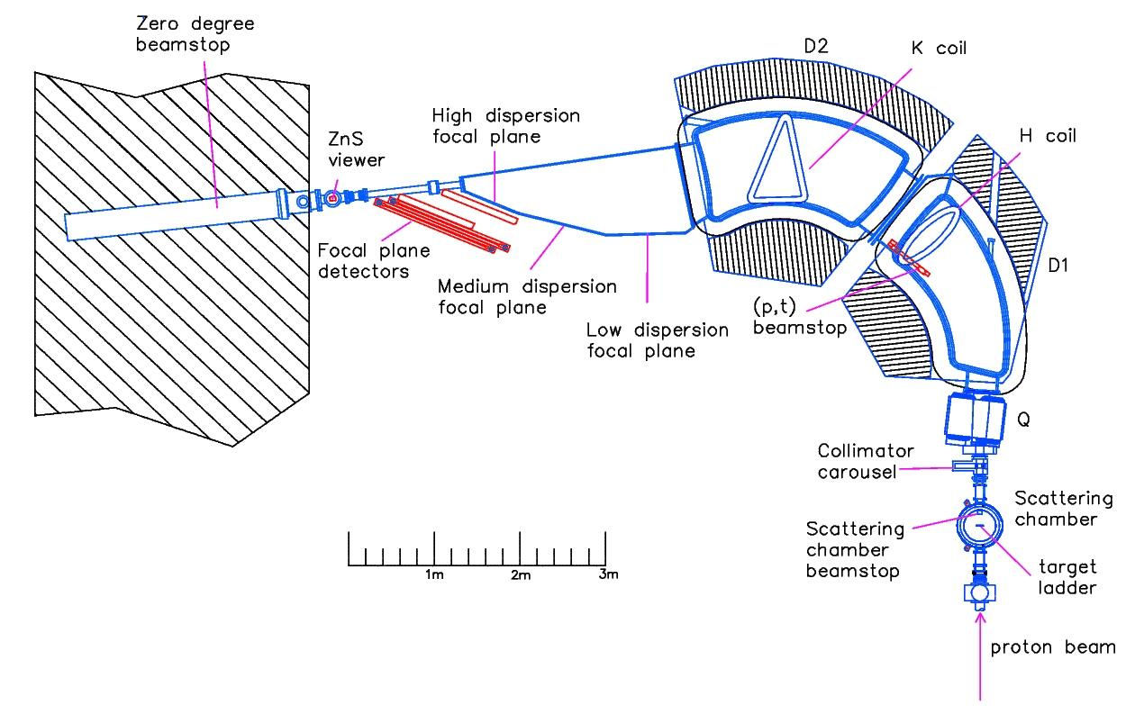
IVGDR Shape Evolution: Relativistic Coulomb Excitation
11
K600 Magnetic Spectrometer at iThemba LABS
200 MeV (p,p’) scattering at 0°
Under these conditions, Coulomb excitation dominates
Self-supporting targets with areal densities between 1.8 and 2.6 mg/cm²
For details, see:
  L.M. Donaldson et al., Physics Letters B 776 (2018) 133.
  L.M. Donaldson et al., Physical Review C 102 (2020) 064327.
L.M. Donaldson – 9th Workshop on Nuclear Level Density and Gamma Strength – 27 – 31 May 2024
Notes:
Recently, the technique utilising proton inelastic scattering with energies of a few hundred MeV at scattering angles close to zero degrees has been developed as a tool to extract electric-dipole strength distributions. Experiments such as these have been a focus of work using the K600 Magnetic Spectrometer at iThemba LABS and the Grand Raiden Spectrometer at RCNP.
The data contain information on the photo-absorption cross sections in the energy region of the GDR.
An advantage of using (p,p’) for photo-absorption measurements is that it is an inclusive measurement relying on the relativistic Coulomb excitation of the target nucleus by the exchange of virtual photons, which does not require the detection of any specific decay mode of the GDR.
That said, we made use of 200 MeV (p,p’) scattering at an angle of 0 degrees. Under these experimental conditions, Coulomb excitation dominates.
We made use of self-supporting targets with areal densities between 1.8 and 2.6 mg/cm^2.
For complete details, see these references.

Slide 12
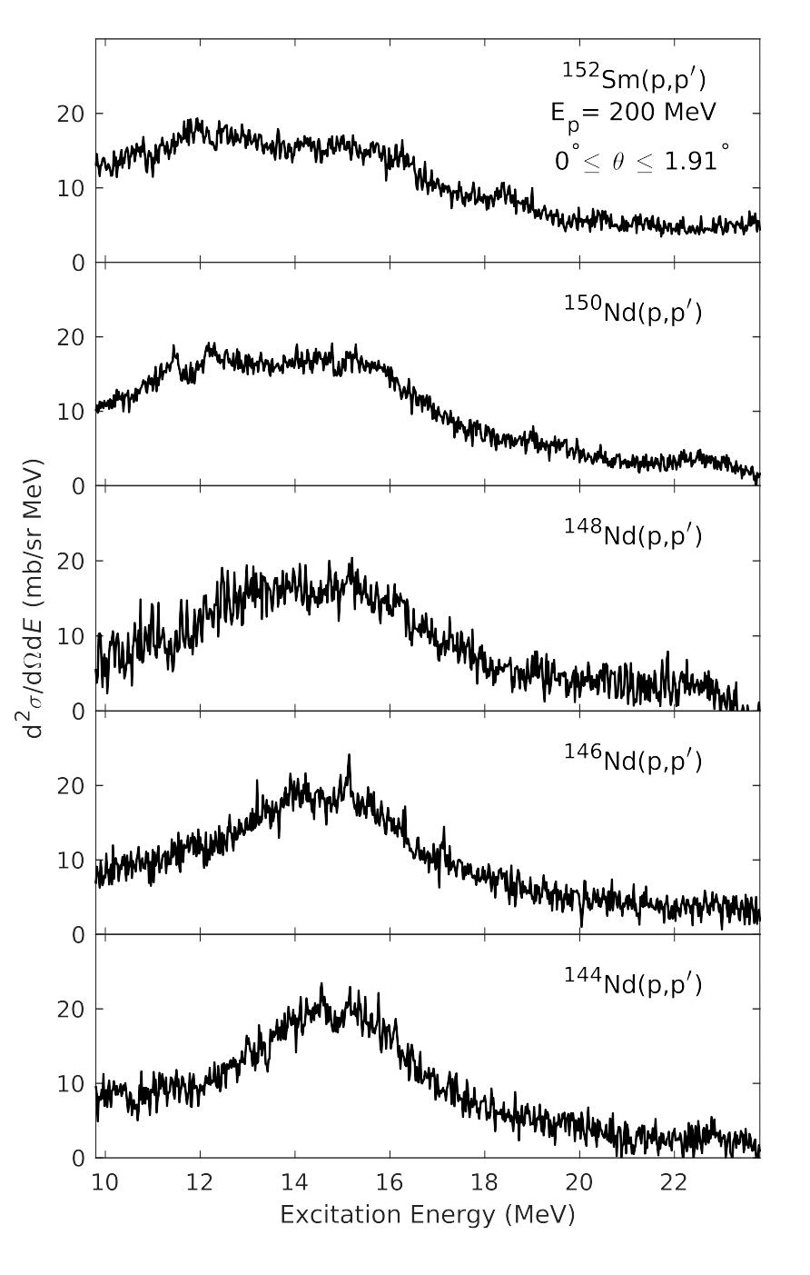
IVGDR Shape Evolution: Relativistic Coulomb Excitation
12
Double-differential cross sections from Coulomb excitation show the following:
  IVGDR between 12 and 18 MeV
  Increasing width from nearly spherical ¹⁴⁴Nd through the transition region to the more deformed ¹⁵⁰Nd and ¹⁵²Sm
We need to compare apples with apples – how do we do that?
L.M. Donaldson – 9th Workshop on Nuclear Level Density and Gamma Strength – 27 – 31 May 2024
Notes:
Here are the double-differential cross sections that we obtained from the described experiment. From these double-differential cross sections, we see:
A broad structure between 12 MeV and 18 MeV that corresponds to the excitation of the IVGDR
We see that the width of the IVGDR increases steadily from the nearly spherical 144Nd through to the more-deformed 150Nd and 152Sm
We would now like to compare our results to the photo-absorption data but we need to compare apples with apples so how do we do that?

Slide 13
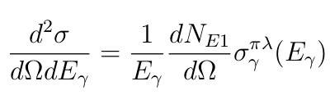
Equivalent Virtual-Photon Method
13
The equivalent virtual-photon method is applied as follows:
Further information on this method can be found in the following papers:
  C. A. Bertulani, 2009, arXiv: 0908.4307 [nucl-th]
  C. A. Bertulani and A. Nathan, Nucl. Phys. A 554 (1993) 158-172
  C. A. Bertulani and G. Baur, Phys. Rep. 163 (1988) 299-408
L.M. Donaldson – 9th Workshop on Nuclear Level Density and Gamma Strength – 27 – 31 May 2024
Notes:
We make use of the equivalent virtual photon method.
In simple terms, in relativistic Coulomb excitation experiments, you have a proton coming in and as it interacts with the nucleus, there are virtual photons exchanged. The equivalent virtual photon method allows us to convert between the double-differential cross sections we have and the photo-absorption cross sections we want. It is summarised by this equation.

Slide 14
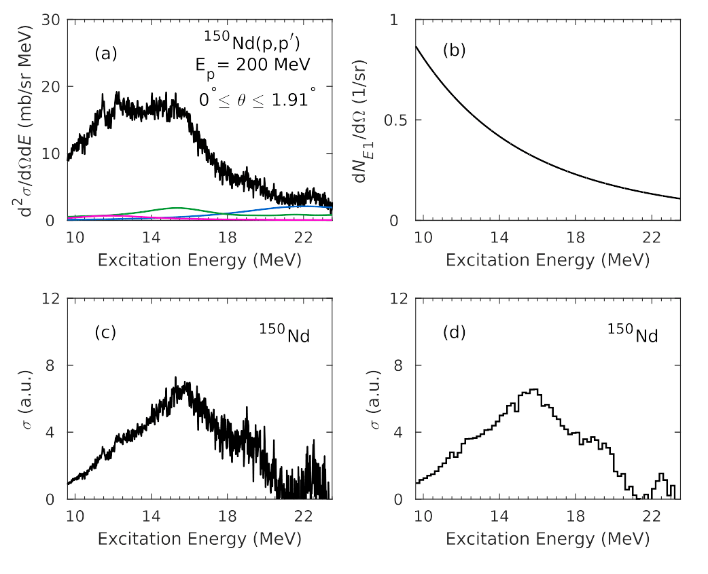
Virtual Photon Method: Conversion to Equiv. Photo-abs CS
14
Process can be divided into three distinct stages:
  Background subtraction in the region of the IVGDR
  Calculation of the virtual-photon spectrum
  Division by this virtual-photon spectrum
Procedure has been tested for several cases and fair agreement has been found
L. M. Donaldson et al., Phys. Lett. B 776 (2018) 133-138
L.M. Donaldson – 9th Workshop on Nuclear Level Density and Gamma Strength – 27 – 31 May 2024
Notes:
The conversion of the measured (p,p’) double-differential cross sections to equivalent photo-absorption cross sections is a three stage process:
- Subtraction of the nuclear background, where the green curve is the ISGMR, the pink curve is the ISGQR and the blue curve is the phenomenological background (which describes the behaviour of the double-differential cross section at high excitation energy where the Coulomb excitation contribution is negligible. It incorporates all unknown multipolarities as well as quasi-free scattering.)
- Calculation of the virtual-photon spectrum
- Implementation of the equivalent virtual-photon method.
This method has been tested for several cases at both iThemba LABS and RCNP and good agreement with photo-absorption cross sections has been found.

Slide 15
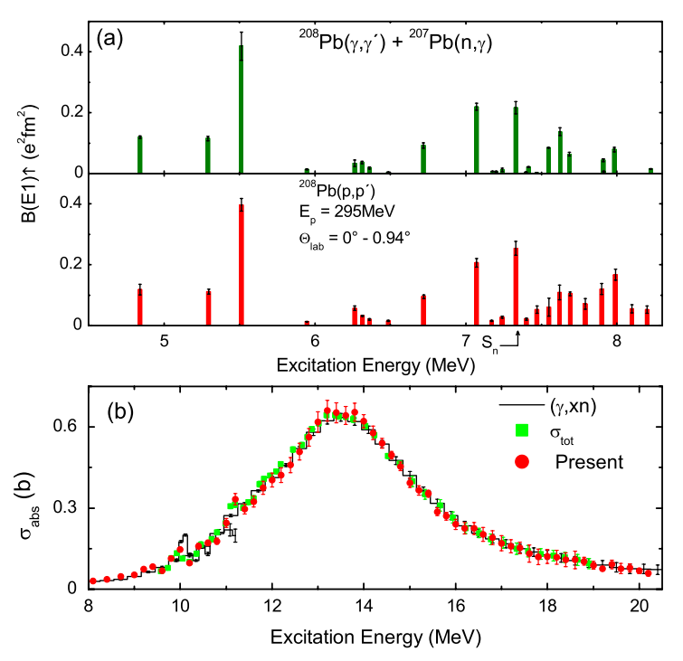
Virtual Photon Method: Test Case Comparison (RCNP)
15
A. Tamii et al., Phys. Rev. Lett. 107 (2011) 062502.
L.M. Donaldson – 9th Workshop on Nuclear Level Density and Gamma Strength – 27 – 31 May 2024

Slide 16
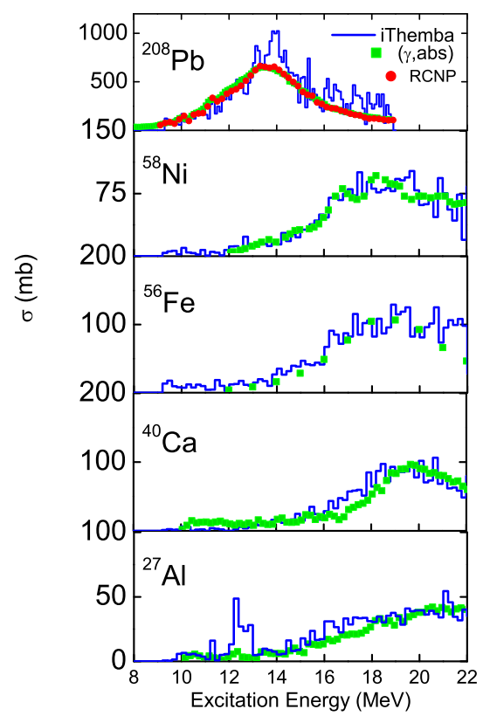
Virtual Photon Method: Test Case Comparison (iThemba LABS)
16
M. Jingo et al., Eur. Phys. J. A 54 (2018) 234
L.M. Donaldson – 9th Workshop on Nuclear Level Density and Gamma Strength – 27 – 31 May 2024

Slide 17
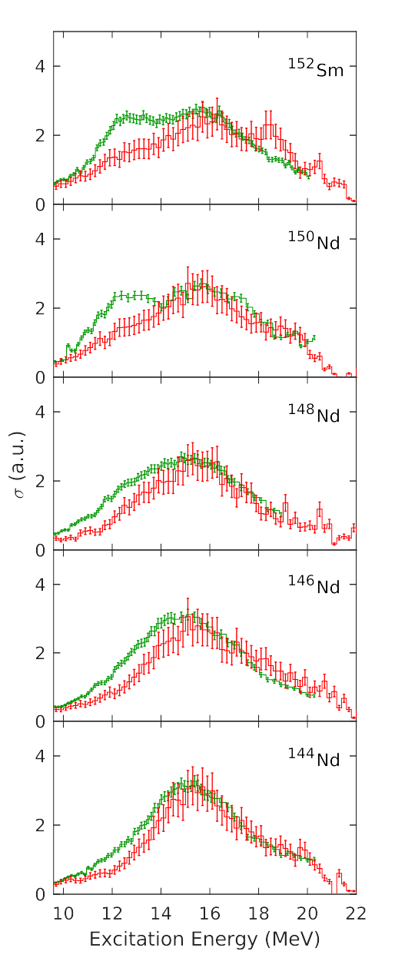
Observed Discrepancies in Photo-Absorption Data – (p,p’) vs (γ,xn)
17
Both show a general broadening with deformation
For ¹⁵⁰Nd and ¹⁵²Sm, Donaldson et al. found a pronounced asymmetry but no split
For spherical and transitional nuclei, Donaldson et al. observed a shift of the centroid to higher energies
SSRPA calculations use the assumption of well-defined deformation
For ¹⁵⁰Nd and ¹⁵²Sm, K=0 component lies above Donaldson et al. but still below Carlos et al.
Donaldson et al. – (p,p’)
Carlos et al. – (γ,xn)
SSRPA
L. M. Donaldson et al., Phys. Lett. B 776 (2018) 133-138
L.M. Donaldson – 9th Workshop on Nuclear Level Density and Gamma Strength – 27 – 31 May 2024
Notes:
This summary figure shows a comparison between the equivalent photo-absorption cross sections from iThemba LABS normalised to the real photo-absorption cross sections from Saclay.
Both sets of data show a general broadening with deformation.
The real photo-absorption results show a double-peaked and very broad resonance for the more-deformed 150Nd and 152Sm, whereas the results from the (p,p’) scattering exhibit a pronounced asymmetry but no well-defined split in the resonance.
For spherical and transitional nuclei, the (p,p’) data exhibit a slight shift of the centroid to higher energies.

Slide 18
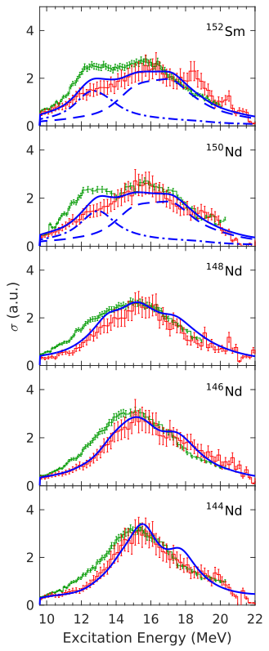
Observed Discrepancies in Photo-Absorption Data – (p,p’) vs (γ,xn)
18
Both show a general broadening with deformation
For ¹⁵⁰Nd and ¹⁵²Sm, Donaldson et al. found a pronounced asymmetry but no split
For spherical and transitional nuclei, Donaldson et al. observed a shift of the centroid to higher energies
Skyrme Separable RPA calculations use the assumption of well-defined deformation
For ¹⁵⁰Nd and ¹⁵²Sm, K=0 component lies above Donaldson et al. but still below Carlos et al.
Donaldson et al. – (p,p’)
Carlos et al. – (γ,xn)
SSRPA
L. M. Donaldson et al., Phys. Lett. B 776 (2018) 133-138
L.M. Donaldson – 9th Workshop on Nuclear Level Density and Gamma Strength – 27 – 31 May 2024
Notes:
Also shown here is the Skyrme Separable Random Phase Approximation calculations, normalised to the high-energy region of the two datasets. For the spherical and transitional nuclei, the SSRPA calculations are in better agreement with the iThemba LABS data, where smaller cross sections are favoured at lower energy.
For the deformed 150Nd and 152Sm, the SSRPA predicts a double-peaked structure, but with a lower K=0 component than the Saclay results and total cross sections that are closer to the iThemba LABS results.

Slide 19
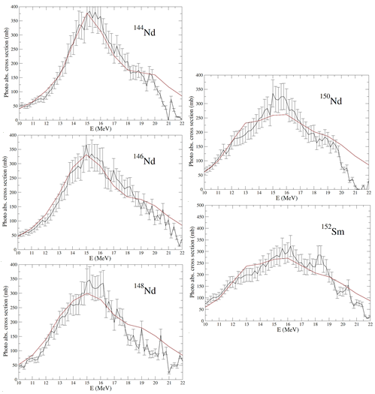
Observed Discrepancies in Photo-Absorption Data – (p,p’) vs (γ,xn)
19
For the spherical and transitional nuclei, there is excellent agreement between experiment and theory in terms of both shape and location of the centroid.
For ¹⁵⁰Nd and ¹⁵²Sm, Relativistic QFAM calculations display much less of a distinct double-peaked structure than Carlos et al.
The Relativistic QFAM calculations show a broad and smeared-out structure, which agrees better with Donaldson et al.
Donaldson et al.
Relativistic QFAM
E. Khan, Private Communication (2023).
L.M. Donaldson – 9th Workshop on Nuclear Level Density and Gamma Strength – 27 – 31 May 2024
Notes:
In addition to the SSRPA calculations, there have been Relativistic Quasiparticle Finite Amplitude Method (QFAM) calculations that have been performed as well. This figure shows the results of the comparison between these calculations and the results from iThemba LABS.
For the spherical and transitional nuclei, there is excellent agreement between experiment and theory in terms of both the shape of the resonance and the location of the centroid.
For the deformed 150Nd and 152Sm, the relativistic QFAM calculations display much less of a distinct double-peak structure than the real photo-absorption results displayed on the previous slide.
The Relativistic QFAM calculations show a broad and smeared-out structure, which agrees better with the iThemba LABS data.

Slide 20
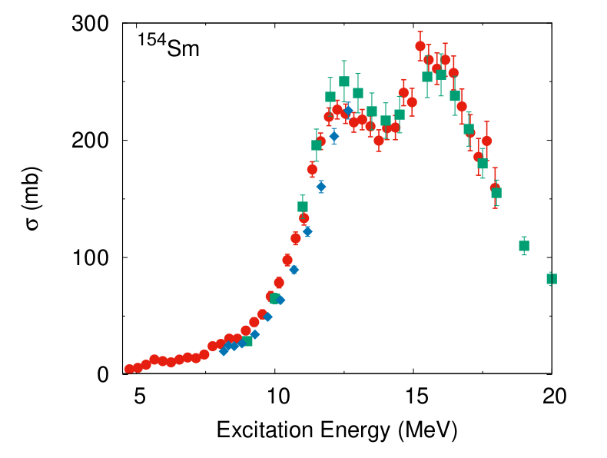
Observed Discrepancies in Photo-Absorption Data – (p,p’) vs (γ,xn)
20
RCNP data
Carlos et al.
Filipescu et al.
Similar to the ¹⁵⁰Nd and ¹⁵²Sm results from iThemba LABS, a different K=0/K=1 ratio is obtained
A clear decrease in the K=0 region and a slight increase in the K=1 region
A. Krugmann et al., to be published
L.M. Donaldson – 9th Workshop on Nuclear Level Density and Gamma Strength – 27 – 31 May 2024

Slide 21

Observed Discrepancies in Photo-Absorption Data
21
(p,p’) vs (γ,xn) from Saclay
Saclay (γ,xn) vs Livermore (γ,xn)
L.M. Donaldson – 9th Workshop on Nuclear Level Density and Gamma Strength – 27 – 31 May 2024

Slide 22
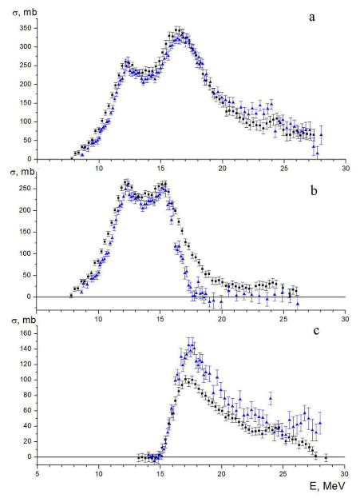
Observed Discrepancies in Photo-Absorption Data – (γ,xn) vs (γ,xn)
22
(p,p’) vs (γ,xn) from Saclay
Saclay (γ,xn) vs Livermore (γ,xn)
  In many cases for the same nuclei
    (γ,1n) cross sections from Saclay are noticeably higher
    (γ,2n) cross sections from Livermore are noticeably higher
  Recent reanalyses of photo-neutron data suggest systematic effects exist because of data processing to account for the neutron multiplicity of the events
    A shift of events from the (γ,2n) channel to the (γ,1n) channel owing to the neutron background in the detectors and the neutron energy distribution when there are competing (γ,1n), (γ,2n) and (γ,np) reactions
σ(γ,Sn)
Saclay
Livermore
σ(γ,1n)
σ(γ,2n)
V. Varlamov et al., European Physical Journal A 50 (2014) 114.
L.M. Donaldson – 9th Workshop on Nuclear Level Density and Gamma Strength – 27 – 31 May 2024
Notes:
It has long been known that inconsistencies in the cross sections and relative contributions of (g,1n) and (g,2n) components exist within and between the Saclay and Livermore datasets.
Recent reanalyses of photon-neutron data suggest that systematic effects exist as a result of the data processing to account for the neutron multiplicity of the events. It seems as though the multiplicity-sorting method used to distinguish the various (g,xn) channels may have led to systematic biases, shifting events from the (g,2n) to the (g,1n) channel owing to, among other factors, the neutron background in the detectors and the neutron energy distribution when there are competing (g,1n), (g,2n) and (g,np) reactions.

Slide 23
Understanding the IVGDR in Heavy Deformed Nuclei
23
We propose an investigation into the following aspects to better understand the GDR in heavy deformed nuclei:
Towards an understanding of the observed discrepancies
1.1 Neutron-multiplicity sorting
1.2 Contributions of quasi-free scattering and phenomenological background to the GDR cross section
Constructing a photo-neutron calibration standard
Triaxiality in deformed nuclei
L.M. Donaldson – 9th Workshop on Nuclear Level Density and Gamma Strength – 27 – 31 May 2024
Notes:
We would like to propose a wide-ranging investigation into several aspects to shed some light on the GDR in heavy deformed nuclei. We will propose this study at the next RCNP PAC later this year.
This includes investigations into the observed discrepancies we have already discussed, the construction of a photo-neutron calibration standard and finally, a study into the effect of triaxiality and shape coexistence in deformed nuclei.

Slide 24
Understanding the IVGDR in Heavy Deformed Nuclei
24
We propose an investigation into the following aspects to better understand the GDR in heavy deformed nuclei:
Towards an understanding of the observed discrepancies
1.1 Neutron-multiplicity sorting
1.2 Contributions of quasi-free scattering and phenomenological background to the GDR cross section
Constructing a photo-neutron calibration standard
Triaxiality in deformed nuclei
L.M. Donaldson – 9th Workshop on Nuclear Level Density and Gamma Strength – 27 – 31 May 2024
Notes:
If we start with the first avenue of investigation, which seeks to understand the observed discrepancies, there are two aspects we need to consider. The first is neutron-multiplicity sorting.

Slide 25
Understanding the IVGDR in Heavy Deformed Nuclei
25
1.1 Neutron-multiplicity sorting
Need a reference case that will allow for a comparison between the virtual-photon data and real-photon measurements obtained at Saclay and Livermore that excludes possible effects from differing neutron multiplicities
Also need a measurement of a reference case that explicitly includes reactions with different neutron multiplicities
Propose a study of ⁹⁰Zr and ¹⁵⁹Tb using the inelastic scattering of 392 MeV protons at very forward scattering angles in conjunction with the Grand Raiden spectrometer at RCNP
L.M. Donaldson – 9th Workshop on Nuclear Level Density and Gamma Strength – 27 – 31 May 2024
Notes:
In order to investigate this, we need a reference case that will allow for a comparison between the virtual-photon data and the real-photon data that EXCLUDES possible effects from differing neutron multiplicities.
In addition to this, we need a measurement of a reference case that EXPLICITLY INCLUDES reactions with different neutron multiplicities.
To this end, we propose a study of 90Zr and a measurement of 159Tb using the inelastic scattering of 392 MeV protons at zero degrees with the Grand Raiden spectrometer at RCNP.

Slide 26
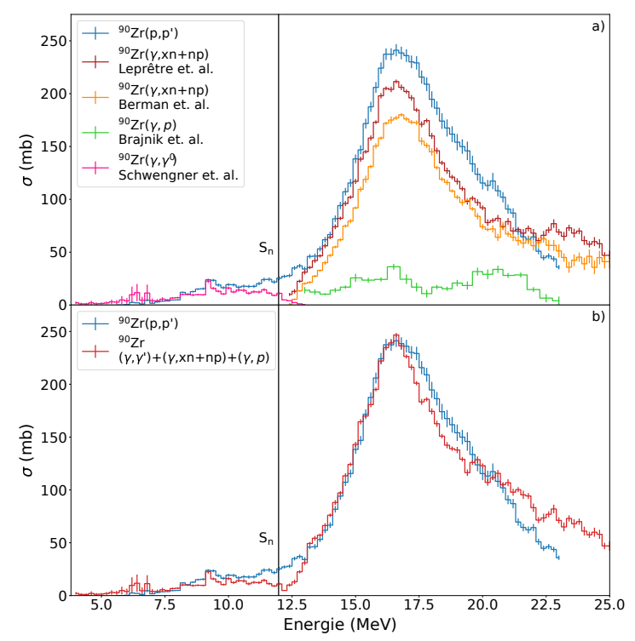
Understanding the IVGDR in Heavy Deformed Nuclei
26
1.1 Neutron-multiplicity sorting – Why ⁹⁰Zr?
Most of the IVGDR falls below the 2n threshold → 1n reactions dominate
Allows for comparison of shape without confounding neutron-multiplicity effects → Relatively simple direct comparison
Multiple datasets exist – real photon data from Livermore, Saclay and HIγS
A positive for this investigation is that ⁹⁰Zr has already been measured at RCNP. The results show good agreement with the results from Saclay provided that the (γ,p) cross section is taken into account.
T. Klaus, PhD. Thesis, TU Darmstadt (2020)
L.M. Donaldson – 9th Workshop on Nuclear Level Density and Gamma Strength – 27 – 31 May 2024
Notes:
In 90Zr, the two-neutron threshold lies at high excitation energy, above the main peak of the IVGDR and so 1n reactions dominate and a comparison can be made WITHOUT the inclusion of any confounding neutron-multiplicity effects.
The advantage with this case is that multiple datasets exist - Livermore, Saclay and Higs.
90Zr has already been measured at RCNP and the results will be published soon. As can be seen here, the results show good agreement with the data taken at Saclay provided that the (g,p) cross section is taken into account.

Slide 27
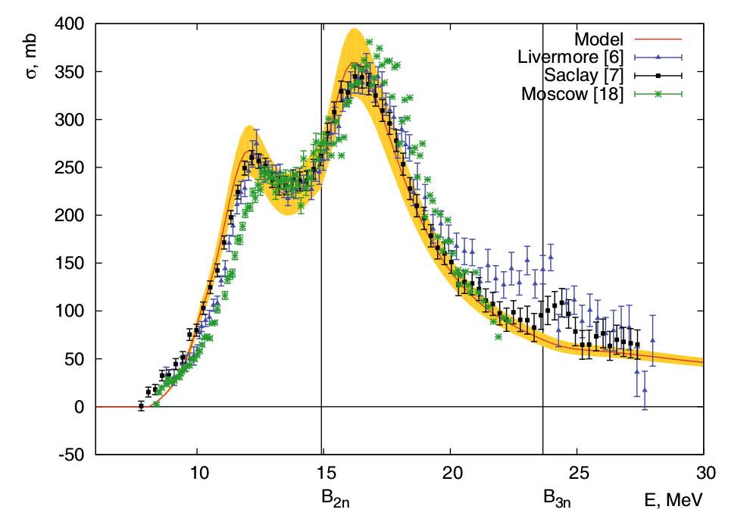
Understanding the IVGDR in Heavy Deformed Nuclei
27
1.1 Neutron-multiplicity sorting – Why ¹⁵⁹Tb?
IVGDR spans the 2n threshold allowing for possible discrepancies due to neutron-multiplicity sorting to be investigated by comparing real- and virtual-photon data
Strongly deformed so significant splitting should be observed
If processing of photo-neutron data from Saclay causes a transfer of events from the 2n to 1n channel then we should see a similar effect to Nd and Sm
Existing data from Livermore, Saclay and the PHOENIX group
V. Varlamov et al., European Physical Journal A 50 (2014) 114.
L.M. Donaldson – 9th Workshop on Nuclear Level Density and Gamma Strength – 27 – 31 May 2024
Notes:
The impact of the neutron multiplicity may be investigated using 159Tb.
In 159Tb, the IVGDR is predicted to have a bi-model distribution which spans the two-neutron threshold. Therefore, we would expect that if the processing of the photo-neutron data from Saclay does, in fact, cause a transfer of events from the (γ, 2n) to the (γ, 1n) channel then we should see a similar effect in these data as we did for the neodymium and samarium data.
Added benefit is multiple sources of data where the comparison of the newly obtained 159Tb data will be made with data from Livermore, Saclay and the PHOENIX group.

Slide 28
Understanding the IVGDR in Heavy Deformed Nuclei
28
We propose an investigation into the following aspects to better understand the GDR in heavy deformed nuclei:
Towards an understanding of the observed discrepancies
1.1 Neutron-multiplicity sorting
1.2 Contributions of quasi-free scattering and phenomenological background to the GDR cross section
Constructing a photo-neutron calibration standard
Triaxiality in deformed nuclei
L.M. Donaldson – 9th Workshop on Nuclear Level Density and Gamma Strength – 27 – 31 May 2024
Notes:
Staying with the first avenue of investigation, which seeks to understand the observed discrepancies, we should discuss the second aspect we need to consider, which is contributions of quasi-free scattering and the phenomenological background to the GDR cross section.

Slide 29
Understanding the IVGDR in Heavy Deformed Nuclei
29
1.2 Contributions of quasi-free scattering and phenomenological background to the GDR cross section
The proton inelastic scattering data on the Nd and Sm isotopes were taken with a proton beam energy of 200 MeV – the maximum energy available at iThemba LABS
This equates to an excitation-energy range of approximately 8 – 24 MeV
Covers main component of the IVGDR, but has limitations with respect to a comprehensive understanding of the full shape of the GDR including the quasi-free scattering and phenomenological background shapes
Accurate background subtraction has implications both for the shape of the GDR as well as for the required normalisation factor between iThemba LABS data and the real photo-absorption results
We propose a measurement of ¹⁵⁰Nd and ¹⁵²Sm with a beam energy of 392 MeV, which corresponds to an excitation-energy range of 7 – 32 MeV
This will allow for the full shape of the GDR to be studied
L.M. Donaldson – 9th Workshop on Nuclear Level Density and Gamma Strength – 27 – 31 May 2024
Notes:
The proton inelastic scattering data on the Nd and Sm isotopes were taken with a proton beam energy of 200 MeV – the maximum energy available at iThemba LABS, which equates to an excitation-energy range of approximately 8 – 24 MeV
This range, although appropriate to cover the main component of the IVGDR, has limitations with respect to a comprehensive understanding of the full shape of the GDR, which includes the quasi-free scattering and phenomenological background shapes.
Accurate background subtraction has implications both for the shape of the GDR as well as for the required normalisation factor between iThemba LABS data and the real photo-absorption results
We propose a measurement of 150Nd and 152Sm with a beam energy of 392 MeV, which corresponds to an excitation-energy range of 7 – 32 MeV.
This will allow for the full shape of the GDR to be studied.

Slide 30
Understanding the IVGDR in Heavy Deformed Nuclei
30
We propose an investigation into the following aspects to better understand the GDR in heavy deformed nuclei:
Towards an understanding of the observed discrepancies
1.1 Neutron-multiplicity sorting
1.2 Contributions of quasi-free scattering and phenomenological background to the GDR cross section
Constructing a photo-neutron calibration standard
Triaxiality in deformed nuclei
L.M. Donaldson – 9th Workshop on Nuclear Level Density and Gamma Strength – 27 – 31 May 2024
Notes:
With an overlapping motivation to the neutron-multiplicity sorting, attention will also be given to the construction of a photo-neutron calibration standard

Slide 31
Understanding the IVGDR in Heavy Deformed Nuclei
31
2. Constructing a photo-neutron calibration standard
The usual normalisation standard is ¹⁹⁷Au, which is excellent for (γ,1n) reactions, but not for (γ,2n) reactions
Consider ¹⁶⁹Tm – Photo-neutron reactions on ¹⁶⁹Tm produce ¹⁶⁸Tm and ¹⁶⁷Tm, which both decay by beta particle emission with reasonable lifetimes producing characteristic gamma rays → Both can be used for photo-activation measurements
A group led by Texas A&M and iThemba LABS (P. Adsley, B. Wellons and L.M. Donaldson) will be performing an activation-based study of ¹⁶⁹Tm with the intention of constructing a photo-neutron calibration standard that can be used for future direct measurements. This will be at ELBE in May and June 2024
We propose a measurement of ¹⁶⁹Tm with a beam energy of 392 MeV, which will provide a unique opportunity to develop this calibration standard using multiple experimental probes simultaneously
L.M. Donaldson – 9th Workshop on Nuclear Level Density and Gamma Strength – 27 – 31 May 2024
Notes:
The usual normalisation standard for photo-neutron measurements is 197Au, which is excellent for (g,1n) reactions but not for (g,2n) reactions prompting a need to find another candidate that may work better.
If we consider 169Tm, we know that photo-neutron reactions on it produce 168Tm and 167Tm, which both decay by beta particle emission with reasonable lifetimes, producing characteristic gamma rays so both of these nuclei can be used for photo-activation measurements.
In parallel to this proposal, a group led by Texas A&M and iThemba LABS is working on an activation-based study of 169Tm with the intention of constructing a photo-neutron calibration standard that may be used for future direct measurements. These photo-activation measurements will be performed at ELBE in May and June 2024.
We propose a measurement of 169Tm with a beam energy of 392 MeV, which will provide a unique opportunity to develop this calibration standard using multiple experimental probes simultaneously.

Slide 32
Understanding the IVGDR in Heavy Deformed Nuclei
32
We propose an investigation into the following aspects to better understand the GDR in heavy deformed nuclei:
Towards an understanding of the observed discrepancies
1.1 Neutron-multiplicity sorting
1.2 Contributions of quasi-free scattering and phenomenological background to the GDR cross section
Constructing a photo-neutron calibration standard
Triaxiality in deformed nuclei
L.M. Donaldson – 9th Workshop on Nuclear Level Density and Gamma Strength – 27 – 31 May 2024
Notes:
Finally, we would like to consider the effect of triaxiality on deformed nuclei.

Slide 33
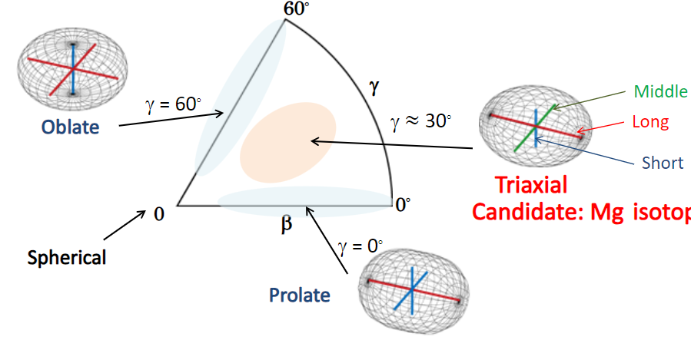
Understanding the IVGDR in Heavy Deformed Nuclei
33
3. Triaxiality in deformed nuclei
Textbook picture: Majority of heavy nuclei exhibit deformed shapes (axially symmetric prolate)
BUT same central and tensor forces as those responsible for shell evolution point to triaxial shapes
Triaxial shape → more complex rotations, which reproduce some experimental data as shown by Configuration Interaction calculations
How it manifests: Nuclei generally accepted to display well-defined double-peak structure (modelled by two Lorentzians) may actually be triaxial with the IVGDR exhibiting a more broad and smeared structure
L.M. Donaldson – 9th Workshop on Nuclear Level Density and Gamma Strength – 27 – 31 May 2024
Notes:
The majority of heavy nuclei exhibit deformed shapes, which are considered to be predominantly axially symmetric prolate.
This is the textbook picture BUT the same central and tensor forces as those responsible for the shell evolution now point to triaxial shapes in many nuclei.
The triaxial shape results in more complex rotations, which better reproduce the low-energy structure of many deformed nuclei.
Nuclei that have been generally accepted to display a well-defined double-peak structure for the IVGDR (modelled by two Lorentzians) may actually be triaxial with an IVGDR that exhibits a more broad and smeared structure such as the shape seen in the 150Nd and 152Sm results from iThemba LABS.

Slide 34
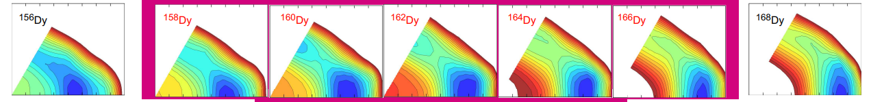
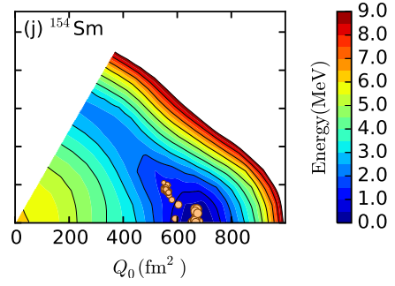
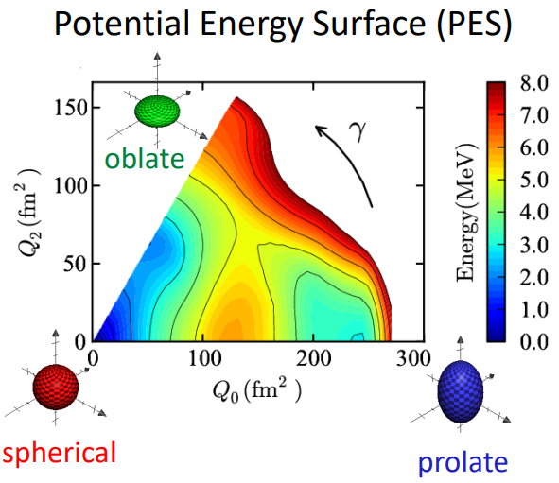
Understanding the IVGDR in Heavy Deformed Nuclei
34
3. Triaxiality in deformed nuclei
A measurement of two nuclei, ¹⁵⁴Sm and ¹⁶⁴Dy, which differ significantly in the predicted degree of triaxiality, is proposed
T. Otsuka et al., arXiv (2023) nucl-th/2303.11299
Y. Tsunoda et al., arXiv (2023) nucl-th/2304.11780v1
L.M. Donaldson – 9th Workshop on Nuclear Level Density and Gamma Strength – 27 – 31 May 2024
Notes:
We propose a study into two nuclei, which differ significantly in the predicted degree of triaxiality.
Shown here are the results of Quasiparticle Vacua Shell Model calculations. Based on these predictions, we propose a measurement of 154Sm and 164Dy.

Slide 35
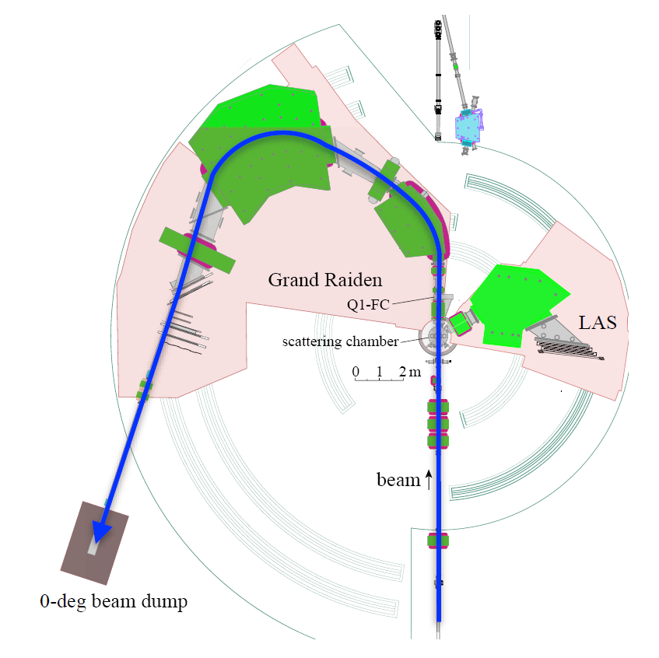
Understanding the IVGDR in Heavy Deformed Nuclei
35
Experimental Details
Two-arm spectrometer system consisting of the Grand Raiden Spectrometer and the Large Acceptance Spectrometer will be employed
GR Spectrometer will be set up in the zero-degree transmission mode
Proton beam with an energy of 392 MeV
Targets with areal densities of approximately 4 mg/cm²: ¹⁵⁹Tb, ¹⁵⁰Nd, ¹⁵²Sm, ¹⁶⁹Tm, ¹⁵⁴Sm and ¹⁶⁴Dy
Data will also be taken at 2.5 degrees and 4.5 degrees to ensure that a Multipole Decomposition Analysis is possible.
L.M. Donaldson – 9th Workshop on Nuclear Level Density and Gamma Strength – 27 – 31 May 2024
Notes:
A two-arm spectrometer system, which will consist of the Grand Raiden Spectrometer and the Large Acceptance Spectrometer, will be used.
The Grand Raiden Spectrometer will be set up in the zero-degree mode and the 392 MeV proton beam will be incident on the targets placed at the centre of the scattering chamber.
Typical beam intensities at 0 degrees are a few nA and we will use these listed targets with areal densities of 4 mg/cm^2.
In addition to the 0-degree measurements, data will be taken at 2.5 degrees and 4.5 degrees to ensure that a Multipole Decomposition Analysis is possible.

Slide 36
Summary
36
We propose the following avenues of investigation
Towards an understanding of the observed discrepancies
1.1 Neutron-multiplicity sorting (¹⁵⁹Tb)
1.2 Contributions of quasi-free scattering and phenomenological background to the GDR cross section (¹⁵⁰Nd and ¹⁵²Sm)
Constructing a photo-neutron calibration standard (¹⁶⁹Tm)
Triaxiality in deformed nuclei (¹⁵⁴Sm and ¹⁶⁴Dy)
This proposal forms part of a greater collaborative effort to probe the nuclear dipole response with real and virtual photons at a number of laboratories around the world using a wide range of experimental techniques.
L.M. Donaldson – 9th Workshop on Nuclear Level Density and Gamma Strength – 27 – 31 May 2024
Notes:
We propose a wide-ranging study of different aspects of the IVGDR, including investigating and understanding the long-known anomalies in the strength of this important mode of nuclear excitation, while working as part of a wider collaboration to try to construct calibration standards and probing the effects of triaxiality and shape coexistence.
This proposal forms part of a greater collaborative effort to probe nuclear dipole responses with real and virtual photons at a number of laboratories around the world using a wide range of different experimental techniques.

Slide 37
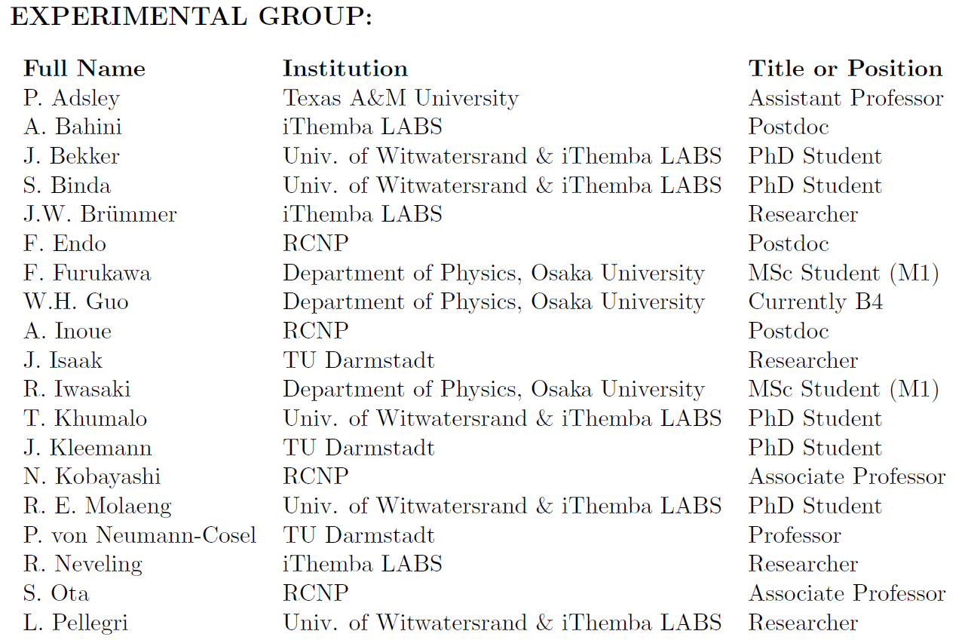
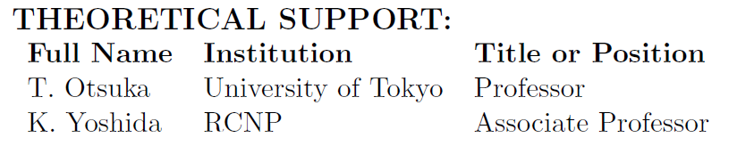
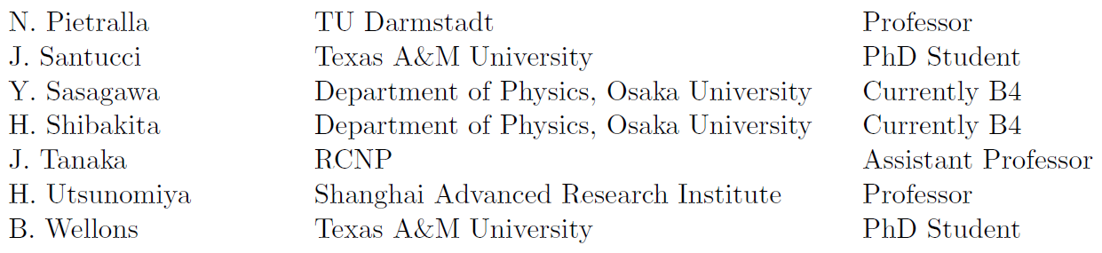
Thank you for your attention ☺
37
L.M. Donaldson – 9th Workshop on Nuclear Level Density and Gamma Strength – 27 – 31 May 2024

Slide 38
38
Backup Slides
Notes:
A good way to get an indication of the shape of the nuclei in an isotope chain is to look at the ratio of the energy of the first 4+ state to the energy of the first 2+ state. This figure shown here separates both the neodymium and samarium isotope chains into four regions: the quasi-spherical region; the intermediate spherical/deformed region, where the nucleus is treated as being spherical on average but with a small deformation, or as having a small permanent deformation; the transitional region and the deformed region. The transitional region is particularly interesting since this region comprises nuclei that alter the properties of nuclear surfaces dramatically. So where the neutron number varies from 88 to 92, there is essentially a phase transition from a spherical vibrator to an axial rotor.
The IVGDR in the Nd and Sm chains has been studied using photo-absorption experiments at Saclay and using relativistic Coulomb excitation at iThemba LABS.

Slide 39
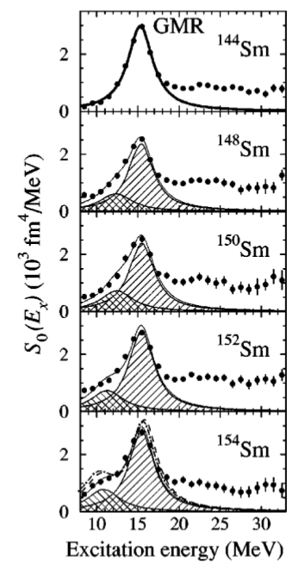
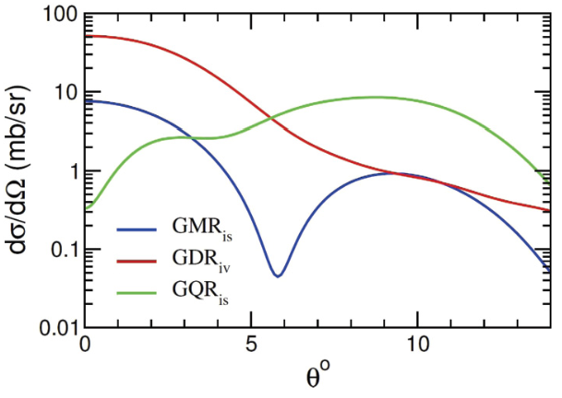
Estimation of ISGMR and ISGQR contributions
39
L. M. Donaldson et al., Phys. Lett. B 776 (2018) 133-138
M. Itoh et al., Phys. Rev. C 68 (2003) 064602.
L.M. Donaldson – 9th Workshop on Nuclear Level Density and Gamma Strength – 27 – 31 May 2024
Notes:
Computed angular distributions of the ISGMR and ISGQR cross sections were determined by DWBA calculations with the code DWBA07 using Quasiparticle Phonon Model (QPM) transition amplitudes and the Love–Franey effective interaction as input.
After averaging over the experimental angular acceptance, these calculations provide a relation between theoretical cross sections and transition strengths under the assumption of a dominant one-step reaction mechanism, which should be well fulfilled at an incident proton energy of 200 MeV. Utilising this proportionality, experimental ISGMR and ISGQR strength distributions can then be converted to (p,p′) cross sections. For comparison, the predicted IVGDR cross section is also shown and clearly dominates the spectra. However, the B(E1) transition strengths (and thus the photo-absorption cross sections) cannot be extracted with this method because the Coulomb-nuclear interference term breaks the proportionality.
Itoh et al. [25] reported isoscalar giant monopole resonance (ISGMR) strength distributions for the Sm isotope chain which could be directly applied to 152Sm. The results of Itoh et al. were also used for the corresponding Nd isotones, which show very similar deformation parameters, with a correction for the global mass dependences of the ISGMR and the ISGQR.
The ISGQR contribution was independently estimated from a recent study of the ISGQR in the Nd isotope chain with methods analogous to Refs. [27–29] in good correspondence with results from the above procedure.

Slide 40
37
L.M. Donaldson – 9th Workshop on Nuclear Level Density and Gamma Strength – 27 – 31 May 2024

