Slide 1
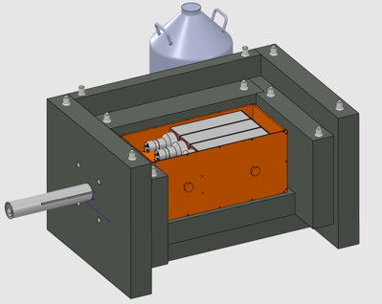
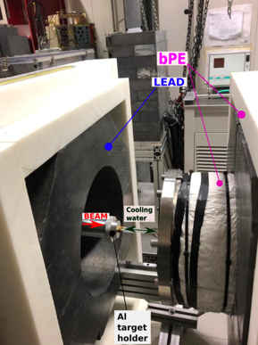
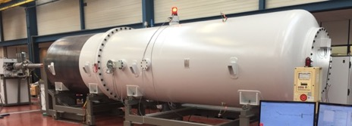
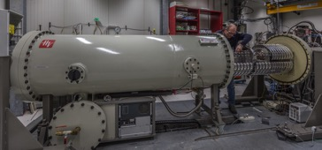




Underground Nuclear Astrophysics: pushing direct cross section measurements toward the Gamow
Oslo 31-05-2024
Gianluca Imbriani
Physics Department of University of Naples Federico II,
Italian National Institute of Nuclear Physics (INFN)

Slide 2
Abundance of elements in our Galaxy

Slide 3
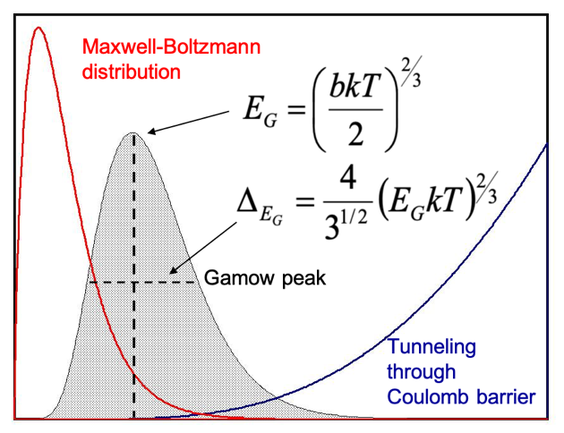
Charged particle reactions in the stars
z₁ z₂
V
E_{C} ~ z₁z₂
S(E) = Astrophysical Factor
projectile
E ~ kT
r_{n}
r
nuclear well
reaction | Coulomb barrier (keV) | E_{G} (keV)
p + p | 550 | 5.9
α + ¹²C | 3430 | 56-200
¹⁶O + ¹⁶O | 14070 | 200-500

Slide 4
Problem of extrapolation
σ(E)
resonance
LOG
SCALE
CROSS SECTION
E_{G}
non-resonant
many orders
of magnitude
direct measurements
S(E)
Interaction energy E
extrapolation needed !
LINEAR
SCALE
extrapolation
direct measurement
p+p [keV] | ³He+³He [keV] | ³He+⁴He [keV] | ⁷Be+p [keV] | ¹⁴N+p [keV]
6 | 22 | 23 | 18 | 27
E_{G}
low-energy tail
of broad
resonance
Most of the reactions of astrophysical interest happen via radiative capture.
³He(α,γ)⁷Be, ¹⁴N(p,γ)¹⁵O , ¹²C(α,γ)¹⁶C...
S(E)-FACTOR
sub-threshold
resonance
non resonant
process
-E_{r}
0
E_{r}
interaction energy E

Slide 5
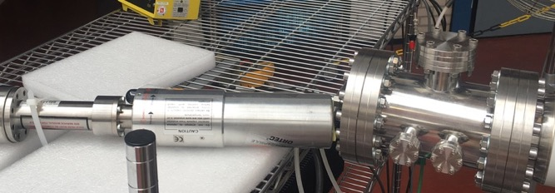
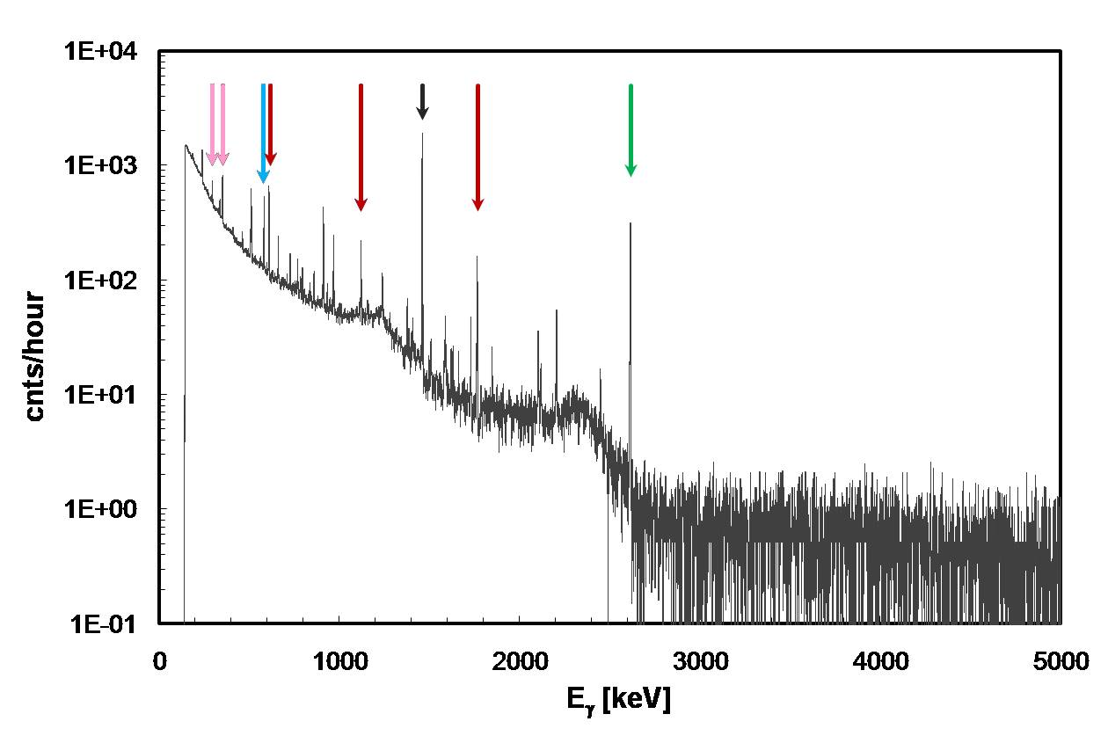


Experimental Challenges of Direct Measurement
Counting Rate = N_{p} x N_{t} x cross section x detection efficiency
10¹⁴ pps ( ~ 100 μA q=1+)
$\sim$10¹⁸ atoms/cm² typical solid state targets
Background
γ-ray spectrum
$\sim$10⁻³⁴ cm² (10⁻¹⁰ b)
Cosmic rays
~ 1 % for high energy γ rays
(HPGe detectors)
C $\sim$ 0.4 counts/hour

Slide 6
γ-ray natural background
Environmental radioactivity (γ-rays of low energy):
  natural radioactive series ²²⁶Ra, ²¹⁴Bi, ²¹⁴Pb (from ²³⁸U) and ²²⁴Ra, ²⁰⁸Tl, ²¹²Pb (from ²³²Th);
  radon (²²²Rn - ²²⁰Rn) a short-lived radioactive gas (from ²³⁸U and ²³²Th respectively);
  long-lived natural radionuclides such as ⁴⁰K, ⁸⁷Rb, ¹¹⁵In, ¹³³La, ¹⁴²Ce, etc.
Cosmic rays (γ-rays of high energy).
²⁰⁸Tl
⁴⁰K
²¹⁴Pb
²¹⁴Bi
²¹⁴Bi
²³²Th
Background
γ-ray spectrum
Cosmic rays

Slide 7
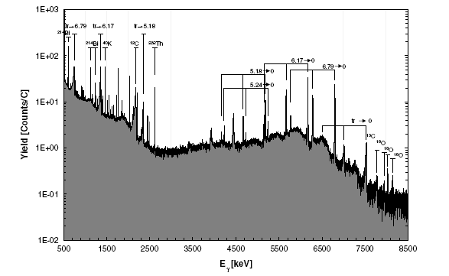
Beam induced background
HpGe spectrum E_{cm}= 230keV
«light» Pb shielding
¹¹B(p,γ)¹²C
Beam induced background
¹⁴N(p,γ)¹⁵O – Imbriani et al. EPJA 25(2005)

Slide 8
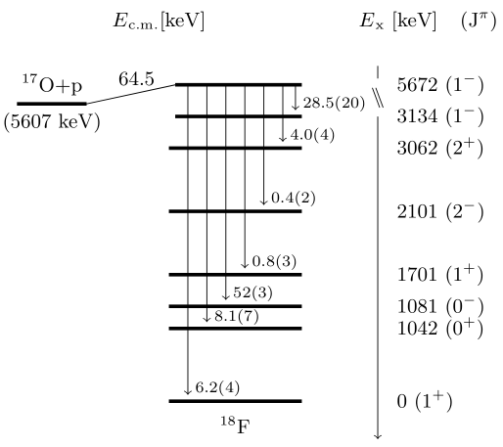
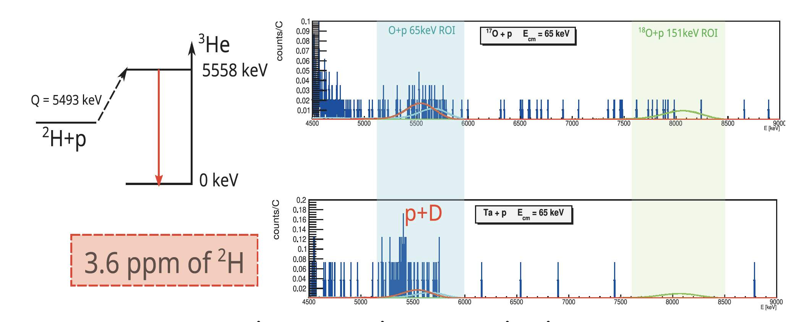
Beam induced background
¹⁷O(p,γ)¹⁸F – Gesuè et al, submitted to PRL

Slide 9
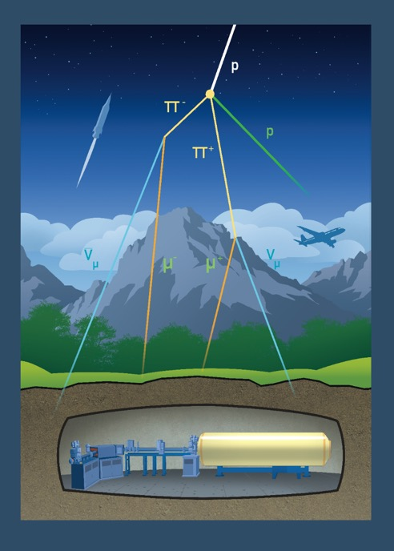
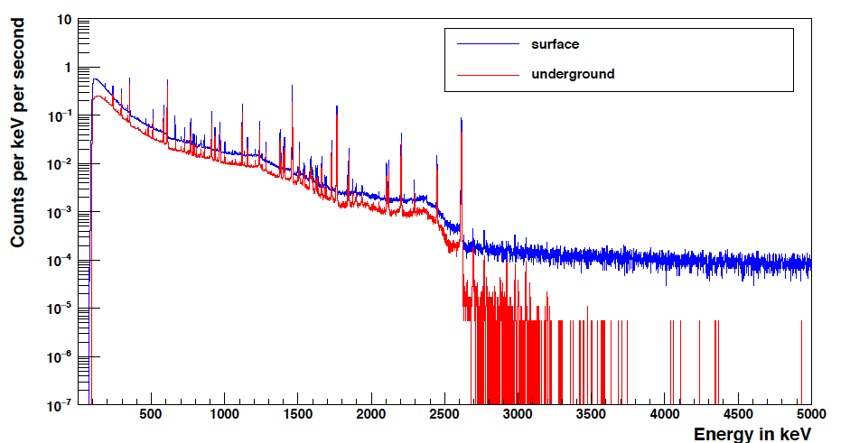
Why going underground: γ-background
Gran Sasso shielding: 3800 m w.e.
E>3.5MeV Counts/keV/hours
0.33
0.00024
cosmic rays
Environmental radioactivity
Radiation | LNGS/out
muons neutrons | 10⁻⁶ 10⁻³
Therefore, the advantage of an underground environment is evident for high Q-value reactions such as ¹⁴N(p,γ)¹⁵O, ¹⁵N(p,γ)¹⁶O, ¹⁷O(p,γ)¹⁸F, ²⁵Mg(p,γ)²⁶Al......

Slide 10
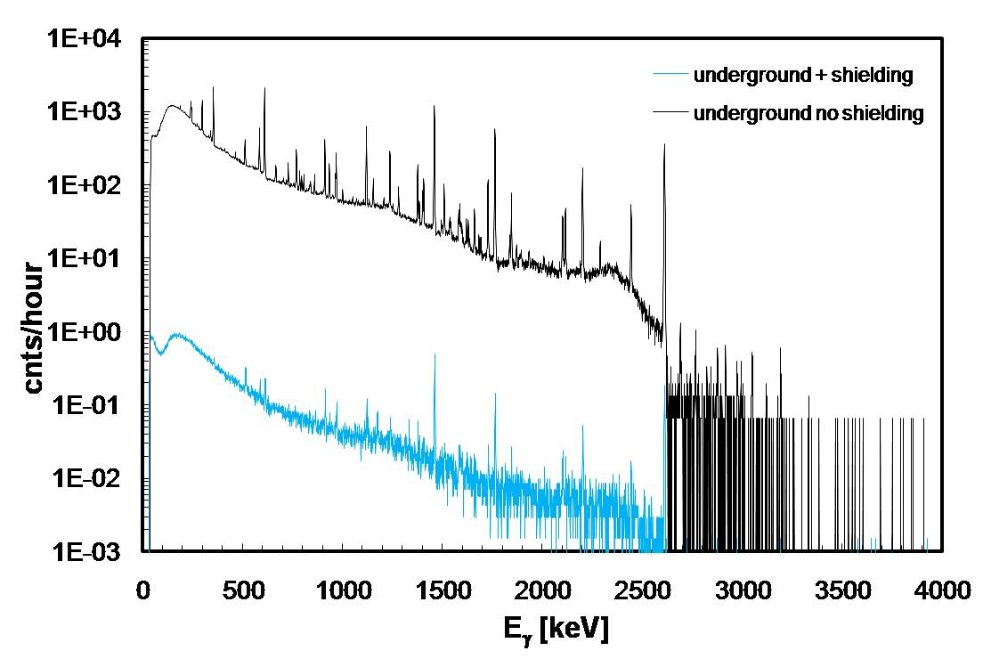
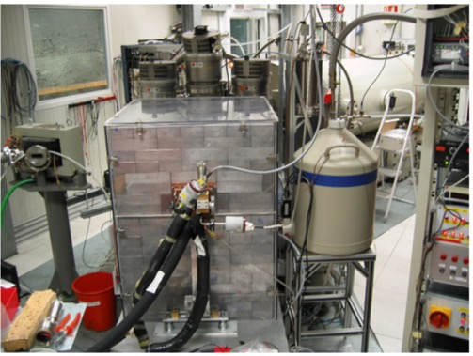
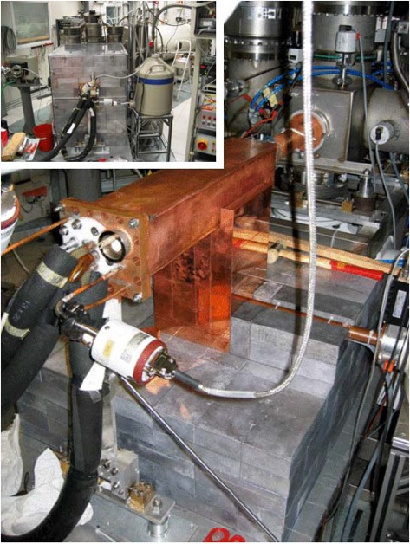
Why going underground: γ-background
Eur. Phys. J. A 39(2009)
3 orders of
magnitude!!!!
25 cm of lead + radon box

Slide 11
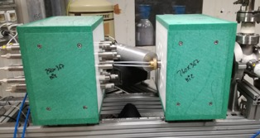
Why going underground: n-background
INTRINSIC: α particles source of intrinsic background from U and Th impurities in the counters’ case
Radiation | LNGS/out
muons neutrons | 10⁻⁶ 10⁻³
Therefore, the advantage of an underground environment is evident for n-source reaction as ¹³C(α,n)¹⁶O, ²²Ne(α,n)²⁵Mg

Slide 12
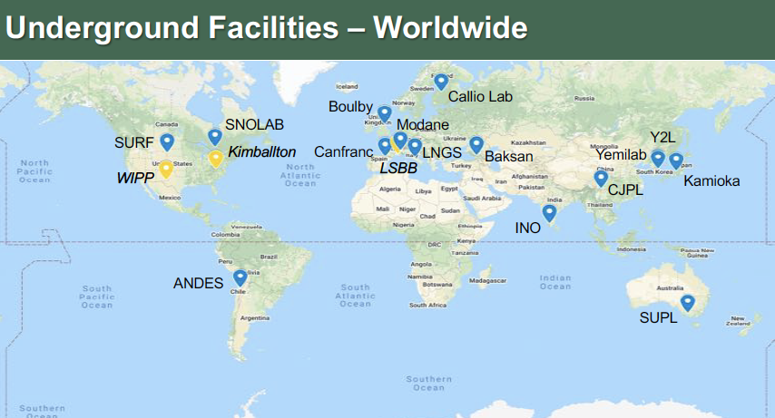
LUNA-LNGS, ITA -> 400 keV and 3.5 MV machines, available beams: H, He⁺, C⁺, C⁺⁺
CASPAR, USA -> 1 MV machine, available beams: H and He⁺
JUNA-CJPL, CHINA -> 400 keV, available beams: H, He⁺, He⁺⁺

Slide 13
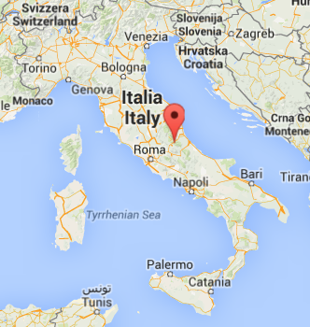
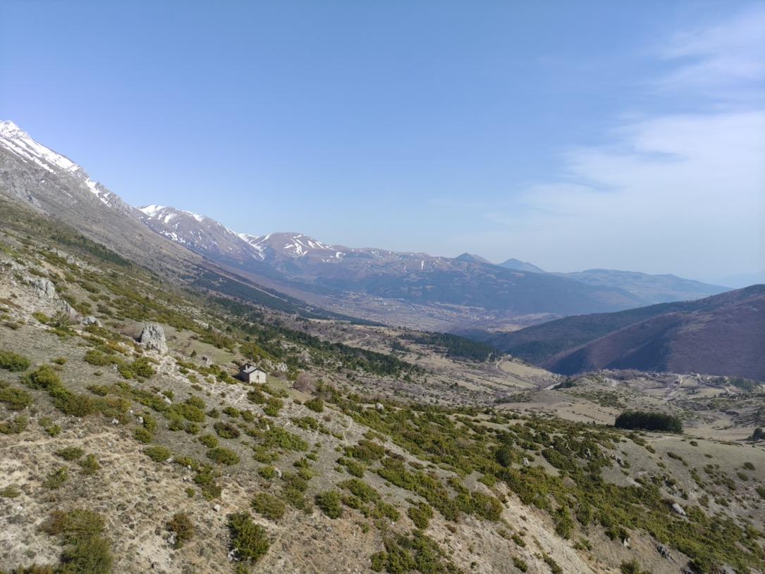
LNGS laboratory
Laboratori Nazionali del Gran Sasso
Notes:
In 20 years he has established the THM as a world renowned approach in NA

Slide 14
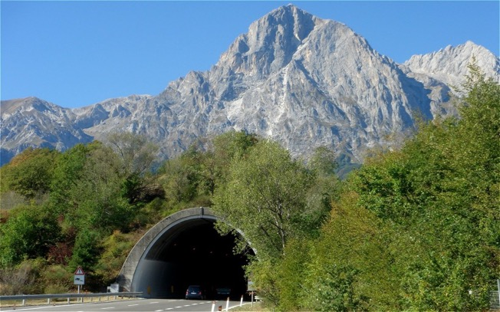
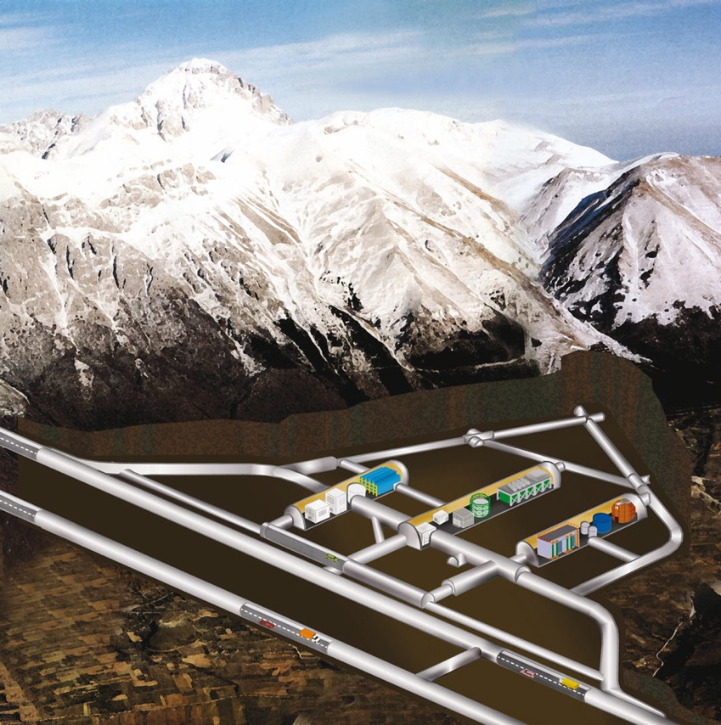
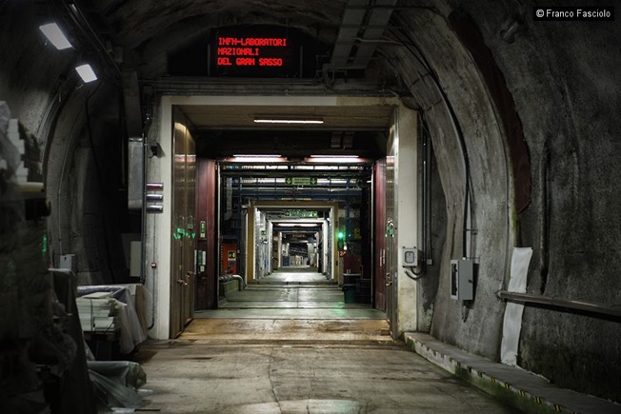
LNGS laboratory
Cosmic ray attenuation: μ → 10⁻⁶
n → 10⁻³
~ 1400 m
(3800 m.w.e.)
Notes:
In 20 years he has established the THM as a world renowned approach in NA

Slide 15
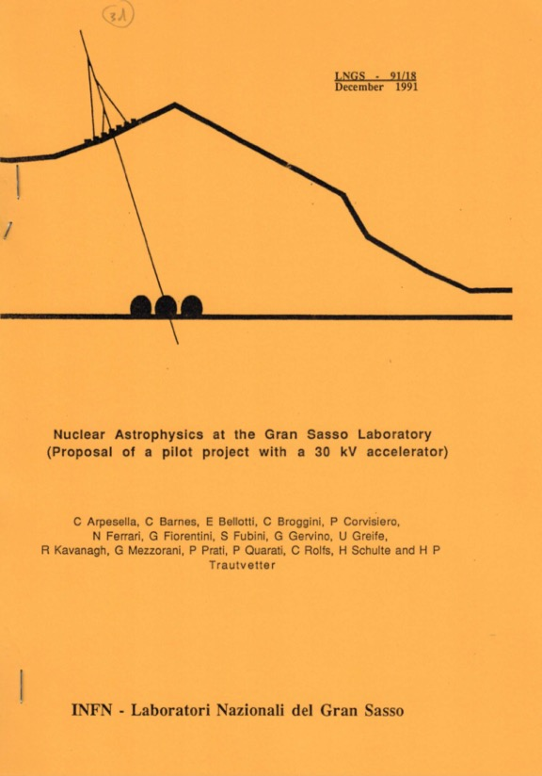

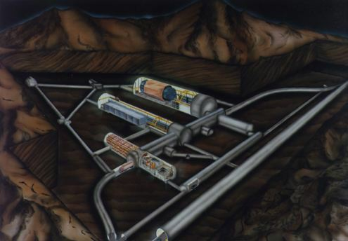
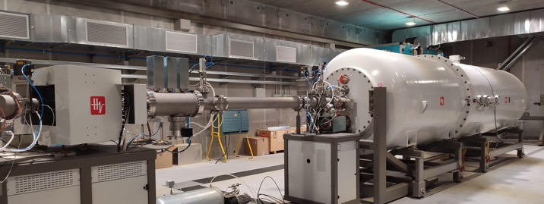
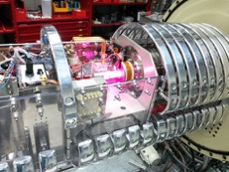
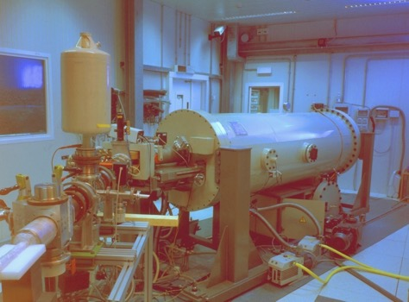
LUNA: a long story of discoveries
LNGS
LUNA-MV – 2022/
LUNA-50 kV
– 1992/00
LUNA-400 kV
– 2000/

Slide 16
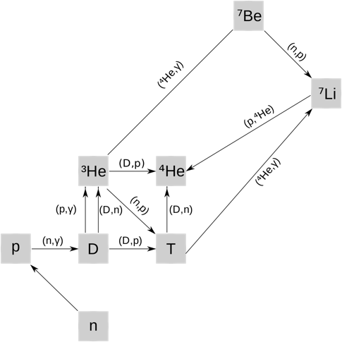
LUNA: a long story of discoveries
pp chain
BBN
Main topics:
Big Bang Nucleosynthesis;
Hydrogen stellar burning;
Solar neutrino;
Age of globular clusters.

Slide 17
LUNA: a long story of discoveries
pp chain
BBN
Main topics:
Big Bang Nucleosynthesis Hydrogen stellar burning;
Solar neutrino;
Age of globular clusters.

Slide 18
LUNA – 400 keV machine
LNGS
Voltage Range :
50 - 400 kV
Output Current:
500 μA
Beam energy spread:
70 eV
LUNA-400 kV
– 2000/

Slide 19
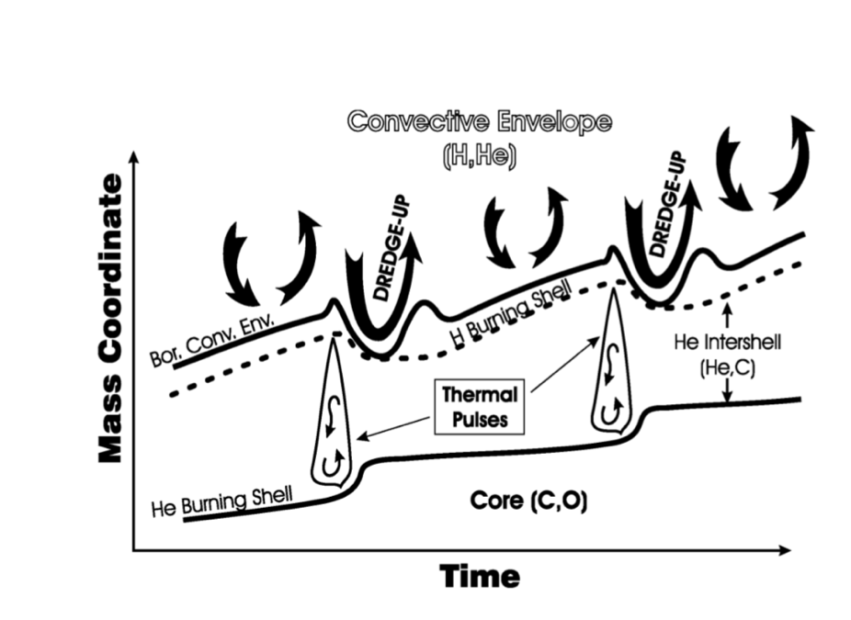
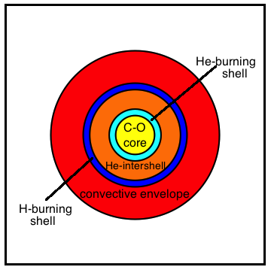
¹³C(α,n)¹⁶O@LUNA400: neutron source for s-process
¹³C(α,n)¹⁶O (Q=2.215 MeV):
    is the main neutron source feeding s-process in low (1-3 M☉) mass TP-AGB stars;
    responsible for nucleosynthesis of half of nuclides heavier than iron;
    average temperature 10⁸ K → Gamow window 140-250 keV.
taken from Straniero et al, Nuclear Physics A 777 (2006)
Notes:
In astrophysics, this reaction is crucial because is the main neutron source feeding the s process, causing the nucleosynthesis of half of nuclides heavier that iron in low mass AGB stars, whose structure is shown in the cartoon below.
13Can takes place subsequently complex convective motions in the He intershell zone of the AGB star in a stellar environment temperature of 10^8 K, that can be transtaled in the Gamow peak between 140 and 250 keV.
In order to improve the stellar models, it is crucial to know the so called reaction rate of the reaction

Slide 20
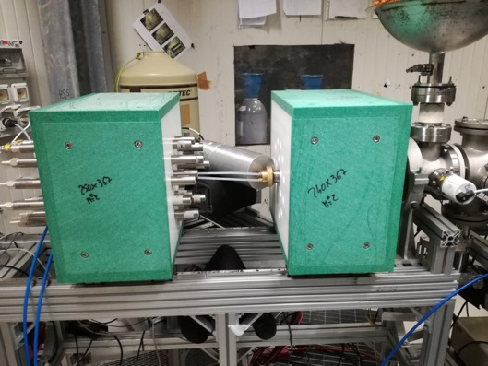
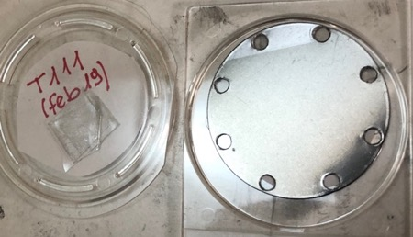
¹³C(α,n)¹⁶O@LUNA400
Detectors:
18 ³He counters embedded in a PE moderator.
120% HPGe
Overall background reduced by 2 orders of magnitude with respect previous direct measurements thanks to:
Underground measurement
material selection (stainless steel case)
Pulse Shape Discrimination
Targets: Evaporated 99% 13C enriched powder on Ta backing.
An innovative target monitoring technique used to check modification under intense alpha beam

Slide 21
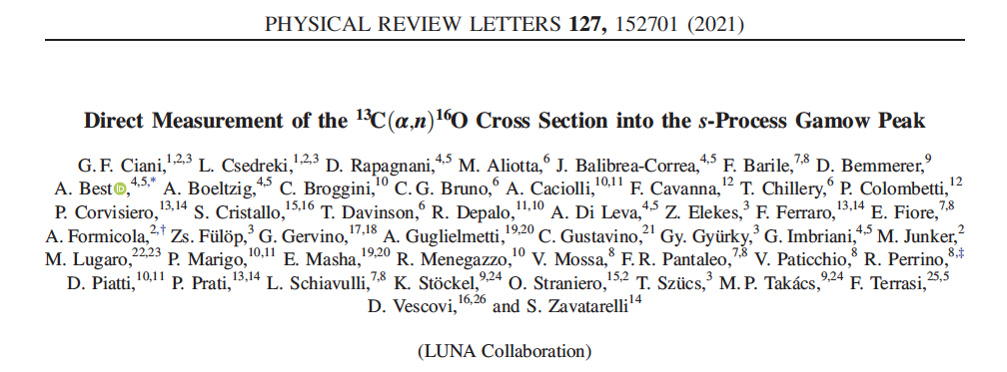
¹³C(α,n)¹⁶O: LUNA results
Data taken in 4 campaigns of 3 months each over about 2 years.
Statistical uncertainty lower than 10 % for our data, overall uncertainty lower than 20%.
Lowest energy data ever achieved and inside the s process Gamow window.

Slide 22
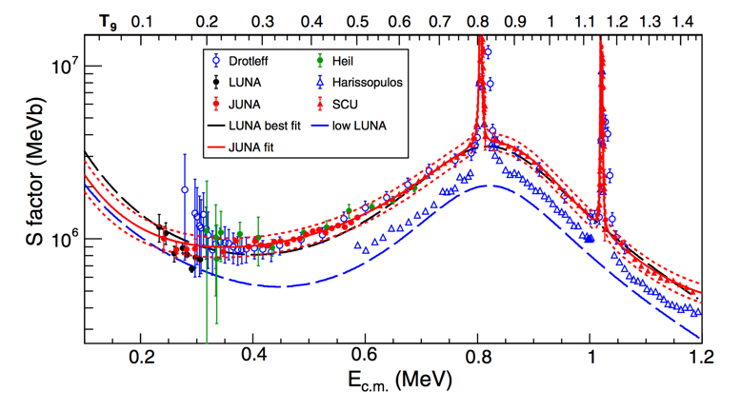
¹³C(α,n)¹⁶O: LUNA results
Main neutron sources during AGB phase
Data taken in 4 campaigns of 3 months each over about 2 years
Statistical uncertainty lower than 10 % for our data, overall uncertainty lower than 20 %.
Lowest energy data ever achieved and inside the s process Gamow window.
JUNA
PHYSICAL REVIEW LETTERS 129, 132701 (2022)

Slide 23
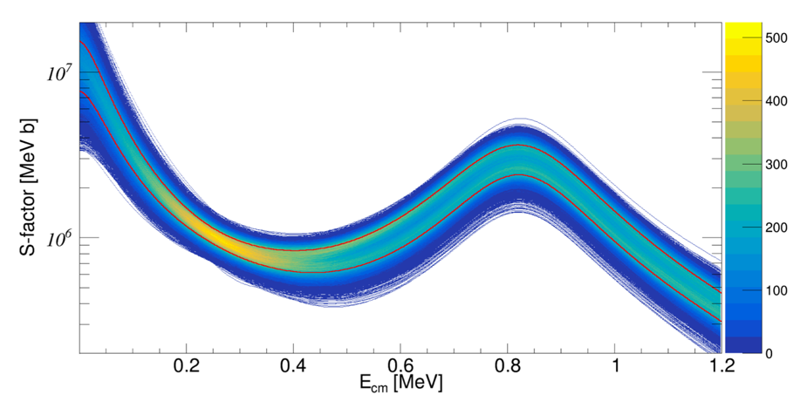
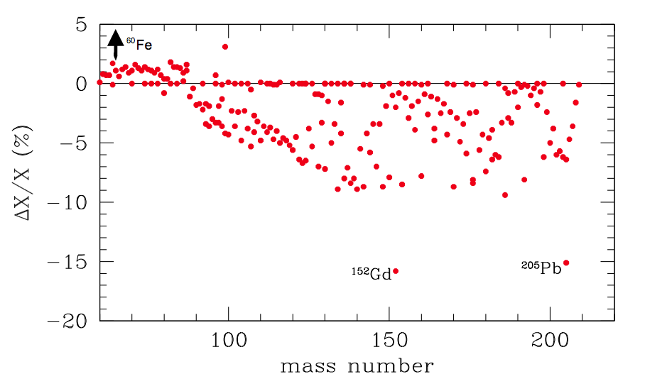
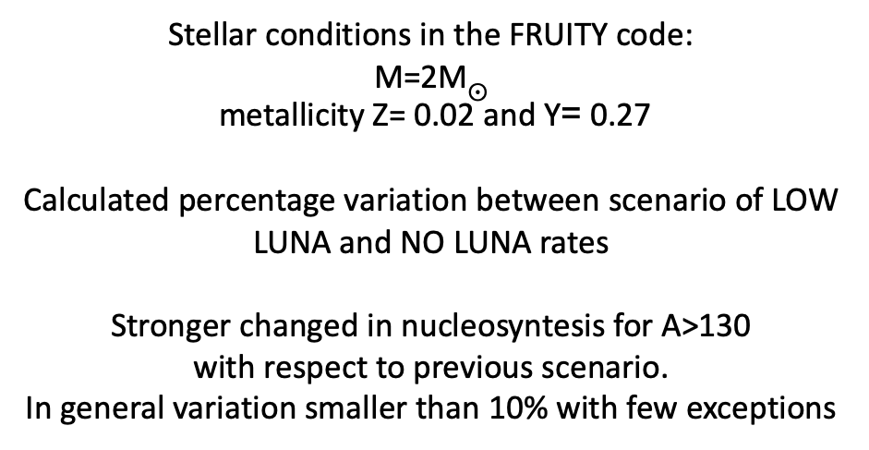
¹³C(α,n)¹⁶O: main neutron souces during AGB
Three reaction rates evaluated
NO LUNA (about +2σ)
LUNA*
LOW LUNA (about -2σ)
Ciani et al, PRL, 127, 152701 (2021)
Stellar conditions in the FRUITY code:
M=2M$⨀$
metallicity Z= 0.02 and Y= 0.27
Calculated percentage variation between scenario of LOW LUNA and NO LUNA rates
Stronger changed in nucleosyntesis for A>130
with respect to previous scenario.
In general variation smaller than 10% with few exceptions
http://141.2.212.122/chanureps/?p=195
Notes:
due to the lower reactin rate, some 13C survives in the inrerpulse and it is burned in the subsequent interpulse at higher temperature (200 MK). This generates a radiative neutron burst with high neutron fulux but lower neutron exposure. This does not change too much the structure of the stellar nucleus but can influence on the variation of some nuclides. Tc99

Slide 24
¹⁷O(p,γ)¹⁸F: CNO H-burning
Footprint of AGB nucleosynthesis and link to other cycles;
65 keV resonance direct measurement;
Expected counting: 0.1 Counts/hour;
Improved passive and active shielding to reduce background at about 5.6 MeV (10 cm of lead + 4 cm of B.P.) and coincidence technique;
BGO detector;
400 C ( equivalent to 2 months of continuous beam operation) and about 100 counts.
Weakest resonance ever directly measured

Slide 25
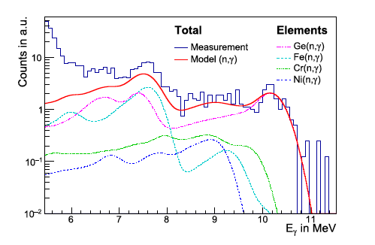
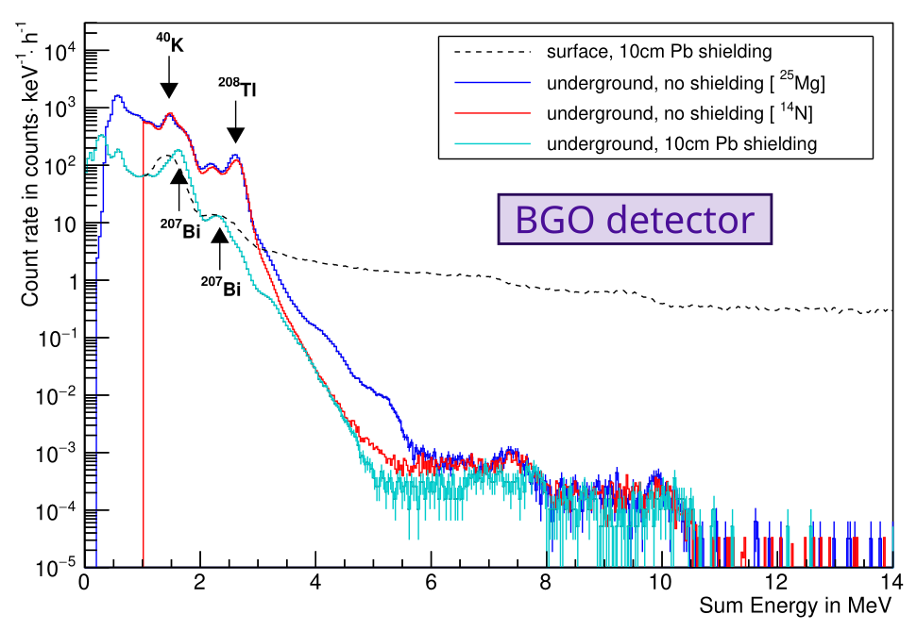
¹⁷O(p,γ)¹⁸F : passive shieldingding
Intrinsic background
Notes:
In 20 years he has established the THM as a world renowned approach in NA

Slide 26
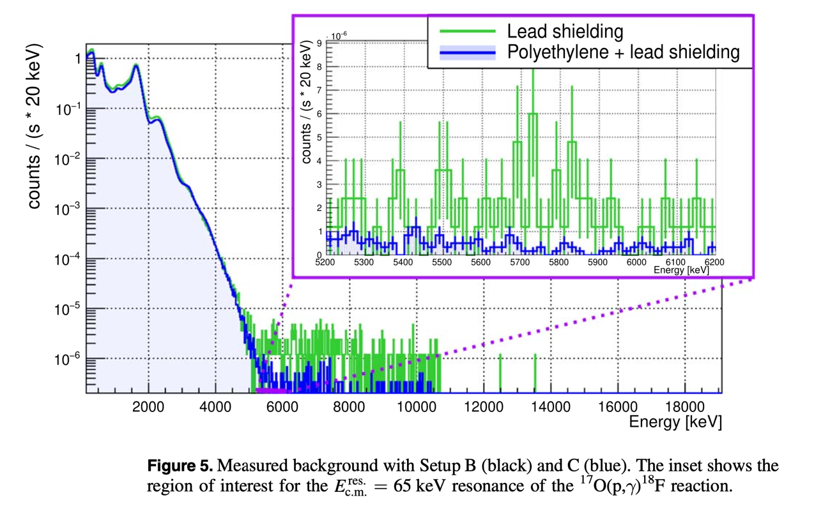
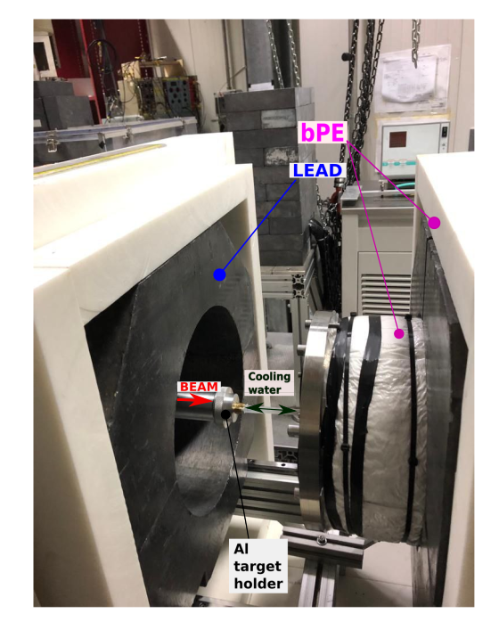
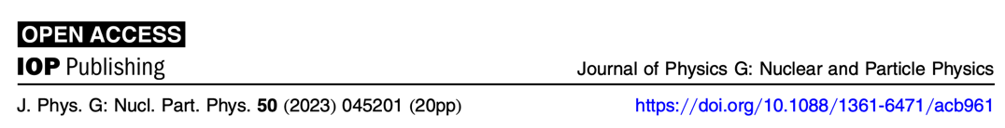
¹⁷O(p,γ)¹⁸F : passive shielding
∽ a factor of 5 of reduction between 5 and 10 MeV.

Slide 27
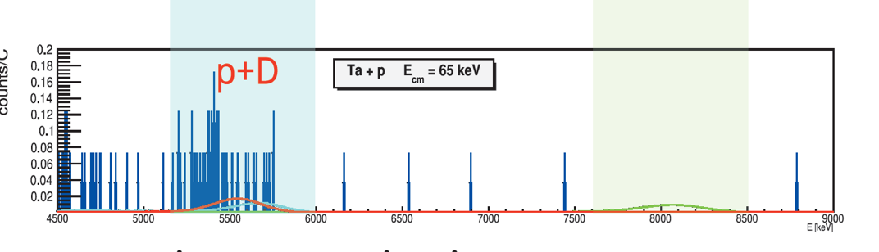
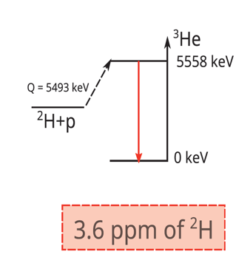
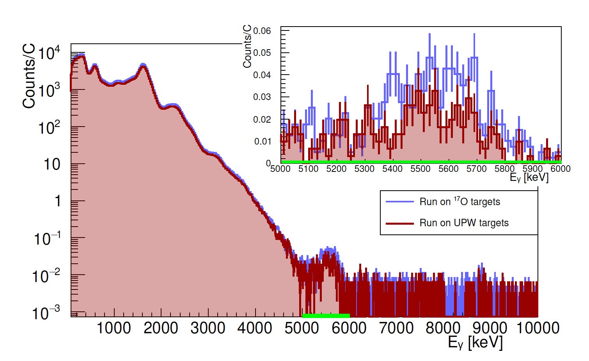
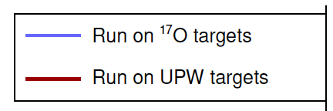
¹⁷O(p,γ)¹⁸F: active shielding
Gesuè et al, submitted to PRL
Comparison between the add-back spectra acquired on 17O and UPW targets.
A peak is visible in the energy region of interest, highlighted in green and shown in the insert in linear scale.

Slide 28
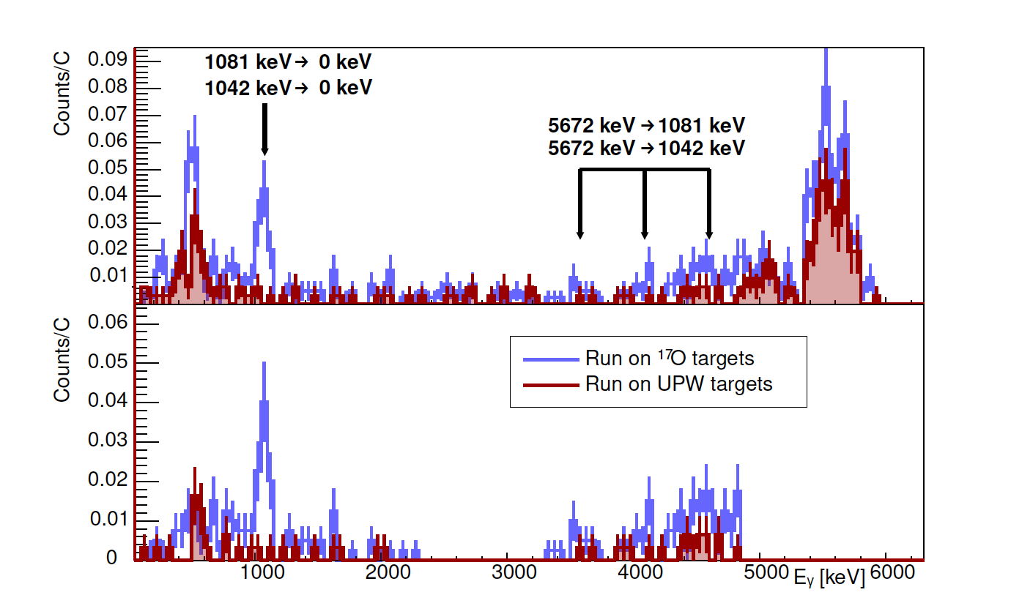
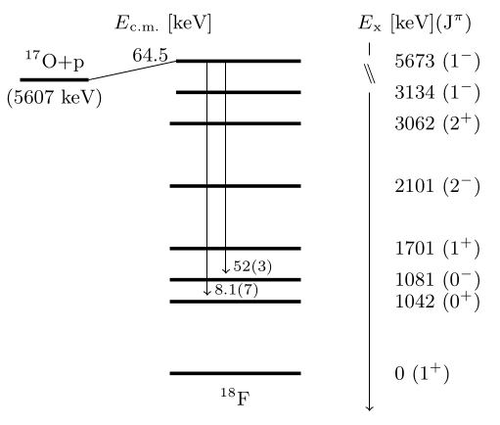
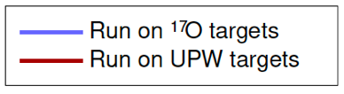
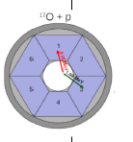
¹⁷O(p,γ)¹⁸F: active shielding (coincidence)
104 counts – 400 C 2 months
40 background – 300 C 2 months
$$Y_{exp}=\left(0.50 ±0.10 stat±0.04sys\right)reactions/C$$
The present resonance strength about a factor of 2 higher than the values in literature, leading to a $Γ_{p}$, in agreement with LUNA result from the (p,α) channel. Such agreement strengthen our understanding of the oxygen isotopic ratios measured in red giant stars and in O-rich presolar grains.

Slide 29







Nuclear Burning in Stars
10
⇒ ⁵⁶Fe Neon, Oxygen, Silicon
Burning
2 ¹²C ⇒ ²⁴Mg Carbon Burning
3 ⁴He ⇒ ¹²C + 8MeV Helium Burning
4 ¹H ⇒ ⁴He + 26MeV Hydrogen Burning
Si-ignition
O-ignition
Ne-ignition
9
C-ignition
log (T_{c})
LUNA MV
He-ignition
8
H-ignition
7
0
2
4
4
6
8
10
log (ρ_{c})

Slide 30
Status of LUNAMV project
LNGS

Slide 31

Avalaible beams:
H, He, C⁺ and C⁺⁺
Competitors:
JUNA, China -> 400 kV machine, available beams: H, He⁺ and He⁺⁺;
CASPAR, USA -> 1 MV machine, available beams: H and He⁺
LNGS is still the unique place where to find an underground carbon beam!

Slide 32
LUNA MV first years scientific proposal
CNO Hydrogen burning, Age of Globular Clusters and C production in AGB:
¹⁴N(p,γ)¹⁵O also for final scientific commissioning the MV accelerator
First experiment
C burning:
¹²C+¹²C fusion Pillar processes
detections of both particles and γ−rays
γ-experiment ready to start
Neutron source:
²²Ne(α,n)²⁵Mg
Data taking will starts next fall

Slide 33


¹²C+ ¹²C motivation
If M_{star}>M_{up}: quiescent Carbon burning→ core-collapse supernovae, neutron stars, stellar mass black holes
If M_{star}<M_{up}: no Carbon burning→ white dwarfs, nova, type Ia supernovae
The reaction produces protons and alphas in a hot environment→ nucleosynthesis in massive stars
O Straniero et al. 2016 J. Phys.: Conf. Ser. 665 012008
(E. Bravo et al, Astronomy & Astrophysics, 535(2011)A1 4)
Carbon burning can trigger Superburst events

Slide 34


The ¹²C+¹²C state of the art
Gamow peak
¹²C+¹²C→ ²⁰Ne + α Q = 4.62 MeV ¹²C+¹²C→ ²³Na + p Q = 2.24 MeV
¹²C+¹²C→ ²⁴Mg + n Q = 2.24 MeV
Several datasets and models
Direct measurements above 2.1 MeV (large uncertainties)
Only indirect measurements below 2.1 MeV (problems with normalization and other discrepancies)
Very large uncertainty below 2.5 MeV
Presence of several states at low energies

Slide 35

The ¹²C+¹²C possible cluster states
subset of the excited 24Mg 0⁺
states that are strongly
populated by ²⁴Mg(α,α’)²⁴Mg
Possible analogy between the Hoyle state in ¹²C as the driver of 3α fusion and
candidate cluster states in ²⁴Mg as fusion

Slide 36


The ¹²C+¹²C potential model
standard potential model
hindrance potential model
Different potential models lead to different ways to extrapolate the low energy cross section (S-factor).
The only way to distinguish is to measure below 2 MeV.

Slide 37
The ¹²C+¹²C reactions@LUNAMV
¹²C+¹²C→ ²⁰Ne + a Q = 4.62 MeV
γ-rays and α particles energies for excited states for ¹²C(¹²C, α)²⁰Ne (Q = 4.617 MeV)
E_{X} (MeV) | J^{p} | Main γ transitions (MeV) |  | ID | E_{α−max} (MeV) (E^{CM} = 2 MeV)
0.0 | 0⁺ |  |  | α₀ | 8.6
1.63 | 2⁺ | 1.63 → 0 1.63 |  | α₁ | 6.8
4.24 | 4⁺ | 4.24 → 1.63 2.61 |  | α₂ | 3.9
4.96 | 2⁻ | 4.96 → 1.63 3.33 |  | α₃ | 3.1
5.62 | 3⁻ | 5.62 → 1.63 3.98 |  | α₄ | 2.2
5.78 | 1⁻ | 5.78 → 1.63 4.15 | 5.78 → 0 5.78 | α₅ | 2.0

Slide 38
The ¹²C+¹²C reactions@LUNAMV
¹²C+¹²C→ ²³Na + p Q = 2.24 MeV
γ-rays and p particles energies for excited states for ¹²C(¹²C, p)²³Na (Q = 2.241 MeV)
E_{X} (MeV) | J^{p} | Main γ transitions (MeV) |  | ID | E_{p-max} (MeV) (E^{CM} = 2 MeV)
0.0 | 3/2⁺ |  |  | p₀ | 5.3
0.44 | 5/2⁺ | 0.44 → 0 0.44 |  | p₁ | 4.8
2.07 | 7/2⁺ | 2.07 → 0.44 1.63 |  | p₂ | 3
2.39 | 1/2⁺ | 2.39 → 0.44 1.95 | 2.39 → 0 2.39 | p₃ | 2.6
2.64 | 1/2⁻ | 2.64 → 0 2.64 |  | p₄ | 2.3
2.70 | 9/2⁺ | 2.70 → 2.07 0.62 | 2.70 → 0.44 2.26 | p₅ | 2.3
2.98 | 3/2⁺ | 2.98 → 0.44 2.54 | 2.98 → 0 2.98 | p₆ | 1.9

Slide 39
The ¹²C+¹²C study via γ detection
¹²C+¹²C→ ²⁰Ne + α Q = 4.62 MeV
γ-rays and α particles energies for excited states for ¹²C(¹²C, α)²⁰Ne (Q = 4.617 MeV)
E_{X} (MeV) | J^{p} | Main γ transitions (MeV) |  | ID | E_{α−max} (MeV) (E^{CM} = 2 MeV)
0.0 | 0⁺ |  |  | α₀ | 8.6
1.63 | 2⁺ | 1.63 → 0 1.63 |  | α₁ | 6.8
E_{γ}=0.44 MeV
¹²C+¹²C→ ²³Na + p Q = 2.24 MeV
E_{γ}=1.63 MeV
g-rays and p particles energies for excited states for ¹²C(¹²C, p)²³Na (Q = 2.241 MeV)
E_{X} (MeV) | J^{p} | Main g transitions (MeV) |  | ID | E_{p-max} (MeV) (E^{CM} = 2 MeV)
0.0 | 3/2⁺ |  |  | p₀ | 5.3
0.44 | 5/2⁺ | 0.44 → 0 0.44 |  | p₁ | 4.8

Slide 40


Underground shielding
Spillane et al. PRL 2009
More than 4 OoM less background compared with Spillane et al.
Massive shielding very effective underground:
we will detect the structures below E_{cm} = 2.5 MeV and presence of hindrance !!!!

Slide 41

LUNA collaboration
Laboratori Nazionali del Gran Sasso, INFN, ASSERGI, Italy/*GSSI, L'AQUILA, Italy
T. Chillery, A. Compagnucci, F. Ferraro, R. Gesué, and M. Junker
Università degli Studi di Bari and INFN, BARI, Italy
G.F. Ciani V. Paticchio, L. Schiavulli
Università degli Studi di Genova and INFN, GENOVA, Italy
P. Corvisiero, P. Prati, S. Zavatarelli
Università degli Studi di Milano and INFN, MILANO, Italy
R. Depalo, A. Guglielmetti,
Università degli Studi di Napoli ”Federico II” and INFN, NAPOLI, Italy
C. Annana, A. Best, A. Di Leva, G. Imbriani, D. Mercogliano, D. Rapagnani
Università degli Studi di Padova and INFN, PADOVA, Italy
C. Broggini, A. Caciolli, P. Marigo, R. Menegazzo, D. Piatti, J. Skowronski, K. Stöckel
INFN Roma, ROMA, Italy
C. Gustavino, A. Formicola
Osservatorio Astronomico di Collurania, TERAMO and INFN LNGS, Italy
O. Straniero
Università di Torino and INFN, TORINO, Italy
F. Cavanna, G. Gervino, P. Colombetti
Konkoly Observatory, Hungarian Academy of Sciences, BUDAPEST, Hungary
M. Lugaro
Institute of Nuclear Research (ATOMKI), DEBRECEN, Hungary
L. Csedreki, Z. Elekes, Zs. Fülöp, Gy. Gyürky, T. Szücs
Helmholtz-Zentrum Dresden-Rossendorf, DRESDEN, Germany
A. Boeltzig, D. Bemmerer, E. Masha,, M. Takács
University of Edinburgh, EDINBURGH, United Kingdom
M. Aliotta, L. Barbieri, C.G. Bruno, T. Chillery, T. Davinson

Slide 43
Background signals
A(b,γ)C
The main problem of direct measurements is determined by the background signals, which, together with the low cross sections, set a limit to the energy range that can be investigated with a simple setup on the Earth surface.
Three are the main sources of background:
  environmental radioactivity ;
  cosmic rays;
  beam-target induced nuclear reactions.
Each of these sources produces background of different nature and energy, so that each reaction to be studied deserves a special care in suppressing the relevant background component.

Slide 44




Coincidence γγ + passive shielding
resonance at 227 keV in ²⁶Mg(p,γ)²⁷Al, 1μA
singles, no
shielding
LENA - experiment
singles, shielding
Intensity
coincidences, no shielding
Longland et al.,
Nucl. Instr. Meth.
A 566, 452 (2006)
γ-ray energy (keV)
Background reduction:
up to 3000 for 0.6 < E_{γ}(MeV) < 3 and 20 for 3 < E_{γ}(MeV) < 9
Strong reduction of the efficiency!!
Notes:
γγ-coincidence methods [28] could lead to a significantly higher suppression factor at the Earth’s surface compared with standard active and passive shielding, but these methods are always coupled to particular nuclear reactions and lead to a reduced detection efficiency. These techniques
reduced background count rates in the regions of Eg . 0:6–3:0 and 3.0–9.0MeV with respect to unshielded singles count rates by factors
of 3600 and 21, respectively.

