Slide 1
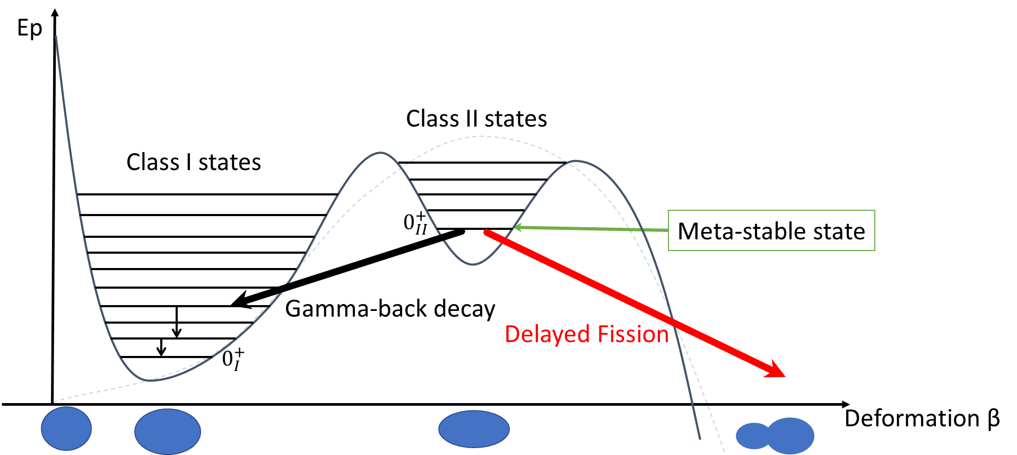

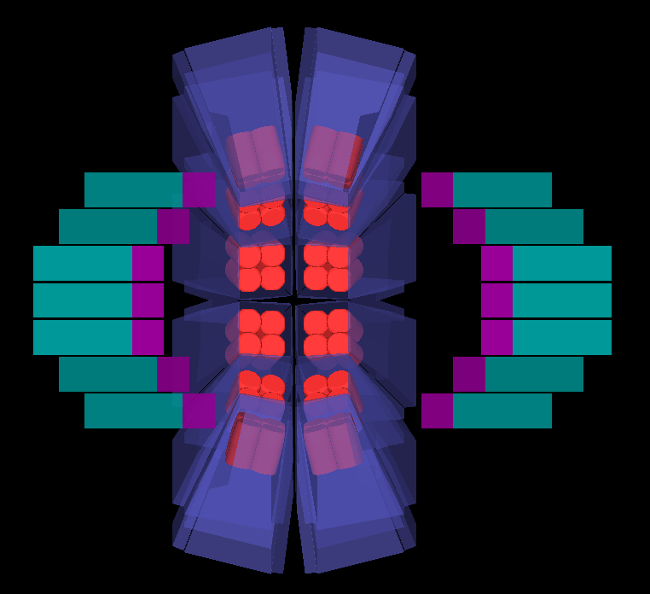

Oslo IX Workshop on Level Density , Gamma Strength 29.06.2024 Corentin Hiver
Study of shape isomer back-decay in actinides
using Nuball2 spectrometer

Slide 2




1. Introduction
Ep
E_{b}
DEFORMATION
EXCITATION
g.s.
Deformation β

Slide 3

1. Introduction
Ep
DEFORMATION -> FISSION
E_{b}
Saddle point
EXCITATION
Spontaneous fission
g.s.
Deformation β

Slide 4

1. Introduction : Fission
Rare phenomenon : fission isomerism

Slide 5

1. Introduction : Fission
Rare phenomenon : fission isomerism

Slide 6
1. Introduction : Fission
Extremely rare phenomenon : gamma back-decay

Slide 7



1. Introduction : Fission
Extremely rare phenomenon : gamma back-decay
$$γ$$

Slide 8
1. Introduction
Liquid drop model
Ep
E_{b}
Deformation β

Slide 9
1. Introduction
Liquid drop model
+
Shell model correction
Ep
a
Axis ratio 2:1
a = 1
b = 2
b
E_{B}
E_{b}
E_{A}
Deformation β
1:1
1,3:1
2:1

Slide 10

1. Introduction
Ep
Super-deformed shape isomer
E_{B}
E_{b}
E_{A}
0⁺_{g.s. II}
$$ΔE ≈2−4 MeV$$
0⁺_{g.s. I}
Deformation β
1:1
1,3:1
2:1

Slide 11


1. Introduction
Ep
Super-deformed shape isomer
E_{B}
E_{b}
E_{A}
0⁺_{g.s. II}
$$τ ≈ 10ns − 10ms$$
$$Delayed fission$$
0⁺_{g.s. I}
Deformation β
1:1
1,3:1
2:1

Slide 12

1. Introduction
Ep
Super-deformed shape isomer
E_{B}
E_{b}
E_{A}
0⁺_{g.s. II}
$$τ ≈ 10ns − 10ms$$
$$γ back−decay$$
$$Delayed fission$$
0⁺_{g.s. I}
Deformation β
1:1
1,3:1
2:1

Slide 13
1. Introduction
Ep
Why study actinides shape isomers ?
Fission studies focus on post-scission
« Blind » to the actual path
E_{B}
E_{b}
E_{A}
Shape isomers are the only direct probe of barrier penetrability
0⁺_{g.s. II}
$$τ ≈ 10ns − 10ms$$
$$γ back−decay$$
$$Delayed fission$$
0⁺_{g.s. I}
Deformation β
1:1
1,3:1
2:1

Slide 14
1. Introduction
Delayed fission
Competing fission/ γ
Terra incognita
Delayed γ decay
Theoritical !
N

Slide 15
1. Introduction
Delayed fission
Competing fission/ γ
Terra incognita
Delayed γ decay
Back-decay is extremely challenging experimentally !
Theoritical !
N

Slide 16
1. Introduction
Delayed fission
J. Schirmer, J. Gerl, D. Habs and D. Schwalm, Phys. Rev. Lett. 63 (1989) 2196 .
Competing fission/ γ
Terra incognita
Delayed γ decay
Back-decay is extremely challenging
experimentally !
Theoritical !
N

Slide 17
1. Introduction
Motivations :
Explore in greater details the gamma back-decay of ²³⁶U
Perform spectroscopy in the second minimum with prompt-delayed coincidences
First steps of high resolution spectroscopy of back-decay in this « Terra incognita »

Slide 18
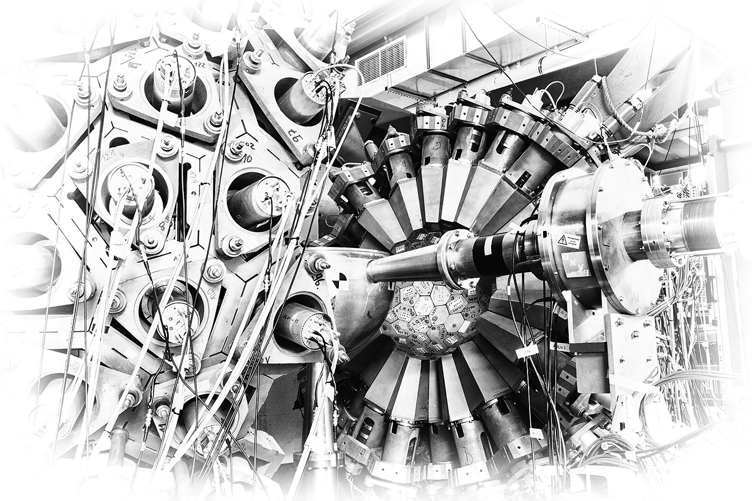

2. Crystal ball experiment : The unambiguous detection
$${}_{92}^{235}U(d,p){}_{90}^{236f}U$$
Missing energy
VS
delayed energy
J. Schirmer, J. Gerl, D. Habs and D. Schwalm, Phys. Rev. Lett. 63 (1989) 2196 .
Darmstadt 4π NaI crystal ball :
60% total energy efficiency calorimeter

Slide 19
2. Crystal ball experiment : The unambiguous detection
Ep
Sn
E_{B}
E_{b}
E_{A}
0⁺_{g.s. II}
0⁺_{g.s. I}
1:1
1,3:1
2:1

Slide 20

2. Crystal ball experiment : The unambiguous detection
Input energy :
E_{beam}+Q_{(d,p)}
$${}_{92}^{235}U(d,p){}_{90}^{236f}U$$
Ep
Sn
E_{B}
E_{b}
E_{b}
E_{A}
0⁺_{g.s. II}
0⁺_{g.s. I}
1:1
1,3:1
2:1

Slide 21
2. Crystal ball experiment : The unambiguous detection
Input energy :
E_{beam}+Q_{(d,p)}
E_{proton}
Ep
Fission
Sn
n
E_{B}
E_{b}
E_{A}
Excitation energy
0⁺_{g.s. II}
0⁺_{g.s. I}
1:1
1,3:1
2:1

Slide 22
2. Crystal ball experiment : The unambiguous detection
Input energy :
E_{beam}+Q_{(d,p)}
Ep
E_{proton}
Sn
Fission
E_{B}
E_{b}
E_{b}
E_{A}
Excitation energy
0⁺_{g.s. II}
0⁺_{g.s. I}
1:1
1,3:1
2:1

Slide 23
2. Crystal ball experiment : The unambiguous detection
Input energy :
E_{beam}+Q_{(d,p)}
Ep
Sn
E_{proton}
E_{B}
E_{b}
E_{b}
E_{A}
0⁺_{g.s. II}
Excitation energy
0⁺_{g.s. I}
1:1
1,3:1
2:1

Slide 24
2. Crystal ball experiment : The unambiguous detection
Input energy :
E_{beam}+Q_{(d,p)}
Ep
E_{proton}
Sn
E_{B}
Excitation range
for fission isomer
E_{b}
E_{b}
E_{A}
0⁺_{g.s. II}
0⁺_{g.s. I}
1:1
1,3:1
2:1

Slide 25

2. Crystal ball experiment : The unambiguous detection
Input energy :
E_{beam}+Q_{(d,p)}
Ep
E_{proton}
Sn
E_{B}
Excitation range
for fission isomer
E_{b}
E_{b}
E_{A}
$$\text{Prompt} \text{electromagnetic} \text{decay}$$
0⁺_{g.s. II}
0⁺_{g.s. I}
1:1
1,3:1
2:1

Slide 26



2. Crystal ball experiment : The unambiguous detection
Input energy :
E_{beam}+Q_{(d,p)}
Ep
E_{proton}
Sn
E_{B}
Excitation range
for fission isomer
E_{b}
E_{b}
E_{A}
$$\text{Prompt} \text{electromagnetic} \text{decay}$$
0⁺_{g.s. II}
$$τ ≈ 100 ns$$
$$γ back−decay$$
$$(Delayed fission)$$
0⁺_{g.s. I}
1:1
1,3:1
2:1

Slide 27





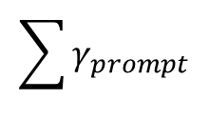



2. Crystal ball experiment : The unambiguous detection
Input energy :
E_{beam}+Q_{(d,p)}
$$Energy balance :$$
Ep
$$E_{proton}$$
Sn
$$E_{prompt}$$
E_{B}
Excitation range
for fission isomer
E_{b}
E_{b}
E_{A}
$$\sum{γ_{prompt}}$$
0⁺_{g.s. II}
$$E_{missing}$$
$$τ ≈ 100 ns$$
$$=E_{in}−E_{prompt}$$
$$γ back−decay$$
$$(Delayed fission)$$
0⁺_{g.s. I}
1:1
1,3:1
2:1

Slide 28

2. Crystal ball experiment : The unambiguous detection
Input energy :
E_{beam}+Q_{(d,p)}
$$Energy balance :$$
Ep
$$E_{proton}$$
Sn
$$E_{prompt}$$
E_{B}
Excitation range
for fission isomer
E_{b}
E_{b}
E_{A}
$$\sum{γ_{prompt}}$$
0⁺_{g.s. II}
$$E_{missing}$$
$$τ ≈ 100 ns$$
$$=E_{in}−E_{prompt}$$
$$γ back−decay$$
$$(Delayed fission)$$
$${=E}_{delayed}$$
0⁺_{g.s. I}
1:1
1,3:1
2:1

Slide 29
2. Crystal ball experiment : The unambiguous detection
Pulsation system : 25ns wide beam pulse, 280 ns between pulses
280 ns
280 ns
280 ns
25 ns
25 ns
25 ns
25 ns
t (ns)

Slide 30
2. Crystal ball experiment : The unambiguous detection
Pulsation system : 25ns wide beam pulse, 280 ns between pulses
280 ns
280 ns
280 ns
Prompt
25 ns
Mostly neutrons
25 ns
25 ns
25 ns
Delayed
t (ns)

Slide 31
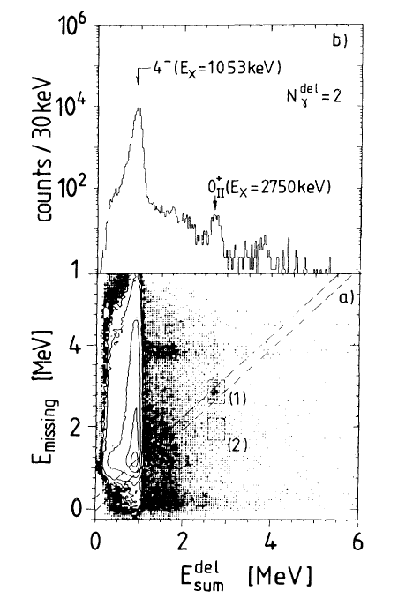
2. Crystal ball experiment : The unambiguous detection
J. Schirmer, J. Gerl, D. Habs, and D. Schwalm (1898)
40 citations

Slide 32
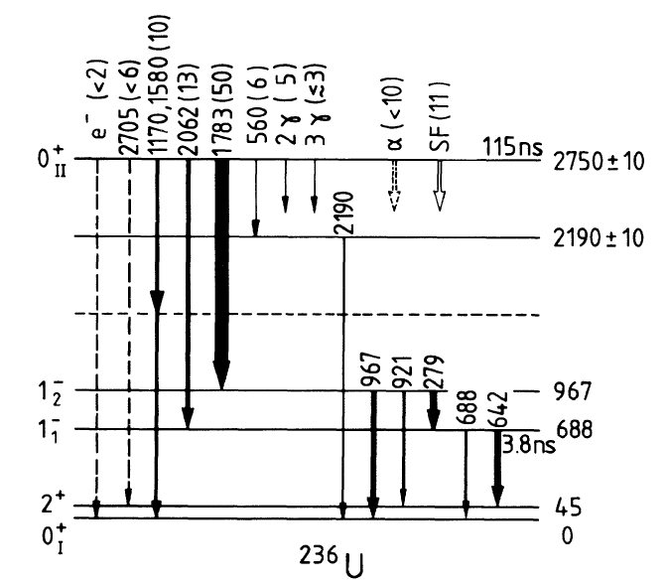
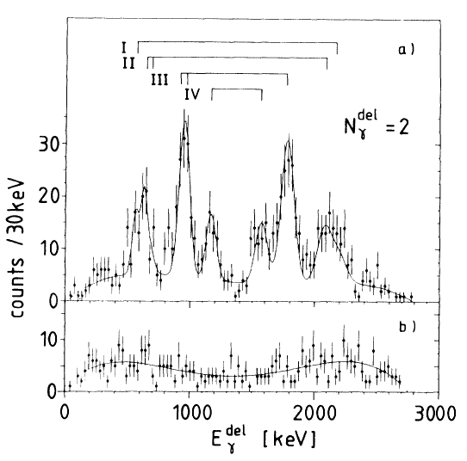
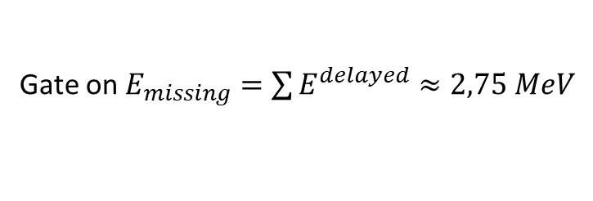
2. Crystal ball experiment : The unambiguous detection
Gate on $E_{missing}=\sum{E^{delayed}}≈2,75 MeV$
J. Schirmer, J. Gerl, D. Habs, and D. Schwalm (1989)
40 citations

Slide 33
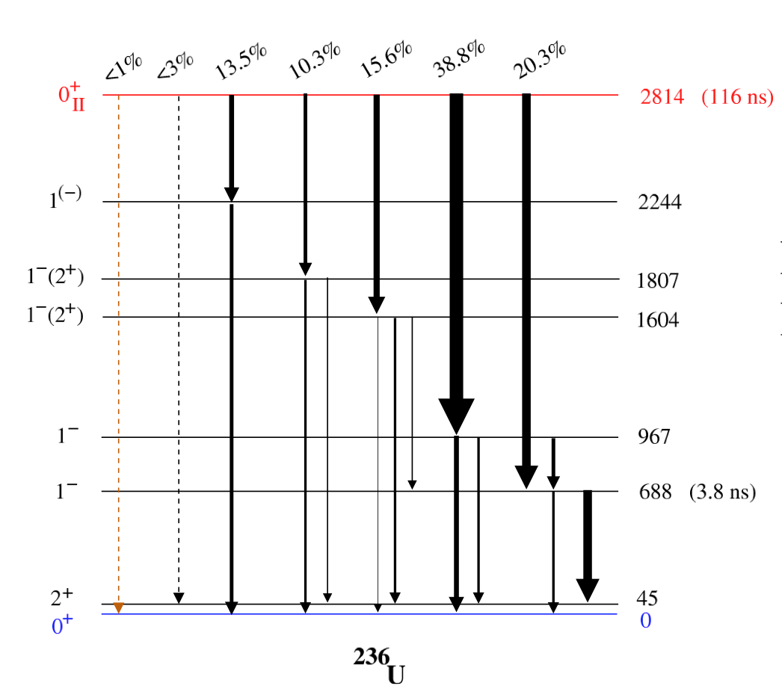
2. Crystal ball experiment : The unambiguous detection
Later remeasurement by P. Reiter, Published in
TPG. Thirolj D. Habs / Prog. Part. Nucl. Phys. 49 (2002) 325-402
125 citations
1843
2125
279
942
688
642
966

Slide 34
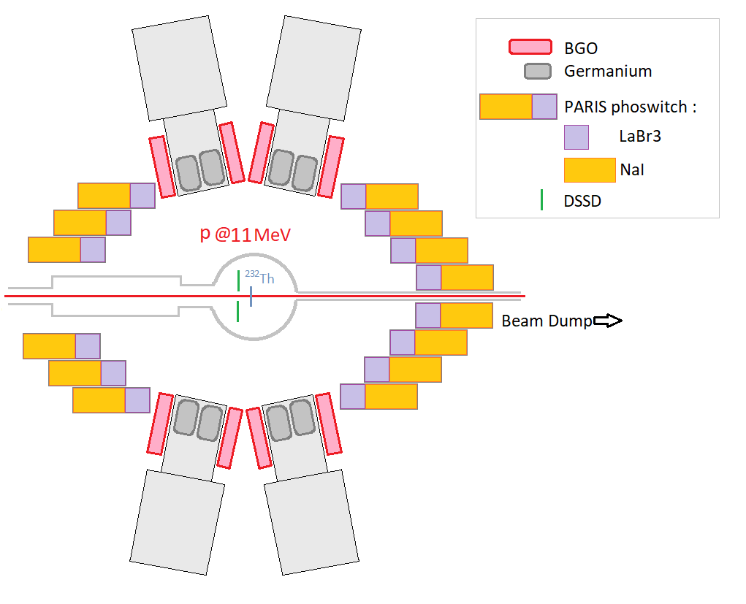

3. 2023, Orsay : High precision spectroscopy with Nuball2
Setup :
24 Ge clovers + BGO, 64 PARIS phoswhich + DSSD
> 300 independent digital channels (FASTER system)
$$γ$$
d
Advantages :
Much better energy resolution (HPGe)
Better beam pulsation (2ns wide pulse vs 25 ns)
Segmented Si DSSD (16 rings, 32 sectors)
-> 10 kHz particle detection rate vs 800 Hz
Triggerless DAQ -> Great flexibility in data analysis
Disadvantages :
Calorimetry full energy efficiency 30% vs 60%
Proton punch through in DSSD
$$γ$$
Beam dump
(Pb)
p
$$γ$$

Slide 35
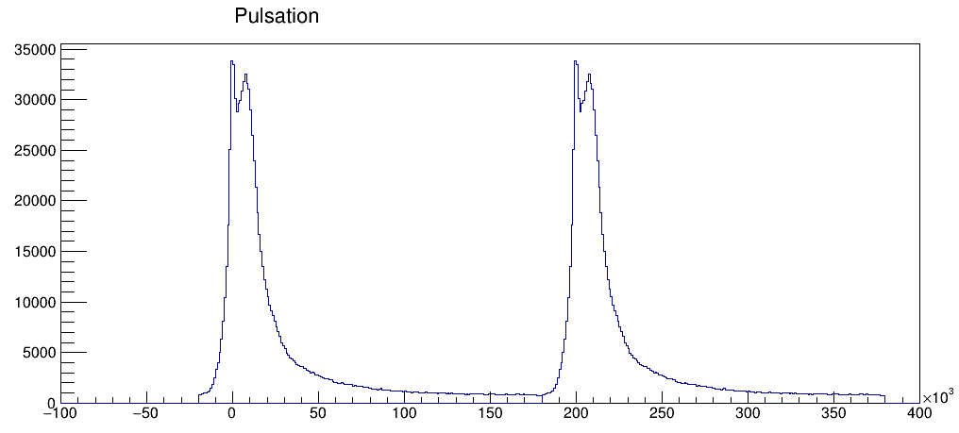
3. 2023, Orsay : High precision spectroscopy with Nuball2
200 ns pulsed beam
Prompt
Mostly neutrons
Delayed
[ns]

Slide 36

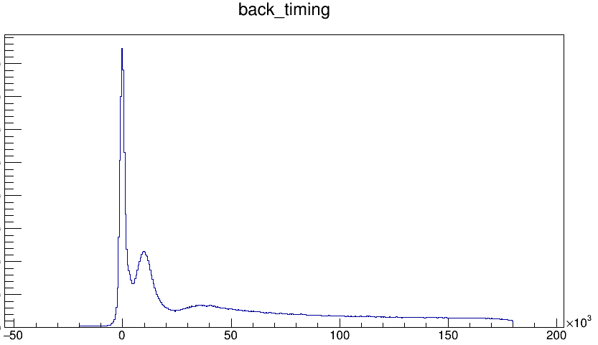
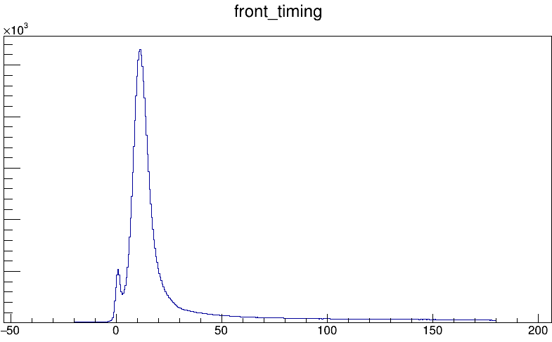
3. 2023, Orsay : High precision spectroscopy with Nuball2
Backward angles
neutrons
Gamma
prompts
Forward angles
Very large forward neutron cone from d beam breakup
Deuteron breakup
Paris Front swarmed by neutrons

Slide 37
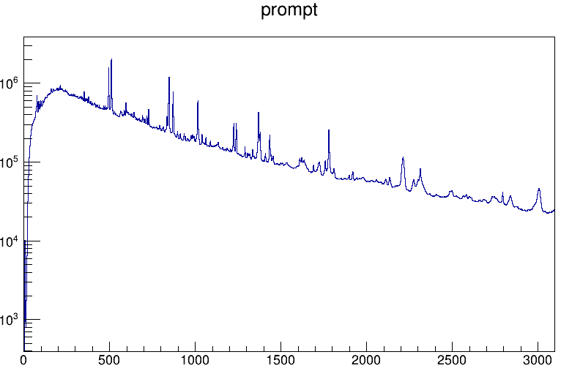
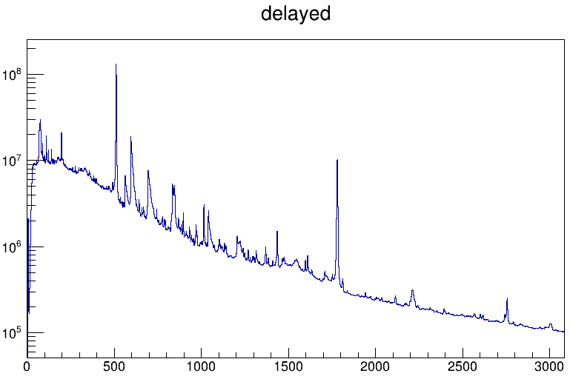
3. 2023, Orsay : High precision spectroscopy with Nuball2
Other open channels (e.g. 235U(d,n))
Transfer induced prompt fission
Beta decay of fission products
Target impurities (e.g. oxygen, aluminium)
Inelastic neutron scattering, capture (break-up of d beam)
Notes:
Spectres hyper complexes : types de réactions parasites. Réactions que l’on cherche ° fission + (d,p) sur contaminants + neutrons sur détecteurs+structure

Slide 38
3. 2023, Orsay : High precision spectroscopy with Nuball2
843 ²⁷Al (d,d’)
511
1014 ²⁸Al : ²⁷Al (d,p)
595 ⁷⁴Ge(n,n’γ)
511
728 ¹⁴N : ¹⁶O(d,α)
1224 ⁵⁷Co : ⁵⁶Fe (d,n)
1238 ²⁸Al (d,p)
1779 ²⁸Si : ²⁷Al (d,p)
X rays
595 ⁷⁴Ge(n,n’γ)
1779 ²⁸Si β⁻ decay
1621 ²⁸Si : ²⁷Al (d,p)
2212 ²⁷Al (d,d’)
1436 ¹³⁶Xe
700 ⁷²Ge(n,n’γ)
2312 ¹⁴N : ¹⁶O(d,α)
2486 ²⁸Al : ²⁷Al (d,p)
2837 ²⁸Si : ²⁷Al (d,p)
834 ⁷²Ge(n,n’γ)
3006 ²⁷Al (d,d’)
2734 ²⁷Al (d,d’)
1013 ²⁷Al(n,n’γ)
1204 ⁷⁴Ge(n,n’γ)
870 ¹⁷O : ¹⁶O (d,p)
1436 ¹³⁸Ba
1379 ²⁵Mg : ²⁷Al(d,α)
1432 ¹⁴²Ce
2212 ²⁷Al(n,n’γ)
2750 ²⁴Mg β⁻ decay
1792 ²⁵Mg : ²⁷Al(d,α)
846 ⁵⁶Fe(n,n’γ)
1039 Al(n,n’γ)
1610 ²⁰⁹Bi
Notes:
Spectres hyper complexes : types de réactions parasites. Réactions que l’on cherche ° fission + (d,p) sur contaminants + neutrons sur détecteurs+structure

Slide 39
3. 2023, Orsay : High precision spectroscopy with Nuball2
Very complex spectra :
many reaction channels open
not pure target (Oxyde, aluminum backing)
neutron scattering on structure
Identified prompt cascades :
Identified delayed cascades :
And those are only the prominant lines !
Notes:
Spectres hyper complexes : types de réactions parasites. Réactions que l’on cherche ° fission + (d,p) sur contaminants + neutrons sur détecteurs+structure

Slide 40
3. 2023, Orsay : High precision spectroscopy with Nuball2
Very complex spectra :
many reaction channels open
not pure target (Oxyde, aluminum backing)
neutron scattering on structure
Identified prompt cascades :
Identified delayed cascades :
And those are only the prominant lines !

Slide 41
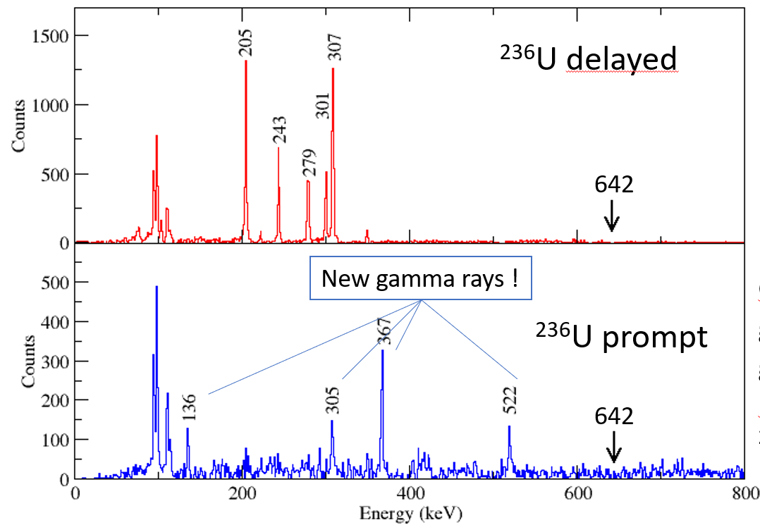
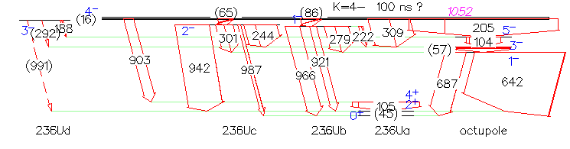
3. 2023, Orsay : High precision spectroscopy with Nuball2
Gate on the 642 keV transition in the delayed spectra :
K = 4- isomer, τ=120 ns
Ep
E_{B}
E_{b}
E_{A}
4⁻, 120ns
0⁺_{g.s. I}
1:1
1,3:1
2:1

Slide 42
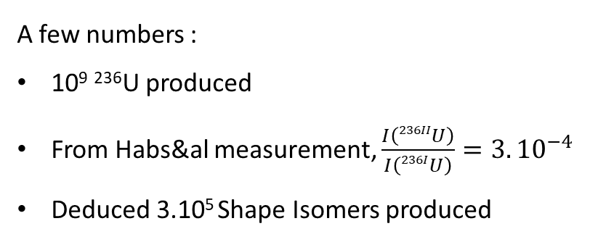
3. 2023, Orsay : High precision spectroscopy with Nuball2
Deduce the expected intensity of and 2125 lines :
1847 keV : 3492 counts
2125 keV : 1671 counts
A few numbers :
10⁹ ²³⁶U produced
From Habs&al measurement, $\frac{I\left(236IIU\right)}{I\left(236IU\right)}=3.{10}^{−4}$
Deduced 3.10⁵ Shape Isomers produced
Methodology : stronger and stronger event-by-event conditions to tend to theirs :
Prompt gamma ray
Prompt and delayed calorimetry condition
Excitation energy conditions
1847
2125
279
942
688
642
966

Slide 43
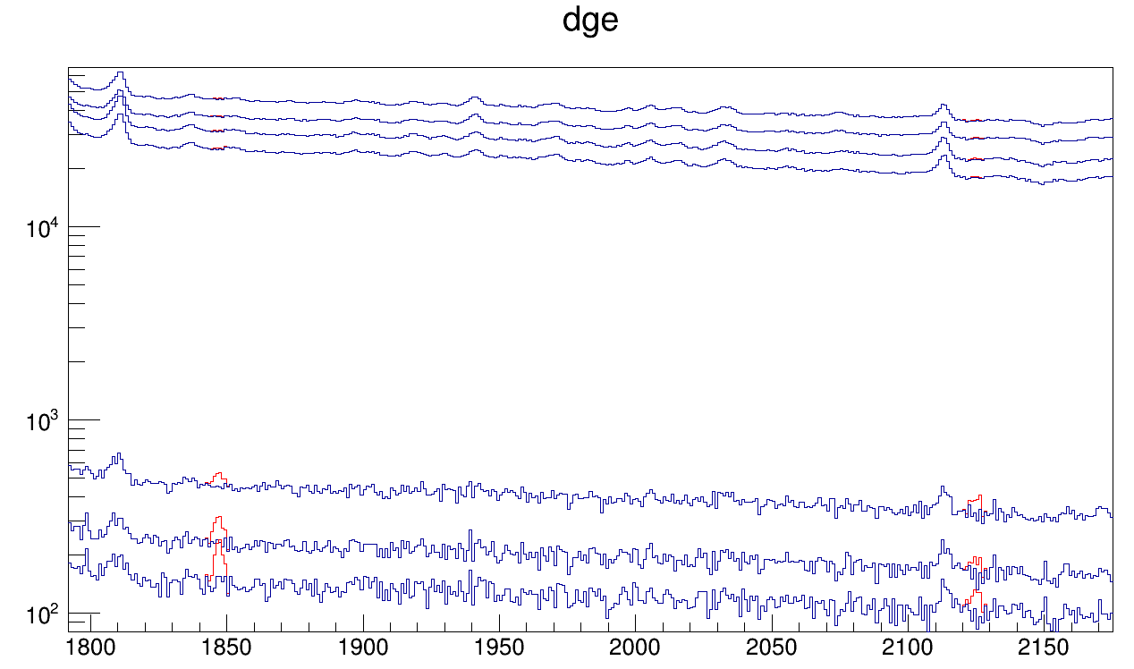
3. 2023, Orsay : High precision spectroscopy with Nuball2
From top to bottom spectra :
1 : Prompt gamma
2 : 1 , ΣE_{prompt}<3,7 MeV
3 : 1 , ΣE_{delayed}<3,0 MeV
4 : 2 , 3
5 : 4 , particule
6 : 5 , E_{excitation} < 6,5 MeV
7 : 5 , E_{excitation} > 4,5 MeV
56Fe
1811 keV
56Fe
2115 keV

Slide 44
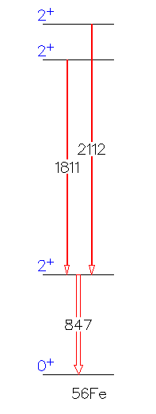
3. 2023, Orsay : High precision spectroscopy with Nuball2
From top to bottom spectra :
1 : Prompt gamma
2 : 1 , ΣE_{prompt}<3,7 MeV
3 : 1 , ΣE_{delayed}<3,0 MeV
4 : 2 , 3
5 : 4 , particule
6 : 5 , E_{excitation} < 6,5 MeV
7 : 5 , E_{excitation} > 4,5 MeV
56Fe
1811 keV
56Fe
2115 keV
⁵⁶Fe(n,n’) in the structure

Slide 45
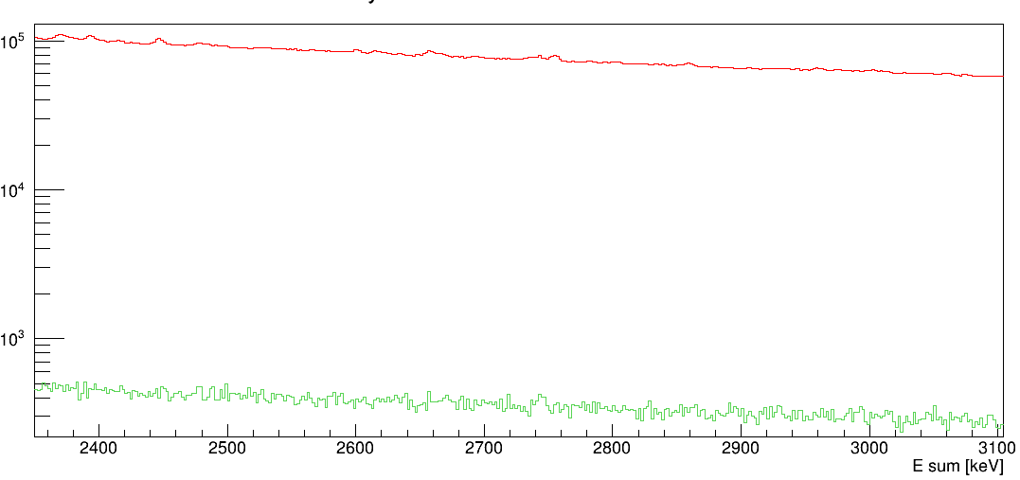
3. 2023, Orsay : High precision spectroscopy with Nuball2
Energy sum of events with two gamma rays :
Gate
ΣE = 2750

Slide 46

2. Crystal ball experiment : The unambiguous detection
$$E_{missing}=\sum{E^{delayed}}≈2,75 MeV$$

Slide 47
2. Crystal ball experiment : The unambiguous detection
$$E_{missing}=\sum{E^{delayed}}≈2,75 MeV$$

Slide 48
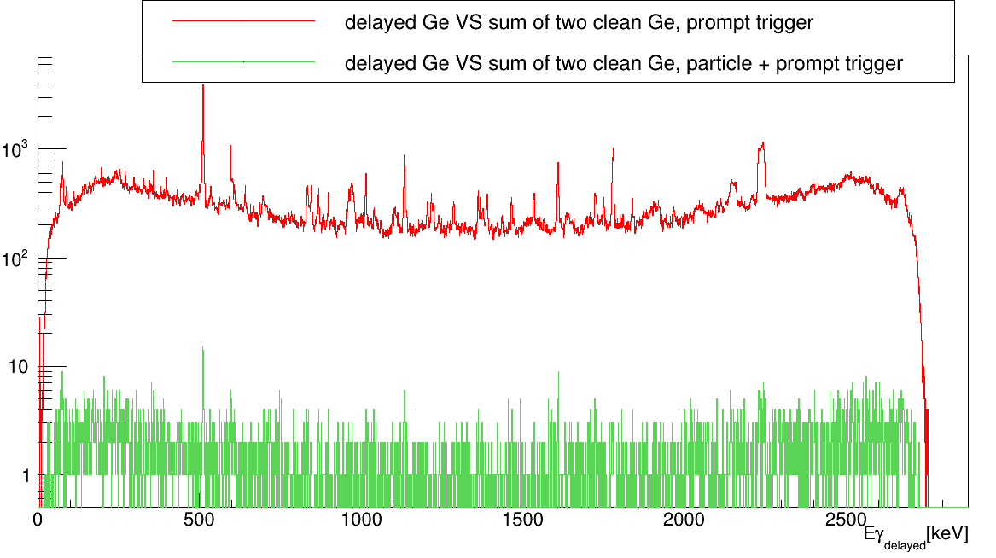
3. 2023, Orsay : High precision spectroscopy with Nuball2
Gate ΣE = 2750

Slide 49
3. 2023, Orsay : High precision spectroscopy with Nuball2
Gate ΣE = 2750
Compton diffusion of ²⁴Na β⁻ decay 2750 keV
⁷⁴Ge(n,n’y) 595 + (2750-695)
²⁸Si : (2750-1779) + 1779
511 + (2750-511)
²⁰⁹Bi 1333 + 1608 keV

Slide 50
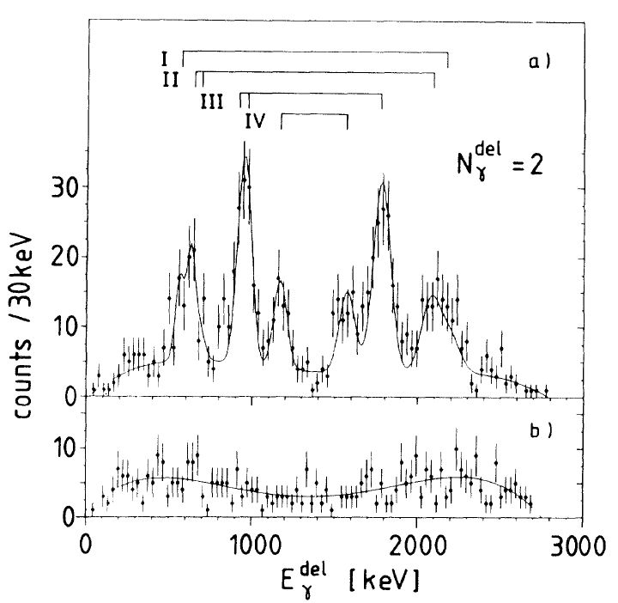
3. 2023, Orsay : High precision spectroscopy with Nuball2
Demand that E_{sum}=2750 keV (Very dangerous!!)
E_{sum}-1779
Random coincidences :
642 + compton of other lines
²⁷Al(n,γ)1779
E_{γ2}
642
E_{sum}-1550
642
E_{sum}-642
1550
642
E_{γ1}
E_{sum}-642
= 2126
642
_{Projected Spectrum}

Slide 51
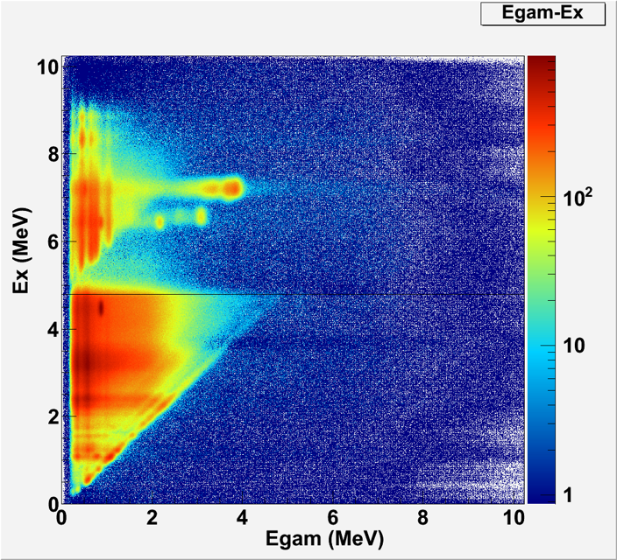
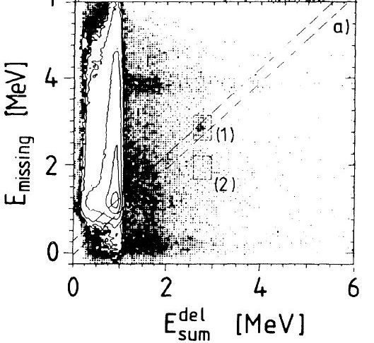
3. 2023, Orsay : High precision spectroscopy with Nuball2
Discrete peaks in E_{missing} can be caused by light target contaminants (e.g. 16O, 12C)
¹²C(d,p)¹³C ex3
E_{missing} = 3 MeV

Slide 52
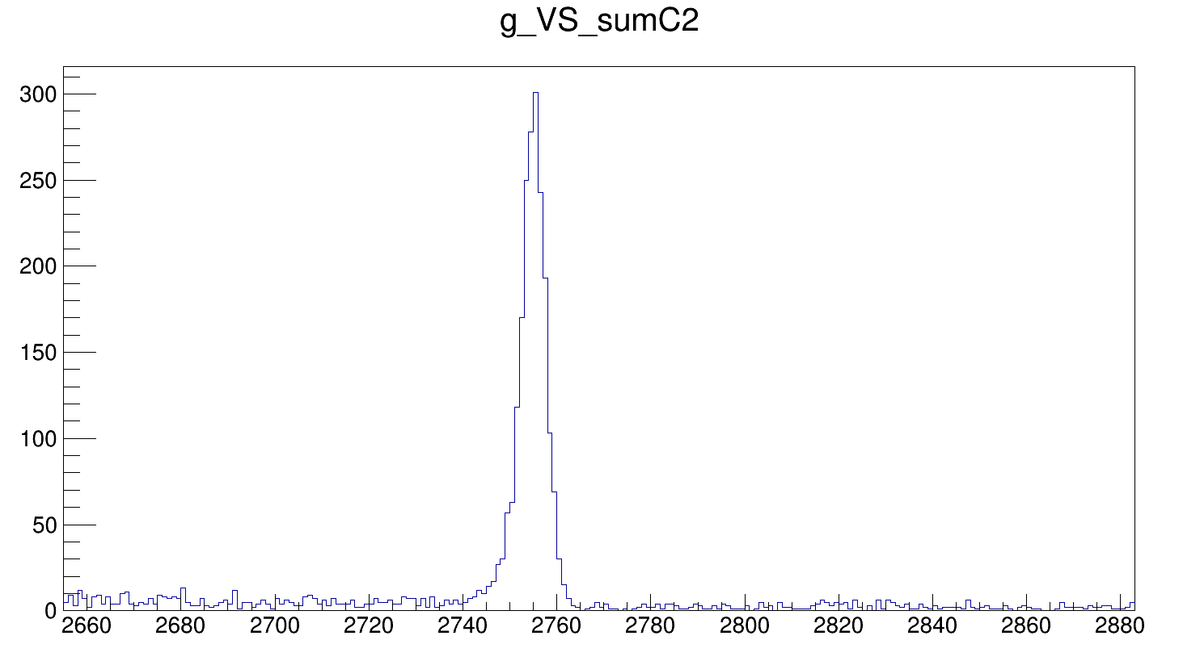
3. 2023, Orsay : High precision spectroscopy with Nuball2
Beam off spectra
²³Na neutron capture -> ²⁴Na
β⁻ decay : ²⁴Na -> ²⁴Mg + 2750 keV
ΣE

Slide 53
Conclusion
Experiment with nu-Ball2 carried out under identical conditions with a more powerful array (Ge over NaI)
We do not confirm the previous result and can’t observe gamma back decay.
We suggest a scenario where the previous result was in fact based on false random coincidences
Back decay, if it exists, must be in the sub-microbarn range
Hence INNER BARRIER PENETRATION/HEIGHT PARAMETERS underpinning theory for the actinide region may well be DIFFERENT than those currently used
A more sensitive search for back-decay in gamma coincidence data for 236U and 233Th is ongoing
New unknown states feeding the 4- isomer in 236U have been observed.

Slide 55
BACKUP

Slide 56
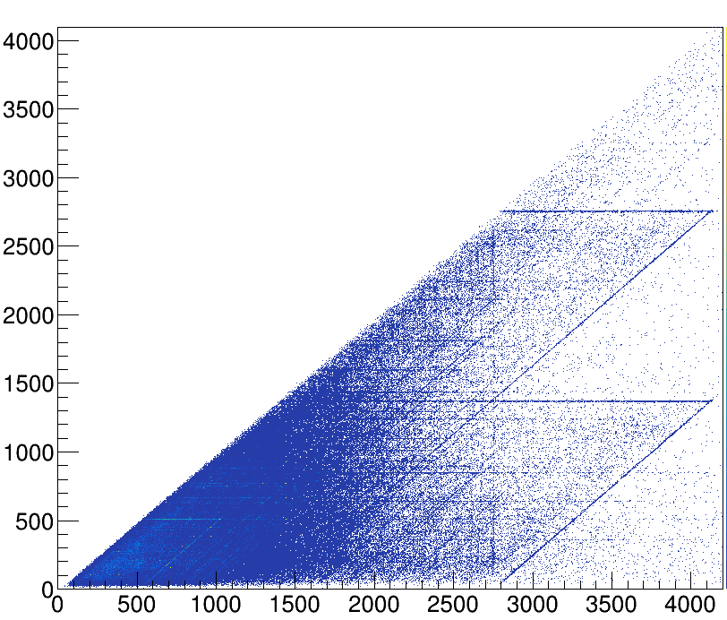
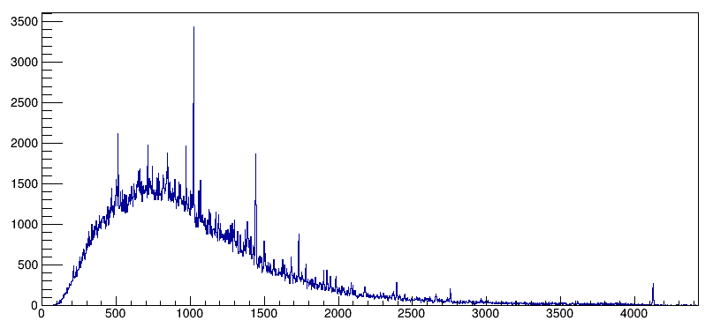
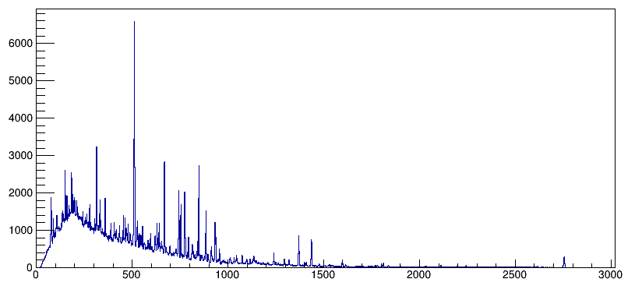
3. 2023, Orsay : High precision spectroscopy with Nuball2
Beam off after the experiment :
ΣE_{γ} = 2750
E_{γ}
ΣE (N_{γ} = 2)
E_{γ} = 2750
ΣE (N_{γ} = 2)
E_{γ}

Slide 57
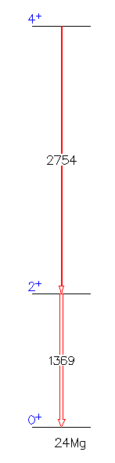
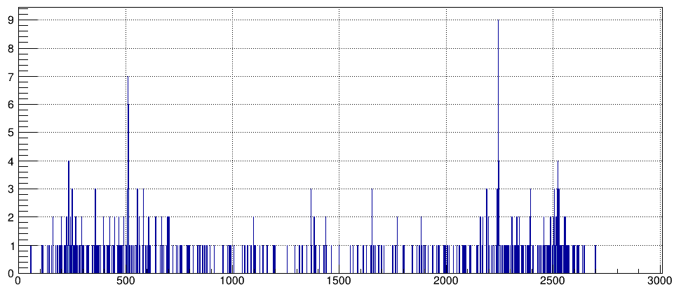
3. 2023, Orsay : High precision spectroscopy with Nuball2
Gate ΣE = 2750
Beam off after the experiment :
Compton diffusion of ²⁴Na β⁻ decay 2750 keV
511 + (2750-511)
1369 + (2750-1369)

Slide 58
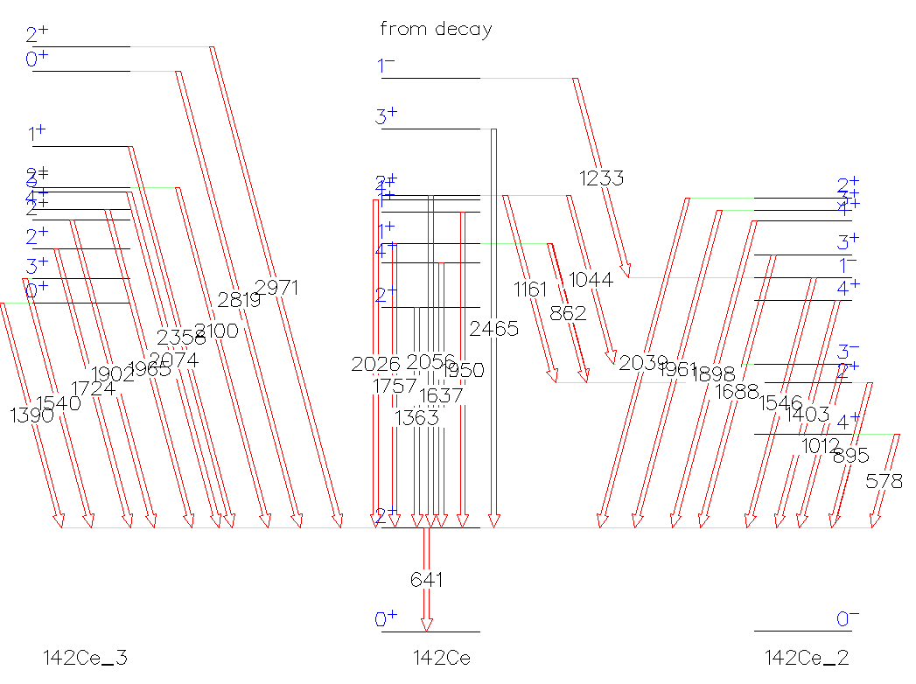
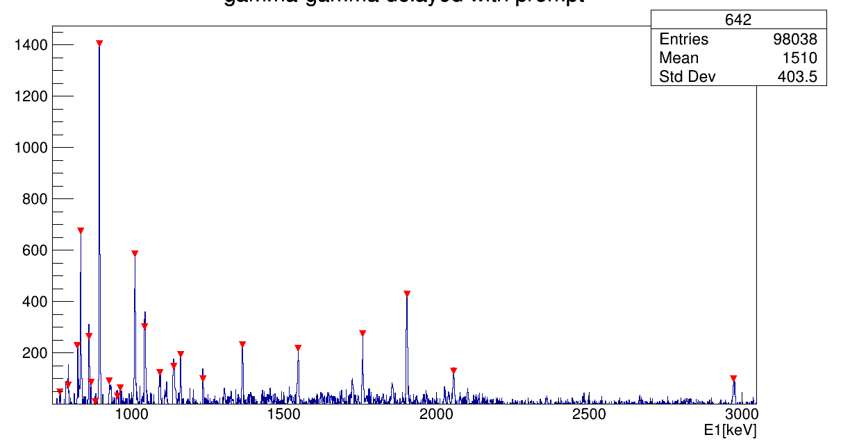
3. 2023, Orsay : High precision spectroscopy with Nuball2
Huge contamination of ¹⁴²Ce above 500 keV !!!

Slide 59
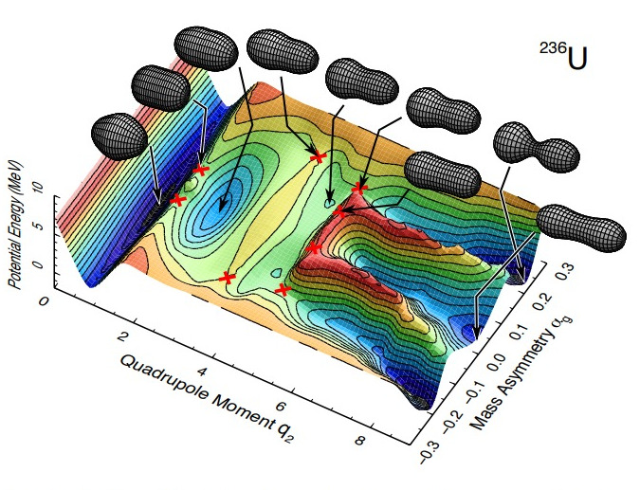
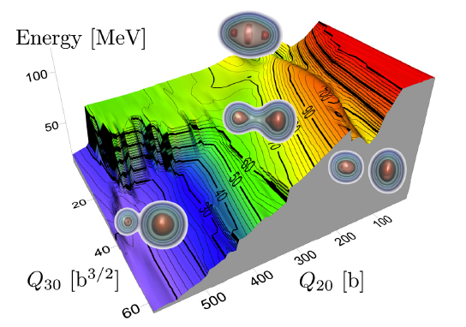
1. Introduction
Fission barrier is actually a N-dimensionnal potential barrier !

