Slide 1




The low-lying electric dipole strength in nuclei: the role of deformation
GDR
PDR?!
Luna Pellegri
University of the Witwatersrand and iThemba LABS

Slide 2

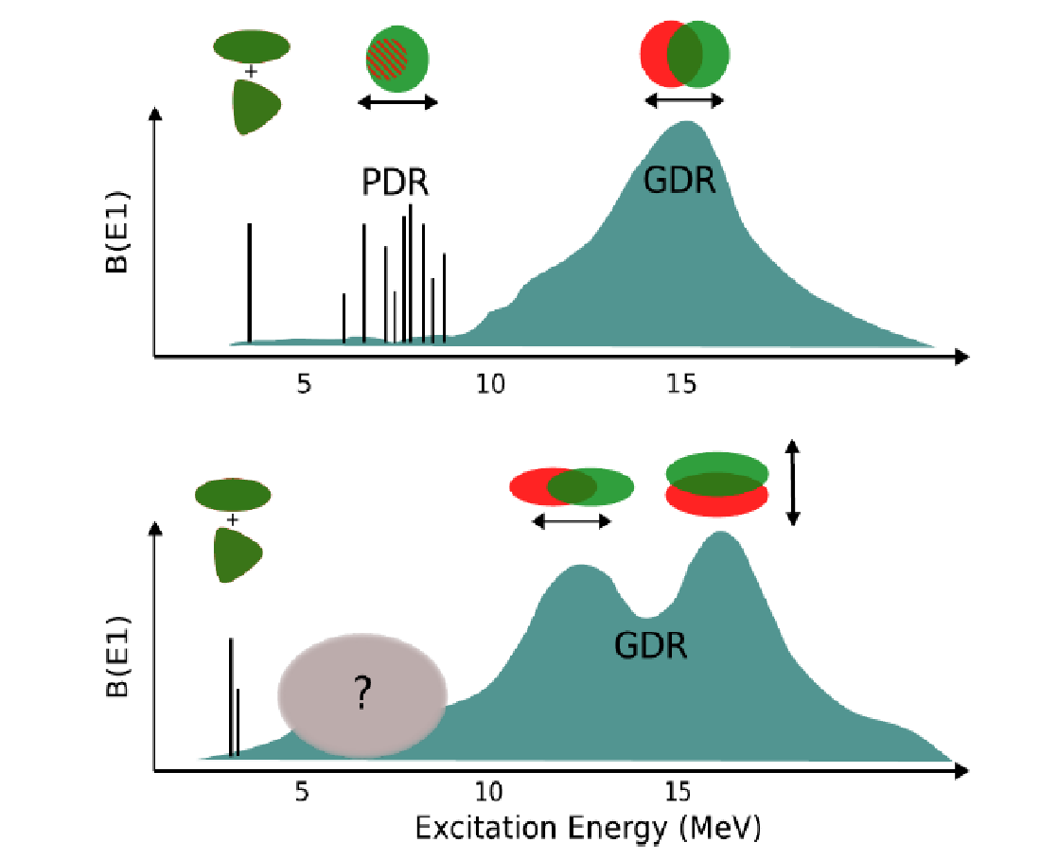
The Electric Dipole Response
Open Questions on PDR
Collective or single particle
IS vs IV interplay
Neutron skin or toroidal
Role of deformation
Thuthukile Khumalo
Recent Review Papers
A. Bracco, E. G. Lanza and A. Tamii, Prog. Part. Nucl. Phys. 106 (2019) 360
E.G. Lanza, L. Pellegri, A. Vitturi, M.V. Andrés, Prog. Part. Nucl. Phys. 129 (2023) 104006

Slide 3
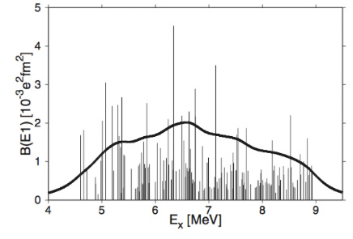
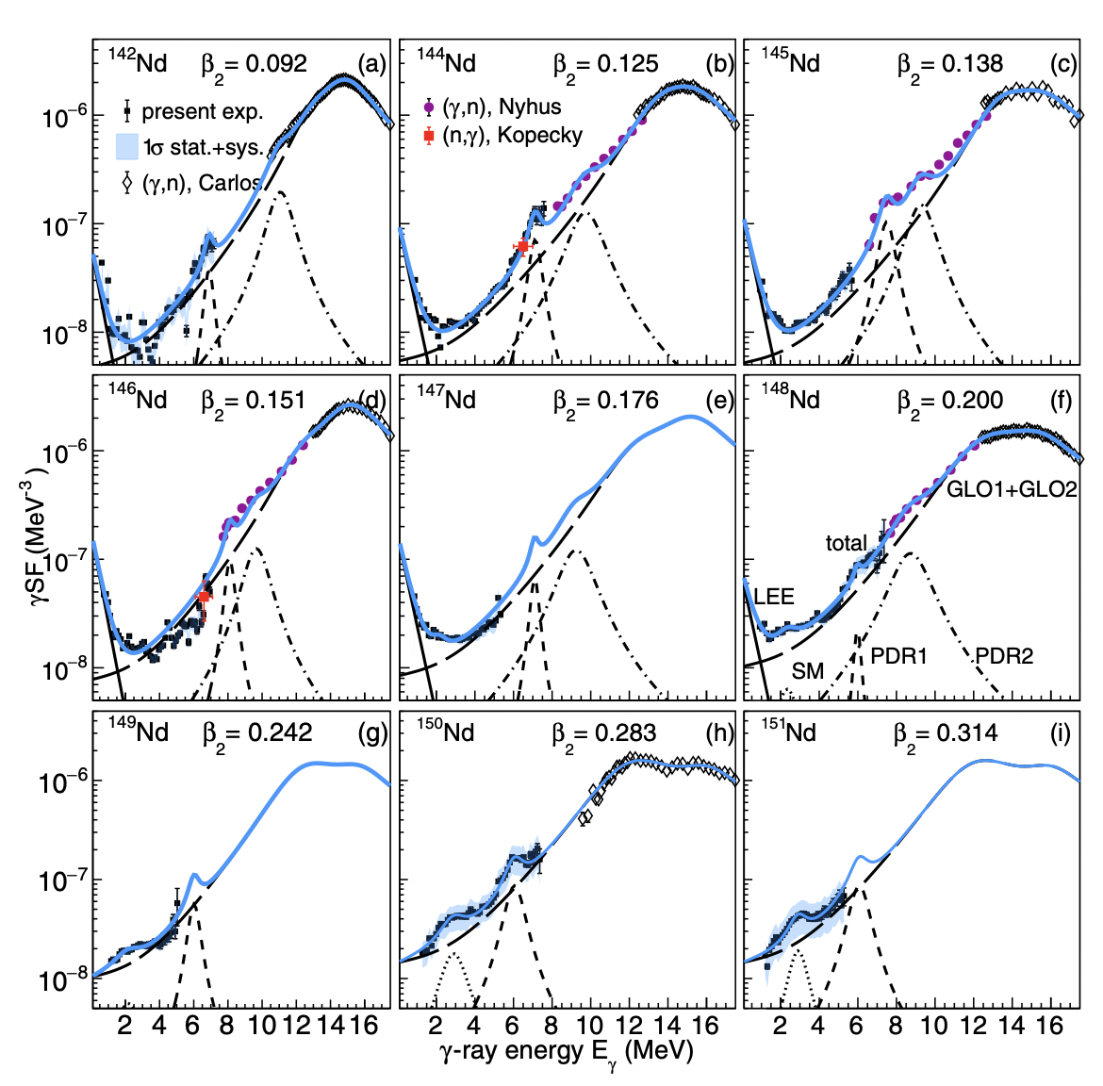
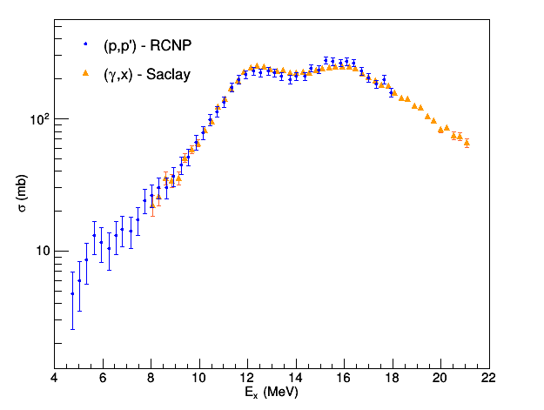
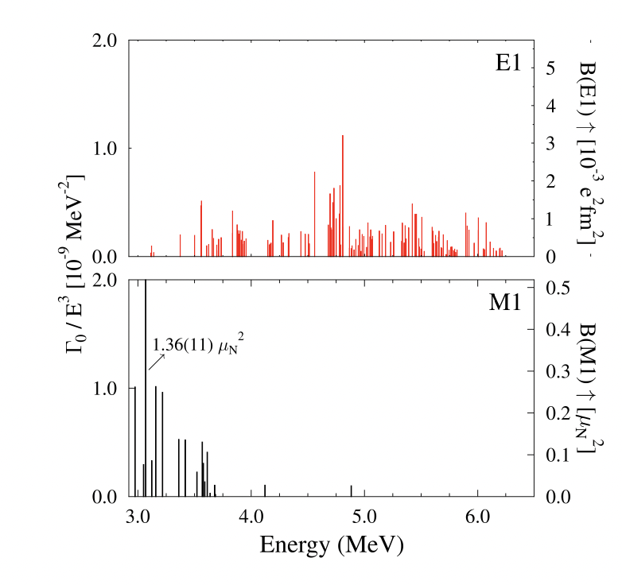
The Electric Dipole Response in Deformed Nuclei
⁷⁶Se(γ,γ) up to 9 MeV at HIγS
Nd isotopes Oslo Method - UiO
¹⁵⁴Sm(p,p’) at 295 MeV - RCNP
P. M. Goddard, et. al. Phys Rev C 88, 064308 (2013)
¹⁶⁵Gd(γ,γ) at HIγS
P. von Neumann-Cosel, private communication
M. Guttormsen et al., Phys Rev C 106, 034314 (2022)
in the experimental realm deformed nuclei are not too much explored
M. Tamkas et al. / Nuclear Physics A 987 (2019) 79–89

Slide 4
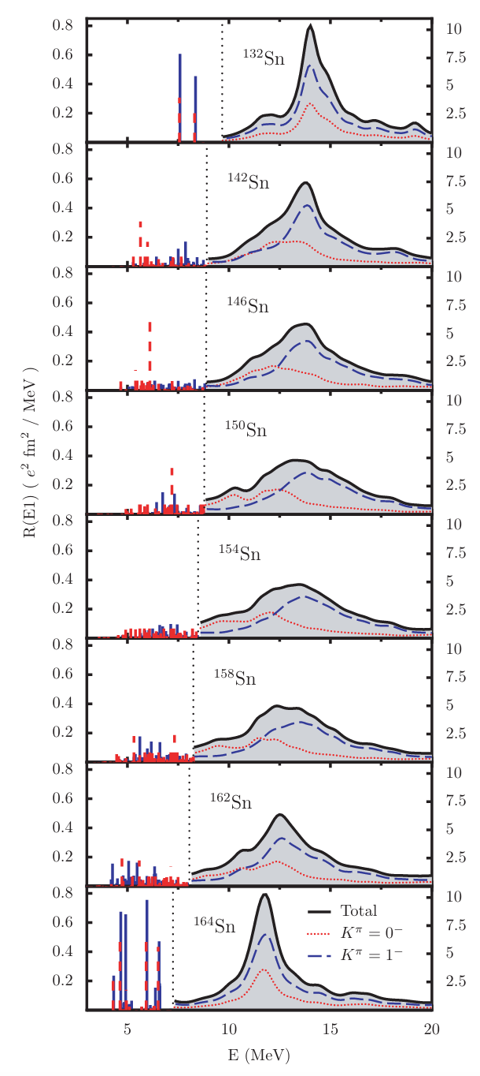
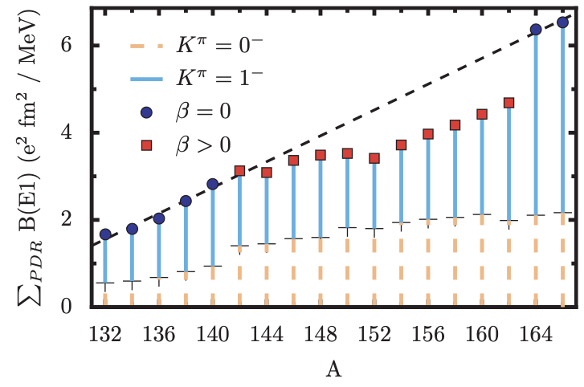
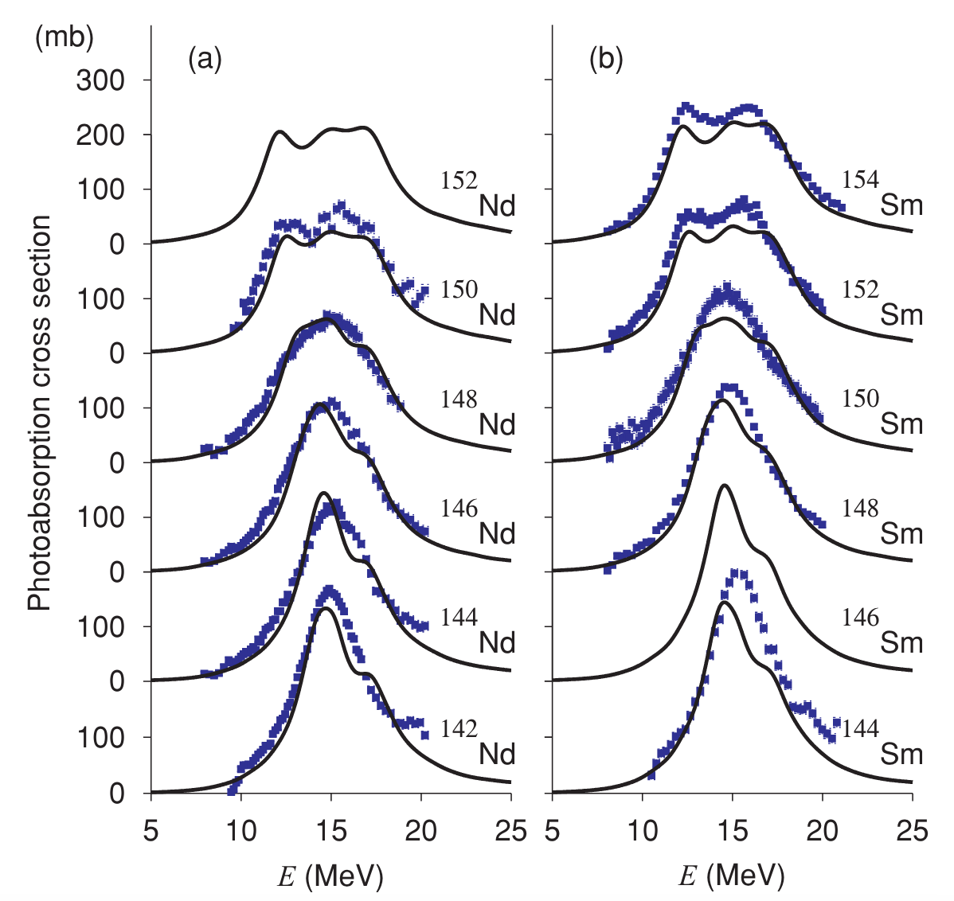
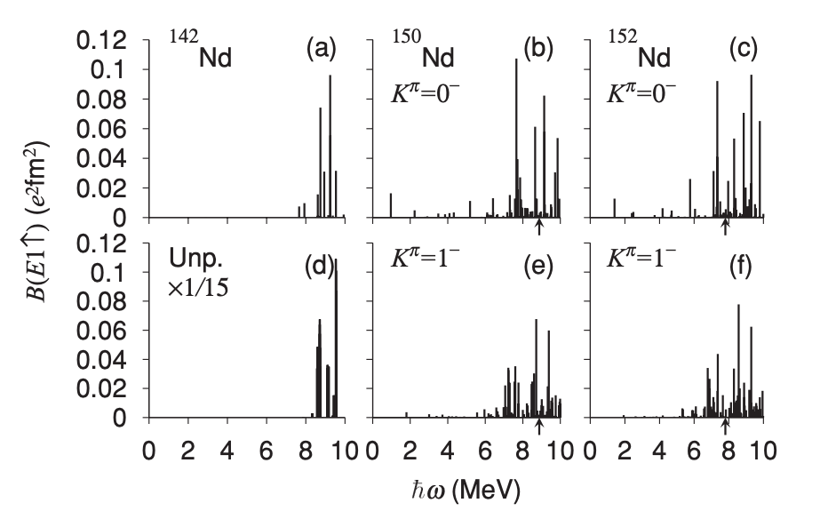
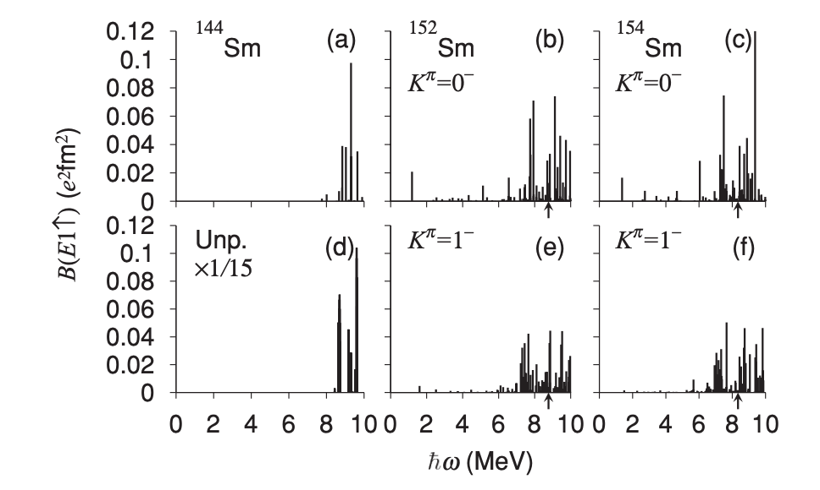
Tin isotopes – RHB + QRPA
Nd and Sm isotopes - HFB plus QRPA with Skyrme interaction
Quench of the low-lying dipole strength with deformation
Substantial increase of the dipole strength with deformation - 5 times more than spherical
D. Peña Arteaga, E. Khan and P. Ring, PRC 79, 034311 (2009)
K. Yoshida and T. Nakatsukasa, PRC 83, 021304(R) (2011)

Slide 5
Tin isotopes – RHB + QRPA
Nd and Sm isotopes - HFB plus QRPA with Skyrme interaction
The two calculations use:
Different treatments for the pairing.
Different use of the treatment of continuum and weakly bound orbitals.
The calculations of Peña et al. are fully self-consistent, and they do not have the contamination of the spurious center-of-mass motion.
Anyone with more deformed nuclei theoretical models for E1?

Slide 6

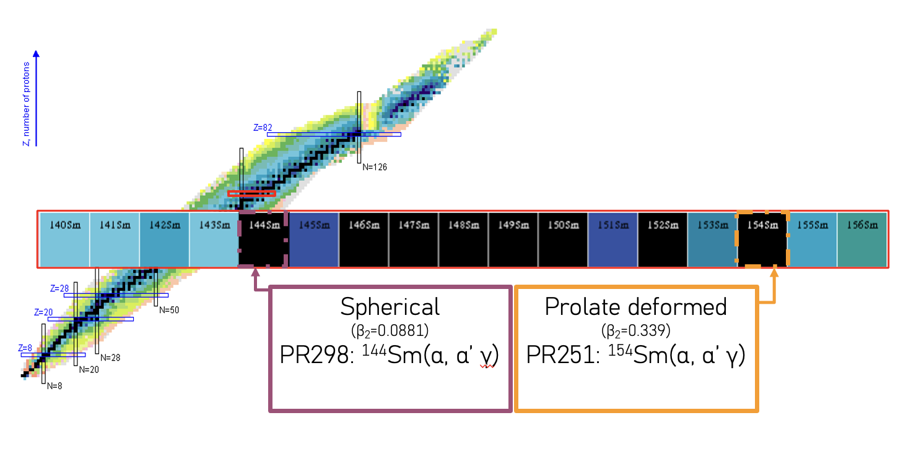
STUDY of the ISOSCALAR Response
Harshna Jivan

Slide 7
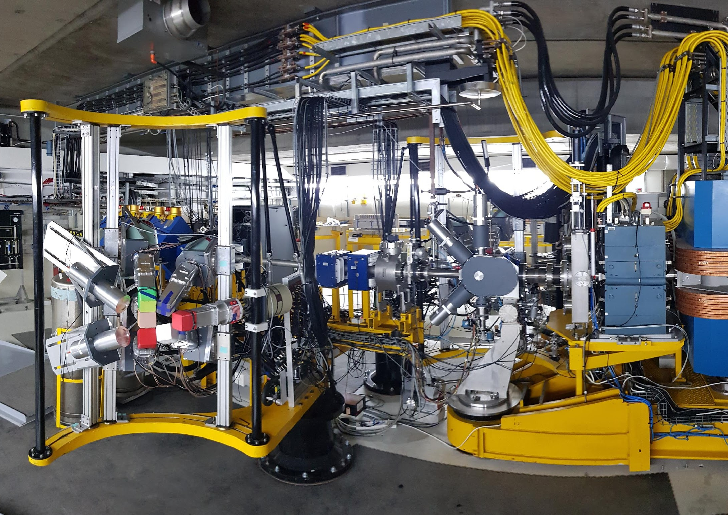
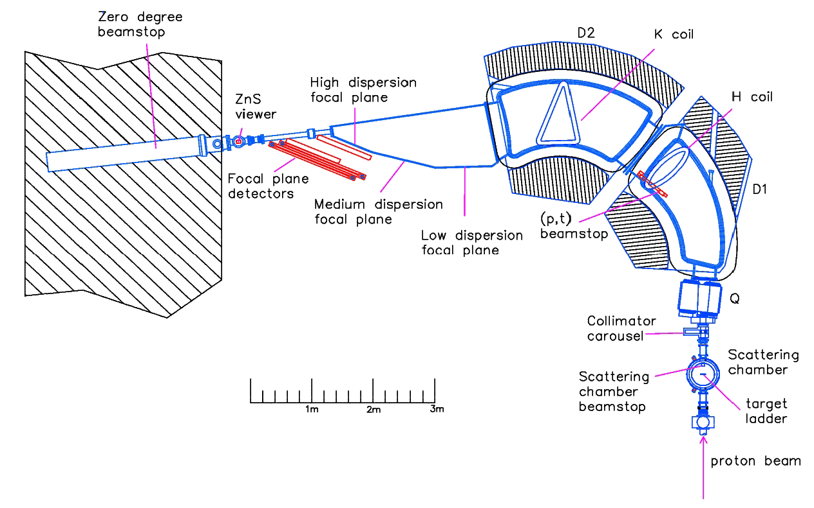
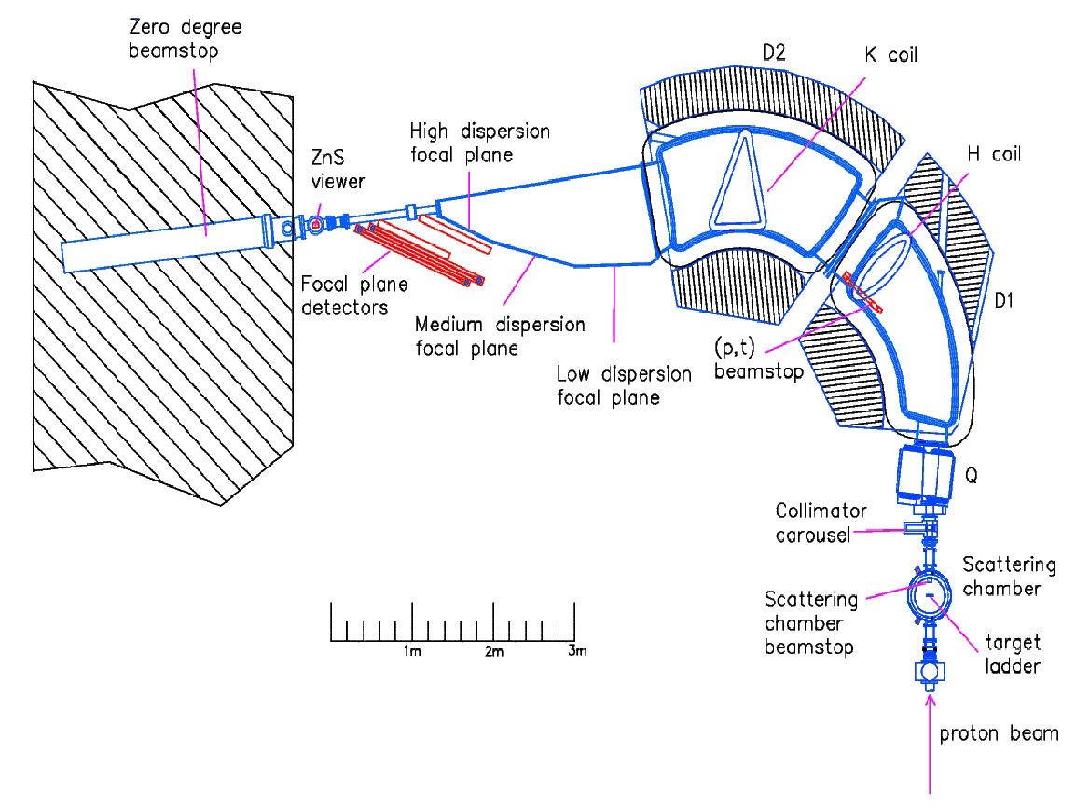
Overview of experiment
K600
BaGeL
At focal plane:
1 XU VDC (position and angle)
1 plastic scintillator paddle (PID)
12 HPGe Clovers + 6 large volume LaBr3:Ce
Target thicknesses
¹⁴⁴Sm: 1.8 mg/cm2
¹⁵⁴Sm: 4.9 mg/cm2
Resolutions:
K600 → 110-135 keV
LaBr → 80 keV @5 MeV
Clover → 15-30 keV @5 MeV
Absolute photopeak efficiency:
0.14-0.3% @ 8 MeV

Slide 8
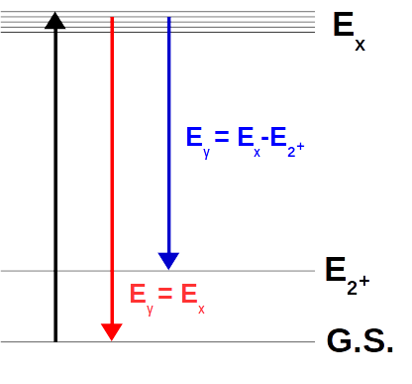
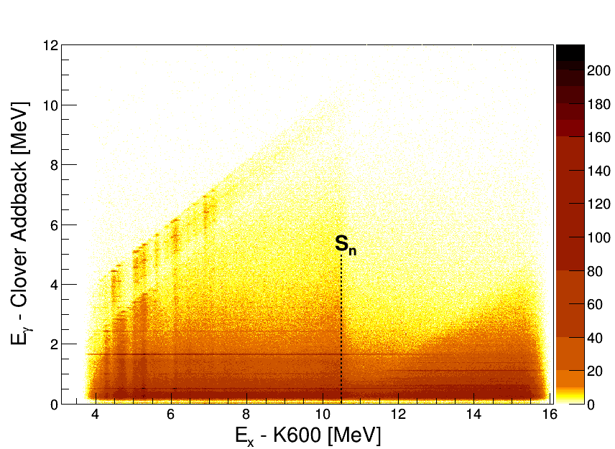
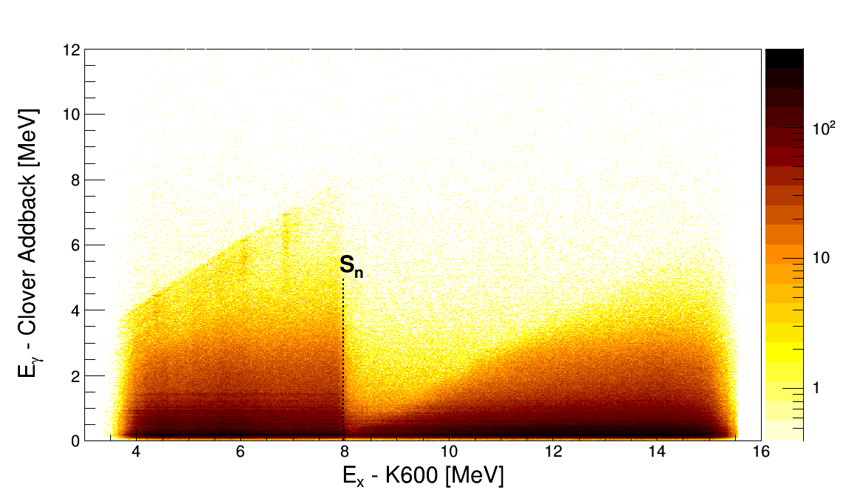
Results for ^{144,154}Sm
¹⁴⁴Sm
¹⁵⁴Sm
⍺-𝛾 correlated events are clearly visible

Slide 9
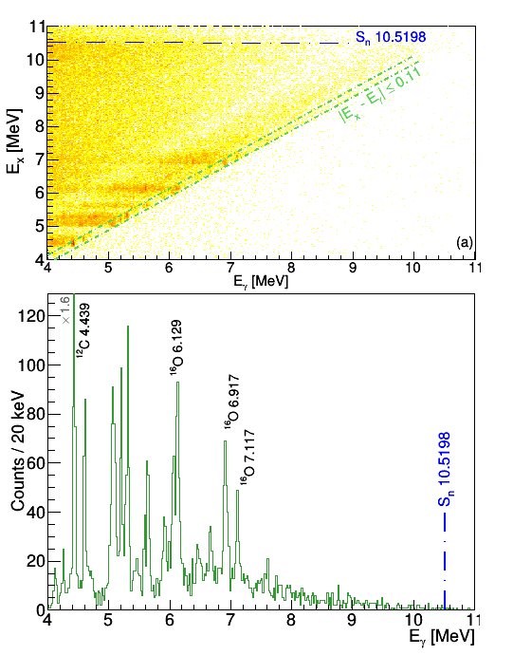
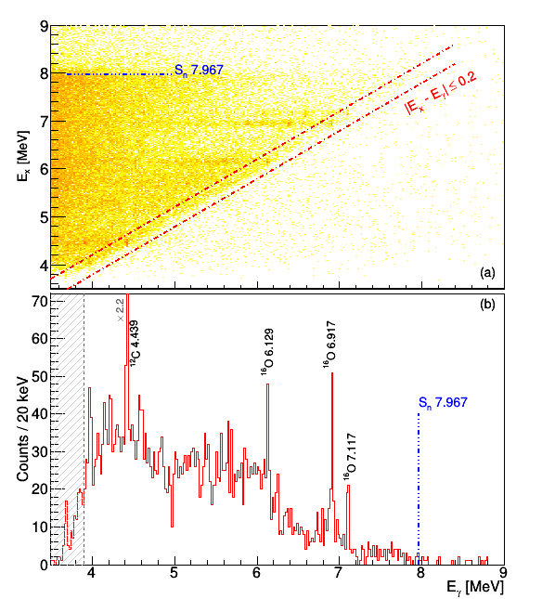
¹⁴⁴Sm
¹⁵⁴Sm
Spherical
Deformed

Slide 10
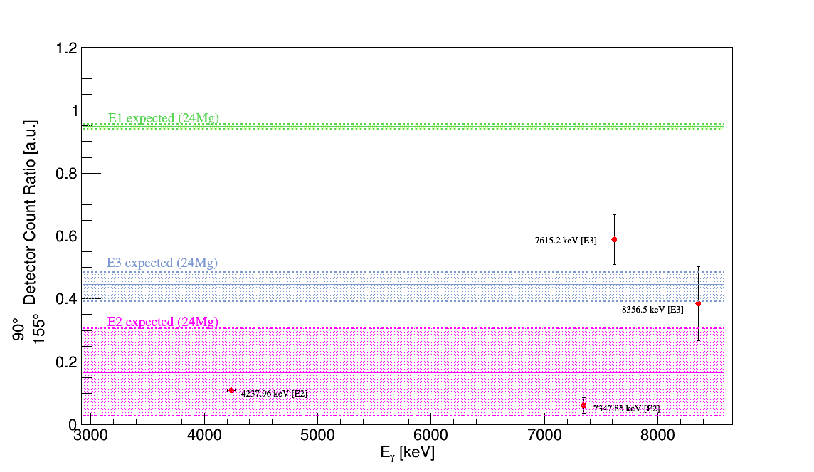
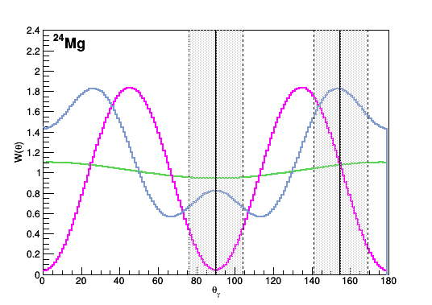
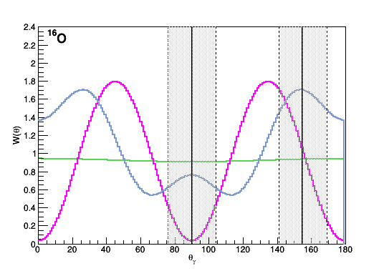
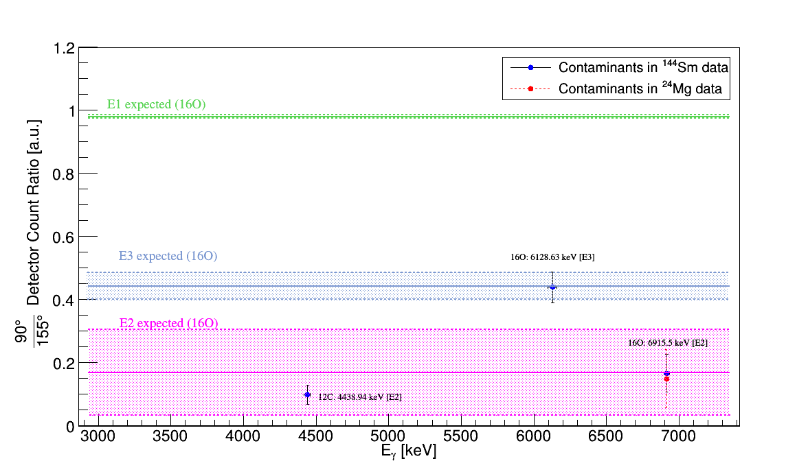
Confirming Multipolarity Character
A practical guide to using the AngCor package - arXiv:2001.11104 [nucl-ex]

Slide 11
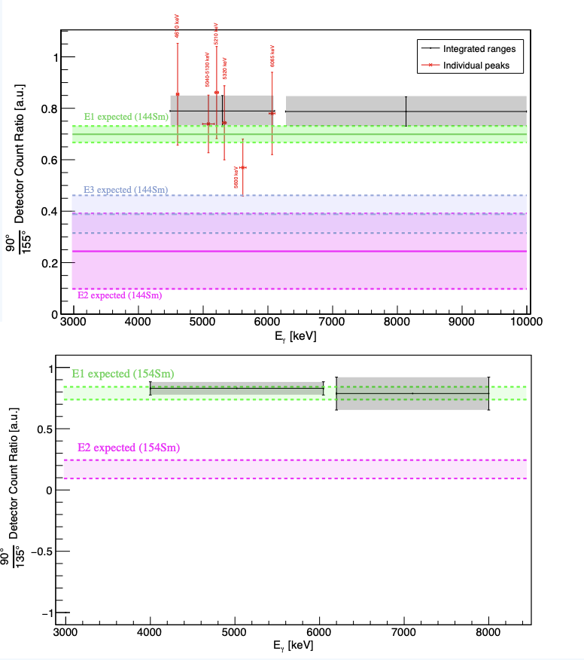
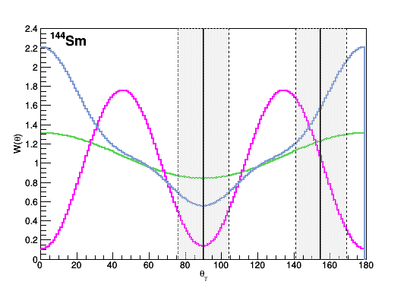
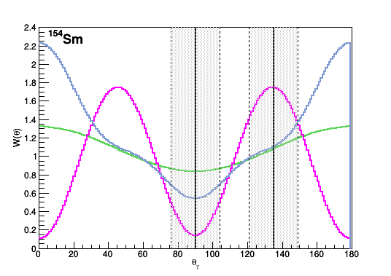
Confirming E1 Character
A practical guide to using the AngCor package - arXiv:2001.11104 [nucl-ex]

Slide 12
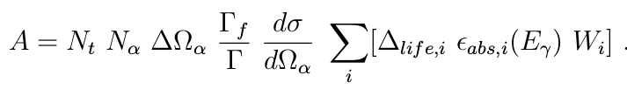
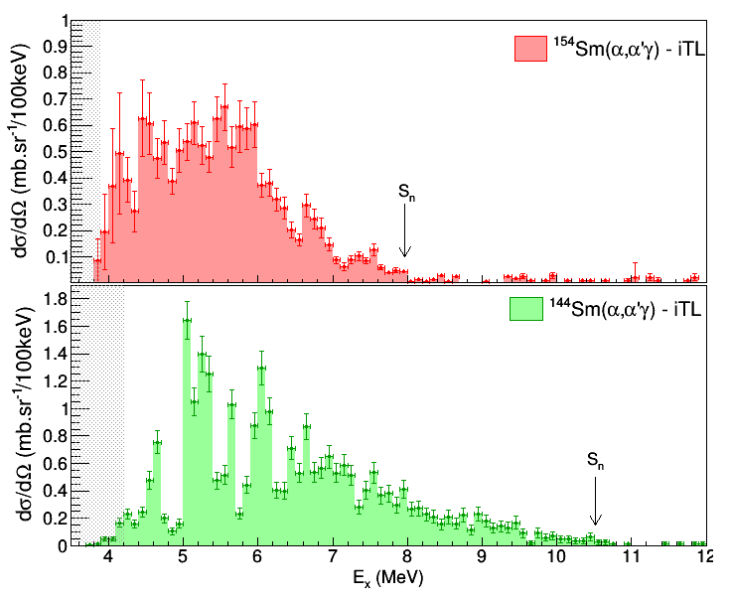
Differential Cross Sections
Deformed
Spherical

Slide 13
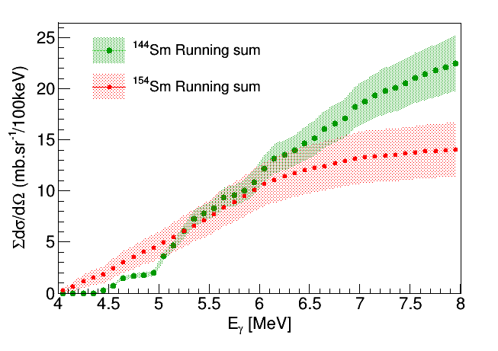
Low-lying E1 strength excited in both nuclei
Higher fragmentation of the strength in the deformed Sm
Hinder of the total cross section below separation energy for the deformed Sm

Slide 14
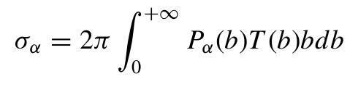
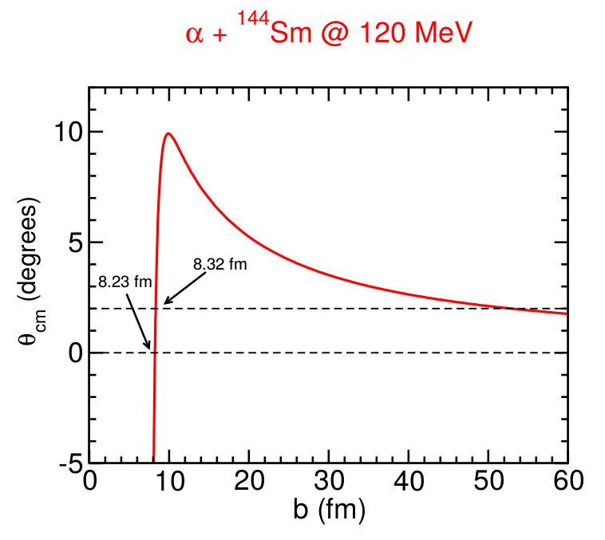
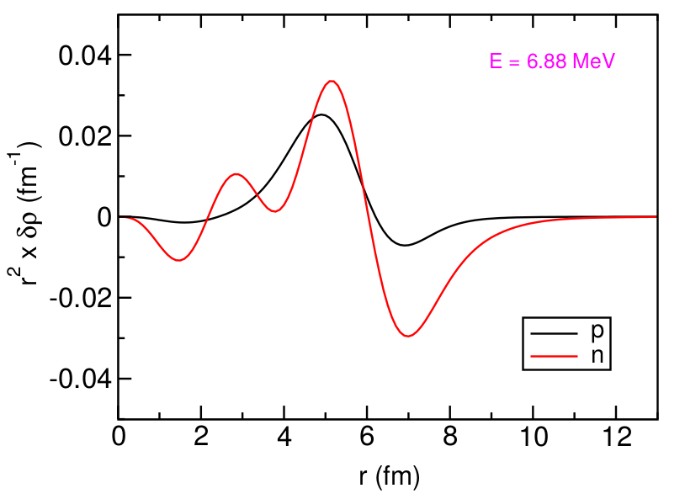
¹⁴⁴Sm theoretical calculation
Inelastic α-scattering excitation cross sections calculated in semiclassical model framework for E1 excitations based on the transition densities obtained from RQTBA (covariant density functional with NL3 parametrization)
2p2h and 3p3h configurations are considered
Performed by Edoardo G. Lanza and Elena Litvinova
Method described in PHYSICAL REVIEW C 89, 041601(R) (2014)

Slide 15
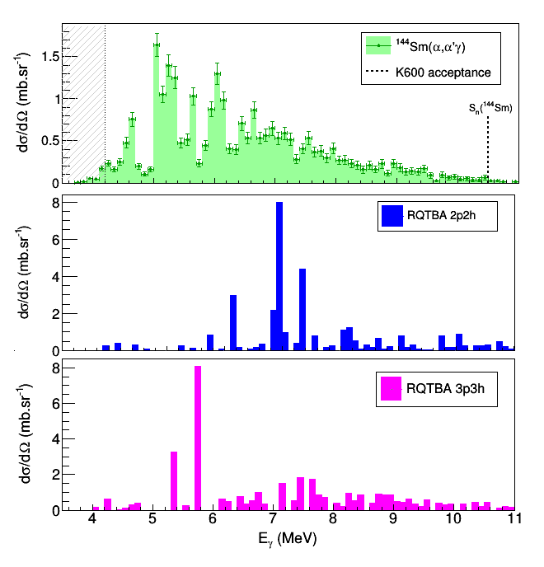
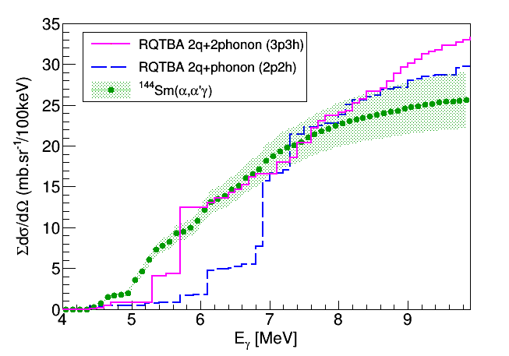
¹⁴⁴Sm
Complex configurations critical for the interpretation

Slide 16
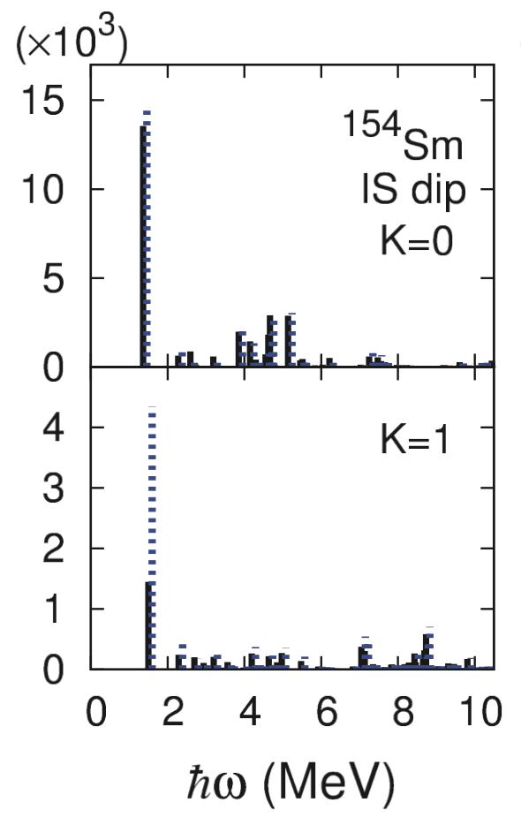
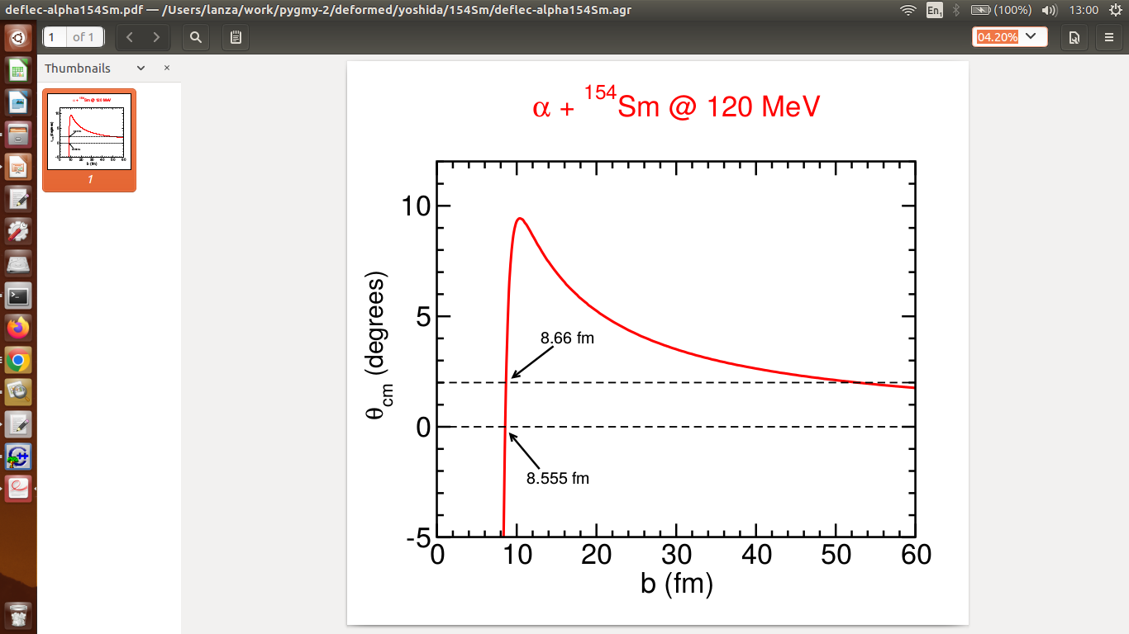
¹⁵⁴Sm theoretical calculation
Transition densities obtained from Deformed HFB+QRPA calculation
K. Yoshida and T. Nakatsukasa, PRC 88, 034309 (2013) and PRC 83, 021304(R) (2011)

Slide 17
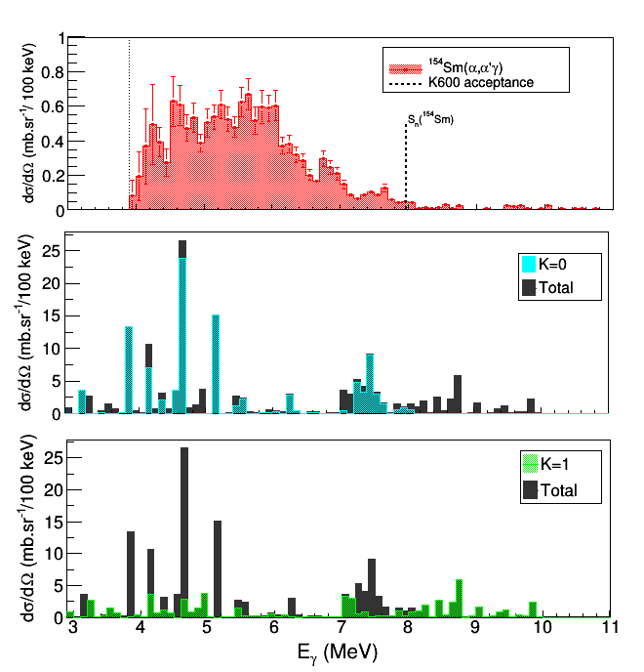
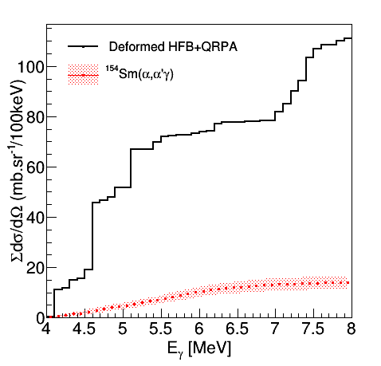
¹⁵⁴Sm
Cross section of 154Sm not reproduced
Overestimation of the total strength
Experimental data show a hinder in the strength as suggested by the RHB+QRPA calculations

Slide 18
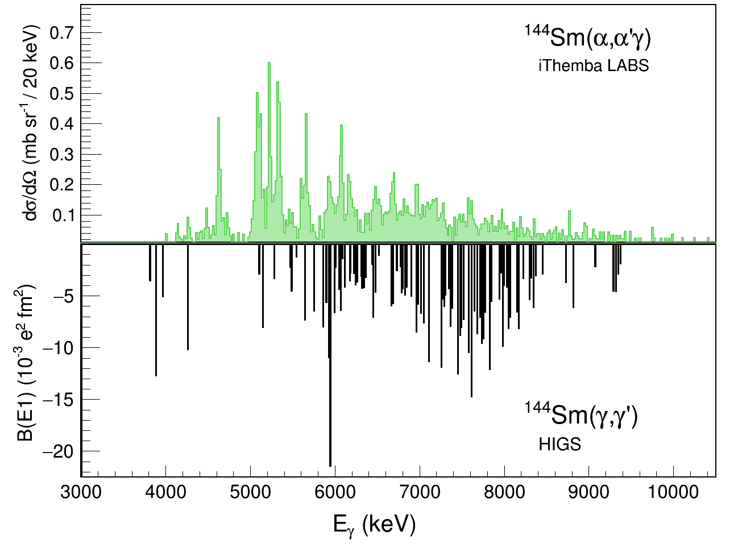
¹⁴⁴Sm - Comparison of (⍺,⍺’𝛾) with (𝛾, 𝛾’) results
Anton Tonchev et al., EPJ WoC 93 (2015) 01030

Slide 19
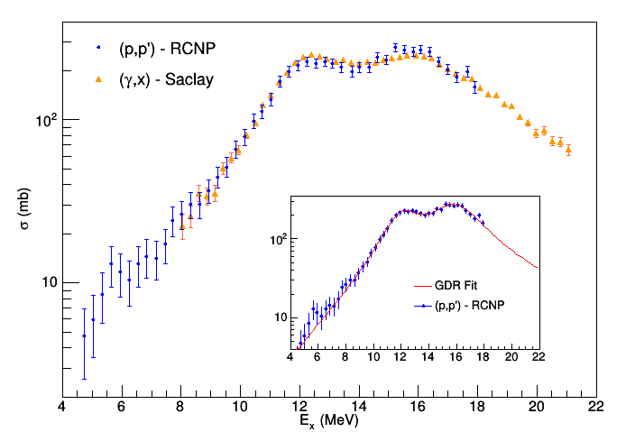
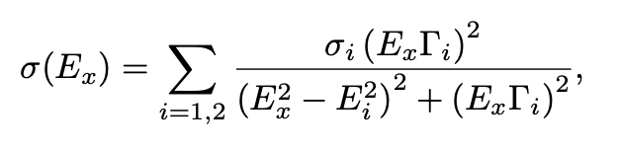
¹⁵⁴Sm(p,p’) at 295 MeV – ISOVECTOR RESPONSE
IVGDR energy region are fitted by the sum of two Lorentzians
P. von Neumann-Cosel, private communication
Work of A. Krumann and P. von Neumann-Cosel

Slide 20
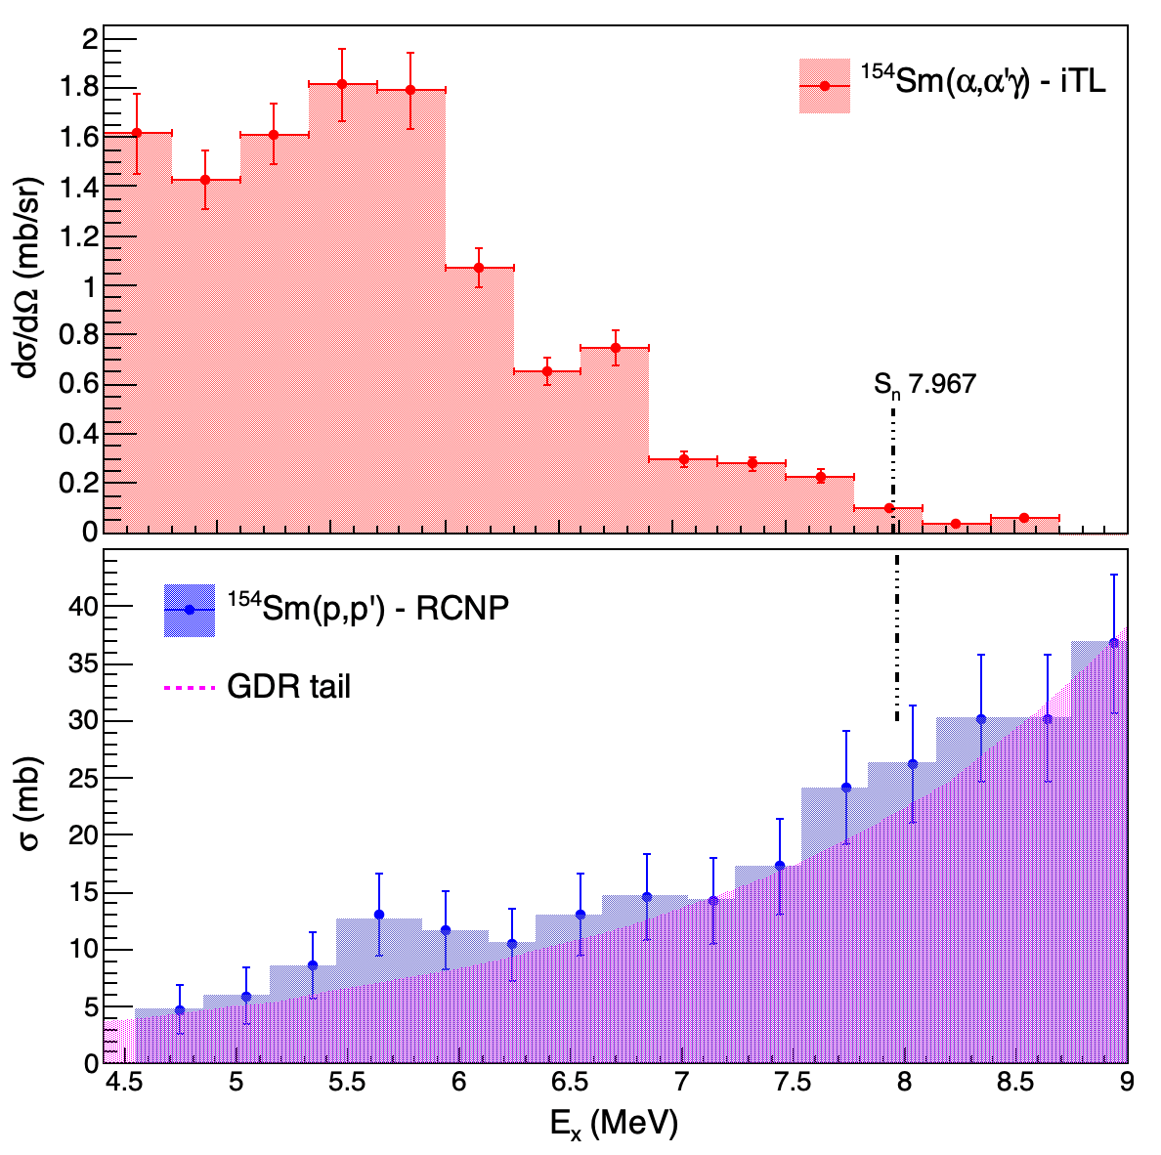
¹⁵⁴Sm - Comparison of (⍺,⍺’𝛾) with (p,p’) results
?
?
Presence of a second peak at 8 MeV depend on the shape of the tail of the IVGDR fit

Slide 21
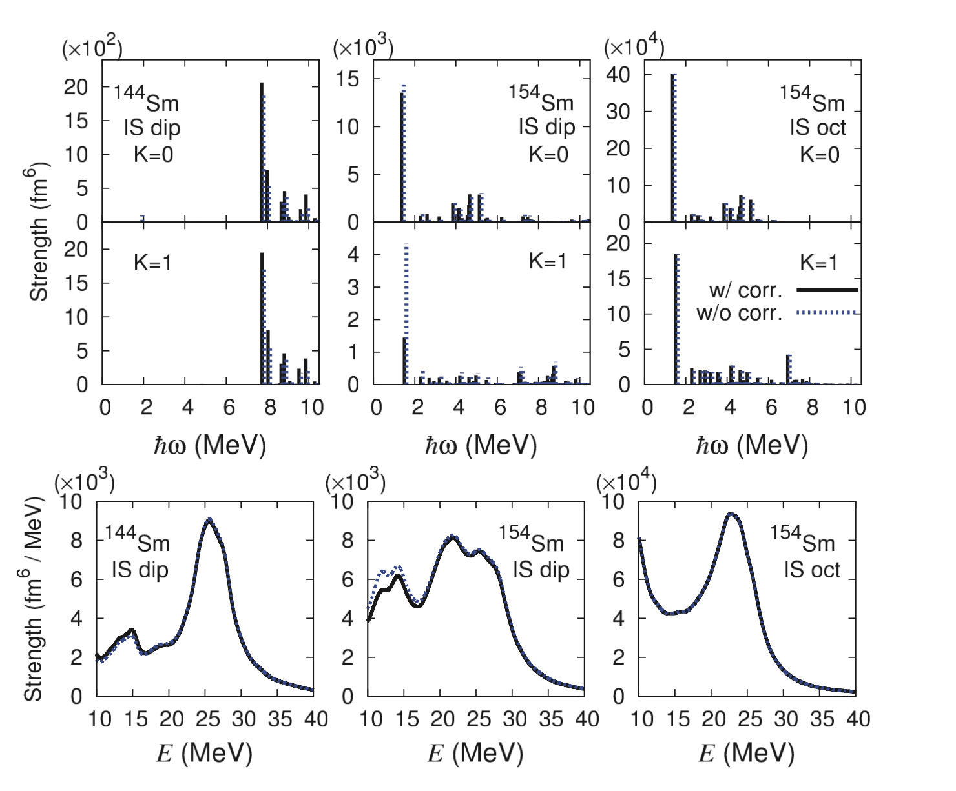
¹⁵⁴Sm - Comparison of (⍺,⍺’𝛾) with (p,p’) results
¹⁵⁴Sm Theoretical Calculations
IS
IS
IV
IV
?
P. von Neumann-Cosel, private communication

Slide 22
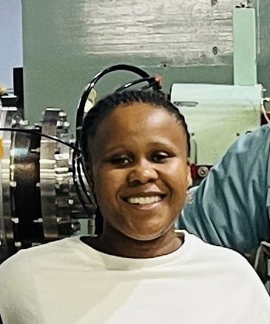
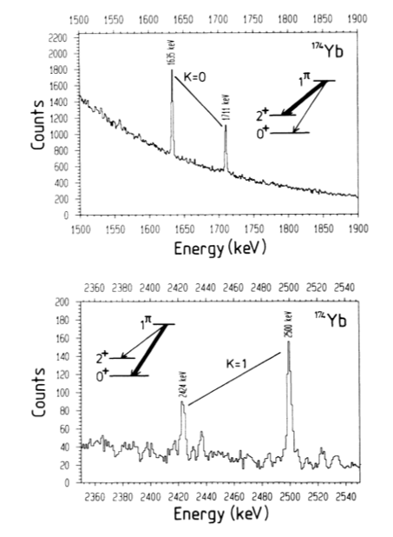
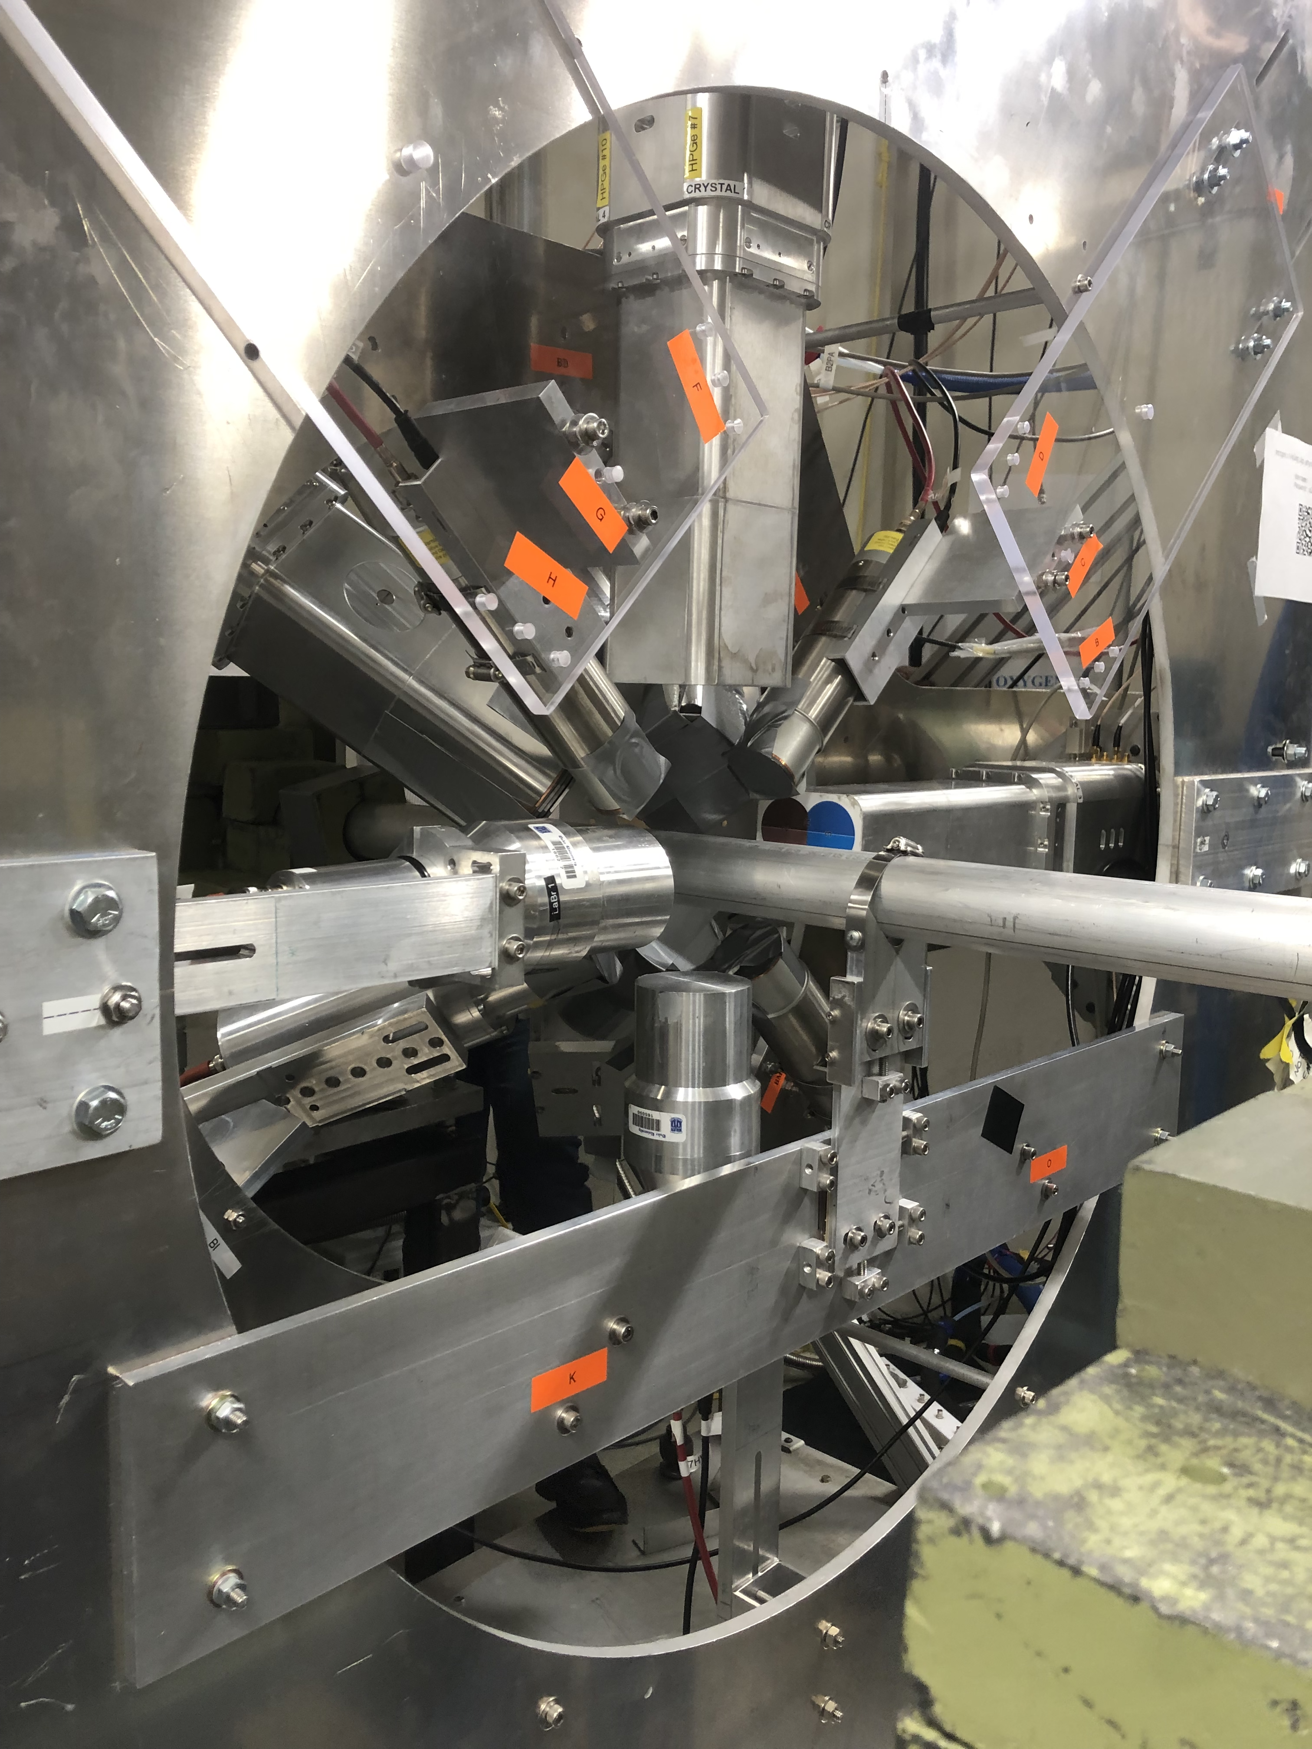
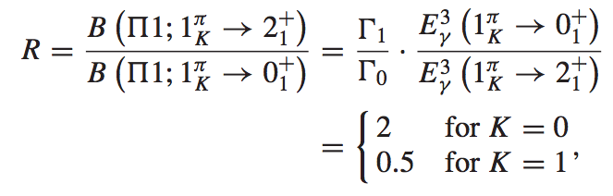
^{154Sm(𝛾, 𝛾’) at HI𝛾S}
ALAGA rule ratio for pure K=0 and K=1 states
¹⁵⁴Sm(γ, γ’) @ HIGS - May 2023
Refilwe Molaeng
Data analysis in progress
Explored only up to 3.5 MeV
Attempt to measure the decay to g.s. and 1st excited state important to understand the splitting
A. Zilges et al. PRC 42 (!990) 1945

Slide 23
^{Conclusions}
The evolution of the PDR with deformation is being investigated using the (α,α’γ) reaction in ¹⁴⁴Sm and ¹⁵⁴Sm @ iThemba LABS
First time that a spherical and deformed nucleus is investigated in the isovector and isoscalar responses below neutron threshold
Results show no K-Splitting in the IsoScalar response. Rather isospin splitting observe as per studies in other nuclei.
Strength deduced from the direct decay appears hindered and more fragmented with deformation when compared to the spherical case
Importance of complex configuration in the description of the strength below S_{n}
¹⁴⁴Sm response in agreement with theoretical predictions while it is not the case for ¹⁵⁴Sm
  Is this due to deformation that hinders individual state structure?
  Does the statistical decay component play a more relevant role in the deformed nuclei?

Slide 24
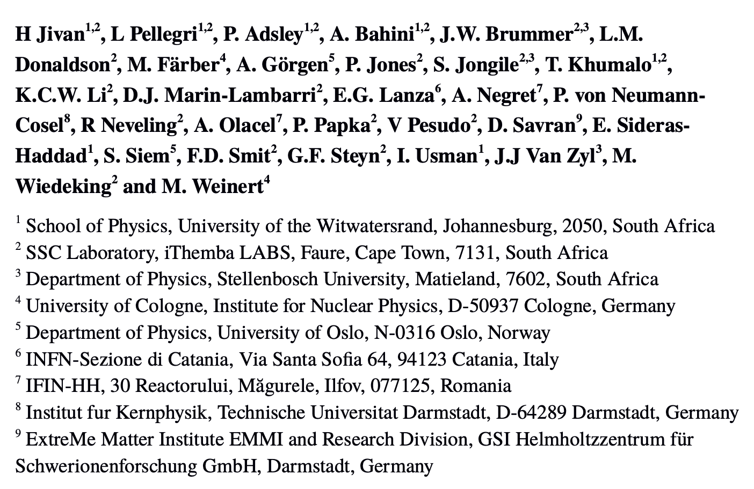
^{Collaboration}
, M Weinert⁴
THANKS TO K. Yoshida, E. Litvinova, E. Lanza for the theoretical calculations

Slide 25

THANK YOU FOR THE ATTENTION

