Slide 1
Recent developments in photonuclear reaction studies with quasi-monochromatic photon beams
- a new approach to nuclear level densities -
Johann Isaak
Institut für Kernphysik, Technische Universität Darmstadt
Oslo Workshop 2024

Slide 2
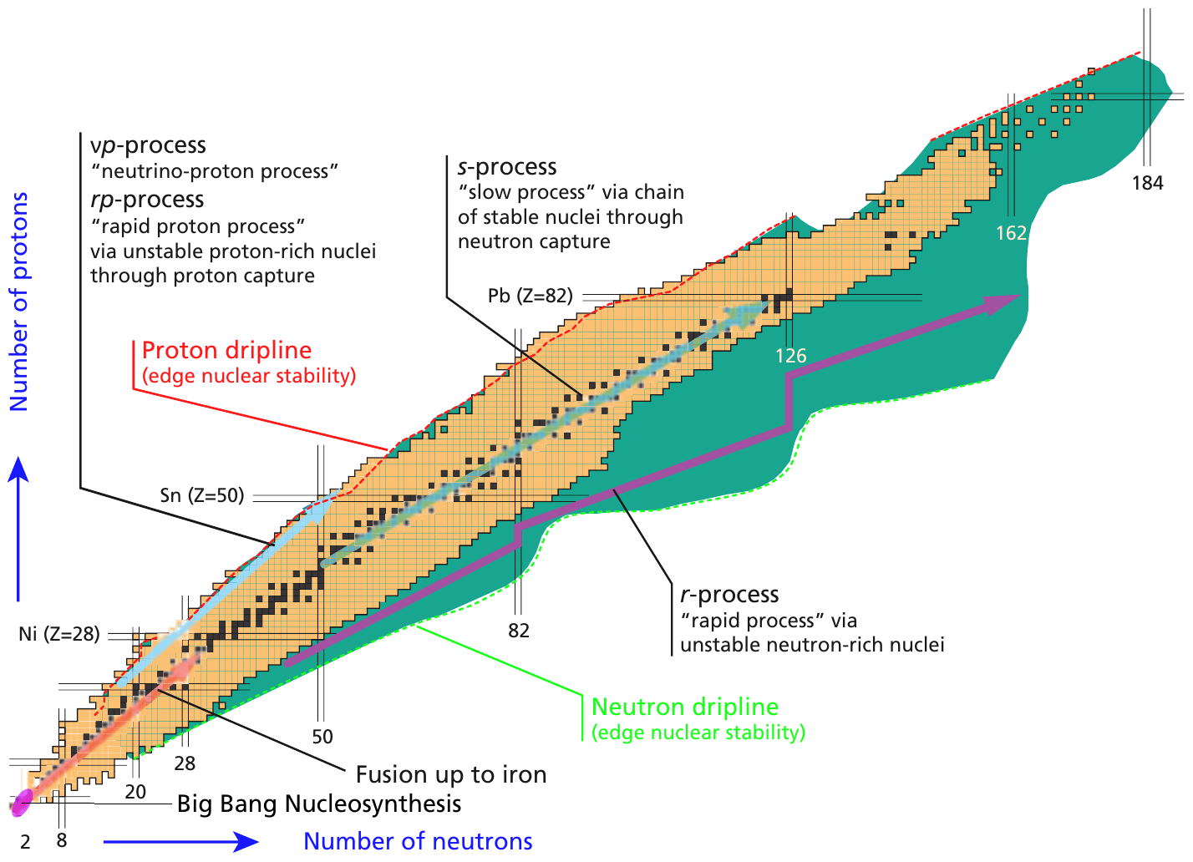
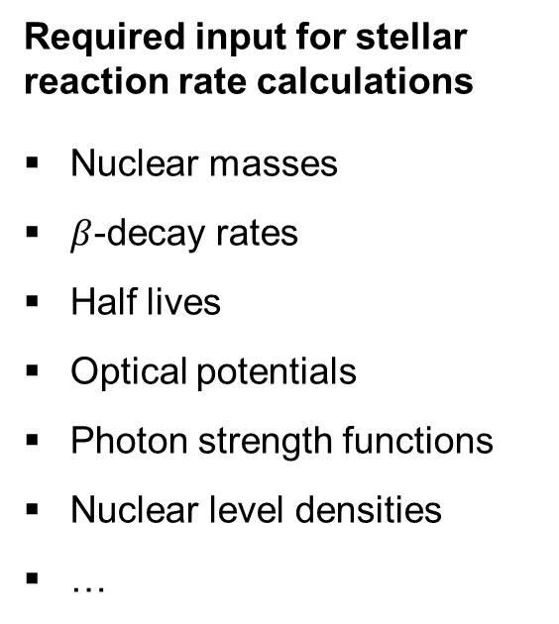
Motivation | nucleosynthesis
Required input for stellar reaction rate calculations
Nuclear masses
$β$-decay rates
Half lives
Optical potentials
Photon strength functions
Nuclear level densities
…
T. R. Rodriguez, J. Phys.: Conf. Ser. 503 (2014) 012038.

Slide 3
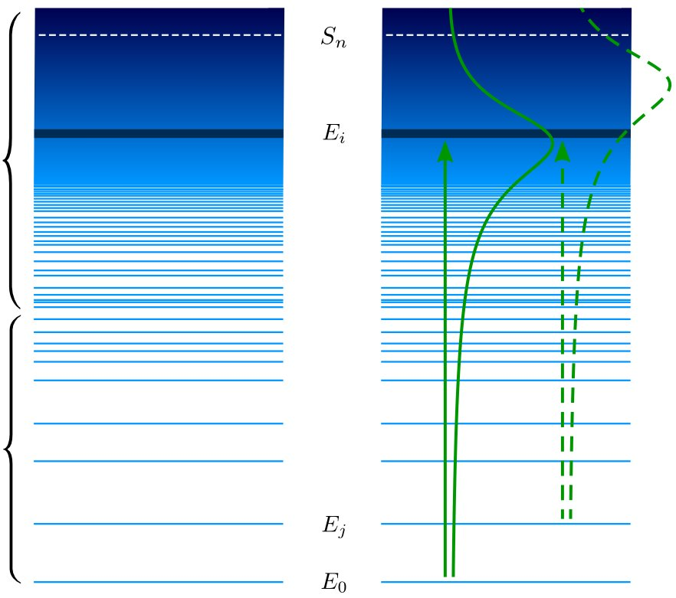
Nuclear level densities & photon strength functions
continuum
Emission
Absorption
challenge
quasi-continuum
measured signal (= reaction rates) not necessarily proportional to NLD & PSF
selectivity for groups of nuclear states
(= spin- and parity quantum numbers)
model-dependent assumptions in reaction theory and/or data analysis
discrete

Slide 4
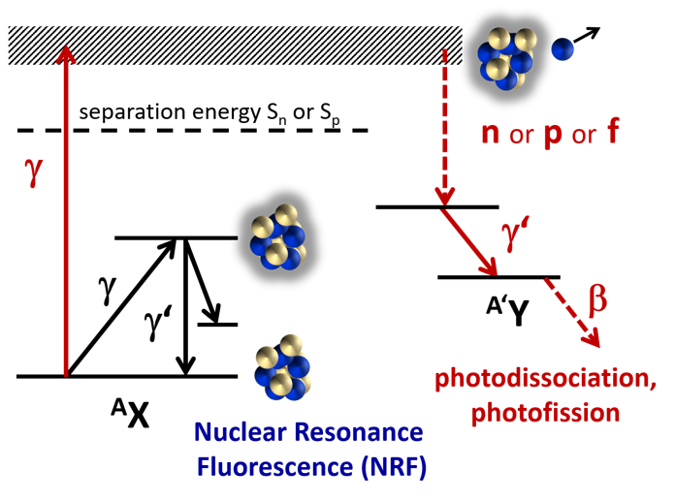
Photonuclear reactions with lcb beams
pure electromagnetic interaction
- (nuclear) model independent
min. angular momentum transfer
- spin selectivity
polarization
- parity related observables
narrow bandwidth
- explore specific excitation energy
A. Zilges, D. L. Balabanski, J. Isaak, N. Pietralla, PPNP 122 (2022) 103903.

Slide 5
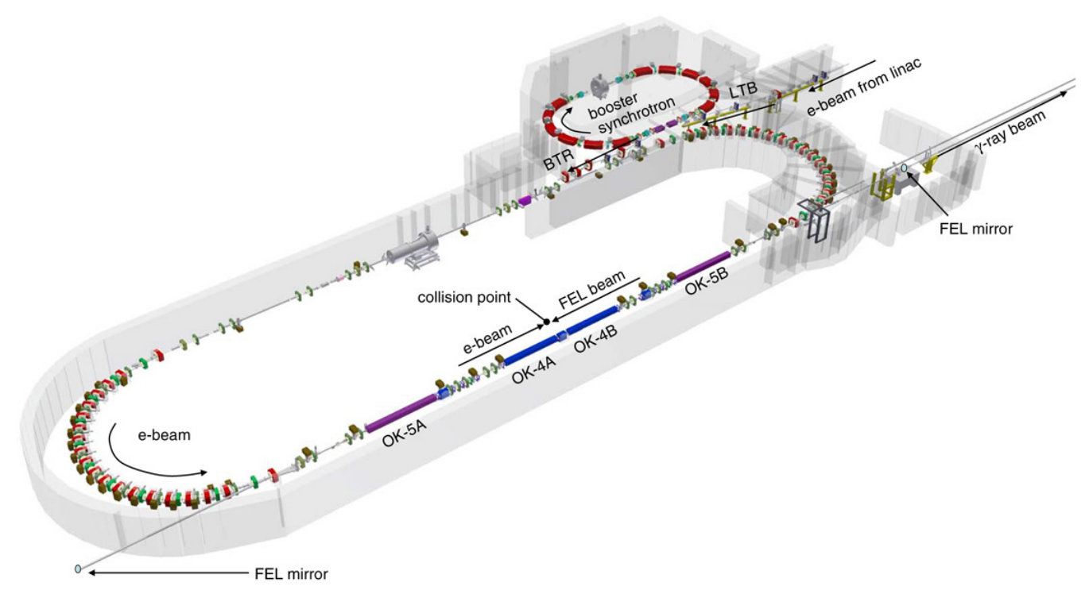
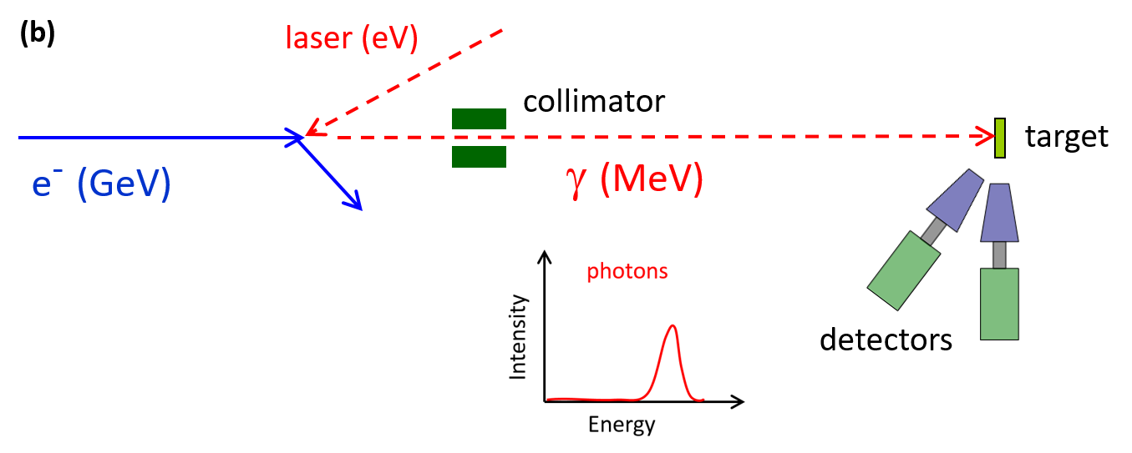
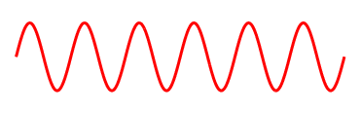
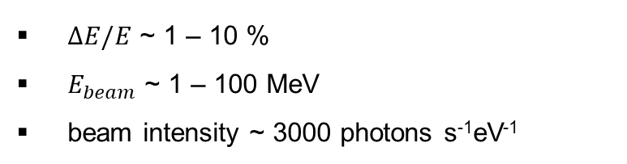
Experiment | photonuclear reactions with LCB beams
Laser-Compton Backscattering
High Intensity $γ$-ray Source (HI$γ$S) at Duke University
quasi-monoenergetic
variable photon beam energies
linear and circular polarization
$ΔE/E$ ~ 1 – 10 %
$E_{beam}$ ~ 1 – 100 MeV
beam intensity ~ 3000 photons s⁻¹eV⁻¹
H.R. Weller et al., Prog. Part. Nucl. Phys. 62 (2009) 257.

Slide 6
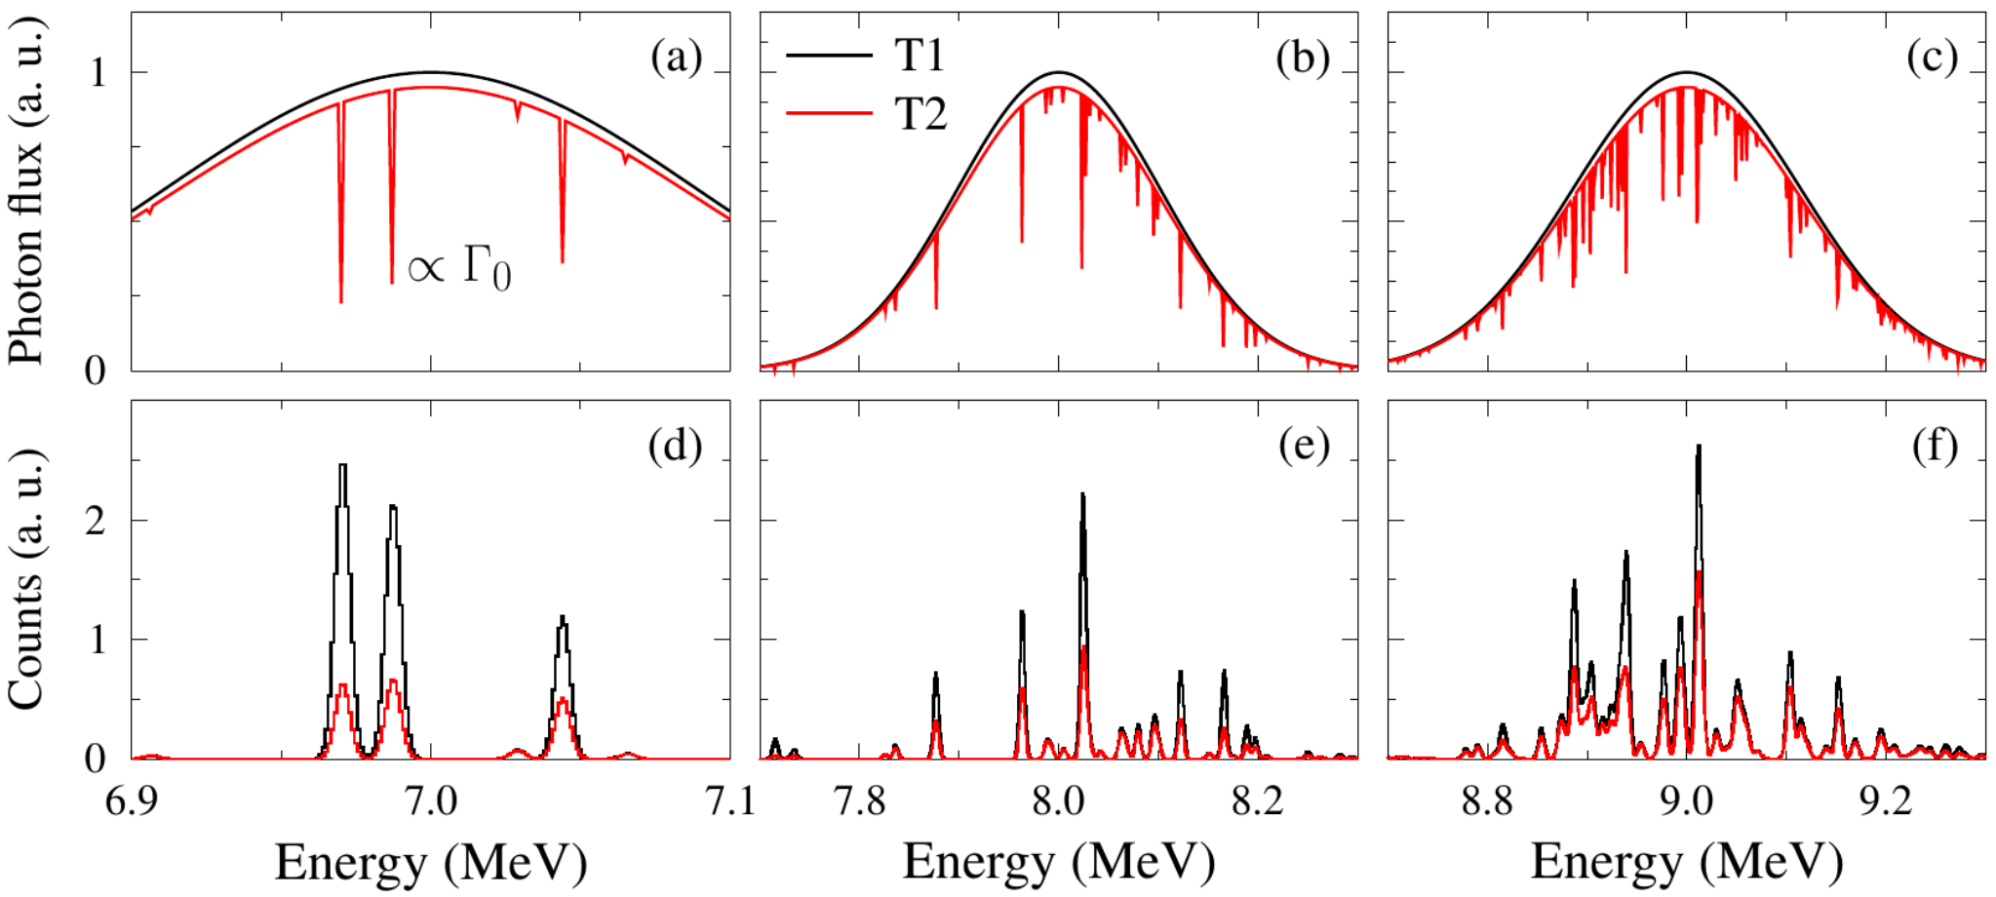
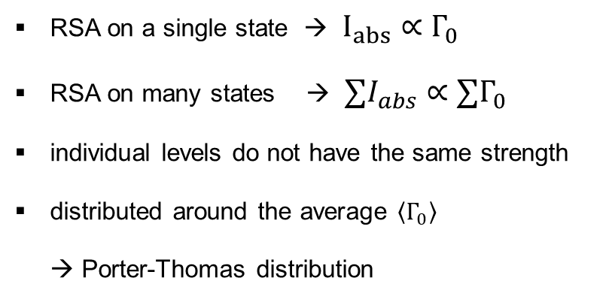
Method | nuclear selfabsorption
Target-1
Absorber
Target-2
RSA on a single state → $I_{abs}∝Γ_{0}$
RSA on many states → $∑I_{abs}∝∑Γ_{0}$
individual levels do not have the same strength
distributed around the average $\left\langle Γ_{0}\right\rangle$
→ Porter-Thomas distribution
Metzger, PNP 7 (1959) 53.
Pietralla et al., PRC 51 (1995) 1021.
Romig et al., PLB 744 (2015) 369-374.

Slide 7
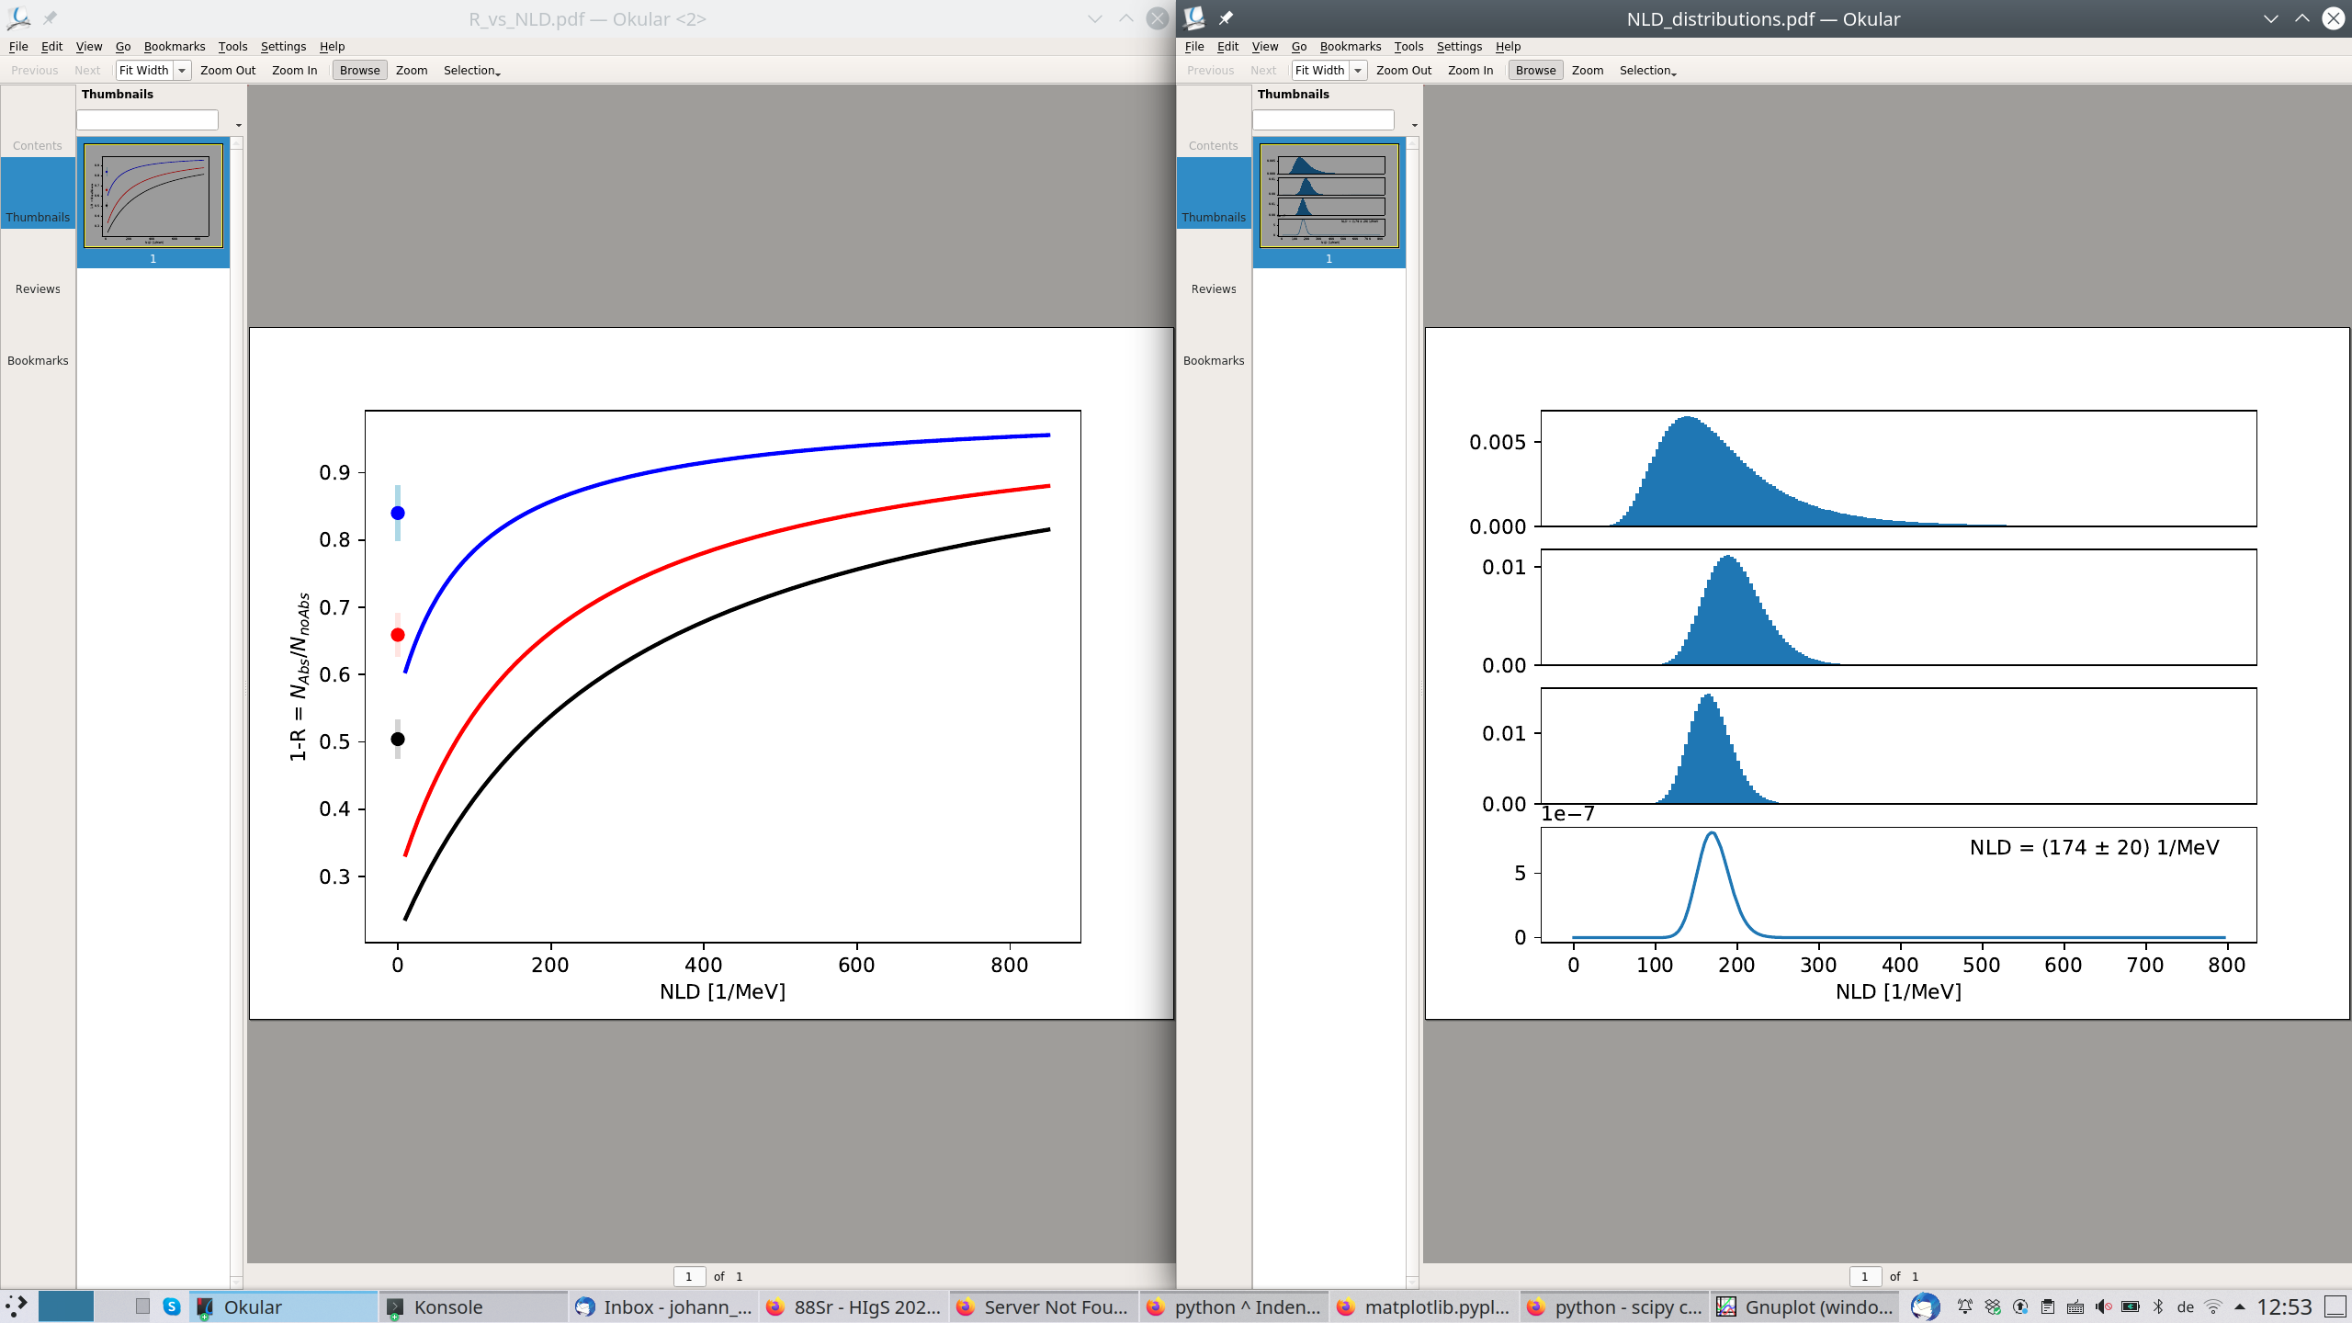


method | integral nuclear selfabsorption
Target-1
Absorber
Target-2
$∑Γ_{0}$ = constant
$$1−R=\frac{N_{Abs}}{N_{noAbs}}$$
Nuclear level density

Slide 8
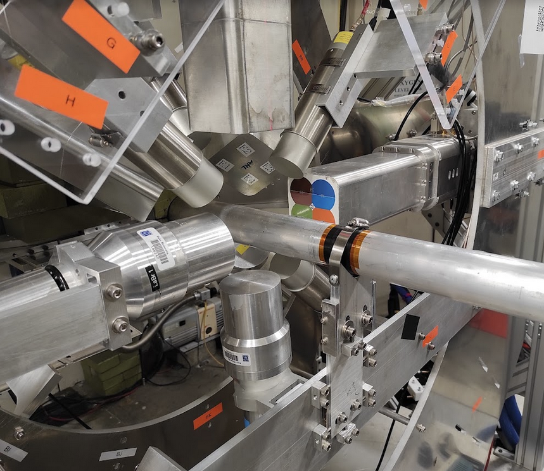
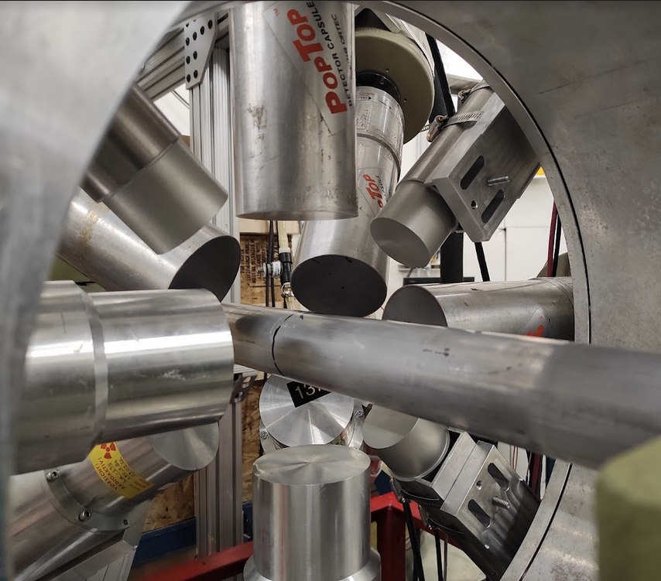
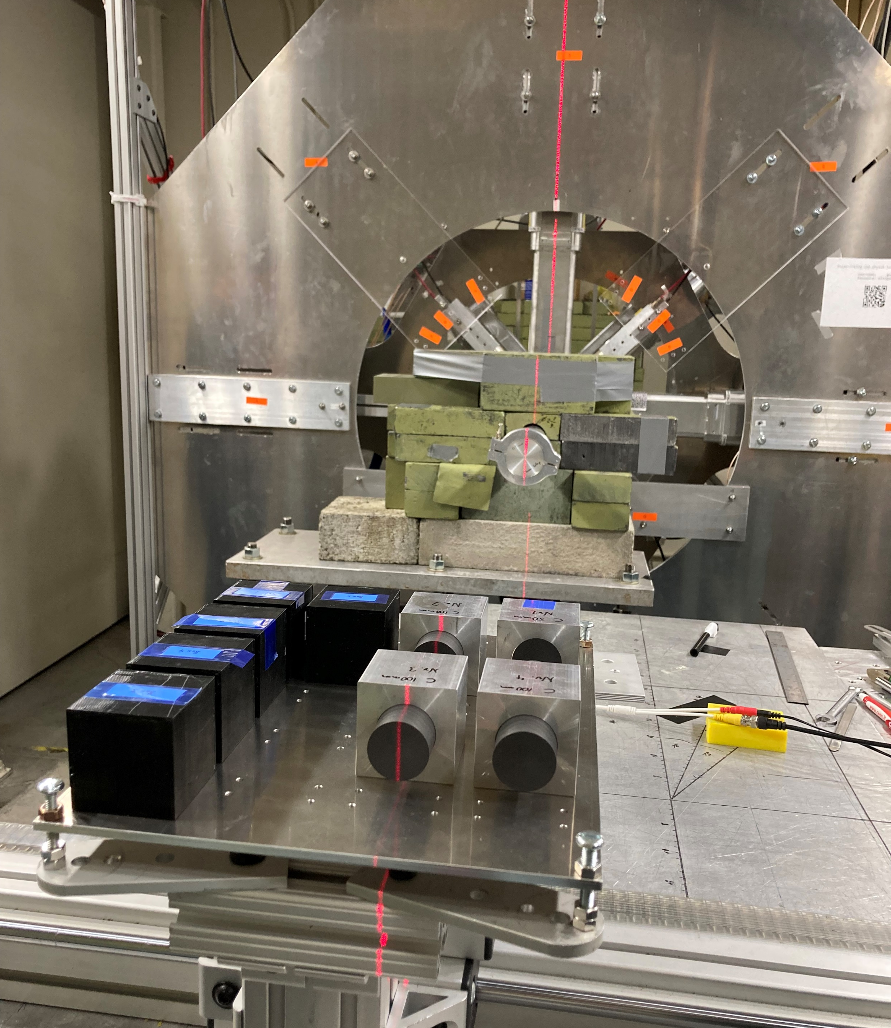
Experiment | measurement setup
Target-1
Absorber
Target-2
D. Savran und J. Isaak, Nucl. Instr. Meth. Res. A899 (2018) 28-31.

Slide 9
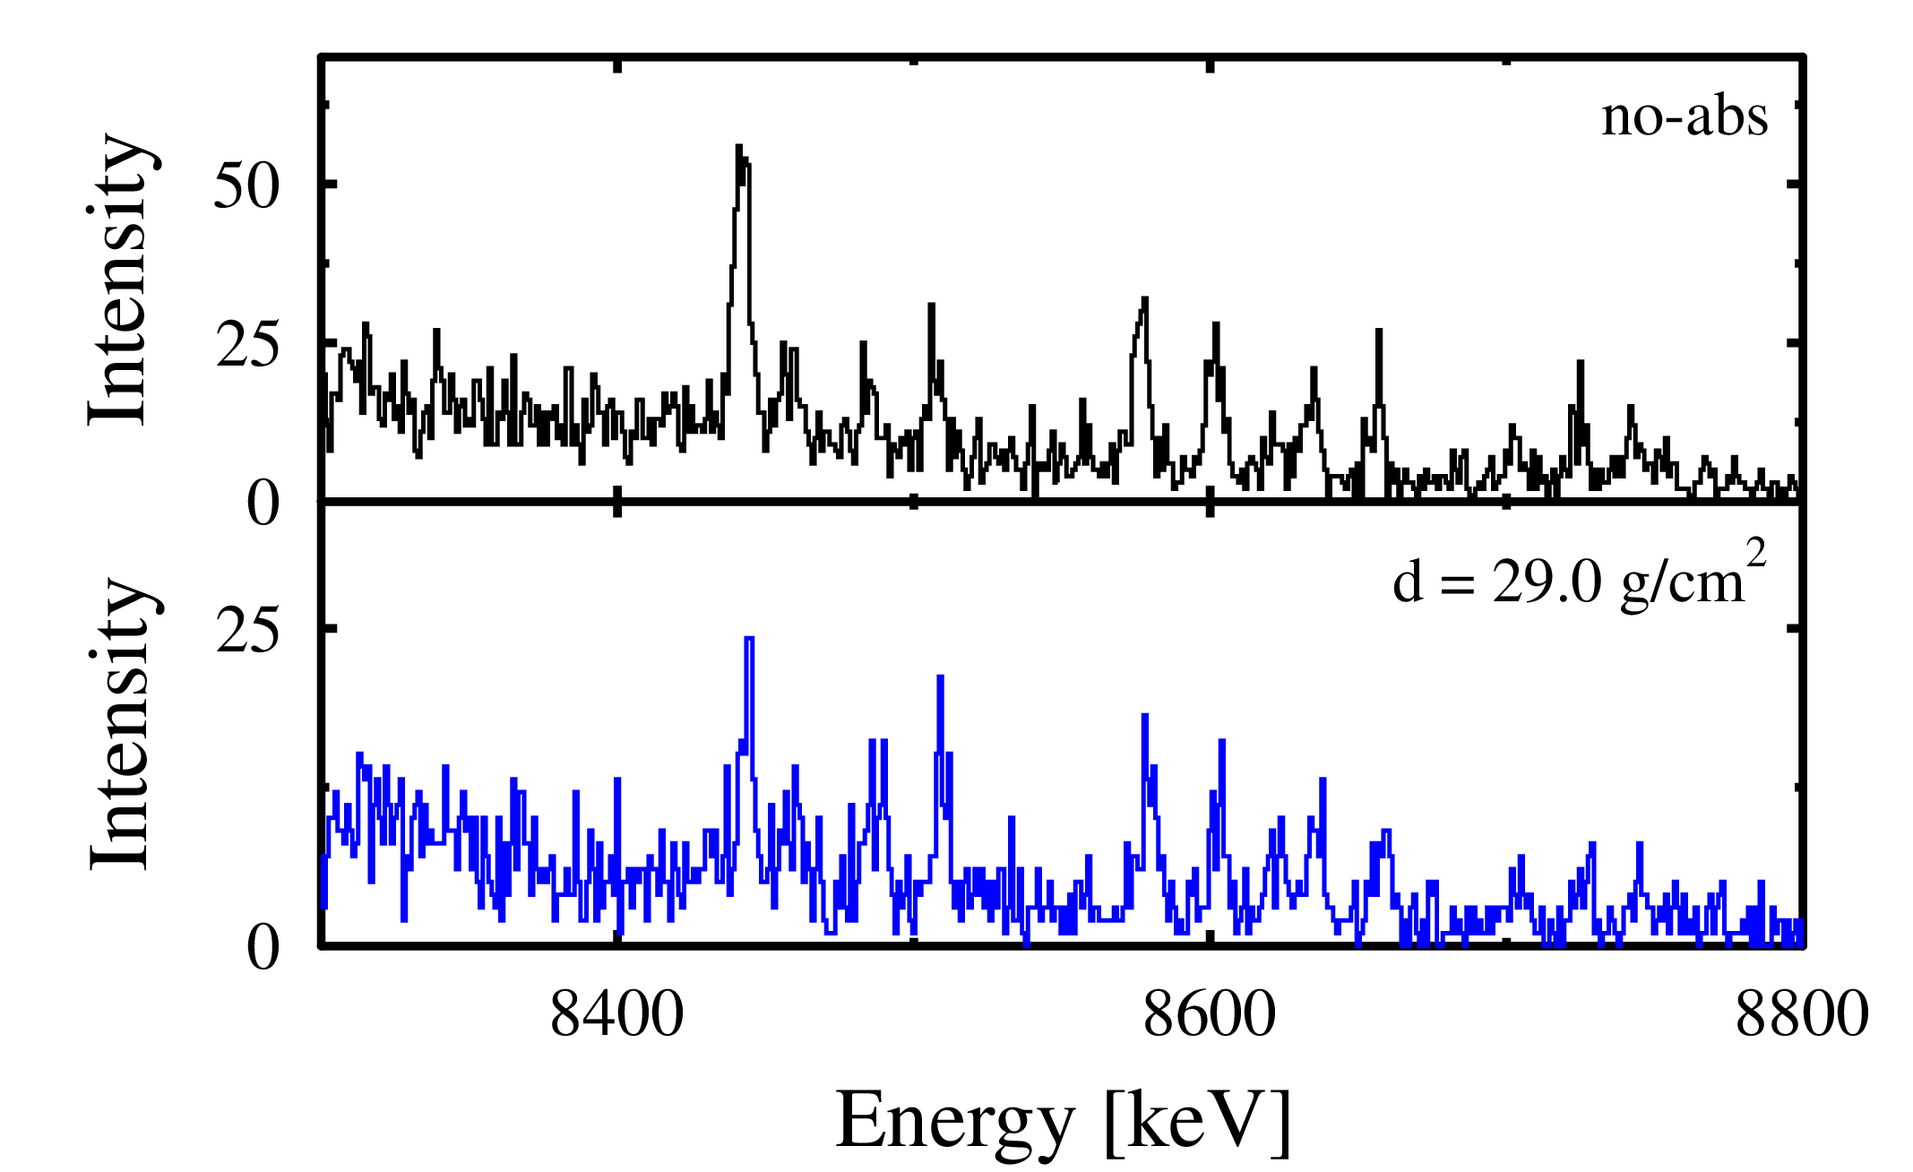
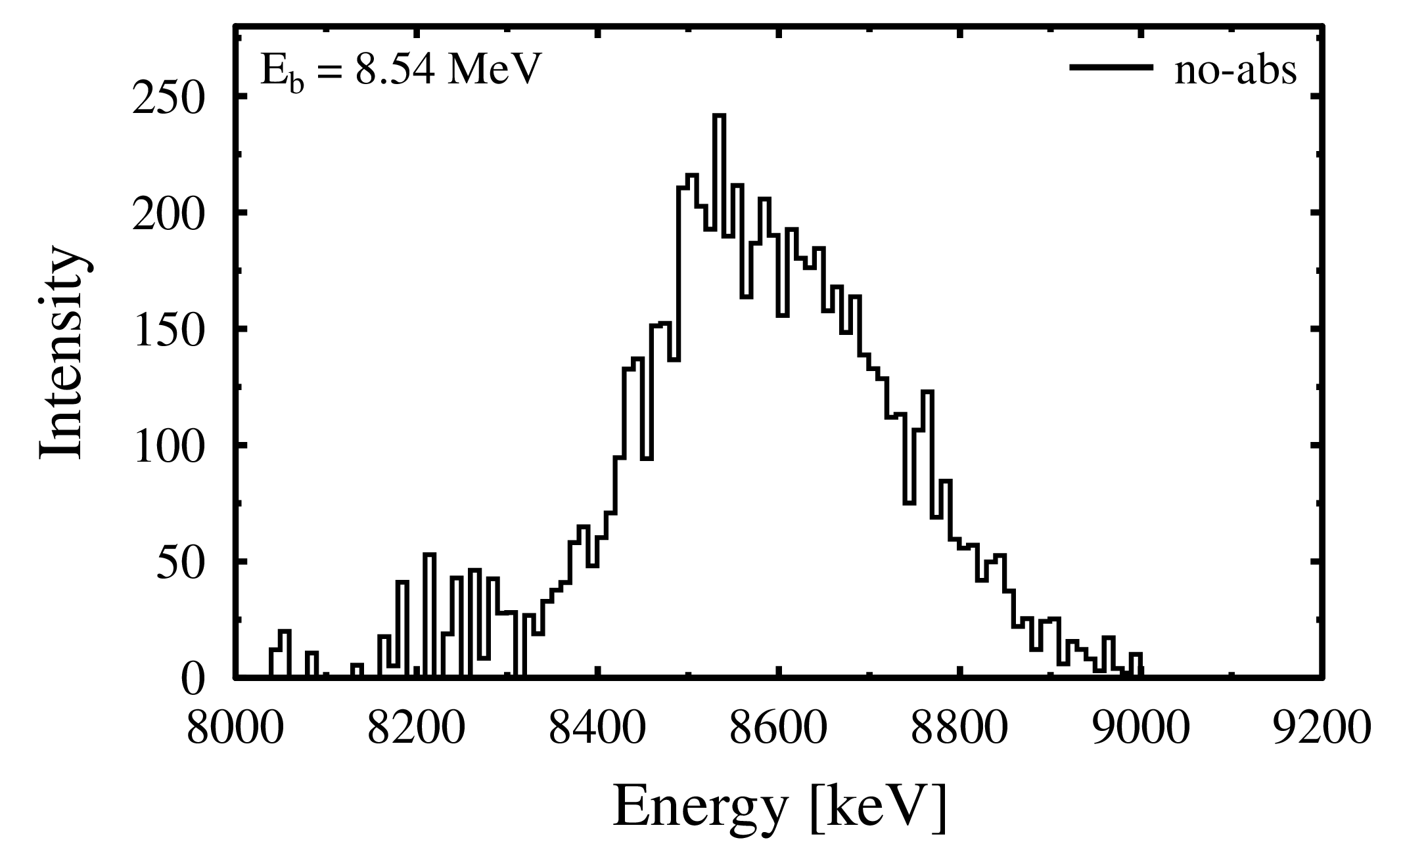
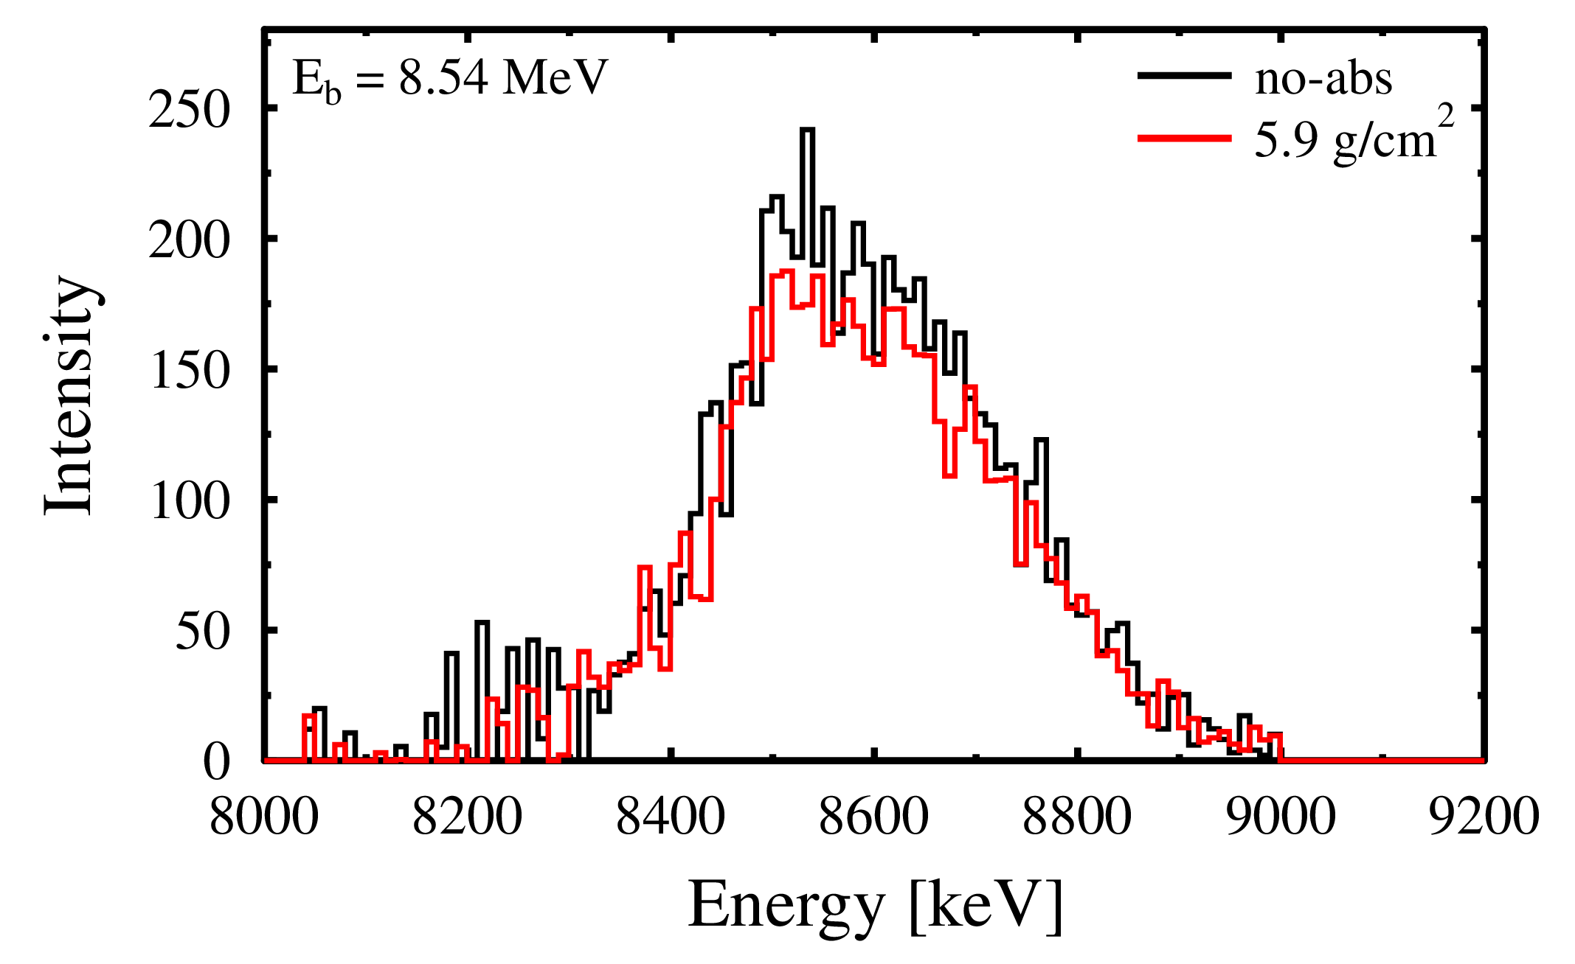
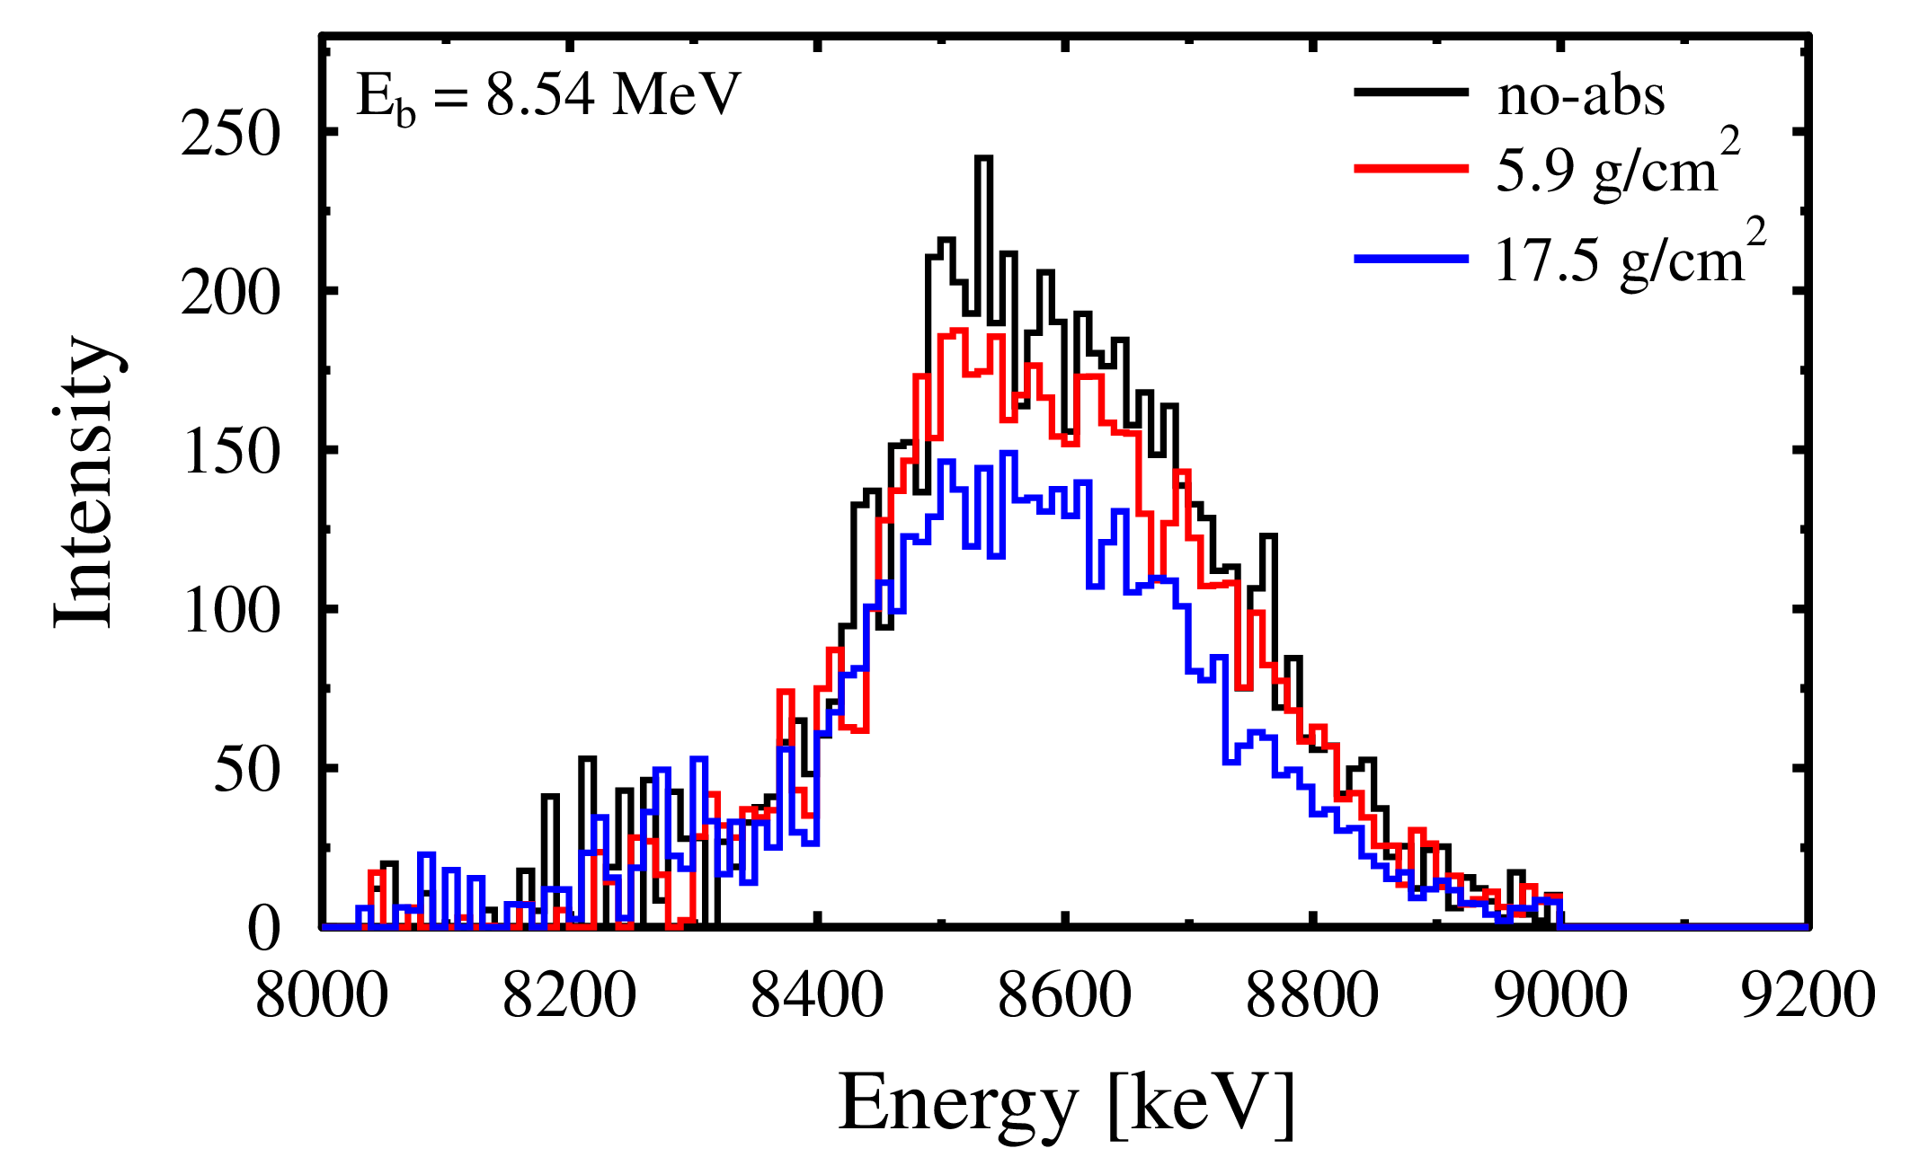
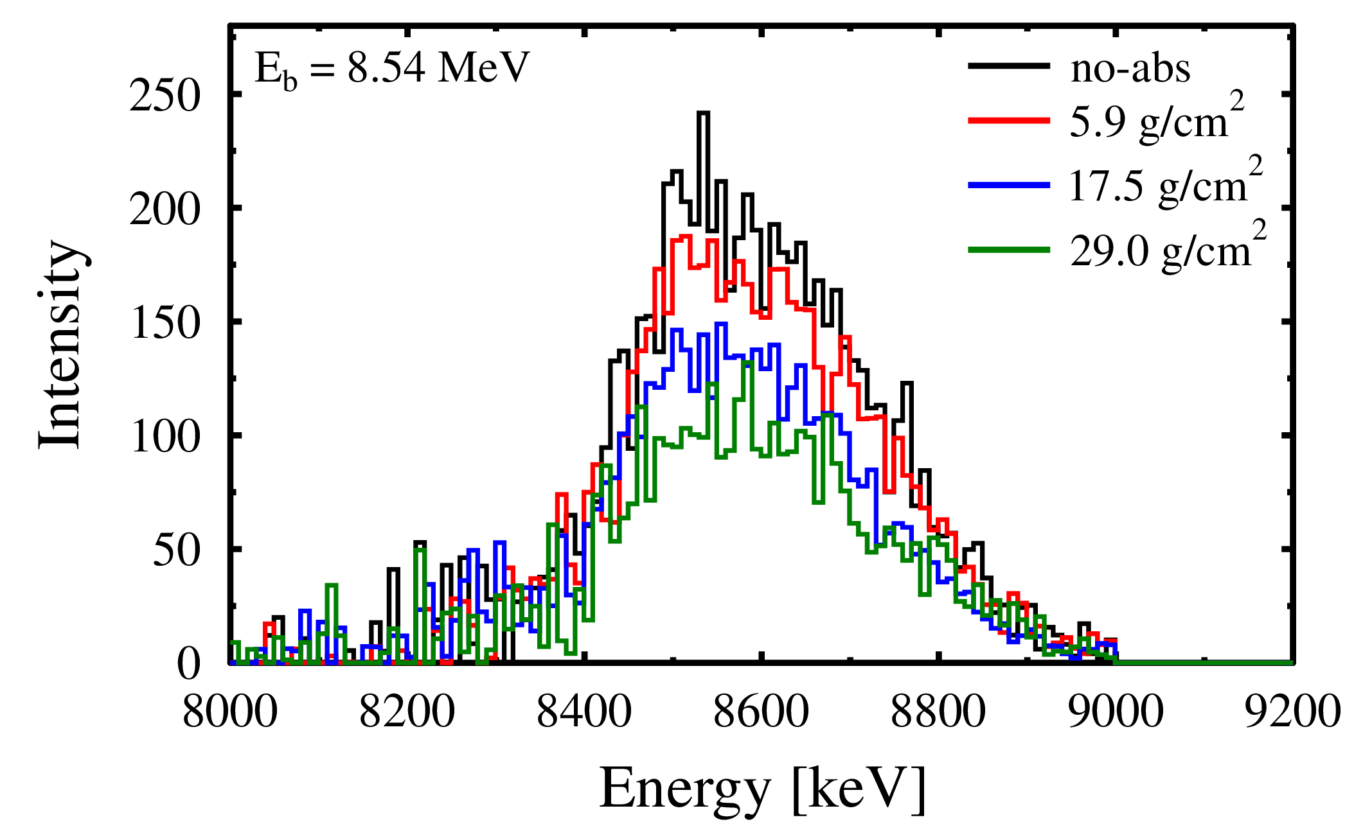
experiment | spectra: the case of ⁸⁸Sr
linearly-polarized photon beam → sensitive to $J^{π}=1^{−}$ states
HPGe
LaBr

Slide 10
analysis | connect rsa with nld: the case of ⁸⁸sr
⁸⁸Sr: E_{b} = 8540 keV
d = 5.9 g/cm²

Slide 11
analysis | connect rsa with nld: the case of ⁸⁸sr
⁸⁸Sr: E_{b} = 8540 keV
d = 17.5 g/cm²
d = 5.9 g/cm²

Slide 12
analysis | connect rsa with nld: the case of ⁸⁸sr
⁸⁸Sr: E_{b} = 8540 keV
d = 29.0 g/cm²
d = 17.5 g/cm²
d = 5.9 g/cm²

Slide 13
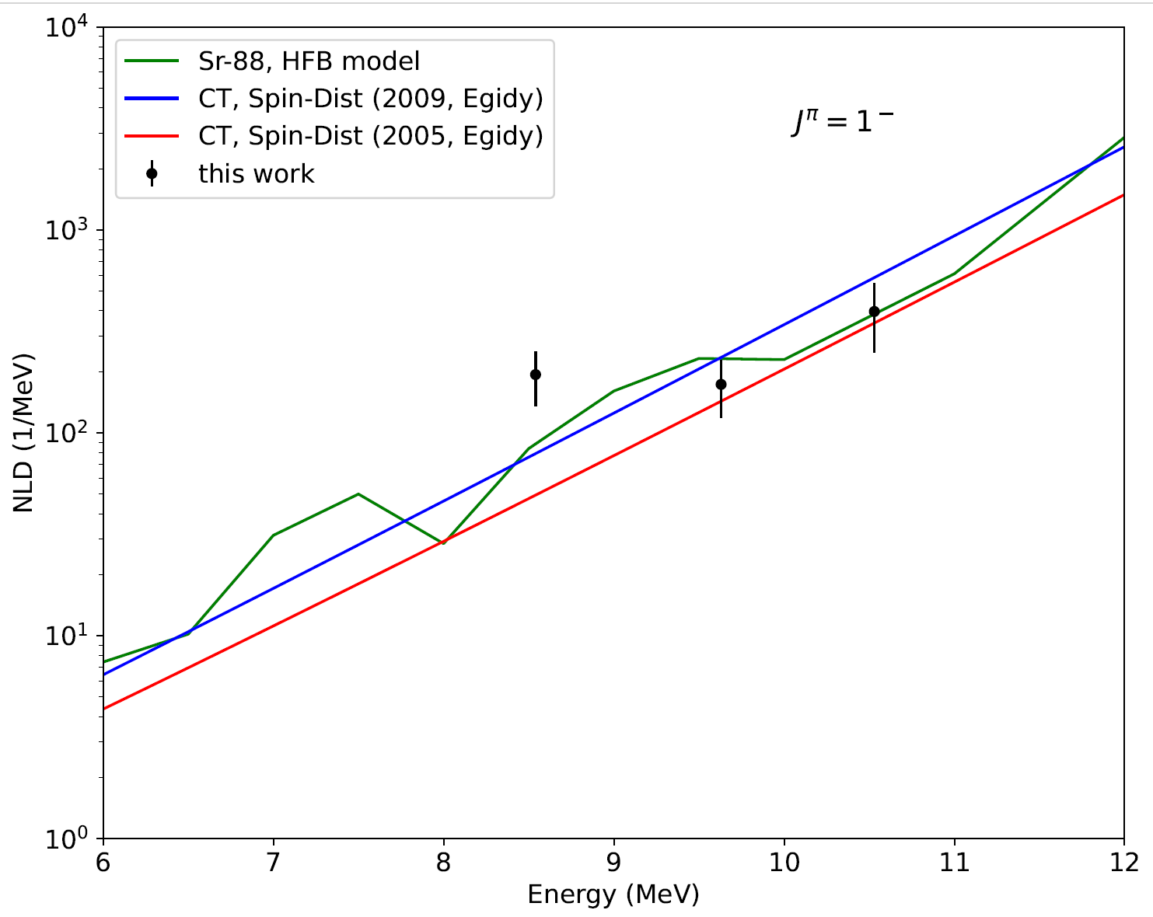
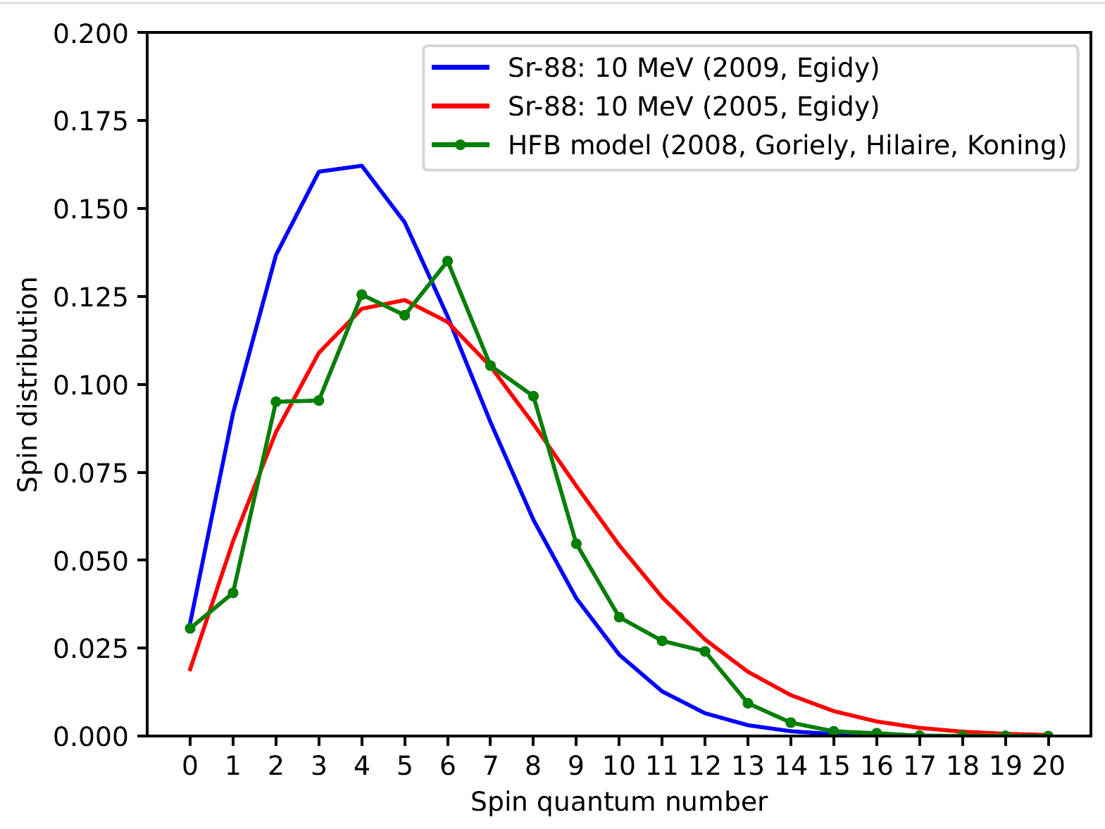
(preliminary) results | comparison to theory: the case of ⁸⁸sr
PRELIMINARY
Can we learn something about the underlying spin distribution?
S. Goriely, S. Hilaire, A.J. Koning, PRC 78 (2008) 064307

Slide 14





Thank you & Collaboration
M. Beuschlein, A. Gupta, J. Hauf, P. Koseoglou, O. Papst, N. Pietralla and V. Werner
IKP, TU Darmstadt, Germany
D. Savran and B. Löher
GSI, Darmstadt, Germany
A.D. Ayangeakaa, S.W. Finch, D. Gribble, R.V.F. Janssens, S.R. Johnson, T. Kowalewski and A. Saracino
UNC, Chapel Hill, NC, USA
TUNL, Durham, NC, USA
Duke U., Durham, NC, USA

