Slide 1
DISTRIBUTION OF CONTINUUM LEVELS AS A FUNCTION OF J FOR DEFORMED NUCLEI
S.M. Grimes
Ohio University

Slide 2
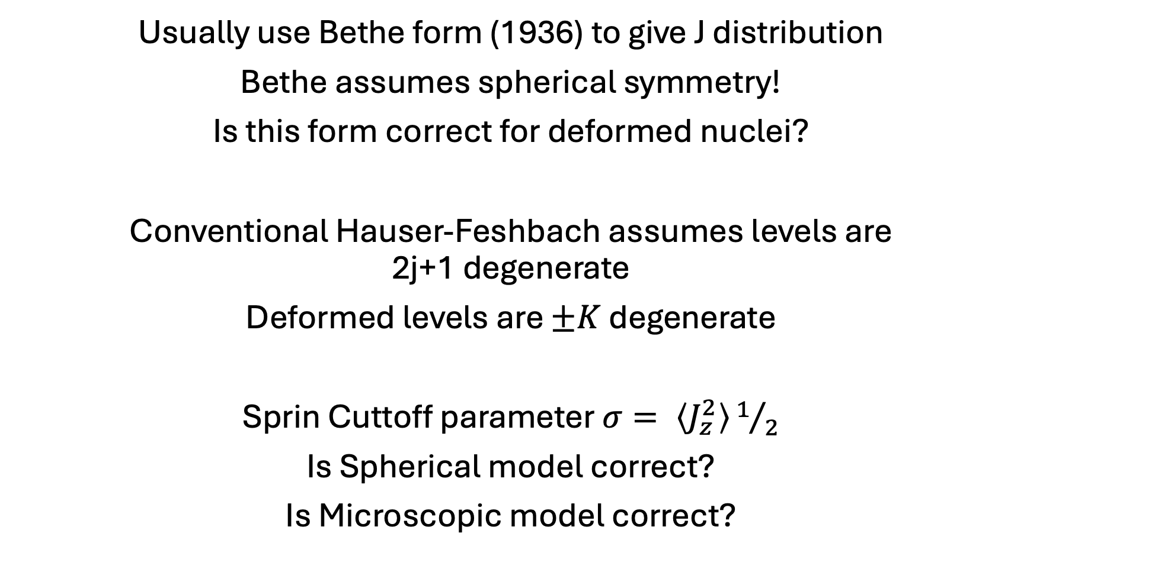
Usually use Bethe form (1936) to give J distribution
Bethe assumes spherical symmetry!
Is this form correct for deformed nuclei?
Conventional Hauser-Feshbach assumes levels are 2j+1 degenerate
Deformed levels are $±K$ degenerate
Sprin Cuttoff parameter $σ= \left\langle J_{z}^{2}\right\rangle 1/2$
Is Spherical model correct?
Is Microscopic model correct?

Slide 3
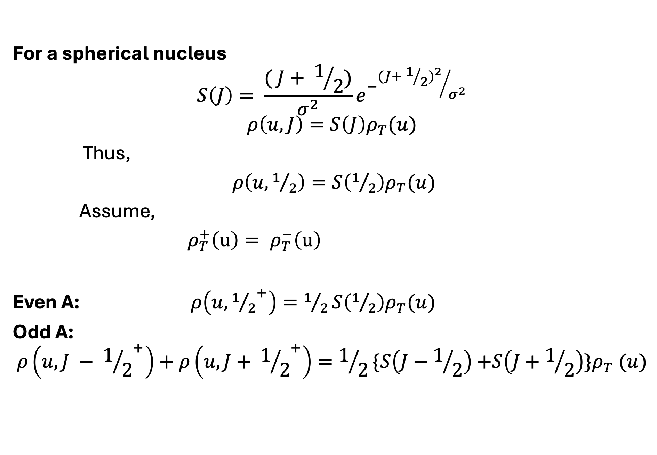
For a spherical nucleus
$$S\left(J\right)= \frac{( J+ 1/2)}{σ^{2}}e^{−{{(J+ 1/2)}^{2}}/{σ^{2}}}$$
$$ρ\left(u, J\right)=S\left(J\right)ρ_{T}(u)$$
Thus,
$ρ\left(u,1/2\right)=S\left(1/2\right)ρ_{T}(u)$
Assume,
$ρ_{T}^{+}\left(u\right)= ρ_{T}^{−}\left(u\right)$
Even A: $ρ\left(u,{1/2}^{+}\right)=1/2S\left(1/2\right)ρ_{T}(u)$
Odd A:
$$ρ\left(u,{J − 1/2}^{+}\right)+ρ\left(u,{J+ 1/2}^{+}\right)=1/2\{S\left(J−1/2\right){+S\left(J+1/2\right)\}ρ}_{T}(u)$$

Slide 4
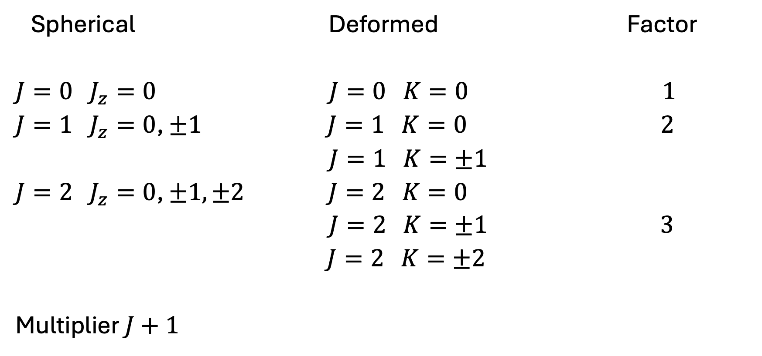
Axial Deformation
Spherical Deformed Factor
$J=0 J_{z}=0$ $J=0 K=0$ $1$
$J=1 J_{z}=0$, $±1$ $J=1 K=0$ $2$
$J=1 K=±1$
$J=2 J_{z}=0$, $±1,±2 J=2 K=0$
$J=2 K=±1$ $3$
$J=2 K=±2$
Multiplier $J+1$

Slide 5
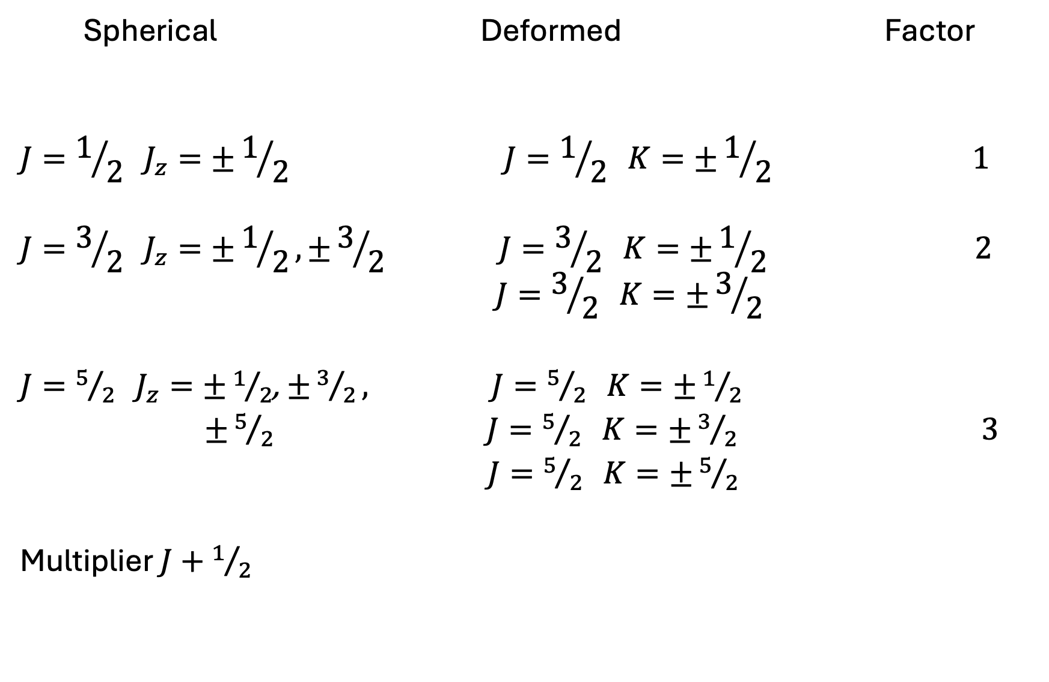
Spherical Deformed Factor
$$J=1/2 J_{z}=±1/2 J=1/2 K=±1/2 1$$
$$J=3/2 J_{z}=±1/2,±3/2 J=3/2 K=±1/{2 }2$$
$$J=3/2 K=±3/2$$
$J=5/2 J_{z}=±1/2$, $±3/2,$ $J=5/2 K=±1/{2 }$
$±5/{2 } J=5/2 K=±3/2 3$
$J=5/2 K=±5/2$
Multiplier $J+1/2$

Slide 6

Also build bands
No multipliers for $J=0, 1/2$
Total multiplication integer $J$
$$R\left(J\right)= \frac{(J+1)(J+2)}{2} level density$$
Half integer J
$$R\left(J\right)= \frac{\left(J+1/2\right)\left(J+3/{2 }\right)}{2} level density$$
Summed over J
Factor $σ_{⊥}^{2}$

Slide 7
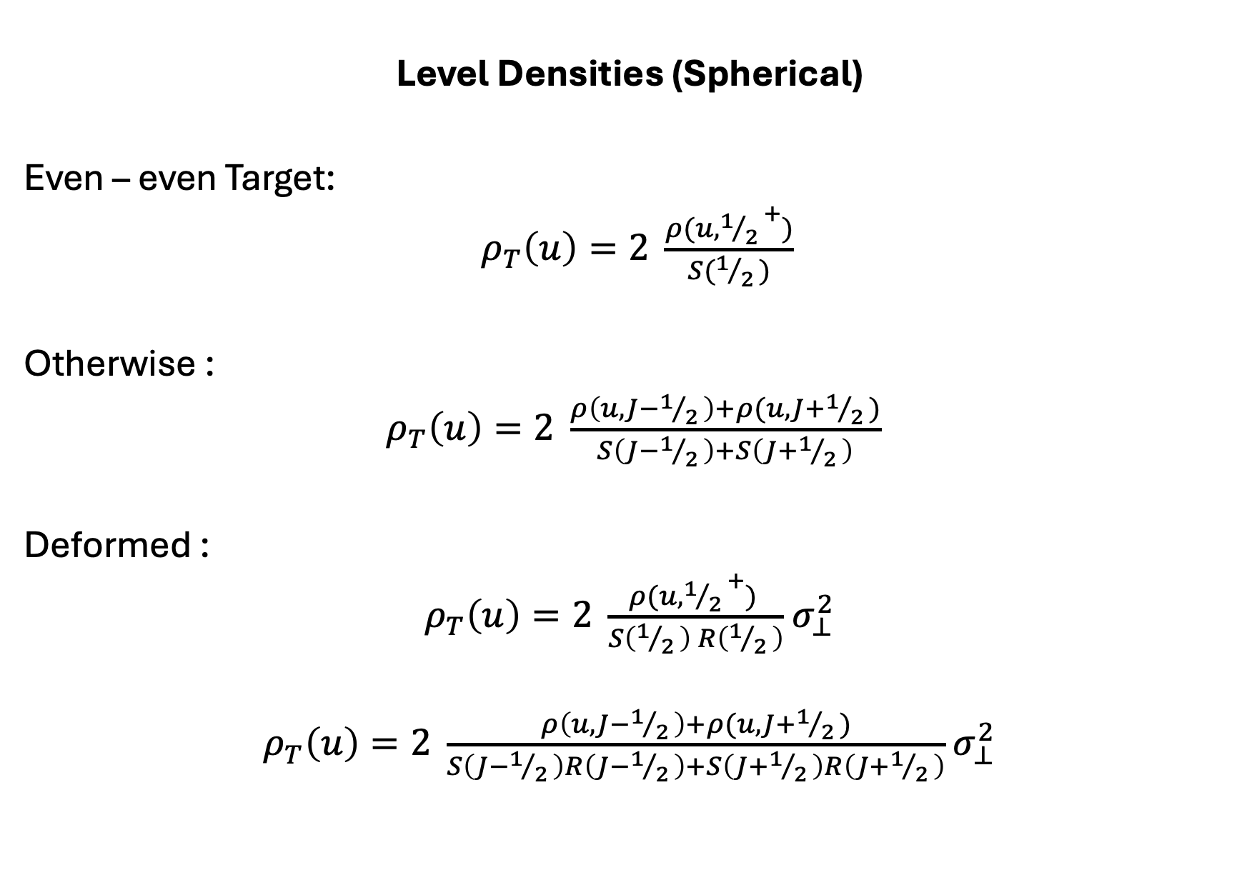
Level Densities (Spherical)
Even – even Target:
$ρ_{T}\left(u\right)=2 \frac{ρ(u,{1/{2 }}^{+})}{S(1/{2 })}$
Otherwise :
$ρ_{T}\left(u\right)=2 \frac{ρ\left(u,J−1/{2 }\right)+ρ(u,J+1/{2 })}{S\left(J−1/{2 }\right)+S\left(J+1/{2 }\right)}$
Deformed :
$ρ_{T}\left(u\right)=2 \frac{ρ(u,{1/{2 }}^{+}) }{S\left(1/{2 }\right) R\left(1/{2 }\right)}$ $σ_{⊥}^{2}$
$ρ_{T}\left(u\right)=2 \frac{ρ\left(u,J−1/{2 }\right)+ρ(u,J+1/{2 })}{S\left(J−1/{2 }\right)R\left(J−1/{2 }\right)+S\left(J+1/{2 }\right)R\left(J+1/{2 }\right)}$ $σ_{⊥}^{2}$

Slide 8
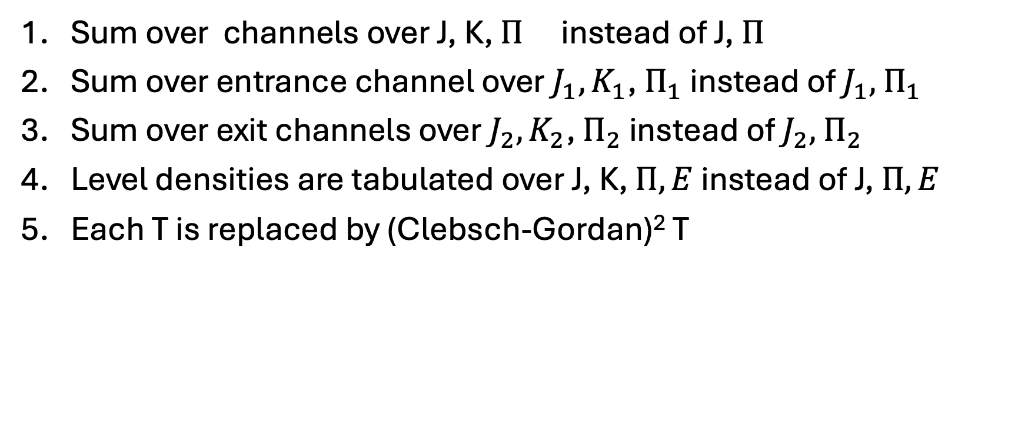
Changes to HF
Sum over channels over J, K, $Π$ instead of J, $Π$
Sum over entrance channel over $J_{1},K_{1}$, $Π_{1}$ instead of $J_{1},$ $Π_{1}$
Sum over exit channels over $J_{2},K_{2}$, $Π_{2}$ instead of $J_{2},$ $Π_{2}$
Level densities are tabulated over J, K, $Π, E$ instead of J, $Π, E$
Each T is replaced by (Clebsch-Gordan)² T

Slide 9
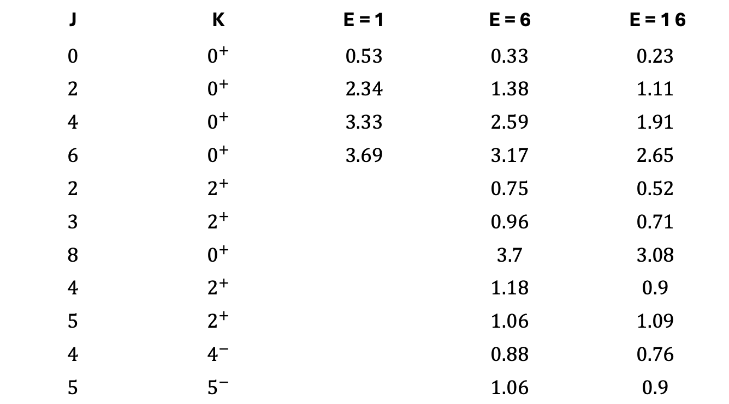
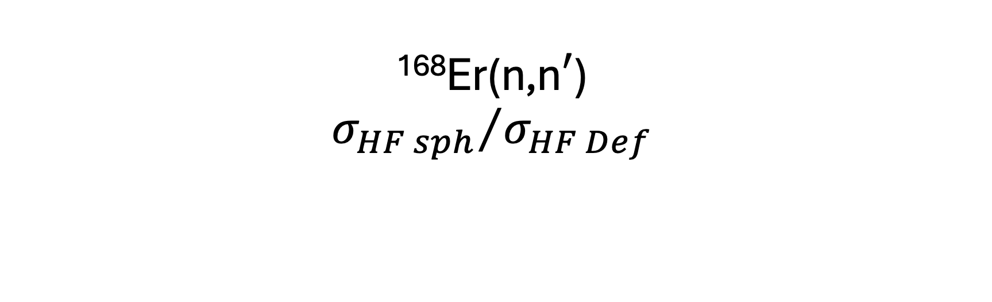
¹⁶⁸Er(n,n$′$)
$${σ_{HF sph}}/{σ_{HF Def}}$$
J | K | E = 1 | E = 6 | E = 1 6
$$0$$ | $$0^{+}$$ | $$0.53$$ | $$0.33$$ | $$0.23$$
$$2$$ | $$0^{+}$$ | $$2.34$$ | $$1.38$$ | $$1.11$$
$$4$$ | $$0^{+}$$ | $$3.33$$ | $$2.59$$ | $$1.91$$
$$6$$ | $$0^{+}$$ | $$3.69$$ | $$3.17$$ | $$2.65$$
$$2$$ | $$2^{+}$$ |  | $$0.75$$ | $$0.52$$
$$3$$ | $$2^{+}$$ |  | $$0.96$$ | $$0.71$$
$$8$$ | $$0^{+}$$ |  | $$3.7$$ | $$3.08$$
$$4$$ | $$2^{+}$$ |  | $$1.18$$ | $$0.9$$
$$5$$ | $$2^{+}$$ |  | $$1.06$$ | $$1.09$$
$$4$$ | $$4^{−}$$ |  | $$0.88$$ | $$0.76$$
$$5$$ | $$5^{−}$$ |  | $$1.06$$ | $$0.9$$

Slide 10
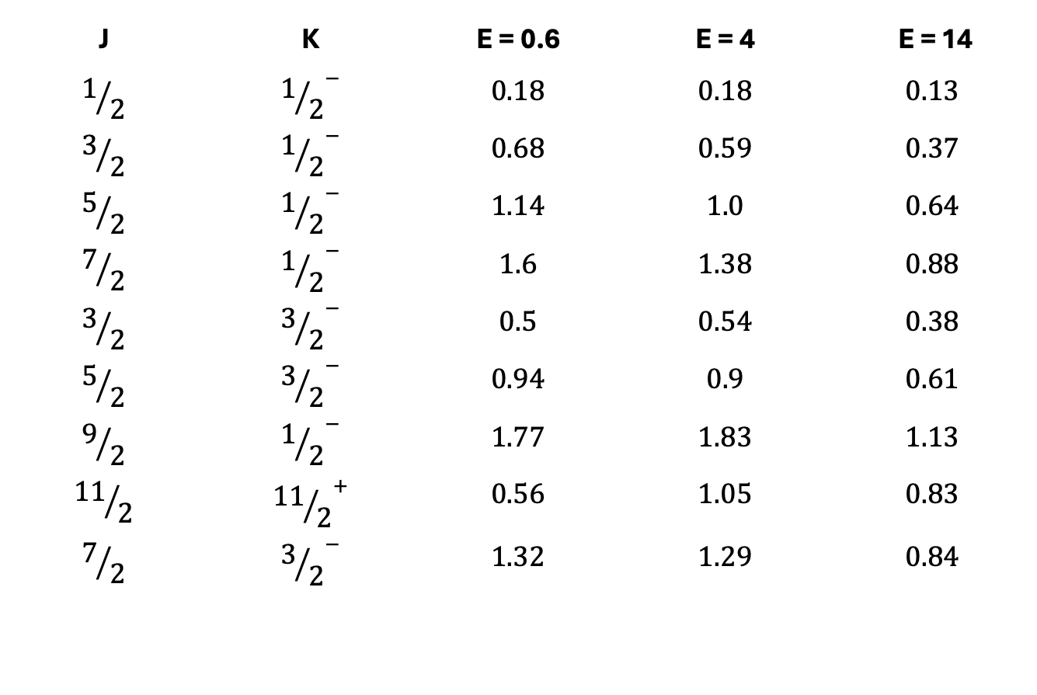
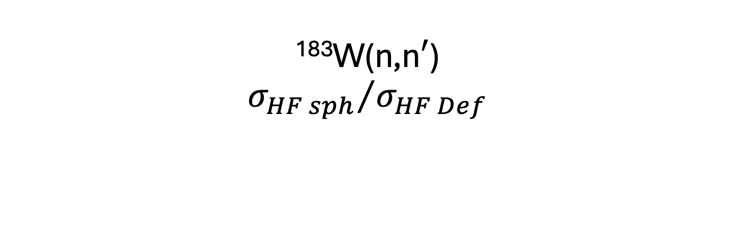
¹⁸³W(n,n$′$)
$${σ_{HF sph}}/{σ_{HF Def}}$$
J | K | E = 0.6 | E = 4 | E = 14
$$1/2$$ | $${1/2}^{−}$$ | $$0.18$$ | $$0.18$$ | $$0.13$$
$$3/2$$ | $${1/2}^{−}$$ | $$0.68$$ | $$0.59$$ | $$0.37$$
$$5/2$$ | $${1/2}^{−}$$ | $$1.14$$ | $$1.0$$ | $$0.64$$
$$7/2$$ | $${1/2}^{−}$$ | $$1.6$$ | $$1.38$$ | $$0.88$$
$$3/2$$ | $${3/2}^{−}$$ | $$0.5$$ | $$0.54$$ | $$0.38$$
$$5/2$$ | $${3/2}^{−}$$ | $$0.94$$ | $$0.9$$ | $$0.61$$
$$9/2$$ | $${1/2}^{−}$$ | $$1.77$$ | $$1.83$$ | $$1.13$$
$${11}/2$$ | $${{11}/2}^{+}$$ | $$0.56$$ | $$1.05$$ | $$0.83$$
$$7/2$$ | $${3/2}^{−}$$ | $$1.32$$ | $$1.29$$ | $$0.84$$

Slide 11
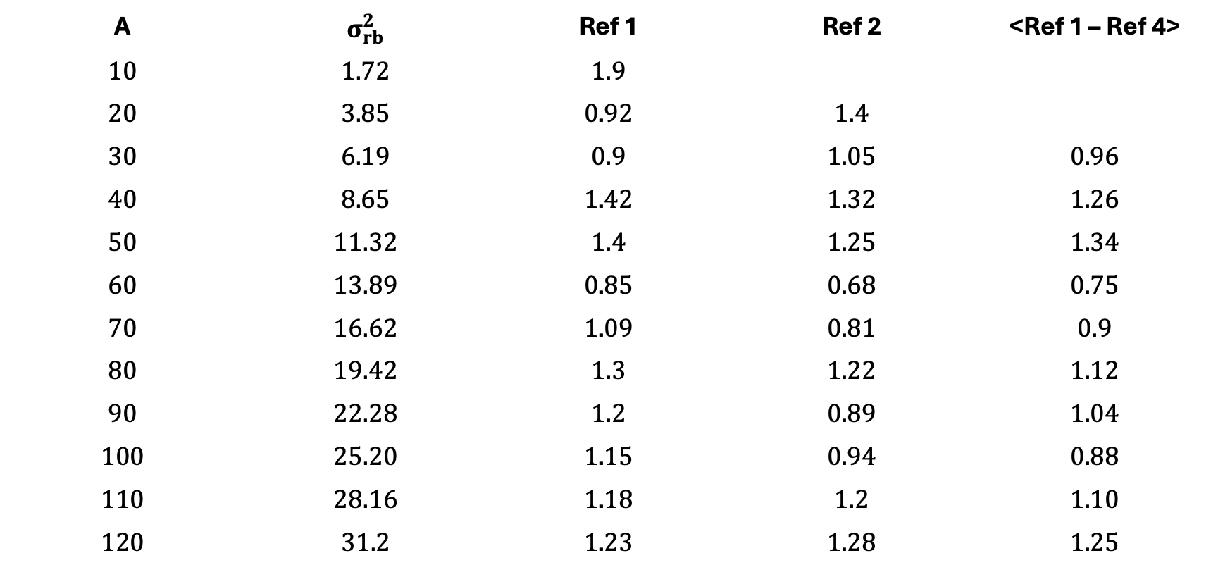
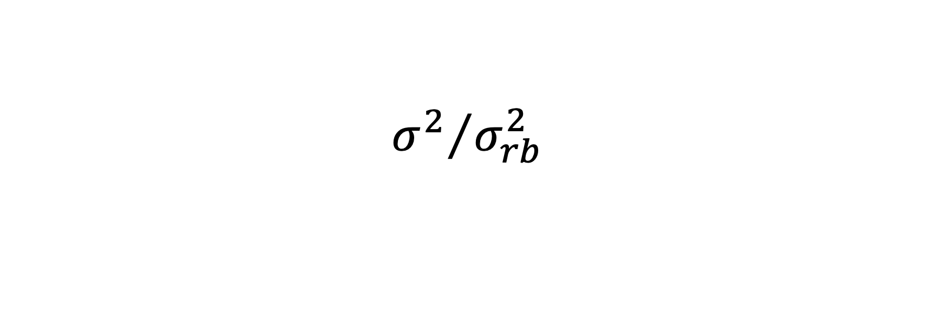
$${σ^{2}}/{σ_{rb}^{2}}$$
A | $$σ_{rb}^{2}$$ | Ref 1 | Ref 2 | <Ref 1 – Ref 4>
$$10$$ | $$1.72$$ | $$1.9$$
$$20$$ | $$3.85$$ | $$0.92$$ | $$1.4$$
$$30$$ | $$6.19$$ | $$0.9$$ | $$1.05$$ | $$0.96$$
$$40$$ | $$8.65$$ | $$1.42$$ | $$1.32$$ | $$1.26$$
$$50$$ | $$11.32$$ | $$1.4$$ | $$1.25$$ | $$1.34$$
$$60$$ | $$13.89$$ | $$0.85$$ | $$0.68$$ | $$0.75$$
$$70$$ | $$16.62$$ | $$1.09$$ | $$0.81$$ | $$0.9$$
$$80$$ | $$19.42$$ | $$1.3$$ | $$1.22$$ | $$1.12$$
$$90$$ | $$22.28$$ | $$1.2$$ | $$0.89$$ | $$1.04$$
$$100$$ | $$25.20$$ | $$1.15$$ | $$0.94$$ | $$0.88$$
$$110$$ | $$28.16$$ | $$1.18$$ | $$1.2$$ | $$1.10$$
$$120$$ | $$31.2$$ | $$1.23$$ | $$1.28$$ | $$1.25$$

Slide 12
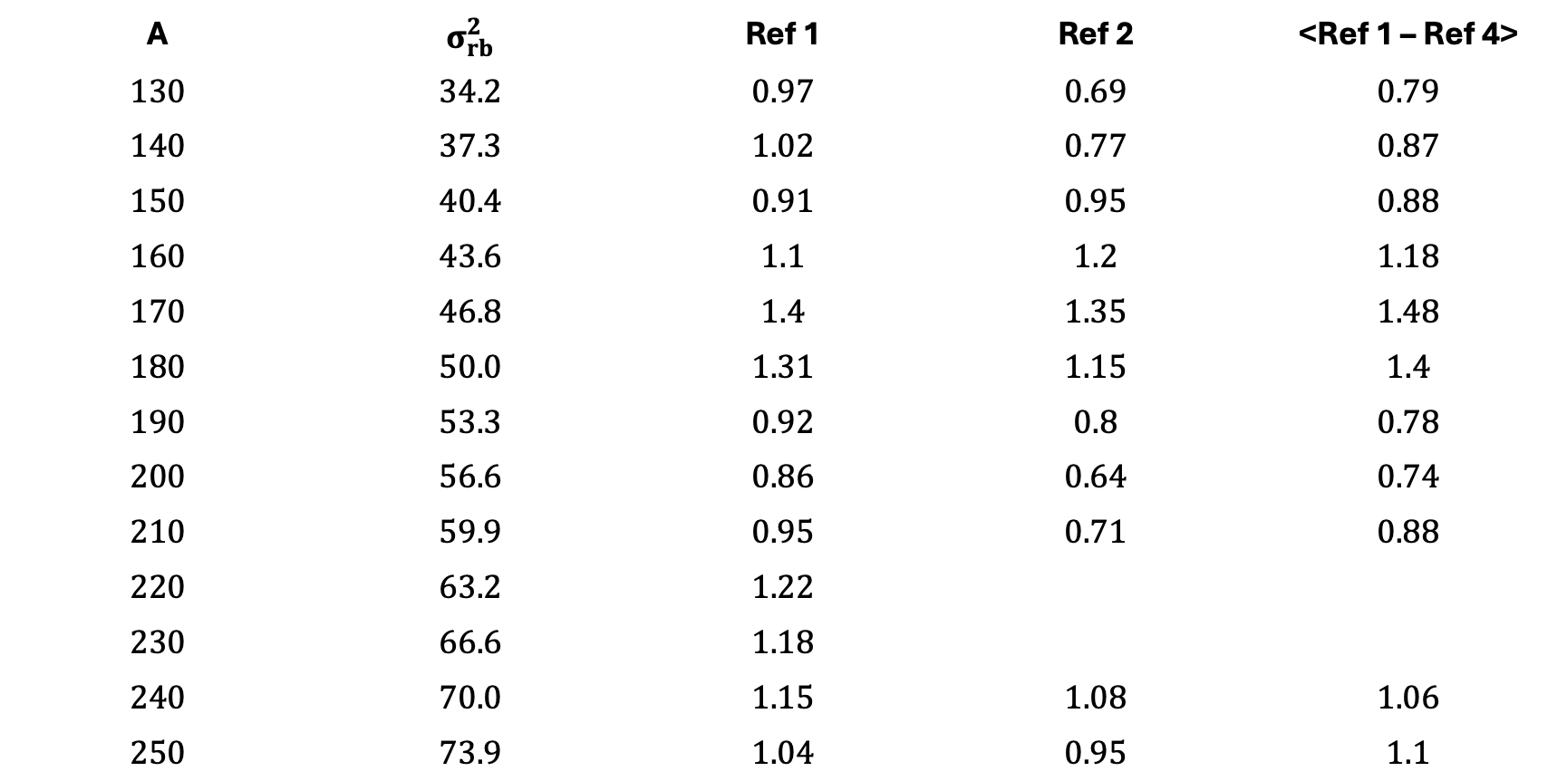
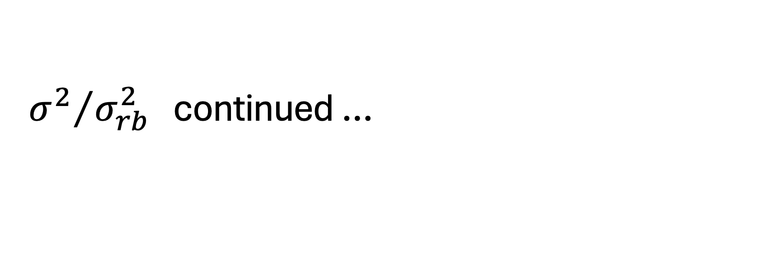
${σ^{2}}/{σ_{rb}^{2}}$ continued …
A | $$σ_{rb}^{2}$$ | Ref 1 | Ref 2 | <Ref 1 – Ref 4>
$$130$$ | $$34.2$$ | $$0.97$$ | $$0.69$$ | $$0.79$$
$$140$$ | $$37.3$$ | $$1.02$$ | $$0.77$$ | $$0.87$$
$$150$$ | $$40.4$$ | $$0.91$$ | $$0.95$$ | $$0.88$$
$$160$$ | $$43.6$$ | $$1.1$$ | $$1.2$$ | $$1.18$$
$$170$$ | $$46.8$$ | $$1.4$$ | $$1.35$$ | $$1.48$$
$$180$$ | $$50.0$$ | $$1.31$$ | $$1.15$$ | $$1.4$$
$$190$$ | $$53.3$$ | $$0.92$$ | $$0.8$$ | $$0.78$$
$$200$$ | $$56.6$$ | $$0.86$$ | $$0.64$$ | $$0.74$$
$$210$$ | $$59.9$$ | $$0.95$$ | $$0.71$$ | $$0.88$$
$$220$$ | $$63.2$$ | $$1.22$$
$$230$$ | $$66.6$$ | $$1.18$$
$$240$$ | $$70.0$$ | $$1.15$$ | $$1.08$$ | $$1.06$$
$$250$$ | $$73.9$$ | $$1.04$$ | $$0.95$$ | $$1.1$$

Slide 13
References
Ref 1 – S.M Grimes, A.V Voinov and T.N. Massey, P.R.C 94 014308
(2019)
Ref 2 – M. Gholani, M. Kildir, A.N Behkami,
Phys Rev C 75 044308(2007)
Ref 3 - A.N Behkami, Z. Kargar, M. Nastradali,
Phys Rev C 66 064307 (2002)
Ref 4 – J.R Huizenga, A.N Behkami, J.S. Sventek, R.W. Atcher, Nuc
Phys A223, 577 (1974)

Slide 14
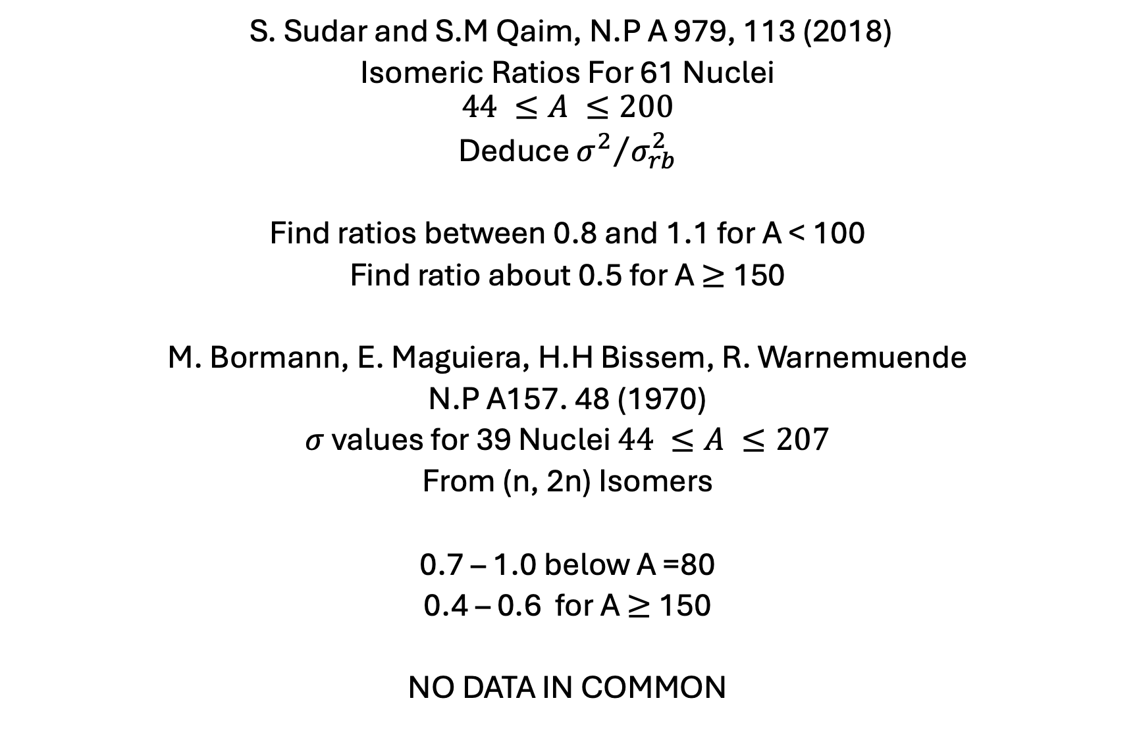
S. Sudar and S.M Qaim, N.P A 979, 113 (2018)
Isomeric Ratios For 61 Nuclei
$$44 ≤A ≤200$$
Deduce ${σ^{2}}/{σ_{rb}^{2}}$
Find ratios between 0.8 and 1.1 for A < 100
Find ratio about 0.5 for A$≥$ 150
M. Bormann, E. Maguiera, H.H Bissem, R. Warnemuende
N.P A157. 48 (1970)
$σ$ values for 39 Nuclei $44 ≤A ≤207$
From (n, 2n) Isomers
0.7 – 1.0 below A =80
0.4 – 0.6 for A$≥$ 150
NO DATA IN COMMON

Slide 15
Bormann Analysis
Only Compound
Only E1
Sudar Analysis
Used Talys
Includes Non Compound
Includes Gammas
Beyond E1
However, both analyses used spherical Hauser-Feshbach Codes

Slide 16
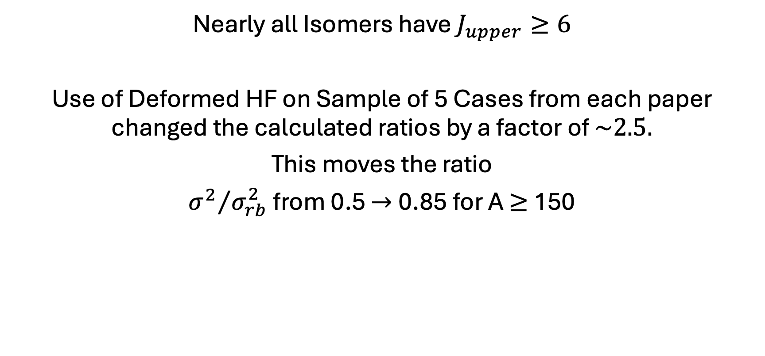
Conclusions
Nearly all Isomers have $J_{upper}≥6$
Use of Deformed HF on Sample of 5 Cases from each paper changed the calculated ratios by a factor of $\sim 2.5.$
This moves the ratio
${σ^{2}}/{σ_{rb}^{2}}$ from 0.5 $→$0.85 for A$≥$ 150

Slide 17
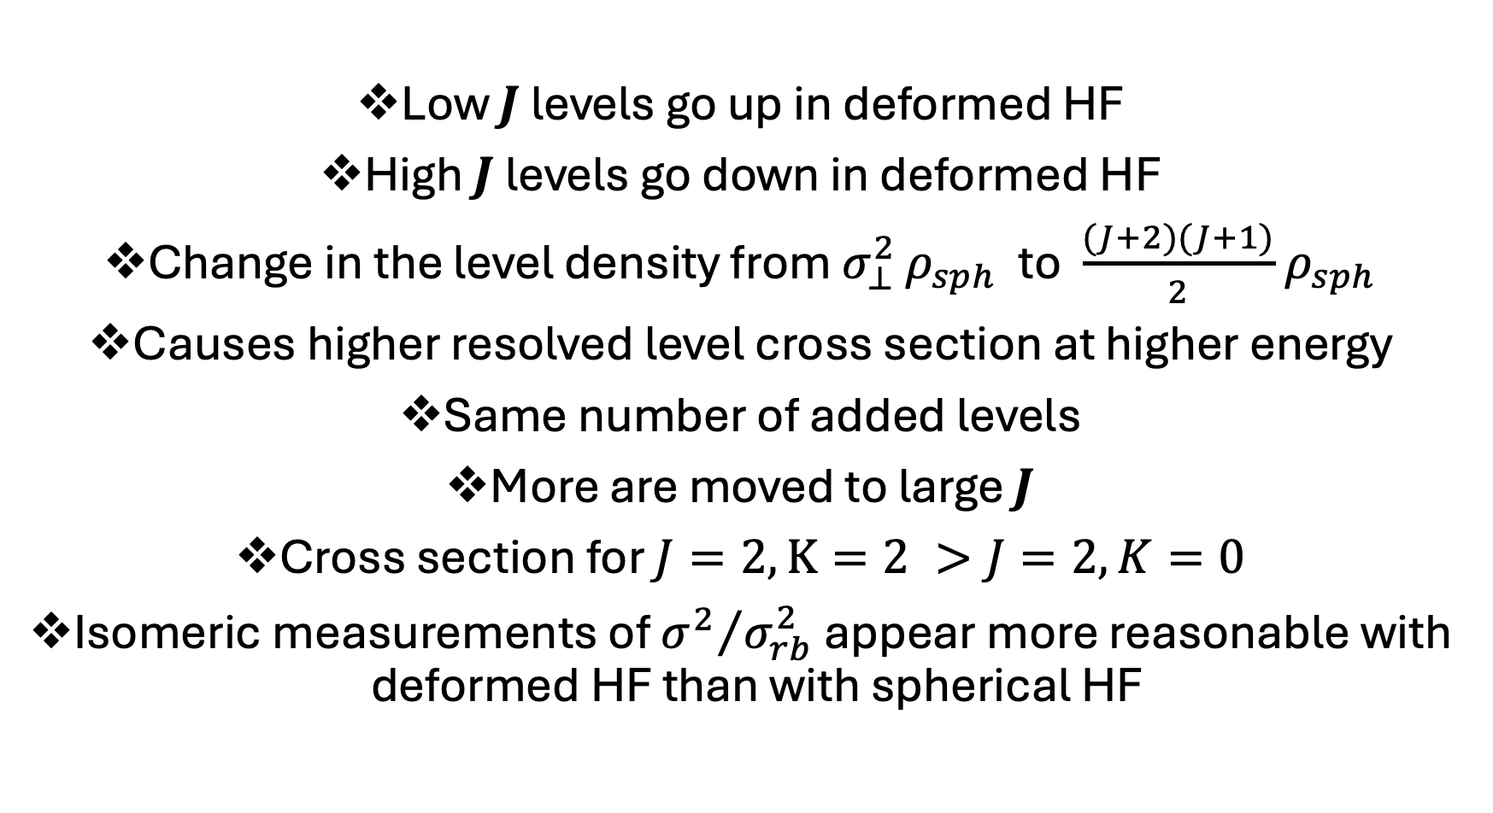
Summary
Low $J$ levels go up in deformed HF
High $J$levels go down in deformed HF
Change in the level density from $σ_{⊥}^{2 }ρ_{sph}$ to $\frac{(J+2)(J+1)}{2}$ $ρ_{sph}$
Causes higher resolved level cross section at higher energy
Same number of added levels
More are moved to large $J$
Cross section for $J=2,K=2 >J=2, K=0$
Isomeric measurements of ${σ^{2}}/{σ_{rb}^{2}}$ appear more reasonable with deformed HF than with spherical HF

