Slide 1


A large-scale shell model calculation study of ¹¹⁶Sn and ¹²⁰Sn
Jenny Finsrud
9th Workshop on Nuclear Level Density and Gamma Strength

Slide 2
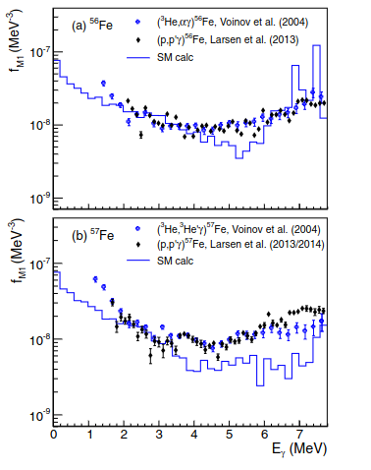
Motivation
Study the low-energy enhancement
M1 contribution
Impact astrophysical neutron-capture reaction rates
Figure from: B. A. Brown and A. C. Larsen, Phys. Rev. Lett. 113, 252502 (2014)
Jenny Finsrud ︳Oslo Workshop 2024

Slide 3
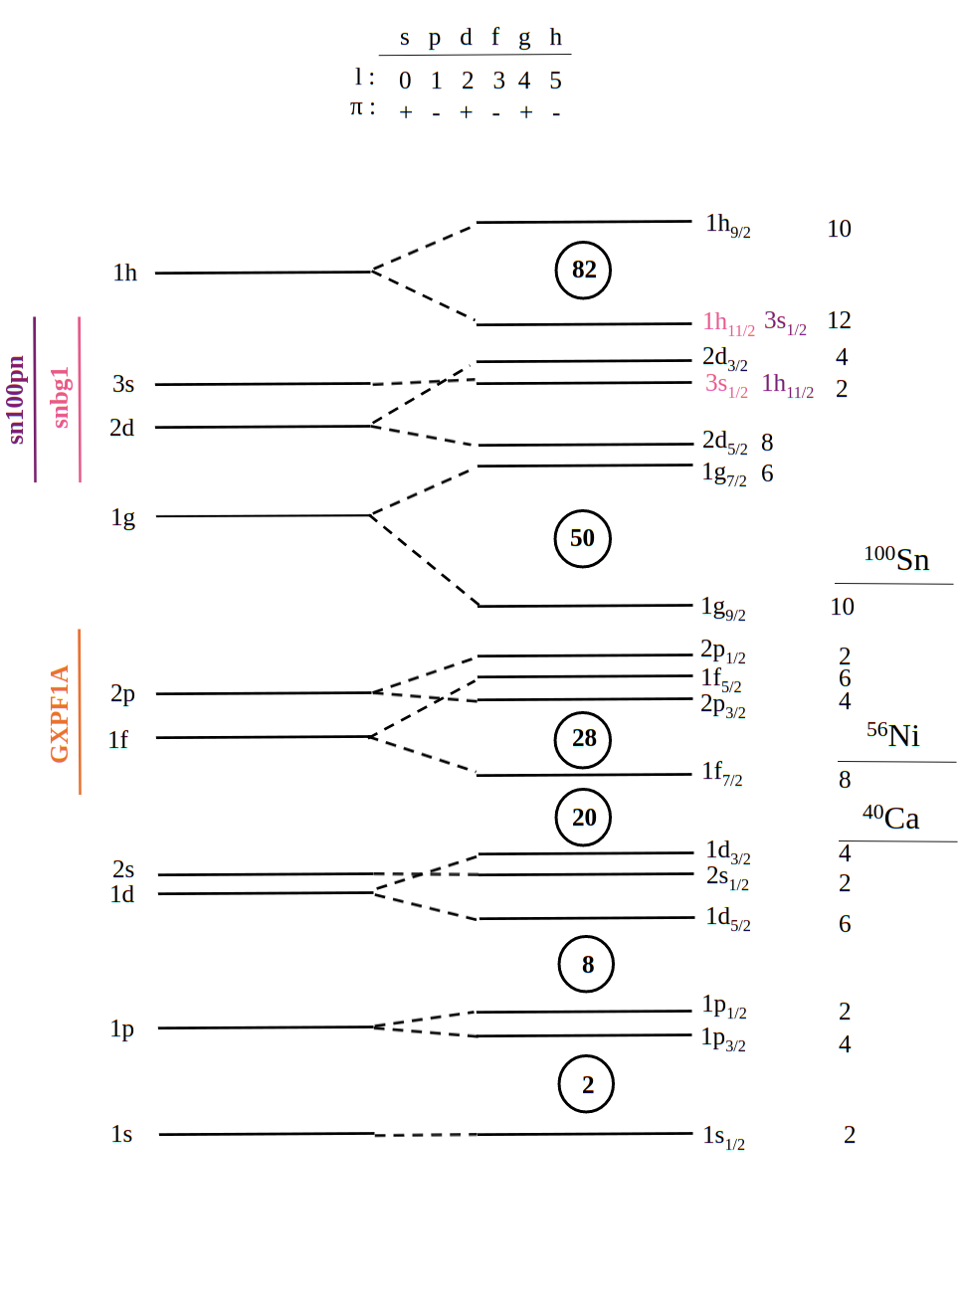
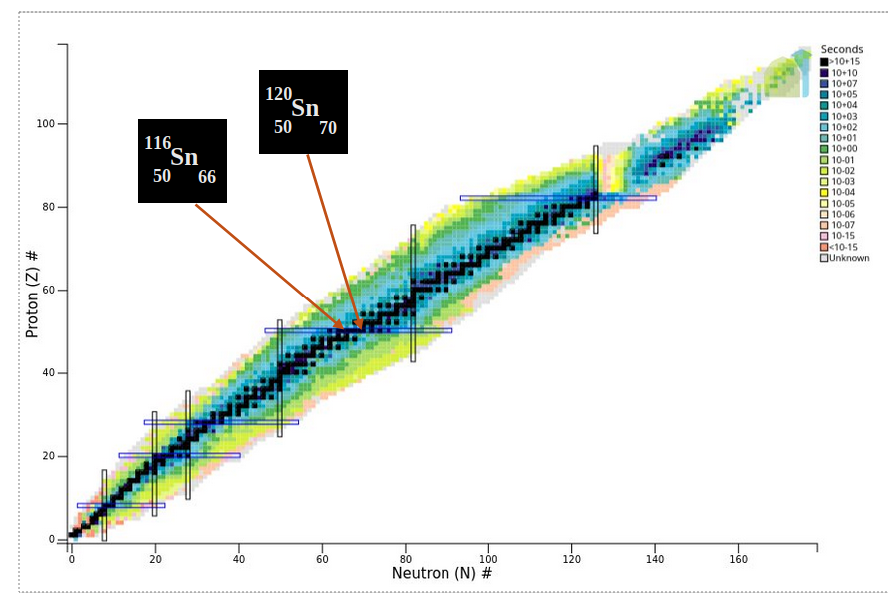
Shell model calculations
Effective interaction
Effective g-factors
Effective charges
Jenny Finsrud ︳Oslo Workshop 2024

Slide 4
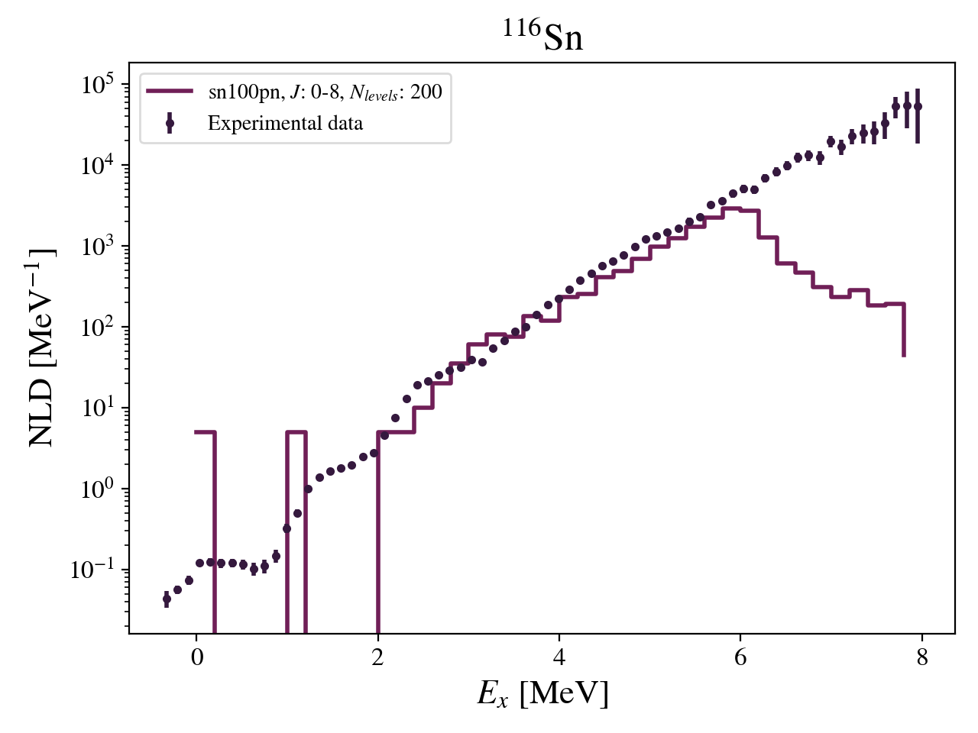
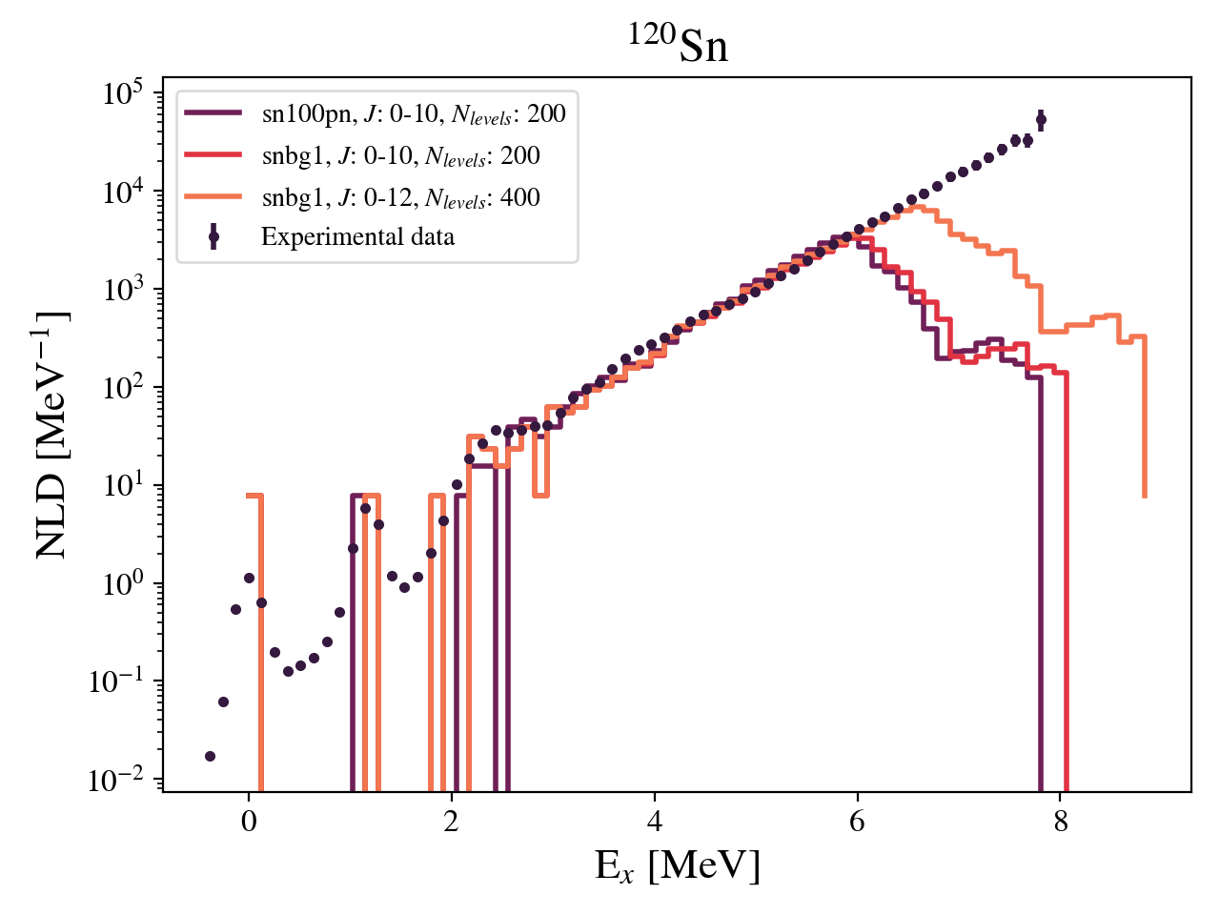
Nuclear Level Density (NLD)
Experimental data ¹¹⁶Sn: M. Markova et al., Phys. Rev. C 109, 054311 (2024)
Experimental data ¹²⁰Sn: M. Markova et al., Phys. Rev. C 106, 034322 (2022)
Jenny Finsrud ︳Oslo Workshop 2024

Slide 5
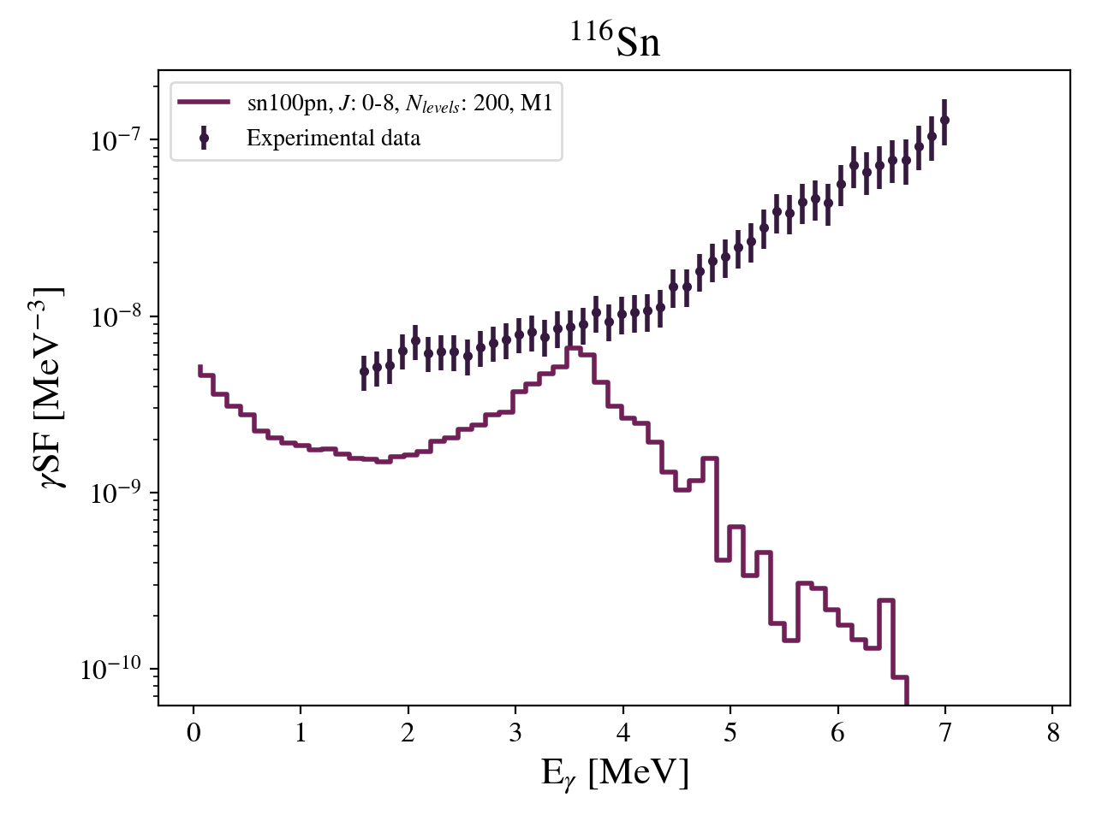
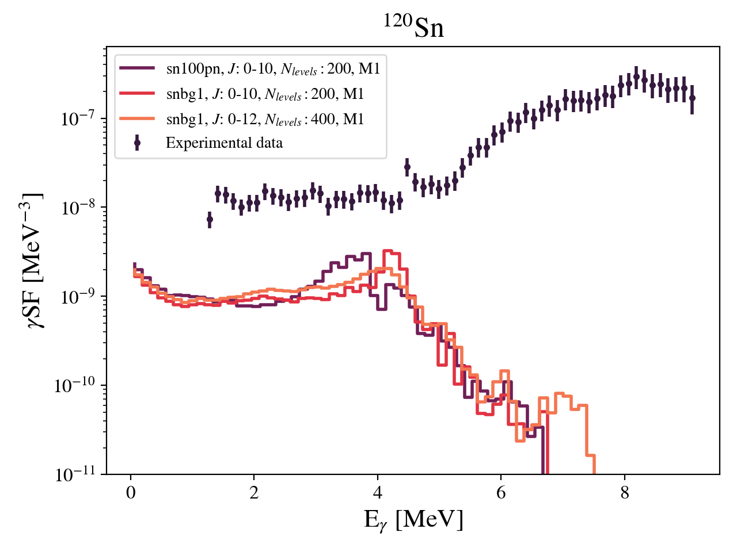
γ-ray strength function (γSF)
Experimental data ¹¹⁶Sn: M. Markova et al., Phys. Rev. C 109, 054311 (2024)
Experimental data ¹²⁰Sn: M. Markova et al., Phys. Rev. C 106, 034322 (2022)
Jenny Finsrud ︳Oslo Workshop 2024

Slide 6
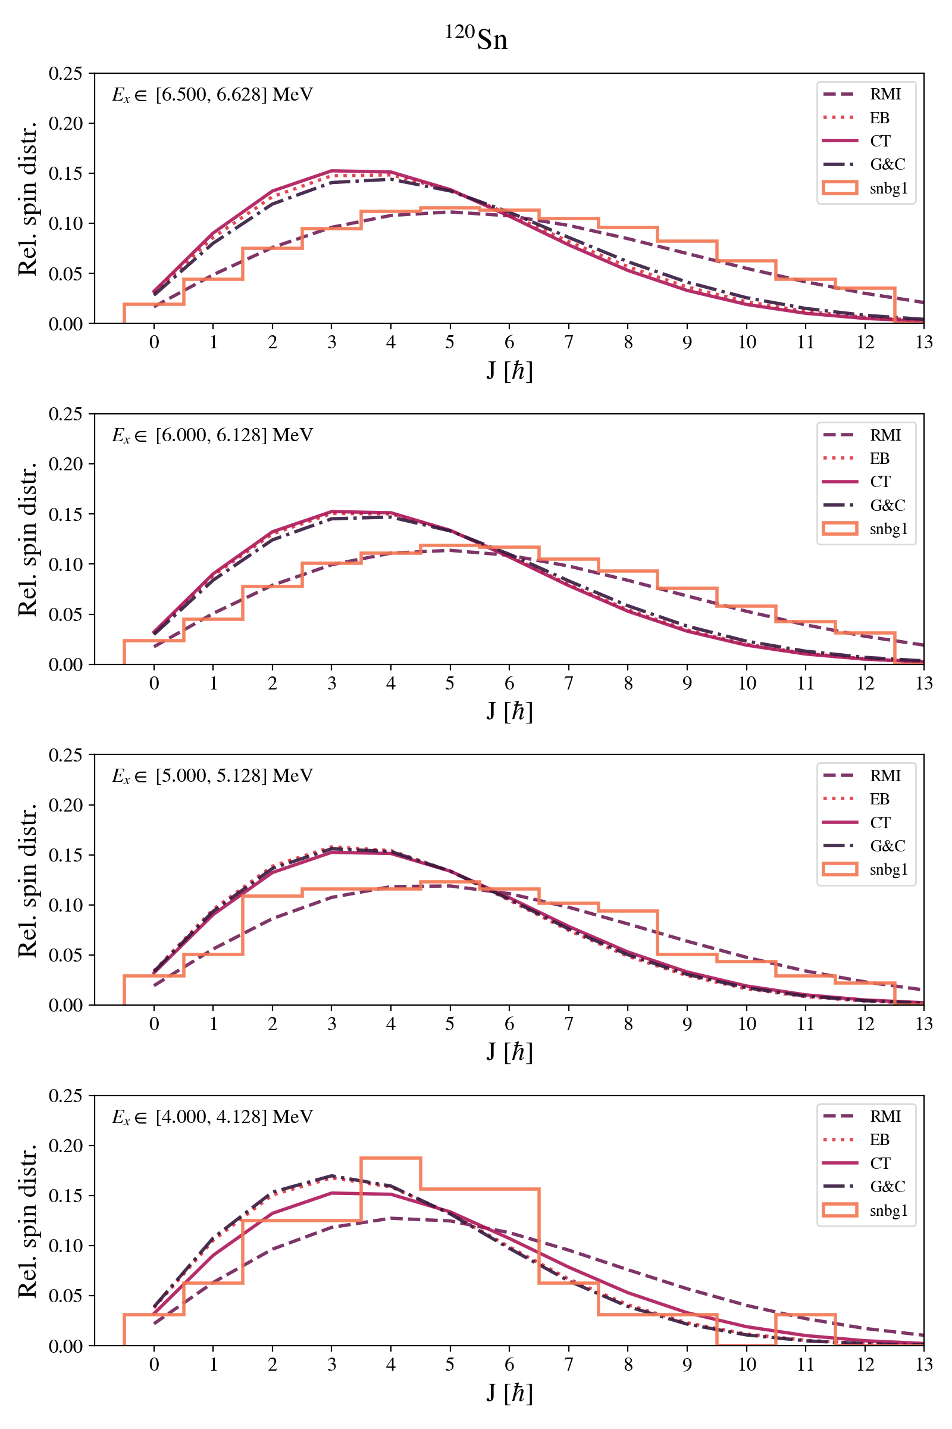
Spin distribution
Jenny Finsrud ︳Oslo Workshop 2024

Slide 7
Thank you!
Jenny Finsrud ︳Oslo Workshop 2024

