Slide 1


Development of a Photon Strength Function Database Interface
S. Jongile
This work is based on research supported in part by the National Research Foundation of South Africa (Grant Number: 118846). We also acknowledge the financial support from the International Atomic Energy Agency

Slide 2
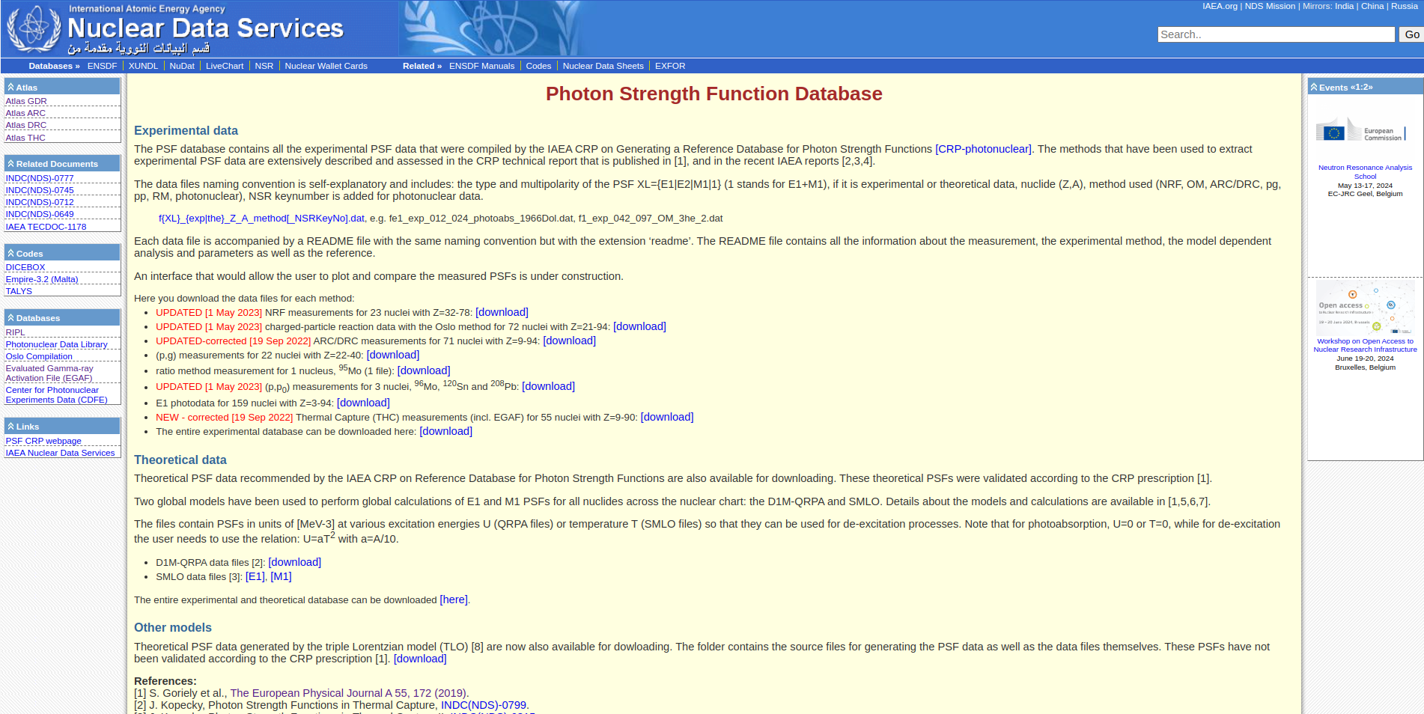
Overview and Motivation
Motivation
Data Growth: There has been a rapid increase in reaction gamma ray data measured to determine photon strength function
over the past two decades.
Varying Results: Different experimental techniques have led to varying results, causing uncertainty. To address this, there has been a coordinated effort to compile recommended photon strengths and model calculations hosted at the IAEA, available at URL:www-nds.iaea.org/PSFdatabase.
Previously, relied on a static webpage that only allowed for file downloads, which limited the ways in which they could interact with and utilize the data.
Solution
New Application: A new interface stands as a robust web application explicitly crafted for the extraction, management, and presentation of PSF data currently available
Previous Static Webpage

Slide 3
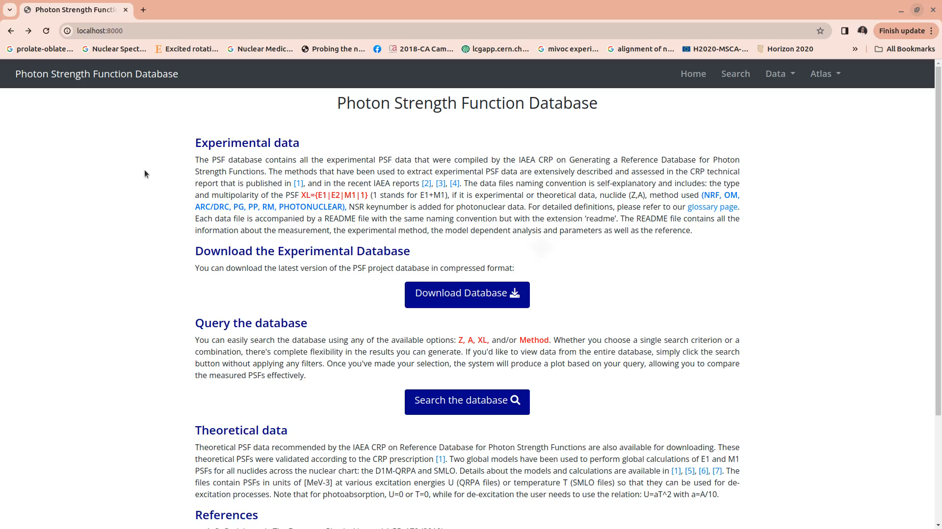

Slide 4


Slide 5
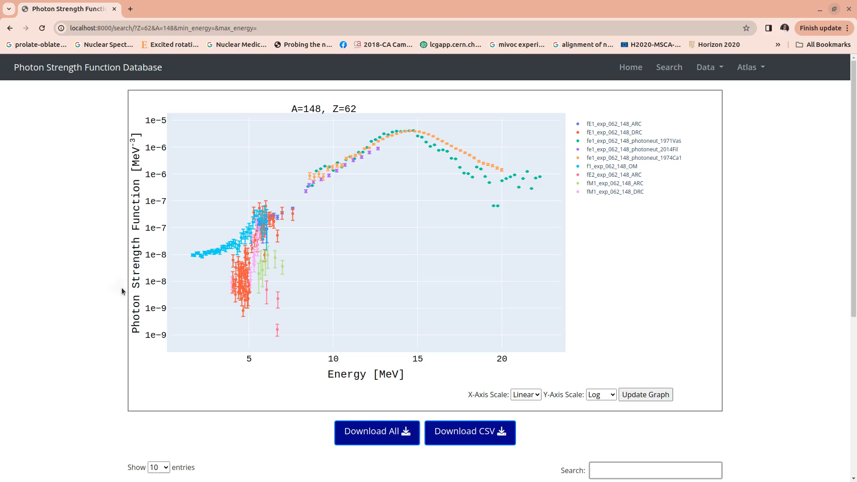

Slide 6
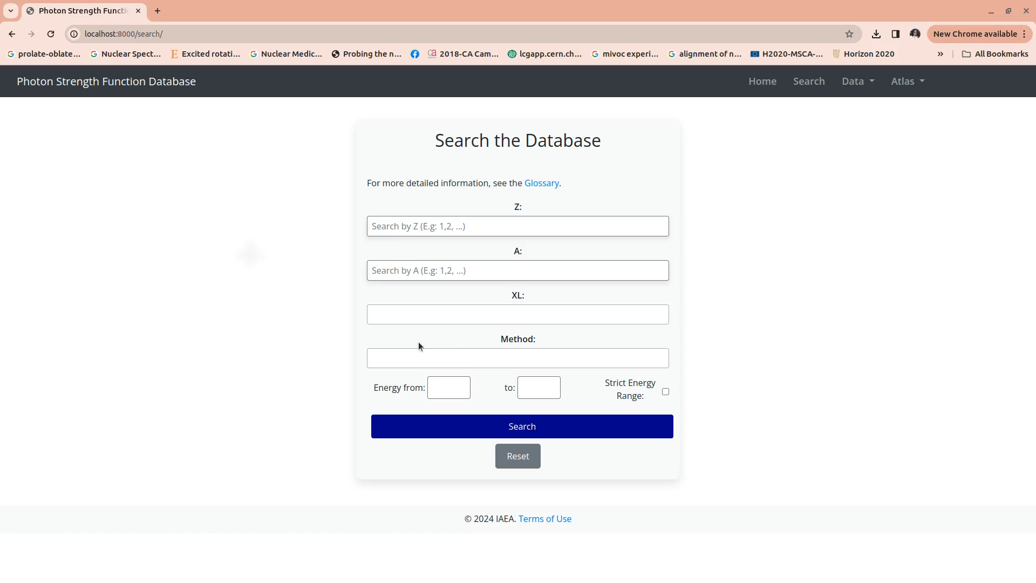

Slide 7
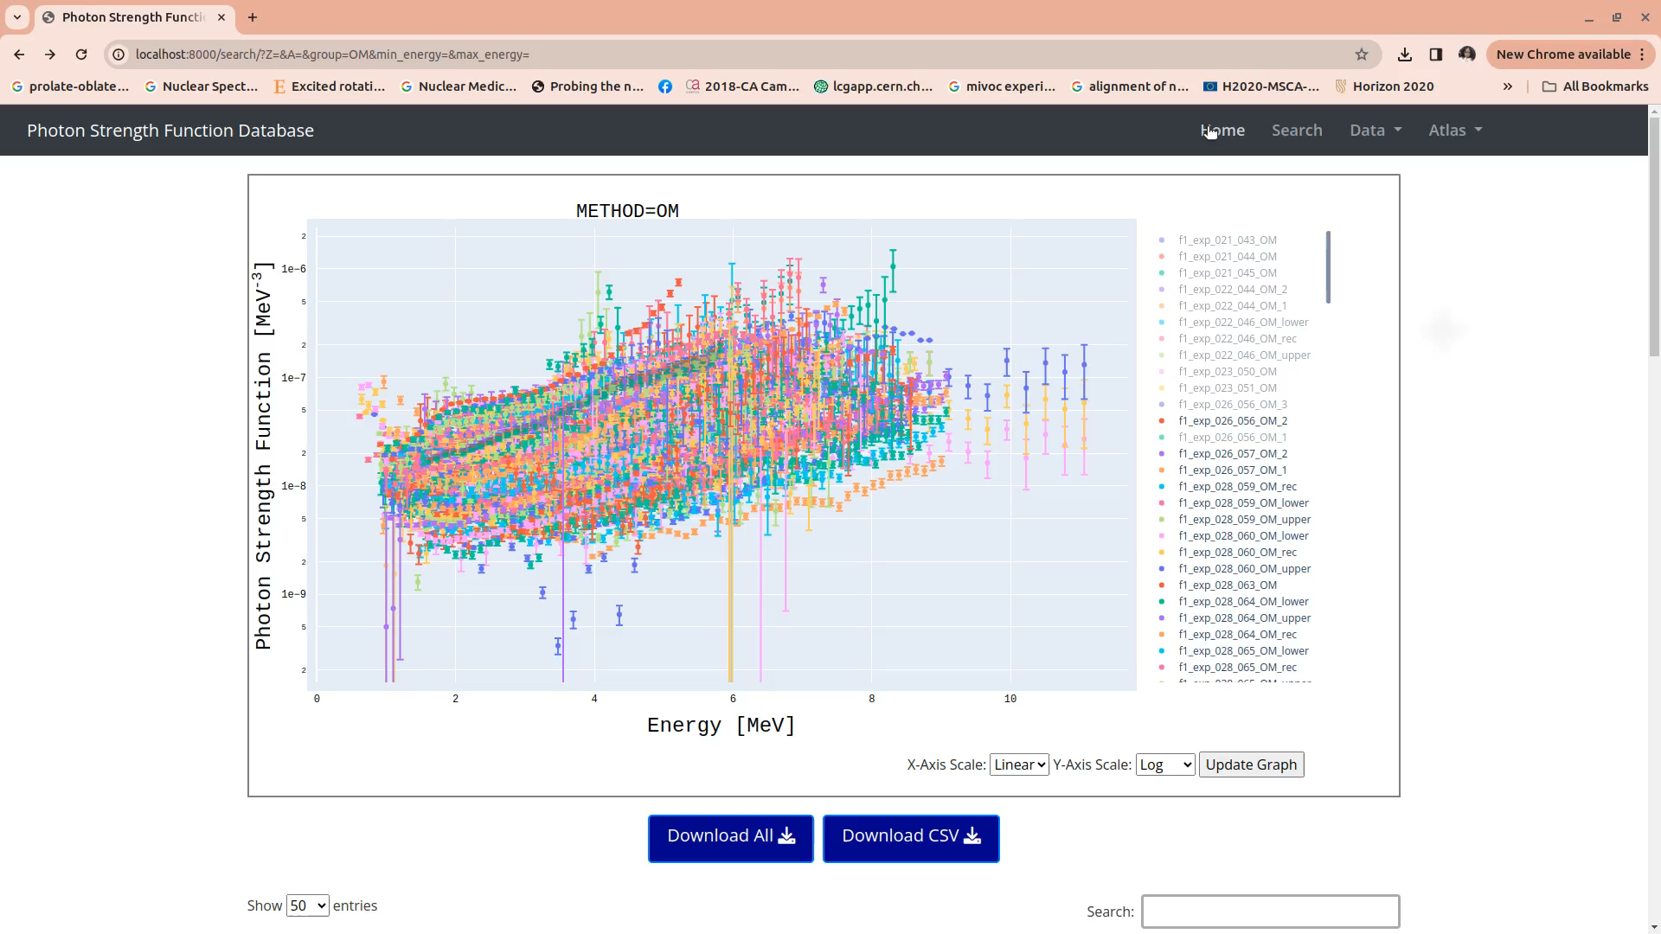

Slide 8
Summary and Future Work
In summary, our new web application significantly enhances the functionality and user experience of the Photon Strength Function database, making it a valuable tool for physicists.
The application will go live in beta testing phase
Future phases of the project will encompass theoretical data as well in addition to other enhancements

Slide 9
Thank you!
This work is based on research supported in part by the National Research Foundation of South Africa (Grant Number: 118846). We also acknowledge the financial support from the International Atomic Energy Agency
Collaborators:
P. Dimitriou , L. Marian, A Koning
International Atomic Energy Agency, Wagramerstrasse 5, A-1400 Vienna, Austria
M. Wiedeking
Lawrence Berkeley National Laboratory
Berkeley, CA, USA
S. Goriely
Institut d’Astronomie et d’Astrophysique, Université Libre de Bruxelles, Campus de la Plaine, CP 226, 1050 Brussels,
Belgium
J. Kopecky
JUKO Research, Kalmanstraat 4, Alkmaar 1817, The Netherlands
M. Krticka
Charles University, V Holešovičkách 2, 18000 Prague, Czech Republic

