Slide 1


Nucleosynthesis around ⁶⁰Fe
via indirect neutron-capture
reaction studies
Artemis Spyrou

Slide 2

10 years of β-Oslo method
East Lansing – 2014
Magne Guttormsen
Ann-Cecilie Larsen
Sean Liddick
Artemis Spyrou

Slide 3
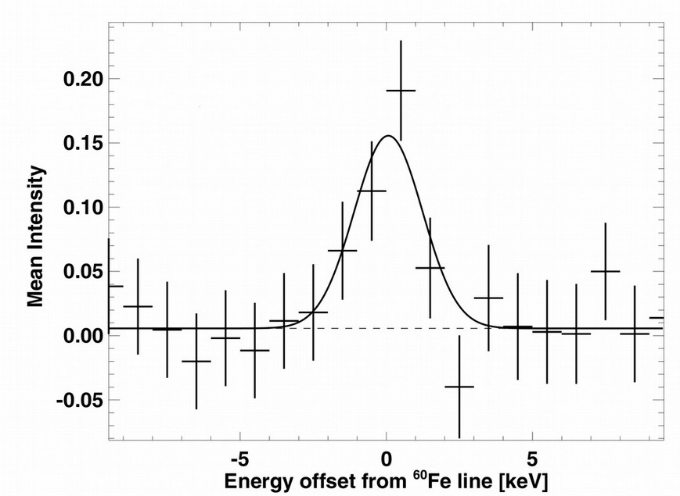
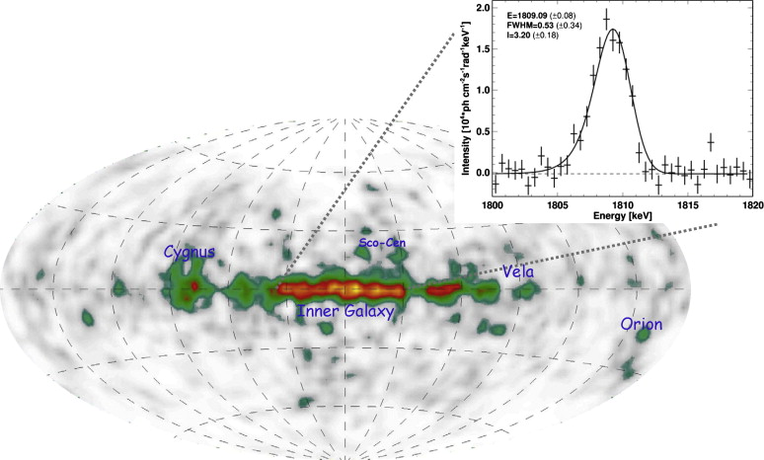
Nucleosynthesis in Massive Stars
Massive stars are a major source of chemical elements through explosions and stellar winds
Long lived radioisotopes provide unique signatures of active nucleosynthesis
⁶⁰Fe: T_{1/2}= 2.6 My
INTEGRAL
²⁶Al: T_{1/2}= 0.7 My
Diffuse observations
⁶⁰Fe
58.6 keV
⁶⁰Co
2505 keV
1173 keV
1332 keV
NASA’s COMPTEL
(1991-2000)
Diehl et al., New Astronomy Reviews 2008
⁶⁰Ni

Slide 4
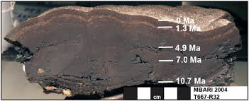
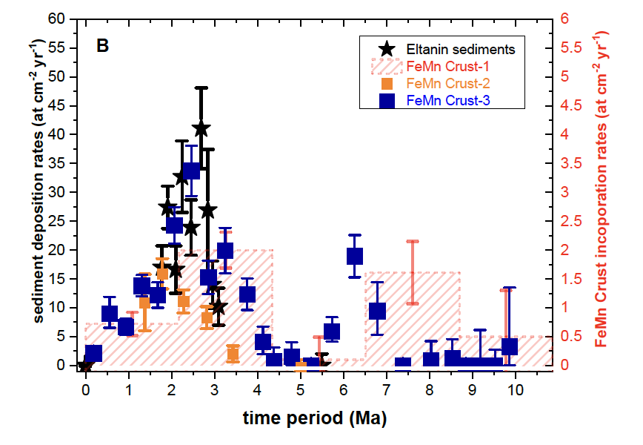
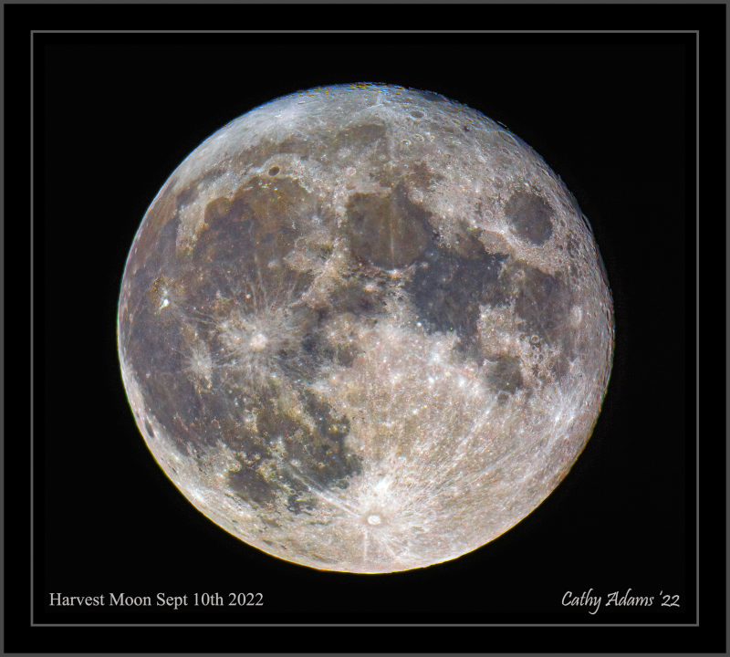
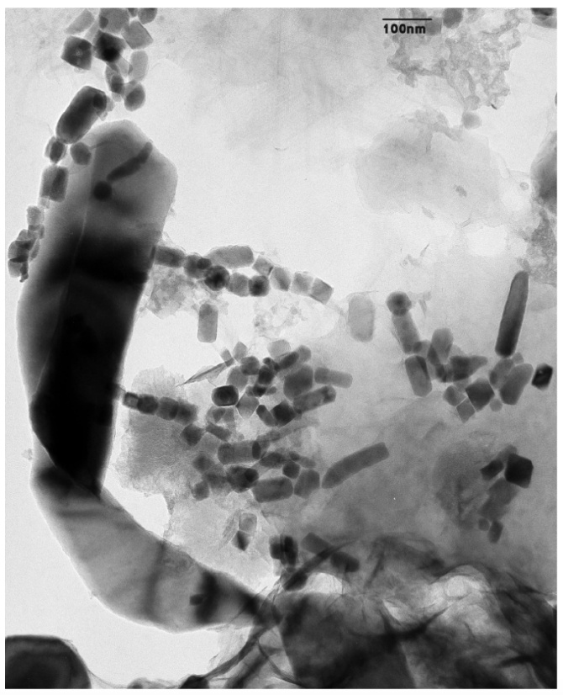
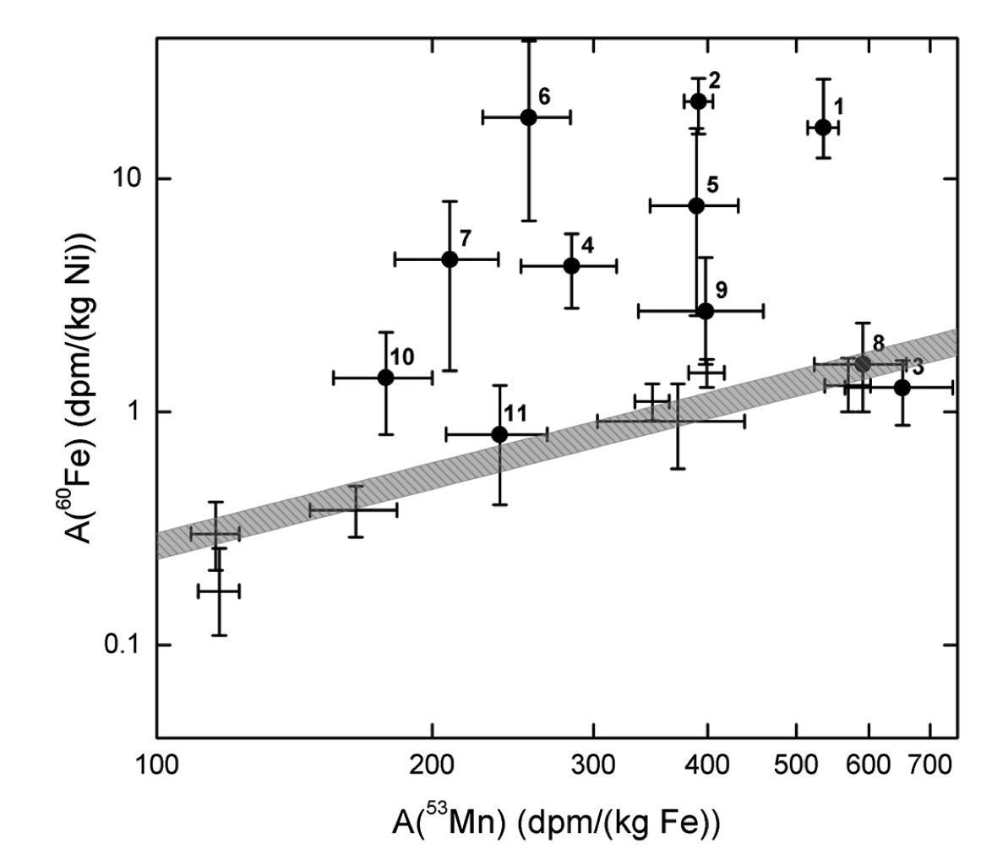
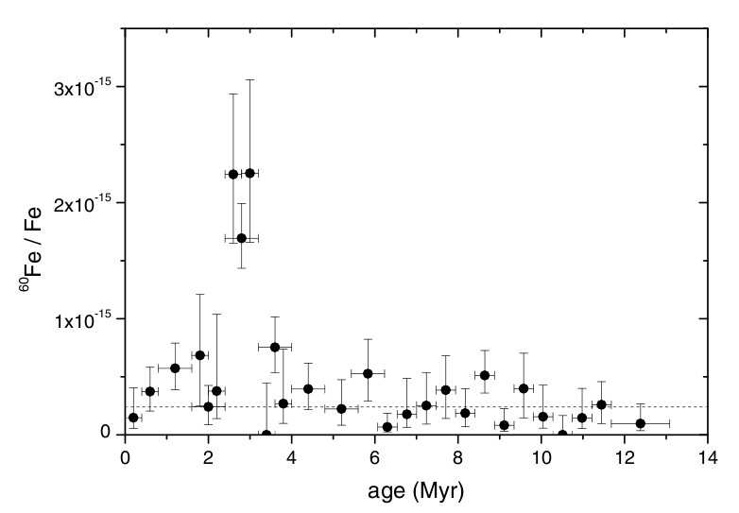
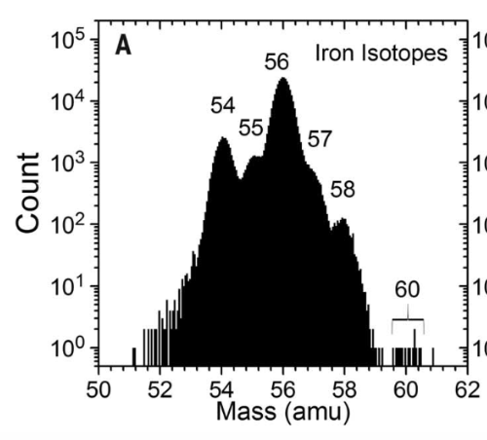
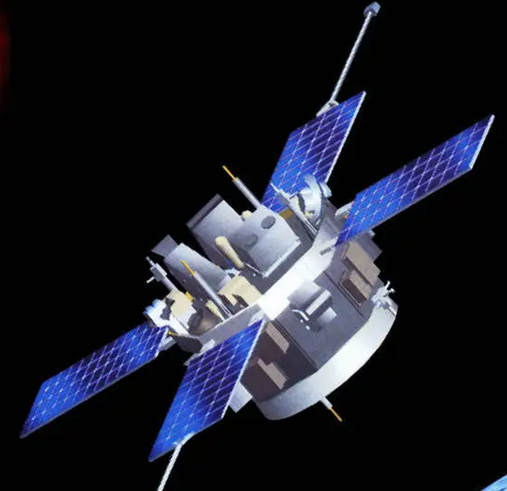
⁶⁰Fe within the solar system
⁶⁰Fe found in ocean sediments, polar ice, magnetofossils, the moon, and cosmic rays.
Wallner, et al., Nature 2016
Fimiani, et al. PRL 2016
Ludwig, et al. PNAS 2016
Binns, et al., Science 2016

Slide 5
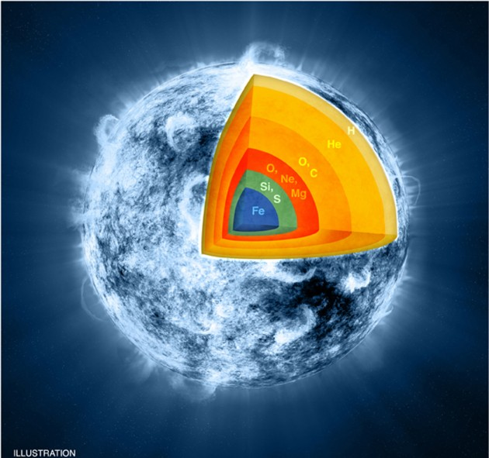
⁶⁰Fe/²⁶Al ratio
The ⁶⁰Fe/²⁶Al ratio for:
  probing nucleosynthesis in massive stars
  Stellar mixing
  Stellar winds
  Rotation
  Explodability
  Neutron star and black hole mass distributions
  Solar system origins (possible pollution by nearby SN).
Both isotopes produced in inner layers of the massive star + ²⁶Al in outer layers.
Source distance, location and number cancel out

Slide 6
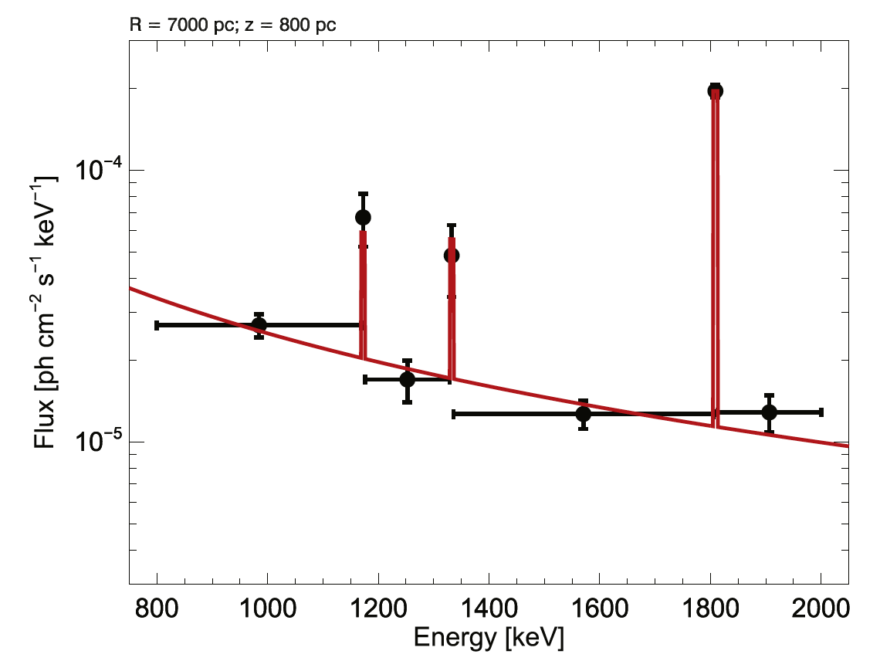
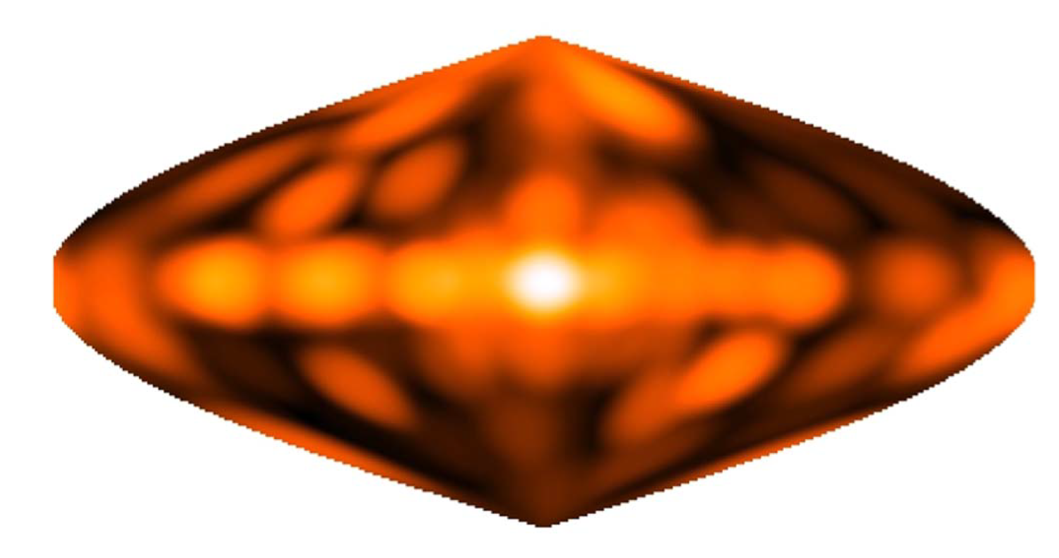
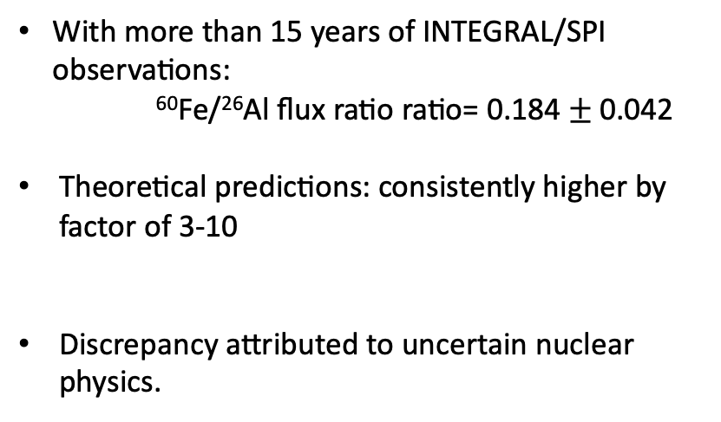
The ⁶⁰Fe/²⁶Al puzzle
With more than 15 years of INTEGRAL/SPI observations:
⁶⁰Fe/²⁶Al flux ratio ratio= 0.184 $±$0.042
Theoretical predictions: consistently higher by factor of 3-10
Discrepancy attributed to uncertain nuclear physics.
⁶⁰Fe ²⁶Al
Wang, et al. ApJ 2020
Woosley-Heger, Phys. Rep. 2007
Limongi-Chieffi, ApJ 2006
Diehl et al. 2021
Wang, et al. ApJ 2020
15 years of INTEGRAL/SPI

Slide 7
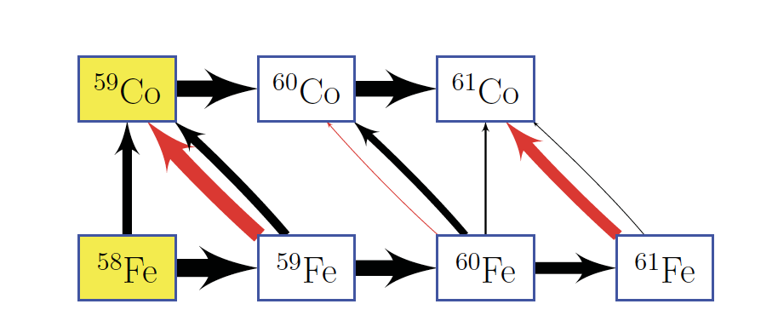
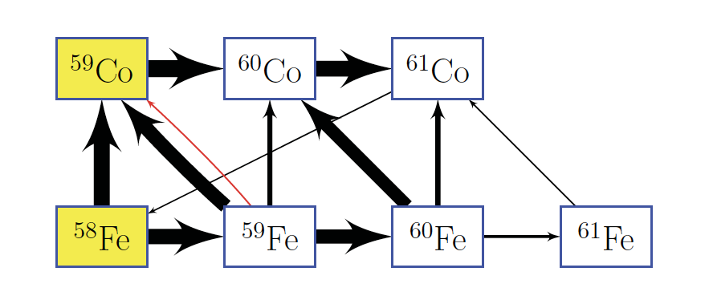
Reaction paths around ⁶⁰Fe
C/Ne Shell burning
C/Ne explosive Shell burning
β decay
Neutron Sources:
²²Ne(α,n)²⁵Mg and ¹²C(¹²C,n)²³Mg
reaction
Diehl, et al. 2021

Slide 8
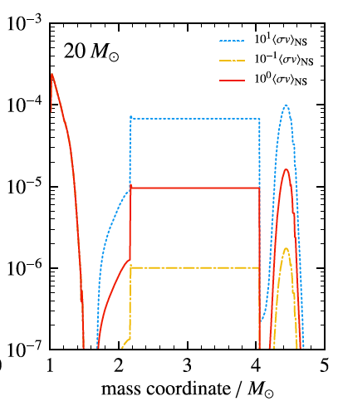
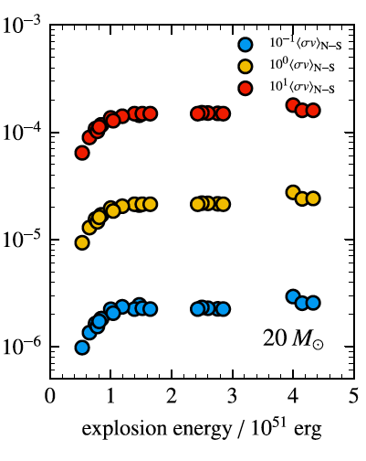


Sensitivity of ⁶⁰Fe to ⁵⁹Fe(n,γ)⁶⁰Fe
⁵⁹Fe(n,γ)⁶⁰Fe
⁵⁹Fe(n,γ)⁶⁰Fe
x10
x10
default
default
x0.1
x0.1
Similar results for 15 and 25 solar masses
Jones, et al. MNRAS 2019

Slide 9
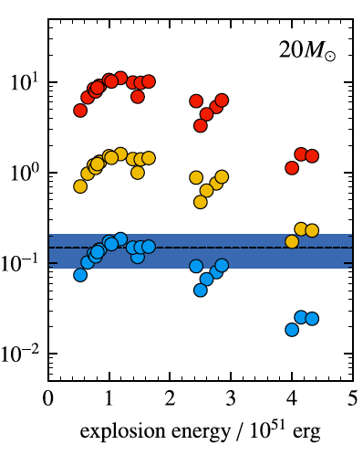

Sensitivity of ⁶⁰Fe/²⁶Al to ⁵⁹Fe(n,γ)⁶⁰Fe
⁵⁹Fe(n,γ)⁶⁰Fe
x10
⁶⁰Fe/²⁶Al flux ratio ratio: almost linear dependence with the ⁵⁹Fe(n,γ)⁶⁰Fe reaction rate.
Models with lower reaction rate or very high explosion energy can match the observed value.
default
Wang 2007
x0.1
Similar results for 15 and 25 solar masses
Jones, et al. MNRAS 2019

Slide 10
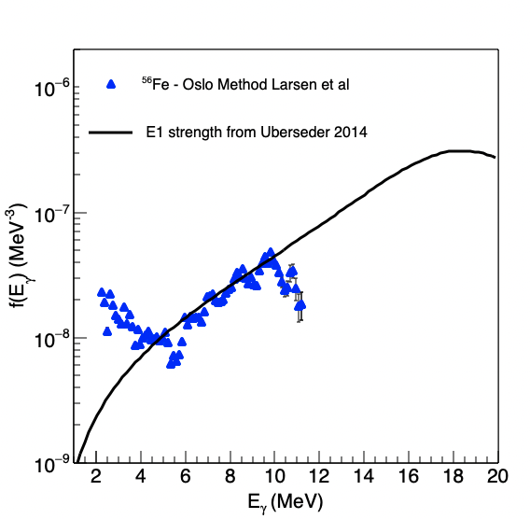
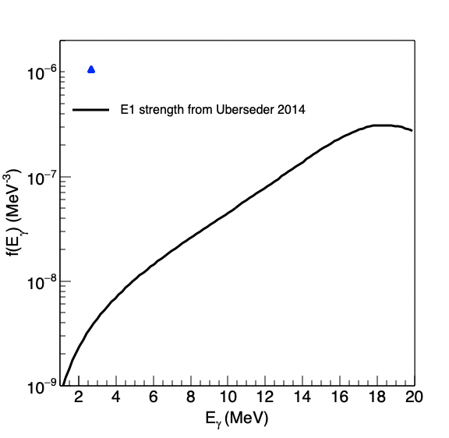
Previous measurements
Direct measurement of ⁵⁹Fe(n,γ)⁶⁰Fe reaction is challenging (⁵⁹Fe T_{1/2} = 44 days)
Two indirect measurements done previously:
  Coulomb dissociation measurement at GSI (Uberseder et al, PRL 2014)
  Surrogate ratio method (Yan et al, ApJ 2021)
No constraints for the γSF at low energies
Uberseder, et al. PRL (2014)
Larsen, et al, PRL (2013)

Slide 11
β-Oslo
Populate the compound nucleus via β-decay (large Q-value far from stability)
Spin selectivity – correct for it
Extract level density and γ-ray strength function
Advantage: Can reach (n,γ) reactions with beam intensity down to 1 pps.
(n,γ)
β⁻
(A, Z-1)
β-n
S_{n} = 8.8 MeV
(A-1, Z)
⁵⁹Fe
⁶⁰Fe
β⁻
γ
(n,γ)
⁶⁰Mn
Q_{β} = 8.4 MeV
(A, Z)
Spyrou, Liddick, Larsen, Guttormsen, et al, PRL2014

Slide 12
National Superconducting Cyclotron Lab
ReAccelerator Facility
SuN
“Stopped beam area”
Gas Stopper
⁶⁰Mn beam:
  59(1)% g.s. 1⁺
  41(1)% isomer 4⁺
Identification based on:
  Known γ-ray intensities
  Beta-feeding intensity
  Half-lives (0.28 s 1⁺ , 1.77s 4⁺)

Slide 13
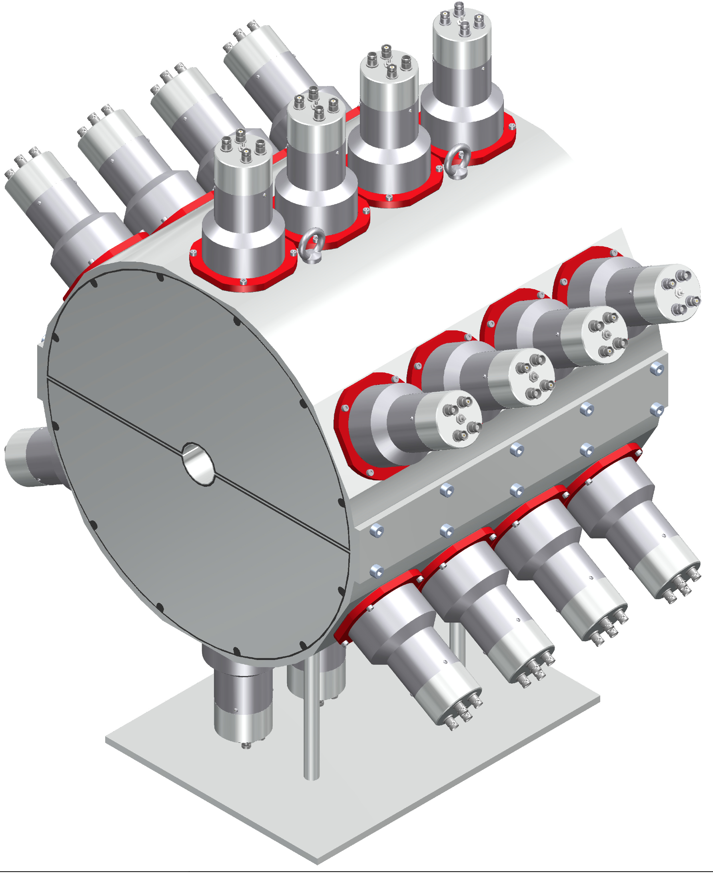
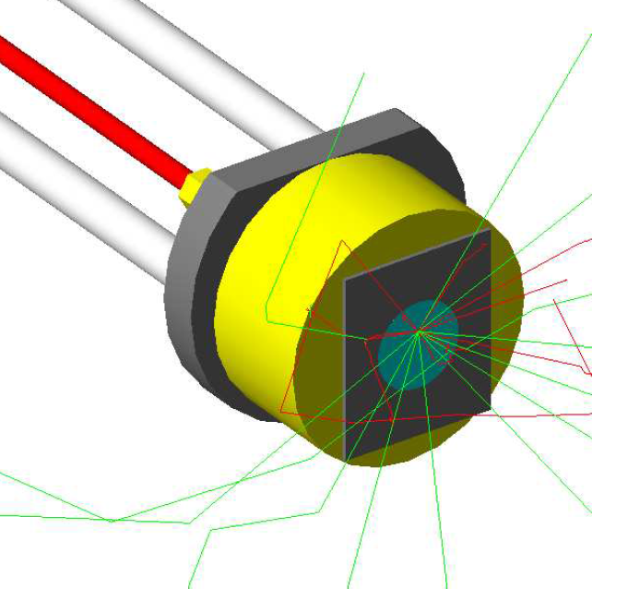
SuN detector
Large size - high efficiency γ-calorimeter
Summing of all γ-rays gives the excitation energy
Segmented detector: information about individual γ-rays
SuN detector + Si
16x16 inch
45 mm borehole
2 pieces
8 segments
24 PMTs
Efficiency > 85% for 1 MeV
16’’
16’’
beam
45 mm
Si surface barrier
Simon., et al., Nucl. Instr. Meth A (2013)

Slide 14
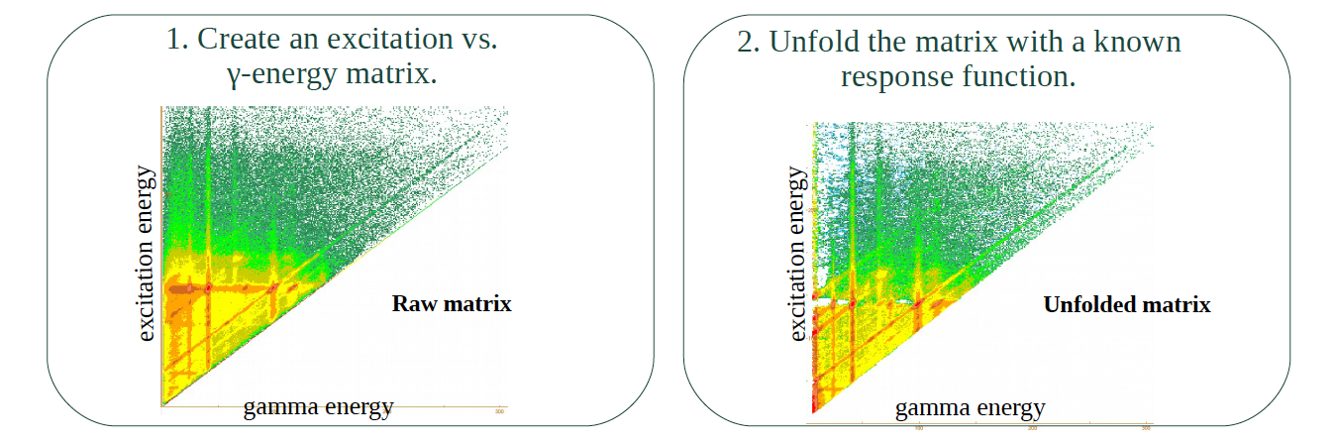
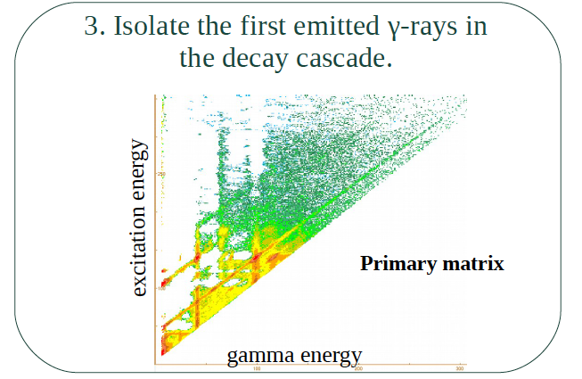
Oslo analysis

Slide 15
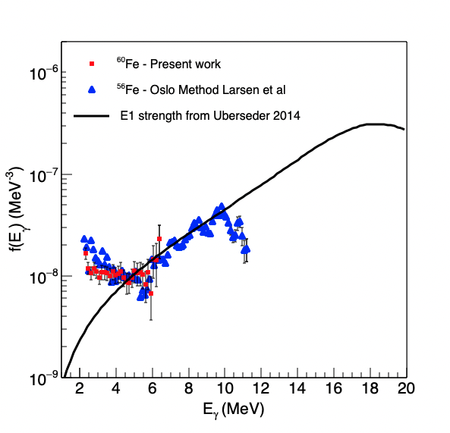
Results
Nuclear Level Density
γ-ray Strength Function
Goriely 2008

Slide 16
Impact on ⁵⁹Fe(n,γ)⁶⁰Fe and ⁶⁰Fe production
Stellar evolution calculations using MESA by Carl Fields

Slide 17
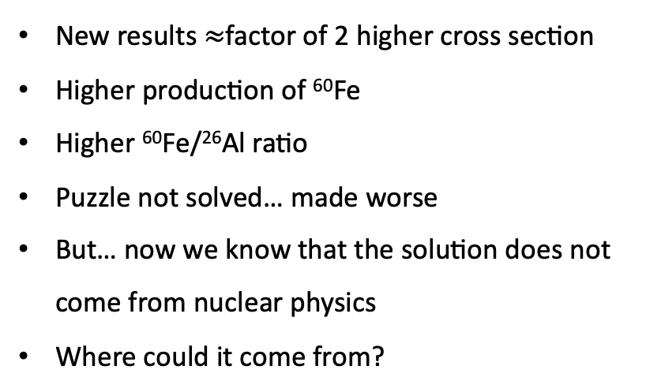
What does this mean?
⁵⁹Fe(n,γ)⁶⁰Fe
New results $≈$factor of 2 higher cross section
Higher production of ⁶⁰Fe
Higher ⁶⁰Fe/²⁶Al ratio
Puzzle not solved… made worse
But… now we know that the solution does not come from nuclear physics
Where could it come from?
x10
default
Wang 2007
x0.1
Jones, et al. MNRAS 2019

Slide 18
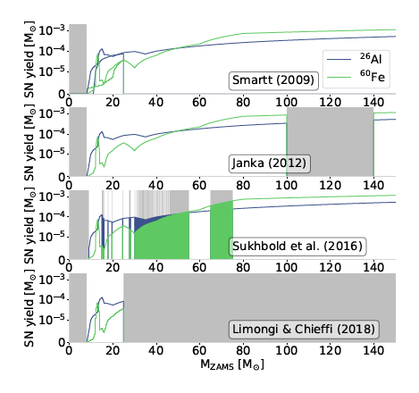
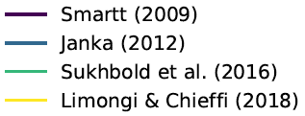
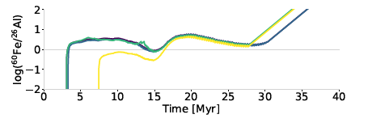
Speculation #1: Explodability
Limongi & Chieffi 2018: No SN above 25 solar masses
Reduced ⁶⁰Fe/²⁶Al ratio
Connected to neutron star/black hole mass distributions
Pleintinger M. M. M., 2020, PhD thesis, Technische Universität München
Diehl, et al. 2021

Slide 19
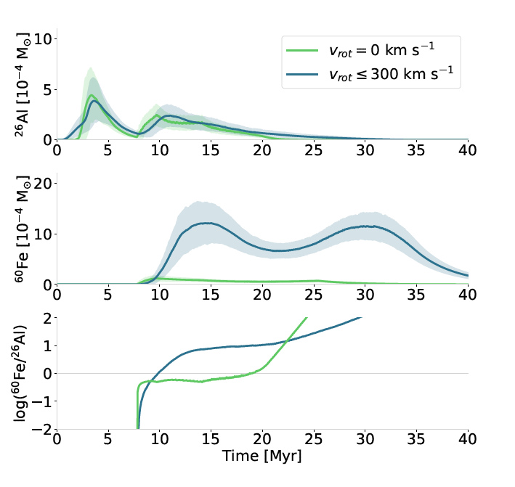
Speculation #2: Rotation
Stellar rotation produces a lot more ⁶⁰Fe
Reason: more neutrons
Rotation seems to increase the ⁶⁰Fe/²⁶Al ratio
Pleintinger M. M. M., 2020, PhD thesis, Technische Universität München
Diehl, et al. 2021

Slide 20
Summary
⁶⁰Fe and ²⁶Al detections can help us understand massive star evolution, explosion and nucleosynthesis
⁶⁰Fe/²⁶Al ratio sensitive probe – models overestimate it
⁵⁹Fe(n,γ) ⁶⁰Fe affects the production of ⁶⁰Fe
New measurement shows a higher reaction cross section, hence more ⁶⁰Fe
⁶⁰Fe/²⁶Al ratio discrepancy even worse
Pointing to stellar properties as a solution to the puzzle - Explodability? Rotation? Other?

Slide 21
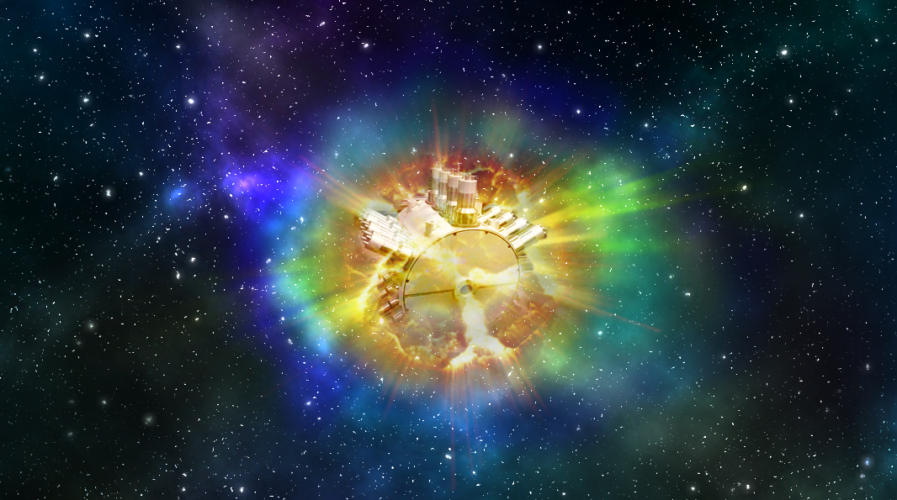






Collaboration
A.C. Larsen
M. Guttormsen
J. Midtboe
B. Crider
S.N. Liddick
K. Childers
A.C. Dombos
K. Hermansenn
R. Lewis
S. Lyons
F. Naqvi
A. Palmisano
D. Richman
H. Schatz
M.K. Smith
C. Sumithrarachchi
D. Muecher
A. Couture
C. Fields
P. Gastis
S. Mosby
C. Prokop
  G. Perdikakis
A. Sweet
  P. DeYoung

