Slide 1
9th Workshop on Level Density and Gamma Strength, Oslo, 2024
Enhancement of Low-energy Magnetic Dipole Radiation
Arising from the Scissors Motion
Fang-Qi Chen
Lanzhou University
29/05/2024

Slide 2
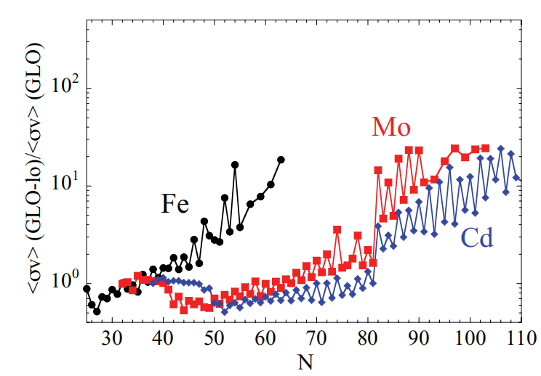
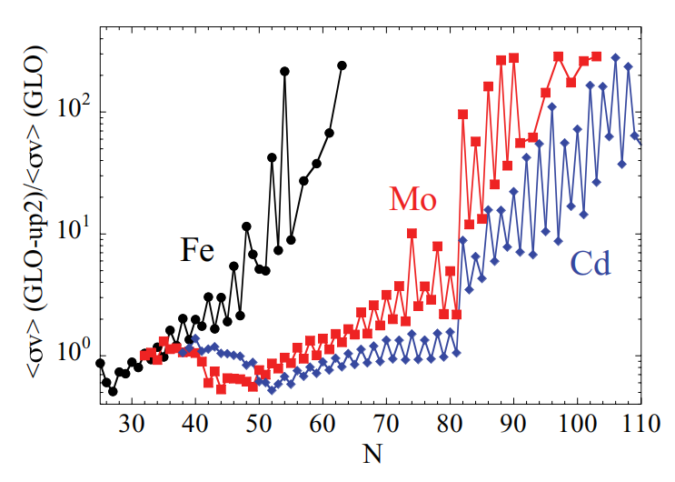
Low-energy enhancement of γ strength function (LEE)
Low-energy enhancement (LEE)
Impact of LEE in neutron capture & r-process
A. Voinov et al, PRL 93, 142504 (2004)
A. C. Larsen, S. Goriely, PRC 82, 014318 (2010)
astrophysical neutron capture rate
enhancement
> 10 times
⁵⁶Fe
⁵⁷Fe
low-energy
w/o LEE
w/ LEE
exists in weakly deformed nuclei
$σ\left(n,γ\right)$ in neutron-rich nuclei largely enhanced
contributed by E1/M1 transitions
non-negligible effect on r-process nucleosynthesis
The origin of the LEE is not yet clear

Slide 3
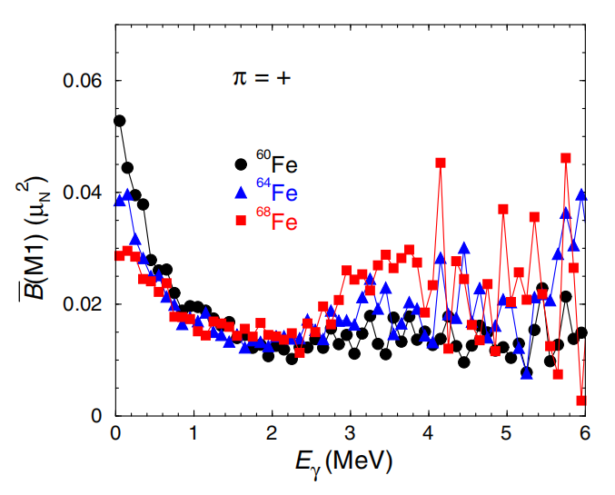
Possible connection between the LEE and the scissors motion
R. Schwengner, S. Frauendorf, PRL 118, 092502 (2017)
LEE
scissors resonance
deformation
LEE
scissors
LEE+scissors
approximately conserved
√ supported by observations of Sm isotopes (w/ large error bars, F. Naqvi et al 2019)
not supported by observations of Nd isotopes (M. Guttormsen et al 2022)
X
?
LEE (weakly deformed)
scissors mode (well deformed)

Slide 4
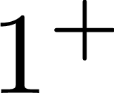
Nuclear scissors mode
Concept
Spectroscopic observation
Microscopic description
neutrons
3
protons
RPA
2
…
strong M1 transitions
MC shell model
1
Projected shell model
(fragmented)
g.s.
LEE？
N. Lo Iudice, F. Palumbo, PRL 41, 1532 (1978)
oscillation
The aim of this work
projected shell model
?
scissors mode (well-deformed)
LEE (weakly deformed)

Slide 5
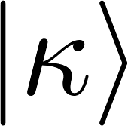
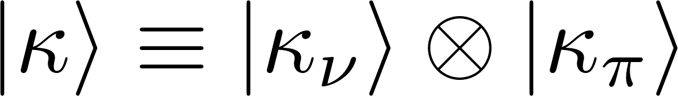
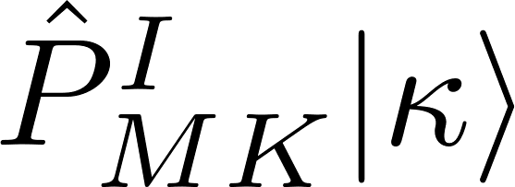
Two-rotor description for the scissors mode
neutrons & protons of different orientations
proton rotation
neutron
rotation
seen as two interacting rotors
scissors motion
rotational motion of two rotors
rotational motion of a single rotor
rotational motion of two rotors:
intrinsic state:
intrinsic state:
laboratory state:
laboratory state:
angular-momentum-projection
observables
observables
Y. Sun et al, PRL 80,672 (1998)

Slide 6
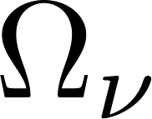
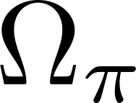
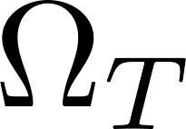
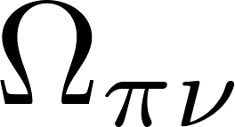
Intrinsic motion of the scissors angle
illustration of the scissors motion
collective wave function
of the scissors angle
microscopic wave function
in terms of the scissors angle
wave function in terms of
neutron orientation
proton orientation
transformation
orientation of the whole system
relative orientation between neutrons & protons (the scissors angle)
rotation of the scissors-like configuration
intrinsic motion of the scissors angle

Slide 7
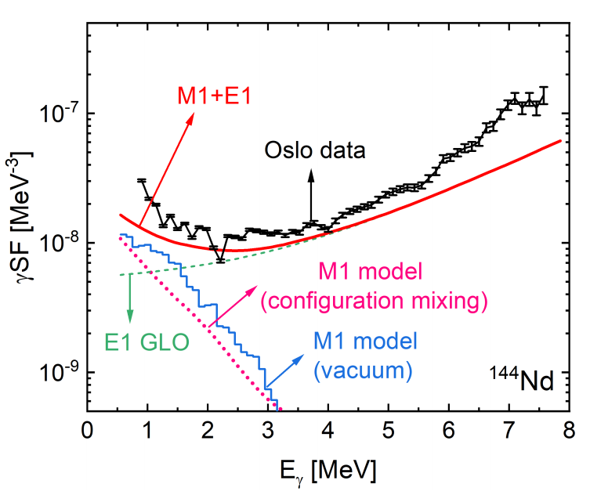
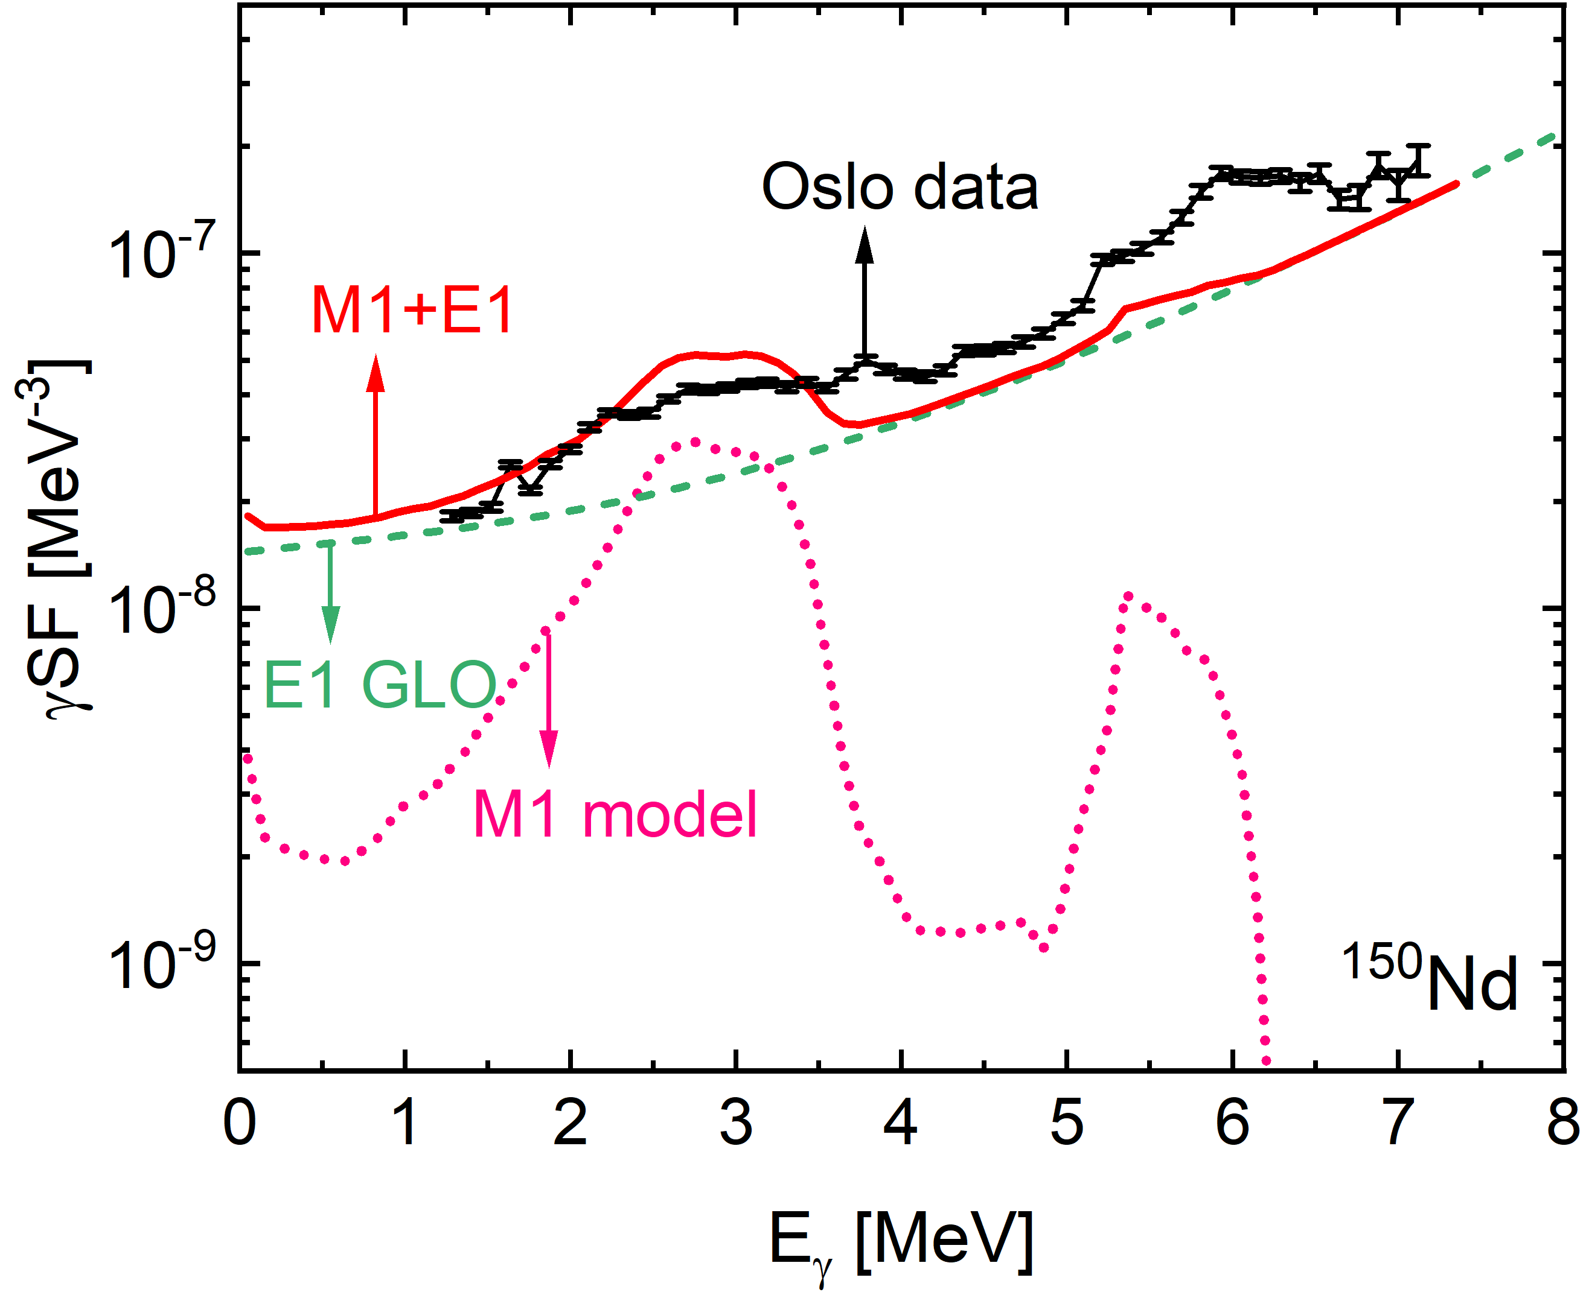
Calculated strength function in comparison with data
Exp reference: M. Guttormsen et al, PRC 106, 034314 (2022)
Exp data: https://www-nds.iaea.org/PSFdatabase
well-deformed case
weakly deformed case
scissors
resonance
LEE
scissors resonance & LEE qualitatively reproduced
LEE emerges with a fixed vacuum configuration
arising from scissors motion

Slide 8
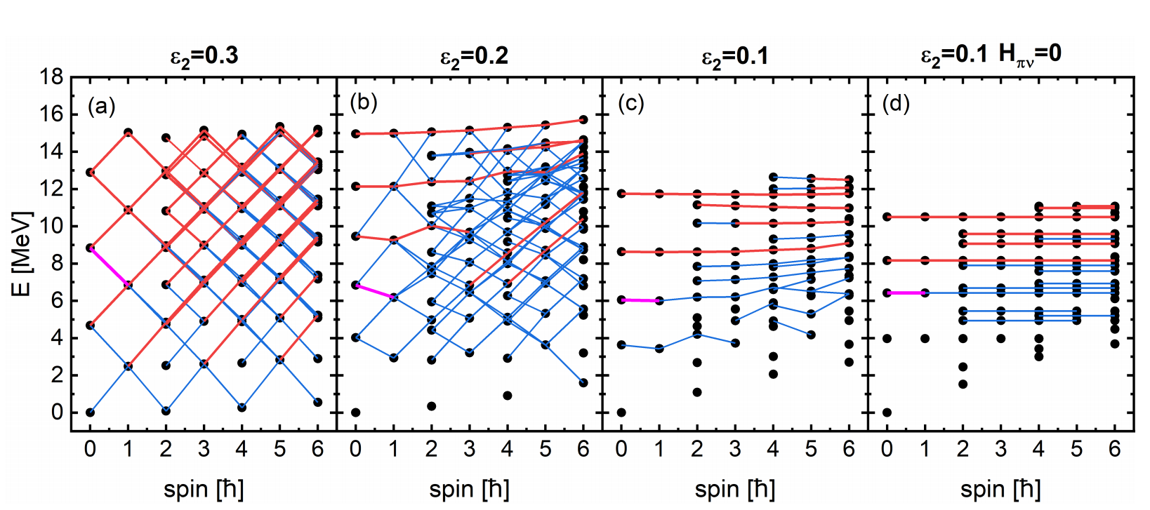
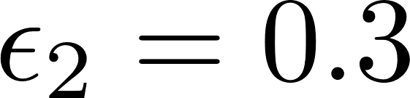
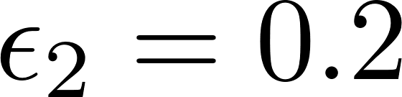
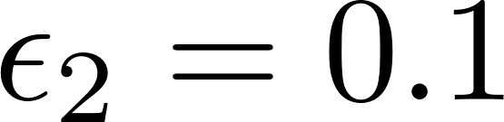
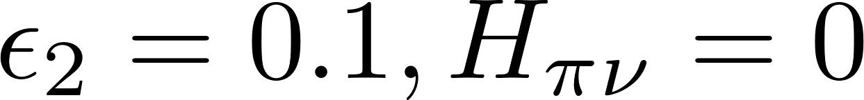
From the scissors resonance to the LEE: towards free scissors motion
Scissors spectra with vacuum configuration
similarity
relatively free?
similarity
exactly free
near-degenerate
exactly degenerate
rhombus-like connection
erosion of rhombus
LEE bands
extreme LEE bands
emergence of LEE bands
(a new kind of regularity)
harmonic oscillation
LEE
free scissors motion

Slide 9
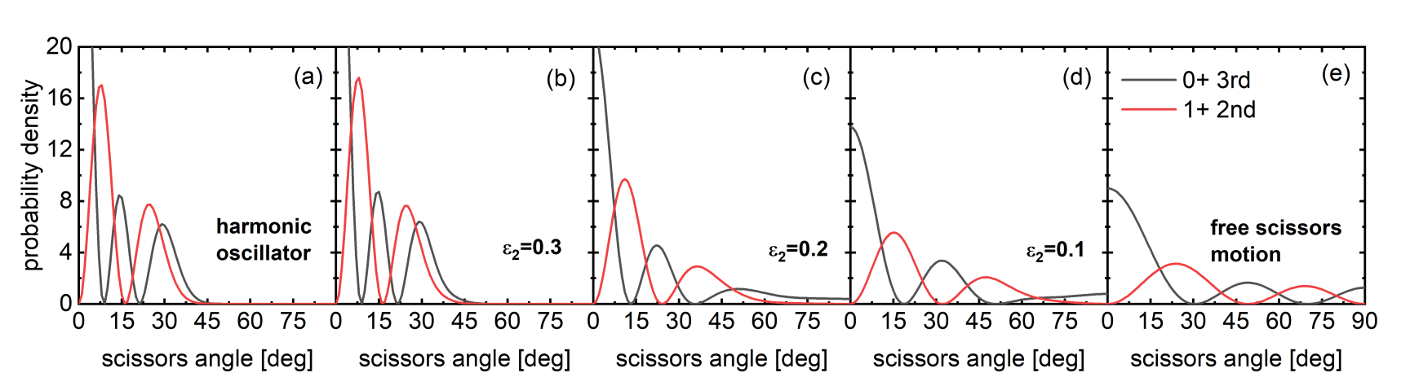
From the scissors resonance to the LEE: towards free scissors motion
Collective wave function of the scissors angle (squared)
strong M1 transition
0+ 3rd
1+ 2nd
harmonic oscillator
(analytical)
scissors vibration
LEE
free scissors motion
(analytical)
evolution with decreasing deformation

Slide 10
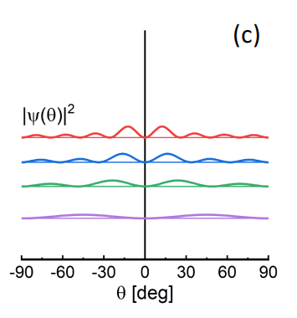
Enhanced freedom in the scissors motion: A simple geometrical effect
scissors angle
reduction of n-p overlap
energy cost
“scissors potential”
well-deformed case
weakly deformed case
extreme case (unrealistic)
large overlap reduction
small overlap reduction
(energy cost)
no overlap
reduction
(energy cost)
(energy cost)
steep potential
flat
potential
completely flat
potential
soft scissors motion (LEE)
free scissors motion
(scissors rotation)
scissors vibration

Slide 11
Summary
The LEE is investigated with the projected shell model designed for the scissors mode.
The LEE arises from the approximately free scissors motion as a straightforward result of reduced deformation.
Perspectives
Role of “soft” (anharmonic) collective motion in the γ strength function
Collaborators:
Yi-Fei Niu (LZU)
Yang Sun (SJTU)
Mathis Wiedeking (LBNL)
Thanks for your attention!

