Slide 1
Probing nuclear level densities and γ–ray strength functions via partial reaction cross sections
Martin Müller, Felix Heim, Benedikt Machliner,
Svenja Wilden, Pina Wüstenberg, and Andreas Zilges
Institute for Nuclear Physics, University of Cologne
9th Workshop on Nuclear Level Density and Gamma Strength
Supported by DFG (ZI 510/8-2) and ChETEC-INFRA (101008324)
mmueller@ikp.uni-koeln.de

Slide 2
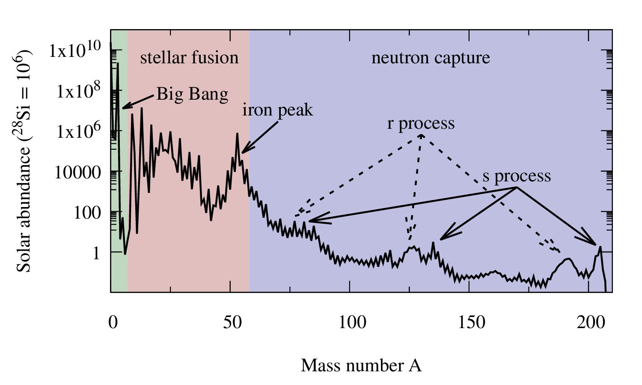
Solar Abundance
Lodders Astrophys. J. 591, 1220 (2003)

Slide 3
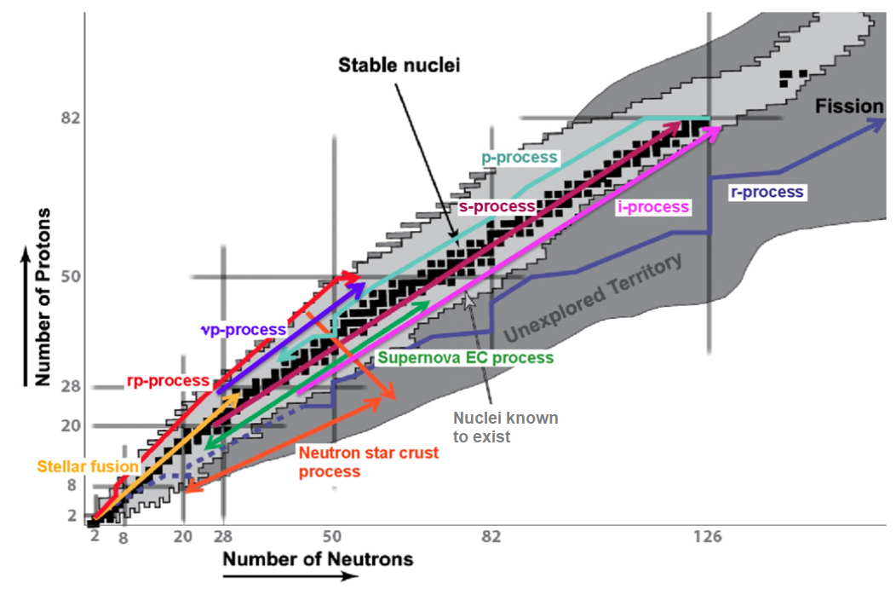
Nucleosynthesis
H. Schatz. J. Phys. G 43, 064001 (2016)

Slide 4
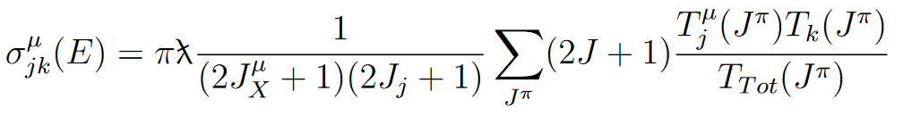
Hauser-Feshbach statistical model
γ strength function (γ -SF)
Nuclear level
density (NLD)
Optical model potential (OMP)
Measure cross sections to constrain nuclear input
Partial cross sections can help reduce sensitivity to the OMP

Slide 5
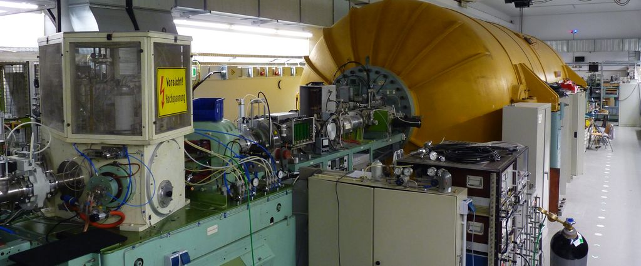
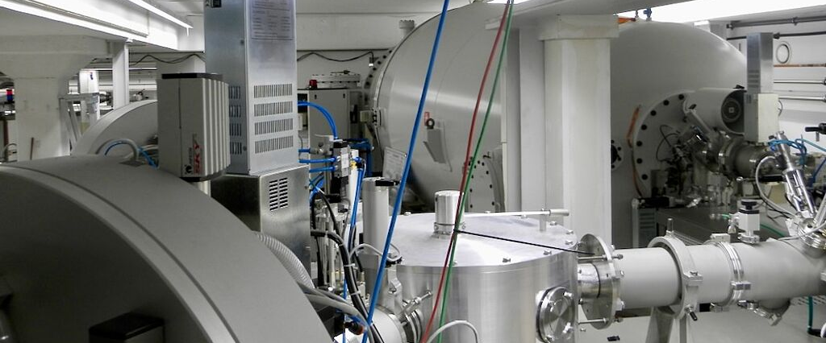
Particle accelerators at Cologne
10 MV FN Tandem accelerator
Sputter source + Duoplasmatron
Experiments:
  ⁵⁵Mn(α,n)⁵⁸Co^{m+g} (benchmark for ^{170,172}Yb(α,n)^{173,174}Hf stacked target experiment)
  ⁵⁸Fe(p,n)⁵⁸Co^{m+g} (activation)
  ⁵⁸Fe(p,γ)⁵⁹Co (in-beam)
  ⁹³Nb(p,γ)⁹⁴Mo (in-beam)
6 MV Tandetron accelerator
Sputter source
Higher beam currents
Autonomous operation
Experiments:
  ⁵⁸Fe(p,n)⁵⁸Co^{m+g} (stacked target)

Slide 6
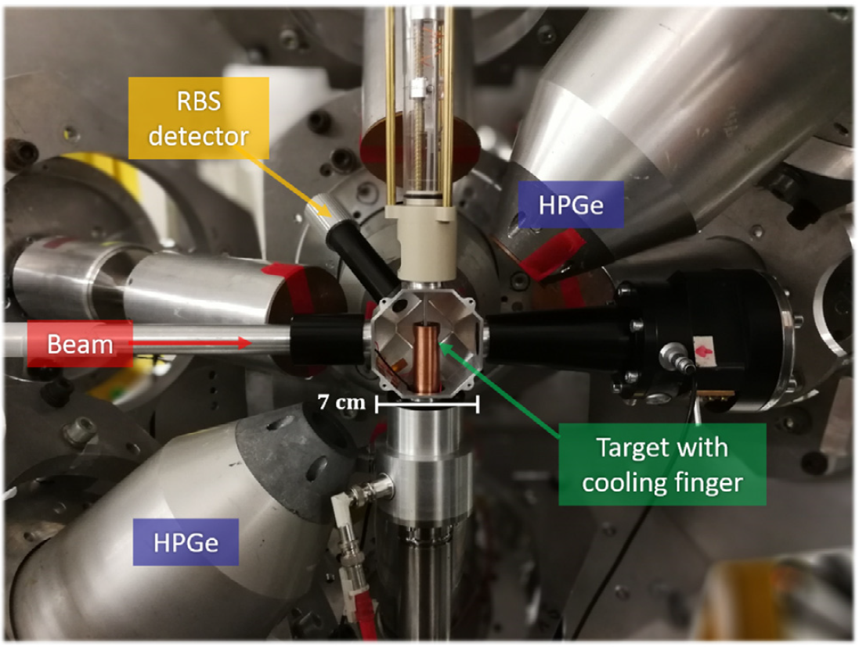
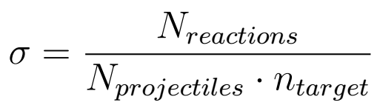
Astro-Setup@HORUS
Astro-Setup@Horus
14 HPGe detectors
6 BGO detectors for active Compton suppression
Silicon detector for Rutherford Backscattering Spectroscopy (RBS)
Efficiency@1.3 MeV: 3 %
-400 V suppression voltage
Experiment
  ⁵⁸Fe(p, γ)⁵⁹Co
  ⁹³Nb(p, γ)⁹⁴Mo
F. Heim et al., Nucl. Instr. Meth. Phys. Res. A 966, 163854 (2020)

Slide 7
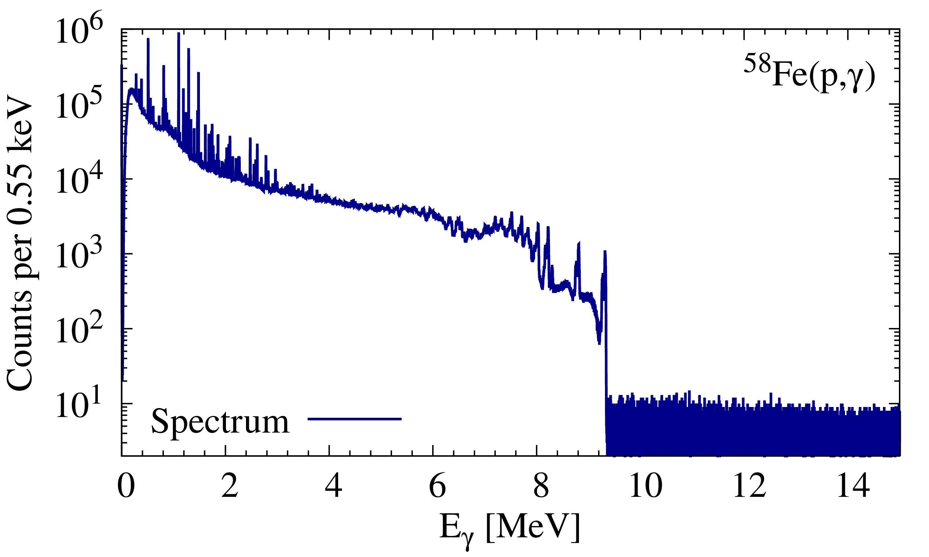



In-beam measurement of radiative capture cross sections
E_{c.m.}±ΔE/2
…
$${9/2}_{1}^{−}$$
Q
$${3/2}_{1}^{−}$$
⁵⁸Fe
target
⁵⁹Co
$${7/2}_{1}^{−}$$
product
Calculate total cross sections by counting ground state transitions (black)
Determine partial cross sections from first generation γ rays (green)
Identify first generation γ rays by gating on population of a specific low lying state in Two-Step Cascade sum spectrum

Slide 8
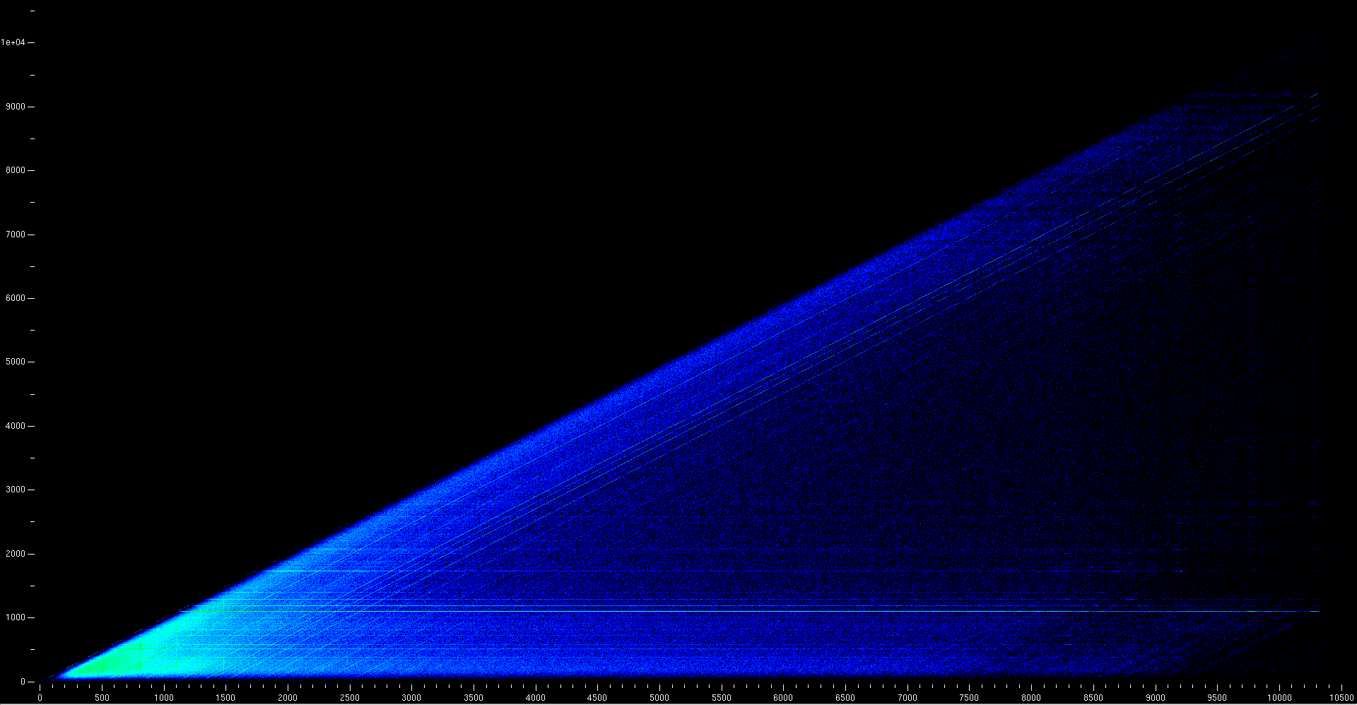
Two Step Cascades: ⁵⁸Fe(p, γ)⁵⁹Co
E _{γ} [keV]
E _{γ,1} + E _{γ,2} [keV]

Slide 9
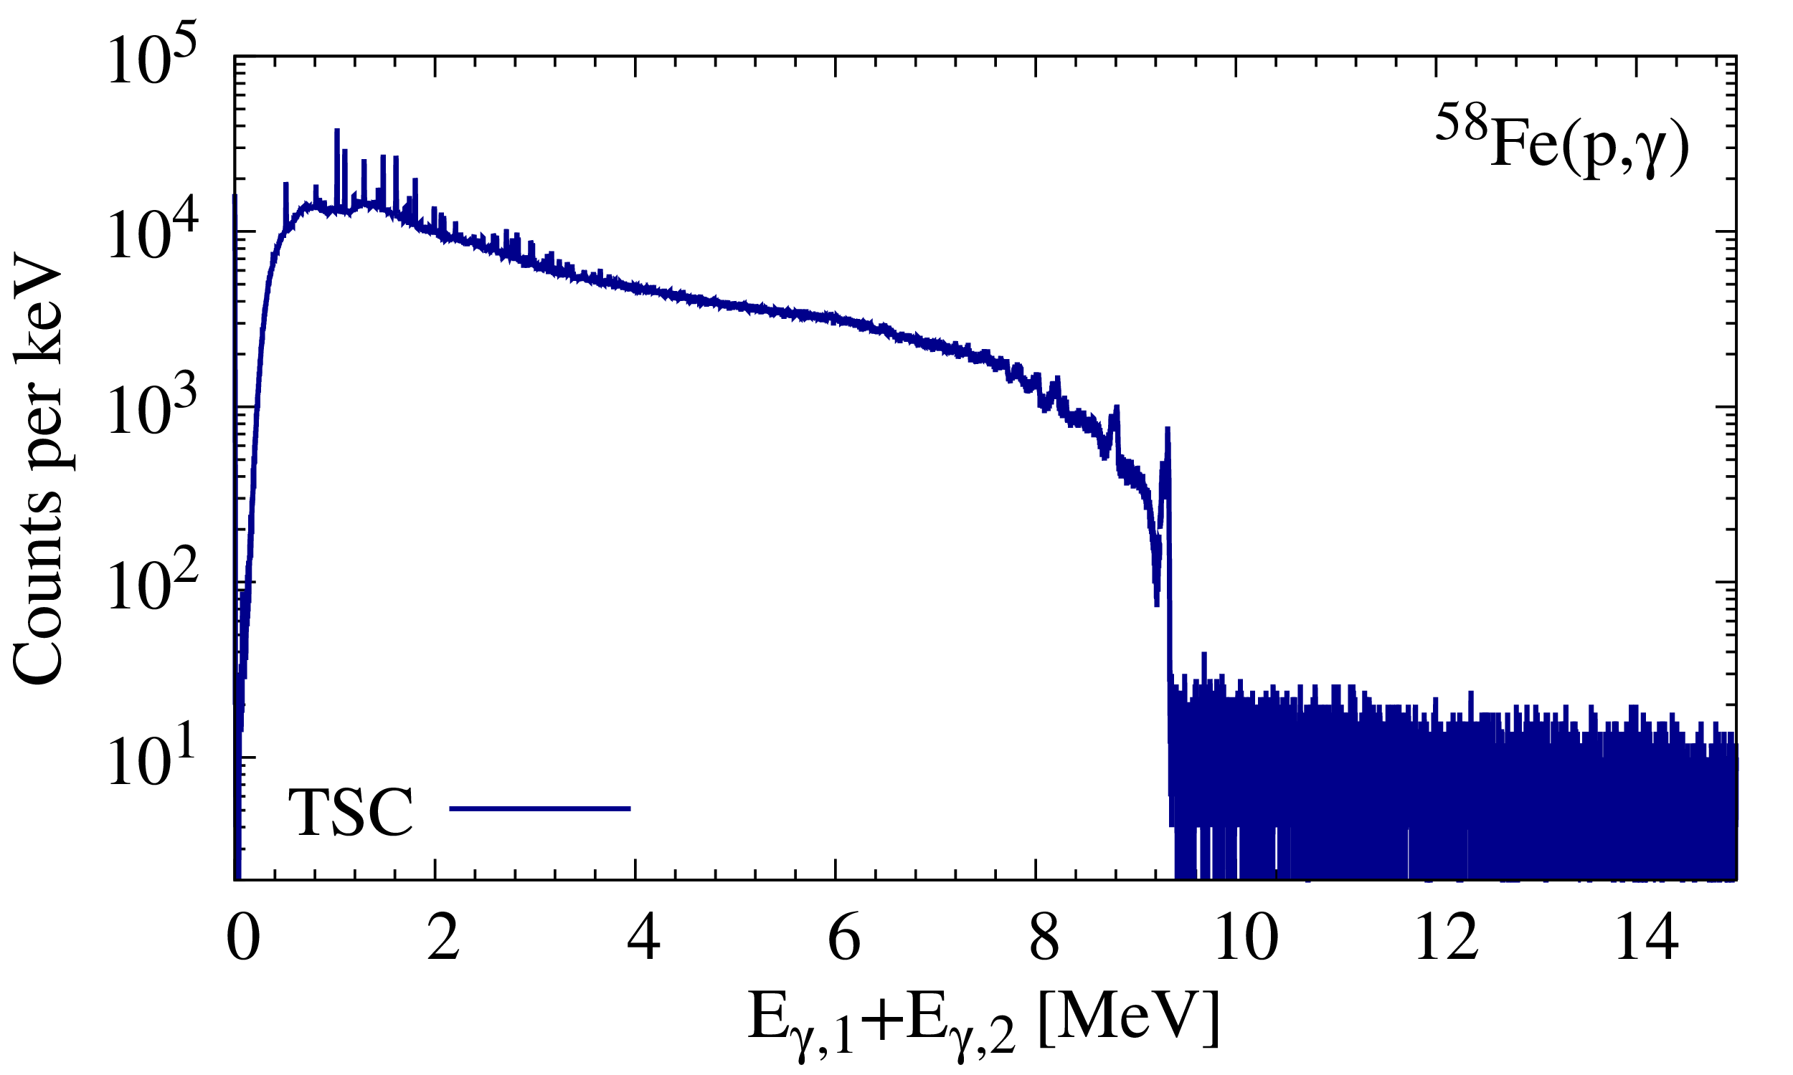
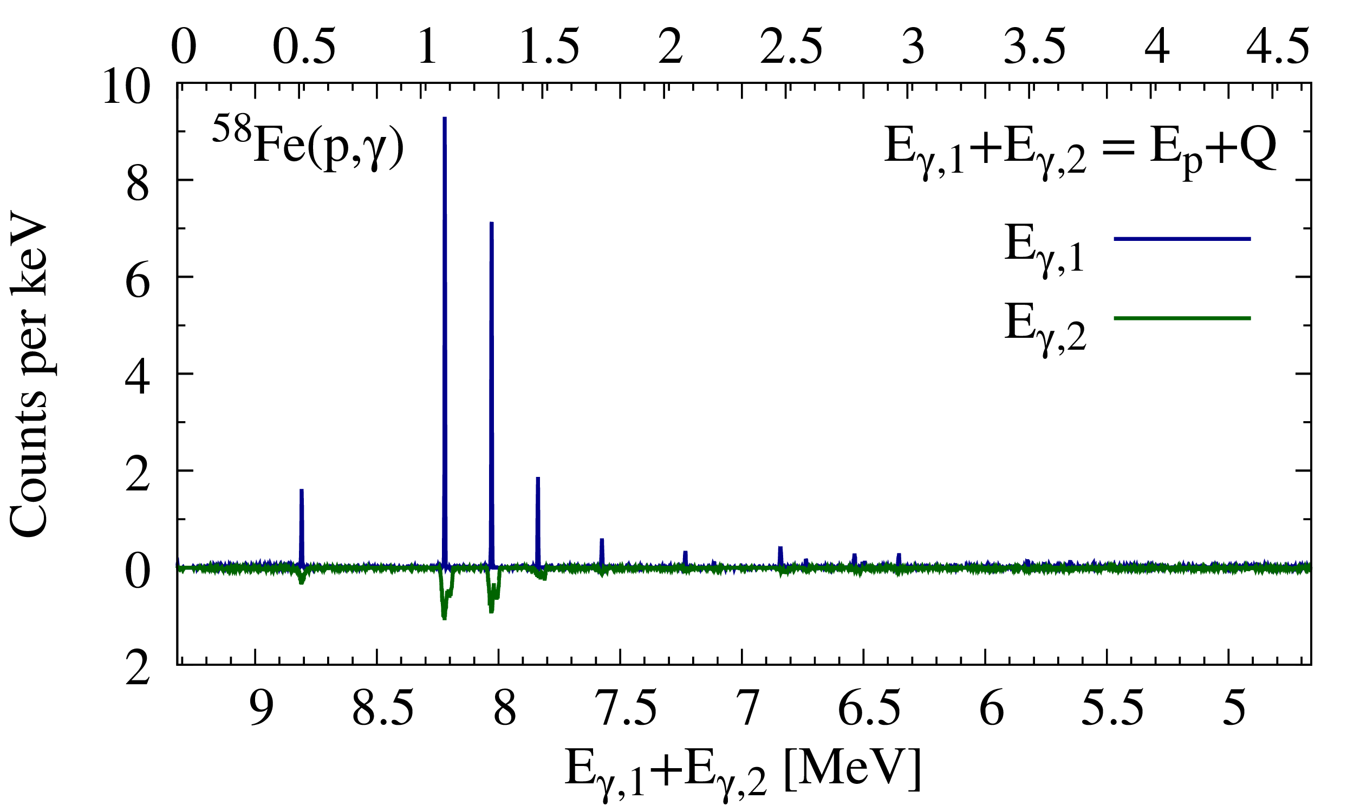
Gating on TSC matrix
Gate on E_{p}+ Q yields two step cascades going from the compound state to the groundstate
For cascades to low lying excited state gate on E_{p} + Q - E_{state}

Slide 10
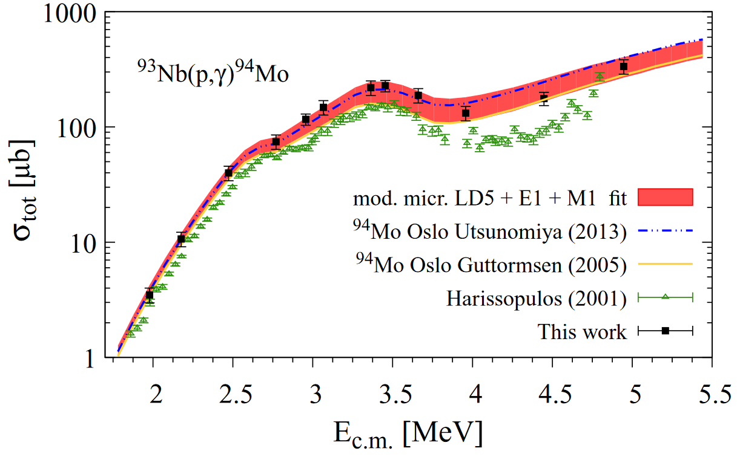
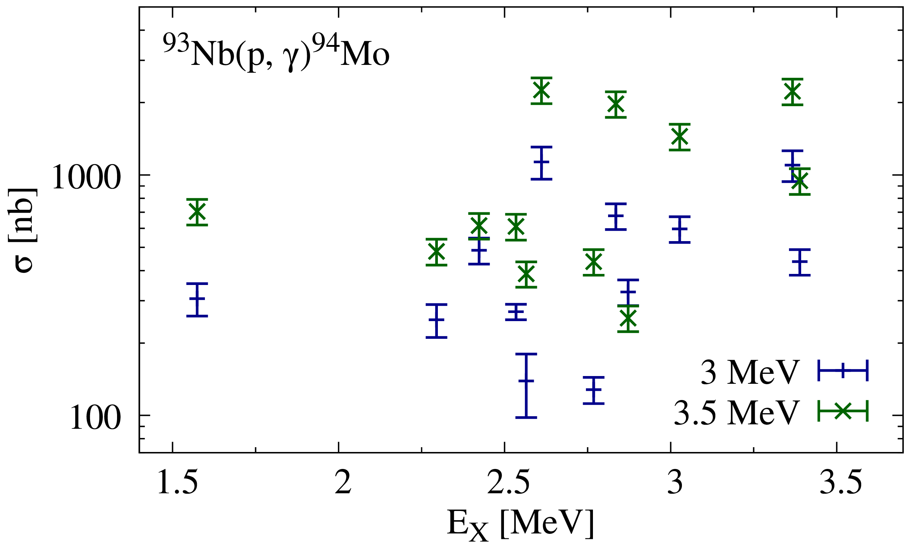
Results: ⁹³Nb(p, γ)⁹⁴Mo
Total cross sections
F. Heim et al., Phys. Rev. C 101, 035807 (2020)
Partial cross sections
F. Heim et al., Phys. Rev. C 103, 025805 (2021)

Slide 11
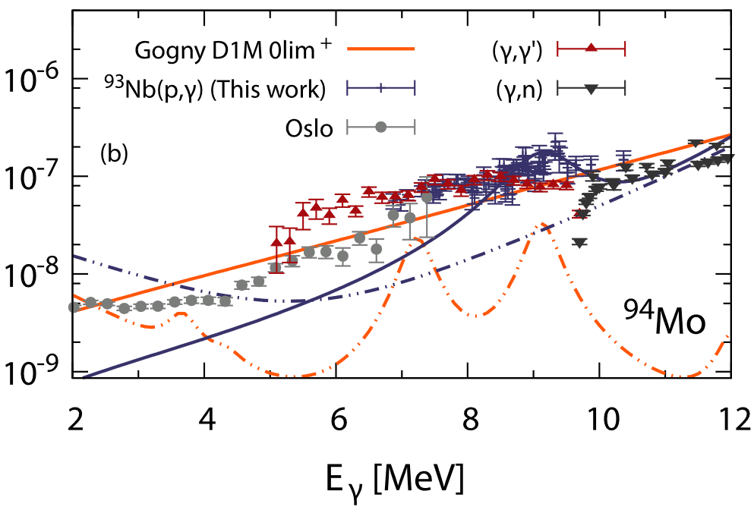

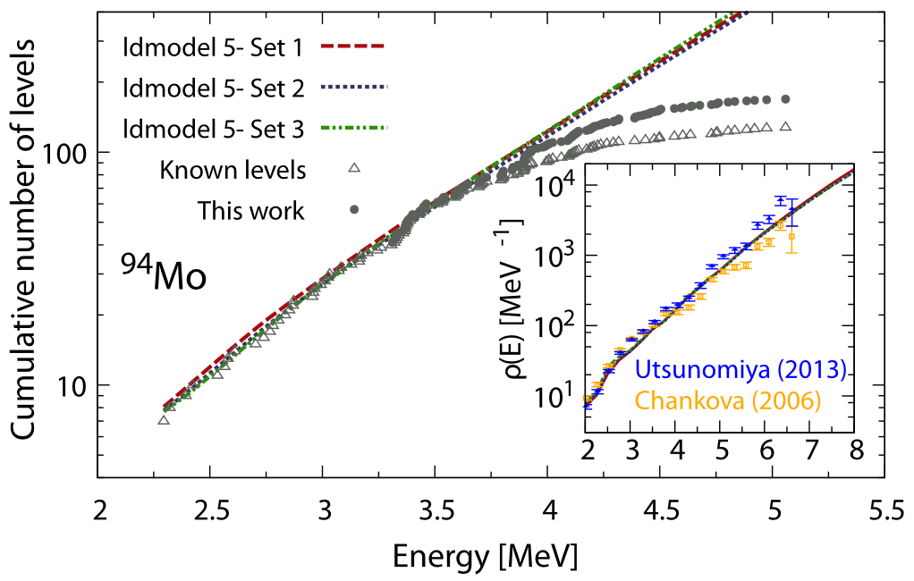
Results: ⁹³Nb(p, γ)⁹⁴Mo
γ-strength function
F. Heim et al., Phys. Rev. C 103, 025805 (2021)
Cumulative number of levels
F. Heim et al., Phys. Rev. C 103, 025805 (2021)

Slide 12
Hauser-Feshbach statistical model
γ strength function (γ -SF)
Nuclear level
density (NLD)
Optical model potential (OMP)
Measure cross sections to constrain nuclear input
Partial cross sections can help reduce sensitivity to the OMP

Slide 13
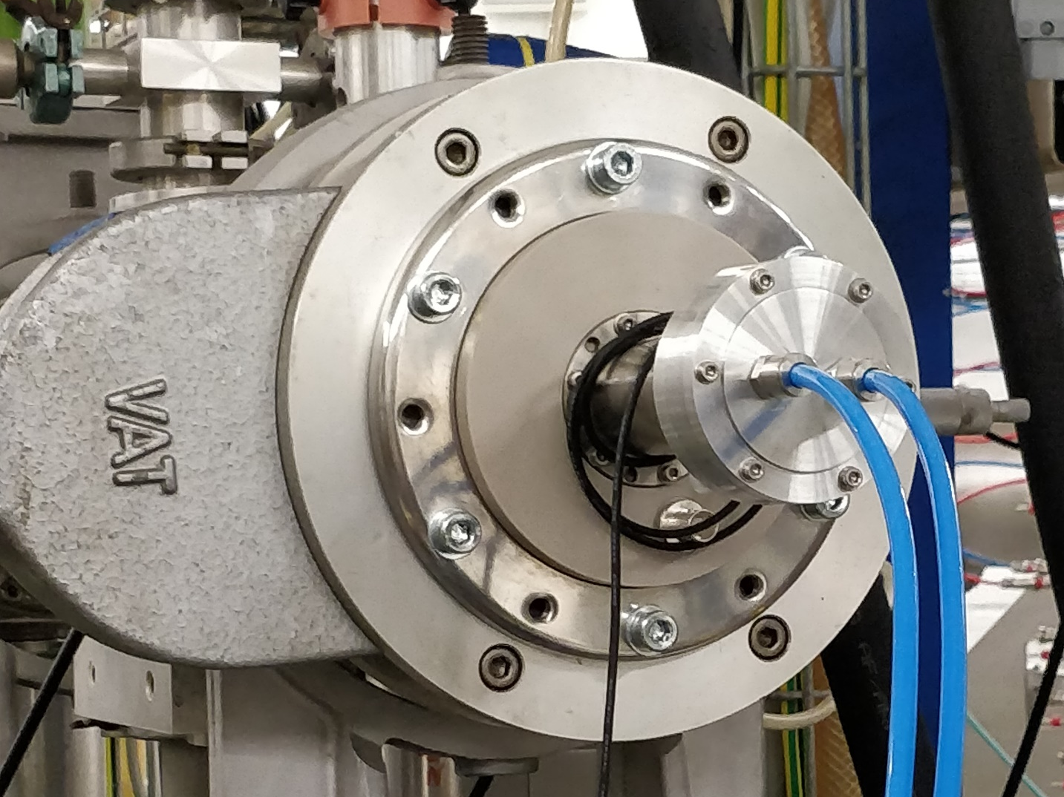
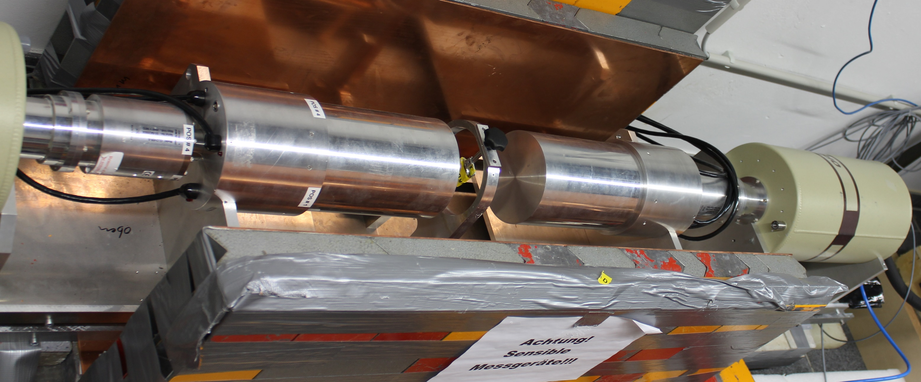
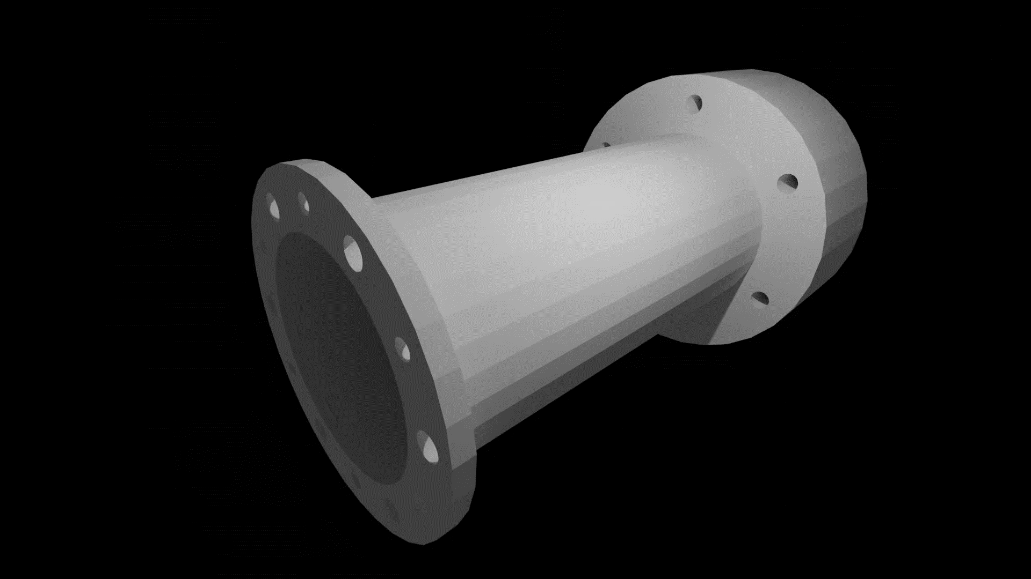
Activation measurement
Stacked target chamber
Holds up to 4 targets
Water cooled
Mountable at both accelerators
Experiments:
  ⁵⁵Mn(α,n)⁵⁸Co^{m+g}
  ⁵⁸Fe(p,n)⁵⁸Co^{m+g}
Cologne Clover Counting
2 rail mounted clover-type HPGe detectors
Efficiency@1.3 MeV: 5 %
Copper lined lead castle for background suppression
Total background count rate: ca. 65 cps
Separate DAQ for each segment
γγ-coincidence measurements possible

Slide 14
Meta-stable state
⁵⁸Co^{m}
T_{1/2} = 9 h
25 keV
⁵⁸Co^{g}
T_{1/2} = 70 d
σ_{m}
product
σ_{g.s.}
⁵⁸Fe
daughter nucleus
target
25 keV transition not observed
Feeding from meta-stable state into ground state can be observed via the ground state‘s β decay

Slide 15
Activation method
decay
product
reaction
T_{1/2}
target
decay
Low rel. intensity of transitions
Low γ-ray energy
Short half live
Background
Limitations might not apply to granddaughter nucleus.
T_{1/2}
Daughter nucleus
Granddaughter nucleus

Slide 16
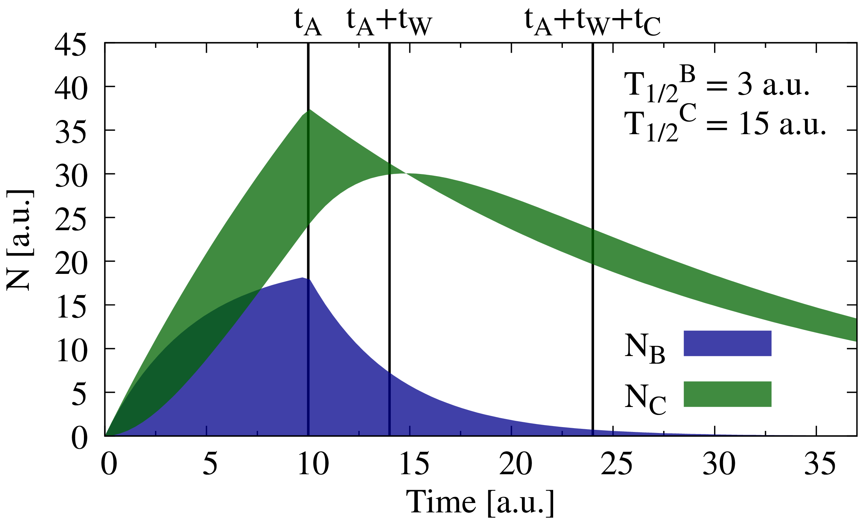
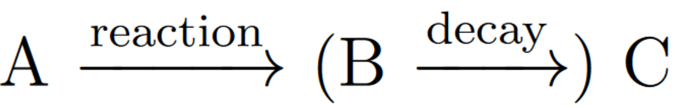
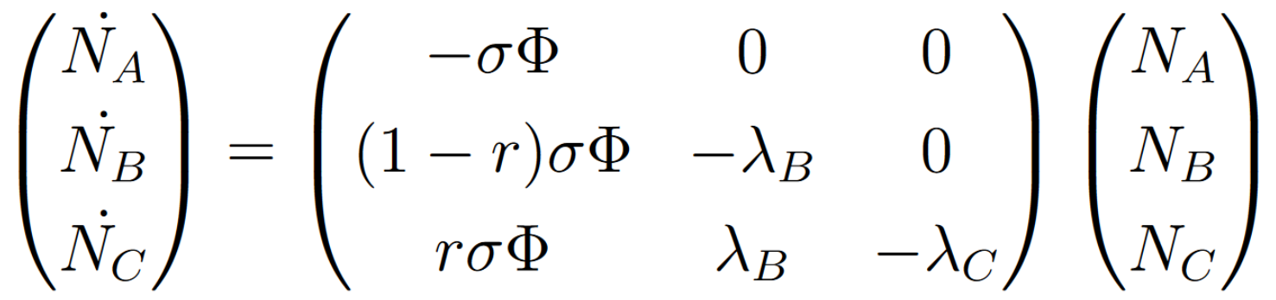
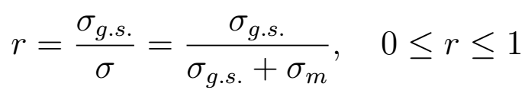
Theoretical description
irradiation
counting
Ground-state-to-total ratio:

Slide 17
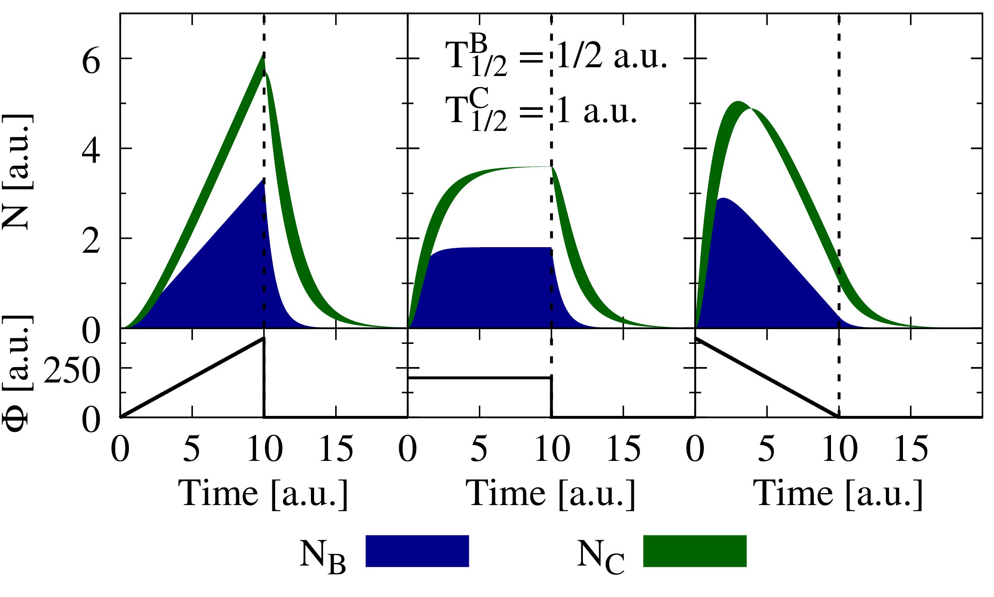
Beam current correction

Slide 18
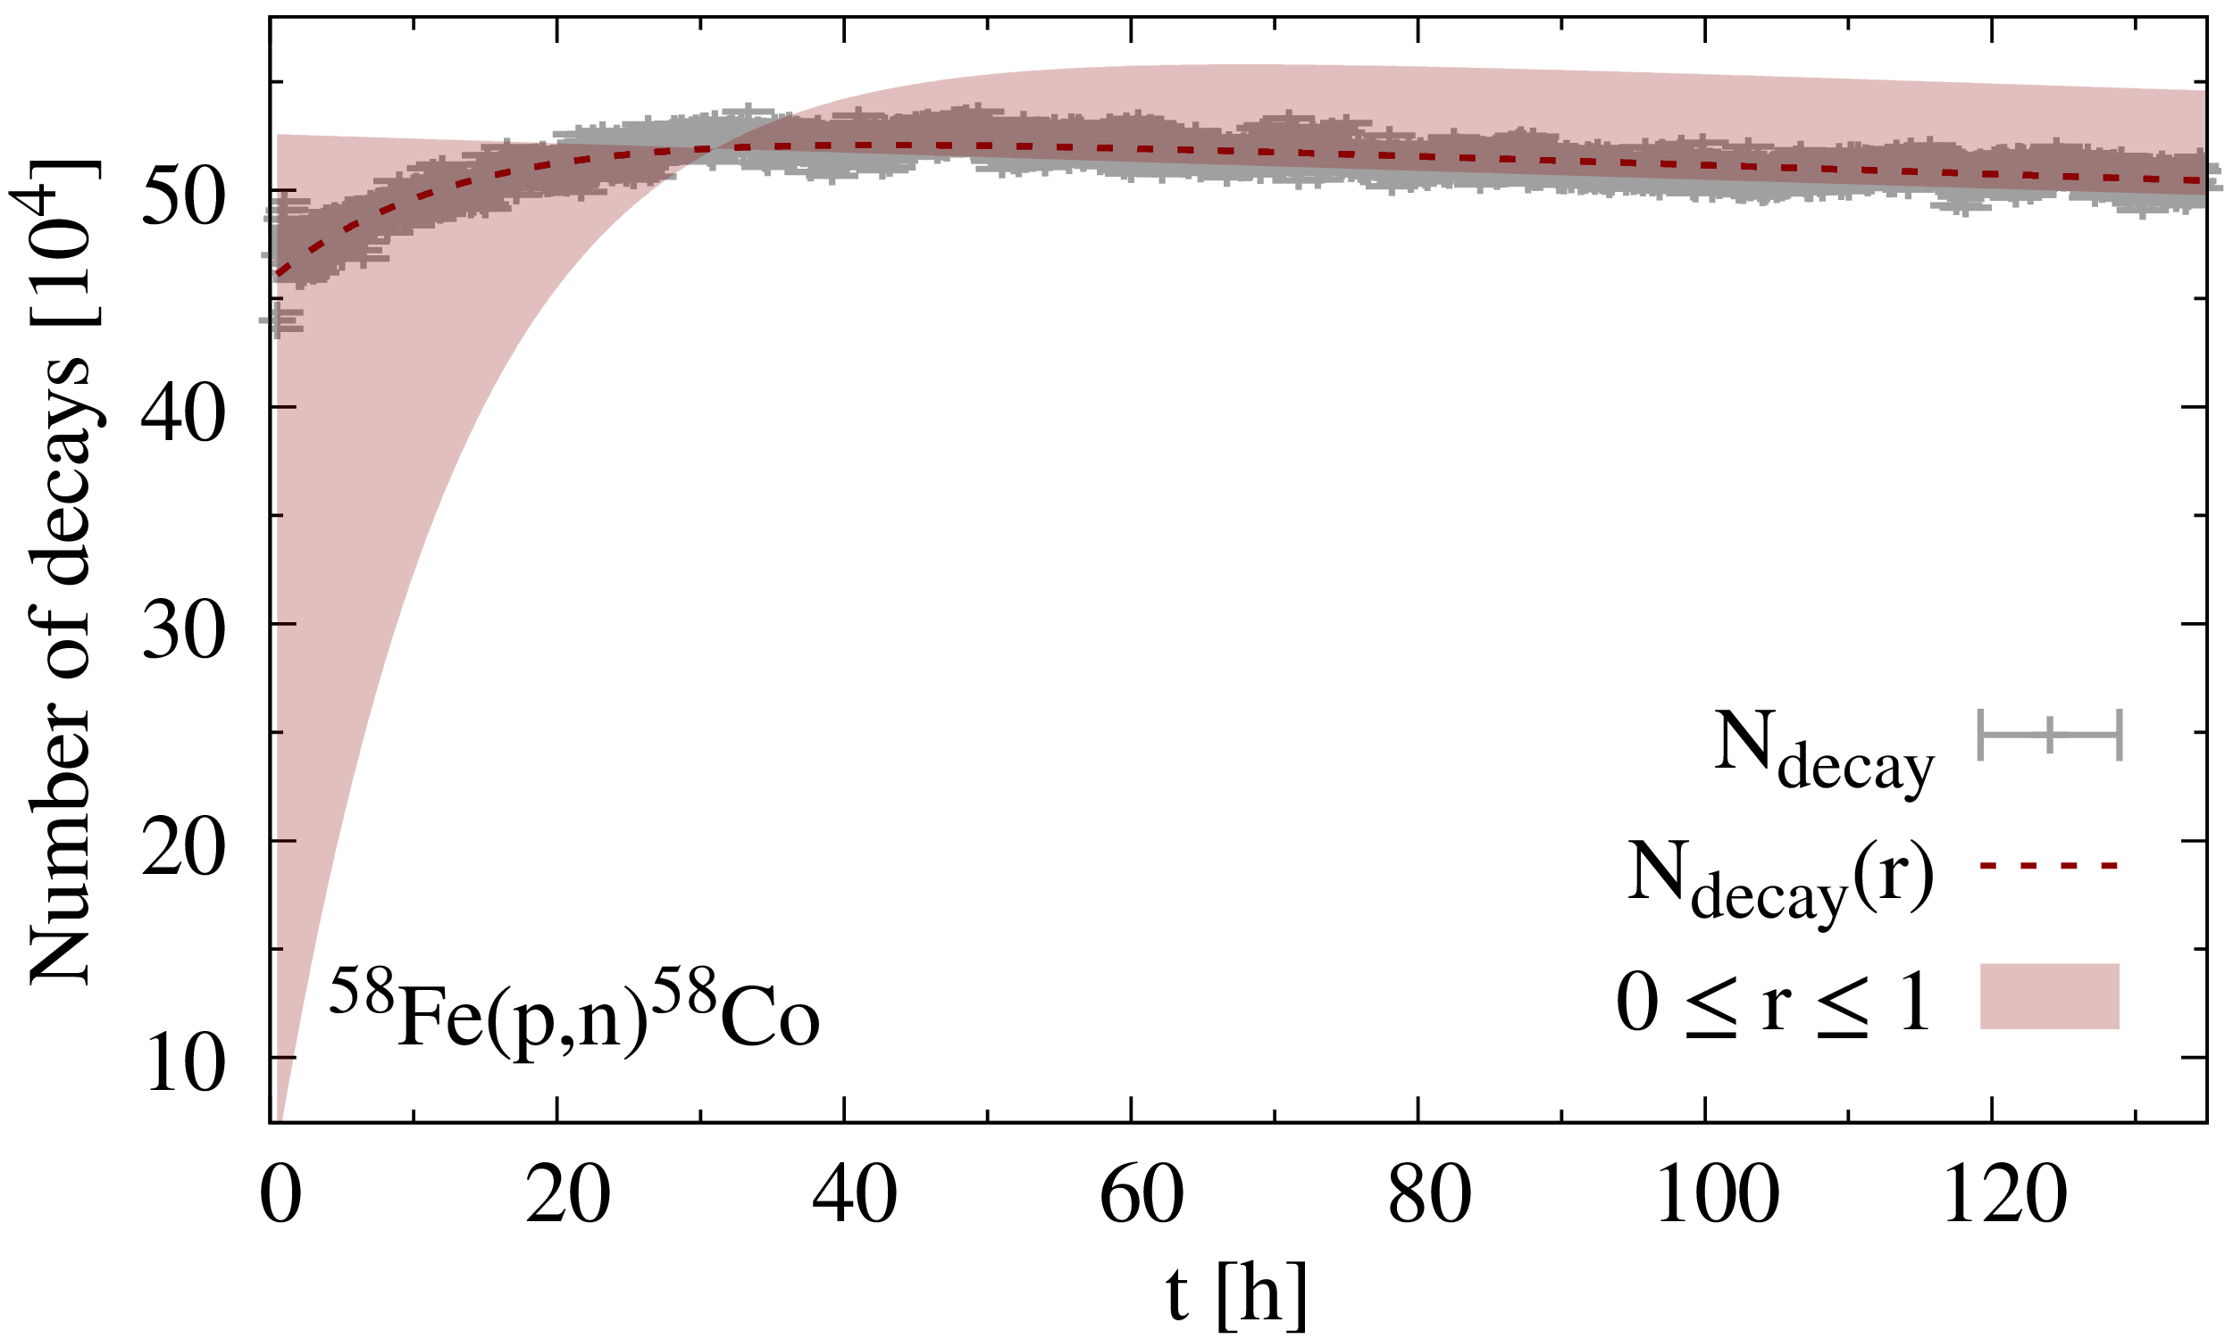
Ground-state-to-total ratio
Fit → r
Integral → σ

Slide 19
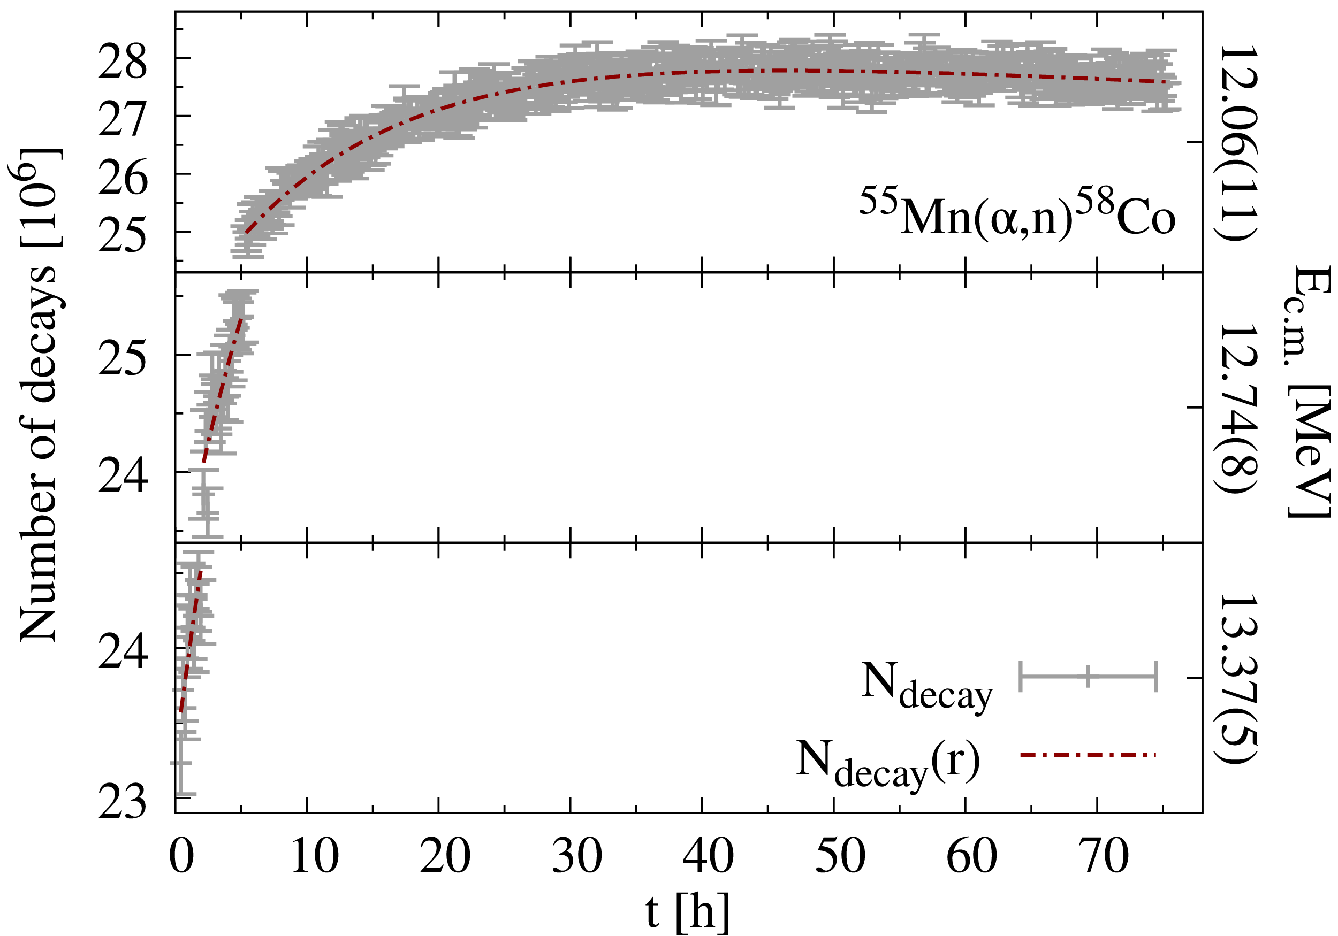
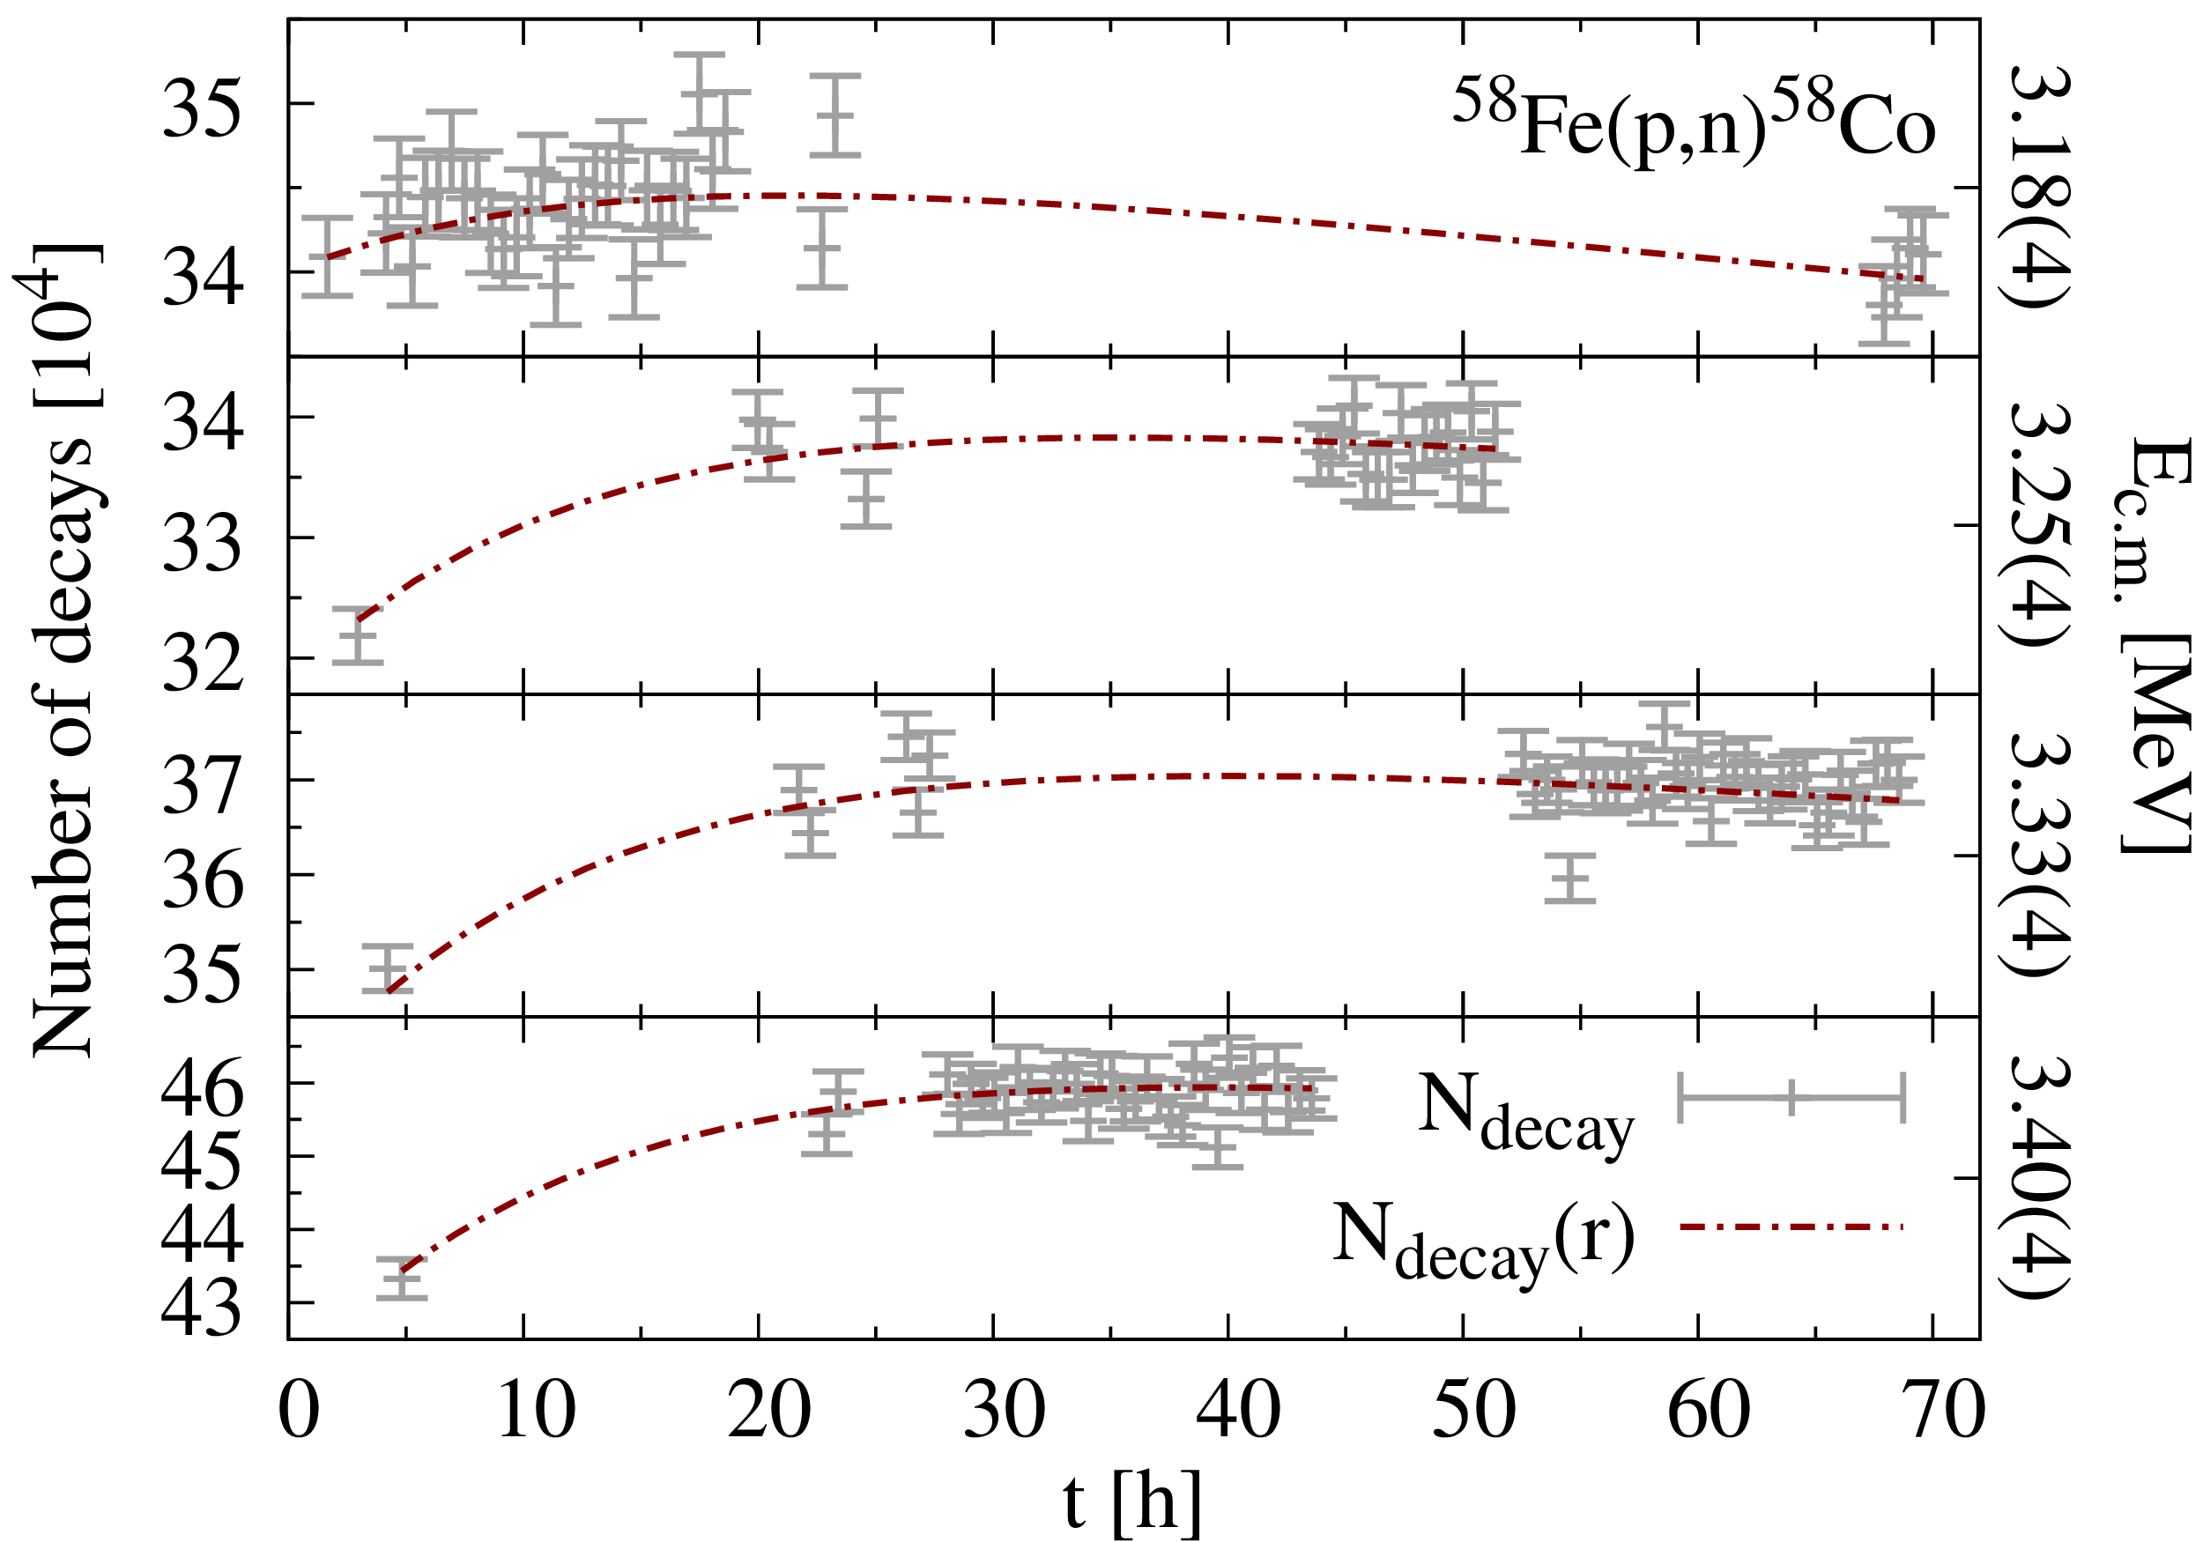
Stacked target measurement scheme
Determination of ground-state-to-total ratio strongly depends on the timing of the measurement
For stacked-target experiments a rotating measurement scheme was adopted

Slide 20
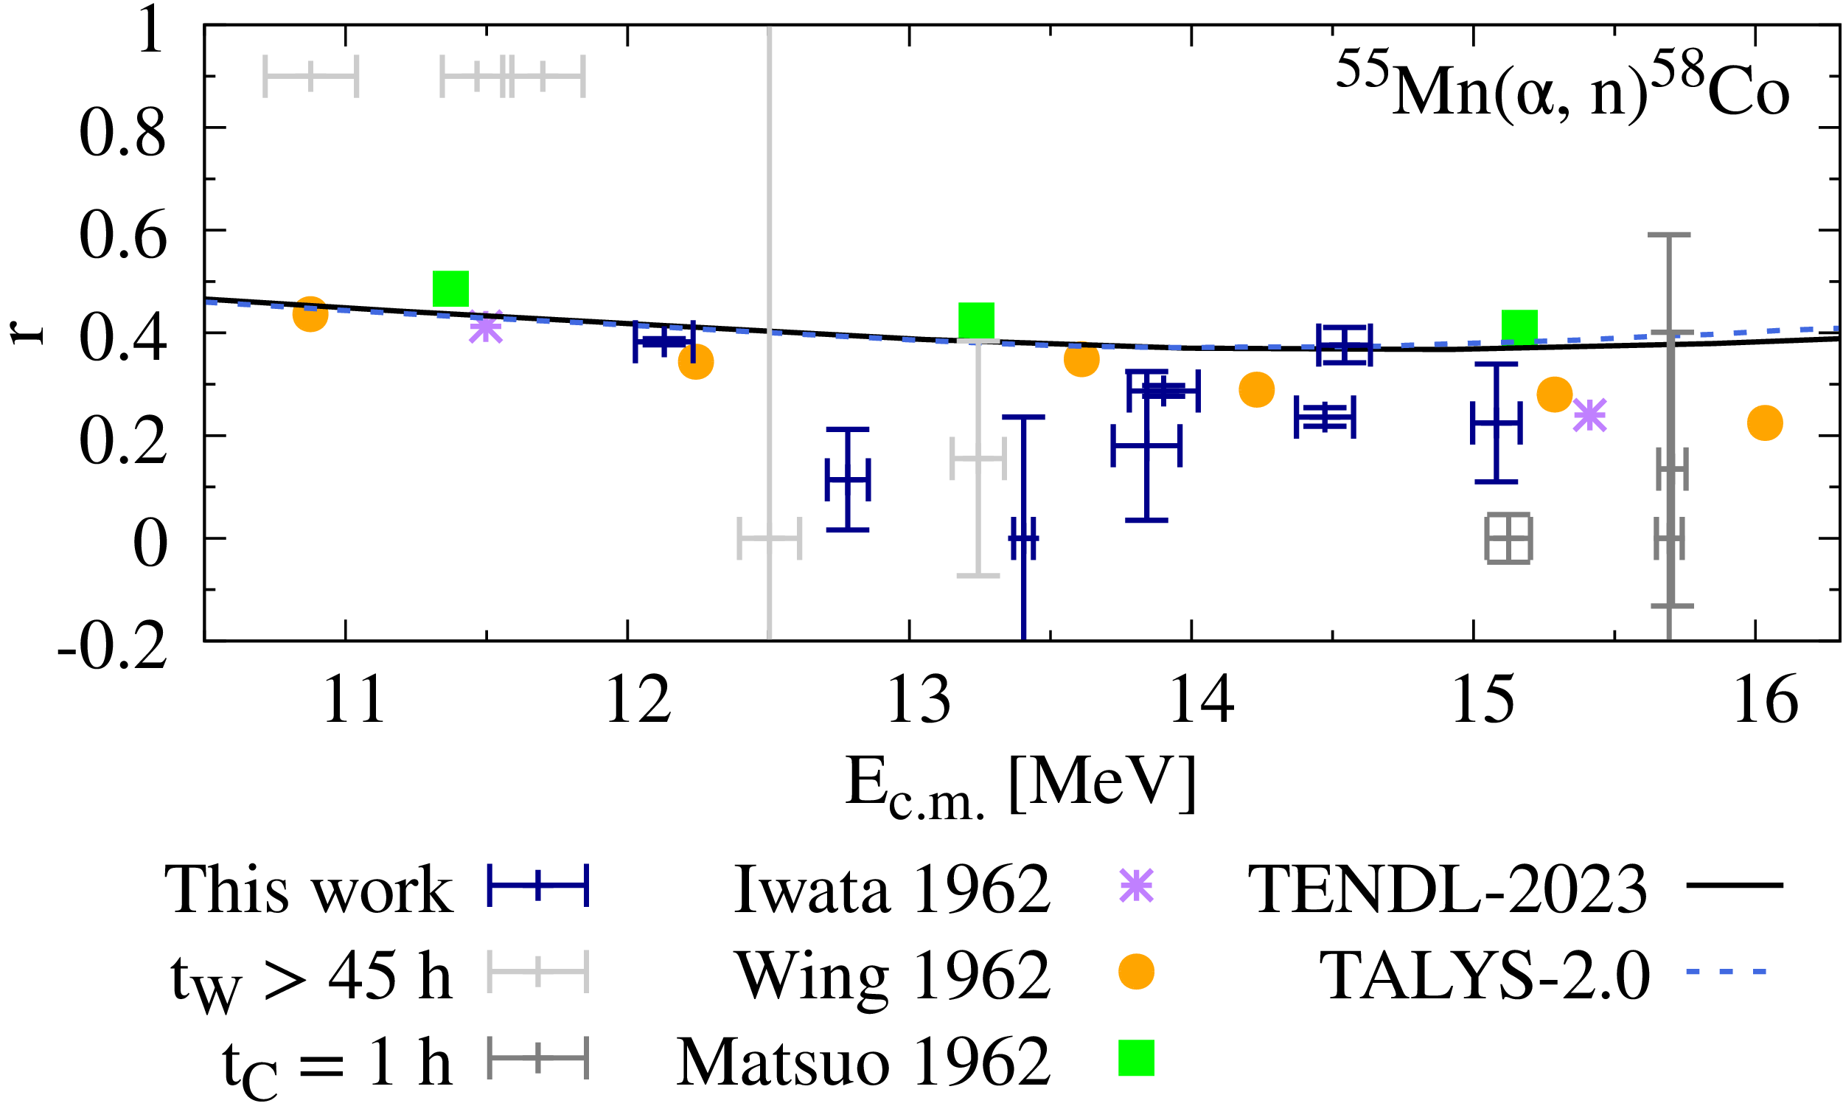
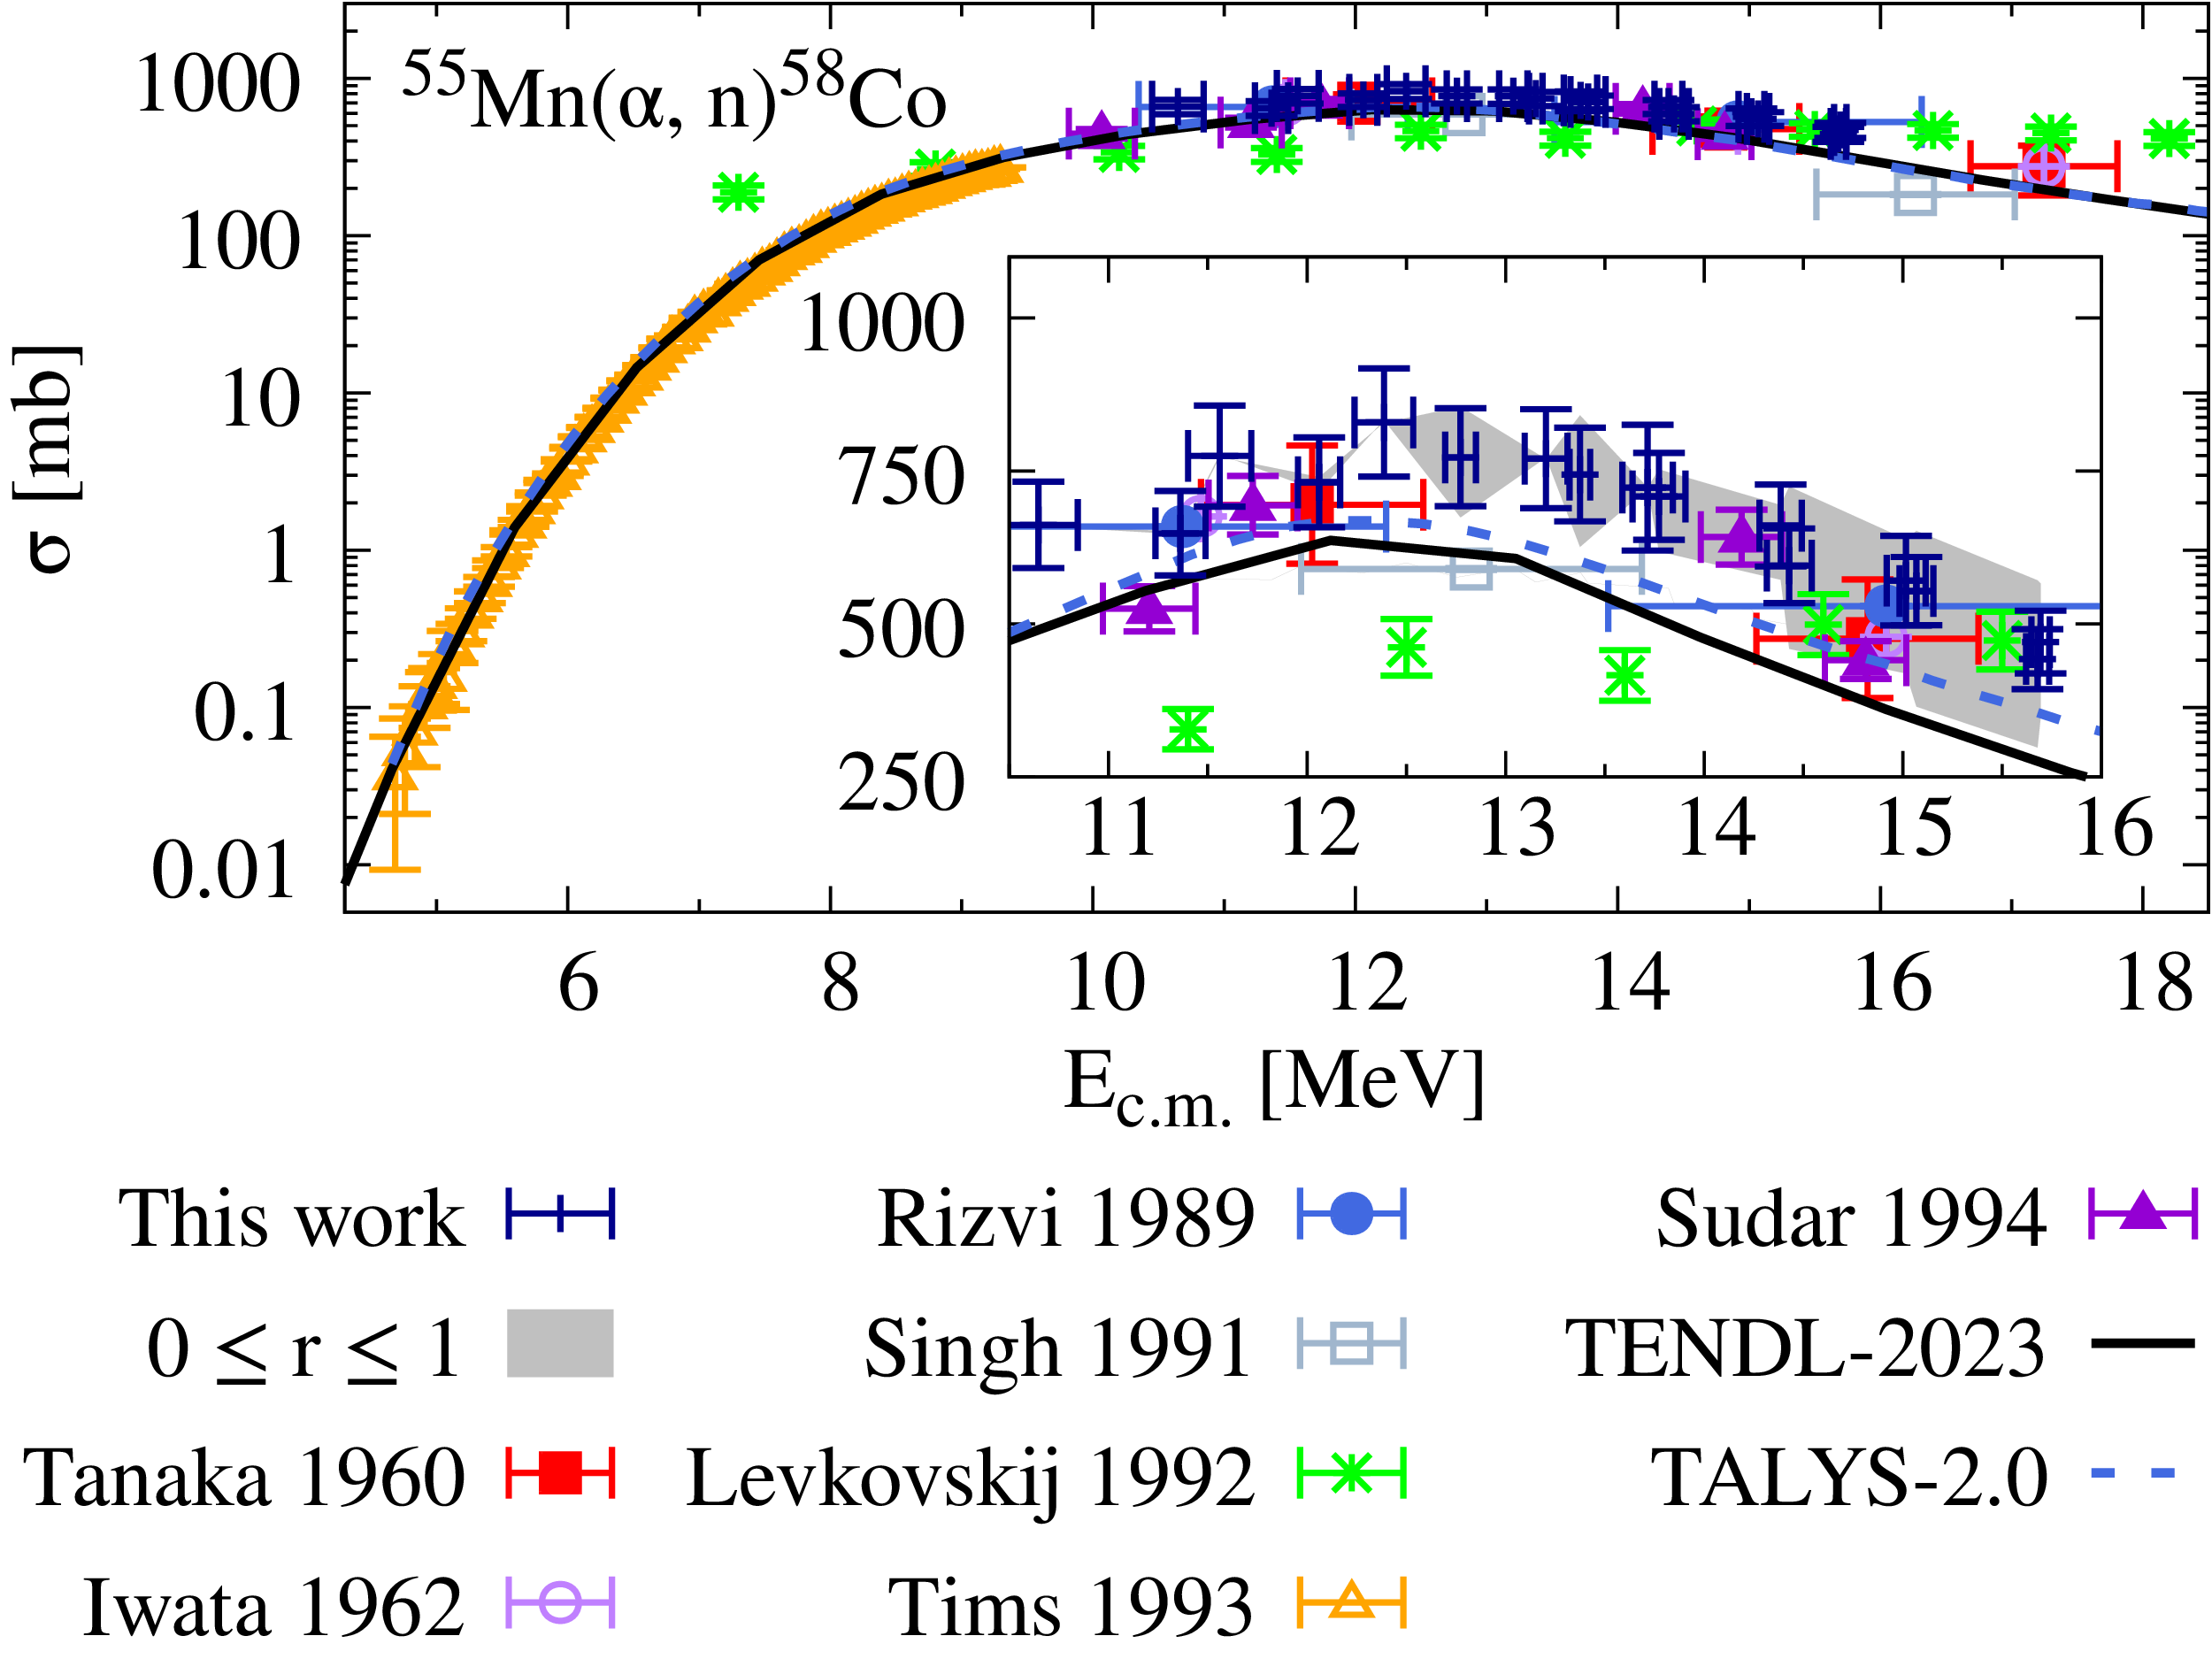
Results: ⁵⁵Mn(α,n)⁵⁸Co
M. Müller et al., Phys. Rev. C 107, 035804 (2023)

Slide 21
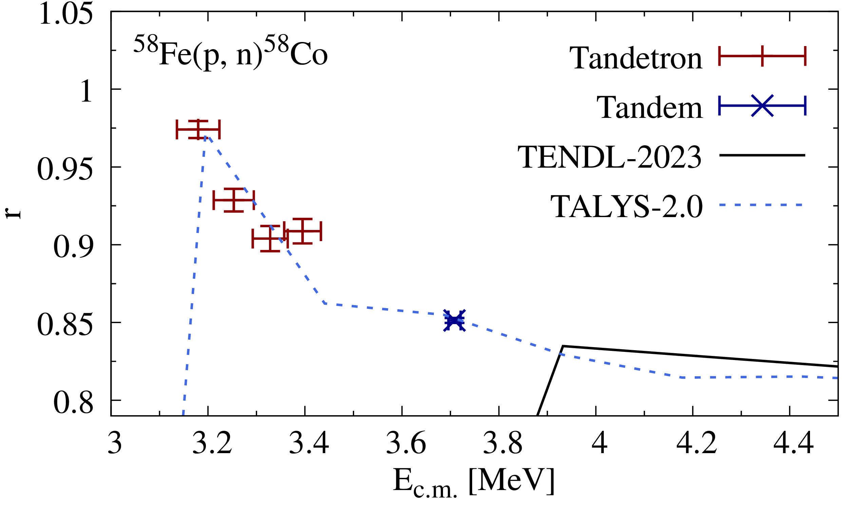
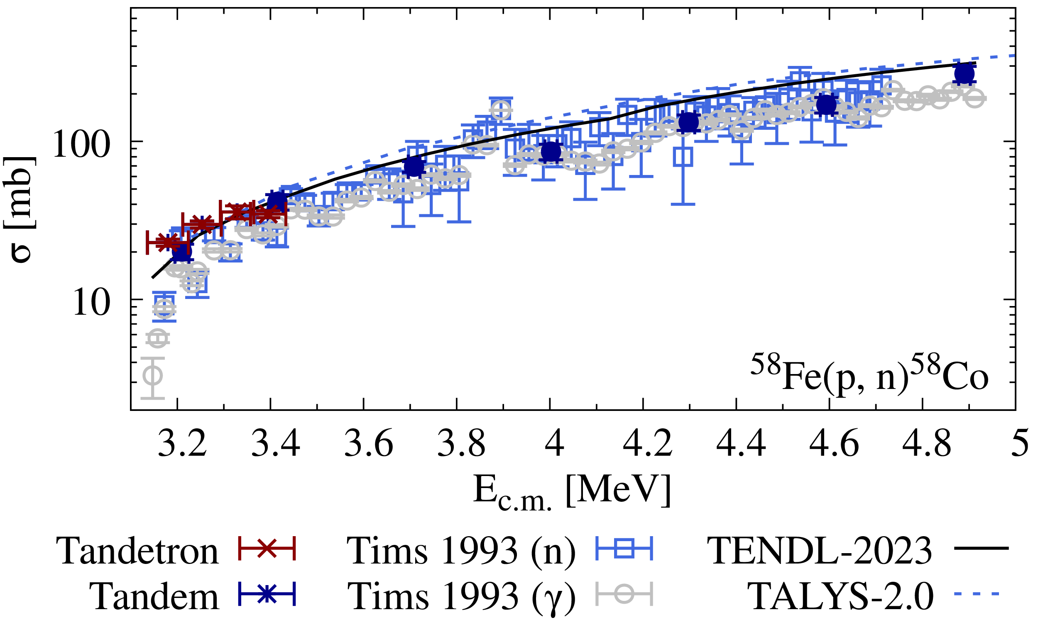
Results: ⁵⁸Fe(p,n)⁵⁸Co
S. Tims et al., Nucl. Phys. A 563, 473 (1993)
P. Wüstenberg, Bachelor’s Thesis (2022)

Slide 22
Summary & Outlook
Reaction | Experiment type | Lowest E_{c.m.} [MeV] | Lowest σ_{tot} [μb] | Status
⁹³Nb(p,γ)⁹⁴Mo | in-beam | 1.96 (2) | 3.5 (5) | F. Heim, et al., Phys. Rev. C 101, 035807 (2020)
⁹⁶Mo(p,n)⁹⁶Tc^{m+g} | activation | 3.84 (2) | 2470 (400) | F. Heim, et al., Phys. Rev. C 103, 054613 (2021)
¹⁰⁷Ag(p,γ)¹⁰⁸Cd | in-beam | 1.98 (3) | 0.62 (10) | F.Heim, et al., Phys. Rev. C 101, 035805 (2020)
¹⁰⁹Ag(p,γ)¹¹⁰Cd | in-beam | 2.45 (3) | 0.48 (6) | F. Heim, et al., Phys. Rev. C 103, 055803 (2021)
¹⁷⁰Yb(α,n)¹⁷³Hf | stacked target | 12.7 (1) | 22 (7) | M. Müller, et al., Phys. Rev. C 107, 035804 (2023)
¹⁷²Yb(α,n)¹⁷⁵Hf | stacked target | 13.13 (8) | 60 (20) | M. Müller, et al., Phys. Rev. C 107, 035804 (2023)
⁵⁵Mn(α,2n)⁵⁷Co | stacked target | 12.1 (1) | 1185 (200) | publication under preparation
⁵⁵Mn(α,n)⁵⁸Co^{m+g} | stacked target | 10.6 (2) | 661765 (70531) | publication under preparation
⁵⁸Fe(p,γ)⁵⁹Co | in-beam | - | - | under analysis
⁸⁷Rb(p,γ)⁸⁸Sr | in-beam | 1.98 (3) | 0.34 (10) | S. Wilden, et al., EPJ Web of Conf. 279, 11004 (2023)
⁹⁶Mo(p, γ)⁹⁷Tc | in-beam | 1.94 (4) | 3.4 (4) | under analysis
¹⁵⁶Dy(p,γ)¹⁵⁷Ho | activation | - | - | experiment under preparation
¹⁵⁶Dy(α,γ)¹⁶⁰Er | activation | - | - | experiment under preparation

Slide 23
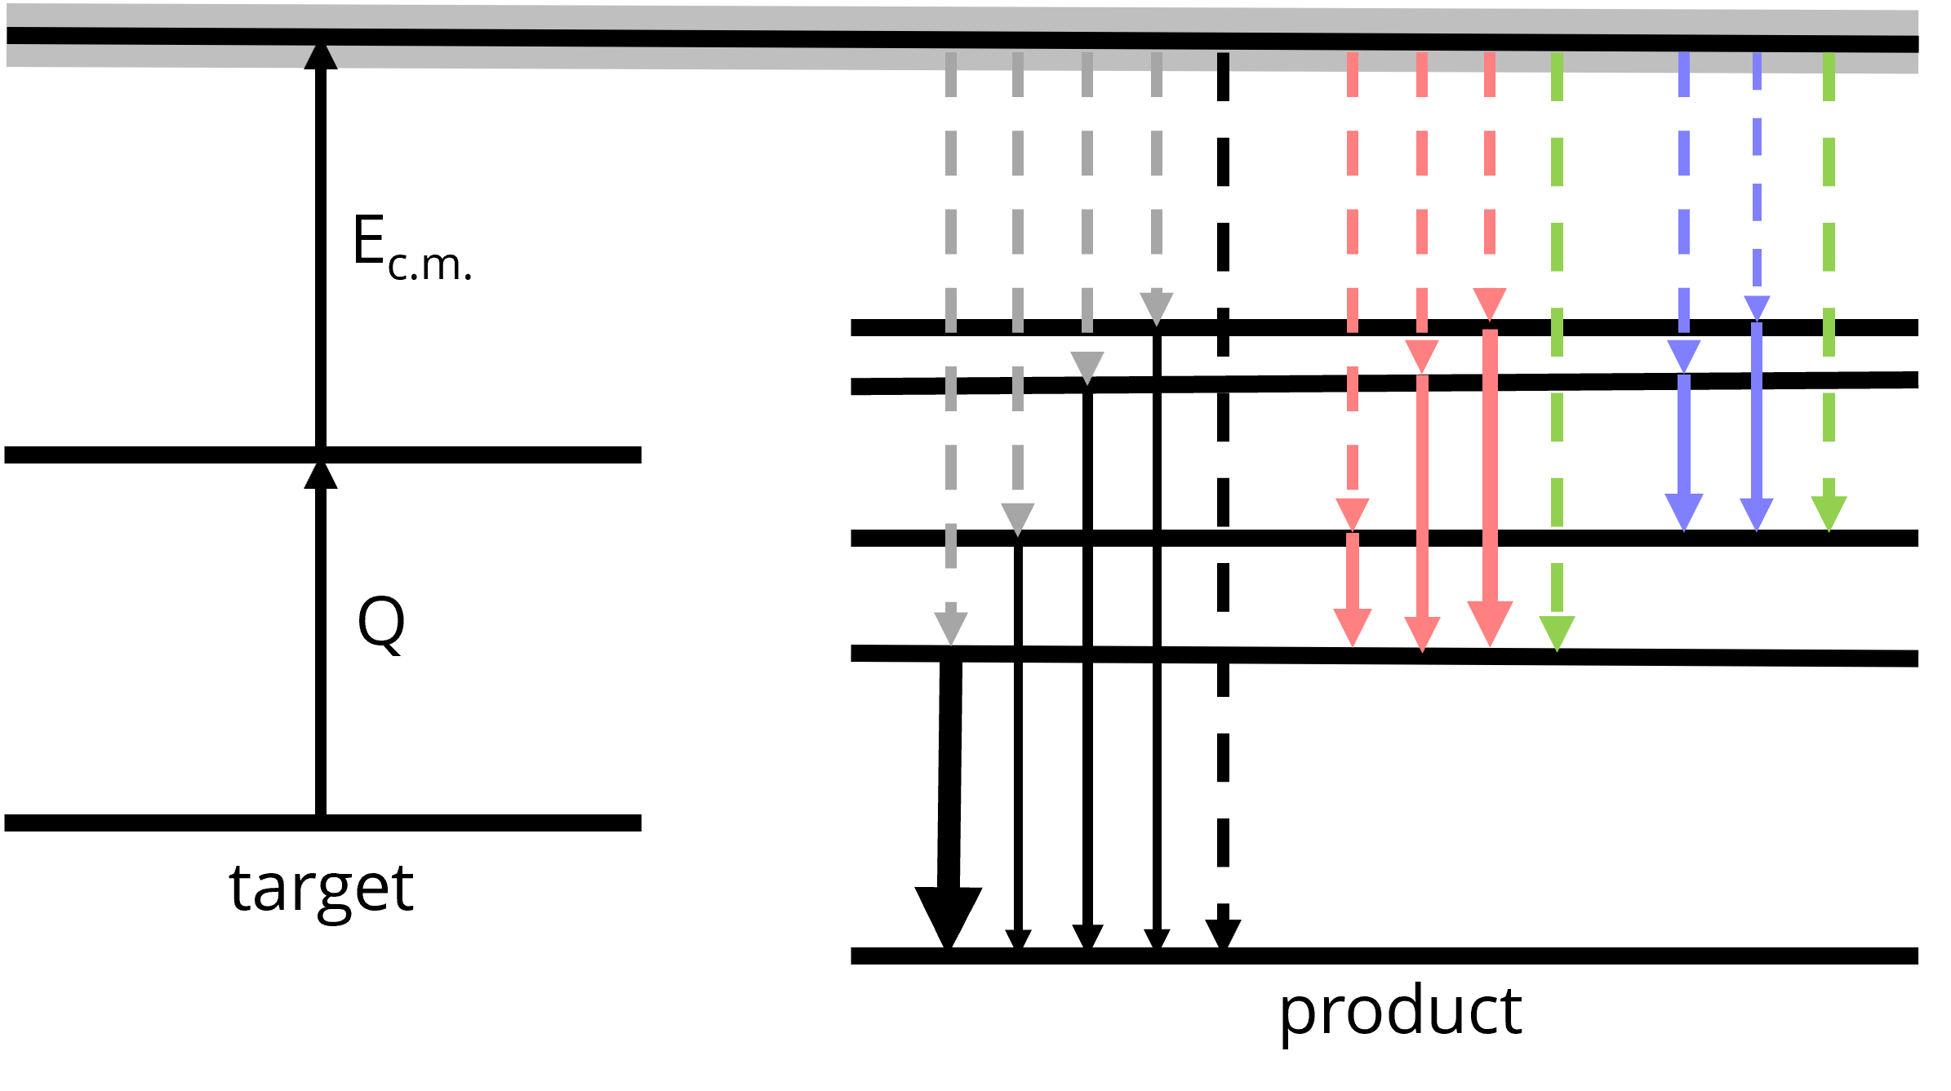

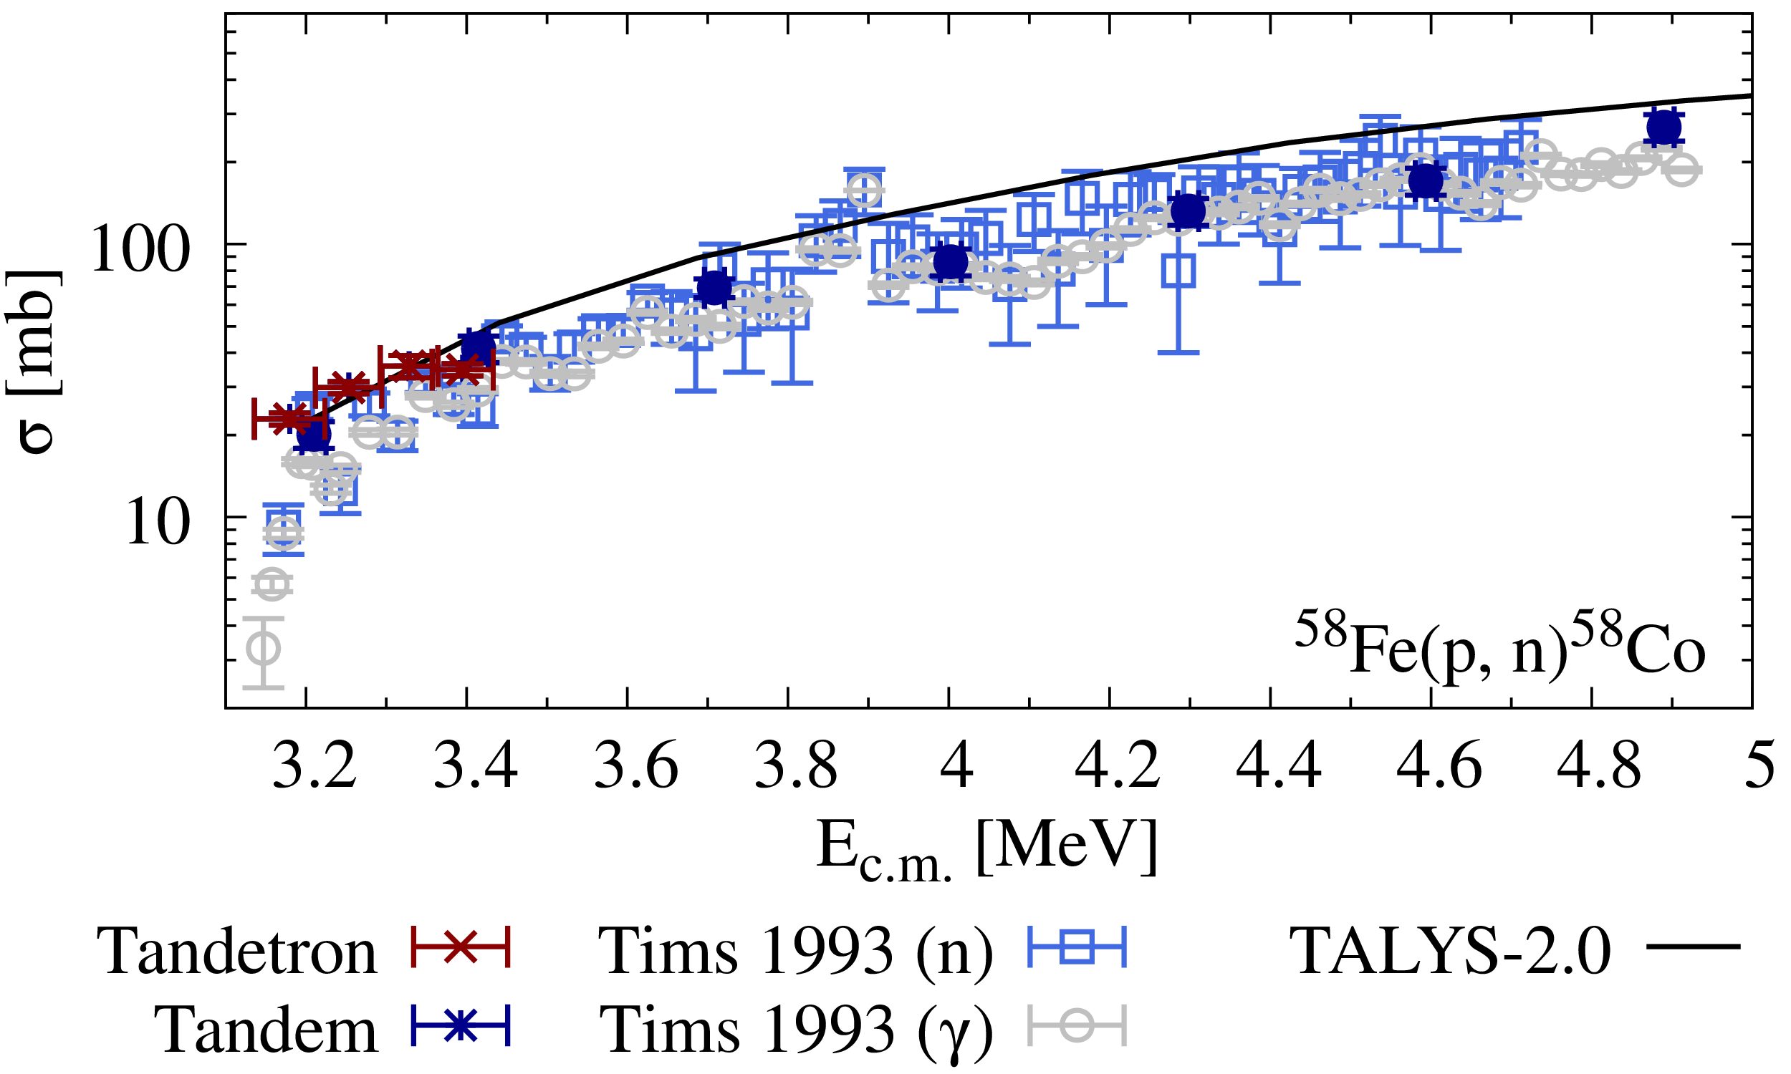
Summary
Setups
⁵⁸Fe(p,γ)⁵⁹Co
In-beam
Activation
⁵⁸Fe(p,n)⁵⁸Co^{m+g}
⁵⁸Fe(p,γ)⁵⁹Co
⁵⁵Mn(α,n)⁵⁸Co^{m+g}

Slide 24
Summary
Setups
⁵⁸Fe(p,γ)⁵⁹Co
In-beam
Activation
⁵⁸Fe(p,n)⁵⁸Co^{m+g}
⁵⁸Fe(p,γ)⁵⁹Co
⁵⁵Mn(α,n)⁵⁸Co^{m+g}

Slide 25
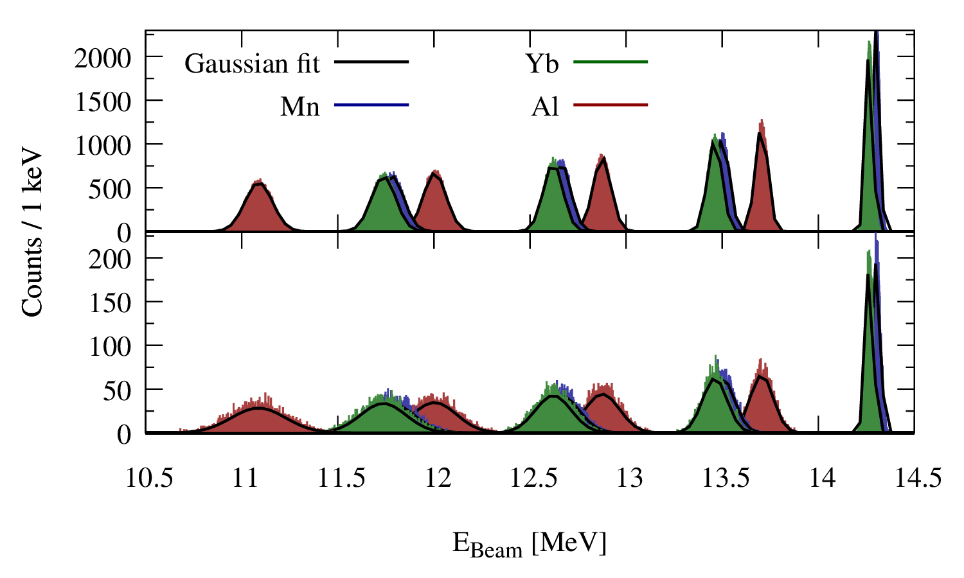
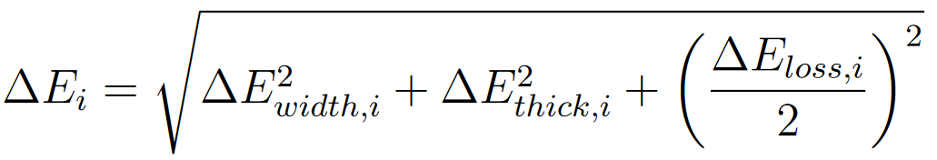
Energy loss simulation
single run
“Beam“
Target 4
Target 3
Target 2
Target 1
10,000 runs

