Slide 1

9th Workshop on Nuclear Level Density and Gamma Strength
Measurement of ⁵⁹Fe(n,g) reaction based on beta-OSLO method
Shilun Jin
Institute of Modern Physics, Chinese Academy of Sciences
Oslo, Norway
28/5/2024

Slide 2
outline
1 Rapid neutron capture process
2 Experiment and LAMBDA
3 Preliminary results & HIAF in future

Slide 3
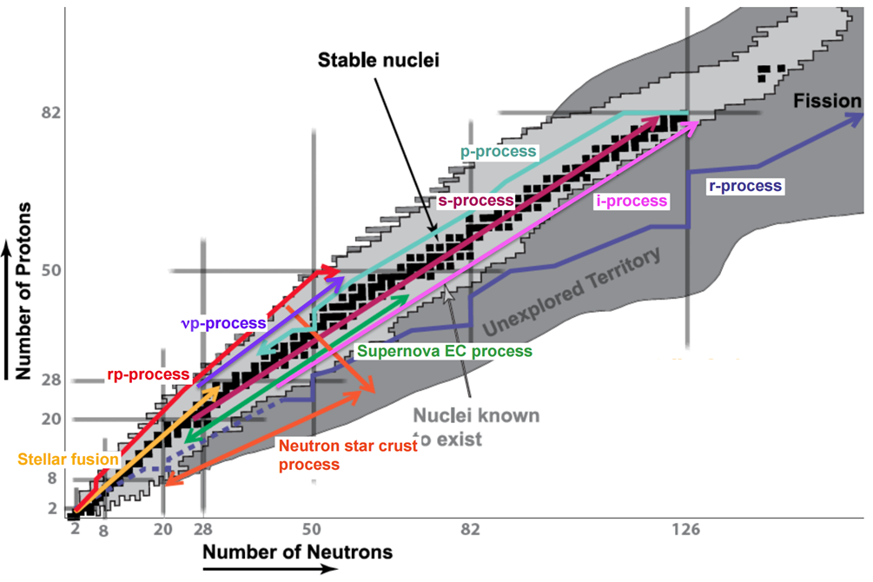
r-process
How were elements from Iron to Uranium made?
Nucleosynthesis process
N-deficient side:
rp-process
P-process:
p-nuclide ⁷⁴Se-¹⁹⁶Hg
νp-process:
^{92,94}Mo ^{96,98}Ru
N-rich side:
s-process:
-slow (n,g) fast β decay
-AGB
-weak, strong/main
-half, stable valley
r-process:
-fast (n,g) slow β decay
-sites?
-weak, strong/main
-half drip line
i-process
Credit. Schatz

Slide 4
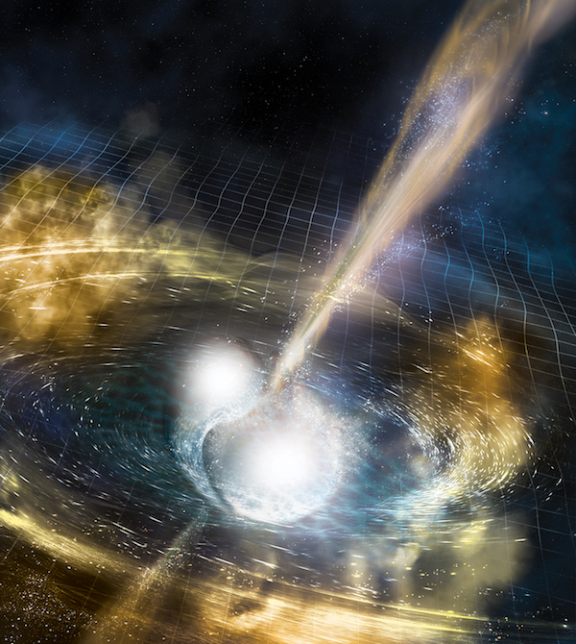
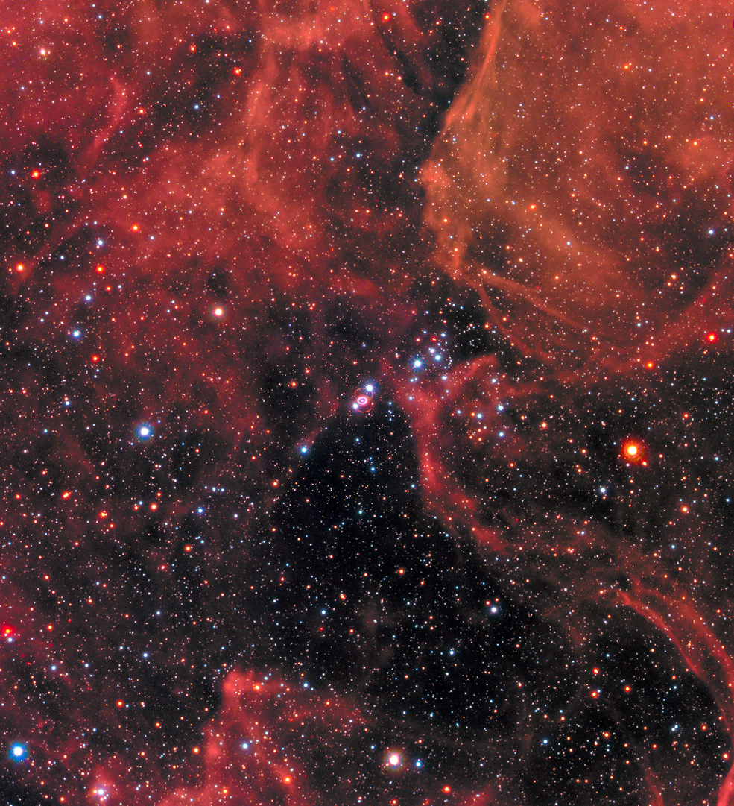
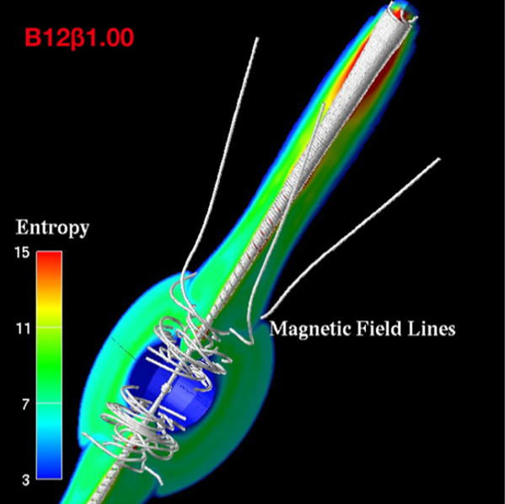
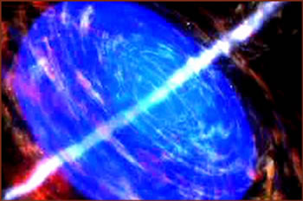
Site of r-process
Neutron Star Merger
GW170817
-GW LIGO/VIRGO 2017
-Afterglow AT 2017gfo
-Lanthanides 2017
-Strontium 2019
-¹⁹¹Os, ²³⁴Th 74days later
2019
Core Collapse Supernovae
-death of massive star
-core collapse & shock wave
-neutrino driven wind
-no heaviest element
-can be proton rich
Magneto HydroDynamics
Supernovae
-strong magnet 10¹²⁻¹⁵G，
-high spin
-3D & 2D models
-2021 UMP SMSS J200322.54−114203.3
-Weak & strong r-process
Collapsar
-massive, rapidly rotating star
-accretion onto the black hole
-produce a beamed jet
-long-duration γ-ray bursts
-3D model 2019, Seigel et al

Slide 5
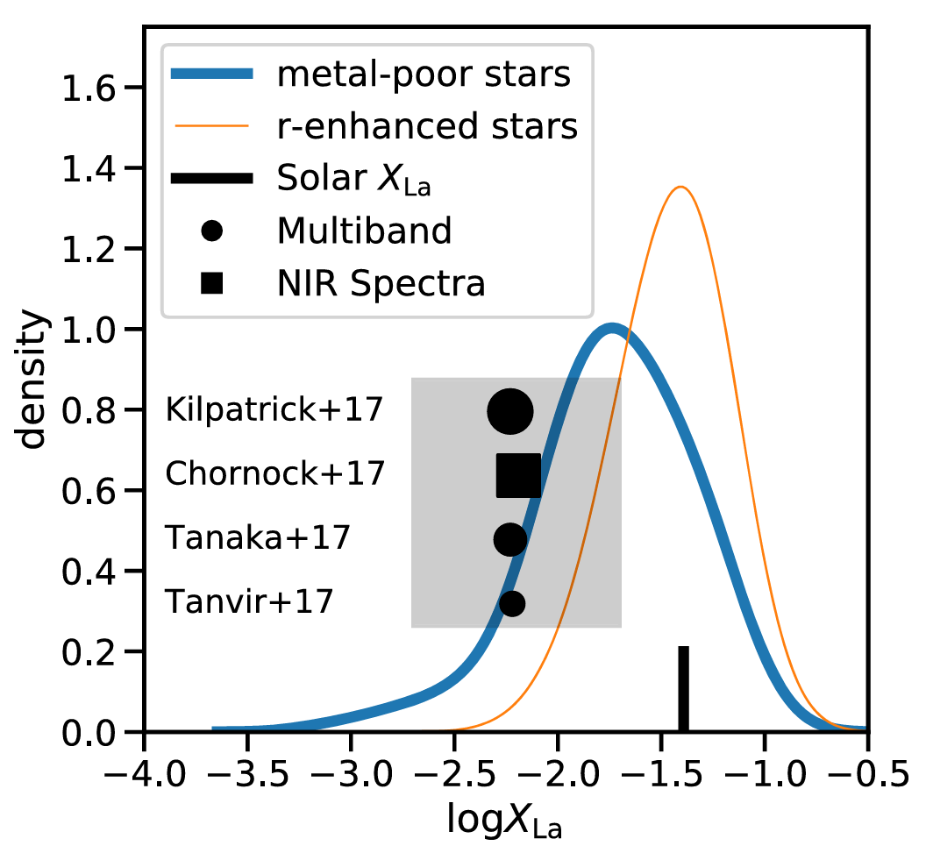
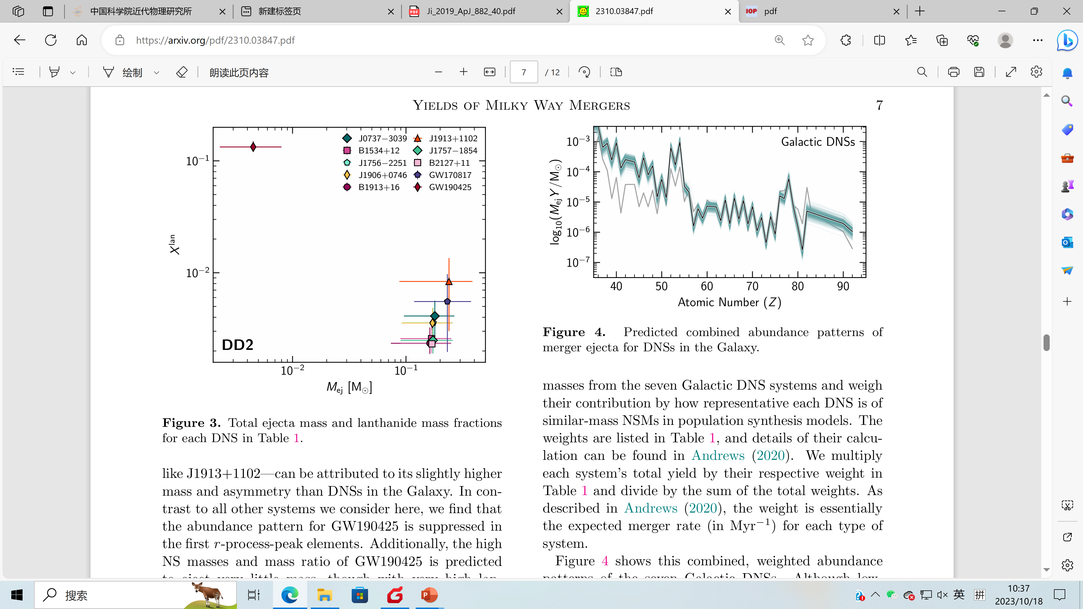
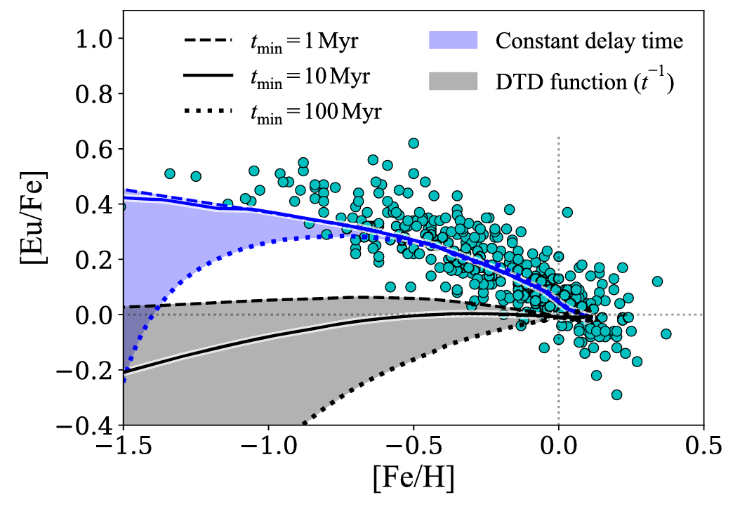
Site of r-process
Is the neutron star merger only dominated site of r-process?
Ji et al. 2019
insufficient La
Côté et al. 2019
Inconsistent with [Eu/Fe]
Holmbeck et al. 2023
Data of DNS, weaker than solar

Slide 6
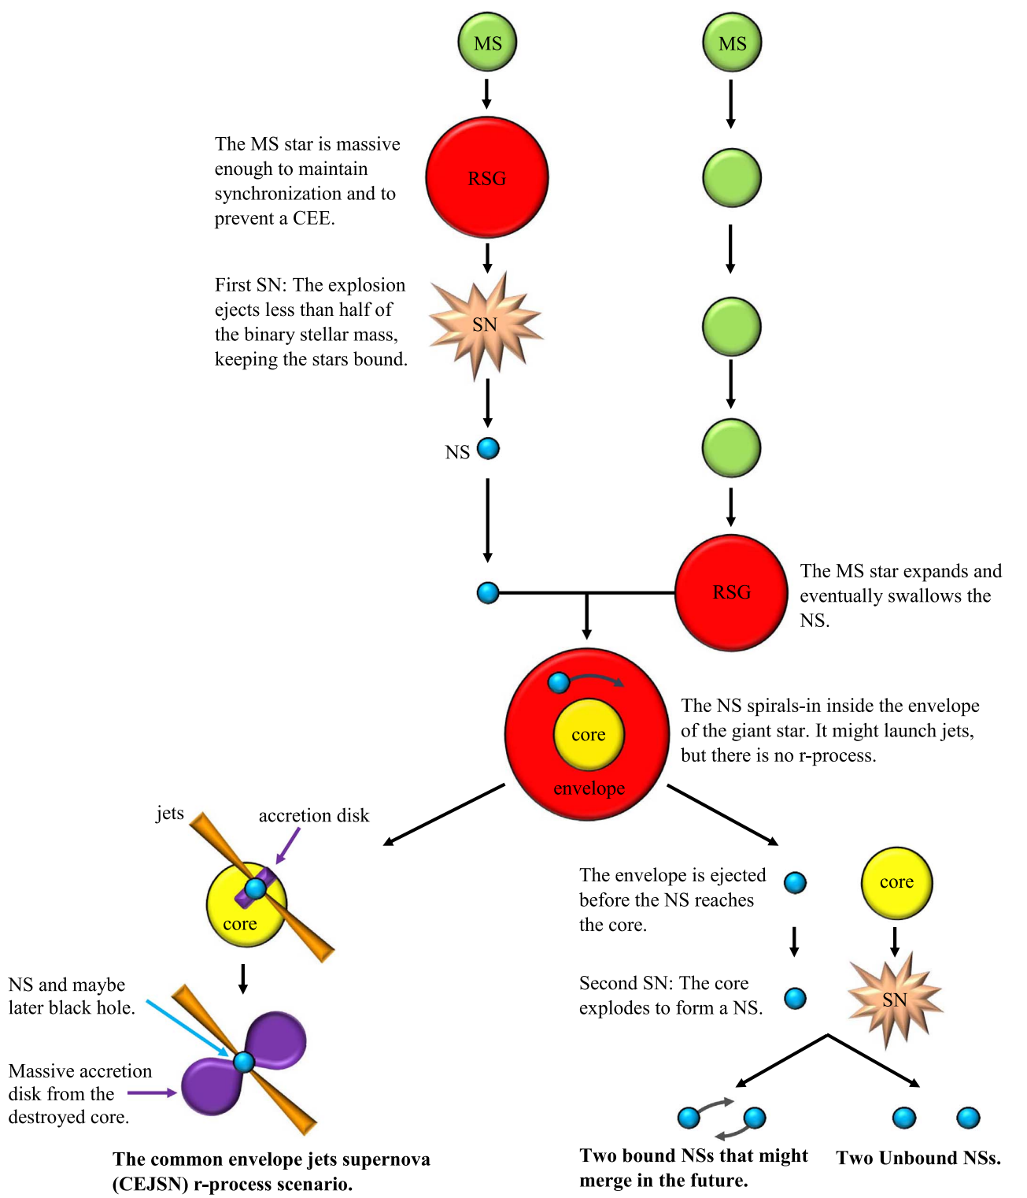
CEJ-SNe
Common Envelope Jet Supernovae
-death of two stars
-RSG and NS
-RSG swallows NS
-Ns spirals in core
-accretion disk formed
-core destroried
-bipolar jet
Credit. Soker

Slide 7
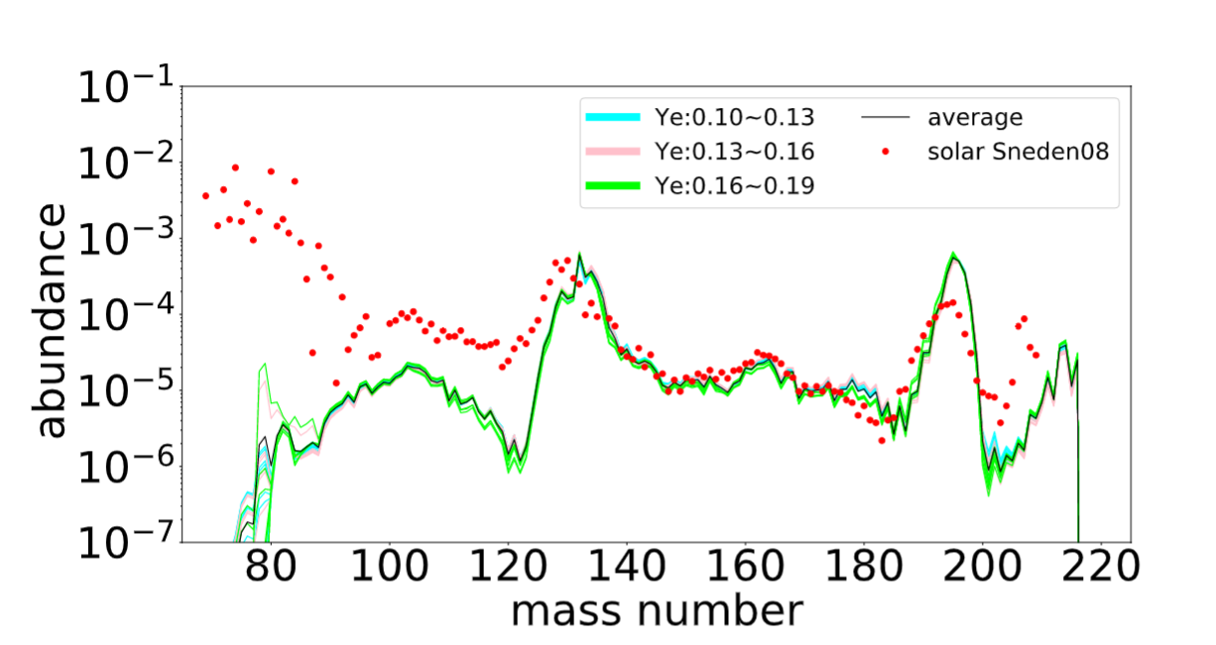
r-process in CEJ-SNe
New density function
Favor A>140
Agreement with La
Strong 3rd peak
Jin & Soker 2024

Slide 8
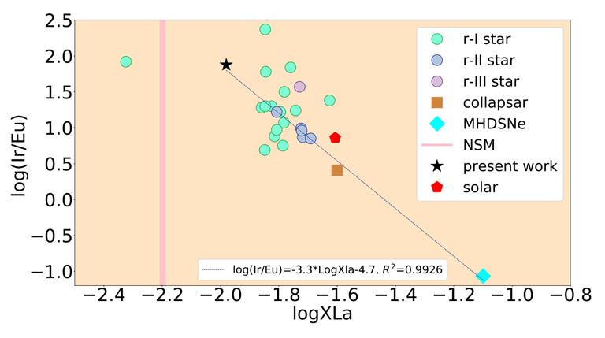
CEJ-SNe
Define log(Ir/Eu)
Explain r-enhanced stars
Actinde Boost Star
2MASSJ09544277+5246414
age ~11b year
Jin & Soker 2024

Slide 9
outline
1 Rapid neutron capture process
2 Experiment and LAMBDA
3 Preliminary results & HIAF in future

Slide 10
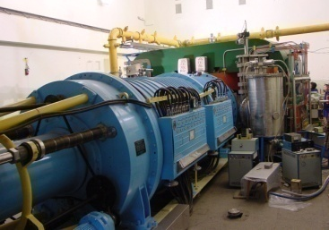
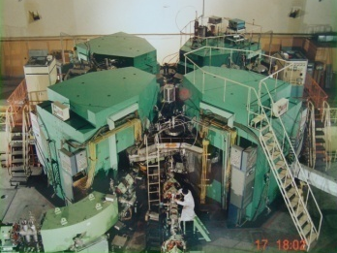
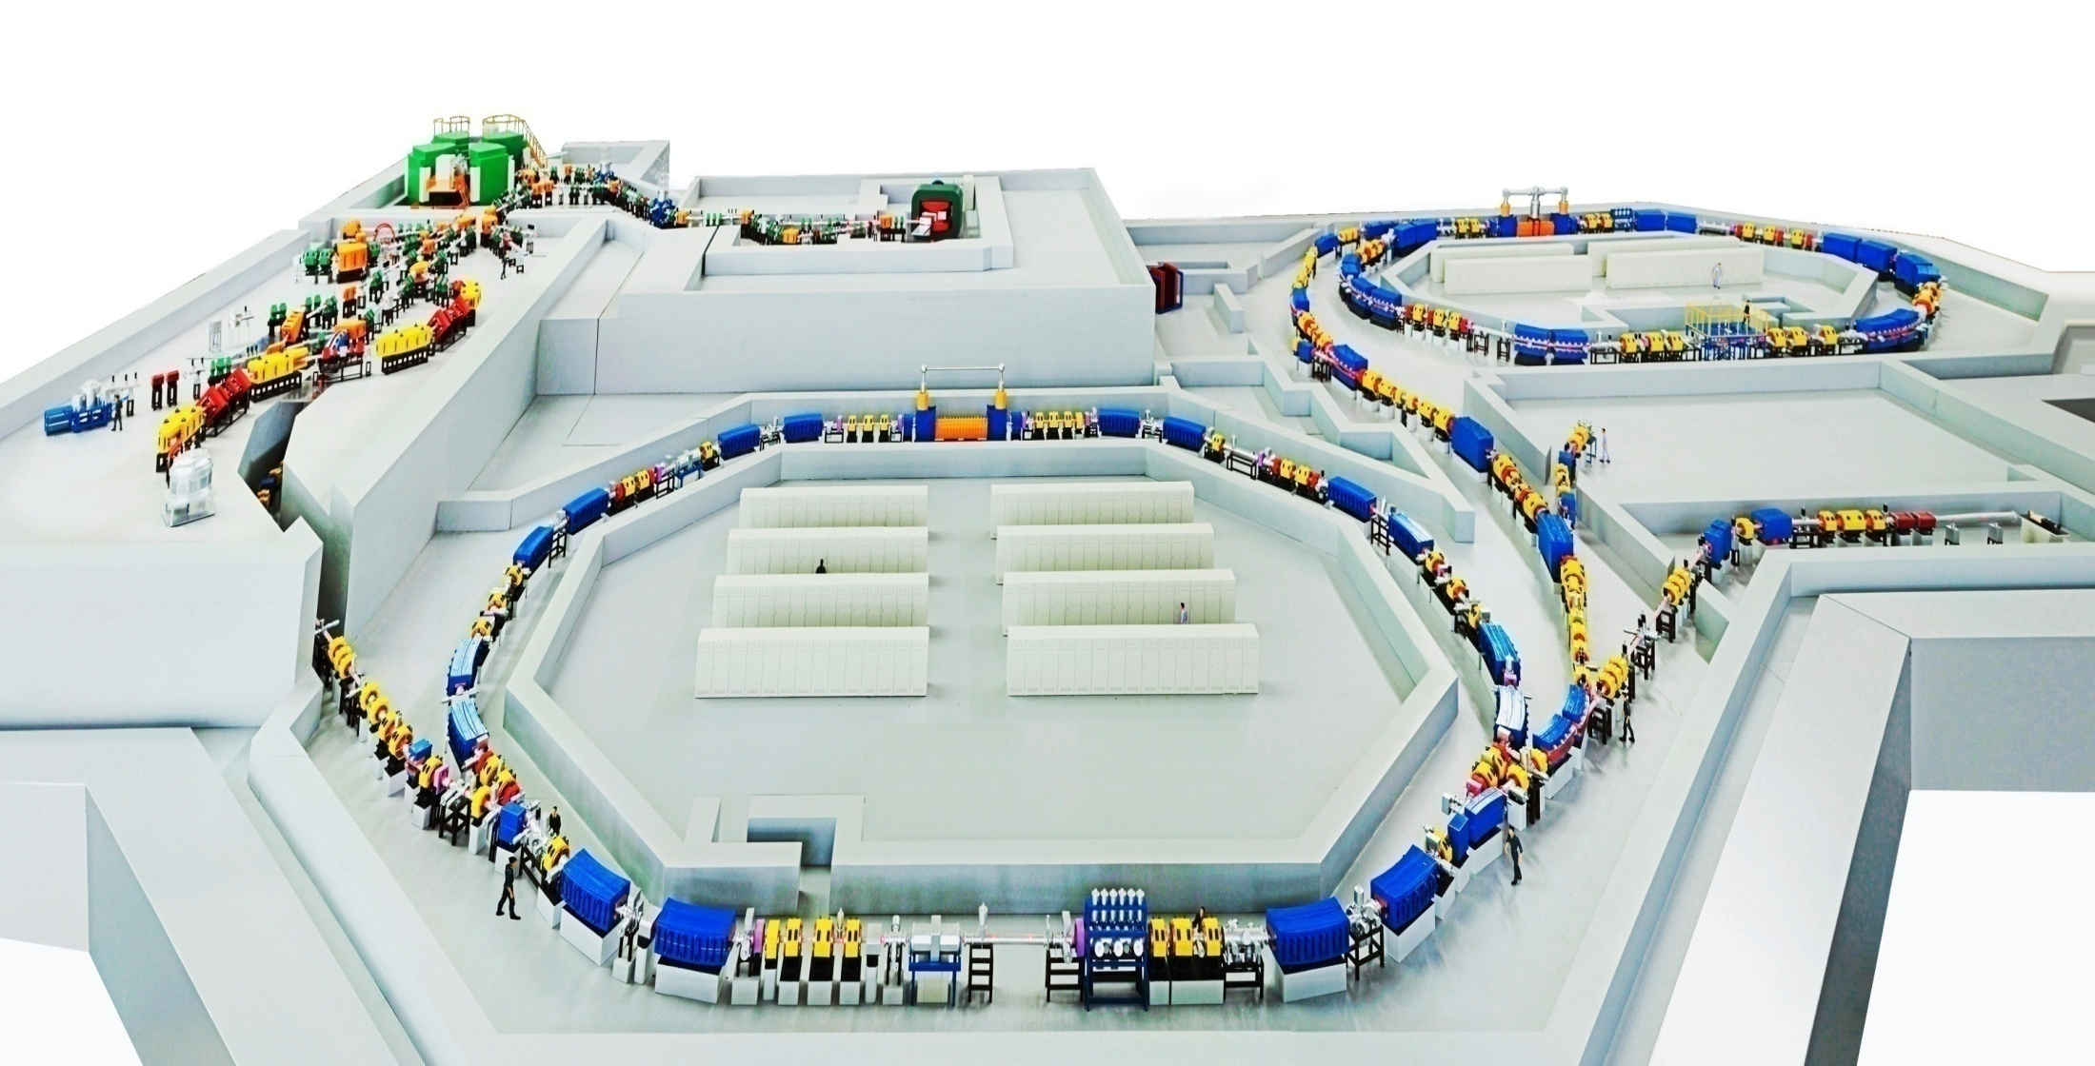
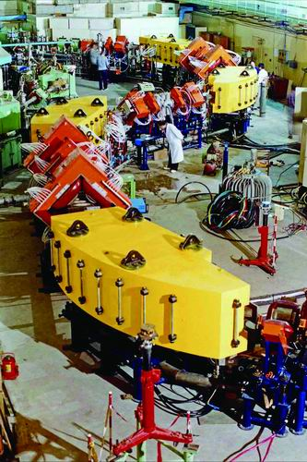
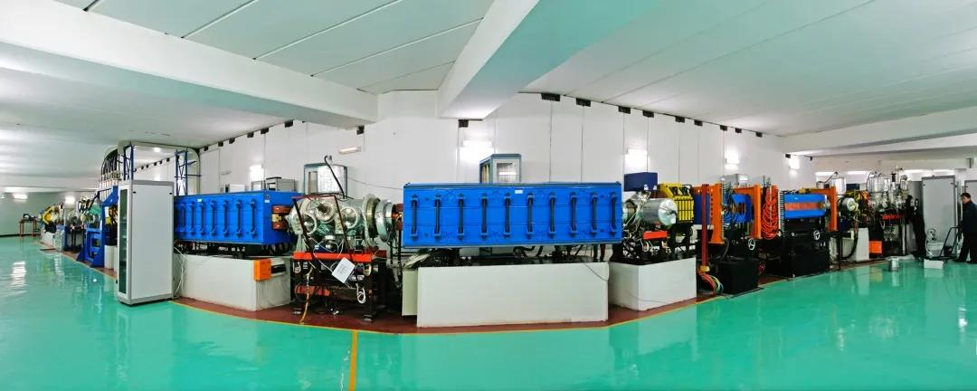
Facility
Heavy Ion Research Facility in Lanzhou (HIRFL)
SSC(K=450)
100 AMeV (H.I.), 110 MeV (p)
SFC (K=69)
10 AMeV (H.I.), 17~35 MeV (p)
CSRe
RIBLL1
RIBs at tens of AMeV
RIBLL2
RIBs at hundreds of AMeV
CSRm
1000 AMeV (H.I.), ≤ 2.8 GeV (p)

Slide 11
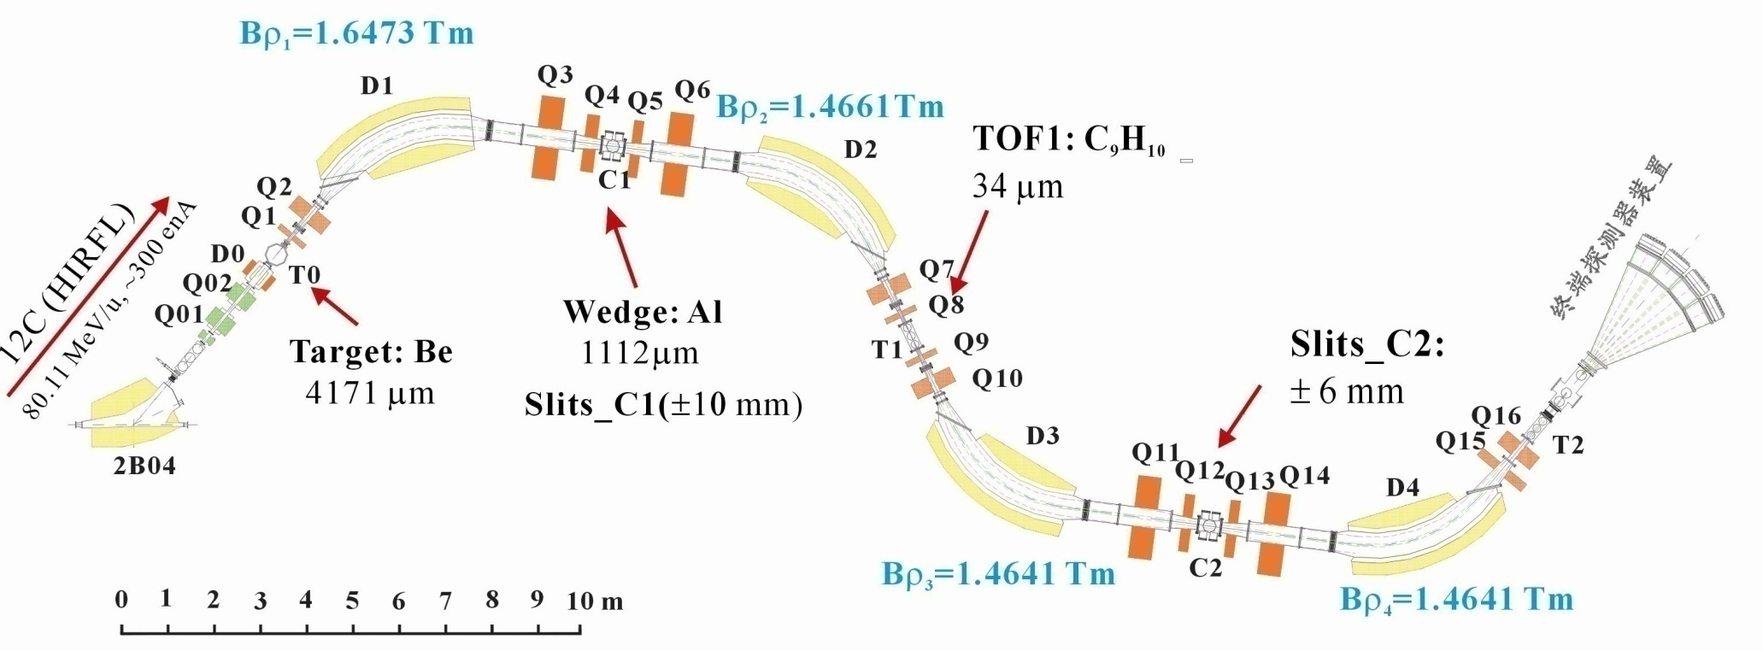
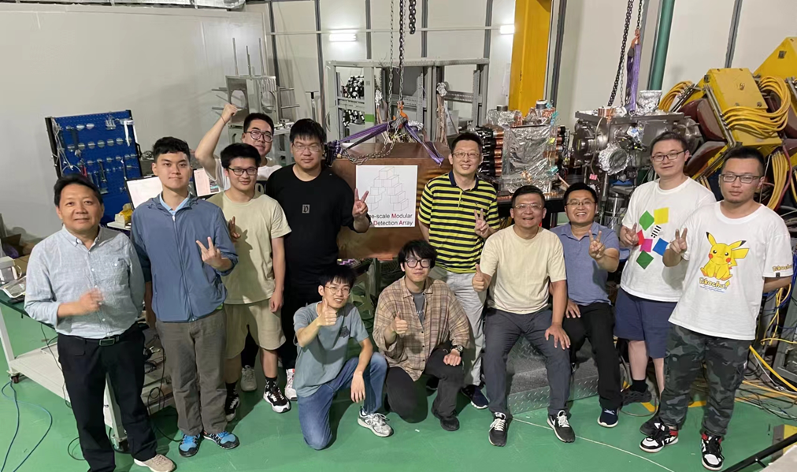
Experimental setup
Radioactive Ion Beam Line in Lanzhou (RIBLL)
Primary Beam: ⁶⁴Ni@60MeV/u
Fast Beam(PF): ⁶⁰Mn
⁶⁰Mn ⁶⁰Fe (NLD&γSF)
Intensity: ~1.2pps
Purity: ~11%
Beam time: ~200 hr
βdecay

Slide 12
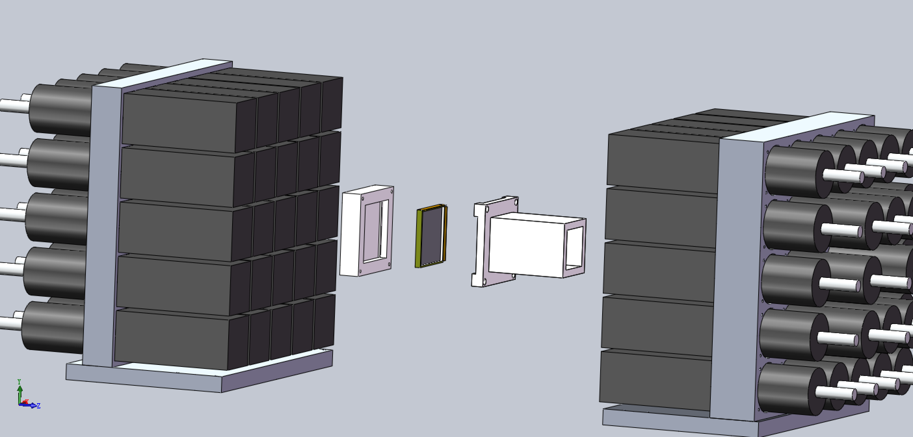
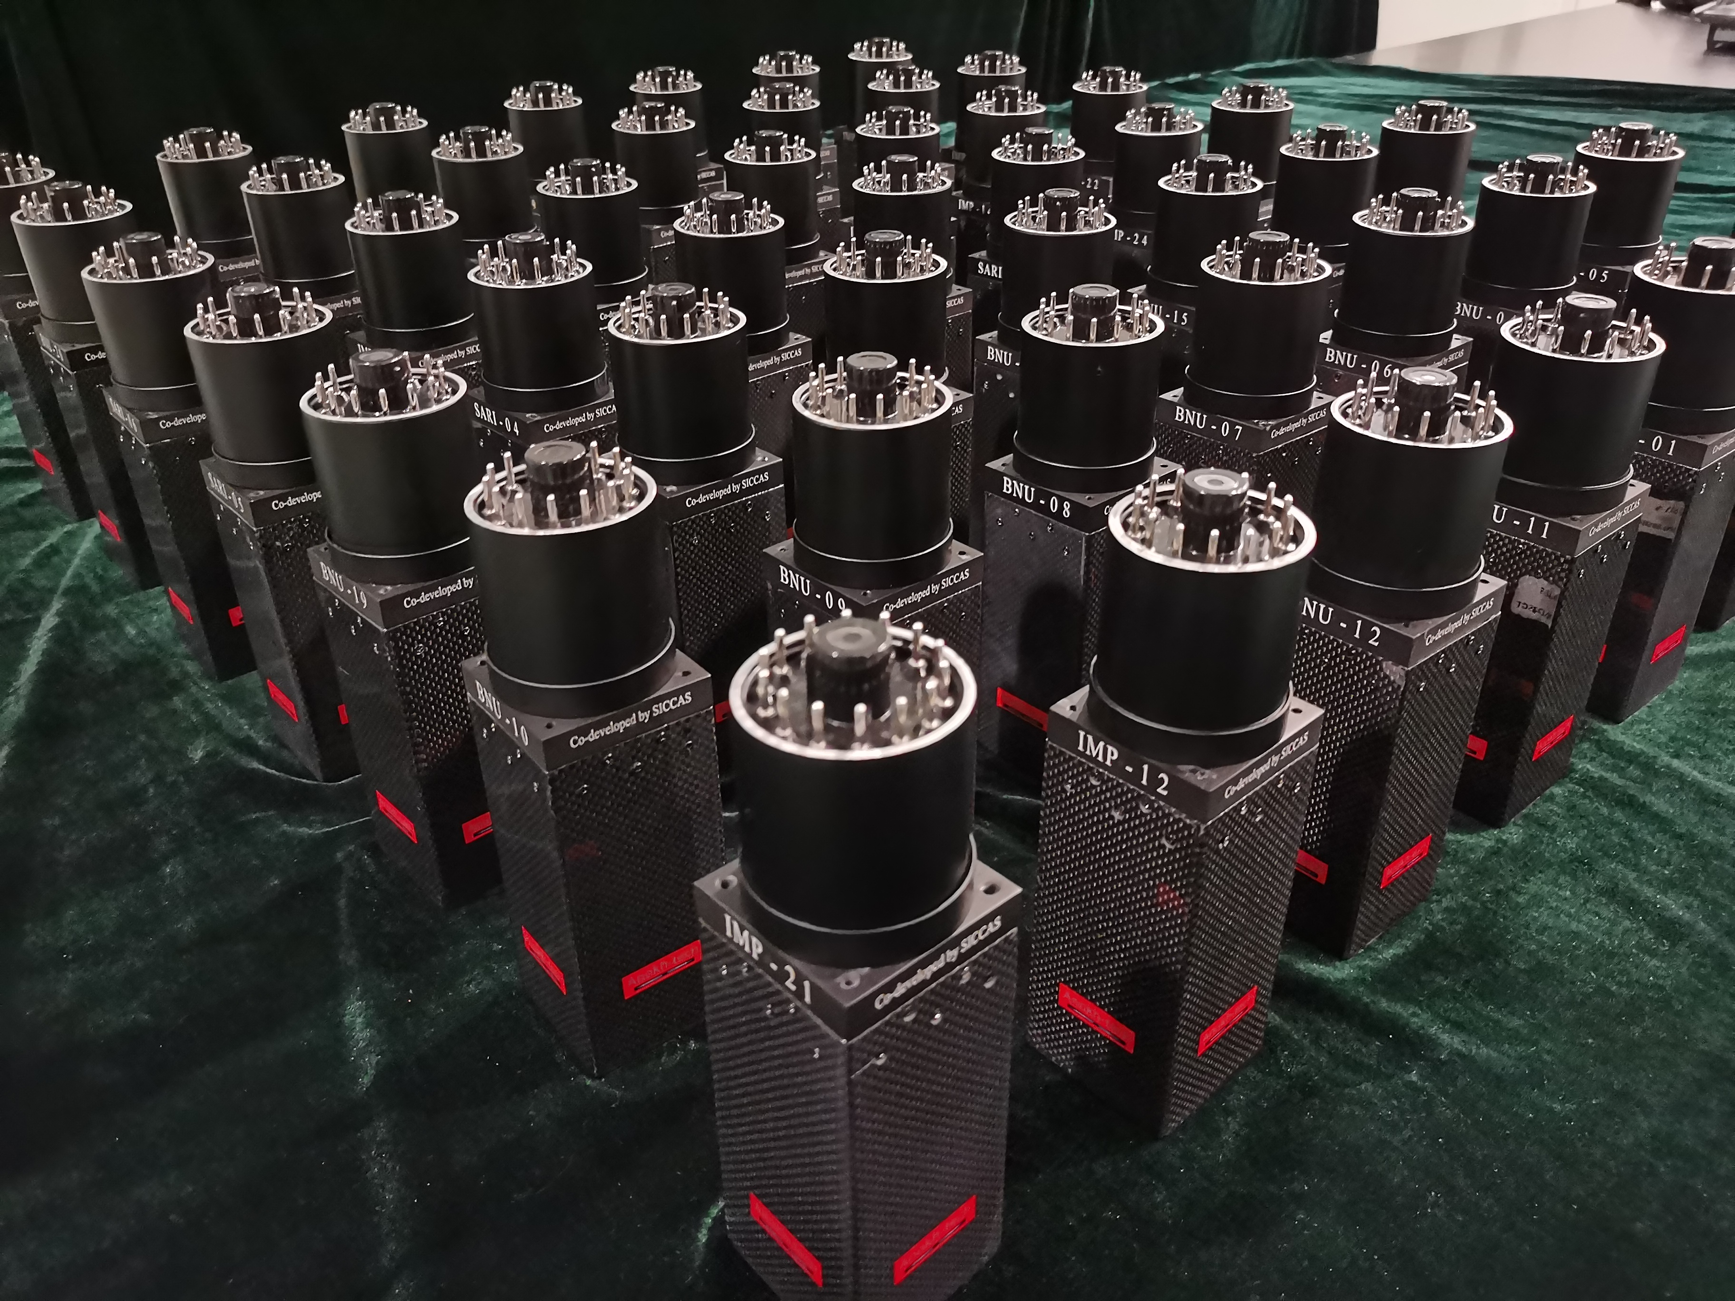
LAMBDA Detector
LAMBDA (LArge-scale Modular BGO Detector Array)
49 BGO modules
-Size:6cm×6cm×12cm
-Energy resolution: <9.7%@662keV
-Total efficiency: 90%@1MeV 80%@10MeV

Slide 13
outline
1 Rapid neutron capture process
2 Experiment and LAMBDA
3 Preliminary results & HIAF in future

Slide 14
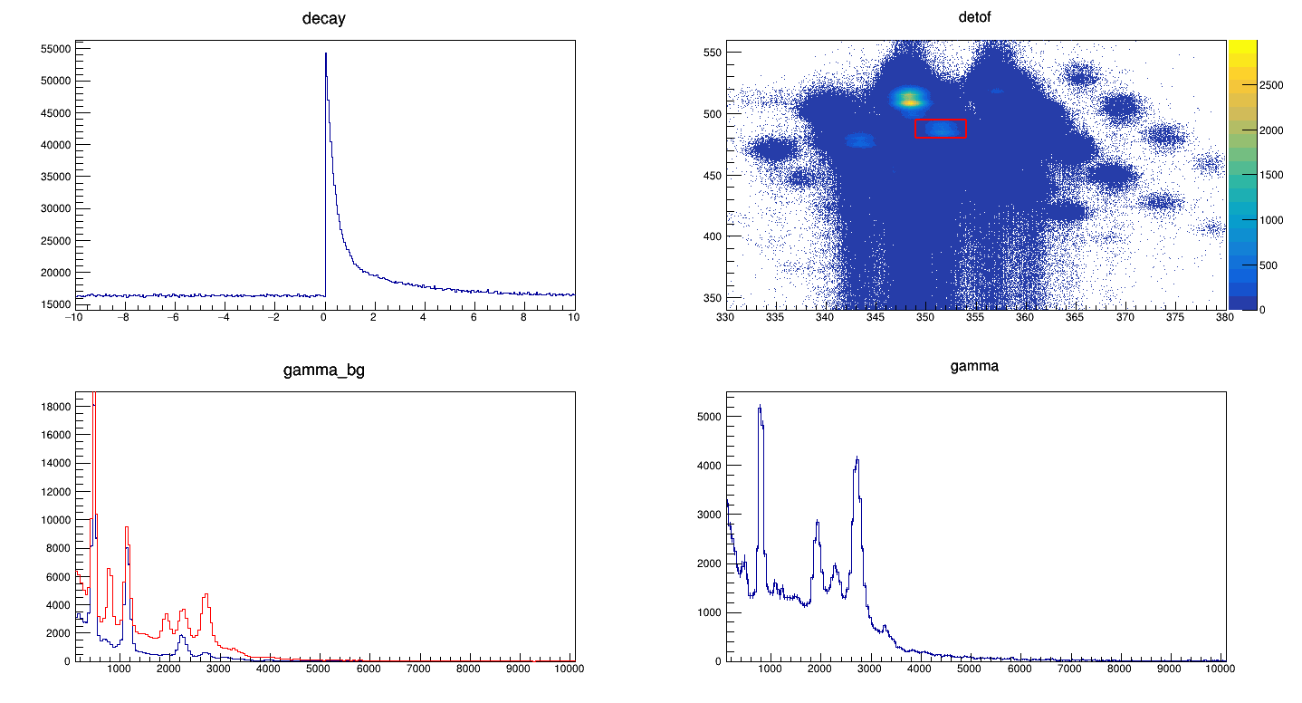
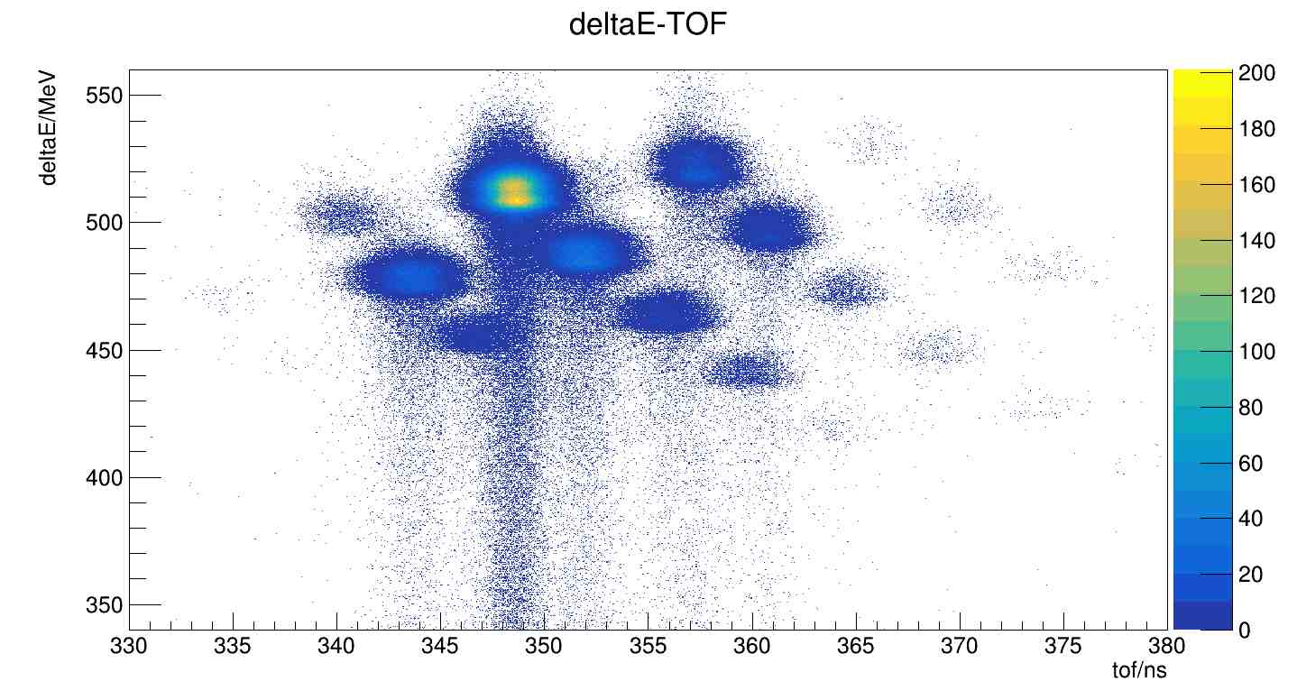
Preliminary results
Electron from
⁶⁰Mn window
G.S./isomer~5.5
⁶⁰Mn
Gamma spectrum gated on ⁶⁰Mn
Background gamma spectrum
Net gamma spectrum from ⁶⁰Mn

Slide 15
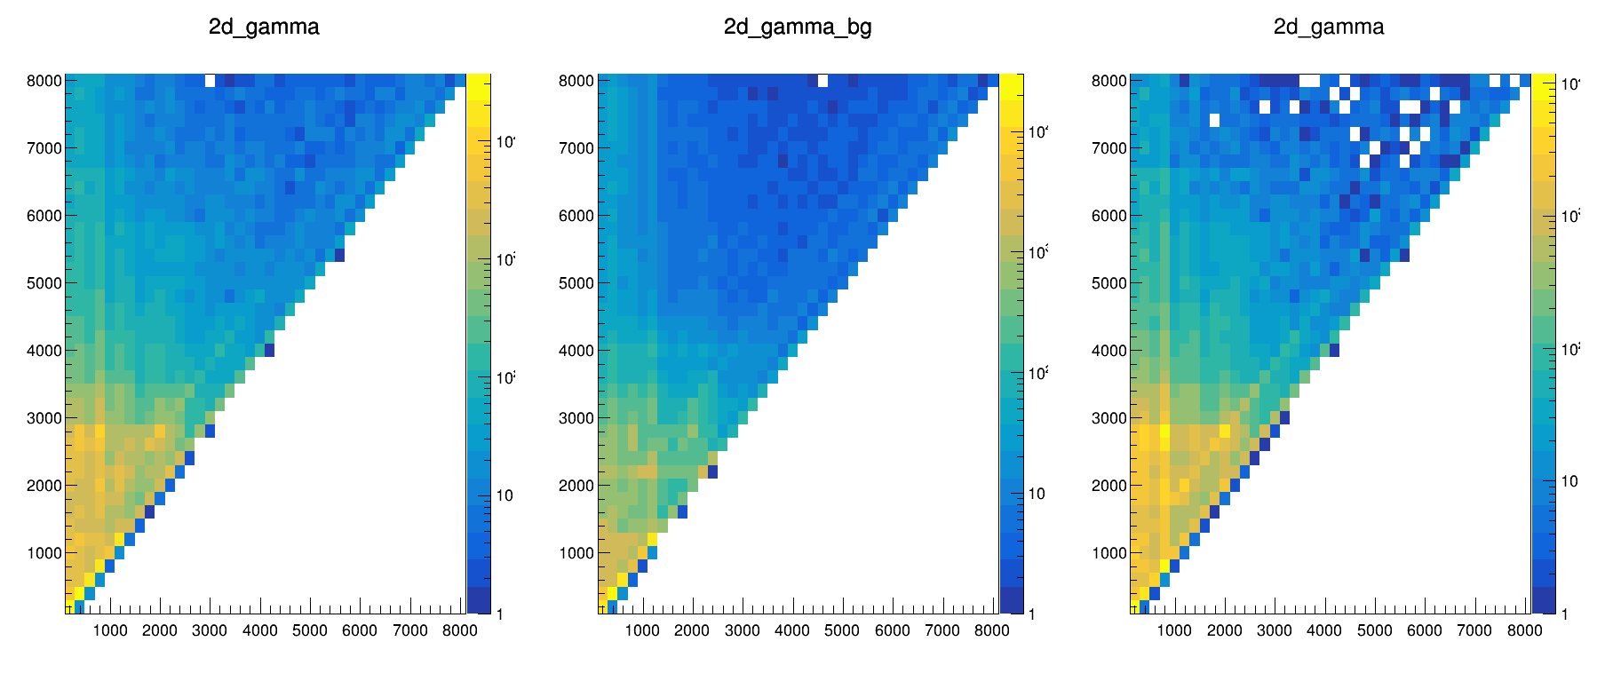
Preliminary results
Summing γ VS individual γ
Calibration
Response function
First generation γ-matrix
...
γ source: ⁶⁰Co, ¹³³Ba,¹⁵²Eu
¹⁴N(p,γ)¹⁵O Will be performed in July
raw

Slide 16
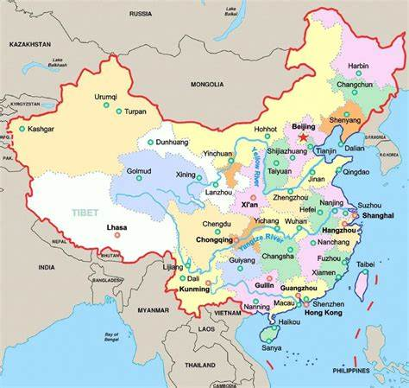
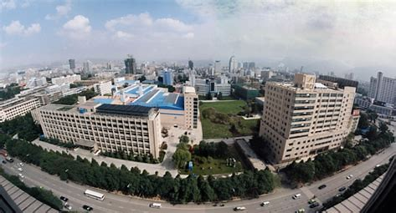
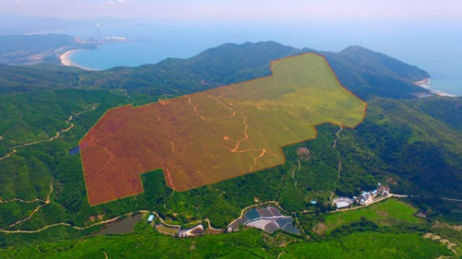
High Intensity Heavy-ion Accelerator Facility
HIRFL
HIAF

Slide 17
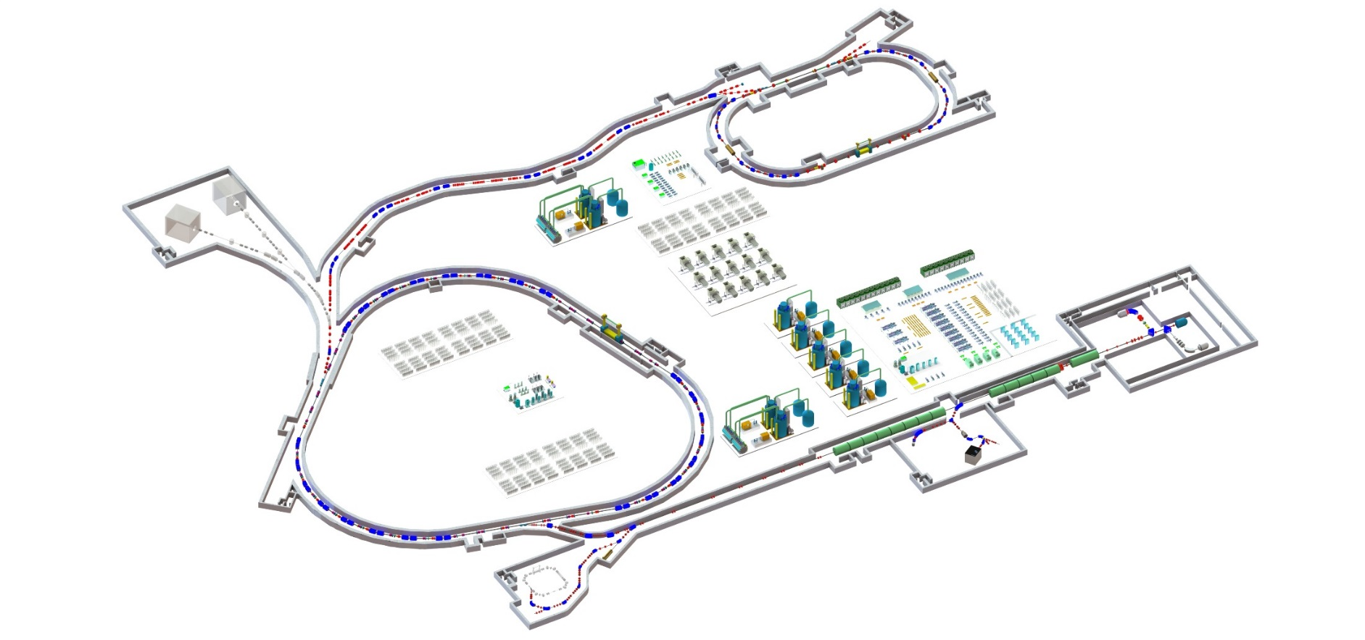
High Intensity Heavy-ion Accelerator Facility
Booster Ring:
Circumference: 569 m
Rigidity: 34 Tm
Aaccumulation
Cooling & acceleration
Spectrometer Ring
Spectrometer Ring:
Circumference: 277.2 m
Rigidity: 15 Tm
Electron cooler
Stochastic cooler
HFRS
45 GHz, 20 KW
ECR ion source
iLinac
Superconducting Ion Linac:
Length: 180 m
Energy: 17 MeV/u (²³⁸U³⁴⁺)
  CW and pulse modes
Booster Ring
Fast ramping operation

Slide 18
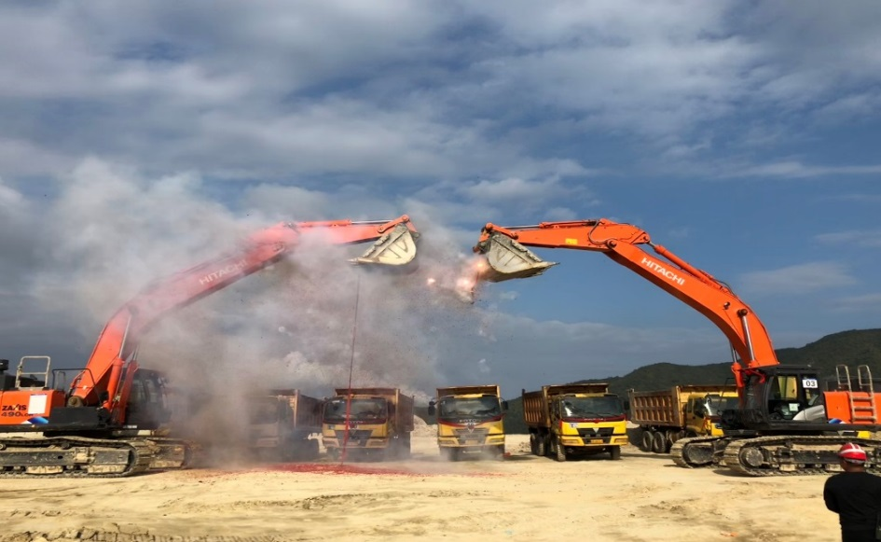
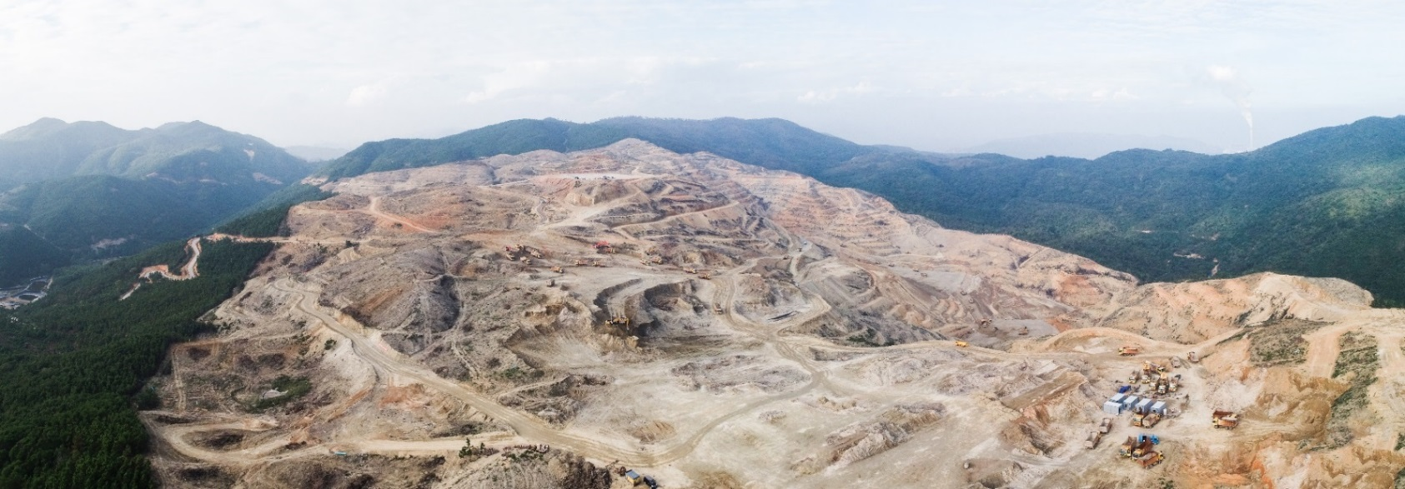
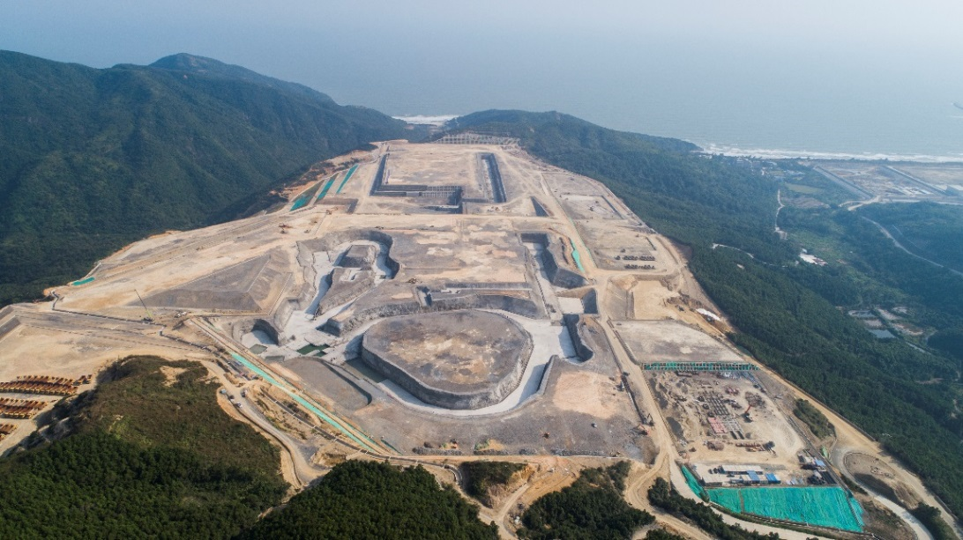
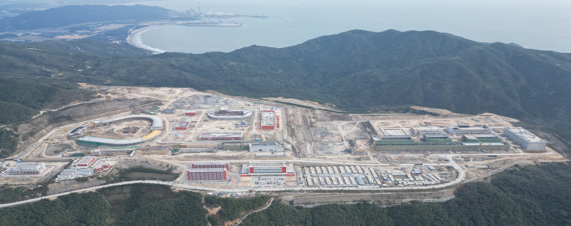
High Intensity Heavy-ion Accelerator Facility
2018, Ground-breaking Ceremony
December 2018
November 2020
November 2023
Local governments provide land, and pay for the facility and office buildings and infrastructure…
The approved budget of HIAF, 1.67 billion CNY, is used for “bare” facility

Slide 19
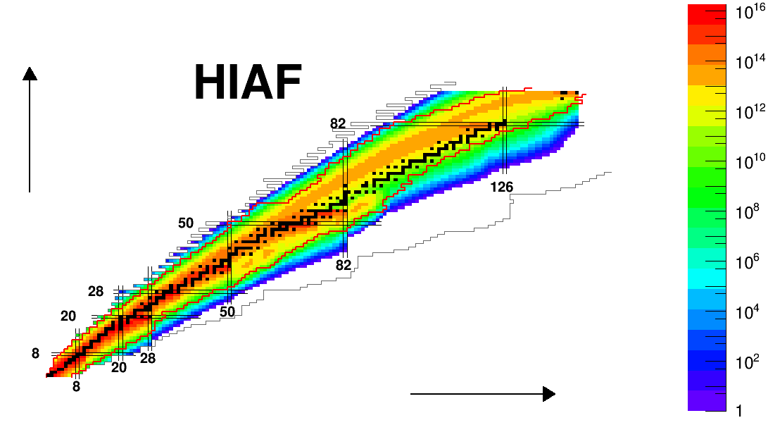
High Intensity Heavy-ion Accelerator Facility
Nuclides Available (Daily Production Yield) at HIAF
One of the world’s most powerful facilities to explore the nuclear chart
⁷⁸Ni: ~0.4/s
¹⁰⁰Sn: ~0.3/s
¹³²Sn: ~10⁶/s
Proton Number
Boundary of Known Masses
Neutron Number
Prolific sources of nuclides far away from the stability line will be provided using various reactions. The limits shown are the production rate of one nuclide per day, which enable the “discovery experiments”

Slide 20
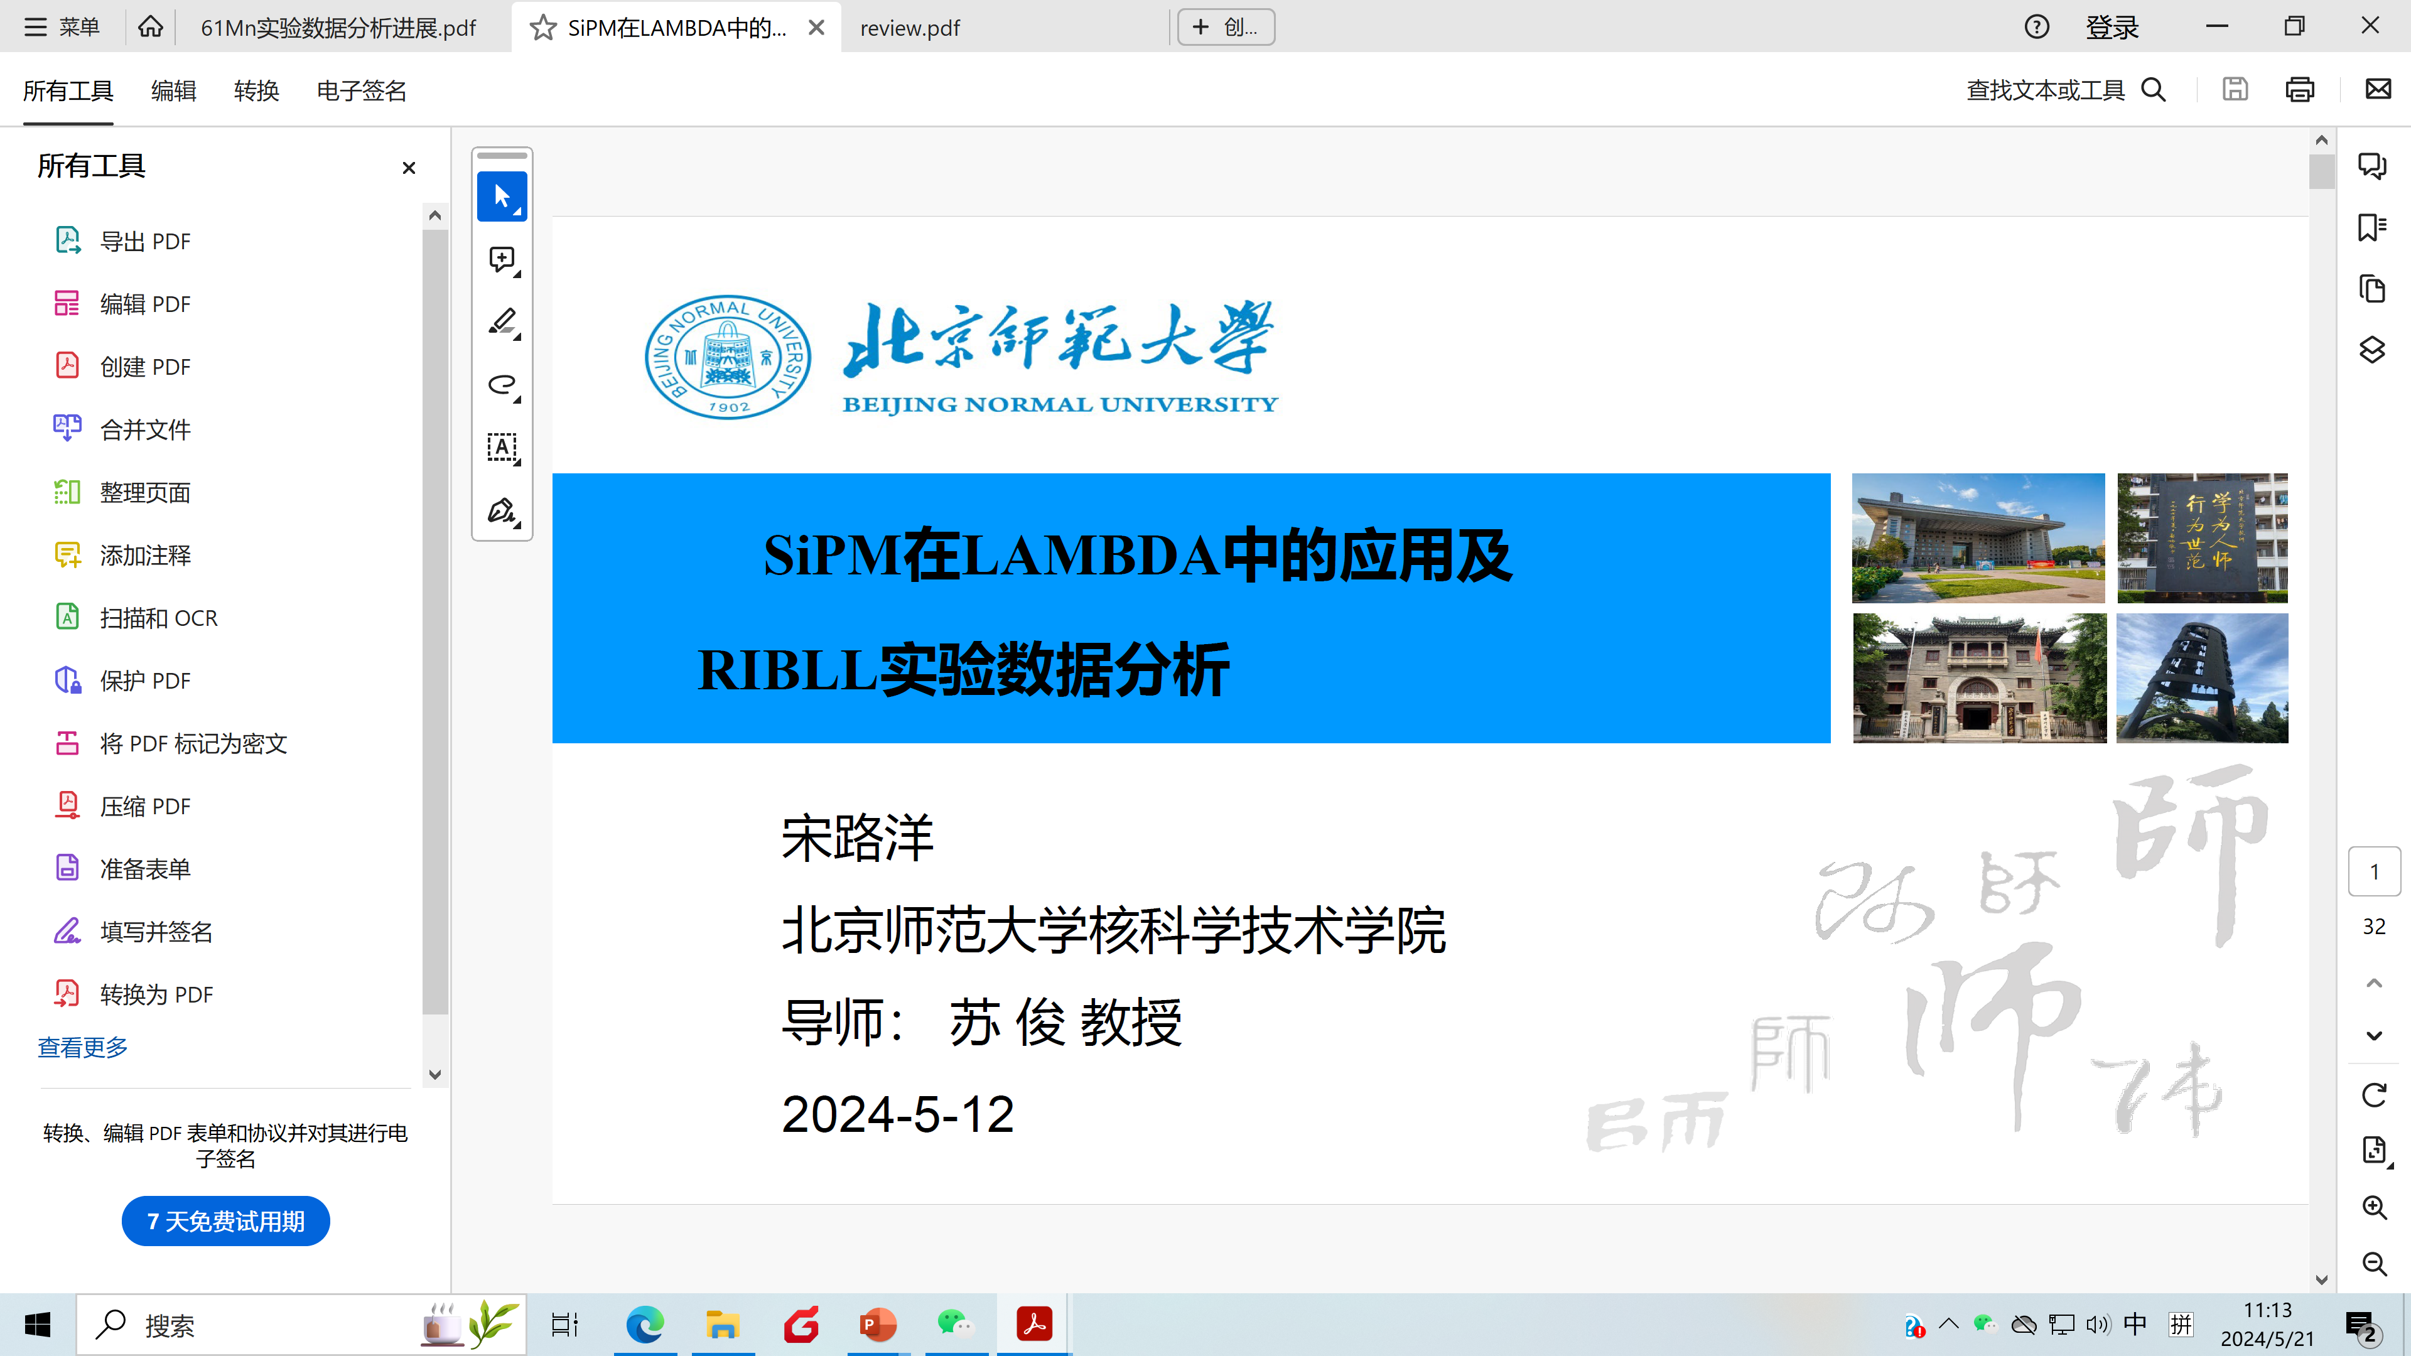

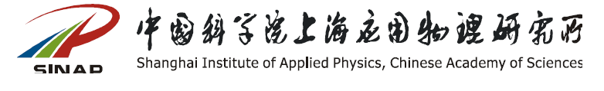
Collaborator
Jun Su, Luyang Song
Yangping Shen
Fei Lu, Leiming Hua
Shilun Jin
Institute of Modern Physics, CAS
jinshilun@impcas.ac.cn

