Slide 1

Indirect experimental method for constraining the ^{193,194}Ir(n,γ) cross sections
S. P. E. Magagula PhD candidate
SSC Laboratory, iThemba LABS P.O. Box 722, Somerset West 7129, South Africa
School of Physics, University of the Witwatersrand, Johannesburg 2050, South Africa
This work is based on the research supported by the National Research Foundation of South Africa (Grant Number: PMDS22070734847) and SAINTS Prestigious Doctoral Scholarship.

Slide 2
Outline
Introduction and Physics motivation.
Indirect method.
Experimental set up.
Oslo method.
Preliminary Results
Outlook

Slide 3
Introduction and Physics motivation
E_{x}
Continuum
Γ ≥D
NLD – Nuclear level density
GSF – Gamma strength function is a characteristic of the average electromagnetic transition properties of excited nuclei
Neutron Capture Cross sections – estimated using the Hauser-Feshbach model implemented in the TALYS code
Quasi-continuum
Γ ≤ D
Discrete states
Γ << D
g.s
Figure1: Level density as excitation energy increases
An approach to constraining cross sections
Allows us to investigate the s-process branching point ¹⁹²Ir

Slide 4
Indirect method and why
Bright red - stable
Peach – unstable
191Ir
192Ir
73.83 days
193Ir
194Ir
19.28 hours
190Ir
11.78 days
Figure2: Part of the Iridium isotopic chain and half lives
Heavy element nucleosynthesis calculations and determining the abundances of elements.
The s- and r- process are equally responsible for the formation of almost all nuclei heavier than iron
For the s-process branch-point nuclei neutron capture cross-section data may not be available or limited to a narrow energy range
¹⁹² Ir is unstable, ¹⁹²Ir(n,γ)¹⁹³Ir
¹⁹²Os(α,tγ)¹⁹³Ir
Use ¹⁹²Os(α,dγ)¹⁹⁴Ir
¹⁹³Ir(n,γ)¹⁹⁴Ir

Slide 5
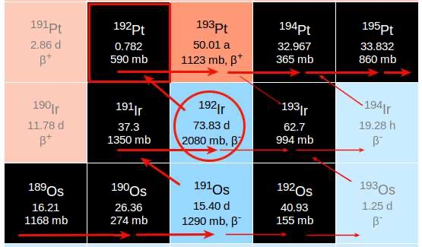
The Branching point
Bisterzo, S., et al. (2015). Monthly Notices of the Royal Astronomical Society, 449(1)
Figure3: The ¹⁹²Ir branch feeding the s-only Pt
Element abundances e.g Pt partially depends on ¹⁹²Ir
Provides information on the s-process neutron density (beta decay – neutron capture)
Compare with DICER data, to benchmark our approach (S, Athanasios, et al. 2022 )

Slide 6
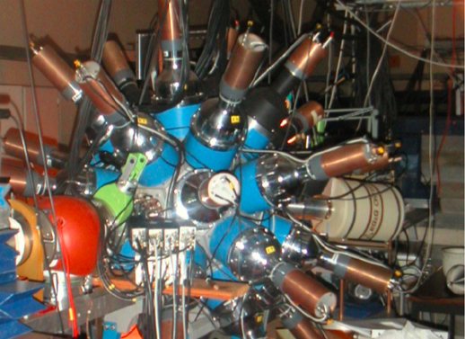
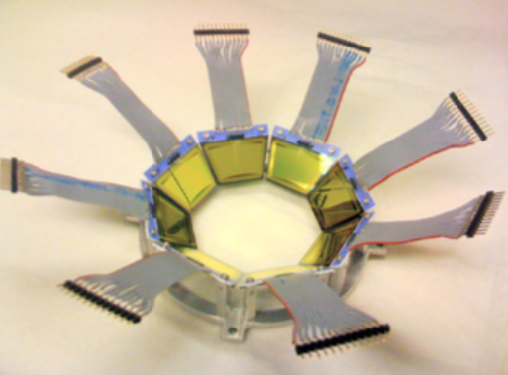
Experimental set up
CACTUS
SiRi
Figure 4: The gamma ray and particle detectors at the Oslo cyclotron lab.
Gamma ray detection
26 NaI(Tl)
¹⁹²Os(α,d), ¹⁹²Os(α,t)
The experiment ran for 5 days
Charged particle detection
64 silicon telescopes placed at backward angels
30 MeV beam energy
With a 0.33mg/cm² thick ¹⁹²Os
M. Guttormsen, et al. Nucl. Instr and Meth. in Phys doi: 10.1016 (2011)

Slide 7
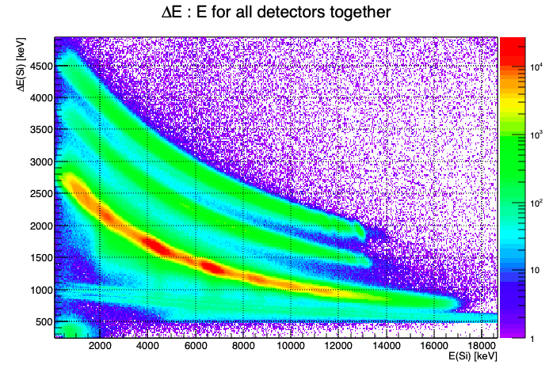
Particle Identification
t
d
p
Figure 5: Particle identification for the ¹⁹²Os(α,p) ¹⁹²Os(α,d) and ¹⁹²Os(α,t) reactions.
Gating on the deuterons for ¹⁹⁴Ir
Gating on the tritons for ¹⁹³Ir
Coincidence matrices

Slide 8
The Oslo Method
GSF and NLD measurements.
This is a combination of techniques that enables users to simultaneously extract the NLD and GSF.
The method takes the coincidence matrix as its starting point, then a set of procedures are subsequently performed, eventually leading to the desired quantities, It consists of the following steps
  Unfolding the coincidence spectrum (M. Guttormsen et al. 1996)
  Extract primary gamma-rays (M. Guttormsen et al. 1987. )
  Extracting the NLD and GSF (A. Schiller et al 2000)
  Normalization

Slide 9
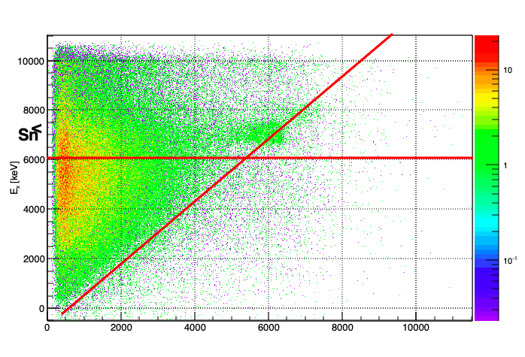
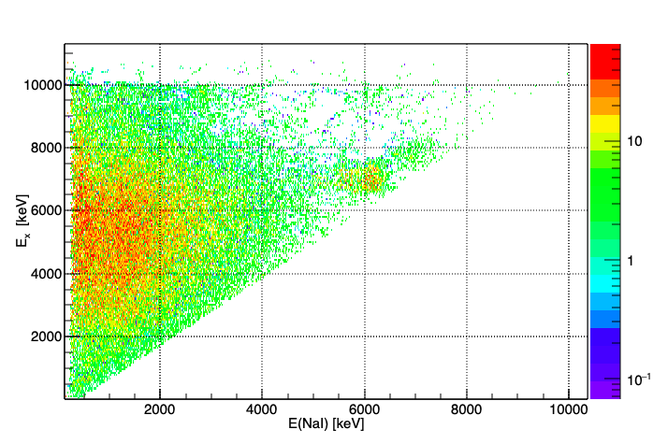
The Oslo Method
E_{x} = E_{γ}
S_{n}
E(NaI) [keV]
Figure 6: Raw and unfolded E_{x}-E_{γ} matrices for ¹⁹⁴Ir.
Raw and Unfolded matrix
Matter Radiation interaction
  Pair production
  Compton scattering
  Photoelectric absorption
S_{n}= 6066 keV from NNDC

Slide 10
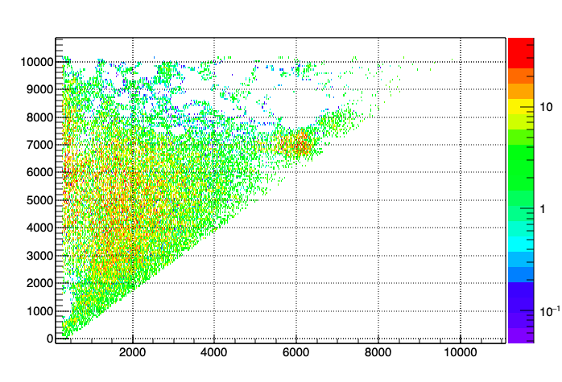
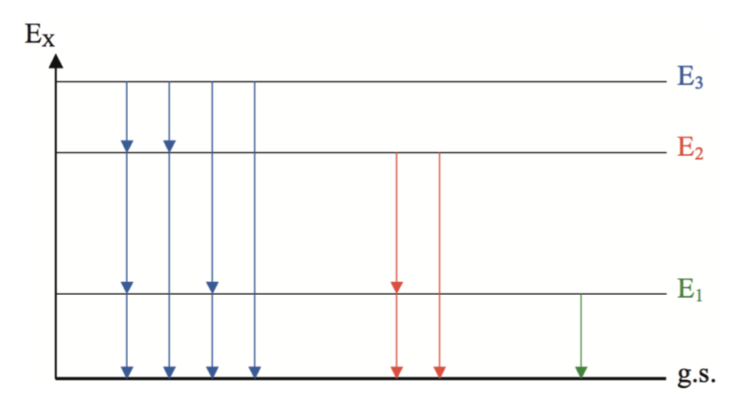
The Oslo Method
First generation method
Independent of how the nucleus was excited (assumption)
Statistical decay
E_{x} [keV]
E(NaI) [keV]
Figure 7: First generation matrix
First generation gamma-rays
P(E_{x},E_{γ})∝ρ(E_{x} −E_{γ})T(E_{γ})
Figure 8: Example of a decay cascade
A.C Larsen PhD thesis 2008

Slide 11
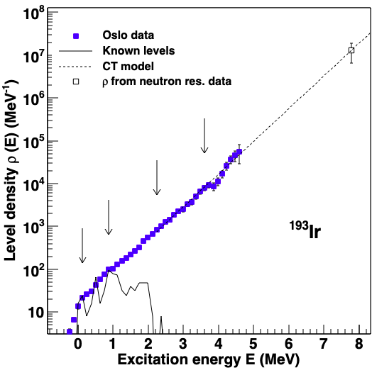
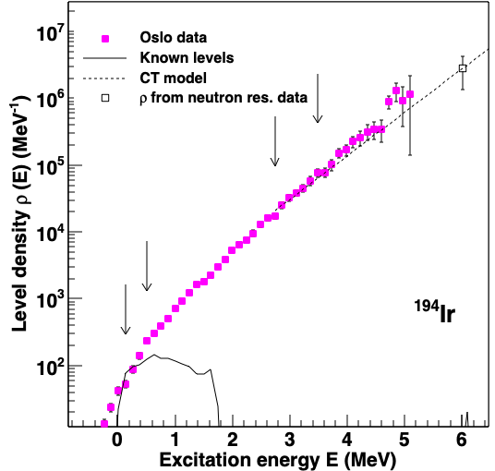
Results (preliminary)
Sn
Constant temp model
Known levels
Figure 9:Nuclear level density for ^{193,194}Ir
National Nuclear Data Center http://www. Nndc
Reference Input Parameter Library http://www-nds.iaea.org/RIPL-3

Slide 12
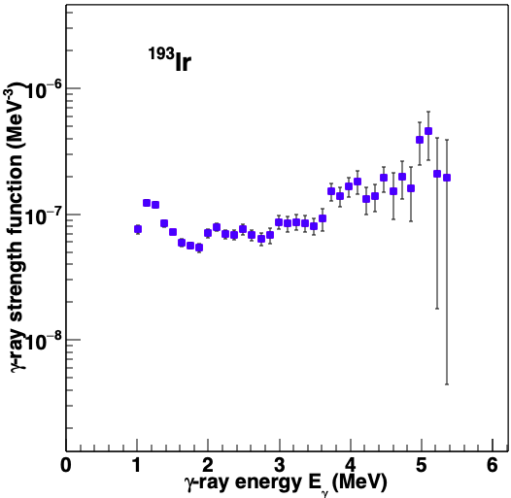
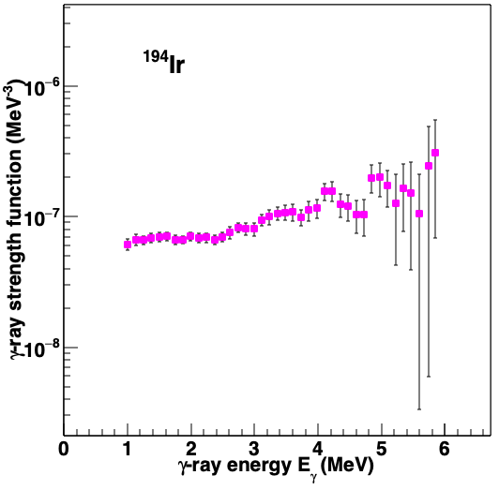

Results (preliminary)
Figure 10: GSF for ^{193,194}Ir
R. Capote et al., 2009

Slide 13
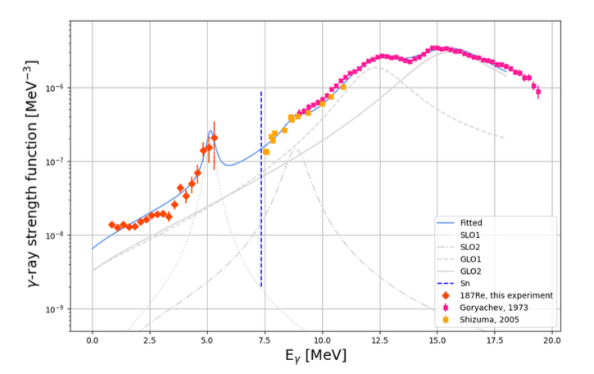
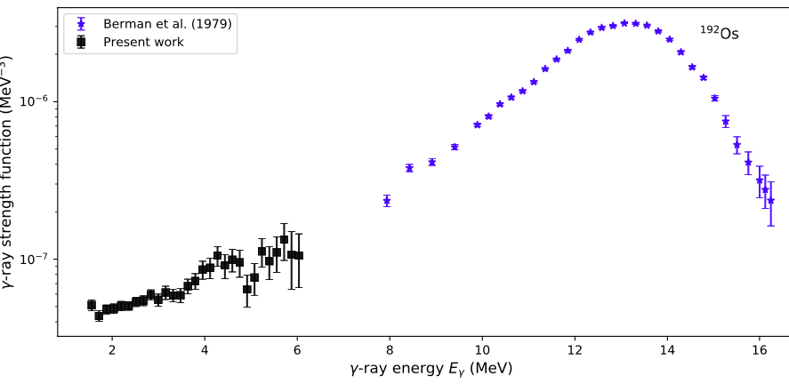
Results (preliminary)
¹⁸⁷Re
¹⁹²Os
Marianne M. Bjørøen Masters thesis
Ina Kristine Berentsen Kullmann Thesis
Figure 11: ¹⁹⁴Ir GSF

Slide 14
Outlook
Finalise the normalization
Compare my data to available GDR data
Use the GSF and NLD obtained for ^{193,194}Ir as inputs in the TALYS code to estimate the ¹⁹²Ir(n,γ) and ¹⁹³Ir(n,γ) neutron-capture cross section.
Compare our ¹⁹⁴Ir results to those obtained by DICER.
Use data to place experimental constrains on the destruction of ¹⁹²Ir by (n,γ)

Slide 15





Acknowledgments
M. Wiedeking
B. V Kheswa
L Pellegri
K. L Malatji
A.C Larsen

Slide 16
Back up slides
First gen
TALYS is a nuclear reaction program with the objective to provide a complete and accurate simulation of nuclear reactions up to energies of 200 MeV,
Device for Indirect Capture Experiments on Radionuclides (DICER) An instrument for making resonance neutron transmission measurements on very small radioactive samples to tightly constrain their neutron-capture cross sections.
at the Los Alamos Neutron Science Centre (LANSCE)

Slide 17





Branching point
branching points that mainly influence the abundance of s-only isotopes
Abundance distribution

Slide 18
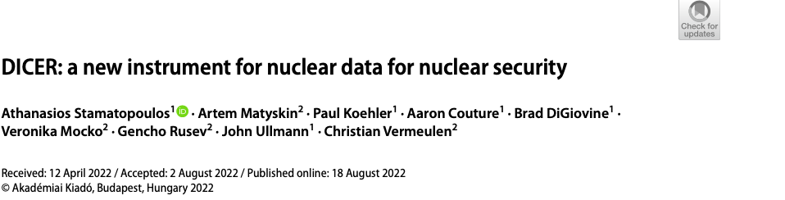
Detector resolution
Stamatopoulos, Athanasios, et al. "DICER: a new instrument for nuclear data for nuclear security." Journal of Radioanalytical and Nuclear Chemistry 331.12 (2022): 4857-4861.

Slide 19
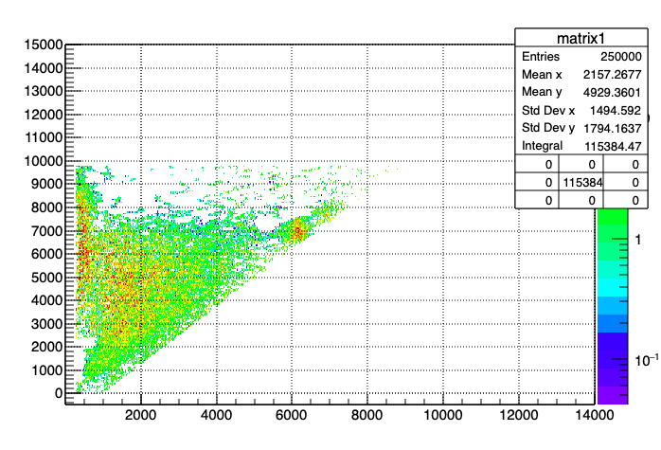
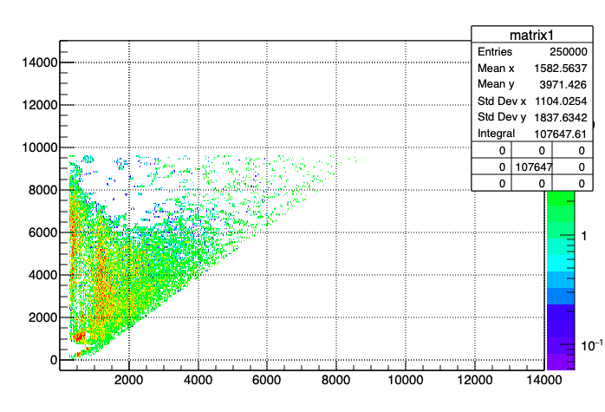
194 Ir
193 Ir

Slide 20
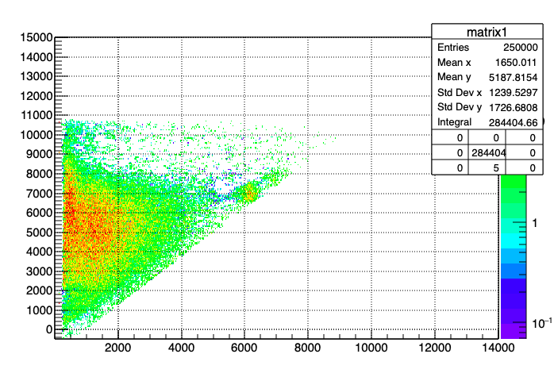
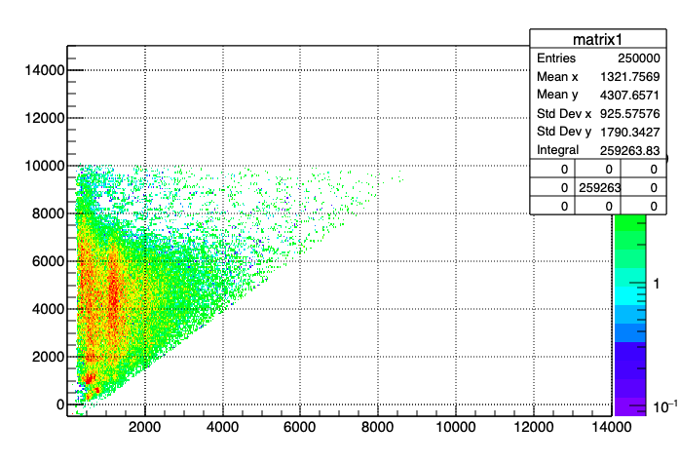
194 Ir
193 Ir

Slide 21
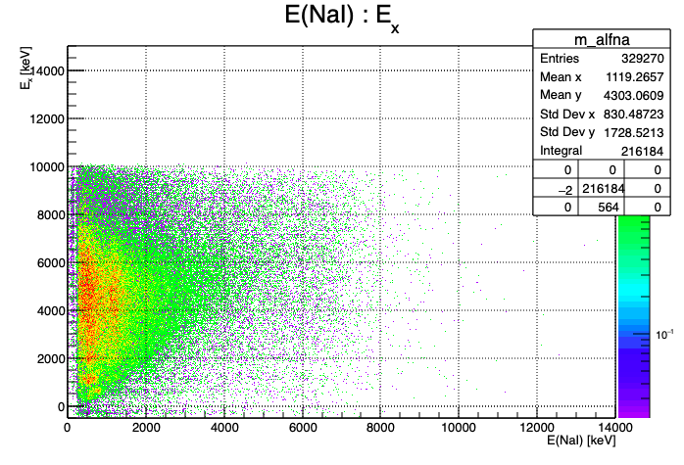
194 Ir
193 Ir

