Slide 1
Extraction of Nuclear Level Densities and gamma-ray strength functions for ⁸⁵Rb compound nucleus relevant to the astrophysical p-process
[Konstantinos Bosmpotinis]
[Oslo meeting ]

Slide 2
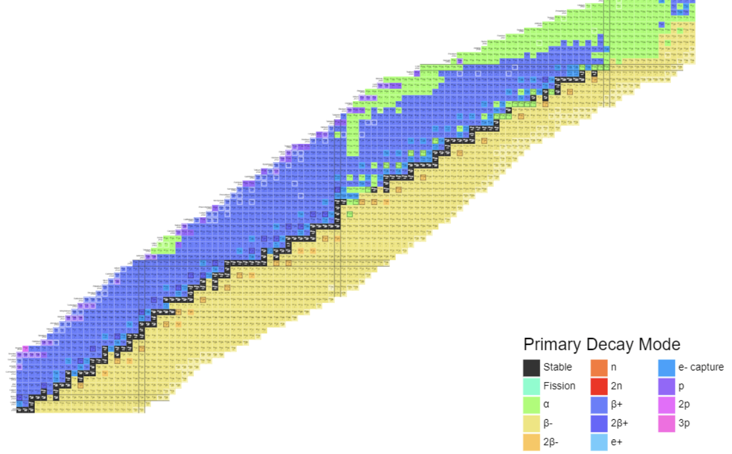
Introduction
How are the elements created?
How to explain the observed abundances?
Nucleosynthesis beyond iron peak?
What is needed from a nuclear physics stand point?
N= 126
p- process
N= 82
r- process
s- process
N= 50

Slide 3
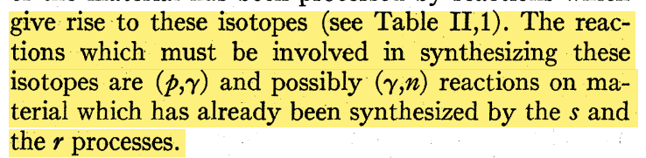
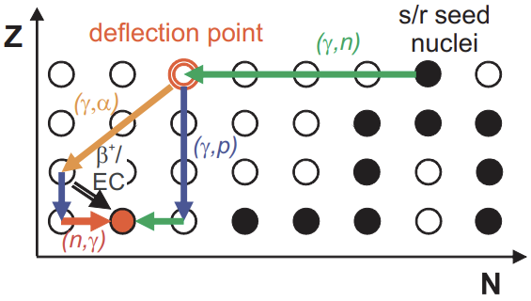
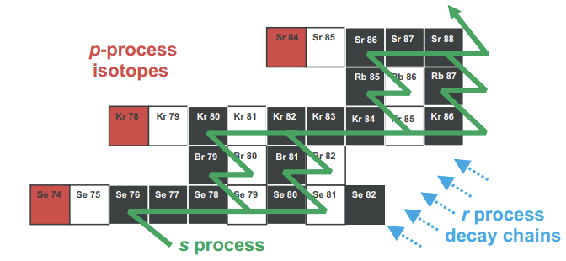
p- process
p-nuclei shielded by s and r-processes
Initially thought to be produced mainly through (p,γ) reactions [1]
Coulomb barrier high for proton captures
Solution → (γ,n), (γ,p) & (γ,α)
(γ,n) slower for more proton-rich nuclei
[1]E. M. Burbidge, G. R. Burbidge, W. A. Fowler, and F. Hoyle, Rev. Mod. Phys. 29, 547 (1957).
Branching point
[2]T Rauscher et al, Rep. Prog. Phys. 76 066201, (2013)

Slide 4
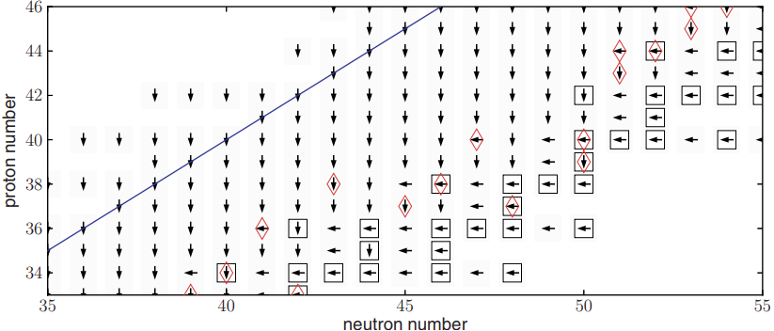
p- process
Short time scales ~ 1 sec
2 < T< 3.5 GK
The p- process possible sites:
  Type II Supernovae
  Type Ia Supernovae
Nuclear network
  Consists of approximately 20.000 reactions on stable and radioactive isotopes → Direct cross-section measurements are challenging.
  Competition between these can determine the p-process nucleosynthesis path → Branching point elements.
T Rauscher et al, Rep. Prog. Phys. 76 066201, (2013)
: N= Z line
: Stable isotopes
: Branching points

Slide 5
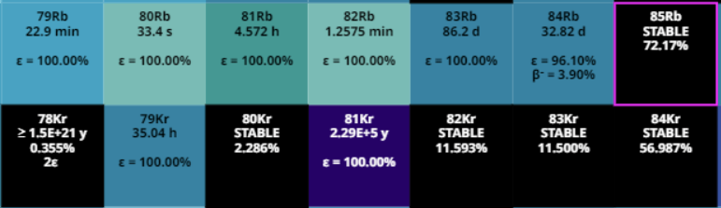
Motivation
Why ⁸⁵Rb is so important for the p-process network?
  Listed as a branch point between the ⁸⁵Rb(γ,p)⁸⁴Kr and ⁸⁵Rb(γ,n)⁸⁴Rb [1]
  Potentially affect the production of ⁷⁸Kr p-nucleus.
  ⁸⁴Kr(p,γ)⁸⁵Rb measured.
  ⁸⁴Rb is unstable → Theoretical calculations to obtain ⁸⁵Rb(γ,n)⁸⁴Rb
(γ,n)
(γ,p)
[1]Raucher, T. (2006). Branchings in the γ-process path revisited. Physical Review C.

Slide 6
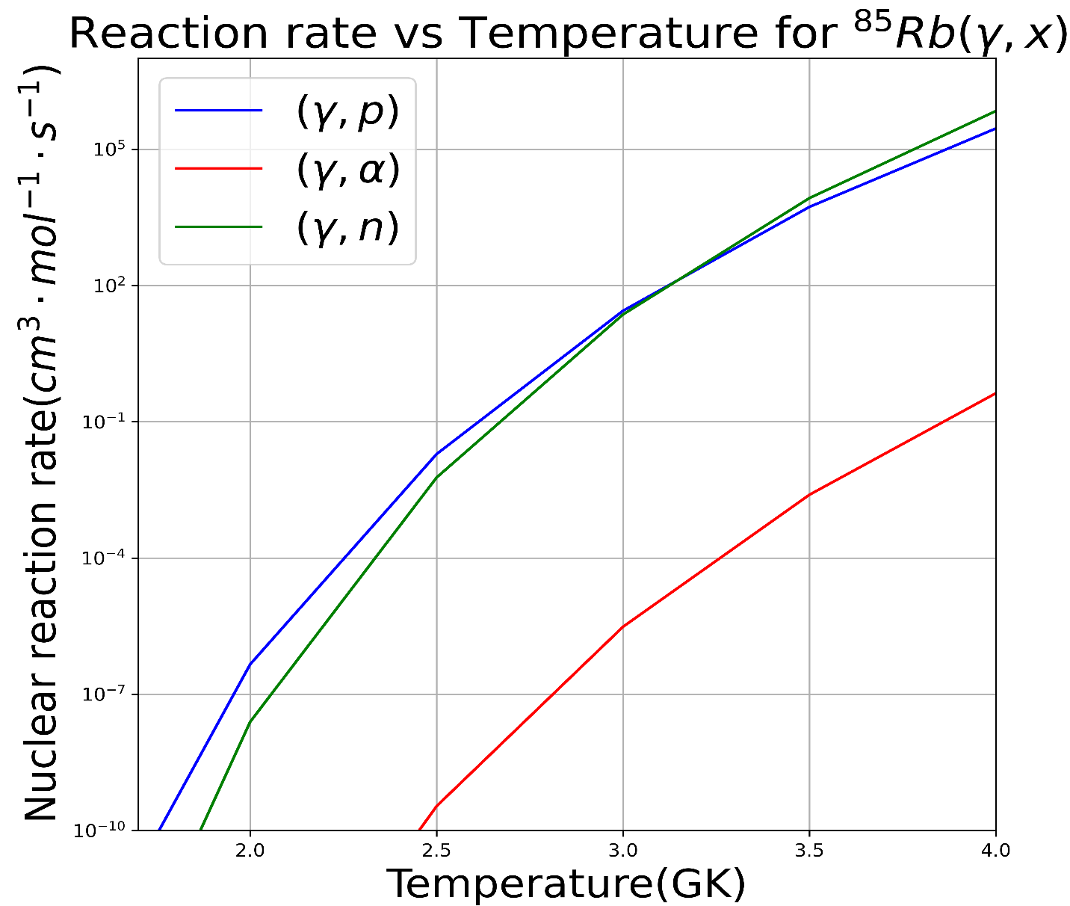
Theoretical reaction rates
Calculations based on theoretical models
Uncertainty ~ 1 order of magnitude
(γ,n)
(γ,p)
JINA REACLIB Database

Slide 7
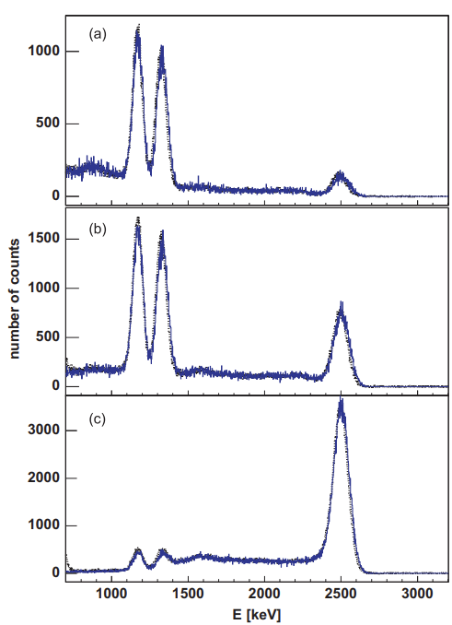
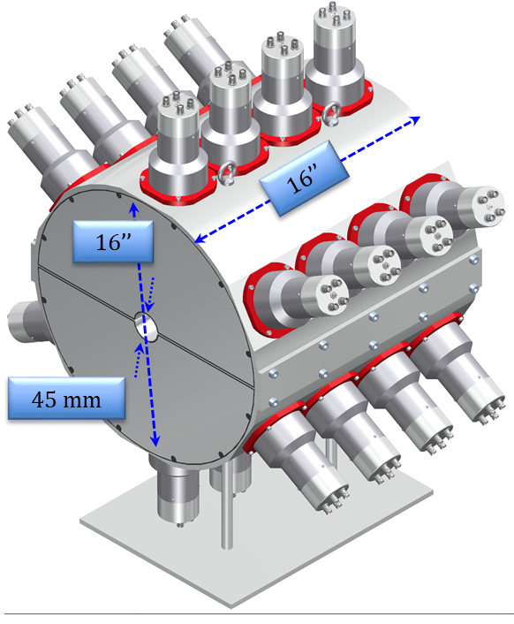
SuN detector
⁶⁰Co
SuN (Summing NaI)
  24 PMTs
  8 segments
  45 mm in diameter borehole
  High efficiency (>85% for 1 MeV photon)
  Almost 4π geometric coverage
  Obtain information about individual gamma rays.
  Perform Total Absorption Spectroscopy (TAS): Obtain information about total excitation energy.
⁶⁰Co peaks at 1173 keV & 1332 keV
Single-segment
β⁻
2505 keV
1173 keV
Top half
1332 keV
⁶⁰Ni
Whole SuN detector
A. Simon, S.J. Quinn, Artemis Spyrou, et al., Nucl. Instr. Meth A 703, 16 (2013)

Slide 8
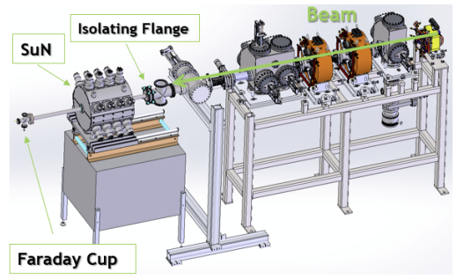
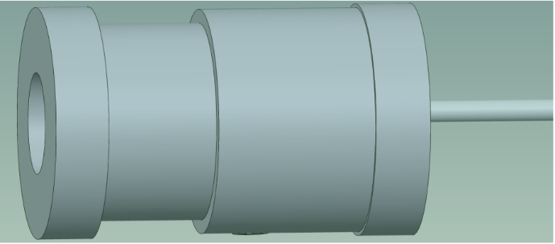
Experimental Set up
The experiment was performed at NSCL at Michigan State University.
A beam of stable ⁸⁴Kr impinged onto a gas hydrogen target (inverse kinematics).
Beam energies 2.7 MeV/u, 3.1 MeV/u, 3.4 MeV/u, 3.7 MeV/u.
Gas cell target
4cm
A. Palmisano et al, 2022, Phys. Rev. C 105.065804

Slide 9
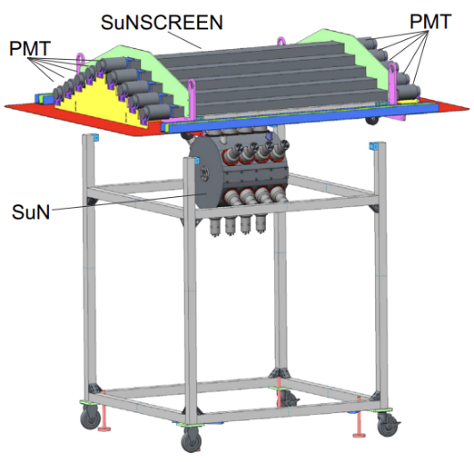
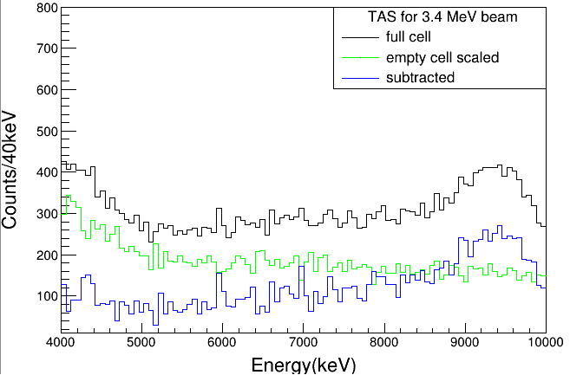

Background subtractions
Veto detector for cosmic background radiation.
Pulsed beam of 100μs every 200 ms
Record room background
Record beam-induced background
  Empty gas cell
  Full gas cell
E. Klopfer et al, Nucl. Instrum. Meth. Phys. Res. A 788, 5 (2015)

Slide 10
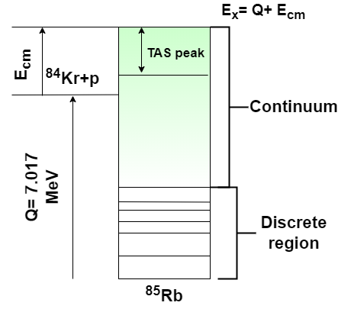
Methodology
RAINIER
G4
Simulated spectra
Fitting
RAINIER [1] code was used to simulate the deexcitation of the compound nucleus.
Excitation energy varied in the energy range 8MeV to 9.8MeV with 100keV step.
NLD: Constant Temperature (T(MeV) & E(MeV)) or BSFG model (a(MeV⁻¹) & E1 (MeV))
gSF: Generalized Lorentzian and Standard Lorentzian
Vary only one parameter for each model, keeping everything else to their default value.
[1]L.E. Kirsch, L.A. Bernstein, A simulation tool for distributions of excited nuclear states and cascade fluctuations, Nucl. Instrum. Meth. Phys. Res. A (2018)

Slide 11
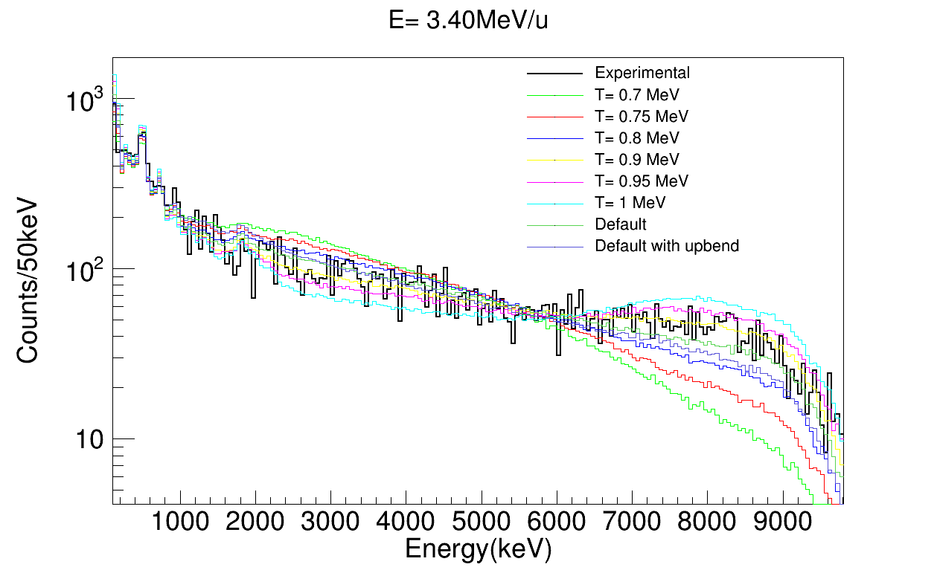
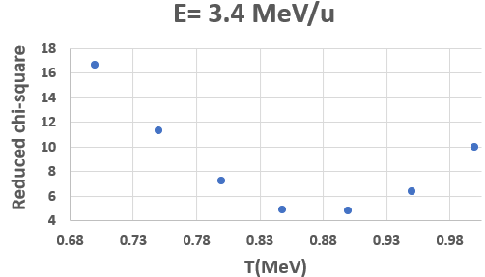
Chi-square fit for various temperatures for the CT model
Preliminary results
Sum of Segments
Minimizes reduced chi-square

Slide 12
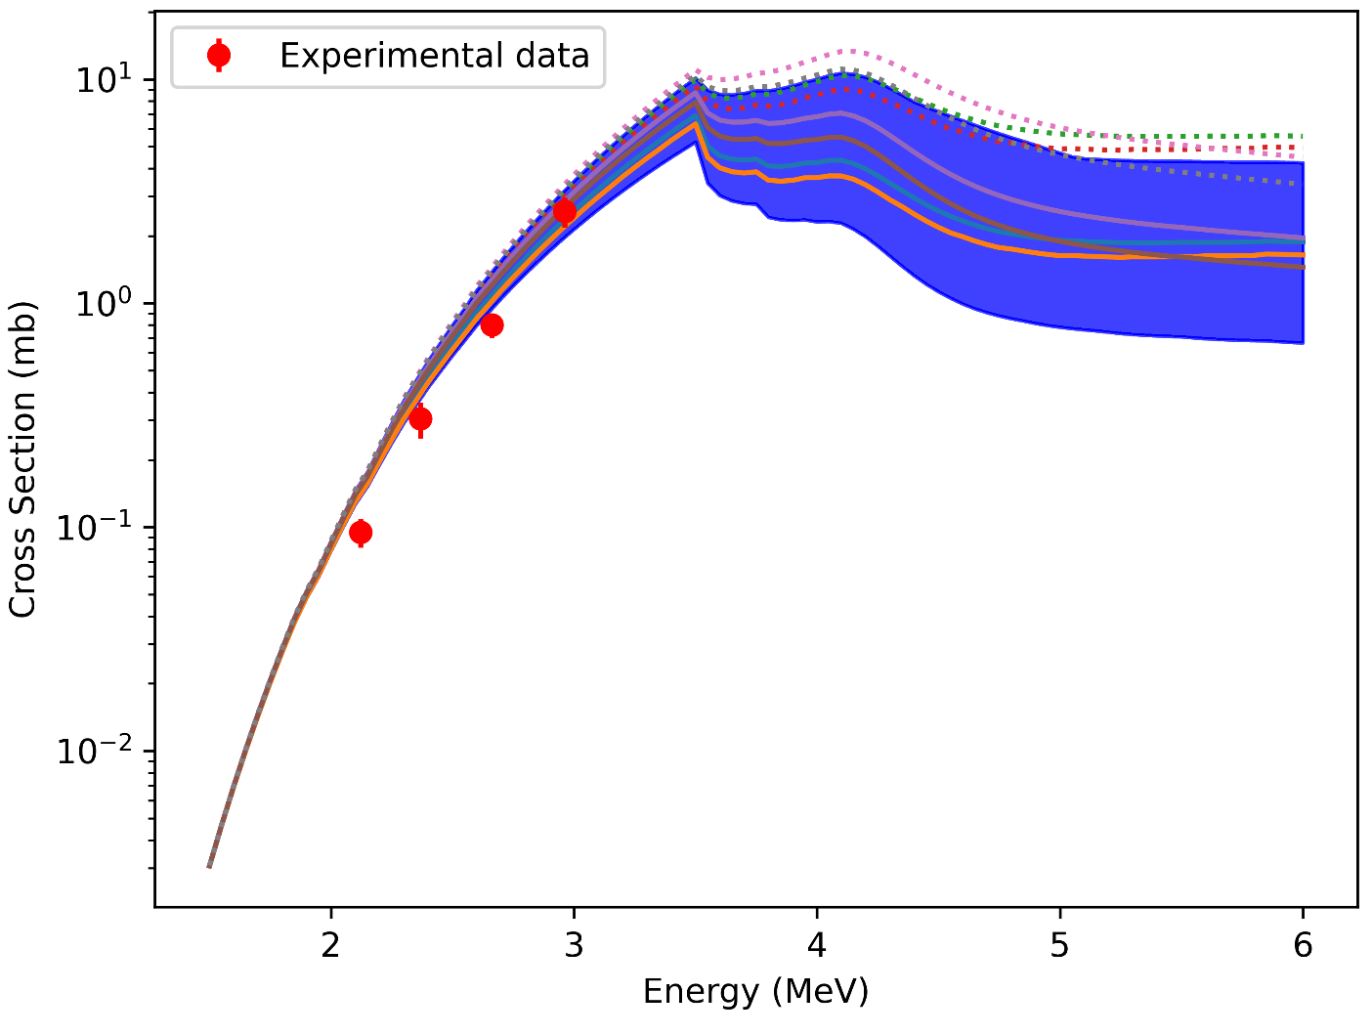
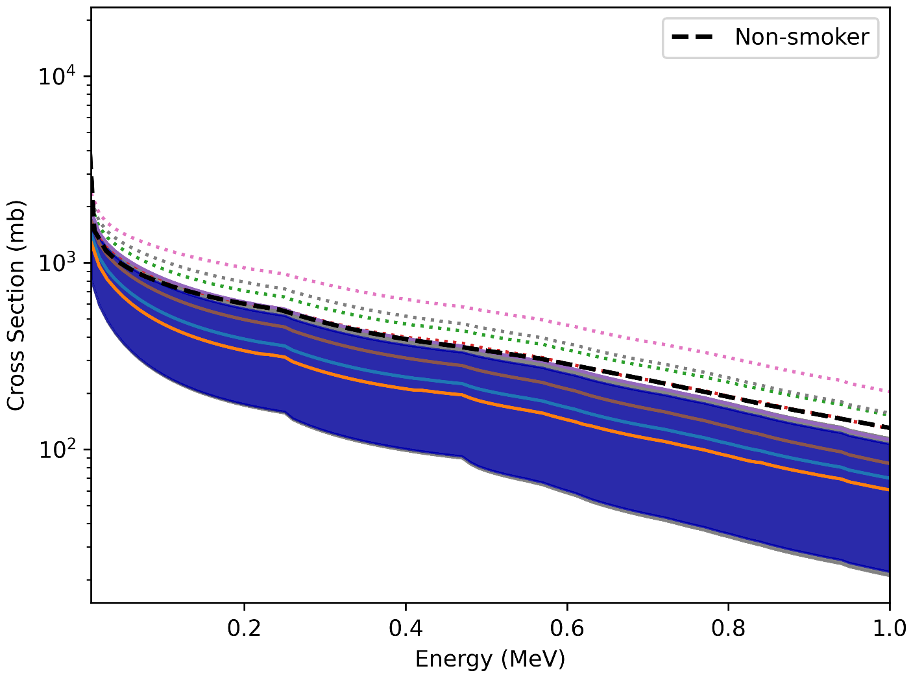
Preliminary Talys calculations
In total 60 different sets of NLD and gSF have been used to fit the experimental data.
⁸⁴Kr(p,γ)
⁸⁴Rb(n,γ)
---- Non-smoker
∙∙∙ GLO
SLO
∙∙∙ GLO
SLO
Preliminary
Preliminary

Slide 13
Summary
We extracted products of NLD and gSF parameters to experimentally constrain the neutron capture cross-section on ⁸⁴Rb.
High sensitivity in the Sum of Segments spectra →information about the individual gamma-rays emitted from the compound nucleus.
Use the statistical chi-square criterion to obtain the model parameters that best fit our data.
Use of TALYS v1.96 with the optimized NLD and gsF parameters obtained in this work.
(γ,n)
(γ,p)

Slide 14


Acknowledgements
Palmisano^{1,2,3}, A. Spyrou^{1,2,3}, A. Tsantiri^{1,2,3}, H. Berg^{1,2,3}, P. A. DeYoung⁴, A. Dombos^{1,2,3}, P. Gastis^{3,5}, O. Gomez⁶, E. Good^{2,3}, C. Harris^{1,2,3}, S. Liddick^{2,3,7}, S. M. Lyons^{1,2,3}, P. Mohr⁸, J. Pereira^{1,2,3}, A. L. Richard^{1,2,3}, A. Simon^{3,6}, M. K. Smith^{1,2}, R. Zegers^{1,2,3}
¹ Department of Physics and Astronomy, Michigan State University,
² Facility for Rare Isotope Beams, Michigan State University,
³ Joint Institute for Nuclear Astrophysics - Center for the Evolution of the Elements,
⁴ Physics Department, Hope College,
⁵ Department of Physics, Central Michigan University,
⁶ Department of Physics, University of Notre Dame,
⁷ Department of Chemistry, Michigan State University,
⁸ Institute for Nuclear Research (Atomki), H-4001 Debrecen, Hungary

Slide 15
Thank you for your attention!
Questions?

Slide 16
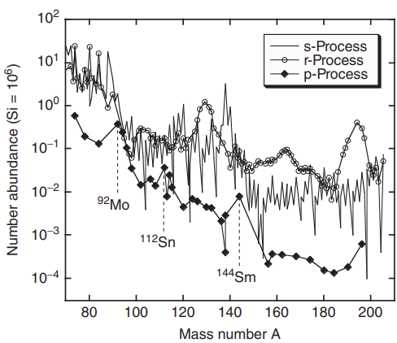
35 stable proton-rich nuclei (74<A<196)
100 times less abundant than adjacent s or r-process isotopes.
Abundances affected by structure effects (favors production of paired nucleons)
Peaks at ⁹²Mo₅₀ and ¹¹²Sn (Z=50), ¹⁴⁴Sm₈₂
Christian Iliadis, Nuclear Physics of Stars, Second, Revised and Enlarged Edition

Slide 17
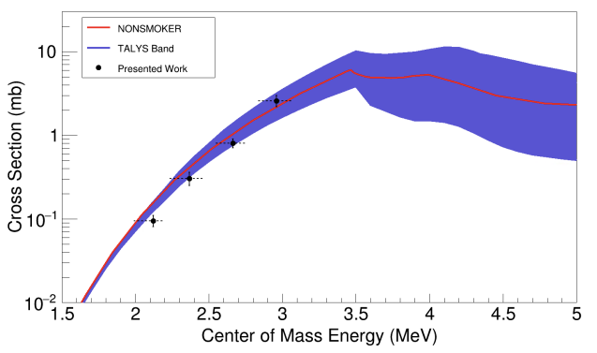
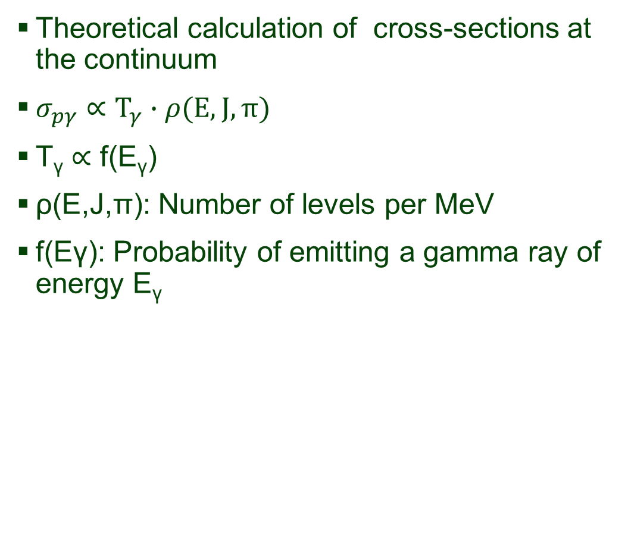
Experimental cross-section measurements of ⁸⁴Kr(p,γ)⁸⁵Rb in the energy range 2.7 MeV/u- 3.7 MeV/u [1]
Theoretical calculation of cross-sections at the continuum
$σ_{pγ}∝Τ_{γ}∙ρ(E,J,π)$
T_{γ} $∝$ f(E_{γ})
ρ(E,J,π): Number of levels per MeV
f(Eγ): Probability of emitting a gamma ray of energy E_{γ}
Goal: Extract products of Nuclear Level Densities (NLD) and gamma-ray Strength Functions (gSF) for ⁸⁵Rb to better constrain ⁸⁵Rb(γ,n)⁸⁴Rb
[1]A. Palmisano et al, 2022, Phys. Rev. C 105.065804

Slide 18
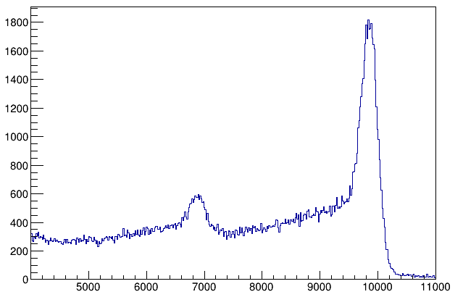
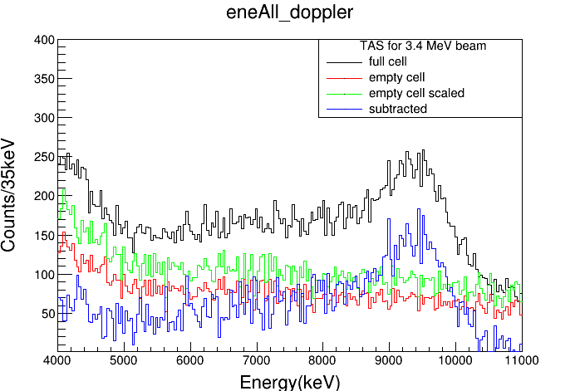
TAS peak of ⁹⁰Zr(p,γ) in regular kinematics
TAS peak of ⁸⁴Kr(p,γ) in inverse kinematics
Inverse
counts
Energy(keV)
Energy (keV)
2μm thick Mo foil at window entrance →Energy Straggling
Gas cell of 4cm long
Inverse kinematics→ Doppler broadening
Region of interest: 8MeV-10 MeV

Slide 19
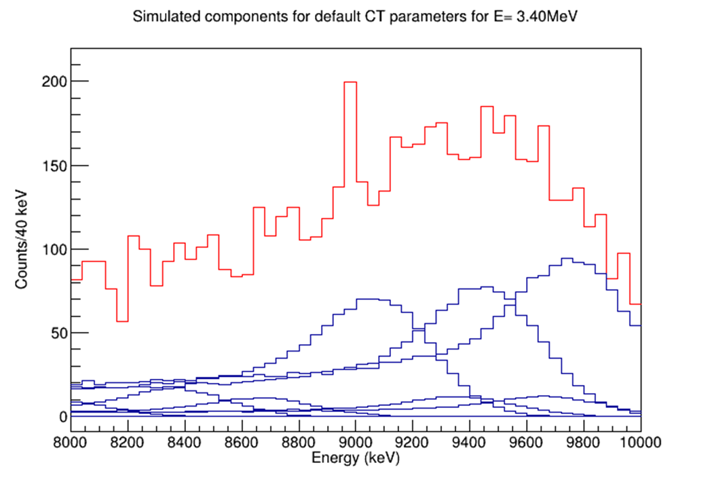
2 MeV wide
Individual components

Slide 20
RAINIER
G4
Simulated spectra
Fitting
Use the RAINIER code output file as an input to the GEANT4 code to account for detector response.
Generate the simulated spectra for each beam energy.
  TAS
  SoS (gated on the TAS peak)
  Multiplicity (gated on the TAS peak)
Fit the simulated spectra to the experimental ones
Obtain the chi-square value for each set of parameters.

Slide 21
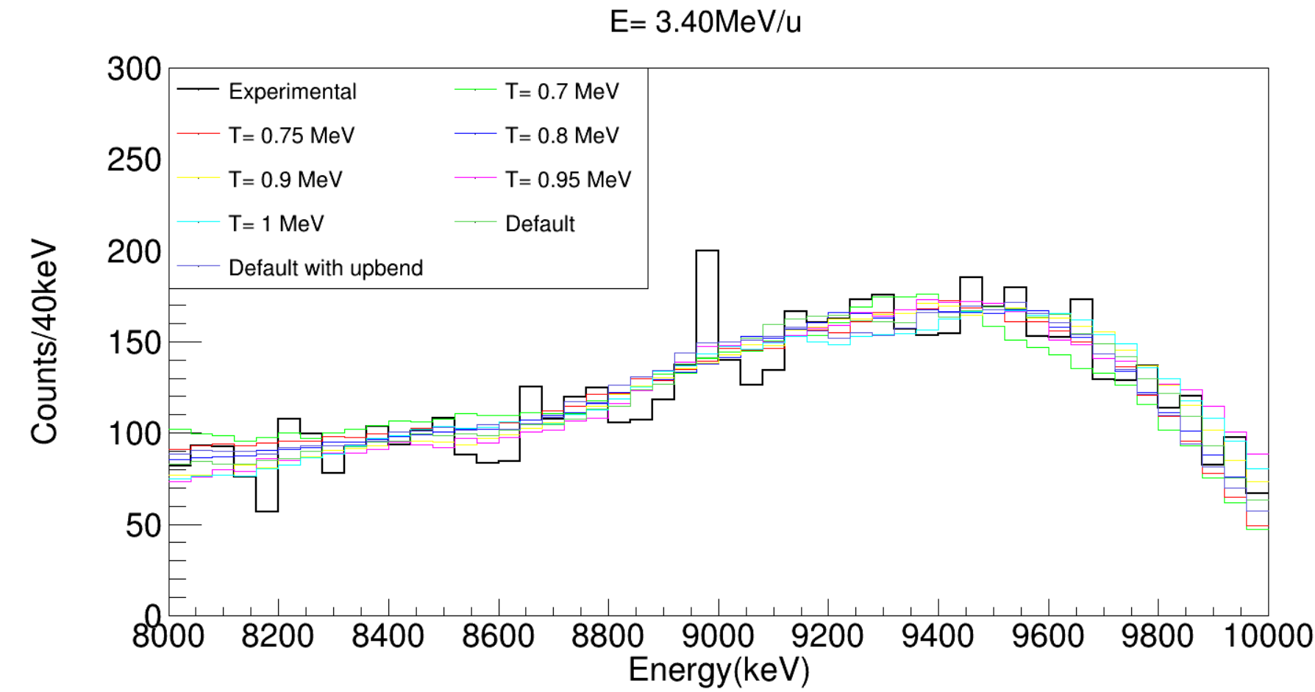
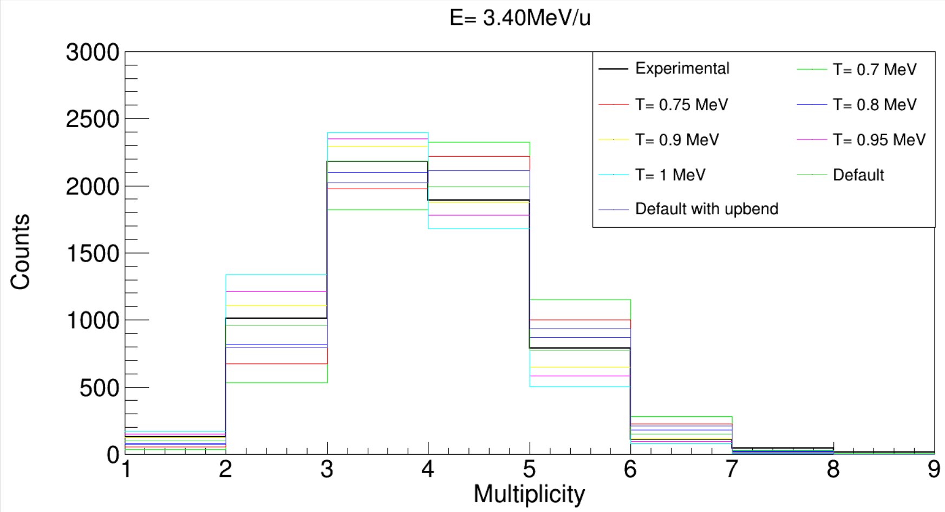
Preliminary results
TAS
TAS
Multiplicity

Slide 22
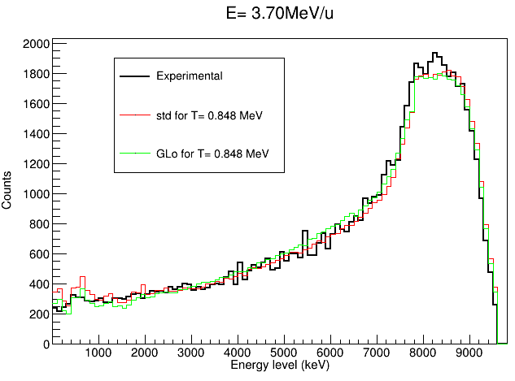
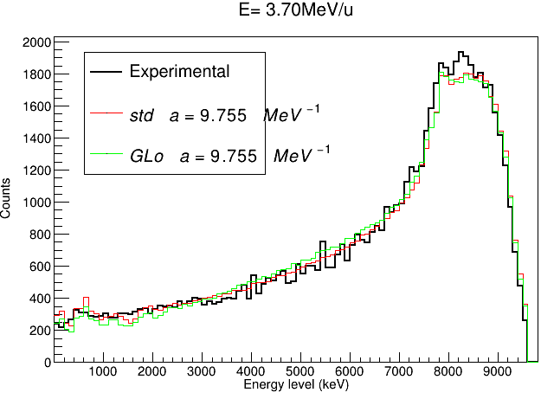

Slide 23
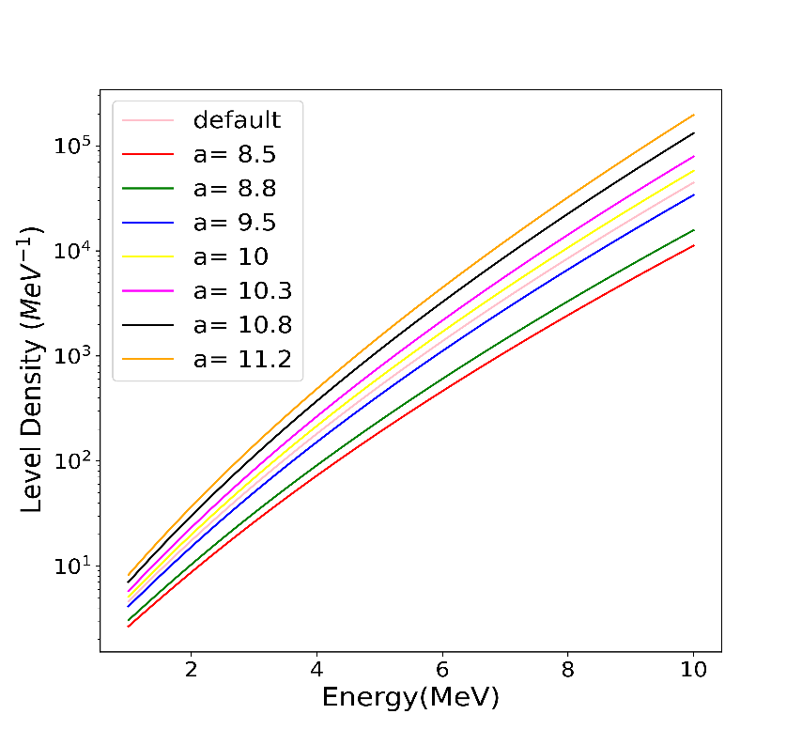
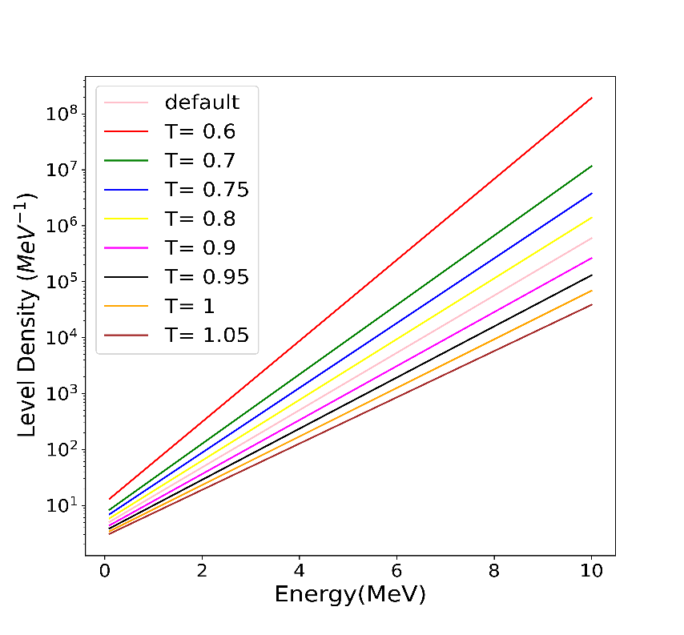
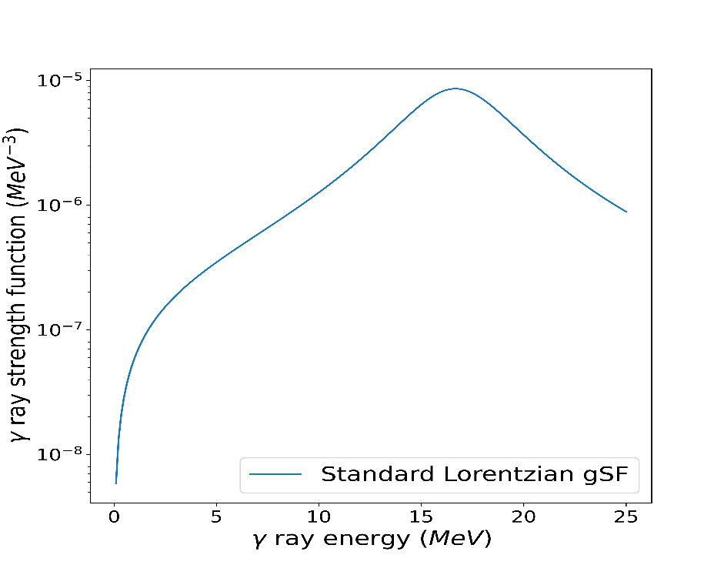
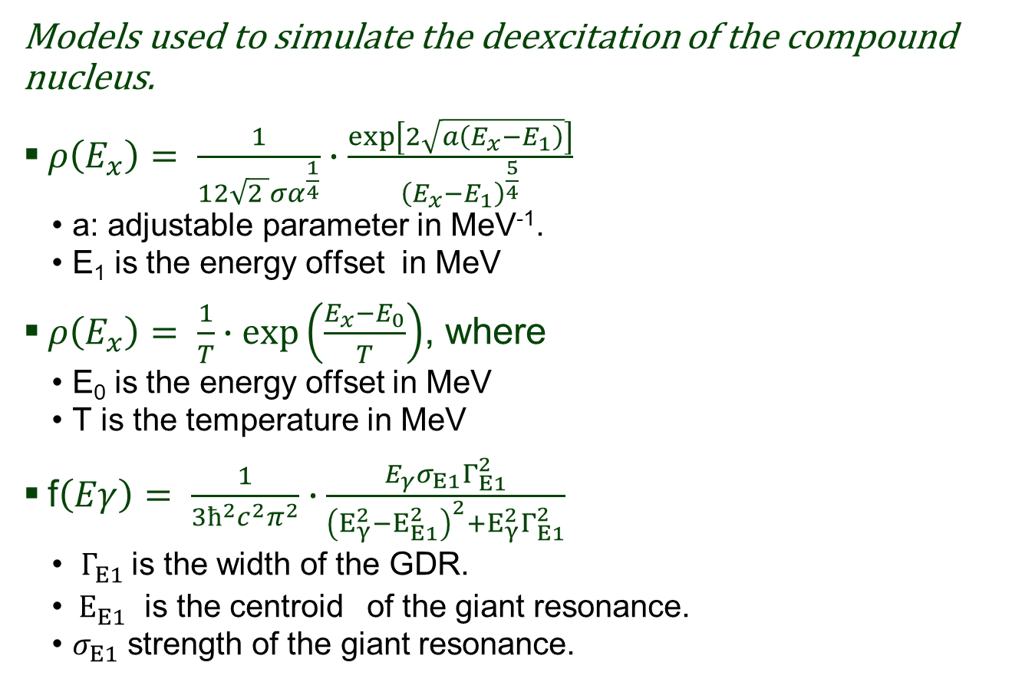
Back-up
Models used to simulate the deexcitation of the compound nucleus.
$ρ\left(E_{x}\right)= \frac{1}{12\sqrt{2 }σα^{\frac{1}{4}}}∙\frac{\exp\left[2\sqrt{a\left(E_{x}−E_{1}\right)}\right]}{{\left(E_{x}−E_{1}\right)}^{\frac{5}{4}}}$
  a: adjustable parameter in MeV⁻¹.
  E₁ is the energy offset in MeV
$ρ\left(E_{x}\right)= \frac{1}{T}∙\exp\left(\frac{E_{x}−E_{0}}{T}\right)$, where
  Ε₀ is the energy offset in MeV
  T is the temperature in MeV
f$\left(Eγ\right)= \frac{1}{3ħ^{2}{c^{2}π}^{2}}∙\frac{E_{γ}σ_{Ε1}Γ_{Ε1}^{2}}{{\left(E_{γ}^{2}−E_{Ε1}^{2}\right)}^{2}+E_{γ}^{2}Γ_{Ε1}^{2}}$
  $Γ_{Ε1}^{}$is the width of the GDR.
  $E_{Ε1}^{}$ is the centroid of the giant resonance.
  $σ_{Ε1}$ strength of the giant resonance.
Complete levels up to 2.37 MeV

Slide 24
Sunscreen- SuN coincidence window 1μs→ cant make it too small→time resolution of SuN (few ns)
Energy levels are retrieved from RIPL3 until the level scheme is complete. Beyond that point, a phenomenological model is used

Slide 25
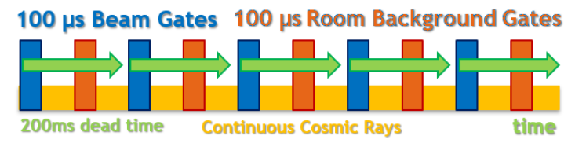
Credit: Alicia Palmisano PhD thesis

Slide 26
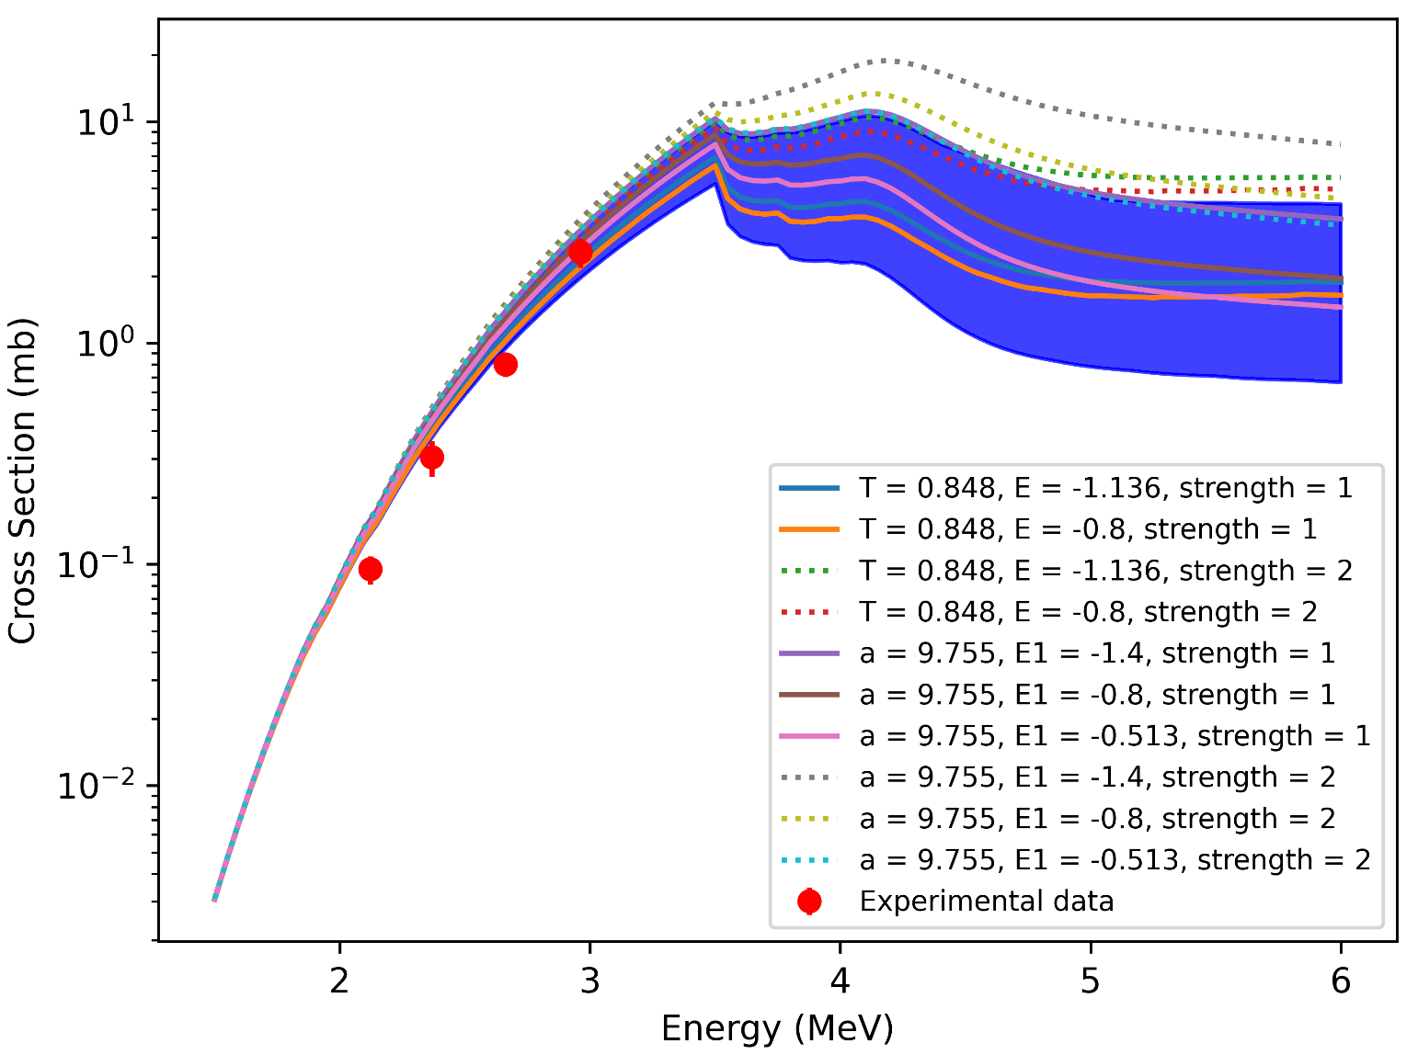
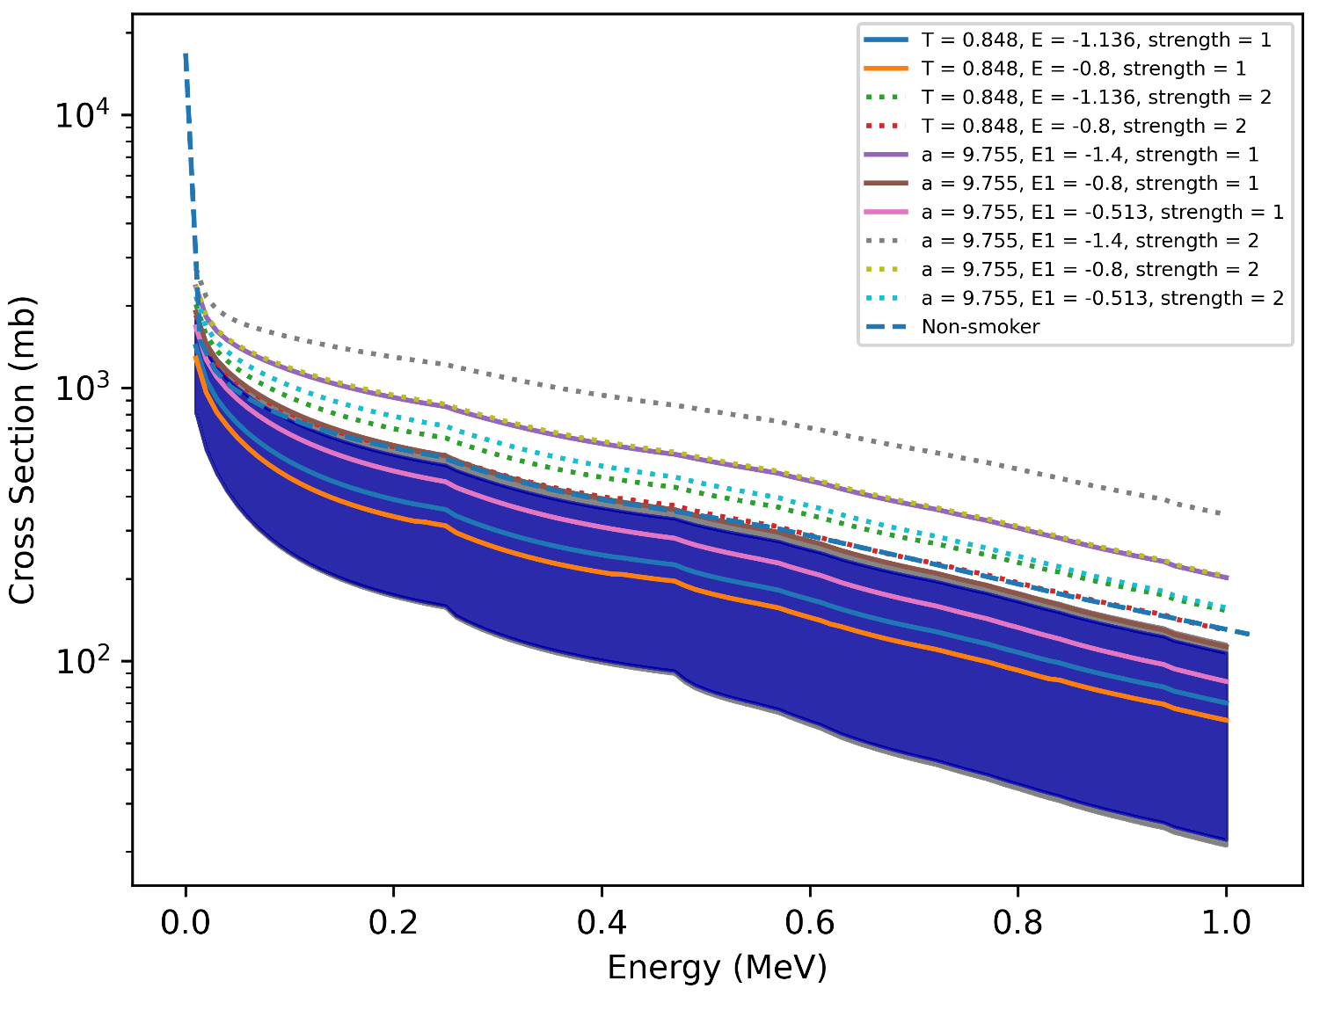

Slide 27
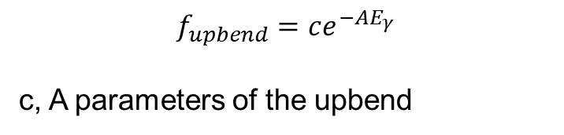
Back-up
 | T(MeV) | E(MeV)
CT | 0.79 | -1.7 |  | -1.136 |  | -0.5
 | 0.848 | -1.136 |  | -0.5 |  | 0
 | E(MeV) | T(MeV)
 | -1.136 | 0.8 | 0.9 |  | 0.95
BSFG | a (MeV⁻¹) | E(MeV)
 | 9.755 | -1.1 |  | -0.8 |  | -0.65 |  | -0.513 |  | -0.3
 | 10 | -0.8 |  | -0.513 |  | -0.1
 | E(MeV) | a (MeV⁻¹)
 | -0.513 | 8.8 | 9.5 |  | 10 |  | 10.3
$$f_{upbend}=ce^{−AE_{γ}}$$
c, A parameters of the upbend

Slide 28

Back-up
Transmission coefficient when populating the compound on the continuum

