Slide 1


Photonuclear excitation of ²⁷Al and particle emission
on PANDORA project.
Yohei Sasagawa,
Research Center for Nuclear Physics(RCNP), Osaka university

Slide 2
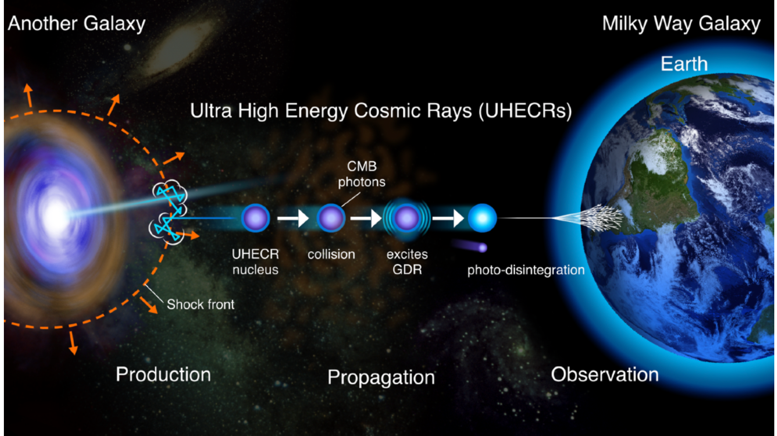
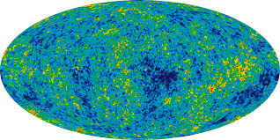
PANDORA
Photo-Absorption of Nuclei and Decay Observation for Reactions in Astrophysics
Cosmic Microwave Background
T~2.73K
UHECR nuclei
CMB photon
excites GDR
photo-disintergration

Slide 3
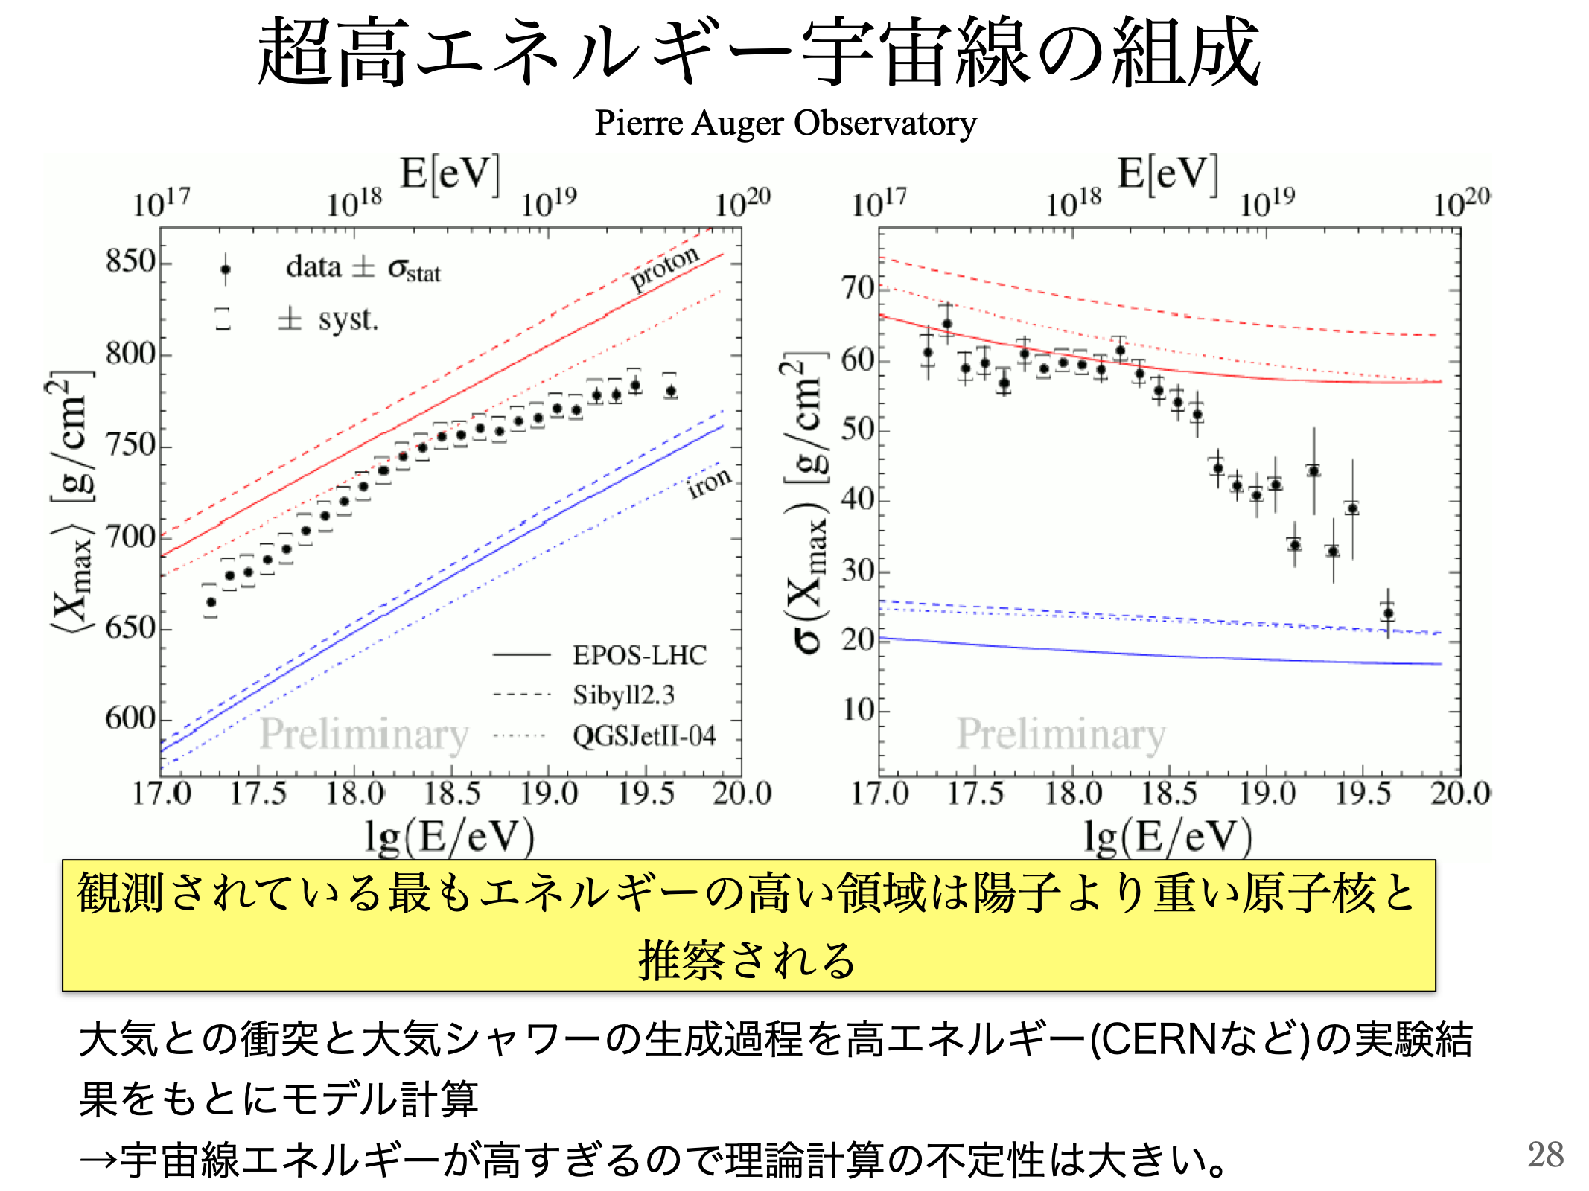
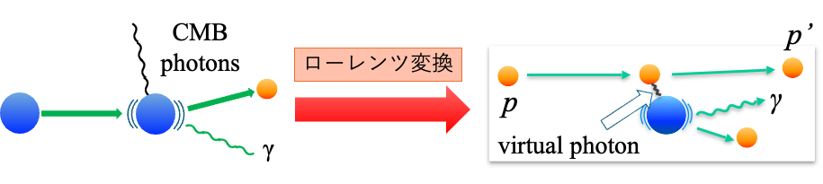
Overview
Pierre Auger Observatory revealed the mass of UHECRs is 1<A<60 (between proton and iron).
The intergalactic reactions are reproduced by inelastic scattering with proton beam <=> (p,p’) reactions of ^{10,11}B, ^{12,13}C, ²⁷Al etc..
Lorentz boost

Slide 4
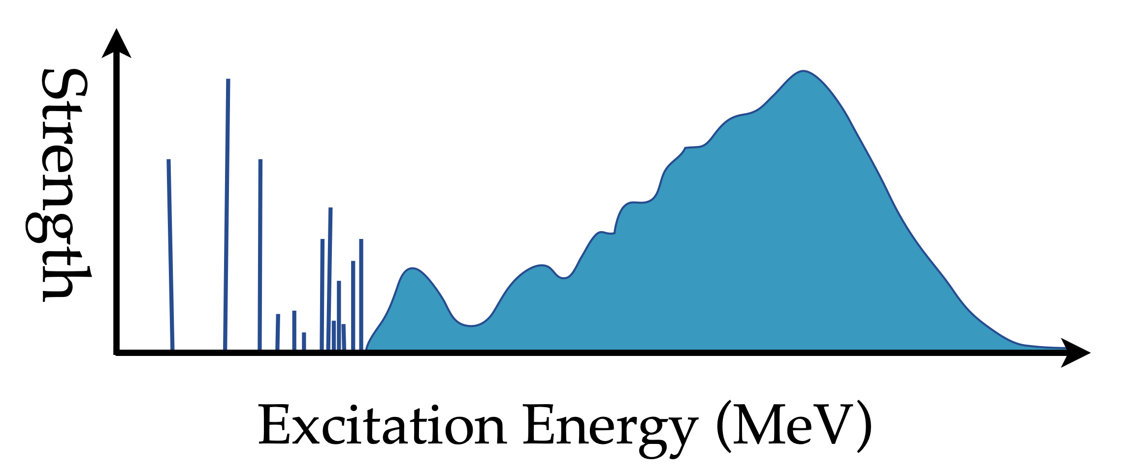
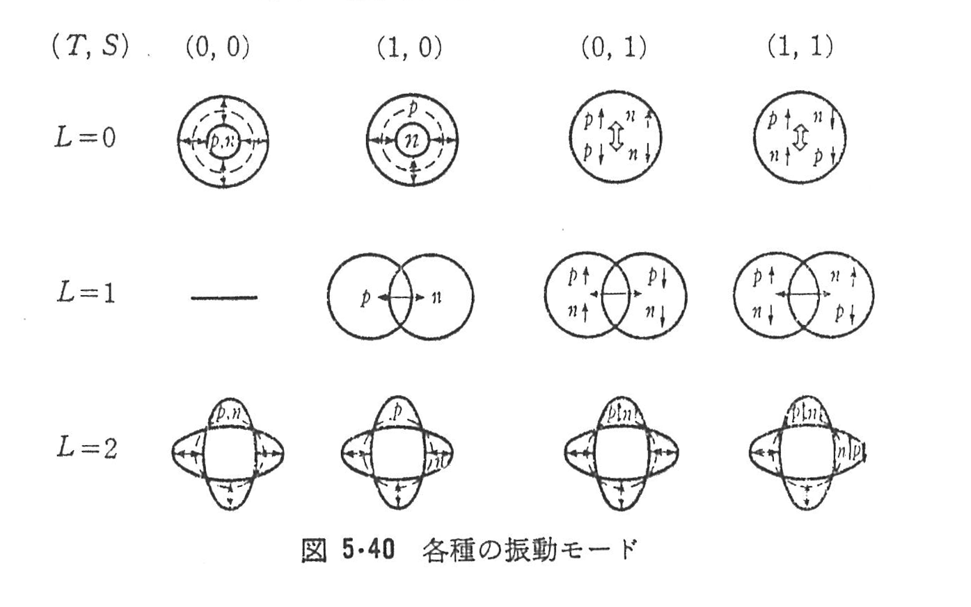
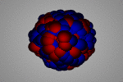




Giant Dipole Resonance
$$(ΔT,ΔS)$$
$$ΔL=0$$
$$ΔL=1$$
$$ΔL=2$$
p
n
IVGDR

Slide 5
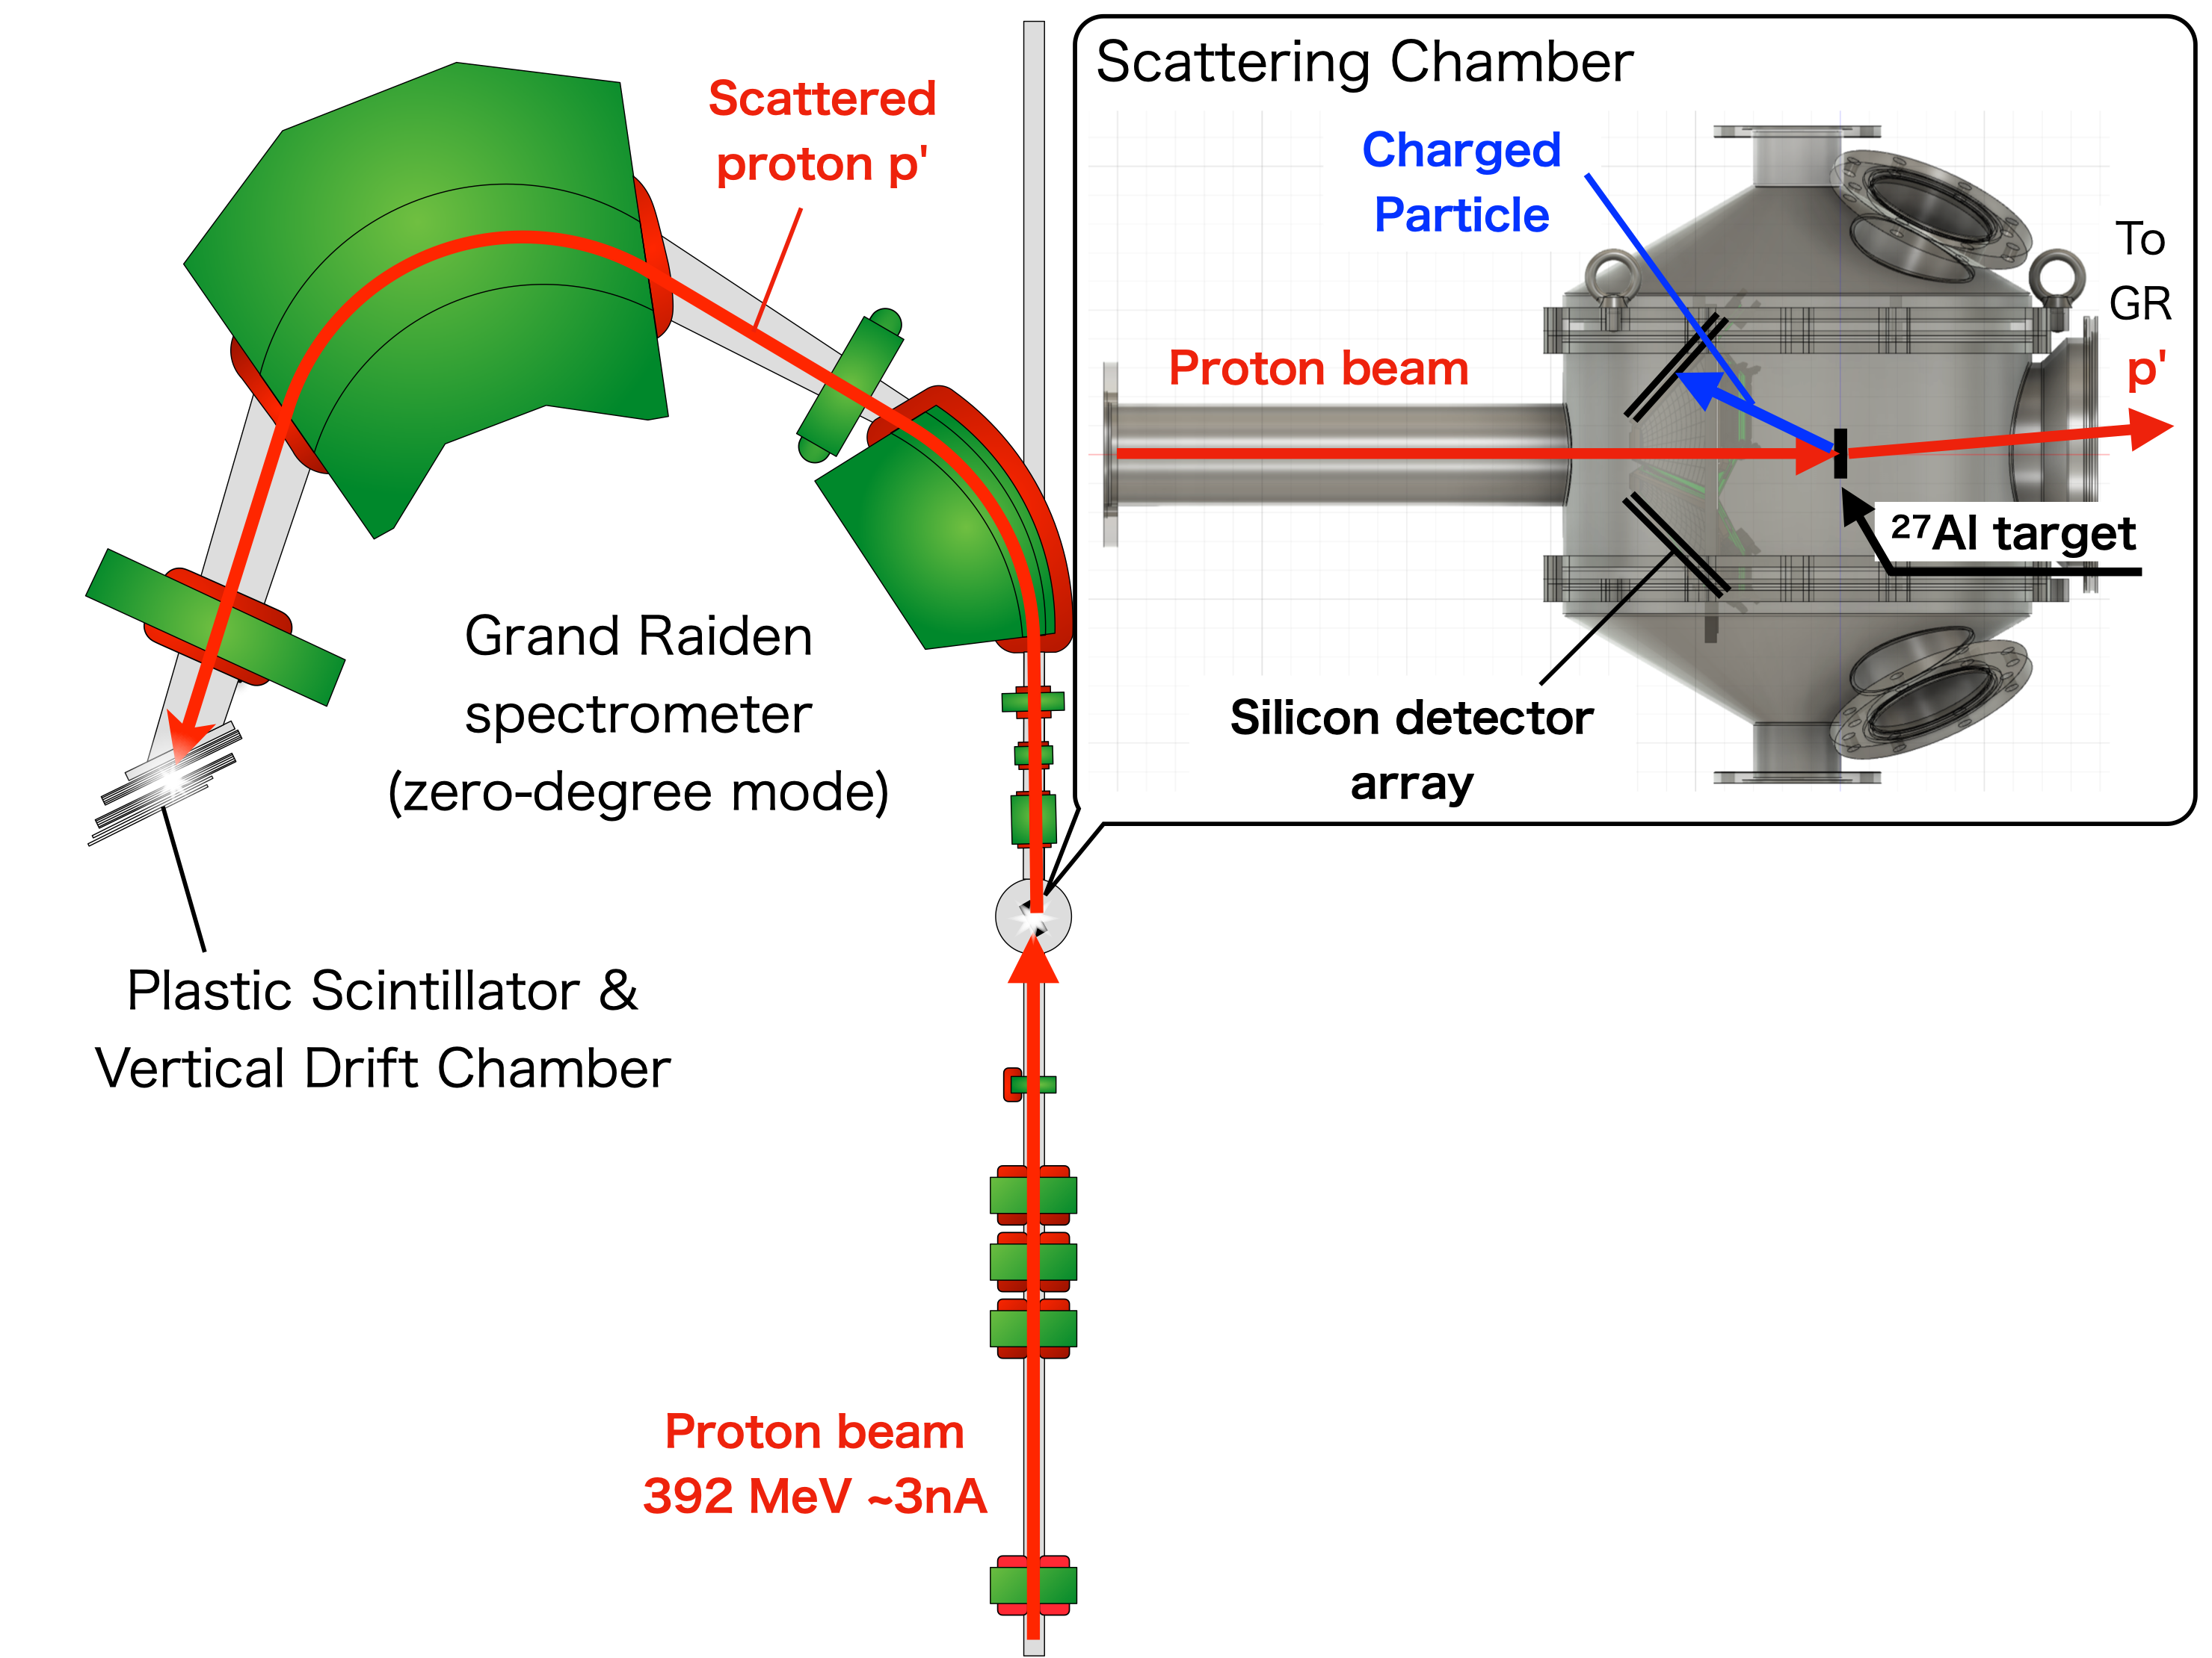
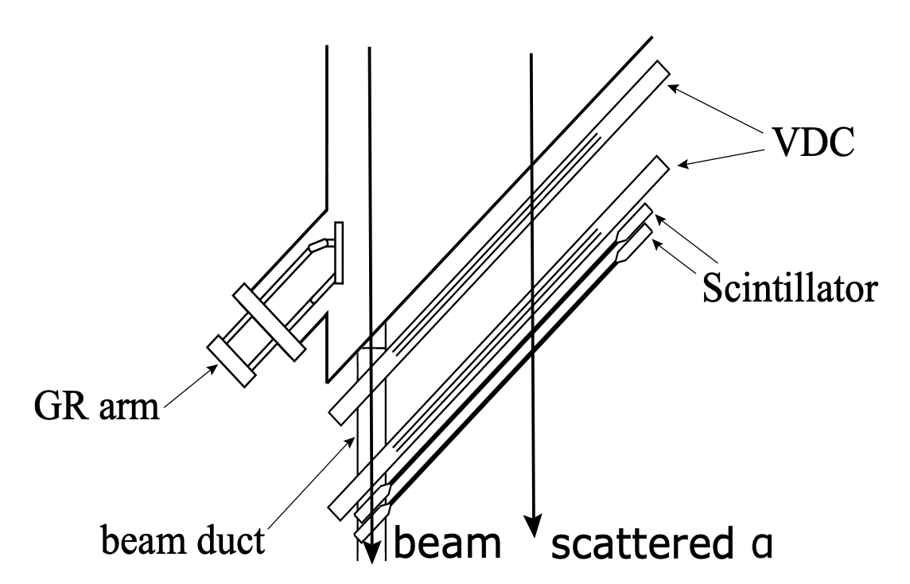
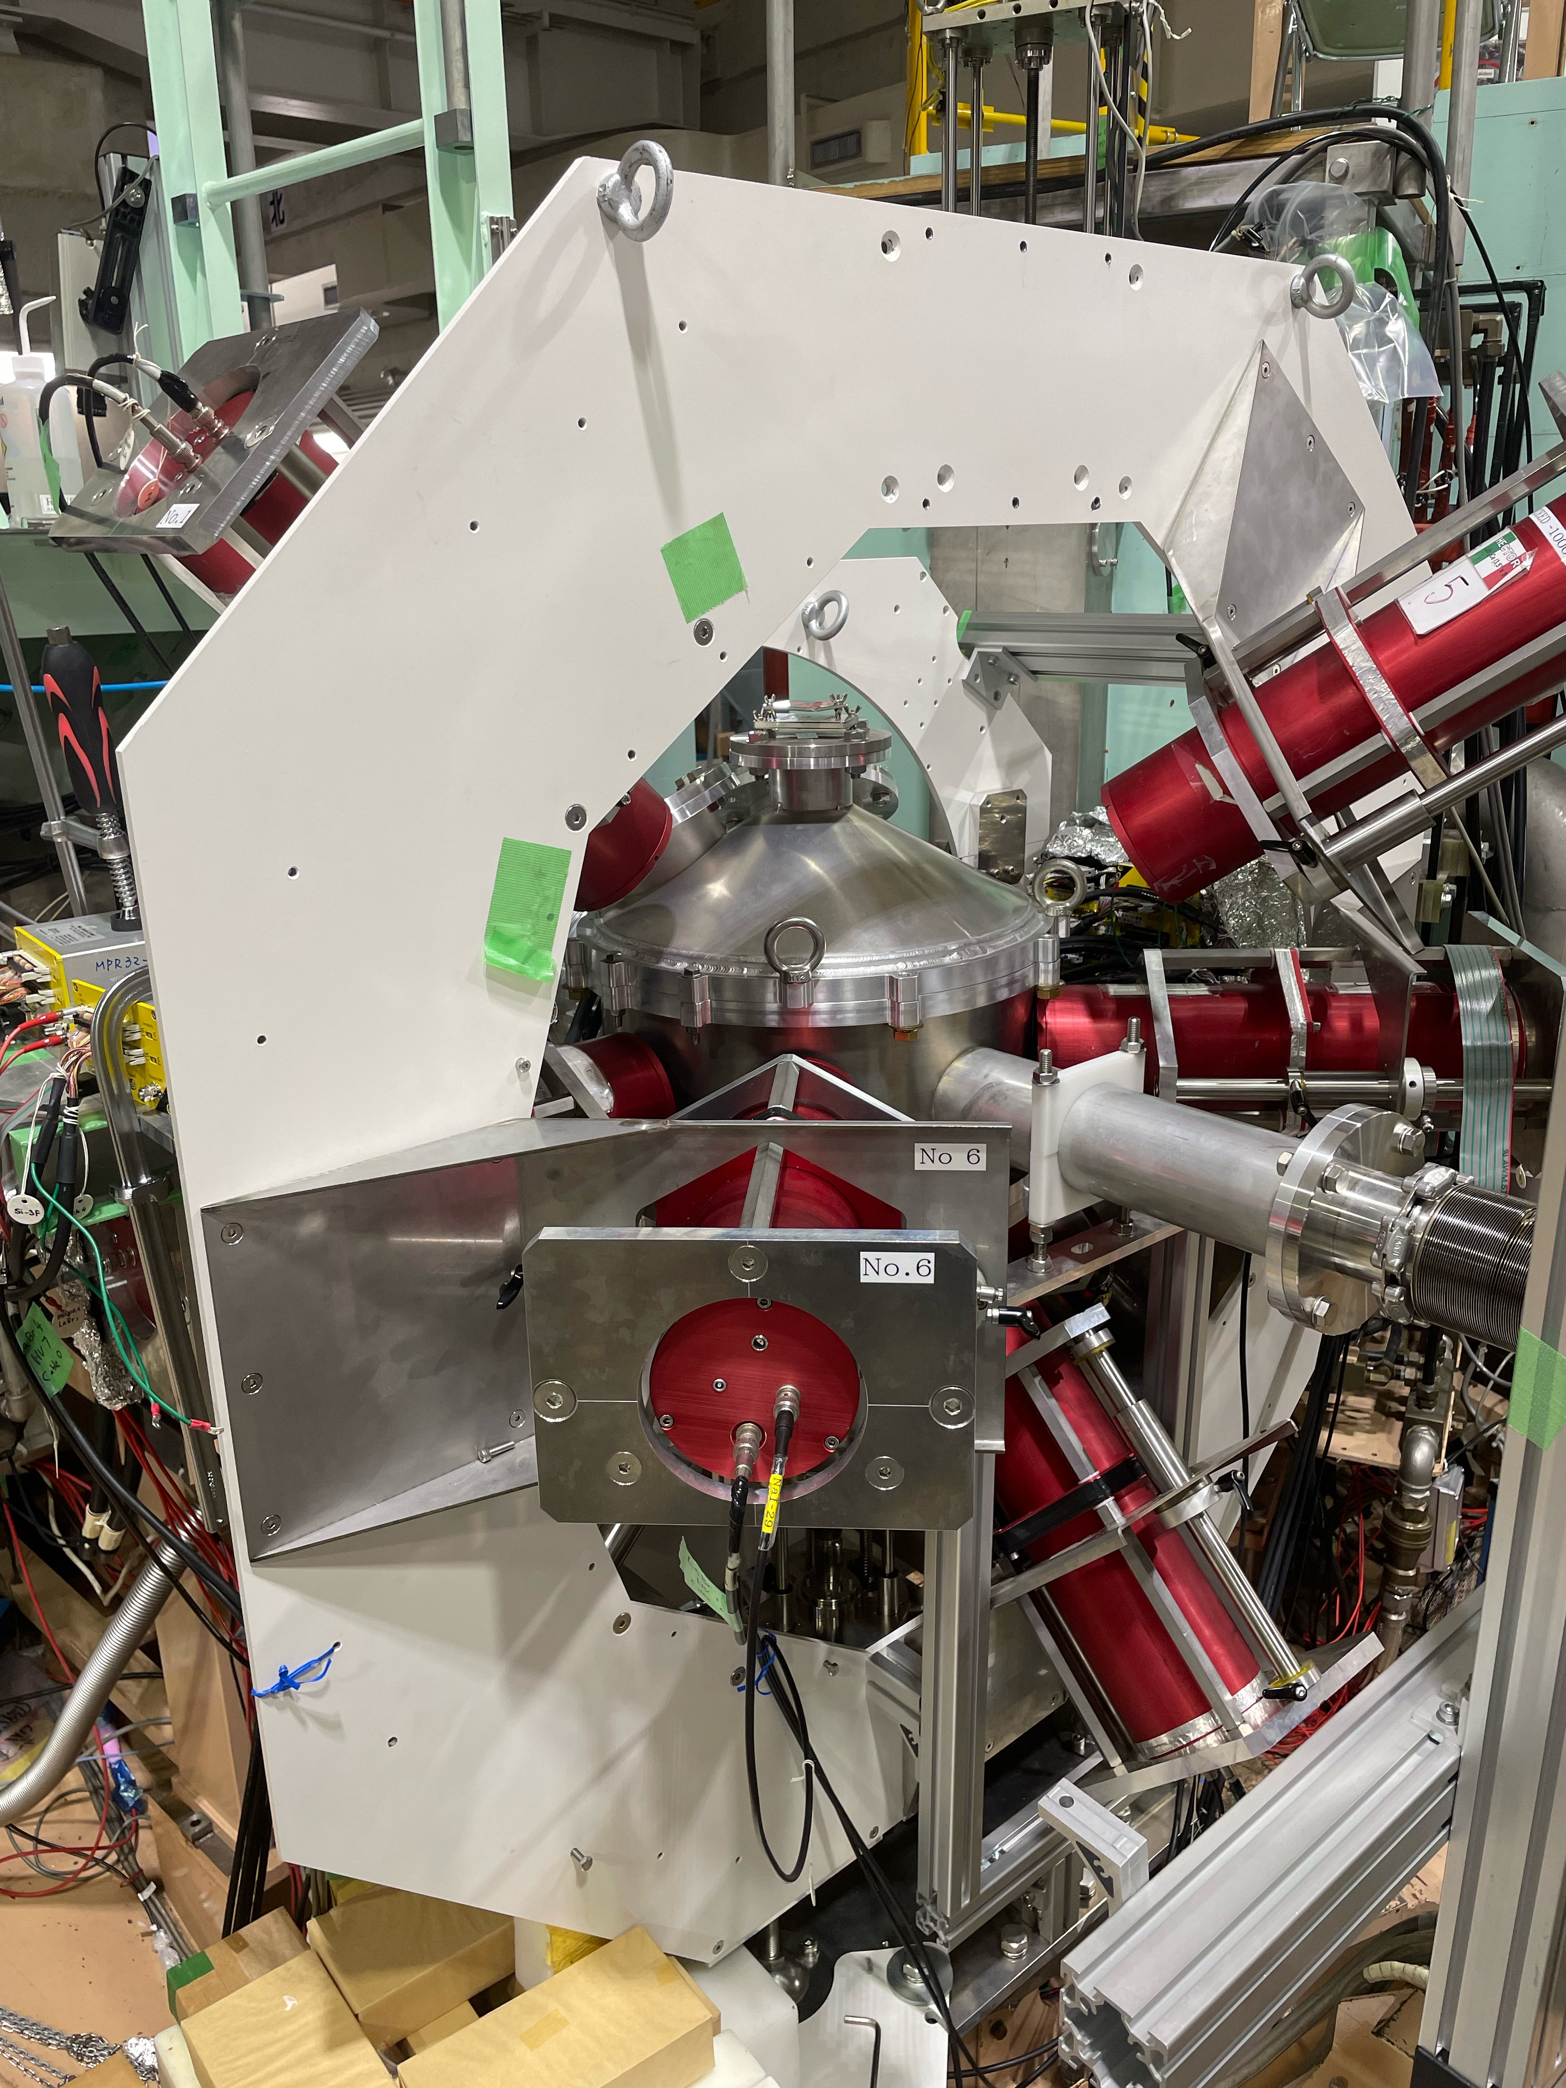
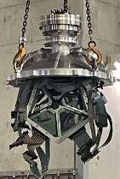
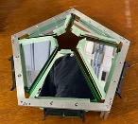
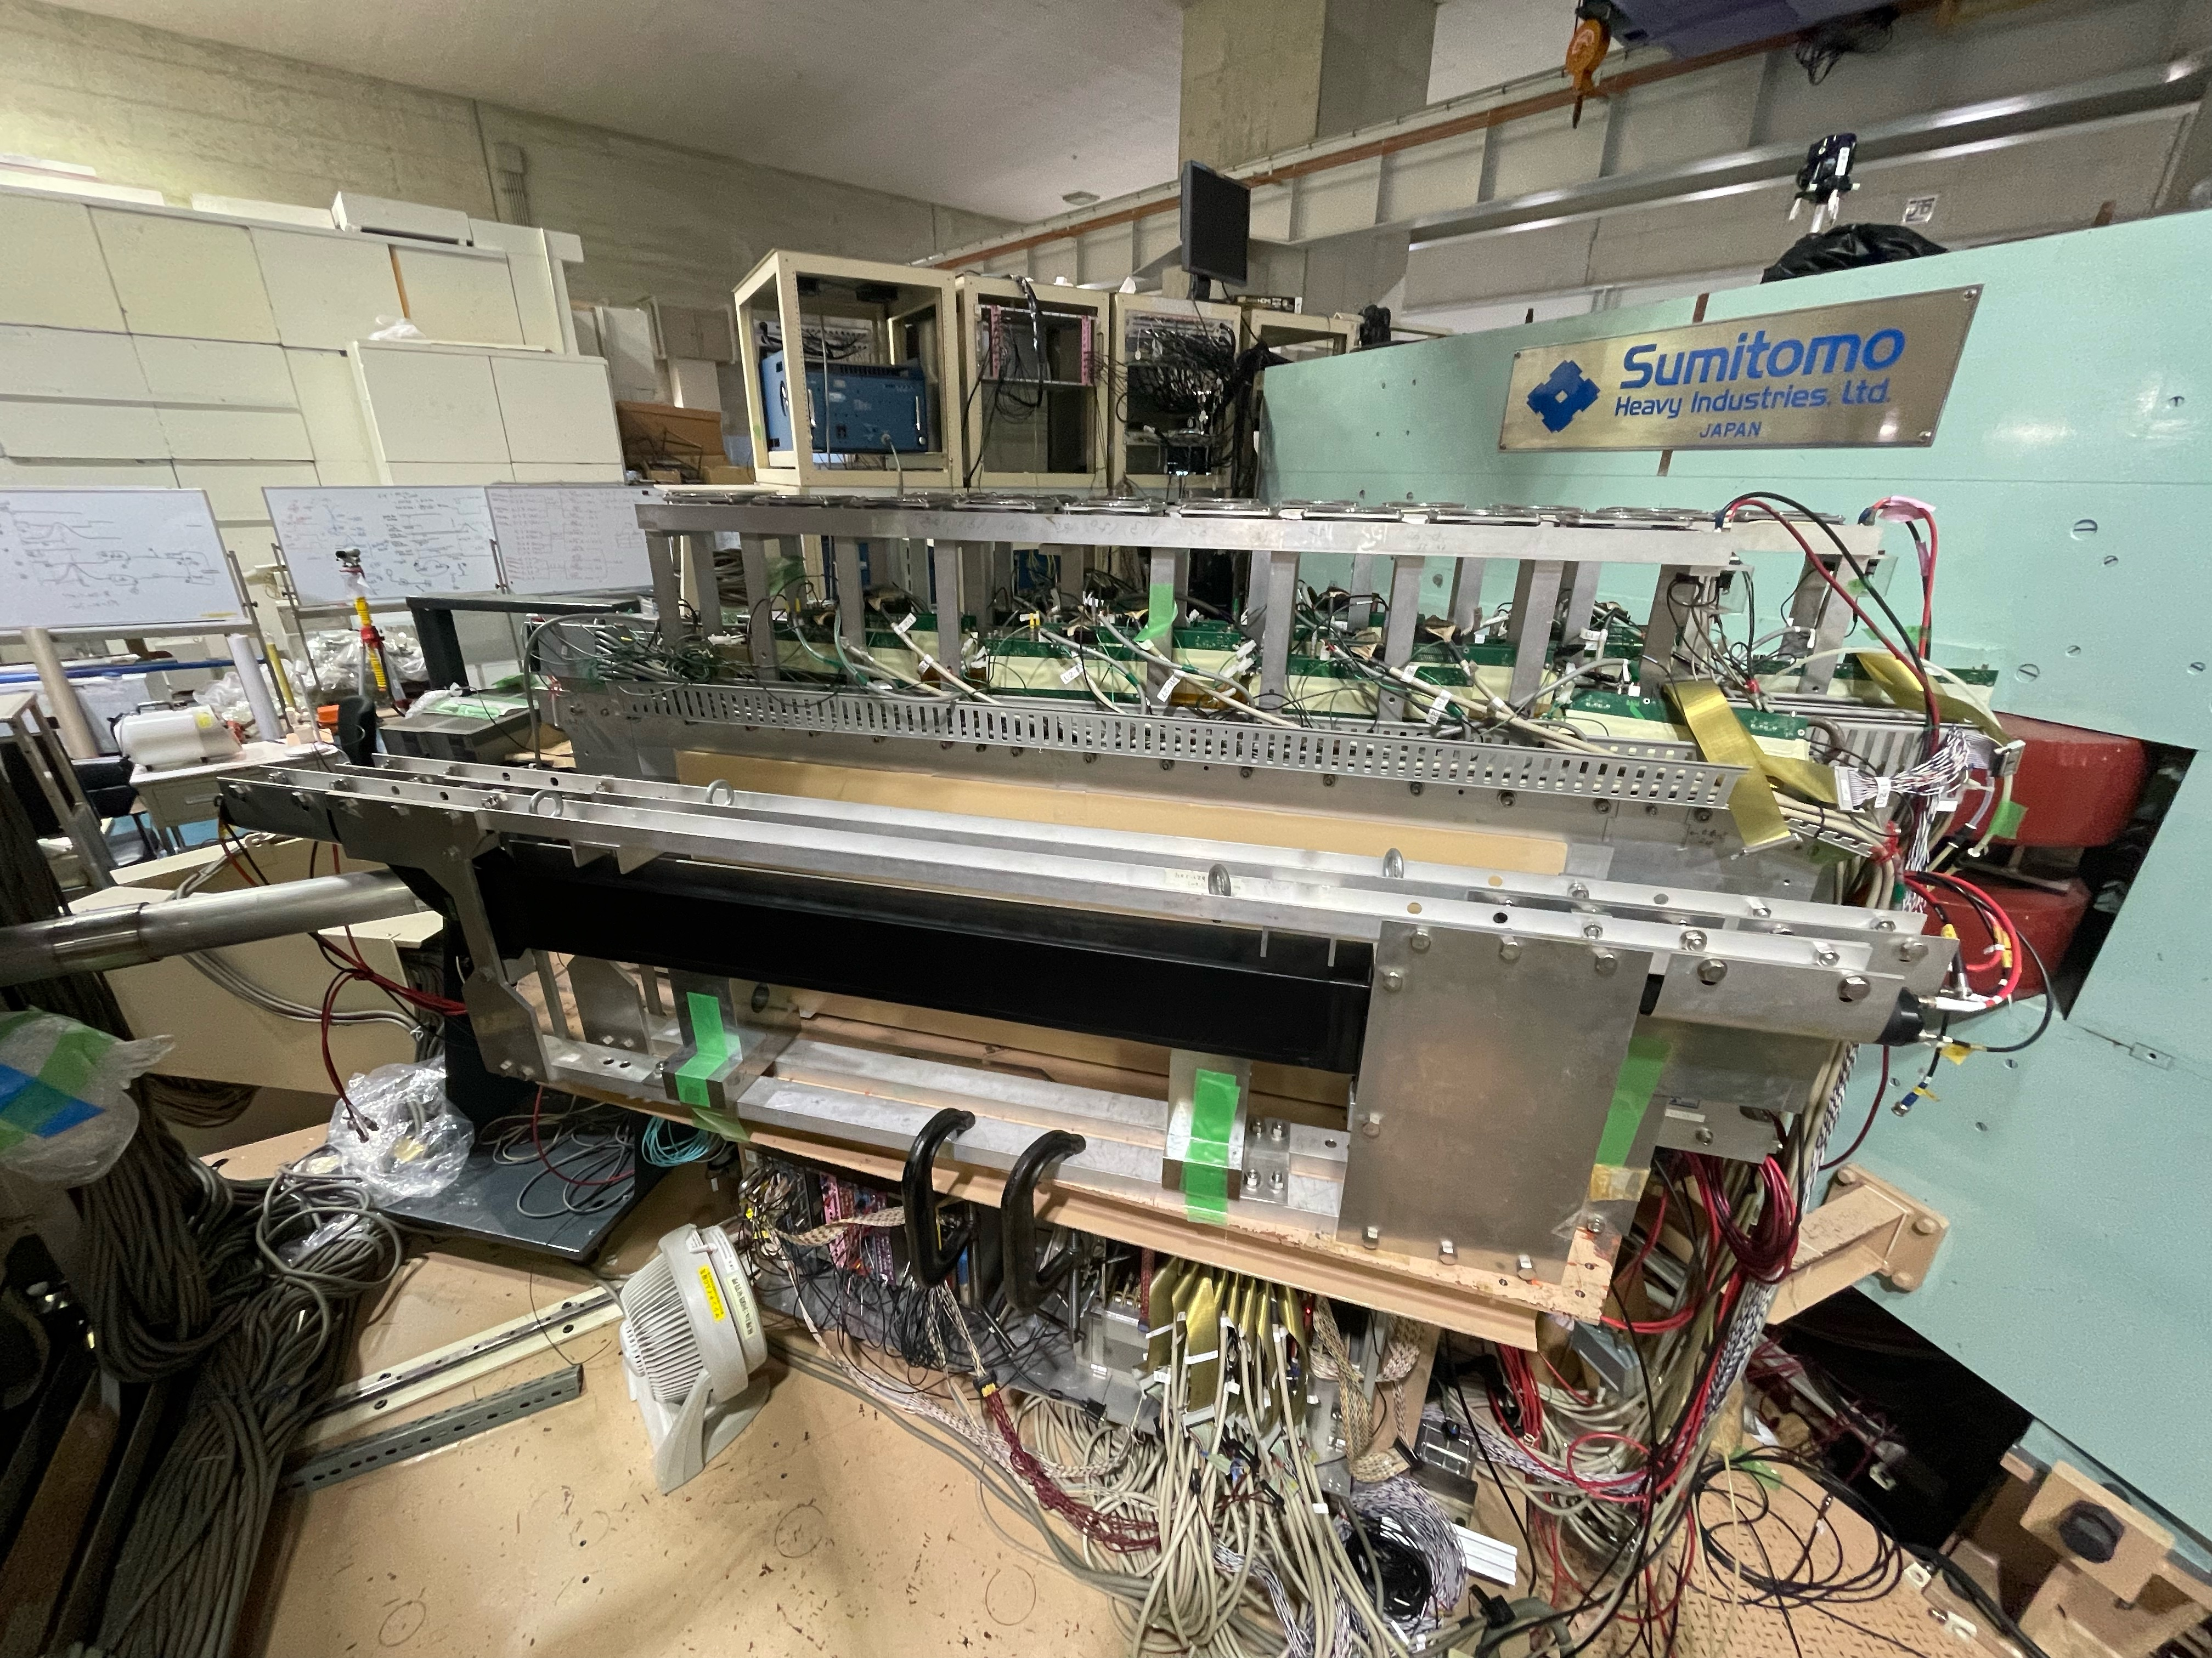
Set-up
@RCNP in Oct. 2023
Target ladder
scattered p
5×2 Si detectors (DSSSD) are inside the chamber and upstream than target position.
There are LaBr3 outside the scattering chamber.

Slide 6
Coincidence analysis
²⁷Al*
Si detectors
+ p,α,(γ)…
GR
Grand Raiden
p
(p,p’)
p’
γ
p,α…
Si
γ
Separation energy=Sx
Target
²⁷Al g.s.
Ex = Eγ = Sx + 27/26 * Ep

Slide 7
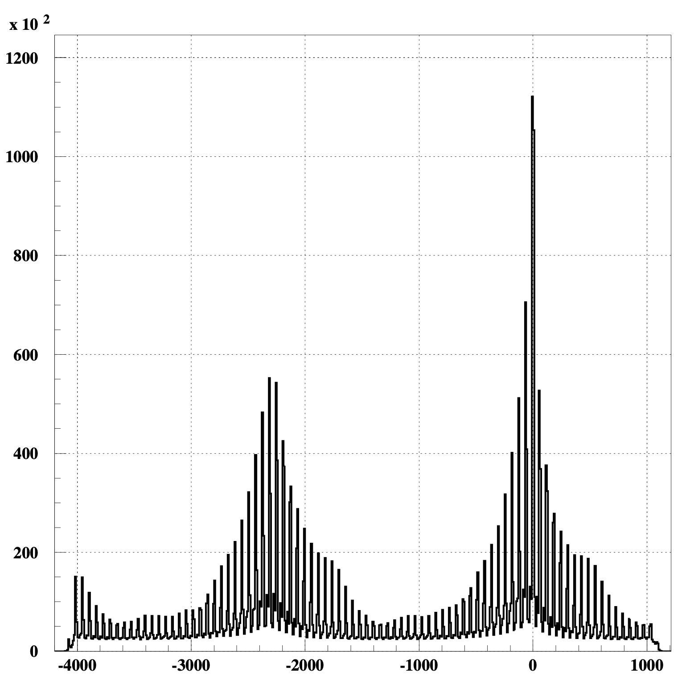
Coincidence analysis
without Si 5-10(with only 4 detectors of 1st-layer)
Si detectors
prompt peak
beam frequency = 1/60[ns⁻¹] →peak interval = 60[ns]
TDC → GR trigger - Si hit time [ns]
applied a gate from TDC (-20~20ns)
→coincidence analysis
subtract events (-80~-40&40~80ns) from events(-20~20ns)
TDC[ns]
Notes:
I checked Si detectors. I checked the time structure.
I apply TDC prompt peak’s gate to do the coincidence analysis of GR and Si.

Slide 8
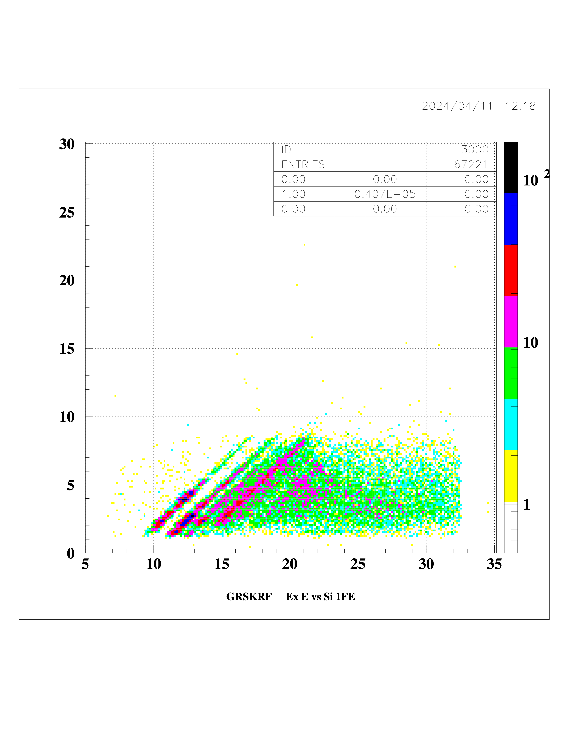
Coincidence analysis
Threshold energy(MeV)
 | proton | deuteron | alpha | neutron
²⁷Al | 8.3 | 17.1 | 10.1 | 13.1
correlations
²⁷Al
Si 1st-layer energy(MeV)
Excitation energy(MeV)
Notes:
This is a correlations between excitation energy and emmited charged particle’s energy.

Slide 9
Coincidence analysis
Threshold energy(MeV)
 | proton | deuteron | alpha | neutron
²⁷Al | 8.3 | 17.1 | 10.1 | 13.1
correlations
²⁷Al
punch through events
27Al(p,p’p)26Mgg.s.
Si 1st-layer energy(MeV)
Excitation energy(MeV)
Notes:
You can see proton decay events clearly and this part is panch through events.

Slide 10
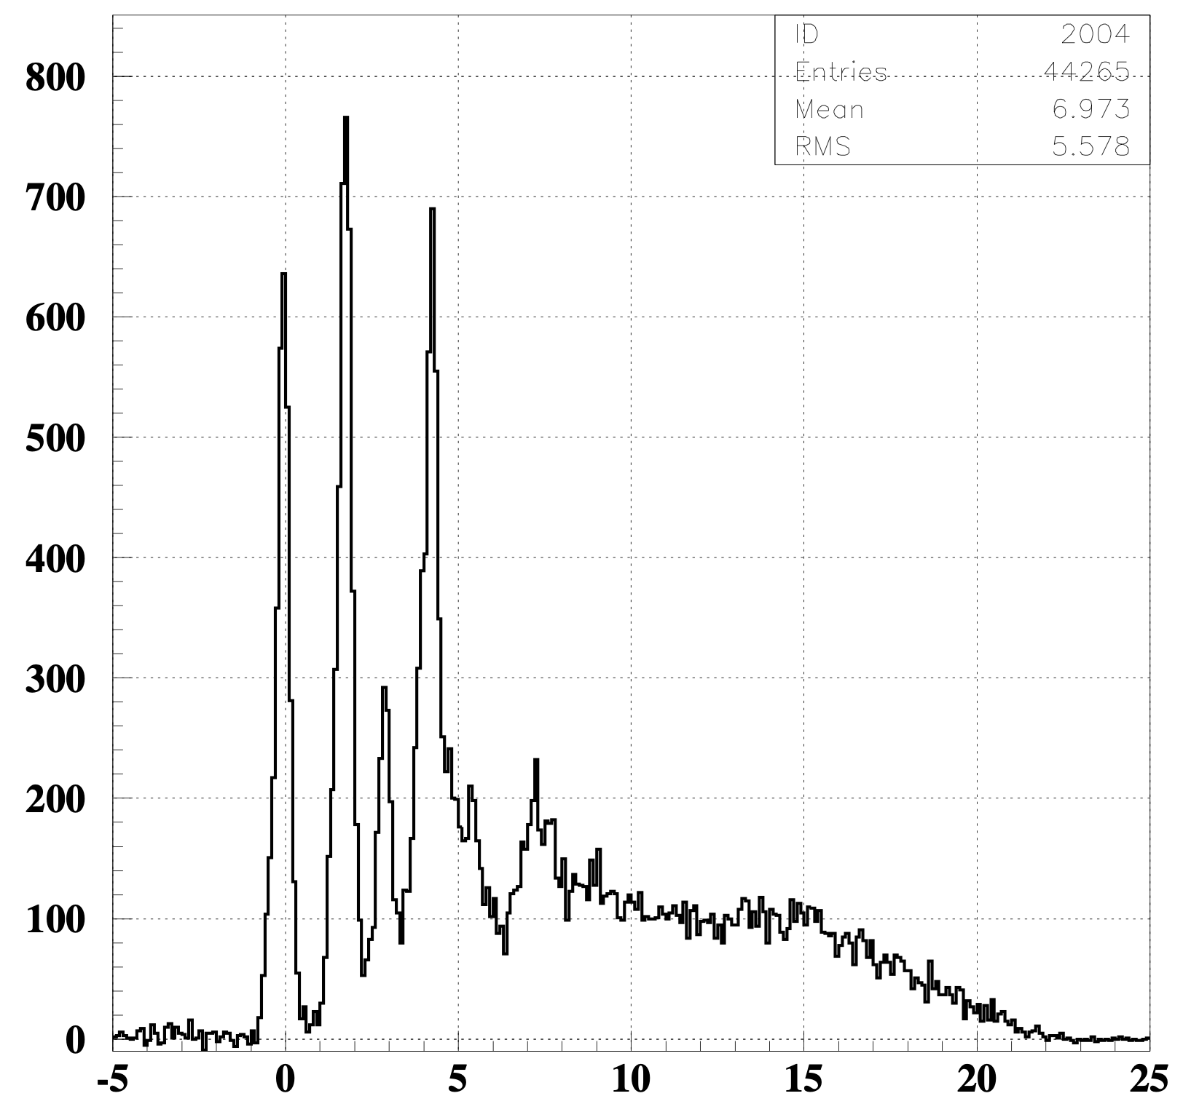
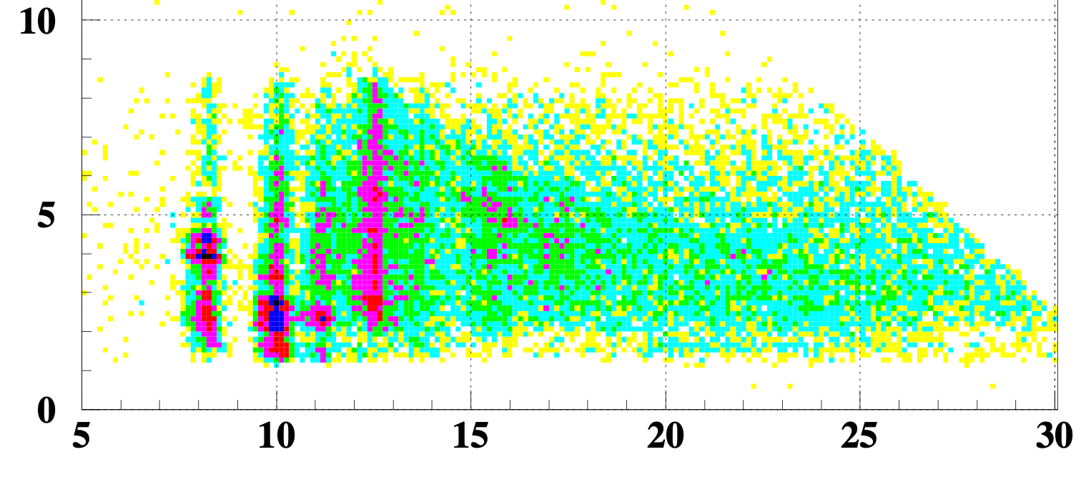
²⁷Al proton decay
excitation energy spectorum of ²⁶Mg
Counts/ch
Si 1f energy(MeV)
Si 1f energy(MeV)
(applied proton gate by Si and after background subtraction)
Excitation energy(MeV)
Si 1f energy(MeV)
Ex(MeV)
Threshold energy
Sp(MeV) (= Ex.E - 27/26*Si1f E)
Ex(²⁶Mg) = Ex(²⁷Al) - 27/26*Si E - 8.3(MeV)
Notes:
I changed the X axis to proton separation energy like this to make this proton decay events lines vertical.
and then project to x-axis.

Slide 11
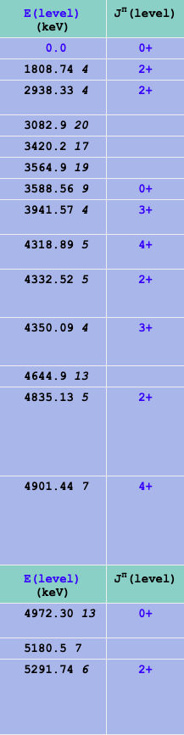
²⁷Al proton decay
²⁶Mg from nndc
excitation energy spectorum of ²⁶Mg
Counts/ch
Si 1f energy(MeV)
2+ (1.81MeV)
g.s.
Si 1f energy(MeV)
(applied proton gate by Si and after background subtraction)
mixed?
Excitation energy(MeV)
2+ (2.94MeV)
Si 1f energy(MeV)
Ex(MeV)
Threshold energy
Sp(MeV) (= Ex.E - 27/26*Si1f E)
Ex(²⁶Mg) = Ex(²⁷Al) - 27/26*Si E - 8.3(MeV)
Notes:
I changed the X axis to proton separation energy like this to make this proton decay events lines vertical.
and then project to x-axis.

Slide 12
Coincidence analysis
Threshold energy(MeV)
 | proton | deuteron | alpha | neutron
²⁷Al | 8.3 | 17.1 | 10.1 | 13.1
correlations
²⁷Al
27Al(p,p’α)23Na
punch through events
27Al(p,p’p)26Mgg.s.
Si 1st-layer energy(MeV)
Excitation energy(MeV)
Notes:
But alpha or deuteron decay is also expected, but these events are hiding behind proton decay events.
It needs to do particle identification by Si.

Slide 13
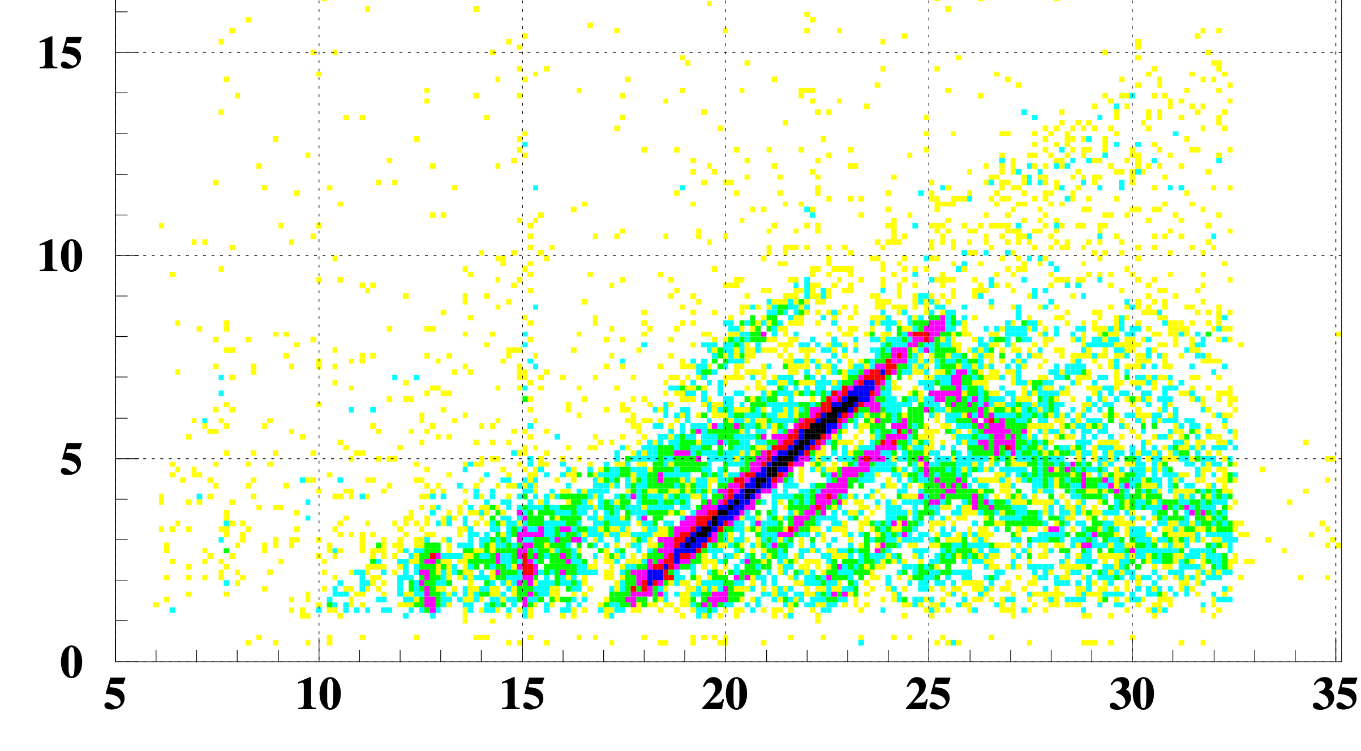
Coincidence analysis
Threshold energy(MeV)
 | proton | deuteron | alpha | neutron
²⁷Al | 8.3 | 17.1 | 10.1 | 13.1
¹²C | 16.0 | 25.2 | 7.4* | 18.7
correlations
12C
12C(p,p’p)11Bg.s.
punch through events
Si 1st-layer energy(MeV)
12C(p,p’α)8Be?
Ex(MeV)
Notes:
it needs to do particle identification by Si. )) I used a 12C data. Proton decay events and alpha decay events are separated in 12C correlation because of the threshold energy.

Slide 14
Coincidence analysis
Threshold energy(MeV)
 | proton | deuteron | alpha | neutron
²⁷Al | 8.3 | 17.1 | 10.1 | 13.1
¹²C | 16.0 | 25.2 | 7.4* | 18.7
particle’s identification at Si
12C
← S’ = Ex - 12/11* Si E = 15
alpha
12C
proton
12C(p,p’p)11Bg.s.
Si 1st-layer energy(MeV)
12C(p,p’α)8Be?
Ex(MeV)
Notes:
I made gates using this line. I defined this line as S’ and devide upper and lower parts. I apply upper gate and lower gate to Si’s E-TOF plot.

Slide 15
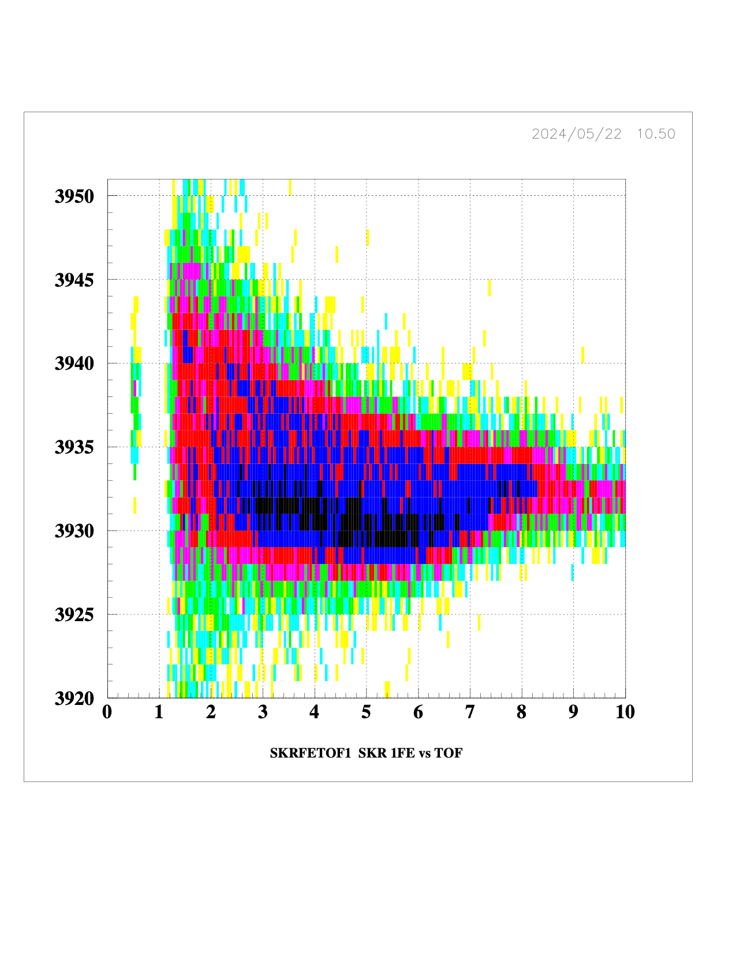
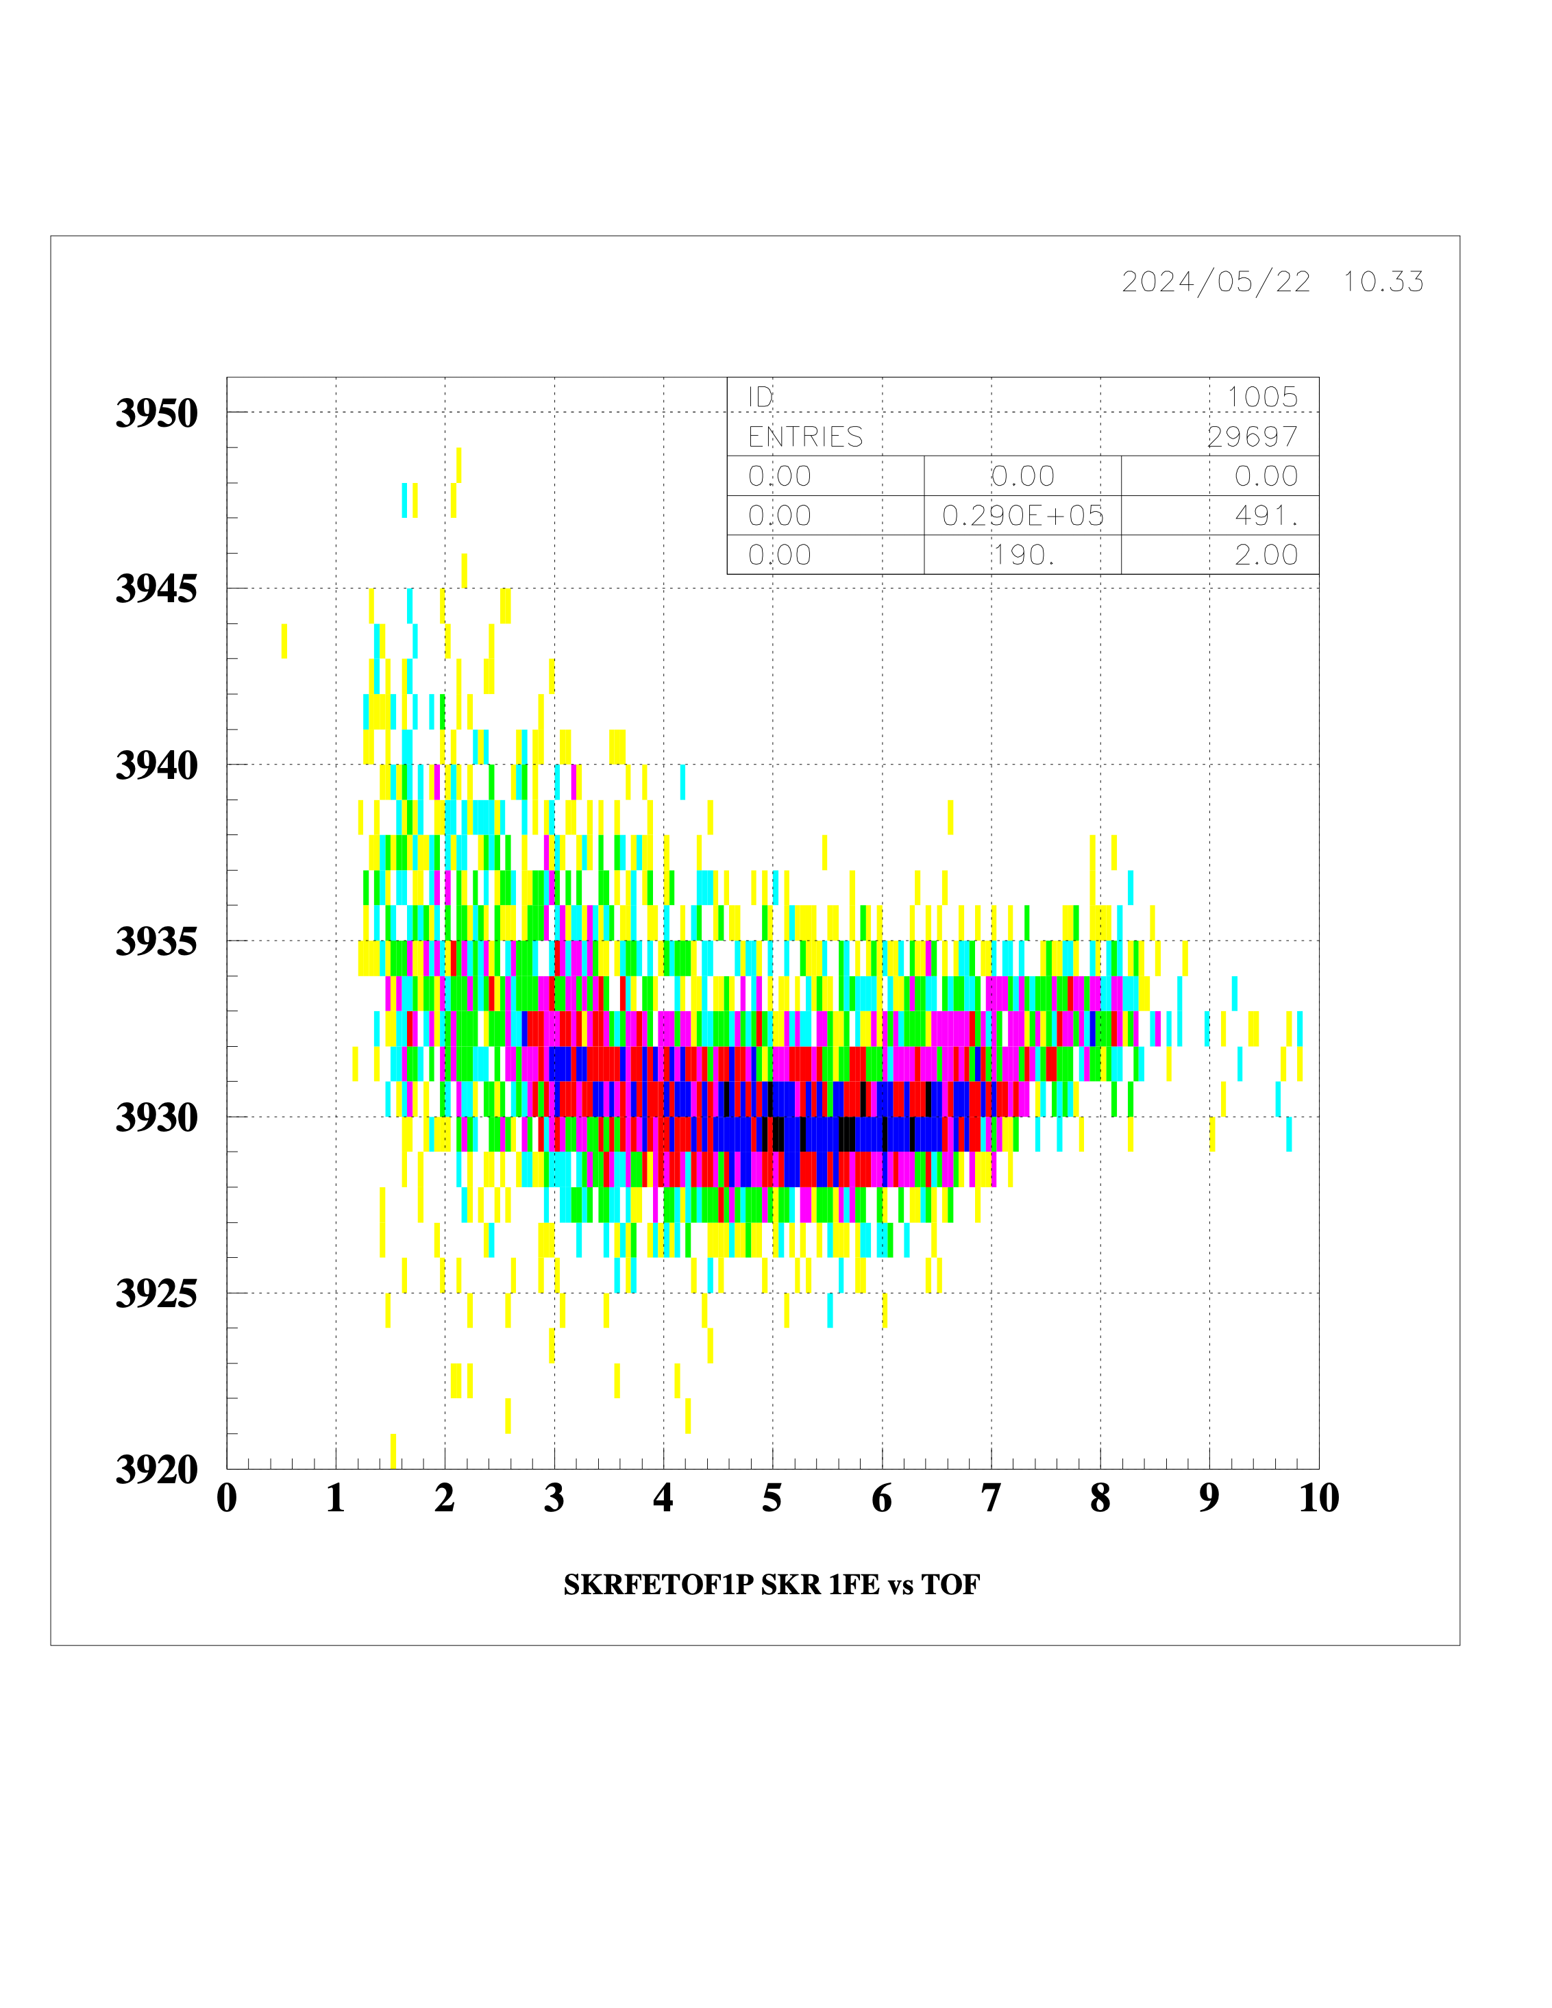
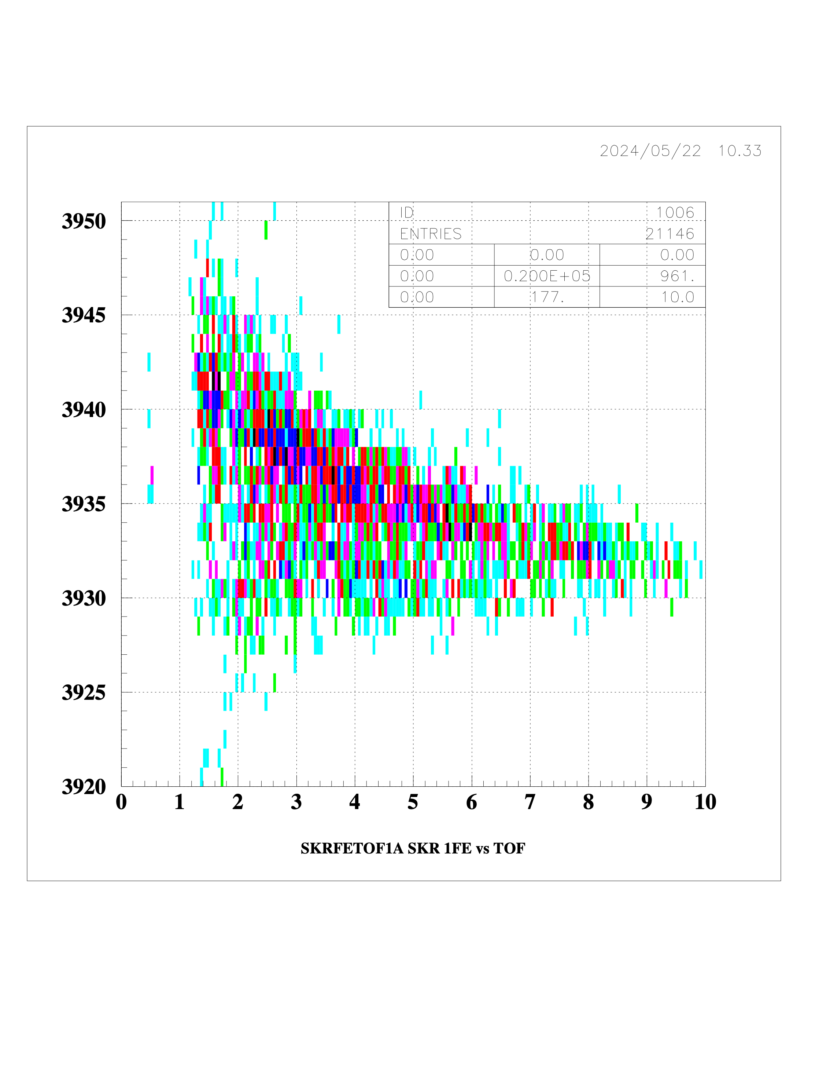
Particle identification
S’ =Ex E - 12/11* Si(1F) E
particle’s identification by E-TOF
TOF = RF signal - SAKRA hit timing (ns)
Si 1st-layer front side energy(MeV)
no gate
S’ > 15 (proton)
S’ < 15 (alpha)
Notes:
they are e-tof plot. x-axis is energy. y-axis is time of flight. left one is E-TOF plot without any gate. Center one is lower part as proton side. Right one is upper part as an alpha side.

Slide 16
TOF[ns]
S’ > 15 (proton)
S’ < 15 (alpha)
alpha
proton
t≡0.375e²-3.75e+17 (mod 30)
t=TOF[ns], e=Energy[MeV]
Energy[MeV]
Notes:
I separate the decay events by quadratic curve,

Slide 17
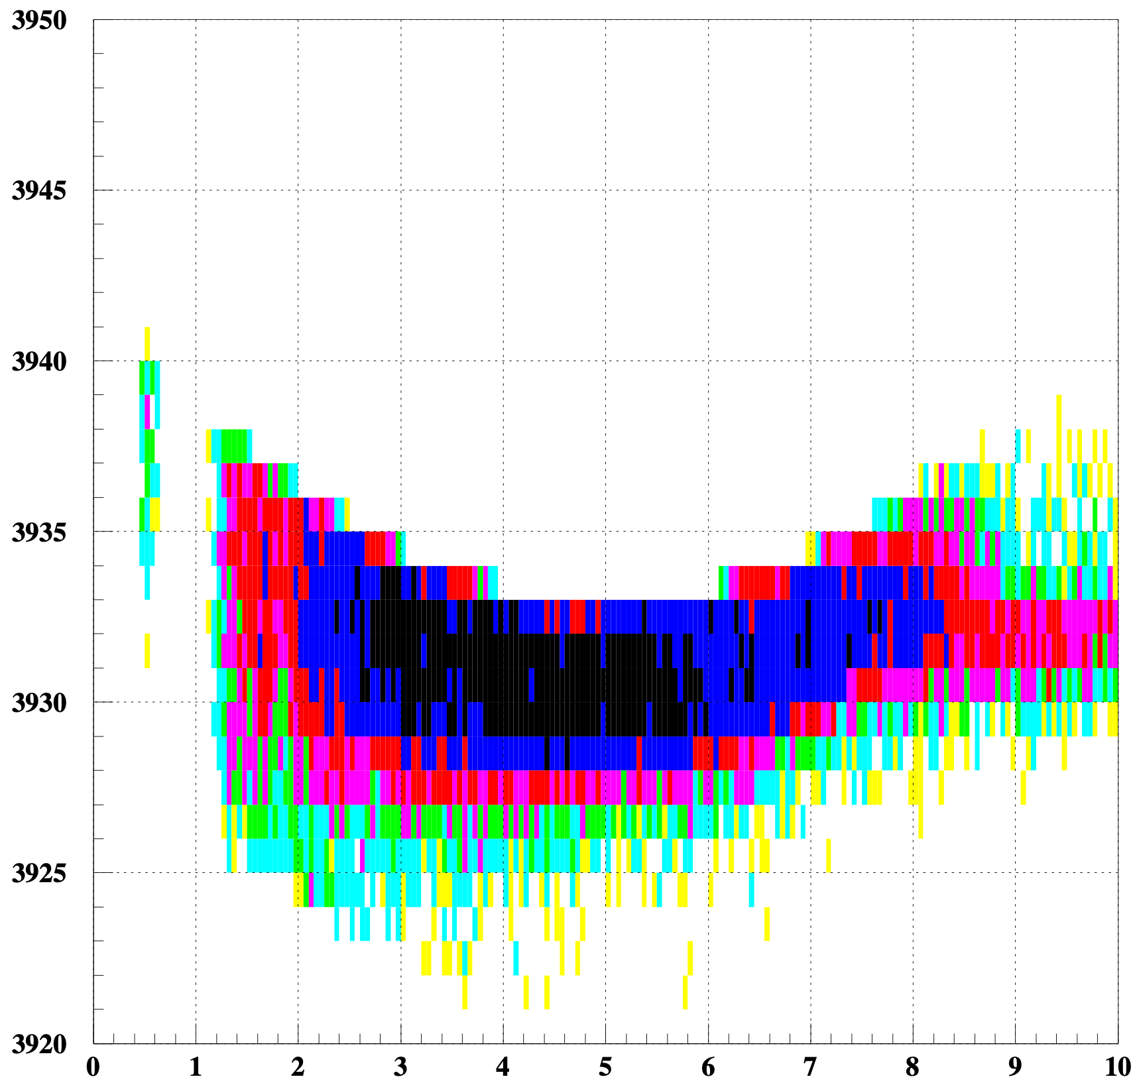
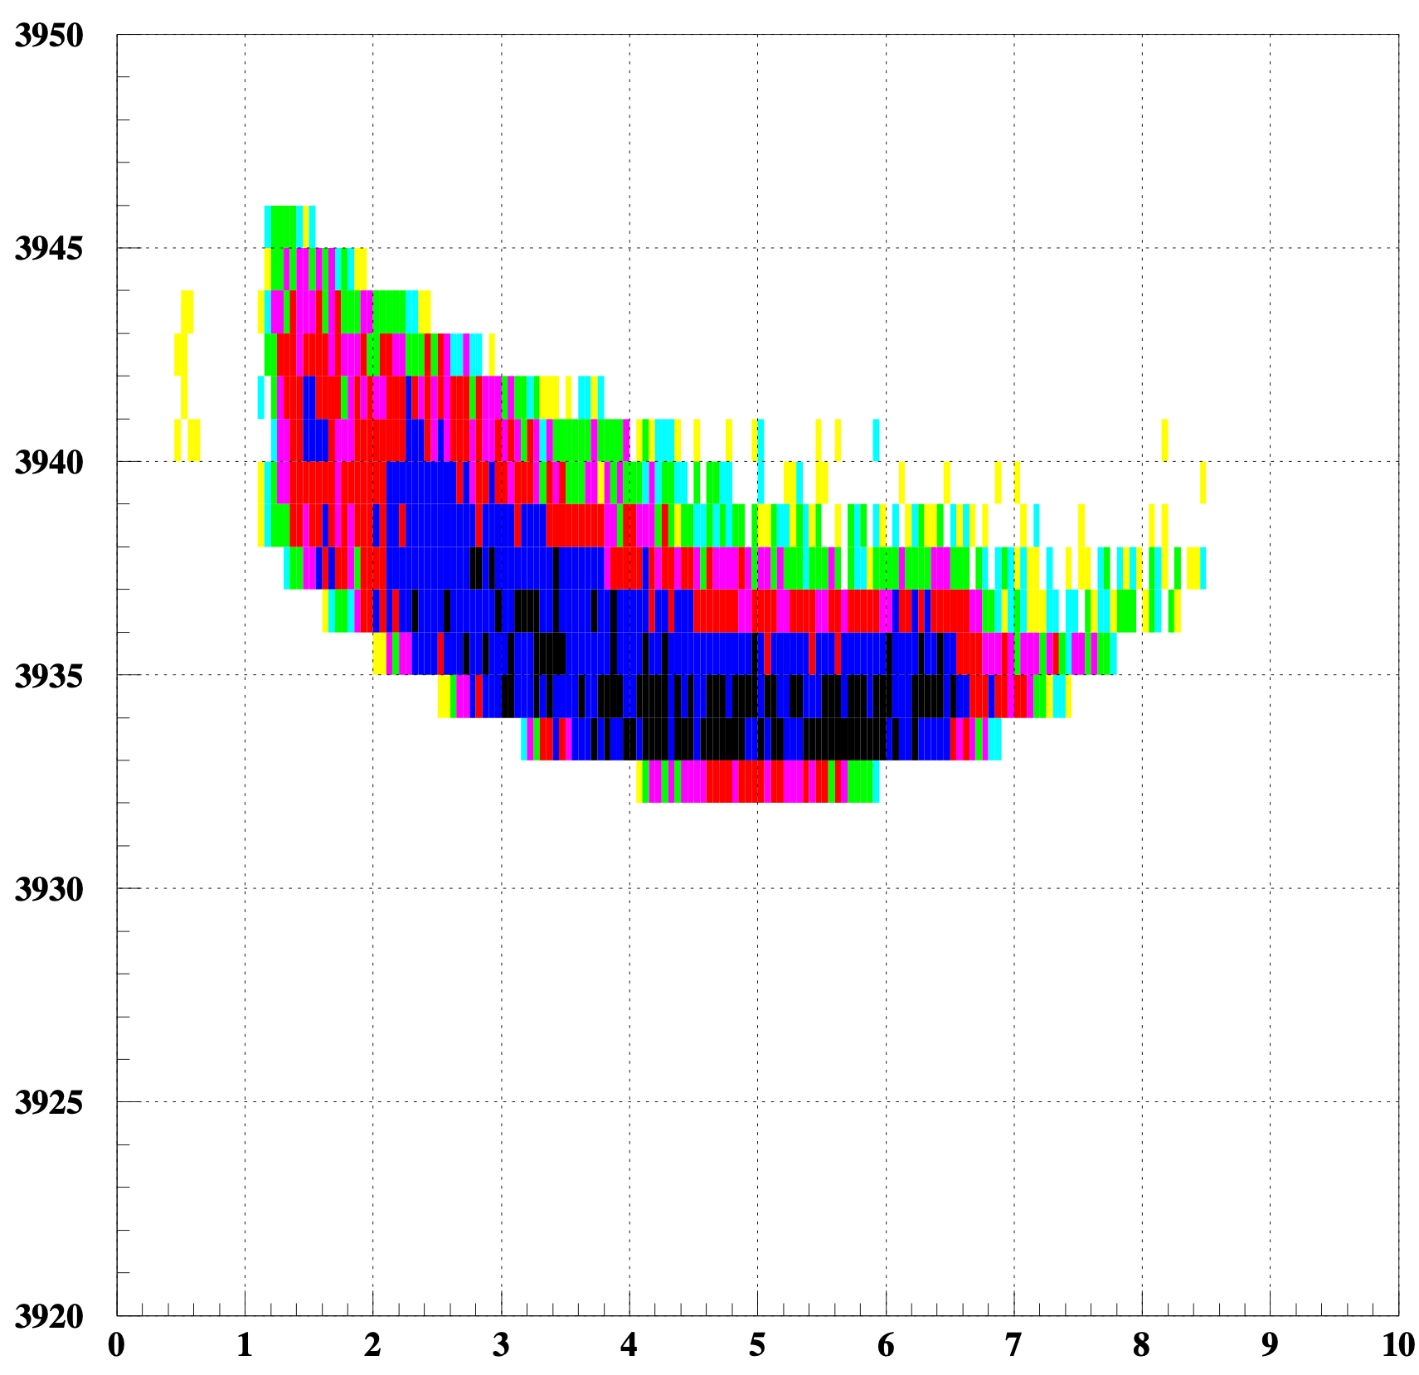
TOF[ns]
proton events
alpha events
Energy[MeV]
Notes:
I apply these gates to 27Al events. and then counted up them using GR

Slide 18
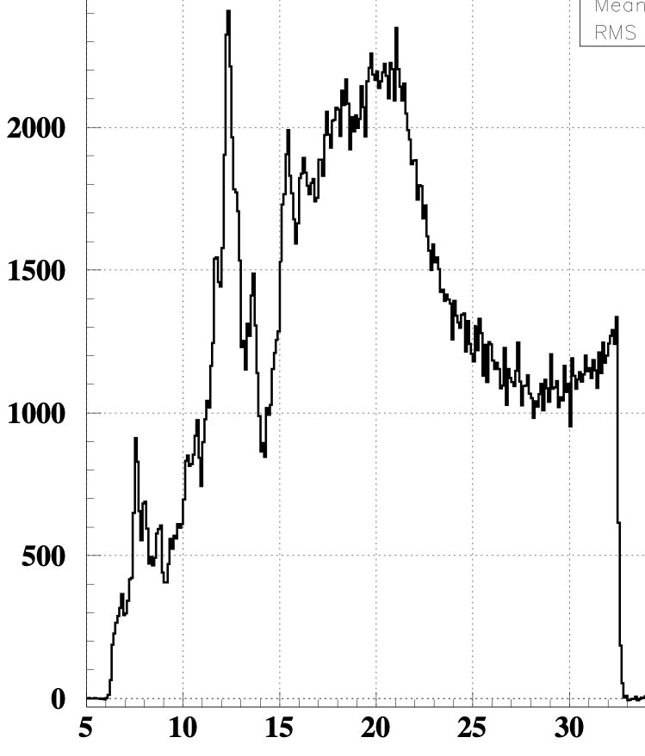
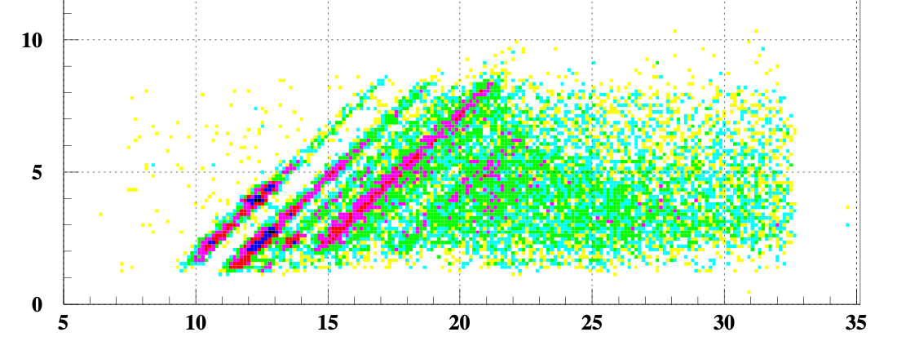
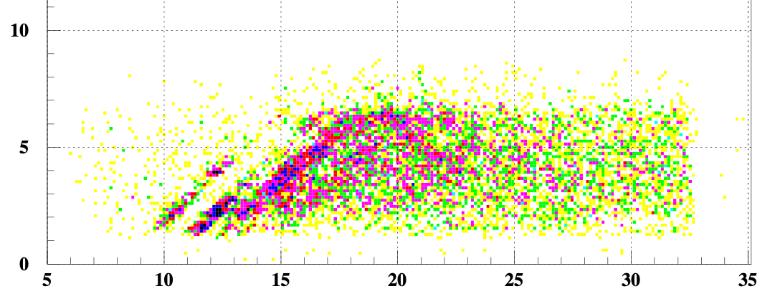
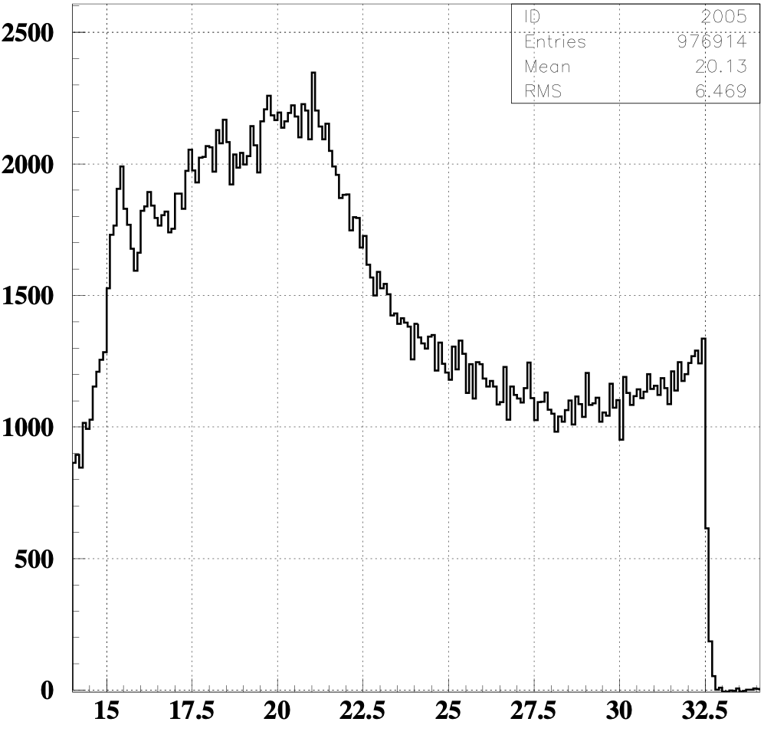
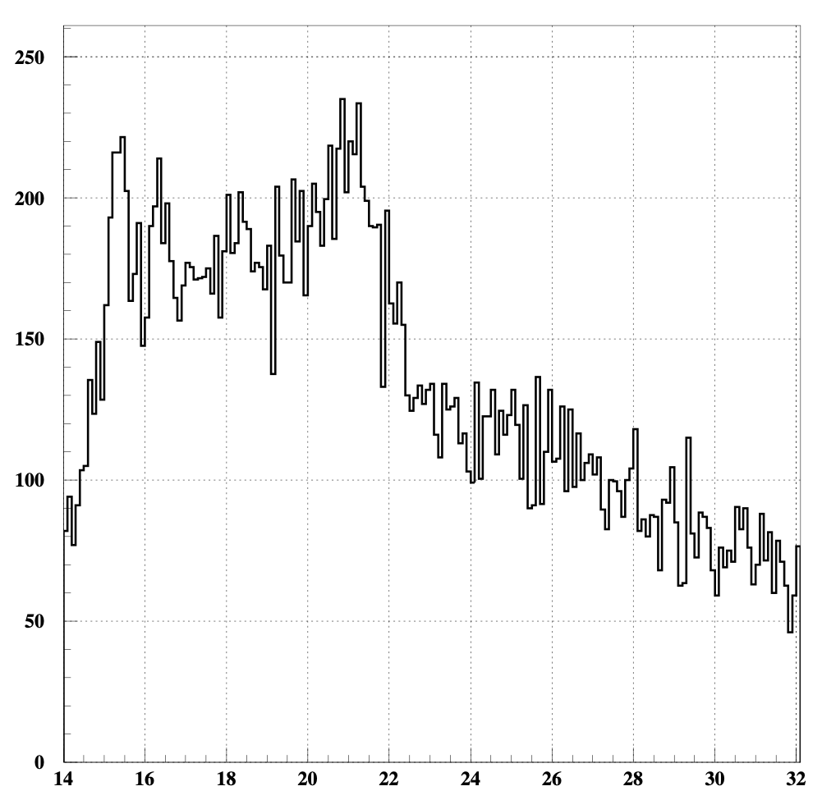
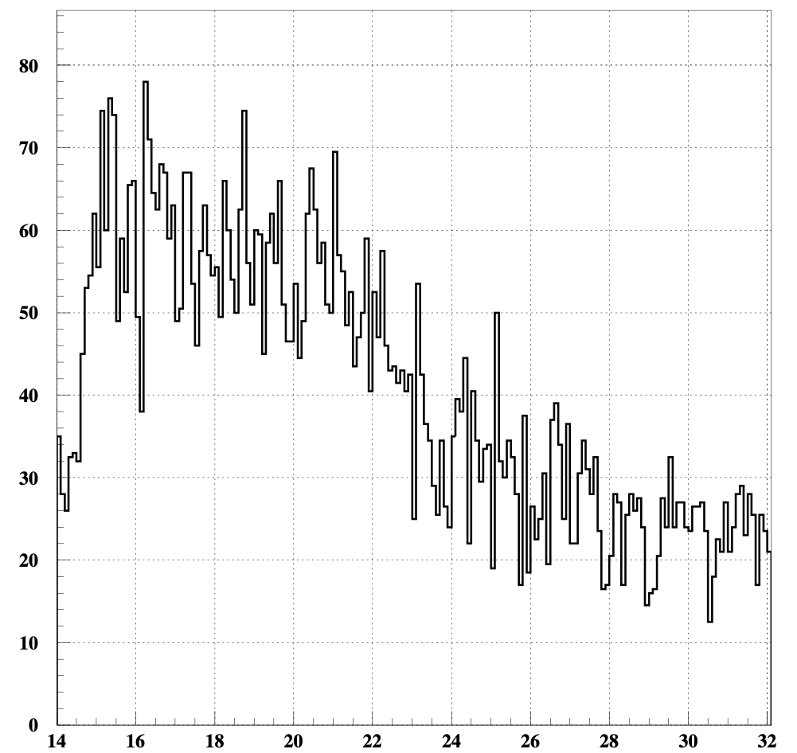
²⁷Al decay channel
Excitation energy(MeV) vs count/ch
proton decay
alpha decay
Si energy(MeV)
all events Ex→14~33MeV
Excitation energy(MeV)
Excitation energy(MeV)
Notes:
I calculated with only GDR part from 14MeV to 33MeV.
checked the correlations and project to x-axis and counted up the events in excitation energy

Slide 19
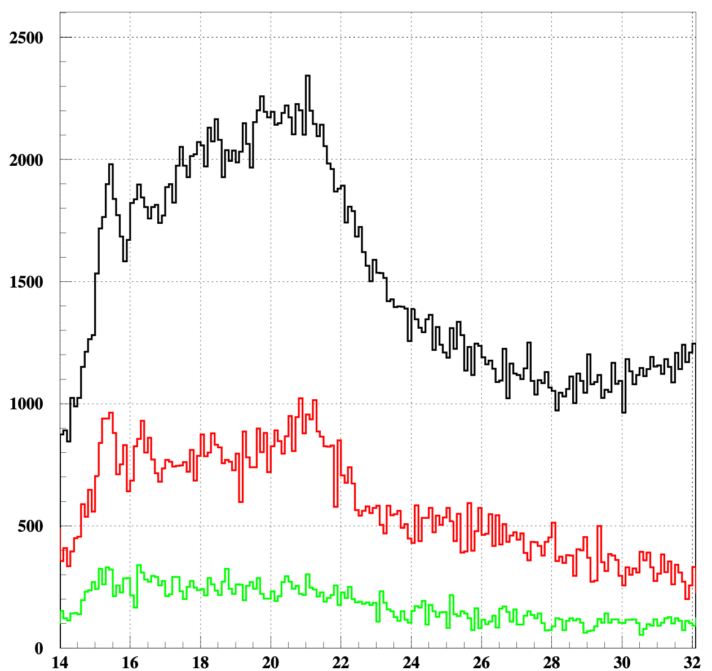
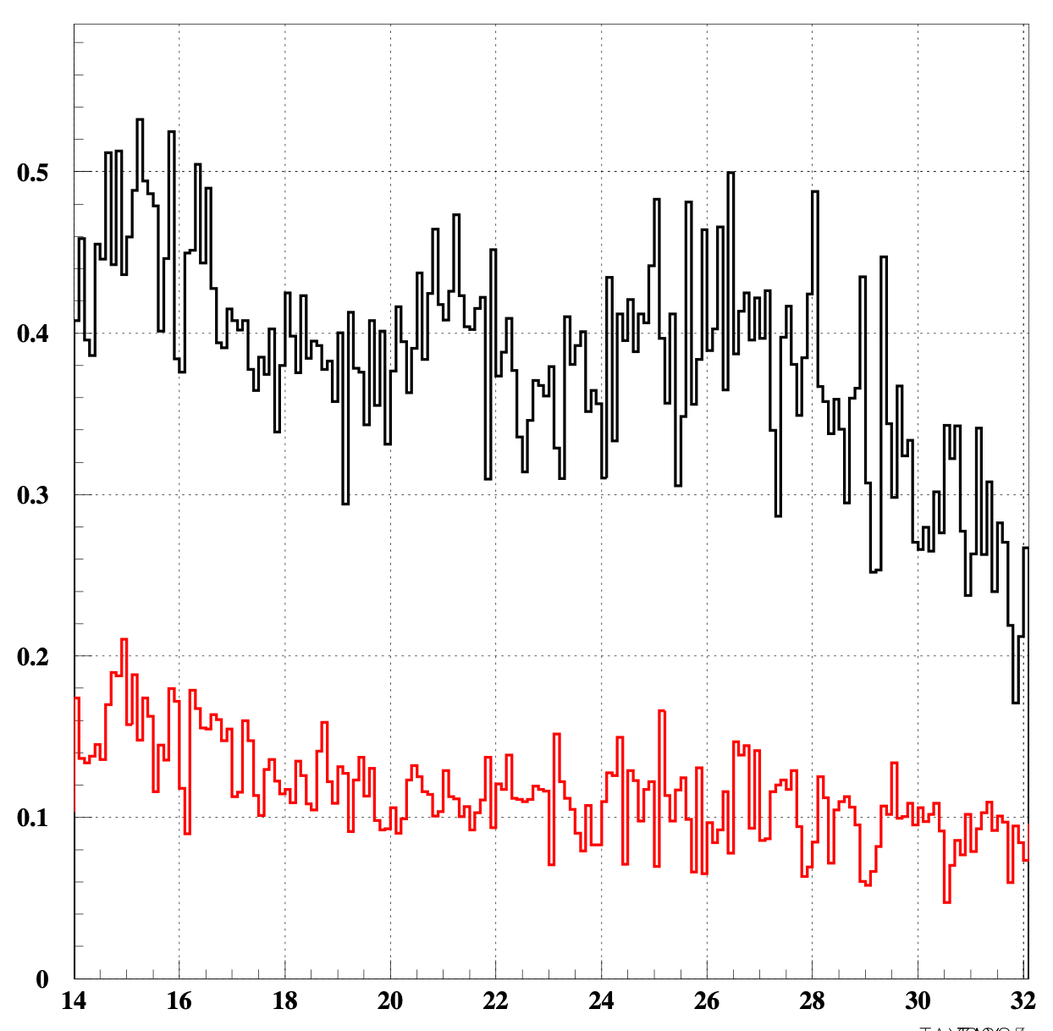
Preliminary results of ²⁷Al
 | all | p-decay | alpha-decay
²⁷Al (14<Ex.E(MeV)<33) | 280353.5 | 24657.5 | 7482.5
effeciency〜0.23
count/bin
branching ratio
black: all red:proton green:alpha
p~38.2%
α~11.6%
black: proton red: alpha
#preliminary
Ex (MeV)
Ex (MeV)
Notes:
This is a preliminaly results of 27Al. proton decay is about 38.2% and alpha decay is about 11.6%. The remaining events should be deuteron decay and neutron decay. especially, deuteron decay can be expected, but we could not identify them.

Slide 20
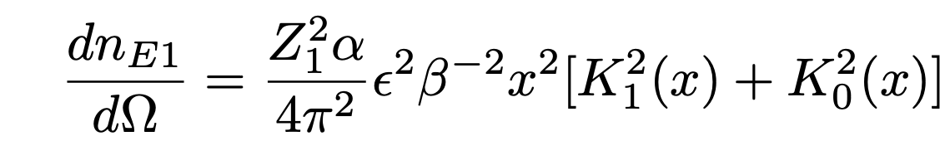

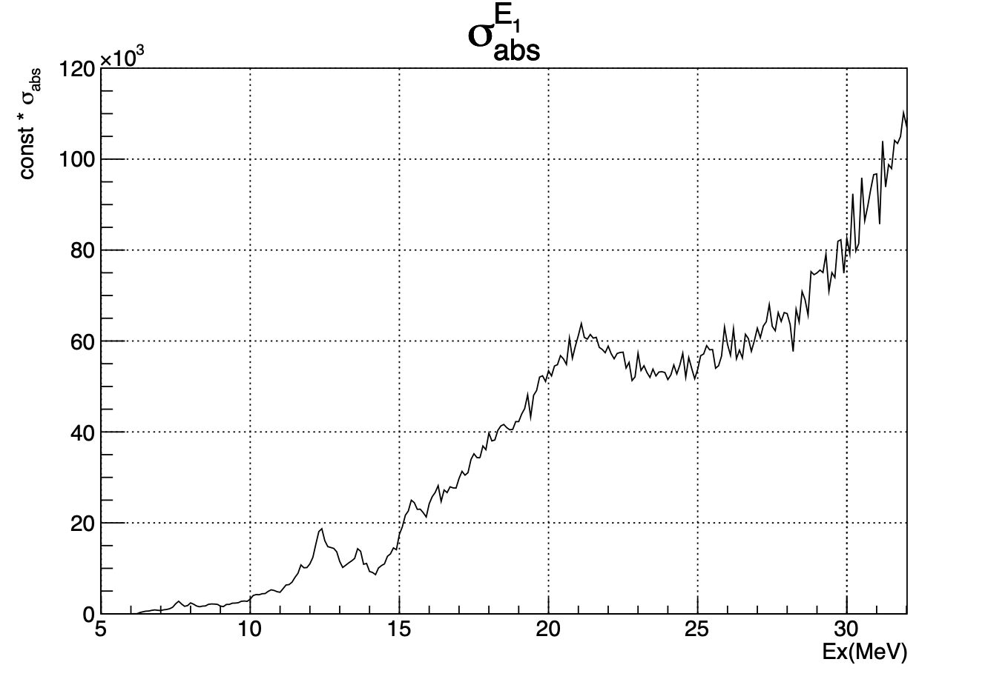
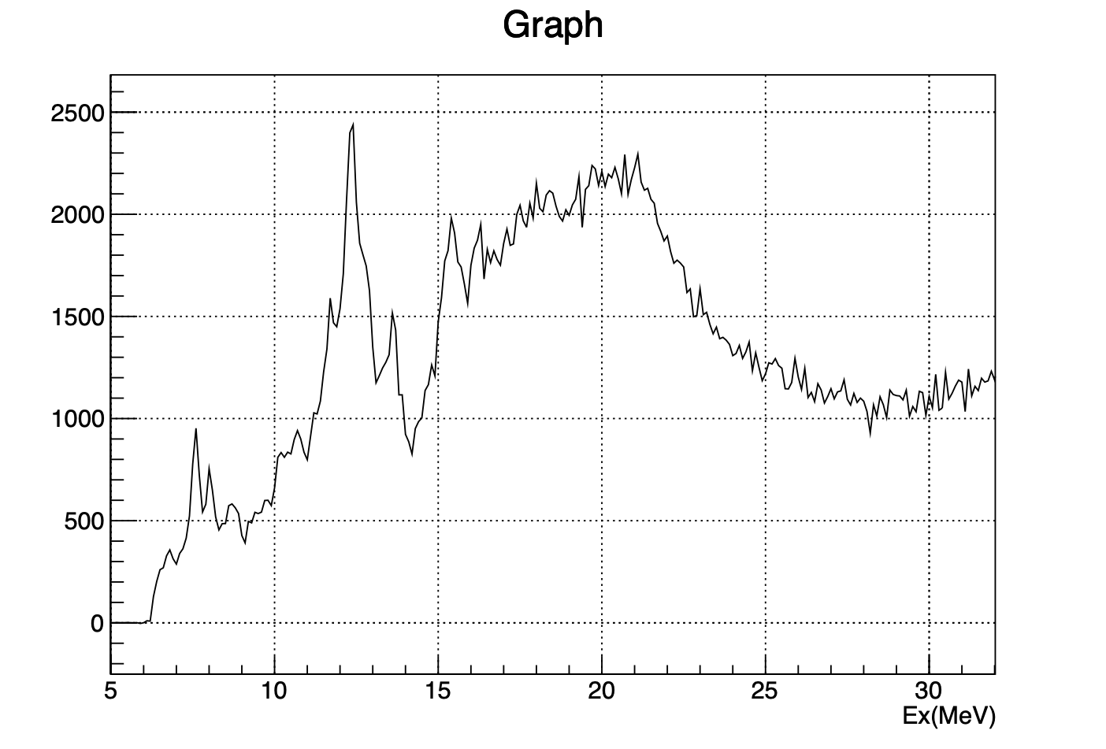
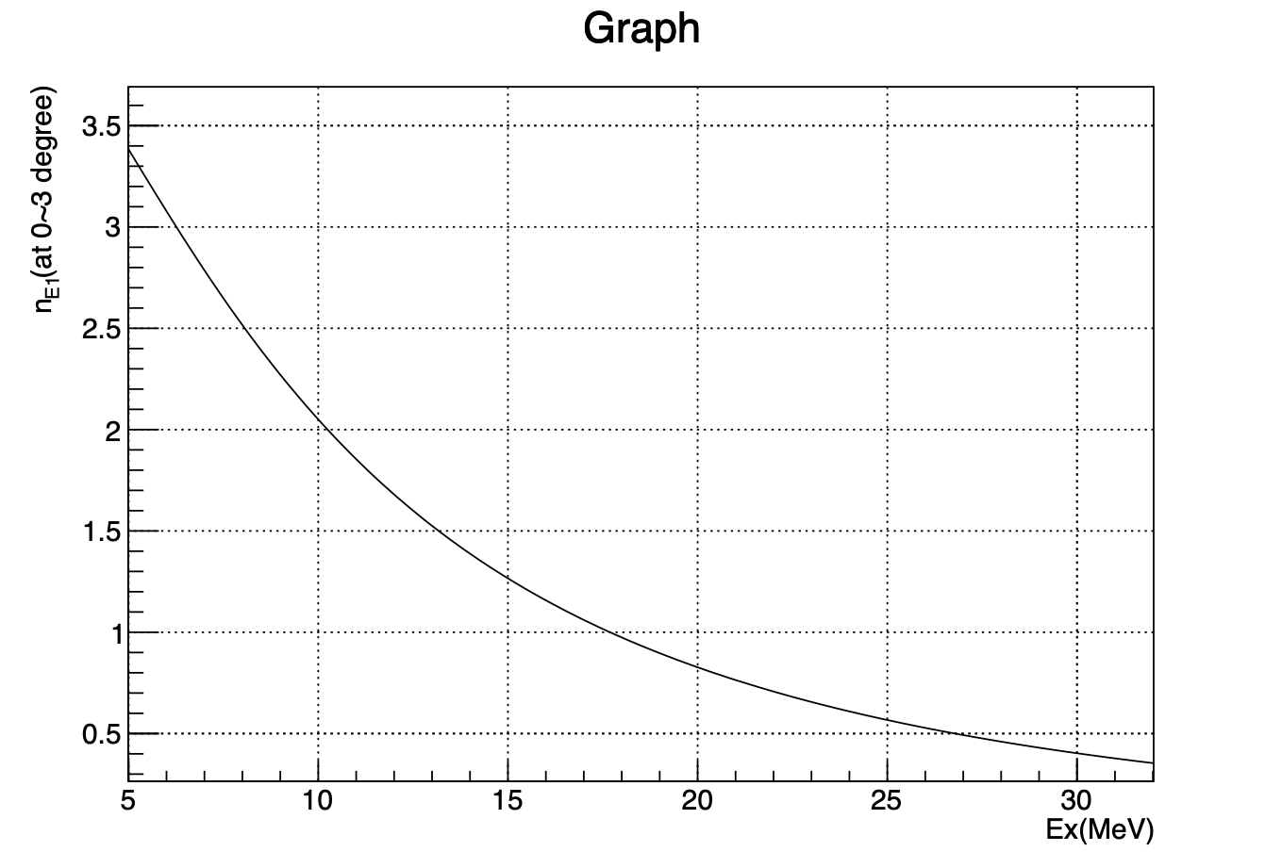
preliminary photo absorption cross section
σabs = Ex ———
integrated over ∆Ω (θ:0~3°, 4msr)
∝ count/eV
/
=
*Ex
#before multipole decomposition
Eikonal calculations (sum of θ=0~3°)
calculated σabs at each energy (the interval is 0.1MeV)
Notes:
I also calculated the photo absorption cross section.
I converted E1 coulumb excitation cross section to photo absorption cross section using equivalent photon number = nE1. E1 coulumb excitation cross section is proportional to excitation energy spectrum of E1 reaction. GR was covered 0 to 3 degree, so integrated equivarent photon number over this solid angle. and then devided defferencial cross section by equivarent photon number. This is a photo absorption cross section of 27Al.

Slide 21
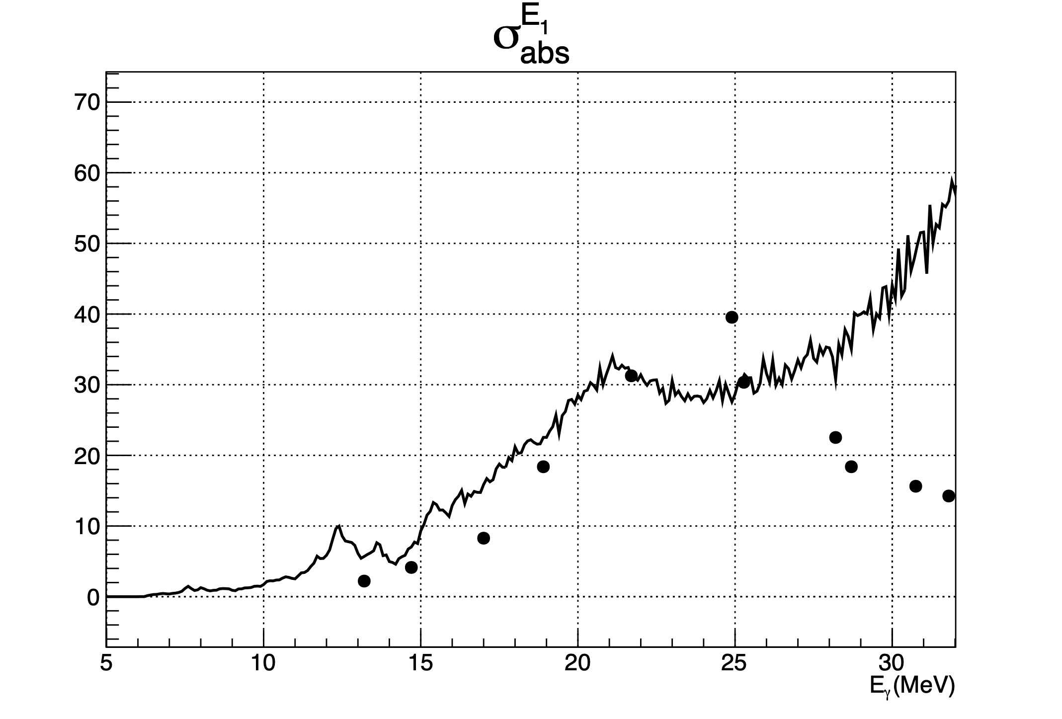
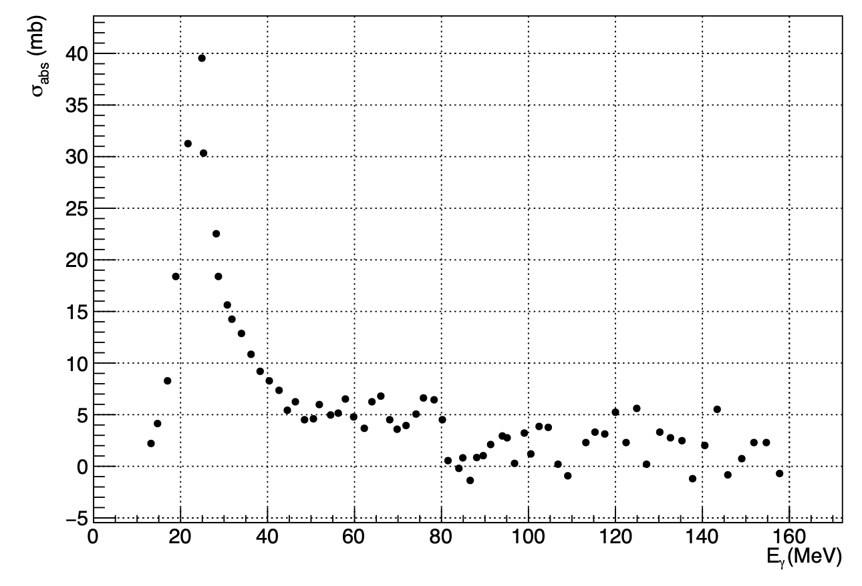
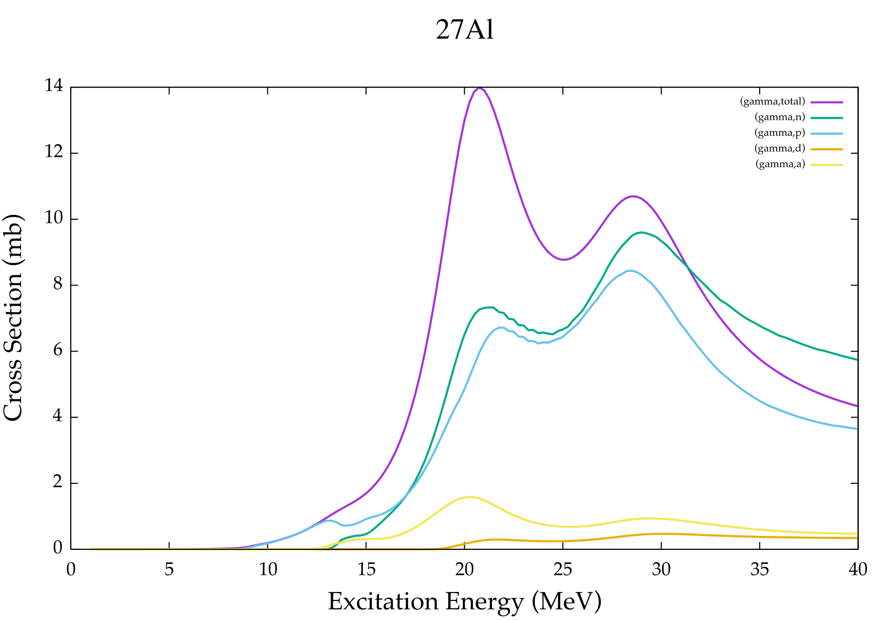
Comparison with data and prediction
Experiment data @ Mainz
make this point match.(21.7MeV)
arbitrary
Talys calculation
total
p
it includes other rections than E1
α
Notes:
I compared with Talys prediction and Experimental data in Mainz.
left specrum’s vertical axis is arbitrary, so made this 21.7MeV data point match and compare them.
peak points are different, I can’t make conclusion. but excitation spectrum included other events than E1 reactions. The result will get better. also in branching ratio calculation.
That’s all.

Slide 22
Future work
To identify charged particles precisely. (while taking into account position dependence?)
To calculate absolute cross section and compare with the Mainz’s data.
To calculate photo absorption cross section from only the E1 reaction by multipole decomposition after checking anglar distribution. (analysis data at 4.5 & 6.6-degrees and sieve-slit)

Slide 23
Summary
The intergalactic reactions of UHECRs are reproduced by (p, p’) reactions.
I measured the photo-nuclear reaction and particle emission from giant dipole resonance
I did the coincedence analysis of GR and Si.
・calculated the branching ratio (proton and alpha decay) of ²⁷Al preliminary. ・converted defferential cross section to the photo absorbtion cross section of ²⁷Al.
Thank you for your attention

Slide 24
backups

Slide 25
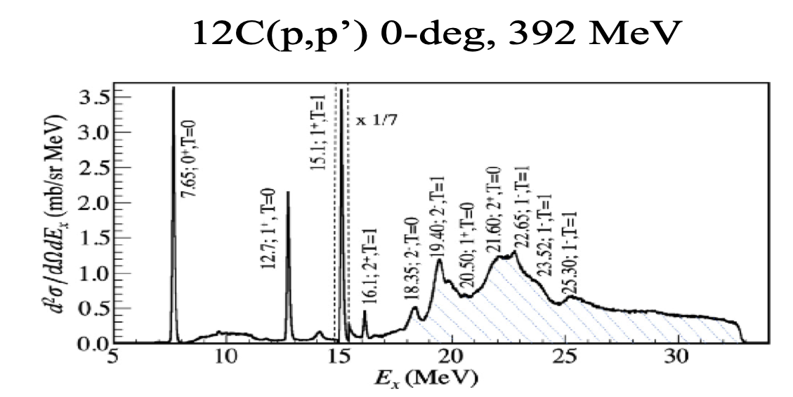
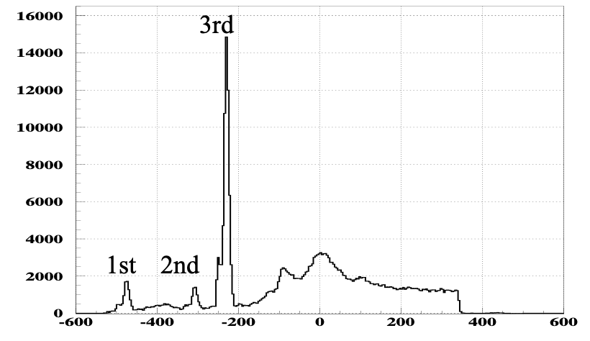
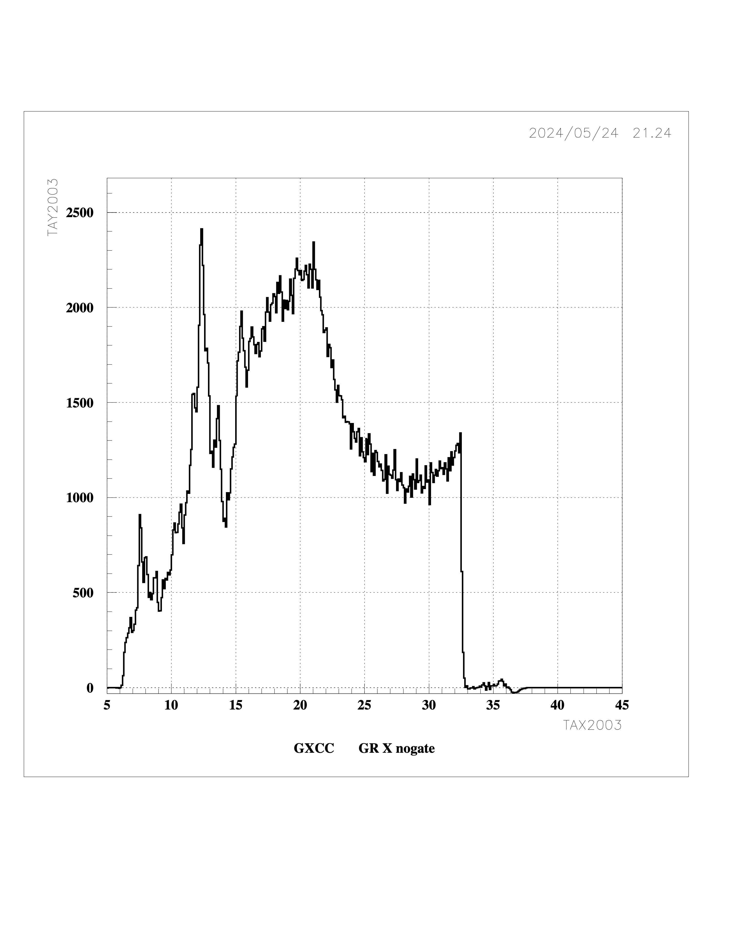
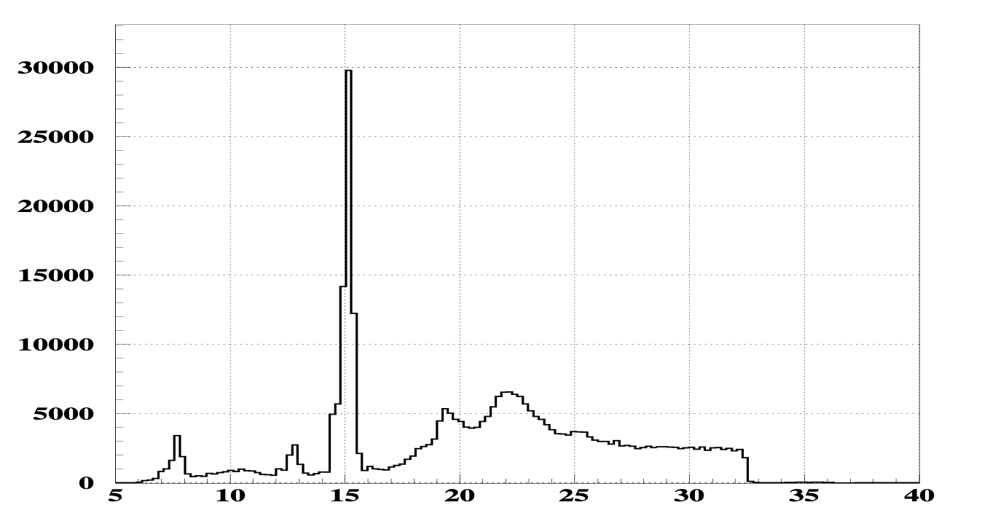
Analysis
only 0-degree data.
depends on each magnetic field
excitation energy calibration
Excitation energy spectrum of ²⁷Al
1⁺
Hoyle state
mm
count/ch
MeV
Ex(MeV)
Notes:
I analysed Grand raiden. x axis is correspond to excitation energy. it is calibrated using 12C data.
This is 27Al excitation energy spectrum

Slide 26
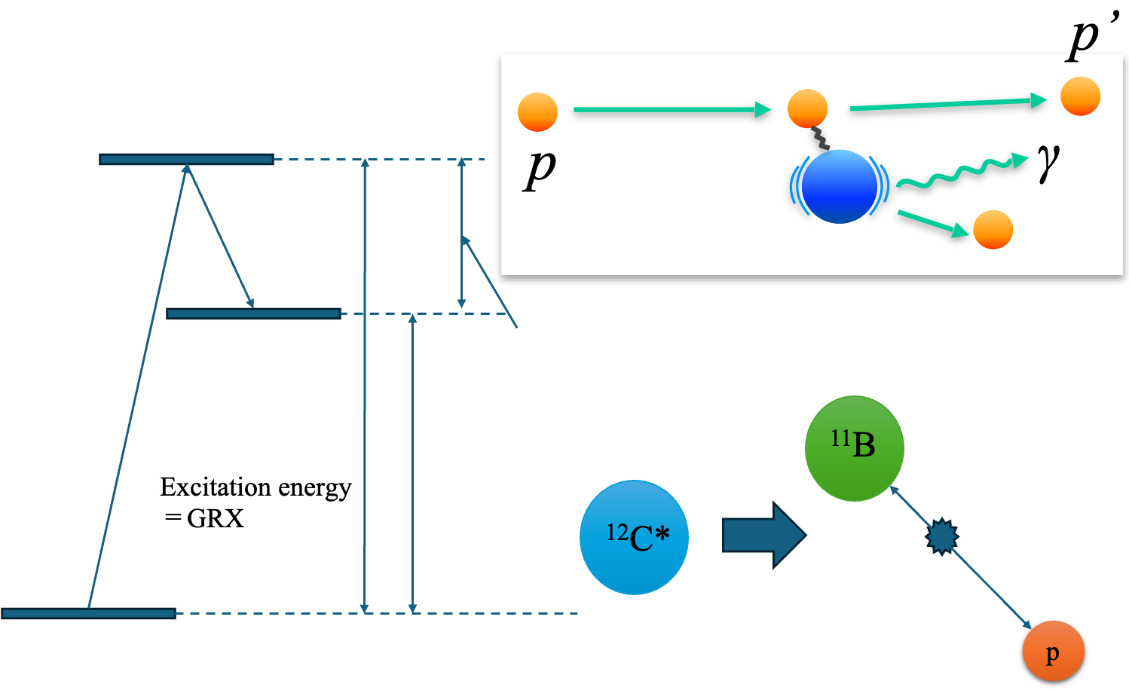
Analysis
²⁷Al*
K
²⁶Mg+p
∝Ep
Ex(Mg) (+1/A*K)
Separation energy(S)
Ex=Eγ
²⁶Mg
K
²⁷Al*
²⁷Al g.s.
Eγ=S+K=S+27/26*Ep
Ep=(A-1)/A*K

Slide 27
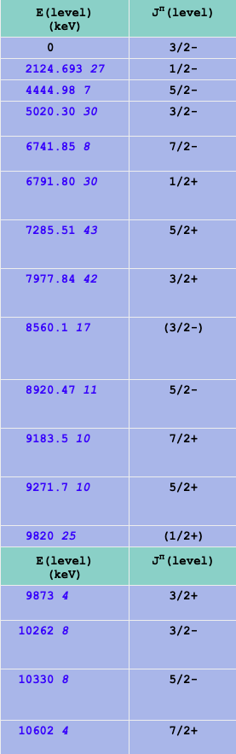
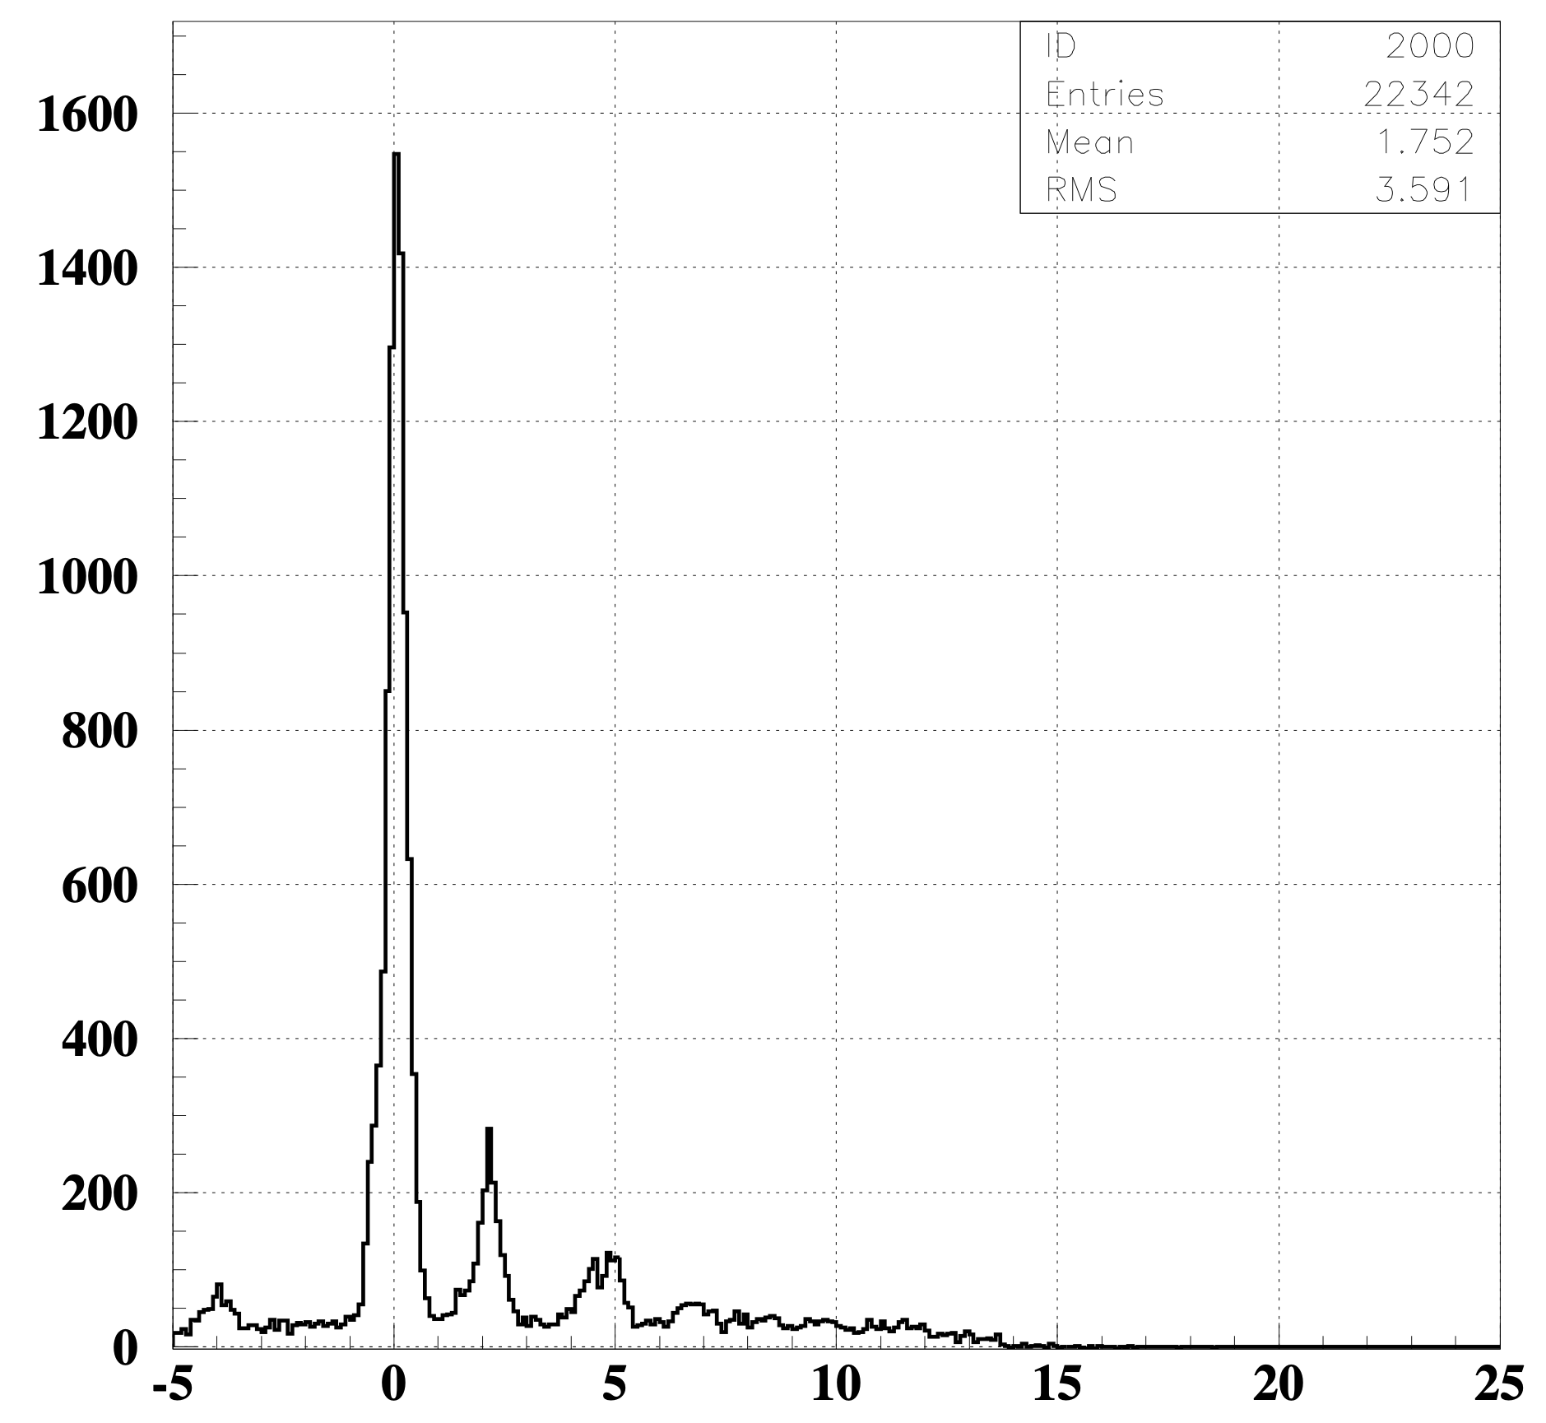
¹¹B from NNDC
¹²C proton decay
excitation spectorum of ¹¹B
Counts/ch
g.s.
Ex(¹¹B) = Ex(¹²C) - 12/11*Si E - 16.0(MeV) (applied proton gate using Si and after background subtraction)
1/2- (2.124693MeV)
5/2-(4.44498MeV) & 3/2-(5.02030MeV)
Ex(MeV)

Slide 28
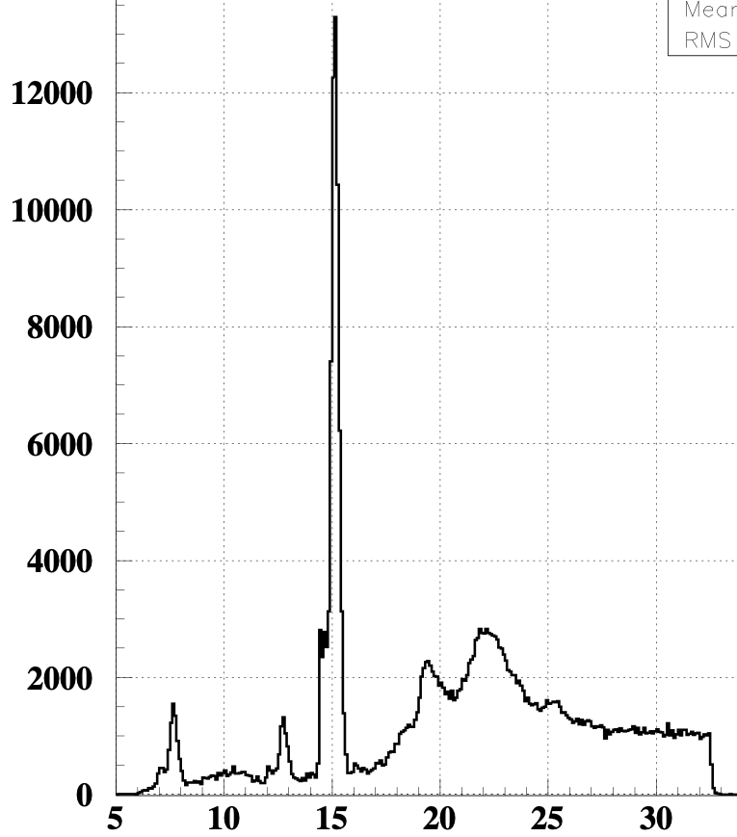
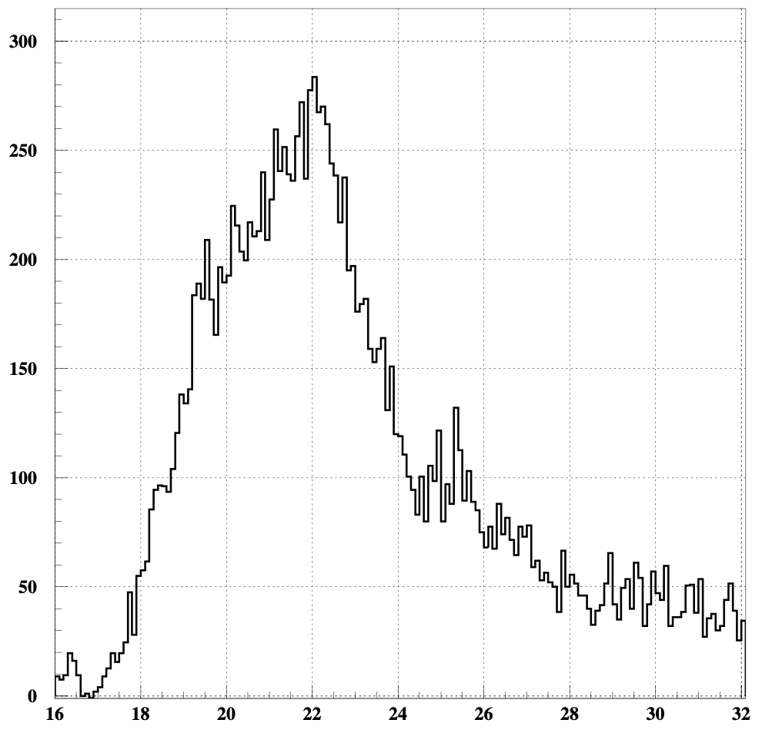
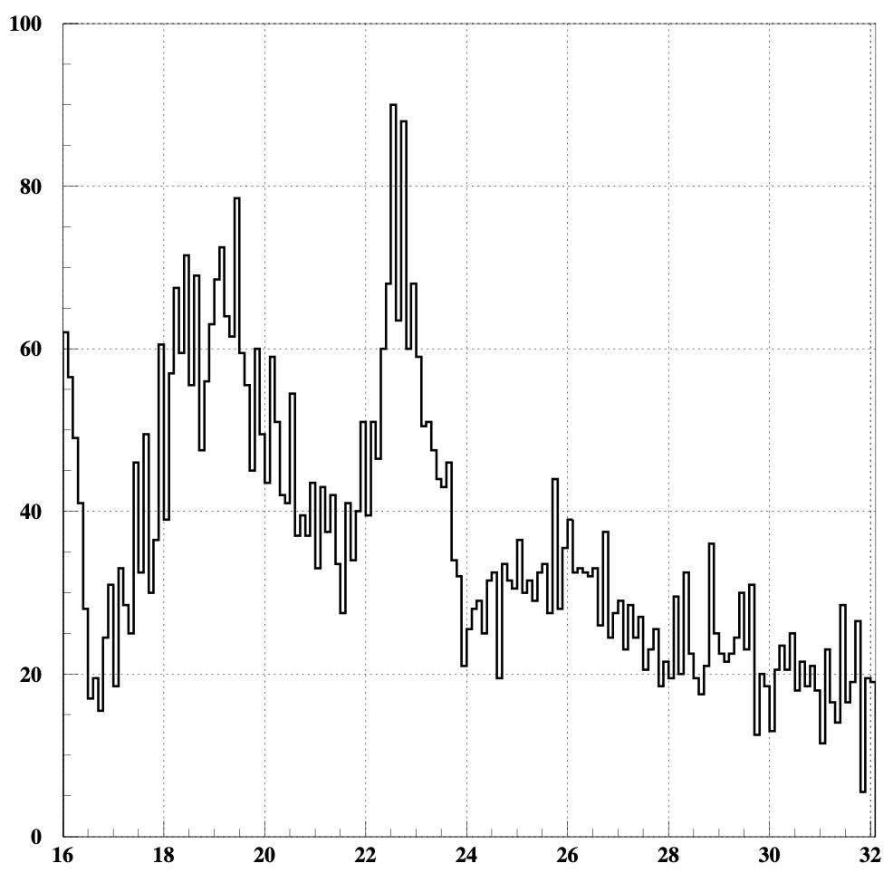
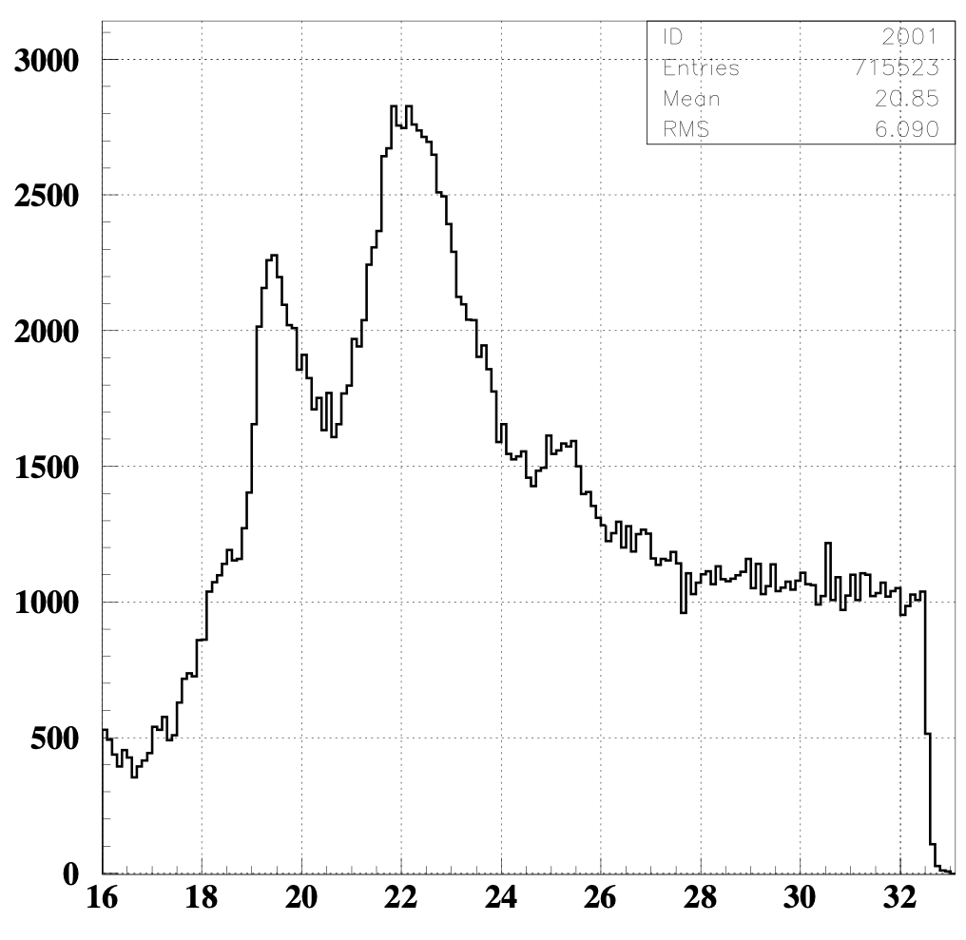
¹²C decay channel
Excitation energy(MeV) vs count/ch
all events 16MeV<Ex
proton decay
alpha decay

Slide 29


¹²C
 | all | proton | alpha
¹²C (16<Ex.E(MeV)<33) | 232210.0 | 16651.0 | 5922.0
effeciency〜0.23 (=4 Si detectors solid angle/4π)
¹²C → p:31.2% α:11.1%
count/bin
branching ratio
Ex (MeV)
Ex (MeV)

Slide 30


Slide 31
GR
p’
(p,p’)
Si
γ
p,α,d..
p
E
γ
²⁷Al*→ decay

