Slide 1
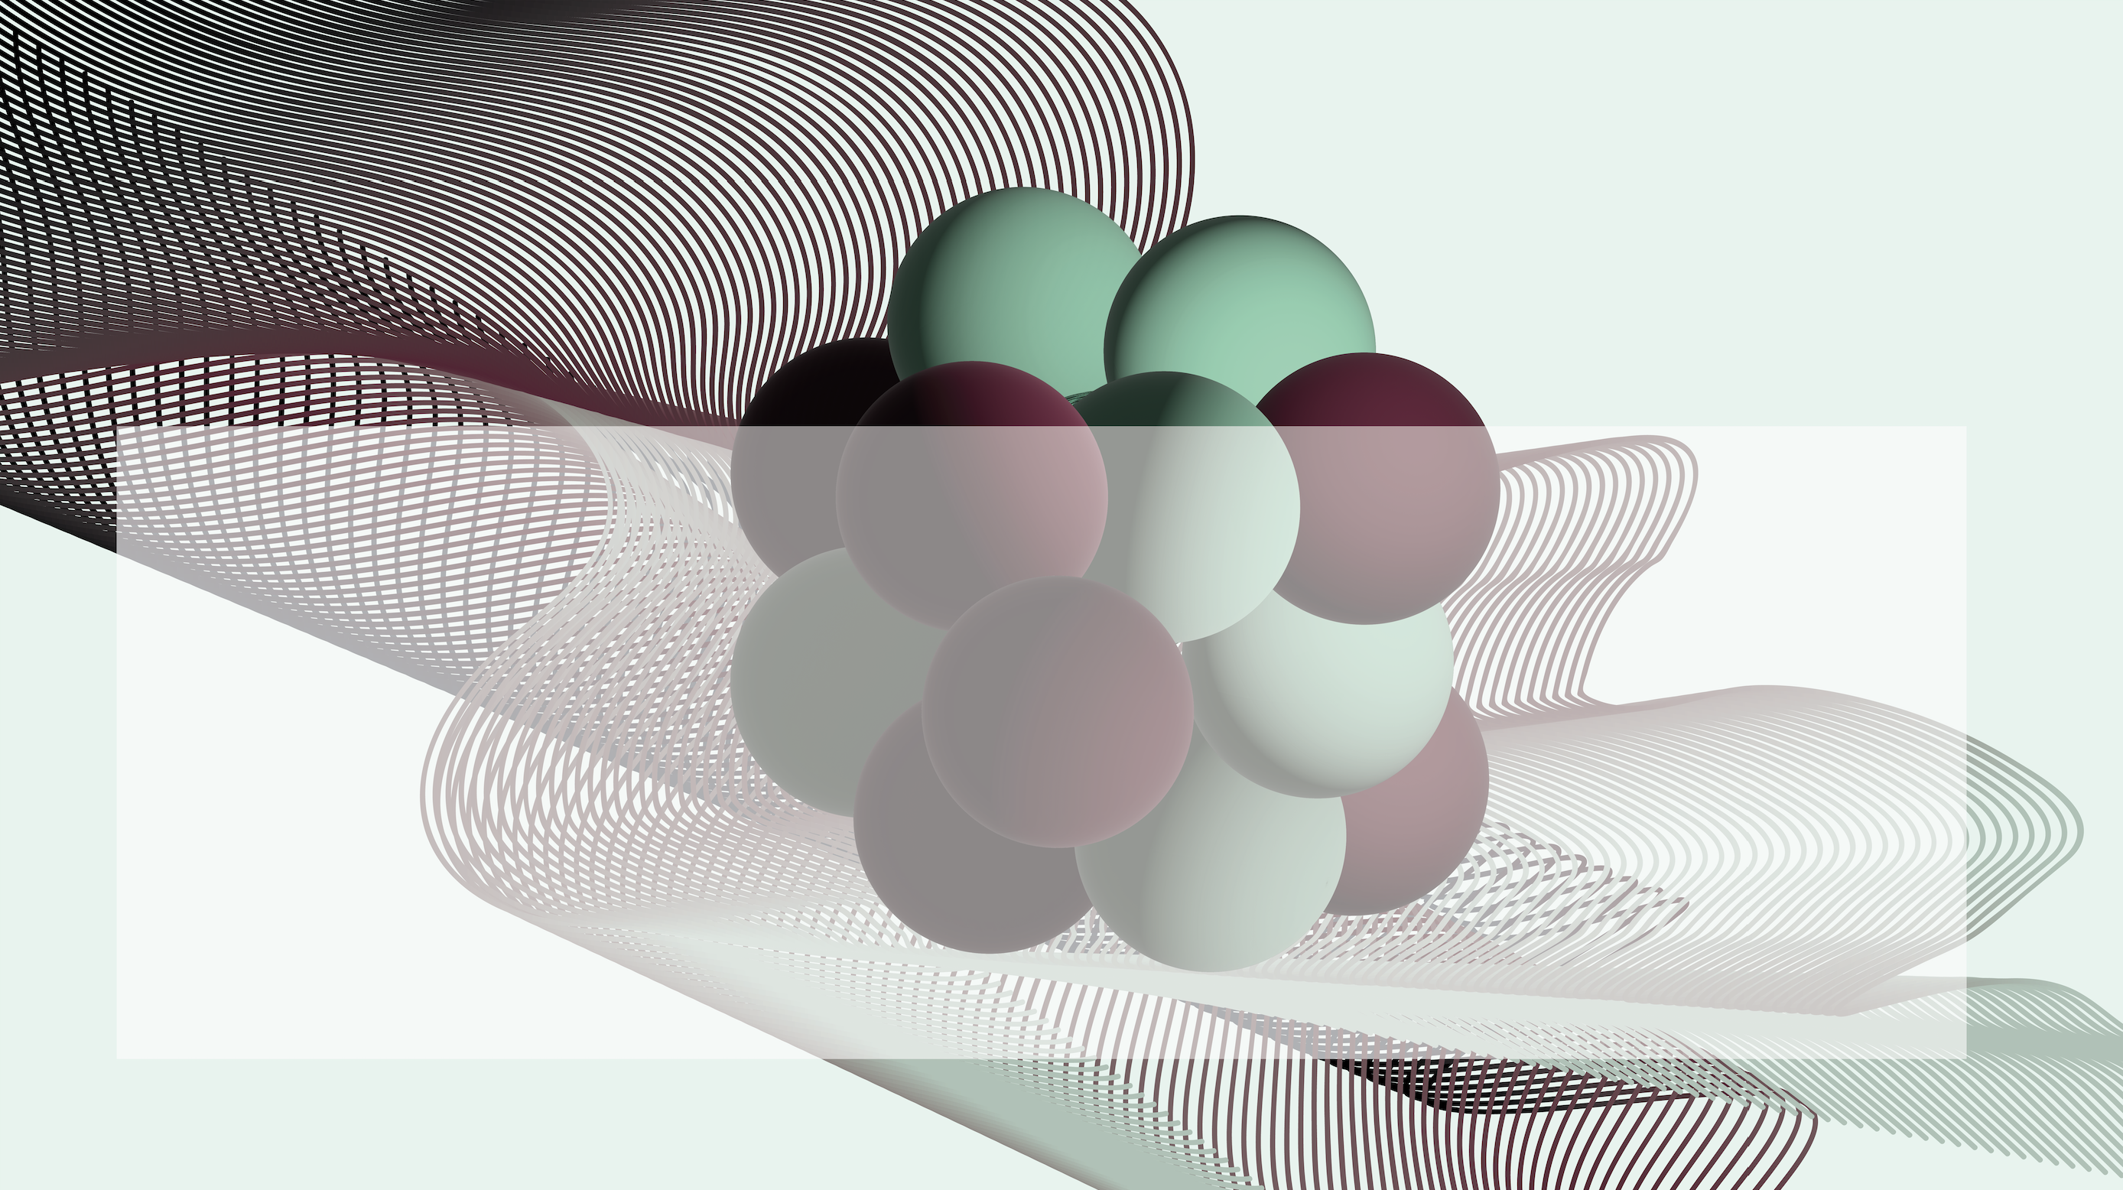
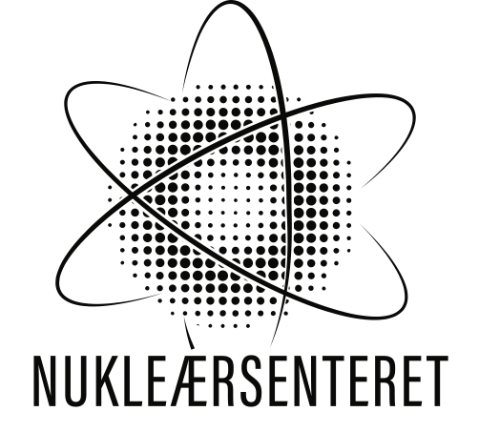

Remeasuring the ɣ-decay branching ratio of
the Hoyle state at OCL
9th Workshop on Nuclear Level Density and Gamma Strength
31.05.24
Wanja Paulsen
Contact: wanja.paulsen@fys.uio.no
Supervisors: Sunniva Siem, Kevin C. W. Li
Wanja Paulsen - 9th Workshop on Nuclear Level Density and Gamma Strength
1

Slide 2
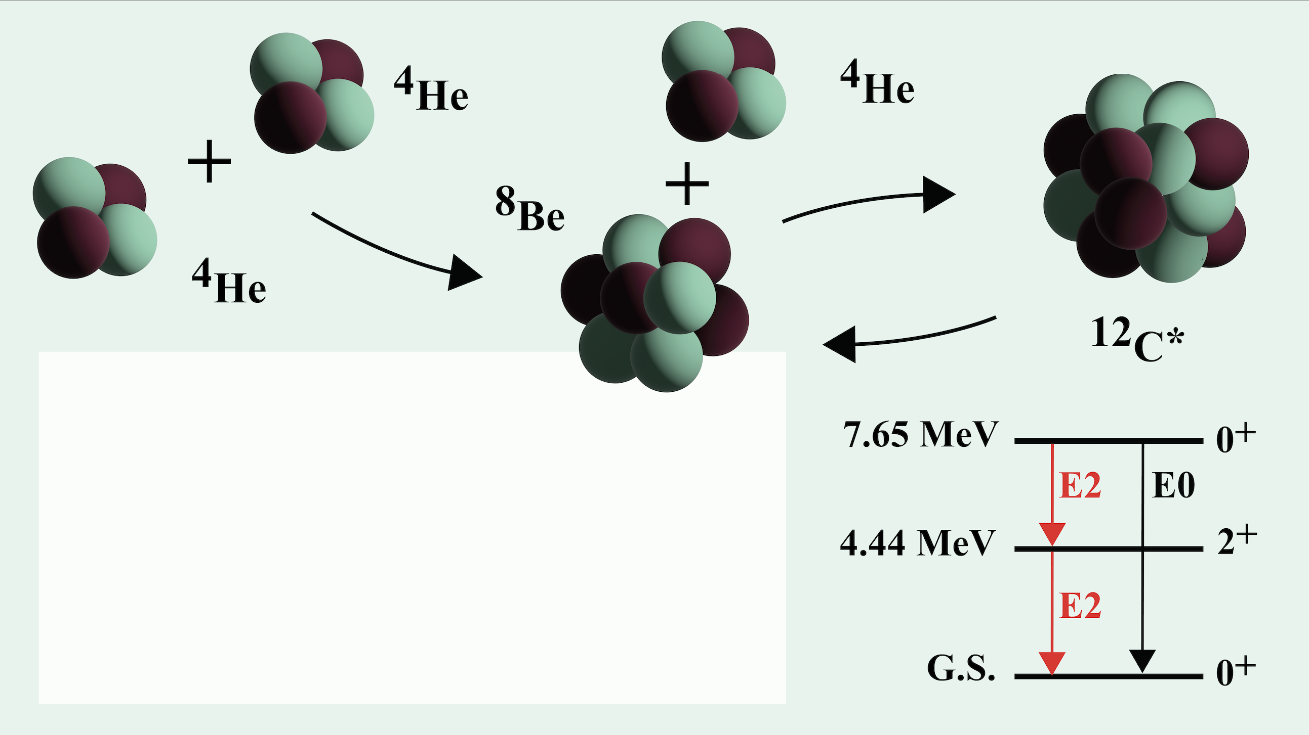
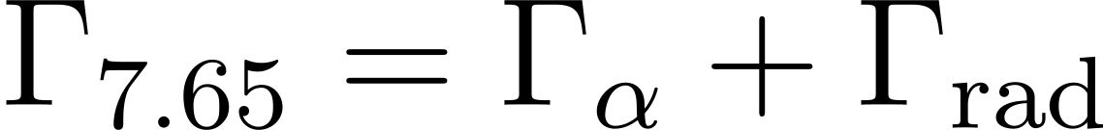
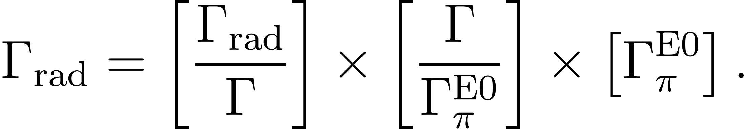
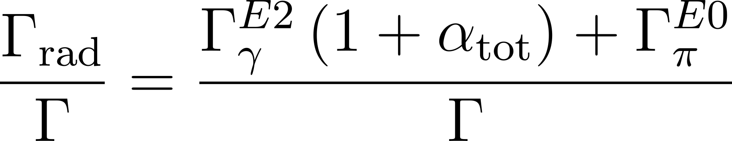
Triple alpha process
Wanja Paulsen - 9th Workshop on Nuclear Level Density and Gamma Strength
2

Slide 3
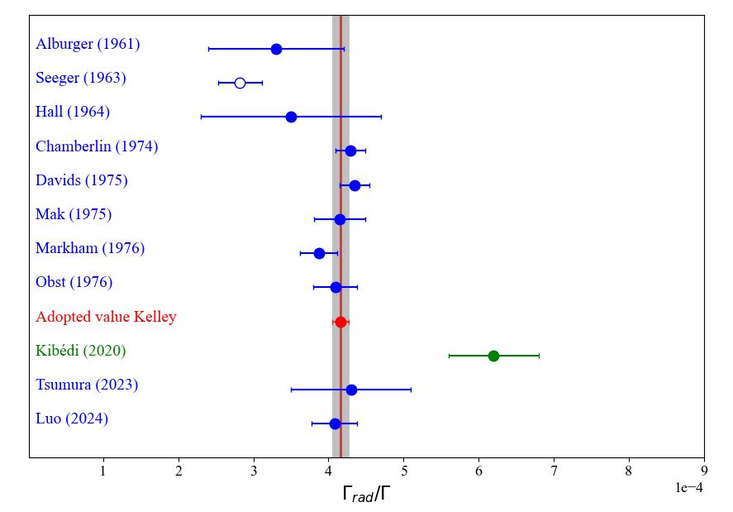
Previous measurements of the radiative branching ratio of the Hoyle state
Wanja Paulsen - 9th Workshop on Nuclear Level Density and Gamma Strength
3

Slide 4
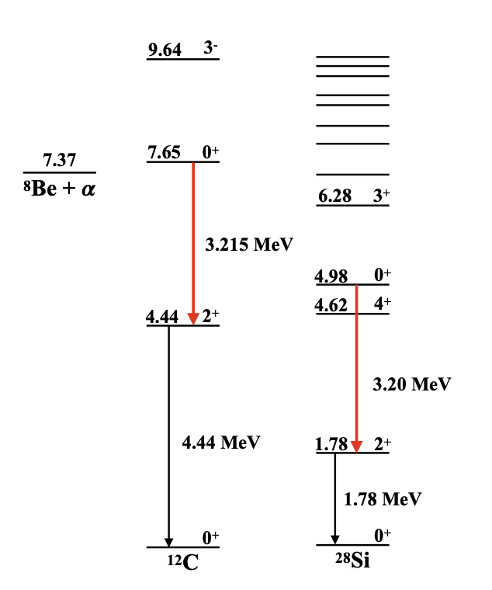
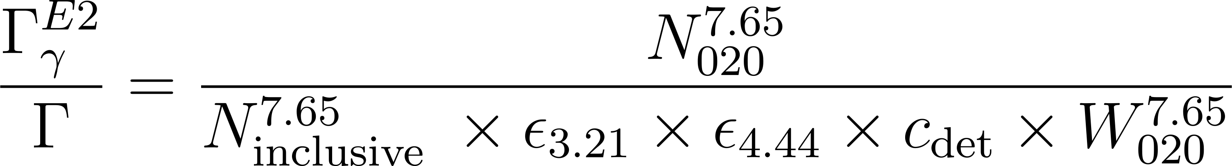
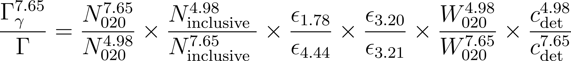

How can we measure the gamma-decay branching ratio of the Hoyle state?
Amount of protons populating the
Hoyle state resulting in the desired
gamma cascade ¹²C(p, p’𝛾1𝛾2)
⨉
Correction factors
=
𝚪𝜸/𝚪
Total amount of protons
populating the Hoyle state
¹²C(p, p’𝛾1𝛾2 + p’3α + …)
Same measurement: Two different analysis methods to obtain 𝚪𝜸/𝚪
A
{
B
A
B
Wanja Paulsen - 9th Workshop on Nuclear Level Density and Gamma Strength
4

Slide 5
How can we measure the gamma-decay branching ratio of the Hoyle state?
Amount of protons populating the
Hoyle state resulting in the desired
gamma cascade ¹²C(p, p’𝛾1𝛾2)
⨉
Correction factors
=
𝚪𝜸/𝚪
Total amount of protons
populating the Hoyle state
¹²C(p, p’𝛾1𝛾2 + p’3α + …)
Same measurement: Two different analysis methods to obtain 𝚪𝜸/𝚪
A
Used by Paulsen et al. (submitted 2024) for all measurements and Kibedi et al. (2020)
{
B
A
Used by Kibedi et al. (2020) and Obst. et al. (1976)
B
Wanja Paulsen - 9th Workshop on Nuclear Level Density and Gamma Strength
5

Slide 6
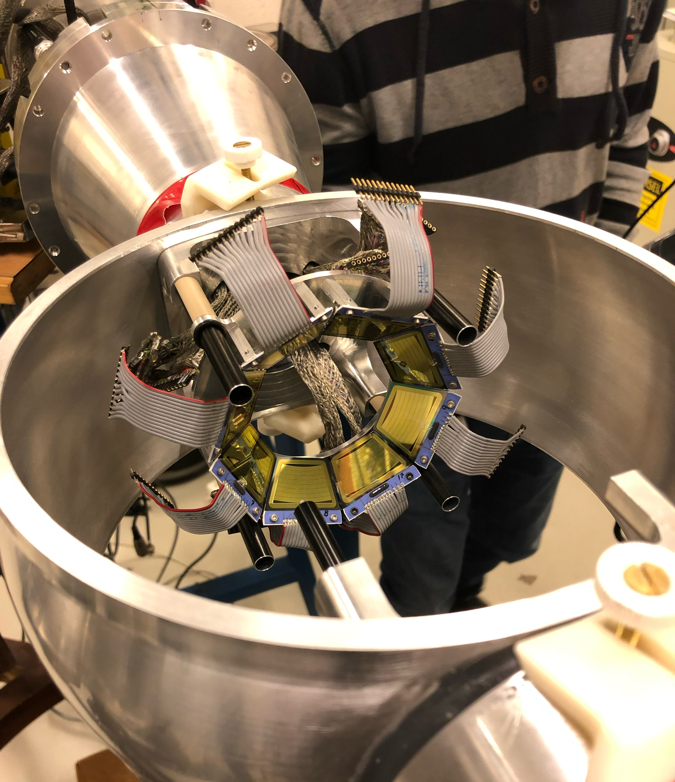
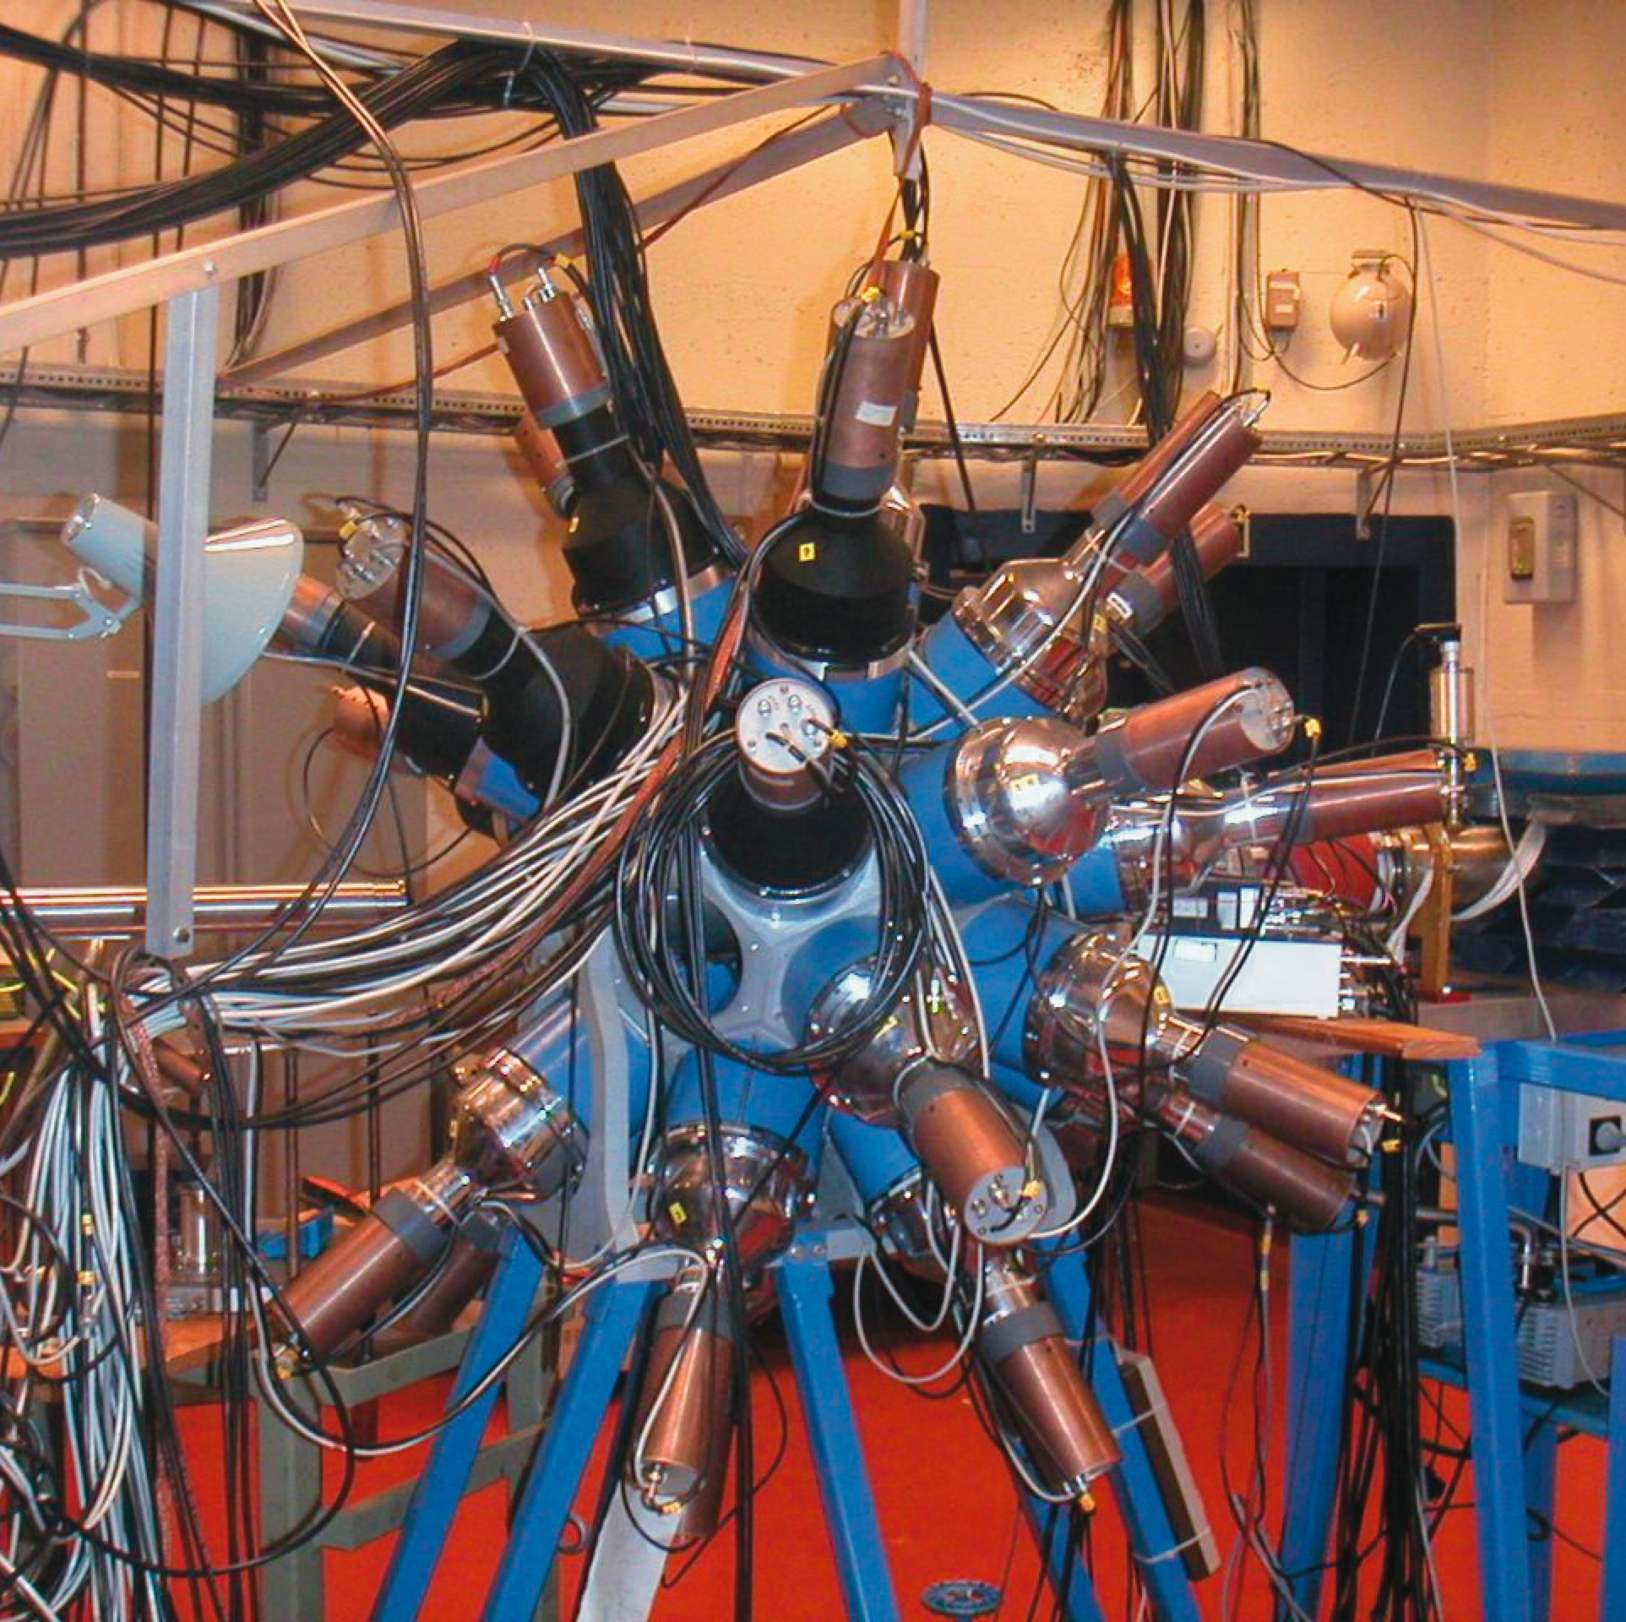
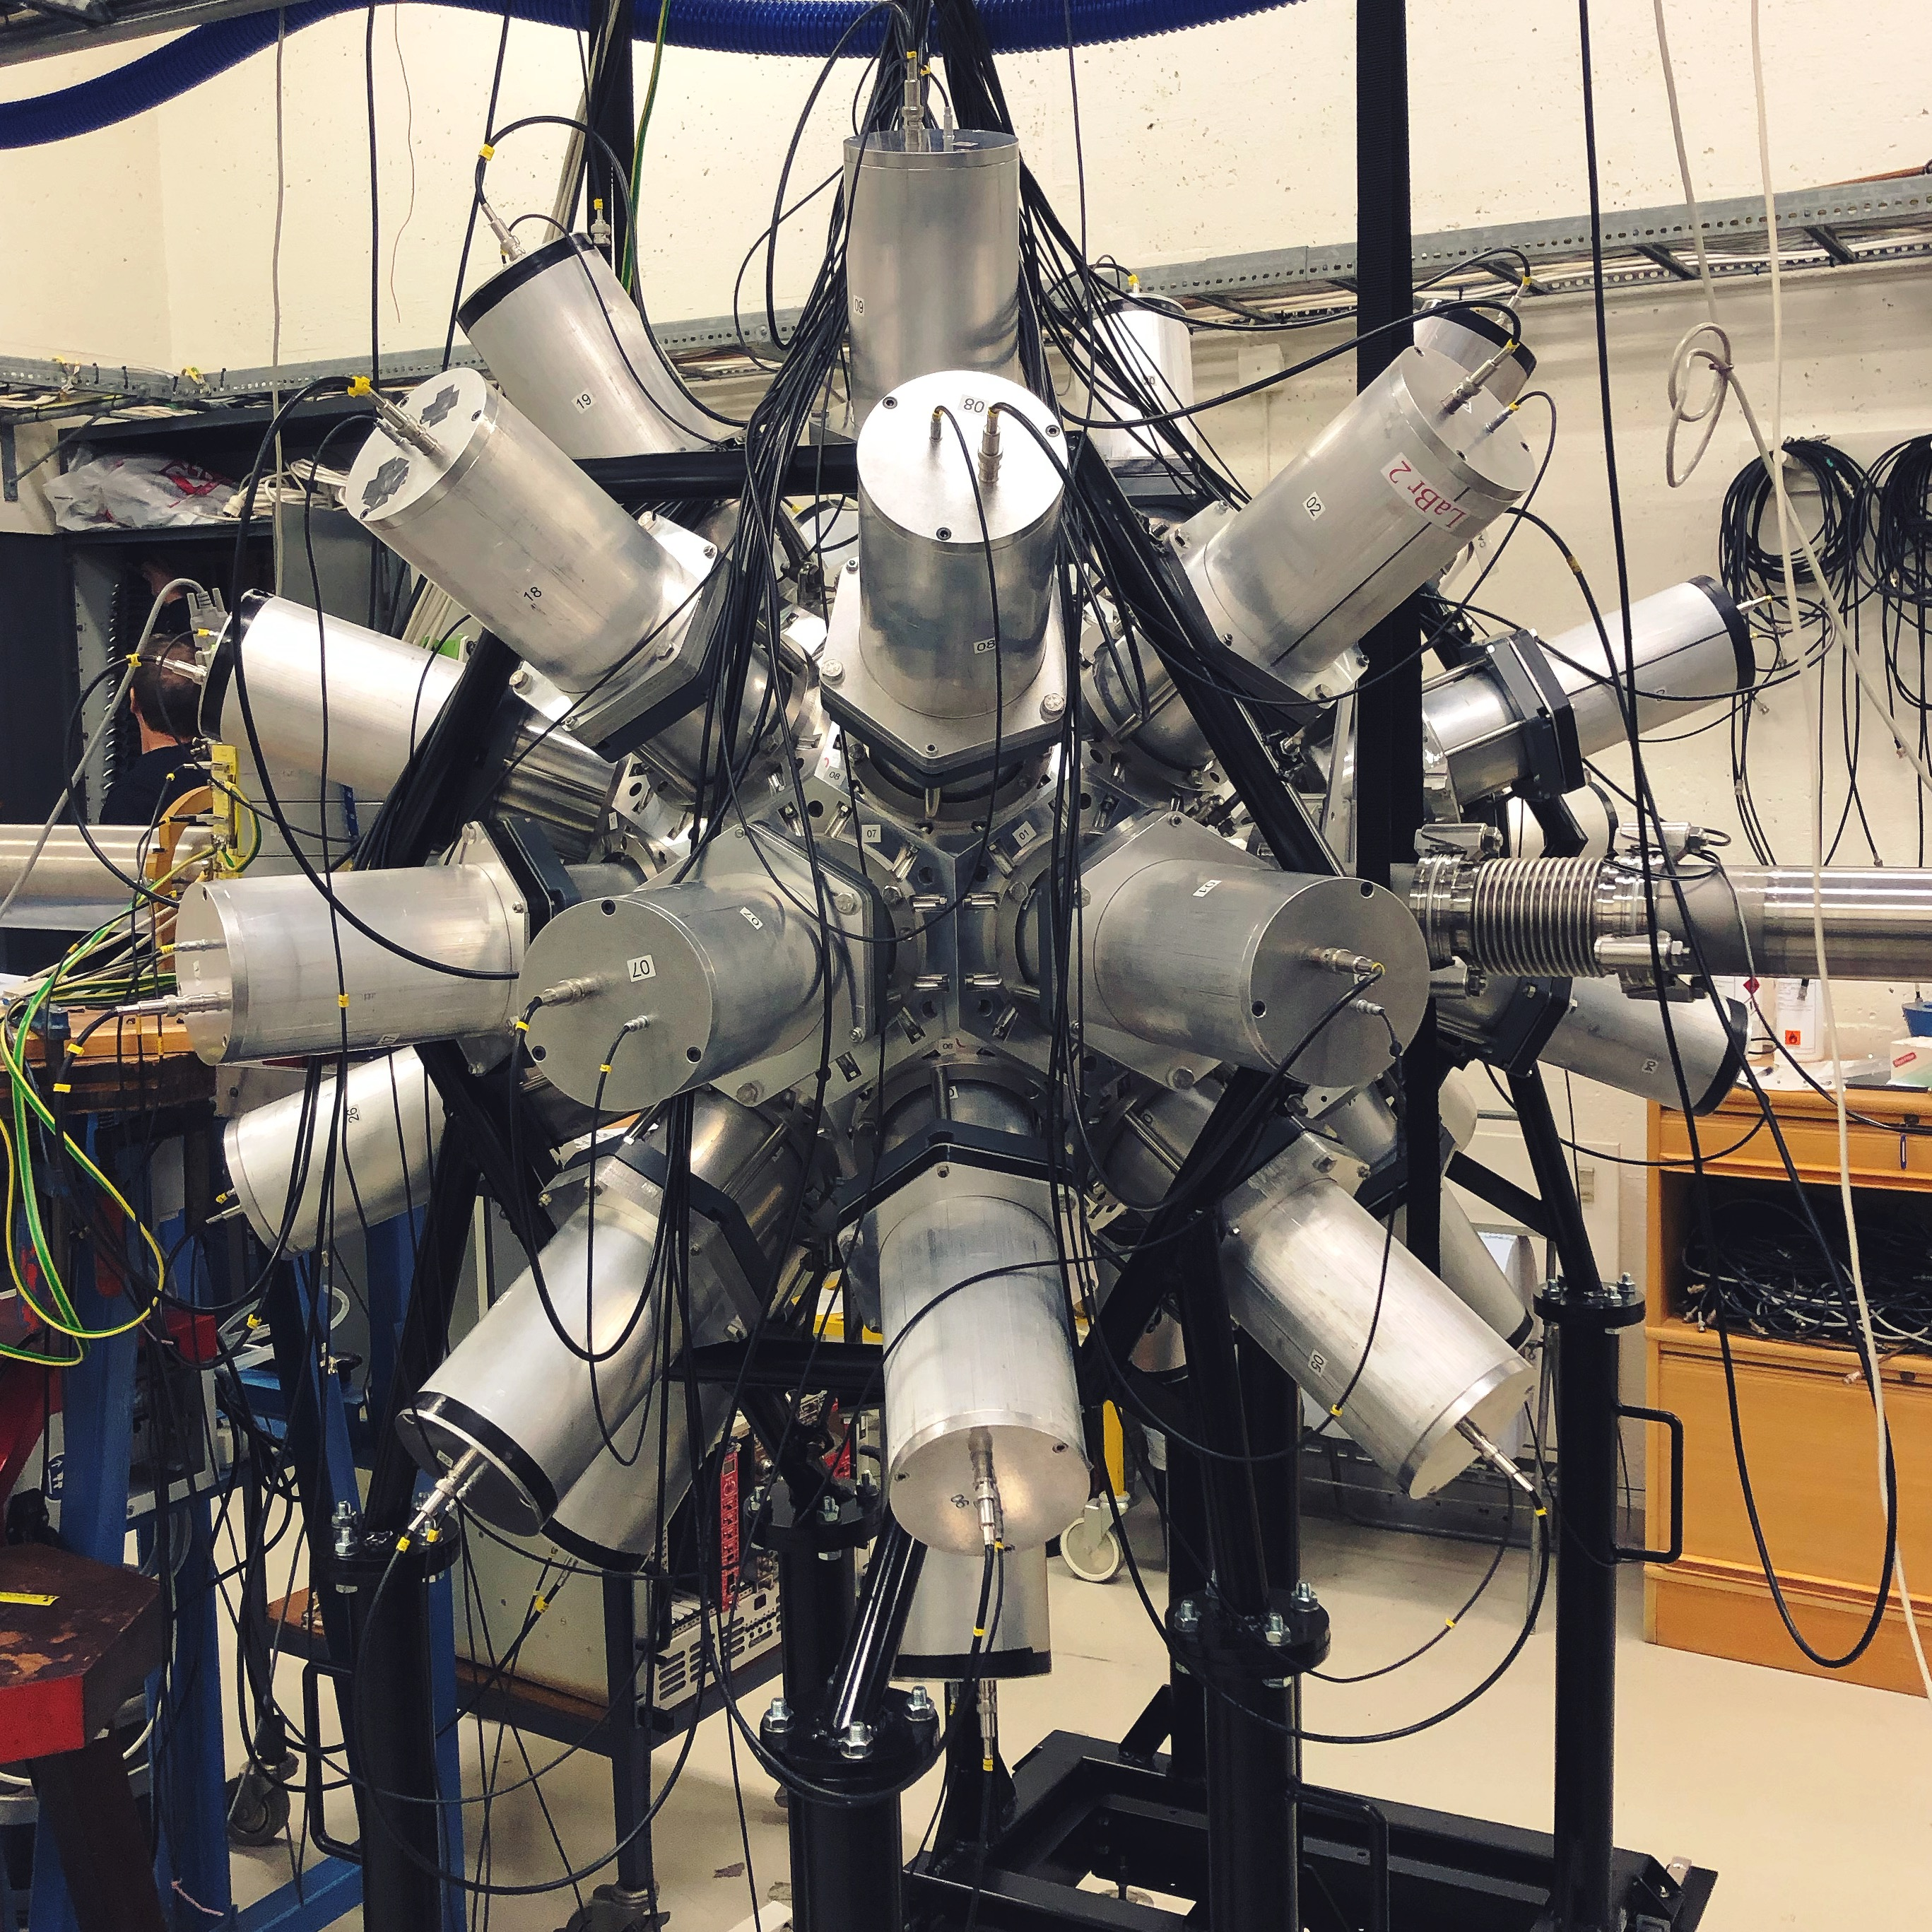
Experimental equipment
SiRi
CACTUS
OSCAR
Wanja Paulsen - 9th Workshop on Nuclear Level Density and Gamma Strength
6

Slide 7
Measurements in this work
2012
2012
2014
¹²C(p,p’)
10.7 MeV protons
CACTUS: 23 NaI (5’’ x 5’’)
Analog AQ
Utilise both layers of particle telescope
²⁸Si(p,p’)
16.0 MeV protons
CACTUS: 23 NaI (5’’ x 5’’)
Analog AQ
Utilise both layers of particle telescope
¹²C(p,p’)
10.7 MeV protons
CACTUS: 26 NaI (5’’ x 5’’)
Analog AQ
Utilise only front layer of particle telescope
2019
2020
¹²C(p,p’)
10.8 MeV protons
OSCAR: 30 LaBr3 (3.5’’ x 8.0’’)
Digital AQ
Utilise only front layer of particle telescope
²⁸Si(p,p’)
16.0 MeV protons
OSCAR: 30 LaBr3 (3.5’’ x 8.0’’)
Digital AQ
Utilise both layers of particle telescope
Wanja Paulsen - 9th Workshop on Nuclear Level Density and Gamma Strength
7

Slide 8
Measurements in this work
2012
2012
2014
¹²C(p,p’)
10.7 MeV protons
CACTUS: 23 NaI (5’’ x 5’’)
Analog AQ
Utilise both layers of particle telescope
²⁸Si(p,p’)
16.0 MeV protons
CACTUS: 23 NaI (5’’ x 5’’)
Analog AQ
Utilise both layers of particle telescope
¹²C(p,p’)
10.7 MeV protons
CACTUS: 26 NaI (5’’ x 5’’)
Analog AQ
Utilise only front layer of particle telescope
Efficiency
Efficiency
Efficiency
Gamma-decay branching ratio
Gamma-decay branching ratio
2019
2020
¹²C(p,p’)
10.8 MeV protons
OSCAR: 30 LaBr3 (3.5’’ x 8.0’’)
Digital AQ
Utilise only front layer of particle telescope
²⁸Si(p,p’)
16.0 MeV protons
OSCAR: 30 LaBr3 (3.5’’ x 8.0’’)
Digital AQ
Utilise both layers of particle telescope
Main result of this work
Efficiency
Efficiency
Reanalysis of Kibédi et al.
[Phys. Rev. Lett. 125, 182701 (2020)]
Gamma-decay branching ratio
Gamma-decay branching ratio
Verification of analysis
Wanja Paulsen - 9th Workshop on Nuclear Level Density and Gamma Strength
8

Slide 9
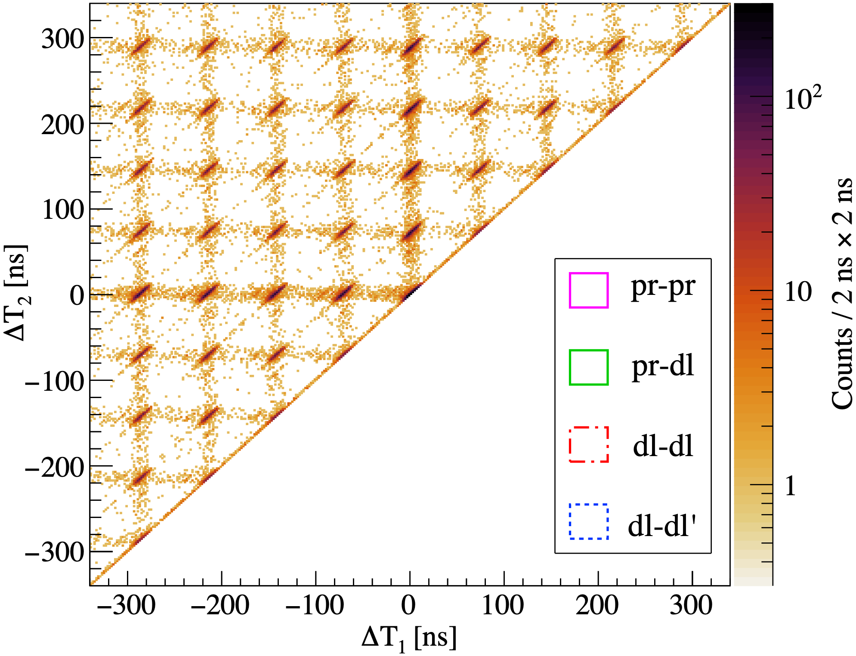
Analysis: Background subtraction
Different combinations of particles:
Proton and both gammas are in coincidence with each other
Proton and one gamma are in coincidence
Both gammas are in coincidence with each other, but not with the proton
Random background
Wanja Paulsen - 9th Workshop on Nuclear Level Density and Gamma Strength
9

Slide 10
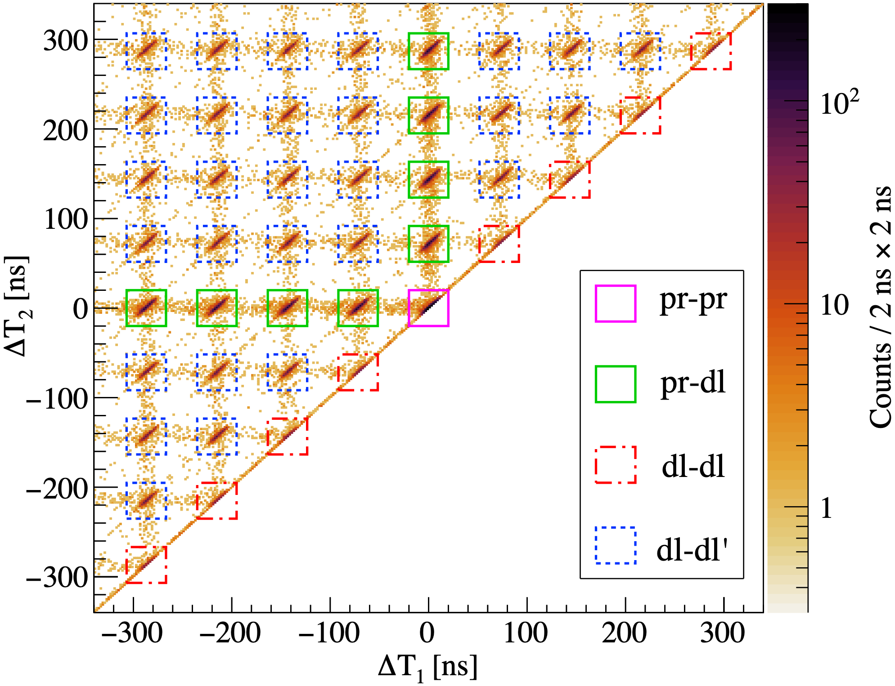
Analysis: Background subtraction
Different combinations of particles:
Proton and both gammas are in coincidence with each other
Proton and one gamma are in coincidence
Both gammas are in coincidence with each other, but not with the proton
Random background
Final yield of triple coincidences:
-
-
+
Wanja Paulsen - 9th Workshop on Nuclear Level Density and Gamma Strength
10

Slide 11
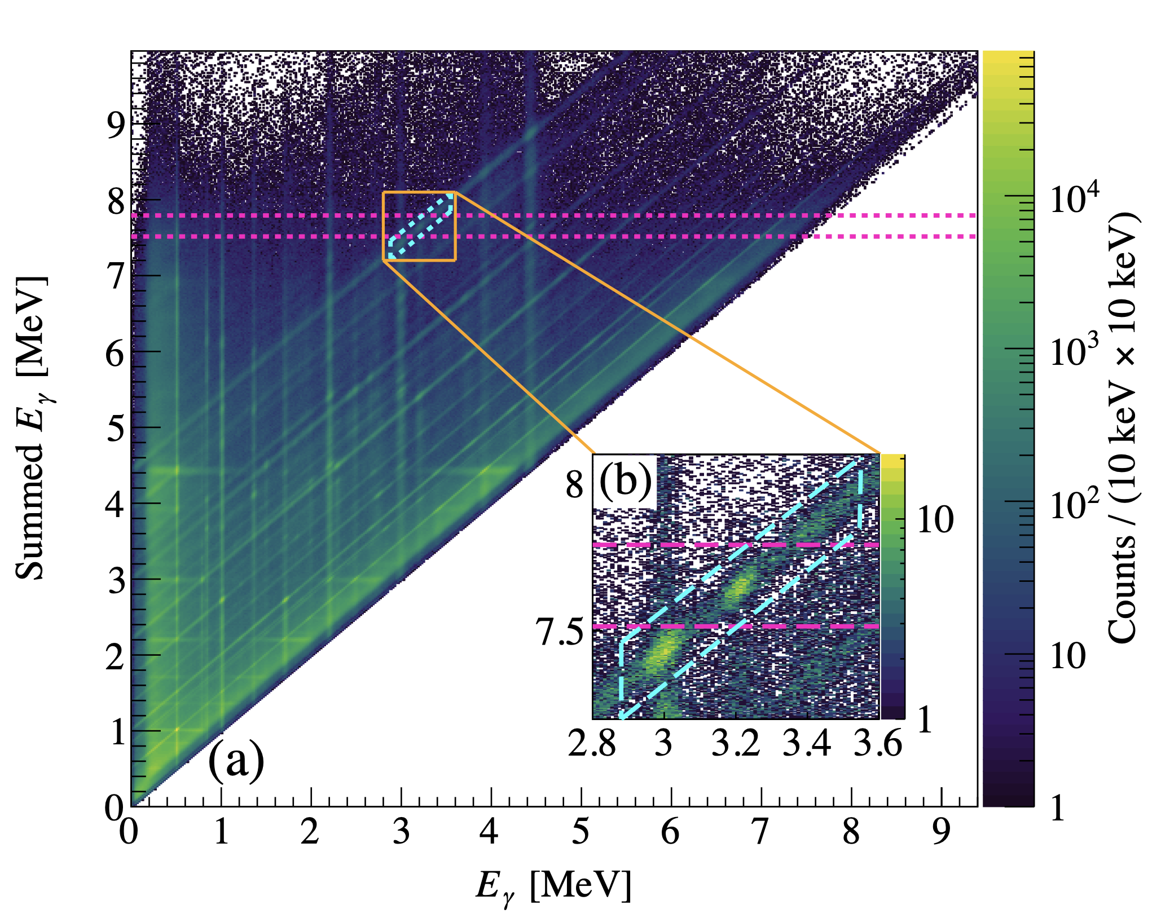
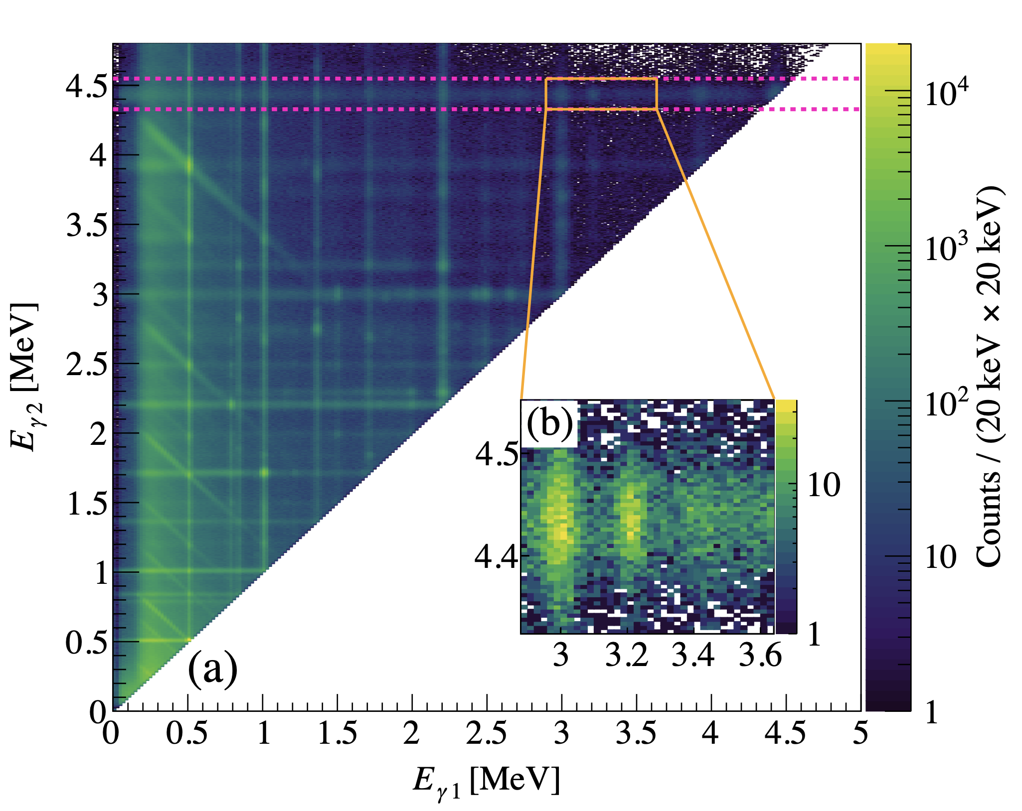
¹²C(p,p’) 2019: Extracting triple-coincidence yields
Summed E𝛾
Gamma-gamma
3𝜎 gate around E𝛾 = 7.65 MeV and diagonal following the Compton scattered E𝛾 = 4.44 MeV 𝛾 ray from the Ex = 4.44 MeV 21⁺ in ¹²C.
3𝜎 gate around E𝛾 = 4.44 MeV from Hoyle state cascade of the Ex = 7.65 MeV 02⁺ in ¹²C.
Wanja Paulsen - 9th Workshop on Nuclear Level Density and Gamma Strength
11

Slide 12
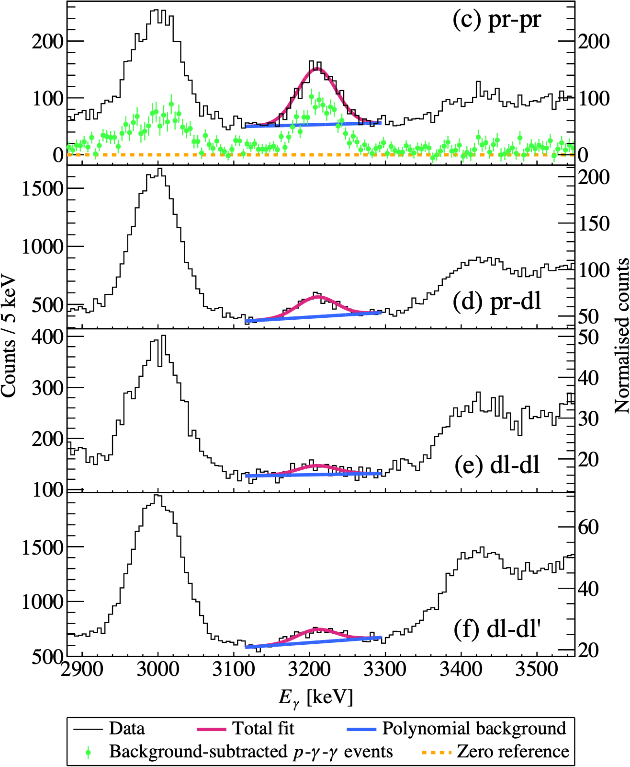
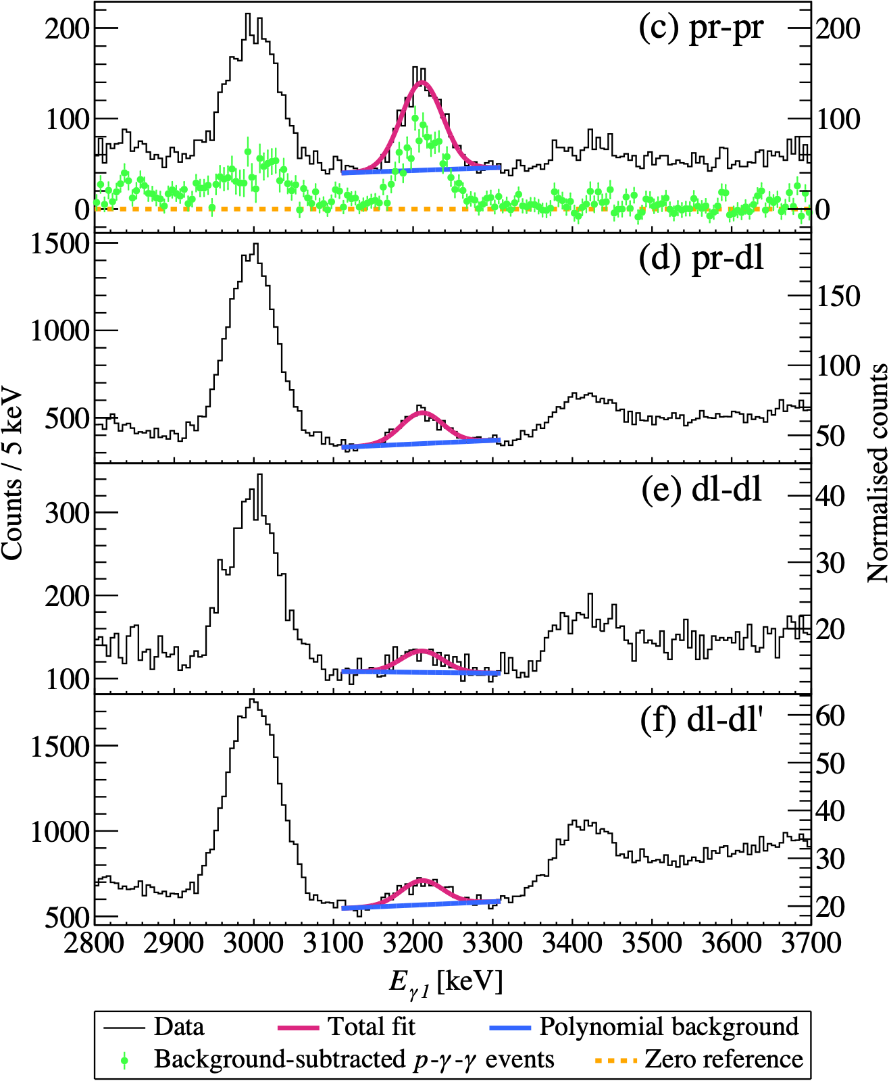
¹²C(p,p’) 2019: Extracting triple-coincidence yields
Summed E𝛾
Gamma-gamma
Wanja Paulsen - 9th Workshop on Nuclear Level Density and Gamma Strength
12

Slide 13
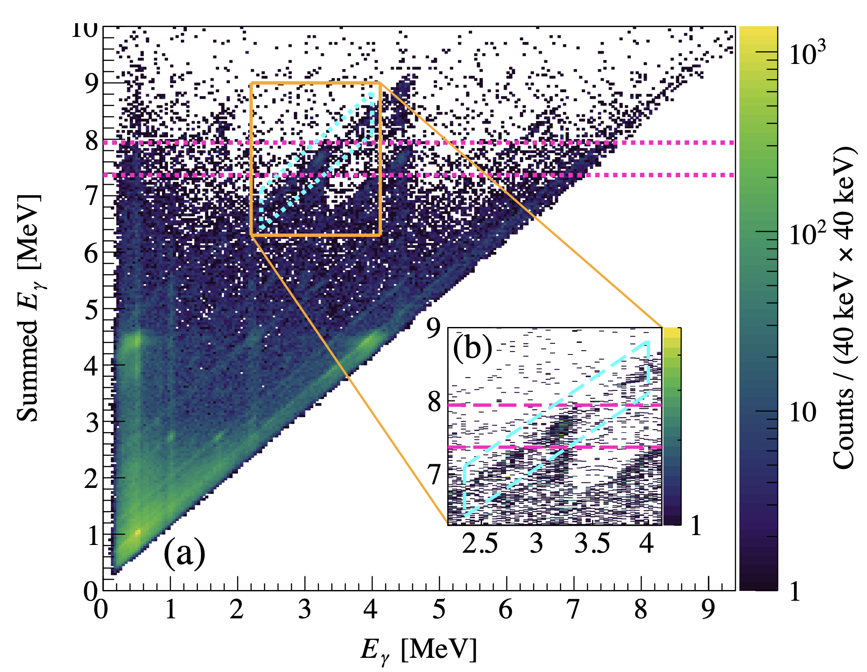
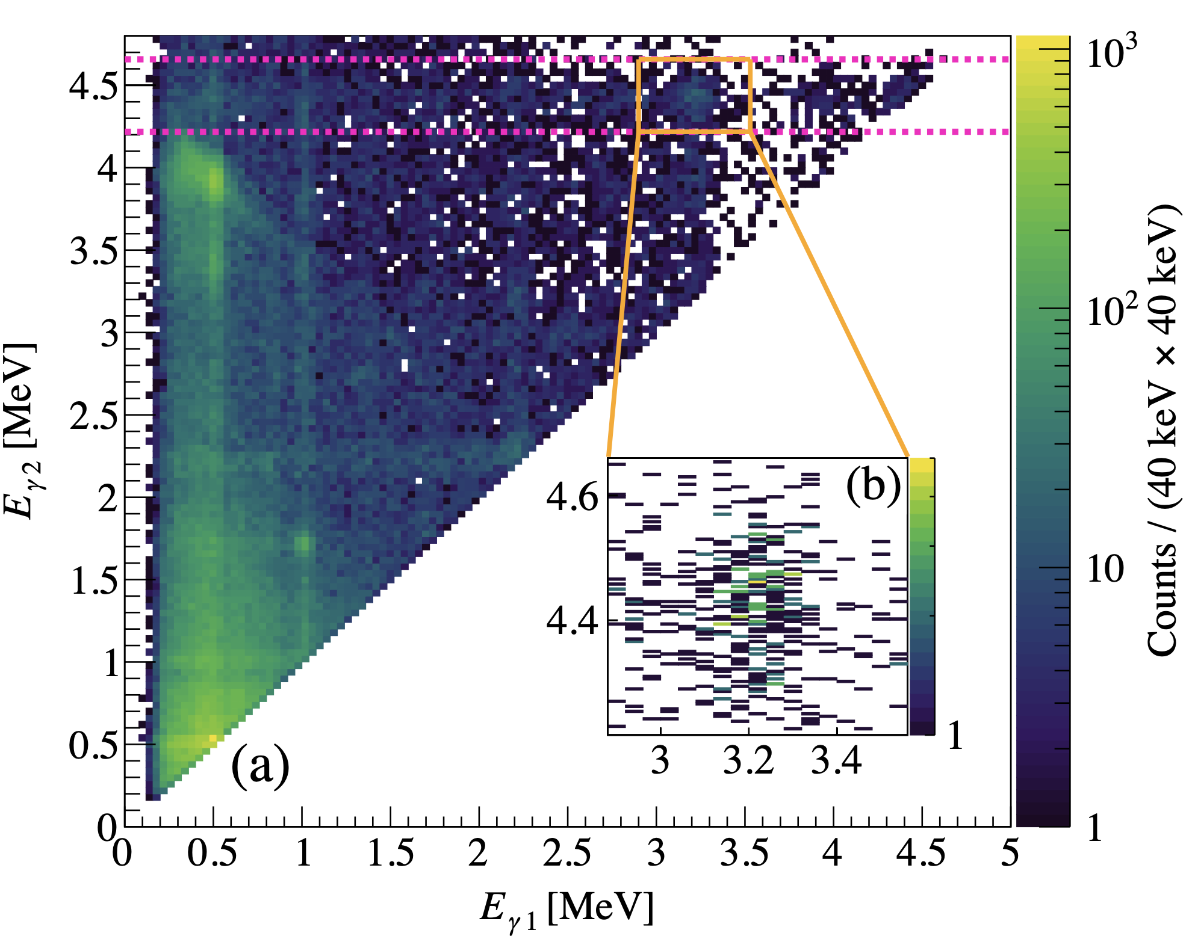
¹²C(p,p’) 2014: Extracting triple-coincidence yields
Summed E𝛾
Gamma-gamma
3𝜎 gate around E𝛾 = 7.65 MeV and diagonal following the Compton scattered E𝛾 = 4.44 MeV 𝛾 ray from the Ex = 4.44 MeV 21⁺ in ¹²C.
3𝜎 gate around E𝛾 = 4.44 MeV from Hoyle state cascade of the Ex = 7.65 MeV 02⁺ in ¹²C.
Wanja Paulsen - 9th Workshop on Nuclear Level Density and Gamma Strength
13

Slide 14
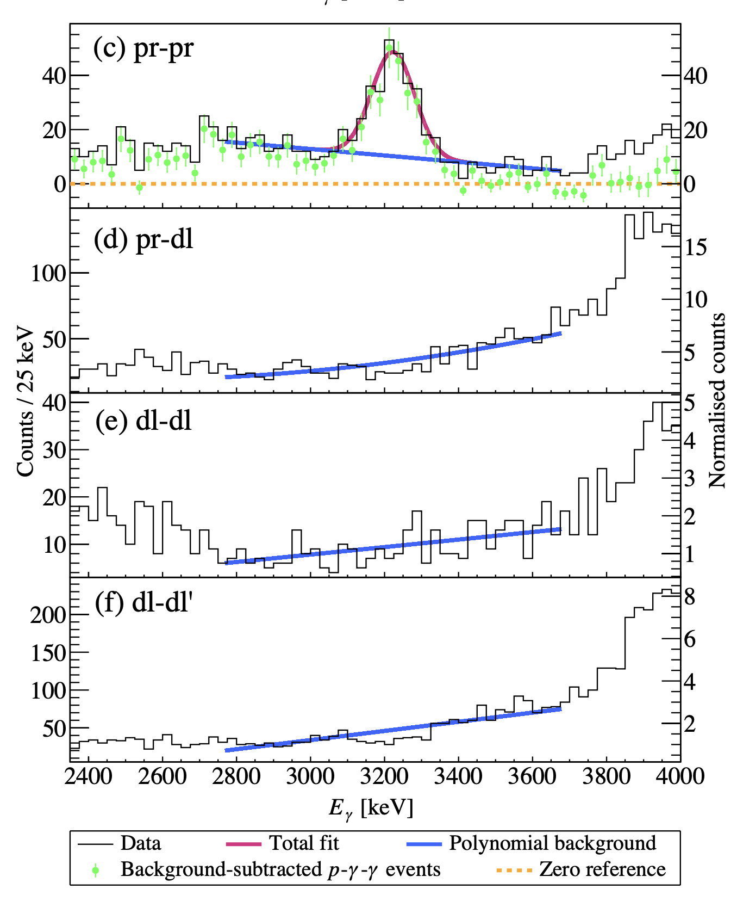
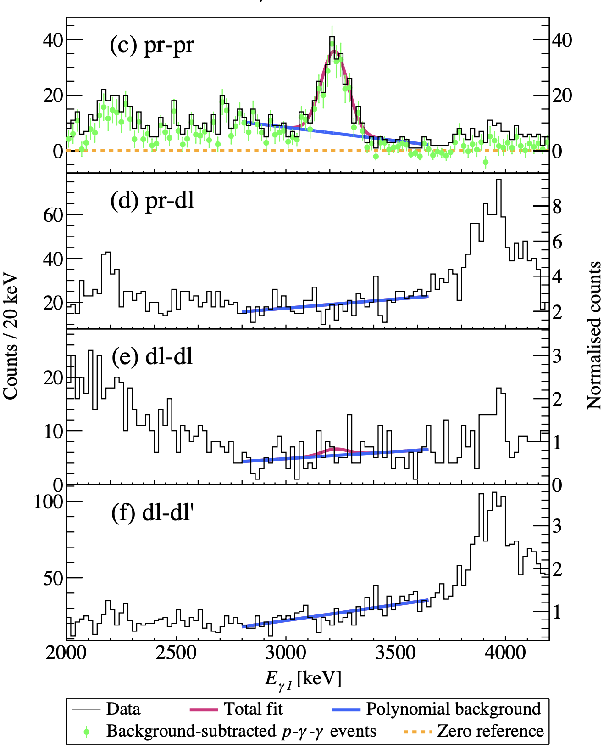
¹²C(p,p’) 2014: Extracting triple-coincidence yields
Summed E𝛾
Gamma-gamma
Wanja Paulsen - 9th Workshop on Nuclear Level Density and Gamma Strength
14

Slide 15
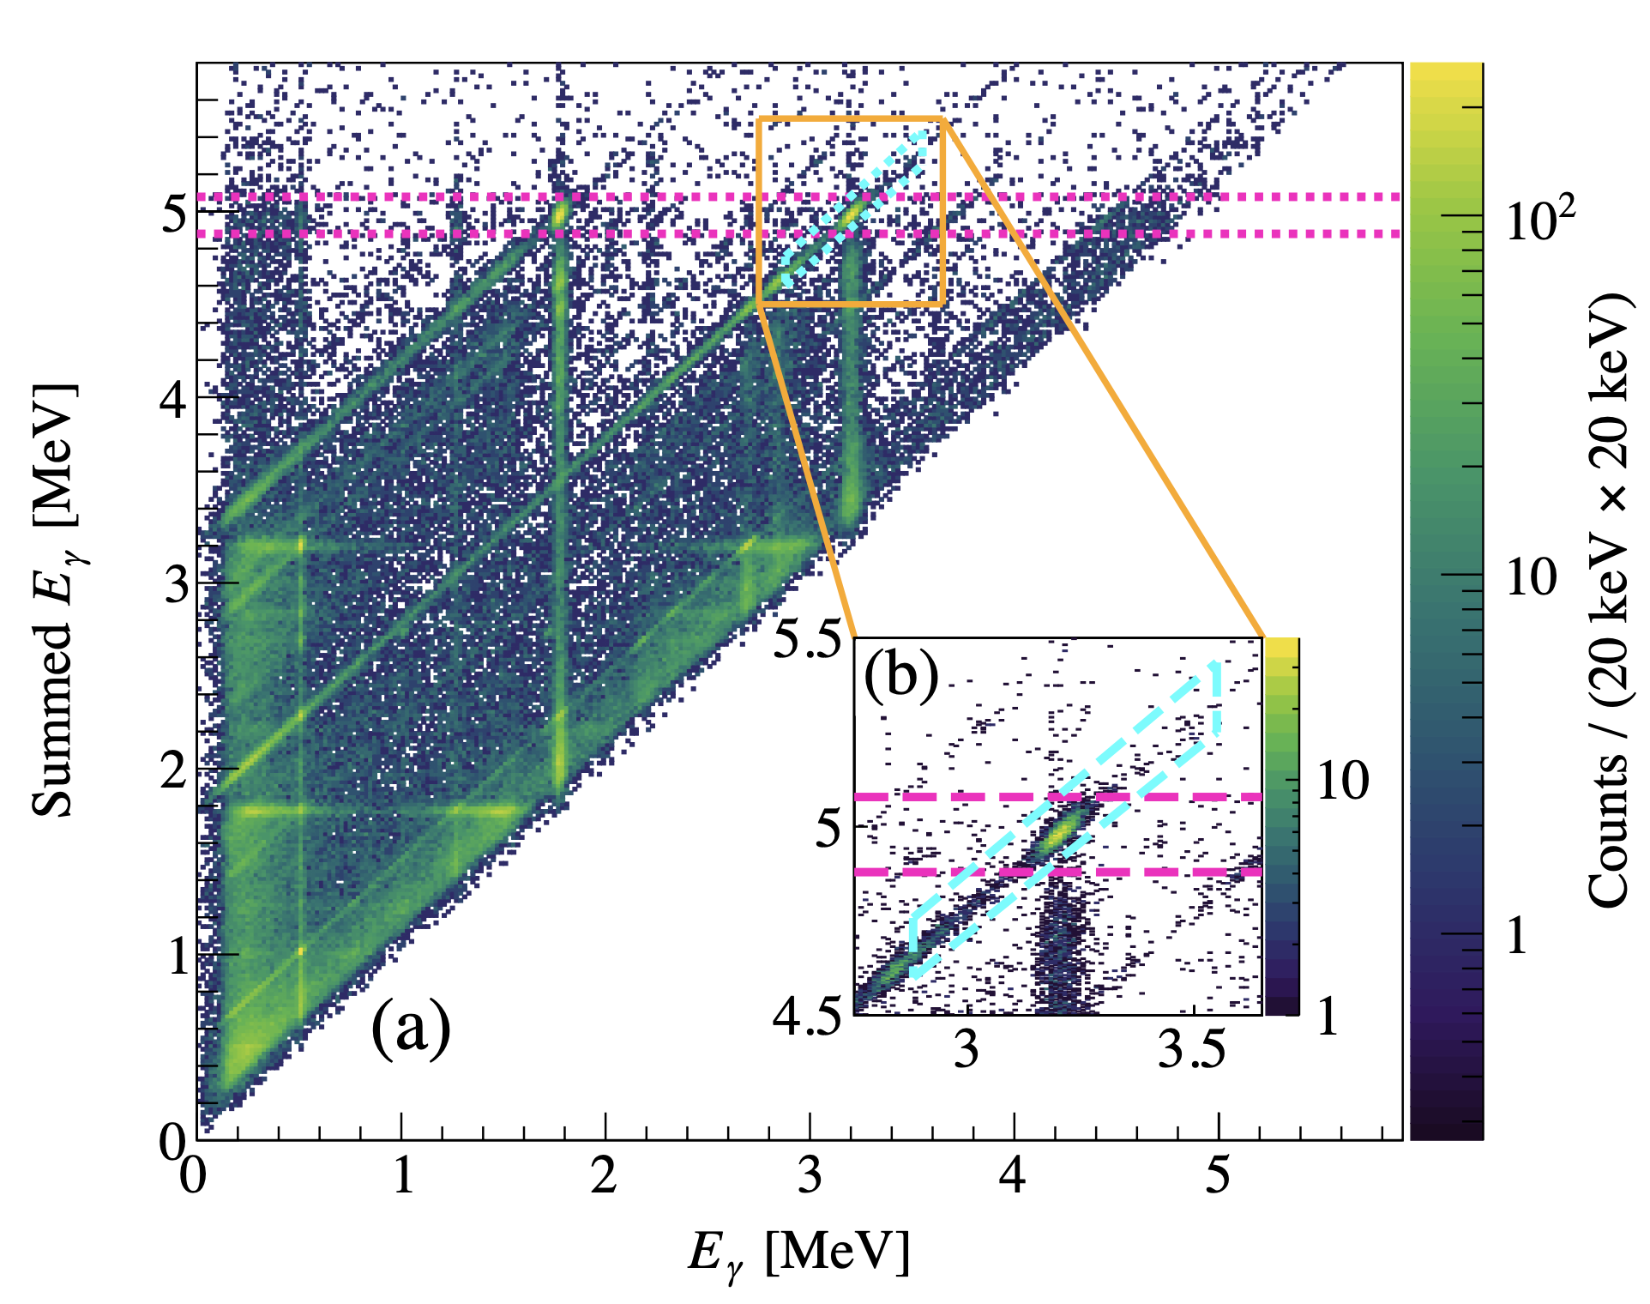
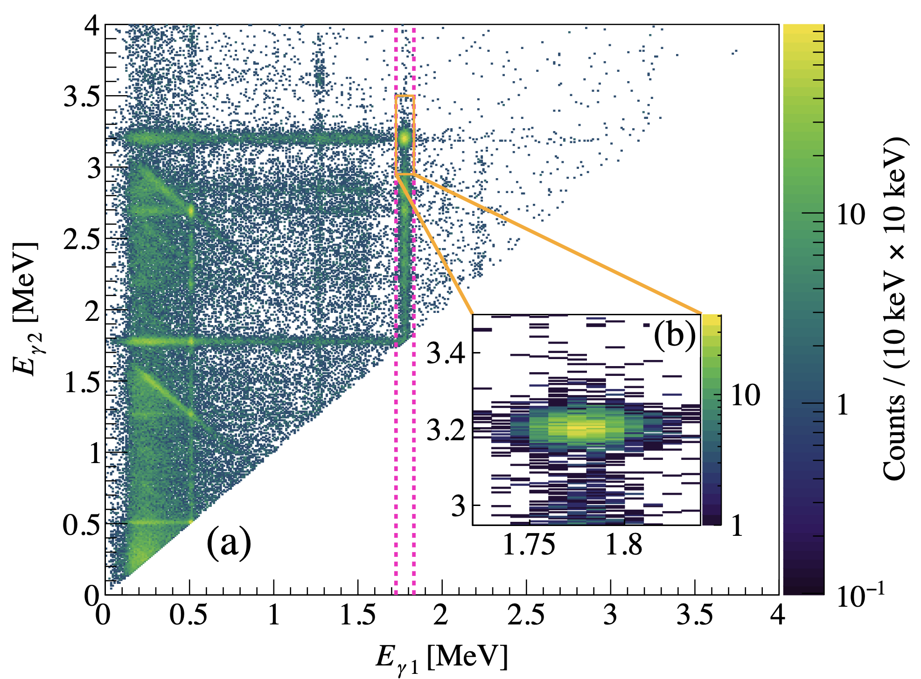
²⁸Si(p,p’) 2020: Extracting triple-coincidence yields
Summed E𝛾
Gamma-gamma
3𝜎 gate around E𝛾 = 4.98 MeV and diagonal following the Compton scattered E𝛾 = 3.20 MeV 𝛾 ray from the Ex = 4.98 MeV 02⁺ in ²⁸Si.
3𝜎 gate around E𝛾 = 1.79 MeV from the cascade from
Ex = 4.98 MeV 02⁺ in ²⁸Si.
Wanja Paulsen - 9th Workshop on Nuclear Level Density and Gamma Strength
15

Slide 16
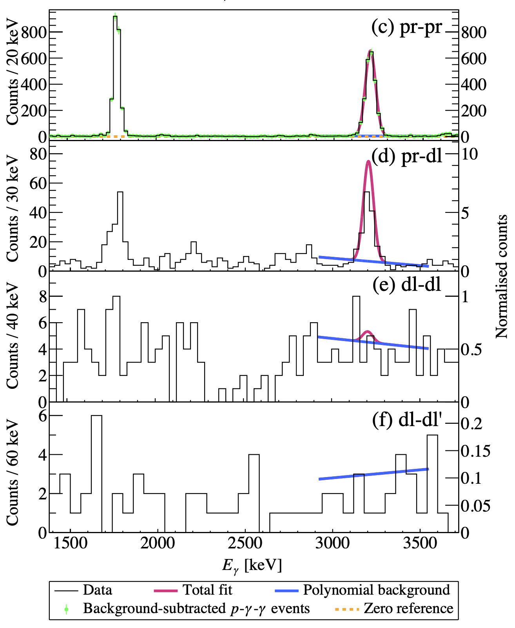
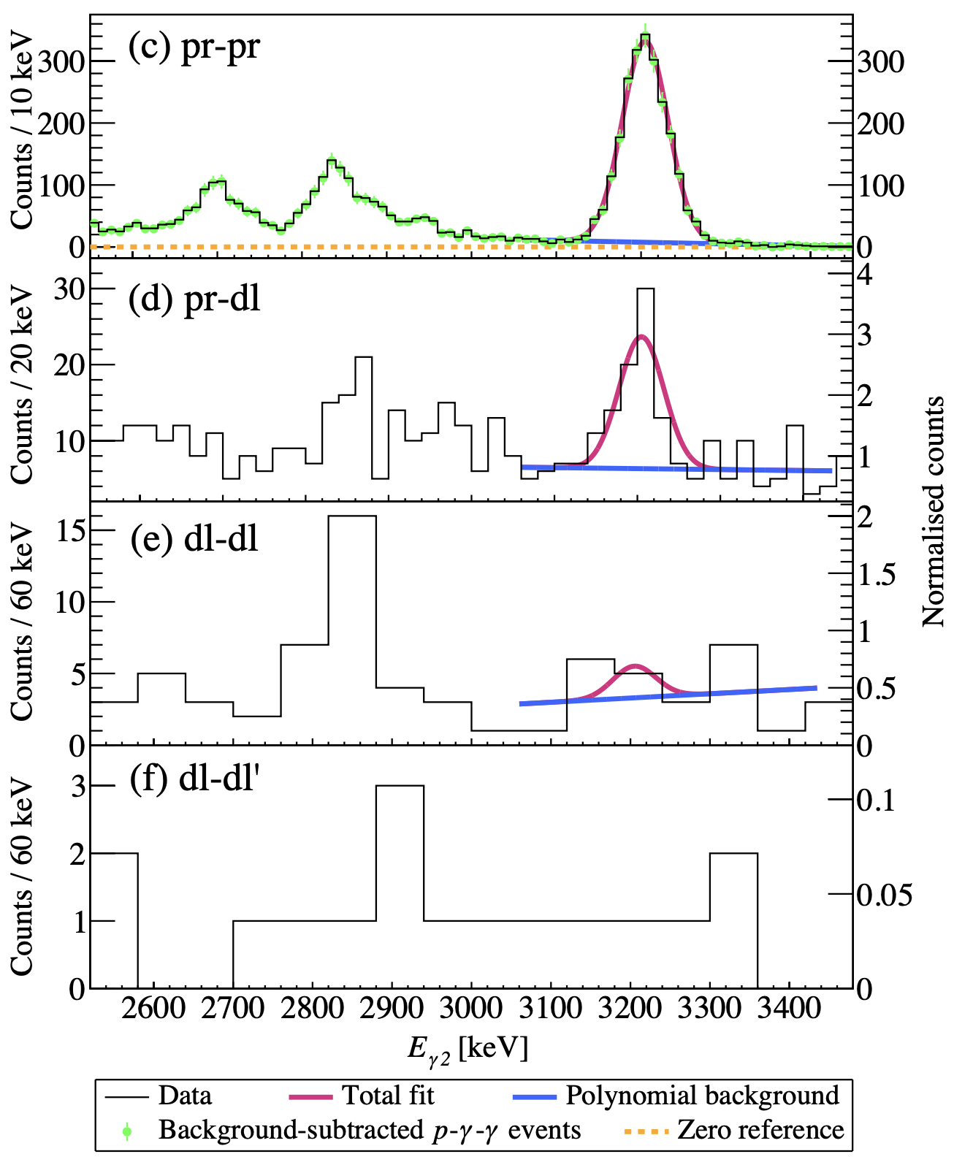
²⁸Si(p,p’) 2020: Extracting triple-coincidence yields
Summed E𝛾
Gamma-gamma
Wanja Paulsen - 9th Workshop on Nuclear Level Density and Gamma Strength
16

Slide 17
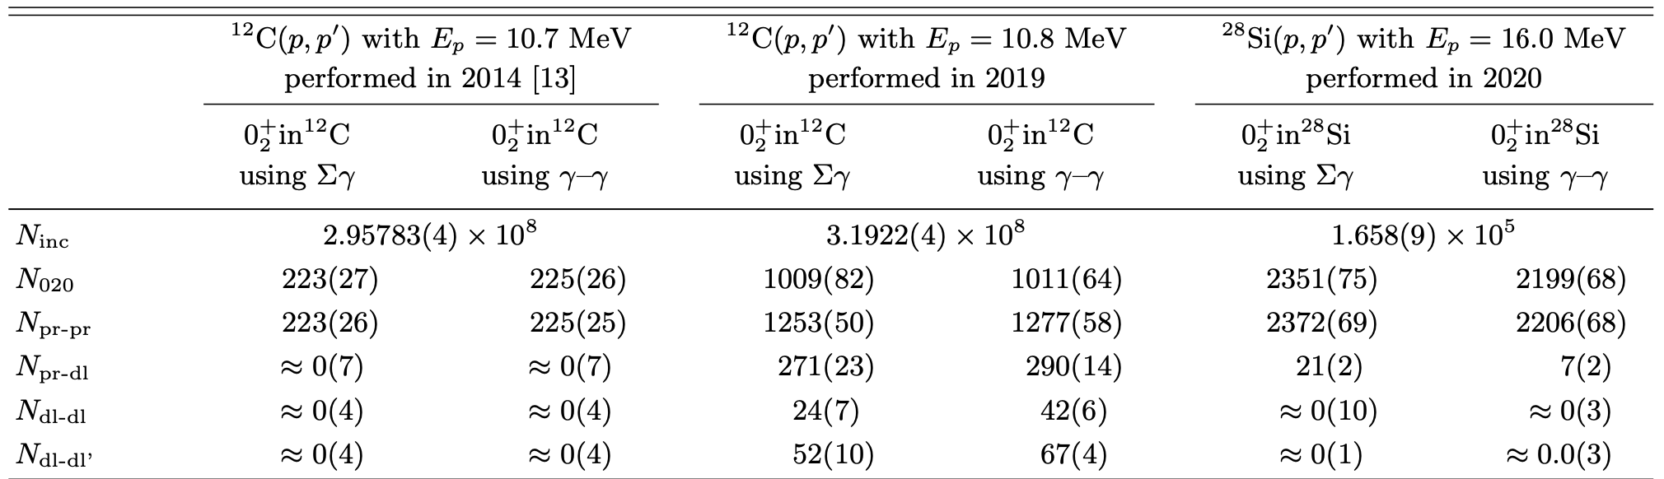
Extracted triple-coincidence yields and inclusive particles
Wanja Paulsen - 9th Workshop on Nuclear Level Density and Gamma Strength
17

Slide 18
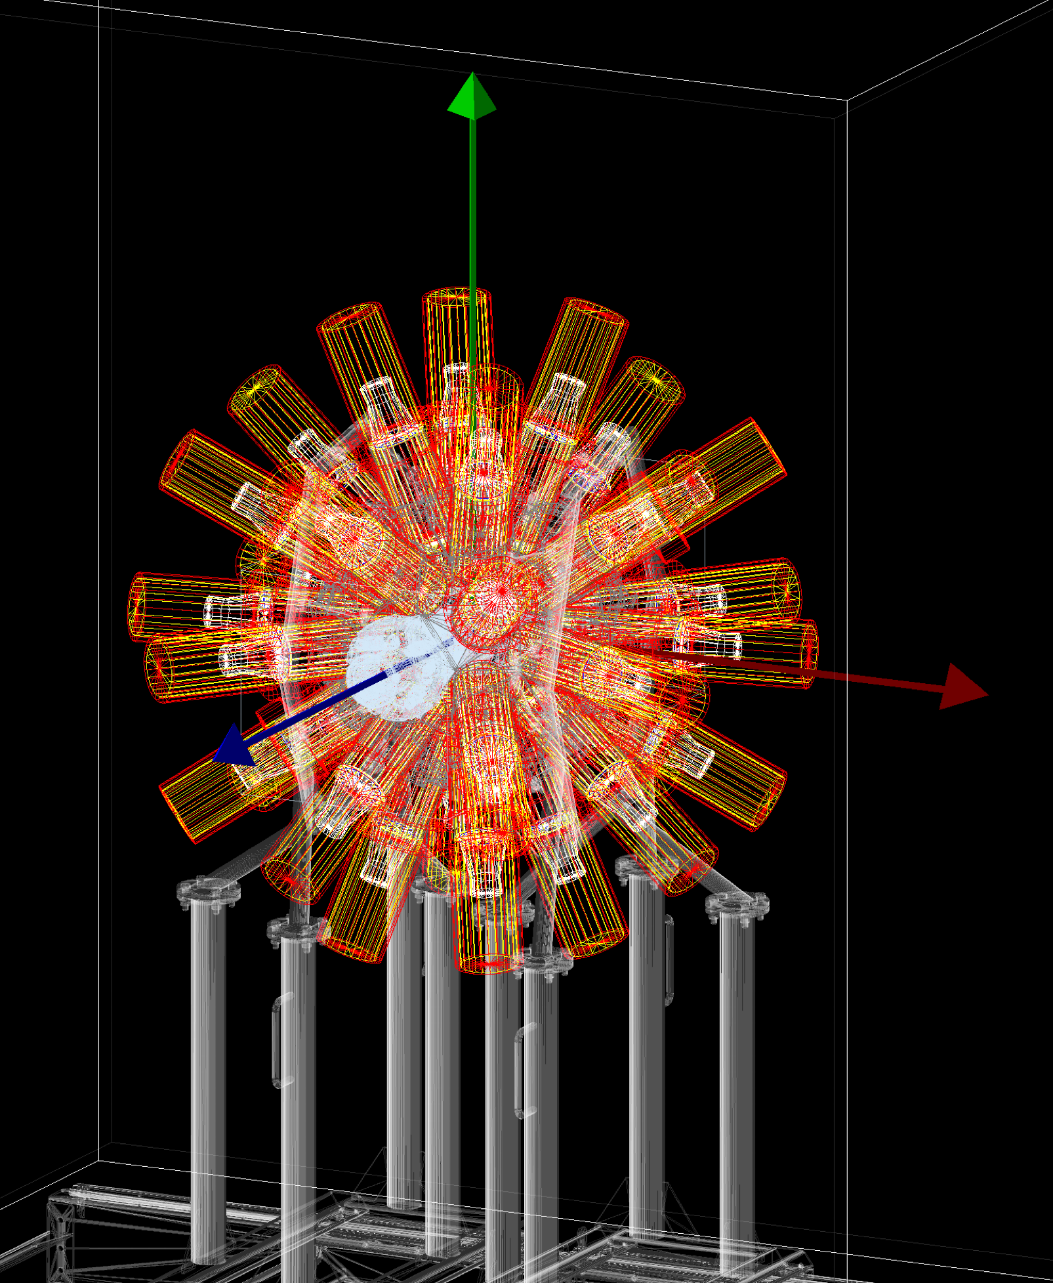
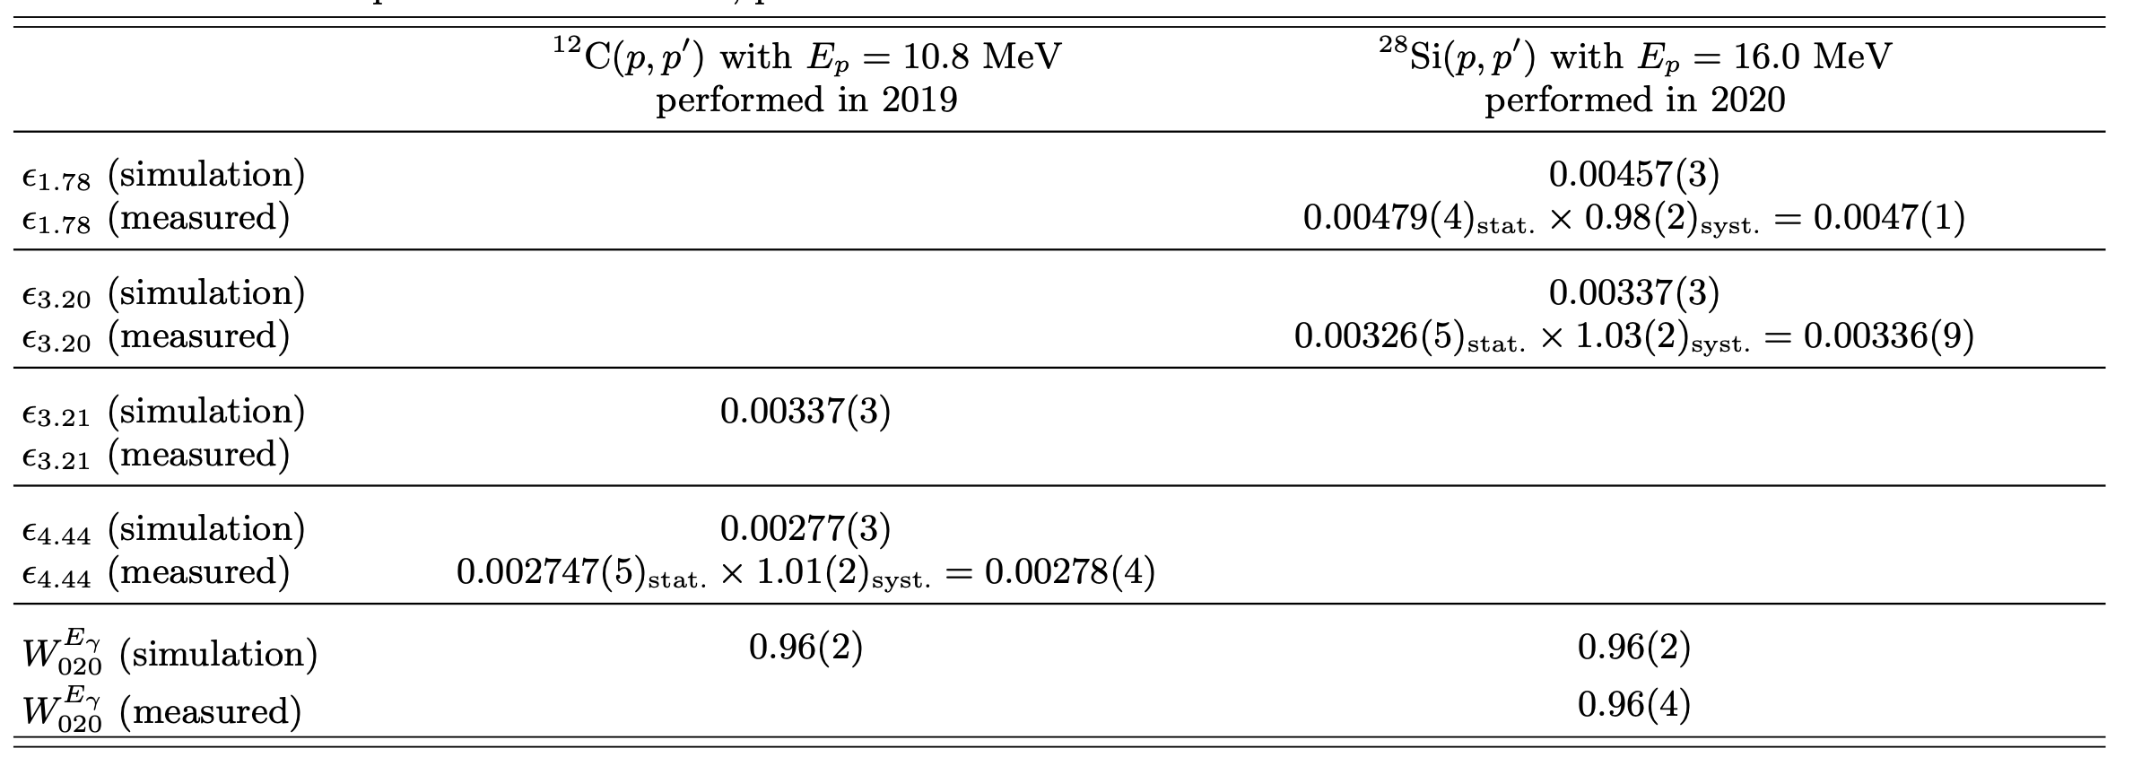
Efficiencies and angular correlation correction factors of OSCAR
The efficiency and the angular correlation correction factors have been calculated by K. C. W. Li using the OSCAR response function in GEANT4 created by Zeiser et al. (2021).
We also measured in-beam efficiencies for several transitions to confirm our simulation results, however all results are extracted using experimental efficiencies.
Simulation accounts for ± 1 mm distance uncertainty for the OSCAR detectors, beam energy differences, corrections from measuring cascading gammas and finite-solid effects of the LaBr3-detectors of OSCAR.
Wanja Paulsen - 9th Workshop on Nuclear Level Density and Gamma Strength
18

Slide 19
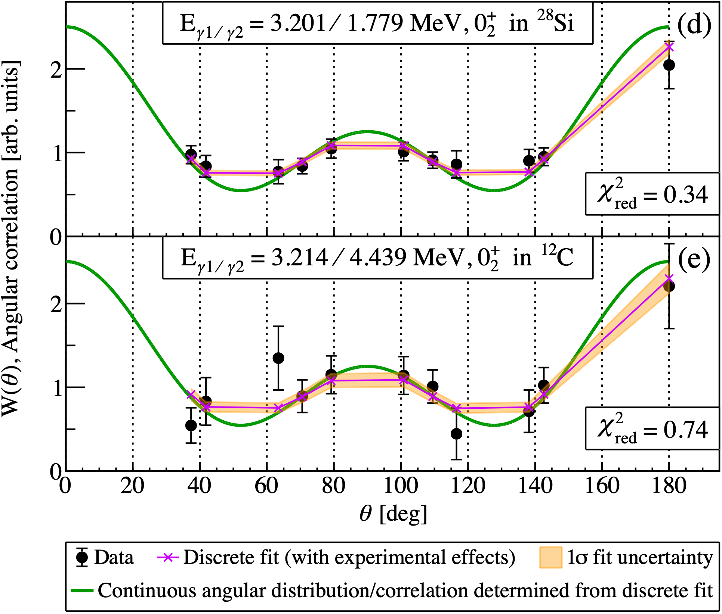
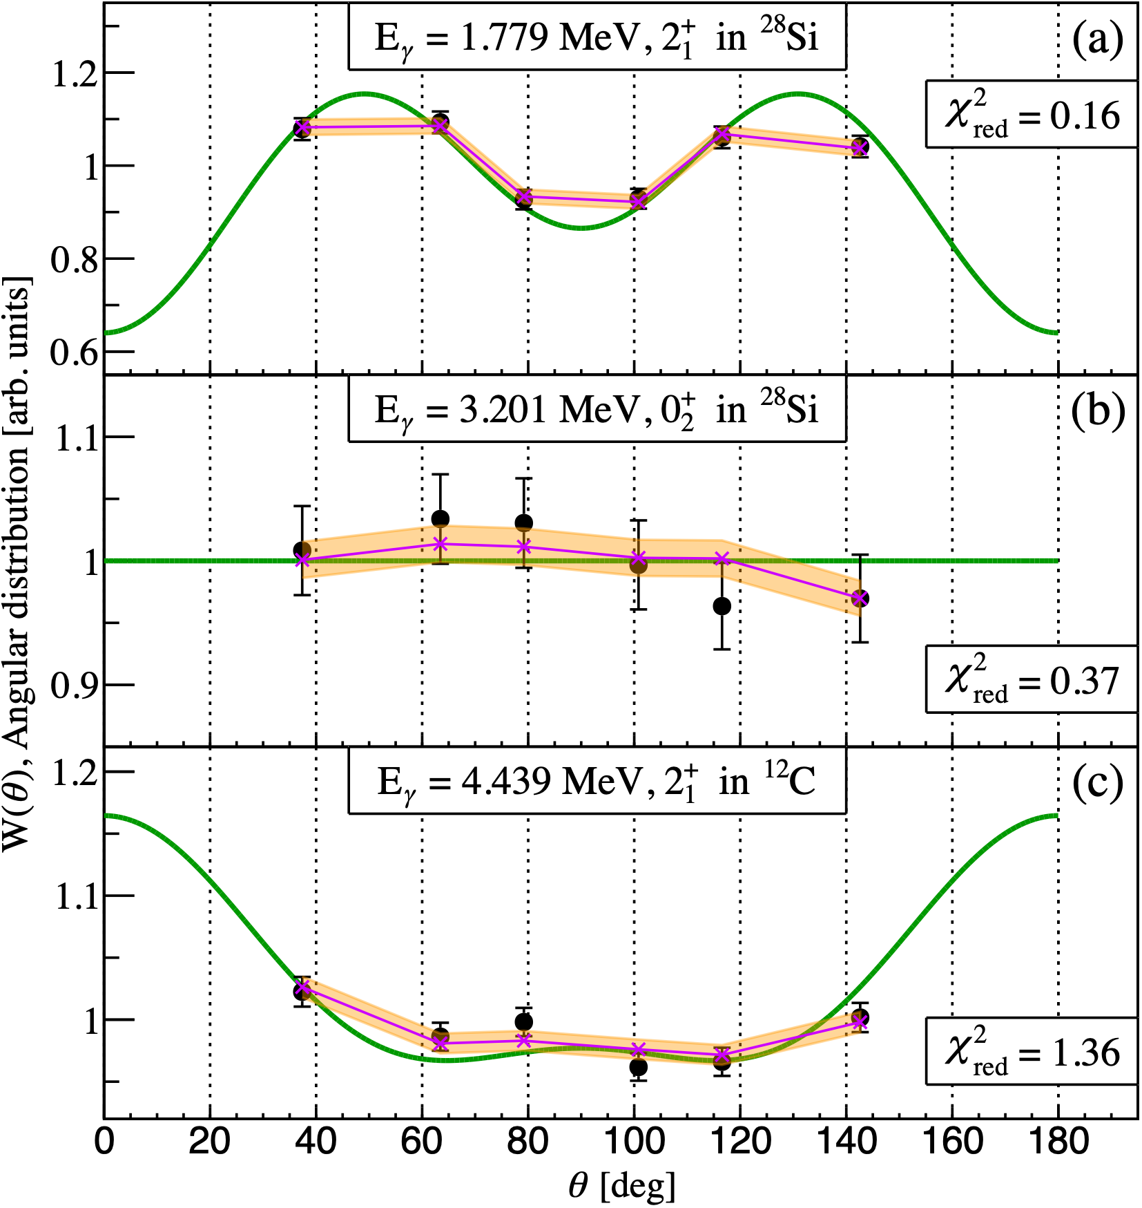
Efficiencies and angular correlation correction factors of OSCAR
Wanja Paulsen - 9th Workshop on Nuclear Level Density and Gamma Strength
19

Slide 20
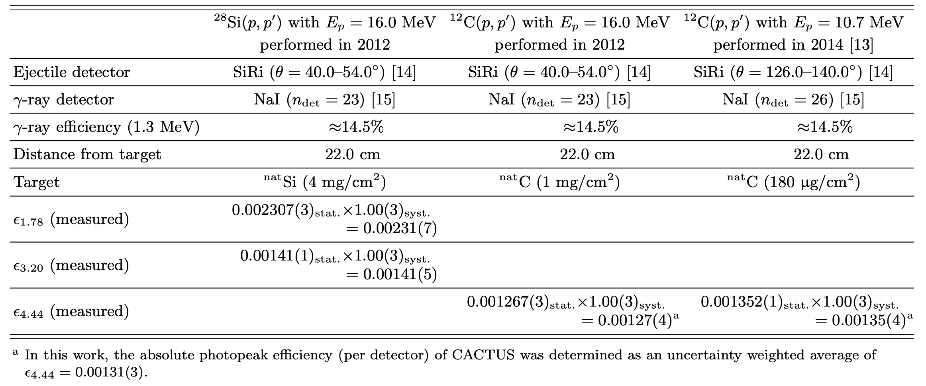
Efficiencies and angular correlation correction factors of CACTUS
For the CACTUS array we do not have a full GEANT4 simulation available.
For results of 2012 and 2014 measurements, no correction to the distance uncertainty for the detectors, beam energy differences, corrections from measuring cascading gammas and finite-solid effects of the NaI(Ti)-detectors of CACTUS.
A 3% systematic uncertainty was added to all efficiencies.
Angular correlation correction factor W020 from Kibédi et al. (2020) was used for all measurements using CACTUS.
Wanja Paulsen - 9th Workshop on Nuclear Level Density and Gamma Strength
20

Slide 21
Corrections to Kibédi et al. (2020)
Throughout the reanalysis of the 2014 measurement, necessary corrections to Kibédi et al. (2020) was discovered.
The absolute photopeak efficiencies presented in the Kibédi et al. (2020) are not absolute, but relative.
  Efficiencies in Kibédi et al. (2020) are simulated using PENELOPE.
  Approximately a factor $\sqrt{2}$ difference from the experimental efficiencies obtained in this work.
The detector combinations used by Kibédi et al. (2020) was cdet = 325. The true number of detector combinations should be cdet = 650.
Through this work we therefore determine the gamma-decay branching ratio obtained using equation A [Eq. 2 in Kibédi et al. (2020)] should be discarded.
The gamma-decay branching ratio obtained using equation B [Eq. 3 in Kibédi et al. (2020)] is still valid, as the efficiencies are relative and the term for detector combinations is removed.
A
B
Wanja Paulsen - 9th Workshop on Nuclear Level Density and Gamma Strength
21

Slide 22
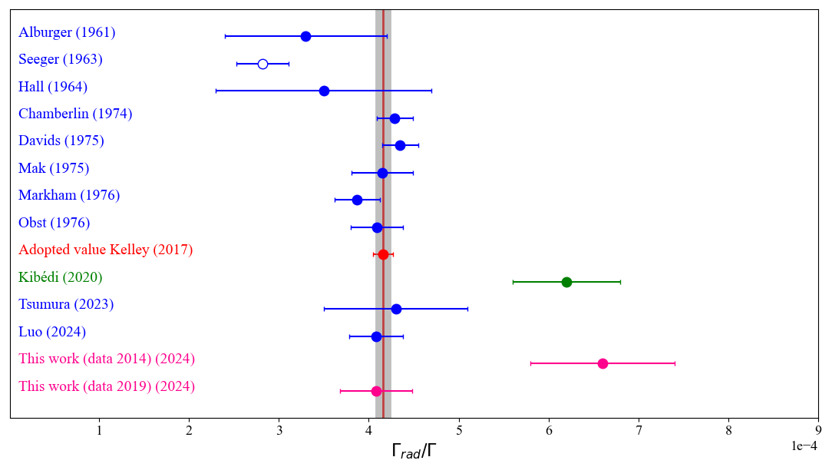
Results of this work
Wanja Paulsen - 9th Workshop on Nuclear Level Density and Gamma Strength
22

Slide 23
Is there a physical justification for the discrepant result?
Cardella et al. (2021, 2023) suggested that the discrepant value of Kibédi et al. (2020) can be explained by excitation of the Efimov state in ¹²C.
The Efimov effect is a quantum mechanical phenomenon where three particles interact in such a way that they form a bound state even when no two of them can form a bound state individually.
The Efimov state is predicted to exist in ¹²C at Ex = 7.485 MeV [Naidon et al. (2017)], meaning that it would decay to the Ex=4.44 MeV 2⁺ state in ¹²C by a E𝛾=3.018 MeV 𝛾 ray.
A study by Bishop et al. (2024), which employed the β-decay population of ¹²C states and astrophysical rate calculations, has yielded strong evidence against the very existence of the Efimov state at Ex=7.485 MeV in ¹²C.
Let us investigate if this is a possible explanation for the discrepant result for the ¹²C(p,p’) measurement from 2014.
Wanja Paulsen - 9th Workshop on Nuclear Level Density and Gamma Strength
23

Slide 24
Is there a physical justification for the discrepant result?
The Efimov state is predicted to exist at Ex = 7.485 MeV, meaning that it would decay to the Ex=4.44 MeV 2+ state in ¹²C by a E𝛾=3.018 MeV 𝛾 ray.
  The resolution of the NaI(Ti) detectors would resolve this peak in the spectrum.
Wanja Paulsen - 9th Workshop on Nuclear Level Density and Gamma Strength
24

Slide 25
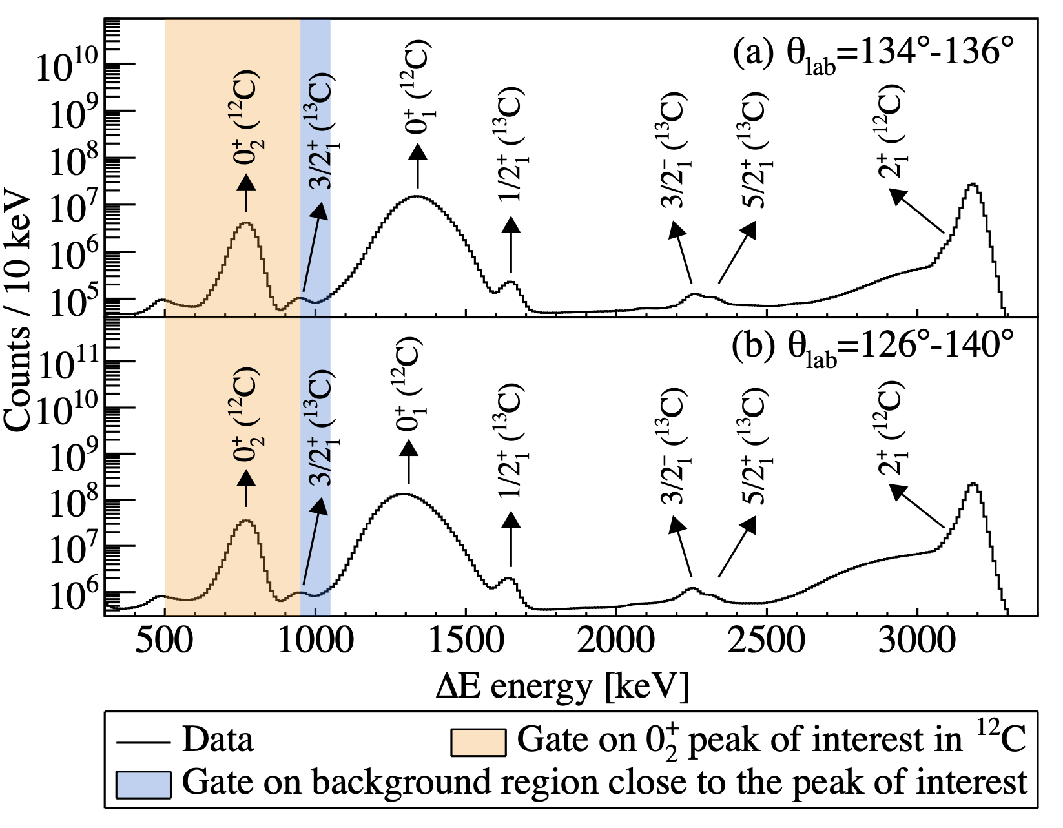
Is there a physical justification for the discrepant result?
The ejectile proton from the Ex = 7.485 MeV will be detected at ΔE ~ 1000 keV.
  The Hoyle state and the Efimov state would be separated by minimum 150 keV when assuming zero dead layer in the ΔE detector. Assuming 25 um deadlayer the separation would be 250 keV. This is easily resolved with the 90 keV resolution of the ΔE detector.
  Let us do a more selective test to investigate the ΔE spectra!
Wanja Paulsen - 9th Workshop on Nuclear Level Density and Gamma Strength
25

Slide 26
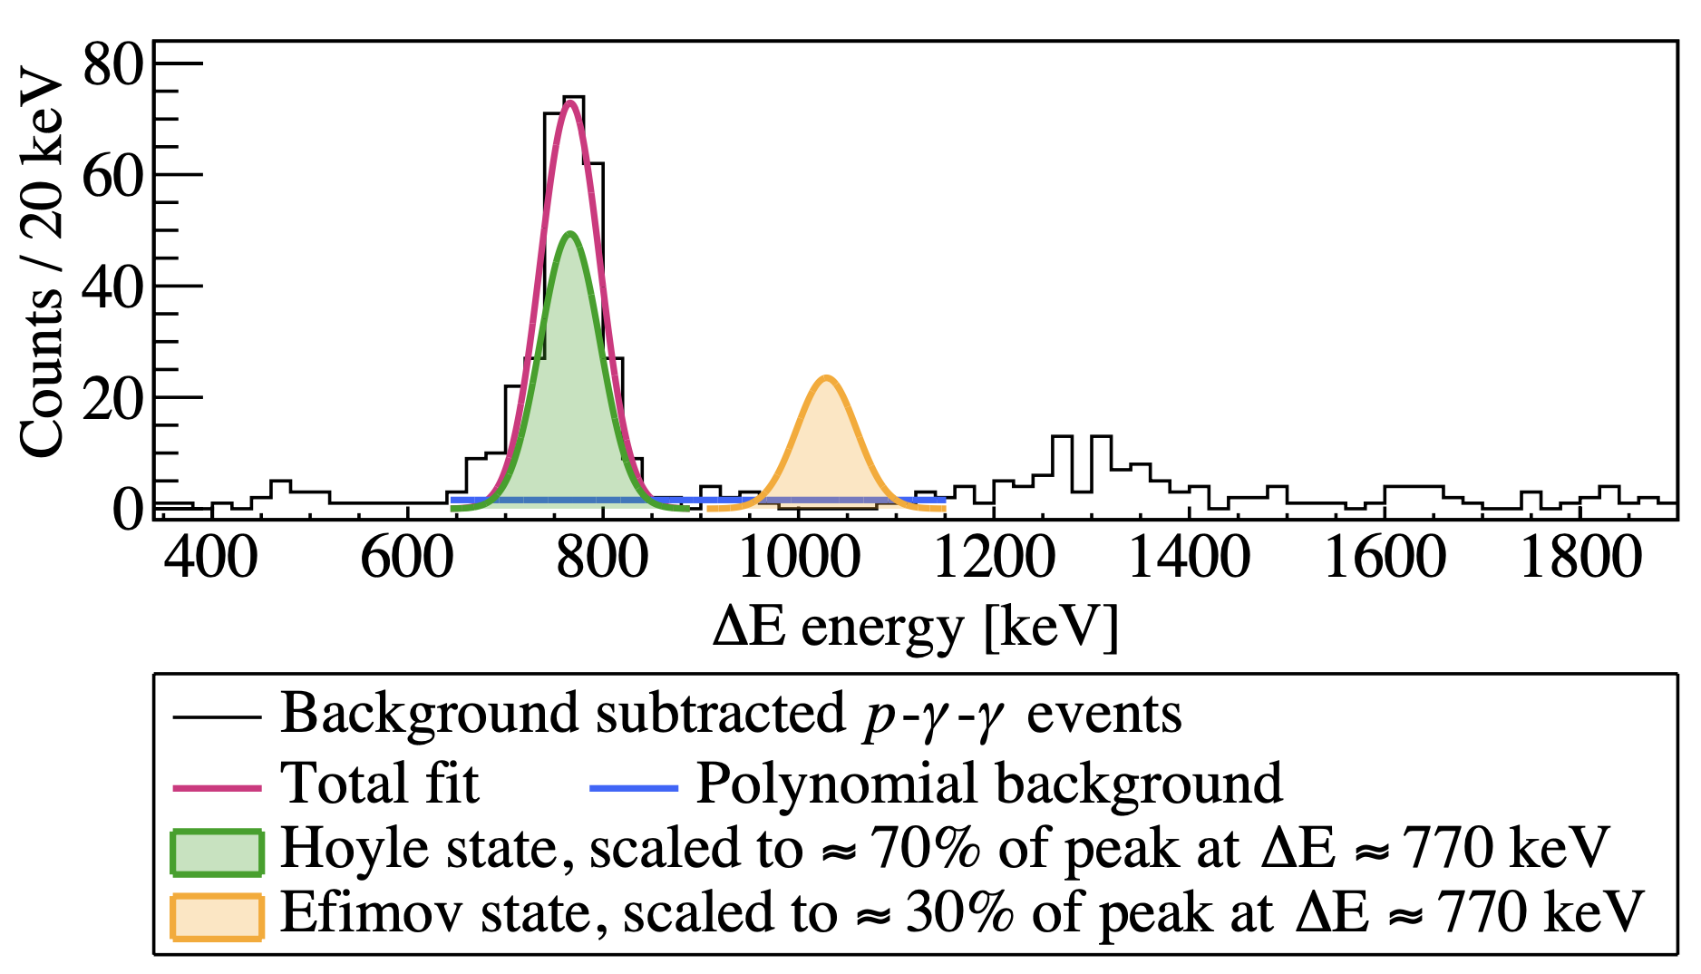
Is there a physical justification for the discrepant result?
We can do a more selective test to find a possible contamination in the ΔE spectrum by gating on the E𝛾=3.21 MeV and E𝛾=4.44 MeV 𝛾-ray photopeaks from the Hoyle state with the same analysis method as performed with all other measurements.
If we assume that the only contribution to the discrepant result of $Γ_{rad}/Γ=6.1(6)×{10}^{-4}$ [Kibédi et al. (2020)] is from the Efimov State, comparing this to the previously accepted value from Kelley et al. (2017) $Γ_{rad}/Γ=4.16(11)×{10}^{-4}$ the expected contribution to the Efimov peak would be 30%.
Wanja Paulsen - 9th Workshop on Nuclear Level Density and Gamma Strength
26

Slide 27
Comparing 2014 and 2019
Finally, the excitation of the Efimov State should be present in the measurement from 2014 and the measurement from 2019.
However, there is no discrepant result from the measurement of 2019.
No physical justification for the discrepant result of Kibédi et al. (2020) and this work could be found.
2019
2014
¹²C(p,p’)
10.8 MeV protons
OSCAR: 30 LaBr3 (3.5’’ x 8.0’’)
Digital AQ
Utilise only front layer of particle telescope
¹²C(p,p’)
10.7 MeV protons
CACTUS: 26 NaI (5’’ x 5’’)
Analog AQ
Utilise only front layer of particle telescope
Wanja Paulsen - 9th Workshop on Nuclear Level Density and Gamma Strength
27

Slide 28
Summary
A new measurement of the gamma-decay branching ratio of the Hoyle state in ¹²C was performed at OCL.
  The results agree well with the previously adopted value from Kelley et al. (2021) of $Γ_{rad}/Γ=4.16(11)×{10}^{-4}$.
An independent reanalysis of the measurement published by Kibédi et al. (2020) was performed.
  Several necessary corrections to the results published by Kibédi et al. (2020) was found.
  The final result was determined to still be valid, as several methods were used to obtain the ${Γ_{γ}}/Γ$.
  The final $Γ_{rad}/Γ=6.7(9)×{10}^{-4}$ determined in this work agree with the discrepant results by Kibédi et al. (2020)
A possible physical justification for the discrepant result was investigated.
  It was determined that the Efimov state is an unlikely candidate for this physical justification.
  No physical justification for the discrepant result of Kibédi et al. (2020) and this work could be found.
More independent measurements for the radiative width of the Hoyle state are crucial. Such new measurements will further substantiate whether the discrepant result by Kibédi et al. (2020) should be excluded from future evaluations.
Wanja Paulsen - 9th Workshop on Nuclear Level Density and Gamma Strength
28

Slide 29
Thank you to all our collaborators
Supervisors
K. C. W. Li^{1 and} S. Siem¹
Coauthors
V. W. Ingeberg^{1 ,} A. C. Larsen^{1 ,} T. K. Eriksen^{1 ,}
H. C. Berg^{1, †,} M. M. Bjørøen^{1,} B. J. Coombes^{2,} J.T.H. Dowie^{2,} F. W. Furmyr¹, F. L. B. Garrote^{1 ,} D. Gjestvang^{1,} A. Görgen^{1,} T. Kibédi^{2,} M. Markova¹, V. Modamio^{1,} E. Sahin^{1,} A. E Stuchbery^{2,} G. M. Tveten^{1,} V. M. Valsdòttir¹
¹Department of Physics, University of Oslo, N-0316 Oslo, Norway
²Department of Nuclear Physics and Accelerator Applications, Research School of Physics, The Australian National University, Canberra, Australian Capital Territory 2601, Australia
† Current address: Facility for Rare Isotope Beams, 640 S Shaw Ln, East Lansing, MI 48824, USA
Special thanks to
J. C. Müller, P. A. Sobas, and J. C. Wikne at the Oslo Cyclotron Laboratory (OCL)
F. Zeiser
Research Council of Norway through its grant to the Norwegian Nuclear Research Centre (Project No. 341985, 245882 and 325714)
UNINETT Sigma2 (using “SAGA” on Project No. NN9895K and NN9464K)
European Research Council through ERC-STG-2014 under Grant Agreement No. 637686 and from the Research Council of Norway, Project Grant No. 316116.
Wanja Paulsen - 9th Workshop on Nuclear Level Density and Gamma Strength
29

Slide 30
References
Kibédi et al. (2020): T. Kibédi, B. Alshahrani, A. E. Stuchbery, A. C. Larsen, A. Görgen, S. Siem, M. Guttormsen, F. Giacoppo, A. I. Morales, E. Sahin, G. M. Tveten, F. L. B. Garrote, L. C. Campo, T. K. Eriksen, M. Klintefjord, S. Maharramova, H.-T. Nyhus, T. G. Tornyi, T. Renstrøm, and W. Paulsen, Radiative width of the Hoyle state from γ- ray spectroscopy, Phys. Rev. Lett. 125, 182701 (2020).
Obst et al. (1975): A. W. Obst and W. J. Braithwaite, Phys. Rev. C 13, 2033 (1976).
Zeiser et al. (2021): F. Zeiser, G. Tveten, F. Bello Garrote, M. Guttormsen, A. Larsen, V. Ingeberg, A. Go ̈rgen, and S. Siem, The γ-ray energy response of the Oslo scintillator array OSCAR, Nuclear Instruments and Methods in Physics Research Section A: Accelerators, Spectrometers, Detectors and Associated Equipment 985, 164678 (2021).
Cardella et al. (2021): G. Cardella, F. Favela, N. S. Martorana, L. Acosta, A. Camaiani, E. De Filippo, N. Gelli, E. Geraci, B. Gnoffo, C. Guazzoni, G. Imm`e, D. J. Marín-Lámbarri, G. Lanzalone, I. Lombardo, L. Lo Monaco, C. Maiolino, A. Nannini, A. Pagano, E. V. Pagano, M. Papa, S. Pirrone, G. Politi, E. Pollacco, L. Quattrocchi, F. Risi- tano, F. Rizzo, P. Russotto, V. L. Sicari, D. Santonocito, A. Trifir`o, and M. Trimarchi, Investigating γ-ray decay of excited 12C levels with a multifold coincidence analysis, Phys. Rev. C 104, 064315 (2021).
Cardella et al. (2023): Cardella, Giuseppe, Bonasera, Aldo, Martorana, Nunzia, Simona, Acosta, Luis, De Filippo, Enrico, Geraci, Elena, Gnoffo, Brunilde, Guazzoni, Chiara, Maiolino, Concettina, Pagano, Angelo, Pagano, Emanuele, Vin- cenzo, Papa, Massimo, Pirrone, Sara, Politi, Giuseppe, Risitano, Fabio, Rizzo, Francesca, Russotto, Paolo, and Trimarchi, Marina, Potential experimental evidence of an efimov state in 12C and its influence on astrophysical carbon creation, EPJ Web Conf. 279, 03001 (2023).
Naidon et al. (2017): P. Naidon and S. Endo, Efimov physics: a review, Re- ports on Progress in Physics 80, 056001 (2017).
Kelley et al. (2017): J. Kelley, J. Purcell, and C. Sheu, Energy levels of light nuclei A=12, Nuclear Physics A 968, 71 (2017).
Bishop et al. (2024): J. Bishop, G. V. Rogachev, S. Ahn, E. Aboud, M. Barbui, A. Bosh, J. Hooker, C. Hunt, H.
Jayatissa, E. Koshchiy, R. Malecek, S. T. Marley, M. Munch, E. C. Pollacco, C. D. Pruitt, B. T. Roeder, A. Saastamoinen, L. G. Sobotka, and S. Upadhyayula, Evidence against the efimov effect in 12C from spectroscopy and astrophysics, Phys. Rev. C 103, L051303 (2021).
Wanja Paulsen - 9th Workshop on Nuclear Level Density and Gamma Strength
30

