Slide 1


Impact of model variations for degenerate neutron capture rates within neutron star crusts
Bryn Knight
Dr. Liliana Caballero
May 28th 2024

Slide 2
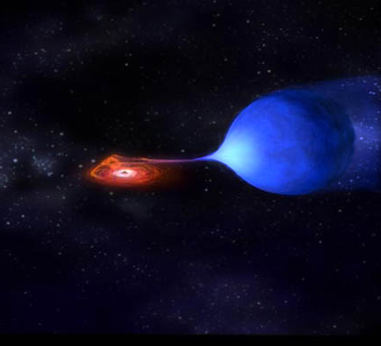
Accreting Neutron star Binary System
Binary system will pair a neutron star with another stellar body
Focus on X-ray Binary system
X-rays are produced by matter falling from donor star to a neutron star

Slide 3
Our Targeted region is a Neutron star’s inner crust
Outer crust: Ions, electron gas
Inner crust: heavy atomic nuclei, relativistic electrons and free neutrons
Outer core: Nuclear pasta, uniform nuclear matter
Inner core: Quark Plasma?
Notes:
Outer crust, density of 10^8 to 10^10 g/cm cubed, ~ 0.5 to 1km
Inner crust, density 10^ 11 to 10^13 g/cm cubed, ~3 to 4 km – pasta fromation
Outer core 10^ 14 to to about double saturation density. Matter is uniform
The region of interest for us is the transition between “inner crust” to outer core – maybe .1 percent of saturation density

Slide 4
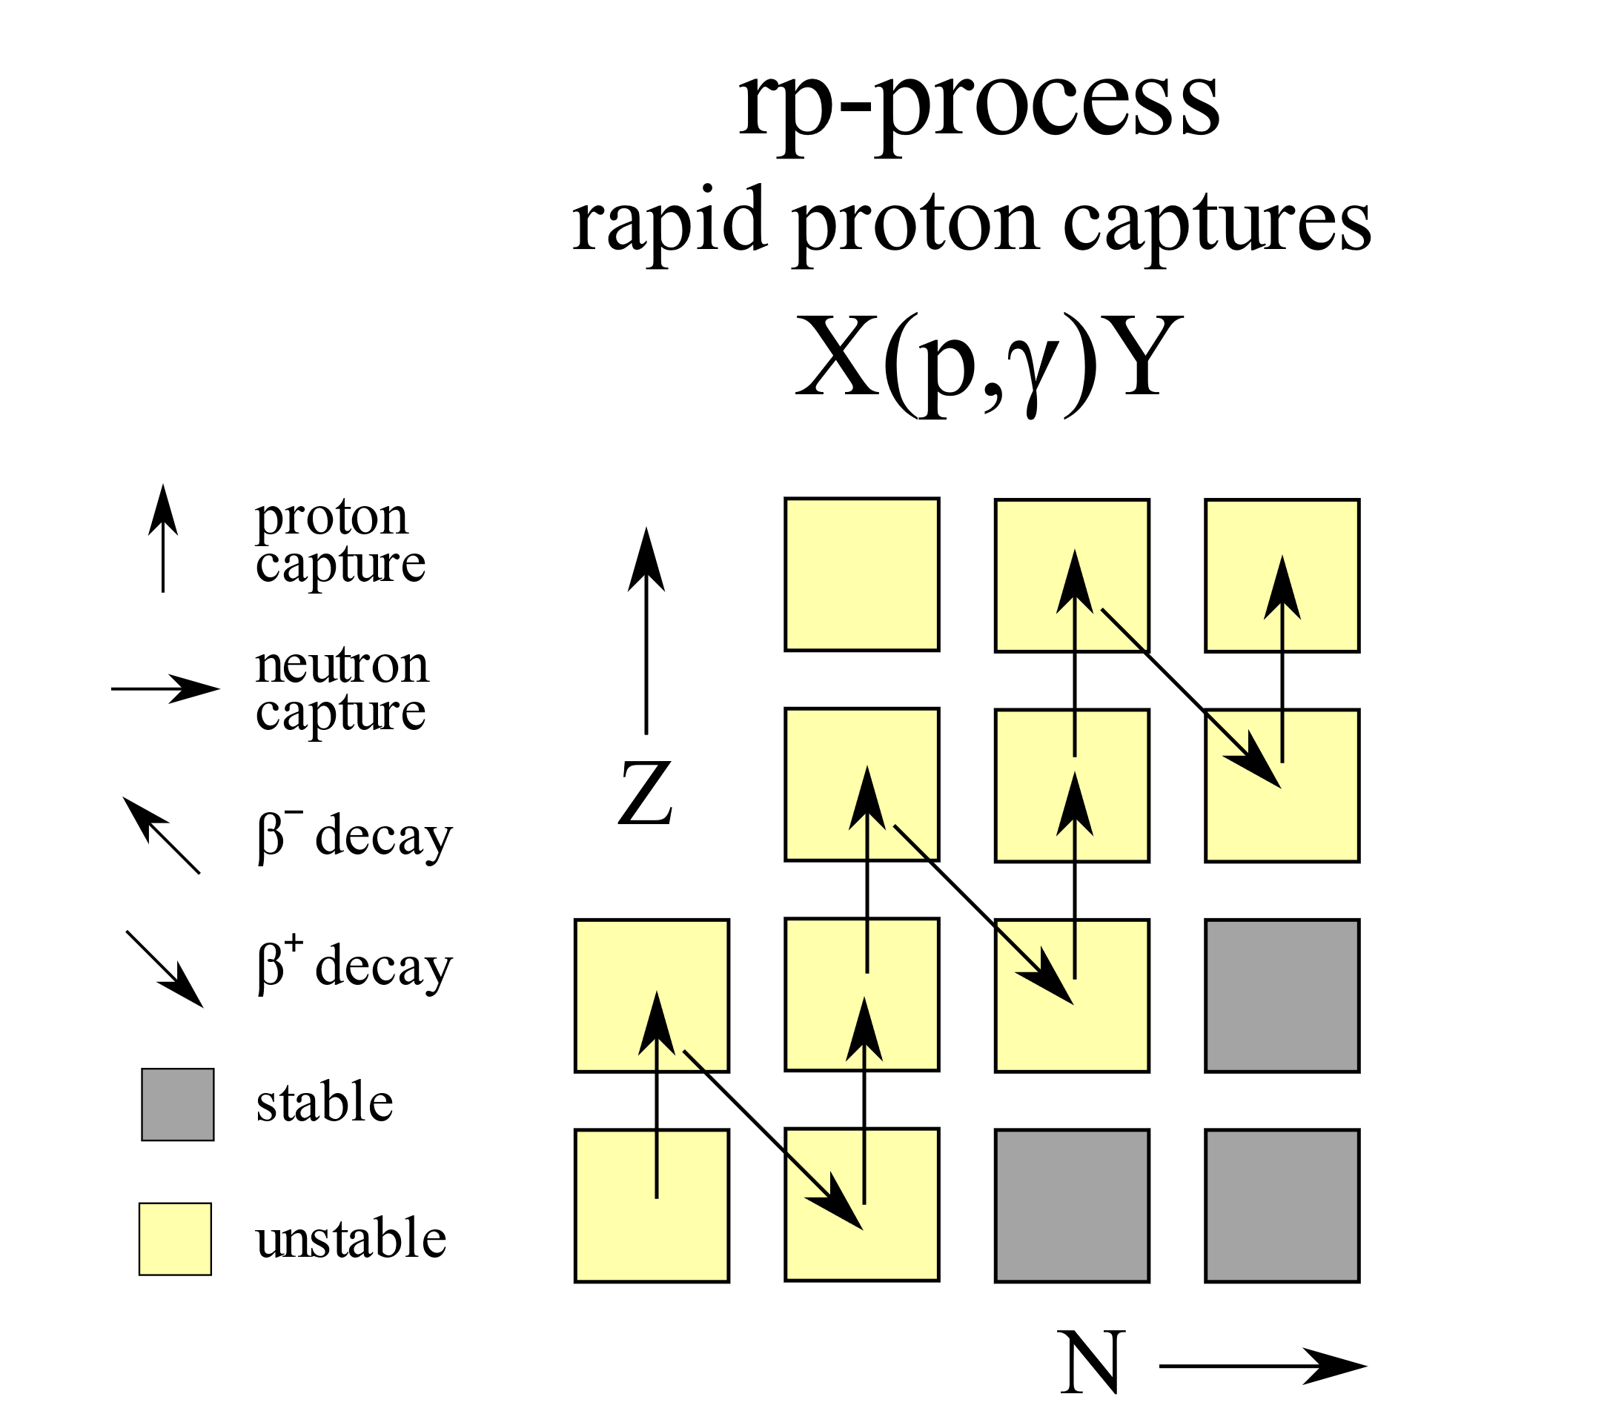
Rp-process ashes act as initial conditions for degenerate neutron capture chains
Neutron star is provided “fuel” via accretion from a companion star, kickstarting rp-process
rp-process by-products (ashes) are relatively stable nuclei, dragged further down the crust¹
Ashes include ⁵²Fe, ⁵⁶Ni and ⁶⁴Ge¹
1-Lau R, Beard M, Gupta S S, Schatz H, Afanasjev A V, Brown E F, Deibel A, Gasques L R, Hitt G W, Hix W R, Keek L, M¨oller P, Shternin P S, Steiner A W, Wiescher M and Xu Y 2018 ApJ 859 62 https://dx.doi.org/10.3847/1538-4357/aabfe0

Slide 5
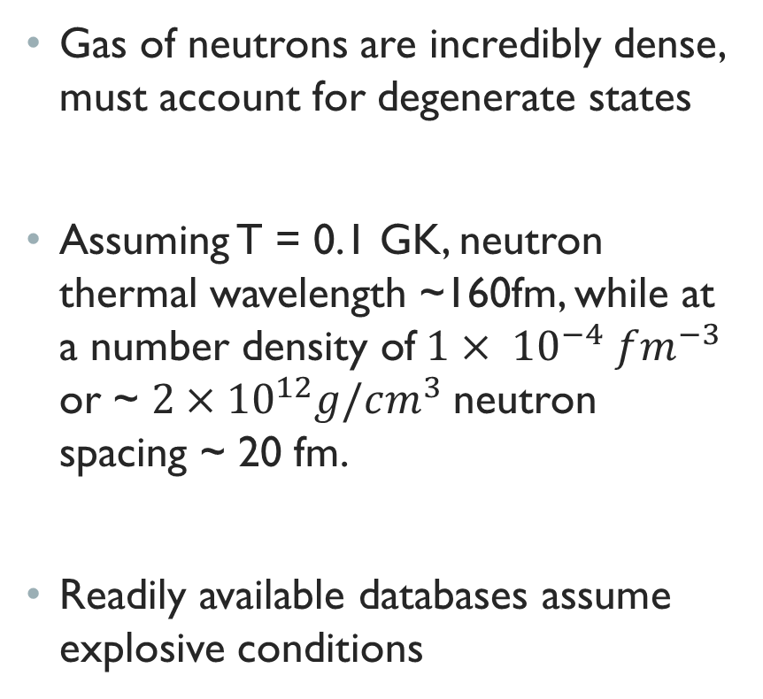
Free neutrons are degenerate at thermodynamic conditions relevant to accreting stars
Gas of neutrons are incredibly dense, must account for degenerate states
Assuming T = 0.1 GK, neutron thermal wavelength ~160fm, while at a number density of$1× {10}^{−4} fm^{−3}$ or ~ $2×{10}^{12}g/cm^{3}$neutron spacing ~ 20 fm.
Readily available databases assume explosive conditions

Slide 6
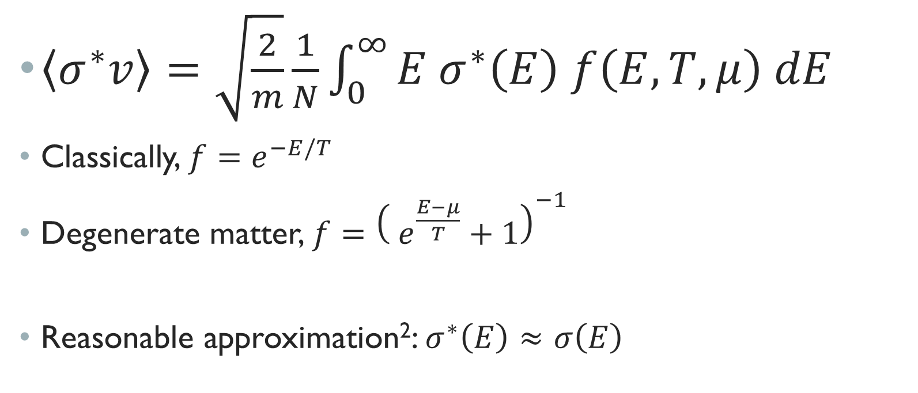
Stellar reaction rates follow a distribution of velocities (energies)
$\left\langle σ^{∗}v\right\rangle =\sqrt{\frac{2}{m}}\frac{1}{N}\int_{0}^{∞}{E{ σ}^{∗}\left(E\right) f\left(E,T,μ\right) dE}$
Classically, $f=e^{−E/T}$
Degenerate matter, $f={\left( e^{\frac{E−μ}{T}}+1\right)}^{−1}$
Reasonable approximation²: $σ^{∗}\left(E\right)≈σ\left(E\right)$
2-Shternin P S, Beard M, Wiescher M and Yakovlev D G 2012 Phys. Rev. C 86(1) 015808 https://link.aps.org/doi/10.1103/PhysRevC.86.015808

Slide 7
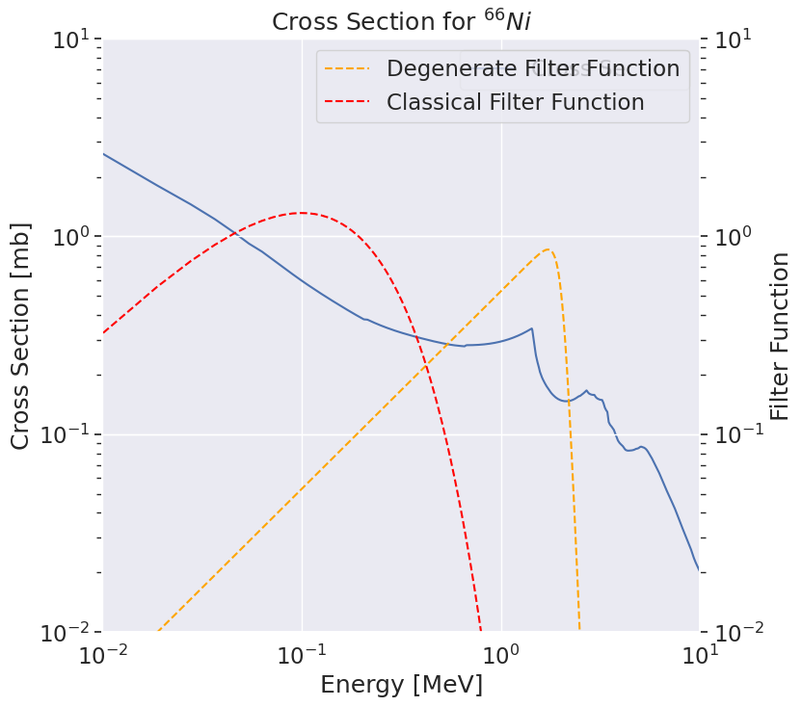
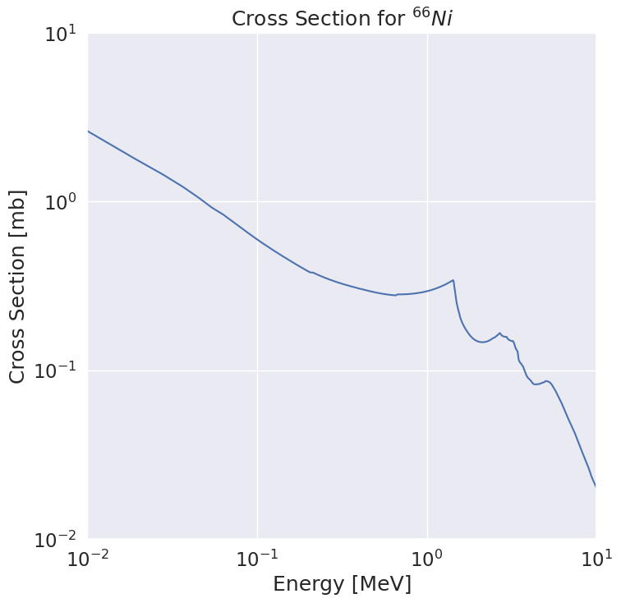
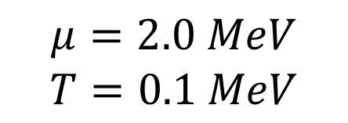
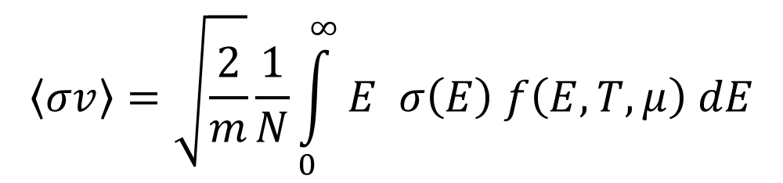
$$μ=2.0 MeV$$
$$T=0.1 MeV$$
$$\left\langle σv\right\rangle =\sqrt{\frac{2}{m}}\frac{1}{N}\int_{0}^{∞}{E σ\left(E\right) f\left(E,T,μ\right) dE}$$
Cross Sections up to ~3 MeV is essential for degenerate capture rates

Slide 8
Variations in theoretical nuclear inputs via TALYS
For neutron rich nuclei, must rely on theoretical inputs
TALYS³ allows a multitude of models when calculating transmission coefficients for the cross section
Determine the impact of mass model, level density, and gamma strength function on degenerate capture rates
3- Goriely S, Hilaire S and Koning A J 2008 Phys. Rev. C 78(6) 064307

Slide 9
TALYS Input Variations
γ-Strength Function | Level Density Model | Mass models
Kopecky-Uhl generalized Lorentzian | Constant temperature + Fermi gas model | Finite Range Liquid Drop Model
Hartree-Fock BCS + QRPA | Back-shifted Fermi gas Model | Hartree-Fock-Bogolyubov using Skyrme Forces
Hartree-Fock-Bogolyubov + QRPA | Generalized super fluid model | Hartree-Fock-Bogolyubov using Gogny Forces
Goriely’s Modified Lorentzian | Hartree-Fock Using Skyrme Force
 | Hartree-Fock-Bogolyubov (Skyrme Force) + Combinatorial method
γ-Strength Function | Level Density Model | Mass models
Kopecky-Uhl generalized Lorentzian | Constant temperature + Fermi gas model | Finite Range Liquid Drop Model
Hartree-Fock BCS + QRPA | Back-shifted Fermi gas Model | Hartree-Fock-Bogolyubov using Skyrme Forces
Hartree-Fock-Bogolyubov + QRPA | Generalized super fluid model | Hartree-Fock-Bogolyubov using Gogny Forces
Goriely’s Modified Lorentzian | Hartree-Fock Using Skyrme Force
 | Hartree-Fock-Bogolyubov (Skyrme Force) + Combinatorial method

Slide 10
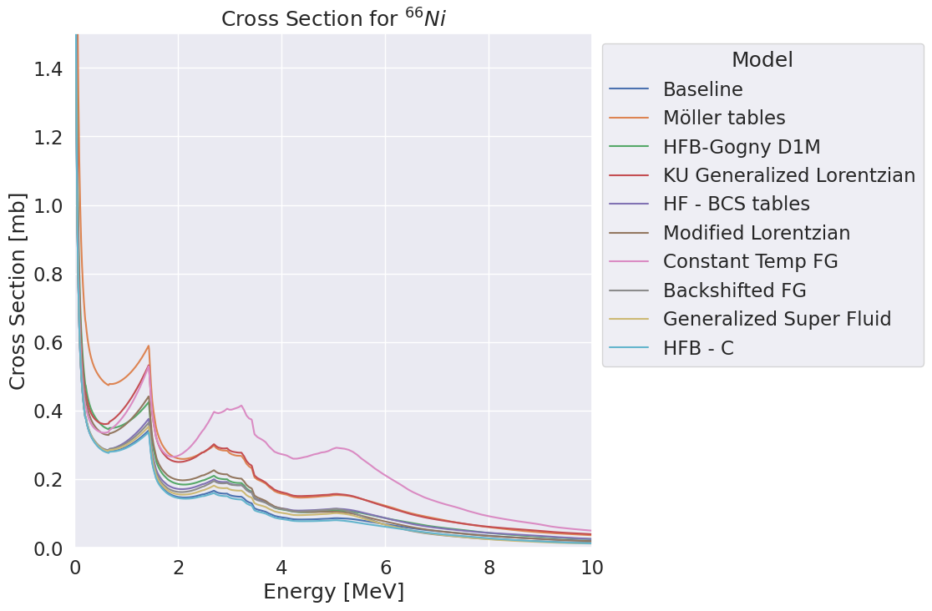

Slide 11
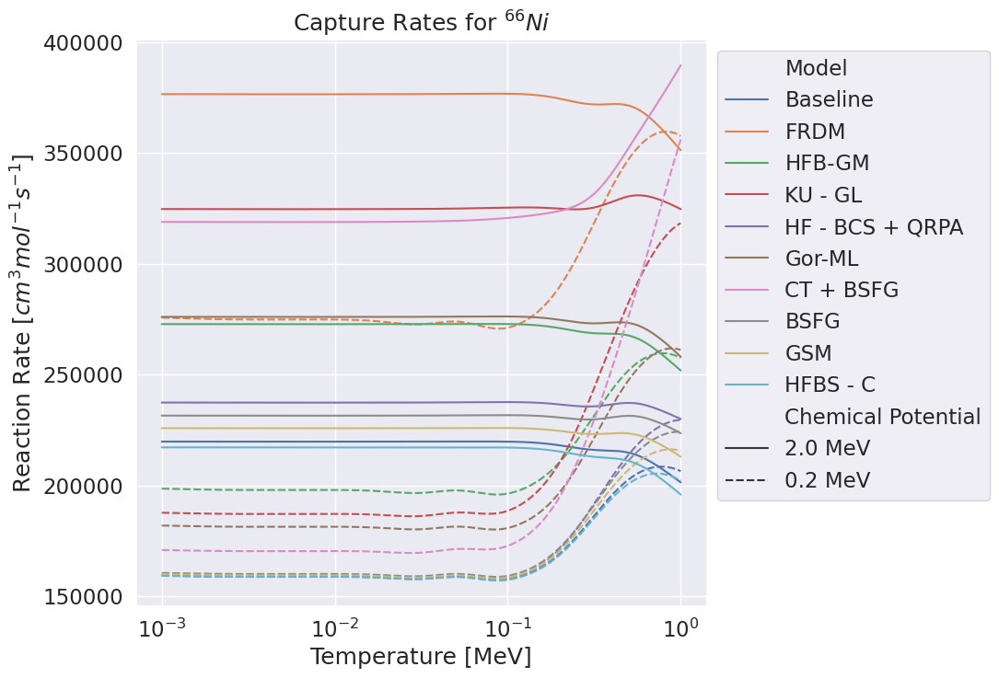

Slide 12
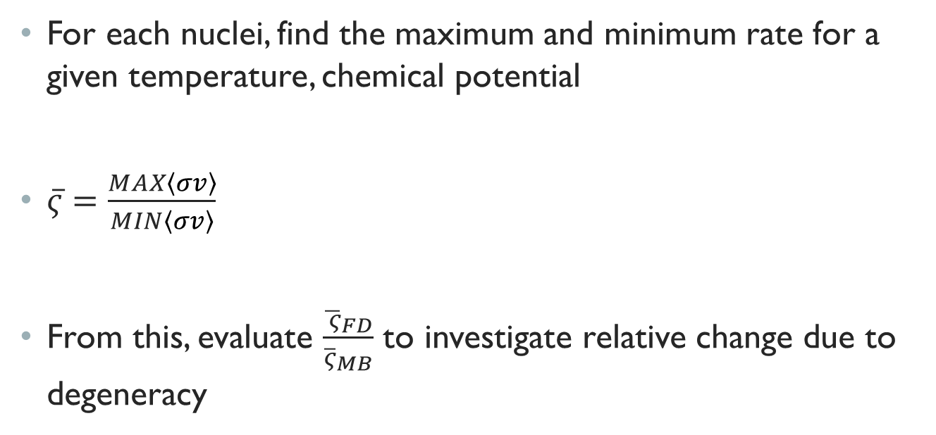
Evaluate Degeneracy impact by comparing max/min rates
For each nuclei, find the maximum and minimum rate for a given temperature, chemical potential
$\overline{ς}=\frac{MAX\left\langle σv\right\rangle }{MIN\left\langle σv\right\rangle }$
From this, evaluate $\frac{{\overline{ ς}}_{FD}}{{\overline{ς}}_{MB}}$ to investigate relative change due to degeneracy

Slide 13
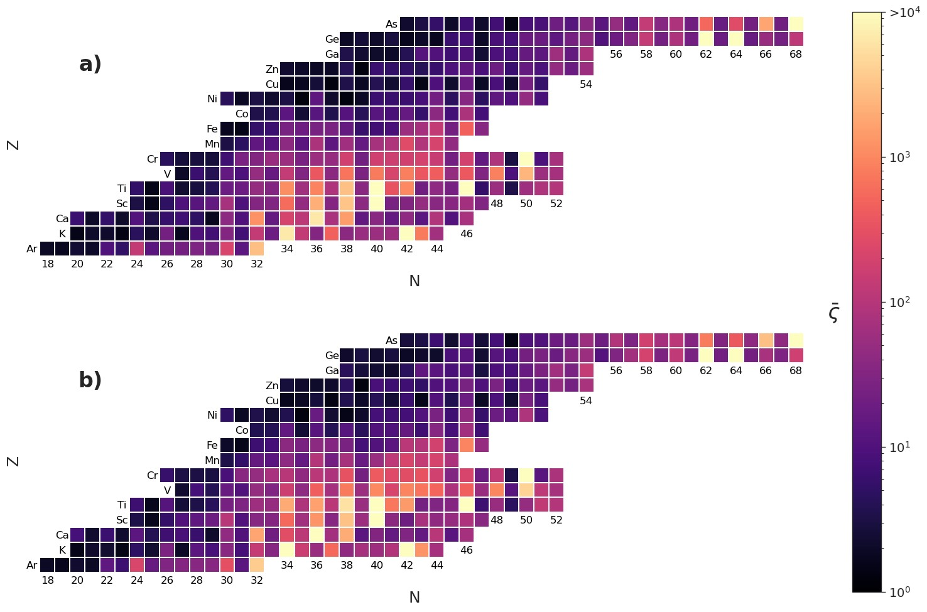
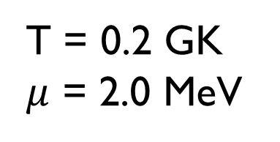
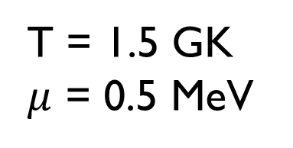
$\overline{ς}$ for degenerate captures with $γ$-SF and LD model variations
T = 1.5 GK
$μ$ = 0.5 MeV
T = 0.2 GK
$μ$ = 2.0 MeV

Slide 14
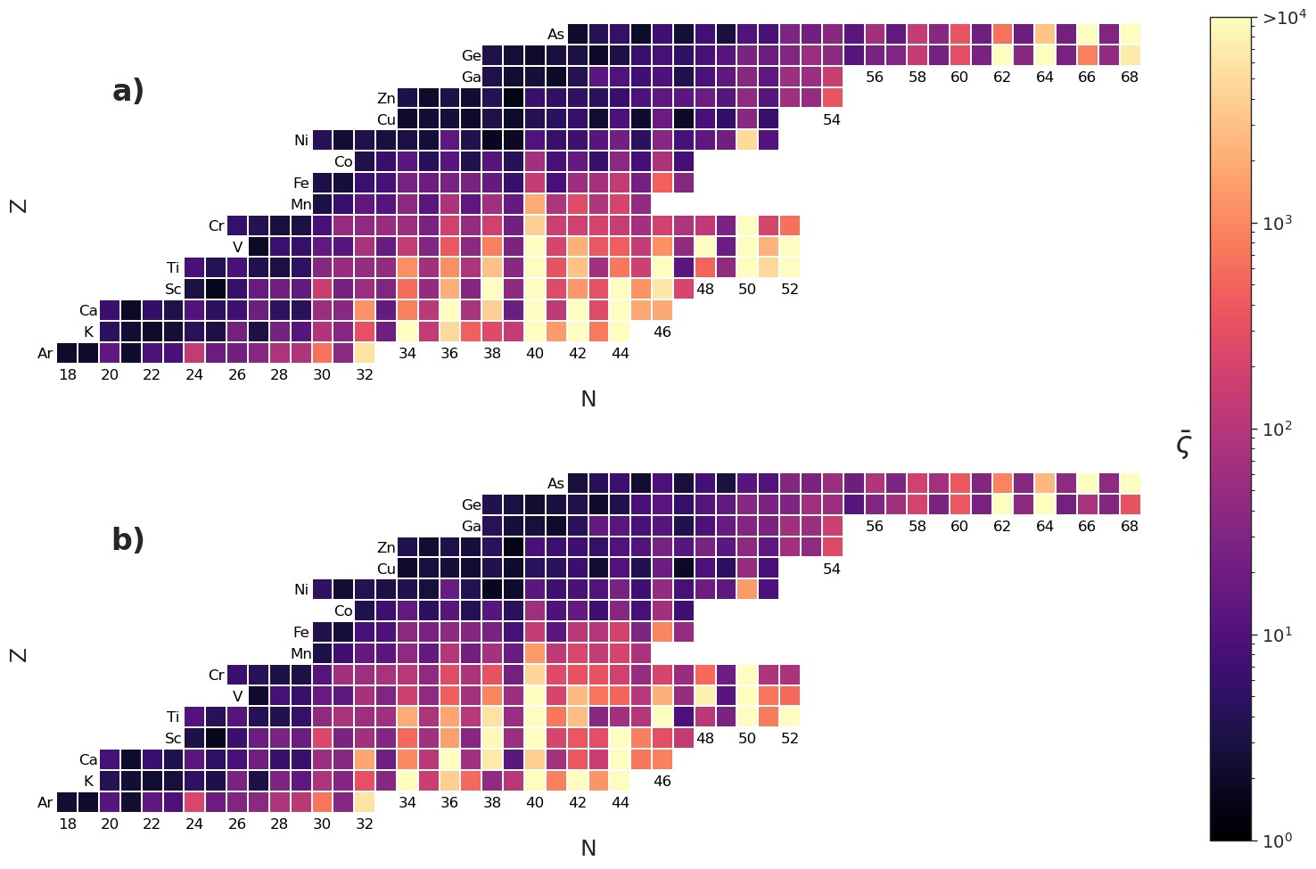
$\overline{ς}$ for degenerate captures with mass, $γ$-SF and LD model variations
T = 1.5 GK
$μ$ = 0.5 MeV
T = 0.2 GK
$μ$ = 2.0 MeV

Slide 15
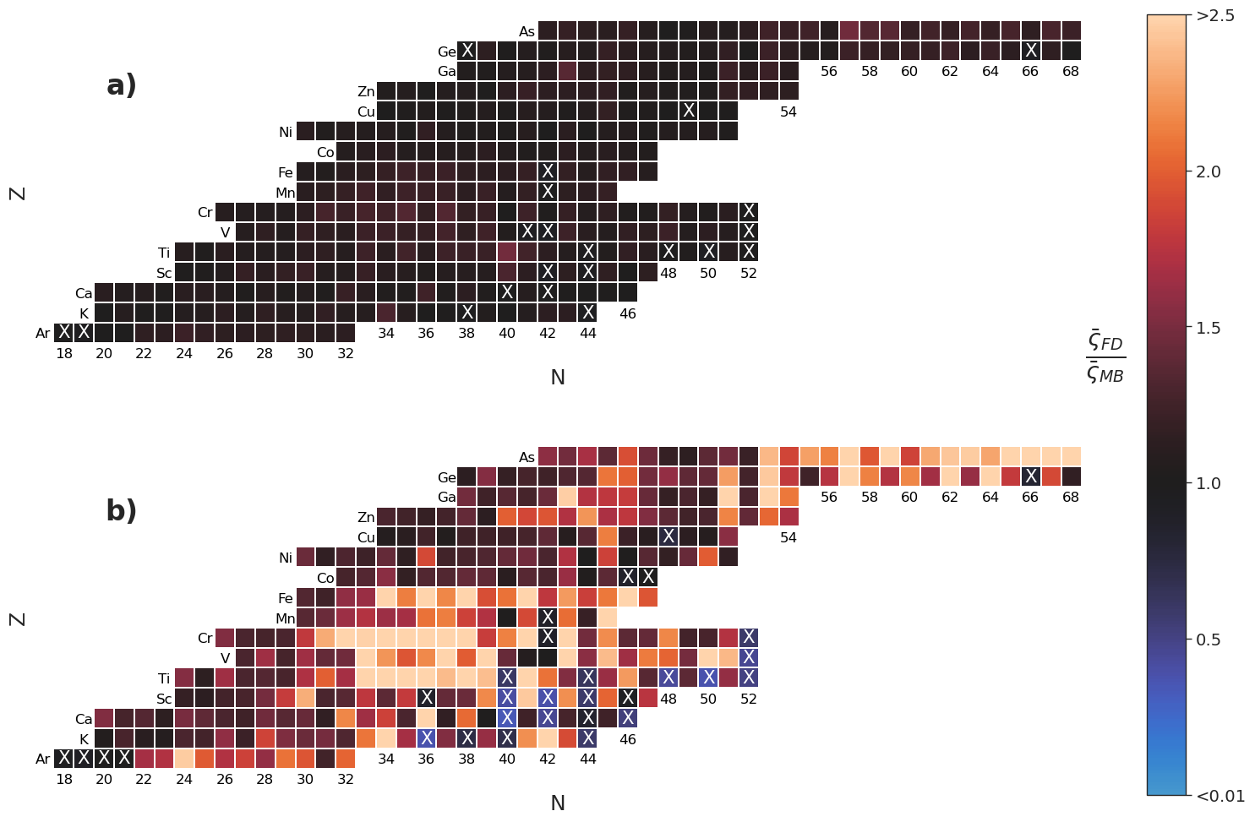

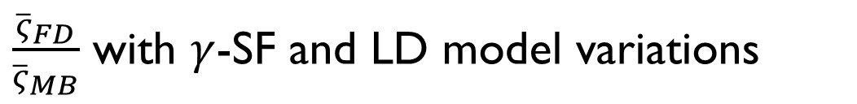
$\frac{{\overline{ς}}_{FD}}{{\overline{ς}}_{MB}}$ with $γ$-SF and LD model variations
X denotes ${{\overline{ς}}_{MB}>\overline{ς}}_{FD}$
T = 1.5 GK
$μ$ = 0.5 MeV
T = 0.2 GK
$μ$ = 2.0 MeV
Notes:
Cooling system creeps spread towards more stable nuclei

Slide 16
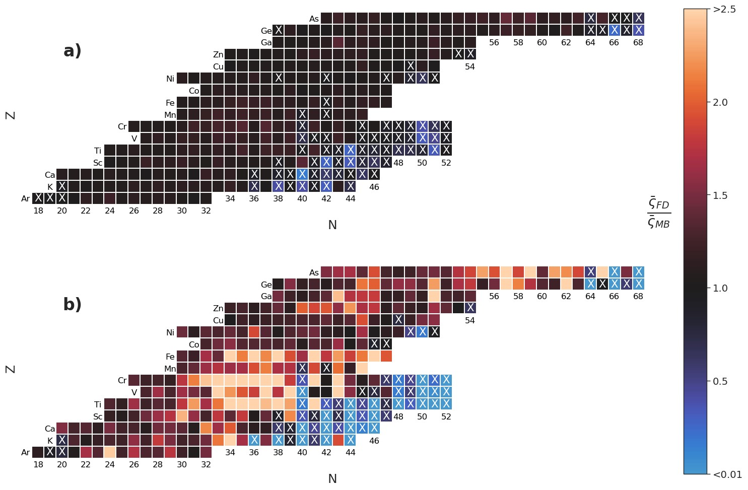
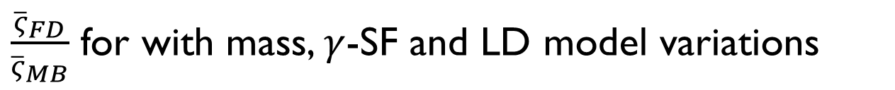
$\frac{{\overline{ς}}_{FD}}{{\overline{ς}}_{MB}}$ for with mass, $γ$-SF and LD model variations
X denotes ${{\overline{ς}}_{MB}>\overline{ς}}_{FD}$
T = 1.5 GK
$μ$ = 0.5 MeV
T = 0.2 GK
$μ$ = 2.0 MeV
Notes:
Cooling system creeps spread towards more stable nuclei

Slide 17

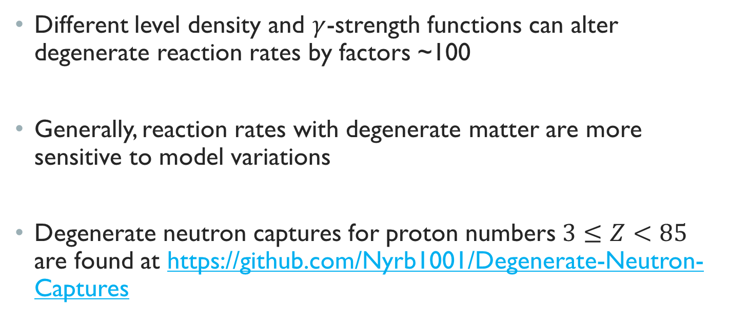
Conclusions
Different level density and $γ$-strength functions can alter degenerate reaction rates by factors ~100
Generally, reaction rates with degenerate matter are more sensitive to model variations
Degenerate neutron captures for proton numbers $3≤Z<85$ are found at https://github.com/Nyrb1001/Degenerate-Neutron-Captures

Slide 18

Thank you!

Slide 19
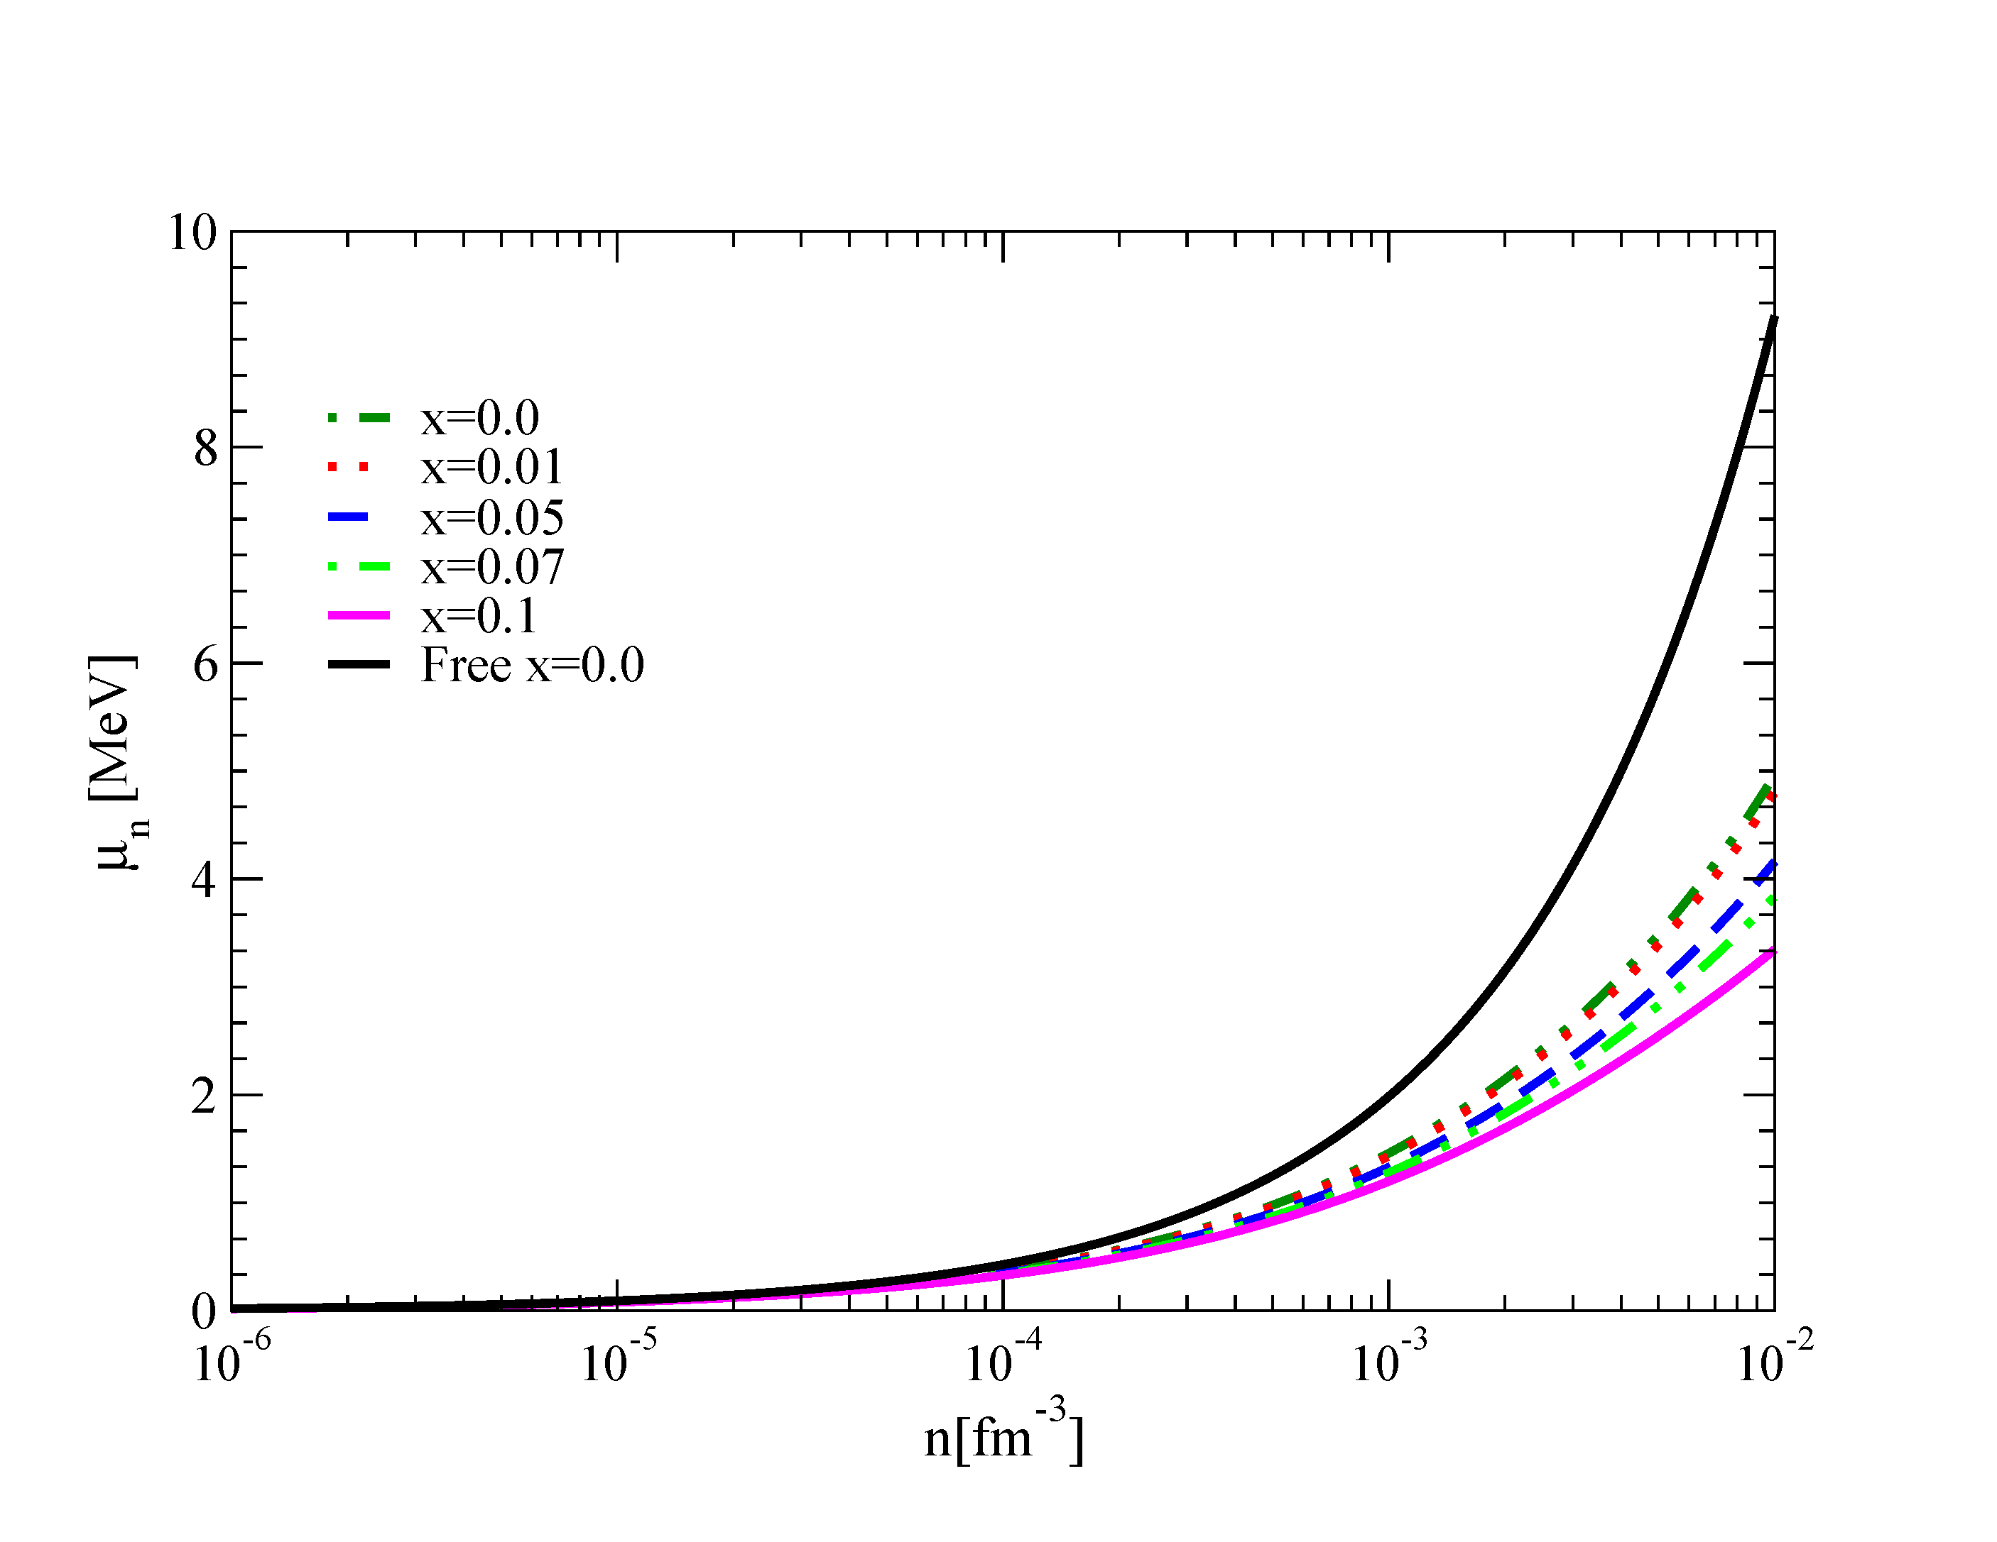
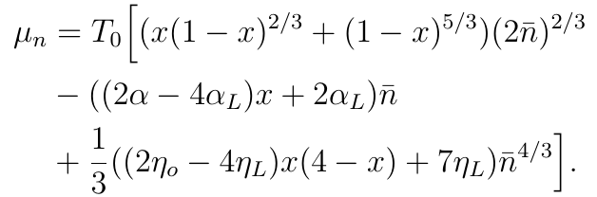
Neutron chemical potential for various proton fractions number densities
Inner crust
Notes:
We convert it to an energy density (E/V) take derivative, get an expression for the chemical potential as a function of density, compare different settings that are relevant to the crust. Closer to the outer crust, higher proton fraction, as we go deeper it should reduce. Use these chemical potential values as boundaries for our calculation.
Typical density range is 1E-5 to 1E-3 fm cubed, typical values are slightly less than 1 MeV
This is not the expression they obtained, but the results agree so ill use the simpler form of it. Its also in agreement with the lee-yang theory for pure neutron matter at low density

