Slide 1
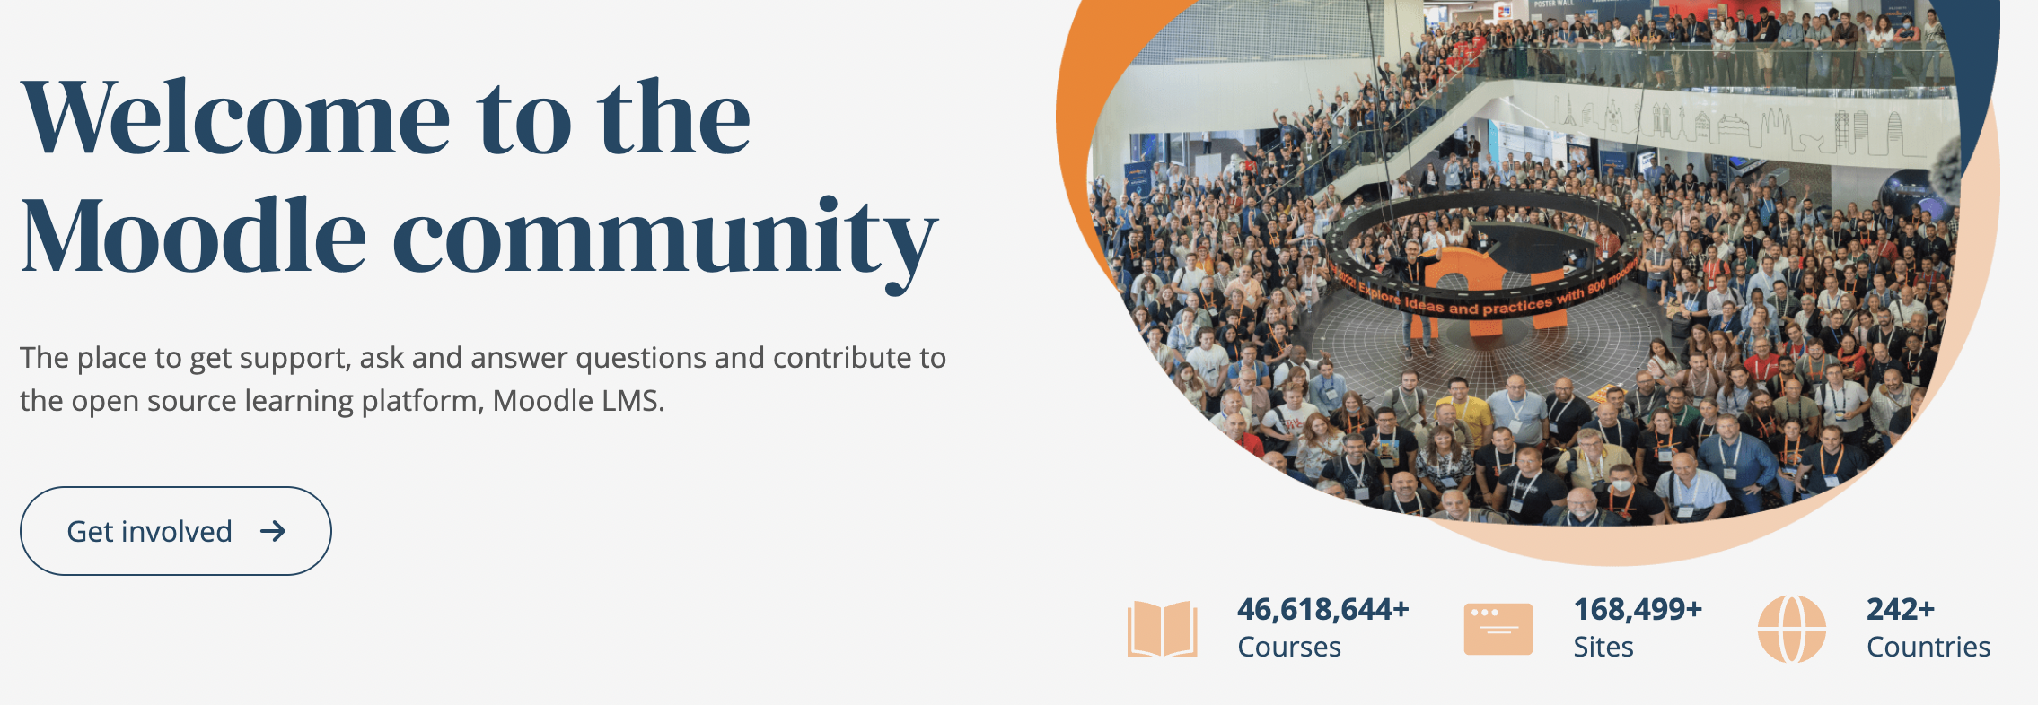
Community-driven Moodle LMS Development:
The Role and Operation of an R&D Committee (PAG)
The Moodle Community in 2024: From MUA to Global PAG and national PAG/Moot Networks
Hiroyuki Harada, Marie Achour, Don Hinkelman
Question 1: Where should MAJ send its Global R&D funds?
Question 2: How should MAJ remake R&D for 2024?

Slide 2
Old to New Moodle.org
Evolution of the Moodle Community—globally and in Japan:
2002: Forums: volunteer user-to-user exchange, including Japanese language forums
2002: Translations: volunteer translators including Japanese language (Mistek)
2004: Fund-raising by Harashima/Hinkelman—gifting buttons “I support Moodle” to donors
2008: Moodle Association of Japan (first not-for-profit organization for Moodle)
2008: MAJ Constitution: 90% post-conference budget for R&D (50% global, 40% domestic)
2009: Annual Domestic R&D grants, Best Innovation Awards, Best Open Courseware
2010: MAJ protects Martin’s trademark “moodle.jp”, MAJ uses Moodle trademark
2014: Moodle Users Association opens: Indiv-Bronze-Silver-Gold Membership
2023: Moodle Users Association closes: Merging into Moodle.org
2023: Moodle.org renewal: Product Advisory Group
2024: Moodle.org renewal: Community funding plan

Slide 3
Stages of New Moodle R&D
Stage 1: 2023
Product Advisory Group
Moodle.org community LMS PAG
Meets monthly
To sort priorities in the Tracker and proposals by various groups to improve Moodle
Facilitated by Brett Dalton
This group is volunteers who know and love Moodle, discussing in English with no fee to pay.
Stage 2: 2024
Community Funding
Moodle.org community funding group
Takes priorities by the global PAG and creates a funding campaign for member organizations and individuals to allocate their contributions.
Facilitated by Marie Achour
These funding campaigns may join with consortiums and national associations to collaborate on both urgent and long range needs.

Slide 4
Emergent Models of Moodle R&D
Consortium Model
Question Bank and Quiz Module Rebuilding for Moodle 4.x
Added new features, new structure, new UI to the question bank/quiz module for 4.0. Implemented in stages for Moodle 4.0-4.4
Facilitated by Luca, Thomas, Tim Hunt
This group is composed of two universities’ representatives with major funding and trusted programmers of HQ such as Catalyst.
National Association Model
Moodle Academic Cooperation (MAC)
Facilitated by Thomas Neidemeier and team
Six universities in Vienna and Graz, Austria combined their IT development to fund plugin development of common needs. Eleven custom plugins are maintained year to year, and nearly ten other programming projects have been nominated and accepted for Moodle LMS core.
National associations in Germany, Japan, Finland and elsewhere could follow this model.

Slide 5
Past MAJ Moodle R&D
(MAJ Constitution: 90% of post-conference budget)
Global R&D: 50%
2008-2012: HQ Donation
Calculated 50% of budget after conference expenses paid. Sent 100-200万directly to Moodle HQ, in addition to paying travel and accommodation expenses of Moodle HQ reprensentative at the MoodleMoot Japan.
2013-2022: MUA Donation
Martin asked MAJ to be founding member of Moodle Users Association. Sent 10,000+AUD per year as Gold Member. MUA closes in 2022-23.
Domestic R&D: 40%
R&D Grants: open application by members for programming grants for new plugins up to 200,000 yen
Training Workshops: Sent Harashima sensei to Hokkaido Moodle Summer Workshop 3 or 4 times.
Best Open Courseware/Best Innovation Website: Supported Showcase and MoodleNet servers with grants

Slide 6
MAJ Moodle R&D History Report
(Rough estimates of data)
Global R&D History
2008: no funds sent
2009: ~1,500,000 yen to HQ
2010: ~1,500,000 yen to HQ
2011: ~1,500,000 yen to HQ
2012: ~1,500,000 yen to HQ
2013: ~1,500,000 yen to HQ
2014: ~1,500,000 yen to HQ
2015: ~1,500,000 yen to HQ
2016: 10,000 AUD to MUA
2017: 10,000 AUD to MUA
2018: 10,000 AUD to MUA
2019: 10,000 AUD to MUA
2020: 10,000 AUD to MUA
2021: 10,000 AUD to MUA
2022: 10,000 AUD to MUA
2023: no funds sent
Domestic R&D History Estimates
2008: no funds spent
2009: 600~1,000,000 yen spent on 2-6 grants
2010: 600~1,000,000 yen spent on 2-6 grants
2011: 600~1,000,000 yen spent on 2-6 grants
2012: 600~1,000,000 yen spent on 2-6 grants
2013: 600~1,000,000 yen spent on 2-6 grants
2014: 600~1,000,000 yen spent on 2-6 grants
2015: 600~1,000,000 yen spent on 2-6 grants
2016: 600~1,000,000 yen spent on 2-6 grants
2017: 600~1,000,000 yen spent on 2-6 grants
2018: 600~1,000,000 yen spent on 2-6 grants
2019: exact data--814,000 yen spent on 5 grants
2020: 600~1,000,000 yen spent on 2-6 grants
2021: 600~1,000,000 yen spent on 2-6 grants
2022: no domestic grants
2023: no domestic grants

Slide 7
2019 MAJ Domestic R&D Report
(Sample of one year’s results found on MAJ R&D webpage, other years are not complete)
Five grants administered for programming costs: 814,000 yen Total
1. Internship Database Module: Ponlawat Weerapanpisit 65,000 yen
Internships, study abroad trips, domestic work/study programs, and teaching practice periods all require a journal be written for students to receive university credit. Four new fields were programmed and contributed to github.
2. Moodle MobileAppに対応した出欠Pluginの開発, Attendance Plugin for Moodle MobileApp
三浦 謙一. Kenichi Miura 200,000 yen
現在、MoodleにはMoodle MobileApp （スマホアプリ）がリリースされているが、このMoodle MobileApp でも動作するPluginを開発するには、非常に難しい技術が必要である。
3. Forum Module Improvements: Matt Cotter 200,000 yen
The goal of this project is to continue improving the forum module and the forum reporting block.
4. Bulk Course Reset: Adam Jenkins 200,000 yen
Winner of the 2019 Best Innovations Award. Developers: Ponlawat Weerapanpisit, Adam Jenkins
URL https://github.com/ponlawat-w/moodle-tool_bulkreset. This plugin is mainly for institutional Moodle administrators.
A second plugin to allow defaults for course resets to be pre-specified by the admin has also been developed. ↓
https://github.com/ponlawat-w/moodle-tool_resetsettings
5. MAJ_Moodle_Showcase_Proposal: Don Hinkelman 149,000 yen
Showcase Programming blocks and MoodleNet Integration, plus Moodle 3.8 and 3.9 upgrade

Slide 8
Stages of a revived R&D Committee (案)
Stage 1: Form Japan
Product Advisory Group
(案)
1. Committee (“PAG”) of institutional members or officers meets to choose priorities
2. Conducted in Japanese in order to increase participation with new members
3. Facilitated by an officer such as Hiroyuki Harada, who is also a university IT staff or engineer
4. This group can be institutional representatives or individual members who want to volunteer.
Stage 2a: Allocate Annual Japan Community Funding
(案)
Global funding: once a year, the Japan PAG holds a survey of members who select their priorities. The Japan PAG sorts these priorities and adds their own judgement according to admin needs.
Domestic funding: twice a year, the Japan PAG meets to select Japan needs for Moodle and allocates available funds. This could be like the former R&D grants.

Slide 9
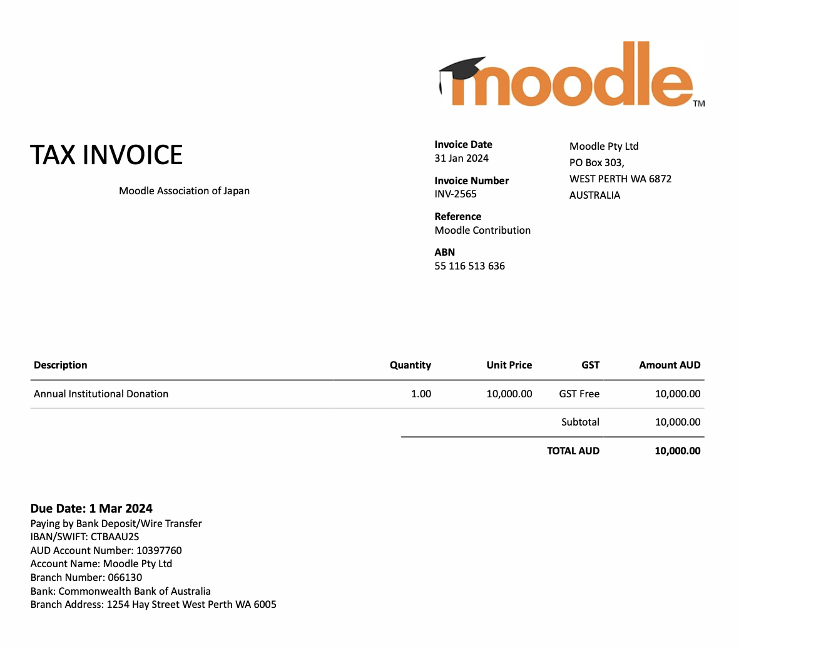
Stages of a revived R&D Committee (案)
Stage 2b: Send undesignated funds to Moodle Pty. Ltd.
(案)
Return to the original system of sending 50% of post-conference membership income to Moodle HQ
1,000,000 - 2,000,000 yen per year

Slide 10
Possible Next Steps
Step 1: Contact current institutional members
Step 2: Meet on Zoom with 3-5 institutional members to get to know each other and exchange how you modify Moodle to fit your university.
Step 3: Contact all Moodle-using universities in Japan with survey—what changes do you want in Moodle? Invite them to be MAJ members.
Step 4: Hold a vote in February after AGM, to select global community funding priorities, and send $10,000 to Perth (or $20,000 for 2 years).

Slide 11
Possible Next Steps
Step 5: Nominate new R&D Chair
Problem is good candidates have heavy work loads (Prof. Kita)
So limit the tasks to:
Approving the survey of Moodle-using universities
Leading a twice a year meeting on line to discuss survey results and recommend allocations to global community funding.
If limited tasks, Harada will ask SGU IT Committee for permission on 3/7)
Other officers who wish to be R&D Chair, of course are welcome for nominations
Step 6: Nominate two R&D Assistant Chairs
Prepare and distribute survey, contact universities
Document R&D activities and distribute results (Don)
2) Lead best innovation awards (David)

