Slide 1



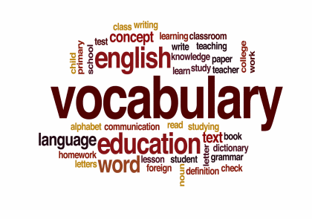
Improving Vocabulary with Moodle
Gordon Bateson
Kochi University of Technology
Time: 17th Feb 2024 (15:10 – 15:50)
Place: Room 2104 (1F of Building 2)

Slide 2
Dictionary ⬄ Practice engine
Information about words
Interactions with words

Slide 3
Dictionary
definitions
CEFR levels
translations
Information about words
samples
meta data
relationships
External wordlist file
External website API
External AI assistant
NAWL
TOEIC
dictionaryapi.dev/api/v2
api.datamuse.com
wordsapi.com
ChatGPT
Gemini
Bing

Slide 4
Practice engine
Game
Game
Interactions with words
Game
Mastery of words
Results

Slide 5
Design considerations
Content is personalized to each student
  context, interests, language level
AI is used to generate content
Use Moodle 4.x programming conventions
  autoloading of PHP classes
  javascript via AMD or modules
  renderer.php and mustache templates
  events, logging, backups
Accessible via Moodle mobile app

Slide 6
Vocabulary module
[1] manages students’ interactions with words
[2] decides when a word has been “mastered”
Subplugins
add functionality … and fun
Tools
allow teachers to manipulate data
AI
allow teachers to share access and prompts
Games
allow students to
interact with words

Slide 7
How it works
Teacher defines word list
Teacher defines “mastery” criteria
Students interact with “words” via “games”
Software maintains “scores” for interactions
Software recognizes when a student has “mastered” a word
Students aim to “master” all words in the word list

Slide 8
Tools
Import
Question bank
Wordlist
Dictionary

Slide 9
Data file (Excel)
Dictionary
Import
Format file (XML)

Slide 10
AI
You can share your keys
and prompts within a context
Site context
Course category context
Course context
Activity context

Slide 11
Games – coming soon
Moodle Quiz questions …
  … but monitored for words they contain
Hot Potatoes (5 types)
Reader module
  AI-generated stories with pictures
Conversation with an AI bot

