Slide 1
Modeling Graviational Waves via Post-Newtonian Expansion and Geometric Optics
Kristine de Boer
Supervisor: Jens Oluf Andersen
19.juni 2025

Slide 2
Table of contents
What are gravitational waves (GW)?
Different types of GW
Detection of GW
Approximation methods for modeling GW
Post-Newtonian (PN) expansion
PN predictions vs observations

Slide 3
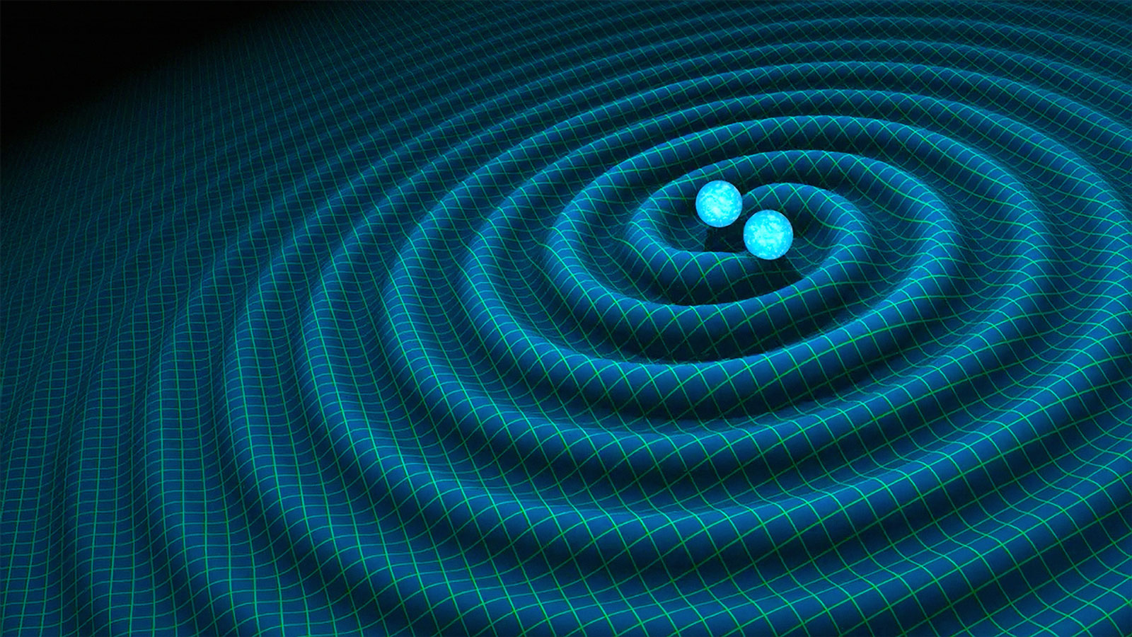
What are gravitational waves?
Ripples in the fabric of spacetime
Caused by massive objects undergoing extreme accelerations
Speed of light
Predicted by Albert Einstein in 1916

Slide 4
The Hulse-Taylor Binary
First indirect evidence¹, 1974
21,000 light years away from Earth
Observed rate of orbital decay matched the predicted to within 0.5%
Nobel Prize in Physics 1993
¹ R. A. Hulse and J. H. Taylor. “Discovery of a Pulsar in a Binary System”. In:The Astrophysical Journal (1975). Accessed 26.09.24.URL: https://articles.adsabs.harvard.edu/full/1975ApJ...195L..51H

Slide 5
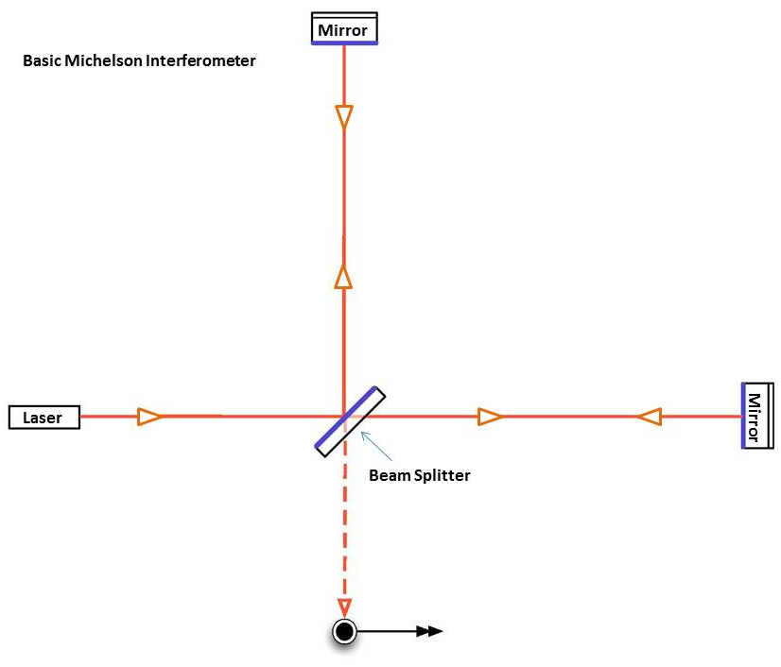
Detection of GWs
September 14 2015
LIGO²
Collision of two black holes, 1.3 billion light-years away
Laser Interferometry
² LIGO - Laser Interferometer Gravitational-Wave Observatory. Accessed 24.09.24.(2024). URL:https://www.ligo.caltech.edu/

Slide 6
Types of gravitational waves
Compact Binary Inspiral GWs
  Binary Black Hole (BBH)
  Binary Neutron Star (BNS)
  Neutron Star-Black Hole Binary (NSBH)
Continuous GWS
Stochastic GWs
Burst GWs

Slide 7

Approximations for modeling GWs
Einstein´s field equation are highly nonlinear
Linearization
  $g_{μν}=$ $η_{μν}+h_{μν}$, $\left|h_{μν}\right|≪1$
Shortwave formalism
  Propagation in curved spacetime far from the source
Post-Newtonian (PN) expansion

Slide 8
Post-Newtonian Expansion
Velocities small compared to the speed of light, but high enough for relativistic corrections to become significant
Systematic expansion in powers of v/c
1PN level
Applying the framework to physical system

Slide 9
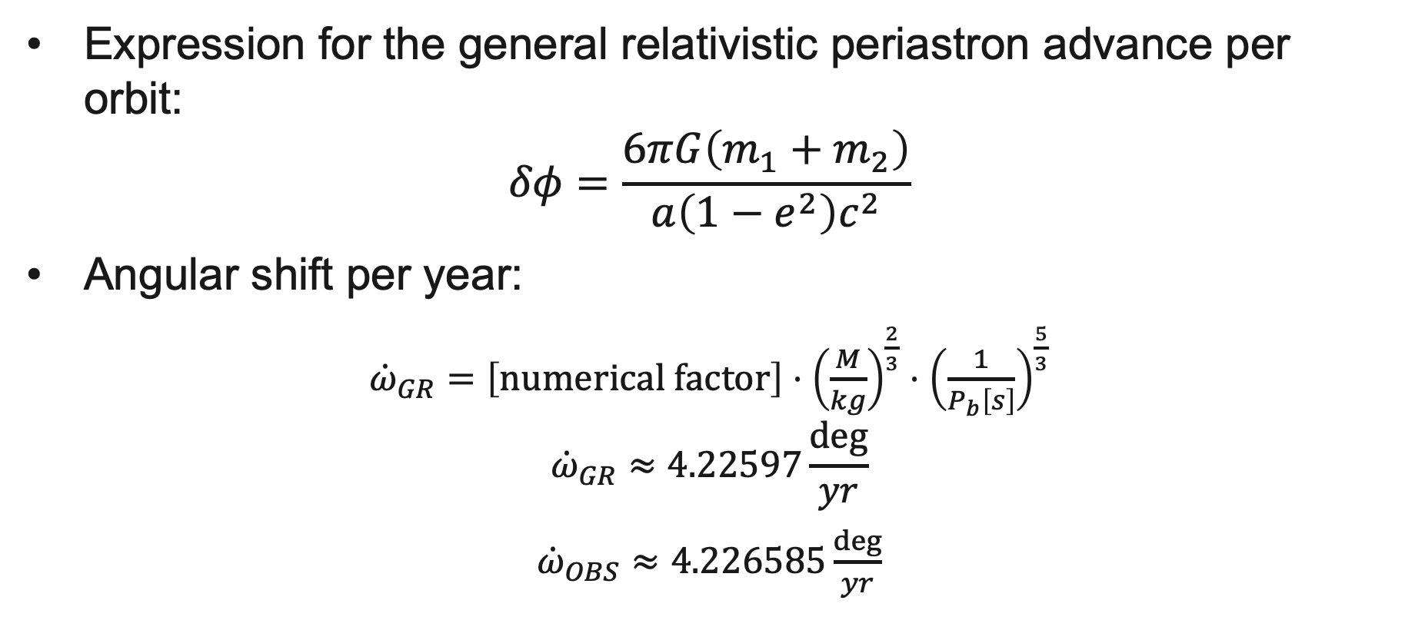
Periastron shift PSR B1913+16
Expression for the general relativistic periastron advance per orbit:
$$δφ=\frac{6πG\left(m_{1}+m_{2}\right)}{a\left(1−e^{2}\right)c^{2}}$$
Angular shift per year:
${\dot{ω}}_{GR}=\left[numerical factor\right]⋅{\left(\frac{M}{kg}\right)}^{\frac{2}{3}}⋅{\left(\frac{1}{P_{b}\left[s\right]}\right)}^{\frac{5}{3}}$
$${\dot{ω}}_{GR}≈4.22597\frac{deg}{yr}$$
${\dot{ω}}_{OBS}≈4.226585\frac{deg}{yr}$
³
³ J. M. Weisberg and Y. Huang. “Relativistic measurements from timing the binary pulsar PSR B1913+16”. In: arXiv (2016). Accessed 18.11.24. url: https://arxiv.org/pdf/1606.02744

Slide 10
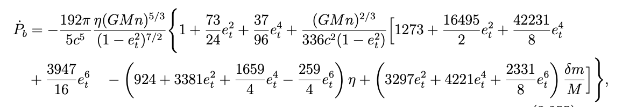

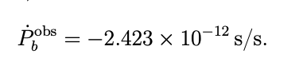
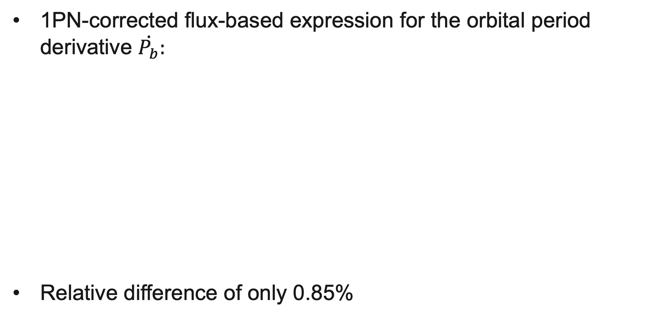
Orbital period decay PSR B1913+16
1PN-corrected flux-based expression for the orbital period derivative $\dot{P_{b}}:$
Relative difference of only 0.85%
³
³ J. M. Weisberg and Y. Huang. “Relativistic measurements from timing the binary pulsar PSR B1913+16”. In: arXiv (2016). Accessed 18.11.24. url: https://arxiv.org/pdf/1606.02744

Slide 11
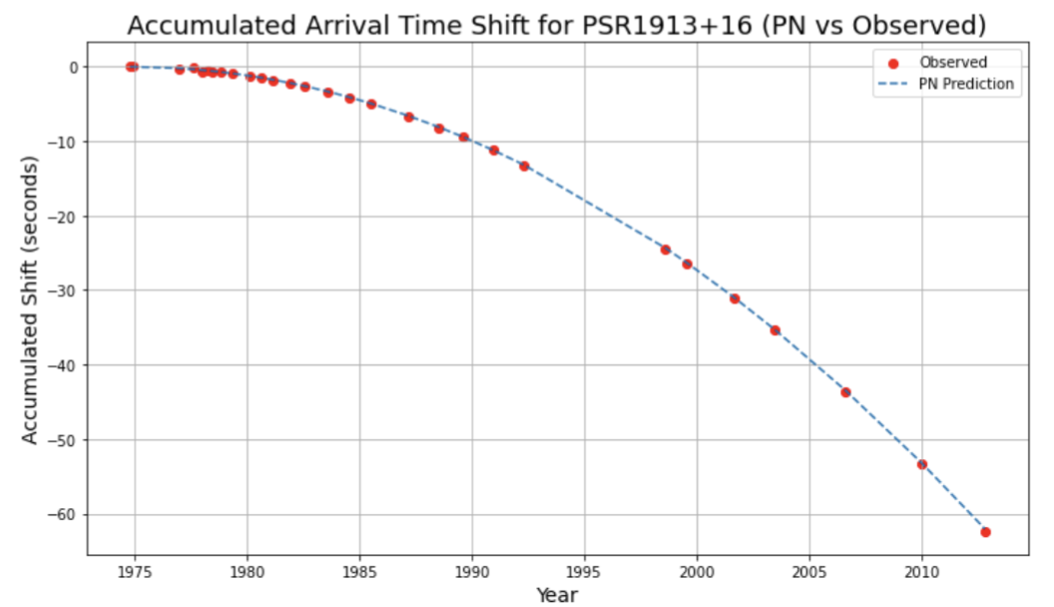
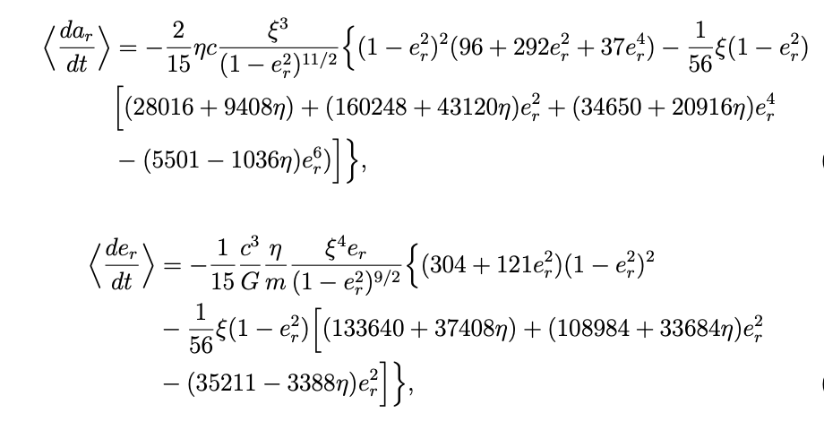
Accumulated Arrival Time Shift - PSR B1913+16
The periastron arrives earlier over time due to gravitational wave emission
These shifts accumulate over decades, measurable with pulsar timing
1PN prediction (blue curve) closely matches timing observations (red dots)
³
³ J. M. Weisberg and Y. Huang. “Relativistic measurements from timing the binary pulsar PSR B1913+16”. In: arXiv (2016). Accessed 18.11.24. url: https://arxiv.org/pdf/1606.02744

Slide 12
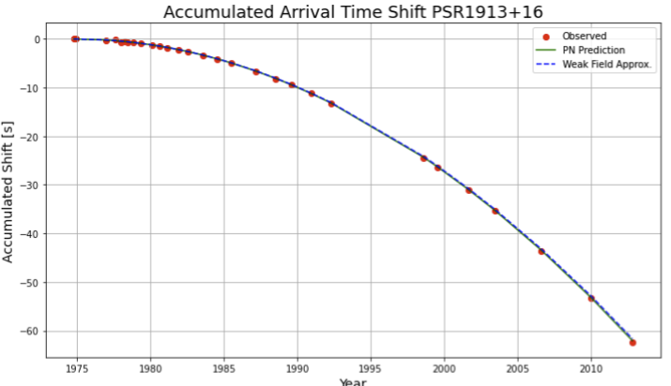
Comparison with Linearized Weak-Field Predictions
Weak-field model uses the quadrupole formula and energy conservation
Indirectly verifying the existence of gravitational waves
PSR B1913+16: ideal system for testing the energy loss due to gravitational waves
³ J. M. Weisberg and Y. Huang. “Relativistic measurements from timing the binary pulsar PSR B1913+16”. In: arXiv (2016). Accessed 18.11.24. url: https://arxiv.org/pdf/1606.02744

Slide 13
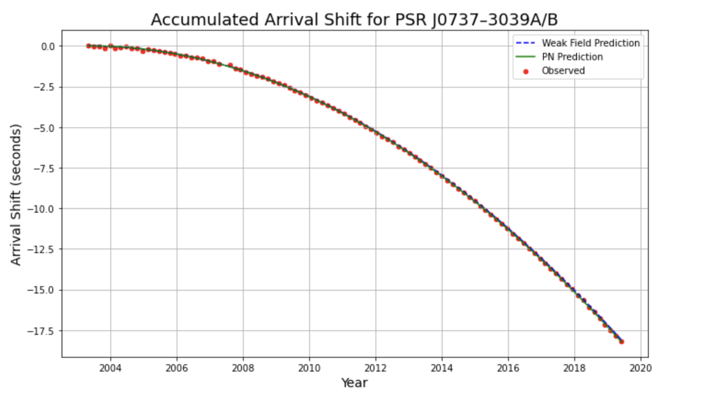
Double Pulsar PSR J0737-3039A/B
Orbital period of just 2.45 hours
Both the 1PN and the weak-field prediction match the observed data well
⁴
⁴ M. Kramer et al. “Strong-field Gravity Tests with the Double Pulsar”. In: Physical Review X 11.4 (2021). Accessed 22.03.25. DOI: https://doi.org/10.1103/PhysRevX.11.041050

Slide 14
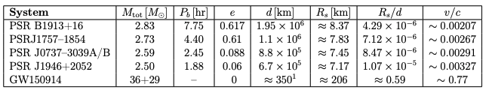
When are 1PN Corrections Necessary?
PSR B1913+16: J. M. Weisberg and Y. Huang. “Relativistic measurements from timing the binary pulsar PSR B1913+16”. (2016).
PSRJ1757-1854: A. D. Cameron et al. “New constraints on the kinematic, relativistic and evolutionary properties of the PSR J17571854 double neutron star system”. (2023)
PSR J0737-3039A/B: M. Kramer et al. “Strong-field Gravity Tests with the Double Pulsar”. In: Physical Review X 11.4 (2021)
PSR J1946+2052: K. Stovall et al. “PALFA Discovery of a Highly Relativistic Double Neutron Star Binary”. In: arXiv preprint arXiv:1802.01707 (2018).
GW150914: B. P. Abbott et al. “GW150914: First results from the search for binary black holecoalescence with Advanced LIGO”. In: Physical Review D 93.12 (2016).

Slide 15
Conclusions and outlook
Two complementary approximation methods
In the near zone: leading order post-Newtonian expansion
The 1PN model tracks the observed arrival shift closely for both PSR B1913+16 and PSR J0737-3039A/B
In the far zone: the shortwave approximation
Together: PN theory describes how gravitational waves are generated, while the shortwave approximation describes how they propagate
Outlook:
  Including higher order of the PN expansion
  Including corrections beyond geometric optics
  Bridging the two regimes

Slide 16
kristdbo@stud.ntnu.no

