Slide 1

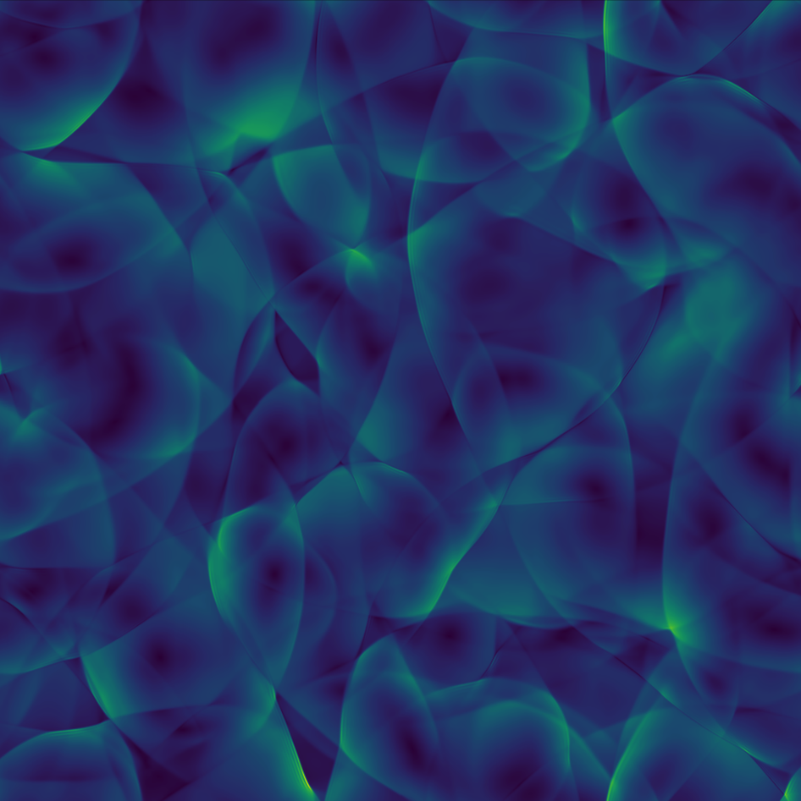








N-PACT Meeting 2025
_____________________________________________________
PT2GWFinder
A Handy Tool for Cosmological PTs and GWs
LIP-Minho | U. Aveiro | U. Stavanger
2025-06-19
_____________________________________________________
Marco Finetti
Support
PRT/BD/154730/2023
Bolsas de Investigação para
Doutoramento FCT-ECIU
Supervisors
António Morais
University of Aveiro | Gr@v
Germano Nardini
University of Stavanger
Contributors
Vedran Brdar (Oklahoma State U.)
Marco Finetti (LIP-Minho | U. Aveiro)
Marco Matteini (Jožef Stefan Institute)
António Morais (U. of Aveiro)
Miha Nemevšek (Jožef Stefan Institute)
Universidade de Aveiro
theoria poiesis praxis
Notes:
PhD student at UA, currently visiting my supervisor GN at UiS.
I’m presenting PT2GWFinder: a Mathematica tool for cosmological PTs, that my collaborators and I recently released

Slide 2

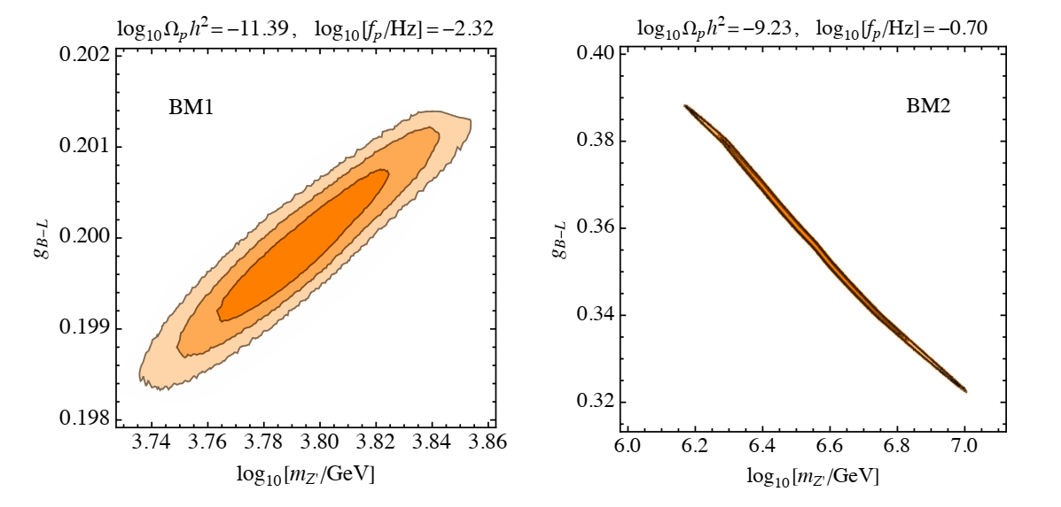
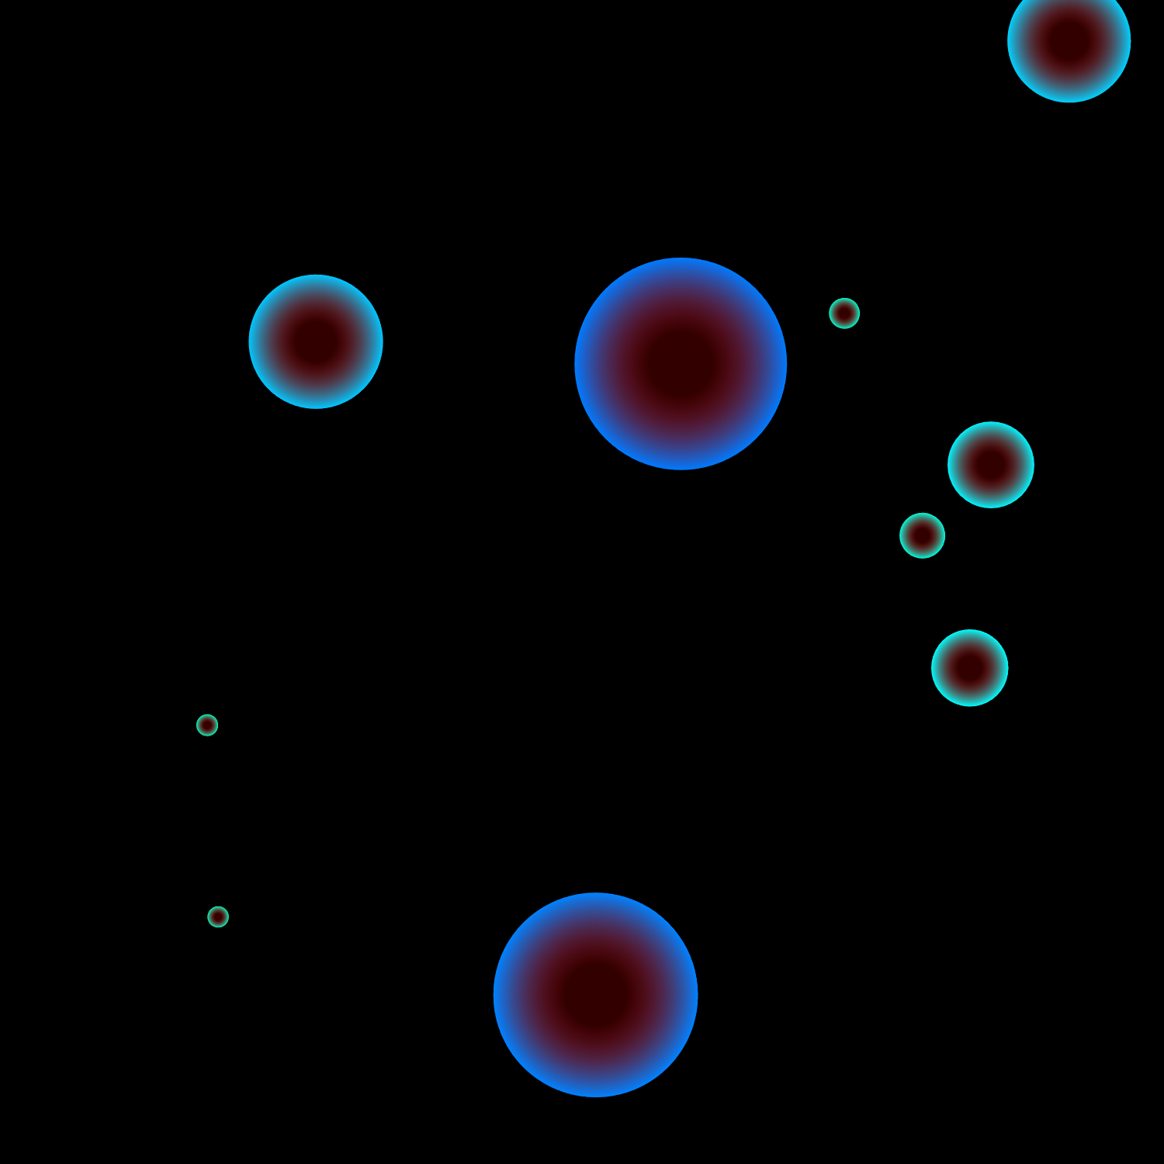










Cosmological Phase Transitions
& PP motivation
$I$ order phase transitions (FOPTs)
Motivation
EW baryogenesis
Constraints on BSM models
$$χ_{L}+χ_{R}$$
CP
$$V$$
$$χ_{L}$$
B+L
$$B$$
$$\left\langle φ\right\rangle ≠0$$
$$v_{w}$$
thermal fluctuation
$$\left\langle φ\right\rangle =0$$
Background | Paclet | Examples | Outlook
roll to true vacuum
quantum tunnelling
$$φ$$
$$→$$
C. Caprini et al. (JCAP10(2024)020)
Notes:
FOPTs:
$T=0→$tunnelling
$T<T_{0}→$ thermally-averaged tunnelling
$T>T_{0}→$ thermal fluctuations
Once derived a thermal EFT
we search the parameter space for FOPTs (by means of this hacked version of CosmoTransitions)
Here I will just mention that
we adopt an energy-scale-independent nucleation criterion
we include the vacuum contribution to the energy density of the Universe
and we compute PT parameters, such as
the transition strength$α$
and the inverse duration $β$
at the percolation temperature
Motivation
EW baryo
BSM constraints
$→$ last week discussion on size of constrained parameter space:
strongly supercooled PTs (conformal models)

Slide 3



Thermal potential $→$ GW analytics
Thermal potential
(BSM)
Bubble
dynamics
Relativistic hydrodynamics
SGWB
EFT $\underset{→}{?}$ SGWB
Analytics
  bounce action: $\frac{S_{3}}{T}\left(T\right)$
  $\frac{d^{2}φ}{dr^{2}}+\frac{2}{r}\frac{dφ}{dr}=∂_{φ}V(φ,T)$
  nucleation: $\frac{S_{3}}{T}≈k$ $\left(\text{EW}: k≈140\right)$
  transition strength: $α=\frac{1}{ρ_{γ}}Δ\left[V−\frac{T}{4}∂_{T}V\right]$
  inverse duration: $\frac{β}{H}=T\frac{d}{dT}\frac{S_{3}}{T}$
Numerical methods
Background | Paclet | Examples | Outlook
  decay rate: $Γ=A\left(T\right){\left(\frac{S_{3}}{2πT}\right)}^{\frac{3}{2}}e^{−\frac{S_{3}}{T}}$
  $T_{n}: \int_{T_{n}}^{T_{c}}{\frac{dT}{T} \frac{Γ}{H^{4}}}∼𝒪\left(1\right)$
  $T_{p}: P_{FV}\left(T\right)≈0.71$
  $\log{P_{FV}}=\frac{4π}{3}v_{w}^{3}\int_{T}^{T_{p}}{\frac{dT^{′}}{T^{′4}}\frac{Γ\left(T^{′}\right)}{H^{4}\left(T^{′}\right)}{\left(\int_{T}^{T^{′}}{\frac{d\tilde{T}}{H\left(\tilde{T}\right)}}\right)}^{3}}$

Slide 4

Thermal potential $→$ GW tool comparison
Similar packages
Package | Language | Maintained | Dimensional reduction | PT+GW parameters
CosmoTransitions | Python | X | X | X
BSMPTScanner | C++ | ✓ | X | ✓
PhaseTracer | C++ | ✓ | ~ | ✓
Background | Paclet | Examples | Outlook

Slide 5

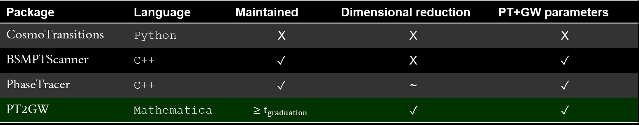
Thermal potential $→$ GW tool comparison
Similar packages
Package | Language | Maintained | Dimensional reduction | PT+GW parameters
CosmoTransitions | Python | X | X | X
BSMPTScanner | C++ | ✓ | X | ✓
PhaseTracer | C++ | ✓ | ~ | ✓
PT2GW | Mathematica | $$≥t_{graduation}$$ | ✓ | ✓
Background | Paclet | Examples | Outlook
Strengths
User-friendly
Freedom to construct effective potential
  interface with DRalgo
Polygonal bounce method (FindBounce)
Modular
arXiv 2505.04744

Slide 6
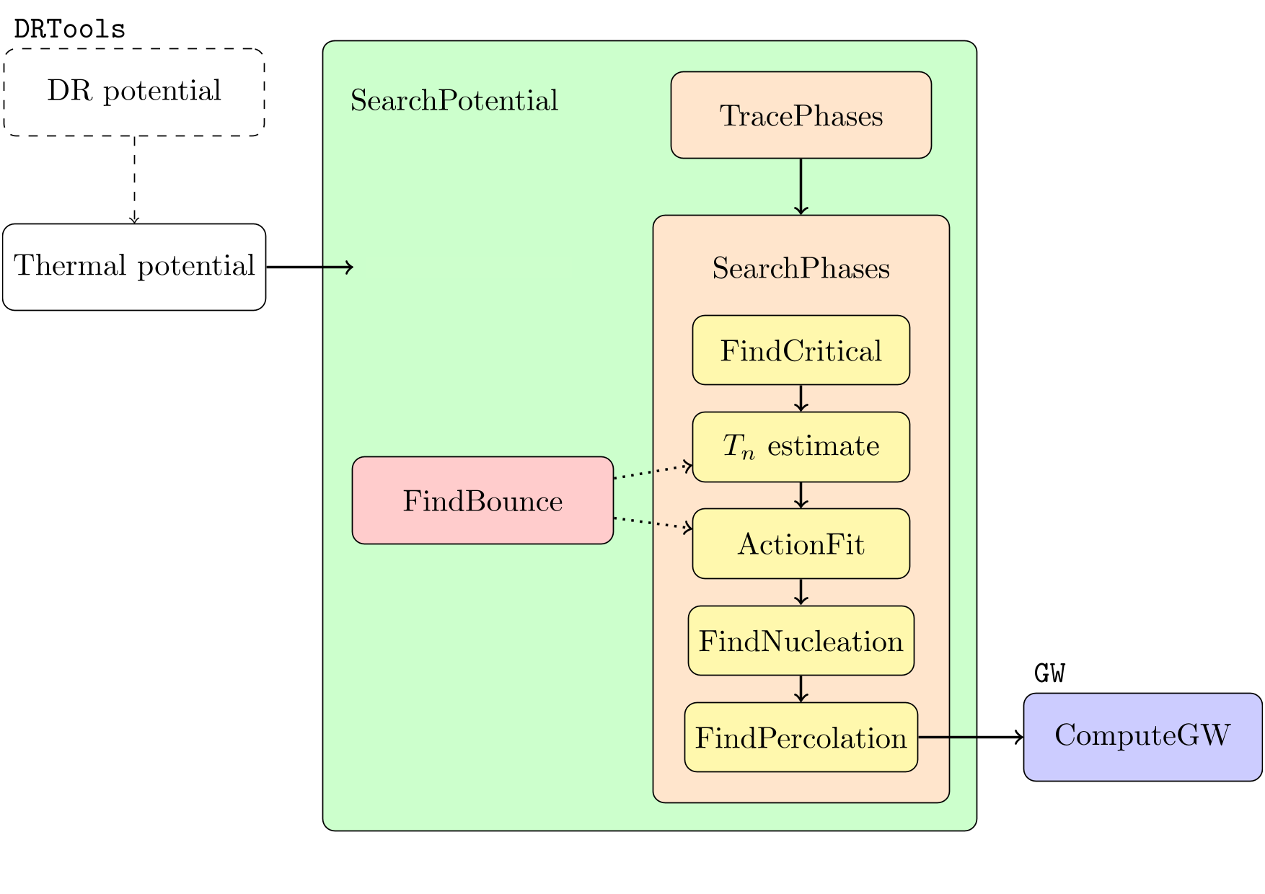
PT2GWFinder schematics
Background | Paclet | Examples | Outlook

Slide 7
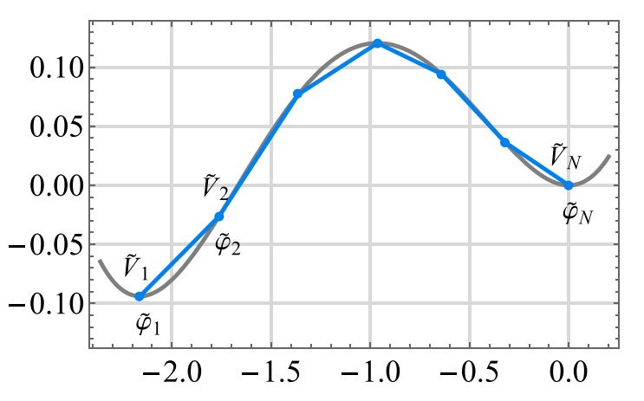

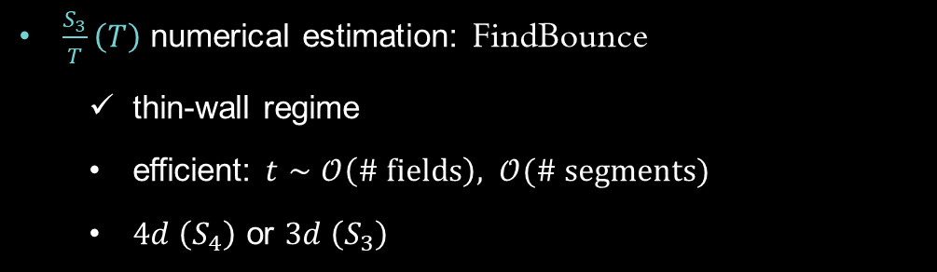

PT2GWFinder method
$\frac{S_{3}}{T}\left(T\right)$ numerical estimation: FindBounce
  thin-wall regime
  efficient: $t∼𝒪\left(\# fields\right), 𝒪(\# segments)$
  $4d \left(S_{4}\right)$ or $3d \left(S_{3}\right)$
polygonal bounce
Background | Paclet | Examples | Outlook
$$V$$
$$φ$$
Guada, Nemevšek, Pintar (CPC 256 (2020) 10748)

Slide 8
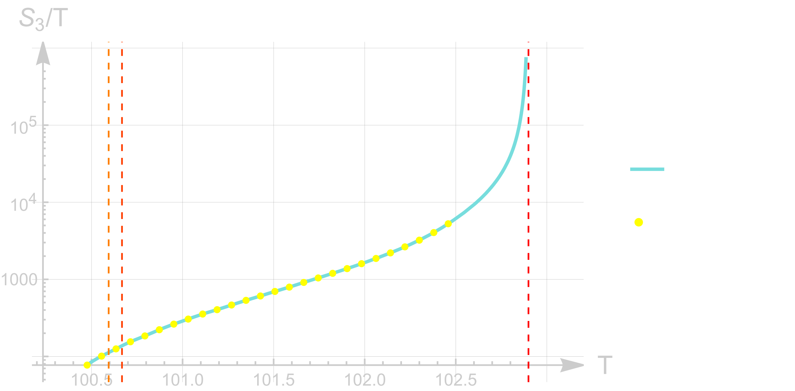

PT2GWFinder method
$\frac{S_{3}}{T}\left(T\right)$ numerical estimation: FindBounce
  thin-wall regime
  efficient: $t∼𝒪\left(\# fields\right), 𝒪(\# segments)$
  $4d \left(S_{4}\right)$ or $3d \left(S_{3}\right)$
Method
  ${\tilde{T}}_{n}$ estimate via $Γ/H^{4}∼1$
  $S_{3}/T$ fit/interpolation about $\left(∼{\tilde{T}}_{n},T_{c}\right)$
  $T_{n},T_{p}$ via above integrals
Background | Paclet | Examples | Outlook

Slide 9
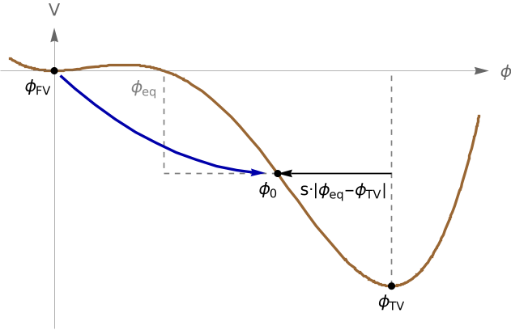
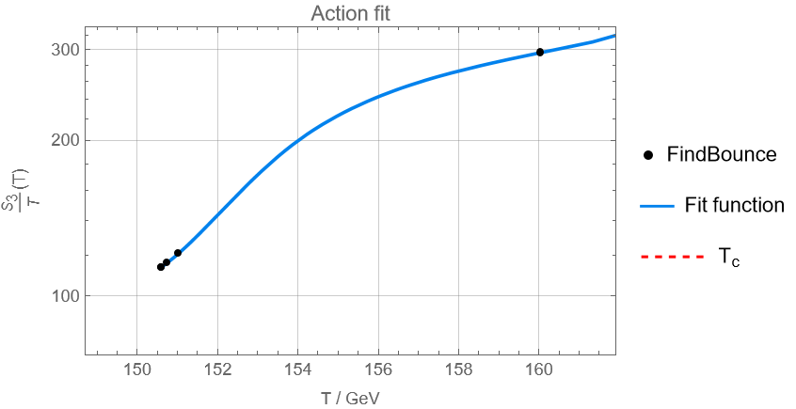
PT2GWFinder action refinement
Several options to refine the bounce solution
  Check profile
    Shift of exit point
    Lower action tolerance
  Refine around inflection
    Bisection method to identify
    the failure temperature
Background | Paclet | Examples | Outlook

Slide 10

PT2GWFinder
GWs
Soundwaves & MHD turbulence:
$→$ double broken power law
$h^{2}Ω_{\text{sw}}\sim K^{2}\frac{f}{f_{1}^{sw}}{\left[1+{\left(\frac{f}{f_{1}^{sw}}\right)}^{2}\right]}^{−1}{\left[1+{\left(\frac{f}{f_{2}^{sw}}\right)}^{4}\right]}^{−1}$
$h^{2}Ω_{\text{tur}}\sim ε^{2}K^{2}\frac{f_{1}^{tur}}{f_{2}^{tur}}{\left(\frac{f}{f_{1}^{tur}}\right)}^{3}{\left[1+{\left(\frac{f}{f_{1}^{tur}}\right)}^{4}\right]}^{−\frac{1}{2}}{\left[1+{\left(\frac{f}{f_{2}^{tur}}\right)}^{2.15}\right]}^{−1.7}$
Bubble wall collisions:
$→$ broken power law
$h^{2}Ω_{\text{sw}}\sim {\tilde{K}}^{2}{\left(\frac{f}{f_{p}}\right)}^{2.4}{\left[1+{\left(\frac{f}{f_{p}}\right)}^{1.2}\right]}^{−4}$
Background | Paclet | Examples | Outlook
C. Caprini et al. (JCAP10(2024)020)

Slide 11
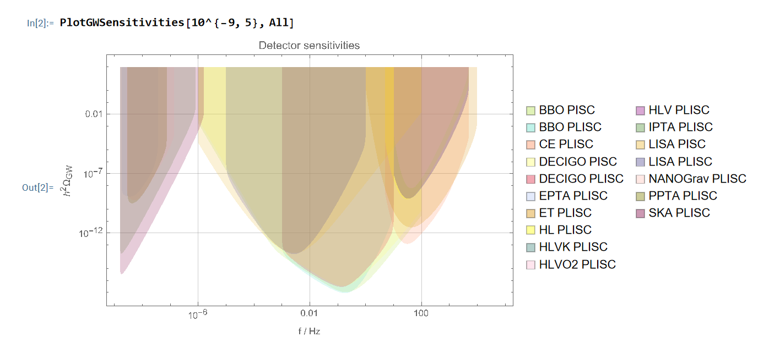
PT2GWFinder
GWs
Background | Paclet | Examples | Outlook
data adapted from K. Schmitz (JHEP01(2021)097)

Slide 12
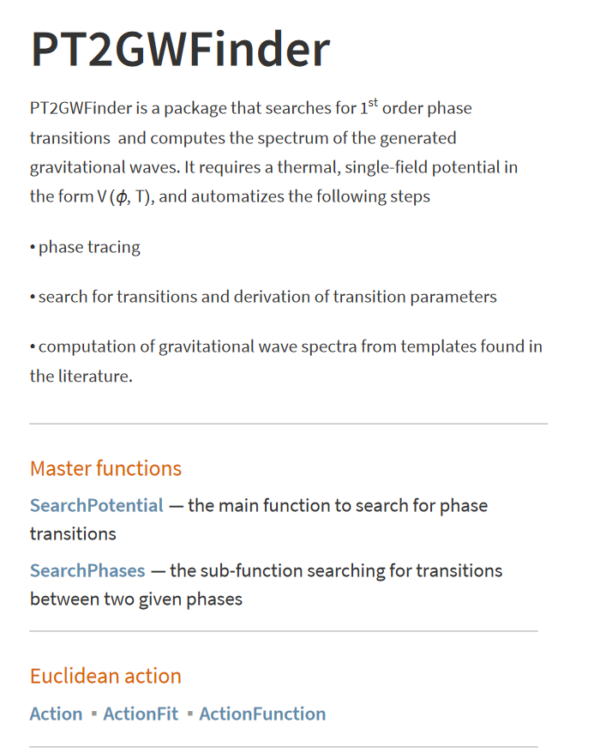
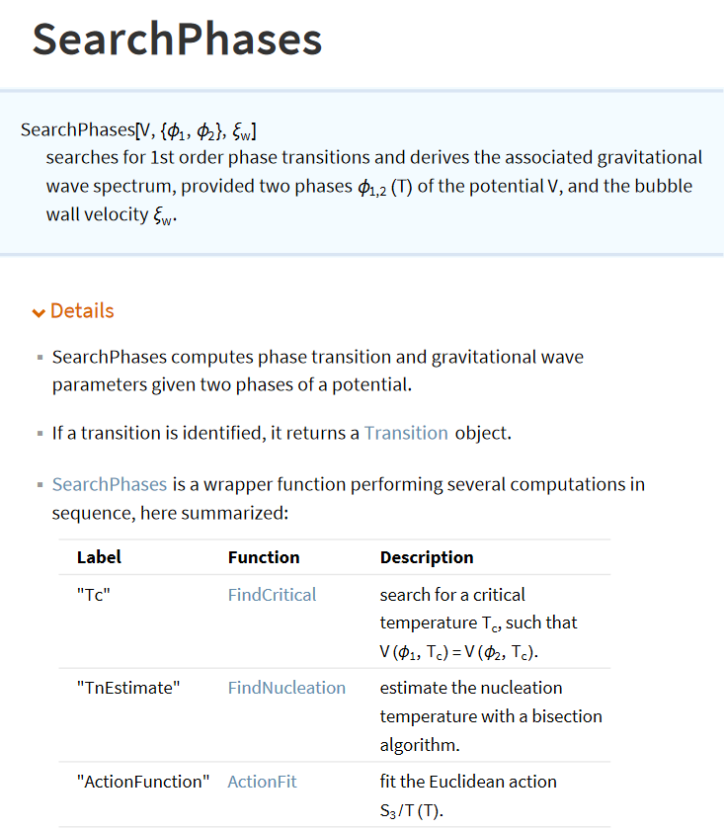
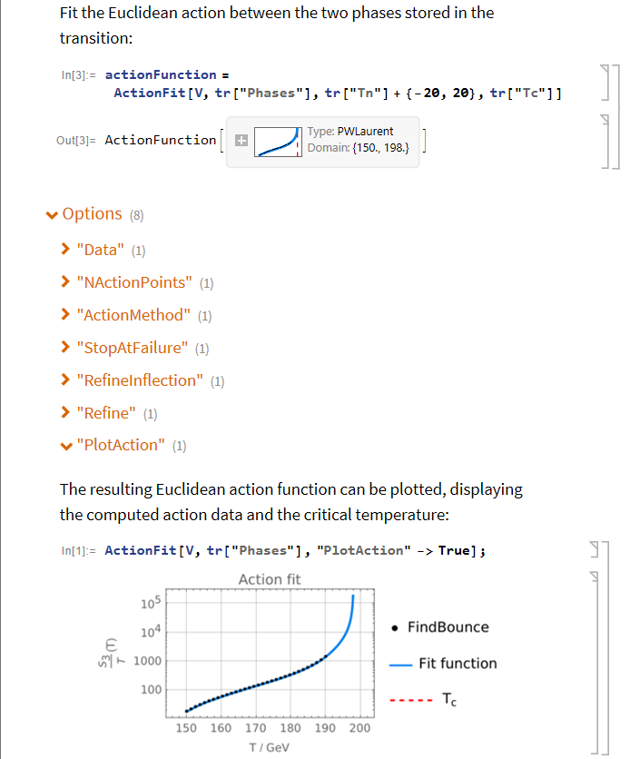
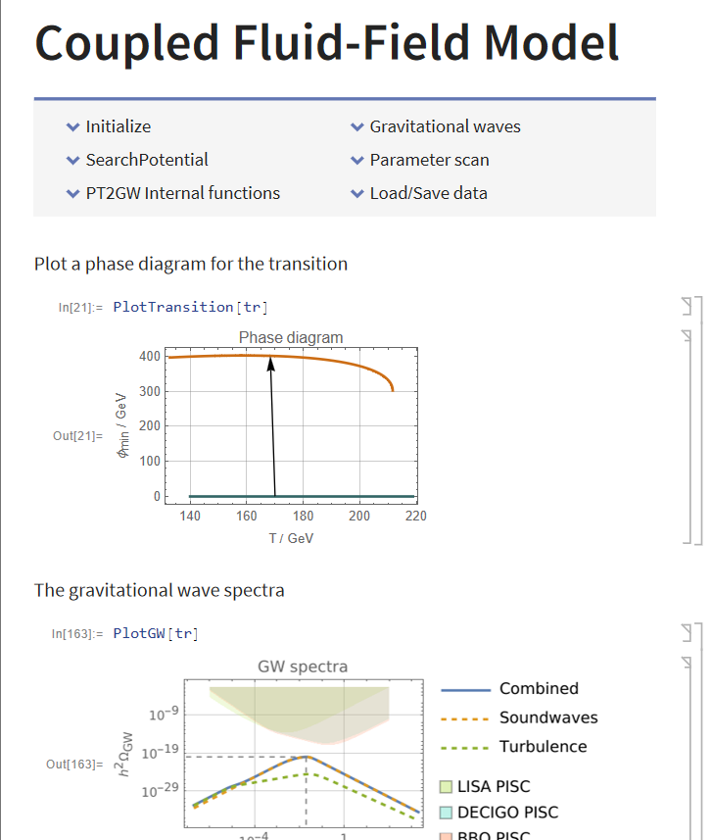
PT2GWFinder fully documented
Background | Paclet | Examples | Outlook

Slide 13
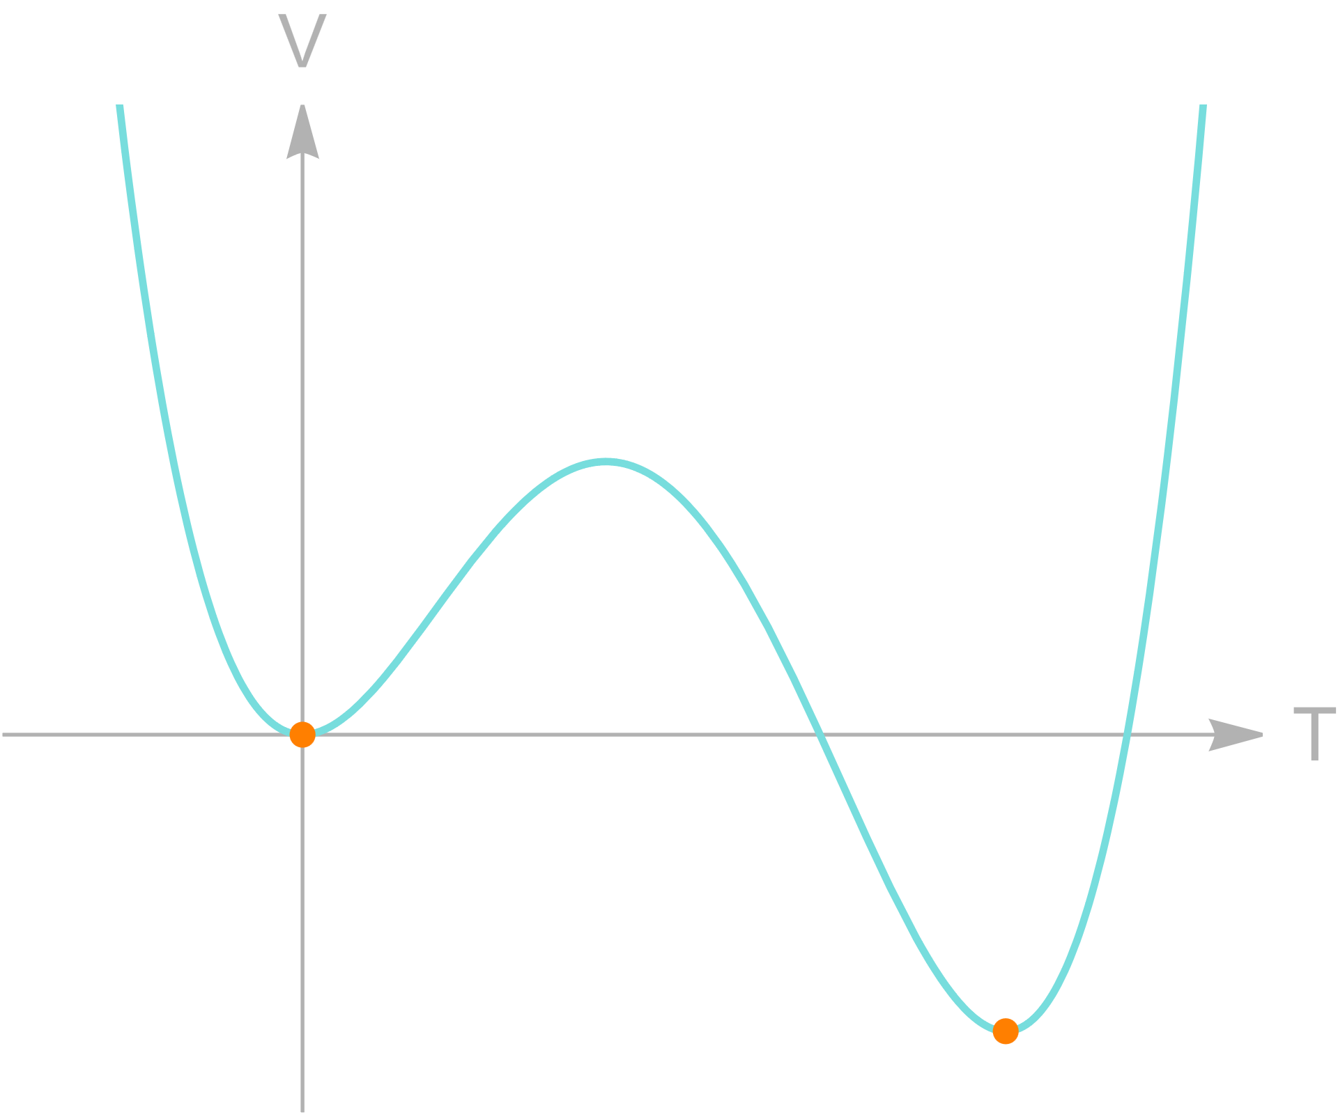
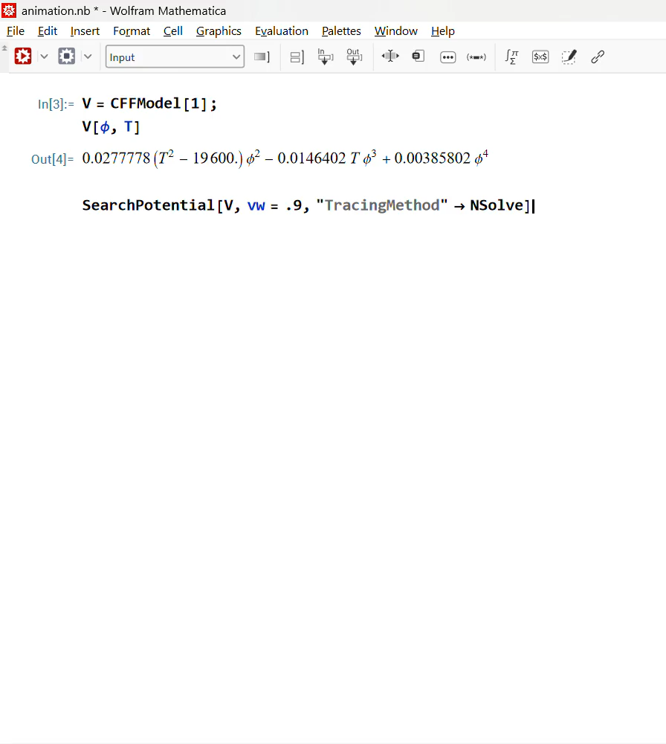

Example
Fluid-field model
Scalar potential
$V\left(φ,T\right)=\frac{c_{2}}{2}\left(T^{2}−T_{0}^{2}\right)φ^{2}−\frac{c_{3}}{3}Tφ^{3}+\frac{c_{4}}{4}φ^{4}$
Analytic derivation of the action
  in thin/thick wall regimes
  intermediate interpolation
  Matteini, Nemevšek, Shoji, Ubaldi (2024, 2404.17632)
Background | Paclet | Examples | Outlook
Linde (1983, NPB 216. 2)
Hindmarsh, Huber, Rummukainen, Weir (PRD.92.123009)

Slide 14
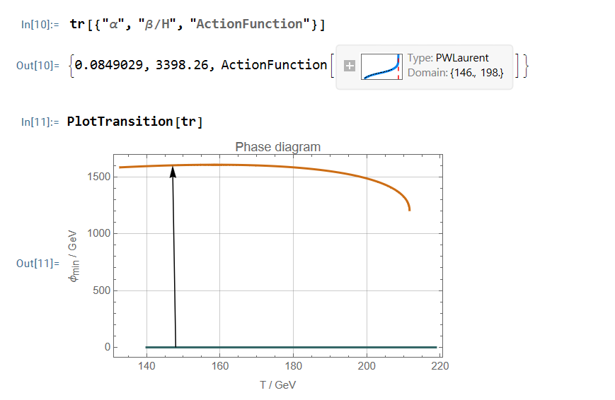
Example
Fluid-field model
Scalar potential
$V\left(φ,T\right)=\frac{c_{2}}{2}\left(T^{2}−T_{0}^{2}\right)φ^{2}−\frac{c_{3}}{3}Tφ^{3}+\frac{c_{4}}{4}φ^{4}$
Analytic derivation of the action
  in thin/thick wall regimes
  intermediate interpolation
  Matteini, Nemevšek, Shoji, Ubaldi (2024, 2404.17632)
Background | Paclet | Examples | Outlook
Linde (1983, NPB 216. 2)
Hindmarsh, Huber, Rummukainen, Weir (PRD.92.123009)

Slide 15
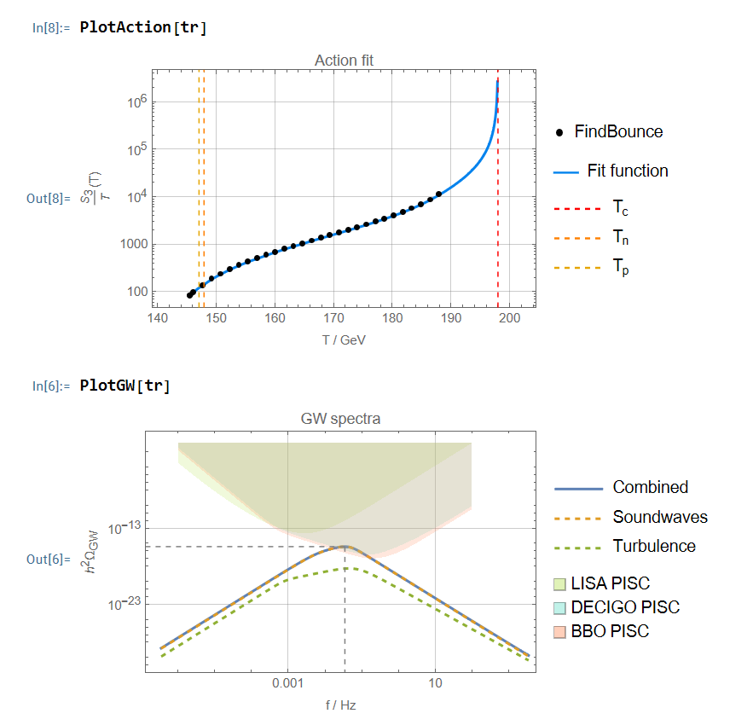
Example
Fluid-field model
Scalar potential
$V\left(φ,T\right)=\frac{c_{2}}{2}\left(T^{2}−T_{0}^{2}\right)φ^{2}−\frac{c_{3}}{3}Tφ^{3}+\frac{c_{4}}{4}φ^{4}$
Analytic derivation of the action
  in thin/thick wall regimes
  intermediate interpolation
  Matteini, Nemevšek, Shoji, Ubaldi (2024, 2404.17632)
Background | Paclet | Examples | Outlook
Linde (1983, NPB 216. 2)
Hindmarsh, Huber, Rummukainen, Weir (PRD.92.123009)

Slide 16
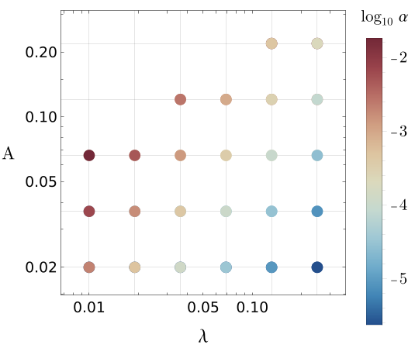
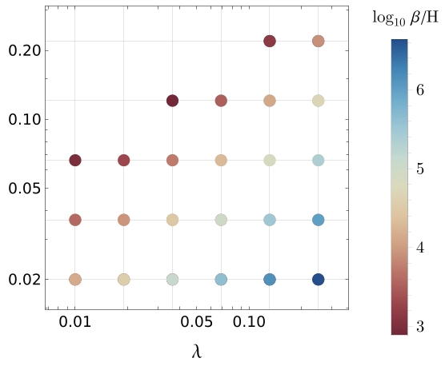
Example
Fluid-field model
Scalar potential
$V\left(φ,T\right)=\frac{c_{2}}{2}\left(T^{2}−T_{0}^{2}\right)φ^{2}−\frac{c_{3}}{3}Tφ^{3}+\frac{c_{4}}{4}φ^{4}$
Analytic derivation of the action
  in thin/thick wall regimes
  intermediate interpolation
  Matteini, Nemevšek, Shoji, Ubaldi (2024, 2404.17632)
Background | Paclet | Examples | Outlook
Linde (1983, NPB 216. 2)
Hindmarsh, Huber, Rummukainen, Weir (PRD.92.123009)

Slide 17
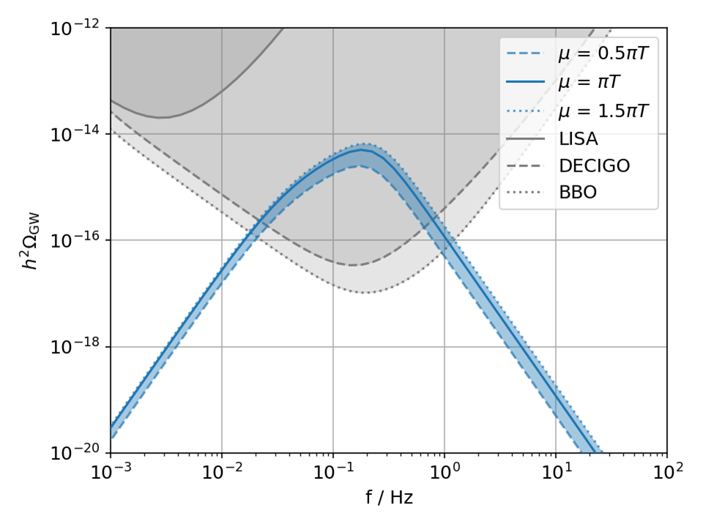





Dimensional Reduction
An improved recipe for thermal EFTs
$$\boxed{4d \underset{→}{t→t+i/T} 3d \text{EFT}}$$
Dimensional reduction (DR)
  time $→$ temperature $⇒$ high-$T$ approach
  include systematically higher-order resummations
Narrower theoretical uncertainties
  $⇒$ narrower GWB uncertainties
DR implementation
Automated extraction Dralgo $→V_{eff}$ ,
including
  export of DR quantities
  RG resolution
  closed-form $V_{eff}\left(φ,T\right)$
$$t$$
$$τ$$
$$T^{−1}$$
Background | Paclet | Examples | Outlook
M. Bertenstam, MF, A.P. Morais, R. Pasechnik, J. Rathsman (2501.01286)
Notes:
Now we want to derive a thermal EFT from the LQ model
yet the standard Coleman-Weinberg approach
is affected by the Linde problem, given that massless vector bosons can break perturbativity.
DR
DR enables us to overcome theis problem by including higher-order resummations
Basically in this approach we trade time for temperature
and we match the original 4d theory to an effective 3d theory, that lives exclusively in a high-T regime
In fact, a whole hierarchy of thermal scales emerges in weakly-coupled EFTs
We implemented DR via DRalgo
matching at NLO the 4d theory living at the hard scale to a 3d theory at the ultrasoft scale
and we made use for the first time of a model-independent routine, which allows us to
export the DRalgo output directly to a python script
that can be run with a version of CosmoTransitions adpated to high-temperatures
This routine performs supplementary high-T computations.

Slide 18
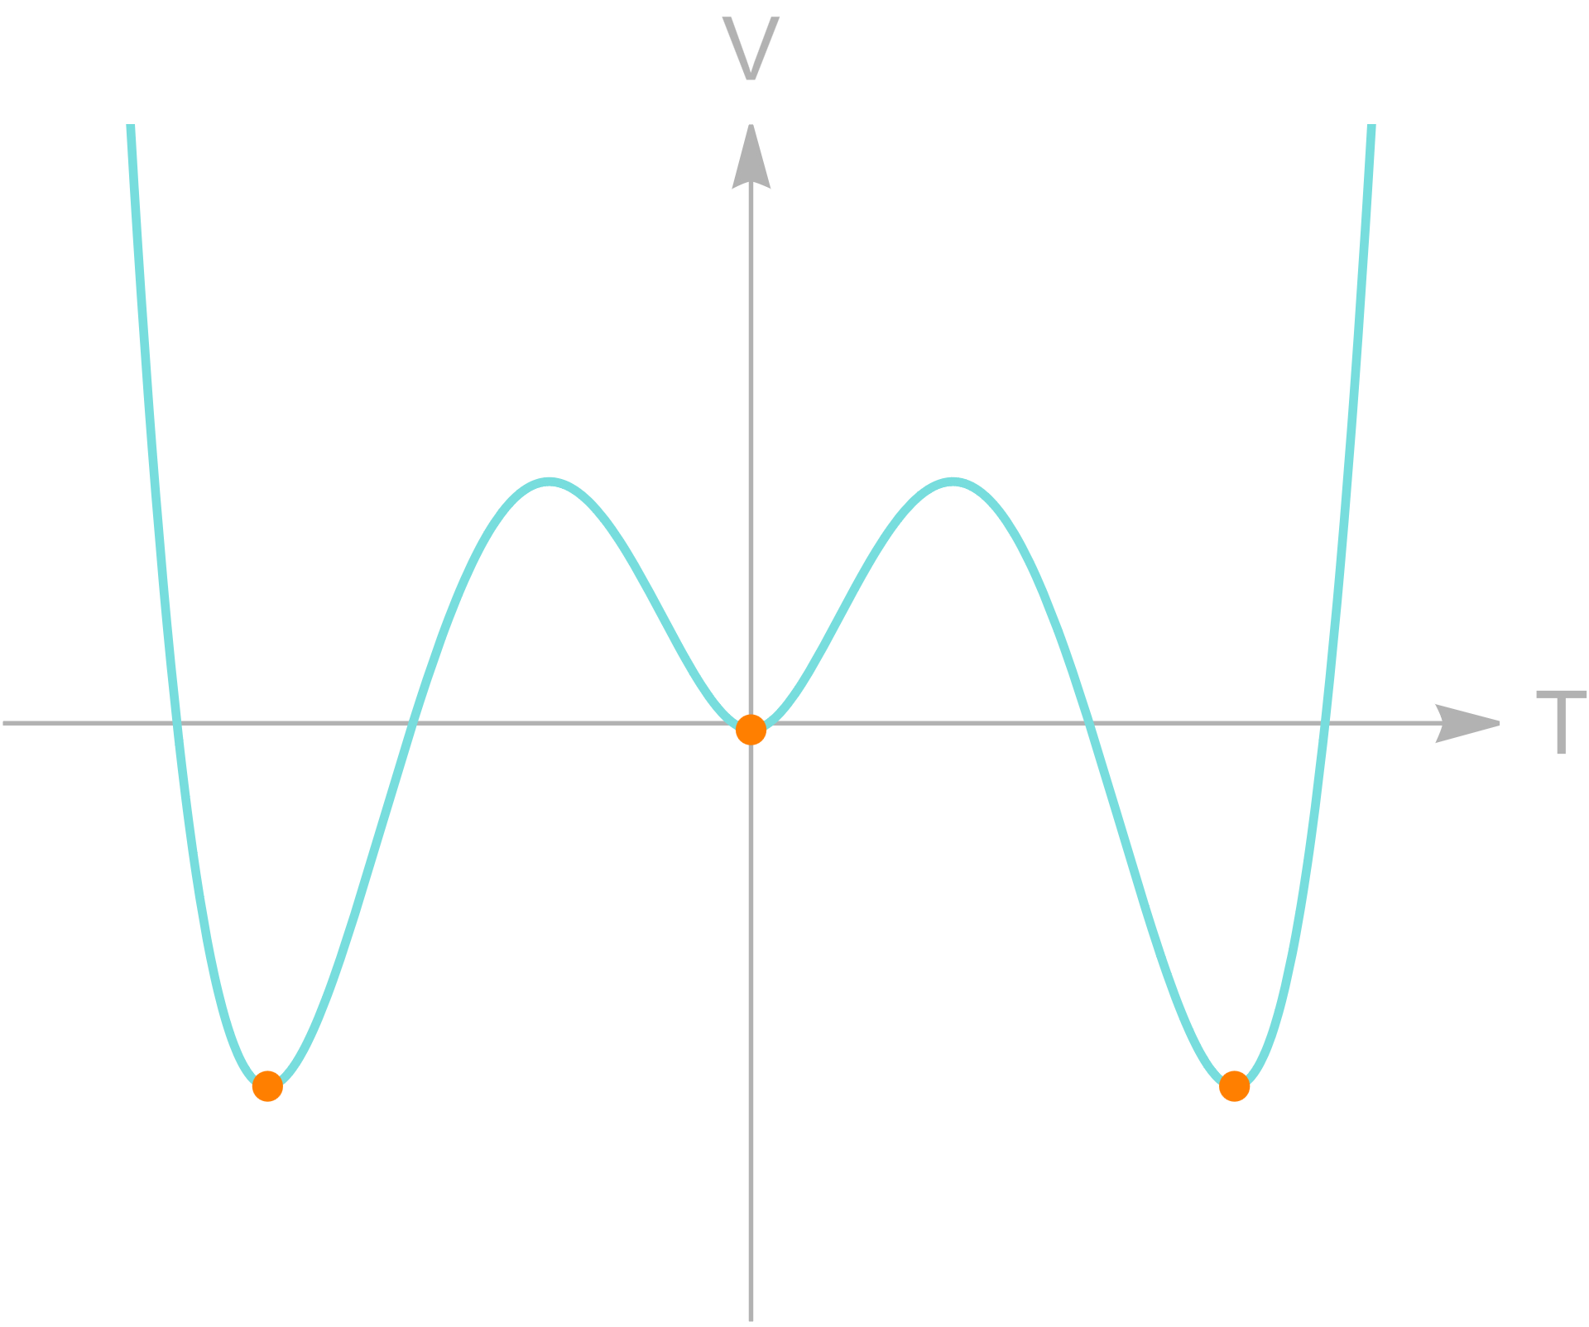

Dimensional Reduction
Dark Abelian Higgs
Dark $U\left(1\right)$ gauge sector
Scalar content:
$V\left(φ,T\right)=μ^{2}φ^{2}+λφ^{4}$
  fermions
$V_{eff}$ @ NLO
Paclet
Background | Paclet | Examples | Outlook

Slide 19
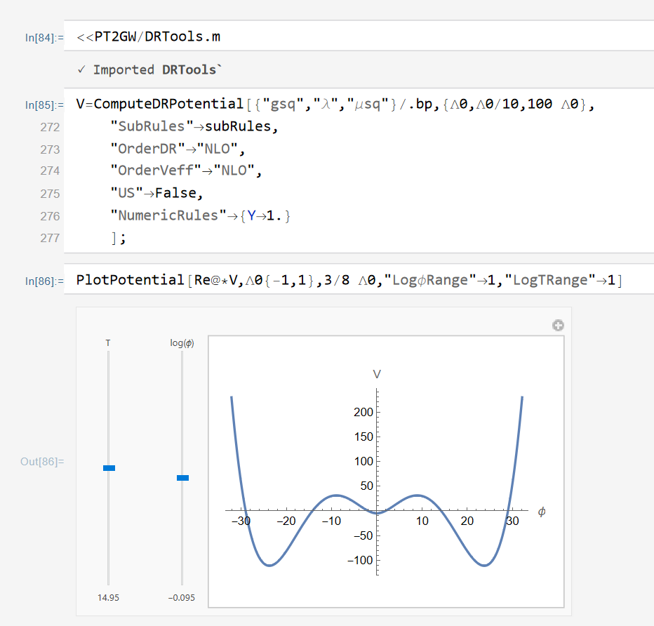
Dimensional Reduction
Dark Abelian Higgs
Dark $U\left(1\right)$ gauge sector
Scalar content:
$V\left(φ,T\right)=μ^{2}φ^{2}+λφ^{4}$
  fermions
$V_{eff}$ @ NLO
Paclet
Background | Paclet | Examples | Outlook

Slide 20
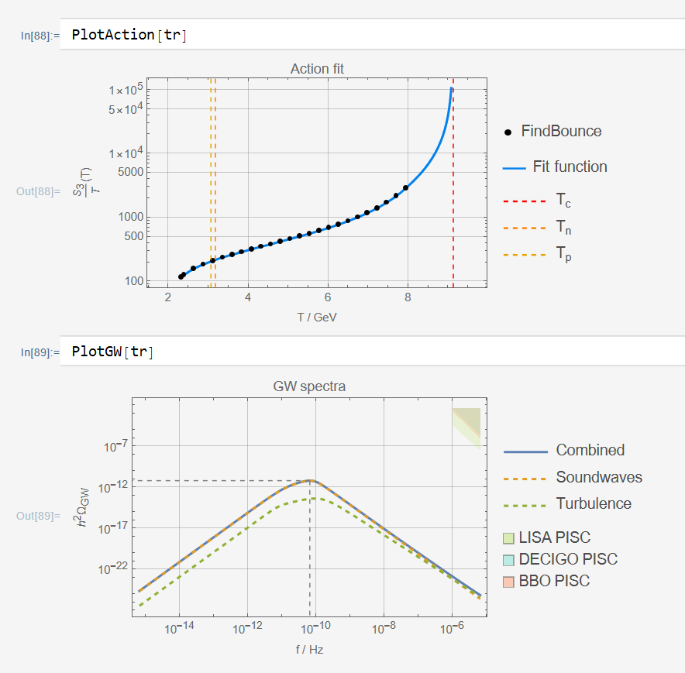
Dimensional Reduction
Dark Abelian Higgs
Dark $U\left(1\right)$ gauge sector
Scalar content:
$V\left(φ,T\right)=μ^{2}φ^{2}+λφ^{4}$
  fermions
$V_{eff}$ @ NLO
Paclet
Background | Paclet | Examples | Outlook

Slide 21
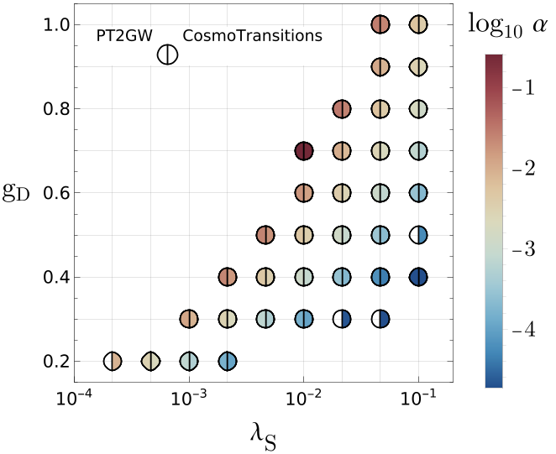
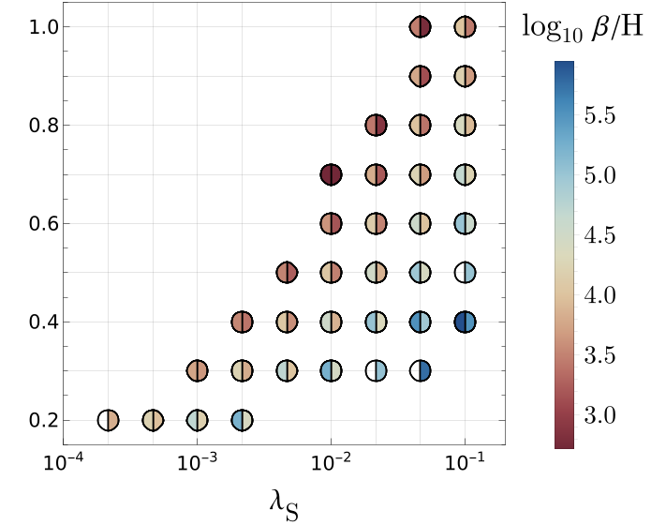
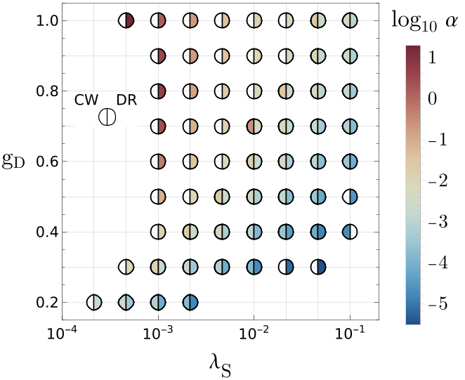
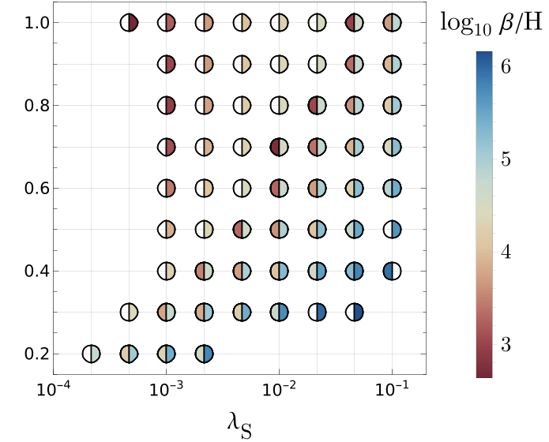
Dimensional Reduction
Dark Abelian Higgs
Dark $U\left(1\right)$ gauge sector
Scalar content:
$V\left(φ,T\right)=μ^{2}φ^{2}+λφ^{4}$
  fermions
$V_{eff}$ @ NLO
Paclet
Background | Paclet | Examples | Outlook

Slide 22
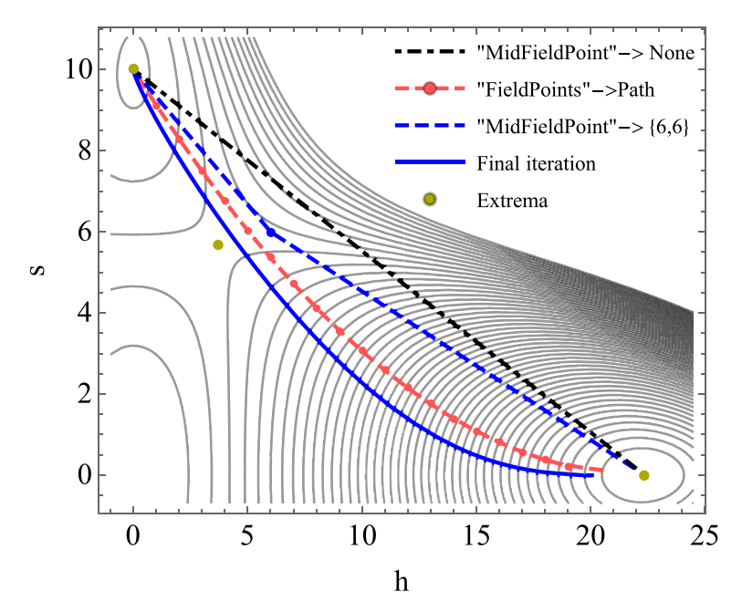




Outcome
& Future Endeavours
Paclet current status
  characterization of FOPTs and GWB
    of single-field models
  $S_{3}/T$ via polygonal bounce (FindBounce)
  optional, user-friendly interface with DRalgo
Upcoming developments
  improved phase-tracing routine
  multi-field
Potential developments
  $v_{w}$ estimation in LTE (WallGo)
  Decay rate prefactor $Γ=A e^{−S_{3}/T}$
  higher order in $β$
  GW uncertainties
Background | Paclet | Examples | Outlook
CPC 256 (2020) 10748
$v_{w}$?
$${\left\langle φ\right\rangle }_{TRUE}$$
$${\left\langle φ\right\rangle }_{FALSE}$$
Suggestions are welcome!
Notes:
I leave you with the conclusions and further developments

Slide 23
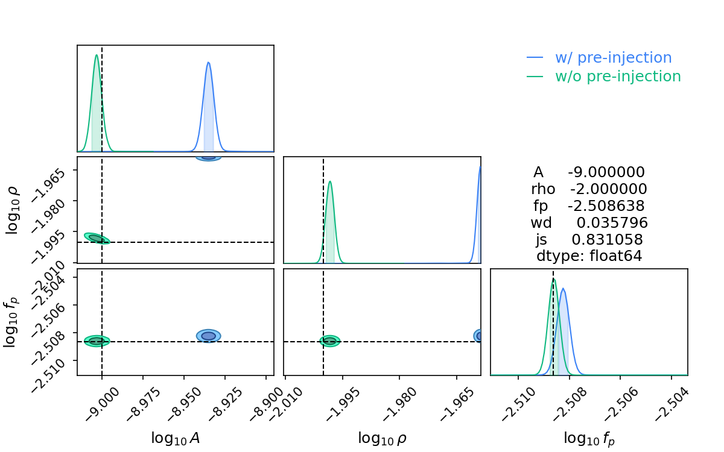
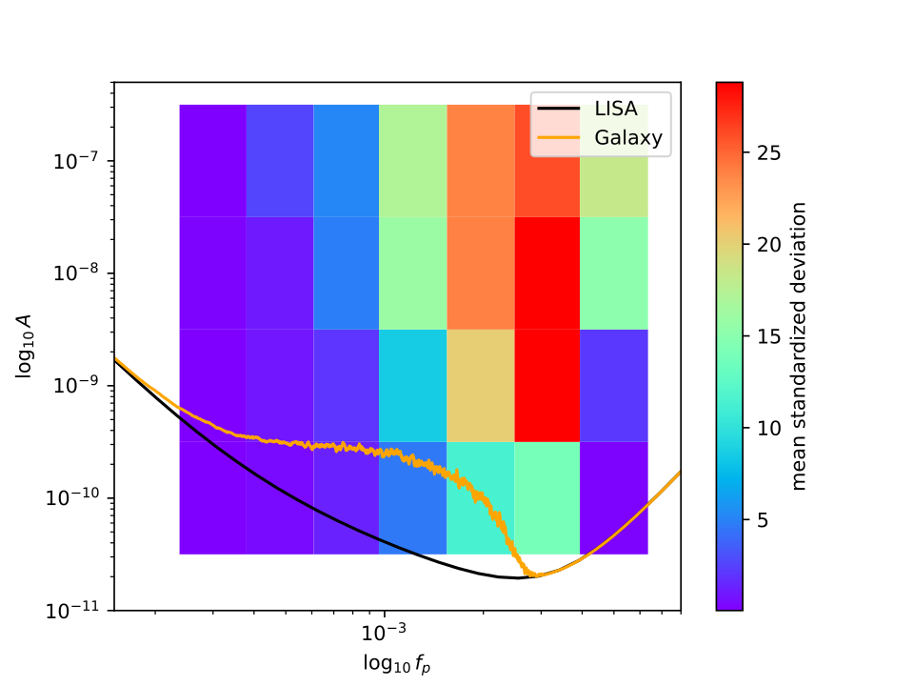
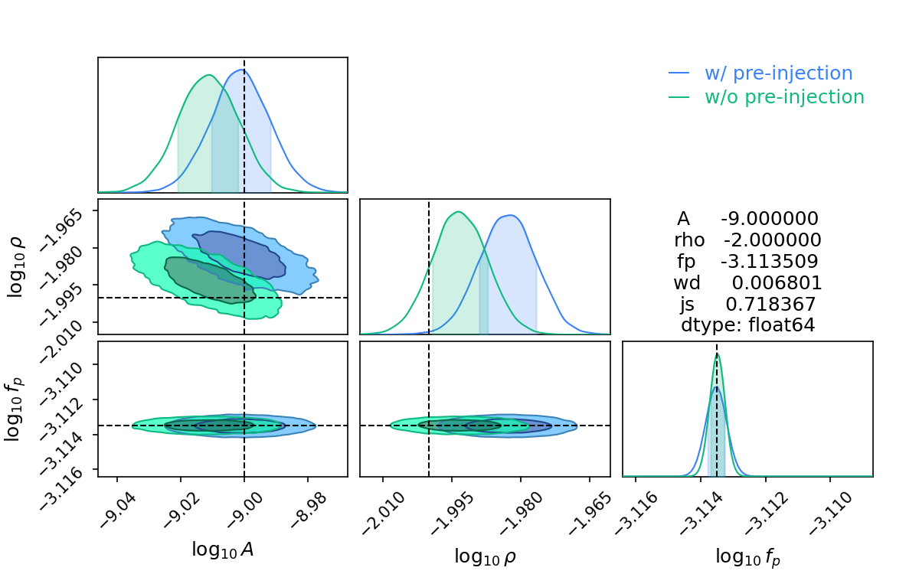
LISA Project
Filtering out the Astrophysical Foreground
Extras

Slide 24
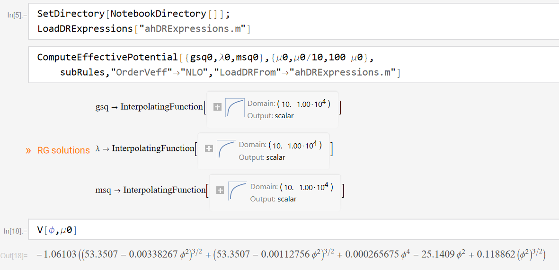
EW Baryogenesis
The matter-antimatter problem
Extras

Slide 25
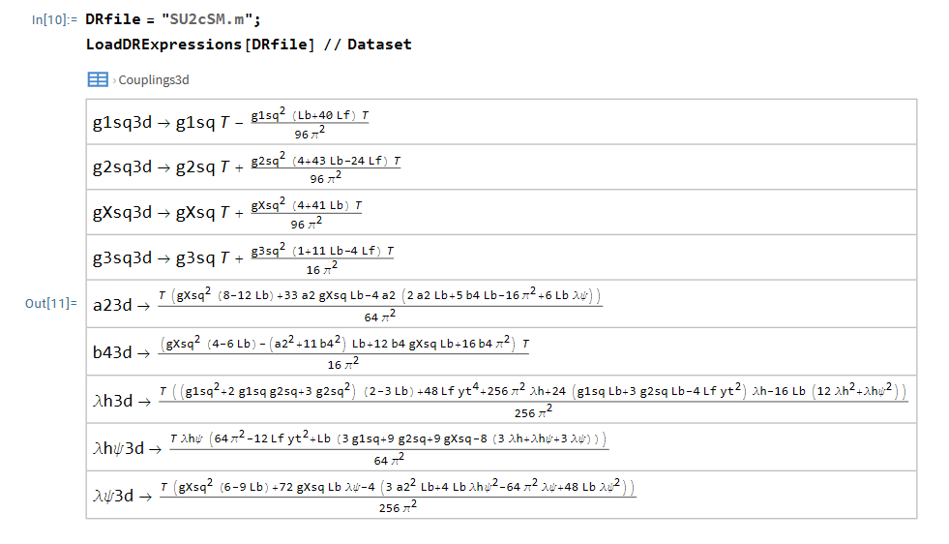
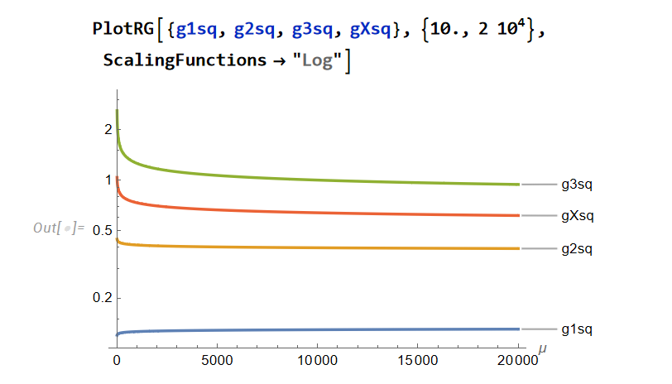

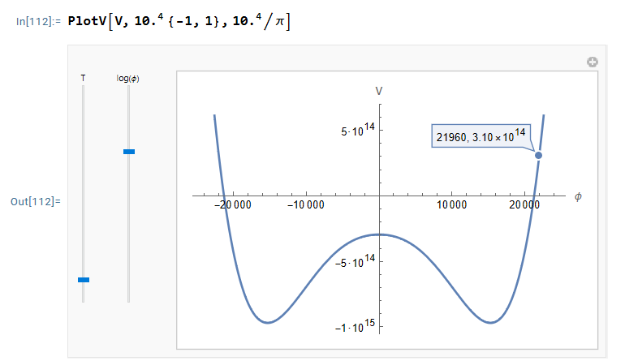

Dimensional Reduction
Paclet Tool
Extras
Extract & store DR expressions ($⇐$ DRalgo)
Benchmark-specific check functions
Construct effective potential

