Slide 1



Heavy quarkonium dynamics at next-to-leading order in the binding energy over temperature
Michael Strickland
Kent State University
Kent, OH USA
N. Brambilla, M.-A. Escobedo, A. Islam, MS, A. Tiwari, A. Vairo, and P. Vander Griend, 2205.10289, to appear in JHEP
XQCD 2022, Trondheim, Norway
July 29, 2022
TUM Global

Slide 2
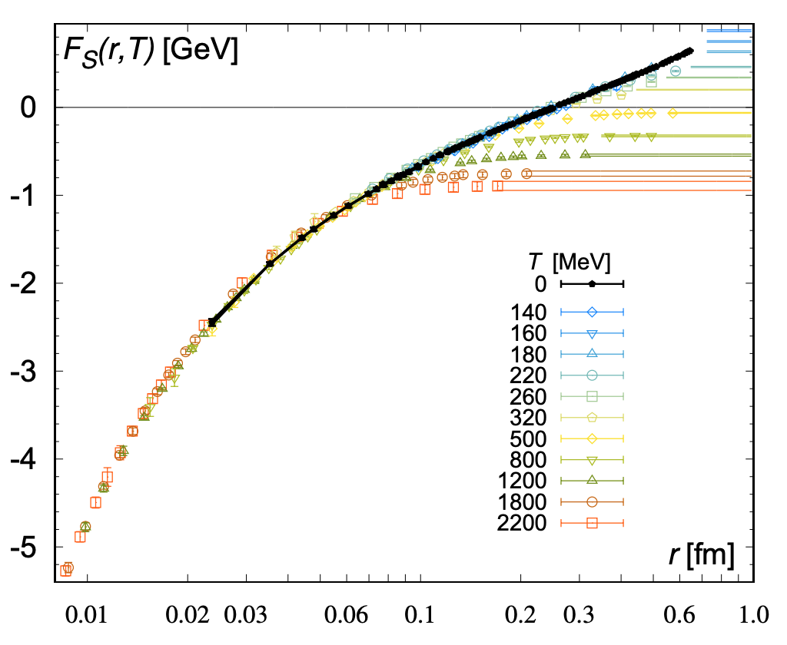
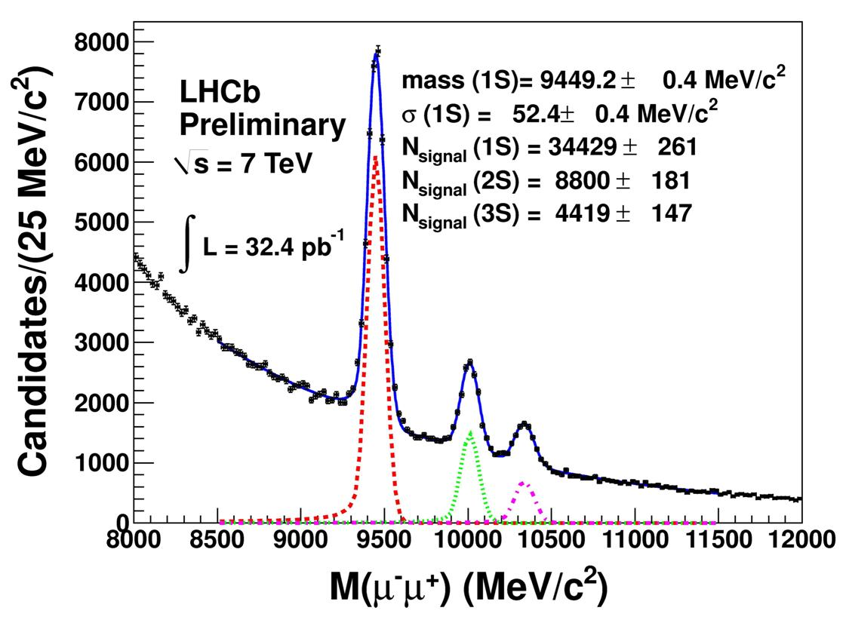
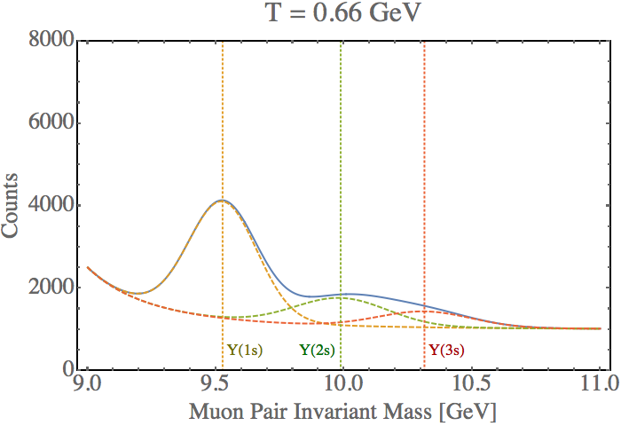
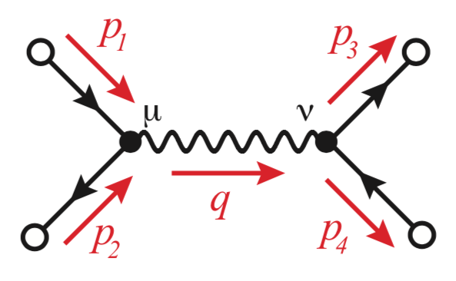
Bottomonium Suppression
In a high temperature quark-gluon plasma we expect weaker color binding (Debye screening
+ asymptotic freedom)
E. V. Shuryak, Phys. Rept. 61, 71–158 (1980)
T. Matsui, and H. Satz, Phys. Lett. B178, 416 (1986)
F. Karsch, M. T. Mehr, and H. Satz, Z. Phys. C37, 617 (1988)
Also, high energy plasma particles which slam into the bound states cause them to have shorter lifetimes → larger spectral widths
TUMQCD Collaboration, 1804.10600
cartoon
$$Υ(1s)$$
$$Υ(2s)$$
$$Υ(3s)$$

Slide 3
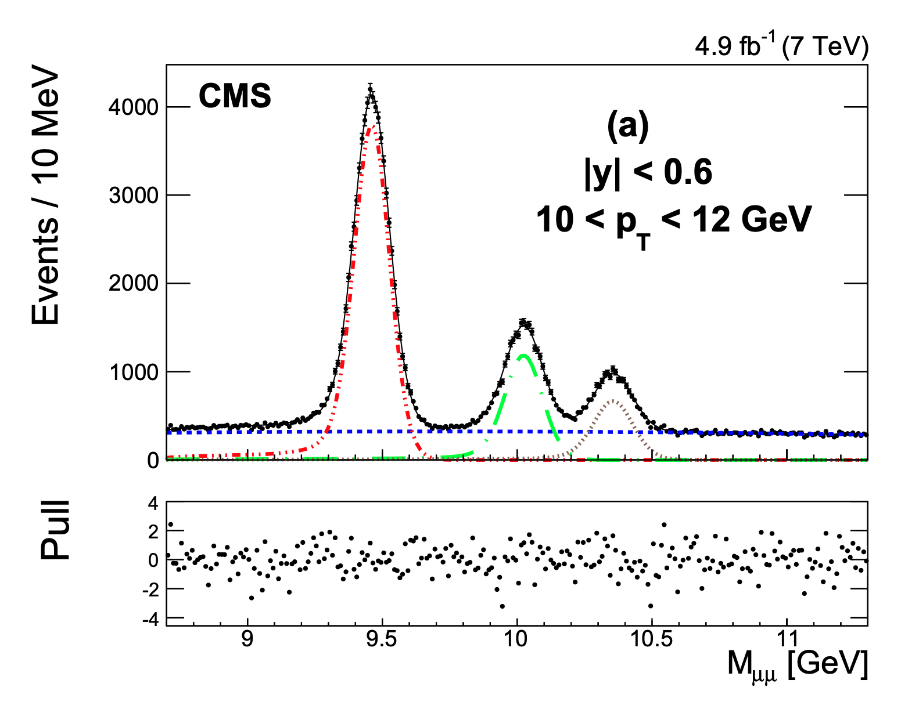
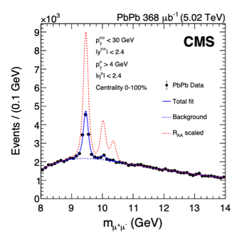
Experimental data – 5.02 TeV Dimuon Spectra
The CMS, ALICE, and ATLAS experiments have measured bottomonium production in both pp and Pb-Pb collisions at 5.02 TeV. Here I show CMS results.
pp
PbPb
$$Υ(1s)$$
pp-scaled
$$Υ(2s)$$
$$Υ(3s)$$

Slide 4
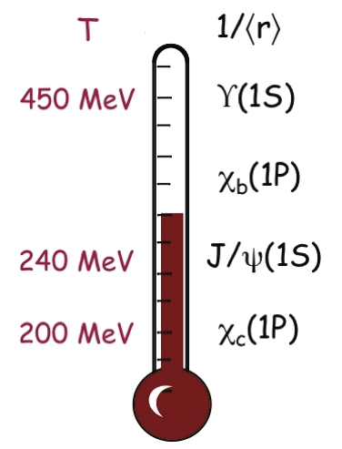
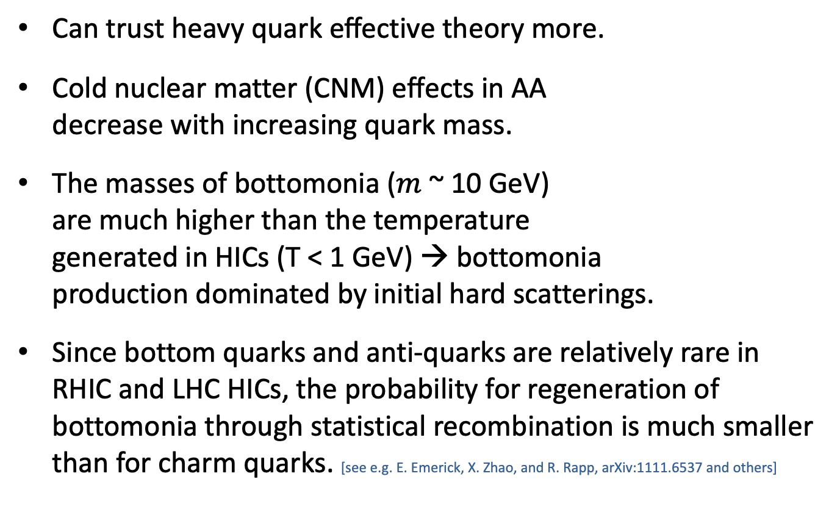
Why focus on bottomonia?
Can trust heavy quark eﬀective theory more.
Cold nuclear matter (CNM) effects in AA
decrease with increasing quark mass.
The masses of bottomonia ($m$ ~ 10 GeV)
are much higher than the temperature
generated in HICs (T < 1 GeV) → bottomonia
production dominated by initial hard scatterings.
Since bottom quarks and anti-quarks are relatively rare in RHIC and LHC HICs, the probability for regeneration of bottomonia through statistical recombination is much smaller than for charm quarks. [see e.g. E. Emerick, X. Zhao, and R. Rapp, arXiv:1111.6537 and others]
A. Mocsy, P. Petreczky,
and MS, 1302.2180

Slide 5
Conceptual problem
Bottomonium states have a large binding energy (1S ~ 1 GeV) and are produced locally (hard processes) at early times in hard collisions (t < 1 fm/c).
They then propagate through the plasma and interact with the medium.
Bound states can break up and potentially re-form due to in-medium transitions induced by in-medium gluon absorption and emission.

Slide 6
Open quantum system (OQS) approach
Probe = heavy-quarkonium state
Medium = light quarks and gluons that comprise the QGP
Can treat heavy quarkonium states propagating through QGP using an open quantum system approach
Total density matrix
Reduced density matrix (medium DOF integrated out)
“Master equation”

Slide 7
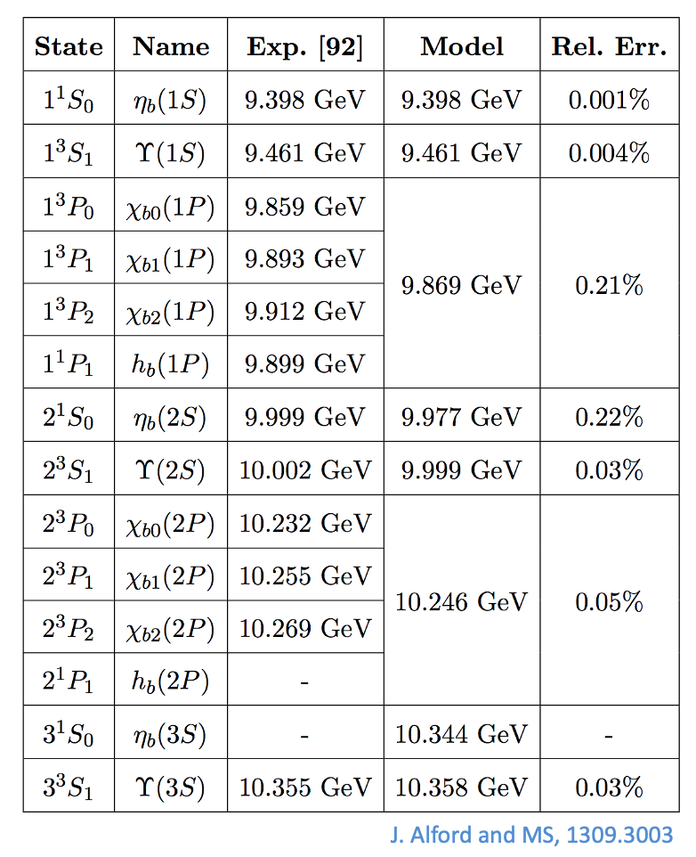
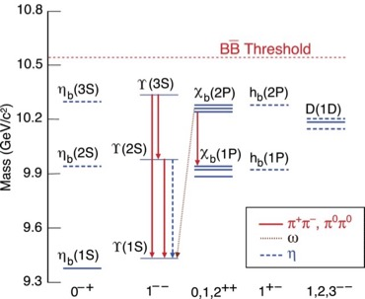
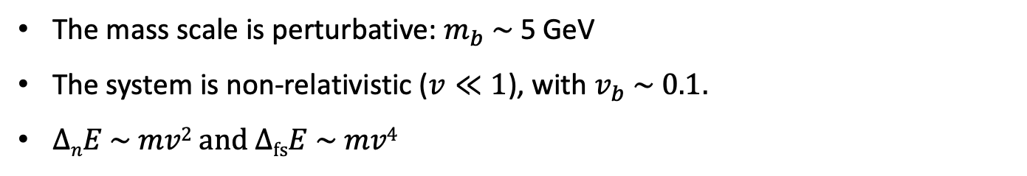
Bottomonium scales
The mass scale is perturbative: $m_{b} \sim$ 5 GeV
The system is non-relativistic ($v≪1$), with $v_{b} \sim 0.1.$
$∆nE \sim mv2$ and $∆fsE \sim mv4$
Results of a non-relativistic potential model

Slide 8
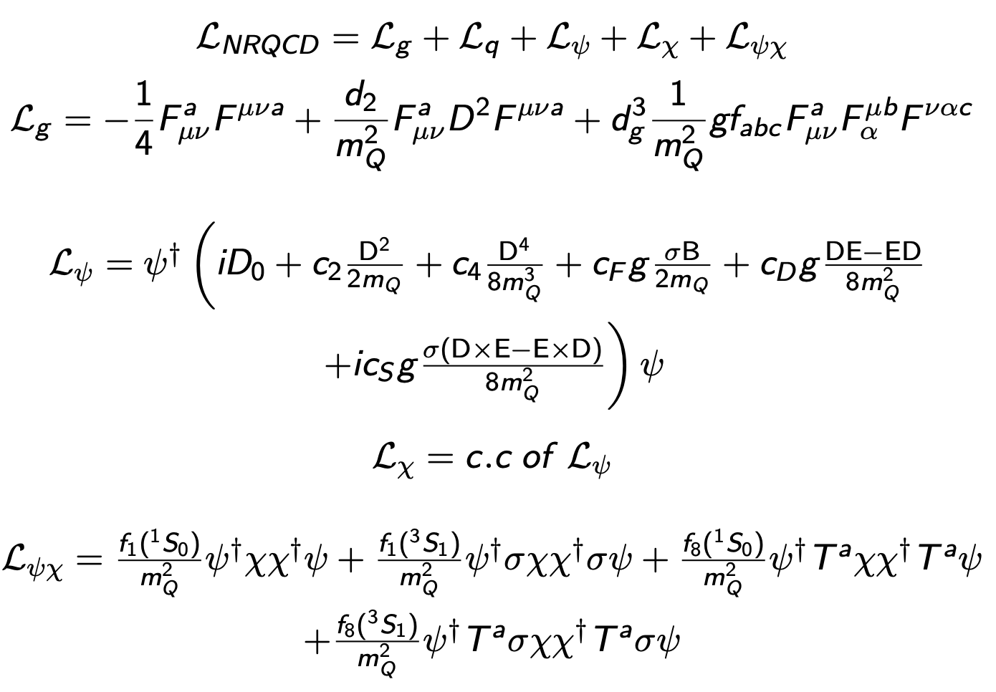
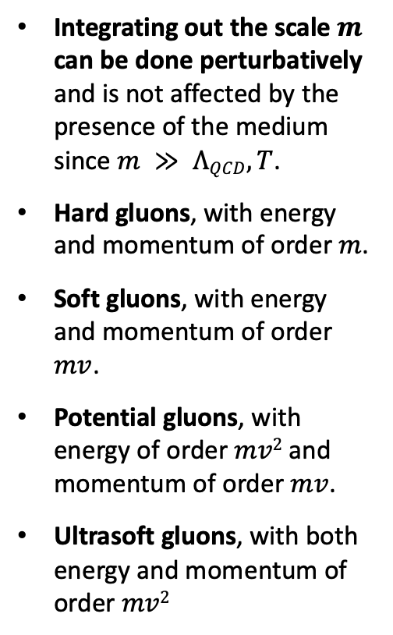
Non-Relativistic QCD (NRQCD)
Integrating out the scale $m$ can be done perturbatively and is not affected by the presence of the medium since $m ≫ ΛQCD,T$.
Hard gluons, with energy and momentum of order $m$.
Soft gluons, with energy and momentum of order $mv$.
Potential gluons, with energy of order $mv2$ and momentum of order $mv$.
Ultrasoft gluons, with both energy and momentum of order $mv2$

Slide 9
NRQCD → Potential NRQCD (pNRQCD)
Pineda and Soto, ‘97; Brambilla, Pineda, Soto, and Vairo ‘99, ‘00, ‘03
Degrees of freedom at the soft scale $mv$ are integrated out
Resulting degrees of freedom are singlet and octet states (see Lagrangian on next slide).
Allows to obtain manifestly gauge-invariant results.
Easier connection to lattice QCD.
We can use this as a starting point.
Power counting
Gauge fields are multiple expanded
Non-analytic behavior in $r$ → matching coefficients $V$

Slide 10


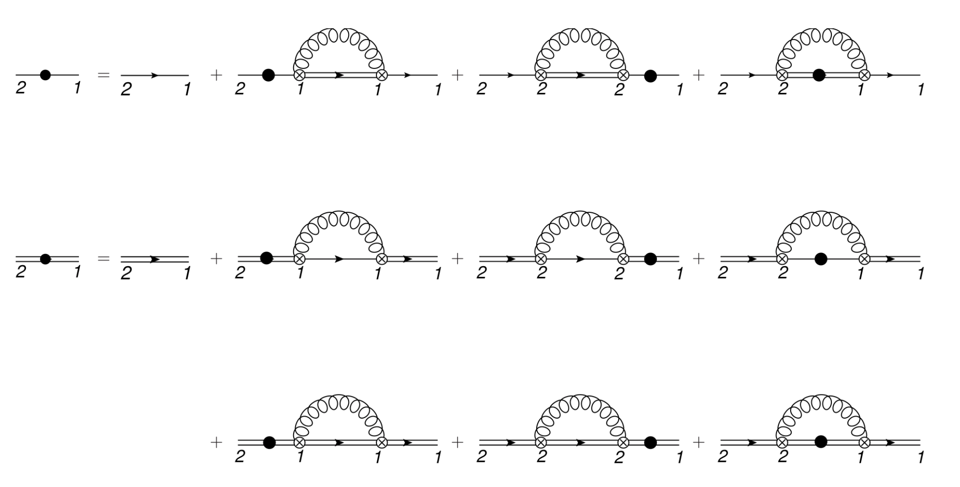
NRQCD → Potential NRQCD (pNRQCD)
Pineda and Soto, ‘97; Brambilla, Pineda, Soto, and Vairo ‘99, ‘00, ‘03
Singlet and octet potentials
Based on this Lagrangian, we can perform first-principles calculations.
Right figure shows diagrams contributing to singlet and octet
self-energies.
These enter into the calculation of Lindblad/collapse/jump operators.

Slide 11
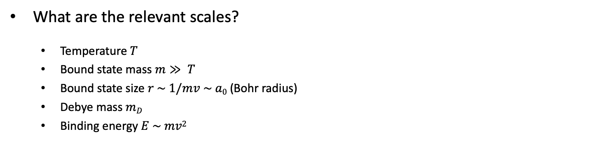
OQS + pNRQCD → Lindblad equation
What are the relevant scales?
  Temperature $T$
  Bound state mass $m≫ T$
  Bound state size $r \sim 1/mv \sim a0$ (Bohr radius)
  Debye mass $mD$
  Binding energy $E \sim mv2$
QCD
$$m$$
perturbative matching
$$μ$$
$$mv \sim \frac{1}{r}$$
NRQCD
$$μ′$$
non-perturbative matching
(long-range quarkonium)
perturbative matching
(short-range quarkonium)
$${mv}^{2} \sim E$$
pNRQCD
Separation of time scales
  Medium relaxation time scale
  Intrinsic probe time scale
  Probe relaxation time scale
$$Λ=T,E$$
N. Brambilla, M. A. Escobedo, J. Soto and A. Vairo, 1612.07248, 1711.04515

Slide 12
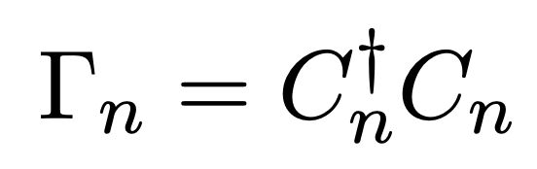
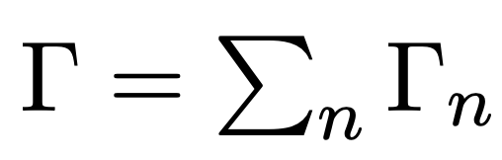
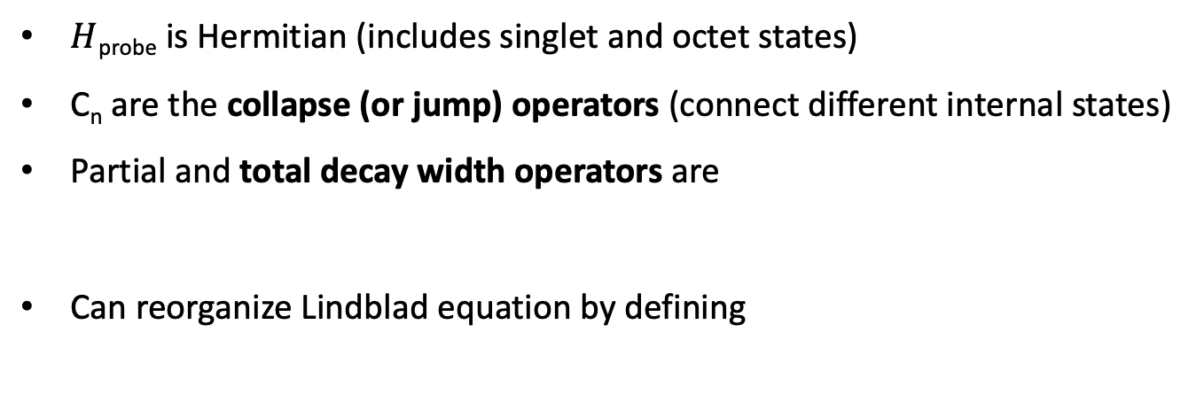
OQS + pNRQCD – Lindblad reorganization
$H$_{probe} is Hermitian (includes singlet and octet states)
C_{n} are the collapse (or jump) operators (connect different internal states)
Partial and total decay width operators are
Can reorganize Lindblad equation by defining
← Non-Hermitian effective Hamiltonian

Slide 13
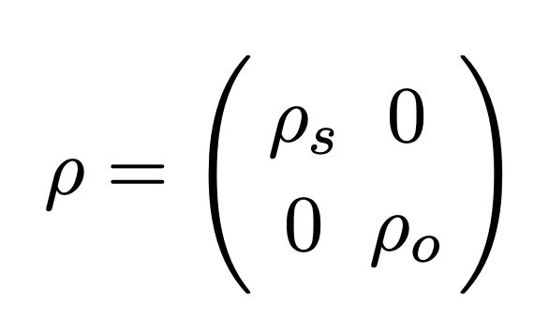
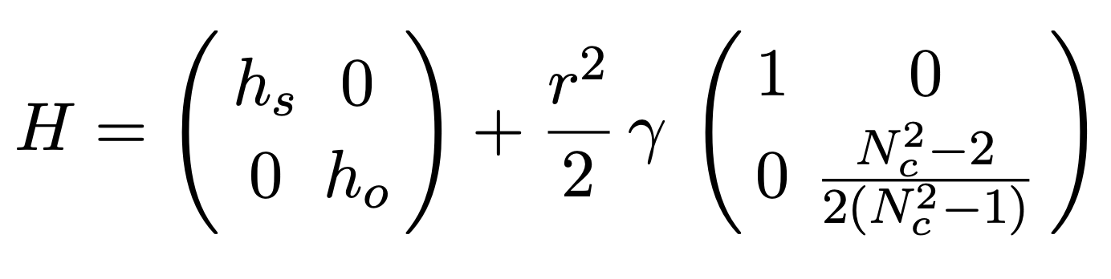
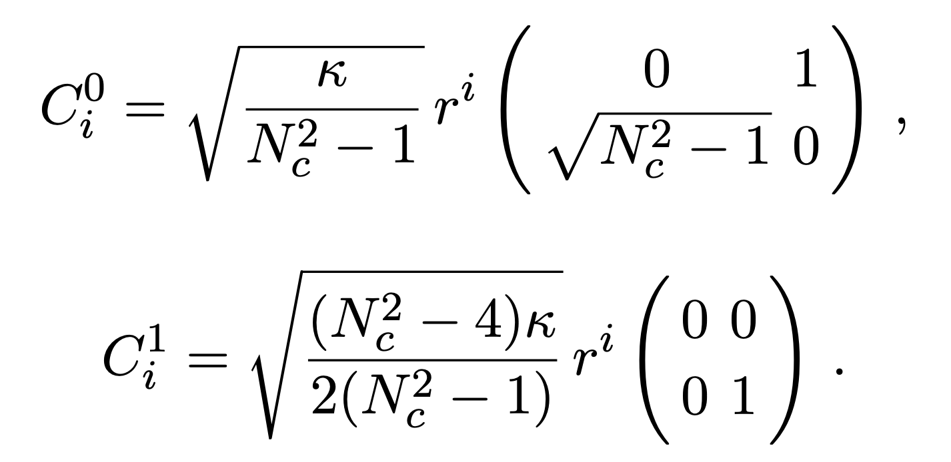
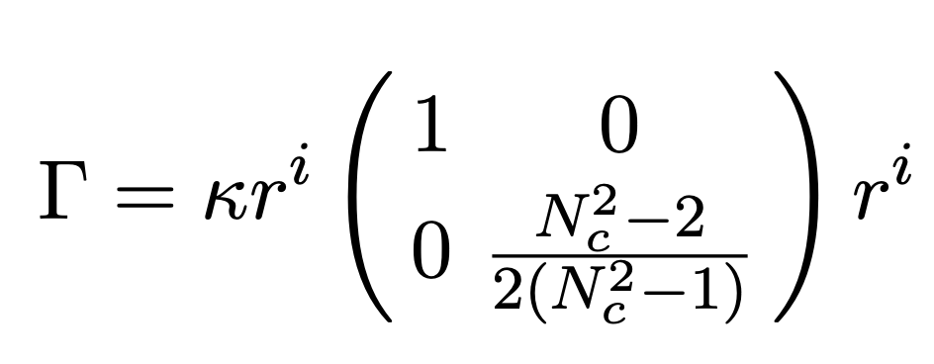
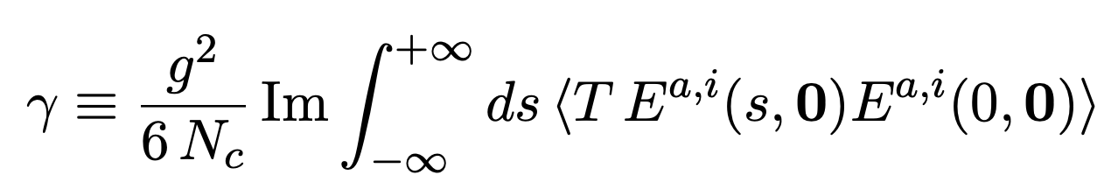
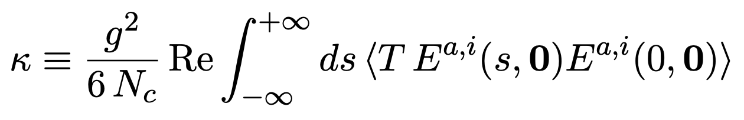
LO OQS + pNRQCD Hamiltonian and collapse operators
N. Brambilla, M. A. Escobedo, J. Soto and A. Vairo, 1612.07248, 1711.04515
mass shift
Total width → Im[V]
Six collapse operators cover
singlet → octet,
octet → singlet
octet → octet

Slide 14
LO OQS + pNRQCD Hamiltonian and collapse operators
N. Brambilla, M. A. Escobedo, J. Soto and A. Vairo, 1612.07248, 1711.04515
Six collapse operators cover
singlet → octet,
octet → singlet
octet → octet

Slide 15
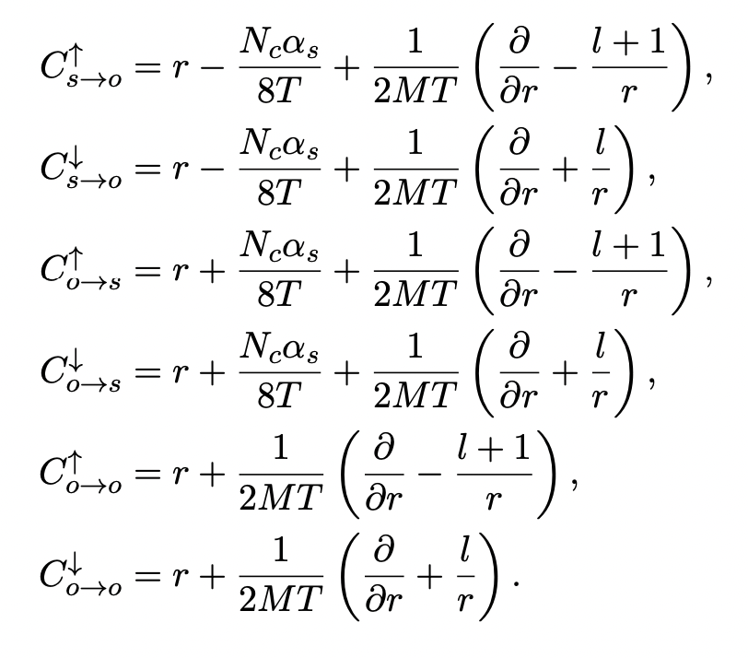
Going beyond leading order in E/T
N. Brambilla, M.-A. Escobedo, A. Islam, M.S., A. Tiwari, A. Vairo, and P. Vander Griend, 2205.10289
Results on previous slides were obtained by truncating at leading order (LO) in E/T (binding energy over temperature). This was extended to NLO in the reference above.
By decomposing states into radial and angular components, for an isotropic system we can rewrite the operators as acting only on the 1d effective wavefunction
u(r,t) = r R(r,t).
At NLO, there are six jump
operators (shown on the right).
Based on these, one can
write down the singlet
and octet non-Hermitian
effective Hamiltonian (see
ref above for details).

Slide 16
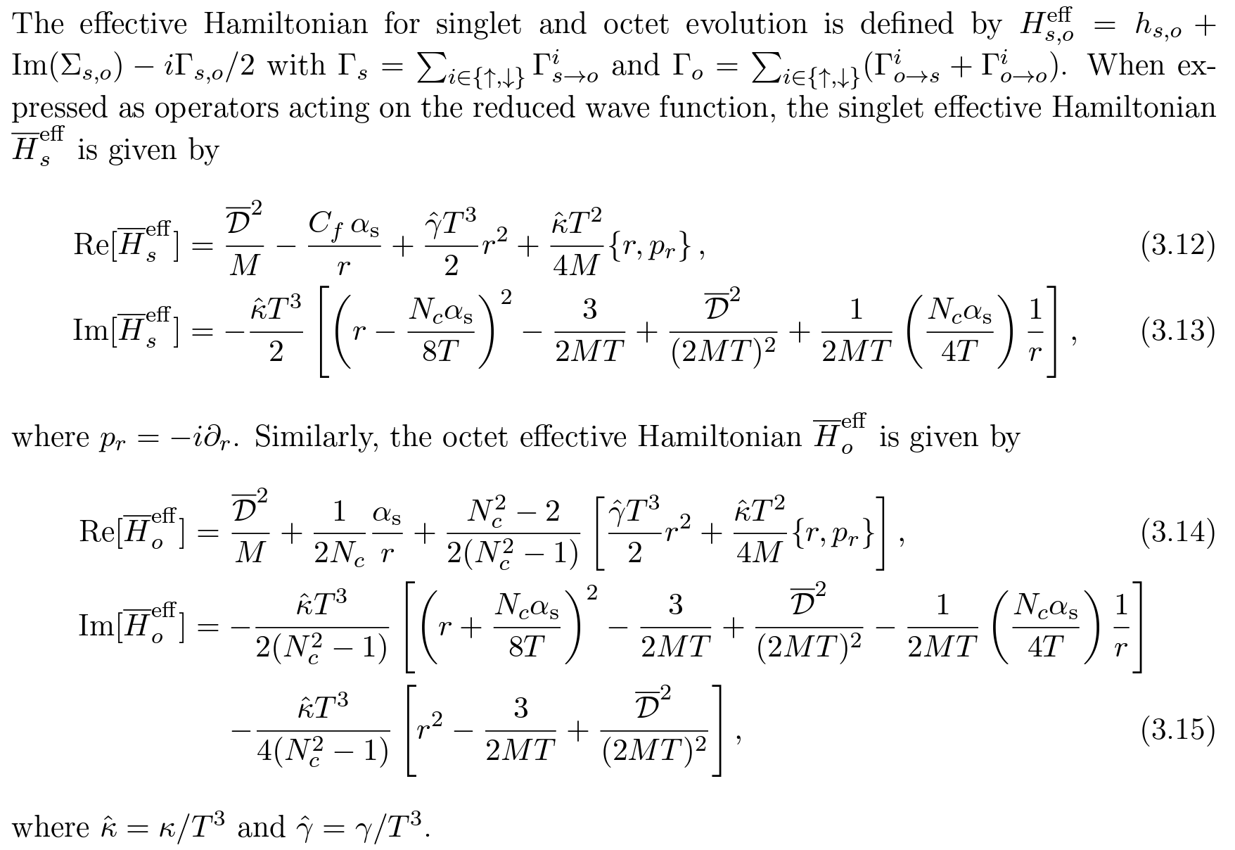
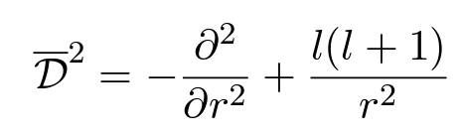
Full NLO effective Hamiltonian
N. Brambilla, M.-A. Escobedo, A. Islam, M.S., A. Tiwari, A. Vairo, and P. Vander Griend, 2205.10289

Slide 17
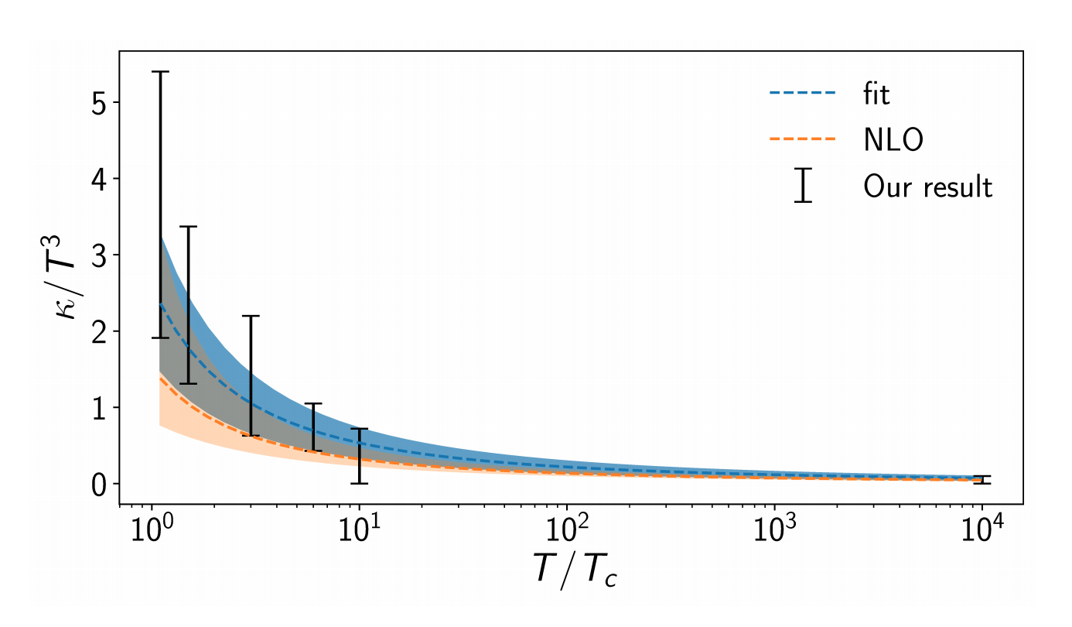
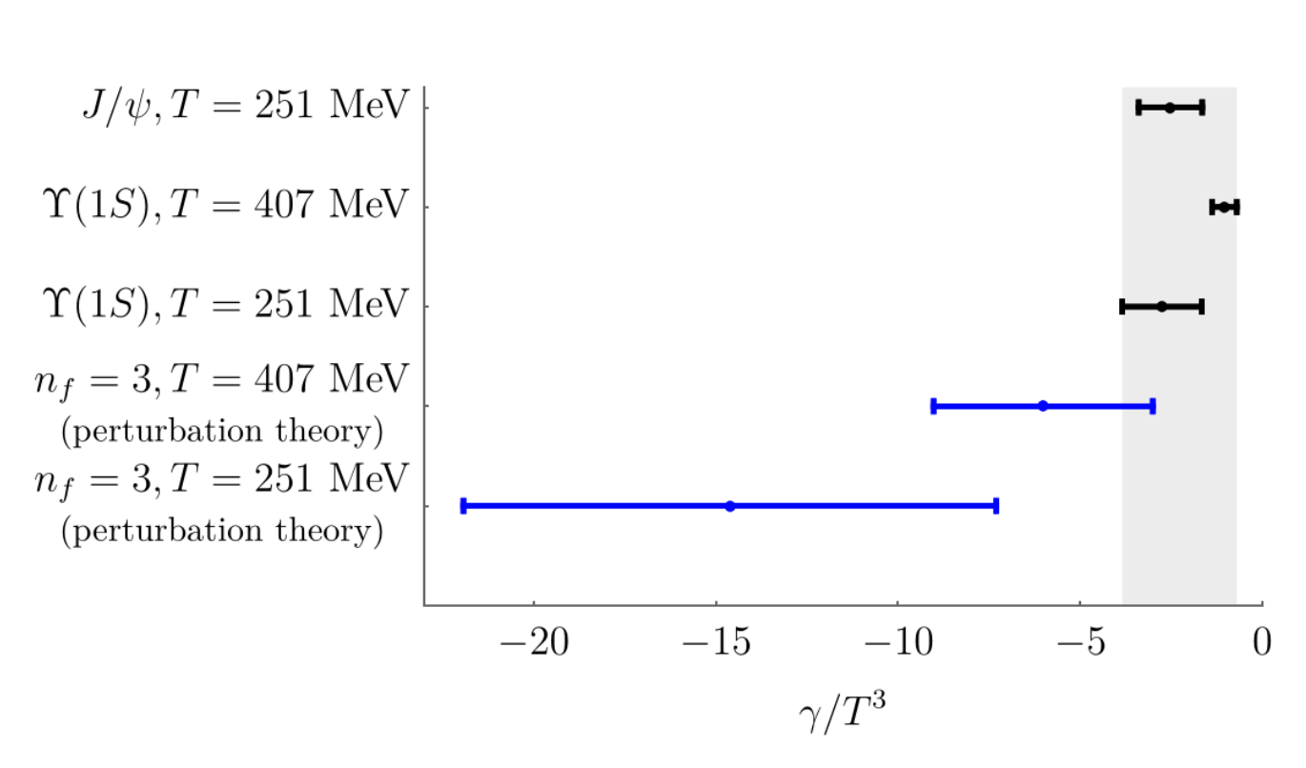
Values of $\hat{κ}$ and $\hat{γ}$ used
N. Brambilla, V. Leino, P. Petreczky, and A. Vairo, 2007.10078
We used NLO fits to recent lattice measurements of the heavy quark transport coefficient $\hat{κ}≡ κ/T^{3}$. Note that this is related to the heavy quark diffusion constant D.
The value of $\hat{γ}≡ γ/T^{3}$ is less constrained, we vary it in the range -3.5 < $\hat{γ}$ < 0.
N. Brambilla, V. Leino, P. Petreczky, and A. Vairo, 2007.10078
N. Brambilla, M. A. Escobedo, J. Soto and A. Vairo, 1612.07248.
N. Brambilla, M. A. Escobedo, J. Soto and A. Vairo, 1711.04515.
N. Brambilla, M. A. Escobedo, A. Vairo and P. Vander Griend, 1903.08063.
N. Brambilla, M. A. Escobedo, A. Vairo and P. Vander Griend, 1903.08063.

Slide 18
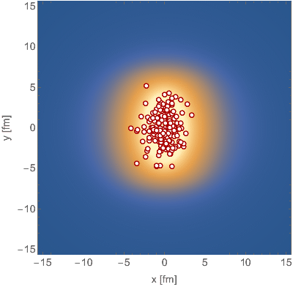
Computing survival probabilities with QTraj
We sampled bottomonium production points and initial COM transverse momentum using Monte-Carlo sampling (physical trajectories).
Temperature evolution provided by 3+1D anisotropic hydrodynamics (good description of identified soft hadron spectra and anisotropic flow, see backup slides for evidence).
Along each physical trajectory, we solved the real-time 3D Schrödinger equation with a complex potential and stochastically sampled jumps → Lindblad equation.
We then solved for the survival probability of S- and P-wave states (see box to the left).
Survival probability
Used $N=4096$points
$L = 108 a0$
$∆t=$2 x 10⁻⁴ fm

Slide 19
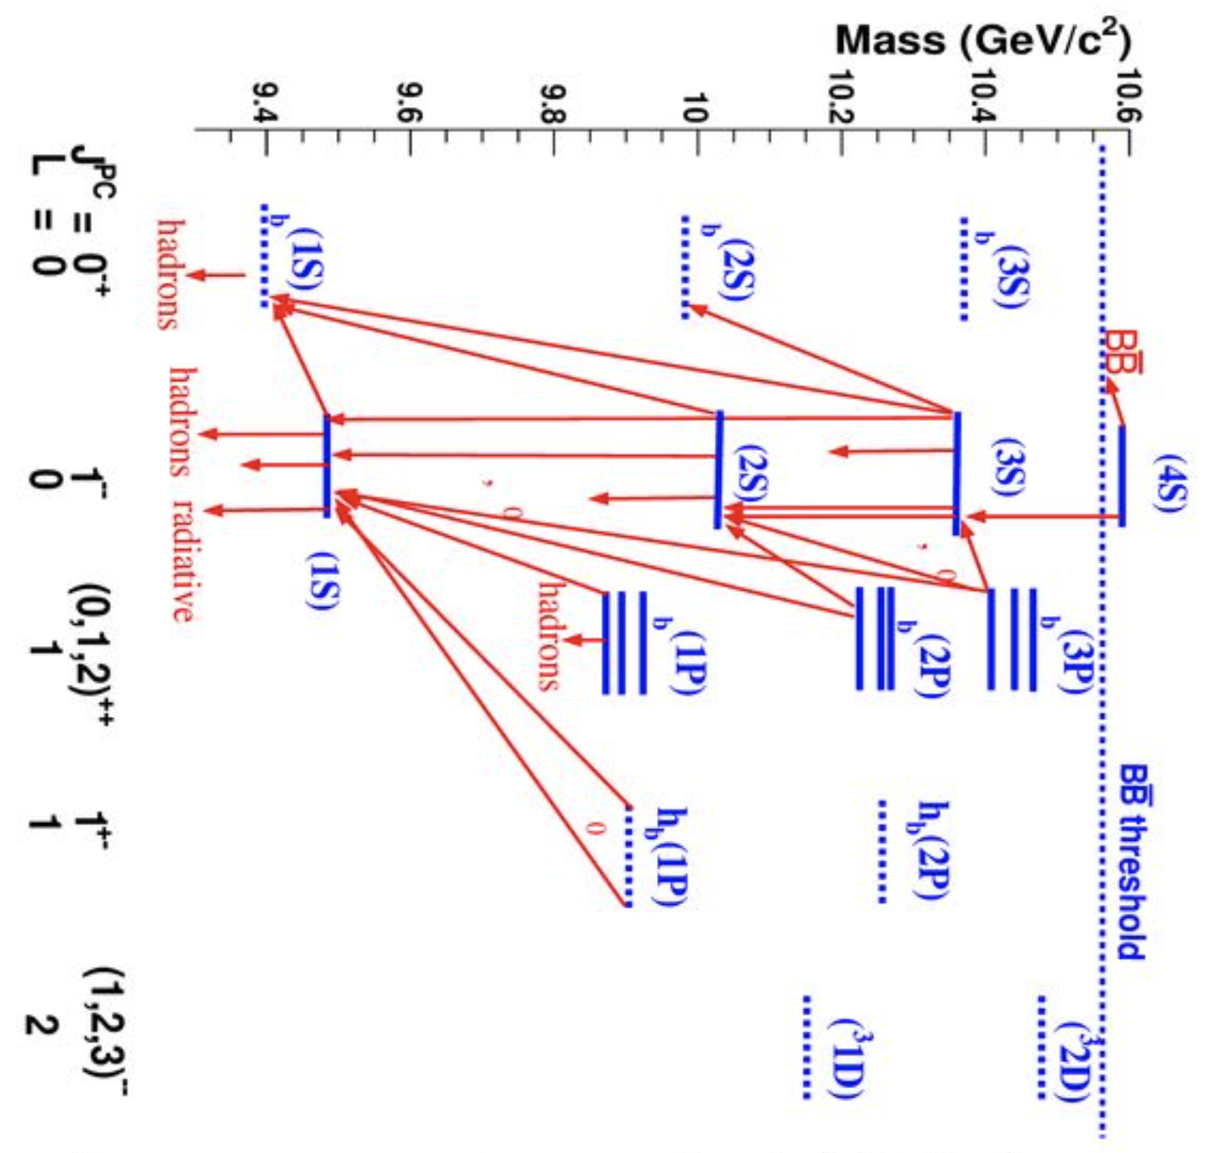
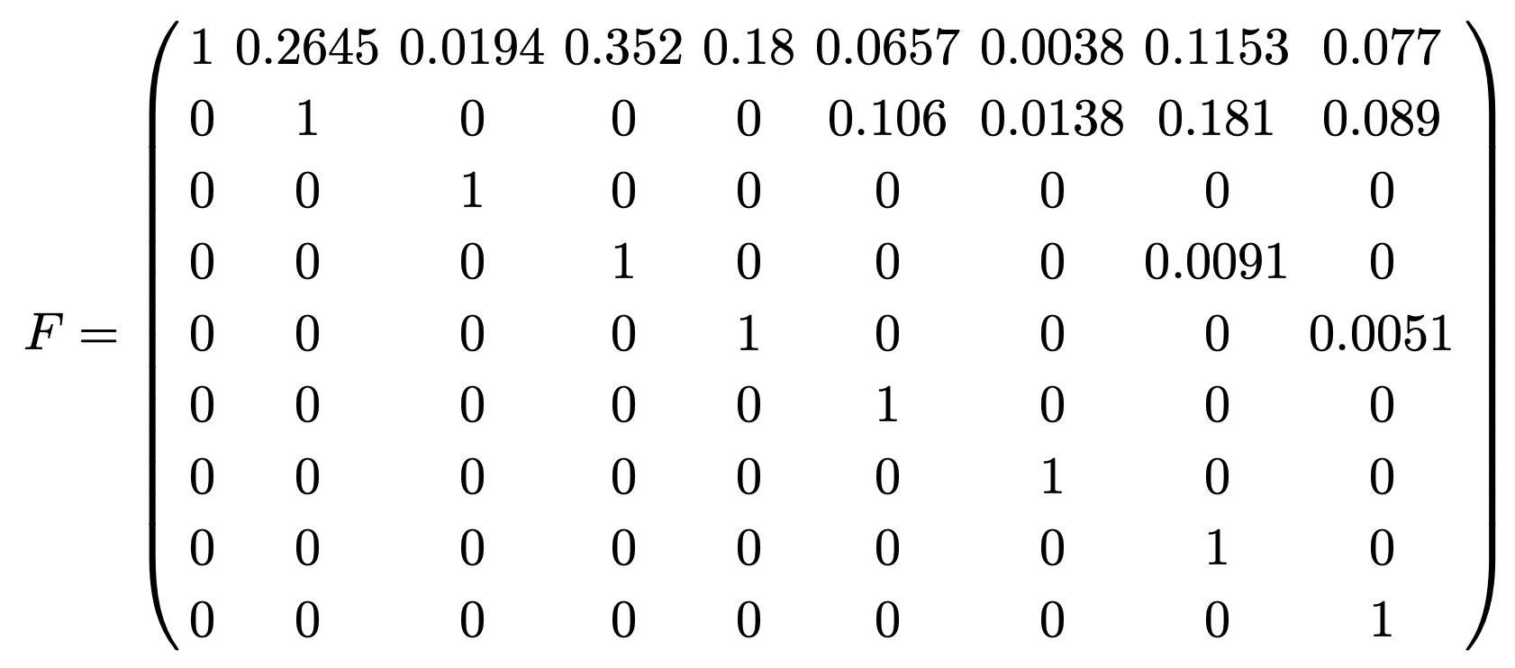
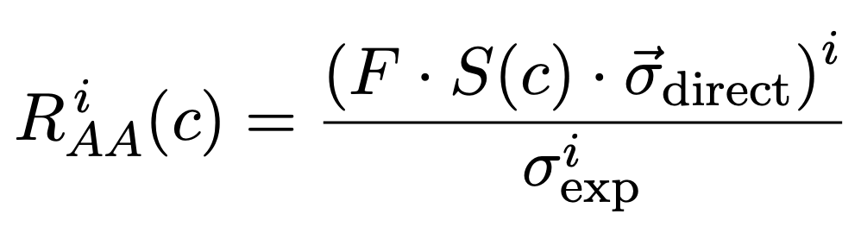
Feed-down implementation
N_{direct} corresponds to (N_{1S}, N_{2S,} N_{1P} x 3, N_{3S,} N_{2P} x 3, N_{2D})^{T} where, e.g., N_{1S} is the final number of Y(1S) states that can decay in the dilepton channel.
N_{direct} can be obtained using <N_{bin}(b)> * σ_{direct} * (Survival probability)
After feed down, we then normalize
by the pp collision result scaled to AA → R_{AA}.

Slide 20
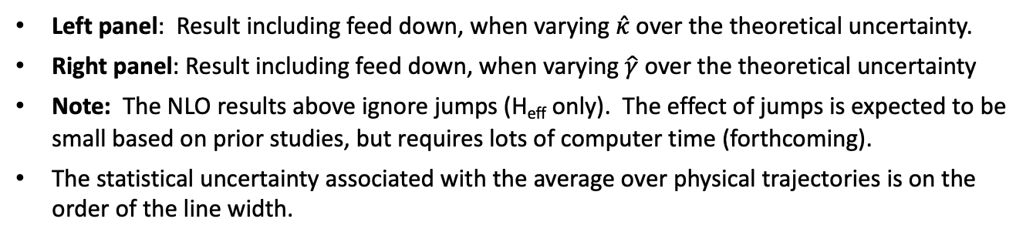
NLO OQS + pNRQCD predictions for R_{AA} vs N_{part} at LHC
N. Brambilla, M.-A. Escobedo, A. Islam, M.S., A. Tiwari, A. Vairo, P. Vander Griend, 2205.10289
Left panel: Result including feed down, when varying $\hat{κ}$ over the theoretical uncertainty.
Right panel: Result including feed down, when varying $\hat{γ}$ over the theoretical uncertainty
Note: The NLO results above ignore jumps (H_{eff} only). The effect of jumps is expected to be small based on prior studies, but requires lots of computer time (forthcoming).
The statistical uncertainty associated with the average over physical trajectories is on the order of the line width.

Slide 21
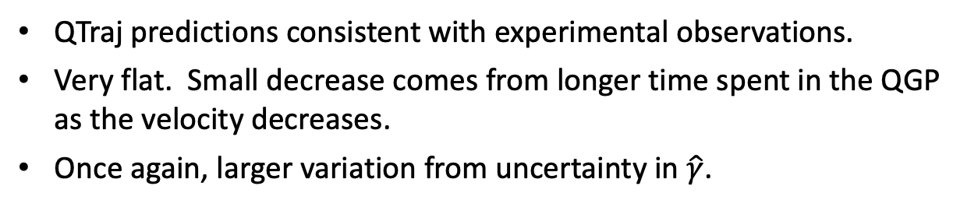
NLO R_{AA} vs transverse momentum
N. Brambilla, M.-A. Escobedo, A. Islam, M.S., A. Tiwari, A. Vairo, P. Vander Griend, 2205.10289
QTraj predictions consistent with experimental observations.
Very flat. Small decrease comes from longer time spent in the QGP as the velocity decreases.
Once again, larger variation from uncertainty in $\hat{γ}$.

Slide 22
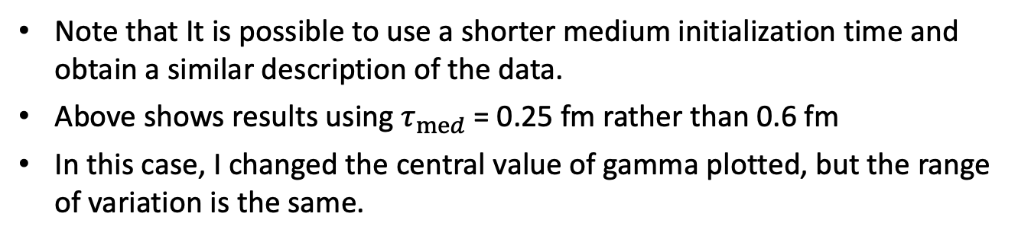
NLO OQS + pNRQCD predictions for R_{AA} vs N_{part} at LHC
N. Brambilla, M.-A. Escobedo, A. Islam, M.S., A. Tiwari, A. Vairo, P. Vander Griend, 2205.10289
Note that It is possible to use a shorter medium initialization time and obtain a similar description of the data.
Above shows results using $τ_{med}$= 0.25 fm rather than 0.6 fm
In this case, I changed the central value of gamma plotted, but the range of variation is the same.

Slide 23
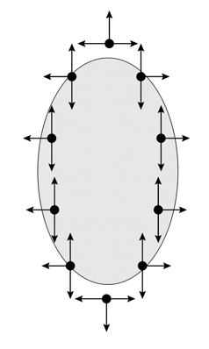
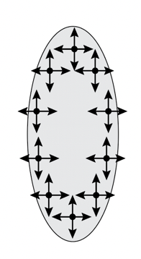
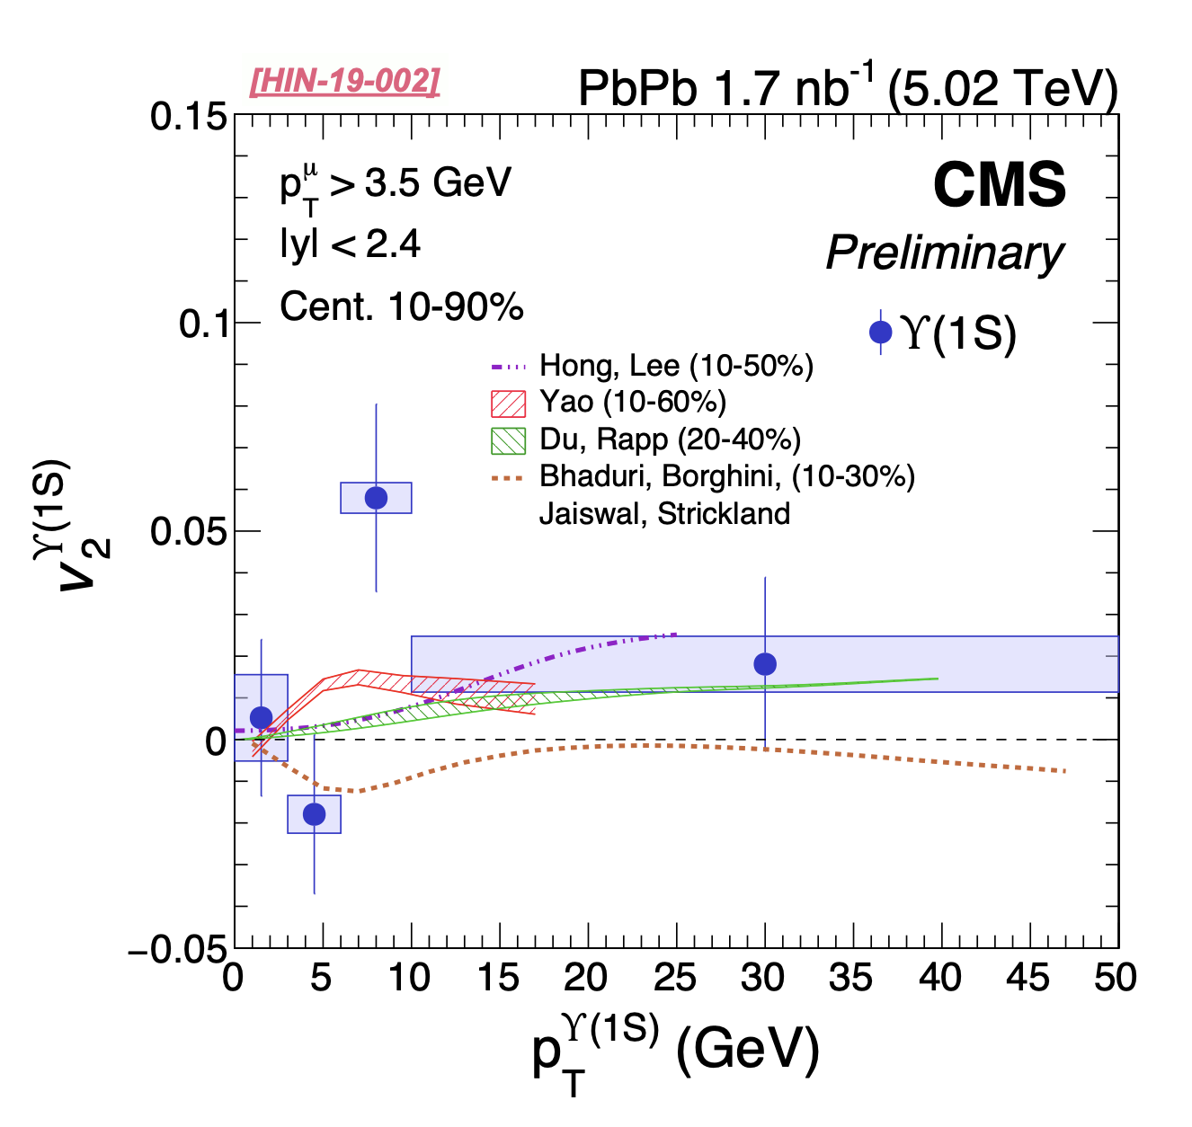
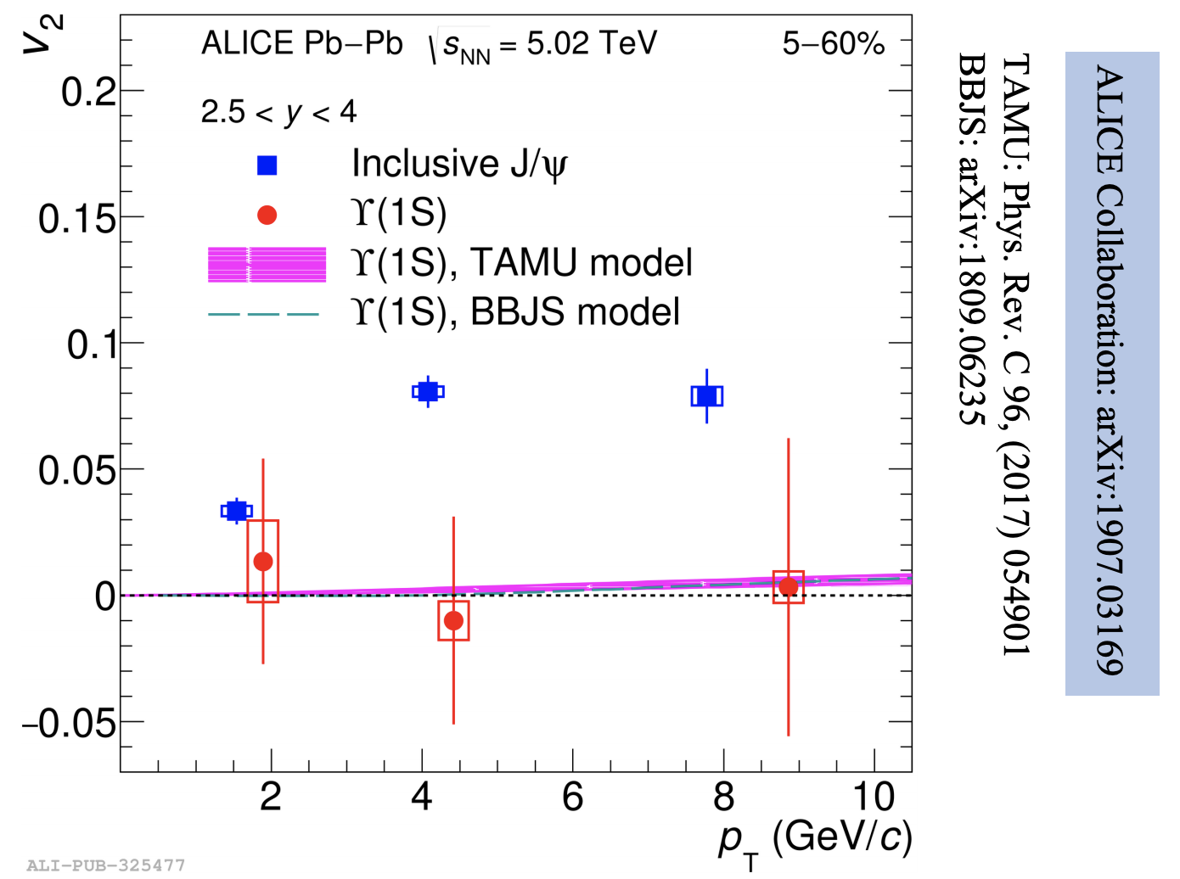
Momentum-space anisotropies
4d flow tomography
Bottomonium probably doesn’t flow in the ”collective flow” sense.
However, there can be momentum-space anisotropies induced by path-length differences in suppression along the short and long sides of the QGP.
Cern Courier, Fall 2019
ALICE
Quark Matter 2019

Slide 24
LO Momentum-space anisotropies at LHC
N. Brambilla, M.-A. Escobedo, M.S., A. Vairo, P. Vander Griend, and J.H. Weber, 2107.06222 (Leading-Order)

Slide 25
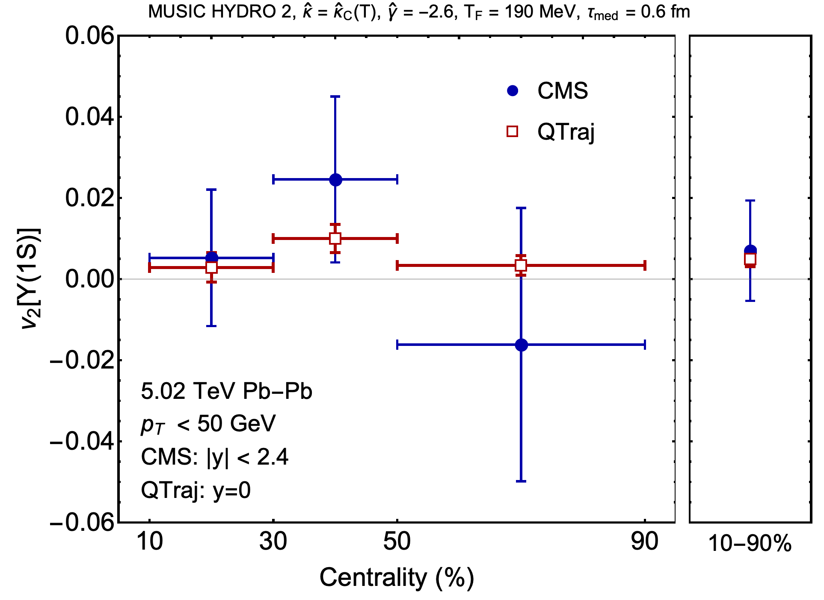
NLO Momentum-space anisotropies at LHC
H. Alalawi, J. Boyd, and M. Strickland, forthcoming
Forthcoming work on including the effect of fluctuating hydrodynamics.
Using MUSIC + IPGlasma IC tuned to 5.02 TeV Pb-Pb collisions.
Agrees well with aHydro results for R_{AA} (not shown).
PRELIMINARY
PRELIMINARY

Slide 26

NLO OQS + pNRQCD predictions for R_{AA} vs N_{part} at RHIC
M. Strickland and S. Thapa, forthcoming
PRELIMINARY
PRELIMINARY
Above are results from the NLO OQS + pNRQCD predictions for R_{AA} at 200 GeV compared to recently reported STAR data (2207.06568). Same parameters at LHC, only changed the hydrodynamic background.
Framework does not predict enough 1S suppression
STAR data indicate similar levels of suppression for the 1S and 2S for N_{part} < 200.
Data from sPHENIX will be useful

Slide 27
Phenomenological KSU model RHIC predictions
A. Islam and M. Strickland, 2010.05457 and 2007.10211
M. Strickland and S. Thapa, forthcoming
PRELIMINARY
PRELIMINARY
Above are results from the KSU phenomenological potential.
It reduces to a Cornell potential with string breaking at T=0. Parameterization gives all observed bottomium vacuum eigenenergies to a few %. For in-medium potential a KMS type potential is used for the real part and the Laine et al result for the imaginary part is used.
The KSU model gets closer to the STAR data for the 1S, however, it can’t explain the 2S results at the same time for N_{part}< 225. The transverse momentum dependence which is dominated by large N_{part} events, is reasonably well described.

Slide 28
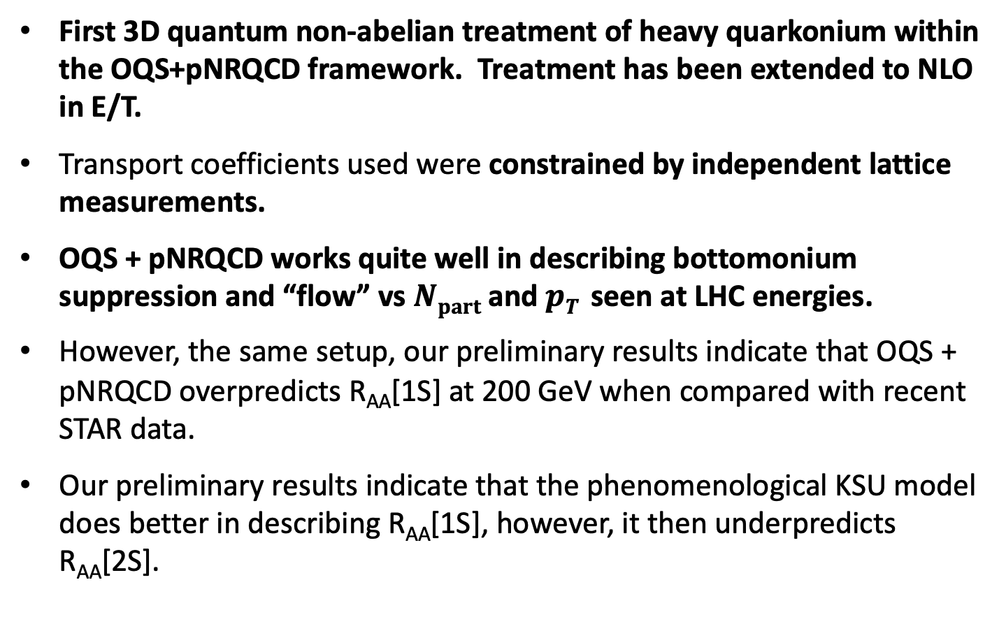
Conclusions and Outlook
First 3D quantum non-abelian treatment of heavy quarkonium within the OQS+pNRQCD framework. Treatment has been extended to NLO in E/T.
Transport coefficients used were constrained by independent lattice measurements.
OQS + pNRQCD works quite well in describing bottomonium suppression and “flow” vs $Npart$ and $pT$ seen at LHC energies.
However, the same setup, our preliminary results indicate that OQS + pNRQCD overpredicts R_{AA}[1S] at 200 GeV when compared with recent STAR data.
Our preliminary results indicate that the phenomenological KSU model does better in describing R_{AA}[1S], however, it then underpredicts R_{AA}[2S].

Slide 29
Additional slides

Slide 30
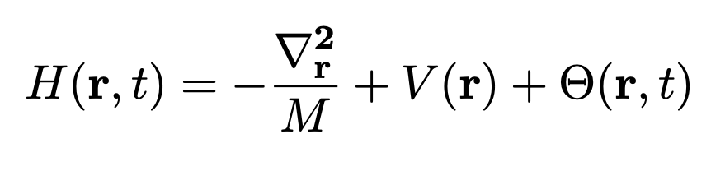
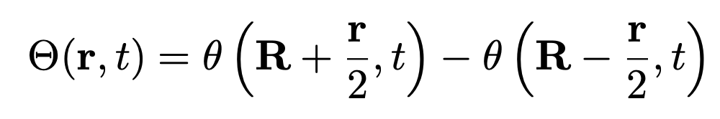


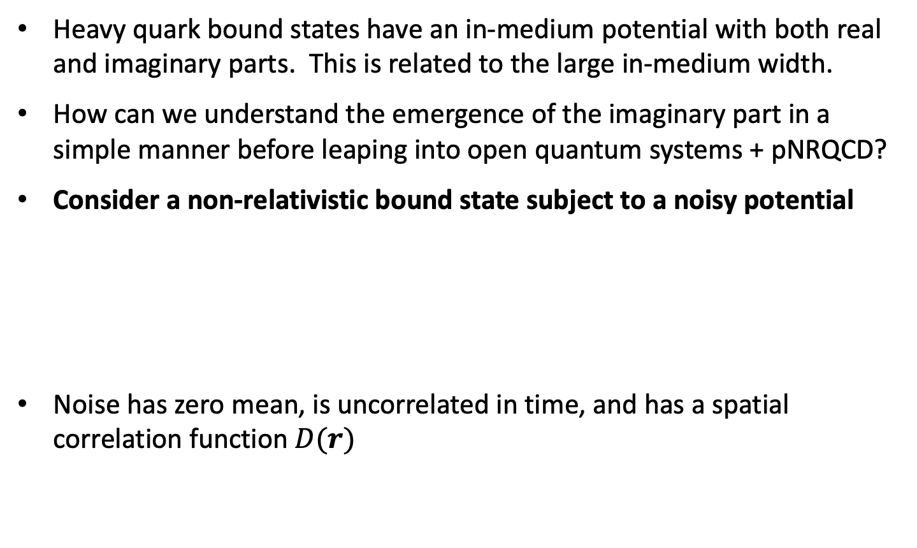
Heuristic understanding – Noisy QM
Heavy quark bound states have an in-medium potential with both real and imaginary parts. This is related to the large in-medium width.
How can we understand the emergence of the imaginary part in a simple manner before leaping into open quantum systems + pNRQCD?
Consider a non-relativistic bound state subject to a noisy potential
Noise has zero mean, is uncorrelated in time, and has a spatial correlation function $D(r)$
Noise due to environment (assumed here to be color neutral).
Note: The treatment presented here does not include possibility of color-charged noise, more on this coming…

Slide 31
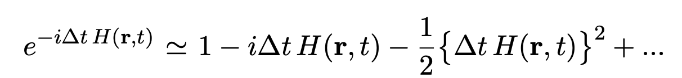
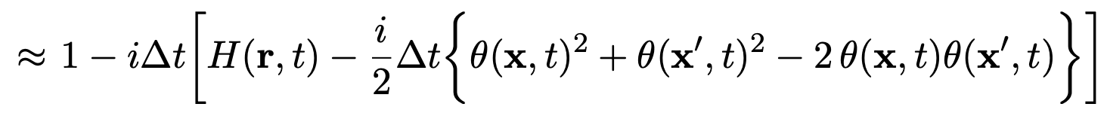
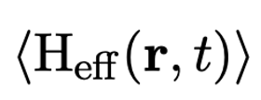
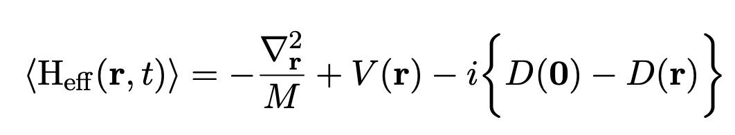

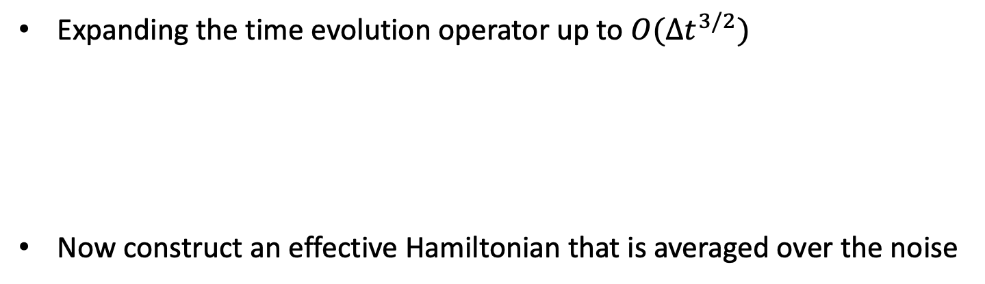
Heuristic understanding – Noisy QM
Expanding the time evolution operator up to $O(∆t^{3/2})$
Now construct an effective Hamiltonian that is averaged over the noise
Imaginary part of the potential
Imaginary part emerges through interference of wave function with itself when summing over environmental noise.

Slide 32
A parallelizable approach: Quantum trajectories
N. Brambilla, M.-A. Escobedo, M.S., A. Vairo, P. Vander Griend, and J.H. Weber, 2012.01240
Non-unitary “no jump” evolution
Can treat this “quantum jump” term stochastically
Can be reduced to the solution of a large set of “quantum trajectories” in which we solve a 1D Schrödinger equation with a non-Hermitian Hamiltonian $Heff$, subject to stochastic quantum jumps.
The evolution with the non-Hermitian $Heff$ preserves
the color and angular momentum state of the system
(but not norm).
Collapse/jump operators encode transitions
between different color/angular momentum
states (subject to selection rules).
For each physical trajectory (path through the QGP) we average over a
large set of independent quantum trajectories → Embarrassingly parallel
Added benefit: Can describe all angular momentum states (no cutoff) .

Slide 33
How can one numerically solve these equations?
Each block of the density matrix in color space can be decomposed into orbital angular momentum blockwise.
Upon truncating in angular momentum ($l ≤ lmax$) one can reduce both
the singlet and octet blocks of the reduced density matrix to size ${(lmax +1)}^{2}$.
One can then discretize the radial wavefunction ($N$ = # of lattice points) and evolve the reduced density matrix using standard differential equation and matrix solvers gives $\sim N^{2}{(lmax +1)}^{2}$matrix size.
Need to describe bound and unbound states with highly localized initial wave function, so the box must be large and have small lattice spacing → large $N$ and large $lmax$.
As $N$ and $lmax$ become large, the computation becomes very challenging.
Need a better/faster method which we can easily parallelize.

Slide 34


Initial bottomonium wavefunction
We took the initial wavefunction to be given by a smeared delta function (local production due to large mass, Δ ~ 1/M) of the form
For a given $l$, the initial state is a quantum linear superposition of the eigenstates of H.
Includes both bound and unbound states.
We took $Δ=0.2 a_{0}$ which reproduces results obtained with a true delta to within 1%.

Slide 35

3+1D hydrodynamical background
We use a 3+1D dissipative code for the hydro background (quasiparticle anisotropic hydrodynamics)
Has been tuned to RHIC and LHC heavy ion collisions
Reproduces spectra, multiplicities, identified elliptic flow of light hadrons, HBT radii, etc.
For 5.02 TeV, T₀ = 630 MeV @ t₀ = 0.25 fm/c

