Slide 1

Jet momentum broadening from effective kinetic theory
Florian Lindenbauer
With K. Boguslavski, A. Kurkela, T. Lappi, J. Peuron, in preparation
XQCD Conference, Jul 29, 2022

Slide 2
Contents
Introduction
Jet quenching in kinetic theory
Results: Scaled thermal distribution, bottom-up thermalization
Approach to attractors
Conclusion

Slide 3
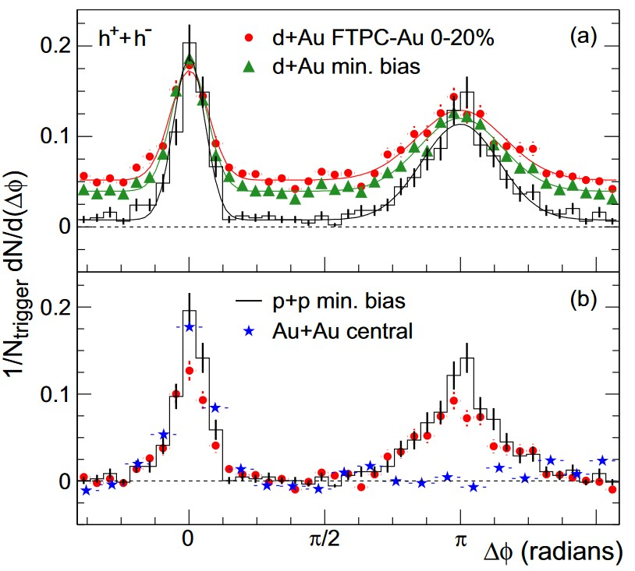
Jet quenching in heavy-ion collisions
Back-to-back peak is suppressed in Au+Au
Quark-Gluon plasma (QGP) is created
Different description at different times:
  Glasma – kinetic theory – hydrodynamics
Rev.Mod.Phys. 93 (2021) 3, 035003 [Berges, Heller, Mazeliauskas, Venugopalan]
Phys.Rev.Lett.91:072304,2003 (STAR Collaboration)

Slide 4
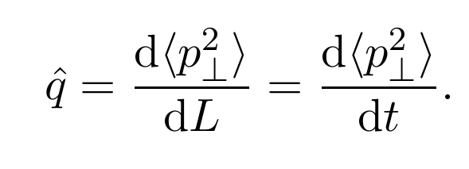
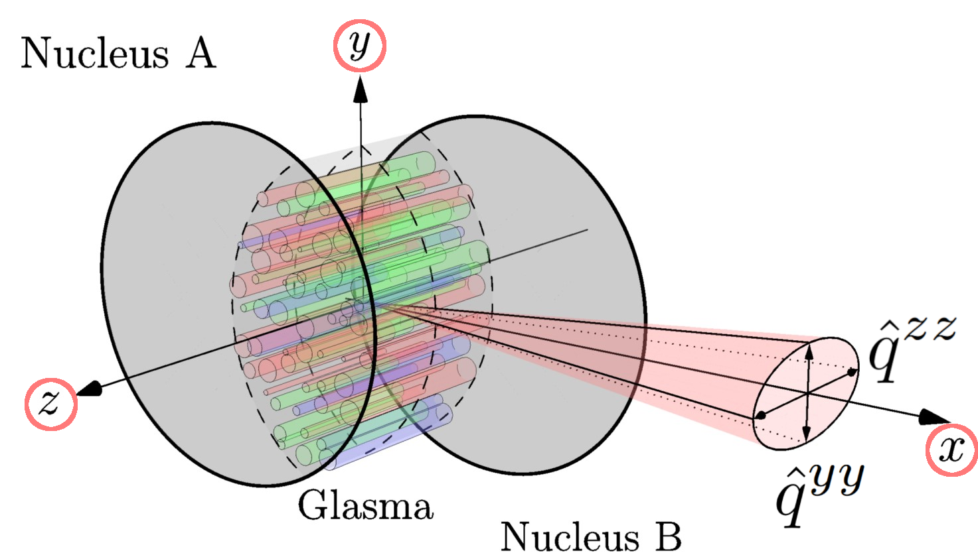
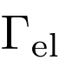
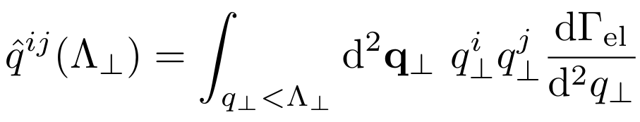
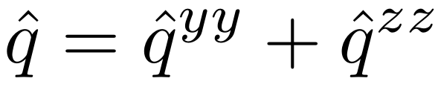
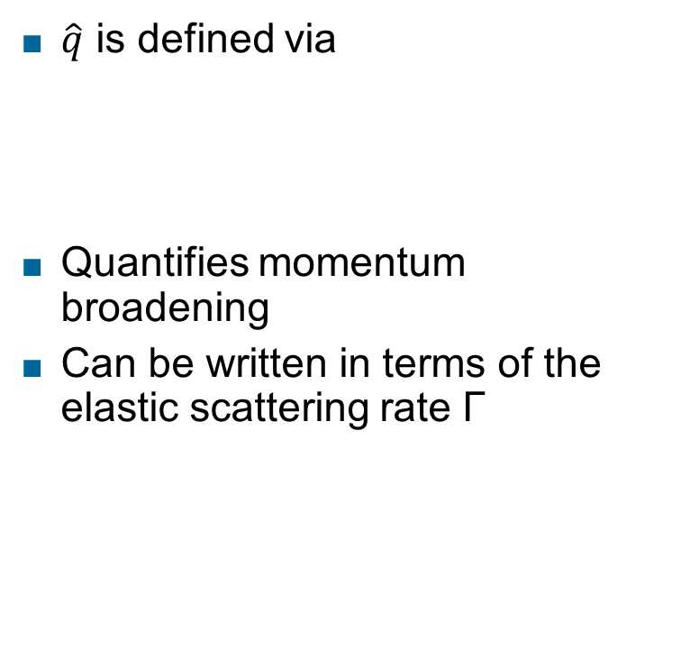
Jet quenching parameter
$\hat{q}$ is defined via
Quantifies momentum broadening
Can be written in terms of the elastic scattering rate Г
Phys.Lett.B 810 (2020) 135810 [Ipp, Müller, Schuh], adapted

Slide 5
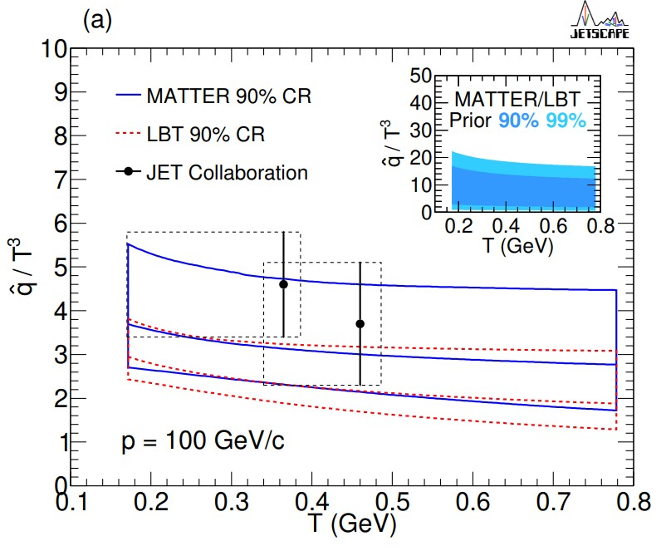
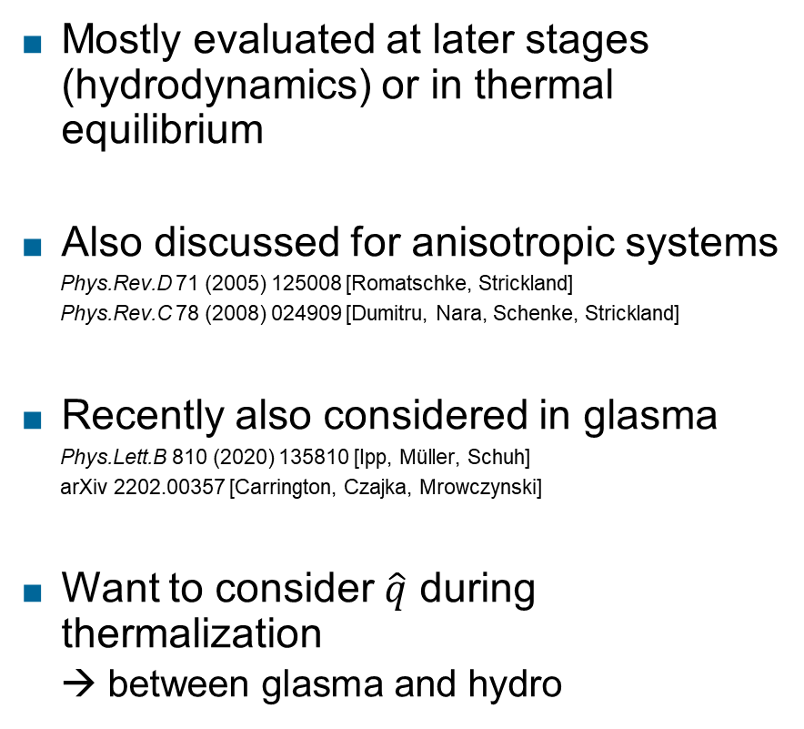
Estimates of the jet quenching parameter
Mostly evaluated at later stages (hydrodynamics) or in thermal equilibrium
Also discussed for anisotropic systems
  Phys.Rev.D 71 (2005) 125008 [Romatschke, Strickland]
  Phys.Rev.C 78 (2008) 024909 [Dumitru, Nara, Schenke, Strickland]
Recently also considered in glasma
  Phys.Lett.B 810 (2020) 135810 [Ipp, Müller, Schuh]
  arXiv 2202.00357 [Carrington, Czajka, Mrowczynski]
Want to consider $\hat{q}$ during thermalization
  → between glasma and hydro
Phys.Rev.C 104 (2021) 2, 024905 [JETSCAPE Collaboration]

Slide 6
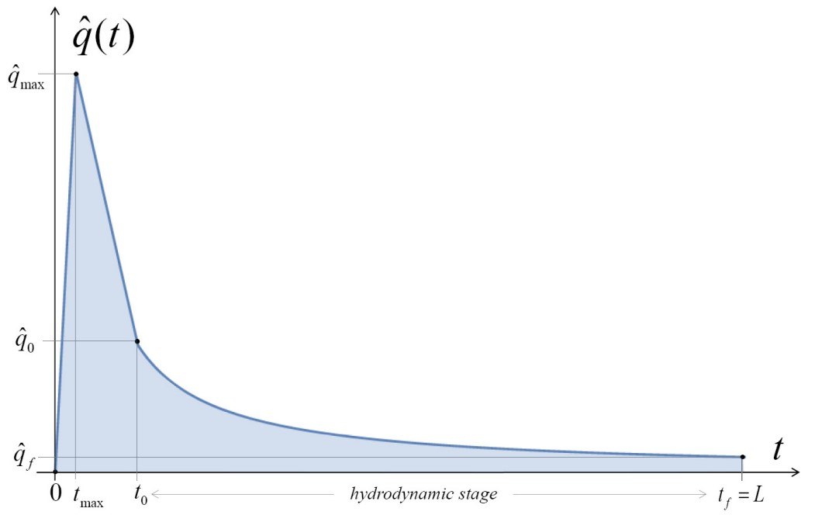
Estimates of the jet quenching parameter
Mostly evaluated at later stages (hydrodynamics) or in thermal equilibrium
Also discussed for anisotropic systems
  Phys.Rev.D 71 (2005) 125008 [Romatschke, Strickland]
  Phys.Rev.C 78 (2008) 024909 [Dumitru, Nara, Schenke, Strickland]
Recently also considered in glasma
  Phys.Lett.B 810 (2020) 135810 [Ipp, Müller, Schuh]
  arXiv 2202.00357 [Carrington, Czajka, Mrowczynski]
Want to consider $\hat{q}$ during thermalization
  → between glasma and hydro
Schematic overview of q evolution
arXiv 2112.06812 [Carrington, Czajka, Mrowczynski]

Slide 7
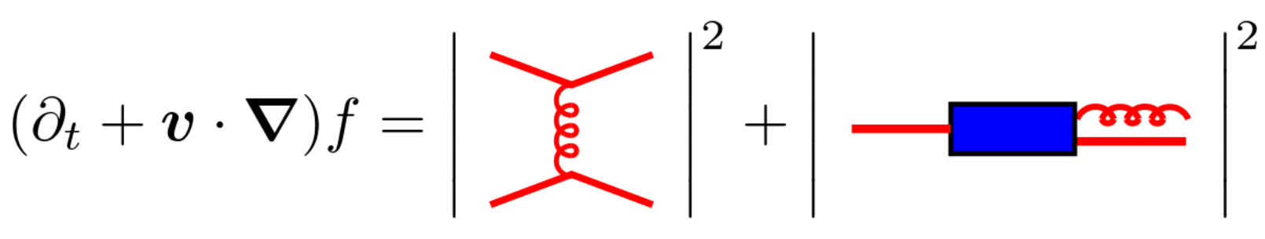
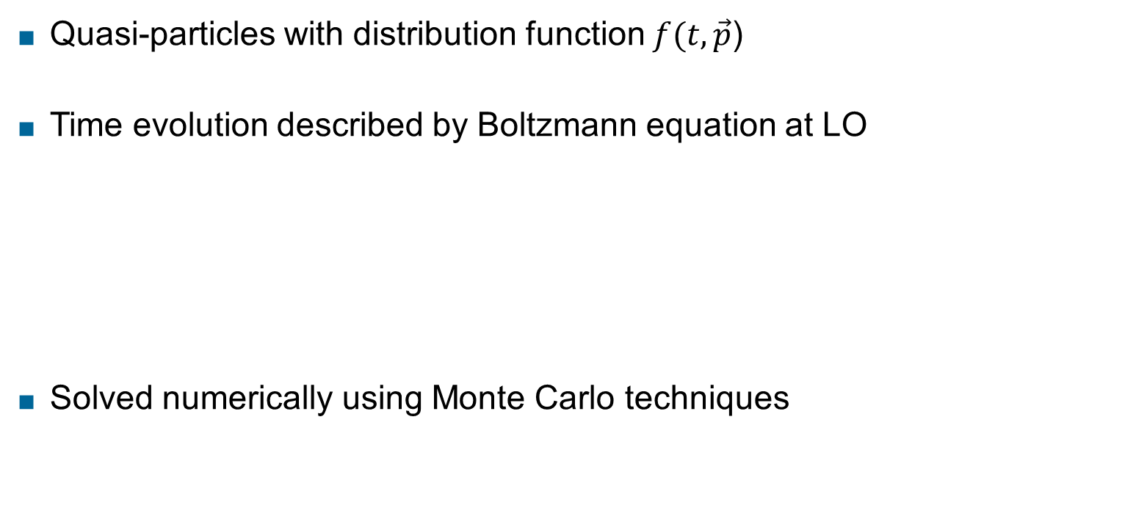
Effective kinetic theory description of the QGP
Quasi-particles with distribution function $f(t, \vec{p}$)
Time evolution described by Boltzmann equation at LO
Solved numerically using Monte Carlo techniques
JHEP01(2003)030 [Arnold, Moore, Yaffe]
Int.J.Mod.Phys.E 16 (2007) 2555-2594 [Arnold]​
Collision term
Phys.Rev.Lett. 115 (2015) 18, 182301 [Kurkela, Zhu]

Slide 8

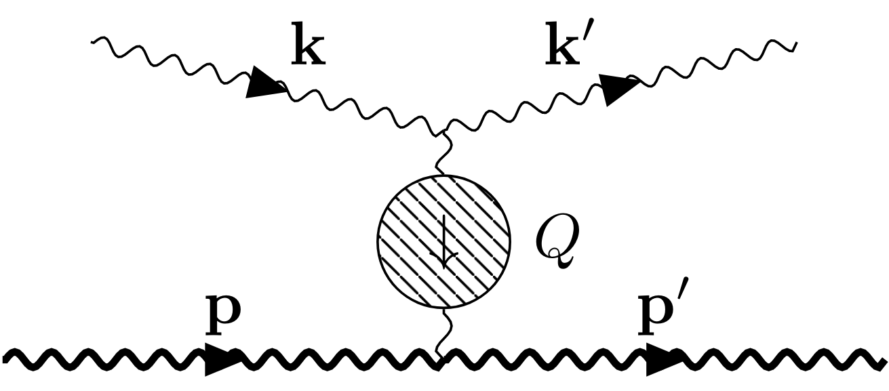
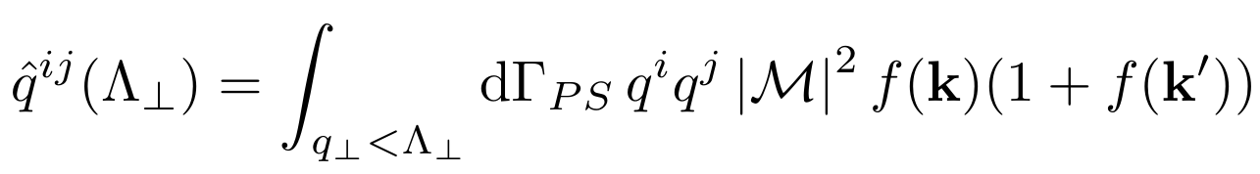

Jet quenching parameter in kinetic theory
Provided we know f(k), :
Ingoing/outgoing state factors
Appropriate phase-space measure
With momentum cutoff $q_{⊥}<Λ_{⊥}$
Matrix element with medium corrections (self-energy)

Slide 9
Screening in the matrix element
Scattering matrix element includes in-medium propagator
Receives self-energy corrections
Anisotropic Hard thermal loop (HTL) self-energy Unstable modes
Approximation: Use isotropic HTL matrix element

Slide 10

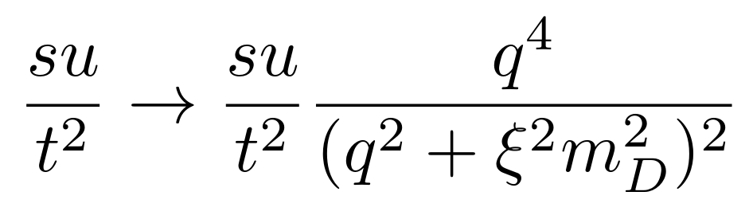
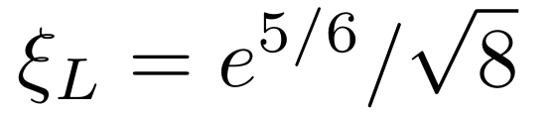
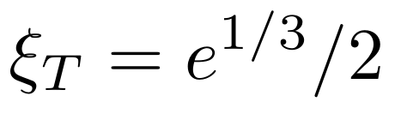
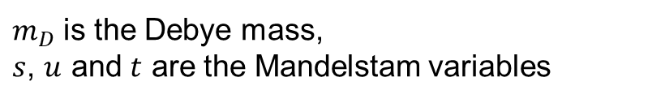
Screening in the matrix element II
Use isotropic HTL matrix element
Also use approximation using single screening constant
Different for longitudinal
and transverse momentum broadening
Phys.Rev.D 89 (2014) 7, 074036 [York, Kurkela, Lu, Moore]
$m_{D}$ is the Debye mass,
$s$, $u$ and $t$ are the Mandelstam variables

Slide 11
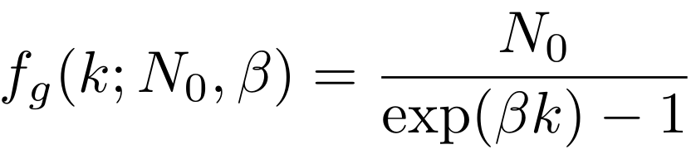
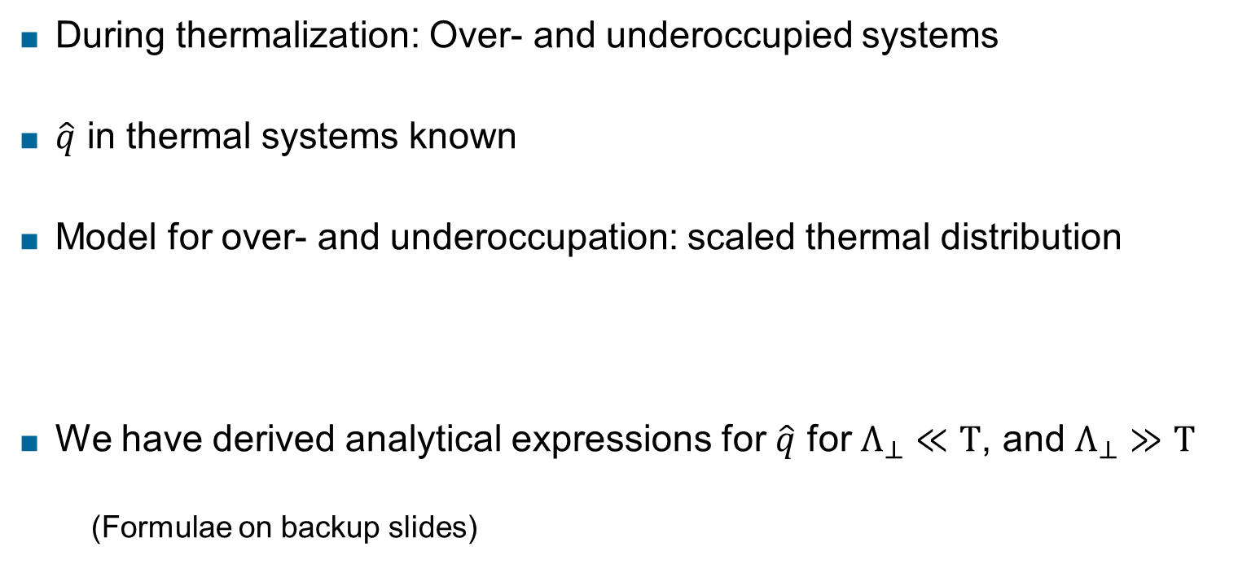
Over- and underoccupied systems: Scaled thermal distribution
During thermalization: Over- and underoccupied systems
$\hat{q}$ in thermal systems known
Model for over- and underoccupation: scaled thermal distribution
We have derived analytical expressions for $\hat{q}$ for $Λ_{⊥}≪T$, and $Λ_{⊥}≫T$
    (Formulae on backup slides)

Slide 12
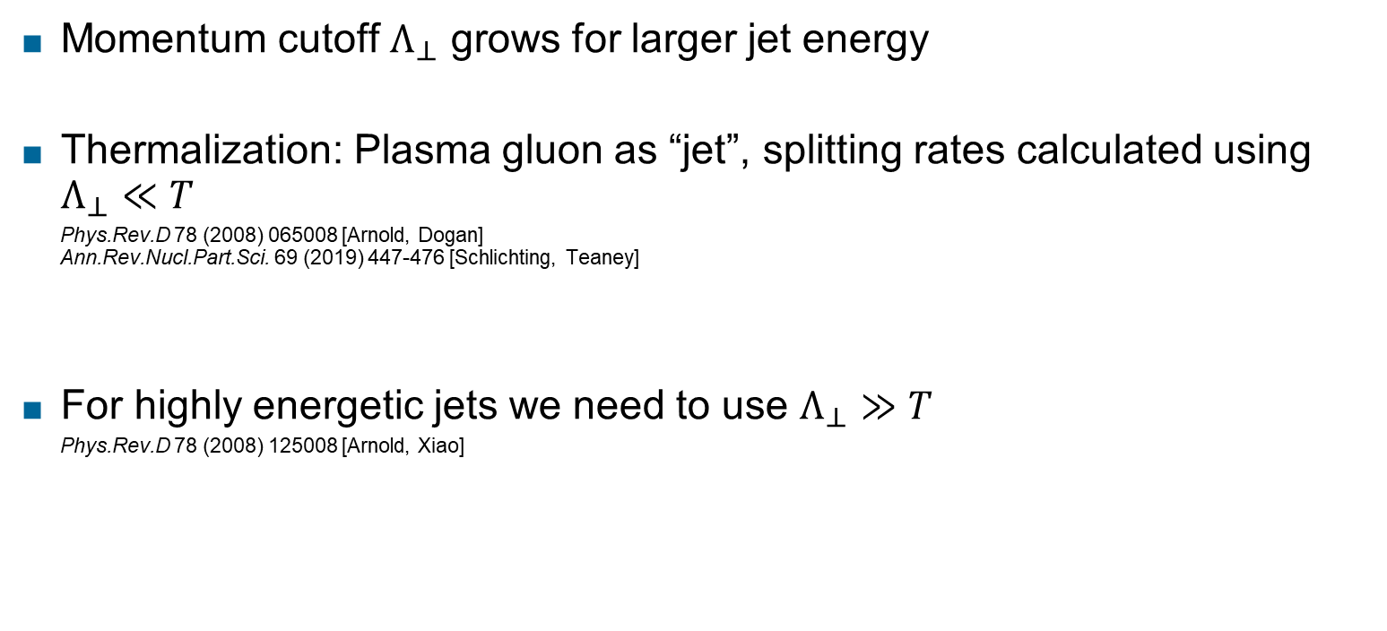
Physical meaning of the momentum cutoff
Momentum cutoff $Λ_{⊥}$ grows for larger jet energy
Thermalization: Plasma gluon as “jet”, splitting rates calculated using $Λ_{⊥}≪T$
  Phys.Rev.D 78 (2008) 065008 [Arnold, Dogan]
  Ann.Rev.Nucl.Part.Sci. 69 (2019) 447-476 [Schlichting, Teaney]
For highly energetic jets we need to use $Λ_{⊥}≫T$
  Phys.Rev.D 78 (2008) 125008 [Arnold, Xiao]

Slide 13
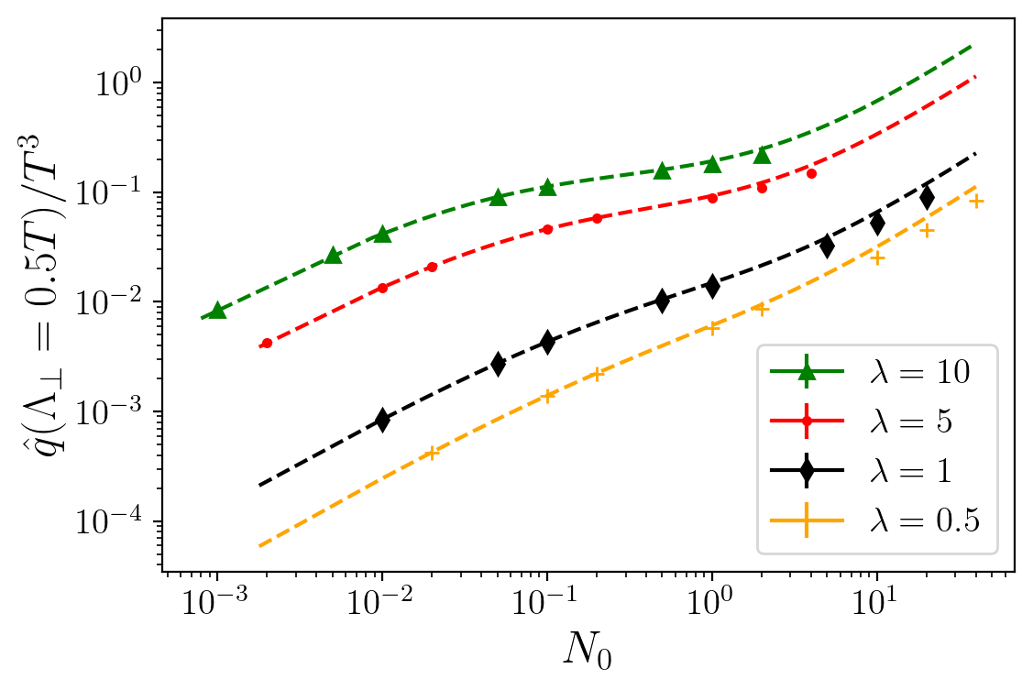
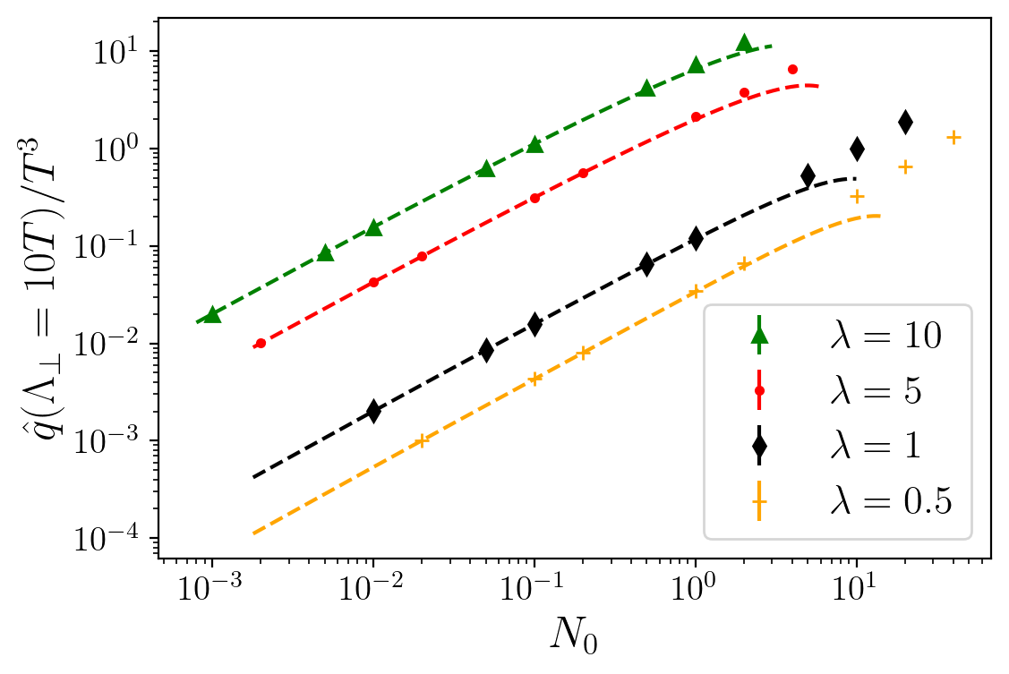

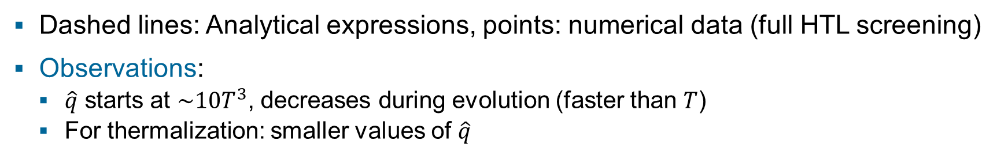
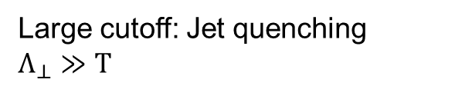
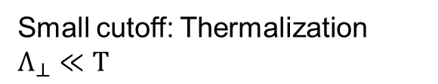
Over- and underoccupied: Scaled thermal distribution
Small cutoff: Thermalization
$$Λ_{⊥}≪T$$
Large cutoff: Jet quenching
$$Λ_{⊥}≫T$$
Preliminary
Preliminary
$$λ=g^{2}N_{C}$$
Dashed lines: Analytical expressions, points: numerical data (full HTL screening)
Observations:
  $\hat{q}$ starts at $\sim 10T^{3}$, decreases during evolution (faster than $T$)
  For thermalization: smaller values of $\hat{q}$

Slide 14
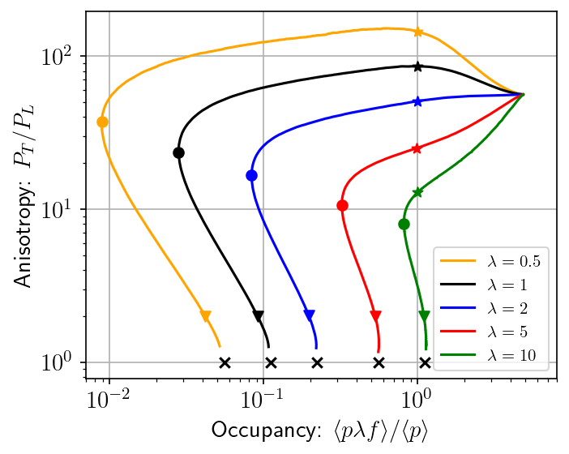
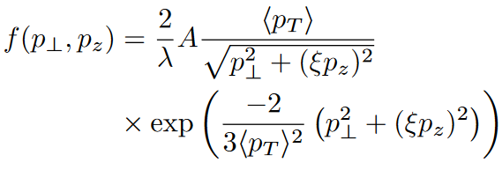
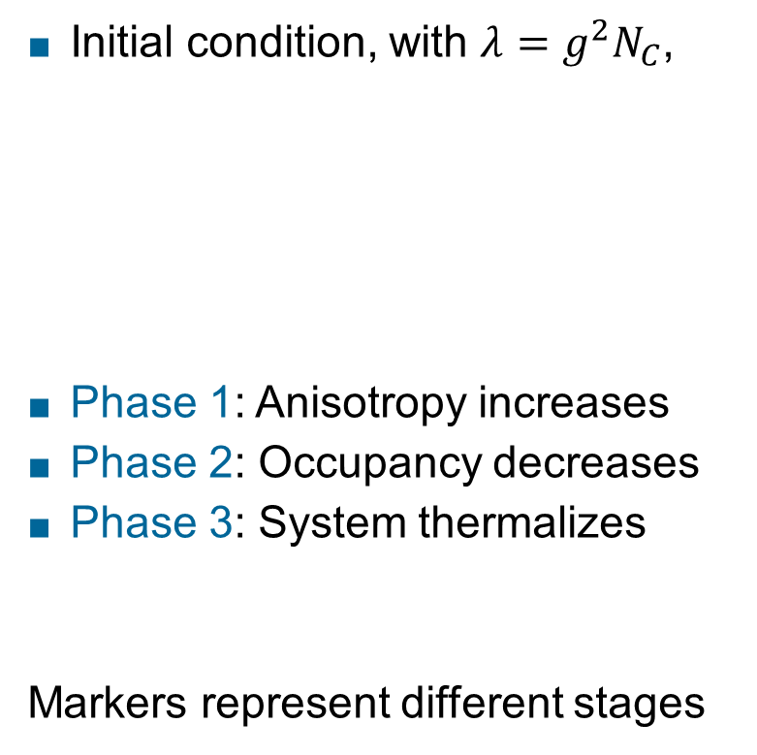
Thermalization in heavy-ion collisions
Time evolution of a purely gluonic plasma
2
Initial condition, with $λ=g^{2}N_{C}$,
Phase 1: Anisotropy increases
Phase 2: Occupancy decreases
Phase 3: System thermalizes
Markers represent different stages
1
Phys.Rev.Lett. 115 (2015) 18, 182301 [Kurkela, Zhu]
3
Phys.Lett.B502:51-58,2001 [Bayer, Mueller, Schiff, Son]

Slide 15
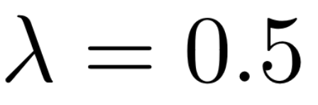
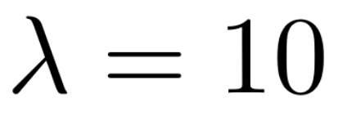
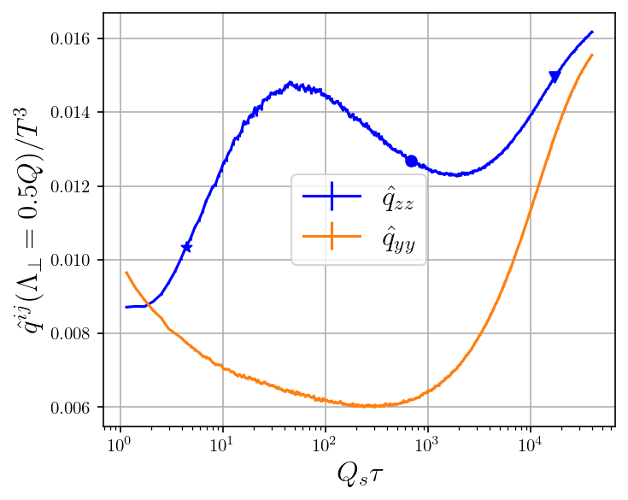
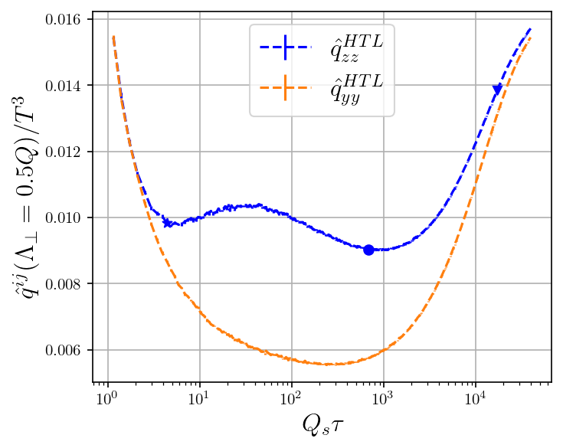
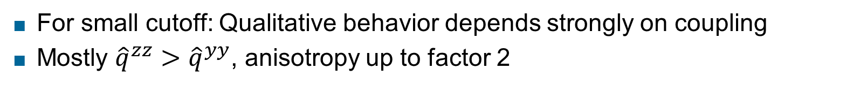
Time evolution – small cutoff
Preliminary
Preliminary
For small cutoff: Qualitative behavior depends strongly on coupling
Mostly ${\hat{q}}^{zz}>{\hat{q}}^{yy}$, anisotropy up to factor 2

Slide 16
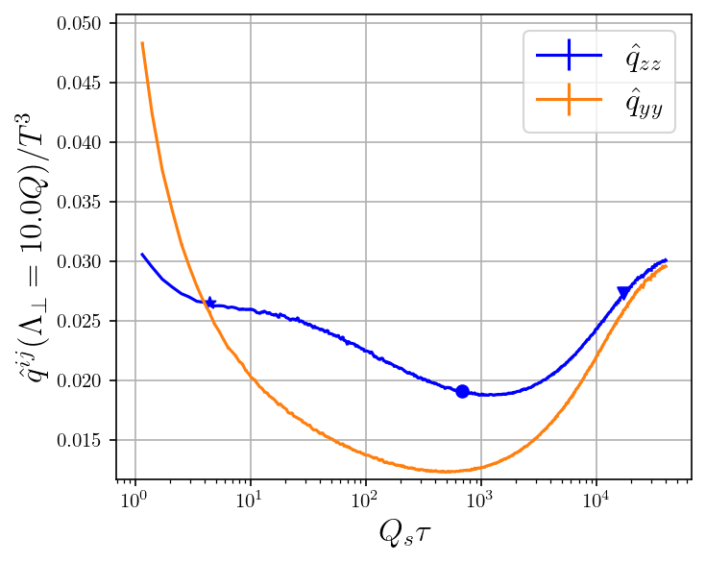
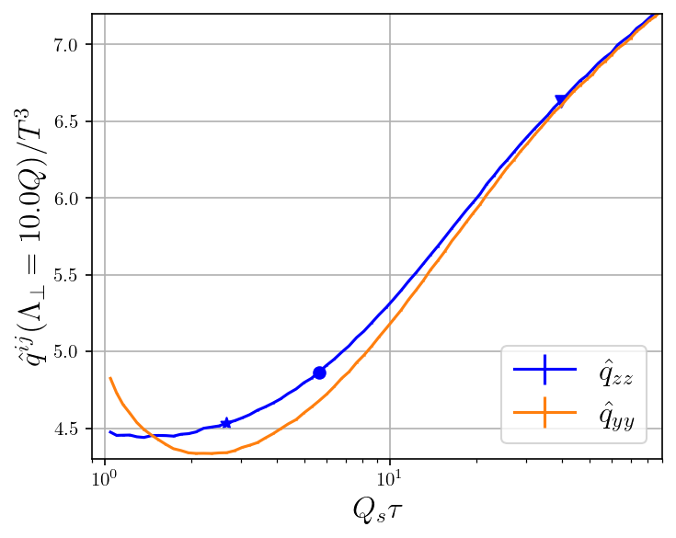
Time evolution – large cutoff
Preliminary
Preliminary
For large cutoff: Qualitatively similar behavior
After overoccupied phase: Same ordering ${\hat{q}}^{zz}>{\hat{q}}^{yy}$ as in glasma

Slide 17
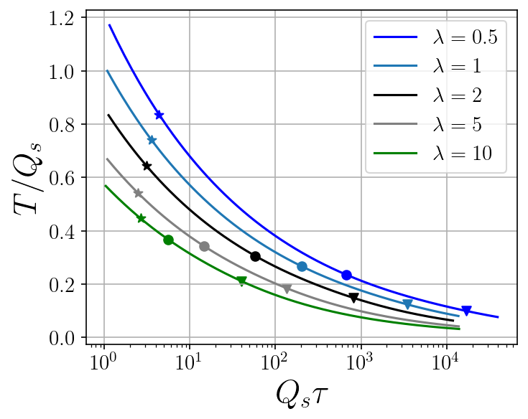
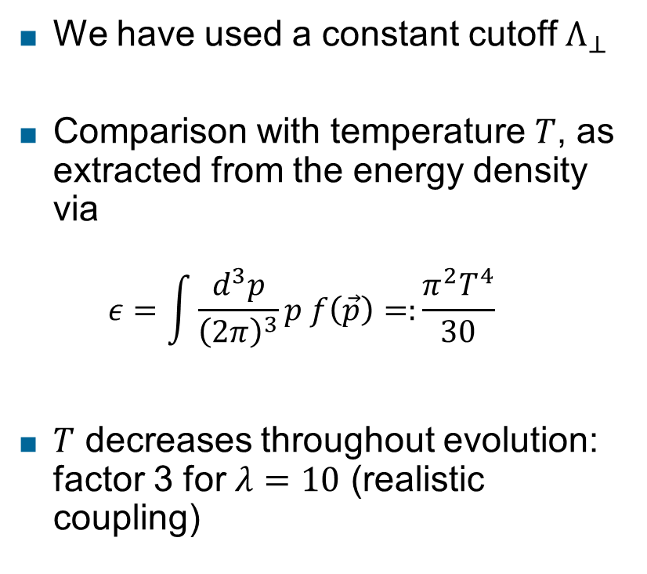
Temperature evolution
We have used a constant cutoff $Λ_{⊥}$
Comparison with temperature $T$, as extracted from the energy density via
  $$ε=\int{\frac{d^{3}p}{{\left(2π\right)}^{3}}p f\left(\vec{p}\right)=:\frac{π^{2}T^{4}}{30}}$$
$T$ decreases throughout evolution: factor 3 for $λ=10$ (realistic coupling)
Preliminary

Slide 18
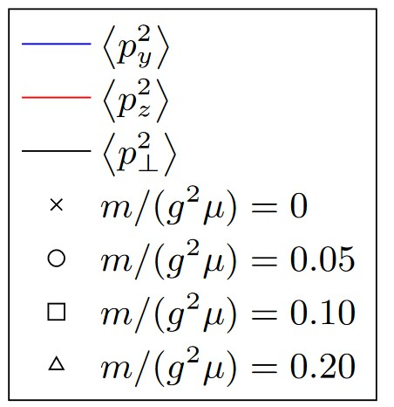
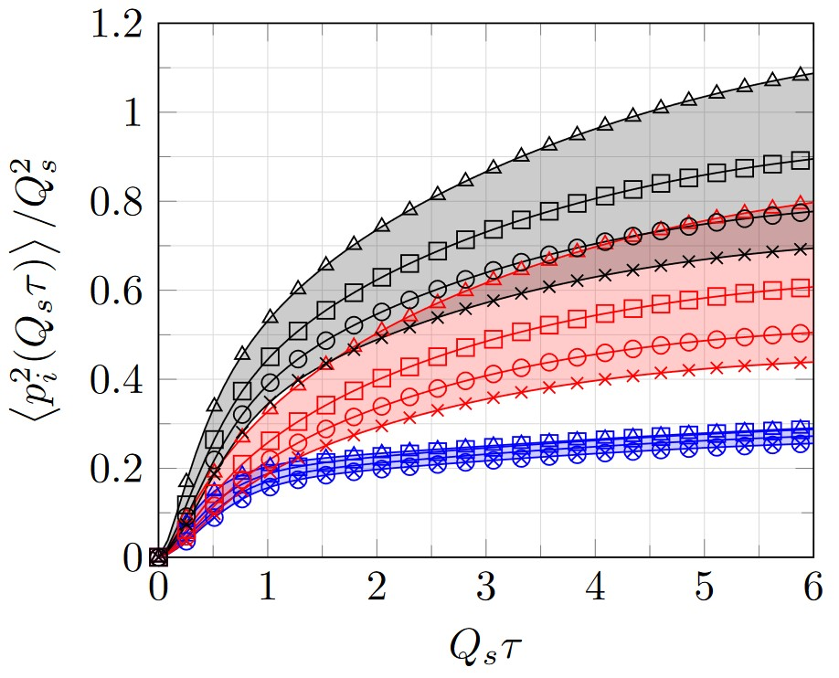


Comparison with the glasma
Accumulated momentum
Different ordering at beginning
Same ordering (after overoccupied phase)
$${∼∫\hat{q}}^{zz}dτ$$
$${∼∫\hat{q}}^{yy}dτ$$
Phys.Rev.D 102 (2020) 7, 074001 [Ipp, Müller, Schuh]

Slide 19
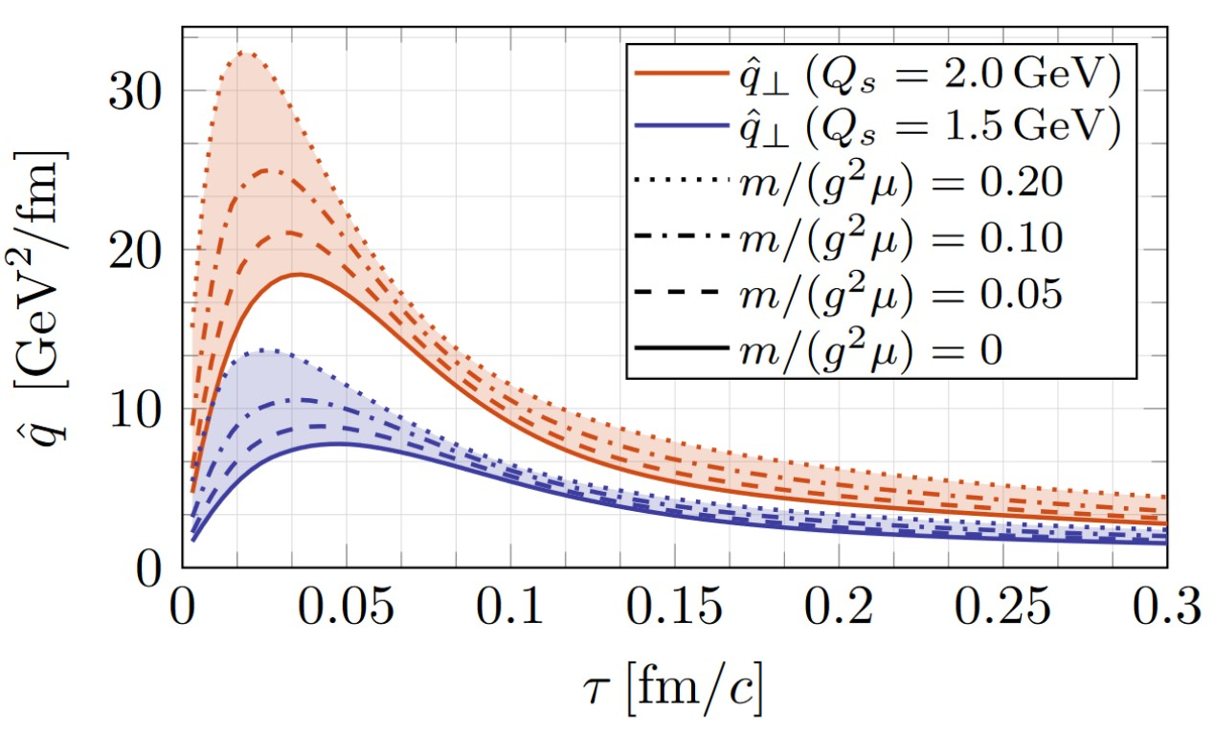
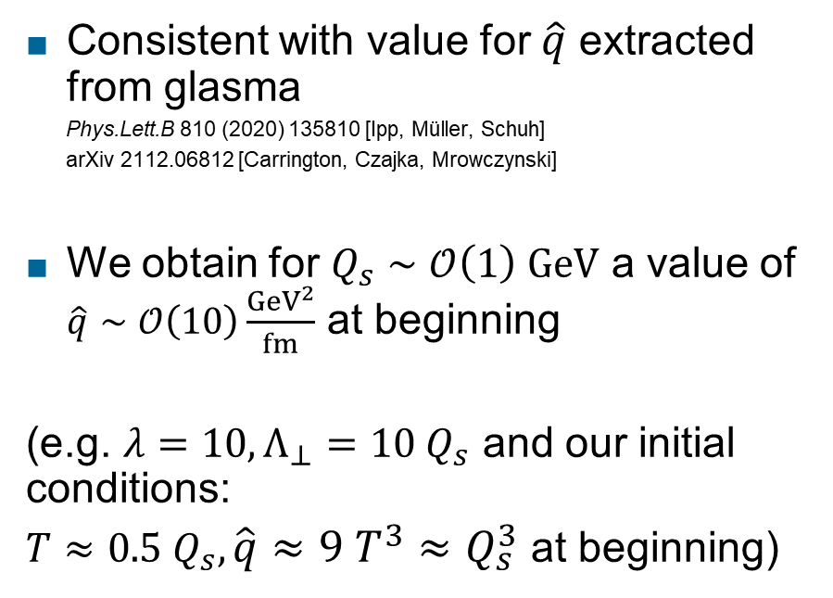
Comparison with the glasma
Consistent with value for $\hat{q}$ extracted from glasma
  Phys.Lett.B 810 (2020) 135810 [Ipp, Müller, Schuh]
  arXiv 2112.06812 [Carrington, Czajka, Mrowczynski]
We obtain for $Q_{s}∼𝒪\left(1\right) GeV$ a value of $\hat{q}∼𝒪\left(10\right)\frac{{GeV}^{2}}{fm}$ at beginning
(e.g. $λ=10, Λ_{⊥}=10 Q_{s}$ and our initial conditions:
$T≈0.5 Q_{s}, \hat{q}≈9 T^{3}≈Q_{s}^{3}$ at beginning)
Phys.Lett.B 810 (2020) 135810 [Ipp, Müller, Schuh]

Slide 20
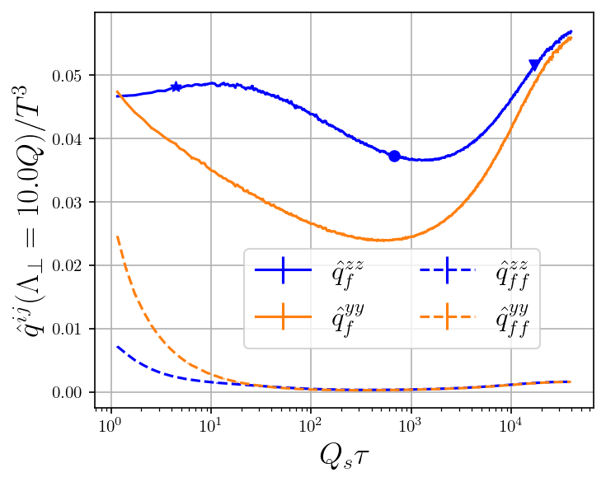
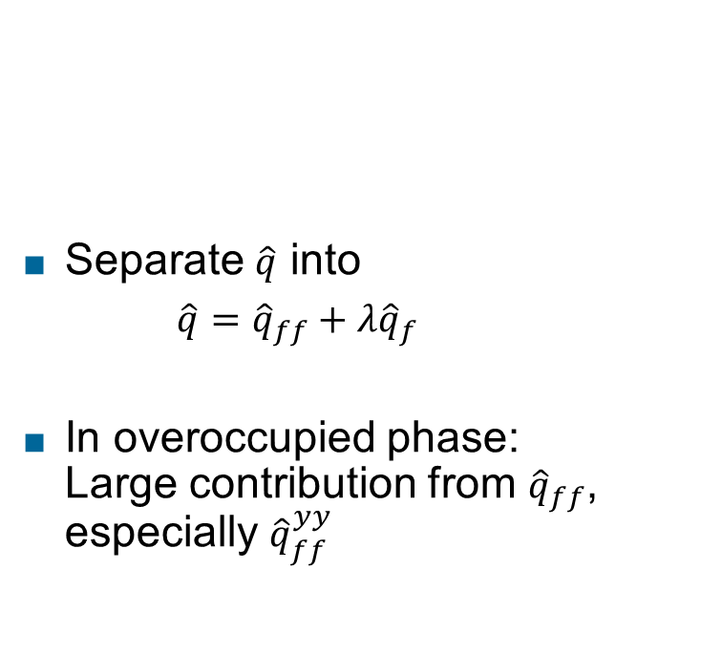
Individual components
Separate $\hat{q}$ into
$\hat{q}={\hat{q}}_{ff}+λ{\hat{q}}_{f}$
In overoccupied phase:
Large contribution from ${\hat{q}}_{ff}$, especially ${\hat{q}}_{ff}^{yy}$
Preliminary

Slide 21
Comparison with isotropic HTL matrix element
Preliminary
Preliminary
Largest effects for small coupling and small cutoff
Others: Qualitatively similar

Slide 22
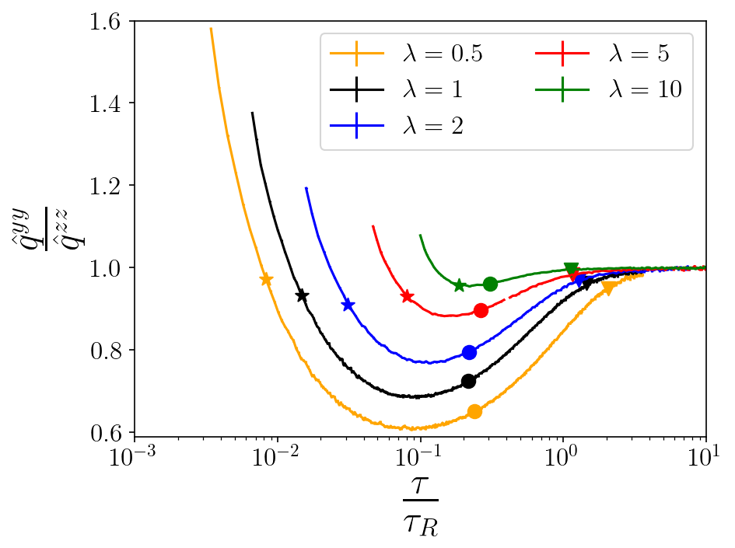
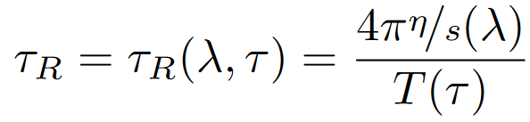
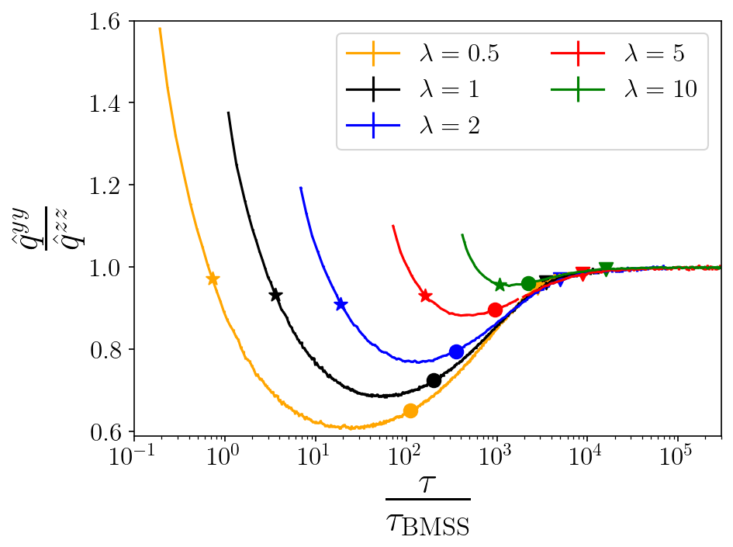
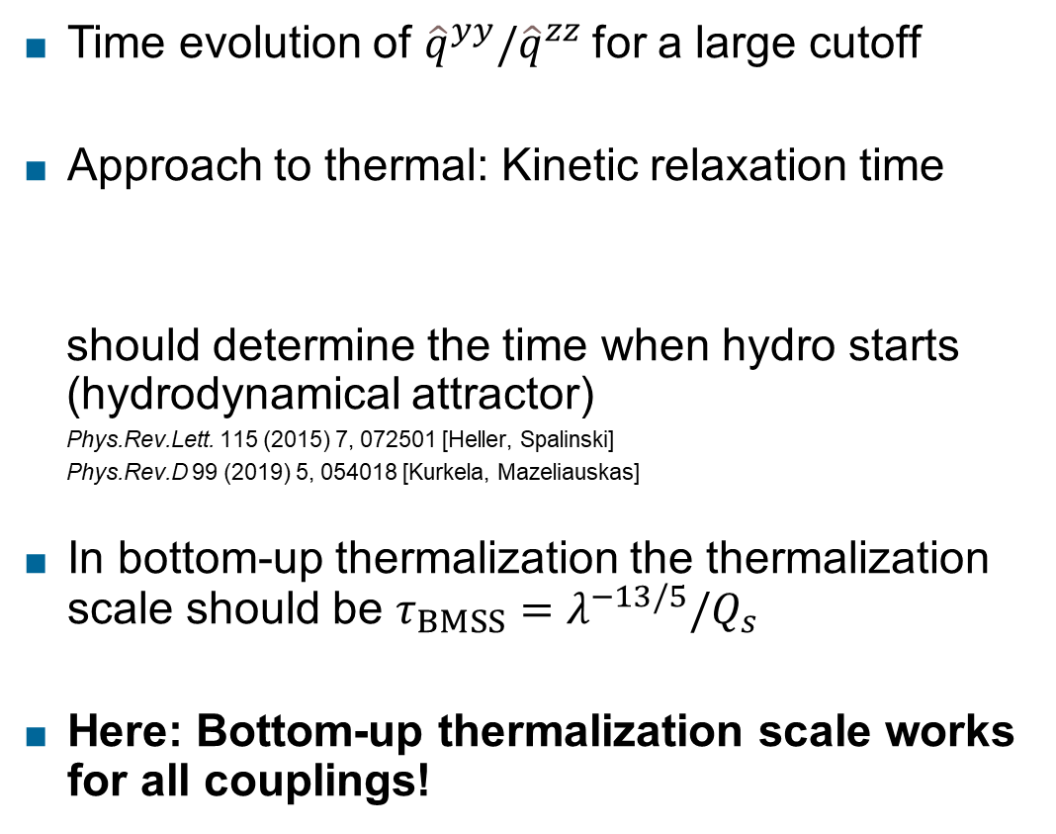
Approach to attractor
Preliminary
Time evolution of ${\hat{q}}^{yy}/{\hat{q}}^{zz}$for a large cutoff
Approach to thermal: Kinetic relaxation time
  should determine the time when hydro starts (hydrodynamical attractor)
  Phys.Rev.Lett. 115 (2015) 7, 072501 [Heller, Spalinski]
  Phys.Rev.D 99 (2019) 5, 054018 [Kurkela, Mazeliauskas]
In bottom-up thermalization the thermalization scale should be $τ_{BMSS}=λ^{−13/5}/Q_{s}$
Here: Bottom-up thermalization scale works for all couplings!
Phys.Lett.B 502:51-58,2001 [Bayer, Mueller, Schiff, Son]
Preliminary

Slide 23
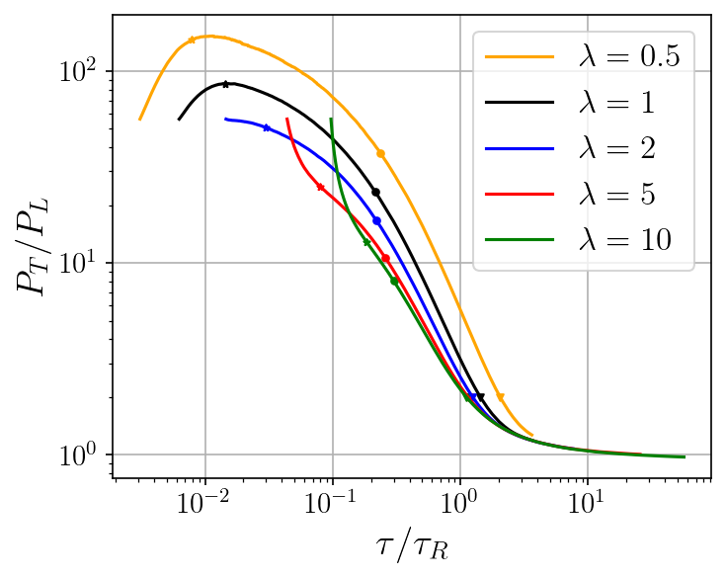


Approach to attractor
Previously, hydrodynamical attractor found for pressure ratio $\frac{P_{T}}{P_{L}}$:
Attractor property in $\frac{τ}{τ_{R}}$.
$$τ_{R}=\frac{4π\frac{η}{s}\left(λ\right)}{T(τ)}$$
Preliminary
Preliminary

Slide 24



Approach to attractor
Previously, hydrodynamical attractor found for pressure ratio $\frac{P_{T}}{P_{L}}$:
Attractor property in $\frac{τ}{τ_{R}}$.
$$τ_{R}=\frac{4π\frac{η}{s}\left(λ\right)}{T(τ)}$$
However, occupation follows bottom-up attractor
$$τ_{BMSS}=λ^{−13/5}/Q_{s}$$
Preliminary
Preliminary

Slide 25




Approach to attractor for heavy-quark diffusion
Heavy-quark diffusion coefficient
Momentum transferred to heavy-quark
Also ratio $κ_{T}/κ_{L}$ follows bottom-up attractor
Preliminary
Phys.Rev.C 71 (2005) 064904 [Moore, Teaney]
Preliminary
$$τ_{BMSS}=λ^{−13/5}/Q_{s}$$

Slide 26

Conclusion
$\hat{q}$ decreases with time during kinetic evolution, being initially of the order of magnitude of the glasma value
$\hat{q}$ components depend on coupling $λ$ and cutoff $Λ_{⊥}$
${\hat{q}}^{zz}>{\hat{q}}^{yy}$during most of the evolution
Different screening approximations provide qualitatively similar results
${\hat{q}}^{yy}/{\hat{q}}^{zz}$ does not follow the hydrodynamical attractor, but BMSS attractor
  Like other observables: $\frac{κ_{T}}{κ_{L}}$, occupancy
  This shows limitations of universality of hydro attractor

Slide 27

Future directions
Different initial conditions, dependence on jet angle and momentum
Different screening approximations
  Relax isotropic screening approximation
Experimental signature of $\hat{q}$ from thermalization stages, impact

Slide 28
Backup slides

Slide 29

Over- and underoccupied: Scaled thermal distribution
For $Λ_{⊥}≪T$:
For $Λ_{⊥}≫T$ and $g\sqrt{\frac{N_{0}}{3}\left(N_{C}+\frac{n_{f}}{2}\right)}≪1$
$$\hat{q}\left(N_{0}\right)=\frac{N_{0}g^{4}T^{3}C_{R}}{24 π^{3}}\ln\left(1+\frac{Λ_{⊥}^{2}}{m_{D}^{2}}\right)\left(N_{0}π^{2}\left(2N_{C}+n_{f}\right)+ζ\left(3\right)\left(1−N_{0}\right)\left(12 N_{C}+9n_{f}\right)\right)$$
$$\hat{q}\left(N_{0}\right)=\frac{C_{R}g^{4}T^{3}}{π^{2}}\left(Ξ_{b}\left(N_{0}^{2}ℐ_{+}\left(Λ_{⊥}\right)+\frac{N_{0}\left(1−N_{0}\right)ζ\left(3\right)}{4π}\ln\left(1+\frac{Λ_{⊥}^{2}}{m_{D}^{2}}\right) \right)+Ξ_{f}\left(N_{0}^{2}ℐ_{−}\left(Λ_{⊥}\right)+\frac{N_{0}\left(1−N_{0}\right)ζ_{−}\left(3\right)}{4π}\ln\left(1+\frac{Λ_{⊥}^{2}}{m_{D}^{2}}\right) \right) \right)$$
$$ℐ_{±}\left(Λ_{⊥}\right)=\frac{ζ_{±}\left(3\right)}{4π}\ln\left(1+\frac{Λ_{⊥}^{2}}{m_{D}^{2}}\right)+\frac{ζ_{±}\left(2\right)−ζ_{±}\left(3\right)}{2π}\left[\frac{1}{2}\ln\left(1+\frac{T^{2}}{m_{D}^{2}}\right)+\frac{1}{2}−γ_{E}+\ln{2}\right]−\frac{σ_{±}}{2π}$$
$ζ_{+}\left(s\right)=ζ\left(s\right)$, $ζ_{−}\left(s\right)=\left(1−2^{1−s}\right)ζ\left(s\right)$, $σ_{+}=0.3860438$, $σ_{−}=0.0112168$
Extending a calculation from Phys.Rev.D 78 (2008) 125008 [Arnold, Xiao]

Slide 30

Comparison with isotropic HTL matrix element
Preliminary
Preliminary

Slide 31


Comparison with isotropic HTL matrix element
Preliminary
Preliminary

Slide 32

Comparison with isotropic HTL matrix element
Preliminary
Preliminary

Slide 33




Time evolution – small cutoff
Preliminary
Preliminary

Slide 34


Time evolution – large cutoff
Preliminary
Preliminary

